Slide 1
Norton Sound Red King Crab
SAFE 2021
Jan 10 2022
Crab Plan Team: Virtual
Toshihide “Hamachan” Hamazaki,
Jie Zheng
Alaska Department of Fish & Game
Division of Commercial Fisheries

Slide 2
NSRKC Stock Assessment Model
Modeling process
Available Data & model fit
5 months
Pot survey
Length
Natural
Mortality
Winter Harvest
& Discards
Winter fishery
Dec - May
NSRKC
SAFE Winter +Summer fishery
Feb 01
Abundance
July 01
Abundance
Summer fishery
Jun - Sept
Summer Harvest
& Discards
Length, CPUE
Molting, Growth &
Recruitment
Natural
Mortality
Trawl survey
Abundance, Length
Tag recovery
7 months

Slide 3
NSRKC Stock Assessment Model
Modeling process
Available Data & model fit
5 months
Length Prop
Pot survey
Natural
Mortality
Abundance
Trawl survey
ST. CPUE
Winter fishery
Dec - May
Feb 01
Abundance
July 01
Abundance
Summer fishery
Jun - Sept
Survey selectivity
=
Catch selectivity
Length Prop
Trawl Survey
Fishery: Retain
Discards
Natural
Mortality
Recruitment
Molting, Growth
7 months
Tag recovery

Slide 4
Assumptions
NSRKC biology
  Molting, Growth, and Recruitment occur just before Feb 01 fishery
  Molted crab become Newshell, unmolted crab becomes Oldshell
  M = 0.18 for length class 1-6, higher mortality of classes 7 and 8
NSRKC fishery
  winter Feb 01, Summer July 01
  Selectivity and retention: same for New and Old shells.
  Winter selectivity: dome shape and the same as winter pot survey selectivity for all years
  Winter retention: Com 2 periods, Sub
  Summer selectivity: logistic and the same for all years
  Summer retention: 3 periods
  Discards mortality: 0.2 for summer and winter

Slide 5
Responses to CPT-SSC (Jan 2021)
•NSRKC Management
Document Legal crab proportion by size
  Provided.
Plot the legal biomass over time using different proportions of legal crab to better understand the magnitude of the impact of the change
  Model is based on abundance not biomass.
  Legal size proportion not part of assessment model, and thus no impacts.
OFL by retained catch
  Will be Implemented for Jan 2022.
  Total OFL not evaluated in the future (no discards estimates)
Include LKTKS in the assessment.
  Waiting Taskforce report projected to finish in April 2022.

Slide 6
Responses to CPT-SSC (Jan 2021)
•NSRKC Biology-Ecology
Revisit Natural mortality M=0.18
Include female clutch fullness CI bounds
Revisit growth assumptions.
  Growth appears to be consistently producing too many large crab.
Investigate size at maturity

Slide 7
Responses to CPT-SSC (Jan 2021)
•Revisit Natural mortality M=0.18
Author Reply
  Use of M=0.18 designated by CPT-SSC
  Previous model analyses M = 0.25~ 0.4
  Model fits tends to be slightly worse than default.
  Higher M, higher OFL
  CPT-SSC rejected increasing M for NSRKC assessment model

Slide 8
Responses to CPT-SSC (Jan 2021)
• Revisit growth assumptions: Overestimating growth appears to be consistently producing too many large crab.
Author Reply: Tag recovery data assembly
1. Crab tagged and released
2. Crab did not molt or molted and grew
3. Crab fished (with size selectivity)
4. Recovered tagged crab size dist

Slide 9
Responses to CPT-SSC (Jan 2021)
• Revisit growth assumptions: Overestimating growth appears to be consistently producing too many large crab.
Author Reply: Tag recovery data assembly
Convert CL length to 8 length classes
Assemble data by years at liberty and remove 0 year at liberty.
Separate tag recovery data pre and post 1993 (change in selectivity)
Remove crab that moved to smaller than tagged size class
Calculate proportion by size class

Slide 10
Responses to CPT-SSC (Jan 2021)
• Revisit growth assumptions: Overestimating growth appears to be consistently producing too many large crab.
Author Reply: Tag recovery data assembly
 | 64-73 | 74-83 | 84-93 | 94-103 | 104-113 | 114-123 | 124-33 | > 134
64-73 | 0 | 1 | 4 | 0 | 0 | 0 | 0 | 0
74-83 | 0 | 0 | 21 | 22 | 4 | 0 | 0 | 0
84-93 | 0 | 0 | 0 | 47 | 91 | 7 | 1 | 0
94-103 | 0 | 0 | 1 | 10 | 196 | 108 | 2 | 1
104-113 | 0 | 0 | 0 | 1 | 75 | 143 | 22 | 0
114-123 | 0 | 0 | 0 | 0 | 4 | 88 | 98 | 24
124-133 | 0 | 0 | 0 | 0 | 0 | 7 | 56 | 25
>134 | 0 | 0 | 0 | 0 | 1 | 0 | 0 | 26
Individual vs. size class growth
  Mean tag: 80mm rec: 85mm , growth: 5mm
  Mean tag class: 80.5mm (74-83), rec 90.5mm (83-93), growth: 10mm

Slide 11
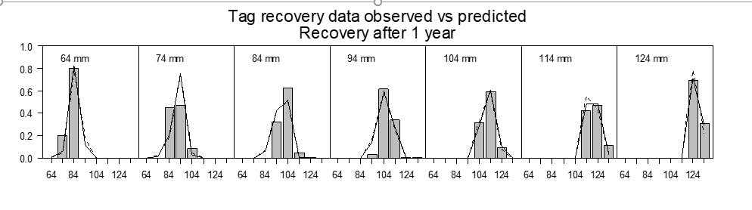
Responses to CPT-SSC (Jan 2021)
• Revisit growth assumptions: Overestimating growth appears to be consistently producing too many large crab.
Author Reply
  Average individual crab growth increments tend to be lower than model transition mean increment.
  However, assessment model growth is based on transition matrix. (data provided from tag-recovery size frequency data: See Appendix H)
  The model appears to fit the data reasonably well. (i.e., Model is not overestimating growth and producing too many large crab).

Slide 12
Responses to CPT-SSC (Jan 2021)
• Investigate size at maturity, reference other rkc stocks if useful.
Author Reply
  Information from other RKC stocks are NOT useful. They are bigger than NSRKC. NSRKC appears to be the smallest of all RKC stocks. Hopefully, Lab studies will determine size at maturity (Leah?)
  More practically, size at maturity does very little effects on determining Tier 4 harvest control (FOFL).
Size at maturity | 94mm (default) | 74mm | 84mm | 104mm | 114mm | 124mm | >134mm
BMSY mil. lb | 4.88 | 5.21 | 4.92 | 3.76 | 2.71 | 1.33 | 0.39
MMB(2022) mil. lb | 5.21 | 5.91 | 5.61 | 4.42 | 2.86 | 1.03 | 0.27
MMB/BMSY | 1.16 | 1.13 | 1.14 | 1.18 | 1.06 | 0.77 | 0.70
Tier 4 a b c | a | a | a | a | a | b | b
FOFL | 0.18 | 0.18 | 0.18 | 0.18 | 0.18 | 0.13 | 0.12
OFL = B*(1-exp(-FOFL))
B: projected biomass subject to fishery (size at maturity not considered)

Slide 13
Responses to CPT-SSC (Jan 2021)
•NSRKC Survey Data
Discards: Provide preferred method.
  LNR: Discards CPUE*Effort (Effort: Total pot pull) LNR2: Adjusted
  Sub: Total catch CPUE*Effort – Retained catch Sub2: Adjusted
  Prop: Retained catch*(Discards/Retained)
  CPT 2021 chose LNR2,
  Author preferred: Prop method. Simpler assumptions, same as how assessment model estimates discards.
  Observer survey terminated: No more discards estimates.
Report pot loss
  Informal data gathering. Need regulation change if we need to collect data more accurately (e.g., mandatory reporting)
VAST (Jon?)
Standardized CPUE
  Revised: 3 separate periods: (and thus 3 fishery qs )
  1977-1993 : large boats offshore
  1994-2007 : small boats nearshore
  2008-2019 : small boats nearshore high-grading

Slide 14
Responses to CPT-SSC (Jan 2021)
•NSRKC Assessment Model
Explore data-weighting assumptions.
Author reply:
  Data-weighting: balance of model fit to various datasets.
  More weight on size comp data -> less fit to trawl survey data
  Current size comp data weights evaluated and accepted by CPT in the past (by eyeballing)
  Objective methods determining data-weighting? (Francis method did not work…)

Slide 15
Responses to CPT-SSC (Jan 2021)
Effects of changing size comp data-weights
Black: default
Red: Reduce weight
Blue: Increase weight

Slide 16
Responses to CPT-SSC (Set-Oct 2021)
•Marketable crab in the legal sized crab.
•Discards biomass estimate in the absence of observer survey
•Assessment model with estimated natural mortality

Slide 17
Responses to CPT-SSC (Set-Oct 2021)
•Marketable crab in the legal sized crab.
•ADF&G only collect legal (>4.75 CW) size data.
•The proportion of legal crab retained by fisherman by length class
Year | 64 | 74 | 84 | 94 | 104 | 114 | 124 | 134
2012 | 0 | 0 | 0 | 0.23 | 0.51 | 0.63 | 0.64 | 0.85
2013 | 0 | 0 | 0 | 0.31 | 0.88 | 0.99 | 1 | 1
2014 | 0 | 0 | 0 | 0.19 | 0.82 | 0.97 | 0.99 | 1
2015 | 0 | 0 | 0 | 0.28 | 0.76 | 0.91 | 0.94 | 0.89
2016 | 0 | 0 | 0 | 0.28 | 0.89 | 0.99 | 1 | 1
2017 | 0 | 0 | 0 | 0.14 | 0.82 | 0.99 | 1 | 1
2018 | 0 | 0 | 0 | 0.87 | 0.98 | 1 | 1 | 0.99
2019 | 0 | 0 | 0 | 0.86 | 1 | 1 | 1 | 1

Slide 18
Responses to CPT-SSC (Set-Oct 2021)
•Estimate discards biomass (D_{b}) in the absence of observer survey
• N_{l} : Crab abundance by size (l)
• S_{s,l} : Fishery selectivity by size (0-1)
• S_{r,l} : Retention probability by size (0-1)
• wm_{l} : Mean weight by size
• q : Fishery catchability

Slide 19
Responses to CPT-SSC (Set-Oct 2021)
•Option 1: calculate discards lb/retained crab coefficient from past observed survey.
• r_{dis} : the discards/retained ratio
• w_{dis} : mean discards weight per discard(lb)
• N_{ret} : the number of retained crab
• Mort_lb : discards mortality biomass per retained crab
= 0.2 ∙r_{dis} ∙ w_{dis}

Slide 20
Responses to CPT-SSC (Set-Oct 2021)
•Estimate discards biomass (D_{b}) mortality in the absence of observer survey
Mort_lb estimated from observer survey
Year | Mort_lb
2012 | 0.686
2013 | 0.254
2014 | 0.306
2015 | 0.316
2016 | 0.084
2017 | 0.078
2018 | 0.122
2019 | 0.164
Average | 0.252

Slide 21
Responses to CPT-SSC (Set-Oct 2021)
•Estimate discards biomass (D_{b}) in the absence of observer survey
Orange: Legal retained
Green: Sublegal unretained
Aqua: Legal unretained
Unobserved unretained crab size and abundance
are highly variable.

Slide 22
Responses to CPT-SSC (Set-Oct 2021)
•Option 2: Use trawl survey size comp, and model estimated selectivity, and retention probability.
Trawl length selectivity = 1.0 , trawl length = true length distribution
Mort_lb estimated from trawl survey, selectivity, retention probability
Year | Mort_lb (Option 1) | Mort_lb (option 2)
2012 | 0.686
2013 | 0.254
2014 | 0.306 | 0.256
2015 | 0.316
2016 | 0.084
2017 | 0.078 | 0.090
2018 | 0.122 | 0.282
2019 | 0.164 | 0.984
Average | 0.252

Slide 23
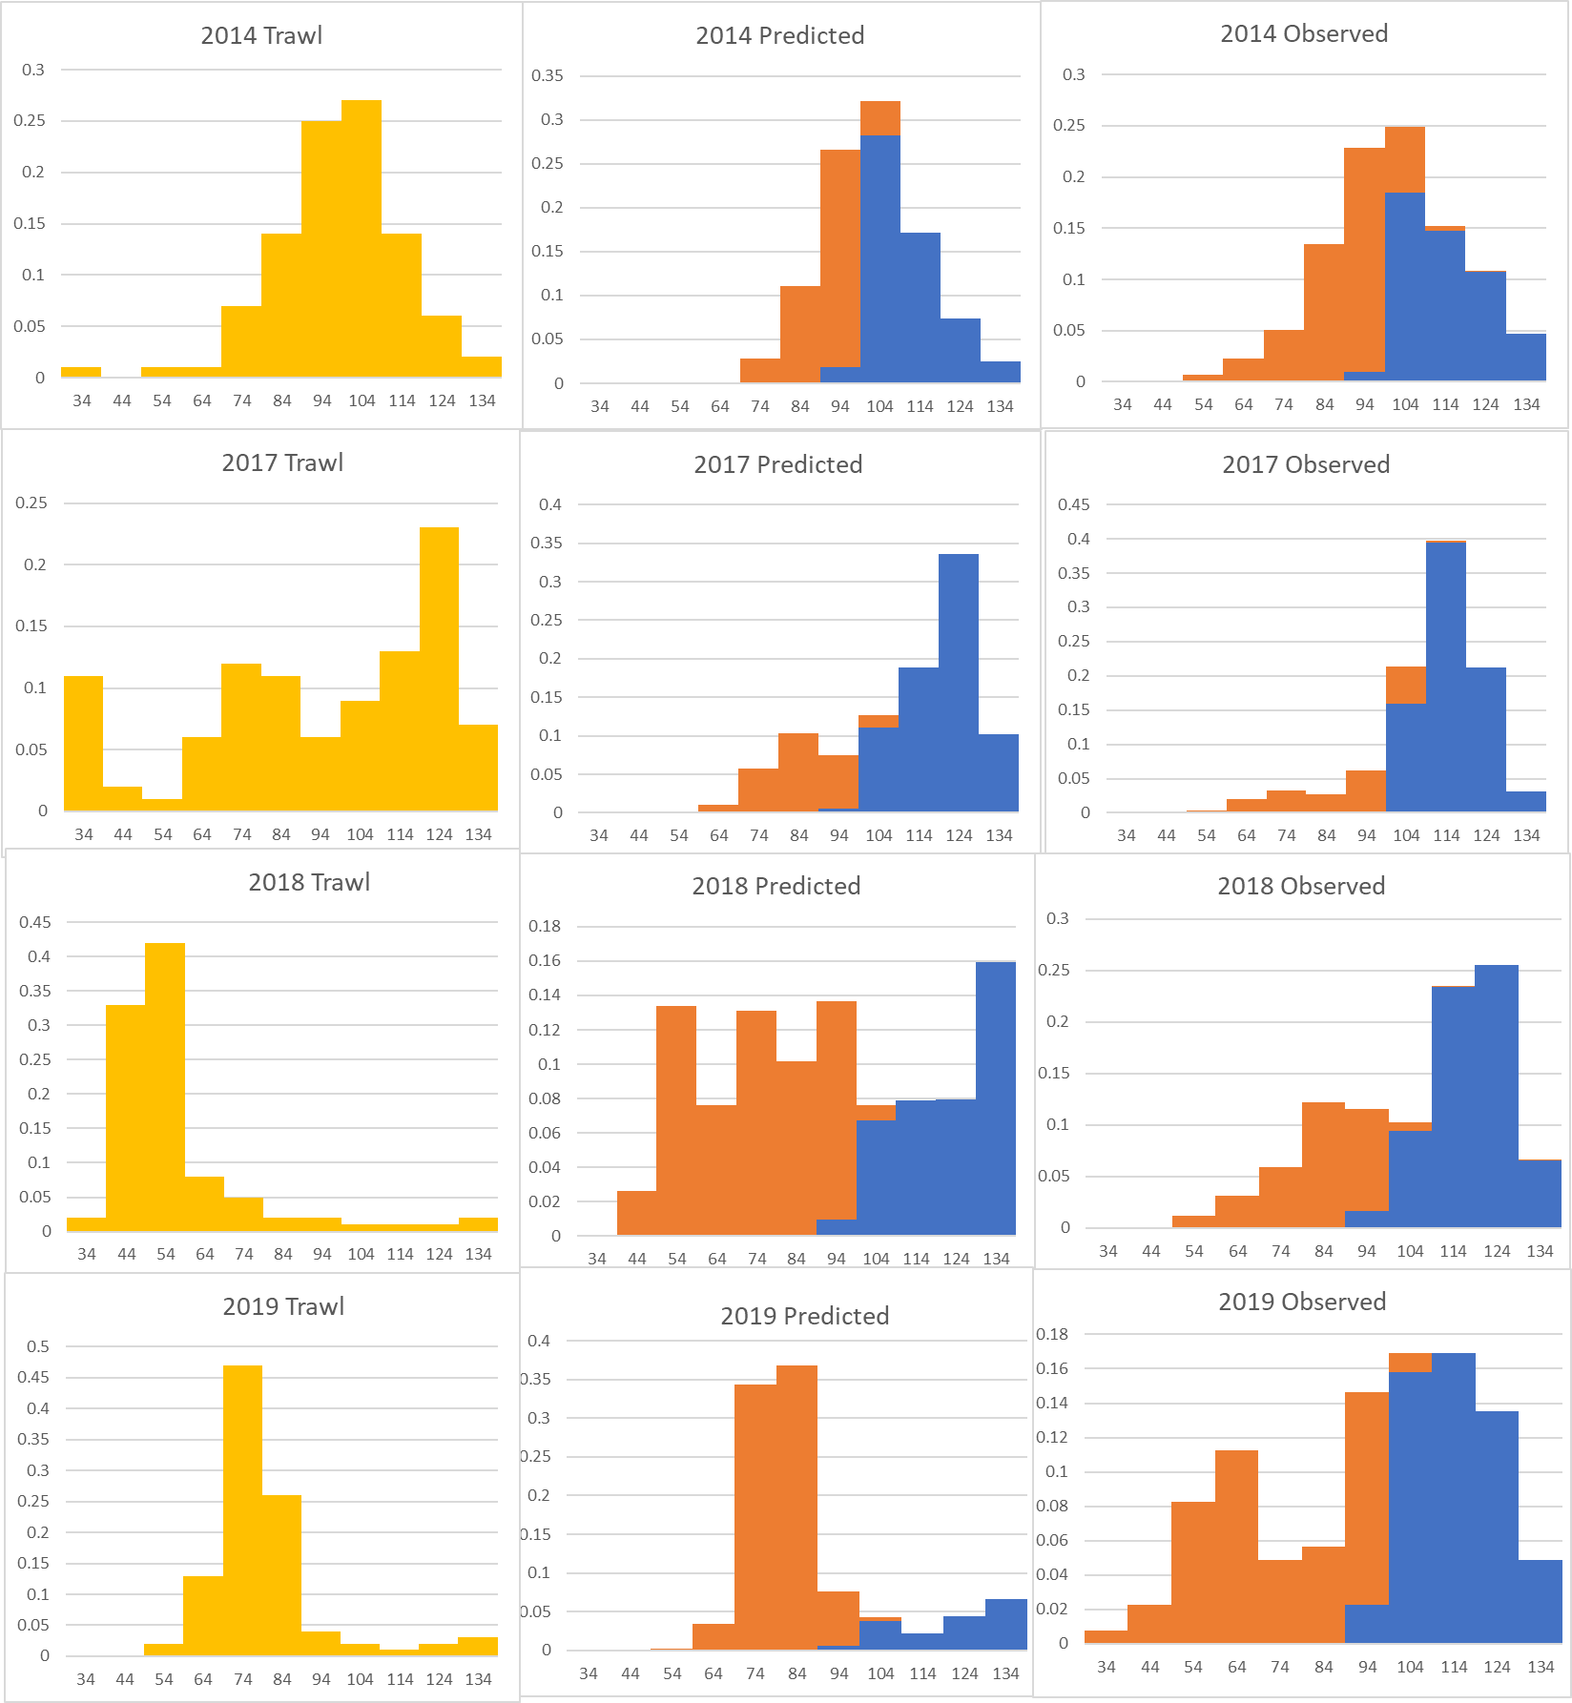
Responses to CPT-SSC (Set-Oct 2021)
•Option 2: Use trawl survey size comp, and model estimated selectivity, and retention probability
Trawl survey not representing true size distribution?
Bad trawl survey selectivity?
(1.0 across all lengths)
Bad selectivity-retention probability?

Slide 24
Responses to CPT-SSC (Set-Oct 2021)
•Option 3: Just use model estimated discards.
NSRKC assessment model calculates discards directly from observed retained catch. Then, why not just use model estimated discards biomass?

Slide 25
Fishery & Data Sept 2021
Winter fishery 2021
  Commercial: 320
  Subsistence: 4655 (total), 2892 (retained)
  Retained data: Not collected O
Summer commercial fishery 2021
  6/25-9/03: 0
  Discards 0, Bycatch from other fisheries: 0.
  No tag recovery
Total harvest: 0.007 mill. lb < ABC (0.35 mill. lb.)
  No overfishing occurred in 2021.
All data FINALIZED
Standardized CPUE Appendix B
ADF&G 2021 Summer trawl survey
  7/19-8/03: 2400.0 k, CV =0.60
NOAA 2021 NBS trawl survey
  7/29-8/7: 2370.0 k, CV = 0.43

Slide 26
2021: Bad weather reduced survey area
Core Stations
Tier 2
Tier 1
Tier 3
Stations not sampled during ADF&G triennial trawl surveys.
standardized zone.

Slide 27
Male abundance (>64mm)
No unsampled area expansion

Slide 28
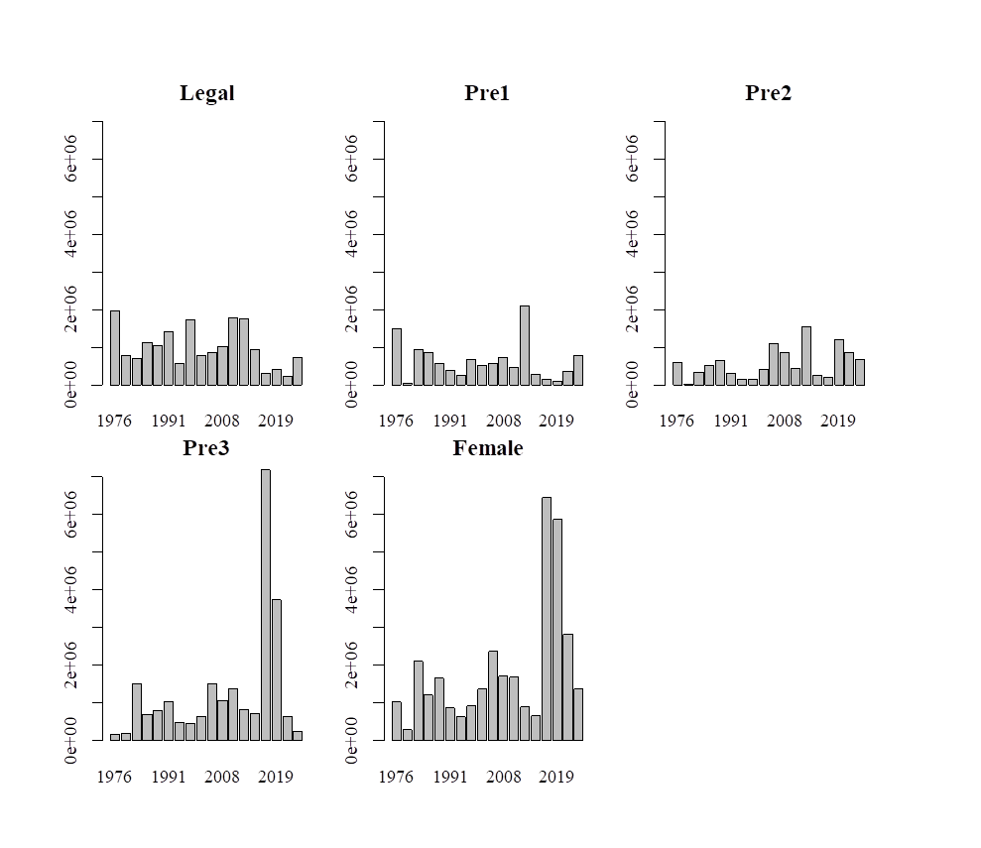
Trawl survey abundance by size sex

Slide 29
Trawl survey abundance by Station
Core Stations
Tier 2
Tier 1
Tier 3
ADFG
NBS
Female
Male

Slide 30
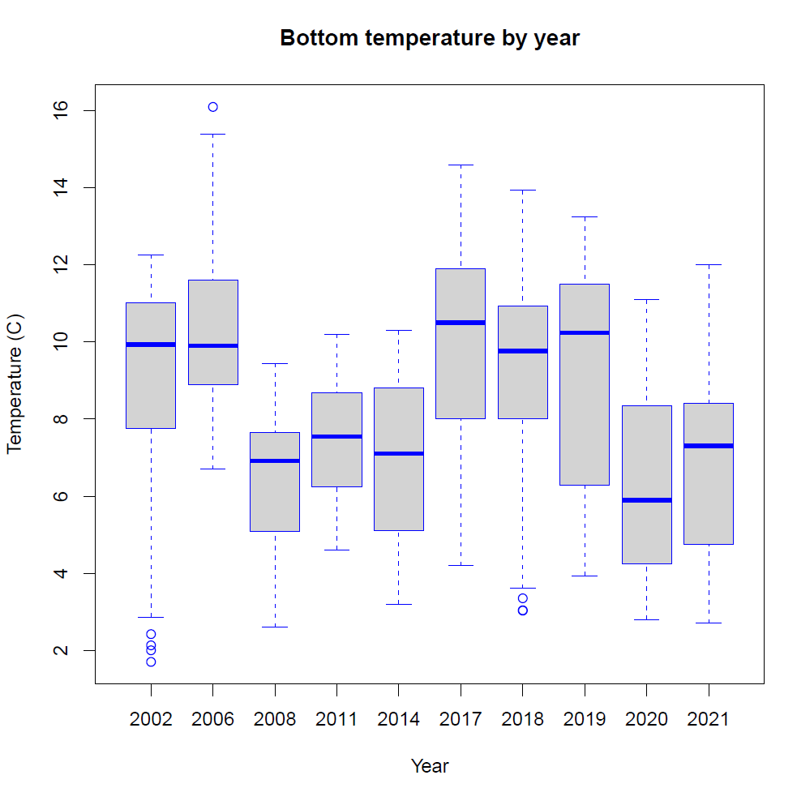
Data collected from HOBO logger deployed on headrope
n = 27 stations
(n=20 stations in 2021

Slide 31
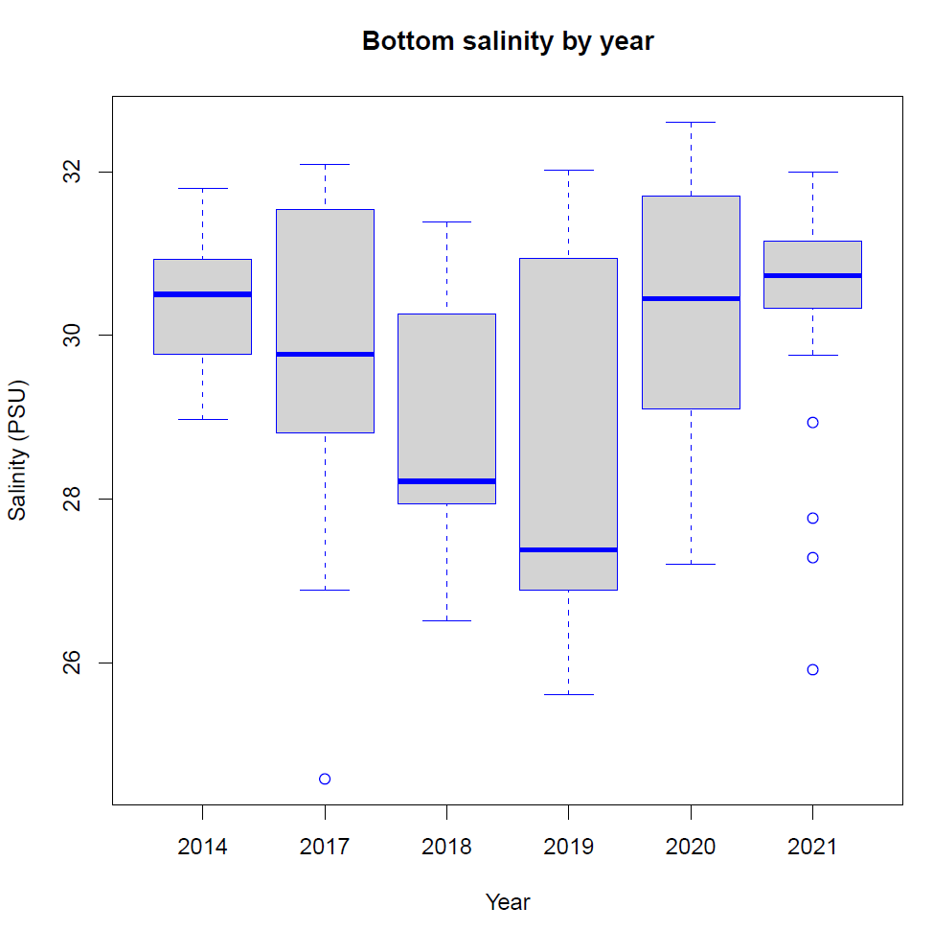
Data collected by CTD deployed before each tow
n = 42 stations
(n=21 stations in 2021)

Slide 32
NSRKC Research 2021
Tackling Assessment Model NSRKC biology assumptions, especially of large crab.
Size dependent mortality
  Is mortality higher for large crab than small crab
Size at maturity
  What is the functional size at maturity of NSRKC?
Large crabs movement
  Do large crabs move out of Norton Sound?

Slide 33
2021 NS red king crab research
Mortality study
Hold small and large crab long term to see if there is differential mortality rates between the sizes.
Sent 26 NS Crab to Kodiak:
8 large (>113 mm CL) and 16 small (<90 mm CL)
(Hope to send more crab later in September),
Hope they will die in peace….
Functional maturity
Determine smallest CL male crab can successfully mate.
Send males (70-75 mm CL) and females to Kodiak prior to mating (January—March 2022)
Collaboration with NOAA and ADF&G
Thank you to Leah Zacher, Jennifer Gardner, Kevin Clark, Justin Leon

Slide 34
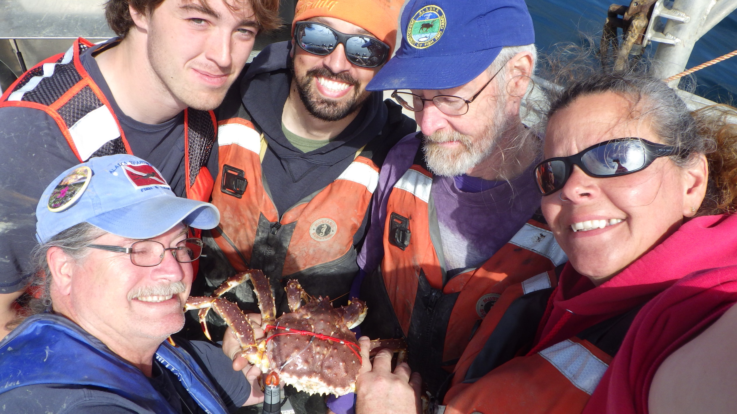
Satellite tagging: Track large crabs
Funded by Bering Sea Crab Research- Led by ADF&G- Kodiak
Thanks to: Ben Daly, Vicki Vanek, Andrew Nault, William Gaeuman, Kevin Clark, Luke Henslee, Ethan Kelso, Justin Leon, Dawn Wehde (NSEDC), and Gabe Blanco

Slide 35
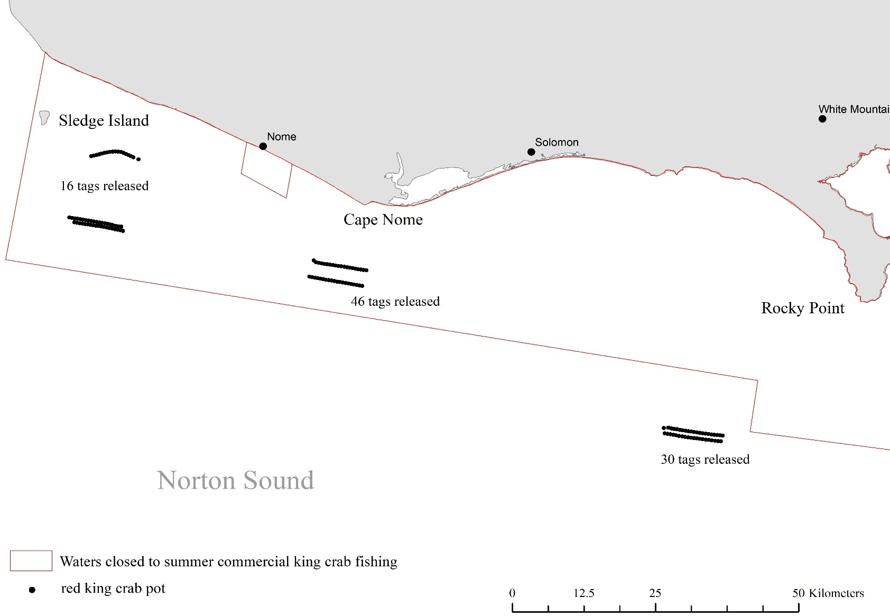
16 tags
46 tags
30 tags
92 tags deployed in 3 areas in Norton Sound- June 12-22
Length : 117-152 mm CL (avg=126 mm CL)
64 New shell, 24 Old shell, 4 Very old shell
31 August release, 61 October release

Slide 36
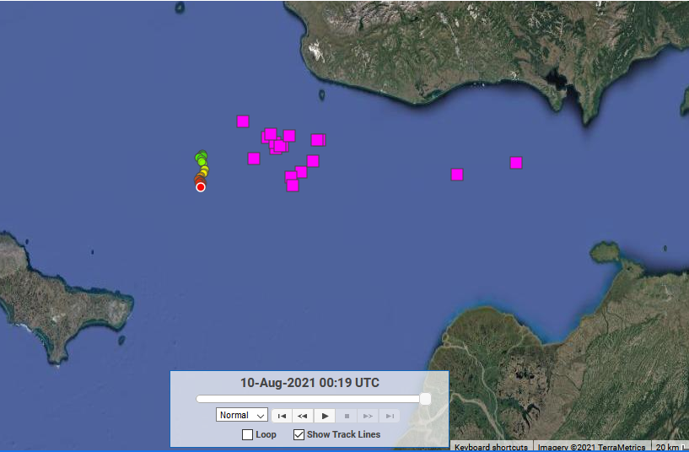
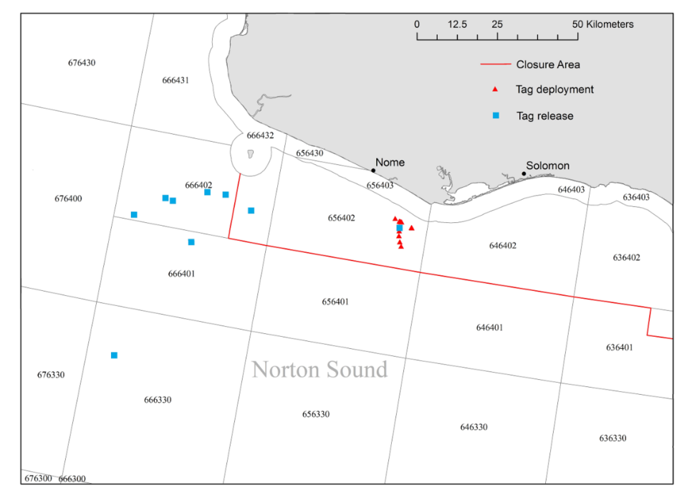
Satellite tags- August release
25 out of 31 tags popped up- still examining locations/movements
No unexpected locations…
Large crabs are neither staying inshore, nor moving out of Norton Sound.
Move out in fall?

Slide 37
Draft NSRKC Assessment Model 21.0 and 21.1 (just for fun)
Model 21.: Model 19.0 with following updates
  Discards estimated with Prop method (Model 19.0e: SAFE 2021)
  Zero summer com catch and size comp:
    Update PRELIMINARY_CALCS_SECTION and likelihood
  Revised Standardized CPUE
    3 data periods: 3 fishery qs
    1977-1993 (large), 1994-2007 (small), 2008-2019 (small & highgrade)
  Two retention probability for summer com
    1977-2007: estimated from 1987-1994 discards length
    2008-2019: estimated from 2012-2019 total catch length
  Two retention probability for winter com
    1977-2007: assumed all legal crabs retained
    2008-2019: estimated from 2015-2018 retained catch length.
Model 21.1 all of the above but M=0.18 for all lengths

Slide 38
NSRKC Final Assessment Models
Model 19.0e: with updated data
Model 21.0: Model 19.0e+ St CPUE with 3qs + 2 summer commercial retention probabilities
Model 21.1: Model 21.0 with M = 0.18 for all length size classes
Model 21.2: Model 19.0e + St CPUE data updated with 3qs.
Model 21.3: Model 19.0e+2 summer commercial retention probability
Model 21.4: Model 21.0 with M estimated equally for all length size classes
Model 21.5: Model 21.0 with M estimated for two length size classes (< 124mm, >123mm CL).

Slide 39
NSRKC Final Assessment Models
Model | Discards Est | St.CPUE | Ret prob | M | Par | Note
19.0e | Prop | 1 | 1 | 0.18+est (L) |  | Default
21.0 | Prop | 3 | 2 | 0.18+est (L) | +4 | Recommended
21.1 | Prop | 3 | 2 | 0.18 | +3
21.2 | Prop | 1 | 2 | 0.18+est (L) | +2 | Bridge 1 to 21.0
21.3 | Prop | 3 | 1 | 0.18+est (L) | +2 | Bridge 2 to 21.0
21.4 | Prop | 3 | 2 | Est | +4
21.5 | Prop | 3 | 2 | Est (S,L) | +5

Slide 40
NSRKC Final Assessment Models
Model | 19.0e | 21.0 | 21.1 | 21.2 | 21.3 | 21.4 | 21.5
Additional Parameters |  | +4 | +3 | +2 | +2 | +4 | +5
Total | 346.67 | 340.05 | 396.6 | 341.58 | 345.08 | 350.20 | 337.31
TSA | 11.46 | 11.78 | 34.9 | 11.71 | 11.48 | 10.97 | 11.03
St.CPUE | -17.21 | -23.57 | -19.0 | -23.73 | -17.25 | -24.19 | -24.45
TLP | 129.81 | 129.67 | 133.30 | 129.94 | 129.66 | 132.03 | 128.34
WLP | 39.30 | 38.88 | 40.75 | 38.91 | 39.28 | 39.78 | 38.87
CLP | 50.00 | 48.28 | 62.55 | 49.60 | 48.64 | 51.49 | 47.79
OBS | 24.11 | 24.36 | 25.47 | 24.23 | 24.20 | 27.93 | 25.10
REC | 2.77 | 2.77 | 2.56 | 2.77 | 2.78 | 2.14 | 2.59
WN | 18.95 | 20.36 | 20.14 | 20.40 | 18.95 | 20.78 | 21.07
DIS | 3.40 | 3.59 | 3.89 | 3.68 | 3.30 | 3.07 | 3.20
TAG | 84.13 | 83.98 | 92.04 | 84.14 | 84.03 | 86.21 | 83.77
RMSE Trawl | 0.35 | 0.35 | 0.56 | 0.35 | 0.35 | 0.33 | 0.34
RMSE CPUE | 0.45 | 0.40 | 0.43 | 0.39 | 0.46 | 0.39 | 0.40
M | 0.18 0.62 | 0.18 0.61 | 0.18 | 0.18 0.62 | 0.18 0.61 | 0.42 | 0.26 0.59

Slide 41
NSRKC Final Assessment Models: Summary
Explore M : Model 21.0, 21.1,21.4, 21.5:
  (rehash of NPFMC 2019 model alternatives).
  No changes in overall results (as expected)
Length-independent M = 0.18 (21.1) generates the poorest model fit.
Length-independent higher M (21.4) moderately improves model fit.
Length-dependent M (21.0) showed great improvement in model fit.
Length-dependent higher M (21.5) had the best model fit.
None of the model alternatives greatly reduced misfit.
  Large crabs, Oldshell crabs

Slide 42
NSRKC Final Assessment Models: Summary
Bridge model analyses: Model 19.0e, 21.2,21.3, 21.0:
Revise st.CPUE timeseries (19.0e. 21.2): changes in model fit ( but this has to happen)
Increase retention probs (19.0e. 21.3): No changes in model fits

Slide 43
NSRKC Final Assessment Models: Summary
Model 21.5 is the best, followed by 21.1, 21.4, and 21.1:
Can’t distinguish model improvement visually, except for trawl survey.
Higher M
  Higher total crab abundance.
  Smaller increase in MMB – BMSY
  Lower projection

Slide 44
Trawl Survey: higher M slightly better fit

Slide 45
St CPUE

Slide 46
Trawl length

Slide 47
Summer Com retain:

Slide 48
Com discards
Discards
Total

Slide 49
Winter pot len new old : Red 21.0, Blue 21.1

Slide 50
Winter com retain len new old : Red 21.0, Blue 21.1

Slide 51
Tag Recovery

Slide 52
Molting, Selectivity, retention

Slide 53
Abundance

Slide 54
MMB

Slide 55
Retrospective

Slide 56
NSRKC Final Assessment Models: Discussion
None of the model alternatives greatly reduced misfit.
  Large crabs, Oldshell crabs
Assumption of oldshell = did not molt.
Tag-recovery with no growth (+/- 3mm) after 1 year of liberty
Molted but no growth, self shell cleaning, shell mis-ID?
Accuracy of distinguishing newshell vs. oldshell?
Released\Recovered | Newshell | Oldshell
Newshell | 29 | 71
Oldshell | 12 | 13

Slide 57
NSRKC Final Assessment Models: Discussion
None of the model alternatives greatly reduced misfit.
  Large crabs, Oldshell crabs
Observer Survey: large (CL>110mm) crabs
Selective shell based discards?
 | Newshell | Oldshell
Retained | 6037 | 1618
Discards | 361 | 381
% discards | 5.6% | 19.1%

Slide 58
Author Recommendation
SSC: “The rationale that it may result in a higher OFL should not prevent exploring a higher value for M if that may be the best description of the dynamics.”
Model 21.0 or Model 21.5
Model 21.5 is better
  Better model fit
  Better retrospective

Slide 59
Author Recommendation OFL
SSC: “The rationale that it may result in a higher OFL should not prevent exploring a higher value for M if that may be the best description of the dynamics.”
Model | 21.0 | 21.5
BMSY (1980-2022) | 4.17 m lb, 1.90 k.t | 4.30 m lb, 1.95 k.t
MMB (2022) | 5.33 m lb, 2.42 k.t. | 4.79 m lb, 2.17 k.t.
Tier 4 status | a | a
F_{OFL} | 0.18 (CL < 124mm) 0.61 (CL > 123mm) | 0.26 (CL < 124mm) 0.59 (CL > 123mm)

Slide 60
Author Recommendation OFL
SSC: “The rationale that it may result in a higher OFL should not prevent exploring a higher value for M if that may be the best description of the dynamics.”
F_{OFL}: Length-independent vs Length-dependent?
Author recommendation: length-dependent
  Consistent with model structure
  Can be reasonable when M = 0.18 is assigned (21.0) but not reasonable when M is estimated (21.5)
  ABC buffer is the right place to deal with uncertainties about OFL.

Slide 61
Author Recommendation OFL
SSC: “The rationale that it may result in a higher OFL should not prevent exploring a higher value for M if that may be the best description of the dynamics.”
F_{OFL}: Length-independent vs Length-dependent?
Author recommendation: length-dependent
  Consistent with model structure
  Can be acceptable when M = 0.18 is assigned (21.0), but does not make sense when length-dependent M is estimated (21.5)
  ABC buffer is the right place to deal with uncertainties about model estimated OFL.

Slide 62
Author Recommendation OFL
SSC: “The rationale that it may result in a higher OFL should not prevent exploring a higher value for M if that may be the best description of the dynamics.”
Model | 21.0 | 21.5
BMSY (1980-2022) | 4.17 m lb, 1.90 k.t | 4.30 m lb, 1.95 k.t
MMB (2022) | 5.33 m lb, 2.42 k.t | 4.79 m lb, 2.17 k.t
Tier 4 status | a | a
F_{OFL} | 0.18 (CL < 124mm) 0.61 (CL > 123mm) | 0.26 (CL < 124mm) 0.59 (CL > 123mm)
Total OFL | 0.89 m lb, 0.40 k.t | 0.96 m lb, 0.44 k.t

Slide 63
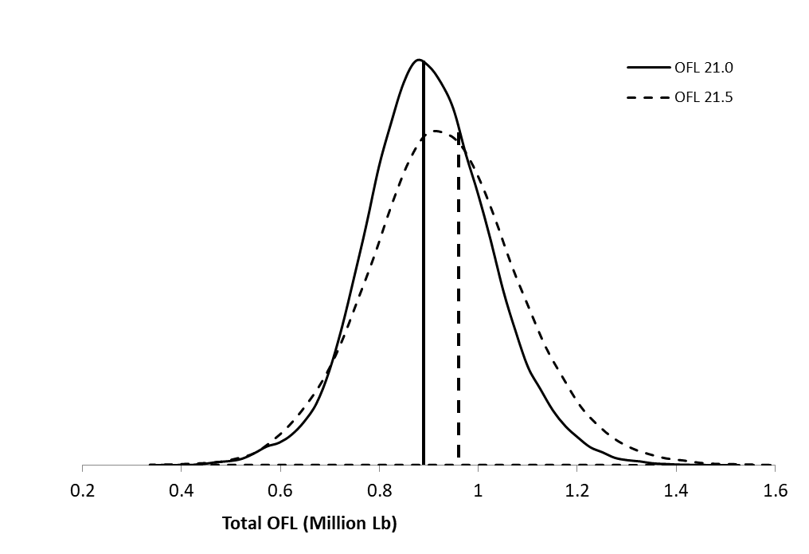
Author Recommendation OFL
SSC: “The rationale that it may result in a higher OFL should not prevent exploring a higher value for M if that may be the best description of the dynamics.”

Slide 64
ABC Buffer
Criteria (measurement stick) determining the level of ABC buffer?
Model | 21.0 | 21.5
BMSY (1980-2022) | 4.17 m lb, 1.90 k.t | 4.30 m lb, 1.95 k.t
MMB (2022) | 5.33 m lb, 2.42 k.t | 4.79 m lb, 2.17 k.t
Tier 4 status | a | a
F_{OFL} | 0.18 (CL < 124mm) 0.61 (CL > 123mm) | 0.26 (CL < 124mm) 0.59 (CL > 123mm)
Total OFL | 0.89 m lb, 0.40 k.t | 0.96 m lb, 0.44 k.t
40% (2021: SSC said so) | 0.53 m lb, 0.24k.t | 0.58 m lb, 0.26 k.t
55% (rationale?) | 0.40 m lb, 0.18 k.t | 0.43 m lb, 0.20 k.t
? % (rationale?)

Slide 65
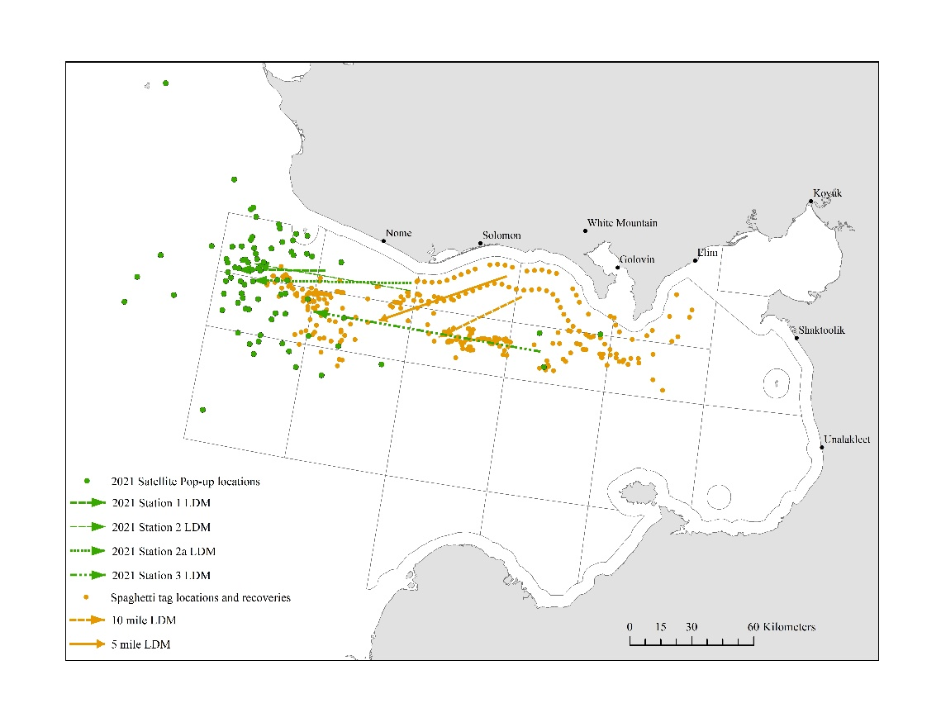
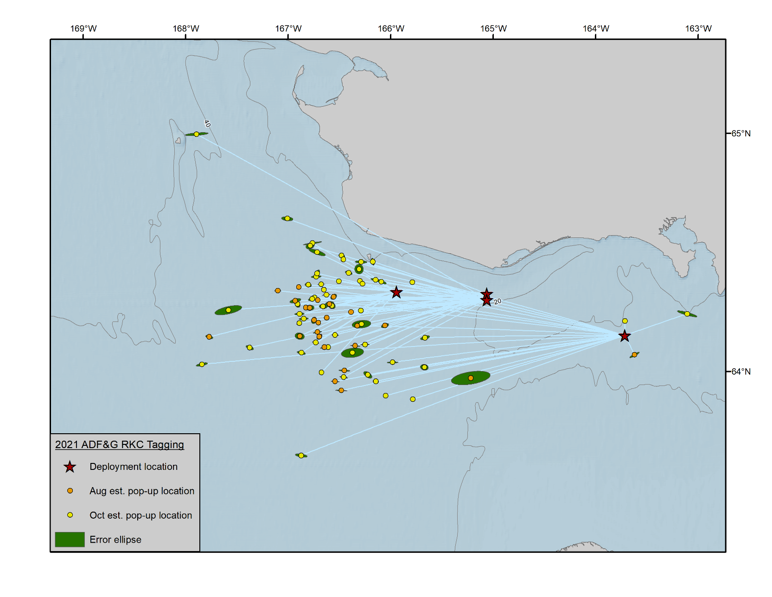
Research Update
Sat tag recovery
Oct loc closer to shore than Aug loc.
Inshore migration?

