Slide 1
Norton Sound Red King Crab SAFE2019
Jan 24 2019
Toshihide “Hamachan” Hamazaki,
Jie Zheng
Alaska Department of Fish & Game
Division of Commercial Fisheries

Slide 2
NSRKC Stock Assessment Model
Modeling process
Available Data & model fit
5 months
Pot survey
Length
Natural
Mortality
Winter Harvest
& Discards
Winter fishery
Dec - May
NSRKC
SAFE Winter +Summer fishery
Feb 01
Abundance
July 01
Abundance
Summer fishery
Jun - Sept
Summer Harvest
& Discards
Length, CPUE
Molting, Growth &
Recruitment
Natural
Mortality
Trawl survey
Abundance, Length
Tag recovery
7 months

Slide 3
NSRKC Stock Assessment Model
Modeling process
Available Data & model fit
5 months
Length Prop
Pot survey
Natural
Mortality
Abundance
Trawl survey
ST. CPUE
Winter fishery
Dec - May
Feb 01
Abundance
July 01
Abundance
Summer fishery
Jun - Sept
Survey selectivity
=
Catch selectivity
Length Prop
Trawl Survey
Fishery: Retain
Discards
Molting, Growth
Recruitment
Natural
Mortality
7 months
Tag recovery

Slide 4
Assessment Model Assumptions
Length classes: CL mm (immature, mature, legal)
  1: 64-73, 2: 74-83, 3: 84-93, 4: 94-103, 5: 104-113, 6: 114-123, 7: 124-133, 8: ≥ 134 mm
Natural mortality M = 0.18 for length class 1-6, higher mortality of classes 7 and 8
Same selectivity and catchability for New and Old Shells
Discards mortality = 0.2
Fishery harvests occur instantly:
  Winter fishery: Feb 01: Nov – May
  Summer fisher: July 01: Jun – Sept
Winter catch selectivity = winter pot survey selectivity

Slide 5
Available Data

Slide 6
Changes Fishery & Data
Winter fishery 2018
  Commercial: 9,189 (20,118 lb.) Down by 65% from 2018
  Subsistence: 4,424 (8,848 lb.) Down by 27% from 2018
Summer commercial fishery 2018
  6/24-7/29: 89,613 (298,396 lb.)
Total retained harvest: 103,217 (0.34 mill. lb.) < ABC (0.35 mill. lb.)
Standardized CPUE update (Appendix B)
ADF&G 2018 Summer trawl survey
  7/22-7/29: 1108.9 k, CV =0.25
Winter Commercial Retained length-shell (2016-18)
Changes in fishery regulation: None

Slide 7
Responses to CPT-SSC Sept-Oct 2018
Provide Tier 3 vs. Tier 4 Pros and Cons
Tier 3
  Pro: Harvest limit based on biological process
  Con: High uncertainties about assumed biological process
    High M of large crab, Knife edge maturity
Tier 4
  Pro: Conventional (Status Quo)
  Con: Ad hoc harvest limit rule
Impacts on fishery
Tier 3 OFL >>>> Tier 4 OFL
  Harvest will be limited by GHL

Slide 8
Responses to CPT-SSC Sept-Oct 2018
Perform sensitivities to the assumed knife-edge cutoff maturity
Maturity data do not exist
Model does not include SR function (add recruits)
  Changing recruits (default < 94mm, changes to < 84mm, <103mm) did not change population dynamics
Used for calculation of B_{MSY}-B_{pred}
  Little change in B_{pred}/B_{MSY} ratio
  OFL is retained Legal crab (maturity has no effects)

Slide 9
Responses to CPT-SSC Sept-Oct 2018
Limit the January discussion to Tier 3 vs. Tier 4. The CPT does not need to see all of the model description again.
  8 Alternative models are presented in Jan 2019 SAFE report.
  Only Author recommended model Tier 3 vs. Tier 4 will be presented and discussed here.

Slide 10
2018 Trawl Survey
2018
Core Stations
Tier 2
Tier 1
Tier 3
Stations not sampled during ADF&G triennial trawl surveys.
Figure 2- Station Map

Slide 11
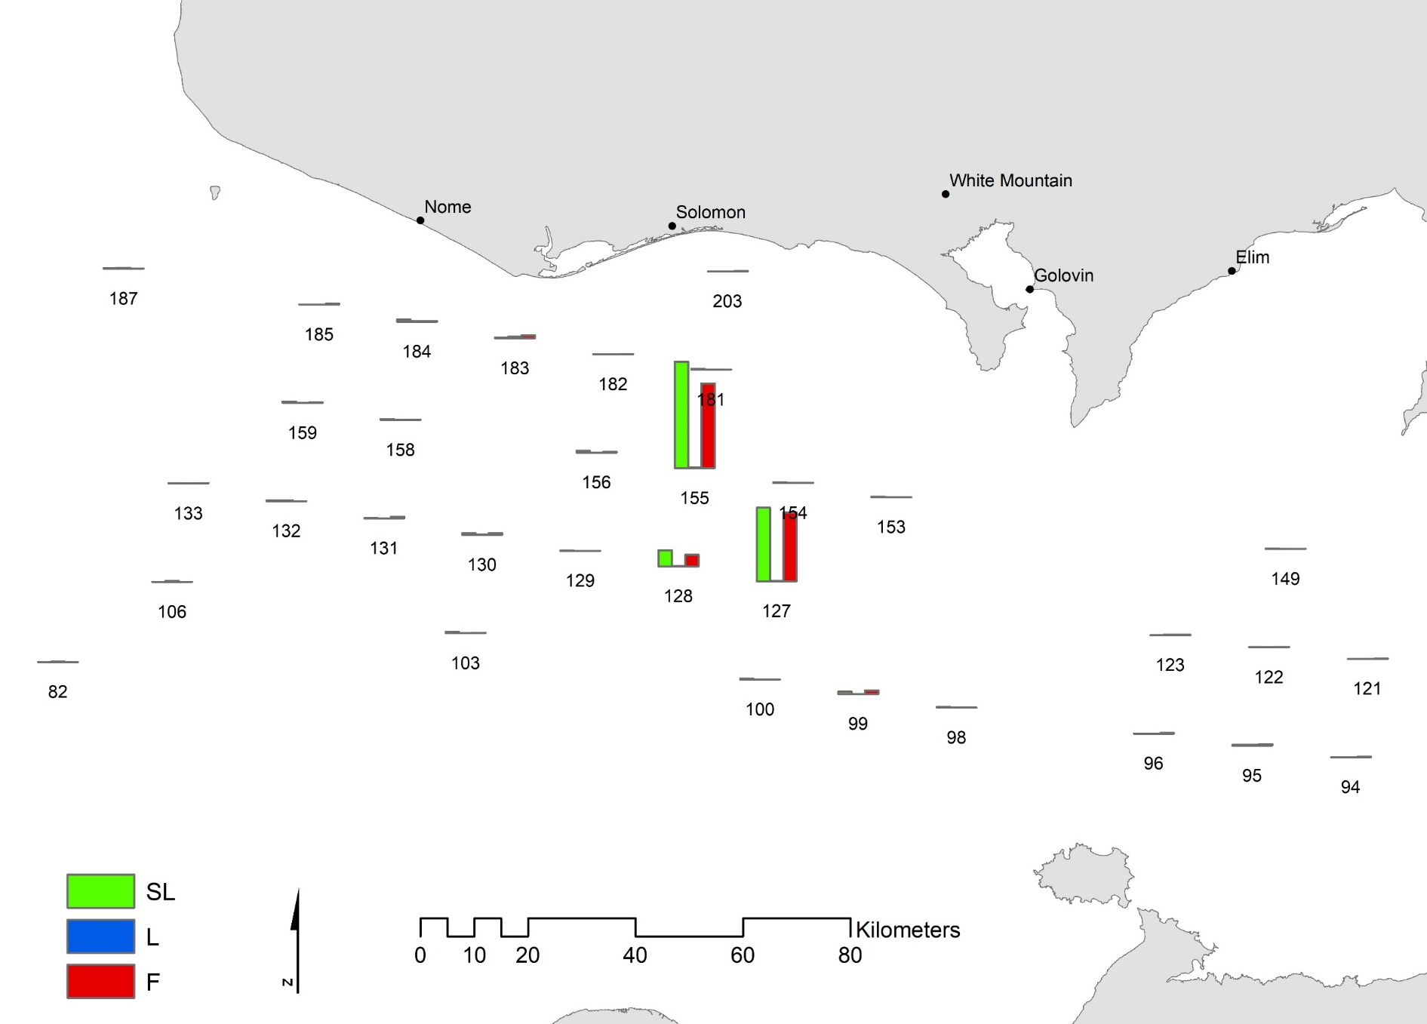
2018 Trawl Survey red king crab distribution

Slide 12
Year | Agent | Female | Legal (>104) | Pre1 (90-104) | Pre2 (76-89) | Pre3 (<76)
1976 | NMFS | 1,021,572 | 1,976,523 | 1,485,909 | 591,973 | 165,849
1979 | NMFS | 302,601 | 771,002 | 39,180 | 8,101 | 185,336
1982 | NMFS | 2,097,511 | 702,561 | 941,075 | 330,374 | 1,513,300
1985 | NMFS | 1,221,058 | 1,119,285 | 850,338 | 526,338 | 690,060
1988 | NMFS | 1,653,212 | 1,051,009 | 568,578 | 638,630 | 792,923
1991 | NMFS | 877,035 | 1,416,006 | 387,234 | 320,579 | 1,033,641
1996 | ADFG | 643,247 | 567,639 | 249,011 | 156,842 | 468,697
1999 | ADFG | 915,135 | 1,718,561 | 682,813 | 155,992 | 467,877
2002 | ADFG | 1,373,860 | 786,389 | 512,964 | 413,754 | 646,672
2006 | ADFG | 2,361,646 | 862,993 | 565,242 | 1,093,104 | 1,501,881
2008 | ADFG | 1,715,846 | 1,016,407 | 727,488 | 848,561 | 1,044,702
2010 | NMFS | 829,599 | 806,809 | 840,798 | 330,033 | 688,283
2011 | ADFG | 1,678,631 | 1,790,972 | 455,708 | 446,136 | 1,380,161
2014 | ADFG | 901,391 | 1,746,881 | 2,109,261 | 1,546,795 | 830,240
2017 | ADFG | 653,182 | 941,797 | 288,615 | 258,235 | 713,943
2017 | NMFS | 1,325,065 | 746,137 | 322,684 | 327,242 | 1,007,975
2018 | ADFG | 6,438,063 | 303,806 | 151,903 | 212,664 | 7,169,809
The lowest legal crab abundance
The highest female and Pre3 abundance

Slide 13
Alternative model selection for 2019 SAFE
Model 18.0: Baseline 2018 model with updated data
  Fit discards length (1987-1994, 2012-2018)
Model 18.1a: Estimate Summer com retention
  Fit total catch length (2012-18)
  (CPT recommended Sept 2018)
Model 18.1b: 18.1a + fit discards (1987-1994)
Model 18.1c: 18.1b + 2 retention
Model 18.1d: 18.1b + 2 total selectivity
Model 18.2: 18.0 + Winter com retention (2015-18)
Model 18.2a: 18.1a + Winter com retention (2015-18)
Model 18.2b: 18.1b + Winter com retention (2015-18)
  CPT Recommended (Jan 2019)

Slide 14
Tier 3 vs. Tier 4 OFL
Tier 4b
MMB₂₀₁₉: 3.12 million lb.
B_{MSY}: 4.57 million lb.
M: 0.18 for length 1-6, 0.583 for length 7-8
F_{OFL}: 0.118 (for all length) or 0.381 for length 7-8
Legal male Biomass catchable : 2.51 million lb.
OFL_{retain}: 0.24 million lb
ABC_{retain}: 0.19 million lb
Length dependent OFL_{retain}: 0.44 million lb

Slide 15
Tier 3 vs. Tier 4 OFL
Tier 3 (Assume 2013-2018 average recruitment)
B₀: 3.48 million lb.
B_{35%}: 1.21 million lb.
F_{35%}: 2.42
F_{40%}: 1.36
OFL_{F35%}: 1.75 million lb
OFL_{F40%}: 1.29 million lb

Slide 16
Tier 3 vs. Tier 4 OFL
Tier 3 OFL is 7 times higher than Tier 4 OFL (due to high M of large crabs)
Harvest will be limited by GHL
AK NSRKC GHL
Legal biomass
< 1.25 million lb 0%
1.25-2.0 million lb up to 7%
2.0-3.0 million lb up to 13%
>3.0 million lg up to 15%
Legal 2.49 million lb
GHL up to 0.32 million lb

Slide 17
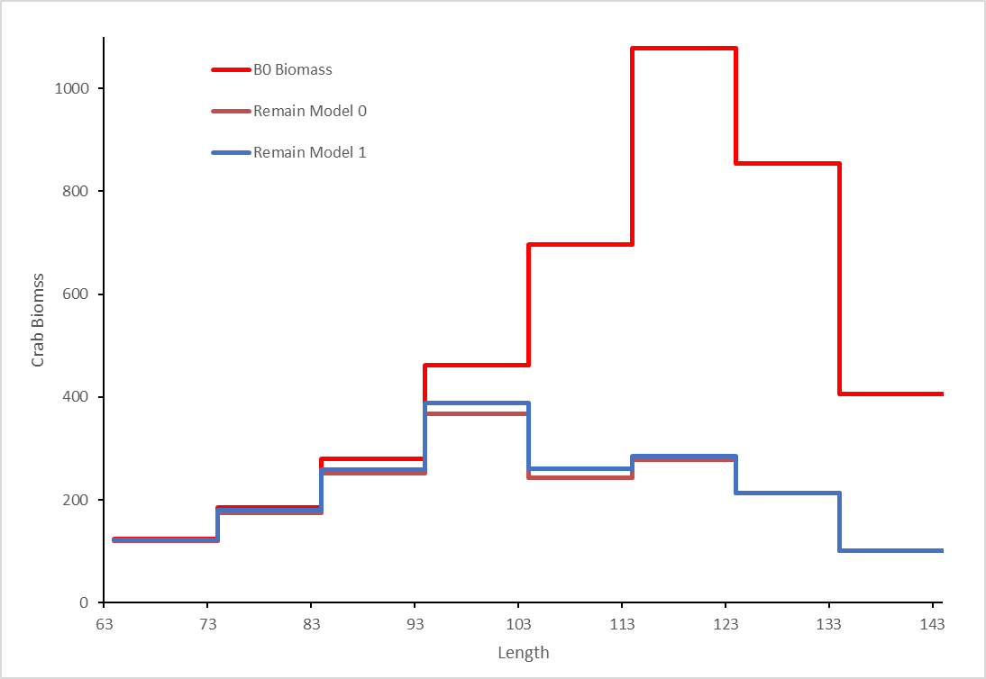
Selectivity & Retention

