Slide 1
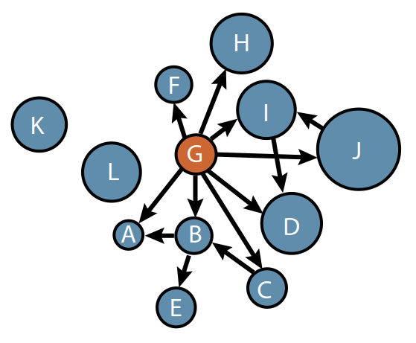
Using Network Analysis to Identify Cross-Fishery Spillovers
Social Science Planning Team Meeting, North Pacific Fisheries Management Council
May 7, 2019

Slide 2
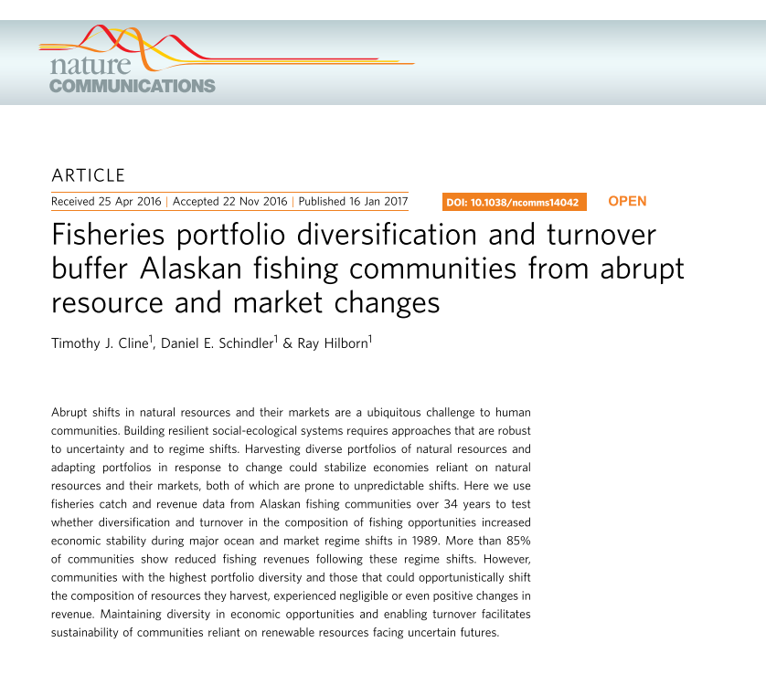
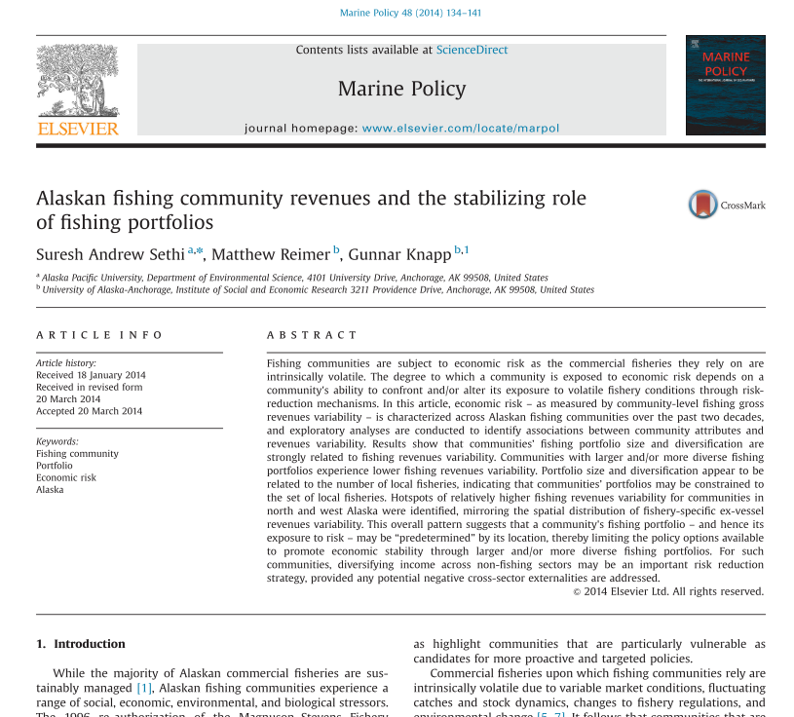
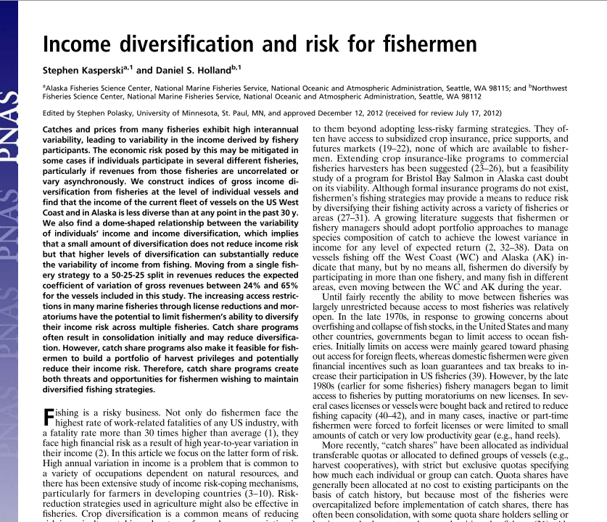
Cross-Fishery Participation
Fishery policies are often directed to a single fishery even though fishers participate in multiple fisheries.
Diversifying participation across multiple fisheries can mitigate risk, smooth incomes, and act as insurance against environmental and policy shocks.

Slide 3
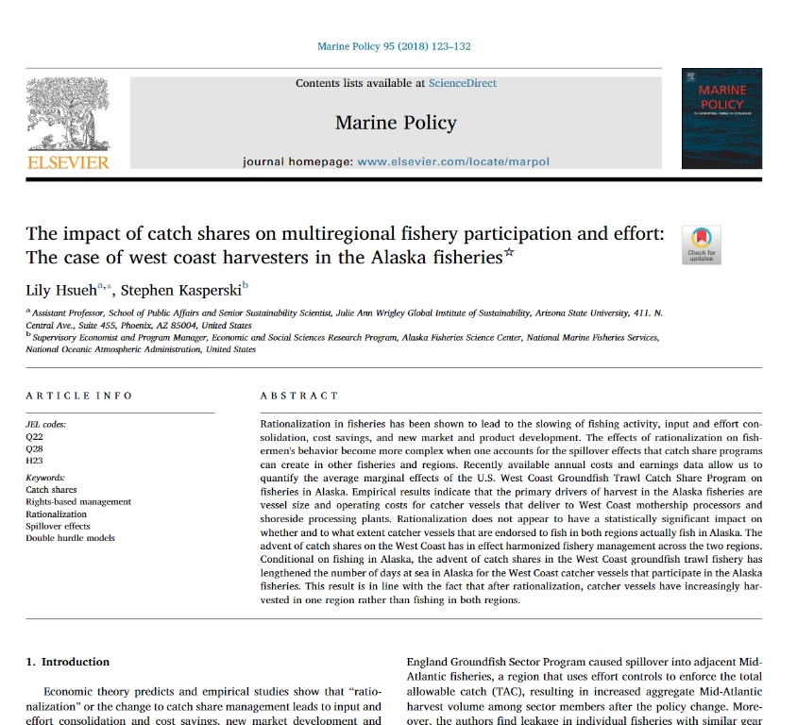
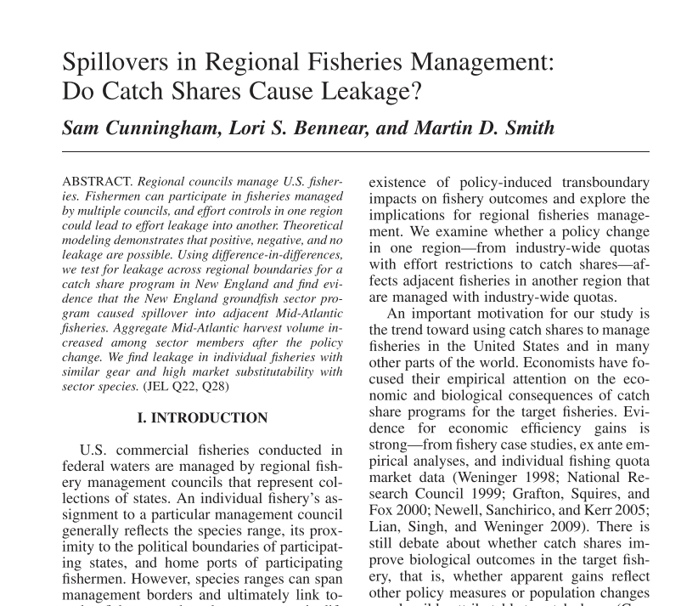
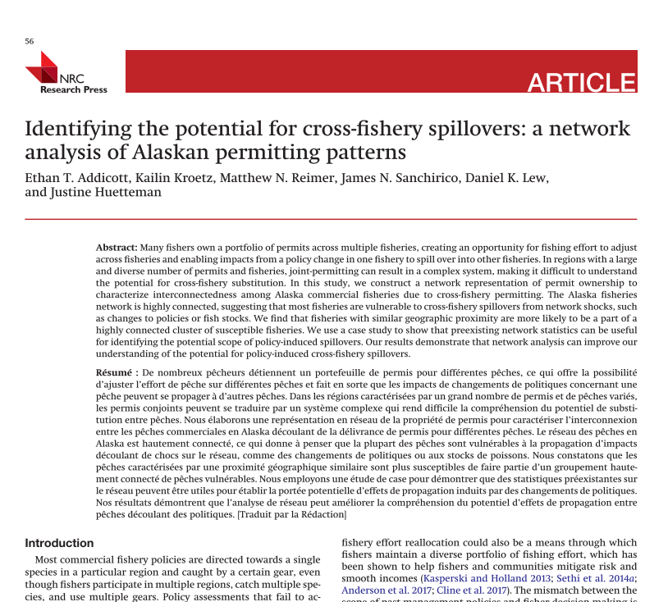
Cross-Fishery Participation
Fishery policies are often directed to a single fishery even though fishers participate in multiple fisheries.
If fishers shift effort to other fisheries, a single-fishery policy could result in “leakage”—i.e., negative or positive impacts on fishers/communities involved in ancillary fisheries.

Slide 4
Cross-Fishery Participation and Cross-Fishery Spillovers
The likelihood and degree of leakage from a single-fishery policy depends on fisher's ability to substitute between fisheries.
Network theory and methods are useful for characterizing and visualizing existing cross-fishery participation and historical substitution between fisheries.
What is Network Theory?
Network theory is the study of graphs and the relations between discrete objects that comprise the graph.
A graph consists of a set of nodes and edges.
Examples:
Node = Fishery. Size of node denotes the number of participants.
Edge connects two nodes (fisheries) if there is at least one shared participant.
Weight of edge connecting two nodes denotes the number of shared participants.

Slide 5
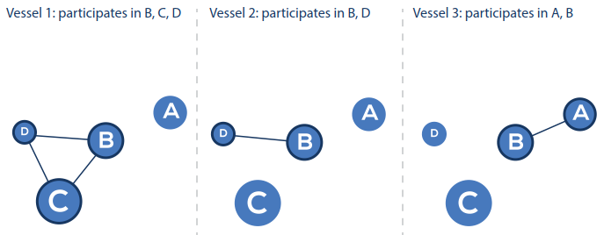
Network Representation of Cross-Fishery Participation

Slide 6
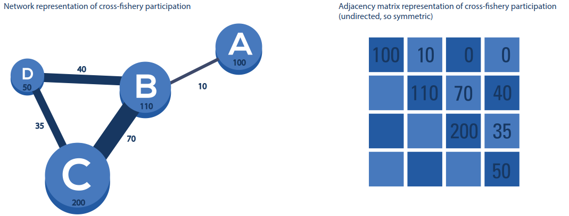
Network Representation of Cross-Fishery Participation
=

Slide 7
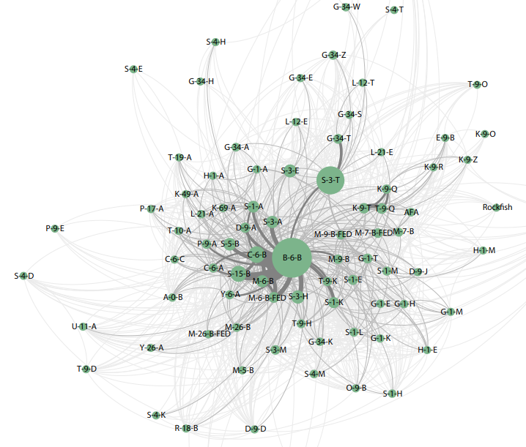
Advantages of Using Network Theory
Visualization
What fisheries share the most participants?
What groups of fisheries share participants?
1991-1993
Halibut longline (B-6-B)

Slide 8
Advantages of Using Network Theory
Visualization
What fisheries share the most participants?
What groups of fisheries share participants?
1991-1993
Sablefish longline (C-6-B)

Slide 9
Advantages of Using Network Theory
Visualization
What fisheries share the most participants?
What groups of fisheries share participants?
1991-1993
Salmon-Bristol Bay-Driftnet (C-6-B)

Slide 10
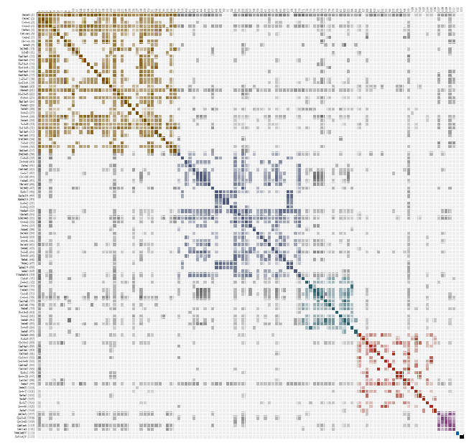
Corresponding Adjacency Matrix

Slide 11
Advantages of Using Network Theory
Quantification
Summarize overall connectivity (system resilience).
Find groups (or clusters) of fisheries that are more likely to share fishery participants.
Track migration of fishers between fisheries over time.
Policy evaluation (prospective)
Use connectivity metrics to determine the likelihood of a policy to generate spillovers.
Use existing patterns of cross-fishery participation to identify the scope of leakage from a policy.
Policy evaluation (retrospective)
Understand how/if previous policies had spillover into other fisheries.

Slide 12
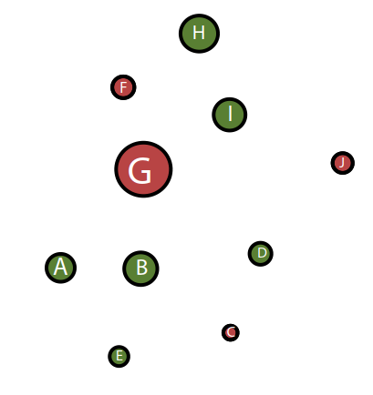
Policy Impacts on Networks
(a) Node size change = change in participation

Slide 13
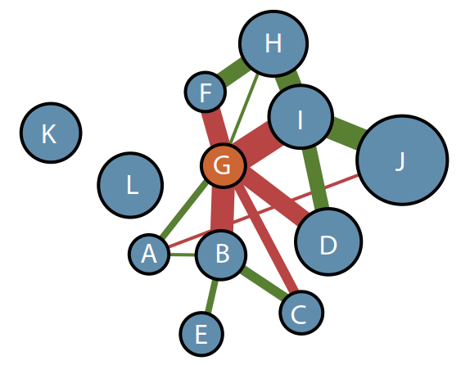
Policy Impacts on Networks
(b) Cross-fishery participation change

Slide 14
Policy Impacts on Networks
(c) Migration (or flow) of permits

Slide 15
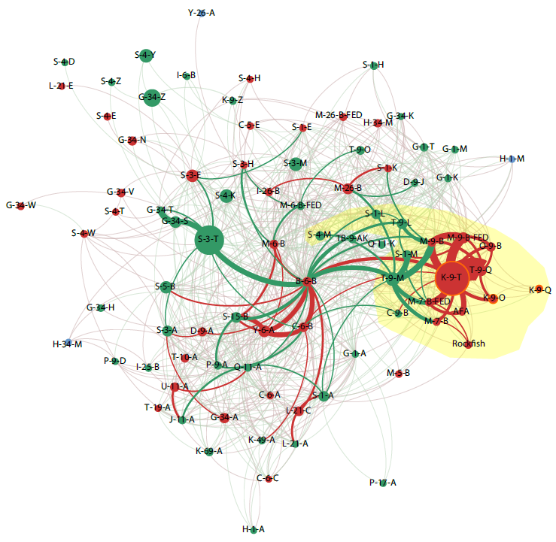
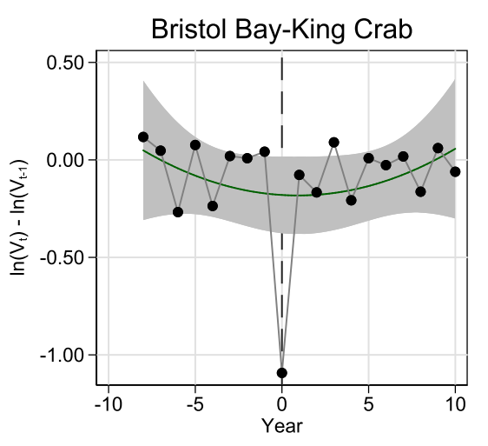
Change in participation after crab ITQs
Change in Participation After Crab ITQs
Red = decrease in node size or edge weight
Green = increase in node size or edge weight
Yellow = ex ante prediction of scope of policy effects
Crab ITQ fisheries
Weighted Degree

Slide 16
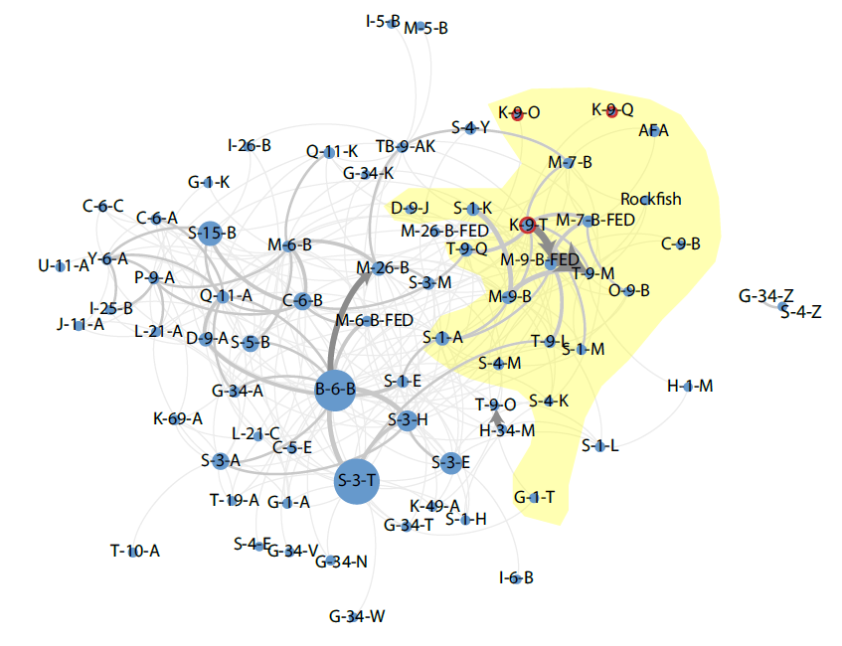
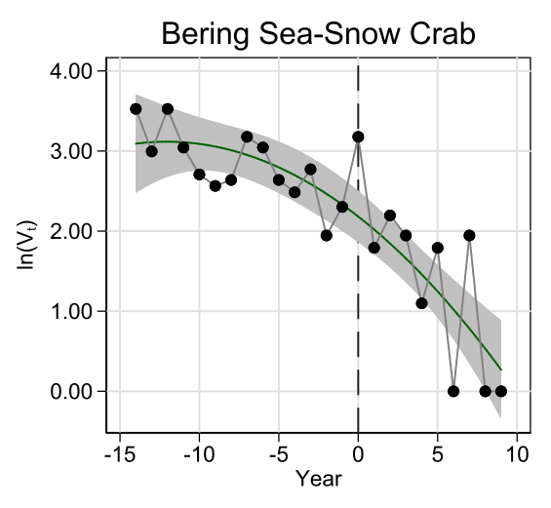
Change in Migration After Crab ITQs
Yellow = ex ante prediction of scope of policy effects
Thickness of arrow proportional to migration
Crab ITQ fisheries
Weighted Degree

Slide 17
Disadvantages of Using Network Theory
Complexity
Data requirements: need all fisheries, participation/landings data.
Computationally intensive—the more complex, the longer it takes to compute.
Visualization challenges—networks can be large and challenging to visualize.
Policy evaluation challenges
Difficult to attribute causality to changes in the network
Past behavior does not necessarily represent future behavior after policy change.
Network metrics do not necessarily have an easy interpretation within the context of fisheries and policy.
Still difficult to communicate results to decision makers.

Slide 18

Thank you!
Funding provided by:

