Slide 1
Research priorities
Plan Team Information
Nicole Watson, Ph.D. | NPFMC Staff
nicole.watson@noaa.gov

Slide 2
Purpose of RESEARCH PRIORITIES
Magnuson-Stevens Act requires Councils to identify 5-year research priorities for fisheries, fisheries interactions, habitat and other areas of research that are necessary for management purposes
Research priorities are selected based on how well they align with or inform management for the federal fisheries the Council manages
Final SSC and Council review will occur at the April 2024 meeting

Slide 3
Purpose of RESEARCH PRIORITIES
After final review, the updated research priorities are provided to:
  Secretary of Commerce
  Alaska Fishery Science Center
  Research and funding entities such as North Pacific Research Board, University of Alaska, University of Washington, Oregon State University, Alaska Department of Fish and Game, Alaska Ocean Observing System
Council has moved to a system of identifying 5-year priorities on a triennial basis
  Last review was in 2021

Slide 4
NPFMC Research PRIORITY Categories
Critical ongoing monitoring
  Information provided by monitoring activities in this category (1) provide an essential management function; (2) cannot likely be acquired through other means; or (3) are required by regulation. (e.g., agency fish surveys, socioeconomic data collections)
Urgent
  Research that is essential for compliance with federal requirements, including National Standards, or that has been identified by management as necessary to aid decision-making. It is expected that a one or two year project would meet the information need. Postponement would have a significant impact on management. (e.g., genetic analyses to resolve stock delineation questions for harvest specifications, fishery interaction studies to provide important input for Biological Opinions or NEPA analyses)
Important (near term)
  Obtaining a new set of data or research result that is likely to aid in the evaluation of a near term or ongoing management goal. The research might involve a time-limited program or work that could continue indefinitely. Postponement will not have an immediate impact on fishery management; however, the information generated will likely inform near term (e.g., <5 year) Council actions. (e.g., studies to improve stock assessment parameters, gear research to reduce bycatch, MSEs, social science surveys to inform new rationalization programs)
Strategic (future needs)
  Research that is valuable but is not associated with an immediate need or near-term (e.g., <5years) Council action. (e.g. long-term climate change studies, ichthyoplankton surveys that have not yet been linked to a stock assessment, monitoring contaminant levels in living marine resources)

Slide 5
SSC Plan for RESEARCH PRIORITIES 2024
Builds on existing process:
  Plan Teams as initial filter of research priorities – both of comprehensive list (database) plus top immediate priorities
  SSC amalgamates all inputs and identifies top 8-12 priorities
  Council considers and adopts final SSC recommendation
Adds new defined pathway for public input
    Opportunity to suggest new research priorities through online public solicitation period, open July to October 31, 2023
    Opportunity to comment on which projects are prioritized at Plan Team review meetings scheduled Nov-Jan, and SSC in February

Slide 6
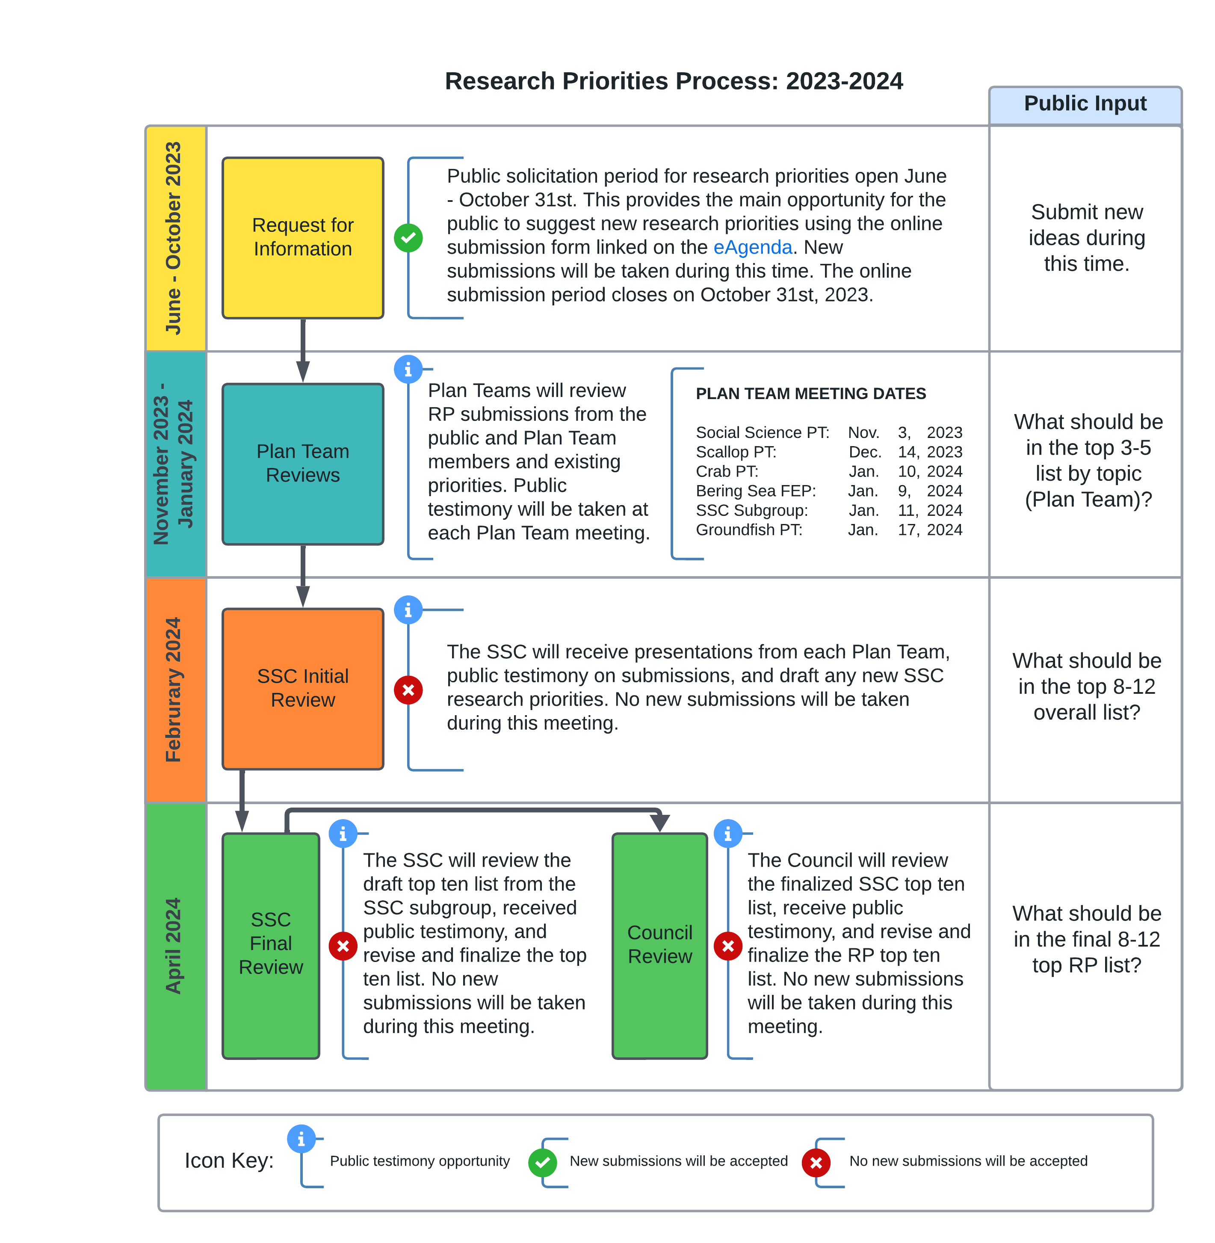
We are here
Notes:
What about birds/mammals/bycatch

Slide 7
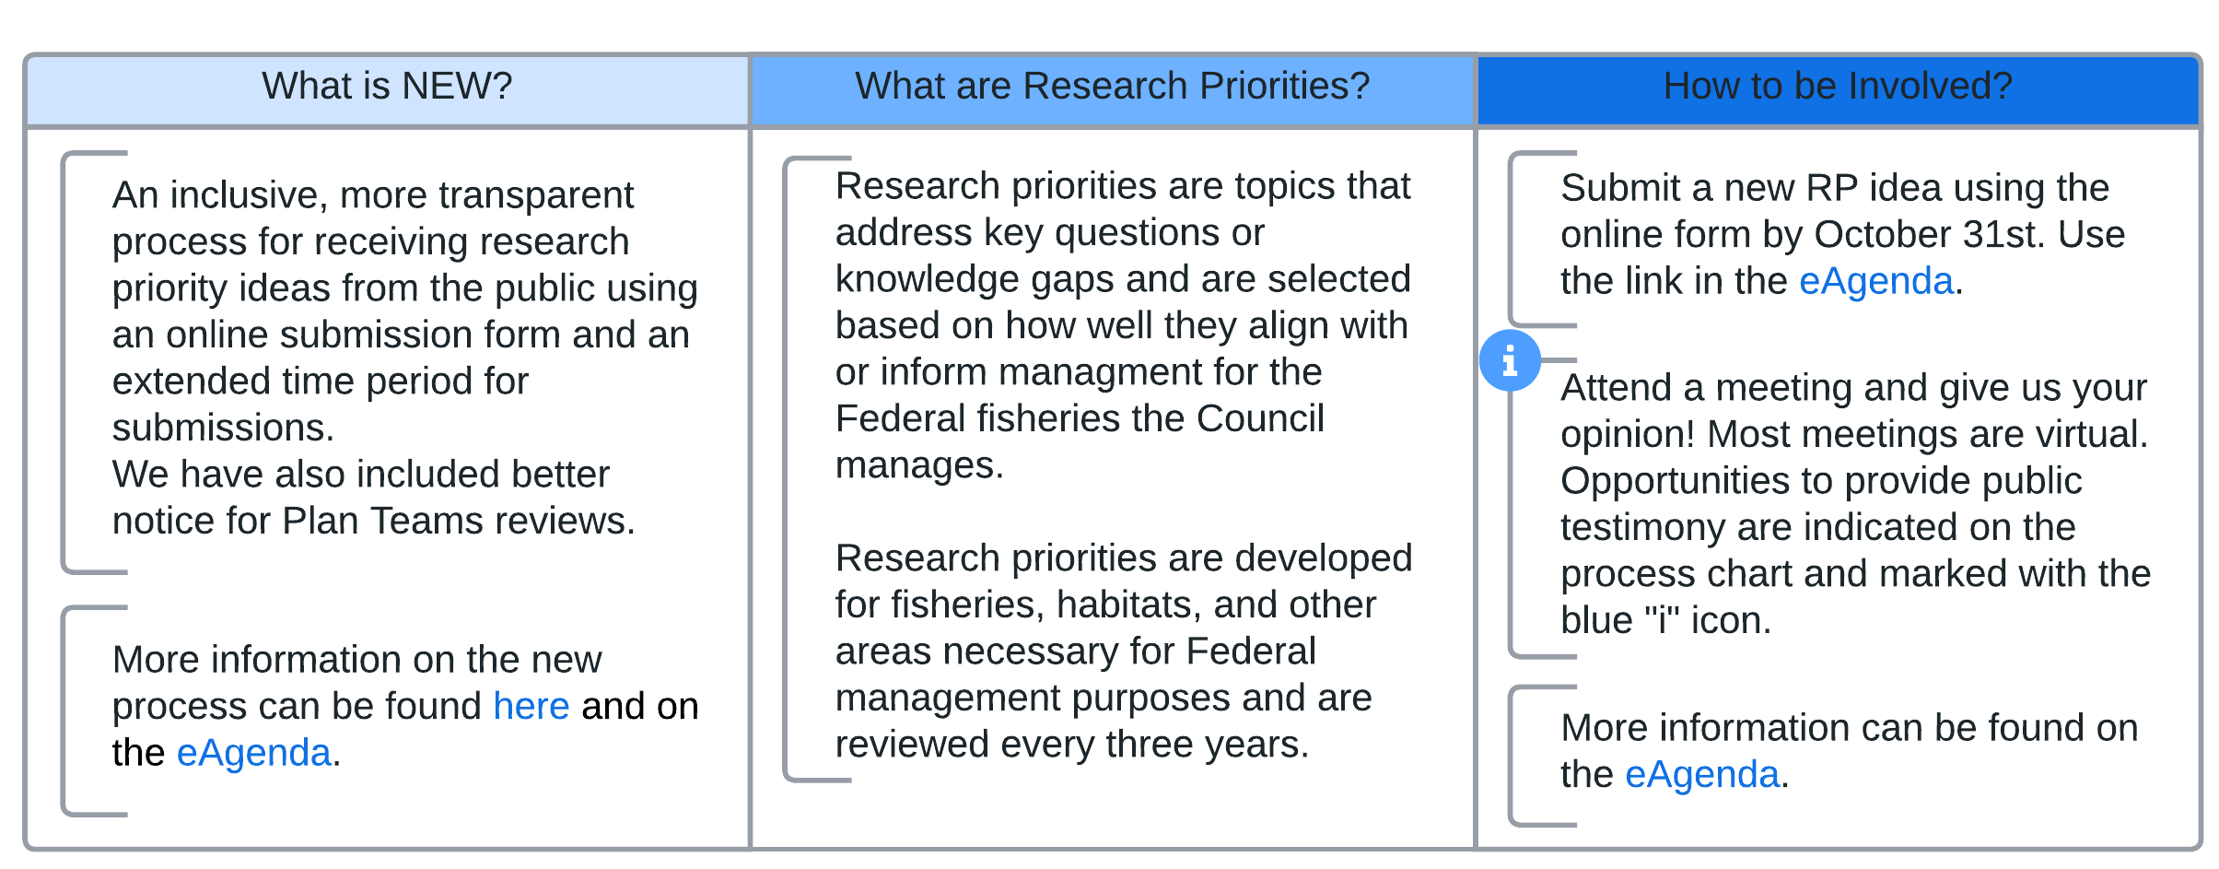
2023-2024 RP Process: additional background
Public Input
Notes:
This is the preliminary Public Input 1-page flyer

Slide 8
Plan Team Role
Research Priorities
Plan Teams will review the submitted research priorities, listen to public comment, and then rank their top research priorities.
The SSC is asking for a top 3-5 research priority list from each Plan Team
Each PT can provide an additional list of what they see as “other important research priorities” that did not make the top 3-5 list but still see as priorities

Slide 9
SSPT member assignments before Nov 3rd
Review the excel sheet of 31 existing research priorities related to human dimensions.
  (There are 162 research priorities in total, we have identified 31 for possible SSPT review. You can review the full list if interested.)
  Read through title and descriptions and consider whether categories are appropriate.
A Google Form will be distributed to SSPT members through email for submission of new priorities. Please use this form if you wish to submit a new research priority of your own.
Review the newly suggested research priorities distributed to members after Oct 31.
At this time, members should consider the list of 31 current priorities + any new submissions from the public or SSPT members and identify your top 3-5 research priorities. Write down the Research ID # for yourself!
  (These could change during the Nov 3rd meeting, but it will be an important starting place for discussion.)

Slide 10
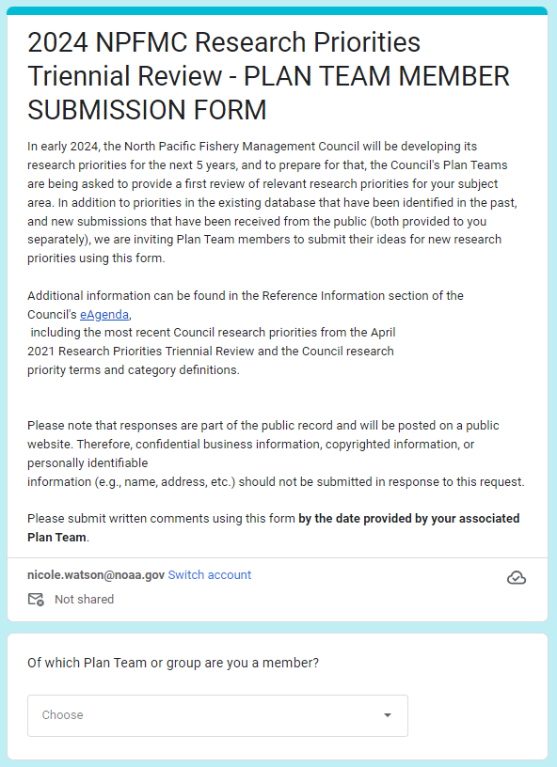
Submitting a SSPT member new priority idea using the Google Form

Slide 11
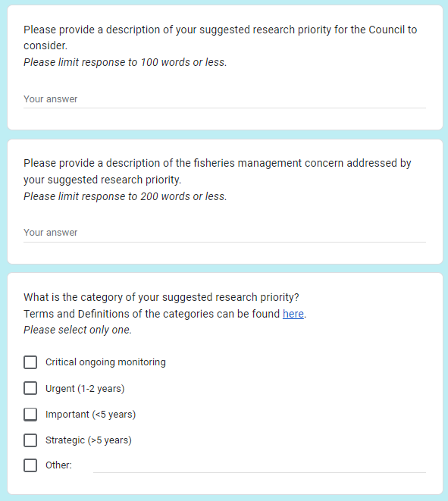
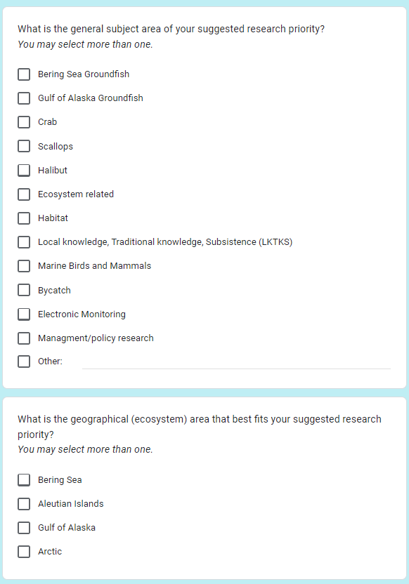
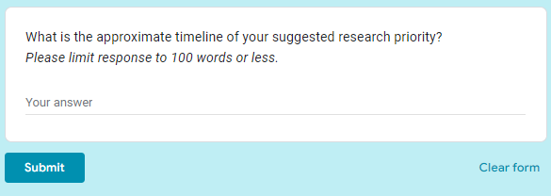
1
2
3

Slide 12
Nov 3rd SSPT meeting
Part 1: Discussion
Whether to add newly suggested research priorities to the list.
Any discussion of existing priorities (e.g., categories, description, etc.).
Discussion on your choice for top 3-5.
Public comment: hoping to focus the public to helping us prioritize (rather than adding new items in at this point)
- Break: members submit top 3-5 to Sarah and Nicole for rank choice voting -
Part 2: Voting
Rounds of rank choice voting to get to our top 3-5 (up to 10 specified)

Slide 13
Nov 3rd SSPT meeting
Virtual meeting – although noticed as hybrid.
Hoping for ½ day: 8:30am – 12:30pm.
Take up discussion of SSPT next steps?

