Slide 1

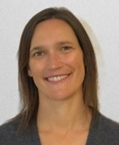
ADVISORY PANEL
ADMINISTRATIVE ISSUES
ANNA HENRY, FEBRUARY 2026
Meeting protocols
B reports highlights
February AP meeting agenda
AP training

Slide 2
CODE OF CONDUCT FOR NPFMC MEETINGS
Participants in the Council process are expected to participate in a manner that is professional and respectful of Council members, staff, advisors, committee members, and the public. Harassment will not be tolerated. All Council participants are responsible for holding each other accountable to the following ground rules:
  Treat everyone with respect.
  Listen and seek to understand differing views or opinions.
  Represent information honestly and openly.
  Refrain from using offensive, disrespectful, or derogatory language.
  Personal or organizational attacks or insults will not be tolerated.
Reports of inappropriate behavior will be taken seriously and followed through to resolution per the Council’s Statement of Organization, Practices, and Procedures, which also includes the NPFMC policy on addressing allegations of harassment.

Slide 3
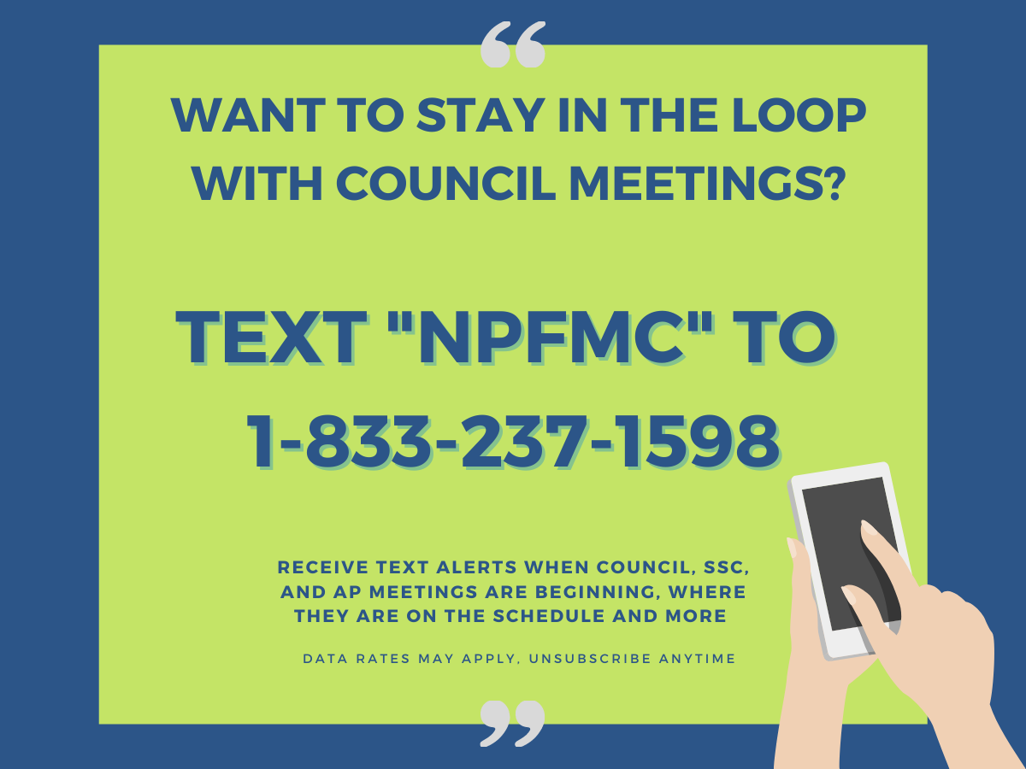
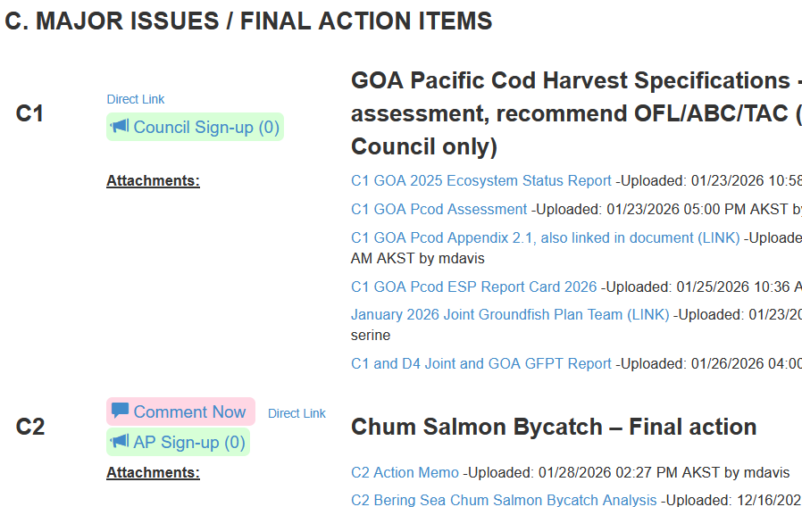
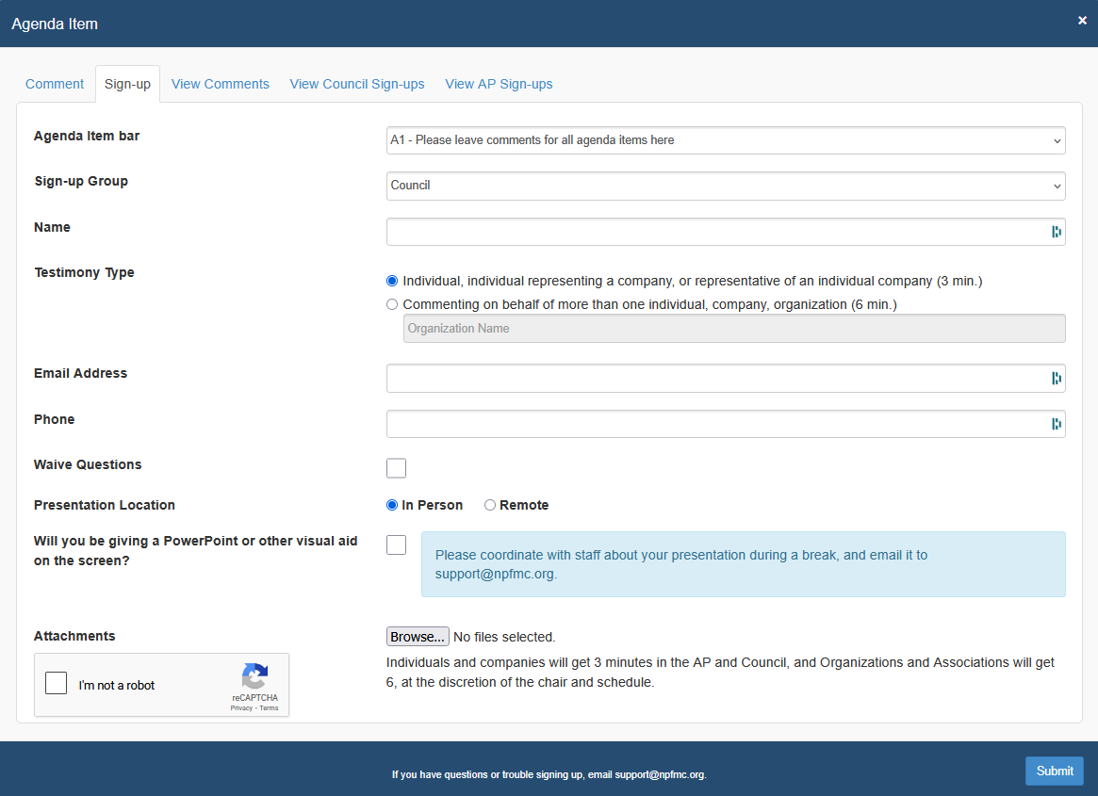
PROTOCOLS FOR PUBLIC TESTIMONY,
TEXT ALERTS
Testimony by topic, under each agenda item
Onscreen timer for oral testimony
  3 min – individuals and companies
  6 min – organizations and associations
Sign up through the eAgenda, next to the agenda item you want to testify on
Fill out the form with your personal details
Attach handouts or ppts if desired. (Contact staff if you want to project a handout.)
Indicate whether in-person or remote.
    If remote, please ensure a strong internet connection and be in a quiet area.
    If calling from a phone, use that number on the signup form so we can unmute you
Meeting is being recorded!
Need help? Use Q&A feature in zoom program, or email support@npfmc.org

Slide 4
HIGHLIGHTS FROM B REPORTS (1/2)
B1 Executive Director’s Report
NMFS HQ VIP visitor – Sam Rauch, Deputy Asst Administrator for Regulatory Programs here on Thursday
Council has opportunity to review EO 14276 comments submitted to NMFS
NPFMC attendees invited to a CDQ-hosted gathering on Weds Feb 4th – see B1 flyer
Due to a Zoombombing incident, NPFMC may need to institute additional security for Committee and Plan Team meetings (you may need to register with an email)
Annual IFQ Report to the Fleet is posted
A bycatch report presentation is posted
Special presentation from BBSRI on inseason genetics
Short primer on eAgenda comment search feature

Slide 5
HIGHLIGHTS FROM B REPORTS (2/2)
B2 NMFS Management Report
Final 2026 Annual Deployment Plan
Year-end inseason management reports for BSAI and GOA
Discussion on NMFS regional office prioritization of fishery management Projects
EDR requirements in place for 2026 (removal will not be effective until 2027)
Cost recovery updates
AFA Vessel Replacement Report
B8 IPHC report
Annual report and letter raising awareness of increased harvest in halibut unguided recreational sector

Slide 6
FEBRUARY 2026 AP MEETING
AP meeting: Scheduled Monday – Saturday (if needed)
  C2 Chum Salmon Bycatch – Final Action
  E Staff tasking
  Issues on the Council agenda that AP is not taking up
    C1 GOA Pacific cod stock assessment review / harvest specifications
    C3 Cook Inlet Salmon stock assessment review / harvest specifications
    Also several SSC-only items

Slide 7
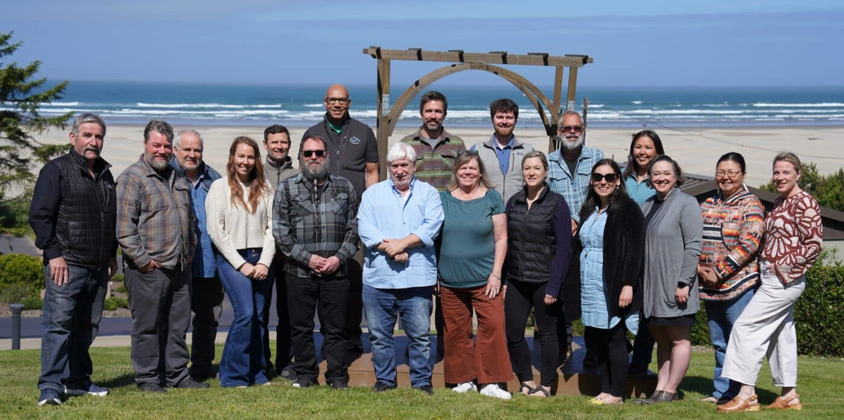
ADVISORY PANEL
MEMBER TRAINING
FEBRUARY 2026

Slide 8
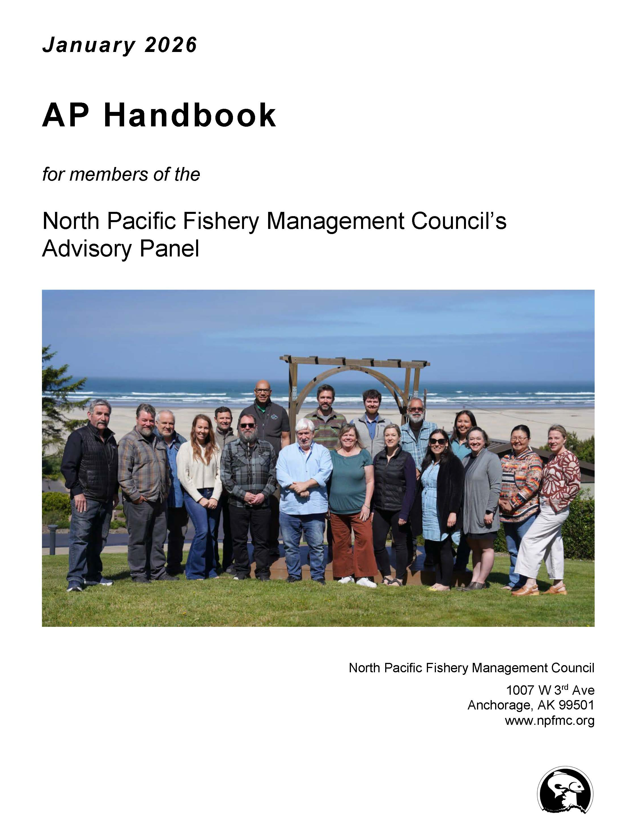
AP HANDBOOK
Handbook includes guidance on how to participate effectively as an AP member
  Living document – we update as procedures adapt, or new questions are raised.
AP reviewed handbook updates most recently in June 2025
  Council removed AP minority reports from Council SOPP in June 2025, as rationale points pro/con accomplish the same purpose
  Minor updates in January 2026: Final references to minority reports were removed in the January 2026 version; change to typical meeting cycle dates; Council personnel

Slide 9
AP STANDARDS OF CONDUCT (PAGES 6-7)
Treat everyone with respect – colleagues, public, staff – at all times during the meeting
Listen and seek to understand differing views or opinions
Remember that many find public testimony intimidating - model a welcoming environment through words and body language
Interact professionally and courteously with your fellow AP members, even during vigorous debate on highly contentious issues
No harassment and incivility
No offensive, disrespectful, or derogatory language
No personal or organizational attacks or insults
Do not speak for the AP or the Council, unless you are delivering the AP report to the Council
No political campaigning / outward show of political support during the AP session

Slide 10
AP MEMBER QUESTIONS FOR STAFF OR PUBLIC (PAGE 10)
Staff presentation
Can ask staff as many questions as you like during this portion of the meeting
Ask the presenter if jargon, acronyms, specialized terms are being used that you don’t understand
Testimony best practices
Keep your questions to the public concise; relevant to testimony provided; limit the use of acronyms / jargon
Respect that our testifiers come from diverse backgrounds and experiences, and may not be comfortable giving testimony
Avoid debating with testifiers
Avoid softball questions
Two questions maximum per AP member per testifier

Slide 11
AP DELIBERATIONS (PAGES 11-12)
Motions are used to organize discussion
    Which side wins/loses vote is not important to Council
    Purpose is to understand the rationale pro/con among the alternatives/options, or for aspects that are contentious
    Recommendations with unanimous AP support are also informative for Council
All AP recommendations should be deliberated in public
Chair may take short standdowns during deliberations, to allow members to focus their thoughts into appropriate language
When speaking in support of or against the motion, try not to repeat points other people have already made unless you have something new to add

Slide 12

MAKING A MOTION (PAGE 12)
Let Chair know at the beginning of the meeting, or as soon as you know, if you intend to offer a motion on an agenda item – helps with planning
    Especially if it’s a new issue under staff tasking
    If more than one person wants to make a motion on the same issue, the informal practice is to allow the member representing the regulated fishery to go first. The Chair can help facilitate advance discussion among members.
Send the motion or amendment in writing to support@npfmc.org so staff can post it on the screen for everyone to see
Admin will put the motion in a google doc to which all members have access, so you can see the whole text regardless of which component is live onscreen
Pro tip for the public:
You can always go to the AP YouTube recording to scroll back and see the full text of the motion

Slide 13
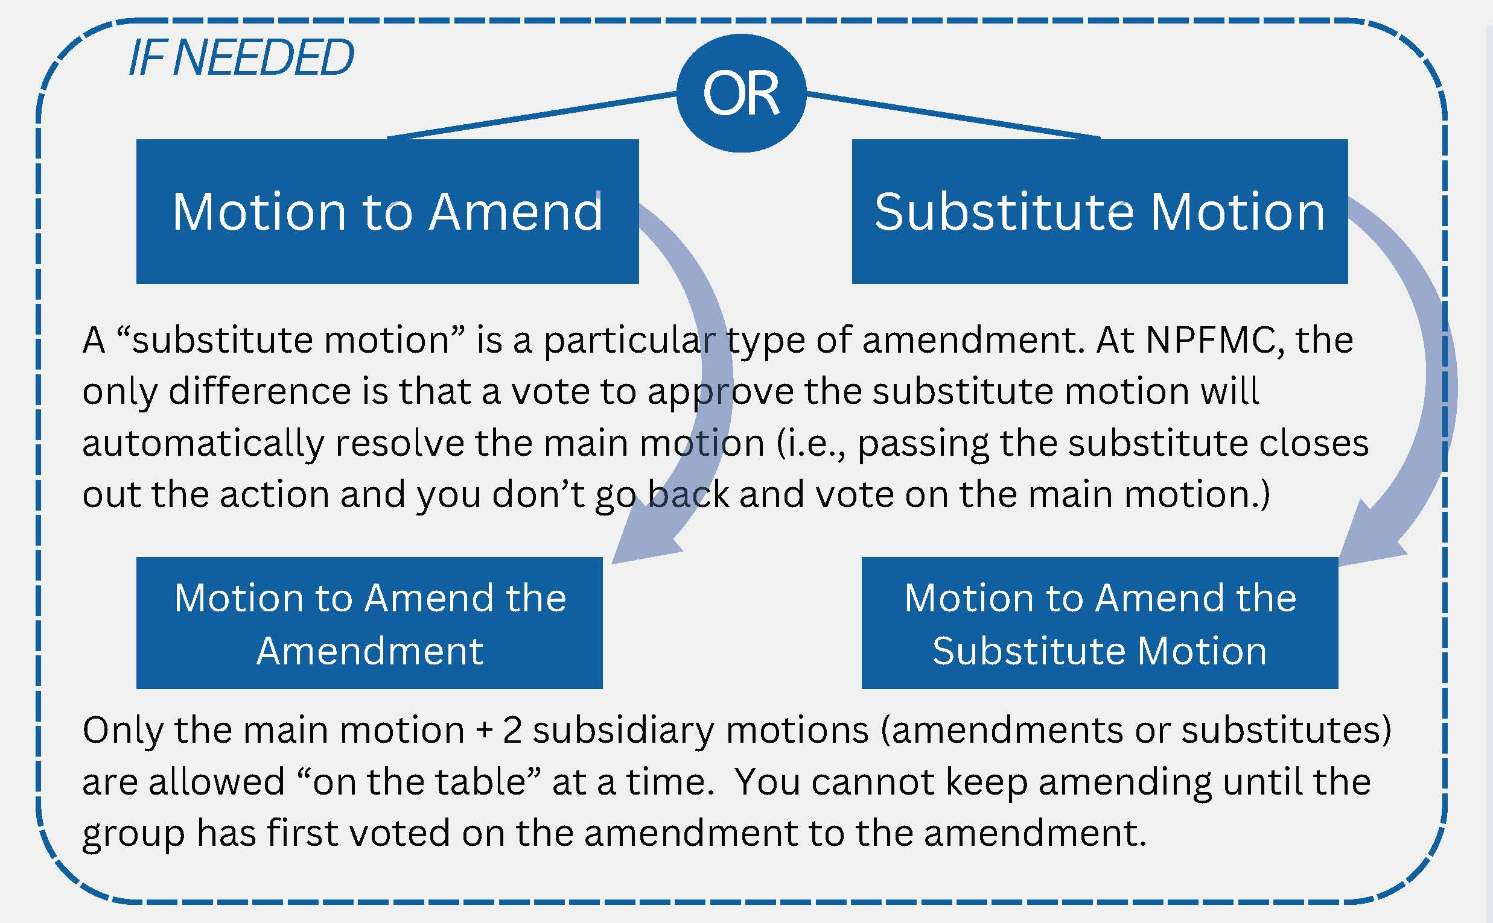
AMENDMENTS (PAGE 11)
Only 2 levels of amendment “on the table” at a time
  But the AP can vote on an amendment to the amendment, and then go back and do more amendments to the amendment individually
Offering a substitute motion counts as an amendment (at NPFMC)
  Replaces the text of the original motion in its entirety
  If the substitute passes, that dispenses with the original motion (can’t go back to it)
Robert’s Rules discourages AP members from revisiting a topic that was already settled by a motion in the same meeting, to avoid redundancy.
  Chair makes the final decision about whether the new motion is substantively different
MAIN MOTION

Slide 14
WHAT GETS INCLUDED IN THE AP REPORT? (PAGE 15)
CLOSE CALL MOTIONS
SUCCESSFUL MOTIONS
Final text for a motion that passes by majority vote
Final text for a motion that fails by 3 votes or fewer
All amendments (pass or fail) associated with that motion, including the original motion language if a substitute motion prevails
Rationale points for / against
All amendments (pass or fail) associated with that motion, including substitute motions
Rationale points for / against
Voting tally for main motion and all amendments
Voting tally for main motion and all amendments
AP ORAL REPORT
Amendments and rationale points are included in the written report, but not read into the Council record
Only the final text of a passed motion is read out loud in the AP report to the Council, along with the final vote tally
Council members may ask questions on any portion of the written or oral report

Slide 15
TRAVEL REIMBURSEMENTS (PAGES 17-19)
Hotel: Please book a) before the deadline, b) under the Council room block
  Council will reimburse for the dates required to attend the scheduled meeting
  Council may not reimburse costs of late bookings
Airfare: must be booked in coach class, from your home airport; best economic value (NO Saver fares, NO green credit offsets, NO travel insurance)
  Send all airfare receipts to nschmidt@npfmc.org, including Atmos (EasyBiz)
  Book early; costs associated with last-minute bookings may be denied
Send reimbursement claims and questions to: nschmidt@npfmc.org

Slide 16
