Slide 1


C2 Draft for Final Action:
BERING SEA ALEUTIAN ISLAND PACIFIC COD SMALL VESSEL ACCESS
October 2022
Presenters: Kate Haapala (NPFMC) and Abby Jahn (NMFS)

Slide 2

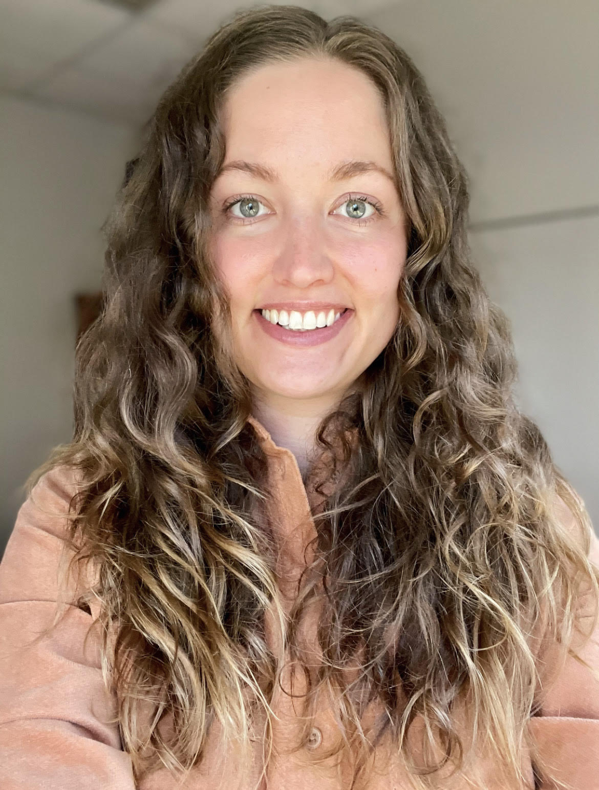
ACTION UNDER CONSIDERATION
A proposed amendment to the BSAI groundfish FMP that would require smaller vessels operating in the <60’ H&L/pot CV sector to harvest Pacific cod from the jig sector’s allocation.

Slide 3
OUTLINE
History of Council action
Purpose & Need statement and description of alternatives
Changes to the RIR since June 2022
Impact analysis
Management & Enforcement

Slide 4
1.2 HISTORY OF COUNCIL ACTION
October 2019
Initiated a discussion paper
June 2021
Received a presentation on that discussion paper
Adopted a Purpose and Need statement as well as a set of alternatives
June 2022
Received a presentation on the Initial Review draft
Modified the Purpose and Need statement
Selected a PPA
October 2022
Review final action draft and recommend a preferred alternative

Slide 5

1.2 PURPOSE AND NEED STATEMENT
Increased participation, reduced Pacific cod TACs, and fewer reallocations from other Pacific cod sectors, have resulted in shortened seasons for the <60 ft hook-and-line and pot catcher vessel Pacific cod sector. Due to their size, smaller vessels in this sector are particularly affected by these shortened seasons because vessel operators have less flexibility to fish when the weather is poor and typically fish waters closer to port which may be less productive. The jig sector allocation has not historically been fully utilized, particularly in the A and C seasons. Allowing these smaller catcher vessels using hook-and-line and pot gear to harvest Pacific cod from the jig sector allocation may increase stability for current fishery participants and potential new entrants with smaller catcher vessels without negatively impacting catcher vessels using jig gear.

Slide 6
DESCRIPTION OF ALTERNATIVES
Alternative 1: No Action
Alternative 2: Redefine the current BSAI Pacific cod jig sector to include H&L or pot CVs less than or equal to:
Option 1: 55’ LOA
  All H&L/pot vessels ≤55’ LOA and jig vessels would form the ‘new small vessel sector’ and required to harvest Pacific cod from the jig sector’s 1.4% allocation.
    BSAI Pacific cod allocation would be apportioned on a trimester basis.
  All H&L/pot CVs >55’ LOA (i.e., 56-59’) would form the ‘redefined <60’ H&L/pot CV sector’ and be required to harvest Pacific cod from their current sector’s 2% allocation.
    BSAI Pacific cod allocation available on January 1.
  Vessels would be eligible for either sector based on the LOA and gear type and would not be able to opt into one sector or another.
Suboption: B-season jig only fishery
  A season (Jan 1-Apr 30): H&L, pot, and jig
  B season (Apr 30-Aug31): jig
  C season (Aug 31-Dec 31): H&L, pot, and jig

Slide 7
PRIMARY ANALYTICAL CHANGES SINCE JUNE 2022
Added clarifying language throughout the impact analysis regarding the uncertainty of smaller H&L/pot vessel’s future fishing behavior.
Information on the days the <60’ H&L/pot CV sector is fishing in a calendar year in relation to the sector’s final allocation (Table 4-1).
Additional specificity for vessels likely to be impacted by LOA (Table 4-2 and 4-3) and community ownership address (Table 4-15 and 4-16).
Vessel stability and safety including spatial data on the <60’ H&L/pot CV sector.
Reallocations v. rollovers (Section 4.3.4)

Slide 8
ANALYSIS OF IMPACTS
Sector composition
Allocations and reallocations
Vessel safety and stability
Revenue
Communities
Environment

Slide 9
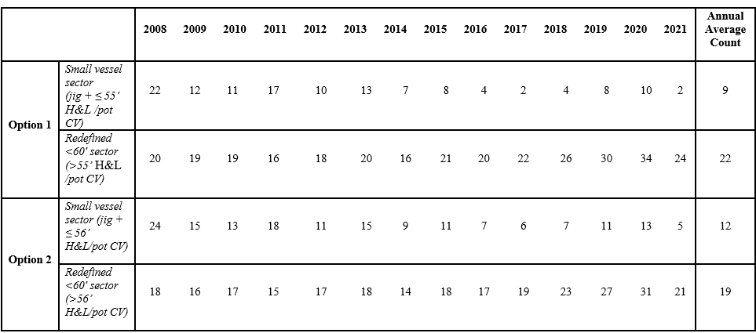
4.3.1 CHANGES IN SECTOR COMPOSITION
The PPA would impact the composition of the current jig and <60’ H&L/pot CV sectors.
Jig –
  33 jig vessels have participated since 2008
    Annual average level of participation is 4 vessels
    1 vessel that regularly participates and would be most impacted by the PPA
<60 H&L/pot CV –
  94 H&L/pot vessels have participated since 2008
    Annual average level of participation is 27 vessels
    61 vessels are >56’ LOA, 5 vessels have a reported LOA of exactly 56’, and 28 vessels are ≤55’ LOA.
Table 4-3 Count of vessels that would have been eligible for the new BSAI Pacific cod small vessel sector and the redefined less than 60’ H&L or pot CV sector under option 1 and option 2 from 2008 through 2021

Slide 10
BSAI PACIFIC COD ALLOCATIONS
The PPA would not impact the jig or <60’ H&L/pot CV sector’s allocation amount.
The PPA would impact the vessel size and gear type that is required to harvest Pacific cod from each allocation.
This action would likely impact reallocations among the two sectors.
Table 3-2 Percent of non-CDQ BSAI Pacific cod sector allocations by BSAI groundfish FMP amendment
Sector | Amend 24 1994 | Amend46 1997 | Amend 64 2000 | Amend 77 2004 | Amend 85 2008
Jig | 2.0 | 2.0 | 2.0 | 2.0 | 1.4
H&L/Pot CV <60’ LOA | 44.0 | 51.0 | 0.7 | 0.7 | 2.0
H&L CV ≥60’ LOA |  |  | 0.2 | 0.2 | 0.2
H&L CP |  |  | 40.8 | 40.8 | 48.7
Pot CV ≥60’ LOA |  |  | 9.3 | 7.6 | 8.4
Pot CP |  |  |  | 1.7 | 1.5
AFA trawl CP | 54.0 | 23.5 | 23.5 | 23.5 | 2.3
Non-AFA trawl CP |  |  |  |  | 13.4
Trawl CV |  | 23.5 | 23.5 | 23.5 | 22.1

Slide 11
BSAI PACIFIC COD REALLOCATIONS
Decisions to reallocate BSAI Pacific cod are based on the hierarchy set in Federal regulations.
  These decisions consider the sector’s capacity to harvest both their initial Pacific cod allocation and any reallocations they may receive.
Any unused portion of the seasonal allowance from any sector, except the jig sector, is rolled over to that sector’s next season.
95% of the jig sector’s initial allocation has been reallocated to the <60’ H&L/pot CV sector (on average, 2008-2021).
  Reallocations from the jig sector have accounted for 30% of the sector’s final allocation.
Table 3-3 2022 BSAI Pacific cod non-CDQ sector allocations and seasonal allowances
Sector | BSAI Sector Allocation (mt) | BSAI Seasons and allowance (mt)
 |  | A B C
H&L/Pot CV < 60’ LOA | 2,671 | No seasonal allowances
H&L CV ≥ 60’ LOA | 267 | Jan 1-June 10 (51%) 136 | June 10 -Dec 31 (49%) 131 | n/a
H&L CP | 65,027 | Jan 1-June 10 (51%) 33,164 | June 10 -Dec 31 (49%) 31,863 | n/a
Pot CV ≥ 60’ LOA | 11,216 | Jan 1-June 10 (51%) 5,720 | Sept 1 -Dec 31 (49%) 5,496 | n/a
Pot CP | 2,003 | Jan 1-June 10 (51%) 1,021 | Sept 1 -Dec 31 (49%) 981 | n/a
Jig | 1,879 | Jan 1- Apr 30 (60%) 1,127 | Apr 30-Aug 31 (20%) 376 | Aug 31- Dec 31 (20%) 376
AFA Trawl CP | 3,086 | Jan 20-April 1 (75%) 2,315 | April 1-June 10 (25%) 772 | June 10- Nov 1 (0%) 0
Amendment 80 | 17,981 | Jan 20-April 1 (75%) 13,485 | April 1-June 10 (25%) 4,495 | June 10- December 31 (0%) 0
Trawl CV | 29,655 | Jan 20-April 1 (74%) 21,944 | April 1-June 10 (11%) 3,262 | June 10-Nov 1 (15%) 4,448

Slide 12
4.3.4.1 REALLOCATIONS V. ROLLOVERS
A policy consideration for the Council under the PPA is whether an unused portion of a seasonal allowance in the new BSAI Pacific cod small vessel sector would rollover seasonally or be reallocated.
At the June 2022 meeting, the Council stated its intent is to maintain the current reallocation hierarchy.
  Provides flexibility to the Regional Administrator and in-season management to make reallocations.
  Could mitigate some of the PPA’s cumulative impacts.
Under this approach, there are different potential future scenarios to consider.
If the redefined <60’ H&L/pot CV sector was still open when NMFS could project unused cod in the new small vessel sector, NMFS could make that reallocation in a way that would allow the sector to continue fishing without experiencing a disruption.
If the redefined <60’ H&L/pot CV sector were already closed and a reallocation could be made, it does not mean NMFS would necessarily reopen the sector.
  NMFS would only reopen the sector if there were enough Pacific cod available to conservatively manage the sector and if vessels are available.

Slide 13
4.3.4.2 REALLOCATION IMPACTS
Under the PPA, the timing of a potential reallocation from the new small vessel sector to the redefined <60’ H&L/pot CV sector could change.
  There is uncertainty about the future fishing behavior of smaller H&L/pot vessels, and it would take a couple of years for in-season management to better predict if or when reallocations could occur.
A season scenarios –
If thew new small vessel sector did fully utilize the A season allowance, the redefined <60’ H&L/pot CV sector would not receive that historically common reallocation of BSAI Pacific cod early in the year.
  It is unlikely that NMFS would be able to compensate for this loss in the A season.
If the new small vessel sector did not fully utilize the A season allowance, NMFS may not have enough information to confidently make a reallocation until later in the year, potentially the small vessel sector’s regulatory closure on April 30.
  Larger H&L/pot vessels are typically participating in other Federal and State waters fisheries in the spring.

Slide 14
4.3.4.2 REALLOCATION IMPACTS
C season scenarios–
Current regulations require a reallocation from the jig sector to the <60’ H&L/pot CV sector on or near September 1.
  Historically important fall opportunity for the <60’ H&L/pot CV sector
    31% of the sector’s landings have been made between September 1 and December 31 (2008-2021, Table 4-9).
The PPA could impact the historically common fall reallocation from the jig to the <60’ H&L/pot CV sector.
  H&L/pot vessels in the new small vessel sector would have an opportunity to harvest Pacific cod in the C season which would delay a potential reallocation to the redefined <60’ H&L/pot CV sector.
    Like the A season, small H&L/pot vessels may or may not harvest the full C season allowance.
  There would be relatively few reallocation opportunities available to reopen the redefined <60’ H&L/pot CV sector on or near September 1 because other sectors have not finished their B or C seasons (Table 3-3).

Slide 15
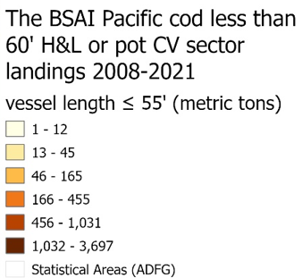
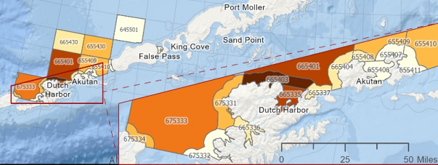
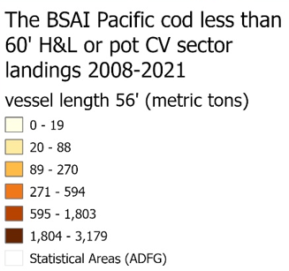
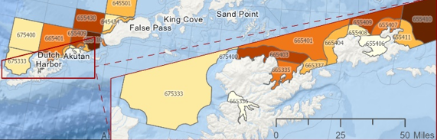
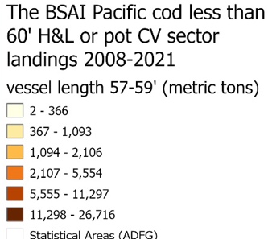
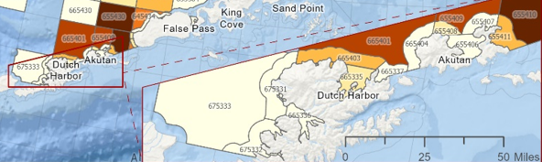
4.3.4 VESSEL SAFETY AND STABILITY
Figure 4-3
Figure 4-4
Figure 4-5

Slide 16
4.3.4 VESSEL SAFETY AND STABILITY
The Council is considering this action to provide more stability to H&L/pot vessels ≤55’ LOA.
The PPA could have a positive impact on the safety and stability of smaller H&L/pot vessels by allowing them more flexibility to determine when to fish.
The PPA could have a negative impact on the safety and stability of larger H&L/pot vessels that could fish at a faster pace early in the year as there could be less BSAI Pacific cod TAC available with a delayed reallocation or no reallocation.

Slide 17
4.3.5 REVENUE IMPACTS
Section 4.3.5 of the analysis provides estimates for the potential revenue impact and opportunity under this action.
There is uncertainty about the magnitude of the incidental revenue impacts that could occur under Alternative 2.
  Not possible to precisely estimate the potential revenue losses or gains under Alternative 2.
    NMFS cannot track the landings that are derived from a sector’s initial allocation or subsequent reallocations.
    Uncertain whether the new small vessel sector would utilize its full allocation (1.4%).

Slide 18
4.3.5 REVENUE IMPACTS
The estimated annual average gross ex-vessel revenue impact for H&L/pot CVs >56’ LOA is a decrease of $1.22 million (Table 4-5), accounting for 22 percent of these vessel’s total revenue for Federal BSAI Pacific cod (on average, 2008-2021).
  There are seven H&L/pot vessels in this group that depend on the fishery for more than 80 percent of their total revenue for all fisheries (2008-2021).
The annual average additional revenue opportunity for H&L/pot CVs ≤56’ LOA is $1.15 million under Alternative 2 (Table 4-7).
  Of the 33 H&L/pot vessels in this size group, the Federal BSAI Pacific cod fishery contributes less than 10 percent of the total revenue for 24 vessels (2008-2021).

Slide 19
4.3.6 DHS STATE WATERS POT FISHERY
Under Alternative 2/PPA, the BOF would need to address the trigger for opening the DHS pot fishery.
  It is uncertain what action the BOF would take to open the DHS pot fishery.
    The BOF could choose the new small vessel sector closing date, the redefined <60’ H&L/pot CV sector closing date, or some other trigger (e.g., hard date).
If the BOF chose to use a sector’s closure date as the trigger, there would likely be negative impacts for those vessels that do not operate in the trigger sector.
11 pot vessels ≤56’ have participated in the Federal BSAI Pacific cod fishery and five have also participated in the DHS State waters fishery (2014-2021).
  For these five vessels, the DHS State waters fishery has contributed $1.51 million in annual average ex-vessel revenue (2014-2021).
42 pot vessels >56’ LOA have participated in the Federal BSAI Pacific cod fishery and 38 have also participated in the DHS State waters fishery (2014-2021).
  For these 38 vessels, the DHS State waters fishery has contributed $7.27 million in annual average ex-vessel revenue (2014-2021).

Slide 20
4.3.7 SUBOPTION - B SEASON AS JIG ONLY FISHERY
There are no anticipated impacts of including the suboption
Jig deliveries are concentrated in the B season
H&L/pot CV deliveries are concentrated in the A and C seasons
Table 4-9 Count of BSAI Pacific cod deliveries, the average number of deliveries, and the percent of total deliveries made by vessels operating in the BSAI Pacific cod less than 60’ H&L or pot CV and jig sectors in each jig sector trimester from 2008 through 2021
 | Season | Count of deliveries | Average number of deliveries | % of total deliveries
Jig | A (Jan 1 - Apr 30) | 14 | 1 | 3%
 | B (Apr 30 – Aug 31) | 373 | 27 | 87%
 | C (Aug 31 - Dec 31) | 43 | 3 | 10%
<60' H&L /pot | A (Jan 1 - Apr 30) | 2,618 | 187 | 66%
 | B (Apr 30 – Aug 31) | 113 | 8 | 3%
 | C (Aug 31 - Dec 31) | 1,261 | 90 | 31%

Slide 21
4.5 COMMUNITY IMPACTS
The PPA could have a distributional impact at the community-level.
Kodiak has the highest number of H&L/pot CVs >56’ LOA with a registered ownership address at 16.
Dutch Harbor/Unalaska has the highest number of H&L/pot CVs ≤55’ LOA with a registered ownership address at 10.
There is one 56’ H&L/pot vessel that regularly participates with a registered ownership address of Dutch Harbor/Unalaska.
  There has also been one 56’ vessel regularly participating since 2016 with Petersburg as its registered ownership address.
Akutan, Dutch Harbor/Unalaska, and Kodiak have each had four unique vessels participate in the BSAI Pacific cod jig sector during the analyzed time period.
  There is one jig vessel with Homer as its registered ownership address that regularly participates in the Federal BSAI Pacific cod jig fishery.

Slide 22
4.4 SUMMARY OF IMPACTS ON FISHING ACTIVITY
Category | Option 1 | Option 2 | Suboption
Fishing location | Not likely to change fishing location. This is outside of the scope of the action.
Timing and Effort | Minimally redistribute effort and modify timing relative to the overall BSAI Pacific cod fishery. H&L and pot vessels in the new small vessel sector would fish seasonal allocations instead of an annual allocation (Section 4.3.2 and Section 4.3.3). Timing and frequency of reallocations would change under this action for the redefined less than 60’ H&L or pot CV sector (Section 4.3.3). |  | No anticipated impacts, may closely mirror historical fishing activity of both sectors (Section 4.3.7).
Authorized Gear Types | No changes to authorized gear types. H&L, pot, and jig gear are authorized under the BSAI Groundfish FMP. Additionally, Federal BSAI Pacific cod sectors are defined by gear type, operation type, and vessel size categories (Section 3.2 and 3.6).
Harvest Levels | No changes to harvest levels. The BSAI Pacific cod TAC is set in accordance with the Pacific cod biomass (Section 3.2).

Slide 23
Section 5: Monitoring and Enforcement Considerations
Implementation –
Revisions to regulations to modify naming conventions
Include new small vessel sector in the annual harvest specifications process for ICA calculations
Vessels would be placed into redefined sectors based on the LOA reported to NMFS on the FFP
Growth period following implementation –
Inseason management, outreach, enforcement
Uncertainty with reallocation timing will decrease over time

Slide 24

Questions?
Kate Haapala
Kate.haapala@noaa.gov
Abby Jahn
Abby.jahn@noaa.gov

Slide 25
Thank you!
Mike Fey, AKFIN
Mary Furuness, NMFS AKRO
Jon McCracken, NPFMC
Krista Milani, NMFS AKRO

