Slide 1

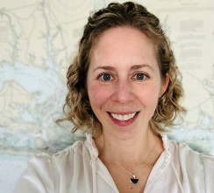
B1 Climate Scenarios Workshop
Planning Update
Katie Latanich, April 2024

Slide 2
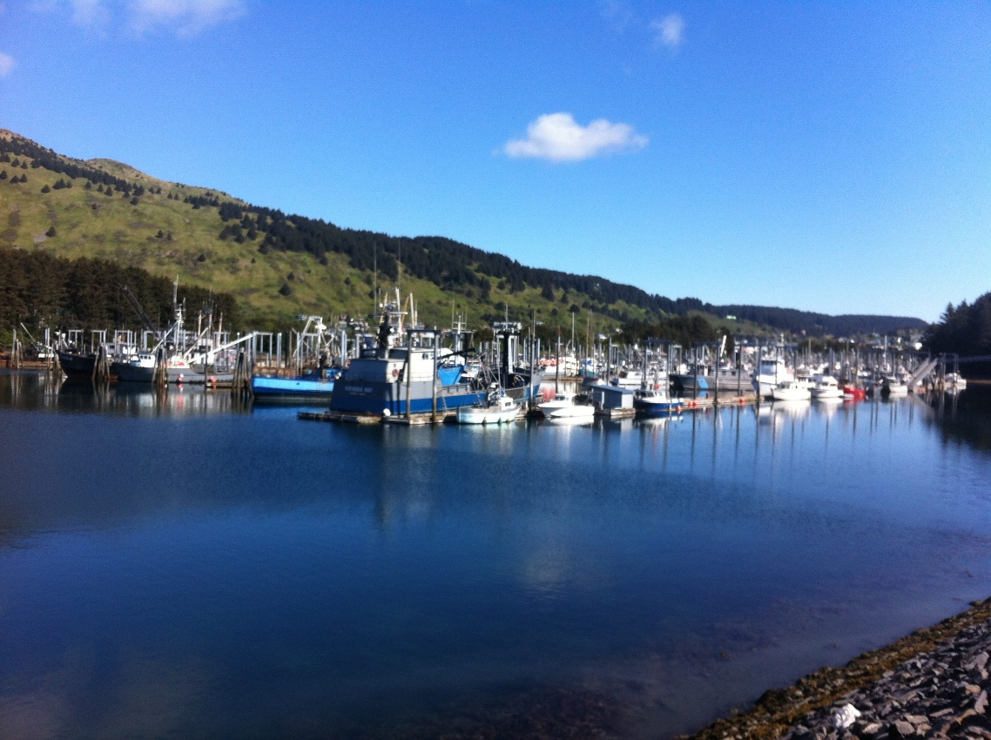

Overview
Workshop: June 5-6, 2024 in Kodiak
Today’s focus: Workshop information, expectations and outcomes
Draft agenda
Scenarios & discussions

Slide 3
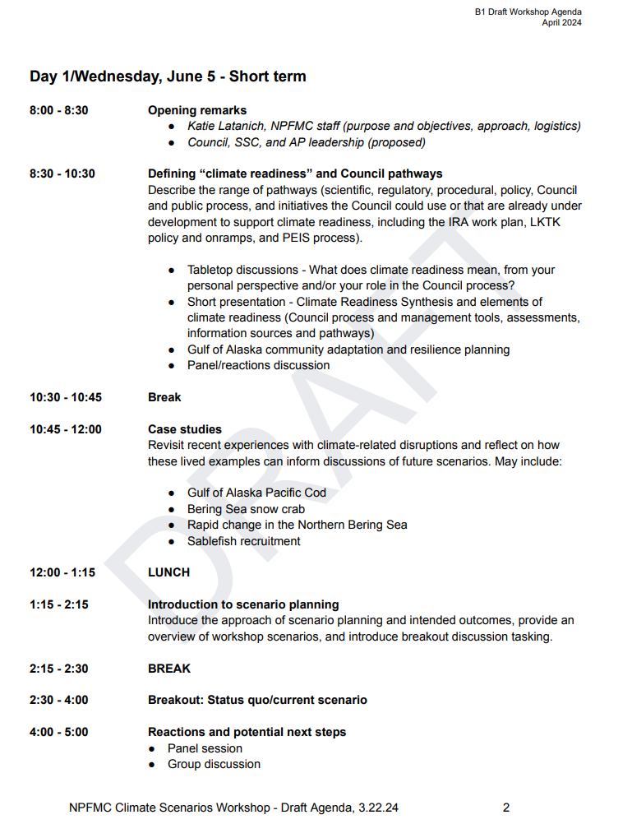
Draft agenda (under B1)
Timing and presentations may change; final agenda to be published in May
Four breakout sessions (3 scenario discussions, one on next steps)
Day 1: context setting and where we are now; Day 2: alternative futures
3 context setting discussions

Slide 4
Draft agenda (under B1)
Day 1 Context setting: 3 sessions to help participants engage
Defining “climate readiness” and Council pathways
  Develop a shared and inclusive understanding of “readiness” and the range of pathways the Council can use to advance climate readiness, including PEIS process, IRA workplan, LKTK protocol and onramps
Case studies
  Anchor discussions of hypothetical scenarios in shared, lived experience
Introduction to climate scenario planning
  Introduce scenarios and discussion approach

Slide 5
Scenario planning background memo (under B1)
Key messages about scenario planning
Planning for climate readiness requires planning for a range of possible futures
Scenario planning involves exploring multiple plausible future scenarios to identify steps for building readiness in an uncertain and unpredictable future

Slide 6
Scenario planning background memo (under B1)
Key messages about scenarios
Scenarios are not meant to be predictive (what could happen, not what will happen)
Scenarios are based in quantitative climate projections
The time frame for scenarios is not fixed
Each short scenario includes similar ingredients: global trends, climate trends, management, technology and information, and fisheries and communities
In all scenarios we’re experiencing more frequent and more severe climate change impacts

Slide 7
Scenario planning background memo (under B1)
We will use scenarios to explore two key uncertainties or axes
One axis is exploring the space of ecosystem-based management tools
More cross-sector coordination and accounting for interactions between species (ecosystem-based management or EBM)
More single-species focused: Ecosystem information is incorporated on a stock-specific basis (ecosystem approach to fisheries management or EAFM)

Slide 8
Scenario planning background memo (under B1)
We will use scenarios to explore two key uncertainties or axes
One axis is exploring the degree of ecosystem change and predictability
Important: In all scenarios we’re experiencing overall warming and increased frequency and magnitude of climate impacts
More predictable and a lower degree of change: periodic climate shocks and events
Less predictable and a higher degree of change: extreme events and shocks re common; major impacts to ecosystem structure and function

Slide 9
Scenario discussions
The very big picture: two-part discussion of each scenario
Scenario exploration – what might it be like to live in this scenario? What are the causes for optimism and concern? What are the pressures facing fishery managers, fishery participants, and communities?
Scenario implications – if you were living in this scenario, what might you need from management and science? What tools, approaches, information products, sources, etc. could help support climate readiness? How might communities of place and practice support climate readiness?

Slide 10
Facilitation
A more focused example: what do we need from the management process?
In all scenarios, we can expect more frequent extreme events but our ability to predict and prepare for them varies.
  If we have strong predictive capabilities, what else do we need to communicate and act on this information?
  If we don’t have strong predictive capabilities, or ecosystems are changing so rapidly we’re in reactive mode and are more reliant on real-time information, what do we need from a management process that can respond quickly and support readiness with little advance warning?

Slide 11
Workshop outputs
From CCTF November 2023 Report (D2, December 2023)
Outcomes and deliverables may include but are not limited to:
Identification of existing and potential climate change-related adaptations and responses, and key risks, barriers, and traps, as well as potential solutions across financial, social, and policy realms.
Synthesis of potential tools and resources to support resilient fisheries, fishing communities, and fisheries management through the Council process, such as:
  Tactical and strategic measures/actions, both near-term and long-term,
  Feasible tools, incremental changes as well as larger/long-term recommendations and potential innovations,
  Climate-informed tools and approaches, needs, and limits.
Identification of the critical gaps in the information, tools, and processes to support effective responses and robust planning.
Summary of recommendations and opportunities that may inform ongoing and future Council actions and policies under a changing climate.

Slide 12
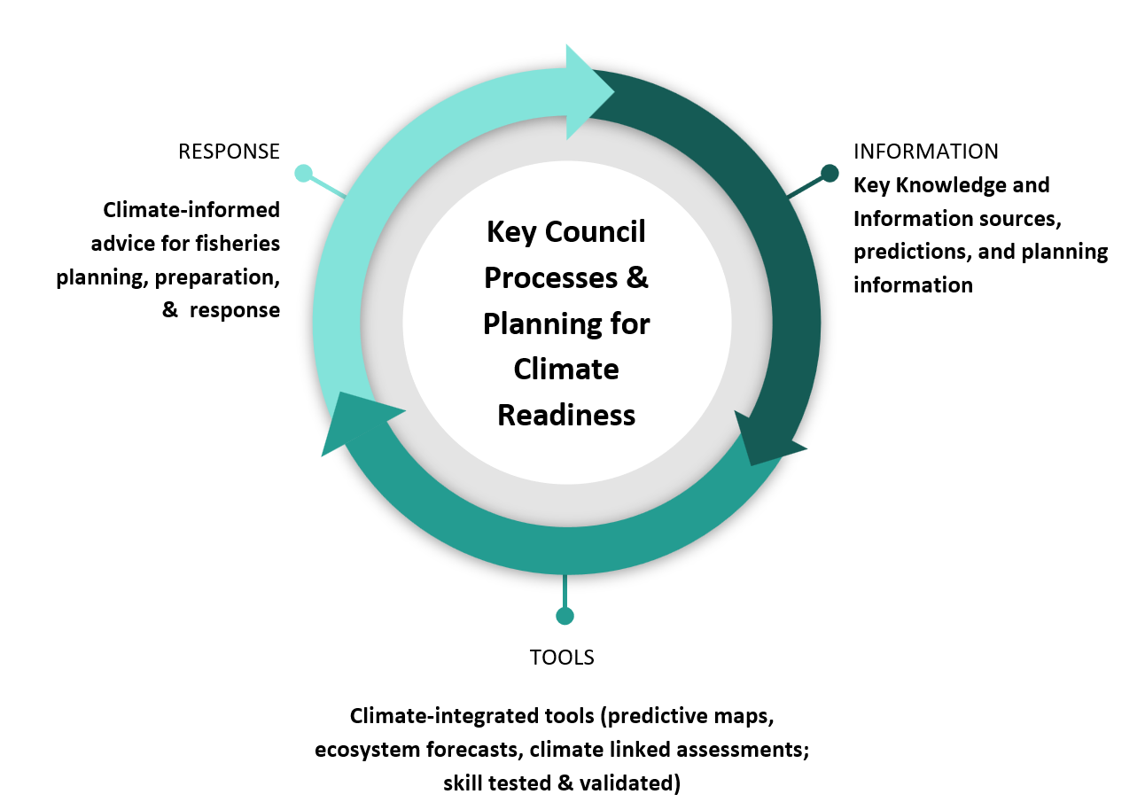
Workshop outputs
K. Holsman, Bering Sea FEP Climate Change Taskforce meeting, 2/26/2024

Slide 13
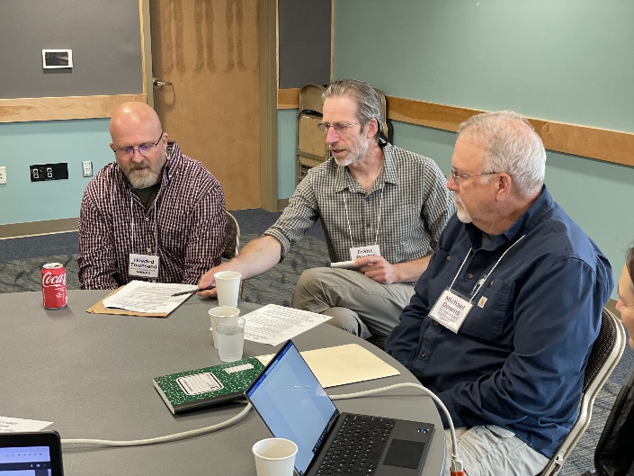
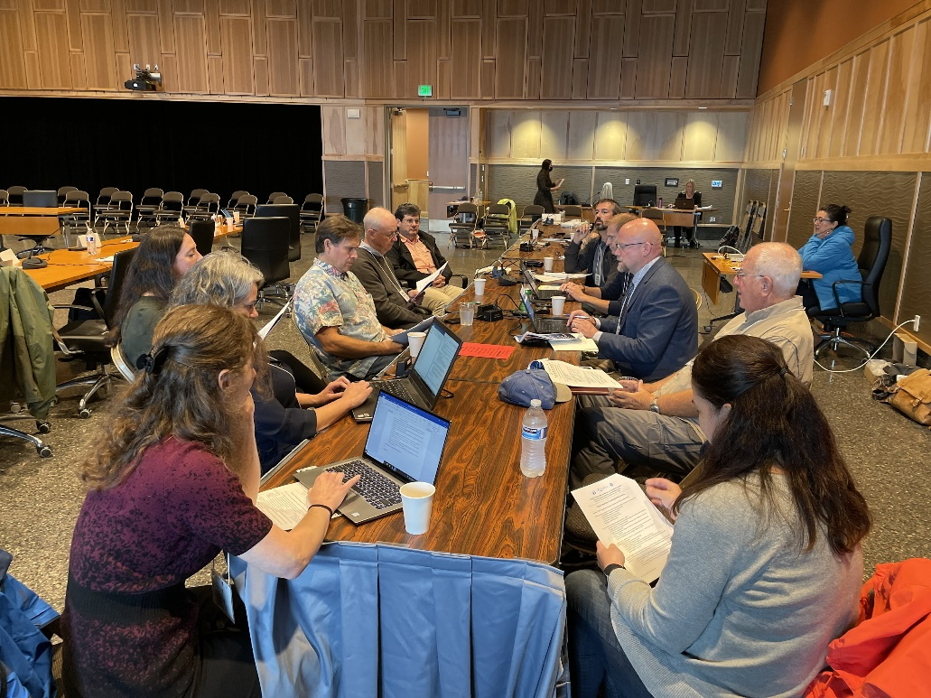
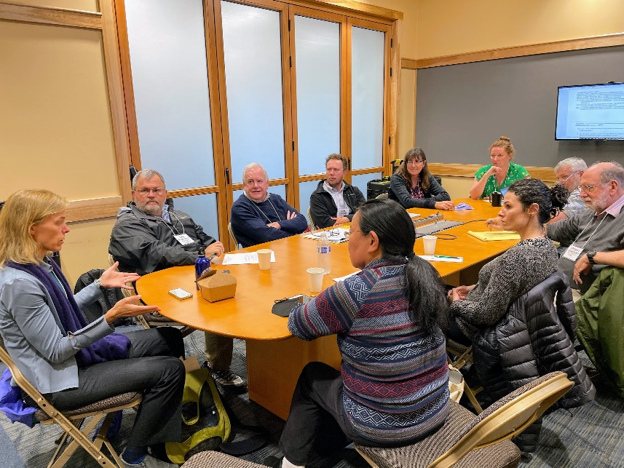
Expectations & engagement

Slide 14
Pre-meeting virtual discussions
Three interactive sessions, available live via Zoom and recorded
Each will include short talks or panels, moderated discussion, and Q&A
Session 1: Climate change impacts in an uncertain future
Wednesday, April 24, 2024 1:00-2:00 pm AK
Session 2: Defining climate readiness
Tuesday, April 30 2024 1:00-2:00 pm AK
Session 3: Introduction to scenario planning
Tuesday, May 14 2024 1:00-2:00 pm AK

Slide 15
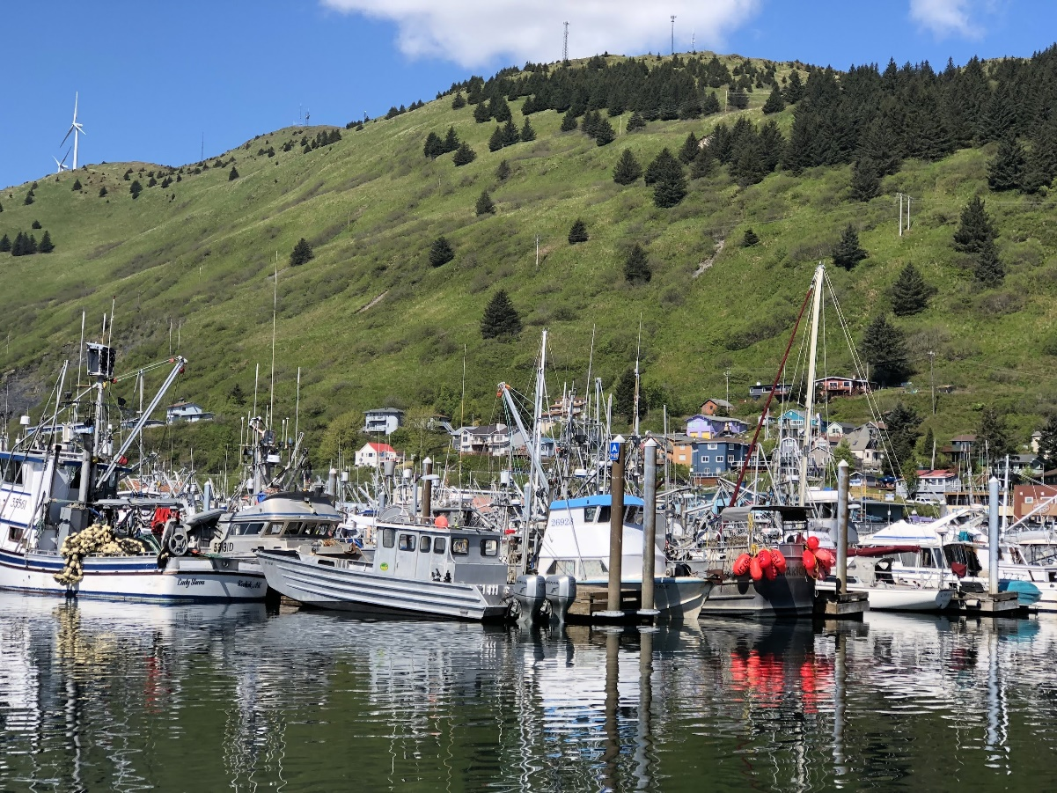
Pre-meeting materials
Agenda
Scenarios and visuals
Scenario planning background memo
Discussion questions
Pre-workshop memo from leadership
Logistical details

Slide 16
Dates and milestones
Month | Tasks & outputs
Jan – March | Agenda development Scenario development Early communications Open registration
April | Council meeting update & briefing book materials (draft agenda, climate scenario planning memo) Finalize scenarios and visuals Virtual session #1 – April 24, 1pm AK Virtual session #2 – April 30, 1 pm AK
May | Virtual session #3 – May 14, 1pm AK Release final scenarios and visuals; additional pre-meeting materials Finalize agenda Facilitation prep and final logistical planning
June | WORKSHOP JUNE 5-6

Slide 17
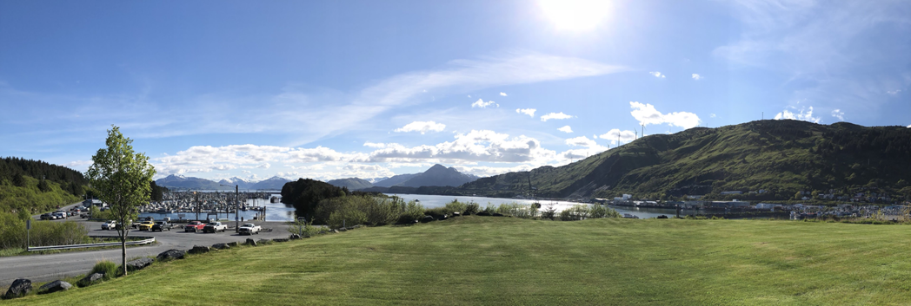

Next steps
Questions?
katie.latanich@noaa.gov

