Slide 1


C2 Draft for Initial Review:
BERING SEA ALEUTIAN ISLAND PACIFIC COD SMALL VESSEL ACCESS
June 2022
Presenters: Kate Haapala (NPFMC) and Abby Jahn (NMFS)

Slide 2

PRESENTATION OVERVIEW
History of the action
Purpose & Need and description of the alternatives
General approach
BSAI Pacific cod affected sectors
Analysis of impacts
Management & Enforcement

Slide 3
SECTION 1.1 HISTORY OF COUNCIL ACTION
October 2019
Public comment describing increased participation and inter-sector competition in the less than 60’ H&L/pot CV sector was resulting in access challenges for smaller vessels.
Council tasked a discussion paper evaluating “the potential impact of expanding the allowable participants to fish off the jig sector allocation to small fixed gear catcher vessels.”
June 2021
The Council received a presentation on the discussion paper tasked in October 2019 and adopted a purpose and need statement and a set of alternatives.
<57’ LOA, trip limits up to 15,000 lbs., and pot limits less than 25 pots.

Slide 4

SECTION 1.2 PURUPOSE AND NEED
“Increased participation in the <60 ft hook-and-line and pot catcher vessel Pacific cod sector by higher-capacity vessels over 57 ft LOA has negatively impacted smaller vessels in the sector through shortened seasons. These shortened seasons limit smaller vessels’ ability to compete within the sector as they are limited to fish in less productive waters near port due to their size. The jig sector allocation has not historically been fully utilized, particularly in the A and C seasons. Allowing these smaller catcher vessels using hook-and-line and pot gear to harvest Pacific cod from the jig sector allocation may provide additional opportunities for current fishery participants and potential new entrants with smaller catcher vessels without negatively impacting catcher vessels using jig gear.”

Slide 5
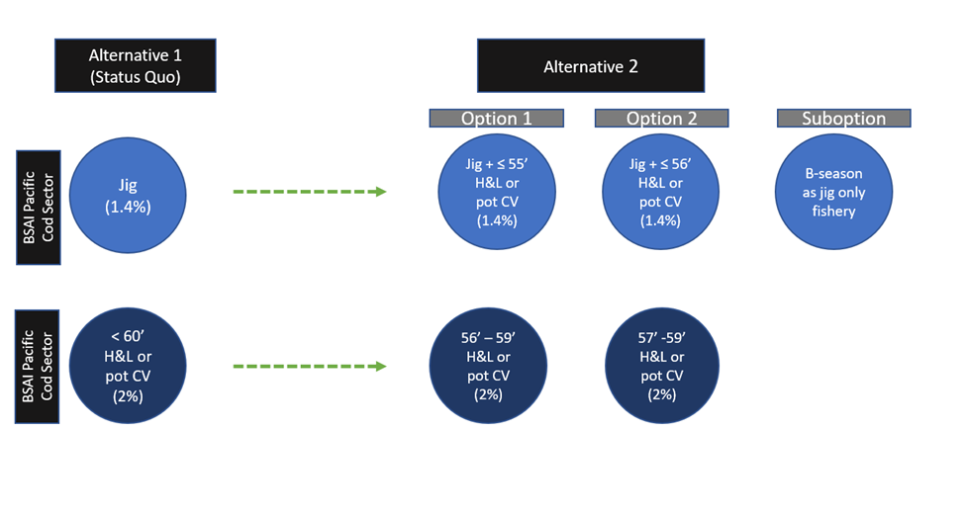
DESCRIPTION OF ALTERNATIVES
Alternative 1: No Action
Alternative 2: Redefine the current BSAI Pacific cod jig sector to include H&L or pot CVs less than or equal to:
  Option 1: 55’ LOA
  Option 2: 56’ LOA
    Suboption: B-season (Apr 30 – Aug 31) jig only fishery.
Figure 2-1 Comparison of changes to BSAI Pacific cod sectors under Alternative 2

Slide 6
GENERAL APPROACH
Table 3-2 Percent of non-CDQ BSAI Pacific cod sector allocations by BSAI groundfish FMP amendment
Sector | Amend 24 1994 | Amend46 1997 | Amend 64 2000 | Amend 77 2004 | Amend 85 2008
Jig | 2.0 | 2.0 | 2.0 | 2.0 | 1.4
H&L/Pot CV <60’ LOA | 44.0 | 51.0 | 0.7 | 0.7 | 2.0
H&L CV ≥60’ LOA |  |  | 0.2 | 0.2 | 0.2
H&L CP |  |  | 40.8 | 40.8 | 48.7
Pot CV ≥60’ LOA |  |  | 9.3 | 7.6 | 8.4
Pot CP |  |  |  | 1.7 | 1.5
AFA trawl CP | 54.0 | 23.5 | 23.5 | 23.5 | 2.3
Non-AFA trawl CP |  |  |  |  | 13.4
Trawl CV |  | 23.5 | 23.5 | 23.5 | 22.1
2008-2021 is the analytical time period, which reflects when the current BSAI Pacific cod allocations under Amendment 85 have been implemented.

Slide 7
GENERAL APPROACH
LOA
  The analysis uses LOA data reported to the CFEC because it is the most up to date data source for vessel length (see Chapter 5 for LOA considerations).
Confidentiality restrictions
  Jig sector has had a relatively low level of participation in recent years, which limits the data that can be displayed for these vessels.
  Five unique H&L/pot vessels with a reported LOA of 56’ that have participated in the Federal BSAI Pacific cod fishery with an annual average level of participation of two vessels (2008-2021).
    For this reason, data are often aggregated so H&L/pot CVs less than or equal to 56’ (option 2) are included in the new BSAI Pacific cod small vessel sector.

Slide 8
SECTION 3.6.1 LESS THAN 60’ H&L/POT CV SECTOR
Includes all CVs that are less than 60’ LOA using H&L/pot gear.
  The typical length of vessels that participate in this sector ranges from 28’ to 58’ LOA.
  The annual average level of participation in the sector is 27 vessels (2008-2021, Table 3-8).
The less than 60’ H&L/pot CV sector receives their entire allocation on January 1 each year.
  The sector has harvested 214 percent of its initial allocation (2008-2021, on average).
  Reallocations from the jig sector have accounted for 30 percent of the sector’s final allocation.
Vessels in this sector primarily participate in Federal BSAI Pacific cod, State-waters GHL cod, IFQ, and salmon fisheries.
Geographically diverse fleet (Table 3-12).
  76 percent of the vessels that have participated in the Federal BSAI Pacific cod fishery since 2008 have a registered ownership address in an Alaska community.

Slide 9
SECTION 3.6.2 JIG SECTOR
The BSAI Pacific cod jig sector includes all vessels using jig gear.
  Since 2008, 33 unique vessels have participated in the sector, and the annual average level of participation is four vessels (2008-2021, Table 3-13).
The BSAI pacific cod jig sector has harvested 16 percent of its initial allocation (2008-2021, on average).
  The three years where a higher percent of the initial allocation was utilized were 2010 at 17 percent, 2011 at 18 percent, and 2012 at 14 percent (see Table 3-13, pg. 32).
Vessels in this sector primarily participate in Federal BSAI Pacific cod, State-waters GHL cod, IFQ, and salmon fisheries.
87 percent of jig vessels that have participated in the Federal BSAI Pacific cod fishery since 2008 have a registered ownership address in an Alaska community (Table 4-17).

Slide 10
SECTION 4.2 ALTERNATIVE 1 (NO ACTION)
The BSAI Pacific cod less than 60’ H&L/pot CV and jig sectors, their allocation, and the hierarchy of reallocations of BSAI Pacific cod among all sectors currently set in Federal regulations would remain unchanged.
No anticipated impacts to BSAI Pacific cod jig sector vessels.
No anticipated impacts to H&L/pot CVs greater than 56’ LOA .
Potential impact to H&L/pot CVs less than or equal to either 55’ or 56’ LOA.
Figure 4-1 BSAI Pacific cod landings (mt) for H&L and pot CVs greater than 56’ LOA compared to the less than 60’ H&L or pot CV sector’s final allocation from 2008 through 2021
It does not appear H&L/pot CVs greater than 56’ LOA are harvesting a larger portion of the sector’s final allocation over time, but they have harvested the majority (2008-2021).
Other factors potentially contributing to a more competitive fishery including declining BSAI Pacific cod TAC since 2012 (except for 2022) and increased participation in the sector.

Slide 11
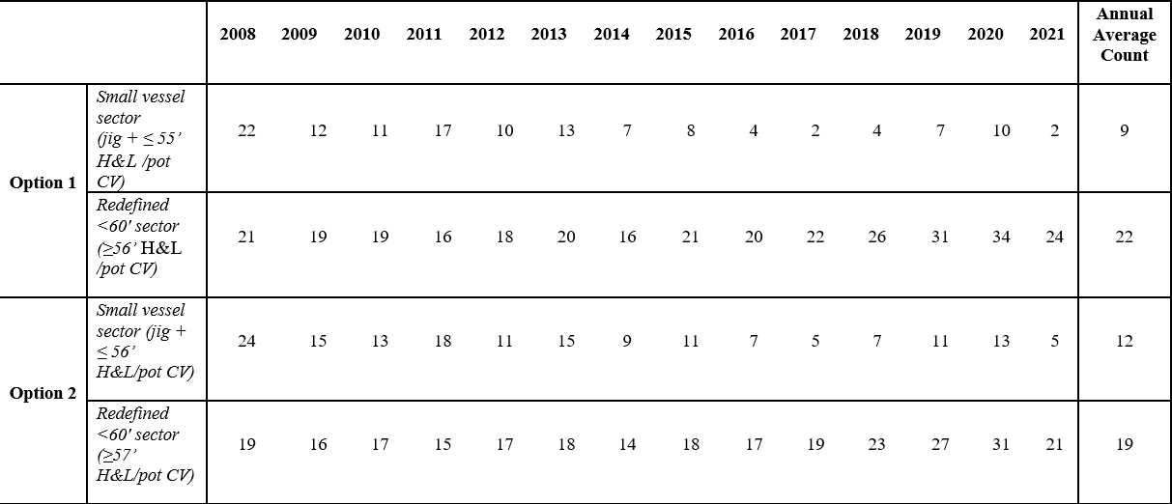
SECION 4.3.1 HISTORICAL PARITICIPATION
Alternative 2 would redefine the Federal BSAI Pacific cod jig and less than 60’ H&L/pot CV sectors.
Table 4-1 Count of vessels that would have been eligible for the new BSAI Pacific cod small vessel sector and the redefined less than 60’ H&L or pot CV sector under option 1 and option 2, 2008-2021

Slide 12
SECTION 4.3.2 HARVEST INFORMATION
Figure 4-2 Comparison of BSAI Pacific cod jig sector initial allocation (mt) and the target landings (mt) of jig, H&L, and pot vessels that would be eligible for the new BSAI Pacific cod small vessel sector under option 1 and 2 from 2008 through 2021

Slide 13
BSAI PACIFIC COD REALLOCATIONS
Chapter 3 provides information on BSAI Pacific cod management, including Section 3.3 on reallocations.
Any unused portion of the seasonal allowance from any sector, except the jig sector, is rolled over to that sector’s next season.
A season reallocations are rare, but reallocations of projected unused BSAI Pacific cod from the jig sector are made to the less than 60’ H&L/pot CV sector between January and March to ensure this sector does not experience a disruption of fishing.
Reallocation decisions consider the sector’s capacity to harvest both their initial Pacific cod allocation and any reallocations they may receive.
Table 3-3 2022 BSAI Pacific cod non-CDQ sector allocations and seasonal allowances
Sector | BSAI Sector Allocation (mt) | BSAI Seasons and allowance (mt)
 |  | A B C
H&L/Pot CV < 60’ LOA | 2,671 | No seasonal allowances
H&L CV ≥ 60’ LOA | 267 | Jan 1-June 10 (51%) 136 | June 10 -Dec 31 (49%) 131 | n/a
H&L CP | 65,027 | Jan 1-June 10 (51%) 33,164 | June 10 -Dec 31 (49%) 31,863 | n/a
Pot CV ≥ 60’ LOA | 11,216 | Jan 1-June 10 (51%) 5,720 | Sept 1 -Dec 31 (49%) 5,496 | n/a
Pot CP | 2,003 | Jan 1-June 10 (51%) 1,021 | Sept 1 -Dec 31 (49%) 981 | n/a
Jig | 1,879 | Jan 1- Apr 30 (60%) 1,127 | Apr 30-Aug 31 (20%) 376 | Aug 31- Dec 31 (20%) 376
AFA Trawl CP | 3,086 | Jan 20-April 1 (75%) 2,315 | April 1-June 10 (25%) 772 | June 10- Nov 1 (0%) 0
Amendment 80 | 17,981 | Jan 20-April 1 (75%) 13,485 | April 1-June 10 (25%) 4,495 | June 10- Dec 31 (0%) 0
Trawl CV | 29,655 | Jan 20-April 1 (74%) 21,944 | April 1-June 10 (11%) 3,262 | June 10-Nov 1 (15%) 4,448

Slide 14
4.3.3 REALLOCATION CONSIDERATIONS
The historically common patterns of annual reallocations from the BSAI Pacific cod jig sector (redefined as the new small vessel sector) to the less than 60’ H&L/pot CV sector (redefined with H&L/pot vessels greater than either 55’ or 56’ LOA) are likely to be impacted under Alternative 2.
Under Alternative 2, option 1 and 2, smaller H&L or pot CVs would have an opportunity to harvest more Pacific cod or extend their harvest of Pacific cod within a season.
Policy choice: The Council would need to consider whether an unused portion of a seasonal allowance in the new BSAI Pacific cod small vessel sector would be reallocated to the redefined less than 60’ H&L/pot CV sector or whether it would rollover to the small vessel sector’s next fishing season.
Fully utilize seasonal allowance
NMFS could no longer maintain the historically common reallocation from the jig sector to less than 60’ H&L/pot CV sector.
May not fully utilize seasonal allowance
Uncertain when NMFS could make a reallocation to the redefined less than 60’ H&L/pot CV sector.

Slide 15
SECTION 4.3.4 DIVERSIFICATION AND REVENUE INFORMATION
There is uncertainty about the magnitude of the incidental allocative effects that could occur under Alternative 2.
Section 4.3.4 provides estimates of revenue impacts under Alternative 2.
NMFS cannot track the landings that are derived from a sector’s initial allocation or subsequent reallocations.
  Not possible to precisely estimate the potential revenue impact or opportunity under Alternative 2.
Uncertain whether the new BSAI Pacific cod small vessel sector would utilize the 1.4 percent allocation and whether TAC would be reallocated or rollover seasonally.

Slide 16
SECTION 4.3.4 REVENUE IMPACTS
If NMFS could no longer maintain the historically common reallocation from the jig sector to the less than 60’ H&L/pot CV sector, larger vessels in the redefined sector would be negatively impacted.
Revenue impact is estimated by assuming there is no jig (new small vessel sector) reallocation to the redefined less than 60’ H&L/pot CV sector.
The estimated revenue H&L/pot CVs greater than 56’ derive from the jig reallocation ranges from $1.06-$2.58 million.
Likely an overestimate because H&L/pot CVs greater than 56’ do not utilize 100 percent of their current sector’s allocation.
Estimate the potential gains this group would experience by assuming they harvest the full 2 percent allocation absent smaller H&L/pot vessels, which amounts to approximately $.15 million (on average).
The estimated annual average gross ex-vessel revenue impact for larger H&L/pot CVs greater than 56’ LOA is a decrease of $1.26 million (Table 4-4).

Slide 17
SECTION 4.3.4 REVENUE IMPACTS
Under Alternative 2, H&L/pot vessels less than or equal to 56’ LOA would have additional opportunity, although their future fishing behavior is uncertain.
Estimate the revenue associated with H&L/pot vessels less than or equal to 56’ LOA fully utilizing the jig sector’s initial allocation, which is $1.87 million (on average).
Account for the historical jig participation.
Estimated annual average additional revenue opportunity for H&L/pot CVs less than or equal to 56’ LOA is $1.08 million under Alternative 2.

Slide 18
SECTION 4.3.4.3 DHS STATE-WATERS POT FISHERY
The DHS pot fishery opens seven days after the Federal BSAI Pacific cod less than 60’ H&L/pot CV sector closes.
  Open to vessels less than or equal to 58’ LOA using pot gear with a limit of 60 pots per vessel.
Under Alternative 2, the BOF would need to address the trigger for opening the DHS pot fishery and what the trigger should be.
  The new small vessel sector closing date, the redefined less than 60’ H&L/pot CV sector closing date, or some other trigger (e.g., hard date).
It is uncertain what action the BOF would take to open the DHS pot fishery, but pot vessels not in the trigger sector would likely need to decide whether they want to participate in Federal or State waters if both were open at the same time.
The annual average gross ex-vessel revenue pot CVs greater than 56’ earn from the DHS fishery is $6.67 million, which is 24 percent of the total gross ex-vessel revenue for all fisheries (2014-2020).
The annual average gross ex-vessel revenue pot CVs less than or equal to 56’ earn from the DHS fishery is $1.21 million, which is 20 percent of the total gross ex-vessel revenue for all fisheries (2014-2020).

Slide 19
4.3.6 SUBOPTION - B SEASON AS JIG ONLY FISERY
Jig deliveries are concentrated in the B season.
H&L/pot CVs’ deliveries are concentrated in the A and C seasons.
If H&L/pot CVs eligible for the new BSAI Pacific cod small vessel sector under Alternative 2 were allowed to harvest BSAI Pacific cod during the B season, it is possible these vessels could constrain jig vessels.
There are no anticipated impacts of including the suboption which largely mirrors the historical fishing activity of both affected sectors.
Table 4-7 Count of BSAI Pacific cod deliveries, the average number of deliveries (per year), and the percent of total deliveries made by vessels operating in the BSAI Pacific cod less than 60’ H&L or pot CV and jig sectors in each jig sector trimester from 2008 through 2021
 | Season | Count of deliveries | Average number of deliveries | % of total deliveries
Jig | A (Jan 1 - Apr 30) | 14 | 1 | 3%
 | B (Apr 30 – Aug 31) | 373 | 27 | 87%
 | C (Aug 31 - Dec 31) | 43 | 3 | 10%
<60' H&L /pot | A (Jan 1 - Apr 30) | 2,618 | 187 | 66%
 | B (Apr 30 – Aug 31) | 113 | 8 | 3%
 | C (Aug 31 - Dec 31) | 1,261 | 90 | 31%

Slide 20
SECTION 4.5 COMMUNITY IMPACTS
Under Alternative 2, there could be a distributional impact at the community-level.
H&L/pot CVs greater than 56’ LOA
  Kodiak has the largest number of unique H&L/pot CVs greater than 56’ LOA with a registered ownership address.
H&L/pot CVs less than or equal to 56’ LOA
  Dutch Harbor/Unalaska has the largest number of unique vessels with a registered ownership address.
Jig
  Akutan, Dutch Harbor/Unalaska, and Kodiak have each had four unique vessels participate in the BSAI Pacific cod jig sector during the analyzed time period.
  There is one jig vessel with a reported owner address of Homer that regularly participates in the Federal BSAI Pacific cod jig fishery.

Slide 21
SECTION 4.4 SUMMARY OF IMPACTS ON FISHING ACTIVITY
NMFS has made the preliminary determination that the proposed action does not result in substantial modifications of fishing location, timing, effort, authorized gear types, and harvest levels.
Any pursuant regulatory changes would have no effect, individually or cumulatively on the human environment, therefore, NMFS foresees this action would qualify for a Categorical Exclusion.
Table 4-8 Summary of impacts on fishing activity
Category | Option 1 | Option 2 without suboption | Option 2 with suboption
Fishing Location | Not likely to change fishing location. This is outside of the scope of the action.
Timing and Effort | Minimally modify timing for new vessels in redefined BSAI Pacific cod jig sector (Section 4.3.2 and 4.3.3). May also minimally modify effort for the redefined less than 60’ H&L or pot CV sector because the reallocations are likely to change (Section 4.3.3). |  | No anticipated impacts, may closely mirror historical fishing activity of both sectors (Section4.3.6).
Authorized Gear Types | No changes to authorized gear types. H&L, pot, and jig gear are authorized under the BSAI groundfish FMP. Additionally, Federal BSAI Pacific cod sectors are defined by gear type, operation type, and vessel size categories (Section 3.2 and 3.6).
Harvest Levels | No changes to harvest levels or sector allocation structure. The BSAI Pacific cod TAC is set in accordance with the Pacific cod biomass (Section 3.2).

Slide 22
SECTION 5 MANAGEMENT AND ENFORCEMENT CONSIDERATIONS
Changes to in-season management and allocations
  Council should consider whether the new small vessel sector’s remaining seasonal allowance would be reallocated to the redefined less than 60’ H&L/pot CV sector or whether the seasonal allowance would rollover to the new small vessel sector’s next season.
Observer coverage
  No changes to current observer coverage requirements:
    Partial coverage for CVs designated on an FFP (H&L, pot, and jig gear)
    Full coverage for CVs using H&L gear and CDQ fishing (exception: CVs ≤ 46’ LOA are in the partial coverage category)

Slide 23
SECTION 5 MANAGEMENT AND ENFORCEMENT CONSIDERATIONS
Enforcement concerns
  BSAI Pacific cod fisheries are a complex management system
  There are challenges with ensuring compliance across Federal and state fisheries and management areas
  As complexity is added, there are cumulative impacts that affect compliance
Additional considerations
  LOA as reported to the CFEC is used in this analysis because it is the best source of data for length
  There are known discrepancies in the data. Analysts advise the Council to consider the following caveats:
    There are varying definitions of length. For example, fishery participants might report the USCG registered length to CFEC instead of the Federal definition of LOA.
    Vessel owners may modify their vessel length without submitting new survey information to NMFS or CFEC.
    Vessel owners may modify their vessel length for inclusion in a particular fishery or BSAI Pacific cod sector.

Slide 24

Questions?
Kate Haapala
Kate.haapala@noaa.gov

