Slide 1















Ecosystem Status Report Aleutian Islands 2023 – NPFMC SSC Dec 2023
Thank you !
Ivonne Ortiz & Stephani Zador
With contributions from:
Anna Abelman, Kerim Aydin, Sonia Batten, Nick Bond, Mathew W. Callahan, Louisa Castrodale, Wei Cheng, Kathleen Easley, Thomas Farrugia, Sarah Gaichas, Timothy Jones, Robb Kaler, Kathy Kuletz, Ben Laurel, Emily Lemagie, Jackie Lindsey, Ivonne Ortiz, Clare Ostle, Noel Pelland, Heather Renner, Lauren Rogers, Nora Rojek, Natalie Rouse, Greg Ruggerone, Kevin Siwicke, Phyllis Stabeno, Rob Suryan, Rick Thoman, Muyin Wang, George Whitehouse, Bruce Wright, Stephani Zador
photos: photolib.noaa.gov

Slide 2





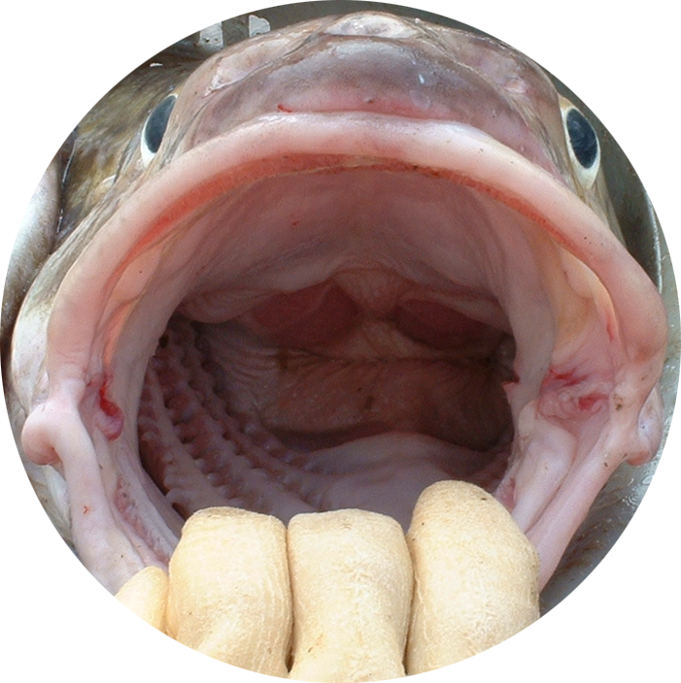
Risk Table
Environmental/Ecosystem Considerations
2023 Ecosystem Status Report – Aleutian Islands
Assessment 2023
Sustained warmer temperature for 10 years
Warmest winter on record
Lowest heat and nutrients flux through passes, deeper mixed layer
Seabirds reproductive success: above mean in EAI; mixed in WAI
HABs increase EAI: 3,793 µg/100 g in blue mussels (1000 µg/100 g potentially fatal)
Multi-year since ~2013/14 –now linked to regime shift
Sustained mid-depth & surface warmer temperatures, lower productivity
Pinks impact: 3rd highest abundance, satellite chla
Rockfish dominate pelagic foragers - energy banked in little preyed-on, long-lived rockfish
(and pink salmon)
Implications for this year
● SST regime shift implies higher temperatures are the new norm
● sat SST 1-13.4°C, Bottom temperature max 6 - 6.6°C, but is warmer in Sep & <100 m depth
● fish &invertebrate prey availability expected in EAI, mixed availability in WAI
● HABs increased risk to human health in EAI
Cumulative effects
● higher bioenergetic costs ● lower productivity ● zoop, fish grow faster
● phenology might start to shift ● changes in prey field timing, composition and location ● rockfish & pink salmon main pathway of zooplankton into foodweb
● past indicators (e.g. PDO) may not be as useful in the future; their relationships with physical and ecological processes may vary as the climate continues to change
Level 2
Multiple indicators showing consistent adverse signals a) across the same trophic level as the stock, and/or b) up or down trophic levels (i.e., predators and prey of the stock)
AI Pacific cod
Level 1
No apparent environmental/
ecosystem concerns
Northern Rockfish
Noteworthy
Large scale changes SST patterns
Key temperatures for AI groundfish
Pcod eating less fish

Slide 3


2023 AI Risk Tables
Level 2
AI Pacific cod
Persistent warm conditions
Narrow optimal thermal range for >20% egg hatch success
Increased bioenergetic costs, increased consumption
Lower amount of fish in diet since ~2010
Lower prey quality resulting in reduced fish condition
Decreased consumption of Atka as prey
Level 1
Warm conditions and lower than average fish condition BUT
Eggs hatch internally – live bearers
Long-lived species -each adult cohort’s genetic composition is heavily influenced by the environmental conditions experienced during the first year at sea (Maselko et al 2020)
Genetic portfolio includes the environmental conditions of every cohort’s first year
No apparent effects from Eastern Kamchatka Pink Salmon
Northern Rockfish

Slide 4
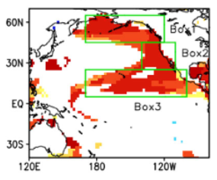
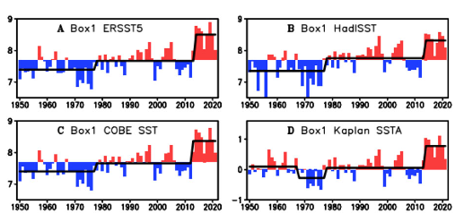
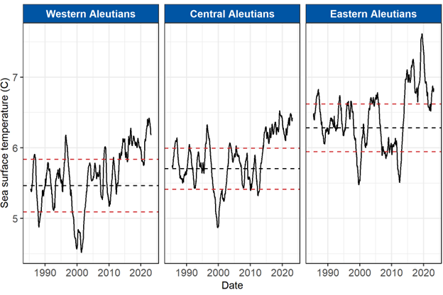
Noteworthy Changes in large scale sea surface temperature patterns
Northern North Pacific
● Thermal regime shift in North pacific annual mean sea surface temperature 2013/14
● PDO indicator may not be as useful as it used to be
● First mode of variability of SST has changed
● Relationships with physical and ecological processes may vary as the climate continues to change
Lemagie & Callahan
WAI
CAI
EAI
Xiao and Ren, 2023. A regime shift in North Paciﬁc annual mean sea surface temperature in 2013/14. Modified from Figures 1 and 2.
Werb and Rudnick, 2023. Remarkable changes in the dominant modes of North Pacific sea surface temperature. Modified from Figures 1b and 3b.

Slide 5
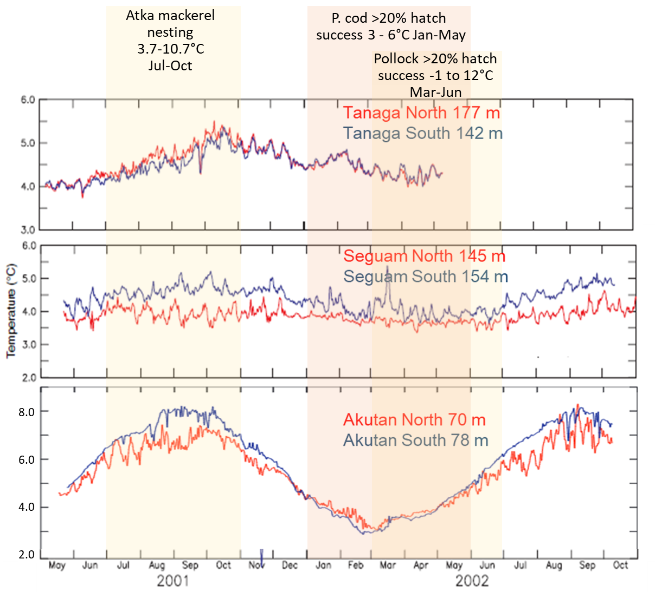
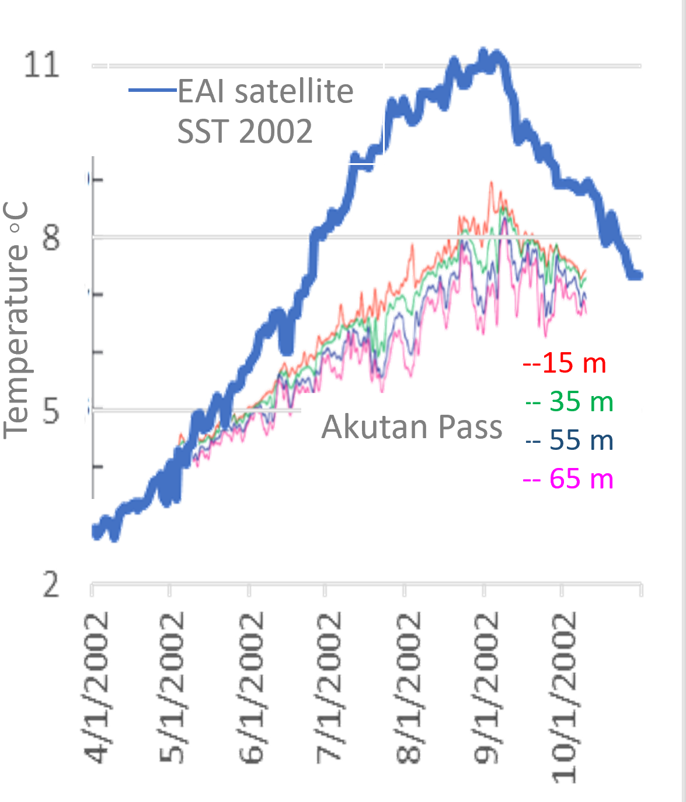
Noteworthy Key temperature ranges for commercial groundfish species in the Aleutian Islands
Persistent warming conditions: The SSC suggested information on which species are most vulnerable to these persistent conditions would be helpful for understanding ecosystem impact
Most vulnerable: Pacific cod, narrow optimal temperature for >20% egg hatch success: 3-6°C January to May at 100-200 m. Eggs adhere to seafloor.
Bottom trawl survey max bottom temperature: 6.6°C potentially same temperature in Jan-May in some areas. No. days ≥6°C since 2014:16
11 times in 2016, depths 68-141m; 6 times depths >100m, across AI
Second most vulnerable: Atka mackerel, wide nesting temperature 3.7-10.7°C in July to October, 15 °C lethal for eggs, shallowest nests at 34 m depth.
Atka mackerel: Bottom trawl survey max SST: 12.3; twice above 12°C max satellite SST 13.39. Satellite SST No. days ≥ 12°C since 2014: 79.
In WAI & EAI.
Mooring data: Staben et al 2005; satellite SST Lemagie & Callahan; bottom trawl temperature, O’Leary. Spawning P. cod data: Neidetcher et al. 2014

Slide 6
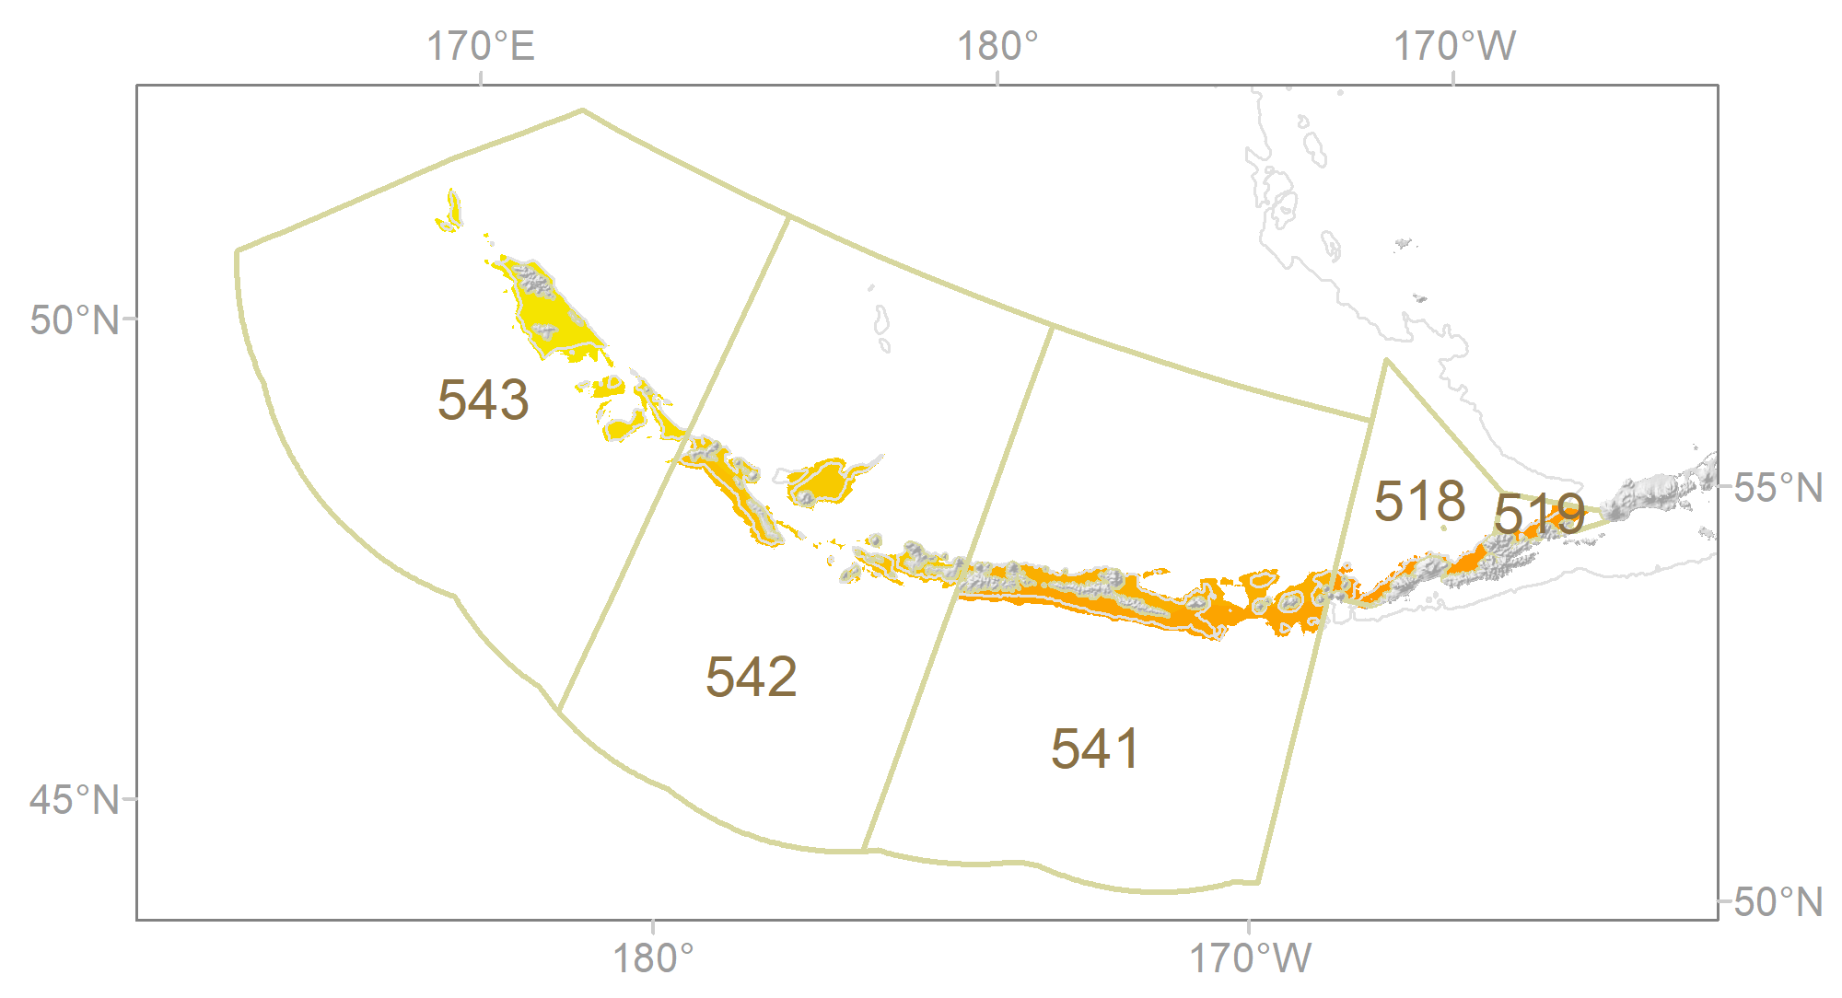
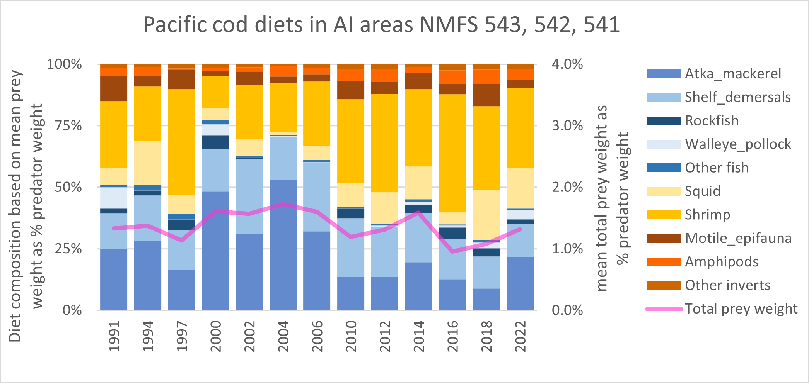
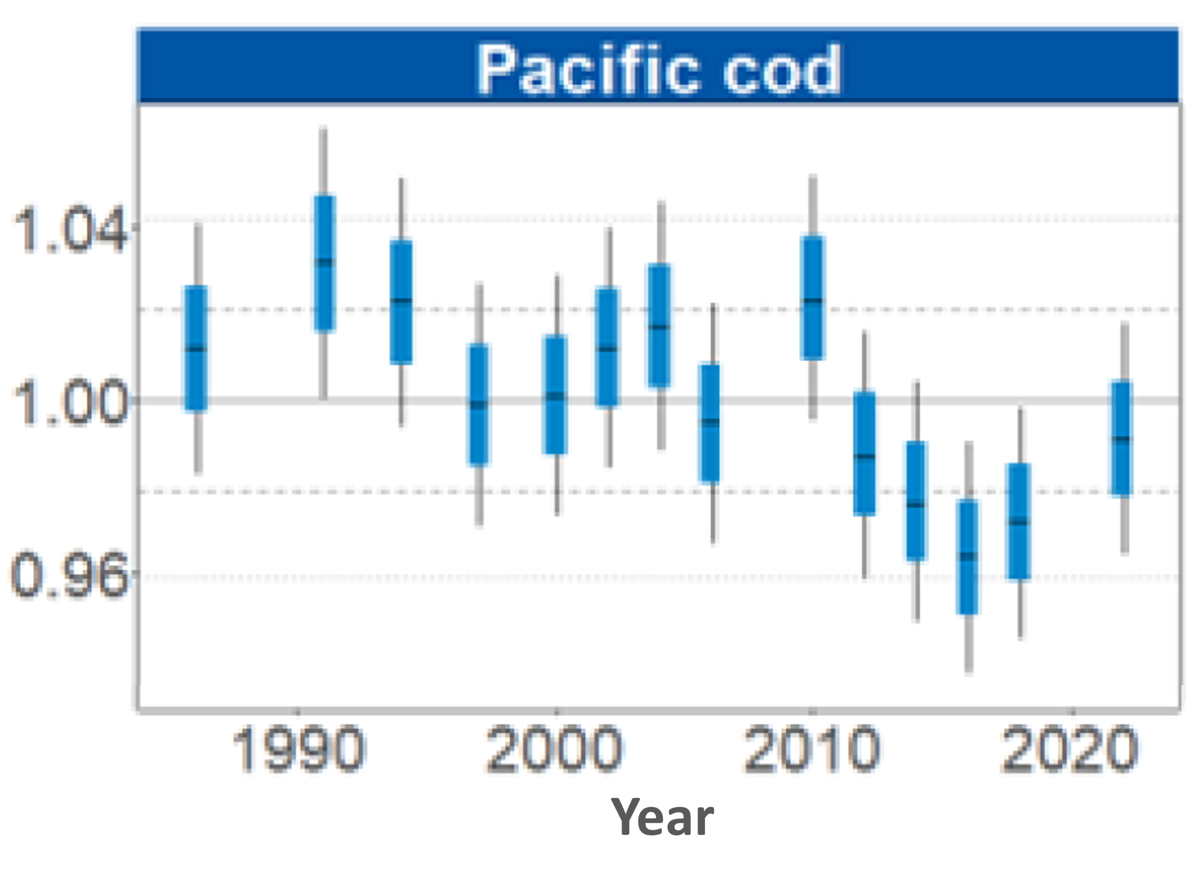
Noteworthy Changes in Pacific cod diets
Declines of non-commercial species in WAI: The SSC encourages efforts to explore mechanistic and food-web links for these observed trends, prioritizing diet data when samples are available
● Less fish in diets
● Even when similar amount of prey was consumed, less fish results in low fish condition
● Lower fish condition potentially due to lower prey quality + potentially higher bioenergetic costs
● Decrease of fish in diet most noticeable in western Aleutian Islands
● Trend not seen east of Samalga where prey consumption was highest in 2022 and condition was (+)

Slide 7
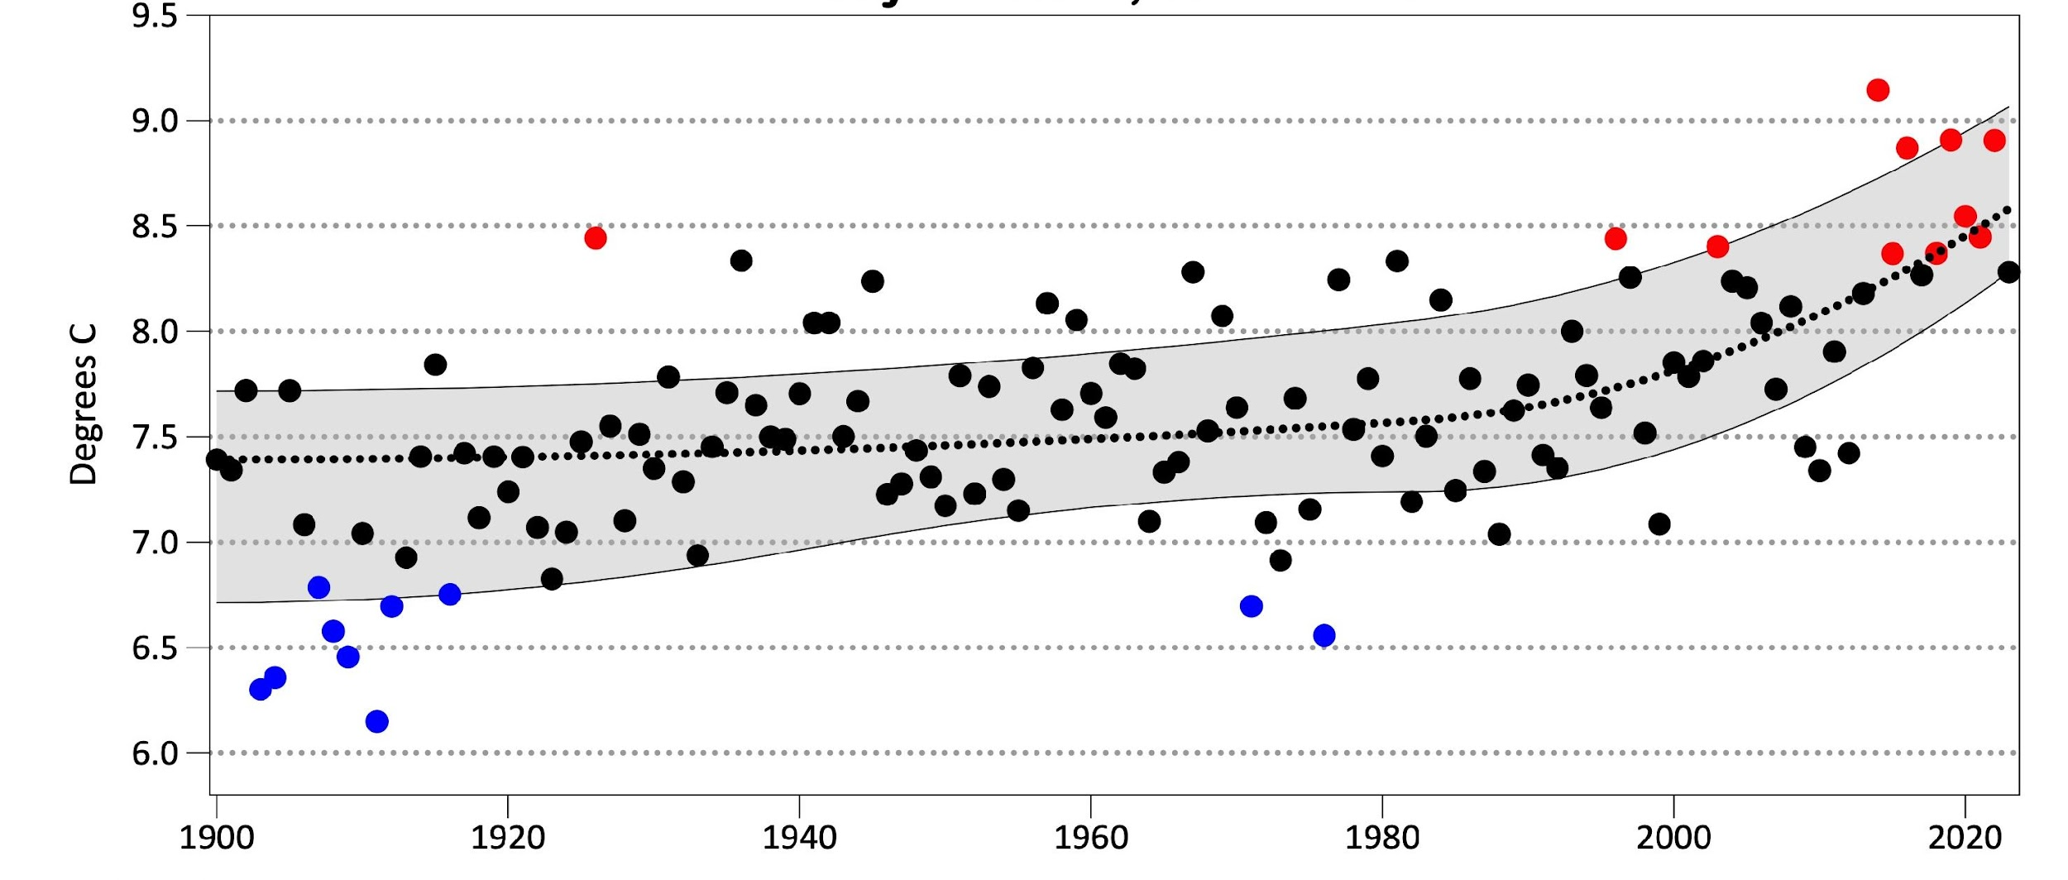
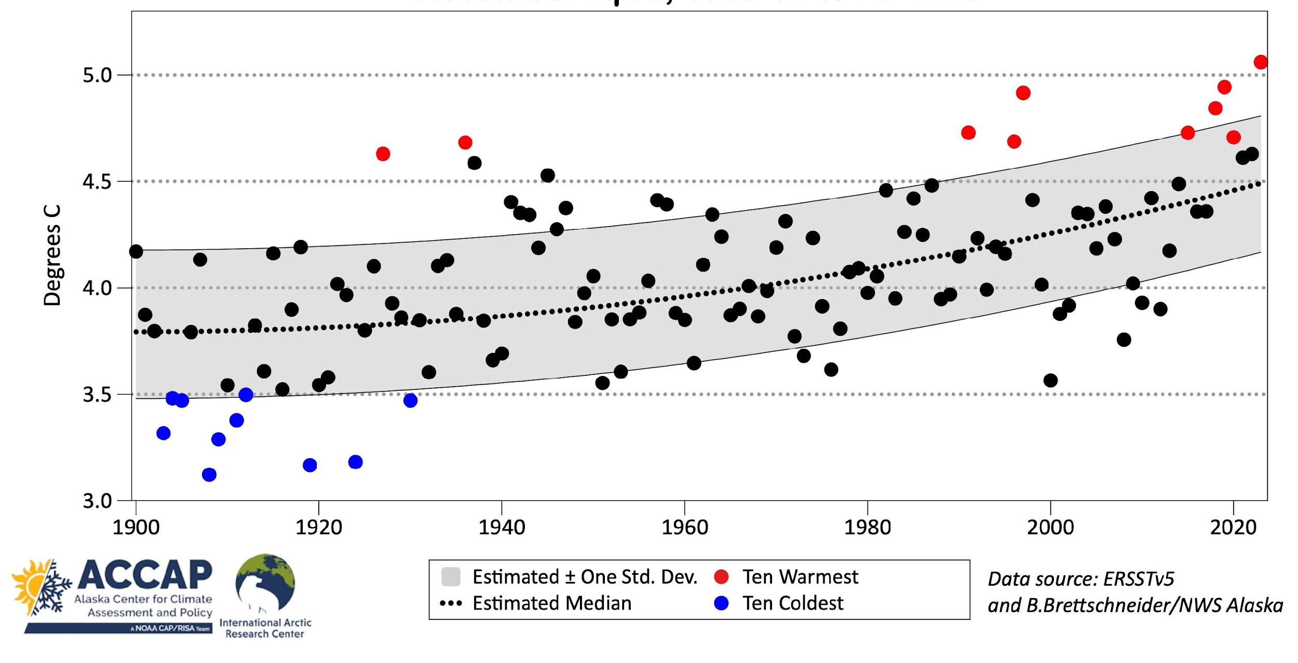
Thoman & Lemagie and Callahan Current Conditions 2023 Oceanography
Summer May-Oct
Long-term Sea Surface Temperature
2023 – Warmest winter in 124 years
Warming trend winter and summer
Winter Nov-Apr

Slide 8
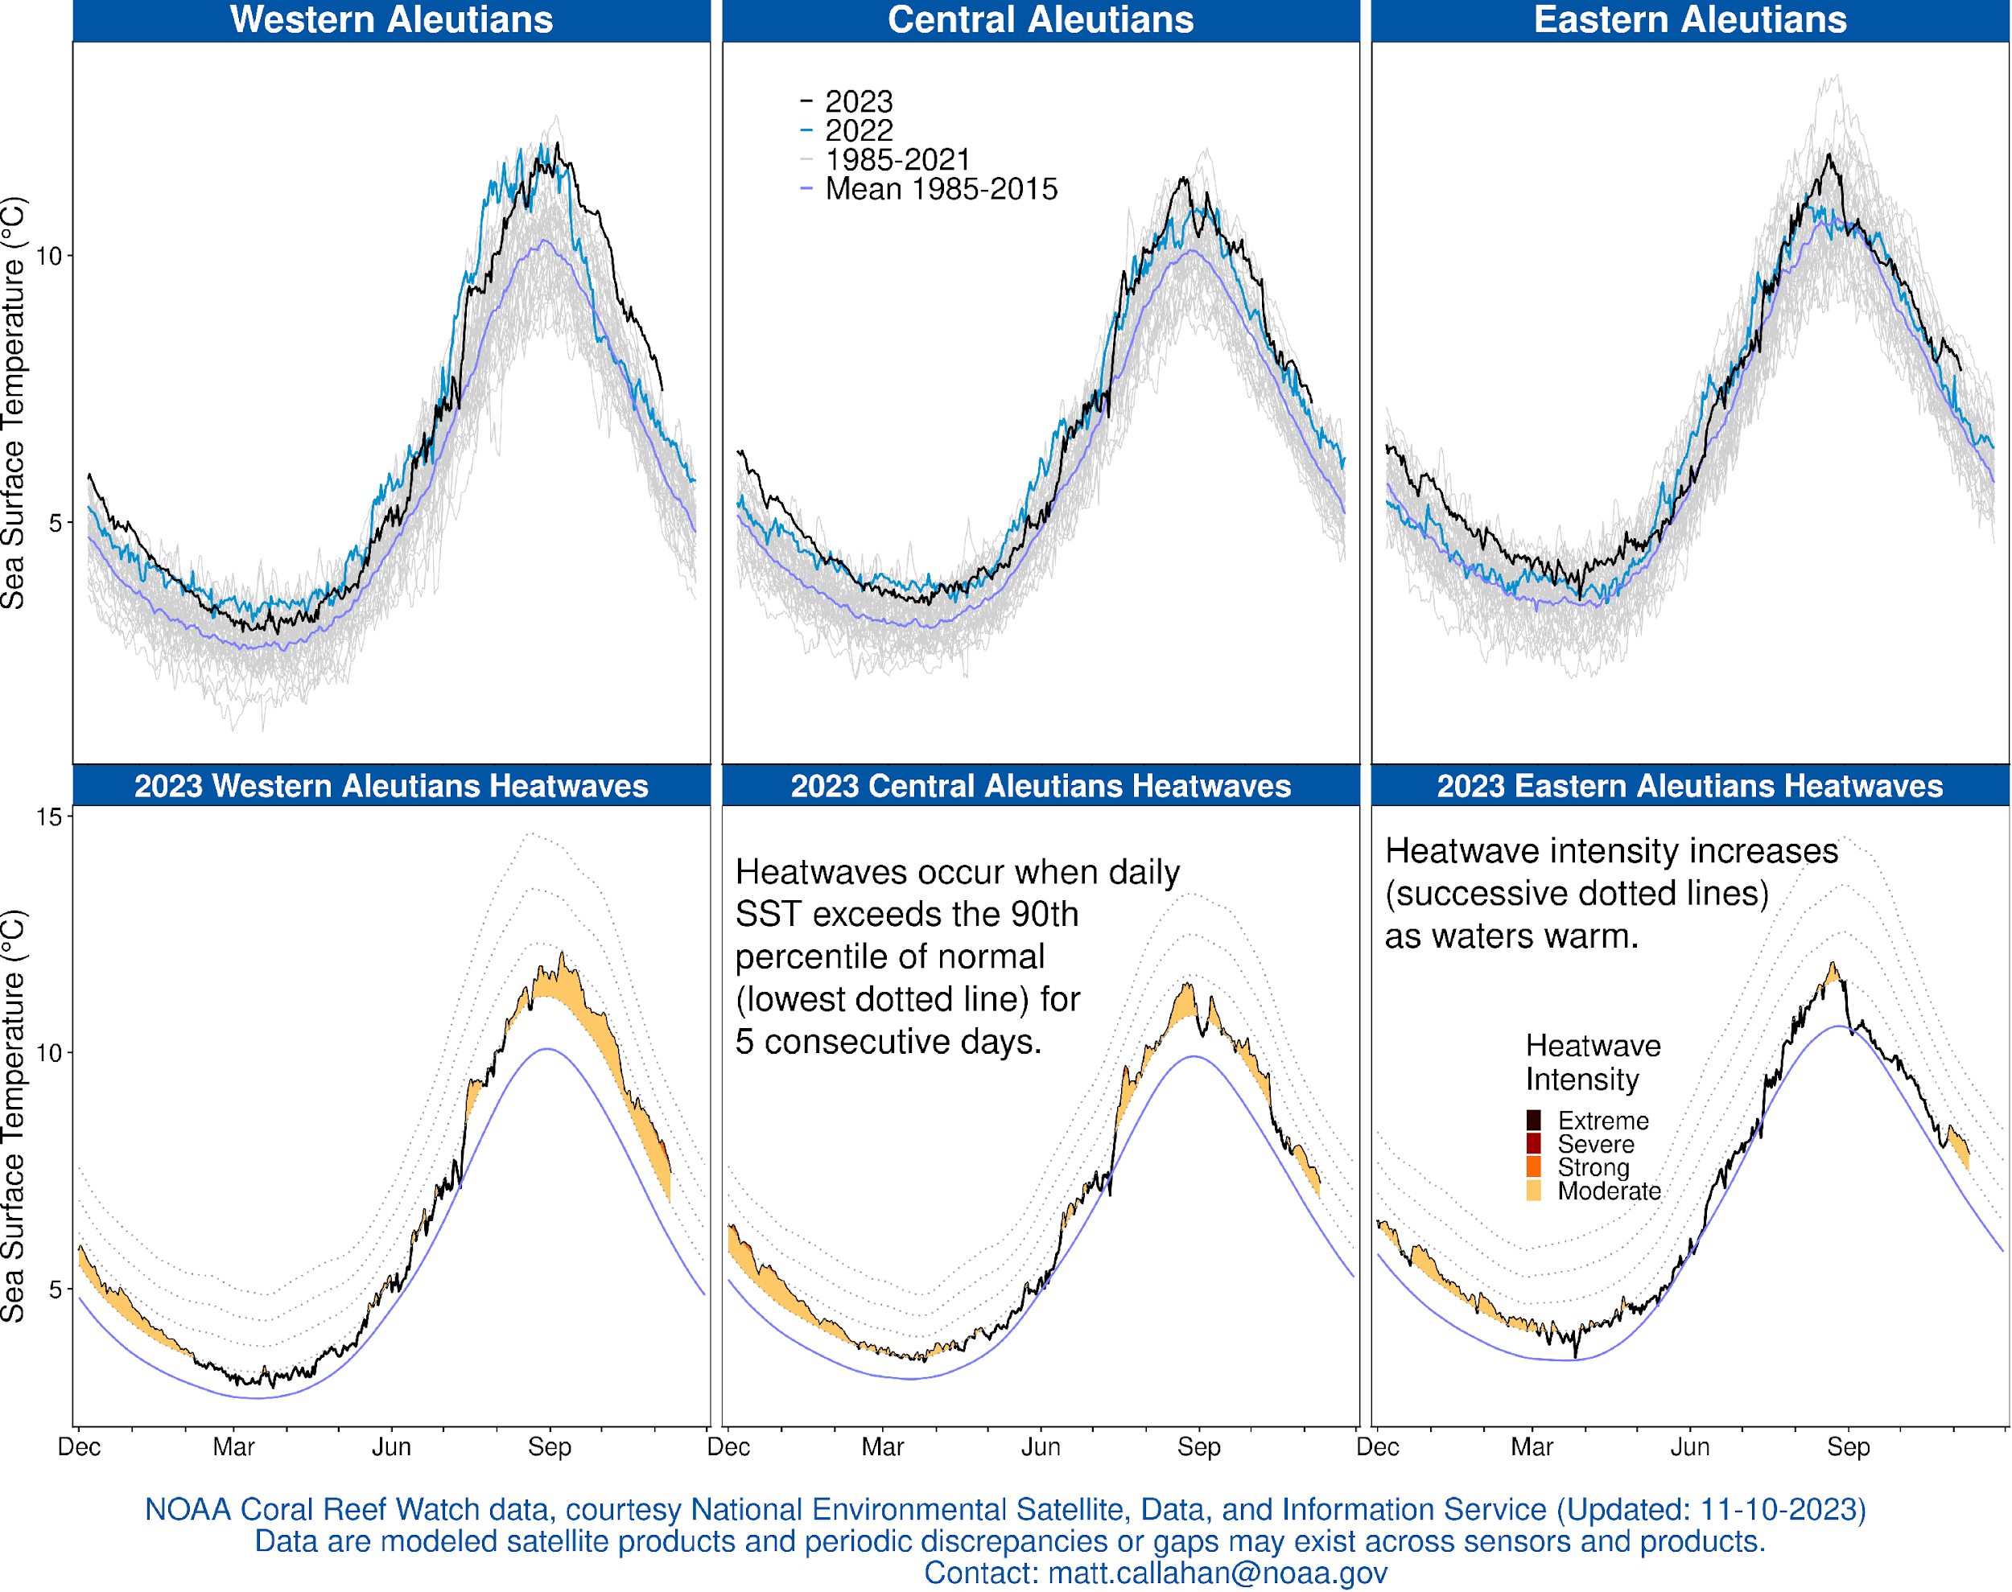
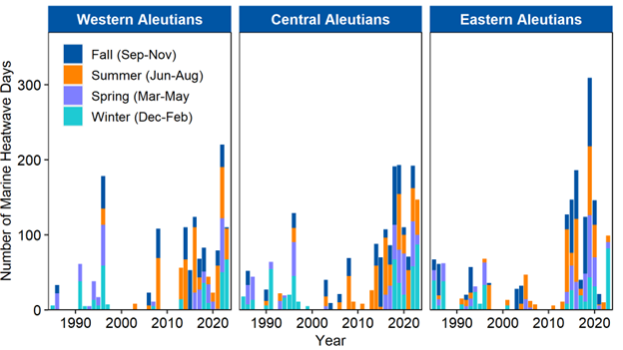
Lemagie & Callahan, O’Leary & Laman Oceanography
Satellite SST
Warm winter throughout
Cooler spring & summer but still above 1985-2015 mean
Current Fall – warmest in WAI
data through 11-12-2023
data through 09-02-2023

Slide 9
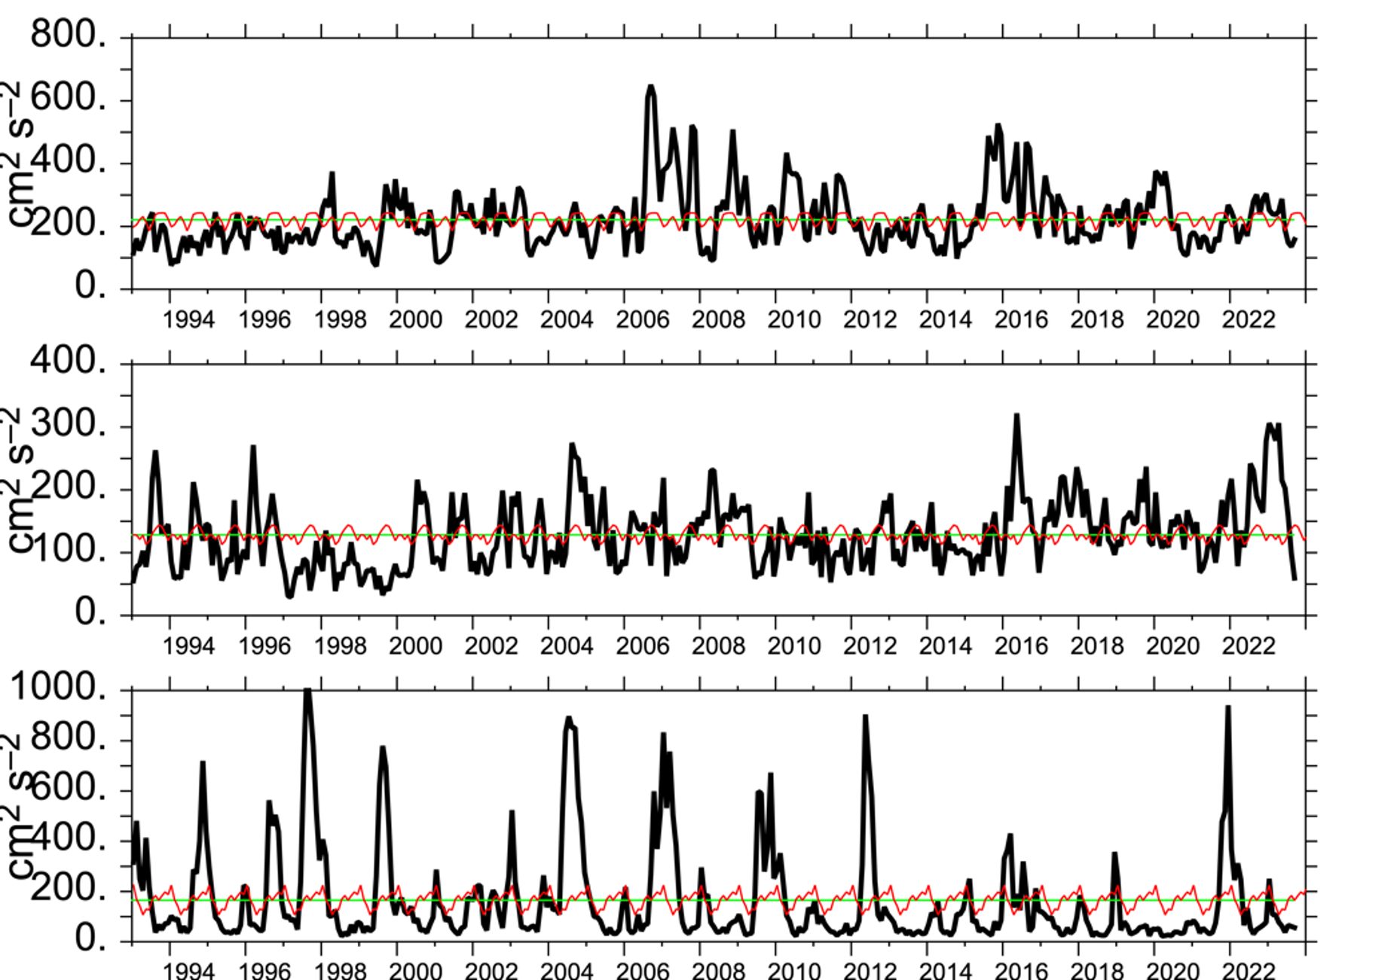
Cheng, Pelland Oceanography
Eddy Kinetic Energy
Historical minima in EAI
Currently below average in all three regions
Lower transport of heat, salt and nutrients through passes
WAI
CAI
EAI

Slide 10
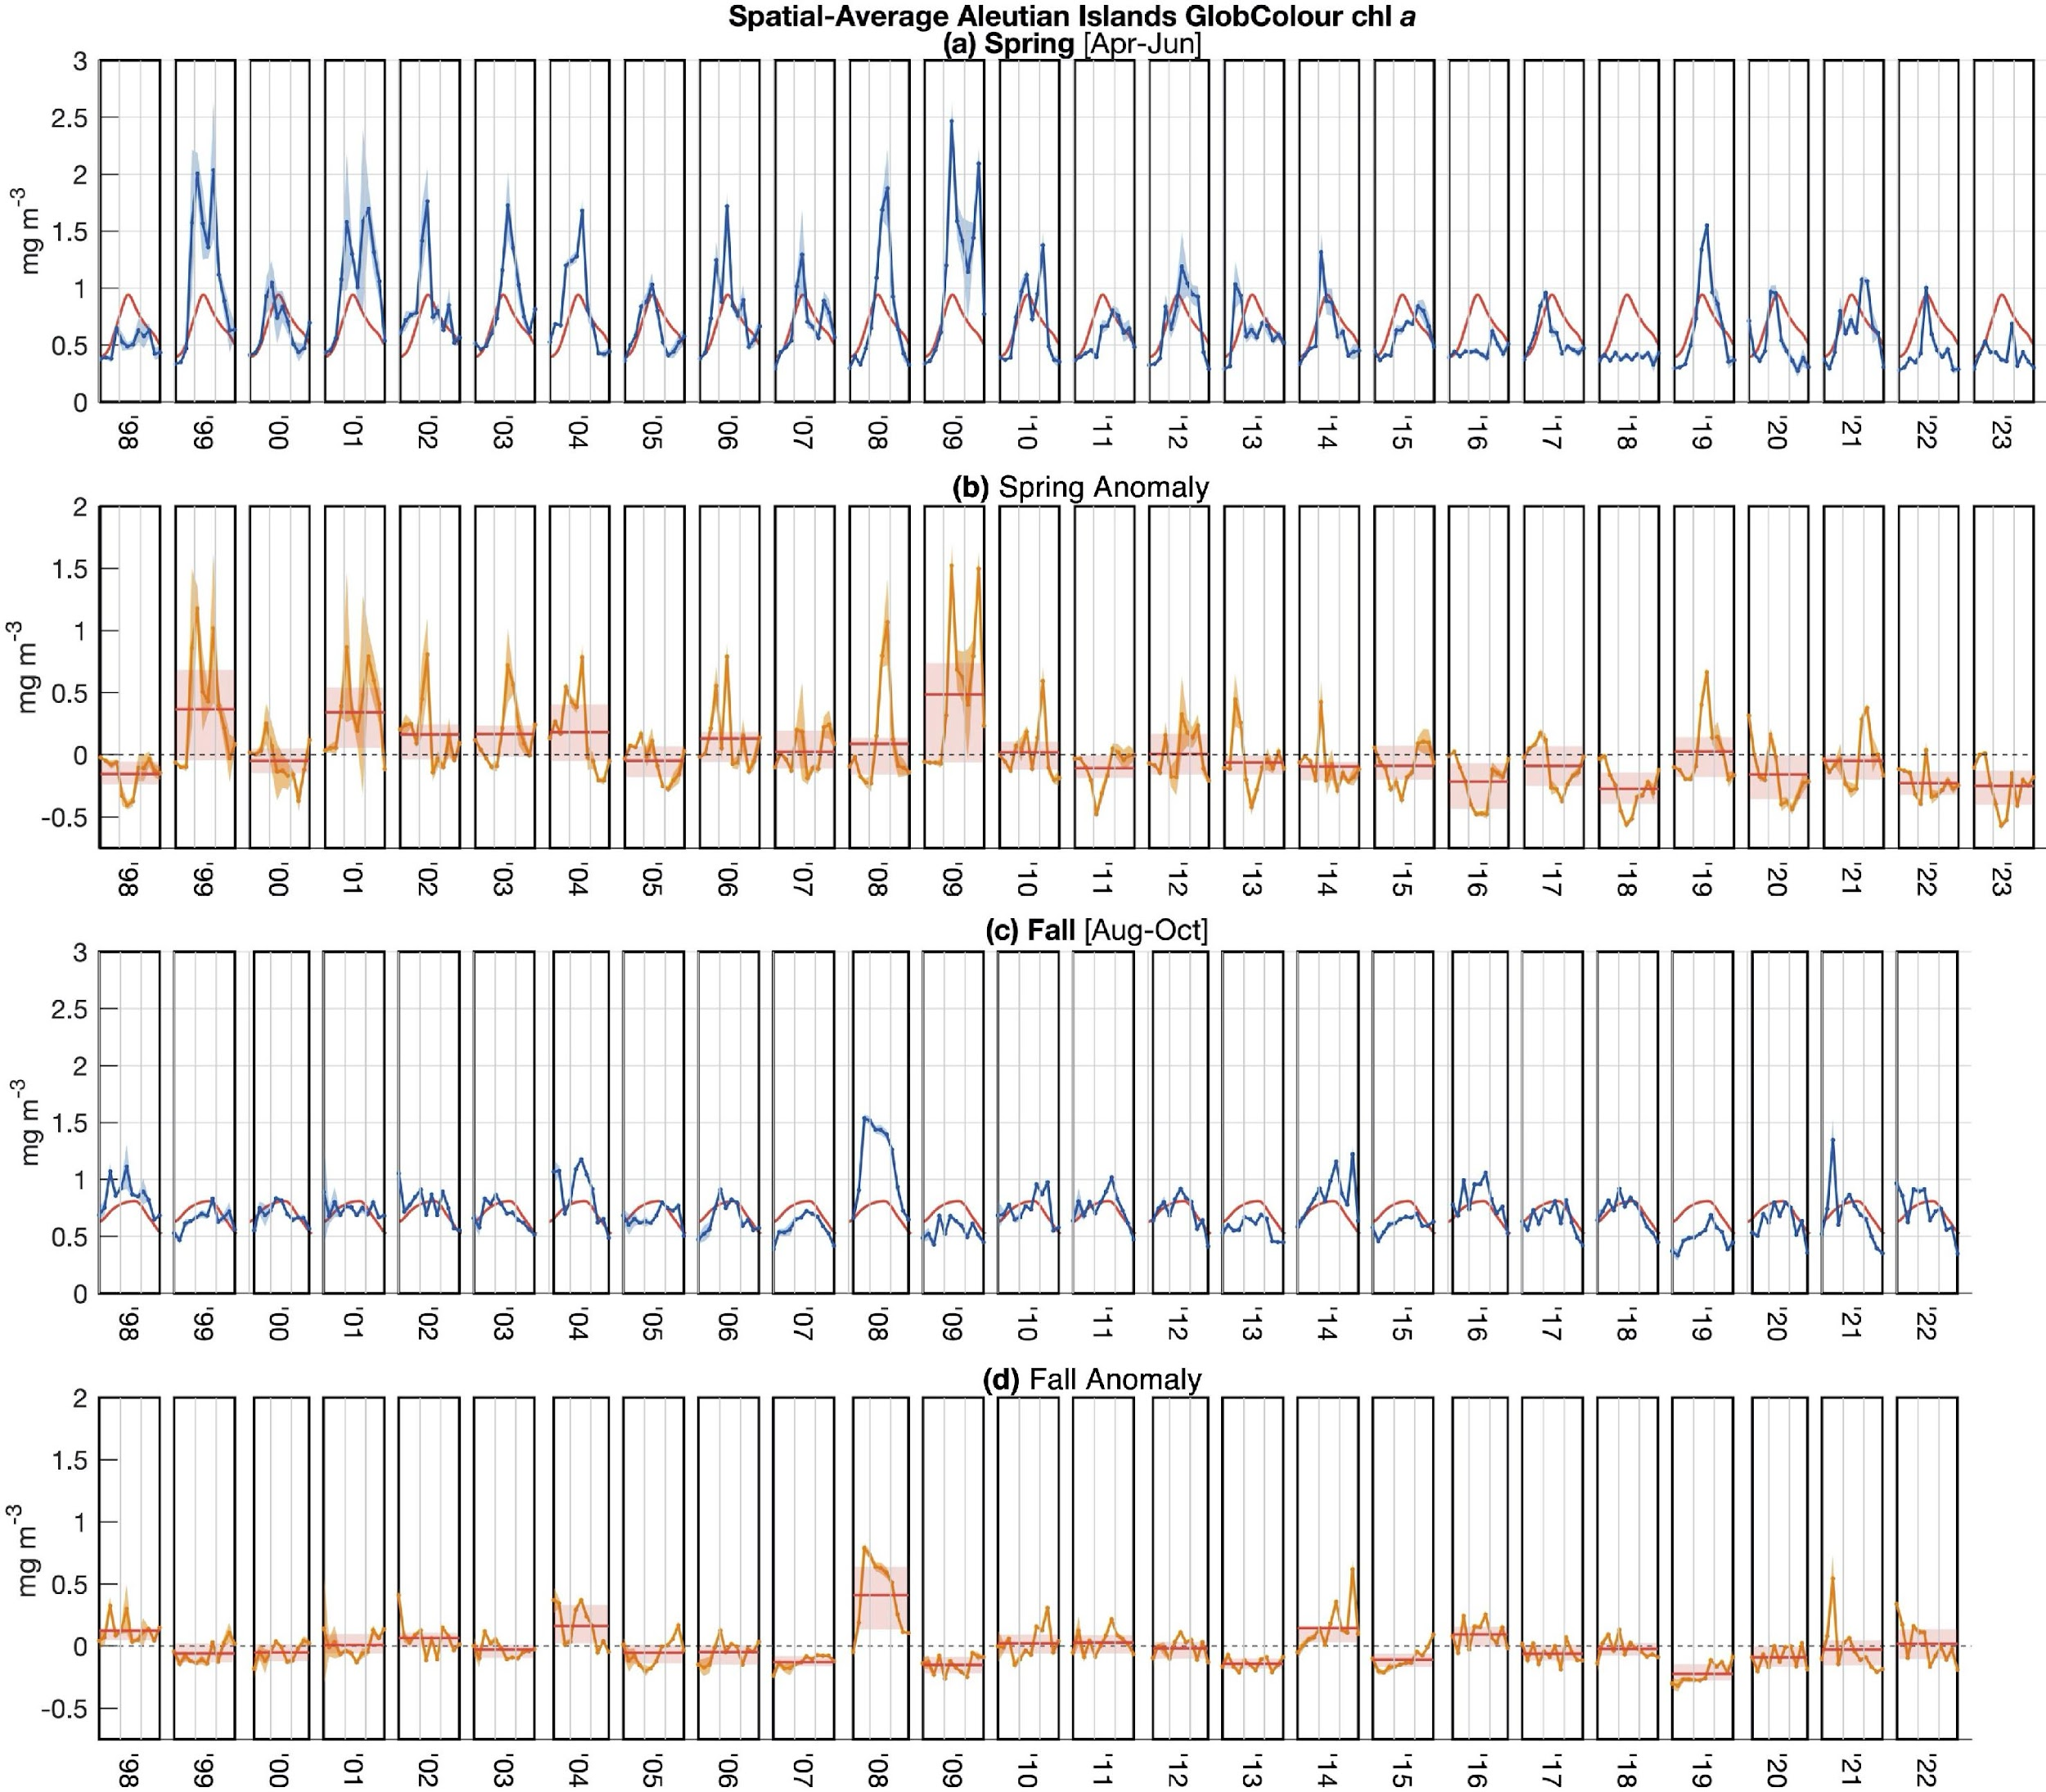
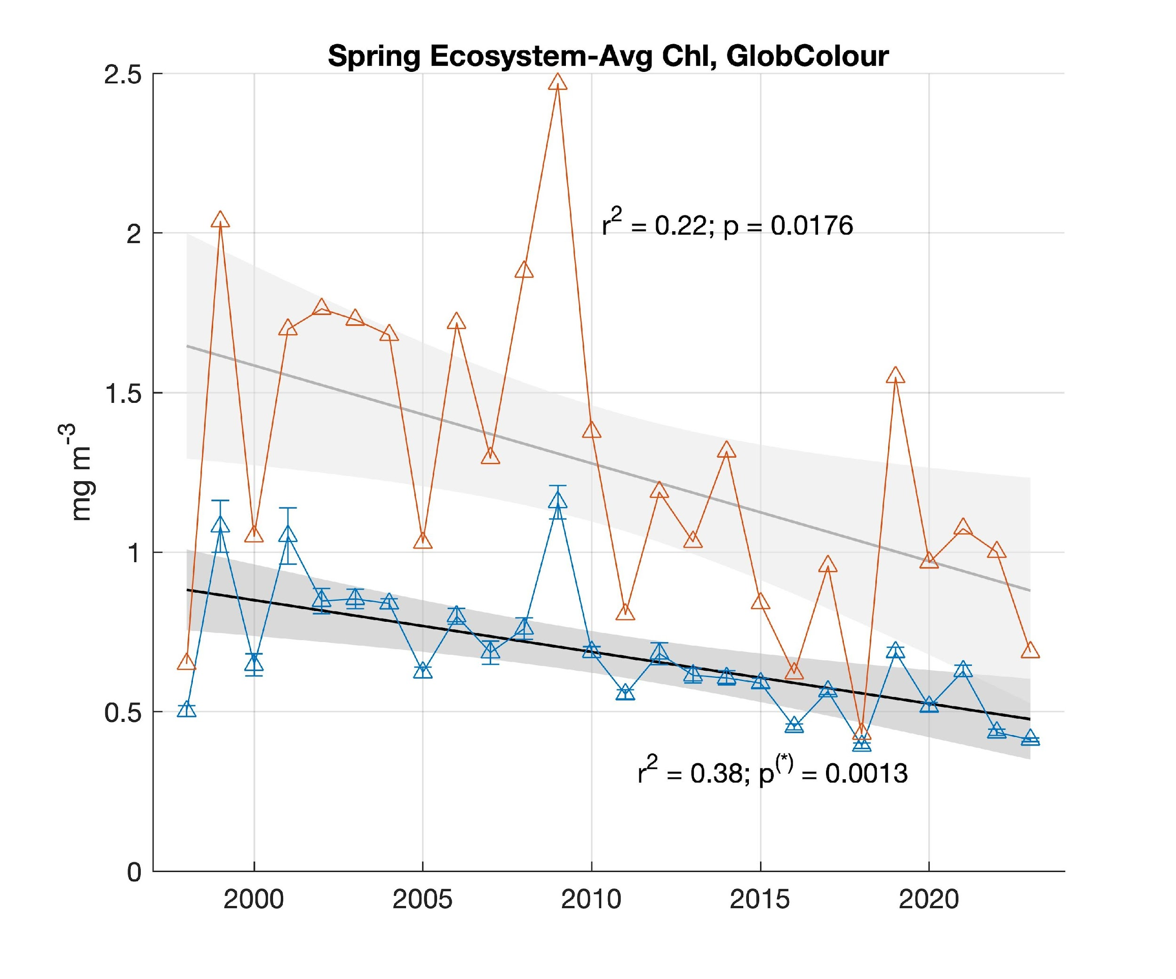
Cheng, Pelland Oceanography
Spring - Average Aleutian Islands Globcoulor chla a by year (Spring Apr-Jun)
Satellite chl-a
Satellite chl-a, spring (Apr-Jun) phytoplankton biomass lower than 1998-2022 spring average
Evidence for a negative trend in spring AI chl-a across the GlobColour time series
Low chl-a also in the adjacent off-shelf areas of EBS, shelf areas of GOA in recent years
Note ratio of small to large phytoplankton fluctuates (next slide)
Spring Anomaly
Year
Spring Ecosystem- Average Chla, GlobColour
r²=0.22; p=0.0176
r²=0.38; p*=0.0013

Slide 11
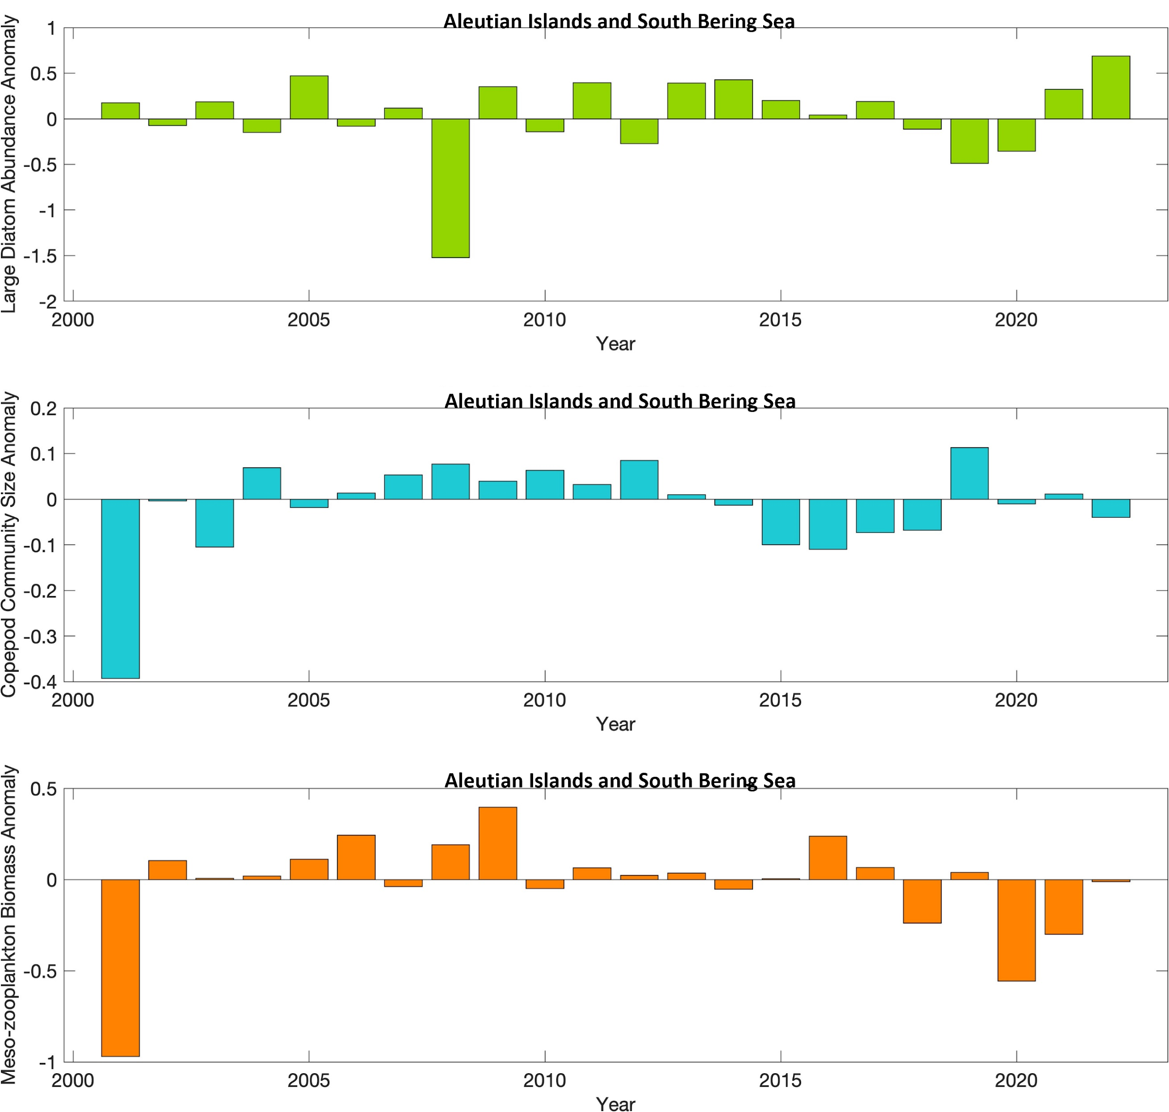
Bond and Ostle & Batten Zooplankton
Continuous plankton recorder
Large diatom biomass in 2022: higher than 2000-2021 average
Smaller size and lower meso-zooplankton biomass than 2000-2021 average in 2022
Large diatoms
Copepod community size
Meso-zooplankton biomass

Slide 12
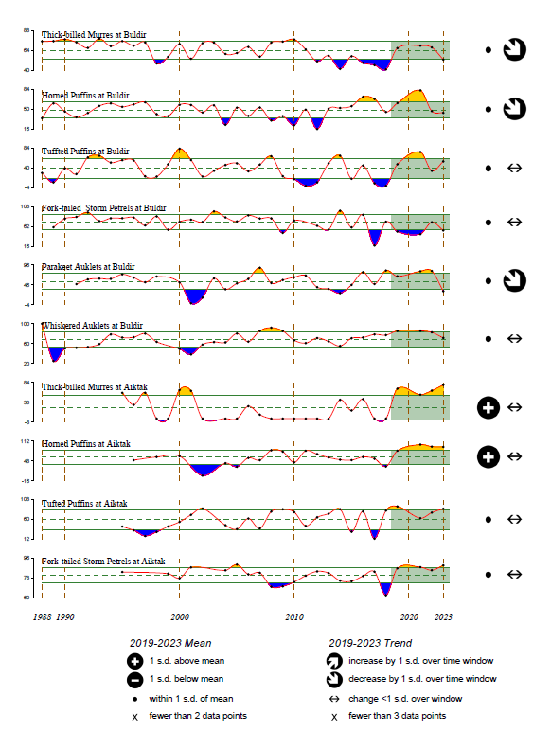
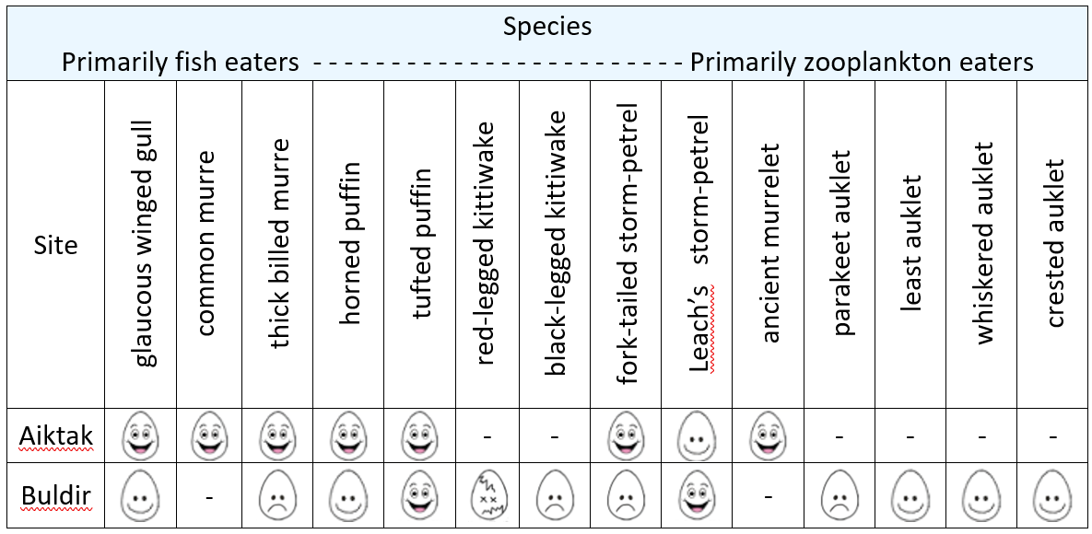
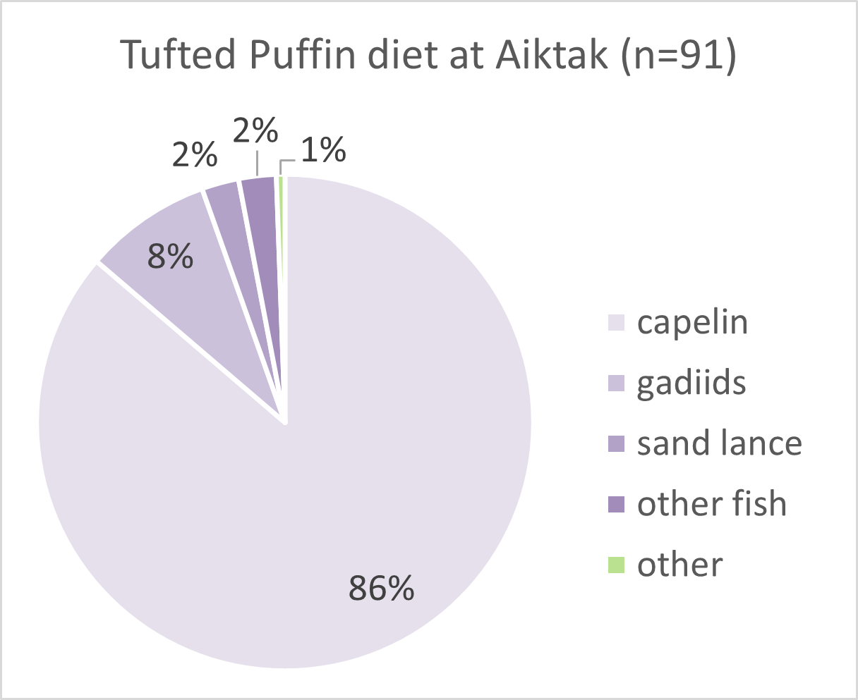
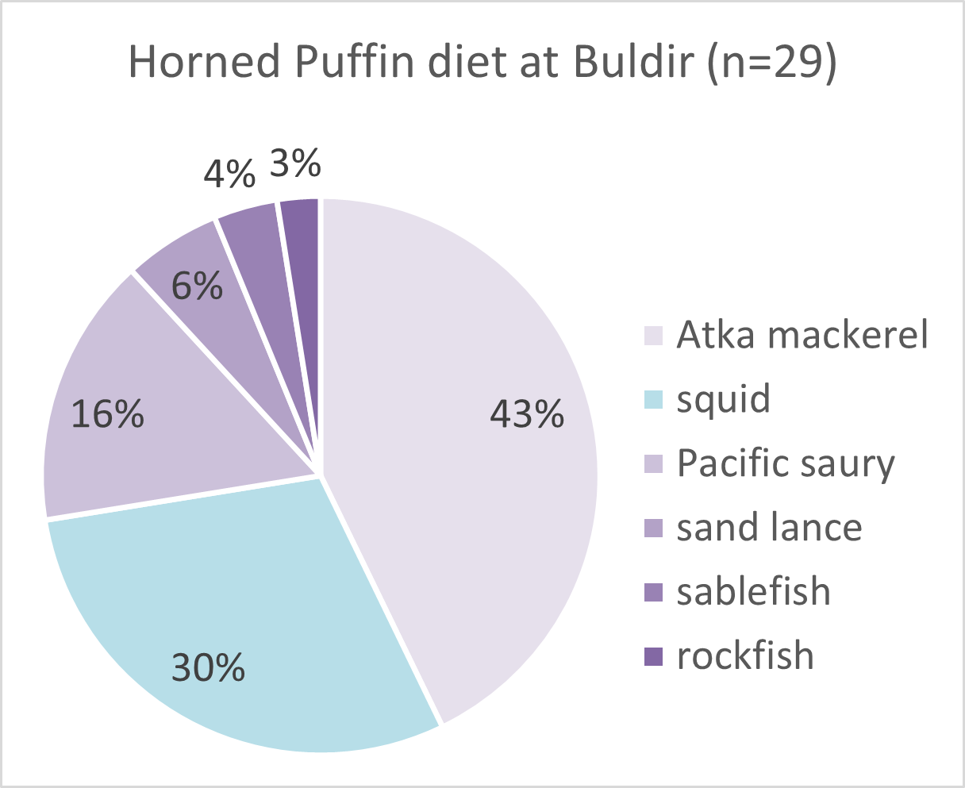
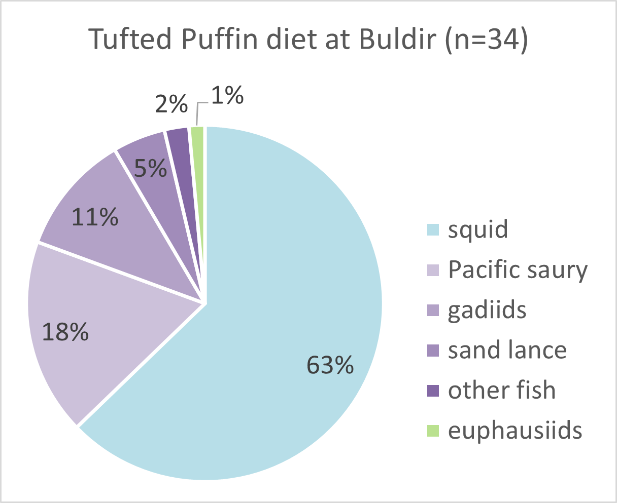
Rojek et al. Seabirds
Seabird Reproductive Success
Average or above for EAI seabirds: good foraging conditions in summer for plankton and fish foragers in EAI; mixed in WAI
Western Aleutians
above
average
EAI
WAI
Seabird Diets
Mostly capelin in the EAI 86% in tufted puffin chick diets
Fish and squid in WAI: 63% squid in in tufted puffin chick diets
Atka mackerel 43% of diet of horned puffins
Eastern Aleutians

Slide 13
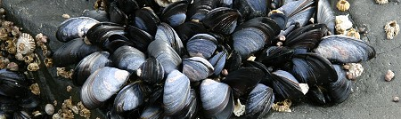
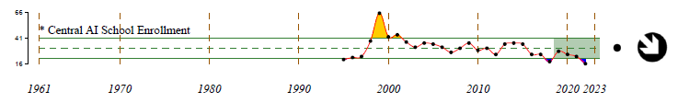
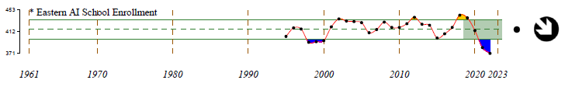
Farrugia et al., Ortiz HABs and school enrollment
Harmful Algal Blooms
Maximum PST recorded in June 15: 3.7x above level considered potentially fatal in humans; 47x above legal limit
Seabirds (shearwaters) planned to be tested for HABs after over 150 carcasses were reported in Akutan in mid-September; 6 samples tested negative for Highly Pathogenic Avian Influenza
School enrollment
  Decreased school enrollment in 2022-23
      Central Aleutians: decrease driven by Adak School
      Eastern Aleutians: decrease driven by Unalaska elementary & high school
Lower enrollment decreases the stability of the community.
Enrollment bottomed out in AK in 2021-22 and has not recovered in the Aleutians.

Slide 14
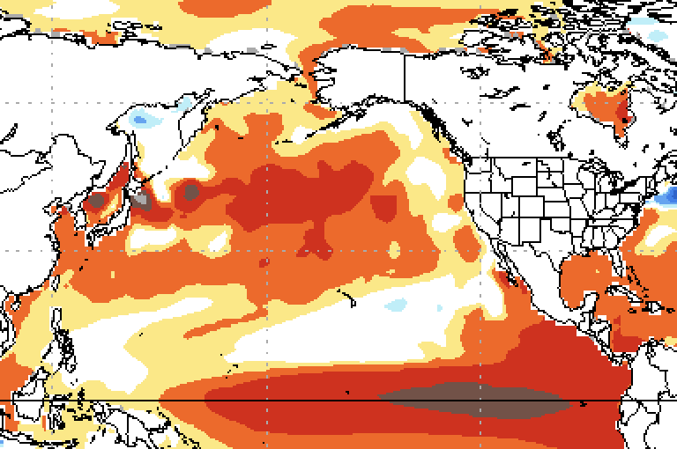
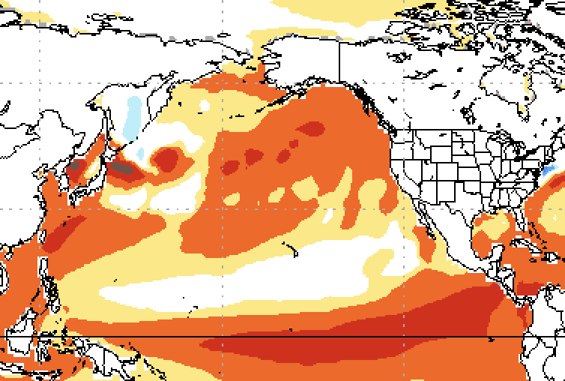
National Multi-Model Ensemble Forecast 2024
62% chance of El Niño during April – June 2024,
Climate prediction center, NOAA https://www.cpc.ncep.noaa.gov/products/analysis_monitoring/enso_advisory/ensodisc.shtml
Warm conditions for western Aleutians (NMME, Bond) for January - March
Ensemble indicates conditions should not be extreme relative to the past 20-30 years
Sea ice should extend south of 60°N perhaps all the way to M2, and as far south as Bristol Bay along the coast
Sea surface anomalies from National Multi-Model Ensemble
January - March
March - May

Slide 15
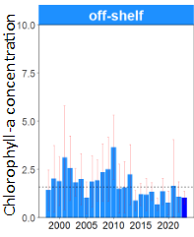
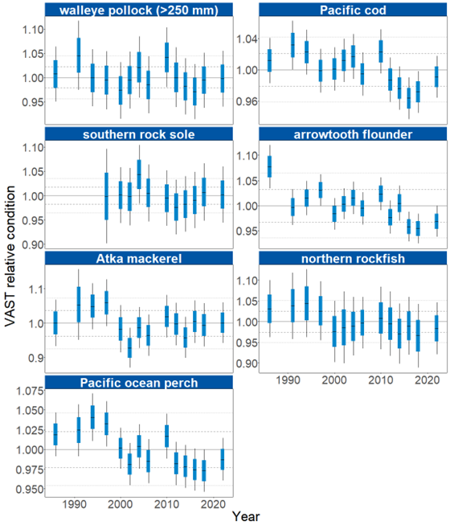
Persistent warm conditions: wide range of effects Multi-year patterns
Satellite chl-a & Copepods
Temperature and Fish Condition
Satellite chl-a, Diatoms & Copepods
Satellite-derived chl-a reverted to generally lower than average since 2014.
Satellite chl-a in EBS off-shelf also decreasing since 2014
Smaller copepods
Lower meso-zooplankton biomass
Temperature and Fish Conditions
Warmer temperatures
Condition factor average or below average since 2014
Higher energetic costs, increased food consumption

Slide 16
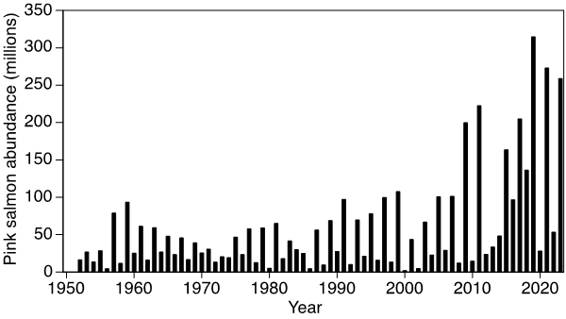
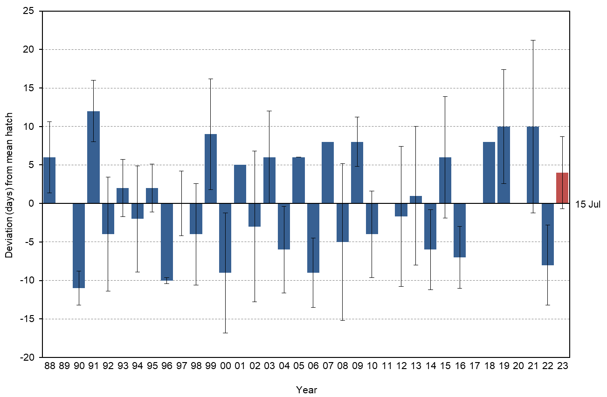
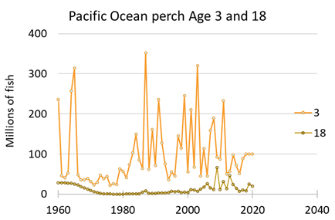
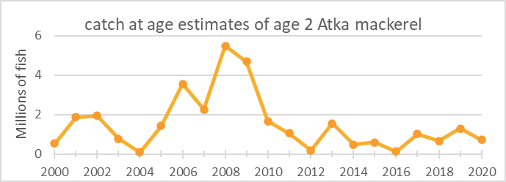
Eastern Kamchatka pink salmon in odd years Multi-year patterns
Eastern Kamchatka pink salmon
Continued high level for a low abundance year
Biennial pattern at several trophic levels from diverse sources
No statistical analysis has been conducted
Potential thresholds: 2009 for high abundance years
Tufted puffin hatch date anomaly at Buldir, Rokek et al.
no effect on reproductive success
Spring (Apr-Jun) satellite chla anomaly GlobColour, Pelland
Lowe et al. 2021
Spencer et al. 2020

Slide 17
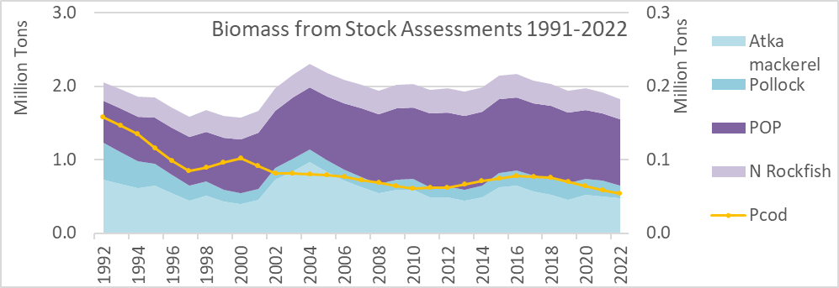
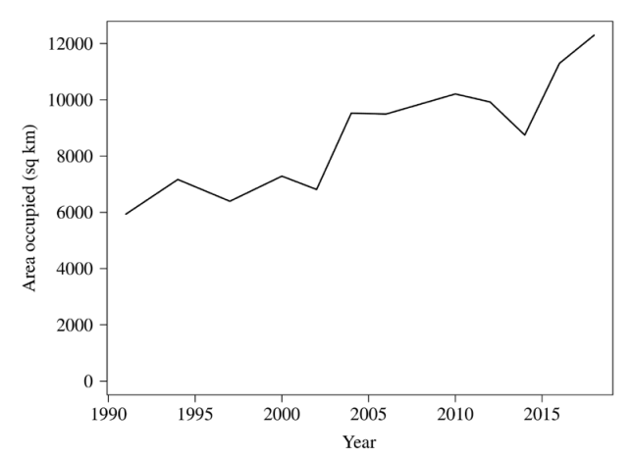
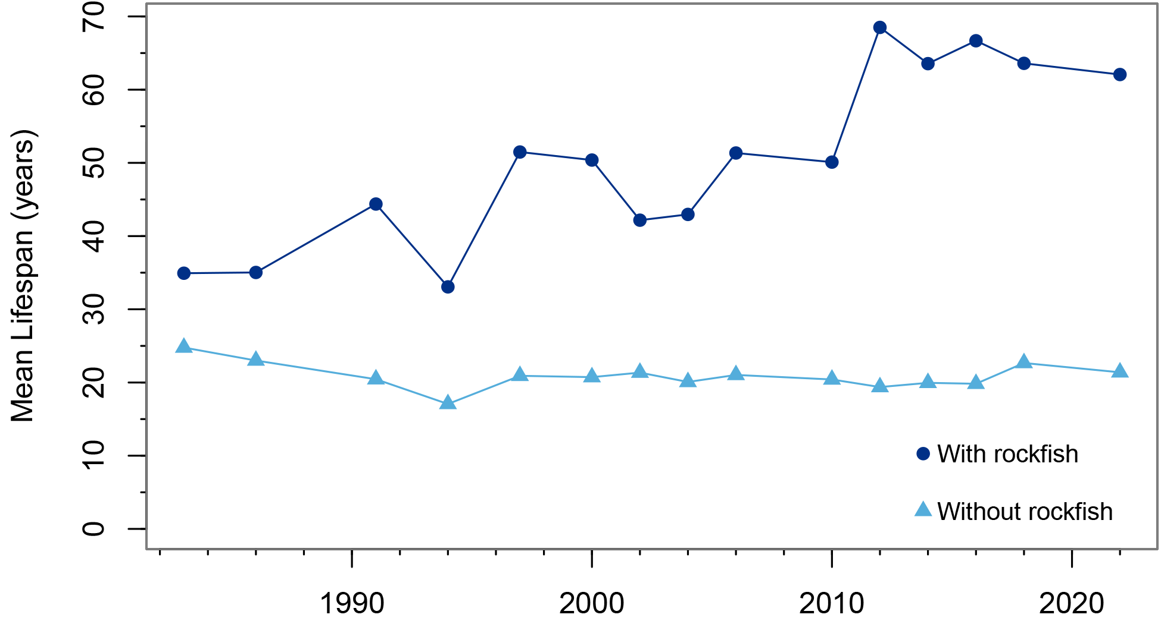
POP and Northern Rockfish as main pelagic foragers Multi-year patterns
Increased competition with other fish feeding on zooplankton, changes in cod diet may be due to decreasing Atka mackerel
POP expanding area occupied
Longer mean lifespan of groundfish community (35 to 60 years) means a slower turnover rate & dampened effects of environmental variability (increased ecological stability)
Spatial competition with Atka mackerel, pollock?
Area occupied by POP
Mean lifespan of groundfish community
Spencer et al., 2020
Whitehouse and Lang

Slide 18


Summary and implications
Jan – Mar warmest winter on record, sustained warmer temperatures and large-scale changes in SST
Potential concern for higher bioenergetic costs, changes in phenology (timing and success of egg development, growth rates,
and utility of past indicators (e.g. PDO may not be as useful in the future)
Lower than average phytoplankton biomass (sat chl-a) and small copepod size
Decreased primary production/ lower availability of large copepods as prey, despite favorable climatological conditions for zooplankton
Seabird reproductive success above average in EAI for plankton and fish-eating seabirds; mixed for WAI
Indicates potential availability of prey and good foraging conditions for both plankton and fish eating groundfish in EAI,
but mixed availability in prey in WAI
HABs increased to 47x FDA limit in June
Indicates potential seasonal risk to human health and risk to predators in the ecosystem
Pacific cod diets
Decreased availability of fish in diets, available prey of lower quality and/ or increased bioenergetic costs and consumption.
Rockfish dominance of pelagic forage fish biomass
Potential for increased competition for zooplankton and decreasing availability of Atka mackerel and pollock as prey for fish and
marine mammals. Rockfish are long-lived and are not a preferred prey item, but may increase resilience of ecosystem
Increasing Eastern Kamchatka pink salmon during both low abundance and high abundance years
Potential biennial pattern cascading to fish and combined with increased temperatures since 2014.
Eastern Kamchatka pink salmon export energy from the system
The persistent warm conditions + rockfish dominance + increasing pink salmon abundance
jointly might indicate
transition of the ecosystem to a state where rockfish and pink salmon are the main pathway of zooplankton into food web

Slide 19

Additional Information Available
Ecosystem Status Reports through 2022 are available here:
ESR Reports (1999-2022)
Notes:
All info and reports available on line

