Slide 1
Considerations for Chionoecetes Reference Points
Martin Dorn
May 18, 2022
Crab Plan Team meeting

Slide 2
Reference points and proxies in the NPFMC tier system (adopted in 2007, in Amendment 24 of FMP)
FOFL — the instantaneous fishing mortality (F) from the directed fishery that is used in the calculation of the overfishing limit (OFL). FOFL is determined as a function of:
FMSY — the instantaneous F that will produce MSY at the MSY-producing
biomass
A proxy of FMSY may be used; e.g., Fx%, the instantaneous F that results
in x% of the equilibrium spawning per recruit relative to the unfished
value
B — a measure of the productive capacity of the stock, such as spawning
biomass or fertilized egg production.
A proxy of B may be used; e.g., mature male biomass
BMSY — the value of B at the MSY-producing level
A proxy of BMSY may be used; e.g., mature male biomass at the MSY-
producing level

Slide 3
The fishing mortality rate of F35%, and biomass reference point of B35% are key elements of harvest control rules for tier 3 crab stocks

Slide 4
Key features of Chionoecetes life history
Molt annually (or close to annually) as juveniles
Both snow crab and Tanner crab undergo a terminal molt to maturity, with changes to morphology.
(This feature is relatively uncommon in crustaceans but not unheard of, e.g. female blue crab undergo a terminal molt to maturity)
Mating is usually associated with the terminal molt for females.
Mating occurs after individual male and female crab pair up.
Female crab are able to store sperm and may not need to be fertilized annually to reproduce.
Female fertilization rates can be evaluated directly during summer surveys by checking for the females for full and viable clutches

Slide 5
Key features of Chionoecetes life history (continued)
Both species of Chionoecetes in the North Pacific show strong sexual dimorphism, with males becoming much larger than females.
Sexual dimorphism occurs across many genera, but is not universal.
Larger male size very likely conveys an advantage in reproduction.
(Example: Elephant seals, where large male size increases the chances of success in direct competition between males for territories to establish a breeding harem.)
Is mate selection by females important for Chionoecetes?

Slide 6
Concerns about the appropriateness of F35% proxy
The F35% proxy for BMSY was based on groundfish life history (Clark 1991, 1996).
For groundfish the metric for reproductive output is female spawning biomass, but mature male biomass has been adopted for crab stocks.
Crab fisheries are male only.
Crab fisheries target the largest mature crab, and smaller but still mature crab are not selected by the fishery.
F35% can result in a very high fishing mortality rate (or no amount of fishing can reduce SPR to 35% of fished.)
Using undifferentiated MMB does not account for potential value for larger crab in the reproductive process.
F35% exerts strong selective pressure for a terminal molt at smaller size.

Slide 7
Possible approaches…
Switch to Tier 4, and set FMSY = M, BMSY = mean biomass over a specified time period.

Slide 8
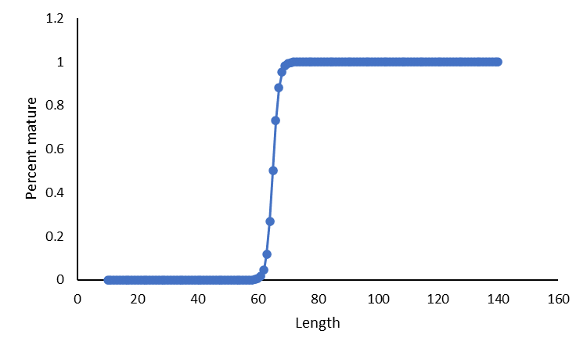
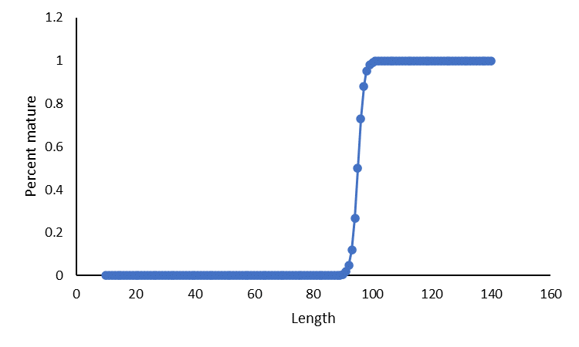
Possible approaches…
Switch from morphometric maturity to functional maturity.

Slide 9
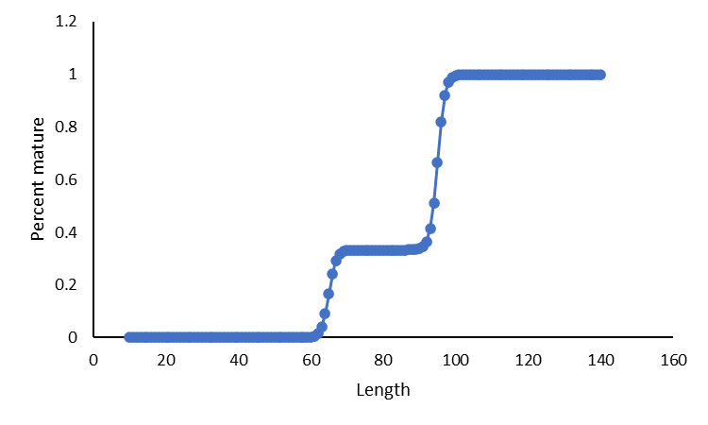
Possible approaches…
Use a stepped maturity schedule to give greater weight to large crab

Slide 10
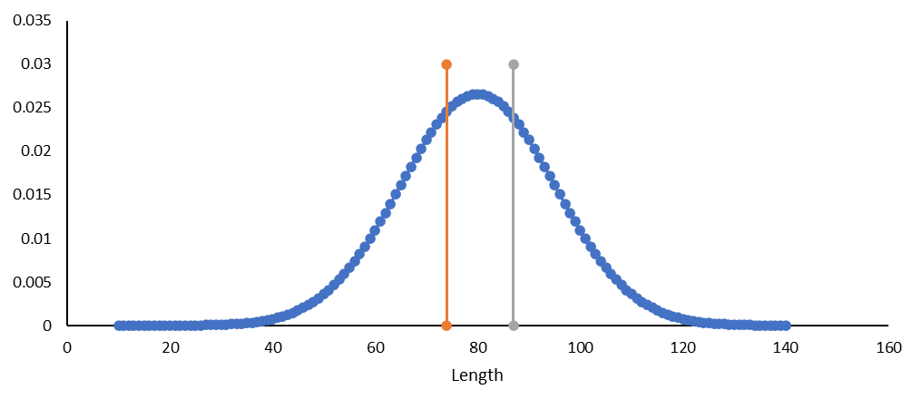
Possible approaches…
Partition unfished mature biomass size distribution into three equal categories, F35% is the fishing mortality that reduces MMB to no less than 35% of unfished for all categories.

Slide 11
Other?
Quantify selective pressure using reaction norms, compare fished and unfished populations…

