Slide 1

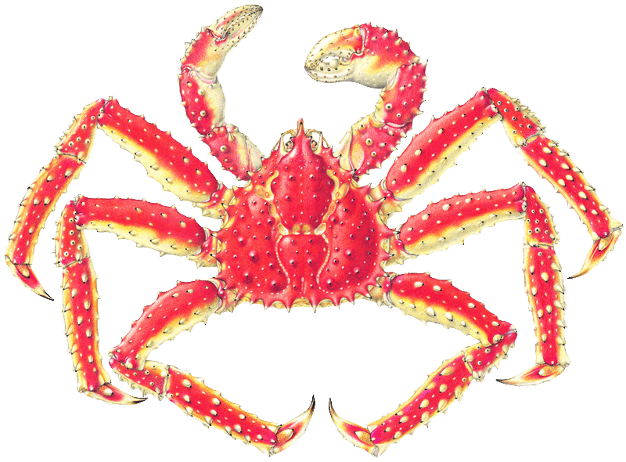
Bering Sea & Aleutian Islands (BSAI)
Crab Observer Program
Overview
Bo Whiteside
Alaska Department of Fish and Game
Westward Region
Crab Plan Team Meeting
Kodiak, AK
January 15, 2020

Slide 2
BSAI Catcher Vessel Crab Observer Coverage Levels¹
Fishery | Observer Coverage
Eastern Aleutian Islands golden king² | 50%
Western Aleutian Islands golden king² | 50%
St. Matthew Island blue king | 100%
Bristol Bay red king | 20%
Bering Sea snow | 30-100%
Bering Sea golden king | 100%
Western Bering Sea Tanner | 30-100%
Eastern Bering Sea Tanner | 30-100%
Grooved Tanner | 100%
Triangle Tanner | 100%
Scarlet king | 100%
¹Catcher processors are require to carry an observer for 100% of crab fishing activity.
²For catcher vessels in the Aleutian Islands golden king crab fisheries, a crab observer must be on board during harvest of 50% of the total weight harvested during each of three trimesters dated August 1 through October 31, November 1 through January 31, and February 1 through April 30 during each registration year.

Slide 3
Crab Observer Duty Priorities by Vessel Type
Catcher Vessel
 | Priority | Duty
Daily Duties | 1 | All reporting duties
 | 2 | Species composition
 | 3 | Miscellaneous duties
Offload Duties | 1 | Brailer weights
 | 2 | Deadloss weights
 | 3 | Size frequency sampling
 | 4 | Legal tally sampling
 | 5 | Miscellaneous duties
Catcher Processor
 | Priority | Duty
Daily Duties | 1 | All reporting duties
 | 2 | Average weights
 | 3 | Species composition
 | 4 | Size frequency sampling
 | 5 | Legal tally sampling
 | 6 | Miscellaneous duties

Slide 4
Observer Reporting Duties
Confidential Interview Daily and Summary Forms (CIF)
  Confidential Interview Forms (CIFs) serve as a daily chronological record of all fishing activity. A CIF data set is comprised of two forms based on a confidential interview between the vessel operator and an observer.
Catch Report Form
  Daily fishing and sampling effort numbers are recorded on the Catch Report Form
Deployment Logbook
  During briefing, observers are issued a Deployment Logbook to detail all observer sampling and vessel fishing activities.

Slide 5
Confidential Interview Form
Daily account of fishing activity, by statistical area and string of gear. Every day during a trip is accounted for, whether fishing occurred or not.

Slide 6
Confidential Interview Summary Form
Offload-specific information and summary of selected information from the DFL and/or CIF.

Slide 7
Catch Report Form
Catch Report Items
Number of Pots Lifted: Total number of pot lifts during a specified period.
Number of Crab Retained: Total number of target species crabs harvested.
Number of Pots Sampled: Number of pots sampled in a 24-hr day.
Average Weight (C/P and F/P only): Average weight of unprocessed crab to two decimal places. C/Ps record daily average weight in daily column and use weekly total from CIF Summary Form.
Sampling Condition Codes: Safety and Confidential Items

Slide 8
Observer Deployment Logbook
Table of Contents
Crab Observer Deployment Logbook Protocol
Briefing Notes
Vessel Safety Checklist
Vessel Diagram
Vessel Crew List
Photo Log
Evidence Collection Log
Lost/Found Crab Pot Log
Biological Specimen Collection Log
Sampling Protocol
Daily Entry Pages
Endangered Species Encounter Reporting Form
Tagged Crab Recovery Form and Instructions
Evidence Collection Checklist
Marine Mammal Mortality/Injury Reporting Form and Instructions

Slide 9
Species Composition Sampling
Species composition sampling is a pot-by-pot assessment of the animals caught in the fishery at a specific depth and location, and with a specific gear type.
  Measure Pots
  Count Pots

Slide 10
Species Composition Daily Sample Pot Quotas
 | Catcher Vessel |  | Catcher Processor
Fishery | Measure | Count | Measure | Count
Aleutian Islands golden king (East and West) | 7* | 0 | 4* | 0
Bristol Bay red king | 7* | 0 | 4* | 0
Bering Sea Tanner (East and West) | 3 | 3* | 2 | 2*
Bering Sea snow | 1 | 3* | 1 | 2*
St. Matthew Island blue king | 10 | 0 | 7 | 0
Pribilof Islands golden king | 10* | 0 | - | -
*Two Chela Height Sample pots will be completed per week. These will replace 2 Species Composition Sample pots.

Slide 11
Species Composition Sampling:
Measure Pots
Observers will:
• Identify, count, and sort all species.
• Measure biological and legal sizes of all commercially important species
• Determine sex of all commercially important crabs.
• Assess shell condition for commercially important crabs.
• Document parasites, diseases, and fresh injuries.
• Count all other species.
• Corals and sponges – “1” will be recorded, by species, to indicate presence in the pot.

Slide 12
Crab and Fish Measurement Form

Slide 13
Species Composition Sampling:
Count Pots
Observers will:
• Identify, count, and sort all species.
• Determine sex for all commercially important crabs.
• Measure legal size of all commercially important species.

Slide 14
Species Composition Forms

Slide 15
Species Composition Forms cont.

Slide 16
Miscellaneous Duties
Chela Height Sampling
Tagged Crab Recovery
Chionoecetes spp. Black Eye Condition
Marine Mammal & Seabird Interactions
Incidental Blue King Crab Reporting

Slide 17
Chela Height Sampling
Objective: to collect carapace size and chela height measurements from male bairdi, opilio, and golden king crabs to estimate the proportion of commercial harvest and bycatch crabs that have undergone the terminal molt to morphometric maturity.
Observers will measure chela heights and carapace size to the nearest tenth (0.1) of a millimeter (mm).

Slide 18
Tagged Crab Recovery
This duty is performed as needed by observers on all vessels in any fishery.
Objective: to record information from recovered tagged crabs to estimate the fishing mortality of legal-size male crabs and enhance existing information on the distribution, growth, maturity, migration patterns, and survivorship of populations of crab species.

Slide 19
Chionoecetes spp. Black Eye Disease Condition

Slide 20
Marine Mammal & Seabird Interactions

Slide 21
Seasonal Timeline
Annual meeting – Dutch Harbor,
April
Program updates (sampling protocols, manuals, data forms, etc.),
May-July**
AIGKC data collection begins,
August
BBRKC, bairdi data collection begins,
October-December
Observer training, opilio data collection begins,
January
*
Observer training,
September
*Data collection requests due
**Debriefing staff on seasonal leave

Slide 22
Data Collection Requests
Challenges:
Time sensitive based on seasonal timeline
Complexity of observer sampling duties are limited by:
  low season to season observer retention
    most data collection is performed by new observers
  time on deck
  staff and training resources

Slide 23
Questions?

