Slide 1
Aleutian Islands Golden King Crab Model Scenarios for May 2020 Assessment
M.S.M. Siddeek^{1,} J. Zheng¹, C. Siddon¹, B. Daly², M.J. Westphal³, and L. Hulbert¹
Alaska Department of Fish and Game, Juneau¹, Kodiak², and Dutch Harbor³, Alaska
January 14, 2020, Kodiak Fisheries Research Center, Kodiak, AK

Slide 2
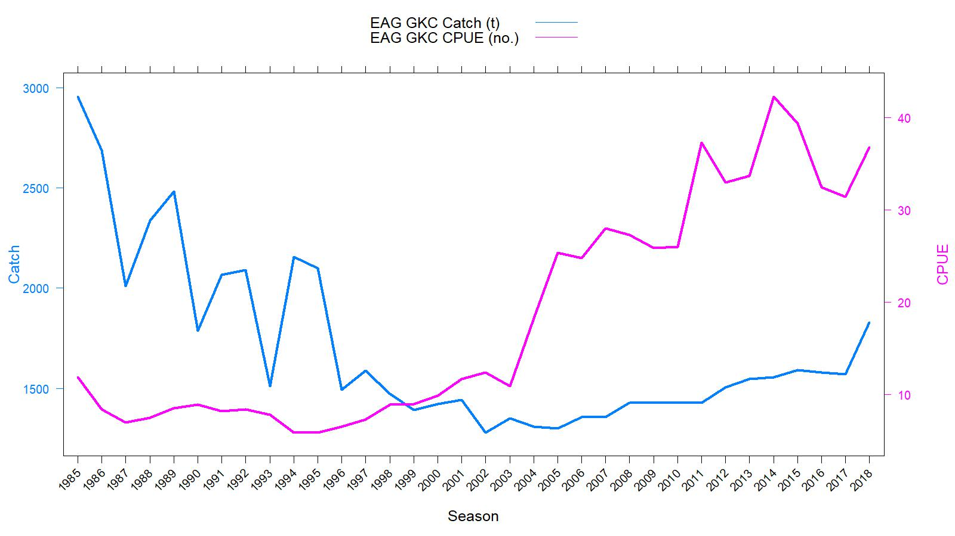
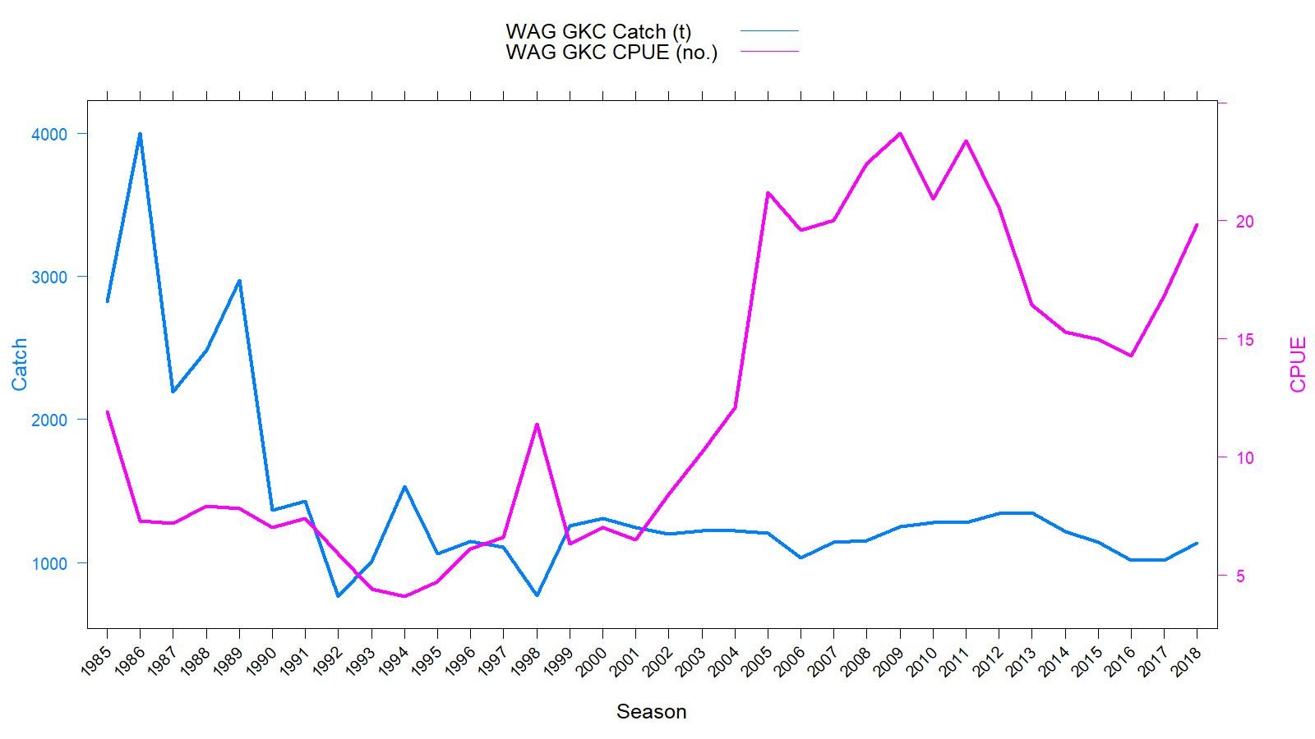
EAG
Catch (t) and CPUE
(number of crab per pot lift), 1985/86–2018/19
Rationalization
TAC
WAG
TACs :
2019/20:
(1) EAG: 4.310 million pounds
(2) WAG: 2.870 million pounds
gear/mesh modification

Slide 3
Topics
Responses to May 2019 CPT and June 2019 SSC comments
Model scenarios for May 2020 assessment consideration
Results

Slide 4
Length based modeling approach
Integrated male-only length-based models fitted to fishery dependent catch and CPUE data.
Constant M of 0.21yr⁻¹.
Projected the abundance from unfished equilibrium in 1960 to initialize the 1985 abundance.
7 scenarios for EAG and 6 scenarios WAG.
Various maturity models for MMB calculation.
Francis re-weighting method for Stage-2 effective sample sizes calculation for all scenarios.

Slide 5
May 2019 CPT (selected) comments
Comment 2: Additional development is needed for fishery CPUE standardization, including further development in year-area interactions, focusing on estimating fishing footprints for each 30X30 block as area weights.
Response:
We followed Campbell’s (2004) approach to address Year:Area interaction for CPUE standardization. Observer sampling locations over the years were used to create finer 1.0 X 1.0 nmi mesh with 10 larger blocks identifying AIGKC distribution patches. Models 19.2, 19.2a, 19.2b, 19.2ba, 19.2c, and 19.2ca considered Year:Area interaction (Appendix A).
.

Slide 6
May 2019 CPT comments continued
Comment 3: Additional work is needed to obtain an index using the cooperative pot survey data for use in the EAG assessment model. Before the survey data can be used in the model, analyze the survey length composition data to check for cohort progress over time to support recent high recruitment estimates for EAG.
Response:
Completed 2015/16, 2016/17, 2017/18, 2018/19, and 2019/20 surveys in EAG. Extended the survey to WAG in 2018/19 and 2019/20. We provide the survey length composition plots to support recent high recruitment estimate for EAG:

Slide 7
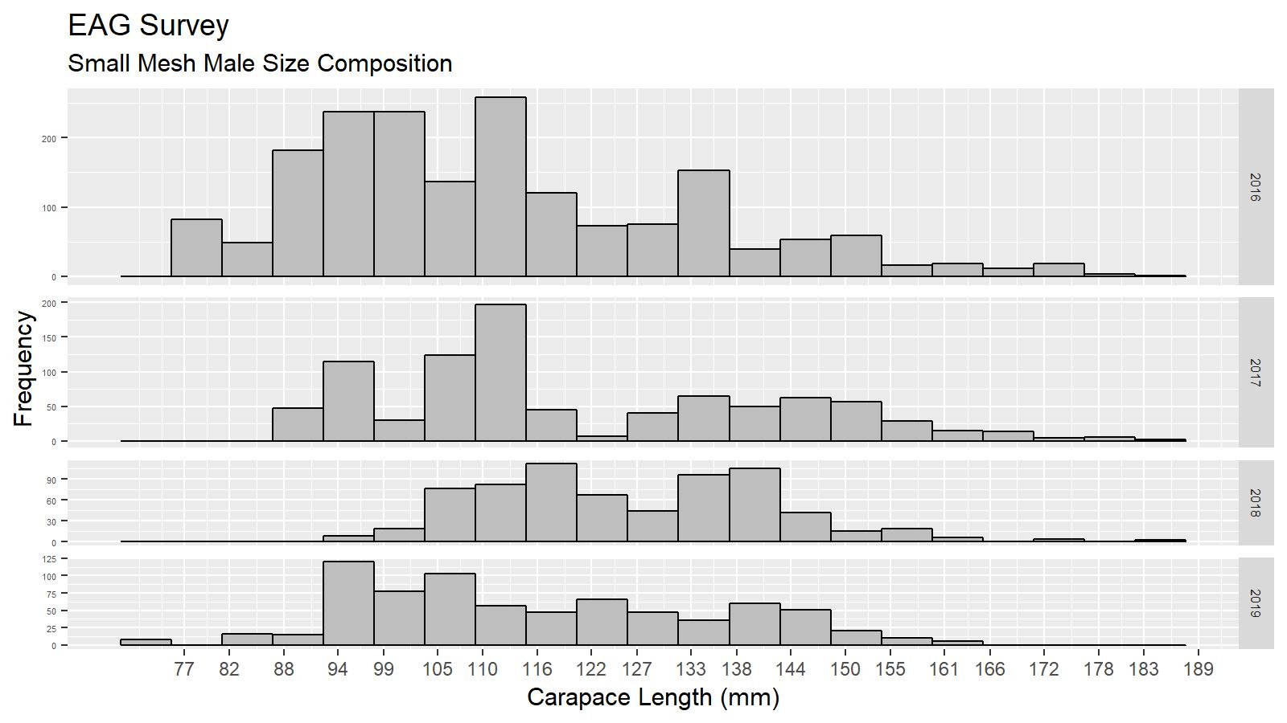
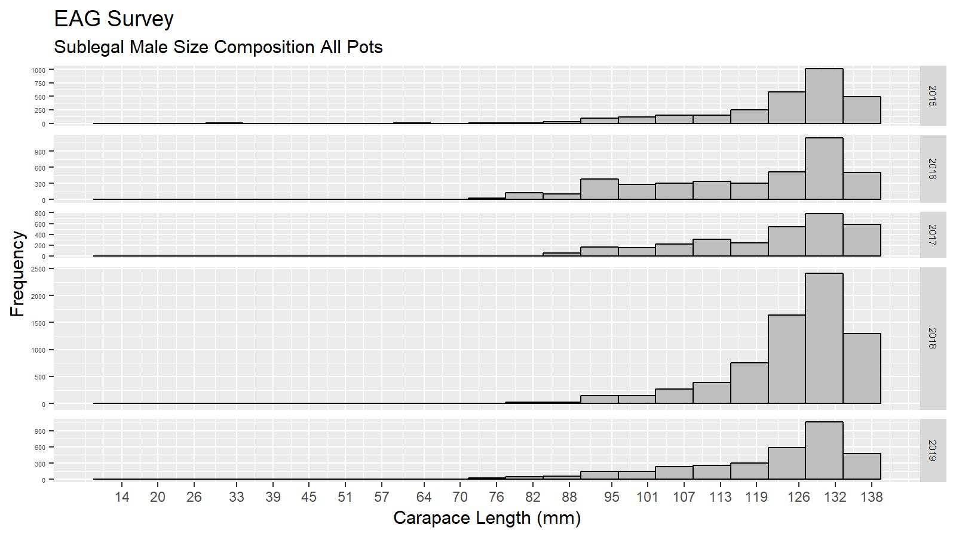
May 2019 CPT comments continued
Figure Intro2. Male size composition from the small mesh size pots deployed in the cooperative survey during 2016 to 2019 in EAG.
Figure Intro3. Sublegal male size composition from king crab pots deployed in the cooperative survey during 2015 – 2019 in EAG.

Slide 8
May 2019 CPT comments continued
Comment 4: The chela measurement data should be reanalyzed using recently collected fishery and survey data to better estimate the maturity of AIGKC.
Response:
We analyzed the chela height data collected during the 2018/19 fishing season from retained catch, observer, and cooperative survey samplings. We used the Bent-Point and Cut-Line approaches to determine maturity proportions by size and fitted logistic maturity curves (Appendix B).
Comment 5:
The bias of retrospective estimates for EAG needs to be checked and investigated for any model misspecifications.
We removed some early years’ (1985–1987) retained size compositions and some terminal years (2015–2018) retained and total catches and size compositions, and then performed the retrospective analysis. Retrospective pattern disappeared (Figure Intro4):

Slide 9
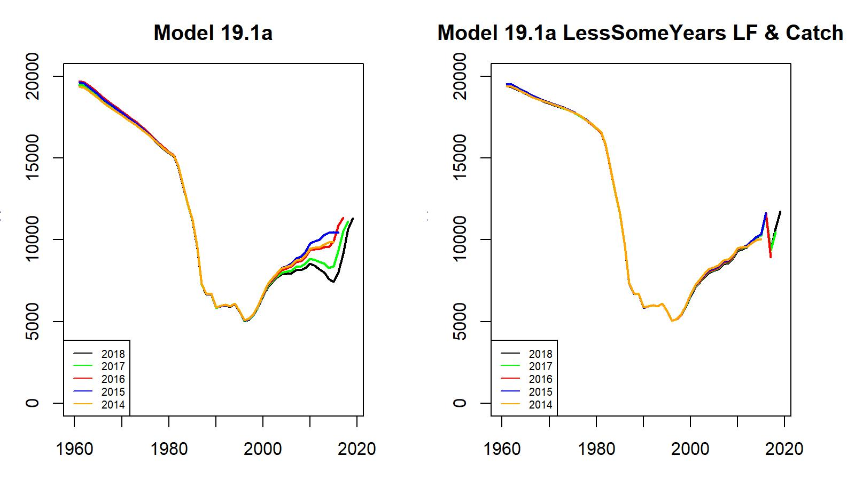
May 2019 CPT comments continued
Figure Intro4. Comparison of retrospective patterns of Model 19.1a (left) status quo fit and 19.1a (right) fit after removing 1985–1987 retained size compositions and 2015–2018 retained and total catches and size compositions, EAG.

Slide 10
May 2019 CPT comments continued
Comment 6:
Uncertainty of recruitment estimates in the terminal years should be assessed in each assessment to determine how many years of recruitment estimates in the terminal years should be excluded for B35% estimation. The range of years to be used to estimate B35% should not be considered fixed
Response:
We compared the standard deviations of Rec_Dev with a fixed proportion (0.7) of Sigma_R and considered the time periods during which standard deviations were below 0.7SigmaR (Figure Intro1). The updated time periods are: 1985–2016 for EAG and 1987–2016 for WAG.

Slide 11
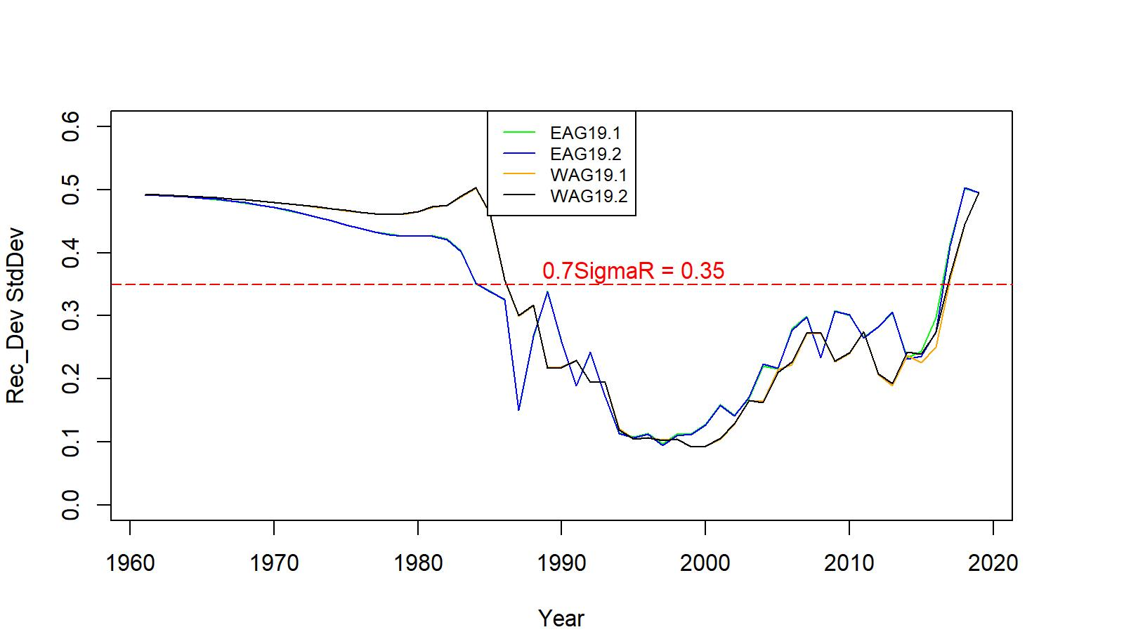
May 2019 CPT comments continued
Figure Intro1. Standard deviation of recruit_dev plot for models 19.1 and 19.2 for EAG and WAG. The mean recruit for years with standard deviation less than 0.7 Sigma R was used to initialize models. Time periods 1985–2016 for EAG and 1987–2016 for WAG were selected for mean recruit estimation.

Slide 12
June 2019 SSC (selected) comments
Comment 1: The SSC reiterates its request for a brief description of the cooperative survey in the assessment document, including the area sampled, size composition, and a summary of trends in CPUE.
Response:
The survey design and activities were presented at the September 2019 CPT meeting which were reported in the CPT minutes to SSC. We are yet to include the description of the survey design in the assessment report because it continues to evolve. However, we present the preliminary results of size compositions (Figure Intro5) and CPUE indices (Tables A.4 and A.5 in Appendix A) from the cooperative surveys.
.

Slide 13
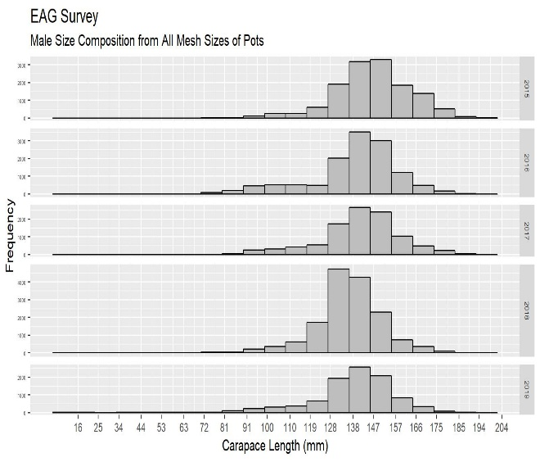
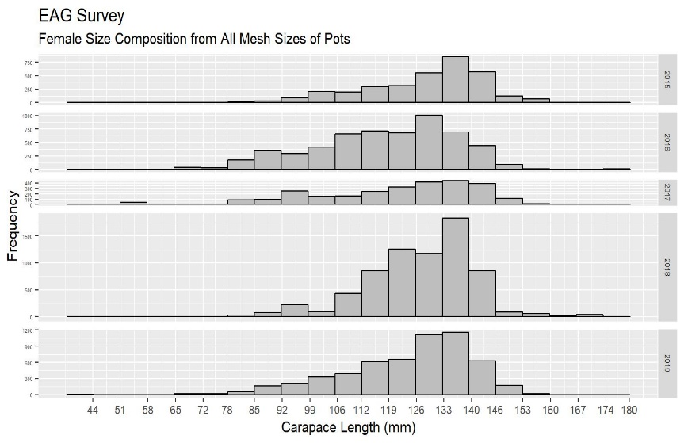
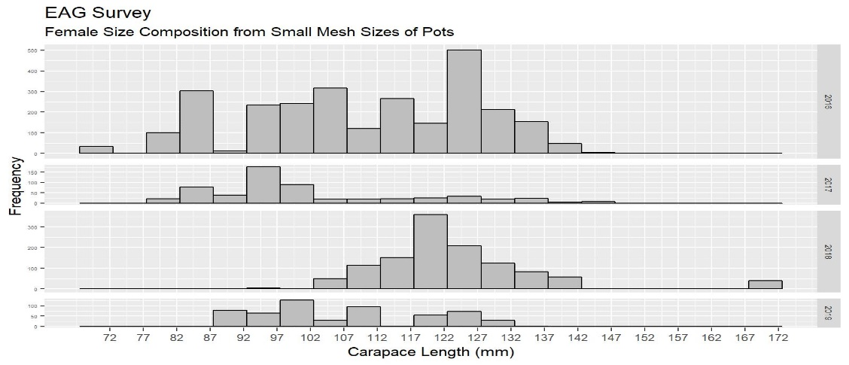
June 2019 SSC comments continued
Figure Intro5. Male (top left) and female (top right) size compositions from all mesh sizes of crab pots; and female (bottom) size composition from small mesh crab pots deployed in the cooperative survey during 2015–2019 in EAG. Bottom figure only covers 2016–2019 data.

Slide 14
June 2019 SSC comments continued
Comment 2: The SSC suggests the authors to continue to look for the source of large estimated recruitment in recent years (in EAG) and reiterates the request that the authors remove one data set at a time from the model as one way to potentially identify the source.
Response:
Please refer to our response to the CPT comment#3. We also investigated the sources of estimated recruitment pulses:
We removed terminal year retained and total catch biomasses and length compositions one-year-at a time until 2014 for model 19.1a. As a result, the 2015 to 2017 recruitment pulses disappeared (Figure Intro6).
.

Slide 15
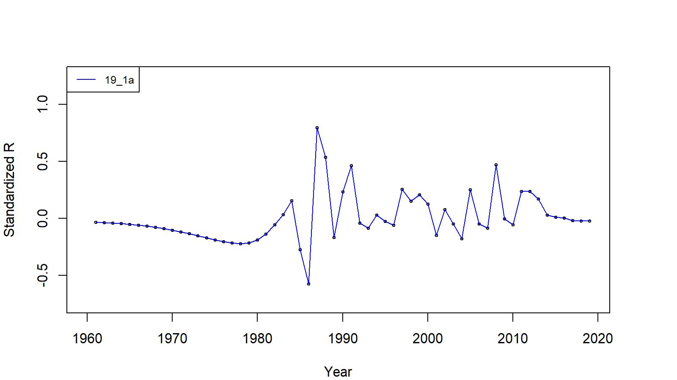
June 2019 SSC comments continued
Figure Intro6. Estimated number of male recruits (crab size ≥ 101 mm CL) for 19.1a model fit for EAG data, 1961–2019. The 2015 to 2018 retained and total catch biomasses and length compositions were removed for this fit. The number of recruits is standardized using (R-mean R)/mean R.

Slide 16
June 2019 SSC comments continued
Comment 3:
The SSC noted that the 30X30 nmi grid cell size appears rather large and may exaggerate the fishery footprint for Year:Area interaction analysis. The authors might consider the use of a smaller grid cell size, which may better represent the spatial distribution of the fishery footprint. Other geostatistical tools might be explored, as well. Perhaps data products and analyses from the recent EFH 5-yr review can be used to estimate the AIGKC fishery footprint (SSC listed several references in connection with this comment).
Response:
We identified fishing footprints at a finer scale 1 x 1nmi grids based on observer pot sampling locations in the 1995/96 to 2018/19 database. We grouped them into 10 large blocks for interaction analysis. The larger blocks are expected to reflect abundance patches in the entire AI. Models 19.2, 19.2a, 19.2b, 19.2ba, 19.2c, and 19.2ca considered Year:Area interaction for observer CPUE standardization (Appendix A).
.

Slide 17
Table A. EAG and WAG model scenarios
Model | CPUE Data Type |  | Maturity Analysis Method | Maturity Curve Type Used or MMB | Time Period for Mean Number of Recruit
19.1 (accepted model in May 2019) | Observer data from 1995/96–2018/19; Fish ticket data from 1985/86–1998/99. Observer CPUE standardization by negative binomial and Fish ticket by lognormal |  | Segmented regression on log(CH/CL) vs CL (EAG: 1991 data and WAG: 1984 data) for maturity determination | Knife-edge maturity 111 mm CL for EAG and WAG | 1987-2012
19.1a | 19.1+ |  | ditto | ditto | EAG:1985-2016; WAG:1987-2016
19.1b | 19.1a+ Fish ticket CPUE standardization by negative binomial |  | Segmented regression on log(CH/CL) vs CL (2018 combined data) for maturity determination | Logistic curve fitted to Segmented regression estimated maturity proportions | ditto
19.1ba | ditto |  | 25% below the fitted segmented regression line for maturity determination | ditto | ditto
19.1c | 19.1b+ |  | Cut-Line on ln(CH) vs. ln(CL) (2018 combined data) for maturity determination | Logistic curve fitted to Cut-Line estimated maturity proportions | ditto
19.1ca | ditto |  | 10% below the fitted Cut-Line for maturity determination | ditto | ditto
19.1d | 19.1c+ EAG 2015–2018 Cooperative Survey CPUE index |  | Cut-Line on ln(CH) vs. ln(CL) (2018 combined data) for maturity determination | ditto | EAG:1985-2016;

Slide 18
Table A. EAG and WAG model scenarios continued
19.2 | Year:Area interaction for observer CPUE standardization. Fish ticket CPUE standardization by lognormal | Segmented regression on log(CH/CL) vs CL (EAG: 1991 data and WAG: 1984 data) | Knife-edge maturity 111 mm CL for EAG and WAG | 1987-2012
19.2a | 19.2+ | ditto | ditto | EAG:1985-2016; WAG:1987-2016
19.2b | 19.2a+Fish ticket CPUE standardization by negative binomial | Segmented regression on log(CH/CL) vs CL (2018 combined data) for maturity determination | Logistic curve fitted to Segmented regression estimated maturity proportions | ditto
19.2ba | ditto | 25% below the fitted segmented regression line for maturity determination | ditto | ditto
19.2c | 19.2b+ | Cut-Line analysis on ln(CH) vs. ln(CL) (2018 combined data) for maturity determination | Logistic curve fitted to Cut-Line estimated maturity proportions | ditto
19.2ca | ditto | 10% below the fitted Cut-Line for maturity determination | ditto | ditto

Slide 19
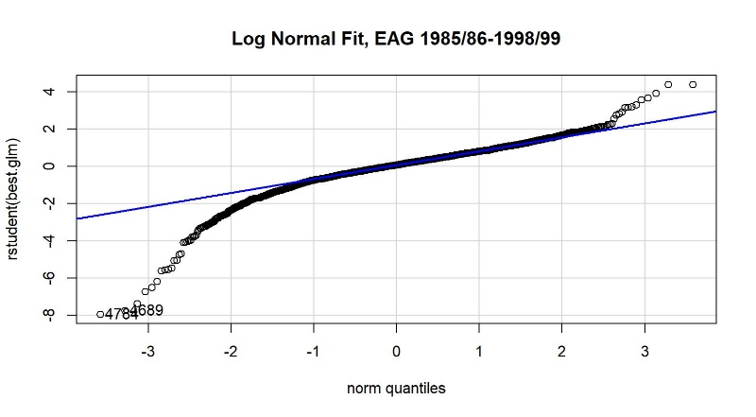
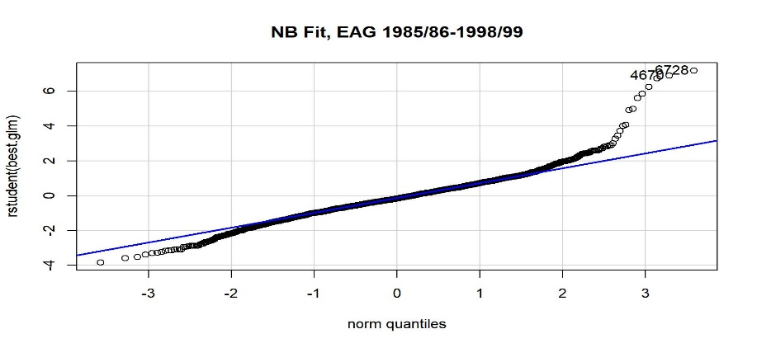
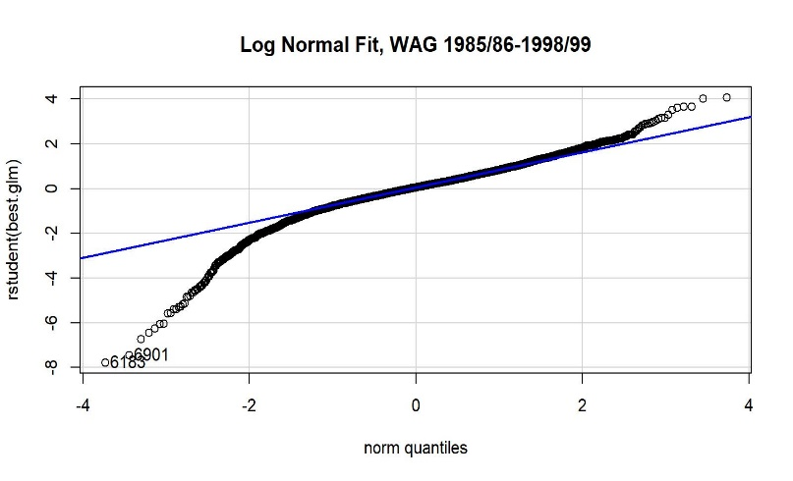
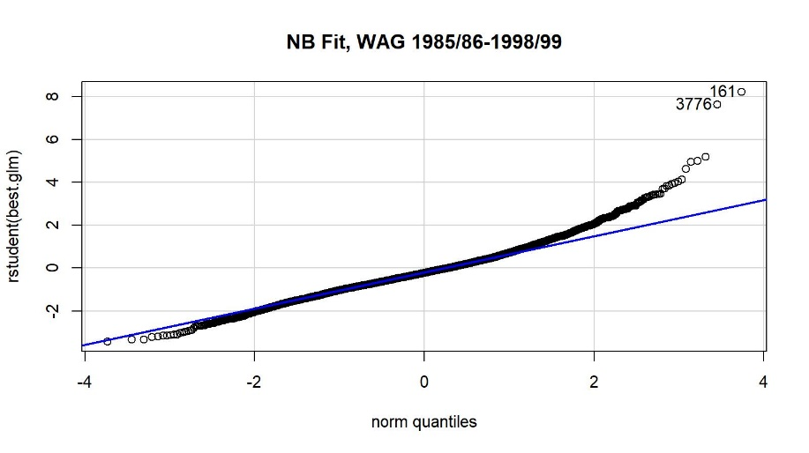
  1.2 Commercial fishery CPUE index by non-interaction model:
CPUE standardization
Figures A.7 and A.8. Studentized residual plots for GLM fit to EAG (top two panels) and WAG (bottom two panels) fisheries CPUE data. Left panel plots are for lognormal errors and right panel plots are for negative binomial errors. The 1985/86–1998/99 fish ticket data set was used.

Slide 20
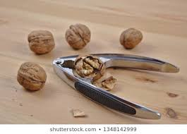
Year:Area interaction- Hard nut to crack – let us try----Nutcracker

Slide 21
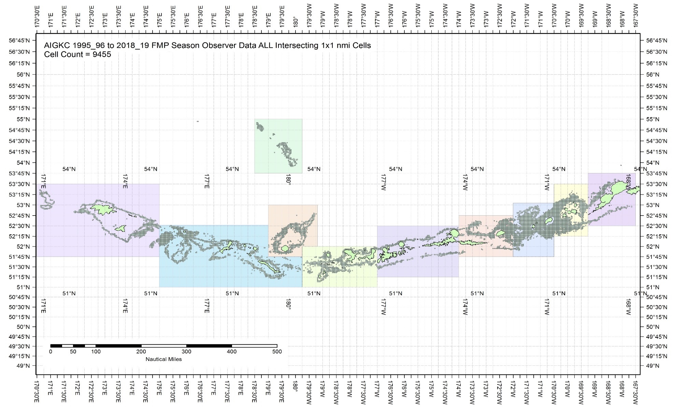
2. Estimation of observer CPUE index by the Year:Area interaction model
Figure A.9. The 1995/96 – 2018/19 observer pot samples enmeshed in 10 blocks.

Slide 22
Table A.1. Number of 1 x 1 nmi grids containing observer sample locations within each block by fishing year for the Aleutian Islands golden king crab, 1995/96 – 2018/19 data. Blocks 1 – 4 belong to EAG and 5 – 10 to WAG.
Year | Block_1 | Block_2 | Block_3 | Block_4 | Block_5 | Block_6 | Block_7 | Block_8 | Block_9 | Block_10
1995 | 125 | 529 | 748 | 379 | 218 | 373 | 112 | 722 | 166 | 122
1996 | 149 | 814 | 761 | 372 | 89 | 473 | 359 | 799 | 200 | 35
1997 | 116 | 530 | 755 | 257 | 202 | 443 | 104 | 568 | 274 | 0
1998 | 78 | 581 | 453 | 236 | 18 | 318 | 157 | 251 | 132 | 0
1999 | 123 | 593 | 454 | 231 | 163 | 476 | 182 | 627 | 193 | 145
2000 | 72 | 540 | 754 | 301 | 187 | 440 | 195 | 555 | 547 | 47
2001 | 123 | 507 | 507 | 329 | 45 | 369 | 288 | 634 | 256 | 9
2002 | 97 | 387 | 584 | 271 | 71 | 341 | 205 | 335 | 242 | 37
2003 | 43 | 492 | 530 | 299 | 111 | 347 | 212 | 465 | 150 | 61
2004 | 81 | 289 | 377 | 216 | 77 | 319 | 150 | 359 | 172 | 116
2005 | 0 | 205 | 221 | 118 | 8 | 220 | 83 | 261 | 54 | 0
2006 | 0 | 154 | 248 | 122 | 15 | 191 | 58 | 220 | 39 | 0
2007 | 0 | 111 | 177 | 110 | 24 | 228 | 78 | 173 | 20 | 0
2008 | 0 | 111 | 203 | 93 | 12 | 181 | 67 | 196 | 0 | 0
2009 | 0 | 59 | 146 | 60 | 6 | 137 | 95 | 220 | 25 | 0
2010 | 0 | 81 | 141 | 85 | 1 | 115 | 73 | 260 | 39 | 0
2011 | 0 | 126 | 117 | 33 | 3 | 83 | 73 | 266 | 9 | 0
2012 | 0 | 146 | 110 | 56 | 7 | 91 | 85 | 312 | 53 | 0
2013 | 2 | 149 | 129 | 51 | 12 | 144 | 105 | 293 | 86 | 0
2014 | 1 | 138 | 96 | 41 | 39 | 120 | 114 | 319 | 37 | 0
2015 | 0 | 135 | 147 | 61 | 46 | 163 | 106 | 280 | 16 | 48
2016 | 0 | 145 | 231 | 63 | 26 | 134 | 89 | 210 | 106 | 0
2017 | 0 | 97 | 170 | 110 | 11 | 87 | 79 | 198 | 118 | 0
2018 | 0 | 91 | 158 | 95 | 7 | 69 | 82 | 204 | 121 | 0

Slide 23
2. Estimation of observer CPUE index by the Year:Area interaction model…. continued
library(MASS)
library(splines)
Step 1:
glm.object<- glm(Legals~Year:Area, family = negative.binomial(0.97),data=datacore)
wpotsampleoutAIC<-stepAIC(glm.object,scope=list(upper= ~(Year:Area+ns(SoakDays,df=8)+Month+Vessel+Captain+Area+Gear+ns(Depth,df=10)),lower=~Year:Area),family=negative.binomial(0.97),direction="forward",trace=9, k=log(nrow(datacore))+1.0)
Step 2:
glm.object<- glm(Legals~Year:Area,family = negative.binomial(0.97),data=datacore)
wpotsampleout<-stepCPUE(glm.object,scope=list(upper= ~(Vessel+ns(SoakDays,df=8)+Gear+Month+Year:Area),lower=~Year:Area),family= negative.binomial(0.97),direction="forward",trace=9,r2.change=0.01)

Slide 24

2. Estimation of observer CPUE index by the Year:Area interaction model …..continued
Final model for EAG:
$\ln\left(CPUE\right)= Gear+Captain+ns\left(Soak, 4\right)+Year:Area$ (A.13)
for the 1995/96–2004/05 period [θ=1.38, $R^{2}=0.2235$]
$\ln\left(CPUE\right)=Vessel+ ns\left(Soak, 9\right)+Gear+Year:Area$ (A.14)
for the 2005/06–2018/19 period [$=2.33, R^{2}=0.1242$].

Slide 25

2. Estimation of observer CPUE index by the Year:Area interaction model ……continued
Final model for WAG:
$\ln\left(CPUE\right)= Vessel+ns\left(Soak, 8\right)+Gear+Year:Area$ (A.15)
for the 1995/96–2004/05 period [θ=0.97, $R^{2}=0.1719$]
$\ln\left(CPUE\right)=Gear+Year:Area+ns(Soak,5)$ (A.16)
for the 2005/06–2018/19 period [$=1.12, R^{2}=0.0681, Soak forced in$].

Slide 26

2. Estimation of observer CPUE index by the Year:Area interaction model ….. continued
Block-scale analysis:
${CPUE}_{ij}= e^{{YB}_{ij}+ σ_{ij}^{2}/2}$ (A.17)
$B_{ij}= N_{\max_{j} }{CPUE}_{ij}$ (A.18)
Following Campbell (2014), $B_{ij}$ index gaps were filled as follows:
(a) Find the maximum block index for each year, $B_{\max_{i}}$
(b) For each year, calculate the relative index for each fished block, $B_{{rel}_{ij}}=\frac{B_{ij}}{B_{\max_{i}}}$
( c) For each block, calculate the mean relative index, $\overline{B_{{rel}_{j}}}$ , across those years when all blocks were fished
(d) For those blocks with either no observer sampling observations or NAs for ${YB}_{ij}$ coefficients, the likely abundance index is set to $B_{{modefied}_{ij}}= B_{\max_{i}} \overline{B_{{rel}_{j}}}$
Annual biomass index,$B_{i}$ , was estimated as,
$B_{i}= \sum_{j}{B_{ij}}$
(A.19)
$Standard deviation ln(B_{i})= \frac{\sum_{j}{{Block_Area}_{ij} × Standard deviation ln(B_{ij}) }}{\sum_{j}{{Block_Area}_{ij} }}$ (A.20)
$Variance\ln\left(B_{i}\right)= {[Standard deviation ln\left(B_{i}\right)]}^{2}$ (A.21)

Slide 27
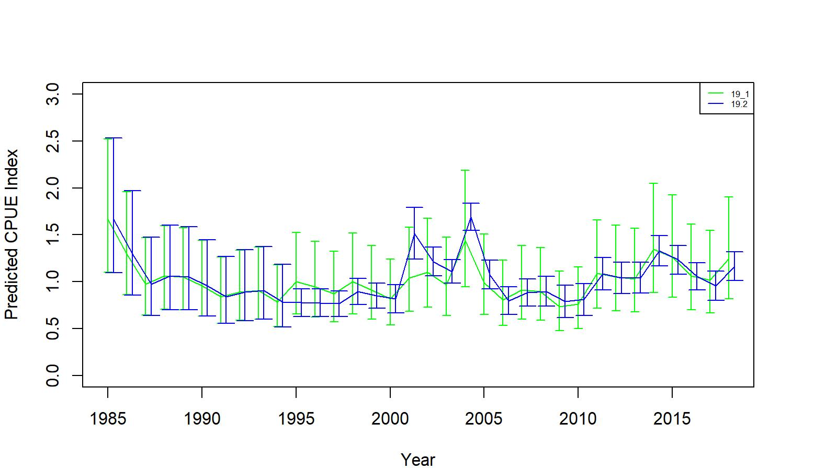
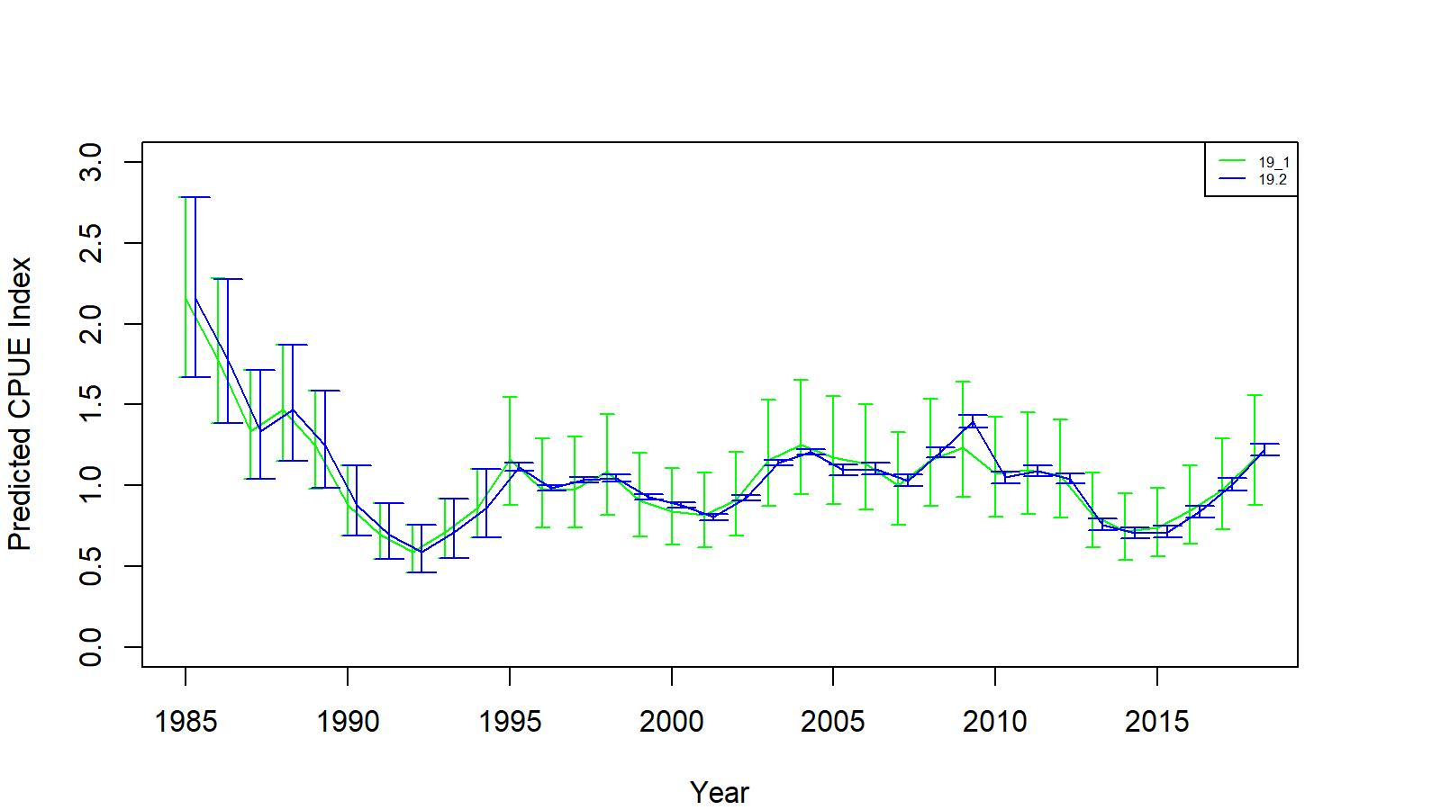
2. Estimation of observer CPUE index by the Year:Area interaction model….. continued
Figure A.10. Comparison of standardized (negative binomial GLM) CPUE indices with +/- 2 SE between no interaction (green line, 19.1) and Year:Area interaction (blue line, 19.2) models for EAG.
Figure A.11. Comparison of standardized (negative binomial GLM) CPUE indices with +/- 2 SE between no interaction (green line, 19.1) and Year:Area interaction (blue line, 19.2) models for WAG.

Slide 28
3. Cooperative survey CPUE index by mixed random effects model
Data:
27,255 records from four-year (2015–2019) surveys.
Year, Vessel Code, Captain Code, String ID, Mesh ID, Sub Sample Rate, Sex, Carapace Length, Catch (count at each size), Legal ID, Latitude, Longitude, Depth, Soak Time, and EAG_WAG ID.
New columns created: VesStringID and VesPotID
Model:
Mixed random effects model considered a random intercept procedure by randomizing the String ID (i.e., VesStringID). So, each string has a different (random) baseline value to predict CPUE.
Best model based on lowest AIC value was the String:Block interation random effects model:
library(MASS)
library(splines)
library(Matrix)
library(lme4)
best.lmefit2<- glmer(SumCatch~ Year+VesPotID+ns(SoakDays, df=9)+ns(Depth, df=6)+(1|VesStringID:Block), family = negative.binomial(2.33), control=glmerControl(optimizer="bobyqa", optCtrl=list(maxfun=100000)), data=eSurvey15_19Subtrim)

Slide 29
AIGKC crab pots are launched in a longline fashion by a vessel - different baseline level of CPUE for each string:
CPUE

Slide 30
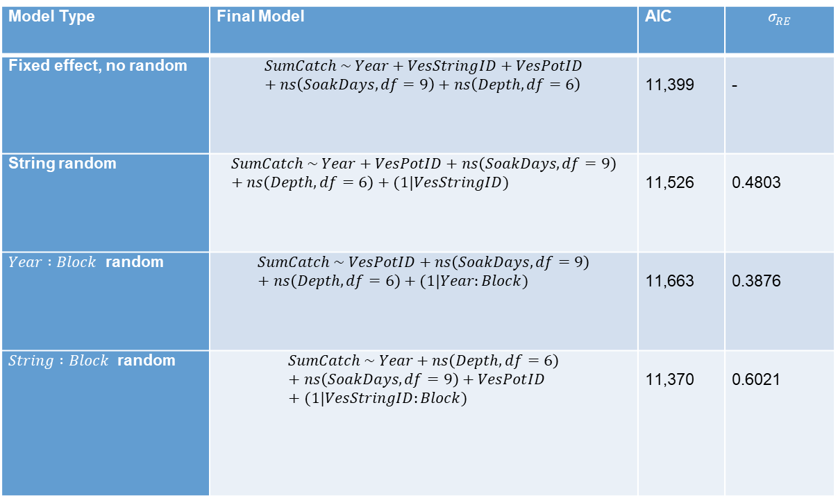
3. Cooperative survey CPUE index by mixed random effects model ….continued
Table A.3. Diagnostic table for the mixed effects models with different random effects structures for 2015–2019 cooperative survey data. σ_{RE} is the standard deviation of the random effects.
Model Type | Final Model | AIC | $$σ_{RE}$$
Fixed effect, no random | $$SumCatch \sim Year+VesStringID+VesPotID+ns\left(SoakDays, df=9\right)+ns\left(Depth, df=6\right)$$ | 11,399 | -
String random | $$SumCatch \sim Year+VesPotID+ns\left(SoakDays, df=9\right)+ns\left(Depth, df=6\right)+(1|VesStringID)$$ | 11,526 | 0.4803
$Year :Block$ random | $$SumCatch \sim VesPotID+ns\left(SoakDays, df=9\right)+ns\left(Depth, df=6\right)+(1|Year:Block)$$ | 11,663 | 0.3876
$String :Block$ random | $$SumCatch \sim Year+ns\left(Depth, df=6\right)+ns\left(SoakDays, df=9\right)+VesPotID+(1|VesStringID:Block)$$ | 11,370 | 0.6021

Slide 31
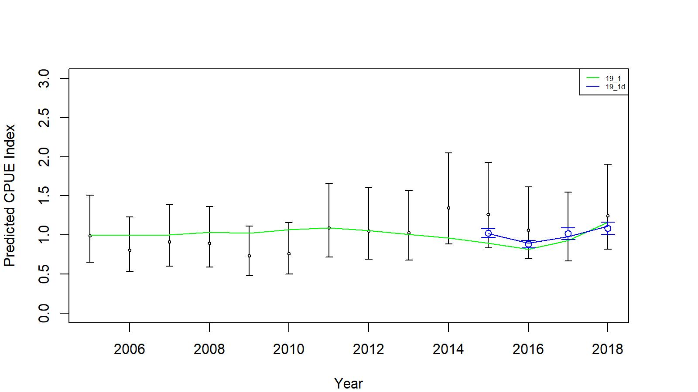
3. Cooperative survey CPUE index by mixed random effects model …. continued
Figure A.13. Comparison of input CPUE indices [with +/- 2 SE for model 19.1 (black small circles) and model 19.1d (cooperative survey, blue large circles)] with predicted CPUE indices (green (19.1) and blue (19.1d) solid lines) by 19.1 and 19.1d model fits for EAG (fishery data:2005/06–2018/19 and survey data: 2015–2018). Model estimated additional standard error was added to each input standard error.

Slide 32
Appendix B: Male maturity determination
Data:
Source | n | EAG | WAG
NMFS 1984 biologist | 1,343
ADF&G 1991 biologist | 2,457
2018/19 observer | 3220
2018/19 retained catch | 2453
2018/19 cooperative pot survey | 362
2018/19 combined | 6035 | 3128 | 2907
Methods:
Bent-Point (segmented regression)
Cut-Line

Slide 33
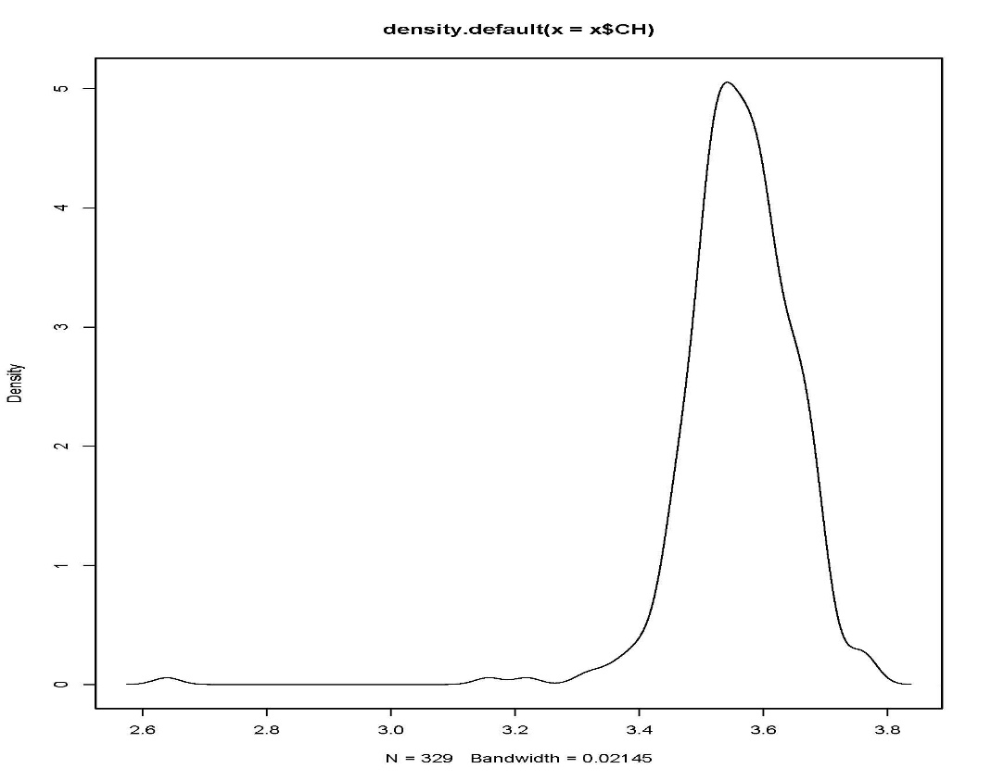
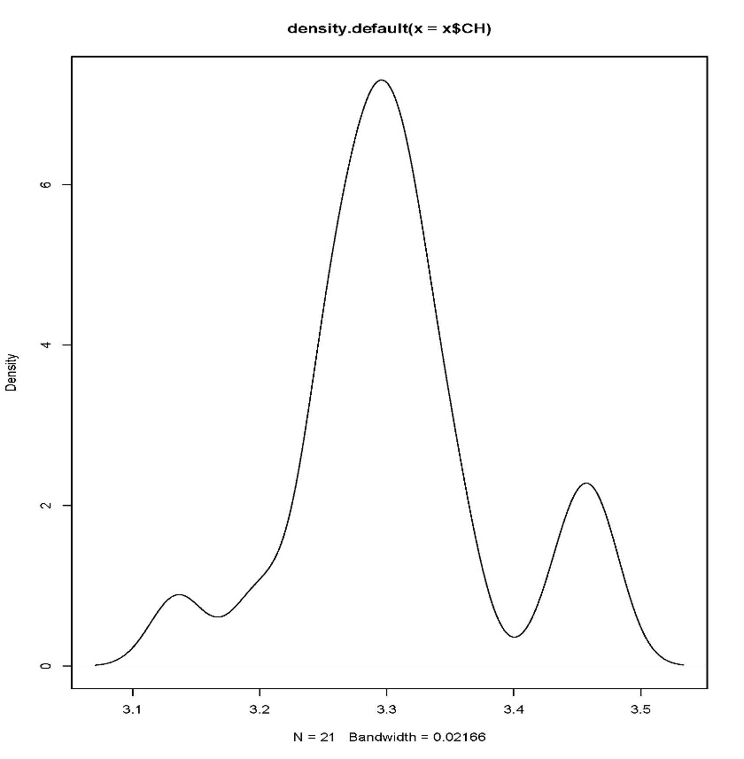
Cut-Line method
Figure B.1. Kernel density plots for 2018 EAG (left) and 2018 WAG (right) chela height data. The Cut-Line method identifies the minimum points of the density distributions in each size bin and fit a straight line through the points to delineate mature and immature crab

Slide 34
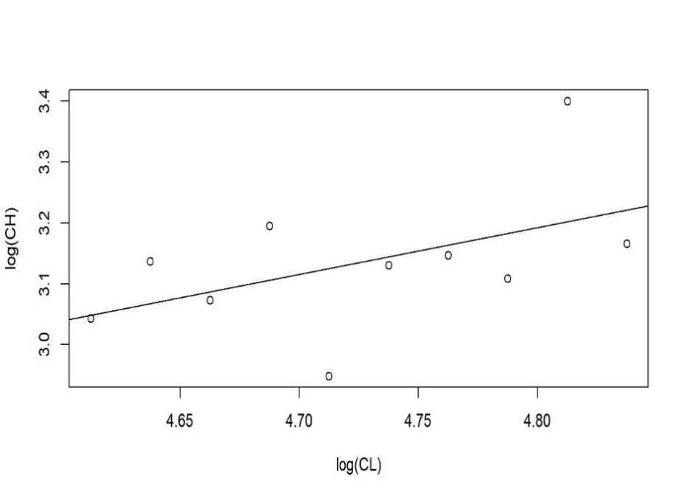
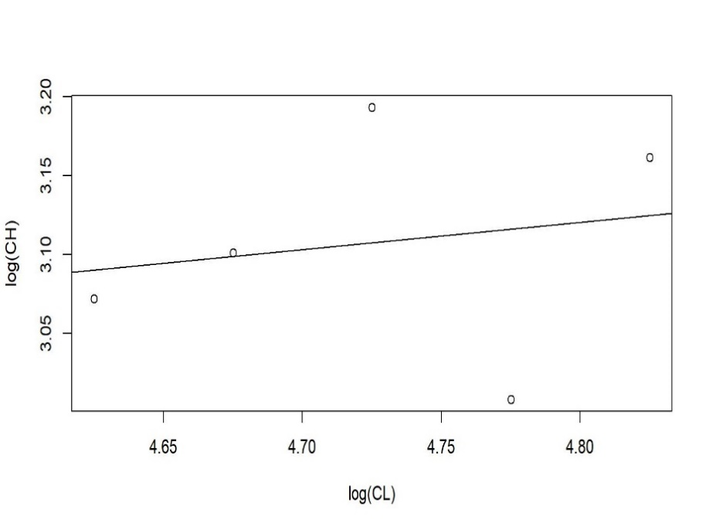
Cut-Line method …. continued
Figure B.1. Kernel density plots for 2018 EAG (left) and 2018 WAG (right) chela height data. The Cut-Line method identifies the minimum points of the density distributions in each size bin and fit a straight line through the points to delineate mature and immature crab

Slide 35
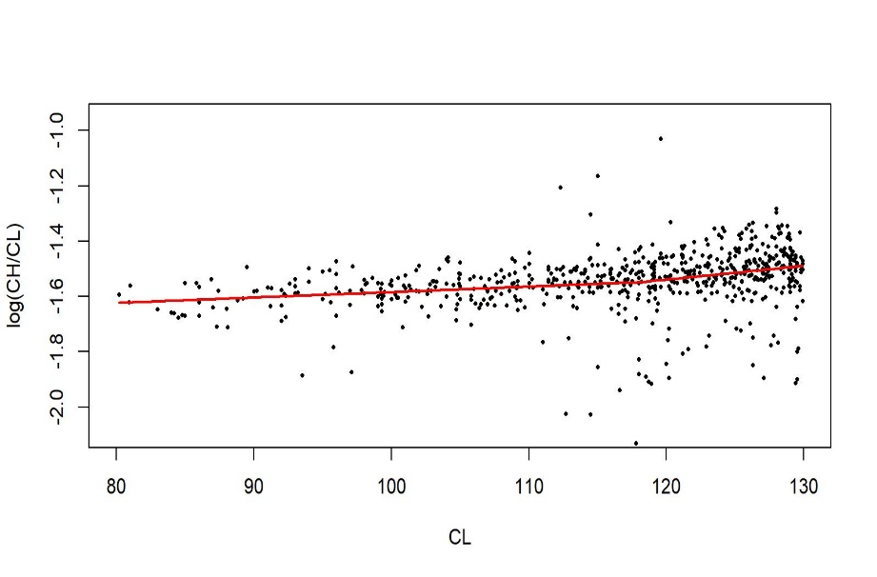
Bent-Point method
Figure B.3. Log (CH/CL) vs CL fits by the Bent-Point analysis on combined 2018/19 data. The 80–130 mm CL range was considered for the analysis.

Slide 36
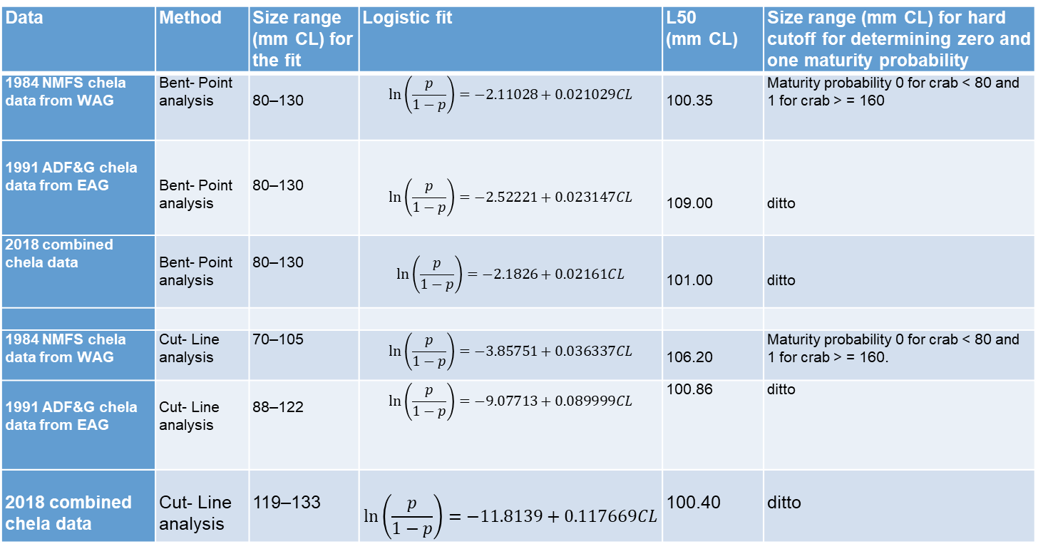
Cut-Line and Bent-Point methods …. continued
Table B.2. Logistic model fit to maturity proportion by carapace size for various sample data by
the Bent-Point and Cut-Line analyses. All fitted parameters were significant at p<0.05.
Data | Method | Size range (mm CL) for the fit | Logistic fit | L50 (mm CL) | Size range (mm CL) for hard cutoff for determining zero and one maturity probability
1984 NMFS chela data from WAG | Bent- Point analysis | 80–130 | $$\ln\left(\frac{p}{1−p}\right)=−2.11028+0.021029CL$$ | 100.35 | Maturity probability 0 for crab < 80 and 1 for crab > = 160
1991 ADF&G chela data from EAG | Bent- Point analysis | 80–130 | $$\ln\left(\frac{p}{1−p}\right)=−2.52221+0.023147CL$$ | 109.00 | ditto
2018 combined chela data | Bent- Point analysis | 80–130 | $$\ln\left(\frac{p}{1−p}\right)=−2.1826+0.02161CL$$ | 101.00 | ditto
1984 NMFS chela data from WAG | Cut- Line analysis | 70–105 | $$\ln\left(\frac{p}{1−p}\right)=−3.85751+0.036337CL$$ | 106.20 | Maturity probability 0 for crab < 80 and 1 for crab > = 160.
1991 ADF&G chela data from EAG | Cut- Line analysis | 88–122 | $$\ln\left(\frac{p}{1−p}\right)=−9.07713+0.089999CL$$ | 100.86 | ditto
2018 combined chela data | Cut- Line analysis | 119–133 | $$\ln\left(\frac{p}{1−p}\right)=−11.8139+0.117669CL$$ | 100.40 | ditto

Slide 37
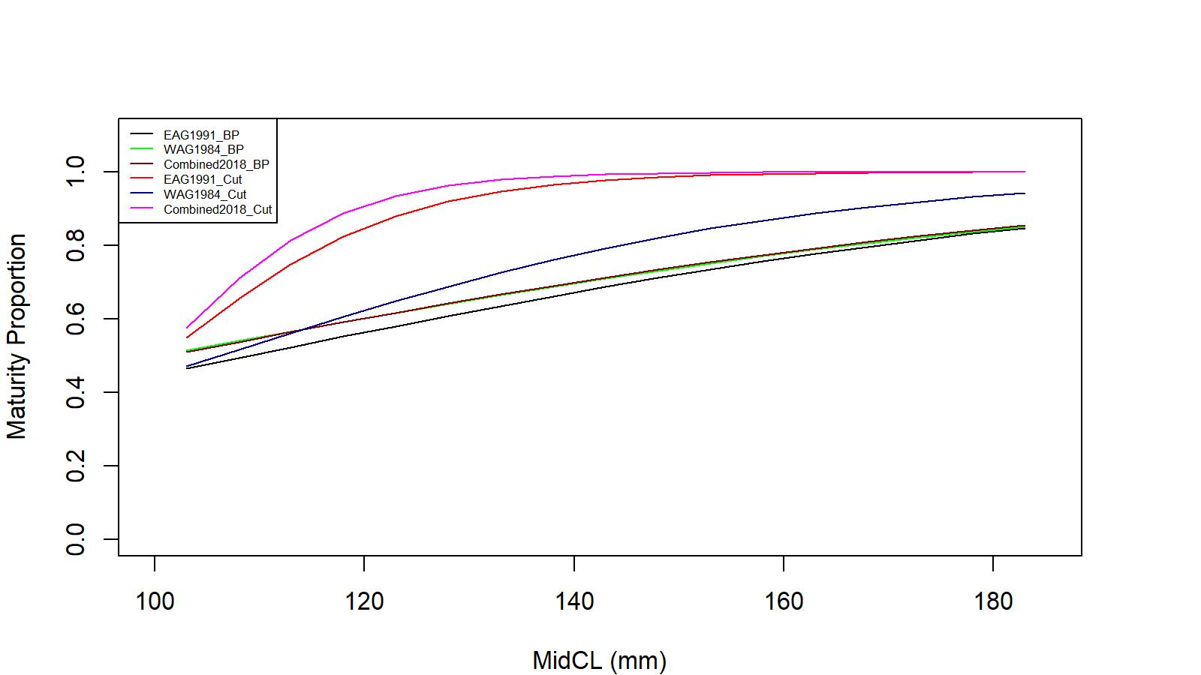
Cut-Line and Bent-Point methods …. continued
Figure B.7. Logistic maturity curves for EAG 1991, WAG 1984, and combined 2018 data for the two methods of analyses: BP=Bent-Point and Cut: Cut-Line.

Slide 38
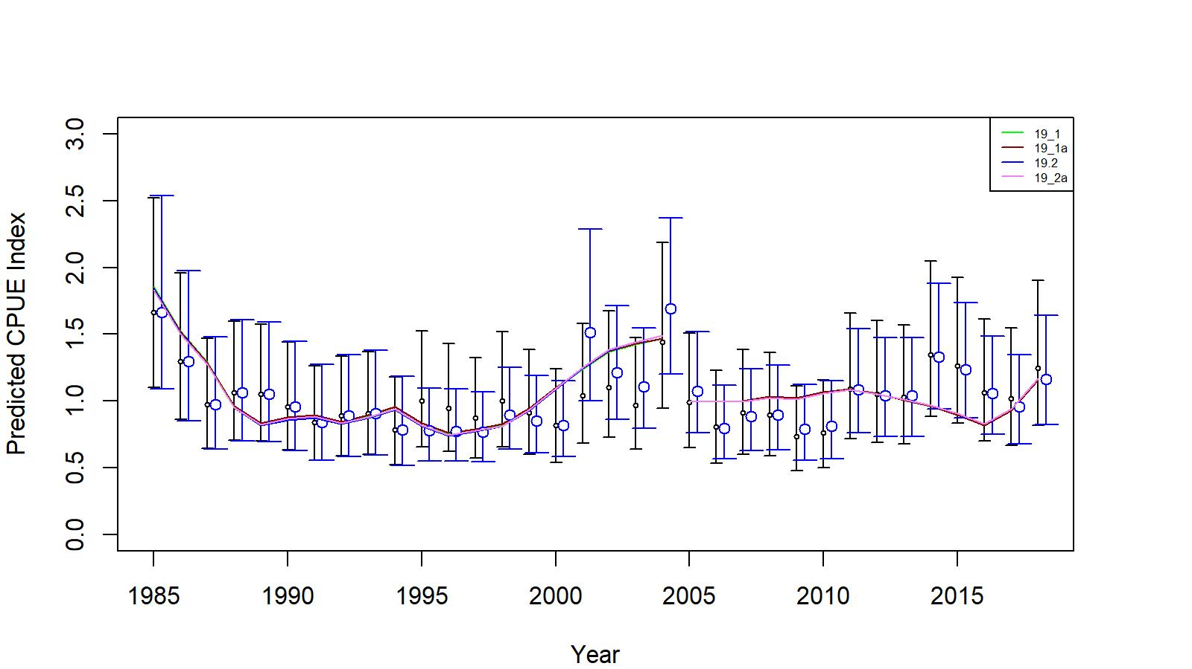
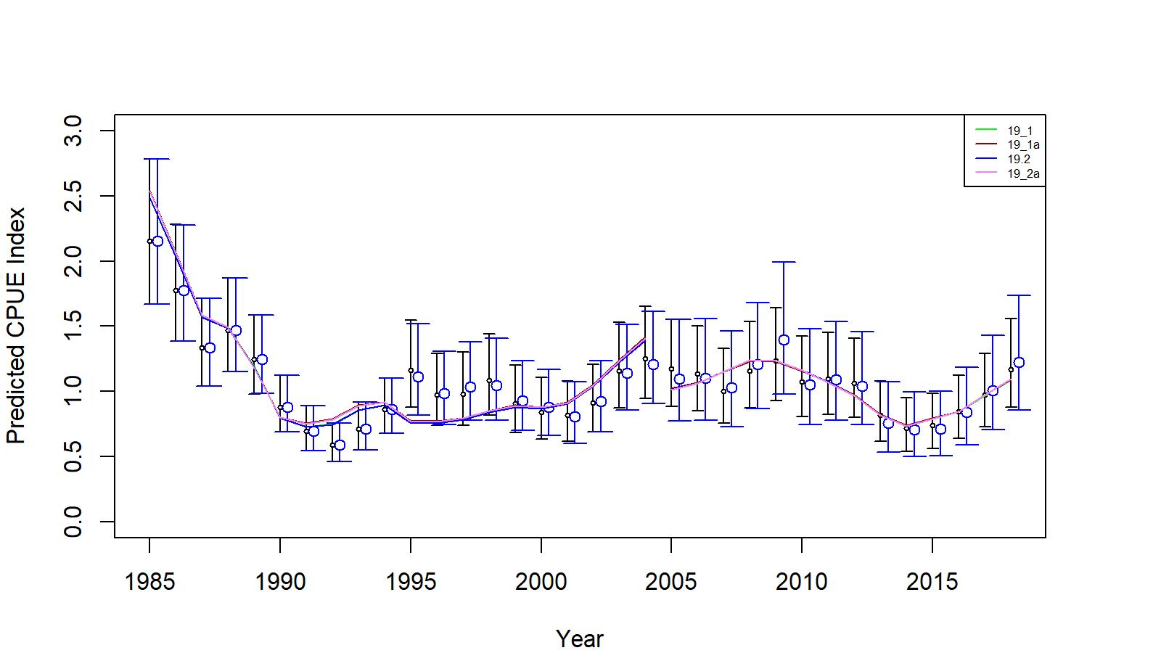
Model results
EAG
WAG
Figs 7 and 17. Comparison of input CPUE indices [with +/- 2 SE for model 19.1 (black small circles) and model 19.2 (blue large circles)] with predicted CPUE indices (colored solid lines) by 19.1, 19.1a, 19.2, and 19.2a models for EAG and WAG, 1985/86–2018/19. Model estimated additional standard error was added to each input standard error.

Slide 39
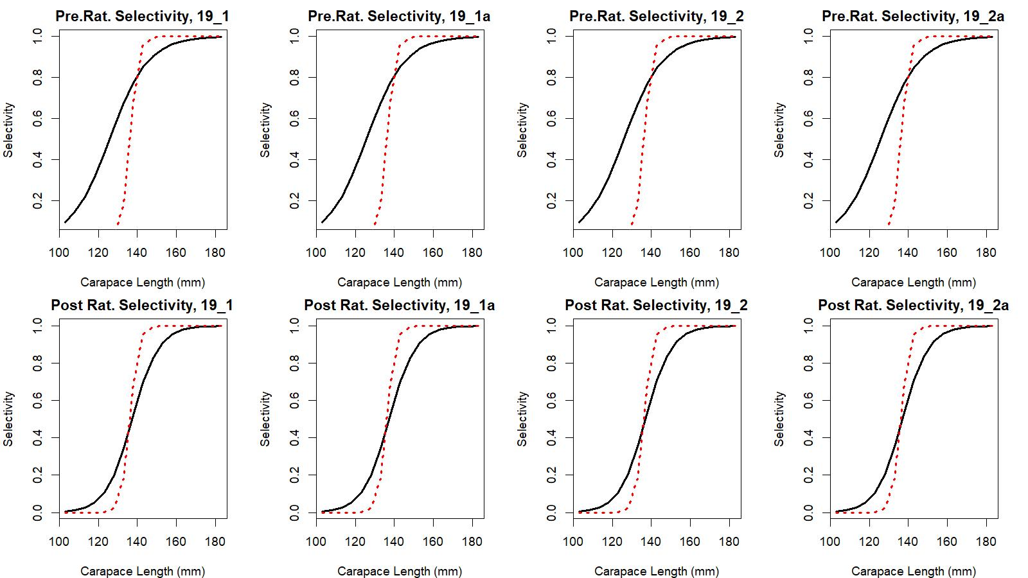
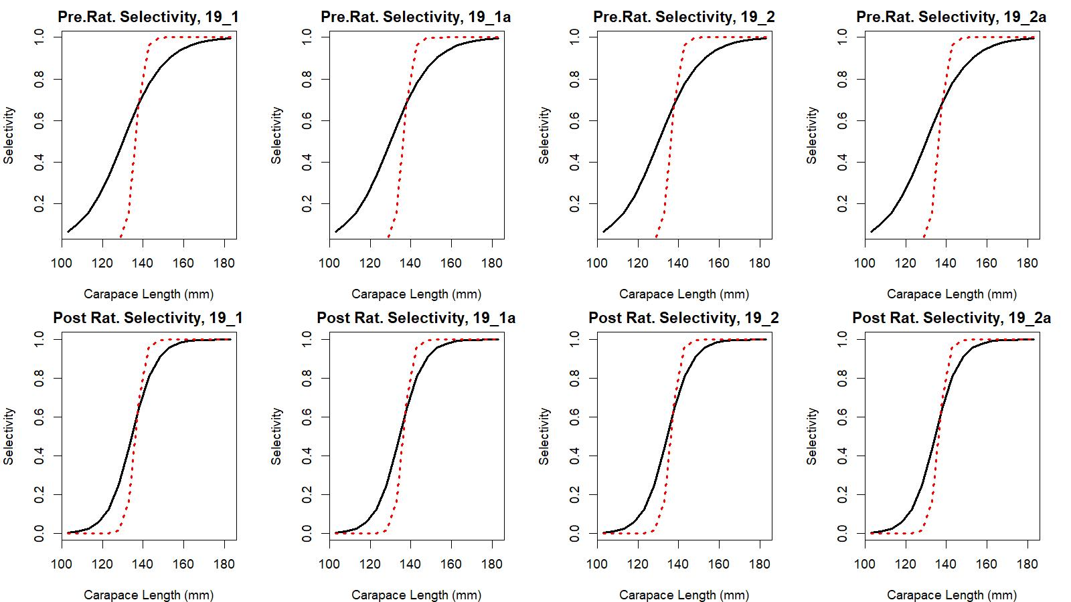
Figure 6 and 16. Estimated total (black solid line) and retained selectivity (red dotted line) for pre- and post- rationalization periods for models 19.1, 19.1a, 19.2, and 19.2a fits to EAG and WAG data.
EAG
WAG

Slide 40
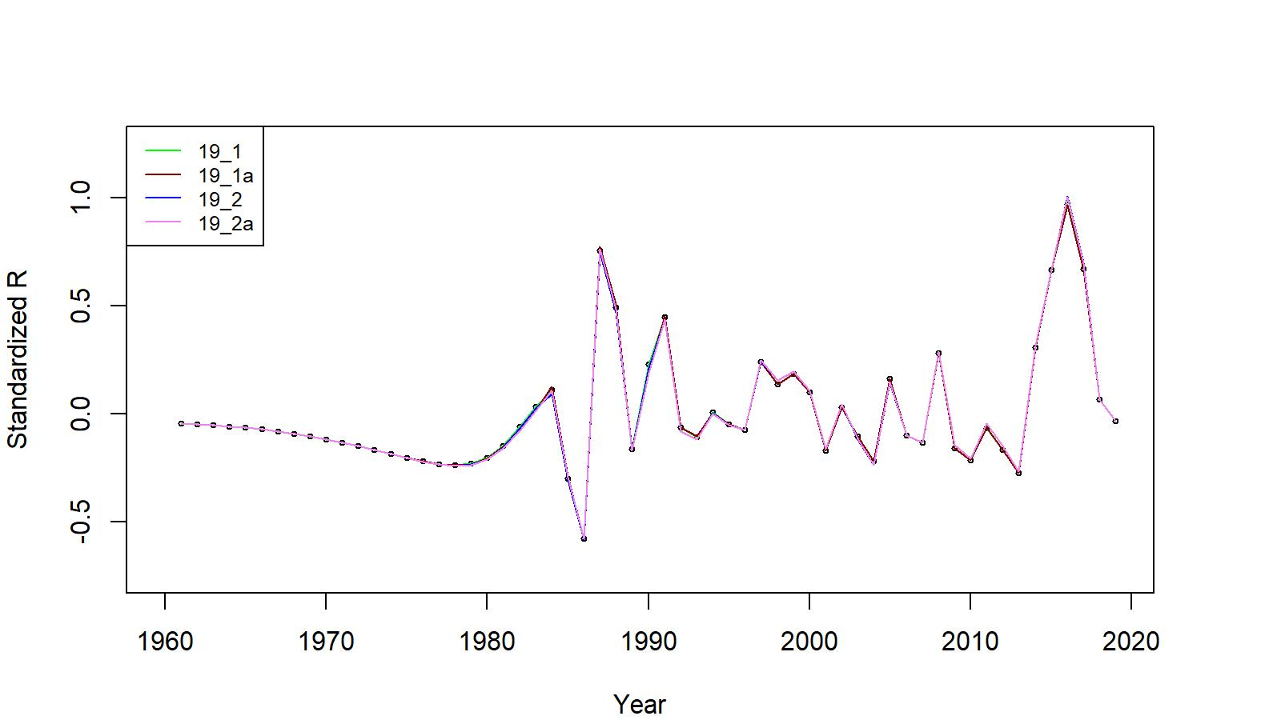
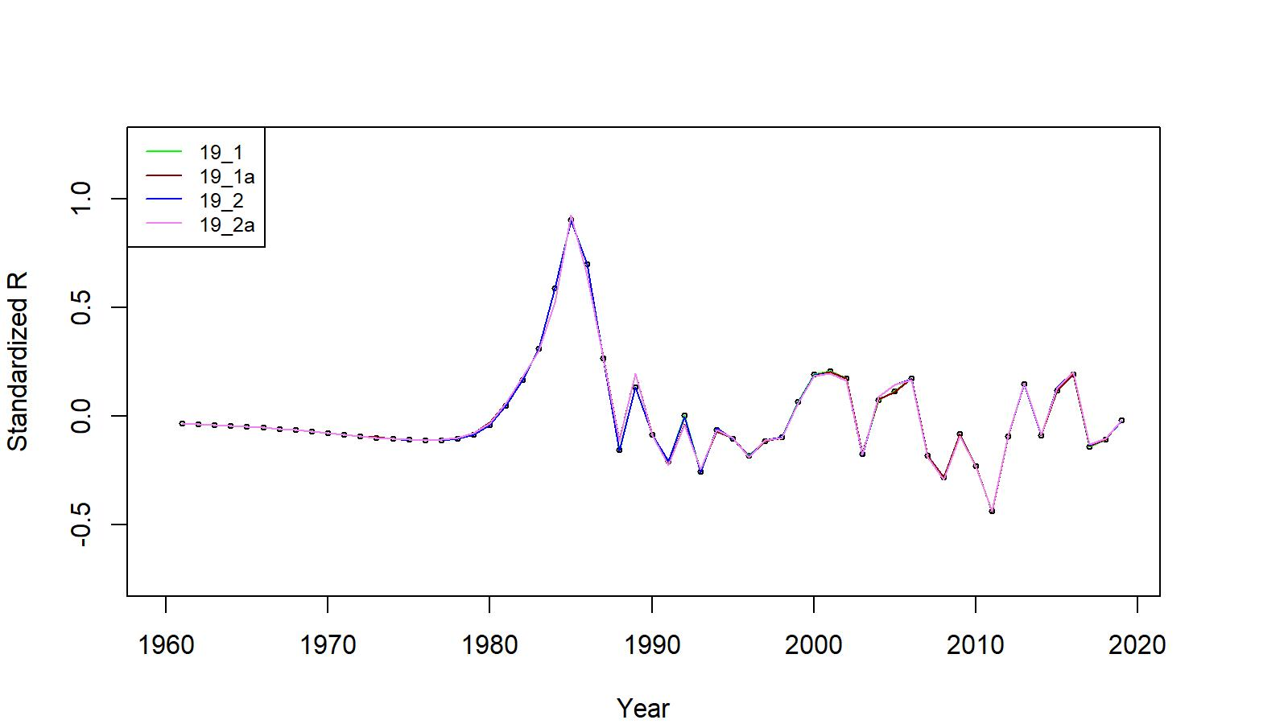
Estimated number of male recruits (crab size ≥ 101 mm CL) for 19.1, 19.1a, 19.2, and 19.2a model fits for EAG and WAG data, 1961–2019. The number of recruits is standardized using (R-mean R)/mean R for comparing different models’ results
EAG
WAG

Slide 41
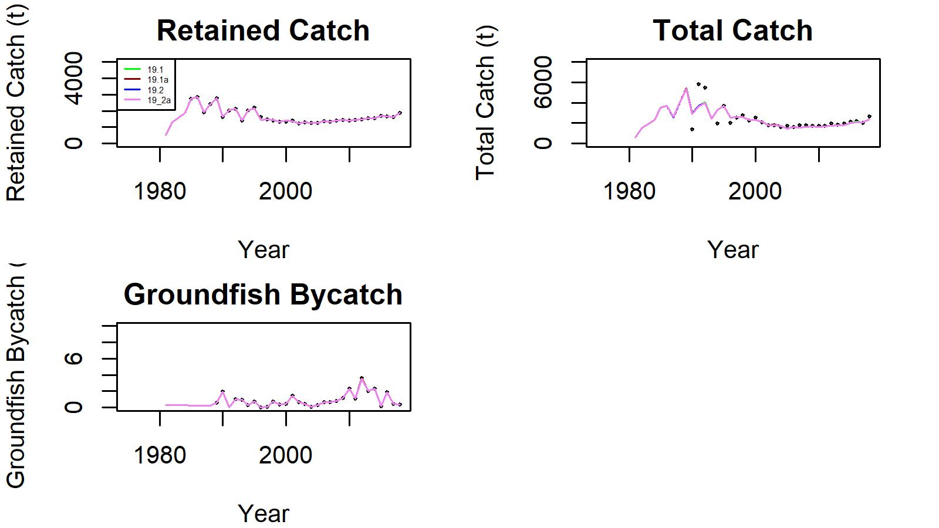
Figure 9. Observed (open circle) vs. predicted (solid line) retained catch (top left), total catch (top right), and groundfish bycatch (bottom left) of GKC for 19.1, 19.1a, 19.2, and 19.2a model fits in EAG, 1981/82–2018/19.
.

Slide 42
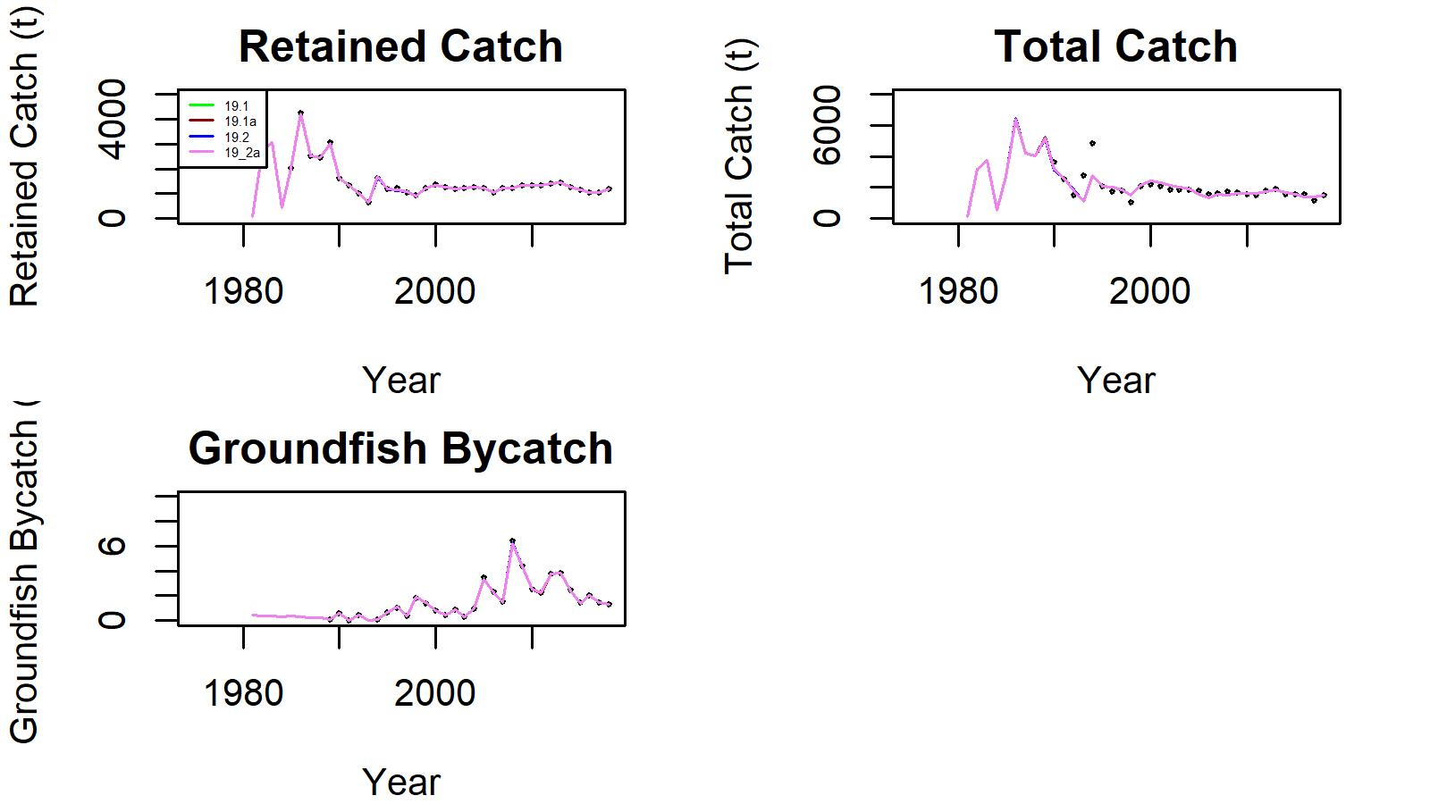
Figure 19. Observed (open circle) vs. predicted (solid line) retained catch (top left), total catch (top right), and groundfish bycatch (bottom left) of GKC for 19.1, 19.1a, 19.2, and 19.2a model fits in WAG, 1981/82–2018/19.
.

Slide 43
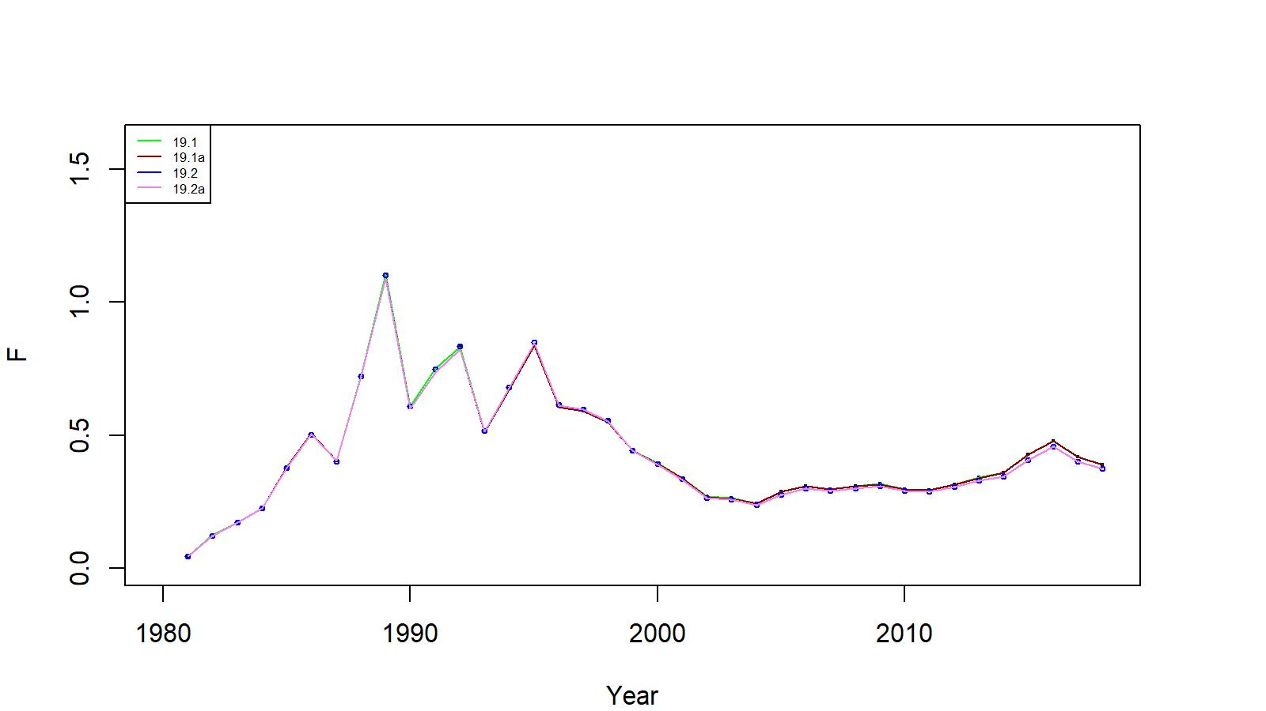
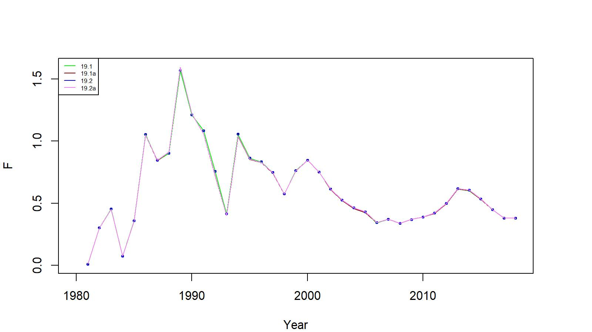
Figures 11 and 21. Trends in pot fishery total fishing mortality of GKC for 19.1, 19.1a, 19.2, and 19.2a model fits in the EAG (top) and WAG (bottom),1981/82–2018/19.
EAG
WAG

Slide 44
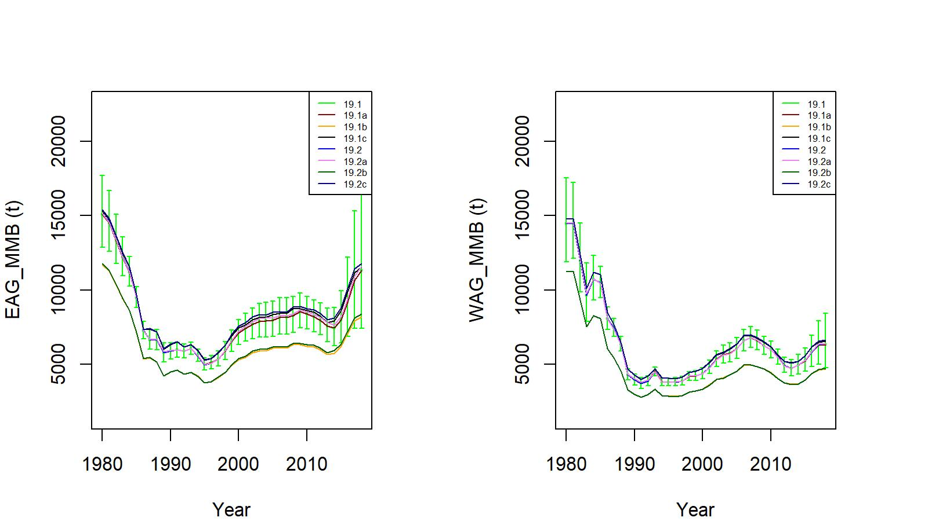
Figure 26. Trends in golden king crab mature male biomass for 19.1, 19.1a, 19.1b, 19.1c, 19.2, 19.2a, 19.2b, and 19.2c model fits to EAG (left) and WAG (right) data, 1980/81–2018/19. Model19.1 estimate has two standard error confidence limits.
.

Slide 45
Table 14. Negative log-likelihood values of the fits for models 19.1 (base), 19.1a, 19.2, and 19.2a in the EAG. Likelihood components with zero entry in the entire rows are omitted.
Likelihood Component | 19.1 | 19.1a | 19.2 | 19.2a
Number of free parameters | 146 | 146 | 146 | 146
Retlencomp | -1251.89 | -1252.15 | -1250.70 | -1251.04
Totallencomp | -1363.66 | -1362.35 | -1365.49 | -1364.13
Observer cpue | -3.49 | -3.51 | -8.11 | -8.07
RetdcatchB | 7.46 | 7.41 | 7.65 | 7.59
TotalcatchB | 22.74 | 22.80 | 22.77 | 22.83
GdiscdcatchB | 0.00 | 0.00 | 0.00 | 0.00
Rec_dev | 7.52 | 7.52 | 7.55 | 7.54
Pot F_dev | 0.01 | 0.01 | 0.01 | 0.01
Gbyc_F_dev | 0.03 | 0.03 | 0.03 | 0.03
Tag | 2692.49 | 2692.48 | 2692.33 | 2692.33
Fishery cpue | -2.3197 | -3.4794 | -2.0787 | -3.2168
RetcatchN | 0.0066 | 0.0067 | 0.0066 | 0.0067
Total | 108.90 | 108.76 | 103.96 | 103.87

Slide 46
Table 24 . Negative log-likelihood values of the fits for models 19.1 (base), 19.1a, 19.2, and 19.2a in the WAG. Likelihood components with zero entry in the entire rows are omitted.
Likelihood Component | 19.1 | 19.1a | 19.2 | 19.2a
Number of free parameters | 146 | 146 | 146 | 146
Retlencomp | -1207.43 | -1211.77 | -1207.24 | -1211.50
Totallencomp | -1509.29 | -1506.14 | -1511.22 | -1508.28
Observer cpue | -12.09 | -13.72 | -11.27 | -11.93
RetdcatchB | 5.03 | 5.14 | 5.08 | 5.19
TotalcatchB | 45.38 | 45.51 | 45.38 | 45.51
GdiscdcatchB | 0.00 | 0.00 | 0.00 | 0.00
Rec_dev | 4.61 | 4.51 | 4.66 | 4.56
Pot F_dev | 0.03 | 0.03 | 0.03 | 0.03
Gbyc_F_dev | 0.04 | 0.04 | 0.04 | 0.04
Tag | 2694.36 | 2694.34 | 2694.41 | 2694.40
Fishery cpue | -9.3215 | -5.6533 | -9.3566 | -5.6998
RetcatchN | 0.0021 | 0.0020 | 0.0021 | 0.0021
Total | 10.42 | 12.29 | 10.51 | 12.31

Slide 47
Table 25. Stock status, reference biomass and fishing mortality, OFL (total catch), and ABC for various models for EAG, WAG, and AI golden king crab stock.
Biomass, OFL, and ABC are in t. Current MMB = MMB on 15 Feb. 2020.
EAG:
Model | Tier | MMB_{35%} | Current MMB | MMB/ MMB_{35%} | F_{OFL} | F_{35%} | OFL | ABC (0.75*OFL)
19.1 | 3a | 6,650 | 9,834 | 1.48 | 0.62 | 0.62 | 3,276 | 2,457
19.1a | 3a | 6,749 | 9,827 | 1.46 | 0.62 | 0.62 | 3,277 | 2,458
19.1b | 3a | 5,228 | 7,337 | 1.40 | 0.57 | 0.57 | 3,066 | 2,300
19.1ba | 3a | 7.085 | 10,115 | 1.43 | 0.75 | 0.75 | 3,789 | 2,842
19.1c | 3a | 6,899 | 9,913 | 1.44 | 0.66 | 0.66 | 3,440 | 2,580
19.1ca | 3a | 7,102 | 10,145 | 1.43 | 0.76 | 0.76 | 3,826 | 2,870
19.1d | 3a | 6,644 | 8,247 | 1.24 | 0.66 | 0.66 | 2,641 | 1,981
19.2 | 3a | 6,706 | 10,031 | 1.50 | 0.61 | 0.61 | 3,352 | 2,514
19.2a | 3a | 6,808 | 10,015 | 1.47 | 0.61 | 0.61 | 3,347 | 2,510
19.2b | 3a | 5,278 | 7,482 | 1.42 | 0.56 | 0.56 | 3,128 | 2,346
19.2ba | 3a | 7,135 | 10,287 | 1.44 | 0.74 | 0.74 | 3,879 | 2,909
19.2c | 3a | 6,910 | 10,054 | 1.46 | 0.66 | 0.66 | 3,558 | 2,668
19.2ca | 3a | 7,151 | 10,317 | 1.44 | 0.75 | 0.75 | 3,918 | 2,939

Slide 48
Table 25 continued.
Model | Tier | MMB_{35%} | Current MMB | MMB/ MMB_{35%} | F_{OFL} | F_{35%} | OFL | ABC (0.75*OFL)
19.1 | 3a | 5,247 | 5,821 | 1.11 | 0.56 | 0.56 | 1,783 | 1,337
19.1a | 3a | 5,369 | 5,829 | 1.09 | 0.56 | 0.56 | 1,784 | 1,249
19.1b | 3a | 4,141 | 4,439 | 1.07 | 0.52 | 0.52 | 1,682 | 1,262
19.1ba | 3a | 5,591 | 6,230 | 1.11 | 0.69 | 0.69 | 2,094 | 1,570
19.1c | 3a | 5,427 | 5,978 | 1.10 | 0.61 | 0.61 | 1,907 | 1,431
19.1ca | 3a | 5,634 | 6,274 | 1.11 | 0.69 | 0.69 | 2,094 | 1,570
19.2 | 3a | 5,248 | 5,866 | 1.12 | 0.56 | 0.56 | 1,798 | 1,349
19.2a | 3a | 5,376 | 5,876 | 1.09 | 0.56 | 0.56 | 1,800 | 1,350
19.2b | 3a | 4,146 | 4,472 | 1.08 | 0.52 | 0.52 | 1,697 | 1,273
19.2ba | 3a | 5,598 | 6,274 | 1.12 | 0.69 | 0.69 | 2,113 | 1,584
19.2c | 3a | 5,434 | 6,023 | 1.11 | 0.61 | 0.61 | 1,924 | 1,443
19.2ca | 3a | 5,641 | 6,318 | 1.12 | 0.69 | 0.69 | 2,113 | 1,584
WAG:
Model | OFL | ABC (0.75*OFL)
19.1 | 5,059 | 3,794
19.1a | 5,061 | 3,707
19.1b | 4,748 | 3,562
19.1ba | 5,883 | 4,412
19.1c | 5,347 | 4,011
19.1ca | 5,920 | 4,440
19.2 | 5,150 | 3,863
19.2a | 5,147 | 3,860
19.2b | 4,825 | 3,619
19.2ba | 5,992 | 4,493
19.2c | 5,482 | 4,111
19.2ca | 6,031 | 4,523
AI:

Slide 49
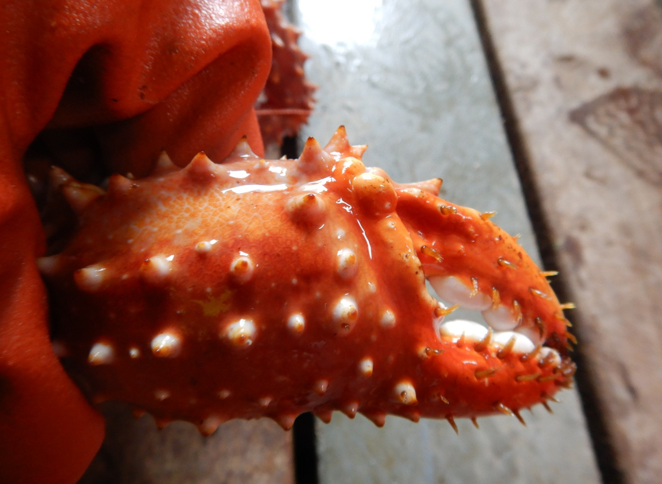
Photo from Vicki Vanek, ADF&G
Thank you

