Slide 1
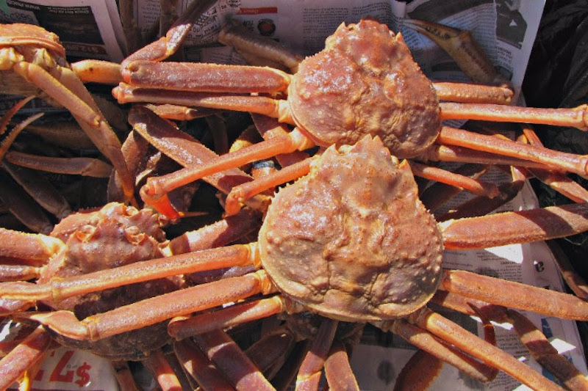

BSAI Crab Ecosystem and Socio-economic Profiles
Erin Fedewa, AFSC Shellfish Assessment Program
January 2020 Crab Plan Team Meeting

Slide 2
Outline for ESP Discussion
+
-How did we get here?
-Past BSAI crab ecosystem initiatives
-AFSC Regional Work Plan funding for developing Ecosystem and
Socio-economic Profiles (Shotwell et al.)
-Where are we now?
-SMBKC ESP
-Stock-specific report cards
-Where do we go next?
-Stock Prioritization
-Indicator development
-Future directions, role and timeline for BSAI crab ESP’s

Slide 3
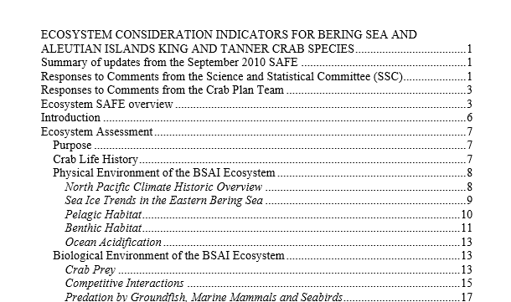
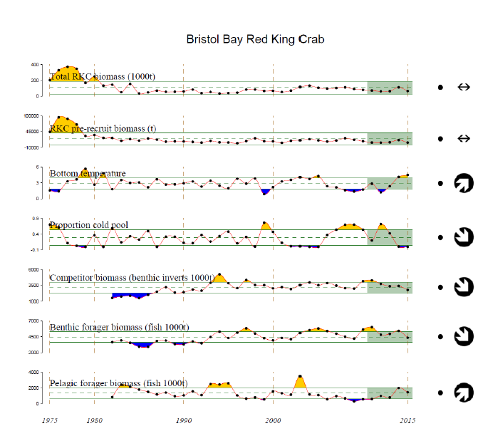
How did we get here?
+
Past BSAI Crab Ecosystem Initiatives:
-Crab Ecosystem Considerations Chapter included as an Appendix in the 2011 SAFE document (Chilton et al.)
-Pilot Bristol Bay Red King Crab report card draft presented to CPT in 2016 by Ben Daly
Notes:
In 2010/2011, a crab ecosystem considerations chapter was developed to present ecosystem indicators in the context of BSAI crab stocks and distill broad-scale information in the Ecosystem Status Reports into a more useful format for crab stocks.
In 2016 the Crab Plan Team prioritized the development of report cards for individual crab stocks as well as a revised ecosystem chapter for the crab SAFE that includes supporting methodology documentation for indicator selection and development. The goal was to have these documents prepared for a presentation to the CPT in January or May. Erin updated report cards for BBRKC, snow crab and tanner crab and presented to CPT in May 2019.

Slide 4
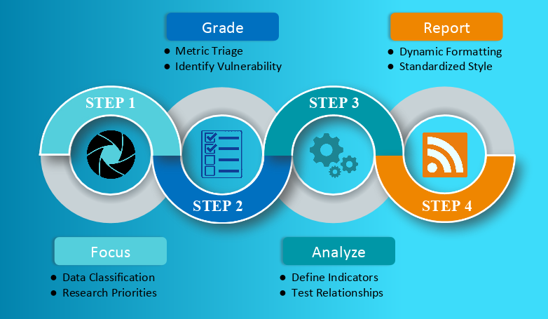
How did we get here?
Socio-economic Profiles (Shotwell et al.)
AFSC Regional Work Plan funding for developing Ecosystem and Socio-economic Profiles
“A standardized framework that facilitates the integration of ecosystem and socioeconomic factors within the stock assessment process and acts as a proving ground for operational use in quota setting.”
Notes:
-Quick Review of ESP’s (see below)
-Highlight May 2019 ESP Workshop with SMBKC ESP example (Erin, Brian and Katie) and participation by several federal stock assessment authors. Goal of the 1st workshop was to review ESP framework, work through examples and review AFSC program research that could assist in development of metrics and indicators
From Kalei’s RWP:
Ecosystem and Socio-economic Profiles (ESP) use data collected from a large variety of national initiatives in a four-step process to generate a set of standardized products that culminate in a focused, succinct, and meaningful communication of potential drivers on a given stock. A preliminary ESP was first introduced for the Alaska sablefish stock in 2017 and the Council recommended ESP development for priority stocks in GOA and BSAI. ESPs are an efficient testing ground for new approaches and provide a set of communication tools that can be tailored to a large variety of audiences in order to effectively merge the ecosystem, socio-economic, and stock assessment disciplines.
Steps in ESP Development:
Data classification: standardized system using main categories of model input data- authors classify their stocks/complexes to identify high priority stocks for conducting an ESP. Grade metrics: select representative metrics for evaluation. Metrics are quantitative stock-specific measures that identify vulnerability or resilience of the stock with respect to biological or socioeconomic processes. Analyze: generate suite of indicators- (timeseries that is updated, reliable, consistent and long term), run statistical tests (i.e. rank scoring or stop light for data poor, Bayesian adaptive sampling for data rich), Report: standardized document with figs/tables, ESP as appendix in SAFE’s

Slide 5
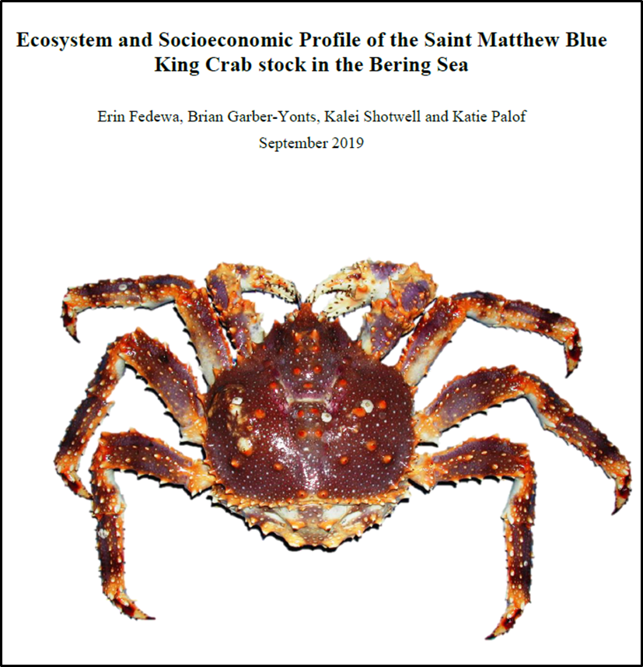
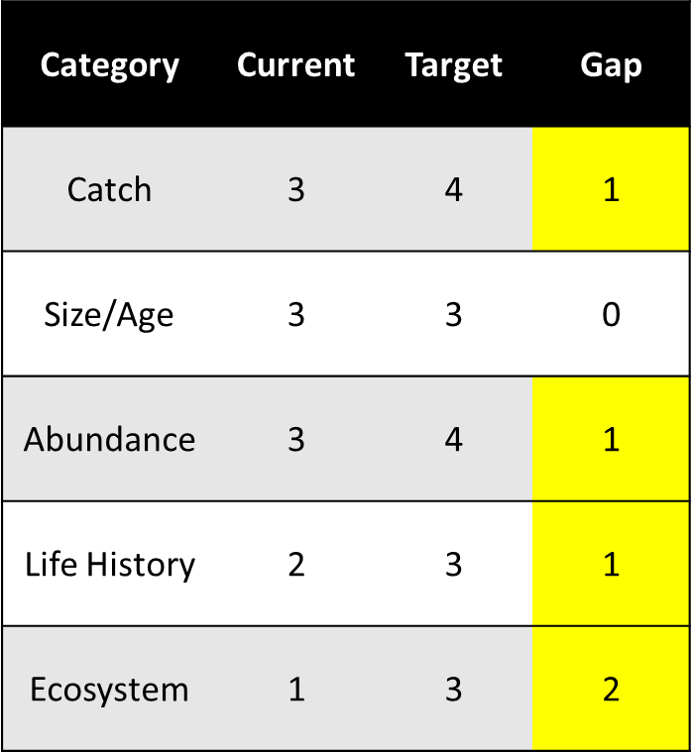
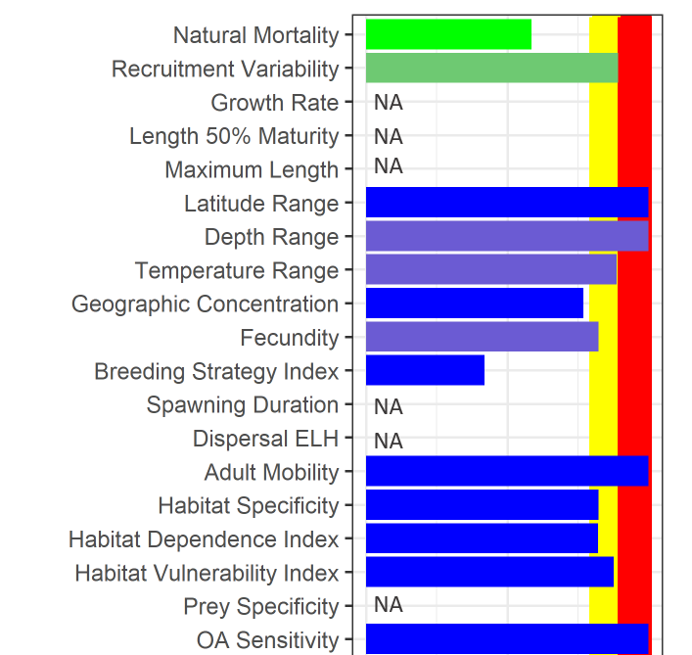
Where are we now?
+
SMBKC ESP included as an Appendix in 2019 SMBKC SAFE chapter and take-aways included in the Environmental Assessment for SMBKC rebuilding plan
Focus
Grade
Analyze
Report
October 2019 NPFMC SSC Minutes:
“The SSC is very pleased to see the ESP for SMBKC……The ESP can provide immediate impact by aiding decisions in recruitment regimes…and the ESP provides a rare and valuable opportunity to better understand the socioeconomic dimensions of a fishery that has not successfully provided for the continuous, sustained participation of fishing communities over time”
Notes:
In 2018 the stock was declared overfished, warranting the Crab Plan Team to request an evaluation of ecosystem factors to inform the stock rebuilding plan.
Highlight SMBKC ESP document compiled by Erin, Brian, Kalei and Katie
Katie gave overview of ESP to Council in Oct during rebuilding plan discussions with positive feedback from the SSC and suggestions for improvement
ESP included in December SMBKC Environmental Assessment presented to Council in December by Jim and Katie: (EA analyses an action to prepare and implement an amendment to the BSAI crab FMP to rebuild the SMBKC stock)
SMBKC ESP Summary:
Ecosystem Considerations
• Despite repeated fishery closures, SMBKC mature male biomass and recruitment estimates remain below-average following a 1989 regime shift in the Bering Sea, suggesting that environmental factors may be impeding recruitment success and stock recovery.
• Highly specific thermal optimums and habitat requirements of SMBKC likely limit mobility in response to warmer than average bottom temperatures and shifting predator distributions in the Bering Sea.
• Large catches of Pacific cod in the St. Matthew Island management boundary in 2016 preceded declines in BKC recruitment and the overfished declaration in 2018.
• Trend modeling for ecosystem indicators revealed poor conditions for SMBKC in recent years, attributed to above average bottom temperatures, a reduction in the cold pool extent, and an increase in mean benthic predator biomass in the St. Matthew Island management boundary.
Socioeconomic Considerations
• Vessel engagement in the SMBKC fishery as measured by annual counts of active vessels during years that the fishery has opened, has declined relative to the pre-rationalization period reflecting consolidation of the crab fleet following rationalization.
• In the most recent open seasons, the active fleet has been reduced to 3-4 vessels, with TAC utilization also declining to 26% during the 2015/16 season.
• Ex-vessel revenue share and the Local Quotient for Saint Paul both reached high values during 2010, concurrent with a peak in ex-vessel price; large declines in both metrics over the subsequent open seasons, despite relatively high ex-vessel prices during the next four open SMBKC seasons indicate that both vessels and processors active during those years have shifted into other fisheries.

Slide 6
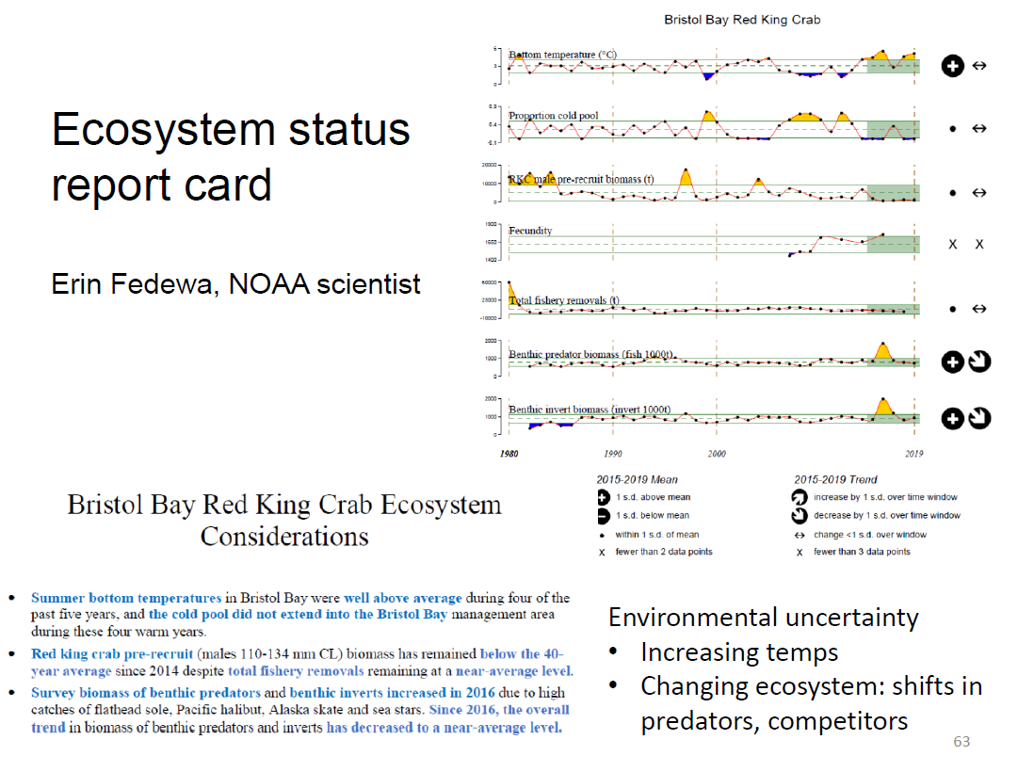
Where are we now?
+
-BBRKC, EBS Tanner and Snow Crab ecosystem report cards produced for ADF&G TAC industry presentation
Slide presented by Ben Daly, Oct 2019
Notes:
-Highlight how report card framework (i.e. just ecosystem indicators with ecosystem summary) differs from ESP standardized framework and 4 step approach –no socio-economic indicator incorporation
-Idea that report card format has been used as a means to communicate uncertainties in management decisions to industry in light of ongoing environmental changes.
-Take from Ben Daly during discussion- is there a more effective way to do so than report card approach?

Slide 7
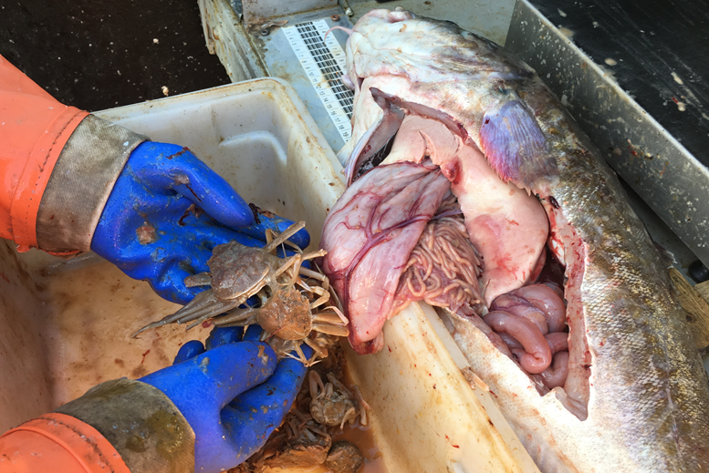
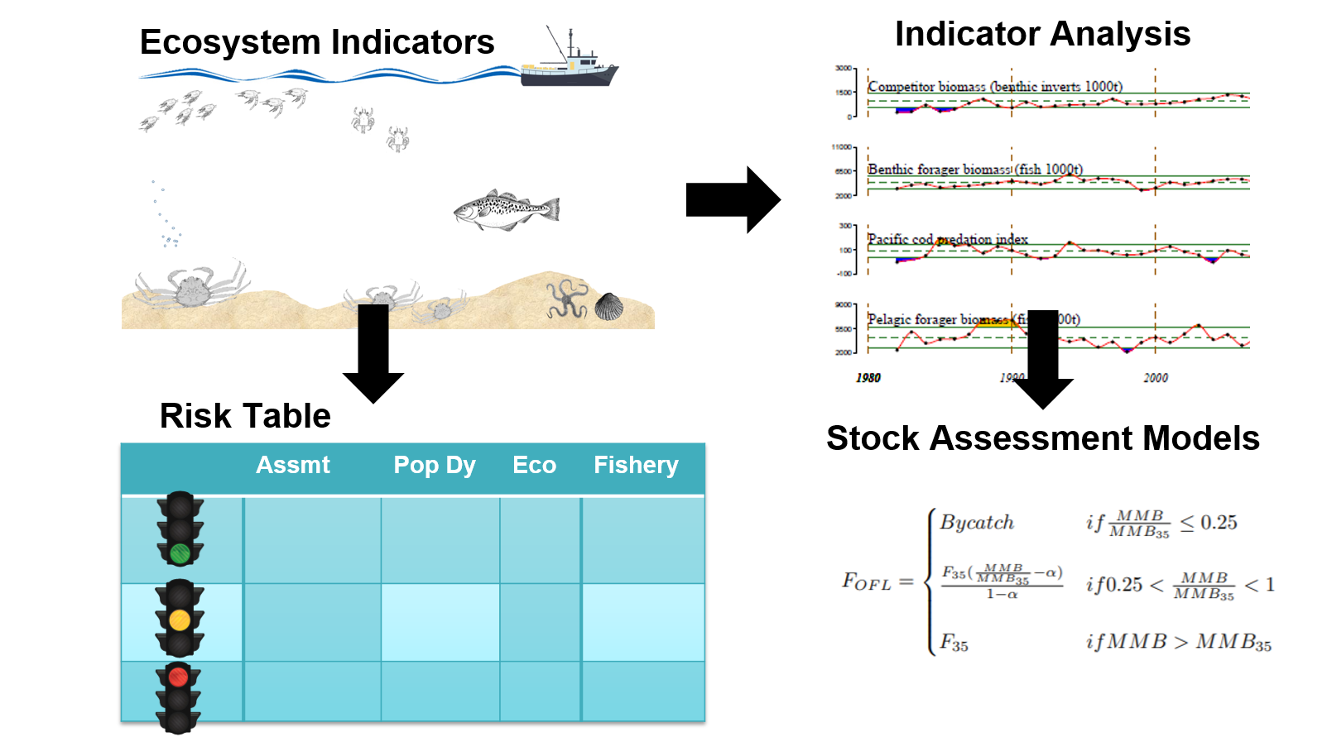
Where are we now?
+
-BBRKC, EBS Tanner and Snow Crab ecosystem report cards presented at BSFRF September Crab Science Symposium
Continued importance of translating ecosystem approaches and findings to BSAI crab industry!
Notes:
-Deep concern with cod predation from industry during panel discussion after symposium. Need to better emphasize the applications of ESP’s in EBFM?
-Erin was approached by several commercial fishermen with great ideas for meaningful indicators- this stresses the importance of involving industry in ESP/report card development and dissemination
Use of indicators in models: as a proxy to inform recruitment (i.e. condition) or as a modifier to inform model parameters such as growth, mortality, catchability or selectivity. Use of indicators in changes to ABC, or to highlight data gaps and research priorities.
Erin: Could also mention that the ESPs are designed to inform the risk tables. So should crab determine to create risk tables, the ESPs will help with that scoring.

Slide 8
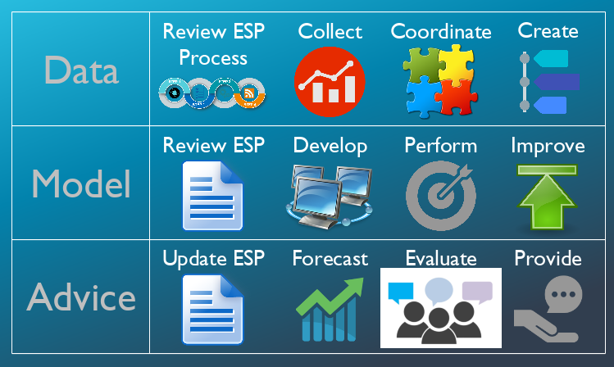
Where do we go next?
+
March 10-12, 2020 ESP modeling workshop
Notes:
2020 Model Workshop Goals (updated from RWP proposal):
1) Review the ESP framework, current and new priority ESPs, data accessibility for ESPs, and Council recommendations regarding ESPs
2) Discuss and generate guidelines for ESP modeling applications from simple indicator development and analysis to advanced multi-species, climate-enhanced models
3) Foster communication and collaboration between programs and discuss the process for ESP contributions, timelines, and avenues for improvement
4) Review the 1st ESP workshop report, outline the 2nd ESP workshop report, and prepare both for producing a technical memorandum series
We will also be reviewing and discussing the guidelines from the SocioEconomic Aspects in Stock Assessments Workshop (SEASAW) that is happening February 11-13, 2020.

Slide 9
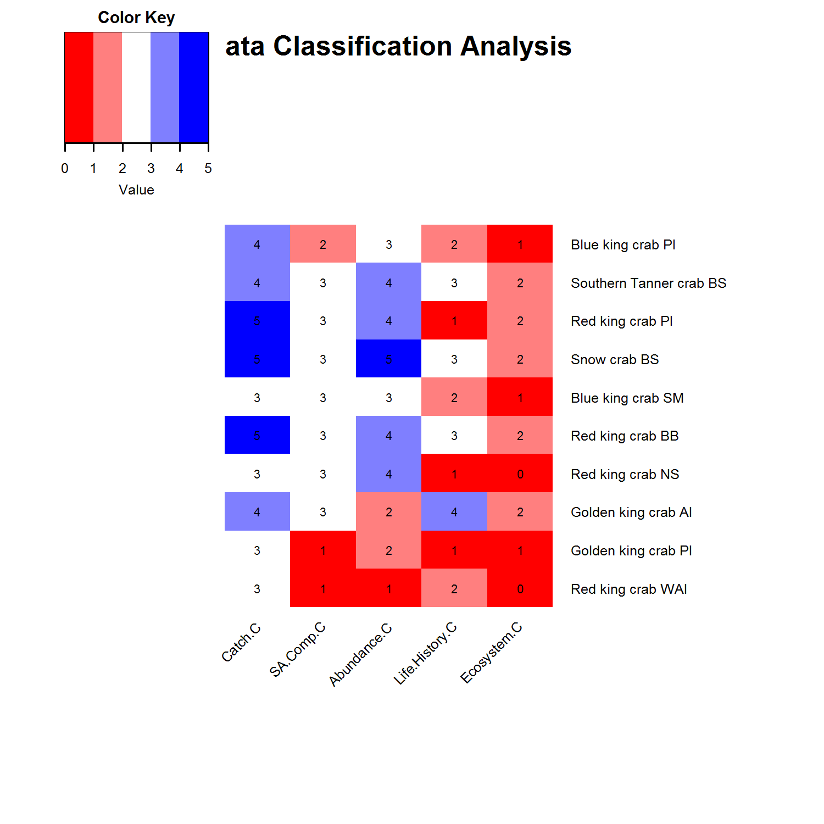
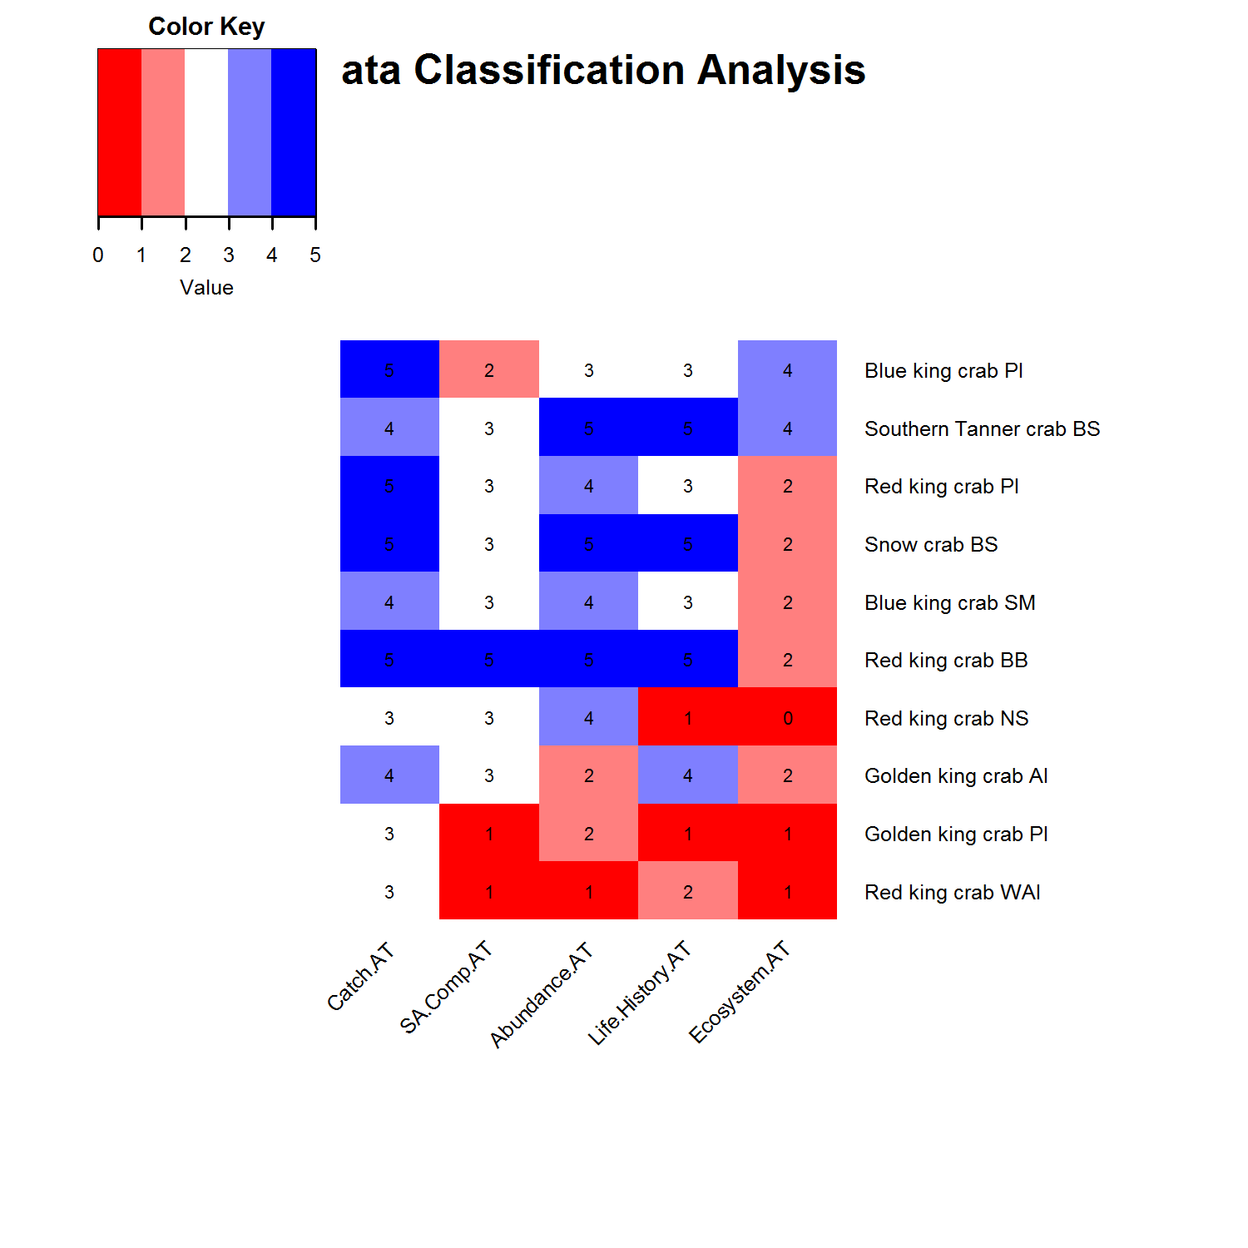
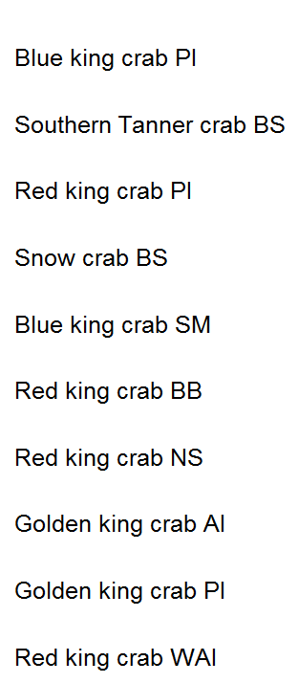
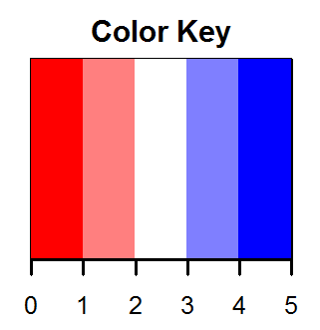
Where do we go next?
+
Prioritize stocks for ESP’s and/or report cards
Current Classification
Target Classification
Catch
Life History
Ecosystem
Catch
Abundance
Life History
Ecosystem
Size/Age
Abundance
Size/Age
Notes:
Erin, here is an updated figure with the current and final target classification scores for crab stocks. I grabbed my pres from Sept Plan Team and updated with final target numbers. I put black arrows by the stocks with a 3 or higher on the target ecosystem. Might be a decent starting point for setting priority stocks for the next ESPs. We are doing something similar for groundfish ESPs and combining with what the SSC has requested. FYI, all Pcod (EBS, AI, and GOA), and BSAI Atka have been discussed by SSC for next September. We are currently discussing how to do that.
Prioritization: goal is to use the data classification results to help start a priority list. Stocks that scored high on either the current or target ecosystem categories would be most likely to start an ESP, or if recommended by SSC specifically.

Slide 10
Where do we go next?
+
Development of regularly updated, reliable and long-term indicators
-What timeline will best allow for indicators to be updated each year?
-How to select informative socio-economic indicators for stocks with extensive fishery closures?
-SSC indicator recommendations:
-OA index for stocks with high vulnerability
-Community engagement and dependency patterns
-Changes in harvest and processing diversity as fishing portfolios, fleet sizes and utilization rates have changed
-Habitat vulnerability indicator
Notes:
Erin, we are going to show an updated version of the data repository (ERDDAP) for accessing ecosystem and socioeconomic indicators at the ESP workshop. We will also discuss timeliness and reliability with the group, so we should include the CPT timeline in this discussion as well.
we also have a webpage developed for pulling satellite time series by the different management regions in AK. It's in development, but getting feedback on what data we should include would be quite helpful. So far we have winds, SST, chlorophyll, and are hoping to include more this next year. This will also all be available through the ERDDAP as we set it up and small regions could be pulled relatively quickly.
From SSC Minutes: The SSC recommends that the ESP be augmented to track indices of community engagement and dependency, by community or aggregations of communities, across the relevant vessel and processing sectors and, for the years following rationalization, quota share ownership by community by share type. Where data confidentiality constraints dictate, the analysts should consider the use of regional as well as local quotient indicators.
Possible OA measures per Kalei: IPHC has a pH sensor on their profilers and they have been collecting data since 2009 on their setline survey. They also have bottom temp, the temp profile, estimate of chlorophyll and dissolved O2.

Slide 11
Where do we go next?
+
Ideas for additional BSAI crab indicators?
-Shellfish assessment program current research:
BBRKC fecundity and movement
Bitter Crab Syndrome prevalence
Pacific Cod predation rates
Snow crab body condition
Effects of OA on crab stocks
Spatial distribution indices (centers of distribution, area occupied)
-Early life history indicators (abundance, phenology)
-Multivariate climate indicators
-Community Engagement
-Bioeconomic models (social and economic drivers of the fishery)
-Benthic Production

Slide 12
Where do we go next?
+
Direction and timeline for future ESP/Ecosystem Report card development
      Role of ESP’s and report cards:
-Target audience? Uses?
-Effective format to communicate with industry
Timeline:
-How often? Updated annually? Presented at May CPT Mtg?
-Updates and improvements to SMBKC to inform re-building?
Development of ESP’s:
-Data contributions, personnel involvement?
-Feedback system?
-Improvements for adapting standardized framework to crab stocks
Notes:
From Kalei: From my perspective it would be good to try to coordinate the ESPs as much as possible. So making sure the data for crab and groundfish indicators are in the ecosystem repository, and available when authors need it. For timeline, at the groundfish PT and ESP workshop we discussed the updating of the ESPs for groundfish and the consensus seems to be to have the first time ESP presented at the September meeting (May meeting for crab). Then subsequent ESPs could be annual shorter updates of indicators with a brief write up of trends and recommendations (we are developing a short form template for this to be used for GOA pollock and sablefish next September). I suspect they will want the short updates at the November meeting for groundfish so they could get as many current year updates as possible since most of the indicators are not ready until October. I suspect for crab you would have fewer current year updates by September, so that might be worth a discussion on what is easiest for workload and not necessarily for current year updates.
For development of ESPs, I’d still like to devote time at each workshop to include a crab stock, so that would be something to discuss, what might be useful to present at the next ESP workshop and what discussions would be helpful on adapting the framework for crab stocks.

Slide 13
Questions?

