Slide 1
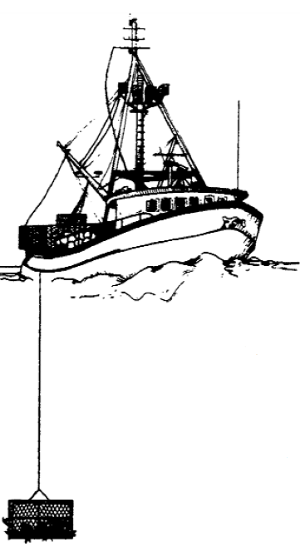
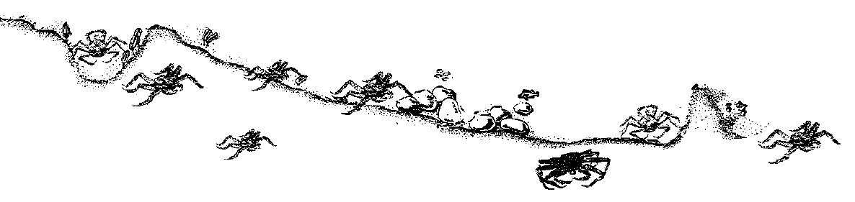
Research and Data Needs for Bering Sea Crab
SSC Research Priorities Workshop
Jan 29, 2020
Seattle, WA

Slide 2
CPT discussion from Jan 2020 CPT meeting
Council staff categorized the existing research priorities into ten larger groups (themes).
The CPT reviewed the 10 larger groups and their subgroups.
The CPT liked this categorization and suggested ways to improve it, including evaluating potential redundancy.
CPT updated priority categories for items in the database that had not yet been prioritized by CPT
Discrepancies in prioritization between CPT and SSC were resolved by matching SSC priority (in most cases).

Slide 3
CTP discussed other high priority topics:
Estimation of discard mortality (borrowing across assessments is extensive)
Management strategy evaluations (very important both for evaluating current and proposed harvest strategies for crab, and for evaluating the effect of climate stressors on crab stocks)
Growth estimation (remains priority for parameterizing stock assessments)
Radiometric aging for natural mortality estimation (Fedewa proposal partially funded)
Impacts of trawling on benthic habitat (are crabs are disturbed by the gear or are moving into areas that are disturbed as food is uncovered by the trawls?)

Slide 4
CPT revisited its top 5 priorities:
148--Spatial distribution and movement of crabs relative to life history events and fishing.
225--Develop projection models to evaluate management strategies under varying climate, ecological, and economic conditions and evaluate impacts to managed resources and coastal communities.
592--Maturity estimates for Bering Sea and Aleutian Island crab stocks.
147/171--Acquire basic life history information (e.g., natural mortality through radiometric aging or other methods, growth, size at maturity) needed to inform the crab assessment models.
New research priority called “Studies on physiological responses to climate stressors”. Description: “Investigate how observed environmental changes (temperature, OA, etc.) affect physiological condition & survival of multiple life stages and reproductive output. Consider interactions among multiple stressors.”

Slide 5
CTP comments on overall approach:
The long list of research priorities is difficult to manage.
There are a number of priorities that are overlapping (for example 147 and 171).
Some priorities are broader and some are more specific.
It might be beneficial to assign Council staff or a small working group to develop a hierarchical approach to listing research priorities
Also condense the list by removing redundancies and overlaps.

Slide 6
Research aligned with research priorities at RACE Shellfish Assessment Program (Kodiak lab)

Slide 7
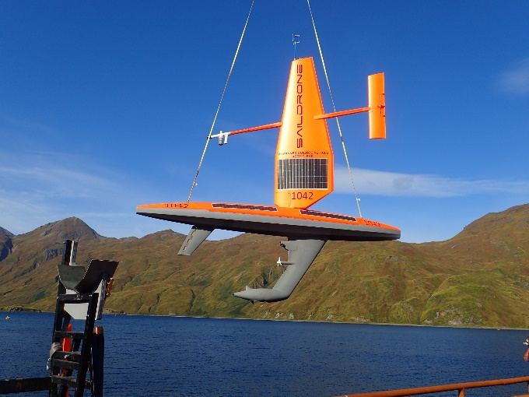
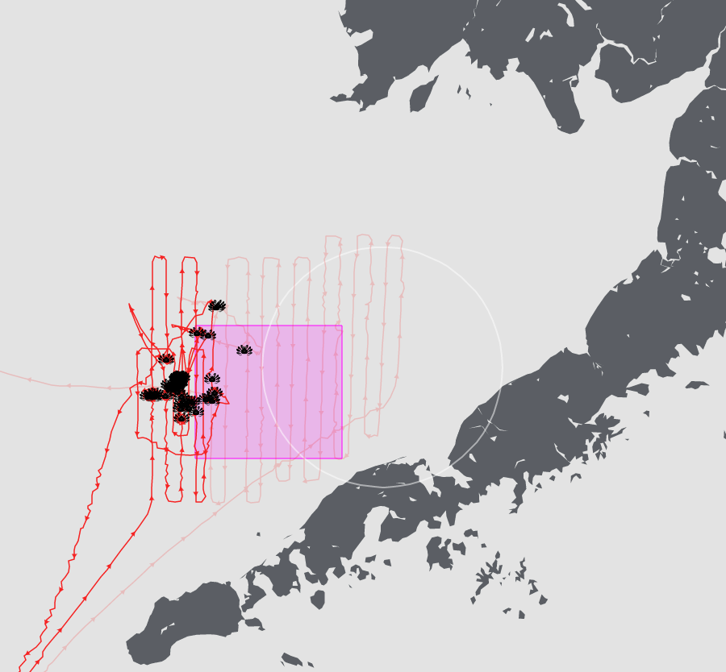
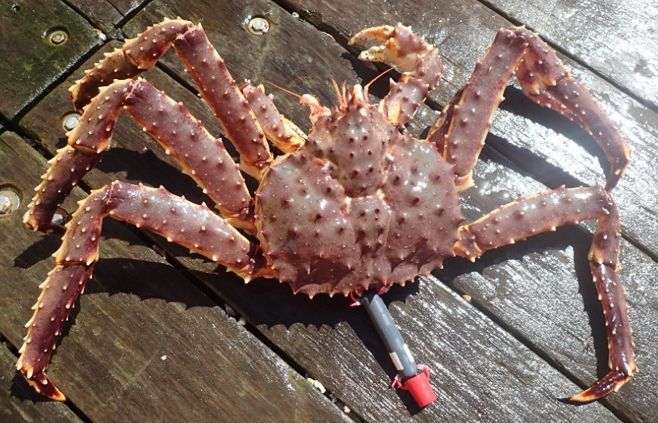
Spatial distribution and movement of crabs relative to life history events and fishing
Determine distribution, movement, essential habitat use, bottom temperature, use of trawl closures ALL outside summer surveys
Seasonal habitat use and movement of Bristol Bay red king crab

Slide 8
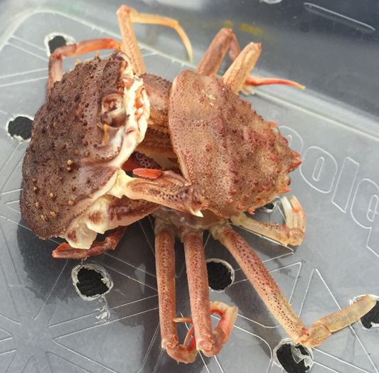
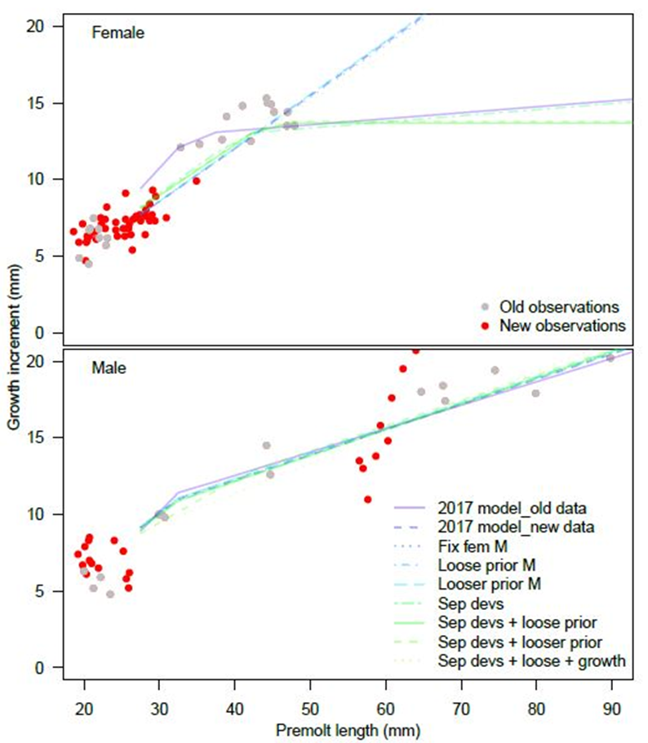
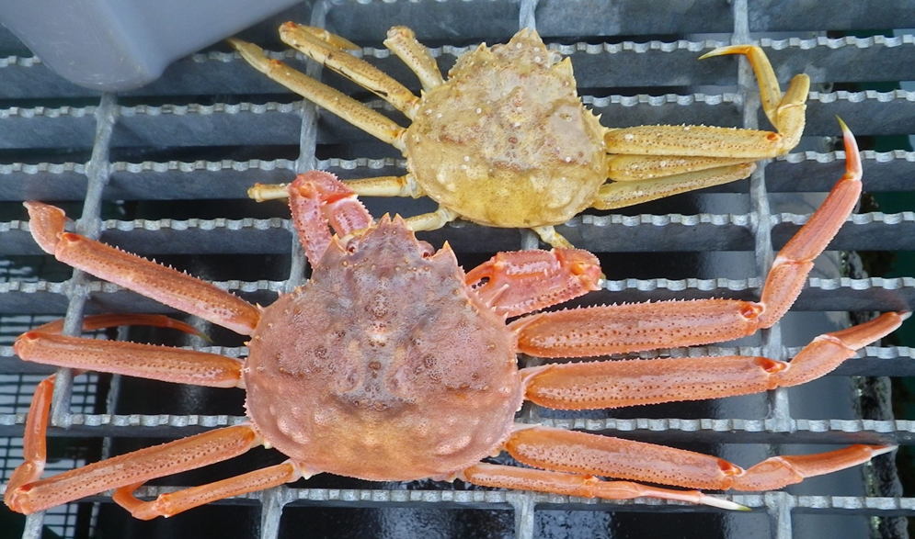
Acquire basic life history information (e.g., natural mortality through radiometric aging or other methods, growth, size at maturity) needed to inform the crab assessment models
Pre- and post-molt length data used to estimate growth per molt function in assessment models
Growth per molt of eastern Bering Sea Tanner and snow crab

Slide 9
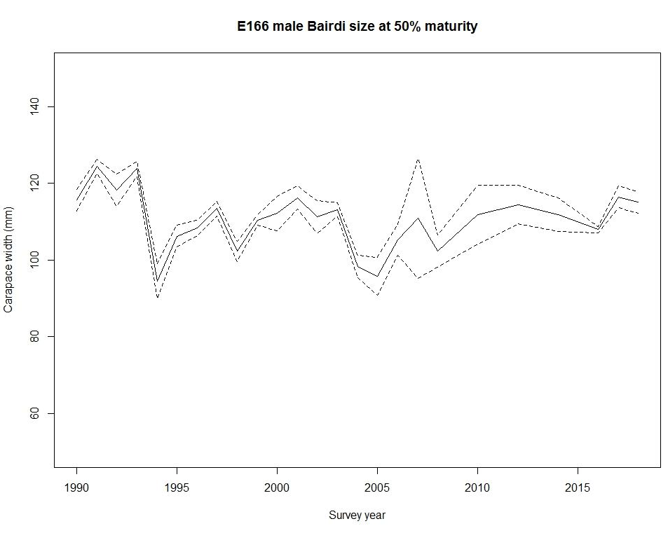
Maturity estimates for Bering Sea and Aleutian Island crab stocks
Variation among years in size at maturity
Tanner crab maturity among years in the eastern Bering Sea

Slide 10
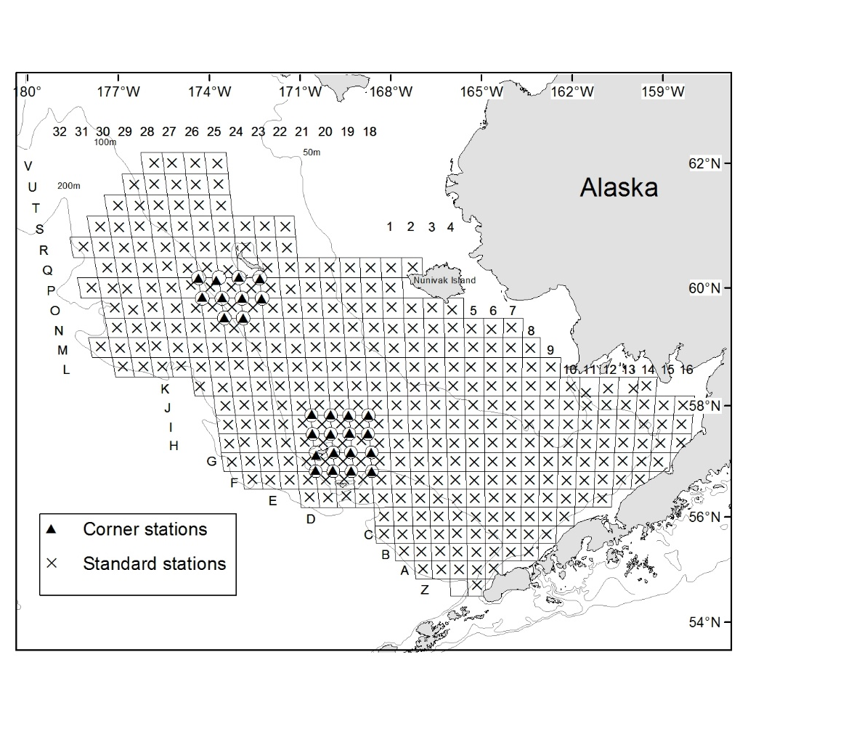
Develop projection models to evaluate management strategies under varying climate, ecological, and economic conditions and evaluate impacts to managed resources and coastal communities
Primarily affects uncertainty estimates in Snow and Tanner Crab stock estimates
Effects of eliminating corner stations around Pribilof and Saint Matthew Islands

Slide 11
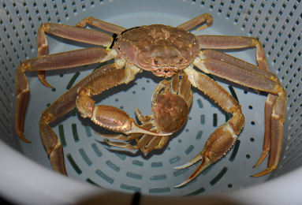
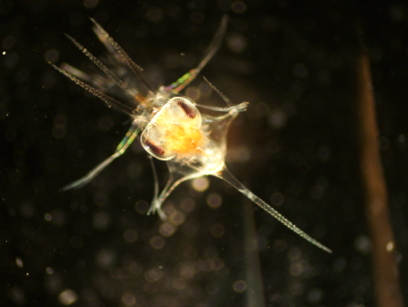
Studies on physiological responses to climate stressors
Future direction for OA research on crabs
OA isn’t the only thing changing; we need to understand interactions with:
  Temperature
  Dissolved oxygen
  Other stressors?
What are the physiological mechanisms
Can crabs adapt?
  Why do some crabs do better than others?
    Within a species
    Among species
  Is there evolutionary potential within populations?
Are there indirect effects?
  Feeding
  Predation
How will the ecosystem respond?
Ocean Acidification

Slide 12
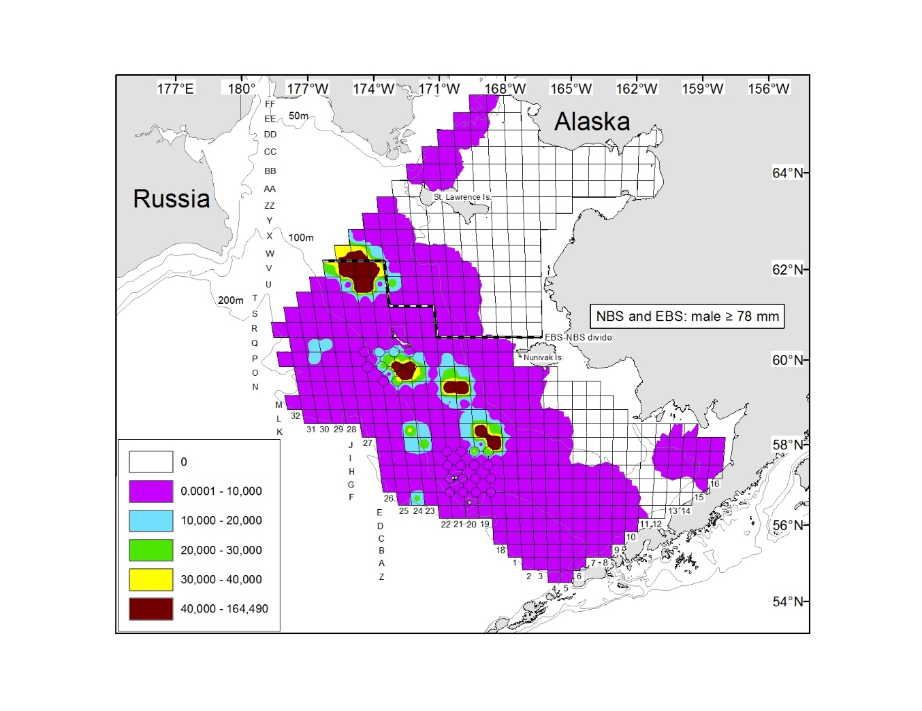
Eastern and Northern Bering Sea Trawl Surveys
Legal sized snow crab now found at the border of the EBS-NBS surveys
Continue to add NBS survey to understand range shifts

Slide 13
Presenters prerogative: a proposal for a hierarchical approach for research on crab stocks

Slide 14
A hierarchical approach for research on crab stocks

