Slide 1
AFSC RPA Ecosystem Surveys:
Gulf of Alaska, Eastern Bering Sea, Arctic
Alaska Fisheries Science Center
Presenter: Janet Duffy-Anderson (EcoFOCI)
SSC Workshop – Research Priorities
January 28, 2020
Seattle, WA

Slide 2
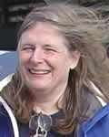
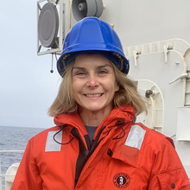
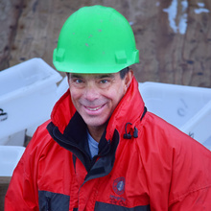
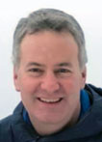
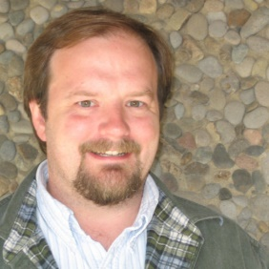
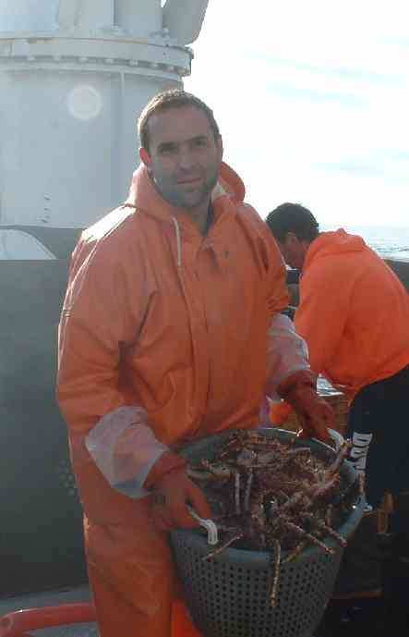
Recruitment Processes Alliance
NOAA Research (PMEL)
EcoFOCI – Stabeno (physics, physical modeling)
NOAA Fisheries (AFSC)
EcoFOCI – Duffy-Anderson (field)
EMA – Farley (field)
RECA – Miller (Acting, previously R. Heintz) (lab)
-------
Regular collaborations (AFSC Programs)
FBEP – Hurst (field, lab)
REEM – Aydin (modeling), ACLIM, CEATTLE, Holsman, Siddon, Shotwell
FEP, ESR, ESPs

Slide 3
Goal & Objectives
RPA Goals: Provide mechanistic understanding of ecosystem, fish recruitment processes; ongoing physical and cross-trophic monitoring (decadal time series); development of indices, synthesis for forecasting
To be used in decision-making
RPA Approach: mechanistic, bottom-up forcing, lower trophic level, fish ELH and new fish production
Today’s Objectives:
RPA Field Surveys (when and where)
Ecosystem Data Collected
Management Applications (2 examples)

Slide 4
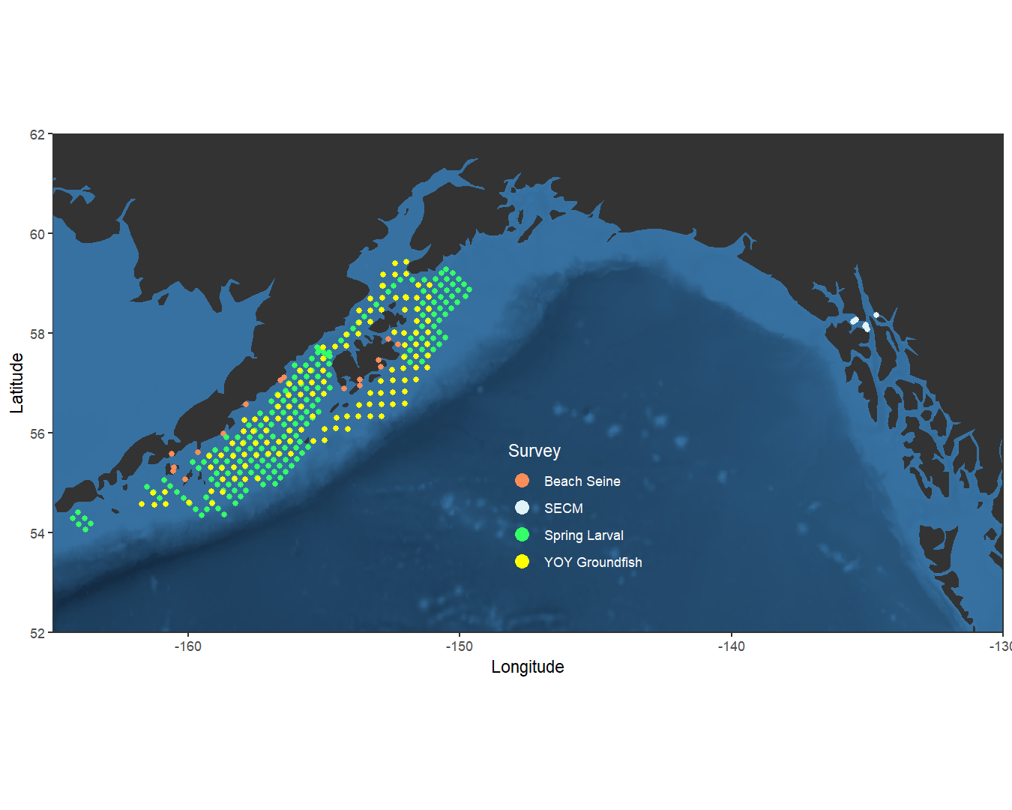
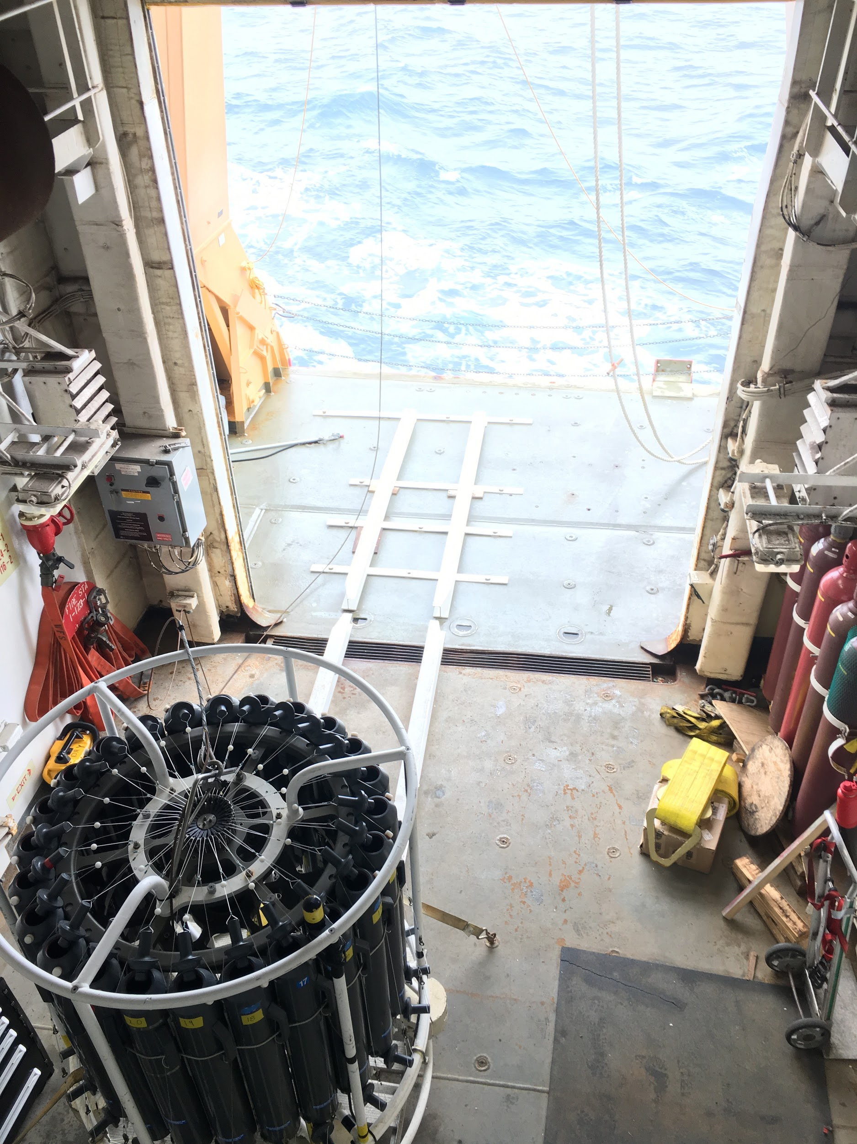
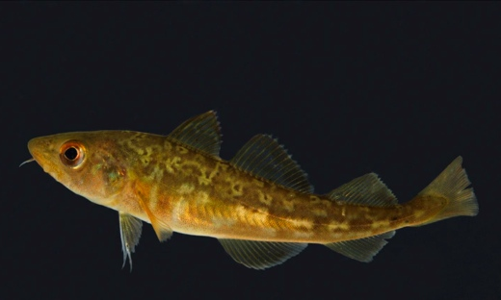
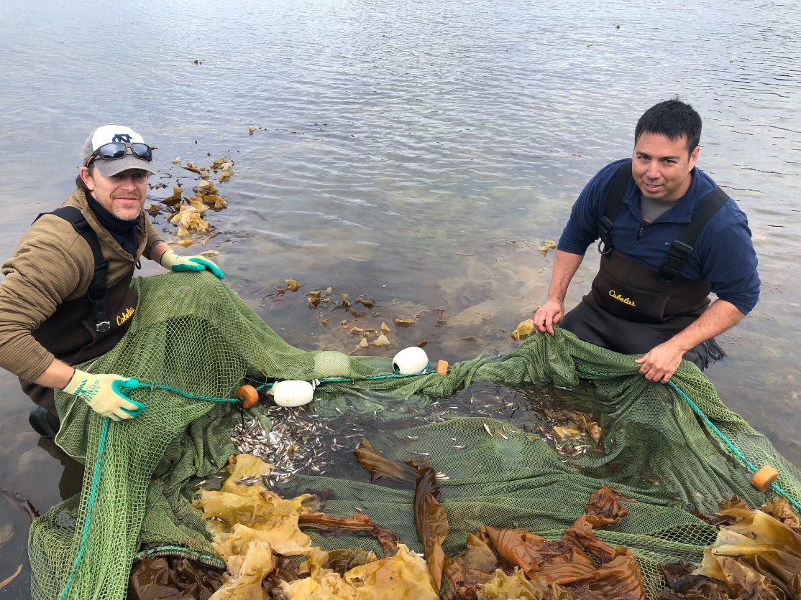
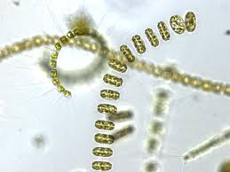
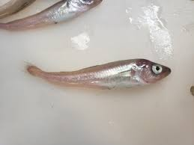
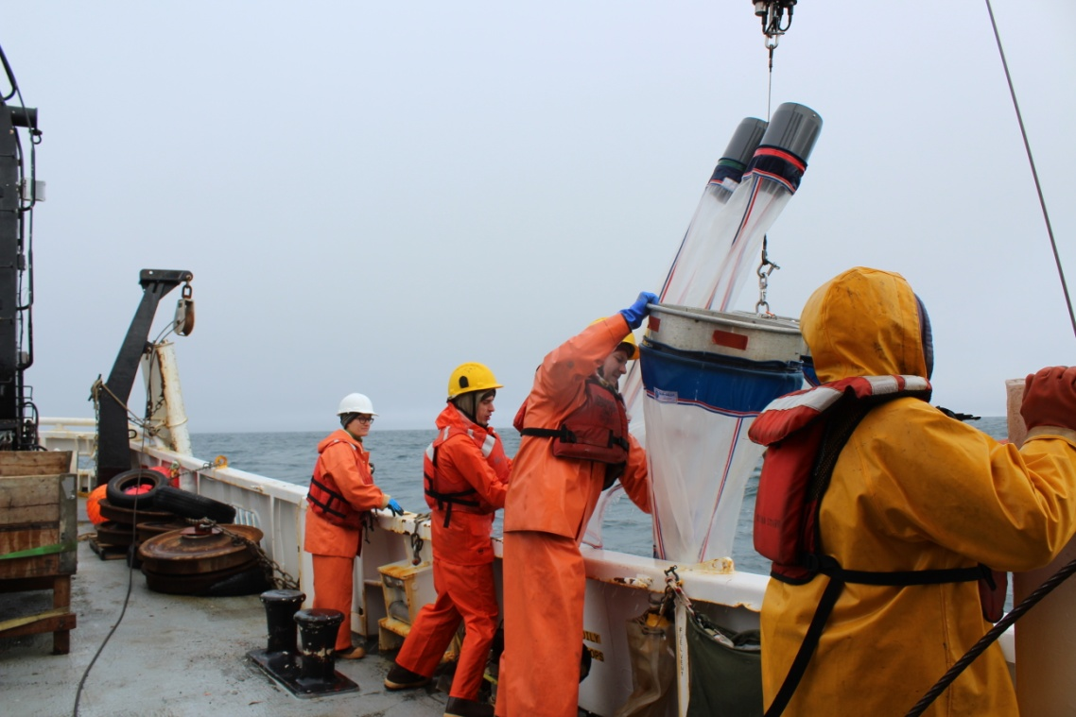
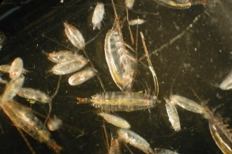
LME: Gulf of Alaska
2019
SURVEYS:
Spring larval – spring, since 1984
SECM – spring/summer, since 1997
Beach seine (FBEP) – summer, since 2006
YOY groundfish & forage fish – summer, fall since 2000
DATA:
Moorings – Shumagins, Cross Sound, Kodiak
Shipboard – CTD (T, S, PAR, O2, ADCP, Seachest
Nutrients, Phytoplankton
Zooplankton (copepods, euphausiids), larval fish (all species)
Fish - Age-0 pollock & Pcod, capelin, eulachon
Acoustics
Nearshore – Age-0 Pcod & Pollock, T, S, O2, cameras
Laboratory – ageing, diet, condition (fish and zp)
Modeling – statistical, biophysical, bioenergetic
Notes:
RPA has conducted ecosystem surveys in the WGOA since mid 1980s. Surveys are conducted in spring (May) and fall (Sept). Conducted annually until 2011 and biennially since then in odd years. Focus is in the WGOA – larval, beach seine, YOY but also SECM in EGOACollect cross trophic data – physics to fish, explain
Data are used in ecosystem models like ACLIM & FEAST, ESRs, and as considerations in quota setting
Ichthyoplankton samples provide data on the larval stages of many of the commercial groundfish species from BT surveys: gadids, flatfishes, rockfishes, sablefish (when neuston tows) etc.
Modeling is done both by the RPA in collaboration with PMEL and in collaboration with REEM. Ex: Kirsten's work on ACLIM and CEATTLE, Hermann ROMS modeling

Slide 5
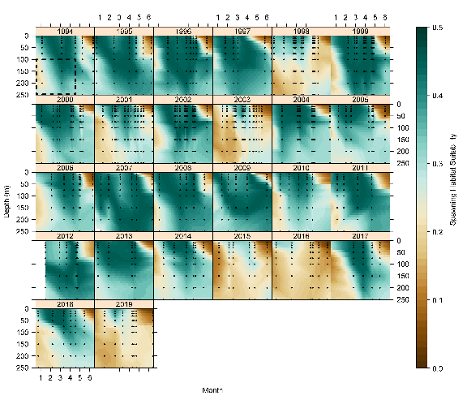
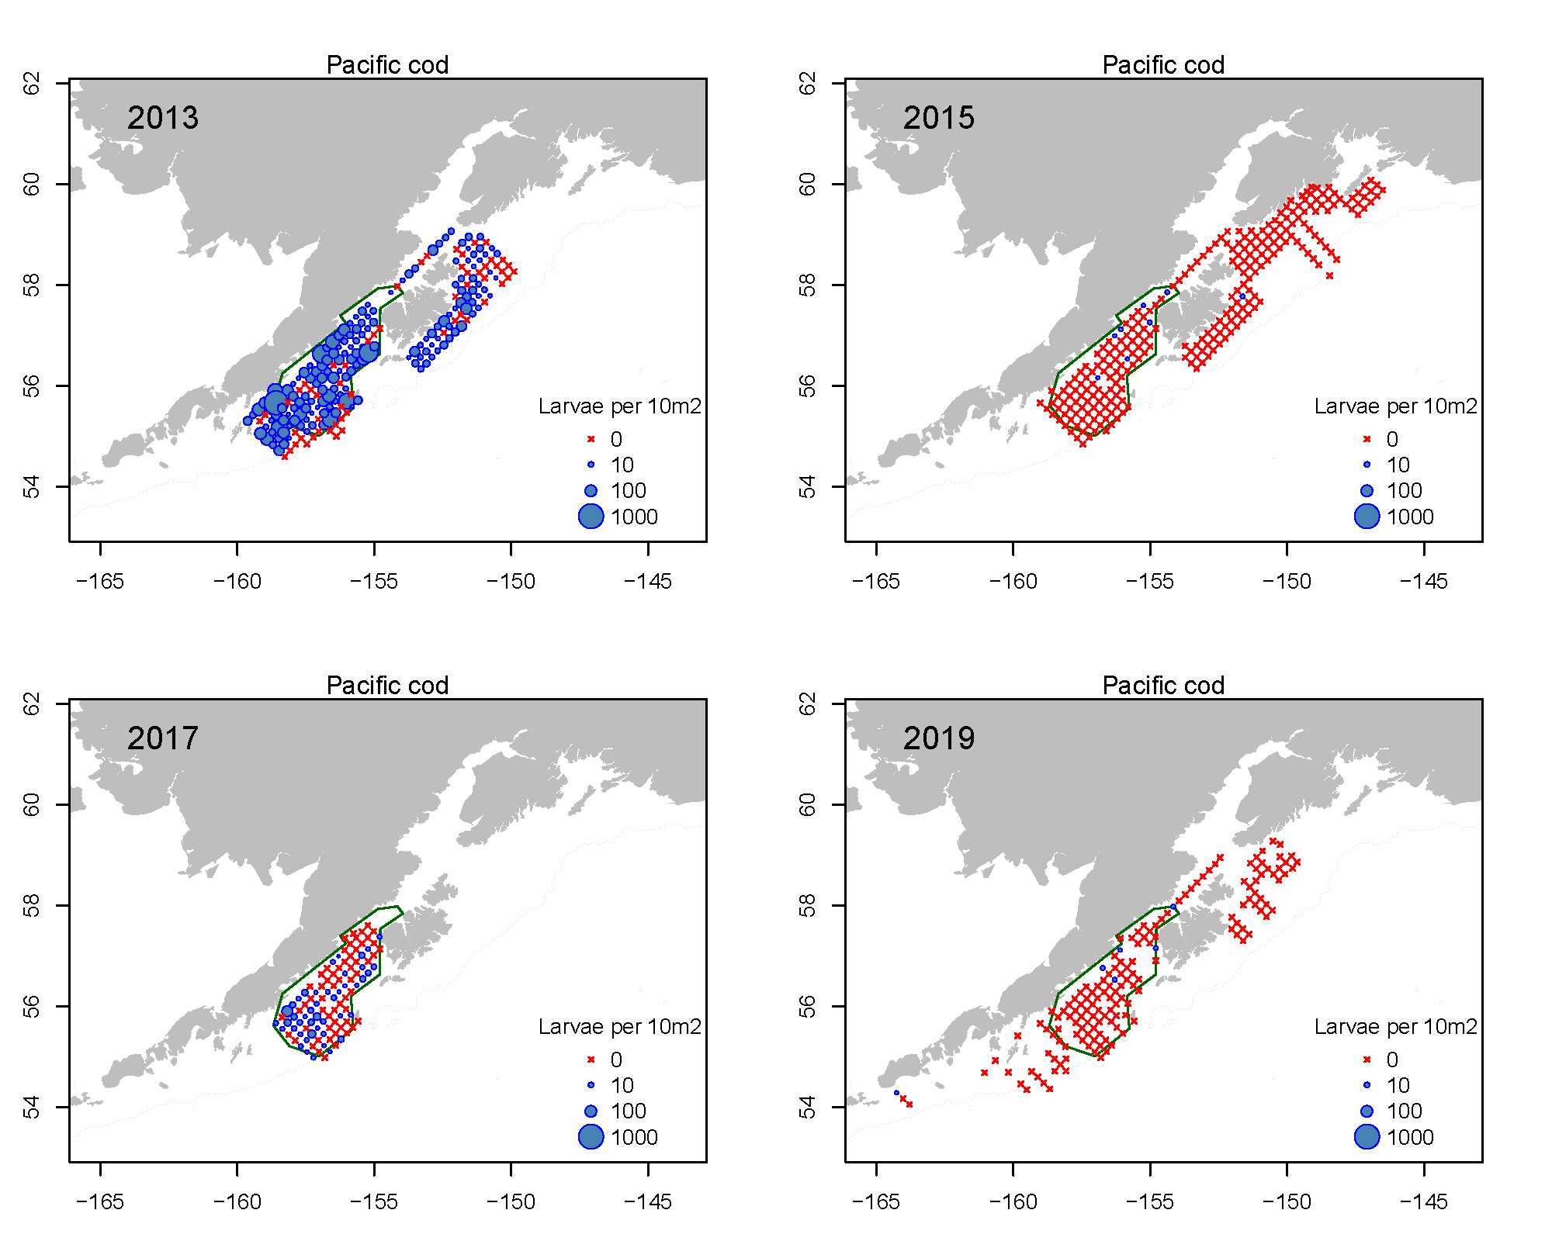
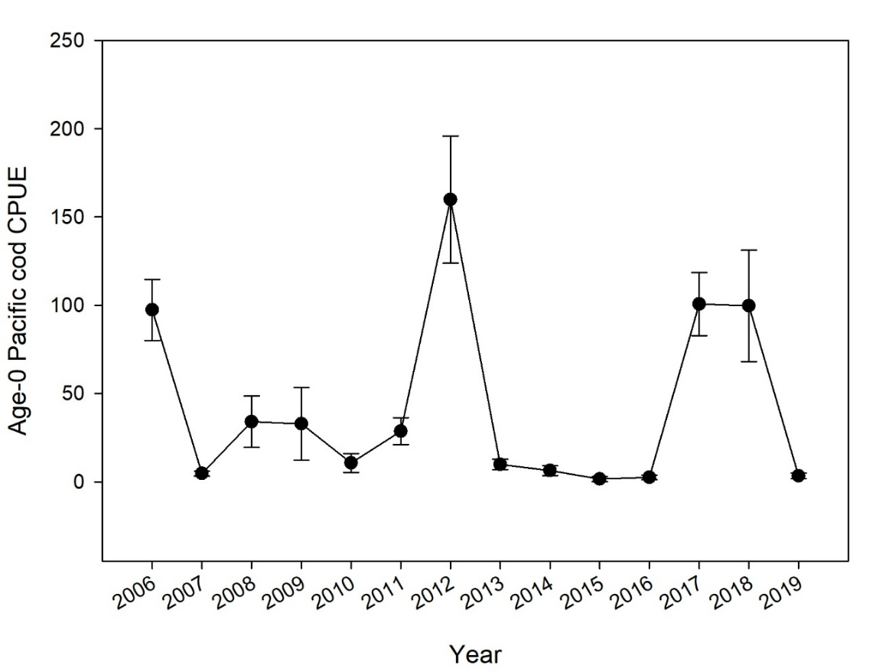
How have RPA results contributed to management?
Example: Pcod and marine heatwaves – mechanisms for decline?
Egg habitat index
Larval time series
Juvenile index
heatwave
heatwave
heatwave
heatwave
FBEP - Kodiak nearshore beach seine
Age-0s
Mechanistic links - able to offer improved understanding of some processes associated with GOA Pcod changes (recruitment)
Projections and indices (spawning habitat index, larval time series, age-0 index), SA risk table
Used in consideration with SA, other ecosystem data in setting/modulating ABC. Considerations in decisions made to keep fishery sustainable
Notes:
Example: Pacific cod in GOA
Pcod production of offspring highly sensitive to effects of marine heatwaves (Blob 2014 – 2016; mini-Blob 2019)
PANEL 1: Pcod eggs – narrow temperature tolerance range, heat increases egg mortality. Figure – green indicates areas of suitable Pcod egg habitat (temp X depth X salinity) in WGOA. Note that during the 2 recent marine heatwaves significant lack of green (Temps much too high). Brown indicates unsuitable habitat and significant Pcod egg mortality
PANEL 2: Production of Pcod larvae during marine heatwave years was significantly depressed. Blue = Pcod larvae caught during survey, red X indicates a tow with no catch.
This information was provided at spring PEEC meeting and were noted as red flags
PANEL 3: Occurrence of Pcod juveniles (age0) in critical nearshore habitat around Kodiak Is is significantly depressed during marine heatwave years. Important bc age0 catch during survey is significantly and positively related to Pcod recruitment at age3.
MANAGEMENT APPLICATION: Data are indicative of poor recruitment of Pcod in upcoming years. Contribute to decisions that help to keep the fishery sustainable over the long term

Slide 6
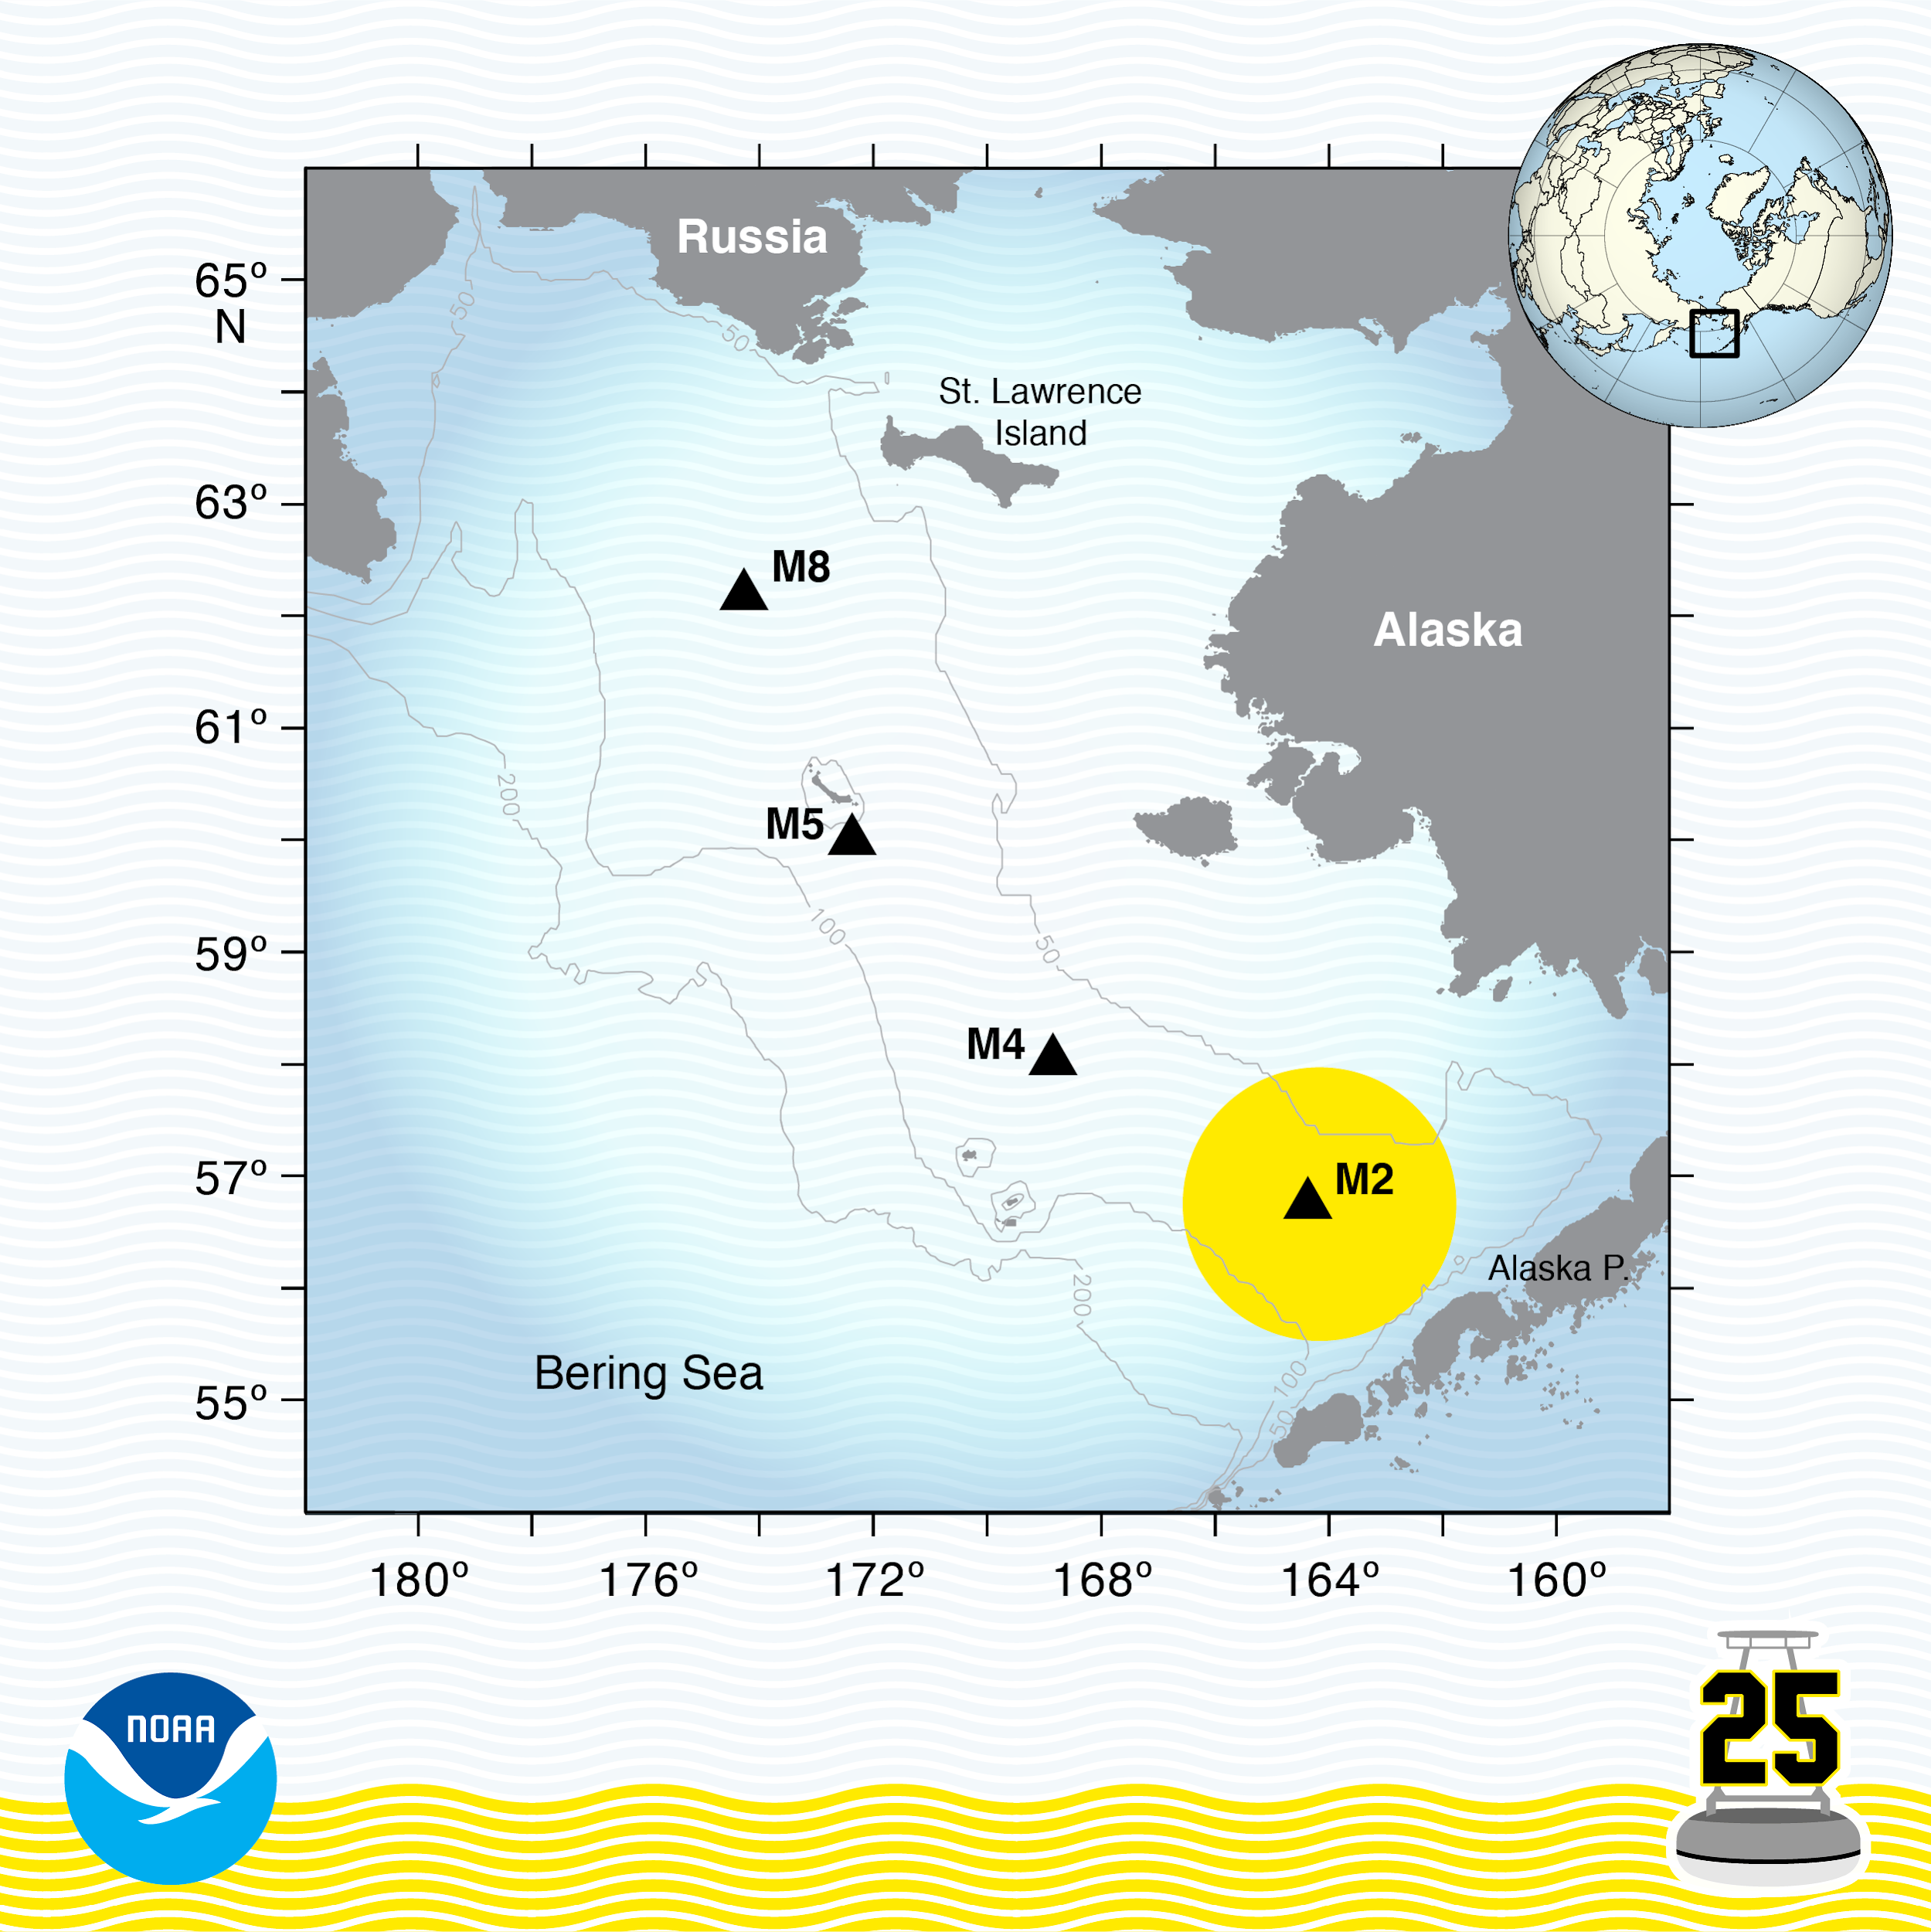
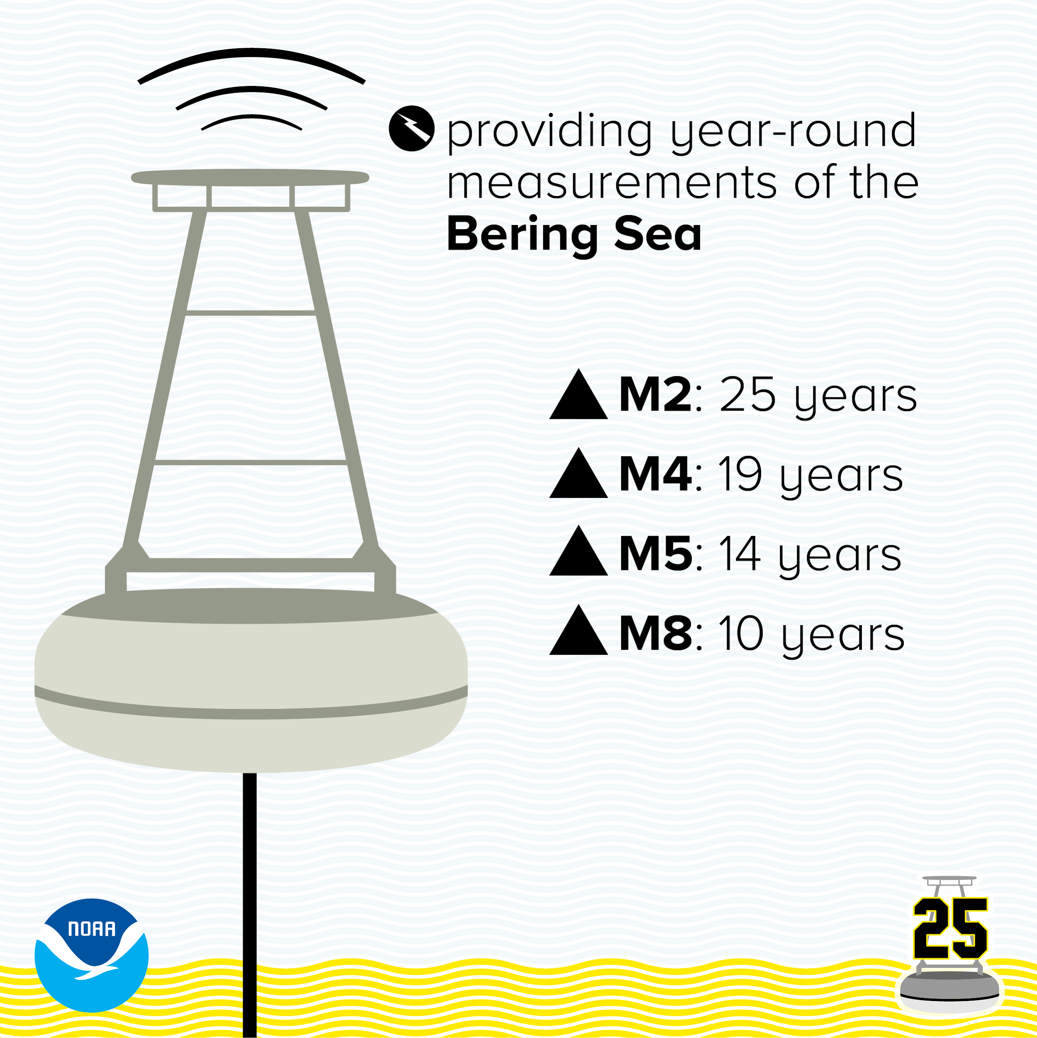
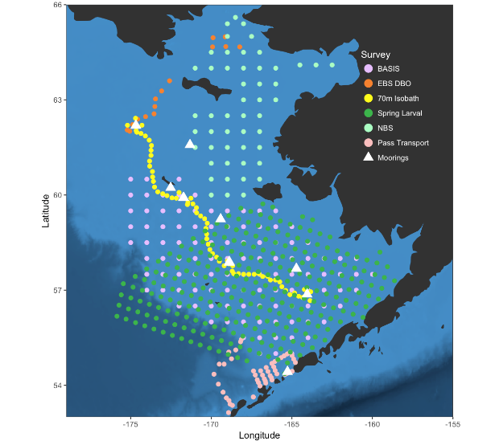
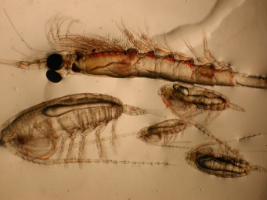
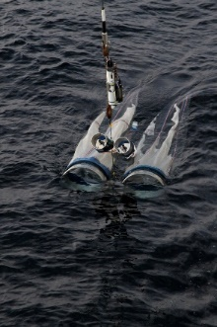
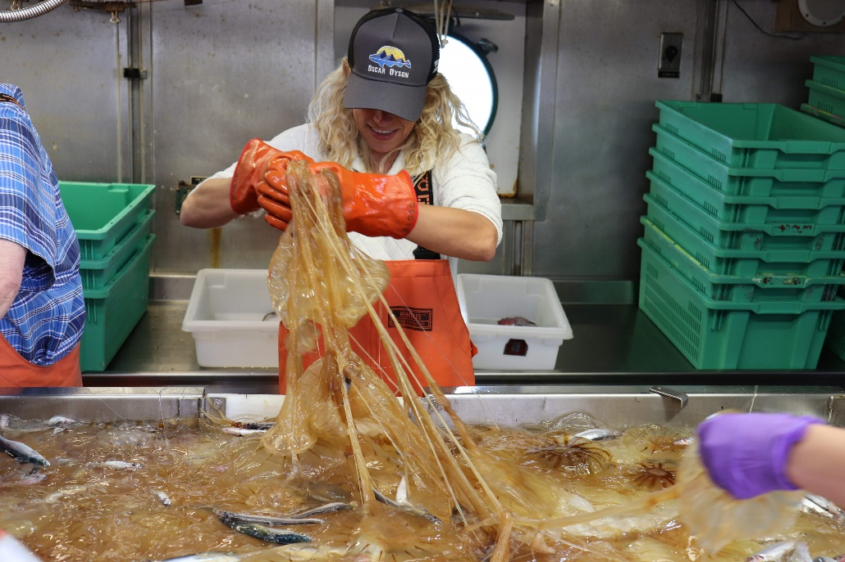
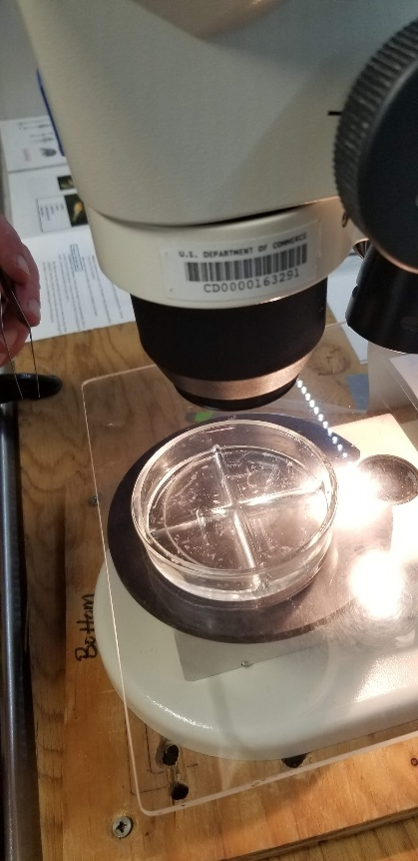
LME: EBS / NBS
2020
SURVEYS:
Spring/Fall Moorings
Spring larval – spring, since 1995
BASIS – summer, fall since 2002
NBS – summer, since 2002
DBO – summer, since 2000
DATA:
Moorings – Prawler (M2, M5); whale acoustics
Shipboard – CTD (T, S, PAR, O2, ADCP, Seachest
Nutrients, Phytoplankton
Zooplankton (copepods, euphausiids, jellyfish), larval fish (all species)
Fish - Age-0 pollock & Pcod, capelin, herring, salmon
Acoustics
Laboratory – ageing, diet, condition (fish and zp)
Modeling – statistical, biophysical, bioenergetic

Slide 7
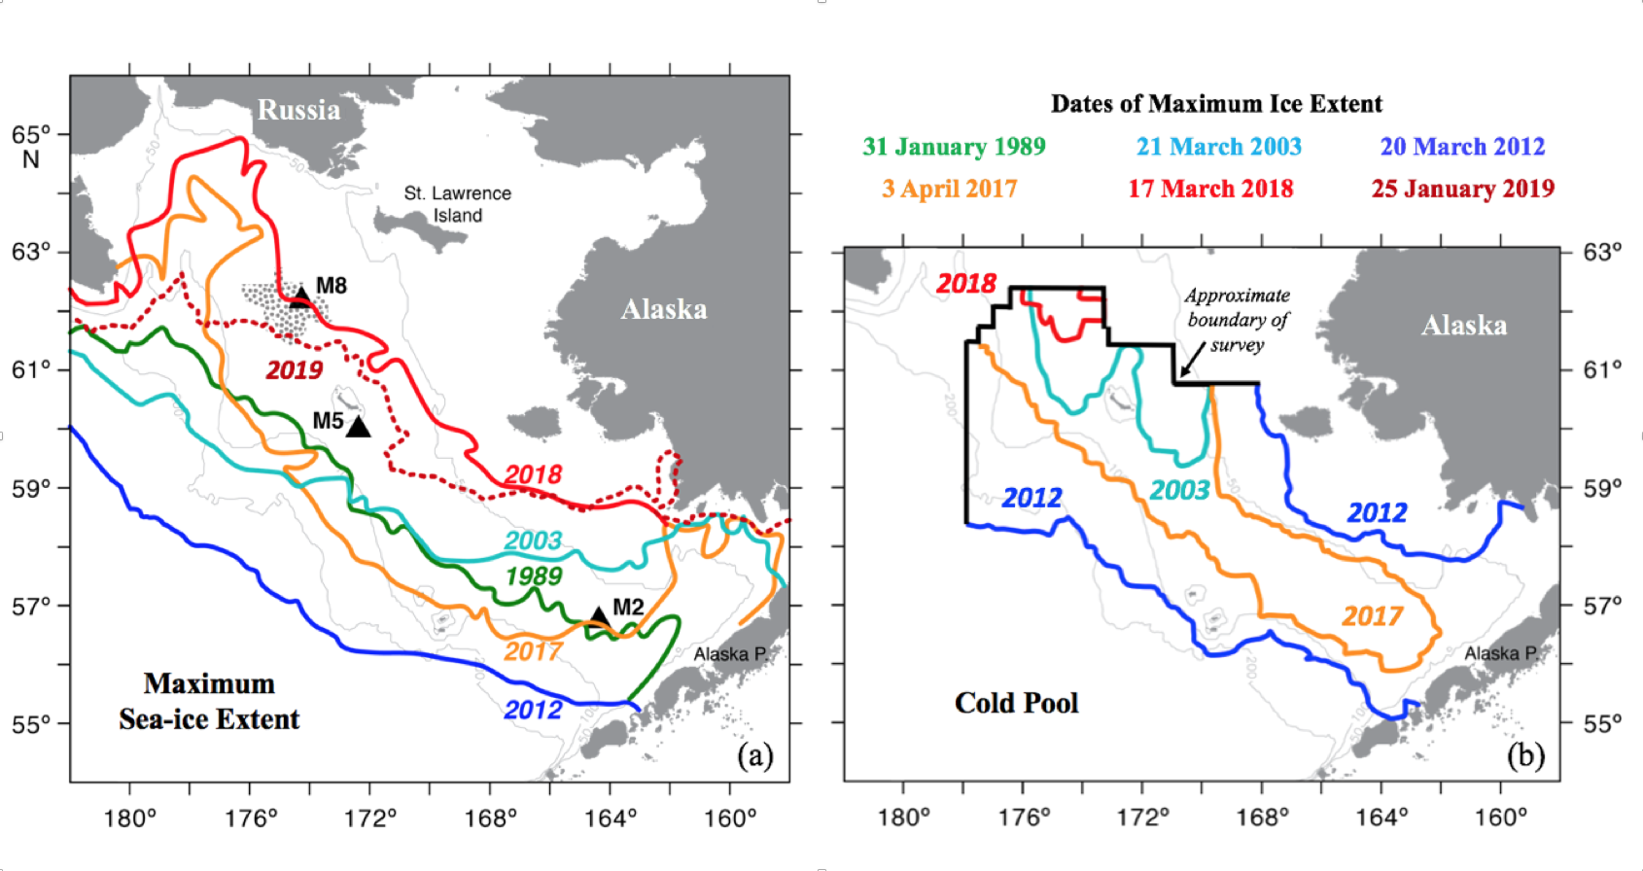
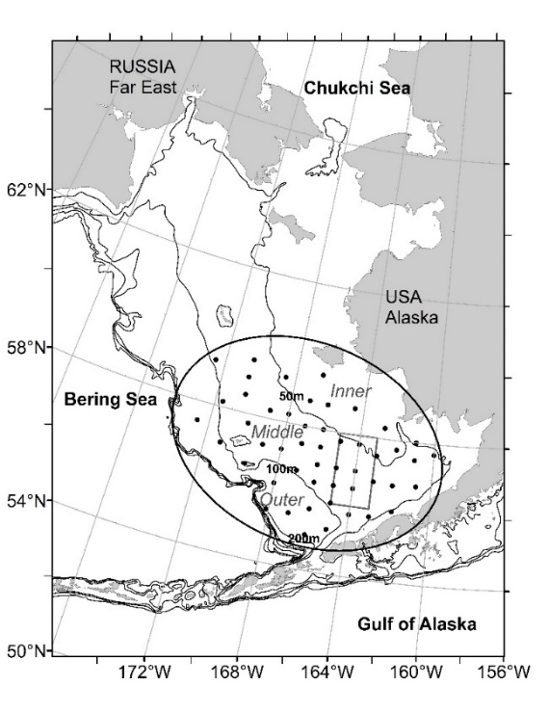
How have RPA results contributed to management?
Example: zooplankton and walleye pollock
Sea ice / Cold Pool
Zooplankton sampling
Zooplankton – pollock recruitment
Age-3 Pollock abund (millions)
VAST-modeled copepod abundance
Mechanistic links - understanding relationship
between lipid rich copepods, provisioning in age-0s, overwinter survivorship, recruitment
Projections and indices (ice index, large copepod index), SA risk table
Used in consideration with SA, other ecosystem data setting/modulating ABC – sustainable fishing
Eisner, Yasumiishi, Thorson, and Kimmel
Notes:
Example: walleye pollock in EBS
PANEL 1: Sea ice extent has been extremely low in recent years (2018-2019). Sea ice determines cold pool size and extent, general thermal conditions over BS shelf (warm vs cold)
PANEL 2: Large sized zooplankton (copepods > 2 mm) are a key prey of juvenile (age-0) pollock and are positively related to sea ice and cold pool extent (more large copepods during cold year; fewer in warm years). Zooplankton are routinely collected by the RPA on ecosystem surveys
PANEL 3: BS pollock recruitment to age 3 is strongly correlated with abundance of large copepods in the age-0 year. Age-0 provisioning on large copepods in summer is critical to overwinter survival success and ultimate recruitment.
MANAGEMENT APPLICATION: Zooplankton data are used as an index of pollock recruitment potential in the BS and are considered during annual quota setting.

Slide 8
Council Priorities currently addressed by RPA
Strategic:
242: Collect / maintain primary production time series
244: Time series on benthic invertebrates and vertebrates
248: Measure / monitor large scale fish population changes
613: Maintain/update biophysical projections
Critical Ongoing Monitoring:
142: Continuation of federal biennial surveys
150: Maintain core biological surveys (biophysical moorings, age-0 surveys, stomach data, zooplankton)
186: Zooplankton biomass & community composition
187: Indicator-based ecosystem assessment for BS
192: Time series of diet data
218: Survey capability for forage fishes

Slide 9
RPA Priorities
Currently implemented:
Expedited, on-board processing – RZA, RLA, condition, AI for zooplankton VPR
Strategic:
Primary production – seasonality, size fractionation, nutritional quality, time series
Zooplankton production – seasonality (esp autumn), krill, annual time series
Overwinter processes – age-0 mortality (starvation, predation, habitat)
Benthic vs pelagic production in the NBS
Critical Ongoing Monitoring:
Spatial structure, temporal dynamics – EGOA & CGOA, SEBS, NBS
Groups of species doing well in current conditions (ex: sablefish, rockfish – resiliency, fleet alternatives)
Notes:
RPA is trying to improve the efficiency and timeliness of reporting.
Rapid on-board series of assessments (RZA, RLA, zp and fish condition at sea)
Also, working to used AI to enumerate zooplankton from VPR or preserved samples
RPA work is an observational discipline and we need platforms and ample shiptime to make these observations. Yes, some can be modeled, interpolated, extrapolated, but there is a certain amount of core measurement that must be made to groundtruth models and provide annual data.
RPA ecosystem data are currently being used to manage or aid in management and how improving them will improve our ability to understand and manage.

Slide 10
THANK YOU

Slide 11
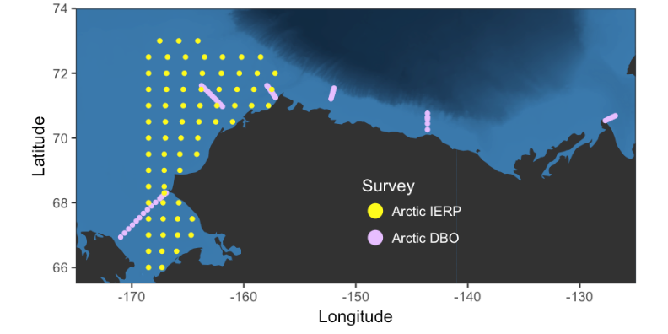
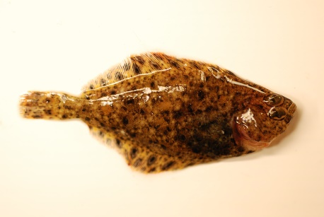
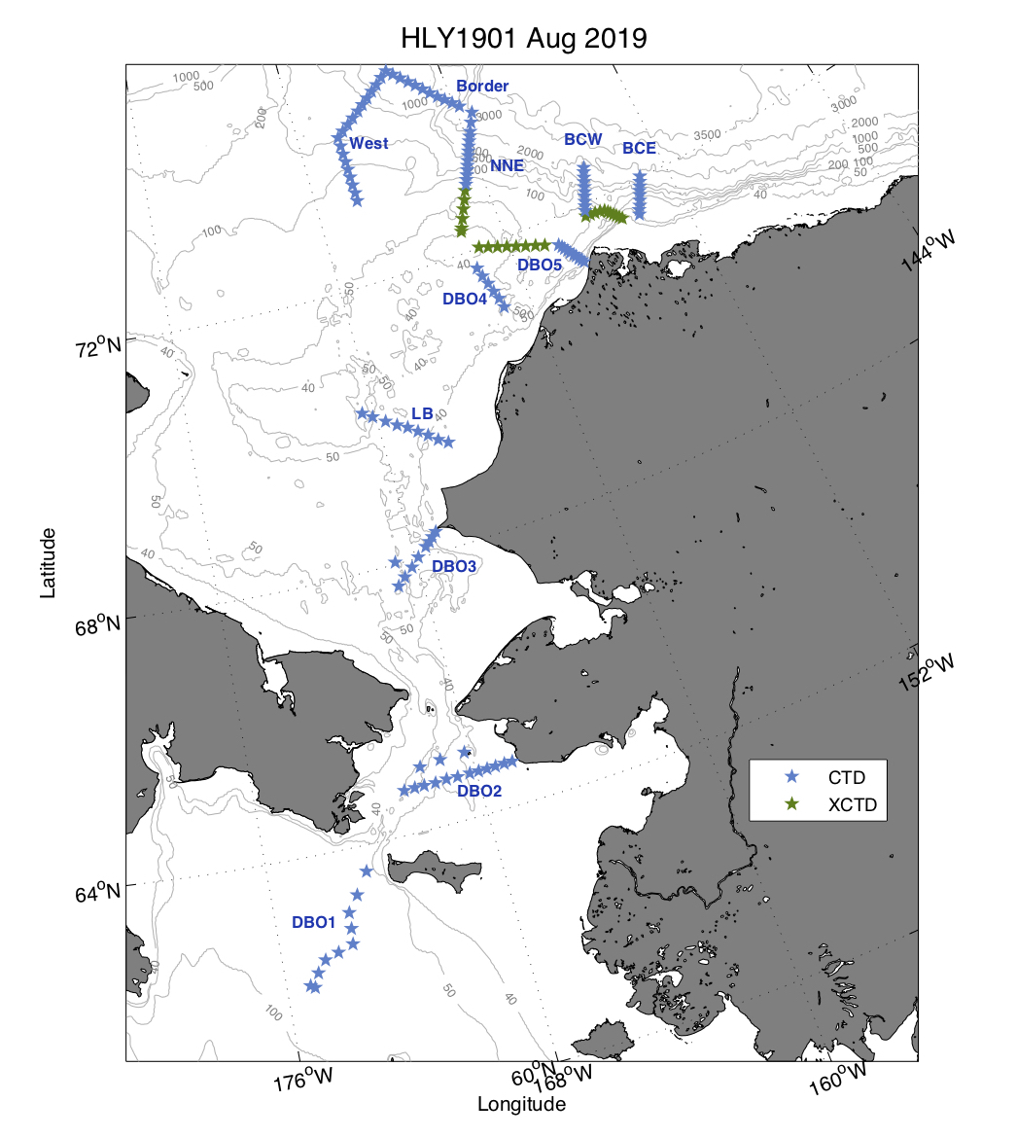
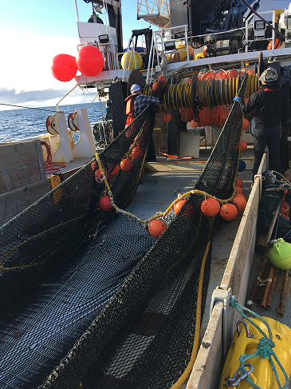

Recruitment Processes Alliance (RPA) Ecosystem Surveys (physics, phytoplankton, zooplankton, eggs, larval, juvenile fish, seabirds, marine mammals)
Arctic - opportunistic
Purpose: Collect observations - sea ice, atmospheric measurements, ocean physics, phytoplankton, HABs, zooplankton, infauna, larval fish, benthic and midwater fish, seabirds, mammals. Determine changes to distributions, fitness, food web dynamics
Application: Loss of sea ice, ecosystem/food web models, Ecosystem Status Reports. Also, implications for local communities
Example: HABs (SAXITOXINS; collaboration with WHOI and NWFSC)
Duffy-Anderson, Eisner, Siddon, Farley, Kimmel, Logerwell
Notes:
RPA has conducted annual ecosystem surveys in the US Arctic since early 2000s. Surveys are conducted summer and are opportunistic contingent upon external funding.
Purpose of surveys is to monitor sea ice, physical oceanography, lower trophics, HABs, new production of various fish species (egg, larvae, juveniles), arctic cod & salmon, and the benthic community
Data are used in models of loss of sea ice, ecosystem /food web models of the arctic, models of connectivity between the BS and the Chukchi, ESRs, and in partnership with local communities. If commercial fish species are moving back and forth between the SEBS and NBS/Arctic then we need to understand (and potentially compensate) for their growth, mortality, and fecundity in the different regions for our assessment models to work
Example: harmful algal blooms in Chukchi Sea
PANEL 1: Maps - collaborating to collect data on HABs from RPA surveys (Arctic IERP, DBO) to determine whether saxitoxins are propagating up the food chain
PANEL 2: collecting zooplankton, krill, fish, clams, crabs, seabird carcasses
PANEL 3:(next slide)
MANAGEMENT IMPLICATIONS: (next slide)

Slide 12
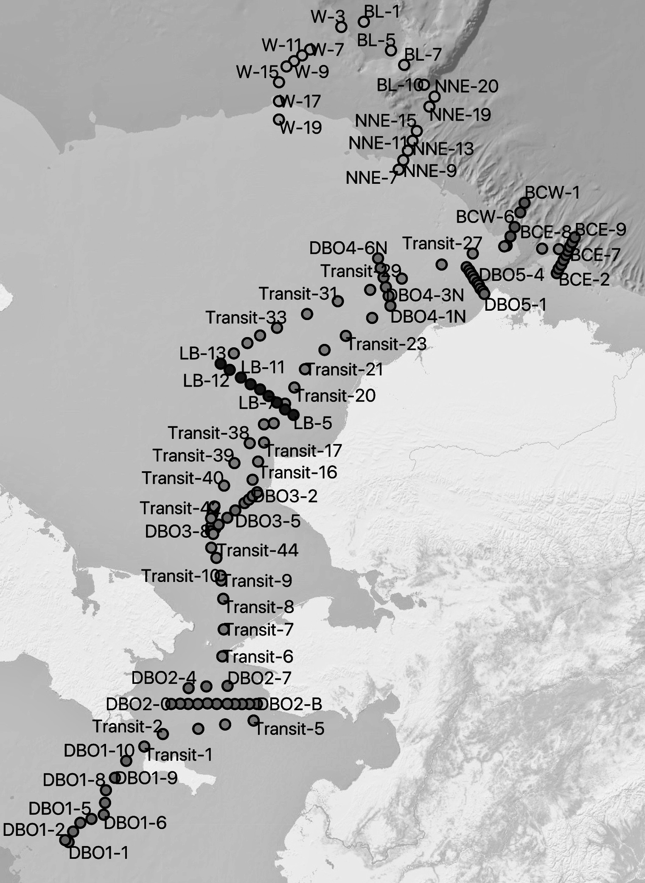

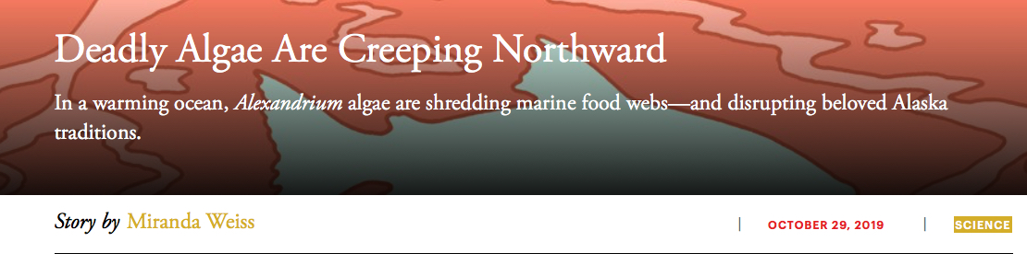
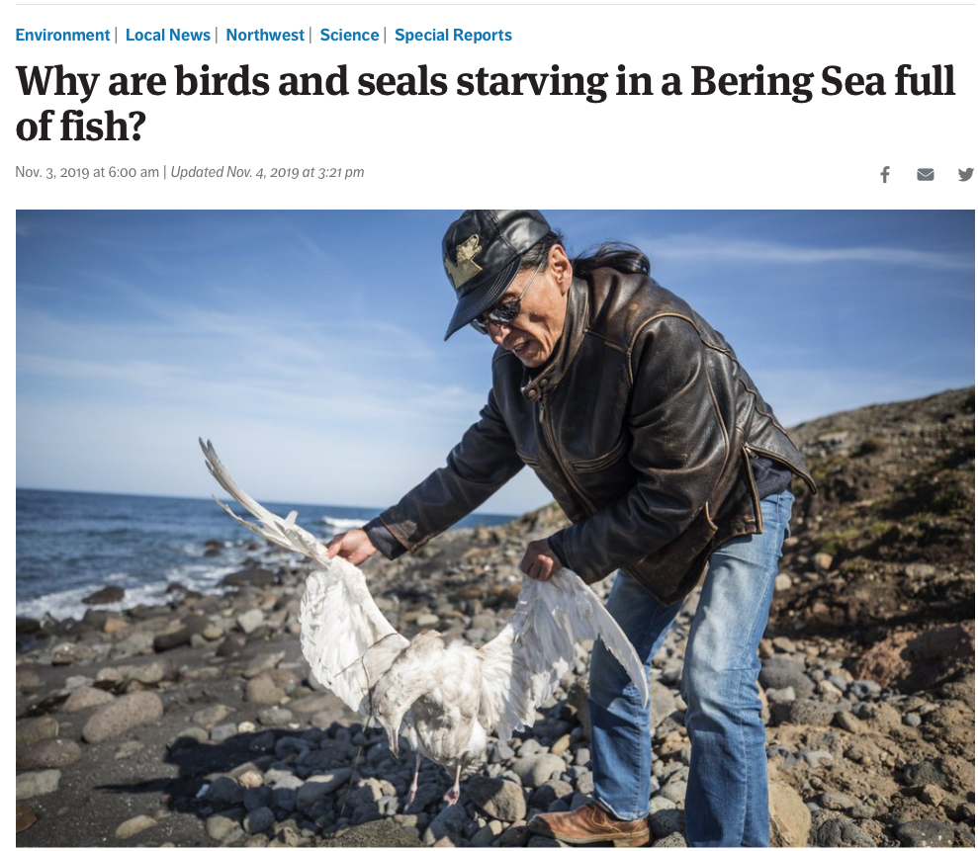
= BDL (no toxin)
HEALY DBO
Cruise
W-Co-Z
= 4-50 ng/g
Co
W
= 51-100 ng/g
C
W
= 101-799 ng/g
Chukchi Sea
C
W
C
W
C
K-W-C
W
≥ 800 ng/g
W
Z
C
Z
C
W-Co-Z
W-Co-Z
W Z
K-C-W-Co-Z
C
Z
K
K
C = Clam
K = Krill
W = Benthic Worm
Co = Copepod
Z = Mixed zooplankton
W
K
Z
W
C
W
W
Z
Z-W
Z-W
C
Z-W
C-W
W
W
Z
C-W
Alaska
W-Co-Z
K
K-W-Co-Z
C
K-C
W
C
Co
Seward
Peninsula
Seattle Times
K
W
W
Z
K-W-Co
C
K
W
Z
W
K-W
Co
Kathi Lefebvre
(NOAA/NWFSC)
Don Anderson
(WHOI)
Z-W
W
K-Z
C-Co
Z-Co
* St. Lawrence Is
W
C
K-Z
C-W
W-Co-Z
K-C
Notes:
Finding HABs occurrences across the food web and in some cases, in higher concentrations than anywhere else in the world.
MANAGEMENT APPLICATION: Local communities are very concerned about HABs infiltrating the food chain. Also potentially responsible for mass seabird and seal die offs. Significant media attention and ongoing monitoring

