Slide 1
GMACS-3
The Control File

Slide 2
Core (theta) parameters
The Core parameters provide the overall scaling of the population and also specify how recruitment is parameterized. The first input is the number of theta parameters
## ntetha
9
For each parameter you need to specify:
Initial value
Lower and upper bounds
Phase (negative means pre-specify)
Prior (0=uniform; 1=normal; 2=lognormal; 3=beta; 4=gamma)
Parameters of the prior

Slide 3
Core parameters-I
## ival lb ub phz prior p1 p2 # parameter ##
## ———————————————————————————————##
0.18 0.15 0.2 -4 2 0.18 0.04 # M
16.5 -10 18 -2 0 -10.0 20.0 # logR0
18.0 -10 25 3 0 10.0 20.0 # logRini, to estimate if NOT initialized at unfished (n68)
16.5 -10 25 1 0 10.0 20.0 # logRbar, to estimate if NOT initialized at unfished
72.5 55 100 -4 1 72.5 7.25 # recruitment expected value (males or combined)
0.726149 0.32 1.64 3 0 0.1 5.0 # recruitment scale (variance component) (males or combined)
0.00 -5 5 -4 0 0.0 20.00 # recruitment expected value offset (females)
0.00 -1.69 0.40 3 0 0.0 20.0 # recruitment scale offset (variance component) (females)

Slide 4
Core parameters-II
Those logNs
LogN0: N-at-size in year 1 is based on unfished size-structure (option 0 for initial conditions; see final section of this presentation)
LogRini: N-at-size in year 1 is based on a fished size-structure – this is the recruitment on which the size-structure is based (also used when free parameters are estimated (options 1 and 3 for initial conditions)
LogRbar: Used for computing recruits after year 1.
Options 2 and 3 differ according to

Slide 5
Core parameters-III
The first two recruitment parameters define the distribution of recruits to size class for males / combined sex:
For a 2-sex model, the values for α and β for females are exponential offsets from the values for males, i.e.:

Slide 6
Core parameters-IV
-0.9 -10 0.75 -4 0 -10.0 0.75 # ln(sigma_R)
0.75 0.20 1.00 -2 3 3.0 2.00 # steepness
0.01 0.00 1.00 -3 3 1.01 1.01 # recruitment autocorrelation
The latter two parameters are only used if recruitment is constrained by a stock-recruitment relationship. The value of σ_{R} cannot be estimated with the context of a penalized likelihood estimation method.

Slide 7
Core parameters-V
Free initial N parameters (option 2)
14.5 5.00 20.00 1 0 5.00 20.00 # logN0 vector of initial numbers at length
14.0 5.00 20.00 1 0 5.00 20.00 # logN0 vector of initial numbers at length
13.5 5.00 20.00 1 0 5.00 20.00 # logN0 vector of initial numbers at length
Free initial N parameters (option 3)
# 0.00 -10 5 2 0 10.0 20.00 # Initial N Deviation for size-class 1 (normalization class)
0.00 -10 5 3 0 10.0 20.00 # Initial N Deviation for size-class 2
0.00 - 10 5 3 0 10.0 20.00 # Initial N Deviation for size-class 3
0.00 -10 5 3 0 10.0 20.00 # Initial N Deviation for size-class 4

Slide 8
Biological parameters-I
# Use custom natural mortality (0=no, 1=yes, by sex and year) 0 # #Custom natural mortality rates (by sex)
#1975 1976 1977 1978
0.18 0.27 0.27 0.27
Custom natural mortality allows the user to pre-specify M by year
Length-weight relationship
(1 = allometry [w_l = a*l^b], 2 = vector by sex)
2
## a (male, female)
4.03E-07 4.08E-07
## b (male, female)
3.141334 3.127956
## Males
0.000224781 0.000281351 0.000346923 0.000422209
## Females
0.0002151 0.00026898 0.00033137 0.00040294

Slide 9
Biological parameters--II
# Proportion mature by sex
0 0 0 0 0 0 ….
0 0 0 0 0 1 ..
# Proportion legal by sex
0 0 0 0 0 0 ….
0 0 0 0 0 1 ..

Slide 10
Growth parameters-I
# Use growth transition matrix option (1,2,3,4,5,6,7,8)
3
# growth increment model (1=alpha/beta; 2=estimated by size-class;3=pre-specified/empirical)
3
# maximum size-class (males then females)
20 16
# Maximum size-class for recruitment(males then females)
7 5
Key note:
Growth-transition matrix = probability of being in a size-class next season GIVEN molt
Size-transition matrix = probability of being in a size-class next season (accounts for molt probability)

Slide 11
Growth parameters-III
Options for setting the growth and size-transition matrices
Option 1: Pre-specify the growth-transition matrix (uses the estimated molt probability)
Option 2: Pre-specify the size-transition matrix directly (molt probability is ignored)
Option 3: The growth-transition matrix is based on gamma-distributed increments (size-increment is gamma)
Option 4: The growth-transition matrix is based on gamma-distributed increments (size after increment is gamma)
Option 5: The growth-transition matrix is based on kappa varying among individuals
Option 6: The growth-transition matrix is based on L∞ varying among individuals
Option 7: The growth-transition matrix is based on kappa and L∞ varying among individuals
Option 8: The growth-transition matrix is based on normally-distributed increments (size after increment is normal)

Slide 12
Growth parameters-II
Options for setting the growth increment model
Option 0: No estimated parameters
Option 1: Three parameters for each growth-increment matrix
Option 2: One parameter per class (plus one for the scale parameter of the beta distribution)
Option 3: Same as Option 2! Except growth data do not appear in the likelihood
Option 4:
Option 5: L∞, Kappa, the variance of Kappa for each growth-increment matrix
Option 6: L∞, Kappa, the variance of L∞ for each growth-increment matrix
Option 7: L∞, Kappa, the variance of Kappa and L∞ for each growth-increment matrix

Slide 13
Growth parameters-III
## number of size-increment periods
1 3
## Year(s) size-increment period changes (blank if no changes)
1983 1994
## number of molt periods
2 2
## Year(s) molt period changes (blank if no changes)
1980 1980
## Beta parameters are relative (1=Yes;0=no)
1

Slide 14
Growth parameters-IV
Single sex; pre-specified growth matrix
# Use custom transition matrix (0, 1, 2, 3)
1
# growth increment model (0=prespecified;1=alpha/beta; 2=estimated by size-class;3=pre-specified/empirical)
0
# maximum size-class (males then females)
3
# Maximum size-class for recruitment(males then females)
1
## number of size-increment periods
1
## Two lines for each parameter if split sex, one line if not
## number of molt periods
1
## Year(s) molt period changes (blank if no changes)
## Beta parameters are relative (1=Yes;0=no)
1

Slide 15
Growth parameters-V
Growth transition matrix option = 3 (size-class specific mean increment)
Growth increment model = 3
Beta parameters are relative
## ival lb ub phz prior p1 p2 # parameter
13.8 0 20 -33 0 0 999 # Females
12.2 0 20 -33 0 0 999 # Females
10.5 0 20 -33 0 0 999 # Females
1.38403 0.5 3.7 7 0 0 999 # Females (beta)
15.4 0 20 -33 0 0 999 # Females
13.8 0 20 -33 0 0 999 # Females
12.2 0 20 -33 0 0 999 # Females
0.0 -1.0 1.0 -7 0 0 999 # Females (beta)

Slide 16
Growth parameters-V (continued)
Two sexes and two molt periods each
## ival lb ub phz prior p1 p2 # parameter ##
## males and combined
145.0386 100. 500.0 3 0 0.0 999.0 # molt_mu males
0.053036 0.02 2.0 3 0 0.0 999.0 # molt_cv males
145.0386 100. 500.0 3 0 0.0 999.0 # molt_mu males
0.053036 0.02 2.0 3 0 0.0 999.0 # molt_cv males
## females
300.0000 5. 500.0 -4 0 0.0 999.0 # molt_mu females (molt every year)
0.01 0.001 9.0 -4 0 0.0 999.0 # molt_cv females (molt every year)
300.0000 5. 500.0 -4 0 0.0 999.0 # molt_mu females (molt every year)
0.01 0.001 9.0 -4 0 0.0 999.0 # molt_cv females (molt every year)

Slide 17
Growth parameters-VII
Growth transition matrix option = 1 (pre-specify growth matrix and estimate molting)
Growth increment model = 0
Beta parameters are relative
# ival lb ub phz prior p1 p2 # parameter
121.5 65.0 145.0 -4 0 0.0 999.0 # molt_mu males or combined
0.060 0.0 1.0 -3 0 0.0 999.0 # molt_cv males or combined
# The custom growth matrix (if not using just fill with zeros)
0.2 0.7 0.1
0.0 0.4 0.6
0.0 0.0 1.0
Molt Probability is a declining logistic function

Slide 18
Growth parameters-VII
Growth transition matrix option = 4 (size after increment is gamma)
Growth increment model = 1
Beta parameters are not relative
## ival lb ub phz prior p1 p2 # parameter ##
99.9 1.0 90.0 -3 0 0.0 999.0 # alpha males or combined
0.00 0.0 0.9 -3 0 0.0 999.0 # beta males or combined
1.365758 0.1 3.0 -4 0 0.0 999.0 # gscale males or combined
99.9 1.0 90.0 -3 0 0.0 999.0 # alpha
0.00 0.0 0.9 -3 0 0.0 999.0 # beta
0 1.885541 0 .1 3.0 -4 0 0.0 999.0 # gscale

Slide 19
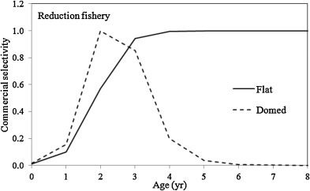
Selectivity and retention parameters-I
Specifying selectivity and retention has three stages:
Specify the type of selectivity pattern (all fisheries and surveys), along with whether they depend on sex / vary with time / etc
Specify how the parameters should be estimated (selectivity then retention)
Specify any asymptotic discard parameters

Slide 20
Selectivity and retention parameters-II
There are 11 rows of inputs (one column for each fishery / survey)
Selectivity-specific
Number of time blocks for selectivity (minimum 1)
Is selectivity sex-specific? (1=yes; 0=no)
Male selectivity pattern (parameters per block)
  0=“parametric” (nclass); 1=individual parameter for each class (nclass); 2=logistic type 1 (2); 3=logistic type 2 (2); 4=double normal (3); 5=uniform=1 (1); 6=uniform=0 (1)
Female selectivity pattern (as above)
Within another gear (point to a gear number within which the current gear is nested – used to model BSFRF surveys)

Slide 21
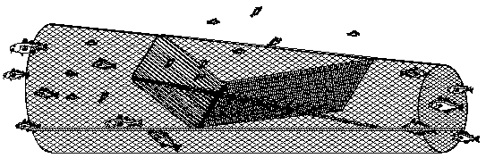
Selectivity and retention parameters-III
There are 11 rows of inputs (one column for each fishery / survey)
Retention-specific
Number of time blocks for retention (minimum 1)
Is retention sex-specific? (1=yes; 0=no)
Male retention pattern (as above)
Female retention pattern (as above)
Are males retained? (1=Yes; 0=No)
Are females retained? (1=Yes; 0=No)
www.fao.org

Slide 22
Selectivity and retention parameters-Example-I
Four fisheries / two surveys:
Logistic selectivity
Males are retained in the first fishery only
Blocked selectivity for the NMFS survey
Block retention for the pot fishery
## Gear-1 Gear-2 Gear-3 Gear-4 Gear-5 Gear-6
## PotFshry TrawlByc TCFshry FixedGr NMFS BSFRF
1 1 1 1 2 1 # selectivity periods
1 0 1 0 1 1 # sex specific selectivity
2 2 2 2 2 2 # male selectivity type
2 2 2 2 2 2 # female selectivity type
0 0 0 0 6 0 # within another gear
## Gear-1 Gear-2 Gear-3 Gear-4 Gear-5 Gear-6
2 1 1 1 1 1 # retention periods
1 0 0 0 0 0 # sex specific retention
2 6 6 6 6 6 # male retention type
6 6 6 6 6 6 # female retention type
1 0 0 0 0 0 # male retention flag (0 = no, 1 = yes)
0 0 0 0 0 0 # female retention flag (0 = no, 1 = yes)

Slide 23
Selectivity and retention parameters-Example-II
There fisheries / two surveys and one sex:
Separate selectivity parameters for fishery 1 and the two surveys
Logistic selectivity for fisheries 2 and 3
Logistic retention for the pot fishery
## POT TBycatch FBycatch NMFS_S ADFG_pot
## Gear-1 Gear-2 Gear-3 Gear-4 Gear-5
2 1 1 1 1 # Selectivity periods
0 0 0 0 0 # sex specific selectivity
0 3 3 0 0 # male selectivity type
0 0 0 0 0 # within another gear
## Gear-1 Gear-2 Gear-3 Gear-4 Gear-5
1 1 1 1 1 # Retention periods
0 0 0 0 0 # sex specific retention
3 6 6 6 6 # male retention type
1 0 0 0 0 # male retention flag (0 -> no, 1 -> yes)

Slide 24
Selectivity and retention parameters-IV
## Selectivity
## index index par sex ival lb ub prior p1 p2 phz period period
# Gear-1
1 1 1 1 137.0030 5 186 0 1 999 4 1975 2017
1 2 2 1 2.6666 0.1 20 0 1 999 4 1975 2017
1 3 1 2 83.9314 5 150 0 1 999 4 1975 2017
1 4 2 2 4.0000 0.1 20 0 1 999 4 1975 2017
# Gear-2
2 5 1 0 149.9950 5 185 0 1 999 4 1975 2017
2 6 2 0 10.0000 0.1 20 0 1 999 4 1975 2017
## Retained
# Gear-1
-1 25 1 1 150 1 999 0 1 999 4 1975 2004
-1 26 2 1 4 1 20 0 1 999 4 1975 2004
-1 27 1 1 150 1 999 0 1 999 4 2005 2017
-1 28 2 1 4 1 20 0 1 999 4 2005 2017
-1 29 1 2 591 1 999 0 1 999 -3 1975 2003
-1 30 1 2 591 1 999 0 1 999 -3 2004 2017
# Gear-2
-2 31 1 0 595 1 999 0 1 999 -3 1975 2017
Males then females
Both sexes
Time blocked
Uniform selectivity

Slide 25
Selectivity and retention parameters-V
# Selectivity
## index index par sex ival lb ub prior p1 p2 period period #
# Gear-1
1 1 1 0 0.4 0.001 1.0 0 0 1 3 1978 2008
1 2 2 0 0.7 0.001 1.0 0 0 1 3 1978 2008
1 3 3 0 1.0 0.001 2.0 0 0 1 -2 1978 2008
1 1 1 0 0.4 0.001 1.0 0 0 1 3 2009 2018
1 2 2 0 0.4 0.001 1.0 0 0 1 3 2009 2018
1 3 3 0 1.0 0.001 2.0 0 0 1 -2 2009 2018
# Gear-2
2 7 1 0 40 10.0 200 0 10 200 -3 1978 2018
2 8 2 0 60 10.0 200 0 10 200 -3 1978 2018
## Retained
# Gear-1
-1 14 1 0 120 100 200 0 1 900 -1 1978 2018
-1 15 2 0 123 110 200 0 1 900 -1 1978 2018
Time blocked;
separate parameters
Logistic selectivity
Logistic retention

Slide 26
Selectivity and retention parameters-VI
You can specify that selectivity is never 1 (due to high grading). This can be achieved directly if separate parameters are estimated for each class. However, that does not allow for time-varying high grading. The asymptotic parameters section allows the user to specify (or estimate) year-specific high grading rates.
# Number of asymptotic parameters
4
# Fleet Sex Year ival lb ub phz
1 1 1975 0.000001 0 1 -3
1 1 2006 0.044000 0 1 -3
1 1 2007 0.019700 0 1 -3
1 1 2008 0.019875 0 1 -3

Slide 27
Index catchability and additional variance-I
Priors must be placed on index catchability and on the variances added to the input CVs for the relative abundance indices (the number of indices is determined from data file)
## ival lb ub phz prior p1 p2 Analytic? LAMBDA Emphasis
1.0 0.5 1.2 -4 0 0 9.0 0 1 1 # NMFS trawl
0.003 0 5 3 0 0 9.0 0 1 1 # ADF&G pot
Solve for MLE for q analytically (=1)
(only uniform or log-normal prior)
Multiplier for the
input CVs
Multiplier for the
Index likelihood

Slide 28
Index catchability and additional variance-II
Additional variance is included by increasing the input CV by an additional term, i.e.:
Input CV
Additional variance
## ival lb ub phz prior p1 p2
0.0000001 0.00000001 10.0 -4 4 1.0 100 # NMFS (PHASE -4)
0.0000001 0.00000001 10.0 -4 4 1.0 100 # ADF&G

Slide 29

F penalties and phases
Initial values for male F and
the female offset to male F
Penalty on
mean F (last phase)
Phases for male
and female Fs
## Mean_F Female_Offset STD_PHZ1 STD_PHZ2 PHZ_M PHZ_F Bound_1 Bound_2 Bound_3
0.22313 0.0505 0.5 45.50 1 1 -12 4 -10 2.95 -10 10 # Pot
0.0183156 1.0 0.5 45.50 1 -1 -12 4 -10 10 -10 10 # Trawl
0.011109 1.0 0.5 45.50 1 1 -12 4 -10 10 -10 10 # Tanner (-1 -5)
0.011109 1.0 0.5 45.50 1 -1 -12 4 -10 10 -10 10 # Fixed
0.00 0.0 2.00 20.00 -1 -1 -12 4 -10 10 -10 10 # NMFS trawl survey
0.00 0.0 2.00 20.00 -1 -1 -12 4 -10 10 -10 10 # BSFRF (0)
Note: Input is needed for the surveys, but this information is not used
Bound on mean F (_1), annual male F offsets (_2),
Female F offsets (_3); Bounds on annual female F offsets still pre-specified

Slide 30
Likelihood specification (composition data)
## LIKELIHOOD OPTIONS
## -1) Multinomial with estimated/fixed sample size
## -2) Robust approximation to multinomial
## -3) logistic normal (NIY)
## -4) multivariate-t (NIY)
## -5) Dirichlet
## ———————————————————————————————————————————
2 2 2 # Type of likelihood
0 0 0 # Auto tail compression (cumulative proportion used in tail compression)
1 1 1 # Initial value for effective sample size multiplier
-4 -4 -4 # Phz for estimating effective sample size (if appl.)
1 2 3 # Composition aggregator (combines compositions into a single male+female row)
1 1 1 # LAMBDA (multiplier on input effective sample size)
1 1 1 # Emphasis (multiplier for actual likelihood)

Slide 31
Time-varying natural mortality-I
The options for time-varying natural mortality are:
## 0 = constant natural mortality
## 1 = Random walk
## 2 = Cubic Spline
## 3 = Time blocks in M relative to the base M (see theta section); blocks are cumulative
## 4 = Time blocks in M (absolute values are estimated)
## 5 = Changes in M for specific years relative to the base M (see theta section)
## 6 = Time blocks in M relative to the base M (see theta section); blocks are not
cumulative

Slide 32
Time-varying natural mortality-II
## 0:
## 1:
## 2:
## 3:
## 4 :
## 5 :
## 6 :

Slide 33
Time-varying natural mortality-III
## Type
6
## Phase of estimation (if not specified elsewhere)
3
## STDEV in m_dev (set to large value to ignore)
0.25
## Number of nodes for cubic spline or number of step-changes for options 3, 4, 5 and 6
2
4
## Year position of the knots (vector must be equal to the number of nodes)
1980 1985
1976 1980 1985 1994

Slide 34
Time-varying natural mortality-IV
## Specific initial values for the natural mortality devs (0-no, 1=yes)
1
## ival lb ub phz Estimated or mirror
1.342575 0 2 8 0
0.000000 -2 2 -99 0
0.262792 0 2 8 0
1.780586 0 2 8 0
0.262792 0 2 8 -3
0.000000 -2 2 -99 0
Return to base value
Mirror parameter 1 for females

Slide 35
Other Controls
1975 # First rec_dev
2017 # last rec_dev
2 # Estimated rec_dev phase
-3 # Estimated rec_ini phase
1 # VERBOSE FLAG (0 = off, 1 = on, 2 = objective func; 3 diagnostics)
3 # Initial conditions (0 = Unfished, 1 = Steady-state fished, 2 = Free parameters, 3 = Free parameters (revised))
1 # Lambda (proportion of mature male biomass for SPR reference points).
1 # Use empirical molt increment data (0=FALSE, 1=TRUE)
0 # Stock-Recruit-Relationship (0 = none, 1 = Beverton-Holt)
10 # Maximum phase (stop the estimation after this phase).
-1 # Maximum number of function calls

Slide 36
Emphasis factors
## EMPHASIS FACTORS (Catch)
#Ret_male Disc_male Disc_female Disc_trawl Disc_Tanner_male Disc_Tanner_female Disc_fixed
1 1 1 1 1 1 1
## ————————————————————————————————————————————————————
## EMPHASIS FACTORS (Priors)
# Log_fdevs meanF Mdevs Rec_devs Initial_devs Fst_dif_dev Mean_sex-Ratio
10000 0 1 2 0 0 10
Recommended

Slide 37
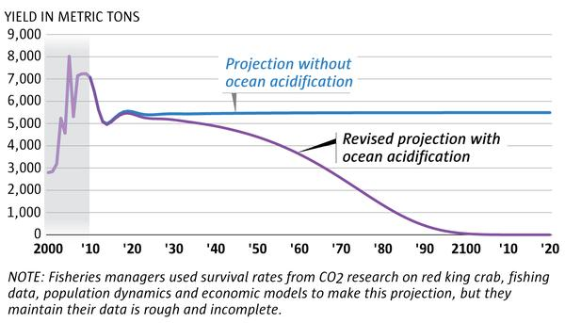
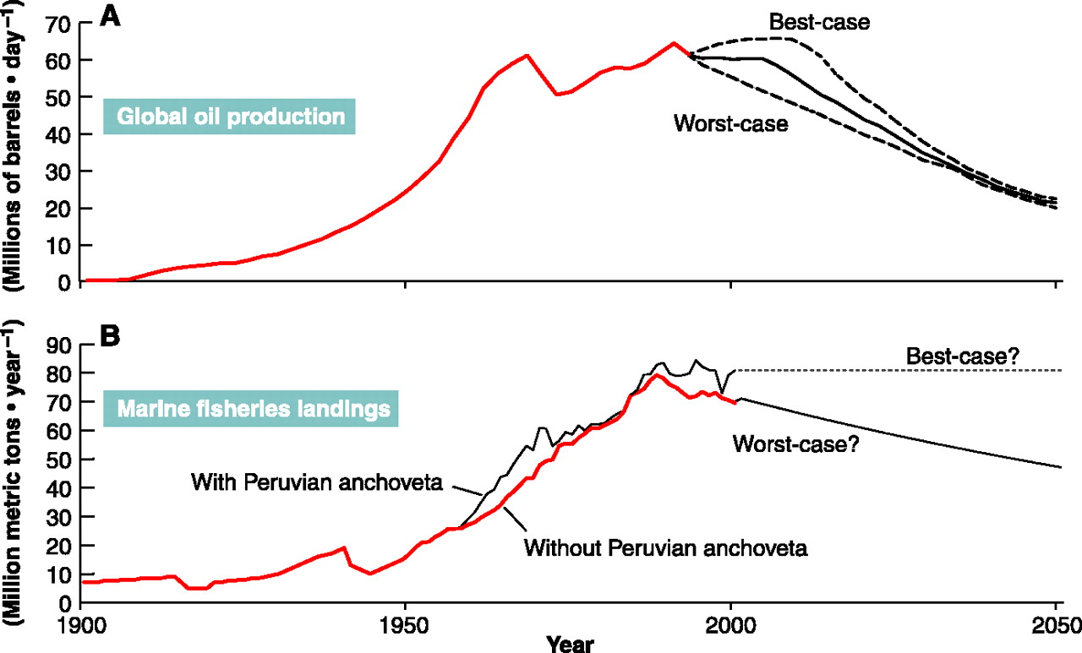
The PRJ File

Slide 38
Basic controls
0 # Set to 0 if you don’t want to compute steepness such that F_{MSY}=F_{35%} nor to plot the
yield function (1=Yes); 0 still computes F_{35%} and OFL.
0 1 1 1 1 1 # Set to 0 if F_{35%} applied to this fleet; 1 if F is to be fixed
1983 2017 # First and last year for average recruitment/MMB for Bspr calculation (Tier 3 or Tier 4)
1983 2017 # First and last year for average sex ratio for computing reference points
2014 2018 # First and last year for average F for discards (computing reference points and projections)

Slide 39
OFL and ABC specification
0.35 # Target SPR ratio for Bmsy proxy.
3 # Tier (3 or 4)
0.10 # Alpha (cut-off of HCR)
0.25 # Beta (limit of HCR)
1.00 # Gamma (Gamma used in the Tier 4 HCR)
0.80 # ABC-OFL buffer
0 # Produce a yield curve (1=yes; 0=no); ignored if steepness is not computed
Note: OFL and ABC are only computed in the SD_phase to save time

Slide 40
Projections-I
2019 # Last year of projection (used to compute the number of projection years
1 # Number of strategies (0 for no projections); how many F values to consider
0 0.18 # Range of F values (F are selected uniformly with the range)
1 # 0 for no mortality for non-directed fleets (see input #1 above); 1=Yes (default)
2 # Mcmc replicates per draw (how many projections to do for each MCMC replicate)
-3423.8 # Fixed B_{MSY} (negative number for replicate-specific); allows pre-specification of B_{MSY}
2 # Stock-recruitment option (1=Mean Recruitment;2=Ricker;3=Beverton-Holt )
6 # delay between spawning and recruitment (in years)
1983 2017 # First and last years for generating future recruitment (only used if Stock-recruitment
option = 1)
0.6 # SigmaR (only used if Stock_recruitment option = 2 or 3) [0.6]

Slide 41

Projections-II
# State strategy
1 # Apply strategies [OFL, ABC] (1=yes;0=no)
0.001729630 # Mean weight to use (mature)
0.001930932 # Mean weight to use (legal)
vectorstock.com
Notes:
The state HCR is hard-wired because each state-strategy is different – can we define a generic structure (e.g. based on Madi’s thesis / Siddeek’s paper)
The annual removal is the minimum of the ABC (total catch) and the calculated state TAC (retained catch).

Slide 42
Finally
# Stop after XX mcdraws (the reduces run-time; for real runs it should be a large number)
10000
## eof
9999

Slide 43

Coding stuff

Slide 44
Personal.TPL
Personal.TPL is a file that produces a user-specific output file (not gmacsall.out).
Outputs that are specific to only one assessment (and that could be computationally intensive)
Code that is in development that could end up in the main branch.
We should discuss what outputs are needed with variances and perhaps a scheme to make this flexible.

