Slide 1
NPFMC Groundfish Plan Team
Research Priorities
January 29th 2020
Jim Ianelli
Steve Barbeaux
and
Grant Thompson

Slide 2
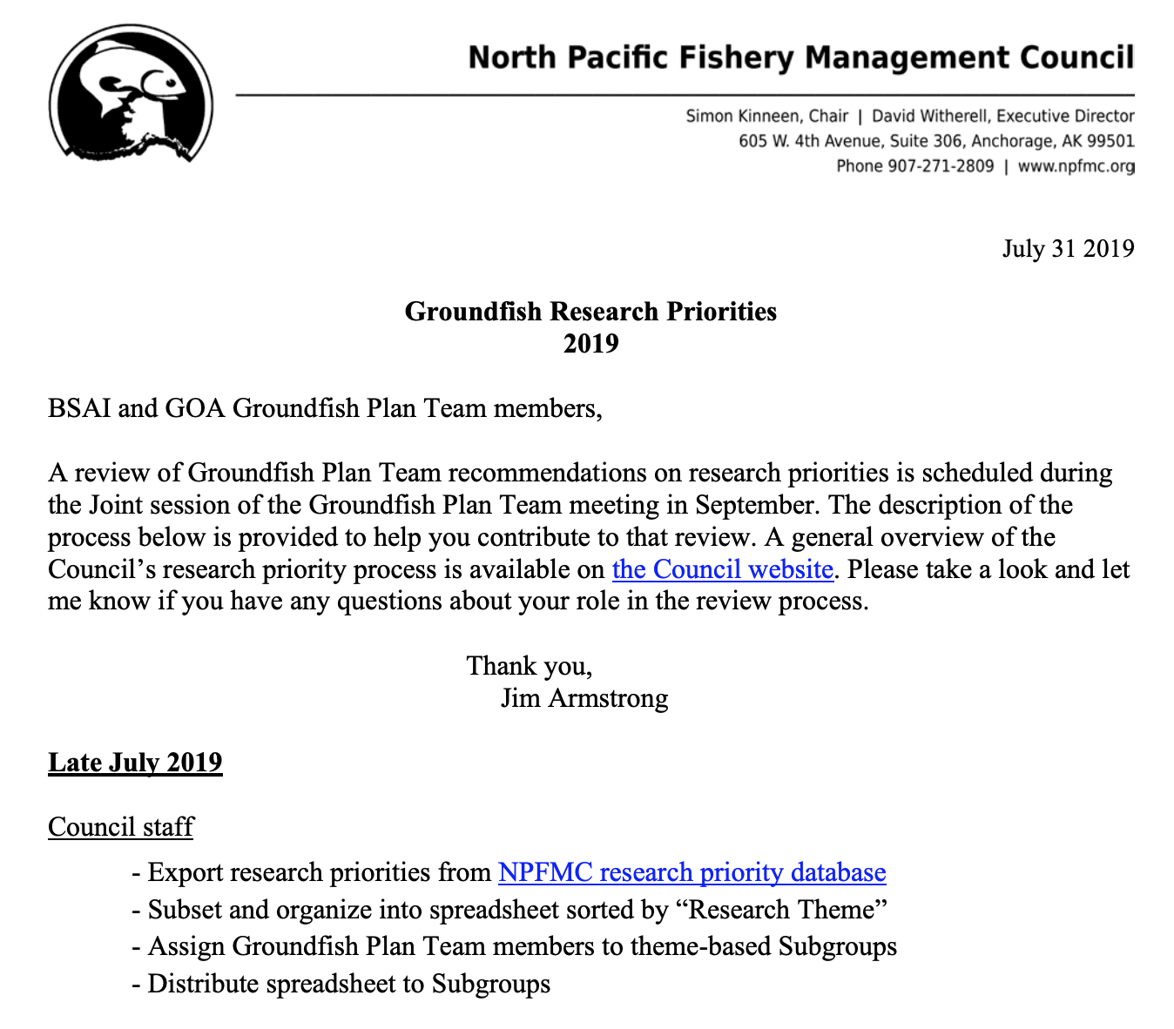
Alaska Groundfish Research Priorities
September 2019 groundfish plan team meetings feedback provided

Slide 3
Plan Team Recommendations
("Critical Ongoing" and "Strategic")
Changes in Priority
New items
Change in Research Status
Example assessment author comments

Slide 4
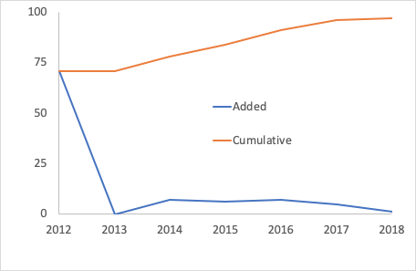
From the database
Groundfish Joint Team

Slide 5
Database had 157 projects, 94 related to groundfish
In Sept 2019 GF Team members reviewed priorities
Identified top projects
Eight top scoring projects identified...

Slide 6
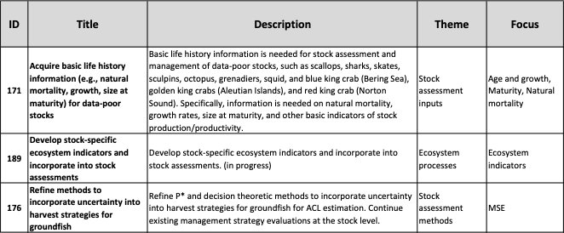
Top Plan Team 8 (1 of 3)
Notes:
Basic life history
stock specific indicators
HCR Refinements

Slide 7
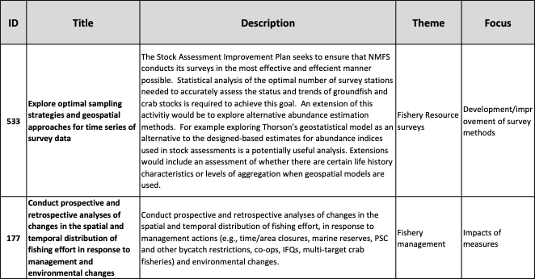
Top Plan Team 8 (2 of 3)

Slide 8
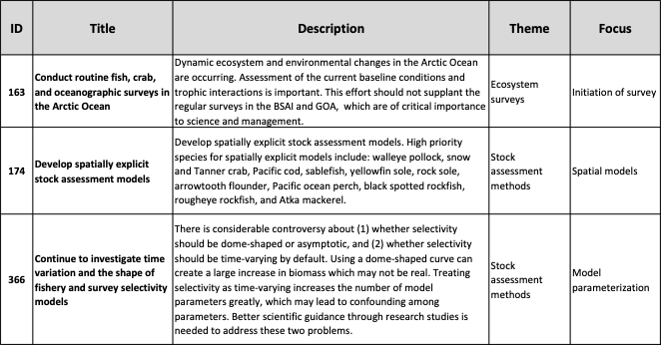
Top Plan Team 8 (3 of 3)

Slide 9
Recap from September Plan Team meetings
Several concerns were raised with the process:
Many are “ideas” rather than actual research proposals
Sometimes no explicit proposal or PI is identified
Process does not consider cost (just value)
No process for filtering, rewriting, or deleting priorities (?)
Proposals rarely from people who knowledgeable about the research
Many valuable/critical research topics are missing
Teams recommended that these issues be raised in the report to the SSC in February
“Urgent” category carries expectation that “a one or two year project would meet the information need,” Teams recommended projects more than two years in place be removed from the “urgent” category
Notes:
The SSC got this presentation in October but no action (in their minutes)

Slide 10
Plan Team Recommendations
("Critical Ongoing" and "Strategic")
Changes in Priority
New items
Change in Research Status
Example assessment author comments

Slide 11
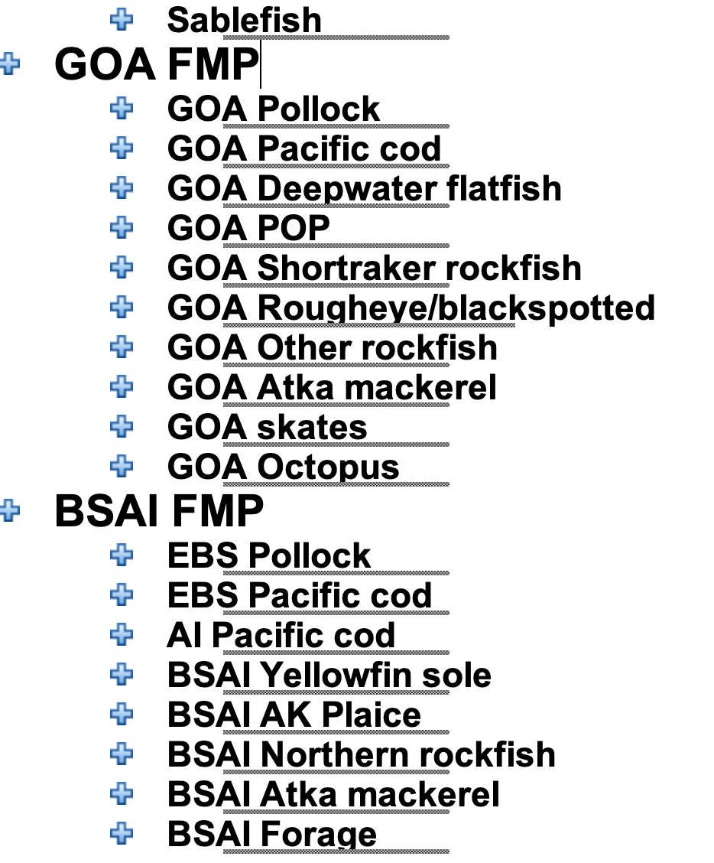

Review of SAFE report chapters (2019 versions)
Are there disconnects between NPFMC and other sources for research priorities?
SAFE report guidelines require “Data gaps and research priorities” section
Extracted them from each
chapter

Slide 12
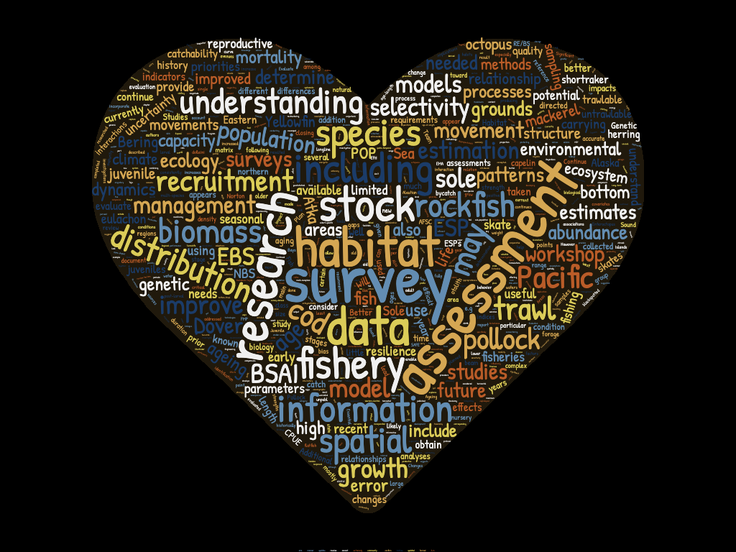

Slide 13
Do these align w/ Research priorities?

Slide 14
Examples
Sablefish
1. Determine stock productivity
a. Recruitment processes
b. Juvenile distribution,
c. habitat utilization, and
d. species interactions
2. Improve estimation of recruitment
3. Activities:
a. Refine fishery CPUE
b. Reconsider available growth data.
c. Re-examine selectivity assumptions
d. Explore the use of environmental data for recruitment
e. Spatially explicit model with movement
f. Condition factors among management areas and years

Slide 15
Examples
GOA Pollock
Consider to explore alternative modeling platforms
Spatial GLMM models for survey indices
Multi-species model (CEATTLE)
ESP
Non-constant natural mortality

Slide 16
Examples
GOA Pacific cod
Spatial dynamics
Interspecific relationships
Climate impact on recruitment
Behavior of fishery, including spatial dynamics
Trawl survey catchability and selectivity
Age determination and aging error
Bycatch in the Pacific cod fisheries

Slide 17
Examples
GOA Dover sole (deepwater flatfilsh)
Evaluate time-varying cohort-specific pattern in the maximum size
Growth and movement patterns
Genetic stock structure
Collect fishery age samples (fishery selectivity)
Ageing error

Slide 18
Examples
GOA POP
1. Determine stock productivity: Recruitment processes, Juvenile distribution, habitat utilization, species interactions
2. Improve estimation of recruitment
3. Trawlable and untrawlable survey areas
4. Acoustic survey applications
5. MSE and MEY considerations
GOA Shortraker
Validation of aging methods for shortraker rockfish
Information on larval, post-larval, or early stage juveniles
Habitat requirements
Rougheye-blackspotted
Species specific density between trawlable and untrawlable grounds
Fishery spatial patterns and behavior
Examining potential age and growth differences between species

Slide 19
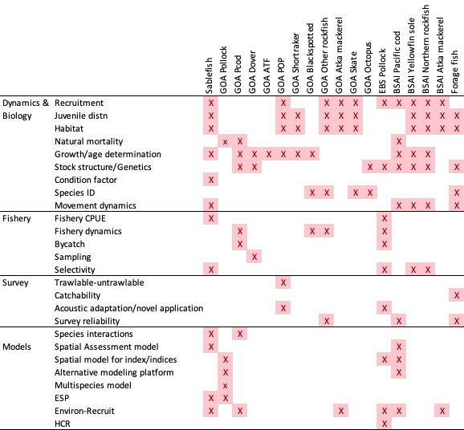
From SAFE Chapters
Note that these are identified (not exhaustive) topics
Notes:
Note that these are identified (not exhaustive) topics

Slide 20
Conclusion?
Teams did reasonably well
Consistent w/ bulk of authors specifications

