Slide 1

Westward Region
Bering Sea Aleutian Islands (BSAI)
King Crab Research
Overview
Vicki Vanek
Crab Plan Team – Jan 2020
Kodiak, AK

Slide 2
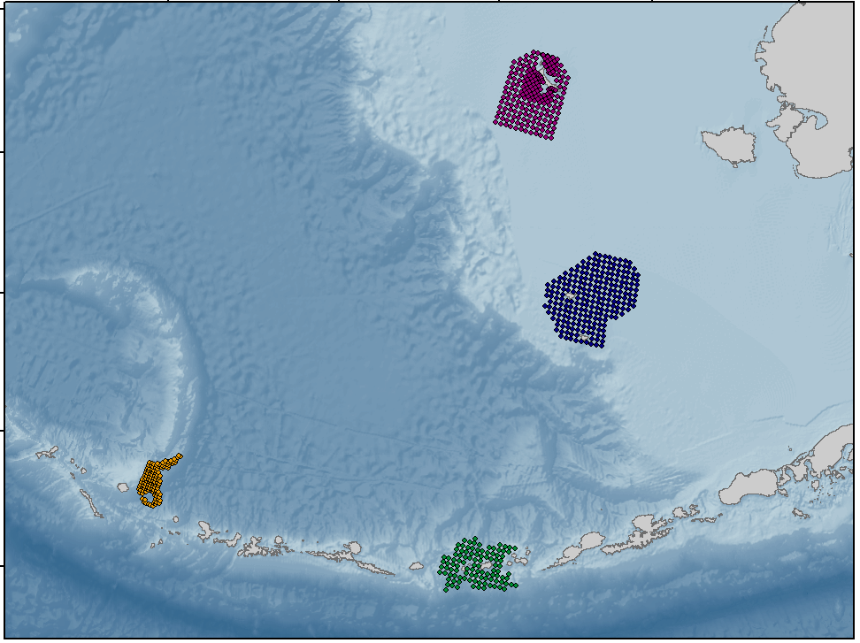
St. Matthew Island
King Crab Pot Surveys
Blue King Crab
1995 - 2018
ongoing
Eastern Bering Sea
Aleutian Islands
Pribilof Islands
Red & Blue King Crab
2003 - 2011
Petrel Bank
Red King Crab
2001, 2006 & 2009
Golden King Crab
1991, 1997 - 2006

Slide 3
St. Matthew Island
King Crab Pot Surveys
Blue King Crab
1995 - 2018
ongoing
Eastern Bering Sea
Aleutian Islands
Pribilof Islands
Red & Blue King Crab
2003 - 2011
Petrel Bank
Red King Crab
2001, 2006 & 2009
Golden King Crab
1991, 1997 - 2006
GKC Gear Selectivity Study - with AKCRF
2012 - precursor to coop survey

Slide 4
St. Matthew Island
King Crab Pot Surveys
Blue King Crab
1995 - 2018
ongoing
2021
Eastern Bering Sea
Aleutian Islands
Pribilof Islands
Red & Blue King Crab
2003 - 2011
Petrel Bank
Red King Crab
2001, 2006 & 2009
Golden King Crab
1991, 1997 - 2006
Golden King Crab Coop Survey
west & east Aleutians
2015 – present
GKC Gear Selectivity Study - with AKCRF
2012 - precursor to coop survey

Slide 5
Ancillary At-Sea Projects
Oceanographic Data
Temperature, Depth, Salinity, pH
Crab Disease
Cottage Cheese Disease
Bitter Crab Disease
Black Eye Condition
Genetics
Collection of Live Crab or Teaching Specimens

Slide 6
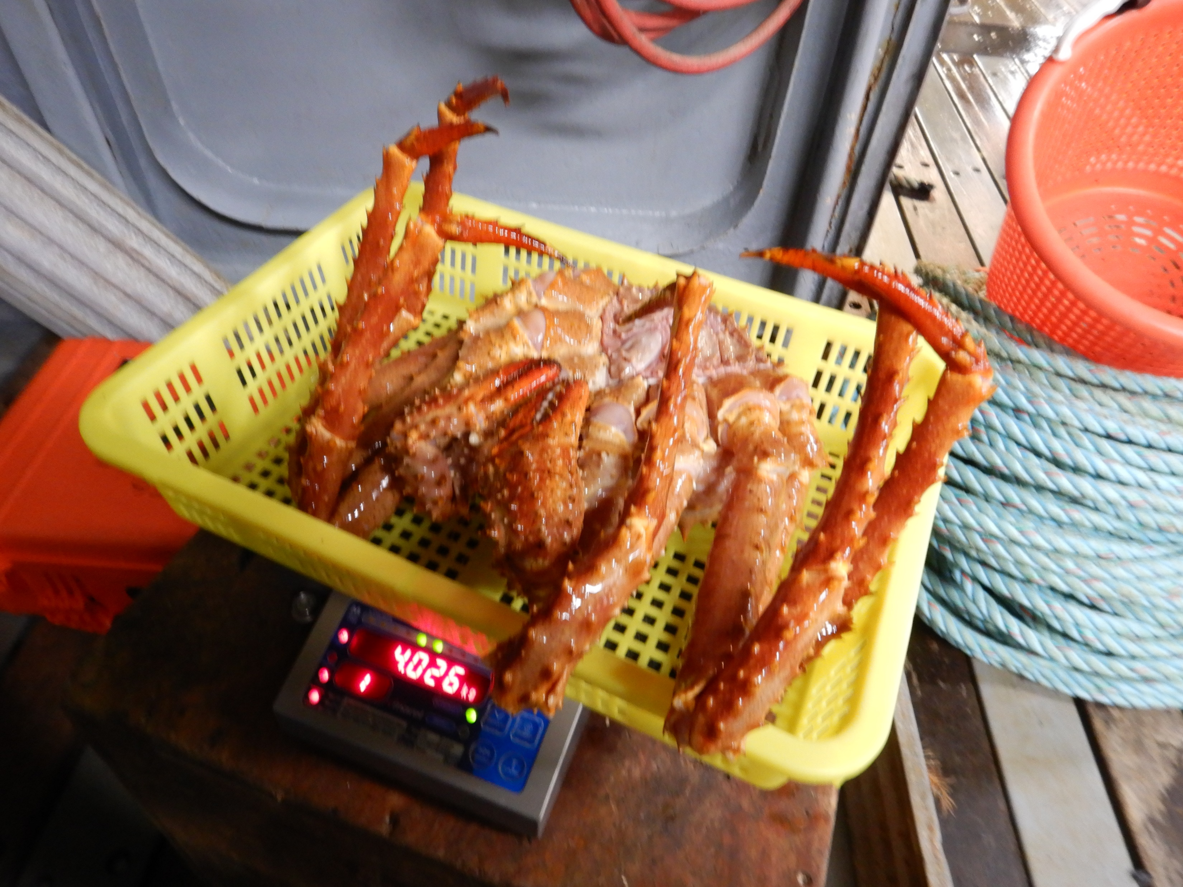
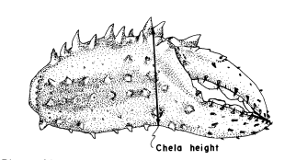
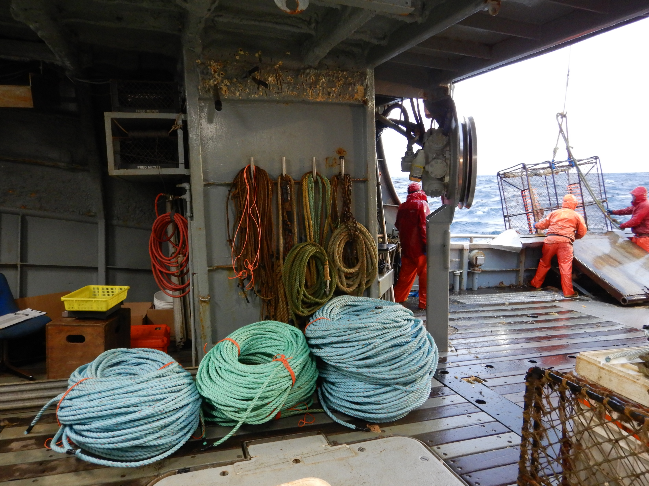
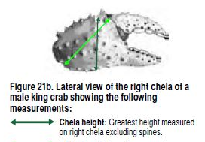
GKC Weight & Chela Height - Western Aleutians
  November 2018
  F/V Alaska Trojan
  362 crab in 1 trip
  40 crab per 5-mm size bin
  Smallest & largest size bins: not able to get 40
Jewett (1985)
1984 NMFS GKC CH
1991 ADF&G Survey
2018 WAG
Marel M1100 motion-compensated scale
Biological Field Techniques for Lithodid Crabs (2005)
Crab Observers

Slide 7
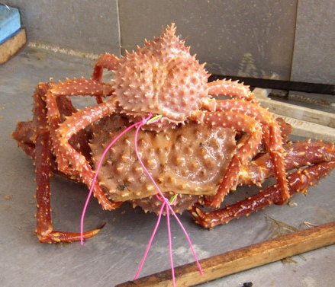
Tagging Studies
St. Mathew Island blue king crab
  Sublegal male
  Legal male
Aleutian Islands golden king crab
  Males & Females
Pribilof Islands Tanner crab
  Legal Males – industry preferred size

Slide 8
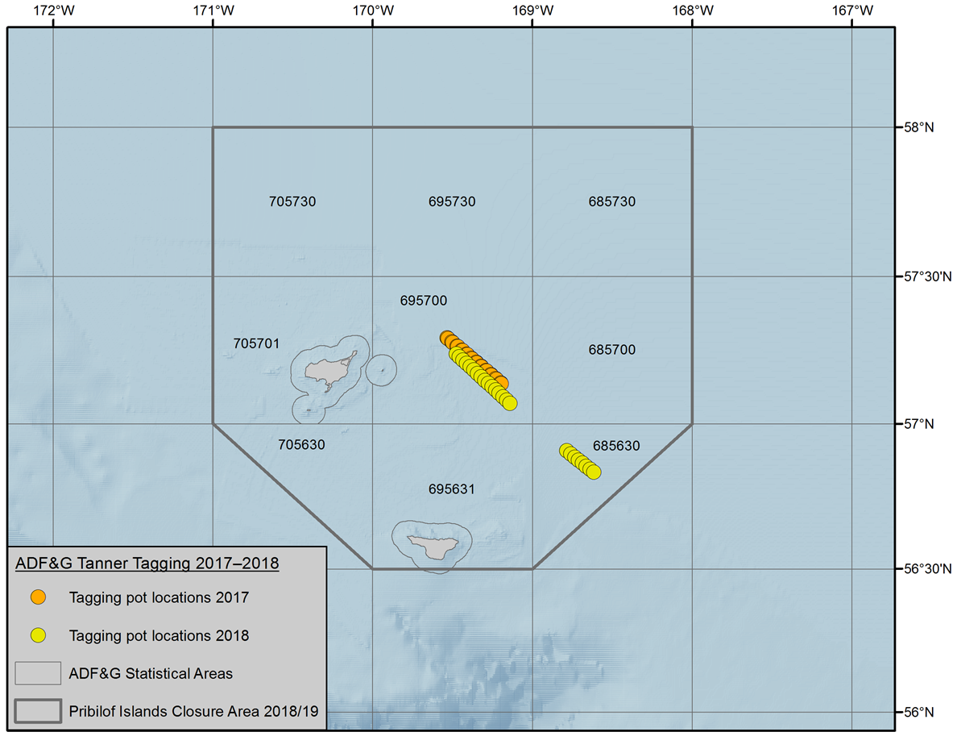
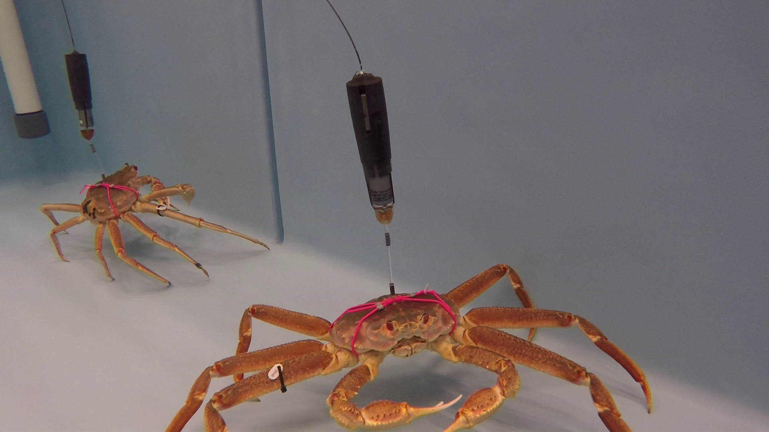
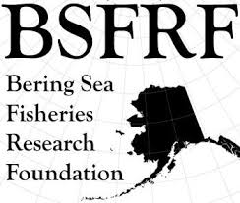
Satellite Pop-Up Tags – Pilot Phase 2017-18
Kodiak Lab
Attachment methods developed & tested
Physical effects on crab
Current effects on tagged crab
Tagged crab behavior in lab Andy
Gibson Cove – still in progress
Satellite tag physical condition Andy
Field Deployment on crab
Center
2017 10 sat tags 458 Floy tags
14 sat tags 651 Floy tags
SE corner
2018 no sat tags 272 Floy tags

Slide 9
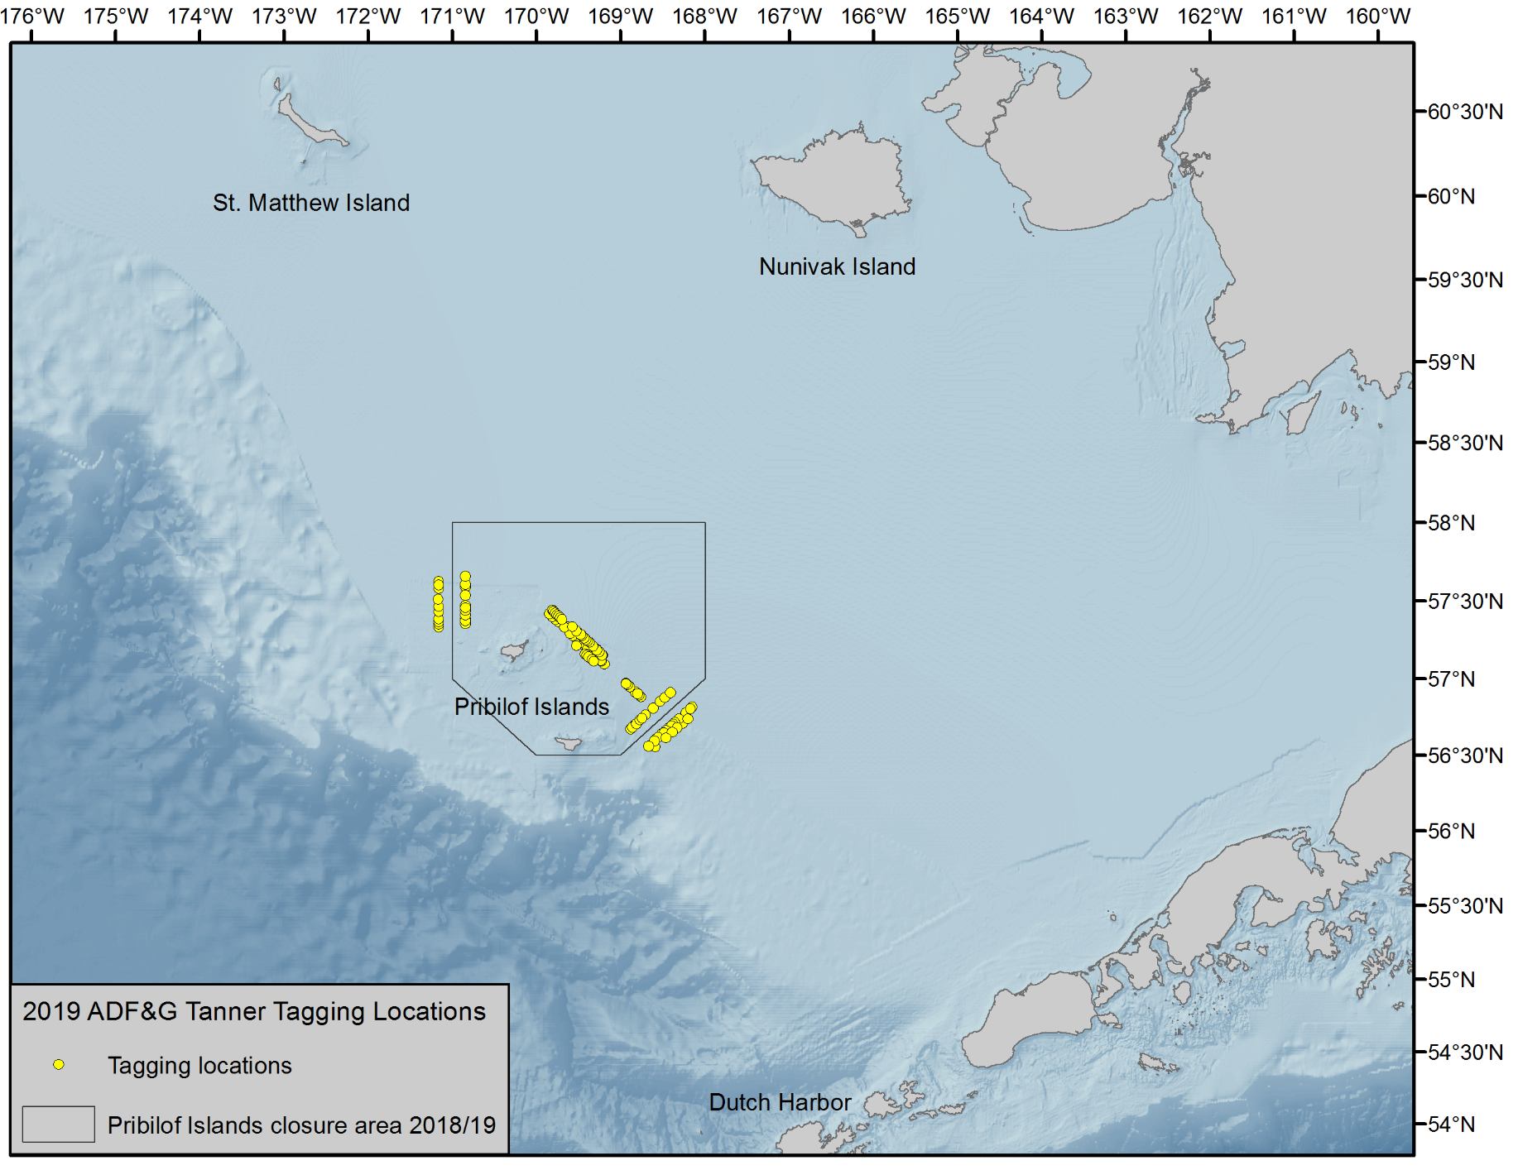


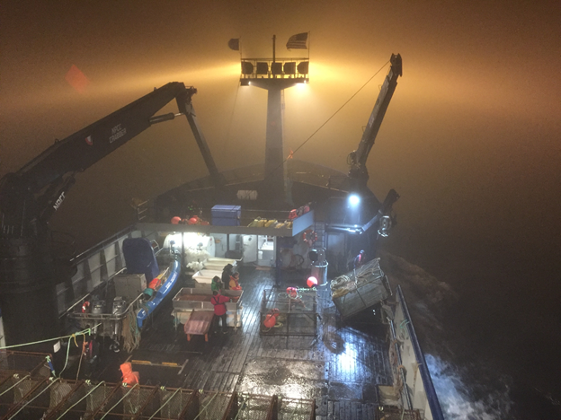
2019 Tagging
Oceanographic Data
Current
Temperature/Depth
Salinity

Slide 10
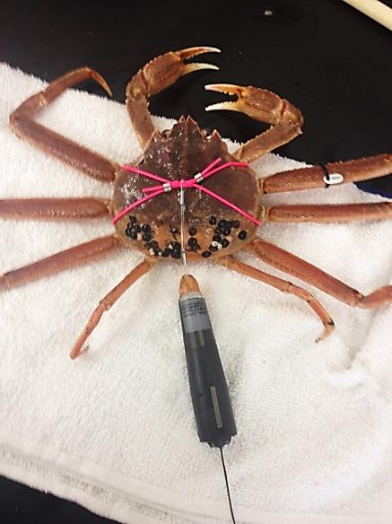
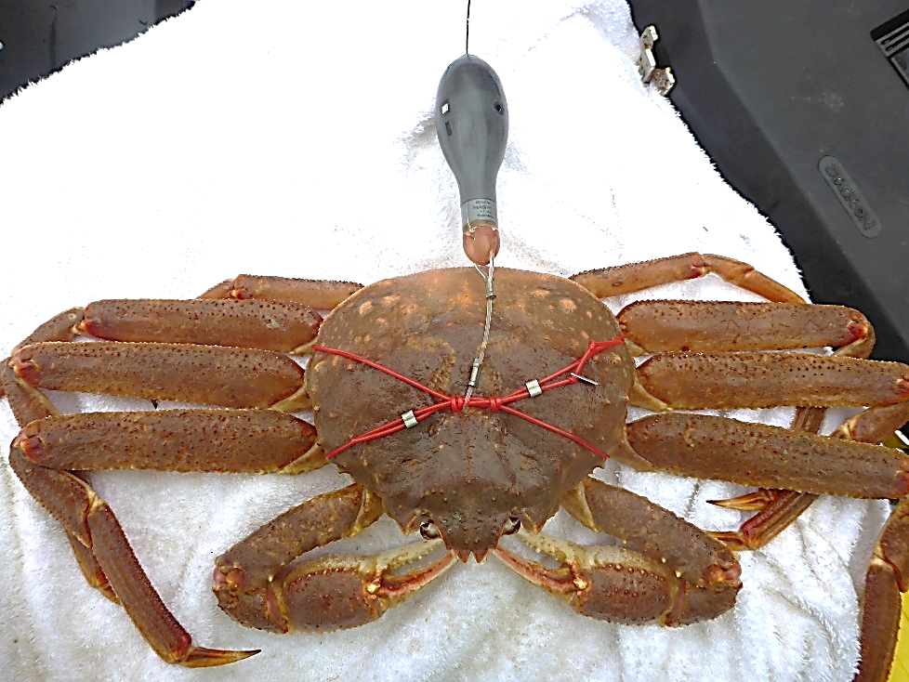
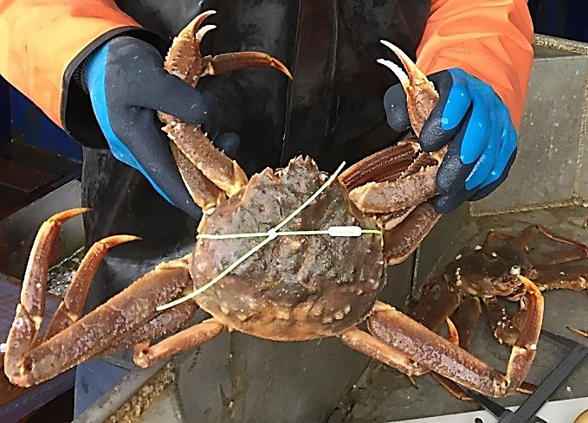
Tags deployed on industry-preferred size Tanner males
Pop-up satellite tags
Wildlife Computers
2019: 140 tags
mrPAT
Wraparound carapace tags
Floy spaghetti tags
2019: 1,442 tags
miniPAT

Slide 11
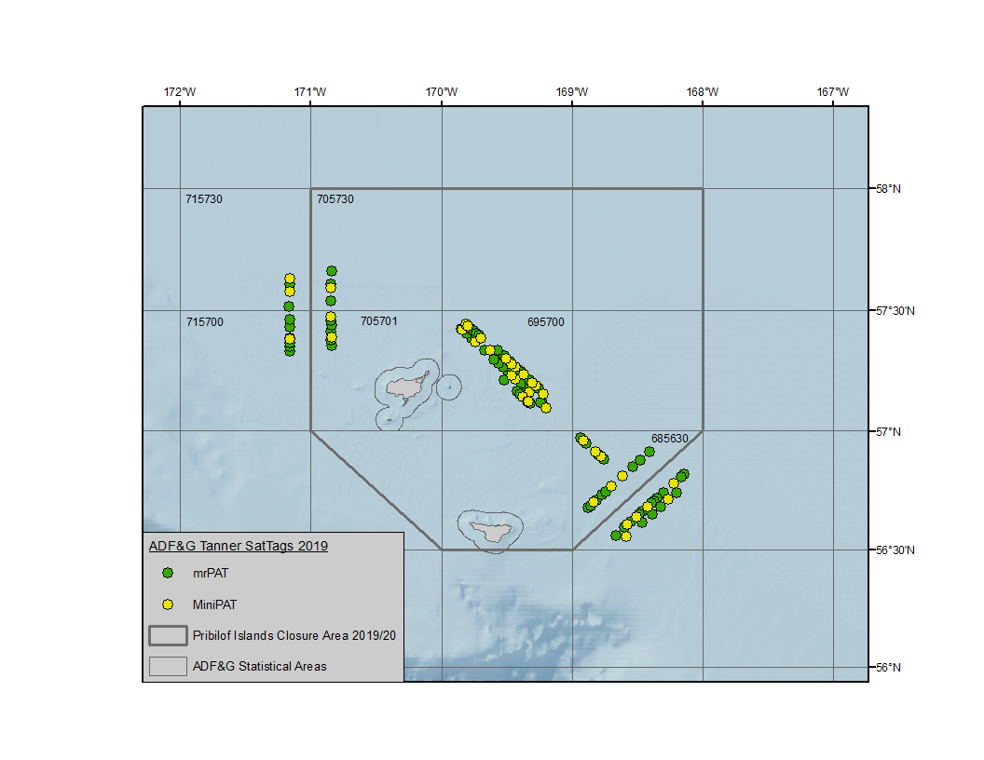
Tagged crab behavior in lab
Future behavior research
Satellite tag condition longterm in ocean
RKC attachment methods
Floy tags: released in same locations as sat tags

Slide 12

Tagged crab behavior in lab
Future behavior research
Satellite tag condition longterm in ocean
RKC attachment methods
FLOY tags
only
Floy only
Floy tags released in same string locations as sat tags

Slide 13
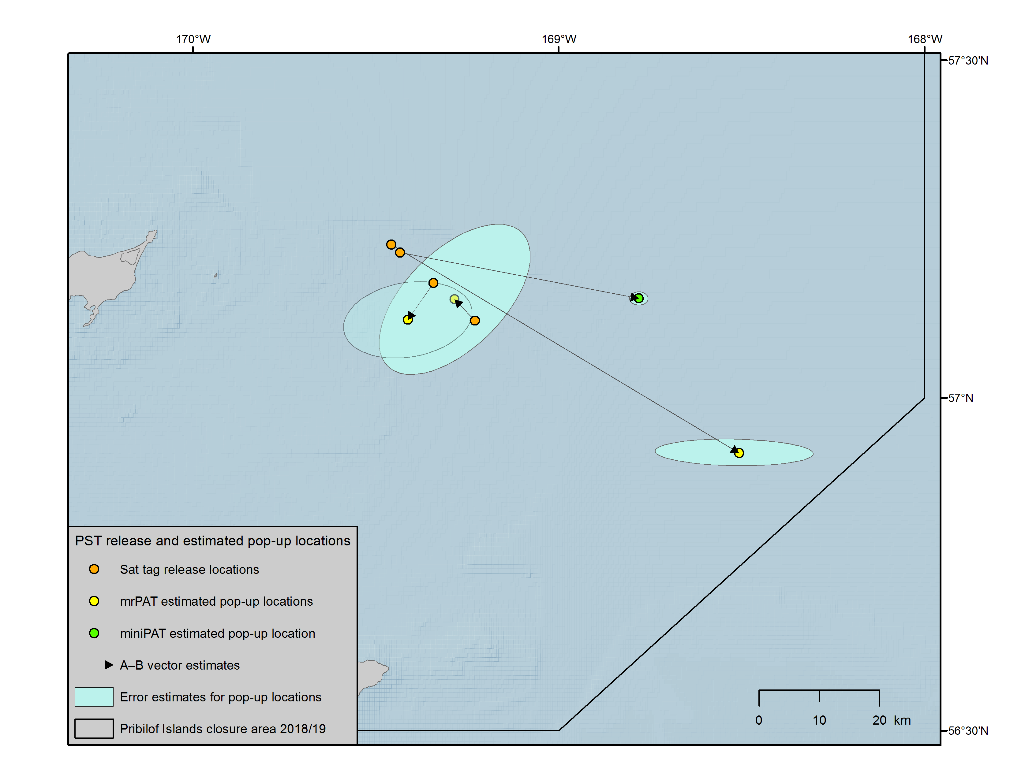
Data Analysis & Area of Pop-up Location
Refining techniques to calculate initial pop-up location area
Time
  Reaches surface
  1st location
  1st high quality location
Drift effects
Quality of Argos locations
2018 deployment: Pop-up locations of 4 tags

Slide 14
2019 Sat Tag Deployment
Deployment Dates: Aug 23 to Sep 2
Scheduled Release Dates:
  Dec 1, Dec 16, Jan 1, Jan 16, Apr 1
See us Friday for live tag transmissions

Slide 15
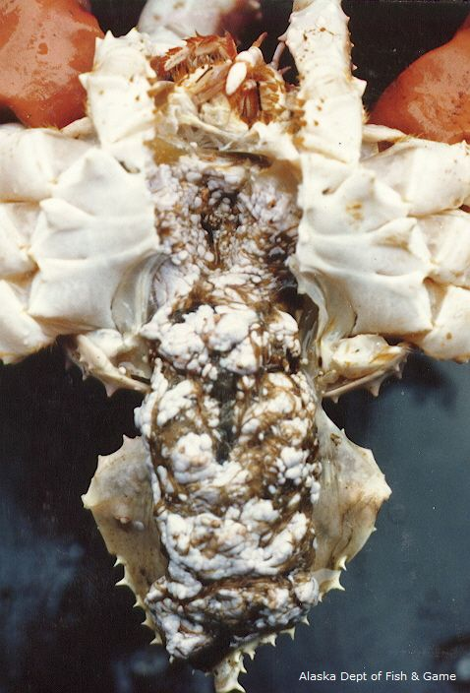
Microsporidia: Cottage Cheese Disease in King Crab
Opportunistic sample collection last 5 years
St. Matthew Island – blue king crab
Pribilof Islands – red king crab
Virginia Institute of Marine Science
Hamish Small
New species
Interest to document species –
environmental changes
potential distribution/prevalence rise
Notes:
Genus Ameson

Slide 16
Historic Survey Databases
Data Requests
  St. Matthew Island – Halibut size comp & catch – IPHC
  St. Matthew Island snow crab
Database Project
  Standardize
    Format
    Codes
  Errors
  Resolve major problems e.g. missing sections
  Treasure hunt

Slide 17
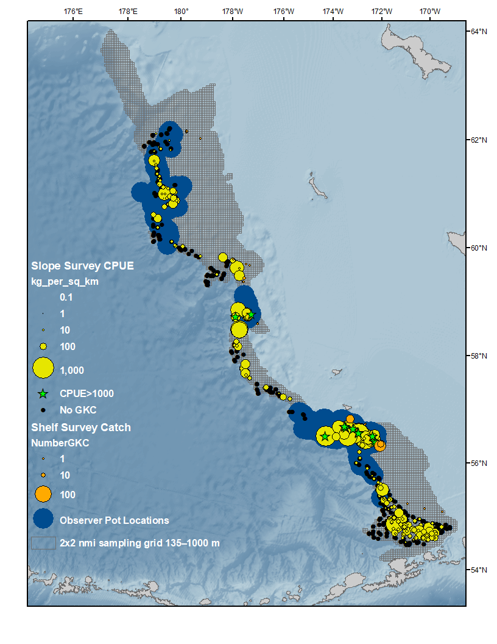
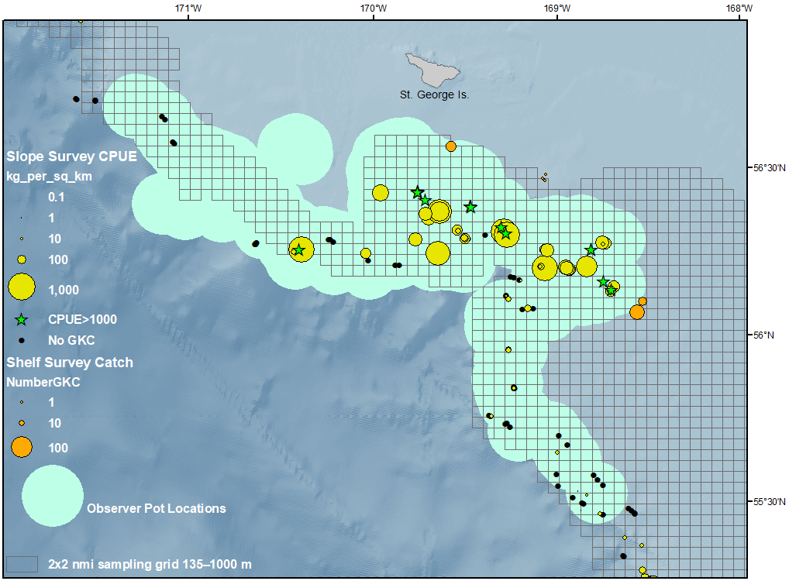
IN THE WORKS – Pribilof Islands GKC Survey
2x2 nmi grid covering 135–1000 m along slope extent
Pribilof Canyon and adjacent likely survey area
Next steps to finish defining habitat:
  Include bycatch of GKC in GF fisheries
  Evaluate best source of bathymetry data
  Decide on final depth range to constrain stations

Slide 18
IN THE WORKS – RKC satellite tagging
RKC tag attachment method
  Development & Testing
Potential tagging in:
  Bristol Bay (2020)
    Compare tag technology, crab movement (acoustic vs. satellite)
    Are crab moving to areas not covered by Saildrones?
  Bering Sea N. District
    Connectivity with Bristol Bay stock
  Norton Sound
    With ADF&G Nome staff in AYK Region
    What happens to large males?
Lab tour

Slide 19
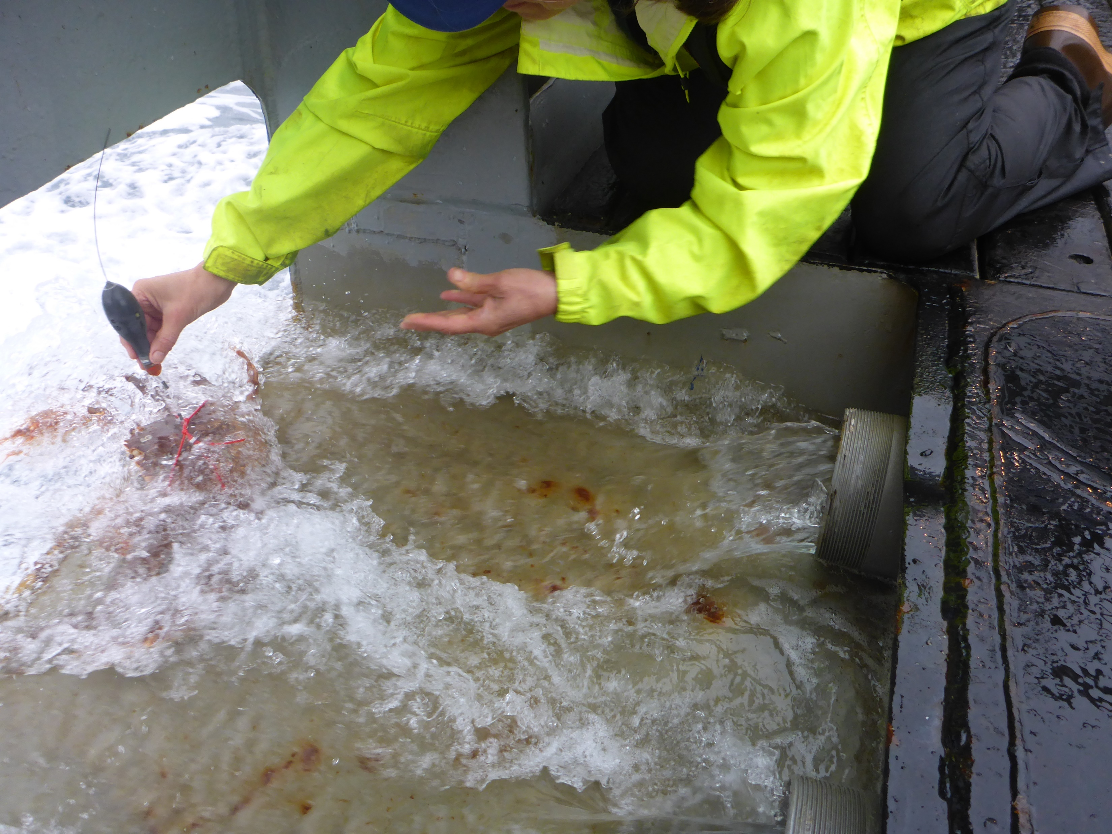
ET Home

Slide 21
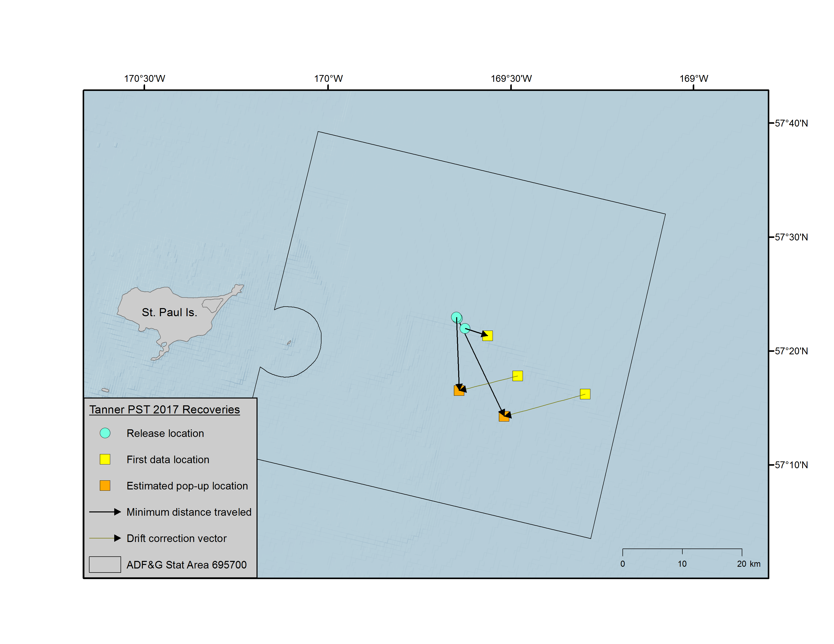

Slide 22
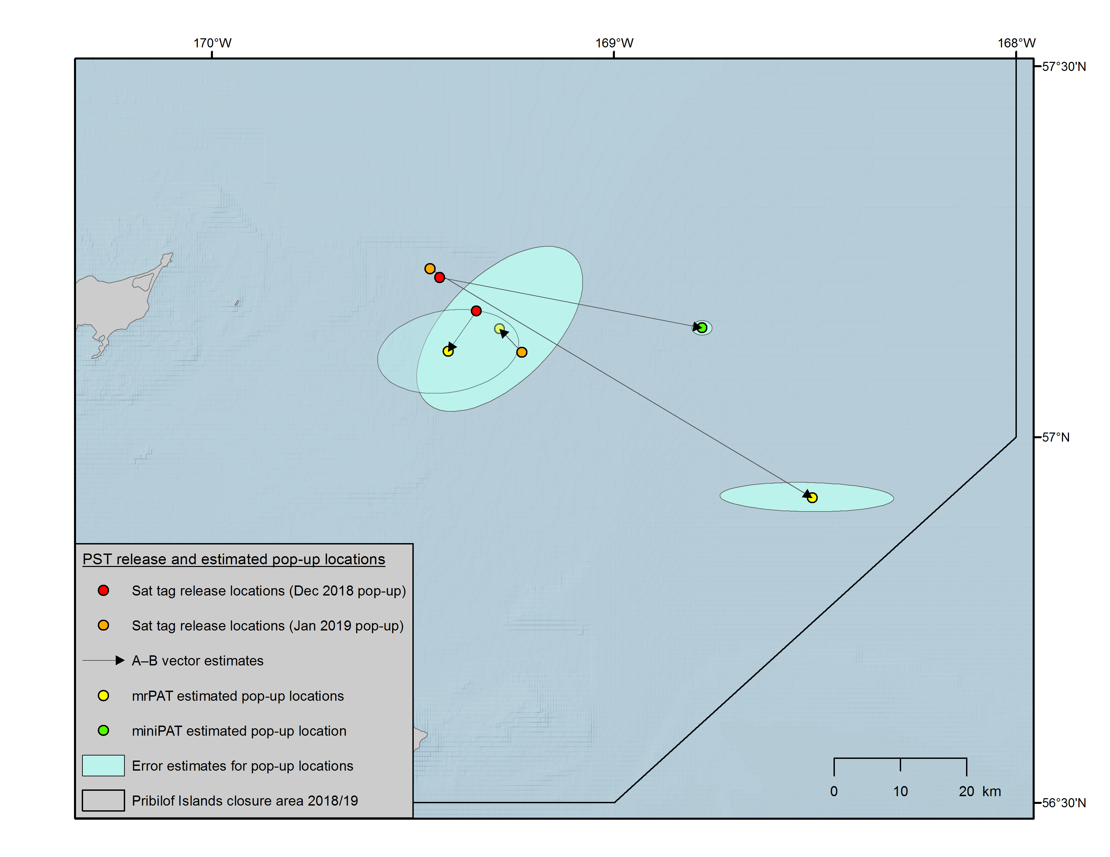

Slide 24
