Slide 1
Acoustic-trawl surveys and ‘critical ongoing monitoring’
Midwater Assessment and Conservation Engineering (MACE) Program
RACE Division, Alaska Fisheries Science Center
Dr. Patrick H. Ressler, Program Manager (Acting)
patrick.ressler@noaa.gov

Slide 2
What is MACE?
Acoustic-trawl surveys for walleye pollock and other species (POP, capelin, euphausiids, ‘forage species’, …) used for stock assessment, ecosystem considerations
Research and development on acoustic, trawl, optical, fixed and mobile survey platforms, observation/survey/monitoring methods
Conservation engineering (reduction of bycatch, habitat impacts of fishing, cooperative research)
Notes:
Not going to talk about CE further in this presentation, not surveys, not critical ongoing monitoring (‘235 Investigate gear modification sand changes in fishing practices to reduce bycatch and PSC’ is a) not surveys and b) is ‘urgent’, but not ‘critical’)

Slide 3
‘Critical ongoing monitoring’?
Council priorities addressed, https://research.psmfc.org/
145 Continuation of State and Federal annual and biennial surveys…. Although an ongoing need, these surveys are considered the highest priority research activity, contributing to assessment of commercial groundfish and crab fisheries off Alaska.
Notes:
‘235 Investigate gear modification sand changes in fishing practices to reduce bycatch and PSC’ is a) not surveys and b) is ‘urgent’, but not ‘critical’

Slide 4
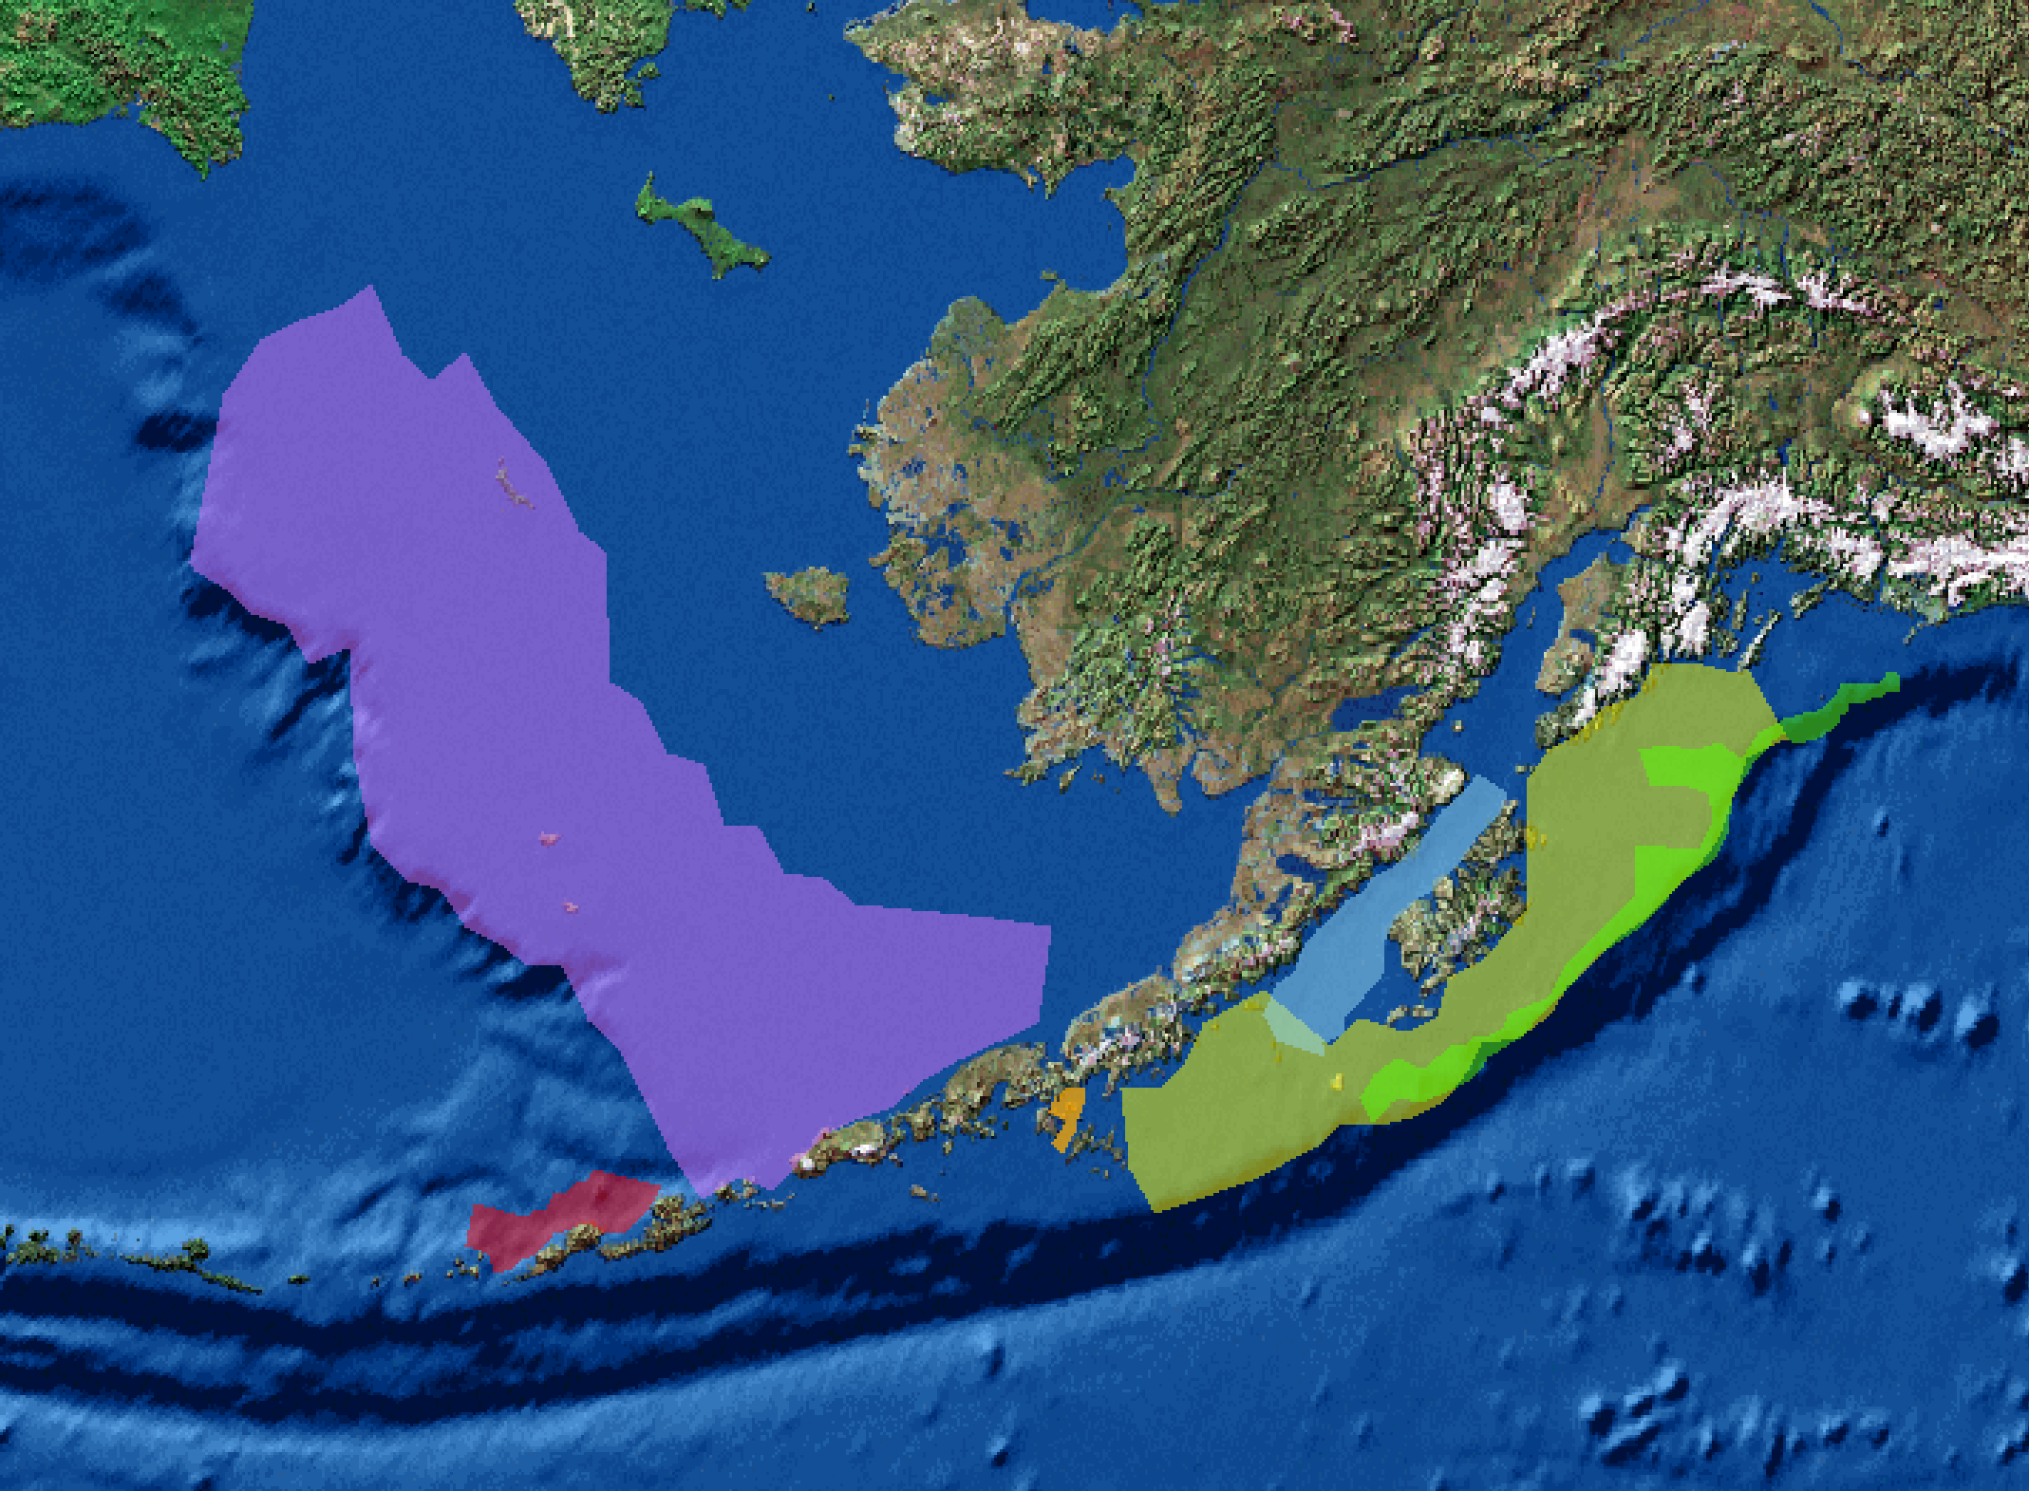
AFSC Major Acoustic -Trawl Surveys
Russia
USA
Alaska
E. Bering Sea
1979+
B = 2.5 million t (2018)
Bogoslof Area
1988+
GOA
2003, 2005
2011+
Shelikof Strait Area
1981+
B = 0.7 million t (2018)
Shumagin Islands
Area
1994 – 1996, 2001+
B = 0.6 million t (2019)
B = 1.3 million t (2019)
B = 17k tons (2018)
B = most recent pollock biomass est.
Notes:
4

Slide 5
Main challenges
Maintaining critical monitoring activities
Continuing world-class R&D
  Improving methods – multispecies surveys, gear selectivity, broadband acoustics, optics, better estimate of survey uncertainty
  Moored echosounders – fish movement and survey timing
  Autonomous vehicles – improving survey efficiency
Responding to new or emerging assessment needs
  Monitoring shifting or expanding species distribution under climate change – northward expansion, Arctic surveys
  Multispecies or new information for midwater assessment — pollock, forage fish, krill, POP,… copepods, myctophids?
  Surveys for difficult to assess species — untrawlable habitat
  Crises of the moment where our methods can help — Pacific cod, diverging survey indices for GOA pollock
Notes:
Survey efficiency, timing
krill
Arctic
Untrawlable/acoustical/optical surveys
Climate change

Slide 6
Practical Challenges
(Stan probably already said something like this…)
Our survey mandate and geographic scope is expanding. There is increased need not only for the most basic information, but also for more information. Our future success will require balancing survey and research effort against available resources, and understanding the impact of changes in what we do to the results/advice we provide.
Your (SSC, Council) needs should help guide prioritization.

Slide 7
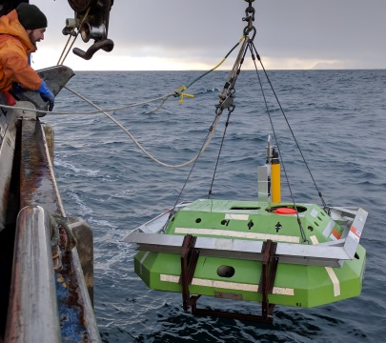
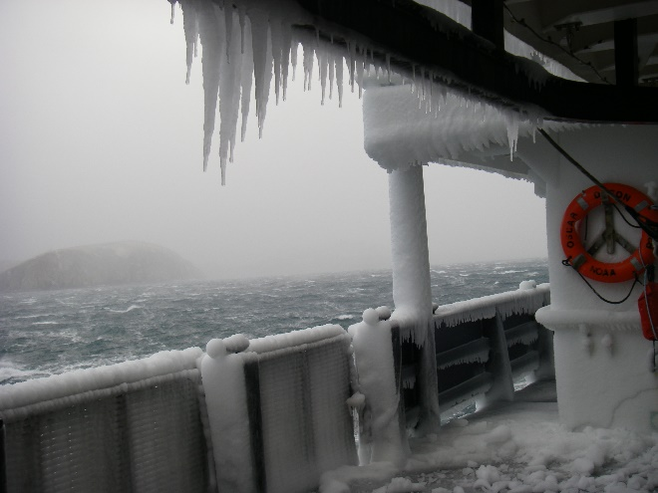
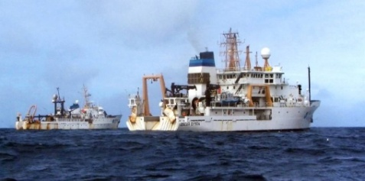
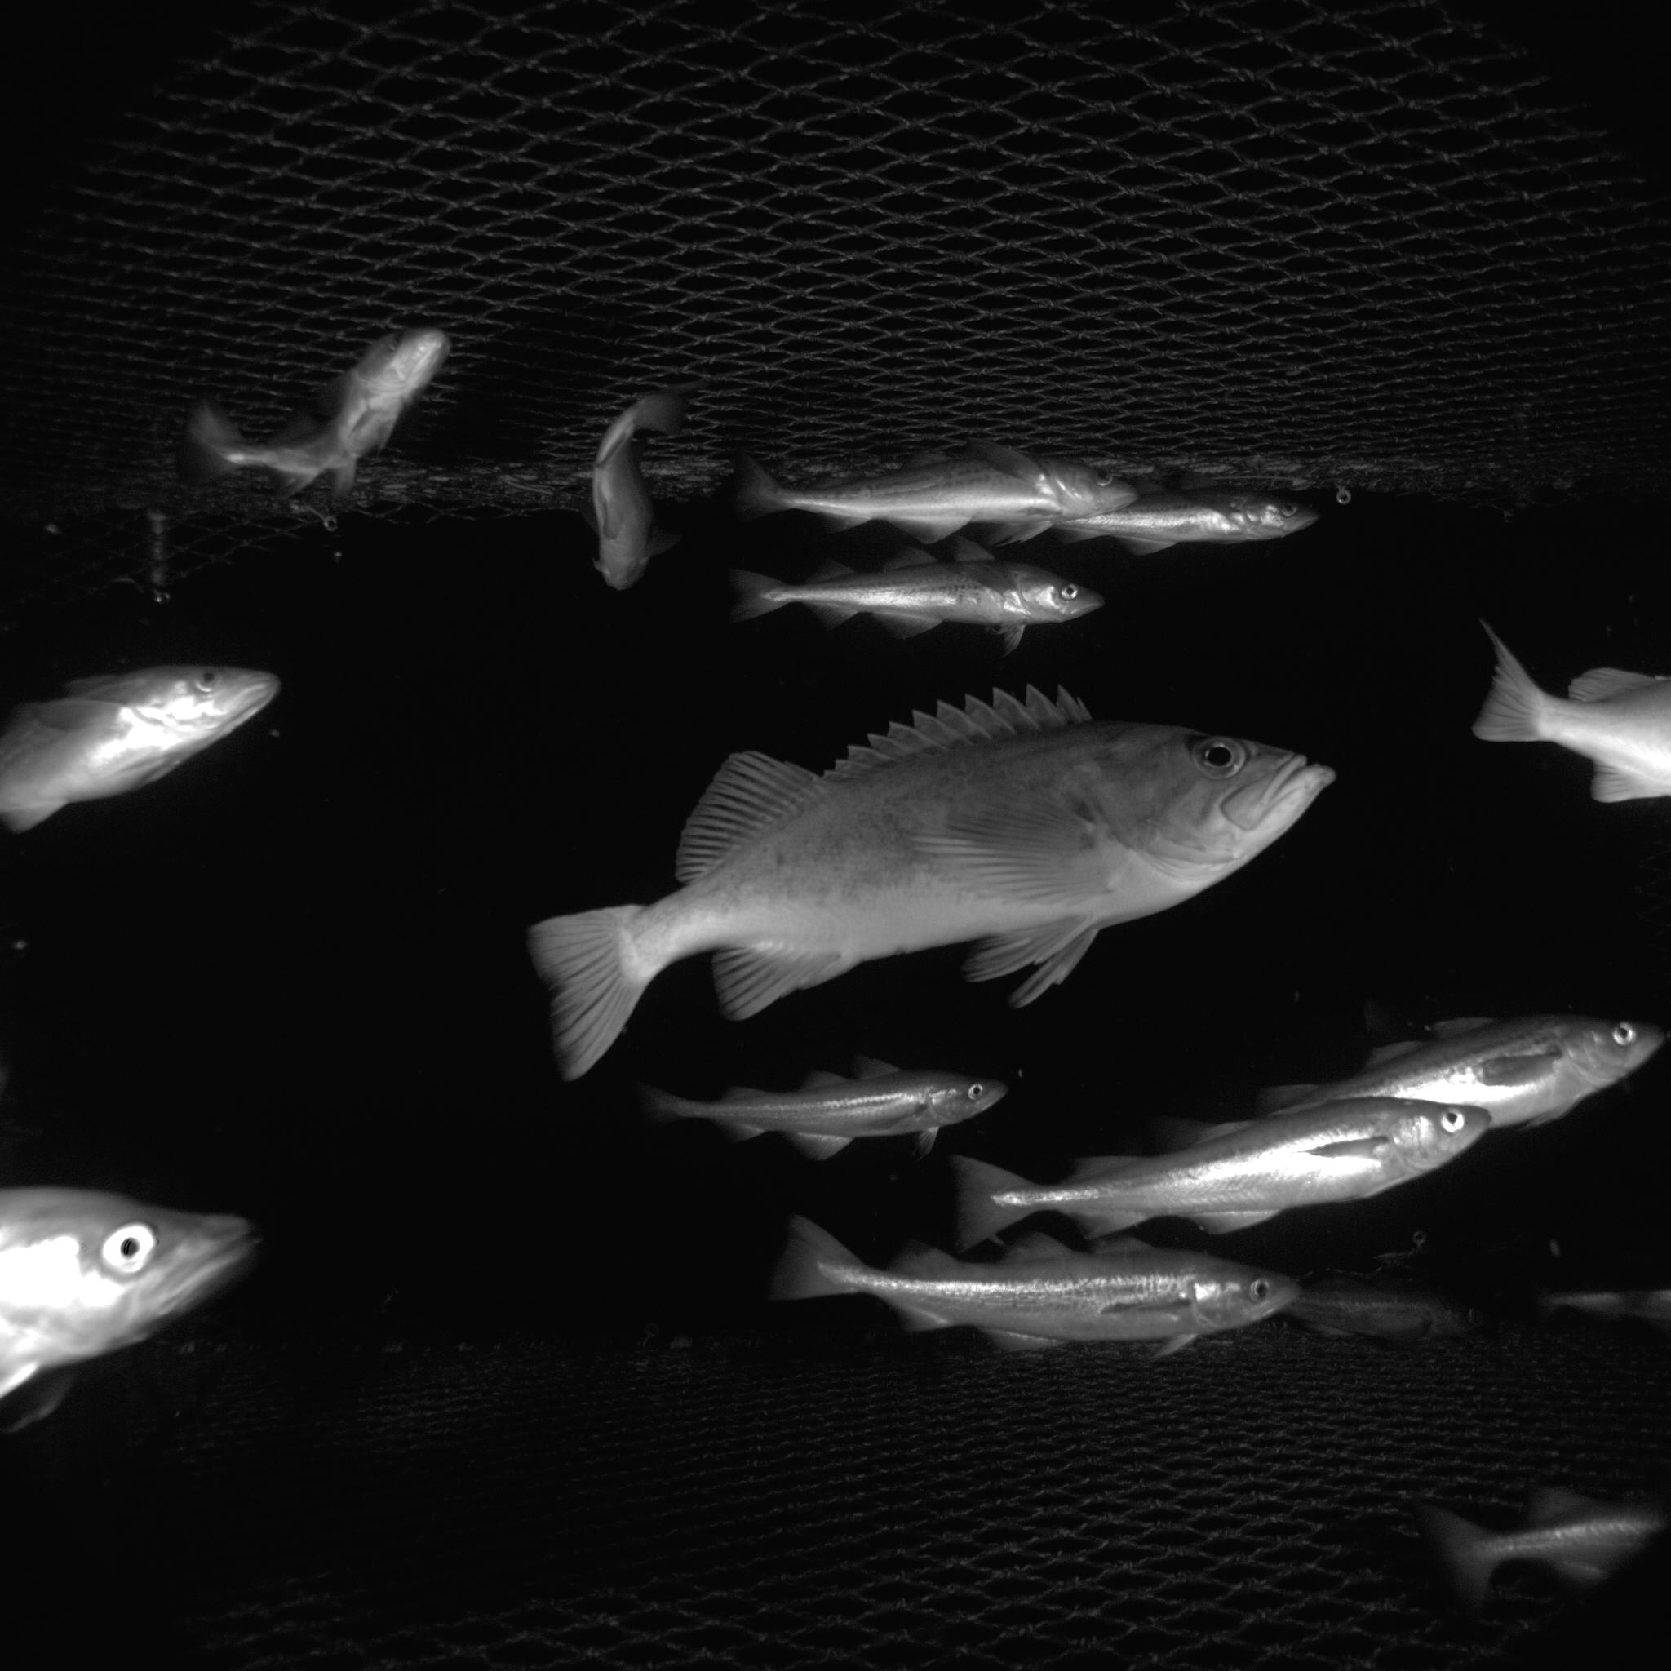
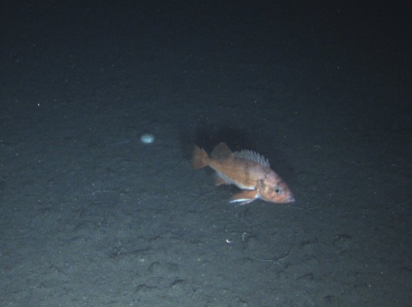
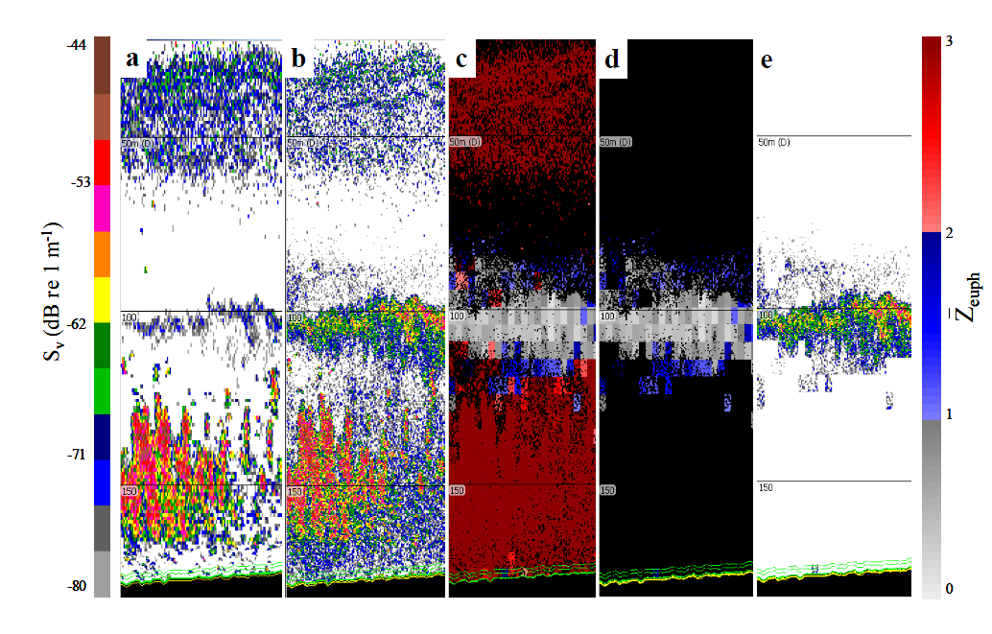
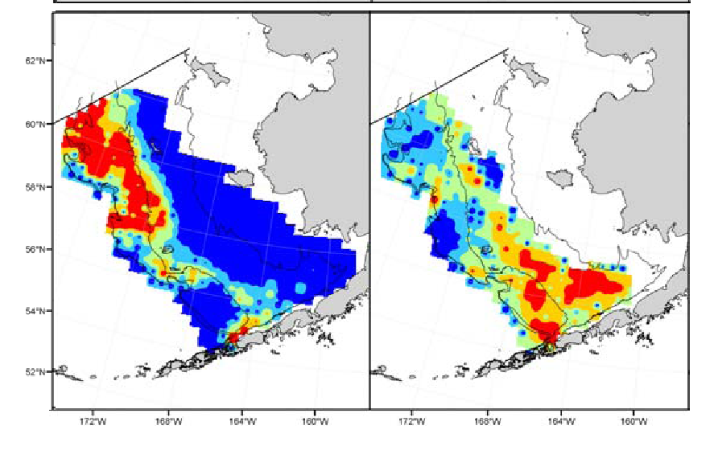
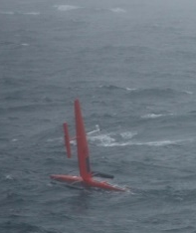
Questions?
pollock
euphausiids

Slide 8
Species Identification
Automated algorithms:
pollock
euphausiids
De Robertis et al., 2010
Ressler et al. 2012

Slide 9
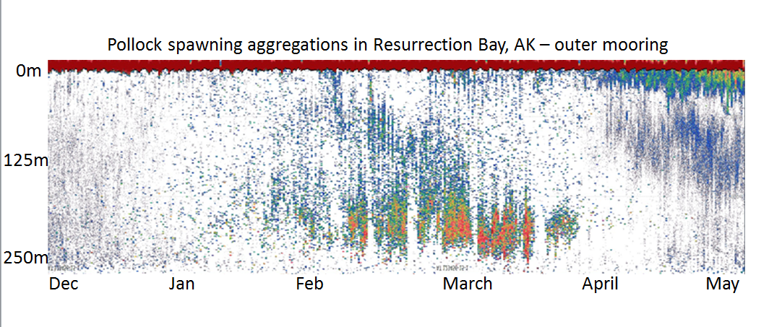
Bottom Moored echosounders
Mooring echogram illustrating arrival (Feb.) and departure (April) of pollock on spawning grounds.
0
250
Pollock
Depth (m)
Depth
Dec May
How have they been used to support stock assessment?
Determine timing of peak spawning for spawning stock surveys.
Provide abundance estimates comparable to vessel-based surveys.
Pollock migrations across the US/Russia border
Describe fish movements over seasonal scales (e.g. Arctic overwintering).
Suitable for environments where one, or few, species dominate backscatter.
De Robertis et al. (2018)

Slide 10
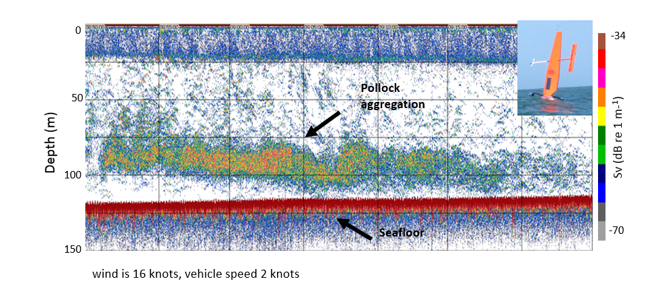
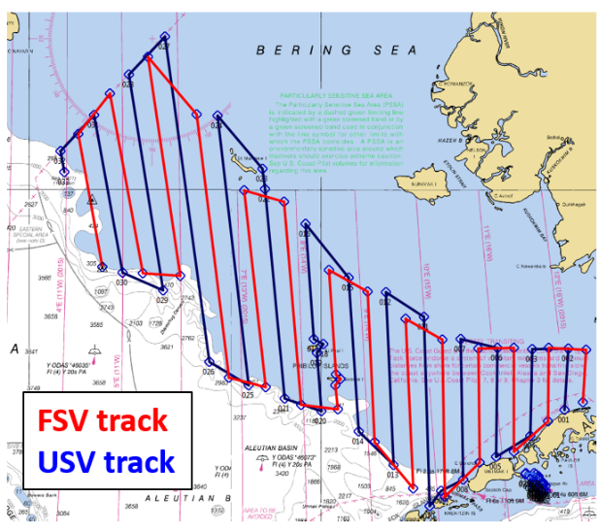
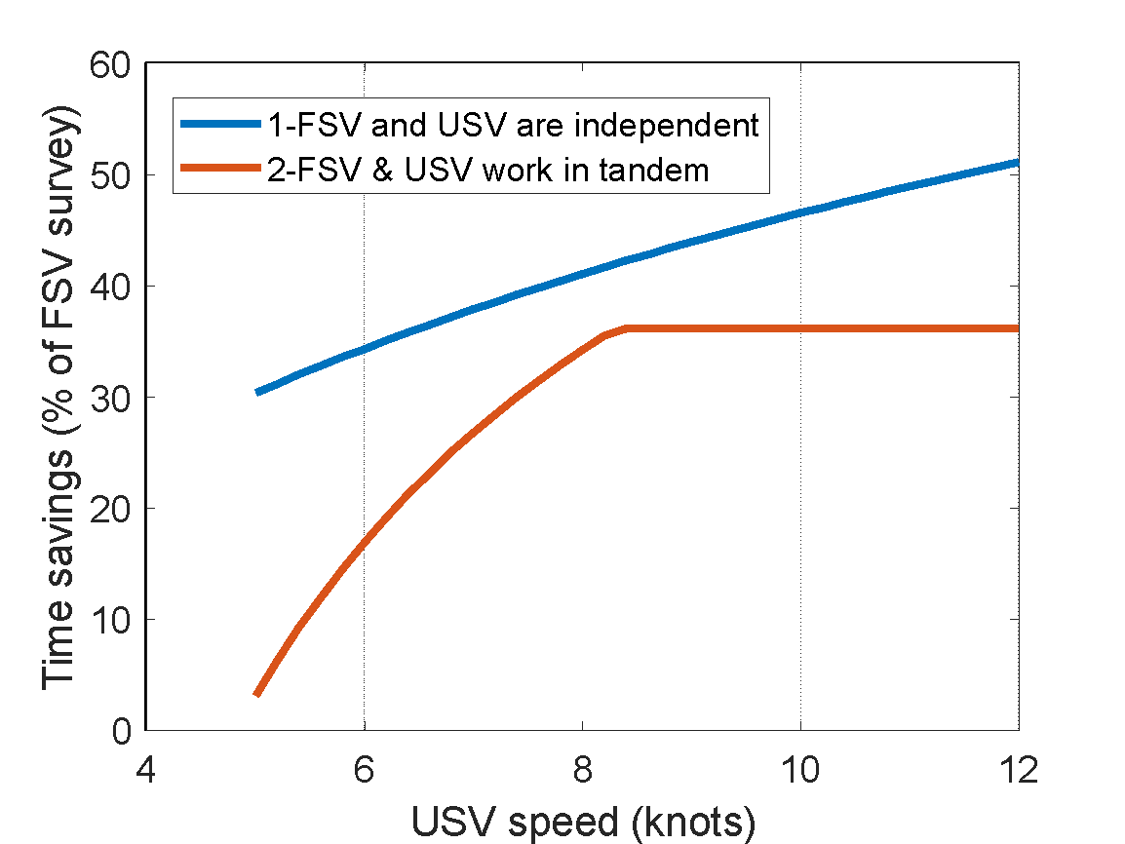
Acoustics from Unmanned Surface Vehicles (USVs)
Tandem USV/FSV approach
0
150
Depth (m)
De Robertis et al. (2019)
Applications:
Enhanced temporal and spatial sampling
Study vessel avoidance biases on surveys
Fur seal predator-prey studies
‘scouting’ to identify areas for expansion of acoustic-trawl surveys
Use of diesel-powered USVs for tandem ship/USV approach to reduce ship time requirements

Slide 11
Survey calibrations to ensure continuity of survey time series
Echosounder comparisons
Ship comparisons
Pre-correction
Noise reduced vessel
detects more
Post-correction

Slide 12
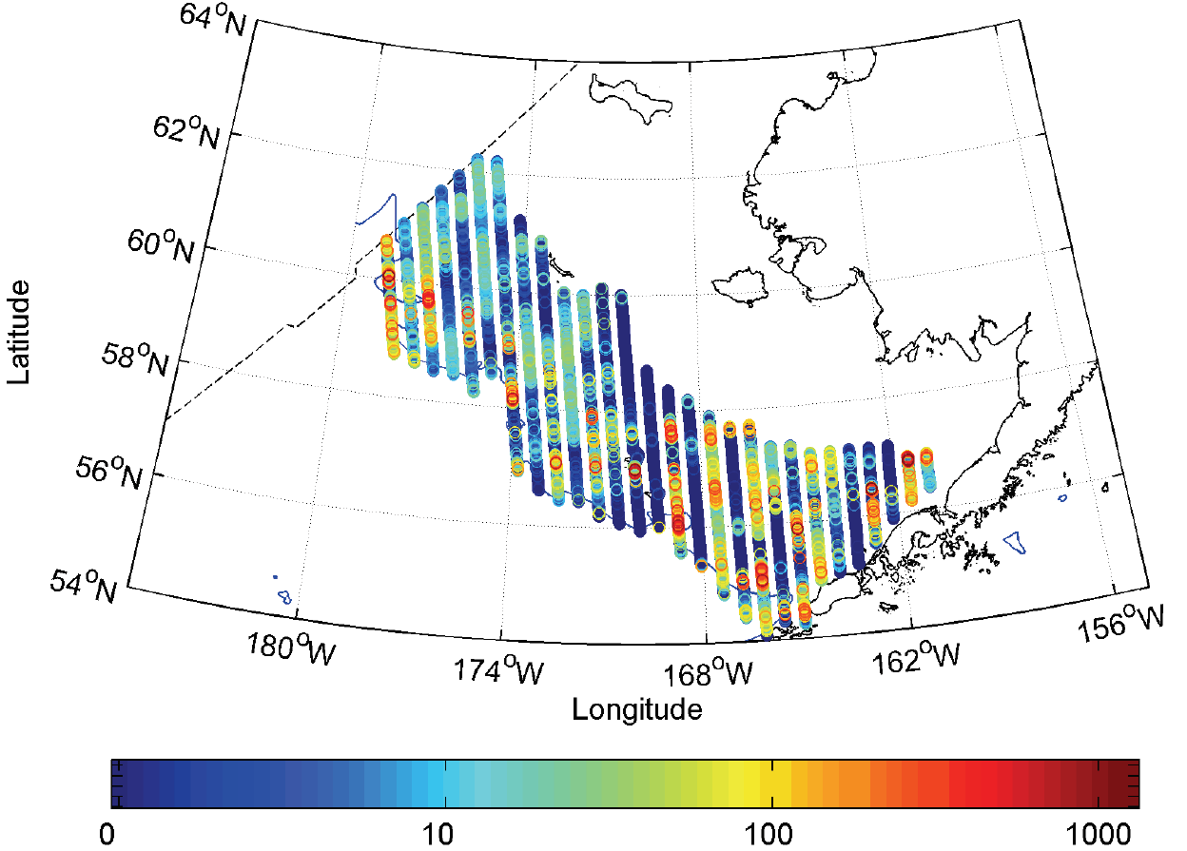
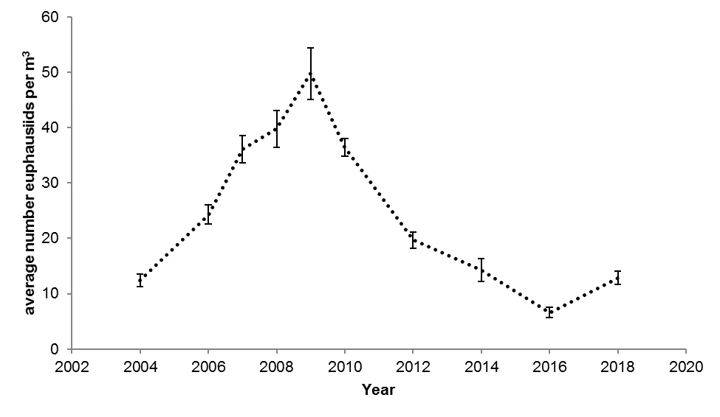
EBS krill
Notes:
Transects of acoustic-trawl survey (2016, as an example) are indicated; colors show acoustic backscatter from krill at 120 kHz (s_A, m^2 nmi^-2); time series plot through 2018 is from latest EBS Ecosystem SAFE. Mainly Thysanoessa inermis and T. raschii, average length between 18 and 20 mm

Slide 13
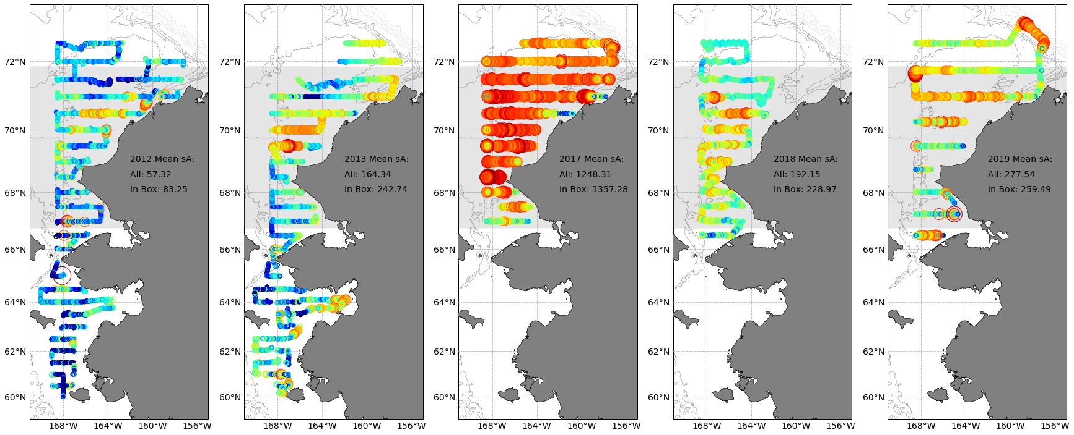
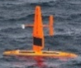
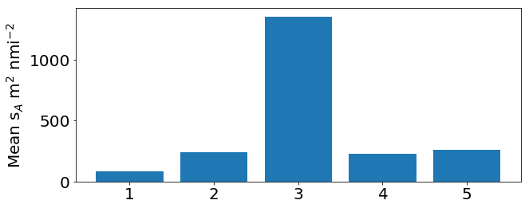
Does the Chukchi Sea Serve as a Nursery for Arctic Fishes?
Ship and Saildrone (2018) acoustic surveys.
There are high abundances of young Arctic cod in the Chukchi Sea, but few adults.
We are trying to understand whether this area serves as a nursery ground, or whether these fish don't survive the winter.
Ship-based surveys, year-round moorings, and autonomous vehicles are being used to investigate the fate of age-0 Arctic cod.
2012
2013
2017
2018
2019
2012 2013 2017 2018 2019
Trawling indicates that backscatter is dominated by Arctic cod
Mean backscatter between 67 °N and 71.5 °N was 5x higher in 2017 than any other year.
Levine, De Robertis, Wilson
Notes:
These two slides describe highlights from MACE’s contribution to the NPRB Arctic integrated ecosystem program.
We are continuing a time series started in 2012/2013. The main result of these surveys is that age-0 arctic cod are abundant in the Northern Chukchi, but adults are scarce.
We are trying to understand whether this area serves as a nursery ground, or whether these fish don't survive the winter.
We are using ship-based surveys, autonomous vehicles, and moorings to investigate where these Arctic cod come from and what their fate is.
This work is the bulk of Robert Levine’s UW PHD dissertation. De Robertis and Wilson are project PI’s.

Slide 14
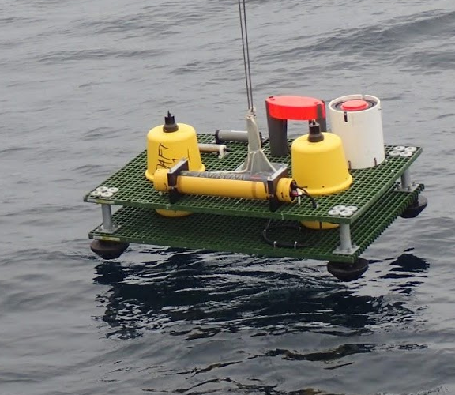
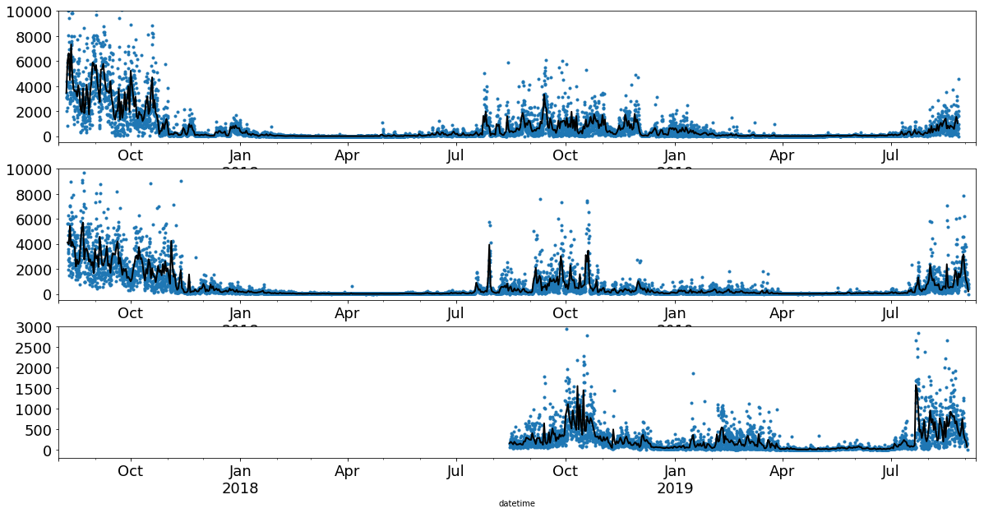
Two-year sonar record from seafloor
(preliminary results 2017-2019)
Arctic cod disappear in mid-winter and return in spring after ice breakup
Abundance exceptionally high in summer 2018
The movements these fish will be tracked as they move through the beam to estimate where they came from and where they go
Southern Chukchi Sea Mooring
Mean s_{A} (m² nmi⁻²)
Wakeup
Daily Mean
2017
2018
2019
Levine, De Robertis, Wilson
Notes:
We placed 3 moorings in the Chukchi sea to better understand the fate of the age-0 Arctic cod we see in the summer surveys.
We used a battery powered echosounder left on the seafloor to make acoustic measurements in over two years (Summer 2017 to summer 2019)
We will track fish as they swim through the acoustic beam to mesure where they come from and where the go.
The plot shows backscatter (almost all from Arctic cod – we know this from trawling in summer) as a function of time. Abundance in the winter is very low.

