Slide 1
Norton Sound Red King Crab
SAFE 2020
Jan 14 2020
Crab Plan Team Kodiak AK
Toshihide “Hamachan” Hamazaki,
Jie Zheng
Alaska Department of Fish & Game
Division of Commercial Fisheries

Slide 2
NSRKC Stock Assessment Model
Modeling process
Available Data & model fit
5 months
Pot survey
Length
Natural
Mortality
Winter Harvest
& Discards
Winter fishery
Dec - May
NSRKC
SAFE Winter +Summer fishery
Feb 01
Abundance
July 01
Abundance
Summer fishery
Jun - Sept
Summer Harvest
& Discards
Length, CPUE
Molting, Growth &
Recruitment
Natural
Mortality
Trawl survey
Abundance, Length
Tag recovery
7 months

Slide 3
NSRKC Stock Assessment Model
Modeling process
Available Data & model fit
5 months
Length Prop
Pot survey
Natural
Mortality
Abundance
Trawl survey
ST. CPUE
Winter fishery
Dec - May
Feb 01
Abundance
July 01
Abundance
Summer fishery
Jun - Sept
Survey selectivity
=
Catch selectivity
Length Prop
Trawl Survey
Fishery: Retain
Discards
Molting, Growth
Recruitment
Natural
Mortality
7 months
Tag recovery

Slide 4
Assumptions
M = 0.18 for length class 1-6, higher mortality of classes 7 and 8
Same selectivity and catchability for New and Old Shells
Discards mortality = 0.2
Fishery harvests occur instantly:
  Winter fishery: Feb 01: Nov – May
  Summer fisher: July 01: Jun – Sept
Winter catch selectivity = winter pot survey selectivity

Slide 5
Final Changes Fishery & Data
Winter fishery 2019
  Commercial: 1,050
  Subsistence: 1,545
Summer commercial fishery 2018
  6/25-9/03: 24,506
Total retained harvest: 0.03 mill. lb. < ABC (0.19 mill. lb.)
All harvest and observer data FINALIZED
Standardized CPUE updated (Appendix B)
ADF&G 2019 Summer trawl survey
  7/17-7/29: 4660.8 k, CV =0.60
NOAA 2019 Summer trawl survey (NS portion)
  8/04-8/07: 2532.4 k, CV =0.30
NOAA 1976-1991 Summer trawl survey
  Abundance data updated: method reviewed
Winter Commercial Retained length-shell Not collected
Tag recovery: Completed.
Changes in fishery regulation: None

Slide 6
Model Data Time Series

Slide 7
Trawl Survey abundance estimate ADFG vs NMFS
ADFG (1996-2019) and NOAA (2010, 2017, 2019)
N = ∑A_{(station)}*CPUE_{(station)}
NMFS (1976-1992)
N = A_{(total area)}*mean(CPUE_{(stations)})

Slide 8
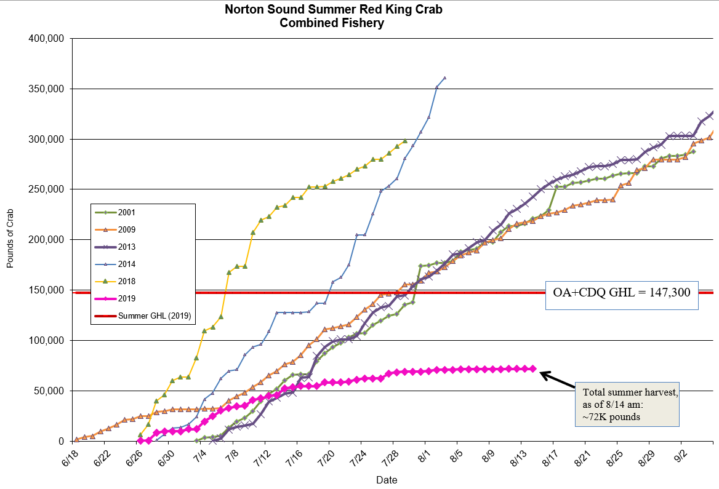
2019 Summer Commercial Fishery

Slide 9
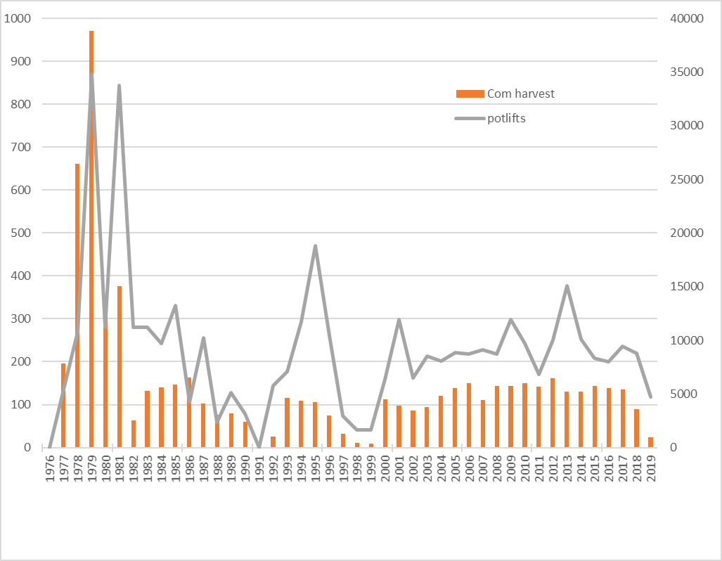
2019 Summer Commercial Fishery

Slide 10
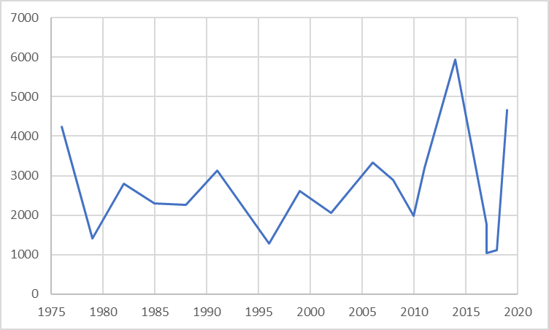
2019 Summer Trawl Survey

Slide 11
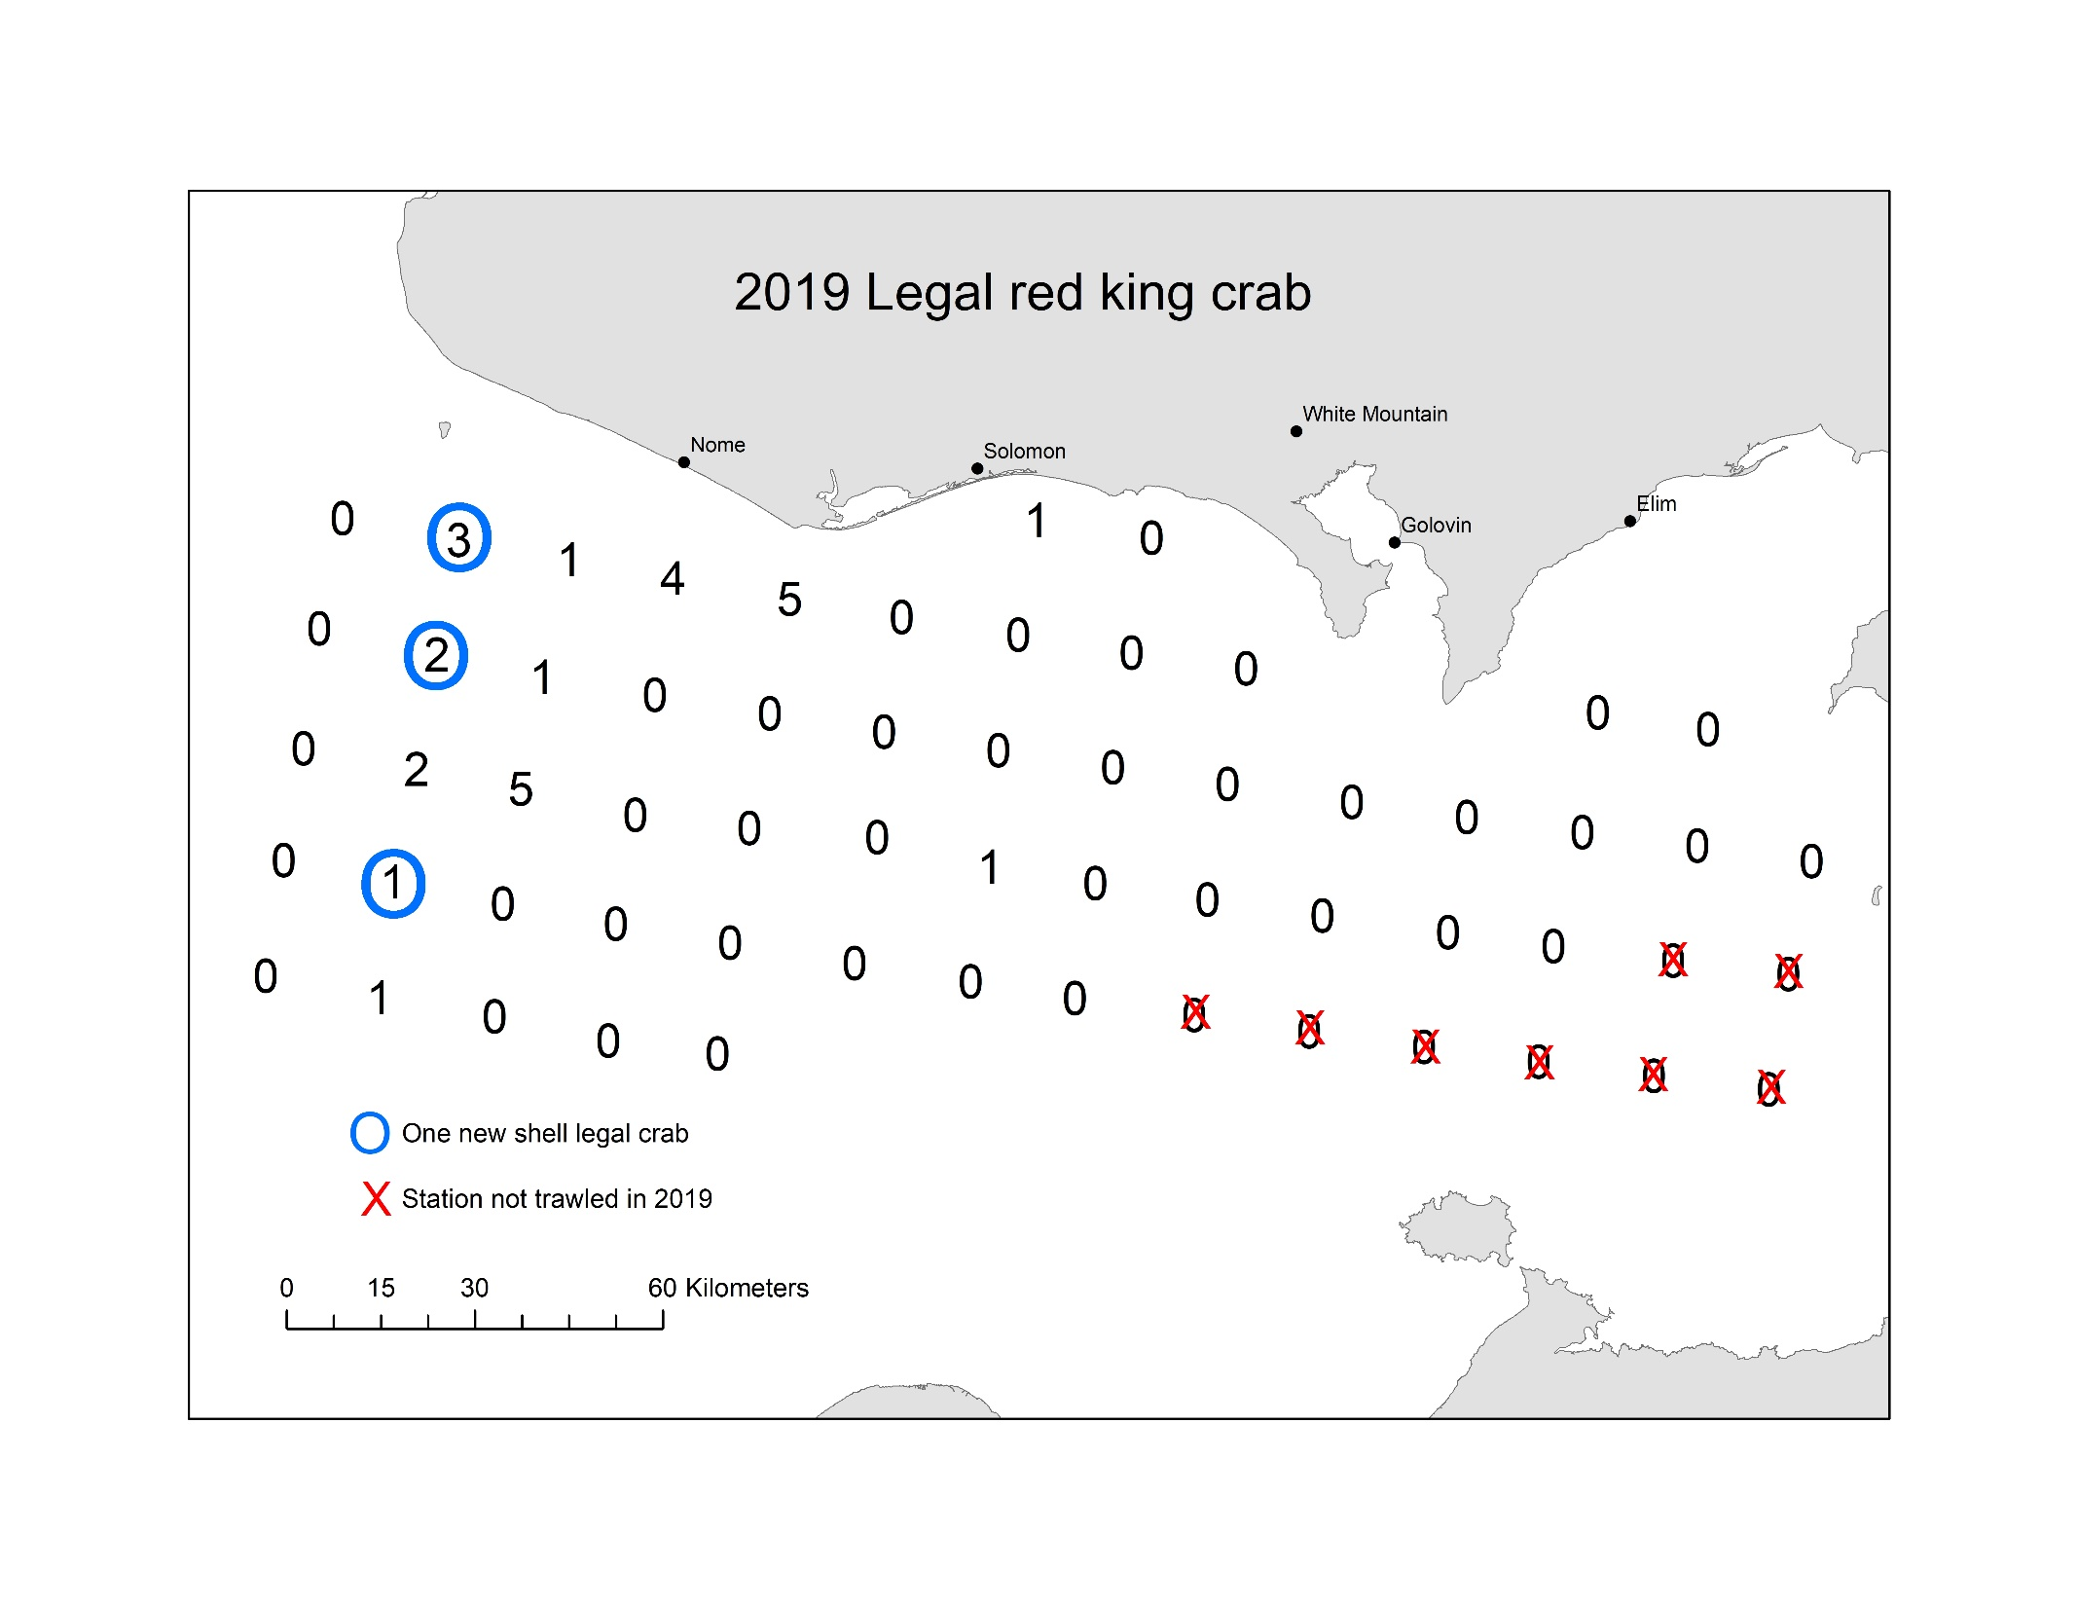
2019 Trawl Survey ADFG
Legal = 27

Slide 12
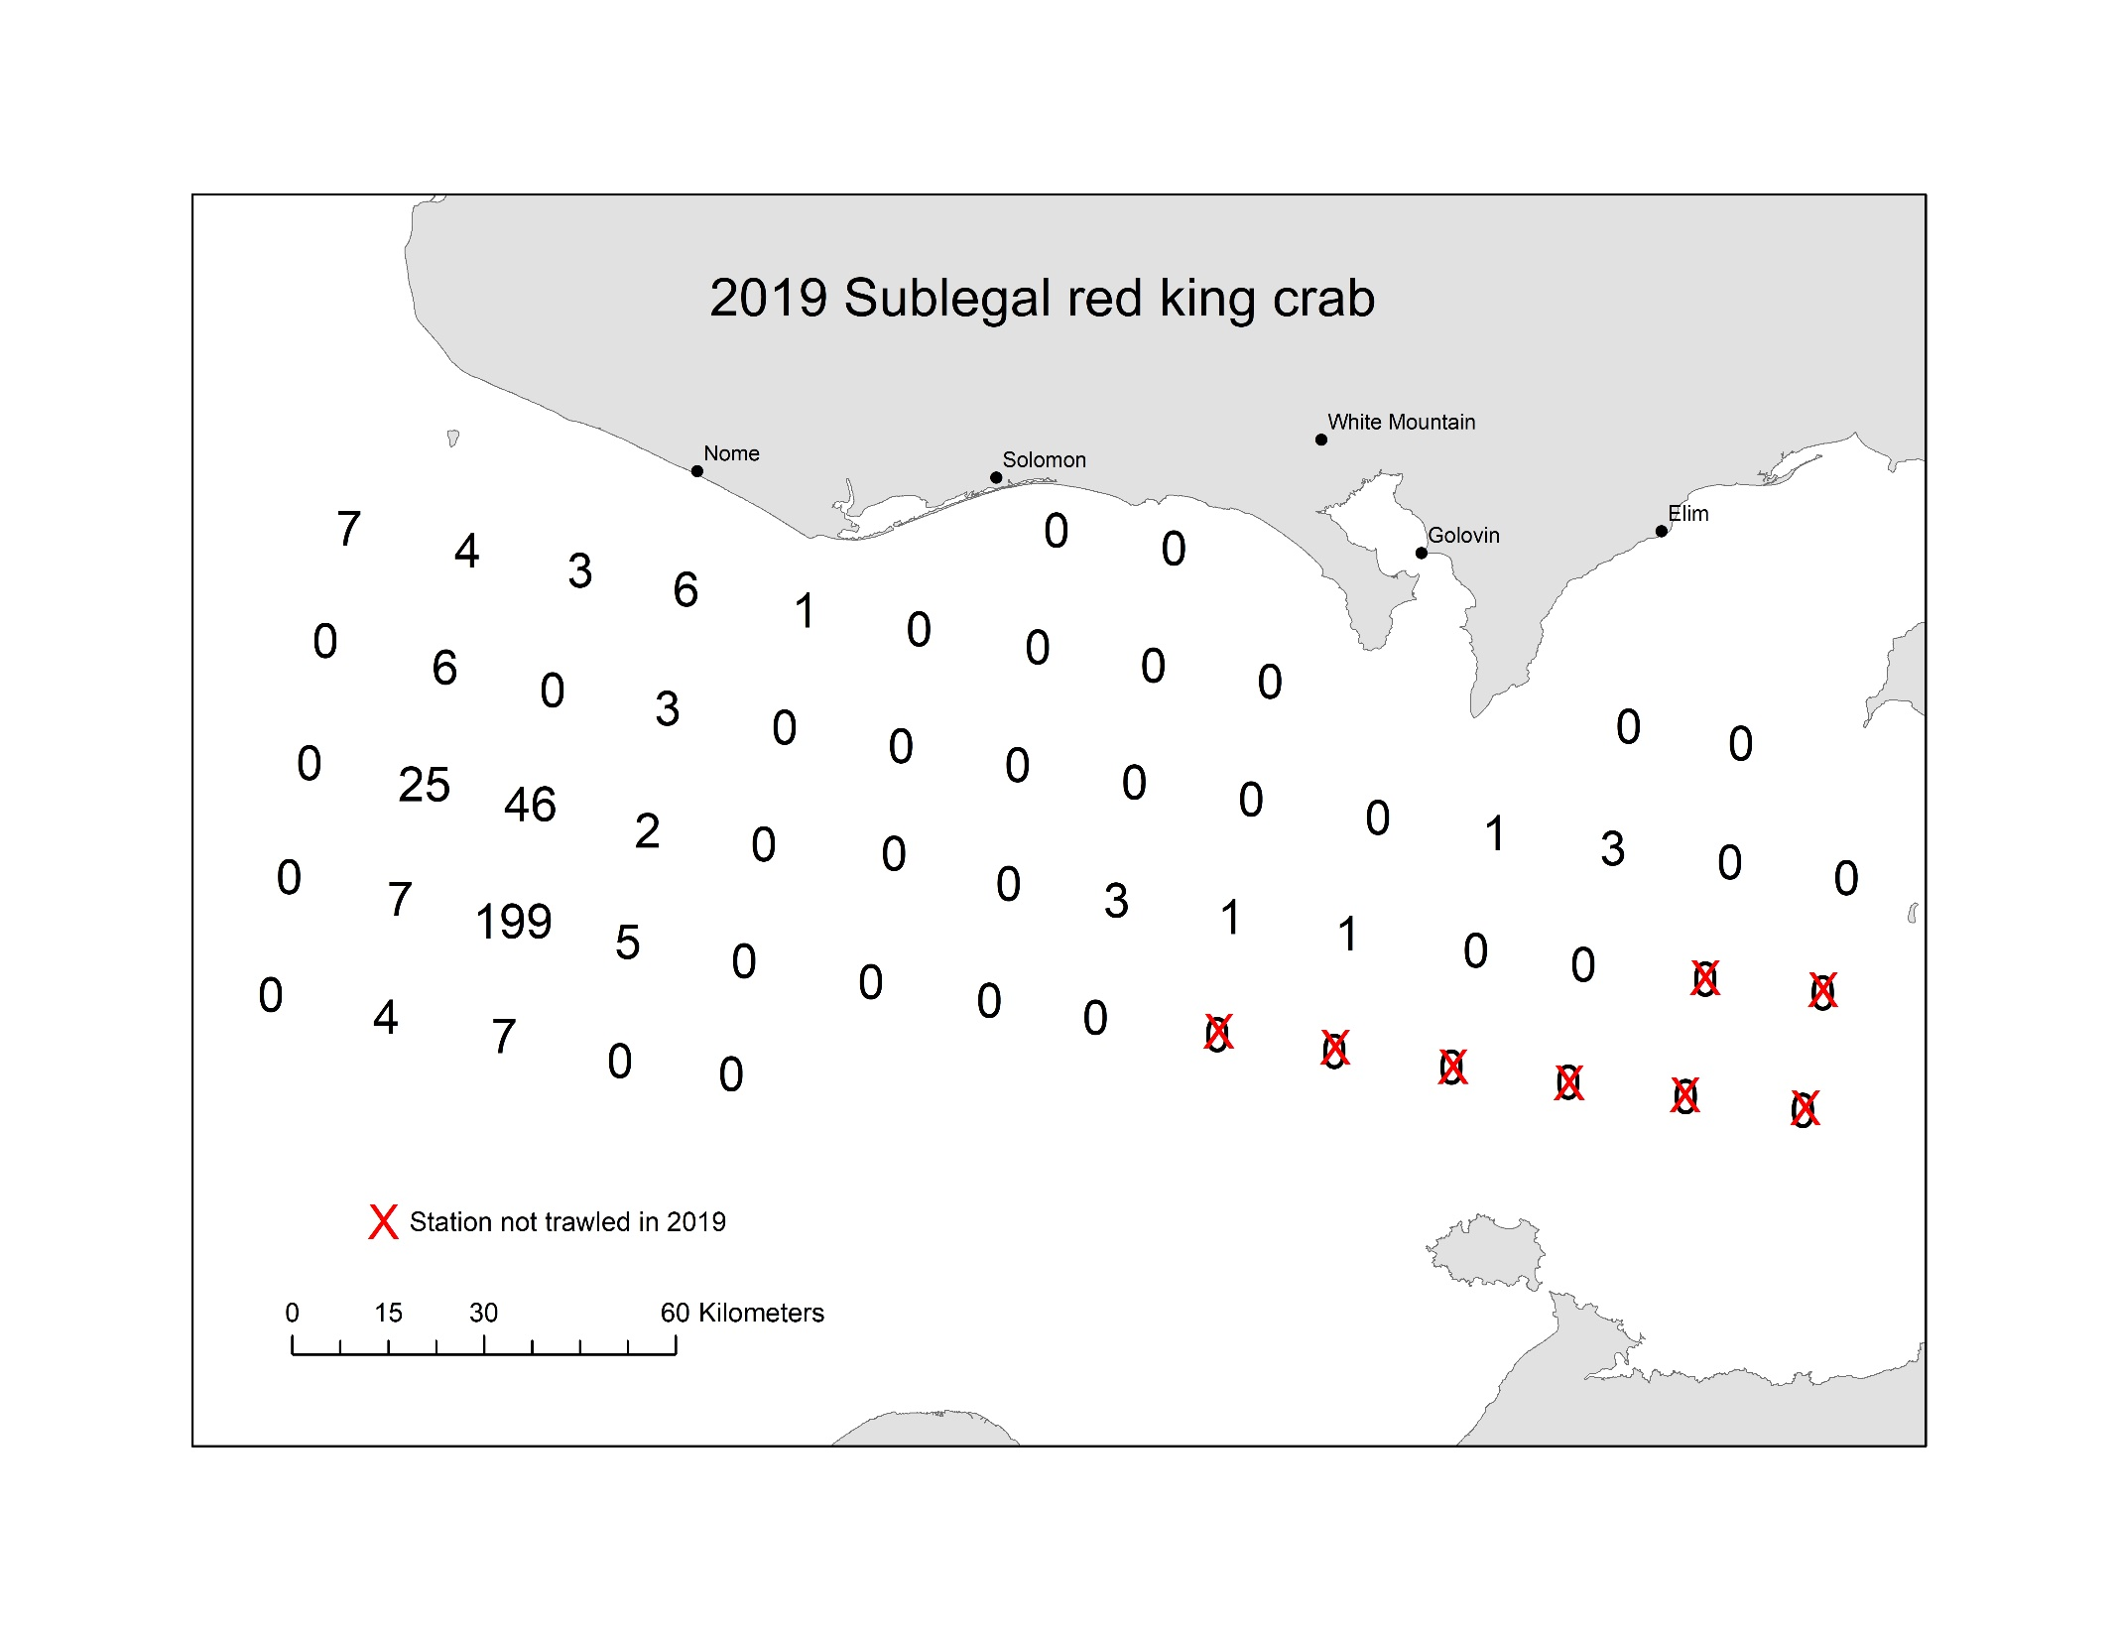
2019 Trawl Survey ADFG
Sublegal = 334

Slide 13

2019 Trawl Survey ADFG
Female= 385

Slide 14
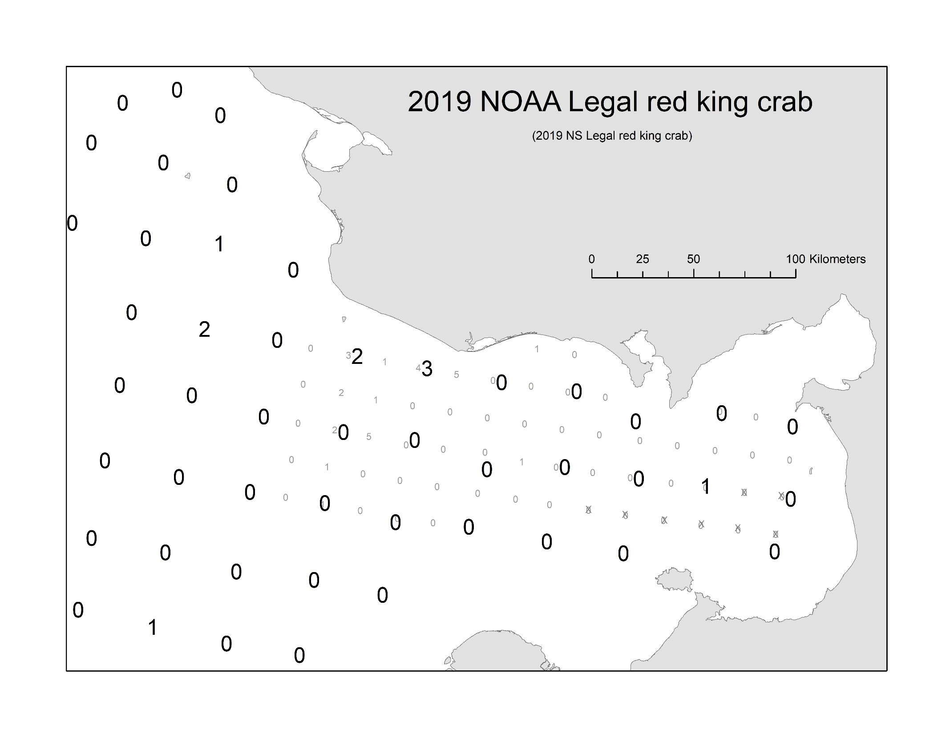
2019 Trawl Survey NMFS
Legal=6

Slide 15

2019 Trawl Survey NMFS
Subegal=70

Slide 16

2019 Trawl Survey NMFS
female=47

Slide 17
Observer Data
Year | FT: Pot | FT: Retain | Obs pots | SL | ML | L | Female | Total
2012 | 10041 | 161113 | 78 | 898 | 1055 | 177 | 152 | 2282
2013 | 15058 | 130603 | 199 | 2775 | 2166 | 258 | 123 | 5322
2014 | 10127 | 129656 | 147 | 1504 | 1838 | 341 | 104 | 3787
2015 | 8356 | 144224 | 69 | 969 | 1676 | 577 | 224 | 3446
2016 | 8,009 | 138997 | 67 | 264 | 1700 | 169 | 878 | 3011
2017 | 9440 | 135322 | 110 | 432 | 2174 | 122 | 373 | 3101
2018 | 8797 | 89613 | 78 | 547 | 1096 | 10 | 574 | 2227
2019 | 5436 | 24913 | 28 | 123 | 142 | 1 | 89 | 355

Slide 18
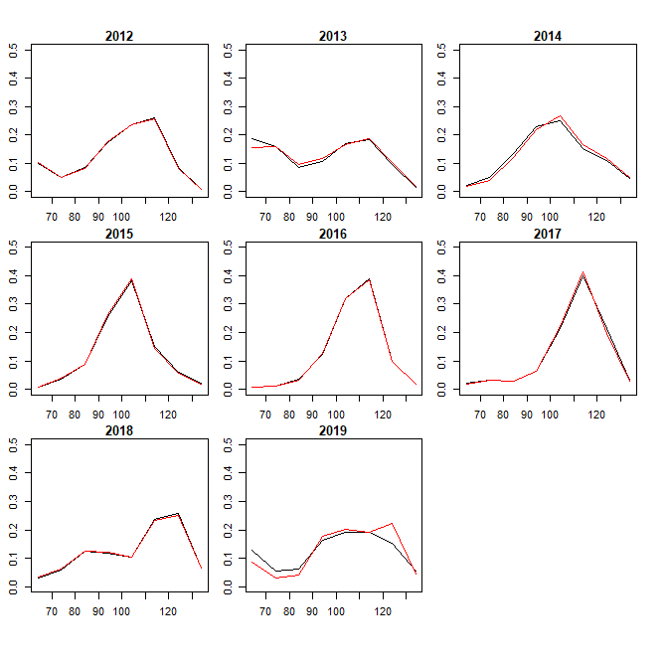
Observer Data: Length Comp
Black: Sample, Red: Spatial weighted

Slide 19
Discards Estimates
CPUE based (ob CPUE = total CPUE)
  LNR: Total Discards = (ob discards)*(total pot lifts)/(ob pot lifts)
  Sub: Total Discards = (ob total catch)*(total pot lifts)/(ob pot lifts) – total retain
Prop based (ob p discards = total p discards) (Assessment model)
  P: Total Discards = (ob discards)*(total retain)/(ob retain)
Year | CPUE.ob | CPUE.ft | Ratio
2012 | 13.53 | 16.05 | 0.84
2013 | 10.88 | 8.67 | 1.25
2014 | 12.50 | 12.80 | 0.98
2015 | 24.29 | 17.26 | 1.41
2016 | 25.37 | 17.36 | 1.46
2017 | 19.76 | 14.33 | 1.38
2018 | 14.05 | 10.19 | 1.38
2019 | 5.07 | 4.58 | 1.10
STAT Area | Trawl % Legal | Trawl Catch Prop | FT Prop | Ob. %Legal | Ob. Catch Prop | FT CPUE
666401 | 62% | 11% | 15% | 72% | 7% | 12.79
656401 | 21% | 19% | 21% | 62% | 18% | 12.03
646401 | 12% | 24% | 19% | 58% | 46% | 14.70
636401 | 31% | 18% | 33% | 68% | 19% | 15.78
626401 | 53% | 28% | 15% | 80% | 2% | 11.78

Slide 20
Discards Estimates
CPUE based (ob CPUE = total CPUE)
  LNR, LNR2: Directly estimate discards
  Sub, Sub2: Discards = Total catch – total retain
Prop based (ob p discards = total p discards) (Assessment model)
  P: Total Discards = (P/(1-P) )*(total retain)

Slide 21
Discards Estimates
NSRKC obs survey is ad hoc. Every discard estimate is ad hoc.
How do we decide which estimate is closest to TRUE discards?

Slide 22
Incorporating discards into model
Model estimates:
Est.discards = Retained Catch*(P.discards)/(P. reatain)
Est.total catch = Retained Catch + Est.discards
With discards:
Total catch = Retained Catch + Discards

Slide 23
Responses to CPT & SSC (Sept-Oct 2019)
None. Do OFL with model 19.0 with updated data

Slide 24
Model Recommendation for 2020 SAFE
 | Jan 2020 | Sept 2019
Model | Model 19.0 | Model 19.0 | Model 19.1 | Model 19.2 | Model 19.3 | Model 19.4 | Model 19.5
 |  |  |  |  | +1 | +14 | +14
Total | 315.9 | 306.1 | 254.4 | 306.2 | 305.8 | 296.5 | 288.6
Trawl | 10.0 | 9.8 | 9.6 | 9.9 | 9.7 | 8.8 | 9.4
St.CPUE | -24.1 | -24.1 | -24.1 | -24.1 | -23.8 | -23.2 | -23.2
Trawl: LP | 115.3 | 110.8 | 109.7 | 110.5 | 110.6 | 108.4 | 105.4
Winter:LP | 38.5 | 39.0 | 39.6 | 38.6 | 38.8 | 41.4 | 42.5
Com: LP | 49.3 | 48.4 | 48.9 | 48.3 | 48.3 | 54.1 | 50.2
Obs: LP | 24.8 | 20.4 | 19.9 | 20.3 | 20.4 | 19.4 | 20.2
REC | 2.7 | 2.6 | 2.7 | 2.4 | 2.5 | 1.8 | 1.9
Winter C: LP | 17.8 | 18.1 | 18.3 | 18.1 | 18.1 | 18.8 | 18.8
TAG | 81.5 | 81.2 | 30.0 | 81.2 | 81.2 | 65.0 | 61.8
BMSY(mil.lb) | 4.58 | 4.66 | 4.70 | 3.40 | 4.00 | 6.72 | 5.13
MMB(mil.lb) | 3.73 | 3.98 | 3.87 | 2.86 | 3.35 | 5.45 | 4.66
Legal (mil.lb) | 2.43 | 2.53 | 2.46 | 1.78 | 2.10 | 2.37 | 2.18
OFL(mil.lb) | 0.29 | 0.31 | 0.29 | 0.22 | 0.26 | 0.46 | 0.60
NOAA q | 0.71 | 0.70 | 0.68 | 1 | 0.81 | 0.66 | 0.71
ADFG q | 1 | 1 | 1 | 1.40 | 1.20 | 1 | 1
M | 0.18/0.58 | 018/0.58 | 018/0.64 | 018/0.52 | 018/0.55 | 0.31 | 0.43

Slide 25
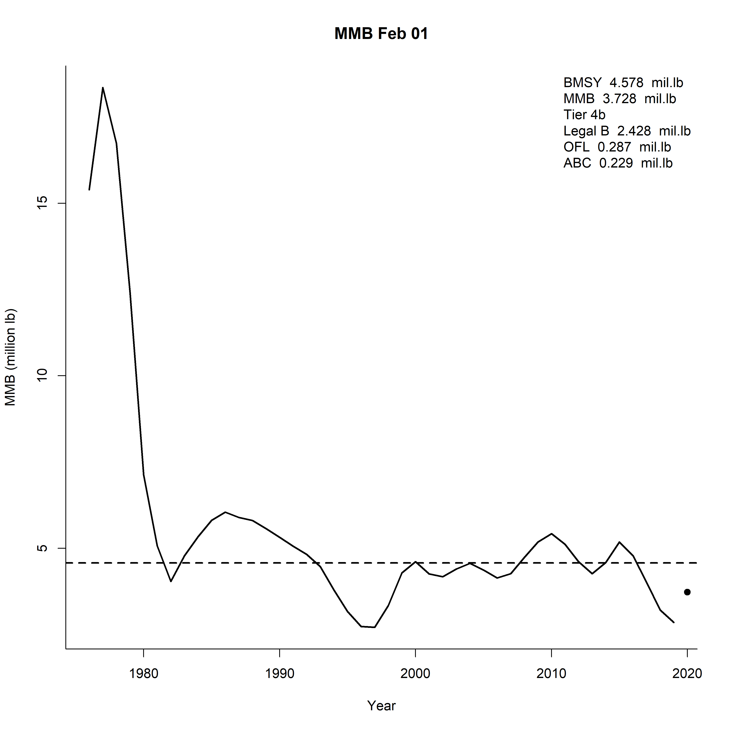
Model Recommendation for 2020 SAFE

Slide 26
OFL and ABC: Table is WRONG!!
BMSY (1980-2020) 4.561 million lb or 2.07 k t
Projected MMB: 3.664 million lb or 1.66 k t
Tier 4b
FOFL = 0.141
Legal male biomass: 2.428 million lb or 1.101 kt
OFL(retained) = 0.287 million lb or 0.13 kt
ABC = 0.8*OFL = 0.229 million lb or 0.104 kt

Slide 27
Model Recommendation for 2020 SAFE
OFL Profile

Slide 28
Alternative model selection for 2020 SAFE
Model 19.4 (red), 19.5 (blue) : (Hide & Kill All option 1,2)

Slide 29
Alternative model selection for 2020 SAFE
Model 19.4, 19.5: (Hide & Kill All option 1,2: Existence of crab that are never caught nor observed -> Higher MMB)

Slide 30
Likelihood
Model | Model 19.0 | Model 19.1 | Model 19.2 | Model 19.3 | Model 19.4 | Model 19.5
BMSY(mil.lb) | 4.66 | 4.70 | 3.40 | 4.00 | 6.72 | 5.13
MMB(mil.lb) | 3.98 | 3.87 | 2.86 | 3.35 | 5.45 | 4.66
Legal crab Catchable (mil.lb) | 2.53 | 2.46 | 1.78 | 2.10 | 2.37 | 2.18
OFL(mil.lb) | 0.31 | 0.29 | 0.22 | 0.26 | 0.46 | 0.60
NOAA q | 0.70 | 0.68 | 1 | 0.81 | 0.66 | 0.71
ADFG q | 1 | 1 | 1.40 | 1.20 | 1 | 1
M | 018/0.58 | 018/0.64 | 018/0.52 | 018/0.55 | 0.31 | 0.43
Due to higher M: F_{OFL} = M

