Slide 1
Effects of ocean acidification on snow crab embryos and larvae
Alaska Fisheries Science Center
William C. Long, Katherine M. Swiney, Robert J. Foy

Slide 2
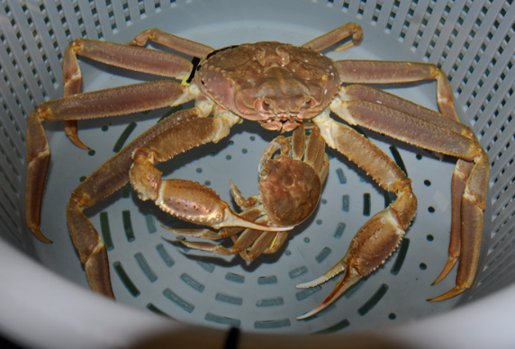
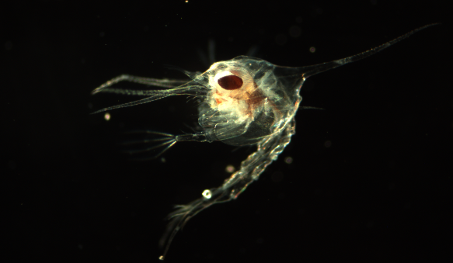
Ocean Acidification
CO₂ increasing in atmosphere
Leads to an increase in CO₂ in the oceans
Leads to a reduction in pH
Lowers saturation state for calcium carbonate
Leads to . . . ?

Slide 3
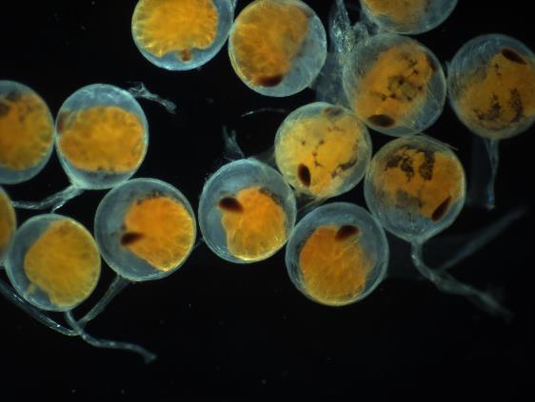
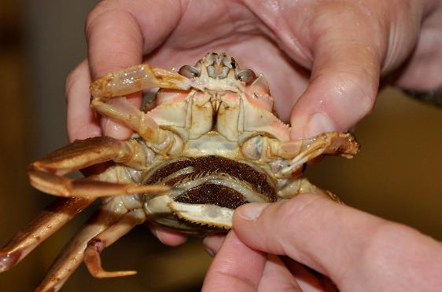
Snow crab, Chionoecetes opilio
Important fishery species
How will OA affect
  Embryos?
  Fecundity?
  Larvae?

Slide 4
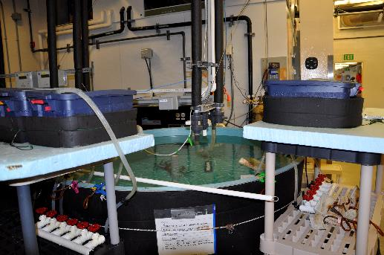

Methods: Experimental Conditions
Ovigerous females captured in trawl
  16 per treatment
Chilled water: 2°C
Flowing seawater acidified with CO₂
  Control (~pH 8.1)
  pH 7.8
  pH 7.5
Held for 2 years
Mated after 1st year

Slide 5
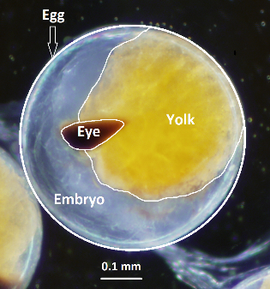
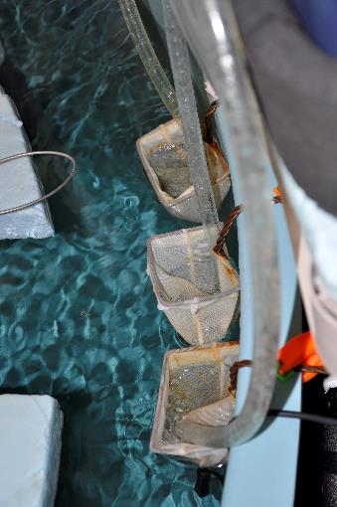
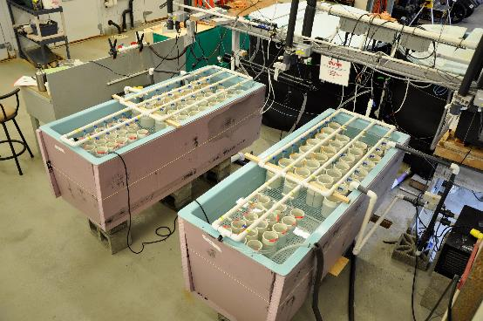
Methods: Measurements
Embryos monthly:
  Staged
  Measured
Fecundity
    Estimated larvae by dry mass
Larvae
  Starvation survival
  Ca/Mg content
    At hatch
    After 7 days in treatment

Slide 6

Results: Embryos Year 1
Clear progression in morphology over development

Slide 7

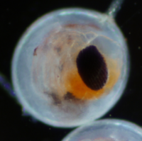
Results: Embryos Year 1
YEAR 1
No differences among treatments
Year 2 very similar results

Slide 8

Results: Fecundity
No difference in either year
In contrast to Tanner crab. . .
a
a
b

Slide 9
Results: Hatching success
95%+ hatching success each year
No difference among treatments

Slide 10

Results: Larval Survival Year 1
  Exposure to low pH as embryos decreased larval survival times
  Larval pH had a very small affect on survival times
  Exposure to low pH as embryos had a positive carry-over effect when larvae were also reared at low pH

Slide 11
Results: Larval Survival Year 2
Exposure to low pH as embryos did not affect larval survival times
Larval pH did not affect survival times
Exposure to low pH as embryos had a positive carry-over effect when larvae were also reared at low pH

Slide 12
Results: Larval Calcification Year 1
Small effect of embryo pH
No effect of larval pH
No interactive effect

Slide 13

Results: Larval Calcification Year 2
No effect of embryo pH
No effect of larval pH
Evidence for acclimatization from previous year

Slide 14

Conclusions
Snow crab embryo development is unaffected by pH
OA does not affect fecundity or hatching success
Small effect on larval survival
  Only in year 1
  Evidence for acclimatization and positive carryover effects in year 2
Small effect on larval calcification
  Only in year 1
  Evidence for acclimatization in year 2

Slide 15
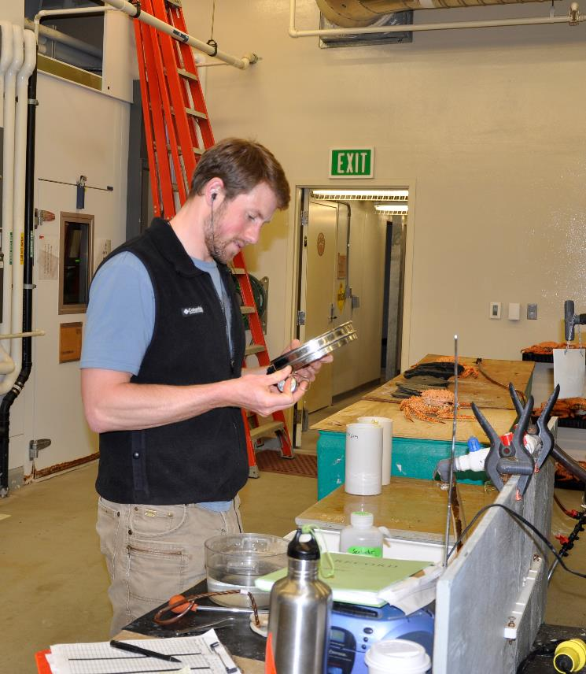
Thanks!
NOAA OA
Allie Bateman
Nick Sisson
Nikki Gabriel
Ben Daly
Lacey Harver
All Kodiak Lab Staff

