Slide 1
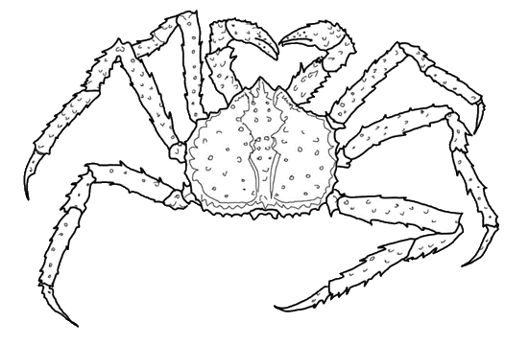
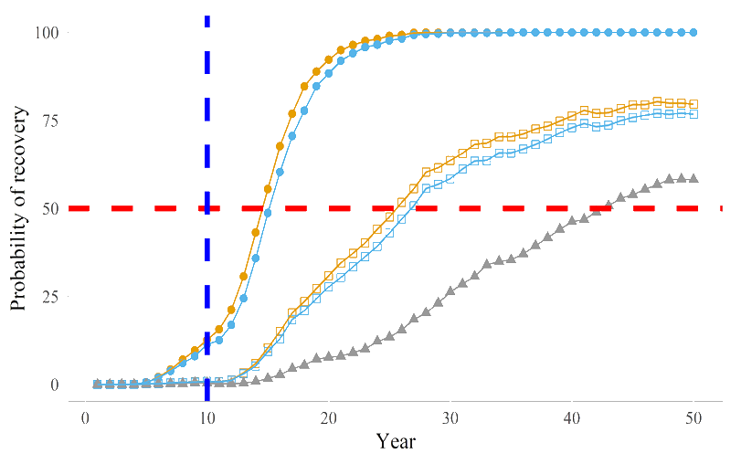
St Matthew Island blue king crab
Rebuilding Plan
Initial Review – Update for CPT
January 2020

Slide 2
Outline
Chapter
1.0
Introduction
  Status change, required action, Statutory,
  NS1, Crab SAFE
Alternatives
Other considerations
  Bycatch, Existing protections, Ecosystem conditions
Rebuilding analysis
  Recruitment, Harvest (Alternatives), Timeframes
Socio-econ Impacts
2.0
3.2.2 –3.2.4
3.2.5 – 3.2.9
3.3

Slide 3
1.2.2 T_{min} and T_{max}
T_{min}
  F = 0
  years for p(B = B_{msy}) ≥ 50 %
  Starting year for the T_{min} is first year rebuilding plan is in place.
If T_{min} > 10 yrs, T_{max}
T_{max}
  Tmin + 1 generation time
  Time at 75% MFMT
  Tmin x 2
T_{min} ~ 14.5 years

Slide 4
1.2.2 T_{min} and T_{max}
T_{min}
  F = 0
  years for p(B = B_{msy}) ≥ 50 %
  Starting year for the T_{min} is first year rebuilding plan is in place.
If T_{min} > 10 yrs, T_{max}
T_{max}
  Tmin + 1 generation time
  Time at 75% MFMT
  Tmin x 2
T_{min} ~ 14.5 years
Average age of spawners in unfished stock

Slide 5
1.2.2 T_{min} and T_{max}
T_{min}
  F = 0
  years for p(B = B_{msy}) ≥ 50 %
  Starting year for the T_{min} is first year rebuilding plan is in place.
If T_{min} > 10 yrs, T_{max}
T_{max}
  Tmin + 1 generation time
  Time at 75% MFMT
  Tmin x 2
T_{min} ~ 14.5 years
Average age of spawners in unfished stock = 14

Slide 6
1.2.2 T_{min} and T_{max}
T_{min}
  F = 0
  years for p(B = B_{msy}) ≥ 50 %
  Starting year for the T_{min} is first year rebuilding plan is in place.
If T_{min} > 10 yrs, T_{max}
T_{max}
  Tmin + 1 generation time
  Time at 75% MFMT (not analyzed, 43 yr)
  Tmin x 2 (not analyzed, 29 yr)
T_{min} ~ 14.5 years
T_{max} ~ 28.5 years

Slide 7
2. Description of Alternatives
Alternative 1 (No Action)
  No rebuilding plan, ABC in projections
Alternative 2 (Rebuilding)
  Option 1 – no harvest
  during rebuilding
  Option 2 – State Harvest
  Strategy

Slide 8
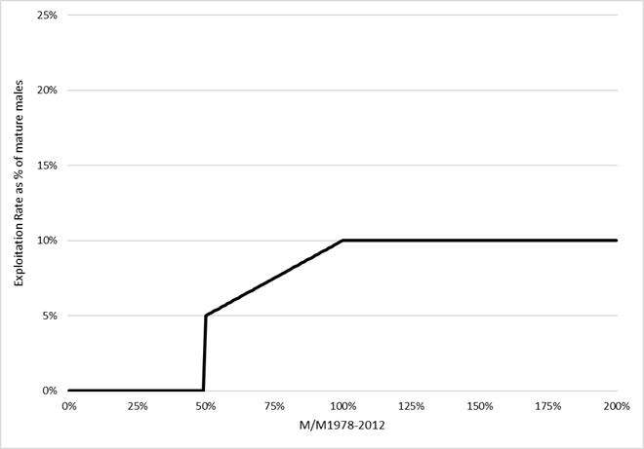
2.2 Alternative 2, Option 2
  Option 2 – State Harvest
  Strategy (5 AAC 34.917)
    Open if MMB ≥ 50% Average 1978-2012
    Max 10% Exploitation
    Assessment provides
    basis
    Closed fishery prior to
    “Overfished” status

Slide 9
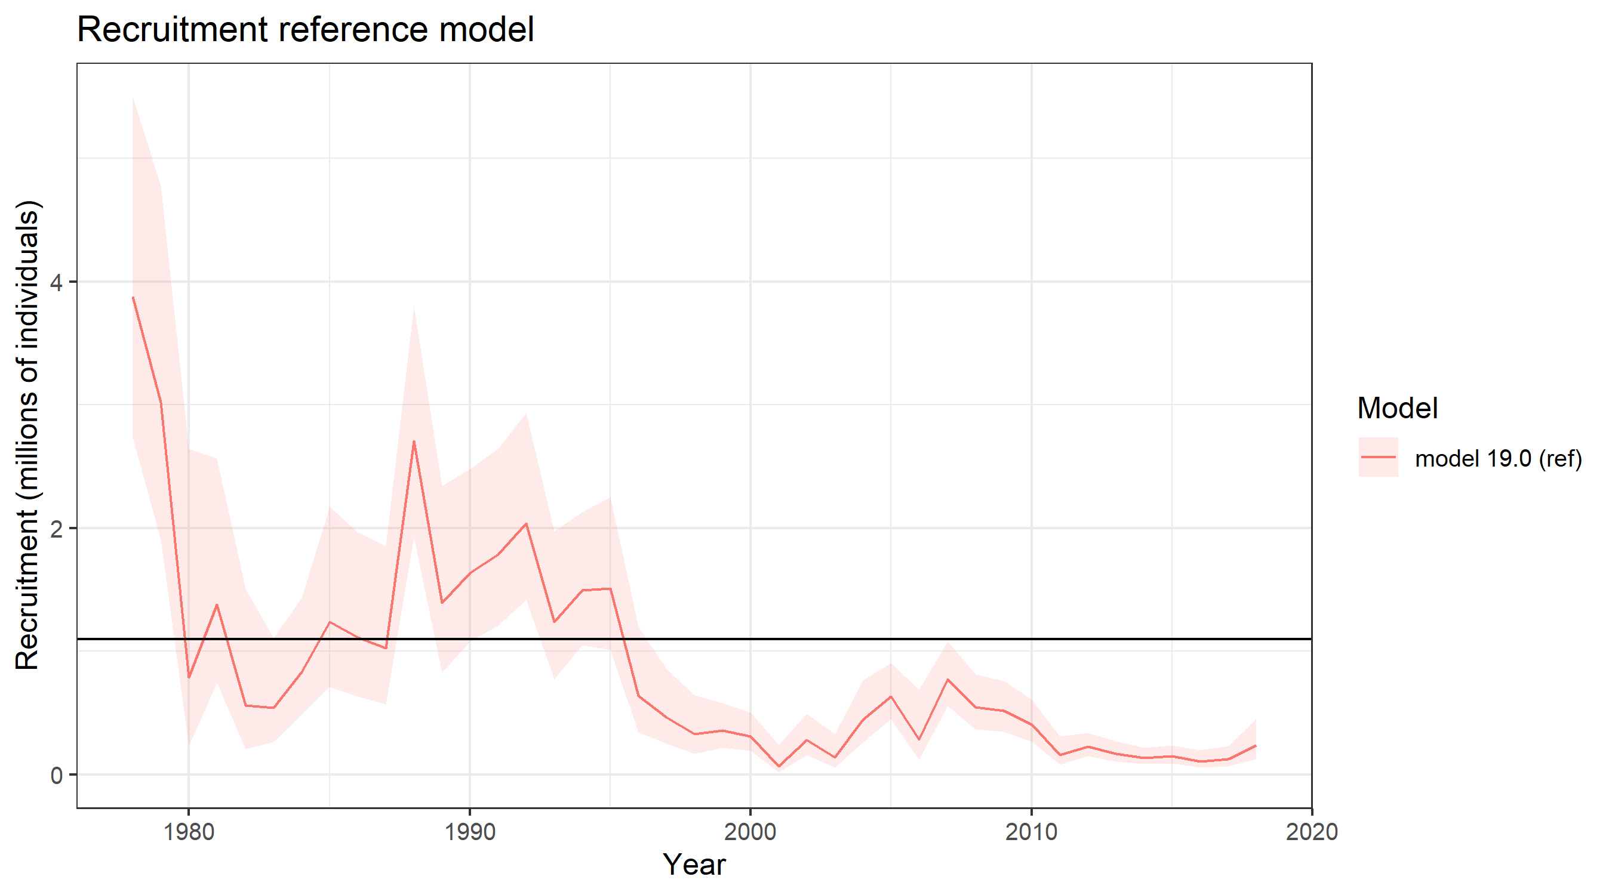
Summary of projections
Random recruitment: All years (1978 – 2018)
  PRO: allows for high recruitment possibilities
  CON: optimistic with current environment, stock status, etc.
Random recruitment: Current regime (1996 – 2018)
  PRO: realistic recruitment expectations for near future
  CON: does NOT allow for increased recruitment
Ricker stock-recruit model
  PRO: Fluctuates with stock size
  CON: weak relationship
1996 breakpoint

Slide 10
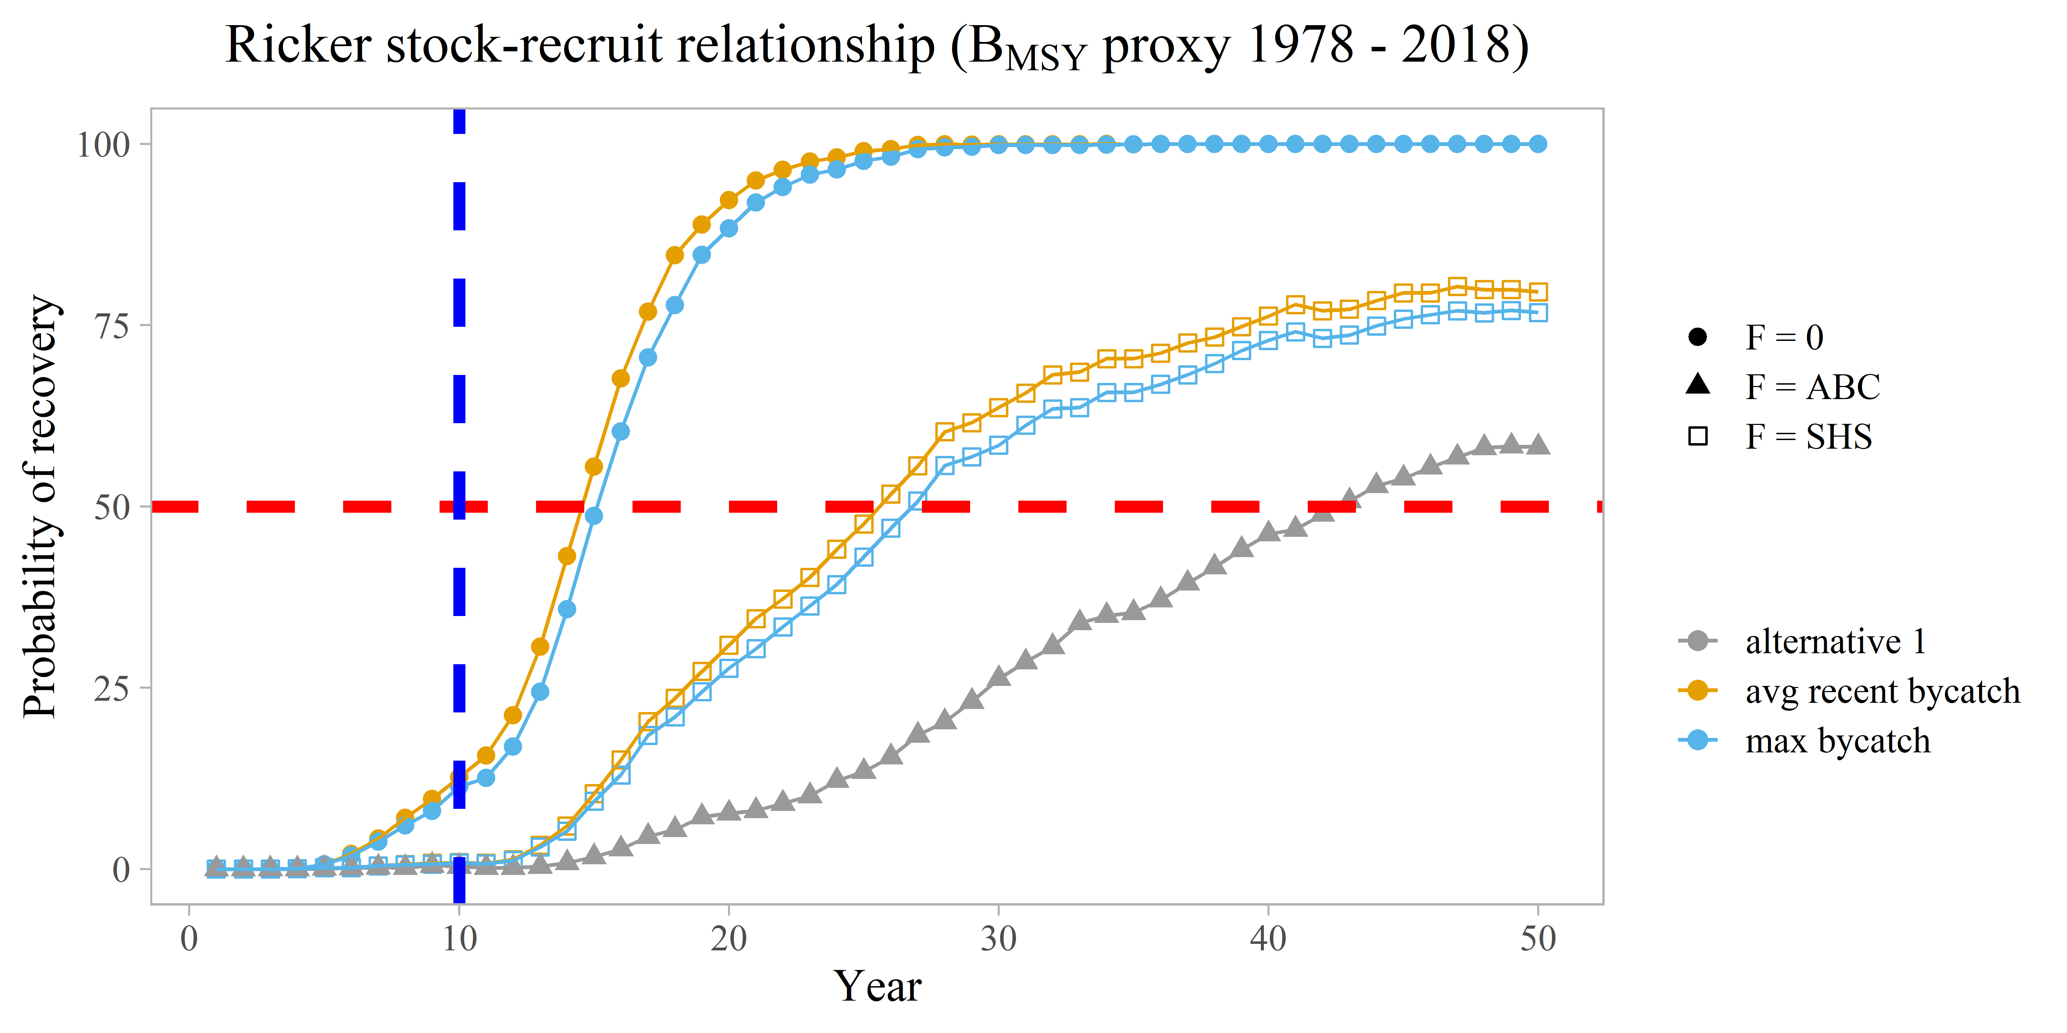
Ricker stock-recruit recruitment projections
Average bycatch levels
F level | T_{min}
F = 0 | 14.5 yrs
F = SHS | 25.5 yrs
F = ABC | 43.0 yrs

Slide 11
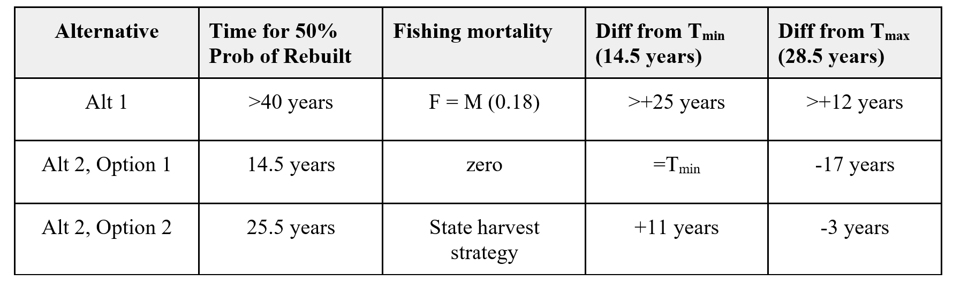
Summary

Slide 12
Council actions following initial review draft
Dec
  Council action as necessary
  Public review draft
Apr
  Council Final action
  SOC final analysis
post April
  NMFS approval and regulations as needed
  Implementation prior to October 2020

Slide 13
SSC Comments – December 2019
Current draft adequate for rebuilding plan
No further modeling or projections needed
Additions to discussion
  Bycatch
    Discussion on what levels would constitute intervention
  Detailed explanation of interaction between Bmsy and SHS
  Add Ricker fit
  Pros/cons for different recruitment projections
    Add discussion about environmental influence on recruitment

Slide 14
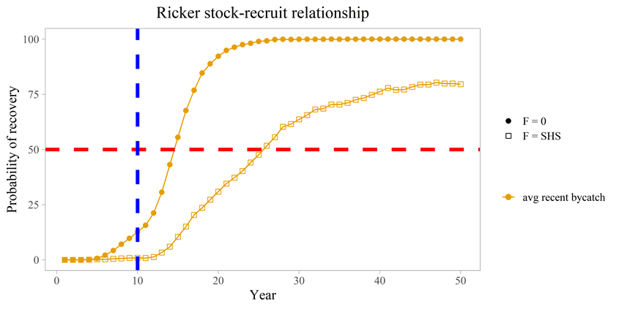
Ricker S-R Model
Recruitment

Slide 15
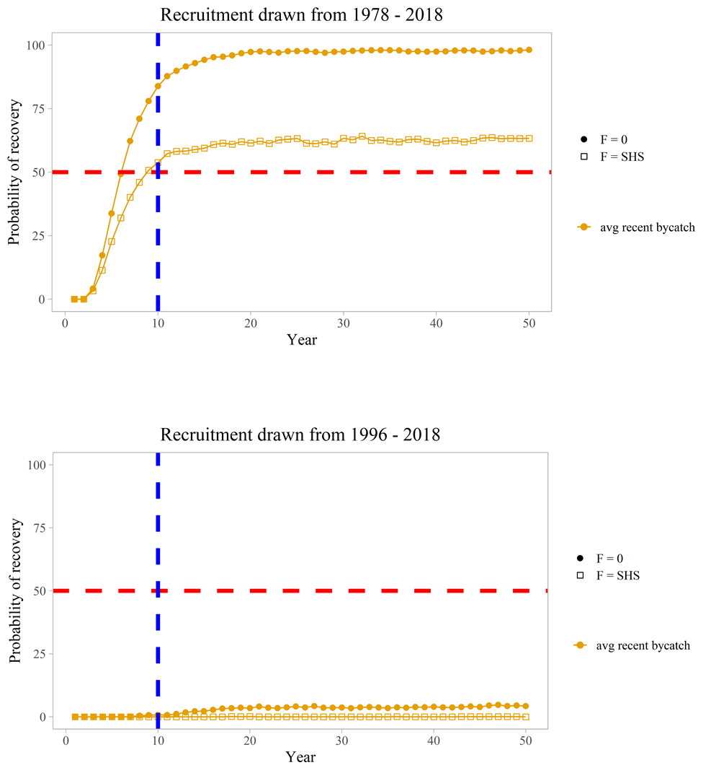
Randomized
1978-2018
Recruitment
1996-2018

