Slide 1
AIGKC Assessment: Comparison of Models 20_1 vs 20_1b Ver2 Outputs
M.S.M. Siddeek^{1,} J. Zheng¹, C. Siddon¹, B. Daly², M.J. Westphal³, and L. Hulbert¹
Alaska Department of Fish and Game, Juneau¹, Kodiak², and Dutch Harbor³, Alaska
May 7, 2020

Slide 2
Table T1. Features of all models, EAG and WAG
Model | CPUE Data Type | Time Period for Mean Number of Recruit Calculation for (a) Initial Equilibrium Abundance Composition and (b) Reference Points Estimations
20_1 (accepted model in May 2019, implemented with up to 2019/20 data) | Observer data from 1995/96–2019/20 Fish ticket data from 1985/86–1998/99. Observer CPUE standardization by negative binomial and Fish ticket CPUE standardization by lognormal models | 1987–2012
20_1b | 20_1+ Fish ticket CPUE standardization by negative binomial | EAG:1986–2017; WAG:1987–2018
20_1b Ver2 | 20_1b+ | EAG & WAG:1987–2012
20_1c | 20_1b+ cooperative survey CPUE indices for 2015–2019. Cooperative survey CPUE standardization by random effects model | EAG:1986–2017
20_1d | 20_1b+ restrict cooperative survey CPUE indices to 2015–2018 | EAG:1986–2017
20_2 | 20_1b+ Year:Area interaction for observer CPUE standardization. | EAG:1986–2017; WAG:1987–2018
20_2b | 20_2+ cooperative survey CPUE indices for 2015–2019 | EAG:1986–2017

Slide 3
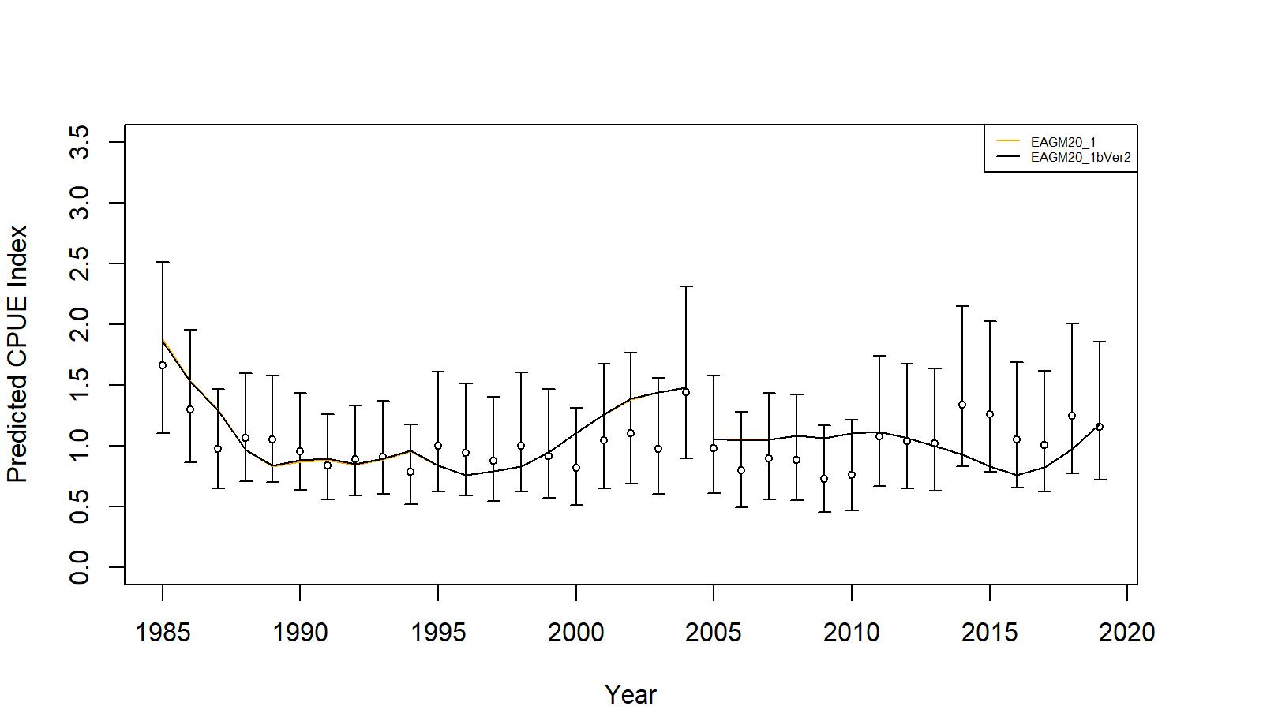
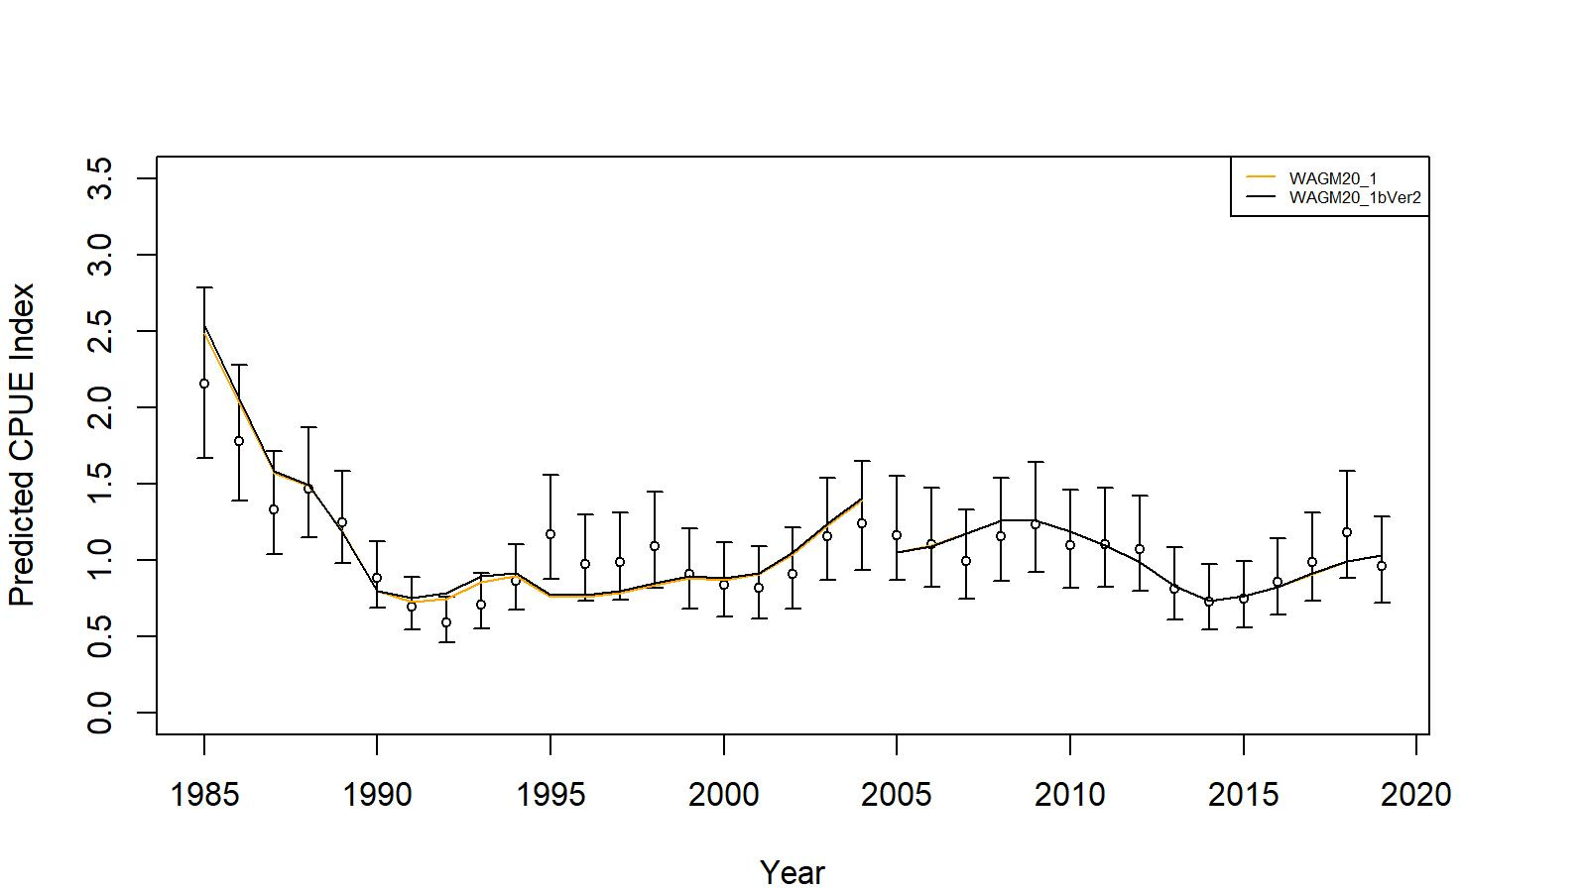
EAG
WAG
Figs. Comparison of input CPUE indices [with +/- 2 SE for model 20_1 (black small circles)] with predicted CPUE indices (colored solid lines) by M20_1, M20_1b Ver2 for EAG (top) and WAG (bottom), 1985/86–2019/20. Model estimated additional standard error was added to each input standard error.

Slide 4
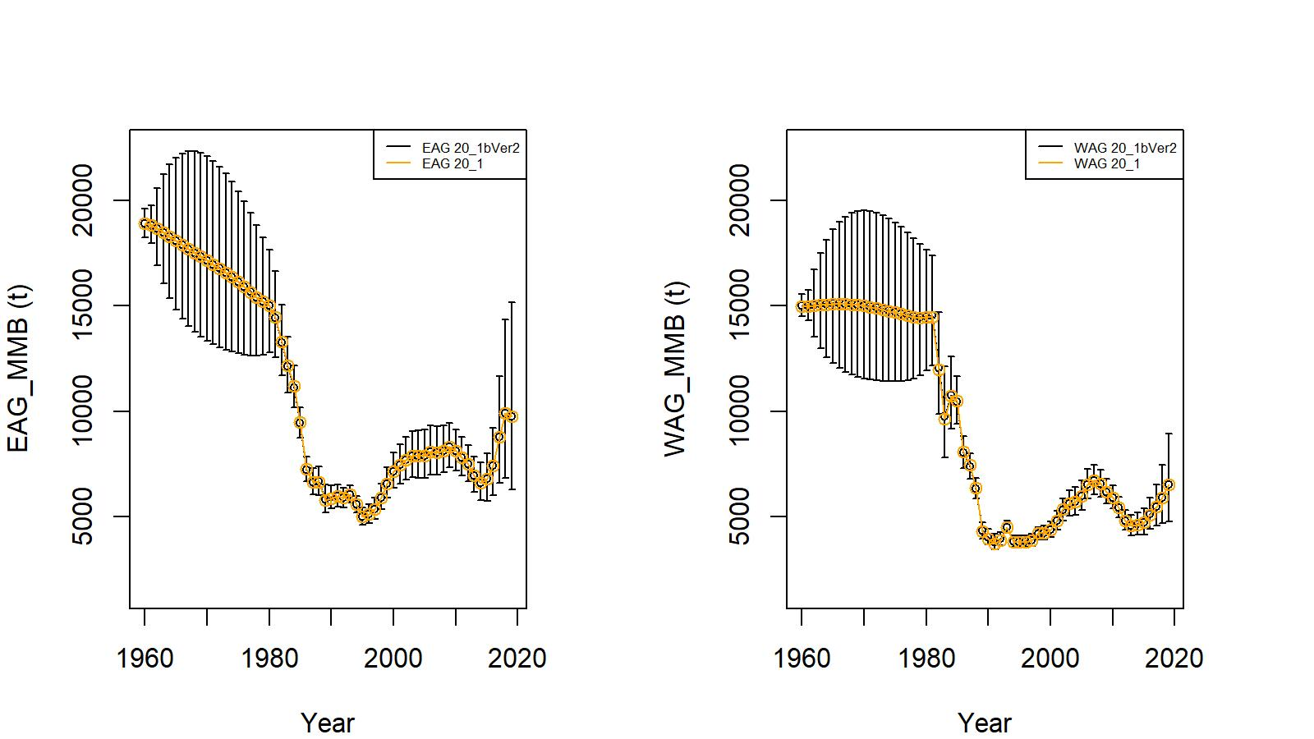
Fig. Trends in golden king crab mature male biomass for models 20_1 and 20_1b Ver2 fits to EAG (left) and WAG (right) data, 1960/61–2019/20. Model 20_1b estimate has two standard error confidence limits..

Slide 5
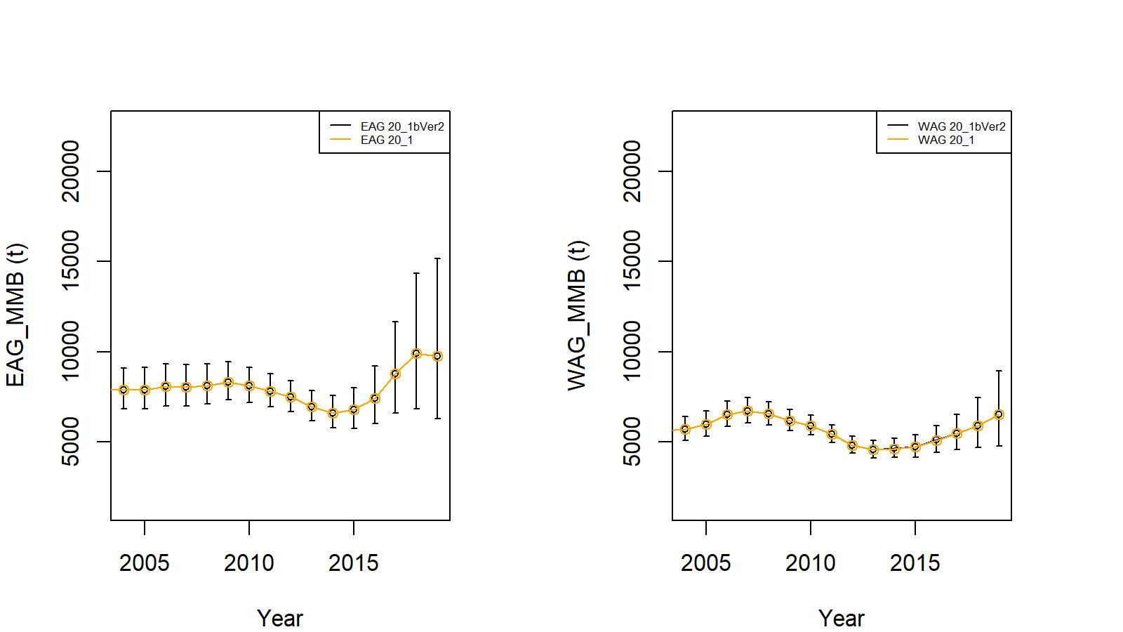
Fig. Trends in golden king crab mature male biomass for models 20_1 and 20_1b Ver2 fits to EAG (left) and WAG (right) data, 2004/05–2019/20. Model 20_1b estimate has two standard error confidence limits.

Slide 6
Status and catch specifications for the entire Aleutian Islands fisheries (1000 t). CPT recommended OFL and ABC are highlighted red.
Year | MSST | Biomass (MMB) | TAC | Retained Catch | Total Catchª | OFL | ABC^{b}
2016/17 | N/A | N/A | 2.515 | 2.593 | 2.947 | 5.69 | 4.26
2017/18 | 6.044 | 14.205 | 2.515 | 2.585 | 2.942 | 6.048 | 4.536
2018/19 | 5.880 | 17.848 | 2.883 | 2.965 | 3.355 | 5.514 | 4.136
2019/20 | 5.909^{c} | 16.323^{c} | 3.257 | 3.274^{d} | 3.693^{d} | 5.249 | 3.937
2020/21e |  | 14.760 |  |  |  | 4.793 | 3.595
2020/21^{f} |  | 15.106 |  |  |  | 4.993 | 3.745
2020/21^{g} |  | 14.774 |  |  |  | 4.798 | 3.599
Total retained catch plus estimated bycatch mortality of discarded bycatch during crab fisheries and groundfish fisheries.
25% buffer was applied to total catch OFL to determine ABC.
c. MMB and MSST estimated by Model 20_1b Ver2.
d. 2019/20 fishery in EAG completed, the WAG fishery is ongoing, over 96% TAC achieved.
e. Model 20_1b, time period for mean recruit calculation for EAG: 1986-2017 and WAG: 1987-2018.
f. Model 20_2, Year : Area interaction considered in CPUE standardization.
g. Model 20_1b Ver 2, time period for mean recruit calculation for EAG and WAG: 1987-2012.

Slide 7
Status and catch specifications for the entire Aleutian Islands fisheries (million lb). CPT recommended OFL and ABC are highlighted red.
Year | MSST | Biomass (MMB) | TAC | Retained Catch | Total Catchª | OFL | ABC^{b}
2016/17 | N/A | N/A | 5.545 | 5.716 | 6.497 | 12.53 | 9.40
2017/18 | 13.325 | 31.315 | 5.545 | 5.699 | 6.487 | 13.333 | 10.000
2018/19 | 12.964 | 39.348 | 6.356 | 6.536 | 7.396 | 12.157 | 9.118
2019/20 | 13.027^{c} | 35.985^{c} | 7.180 | 7.219^{d} | 8.141^{d} | 11.572 | 8.679
2020/21e |  | 32.540 |  |  |  | 10.566 | 7.925
2020/21^{f} |  | 33.303 |  |  |  | 11.008 | 8.256
2020/21^{g} |  | 32.571 |  |  |  | 10.579 | 7.934

