Slide 1
Economic Status of the Groundfish Fisheries off Alaska, 2018
Alaska Fisheries Science Center
Presented by:
Ben Fissel
AFSC Economics and Social Sciences Research Program (ESSRP)
Nov. 13, 2019

Slide 2
Structure of the Economic SAFE

Slide 3
Economic Status Report, 2018:
Core Content of the Nov. Draft
Executive Summary: 2018 highlights
  Report Card Metrics
  Plan Team Reports (forthcoming)
Overview of the Economic Data Tables
Economic Data Tables
    All Alaska summary Tables (1-9)
    BSAI data Tables (10-25)
    GOA data Tables (26-41)
    Halibut data Tables (H1-H10).
    Tables primarily cover: Retained catch, ex-vessel value and prices, first-wholesale production and prices, vessel counts, and fishing and crew weeks.

Slide 4
Economic Status Report, 2018:
Draft Content (Nov.)
Economic Performance Indices
Wholesale and ex-vessel price projections
Market Profiles
Amendment 80 Economic Data Report
Gulf Trawl Economic Data Report (forthcoming)
Amendment 91 Economic Data Report (forthcoming)
Recent and ongoing ESSRP research and publications
The sections covering Catch Share Performance Metrics
and Community Participation are being moved outside this report.
New, revised or planned content in RED
Notes:
The safe is getting too large to go through each chapter in detail. Consequently more attention will be given to sections new and revised sections.
In particular, seeking comments on

Slide 5
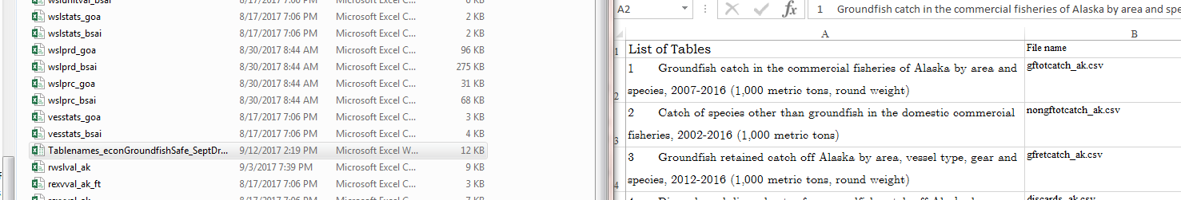

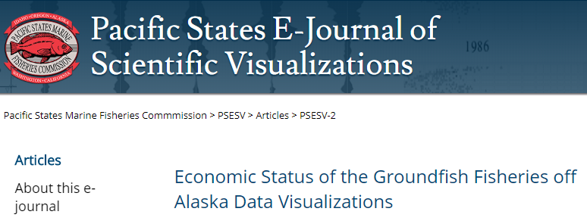
Where to find Groundfish Economic data
\\nmfs\akc-public\Dropbox\Fissel\EconomicSAFEData2019 (AFSC only)
Open Tablenames_econGroundfishSafe.csv
To get an excel sheet matching table names to file names.
The data will be publicly available through the AKFIN Apex reporting https://reports.psmfc.org/akfin
The data also will be publicly available through the Pac States E-journal of Sci Visualization (PSESV) https://psesv.psmfc.org/PSESV-2/

Slide 6
Status and Trends

Slide 7
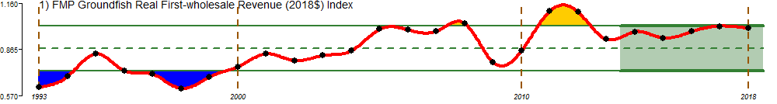
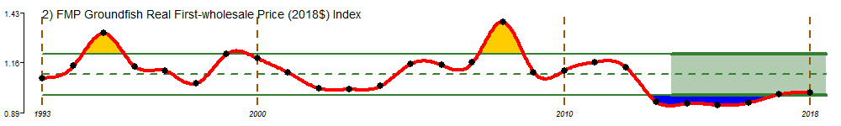
Report Card Indices
FMP Groundfish real first-wholesale revenue (2018$) index
FMP Groundfish real first-wholesale price (2018$) index
Notes:
Real 1st wsl rev/week up largely because CV fishing weeks down while production was relatively stable.

Slide 8
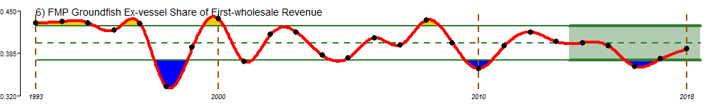
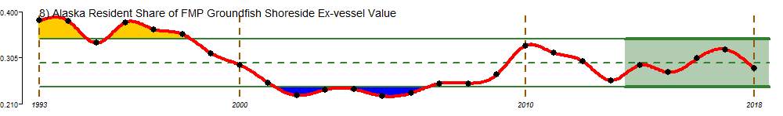
Report Card Indices
FMP groundfish ex-vessel share of first-wholesale revenue
Alaska resident share of FMP groundfish shoreside ex-vessel value
Notes:
Ex-vessel share of 1st wsl rev up because of ex-vessel prices.
AK resid share of shrsd value down because of sablefish price decrease and GOA pcod.

Slide 9
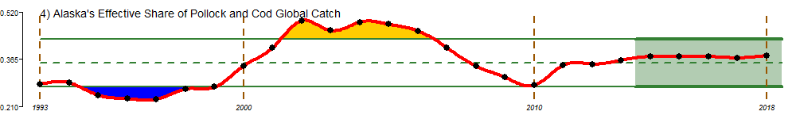
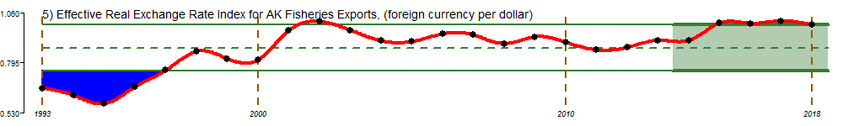
Report Card Indices
Alaska’s effective share of pollock and cod global catch
Effective real exchange rate index for AK fisheries exports (foreign currency per dollar)
Notes:
Share of global catch remains stable
exchange rates remain high headwind for exports

Slide 10
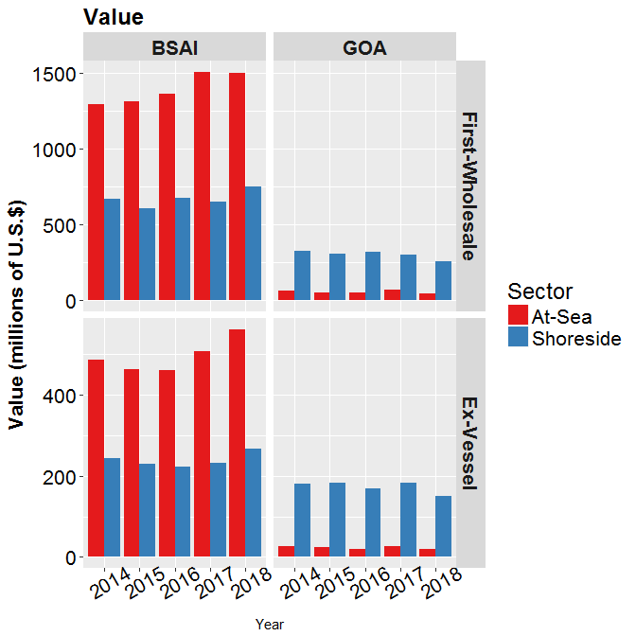
Alaska’s Groundfish Fisheries in 2018
Total catch: 2.2 million t
(decreased 3%)
Aggregate value increased in BSAI decreased in GOA.
Wholesale value:
$2.54 billion (down 1%)
Ex-vessel value:
$995.7 million (up 3%)
Percent change adjusted for inflation.
Values in figure nominal (not adjusted for inflation)
Notes:
Catches and productions in aggregate were stable. In general value was up with prices which were increasing for most species in both the ex-vessel and first-wholesale markets. The most significant gains were seen in the BSAI at-sea sector. The reasons for this can be seen a little better by looking at the species break down for the region.

Slide 11
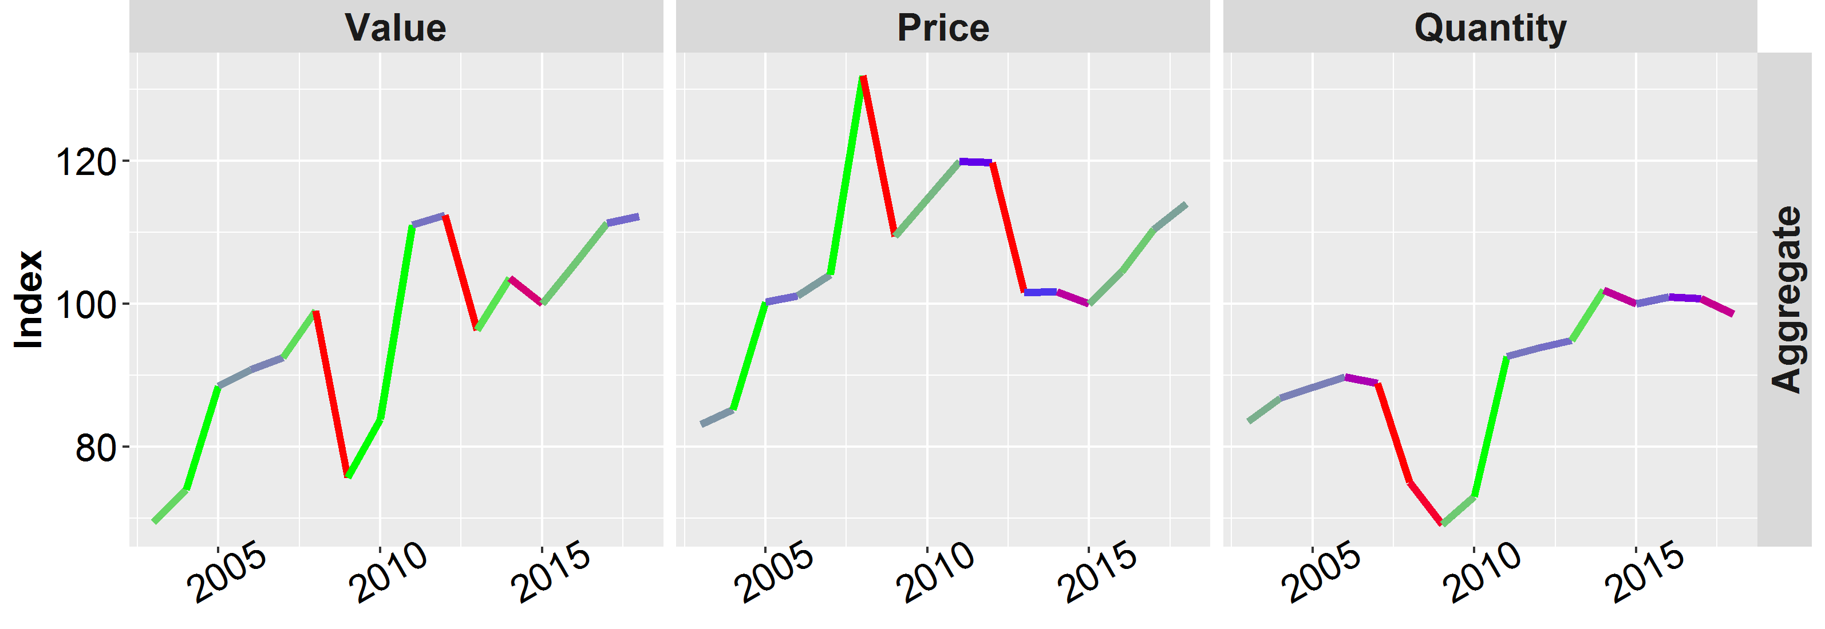
Alaska’s Groundfish Fisheries in 2018
Alaska First-Wholesale Economic Indices
In the aggregate:
Value increased and prices increases were the dominant factor
Substantial differences in changes of species level catch

Slide 12
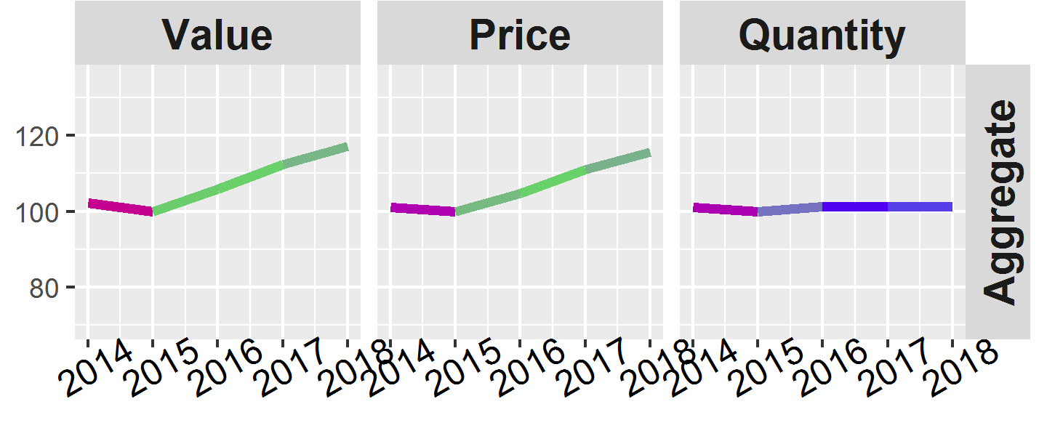
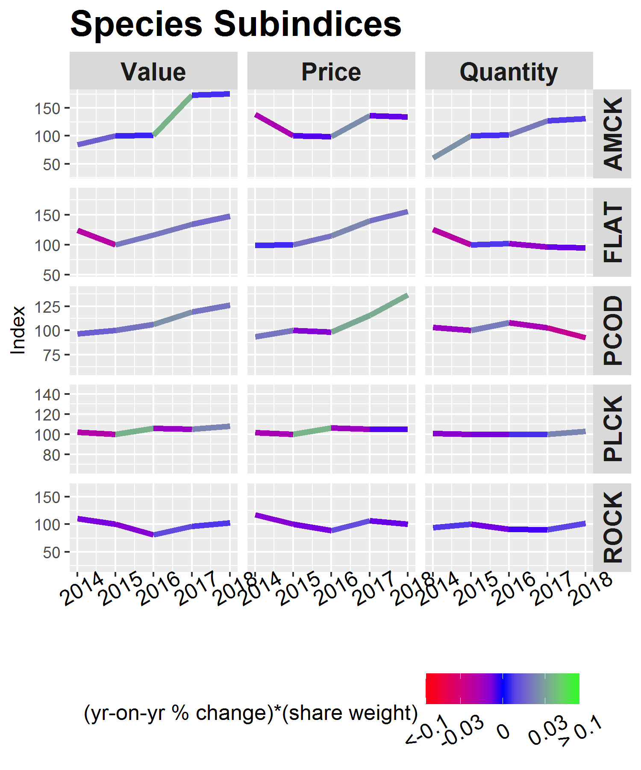
Species
BSAI First-Wholesale
Economic Indices
Value stable:
  Atka mackerel
  Rockfish
Value increased:
  Pollock
  Pacific cod
  Flatfish
Indices are nominal (not adjusted for inflation)

Slide 13
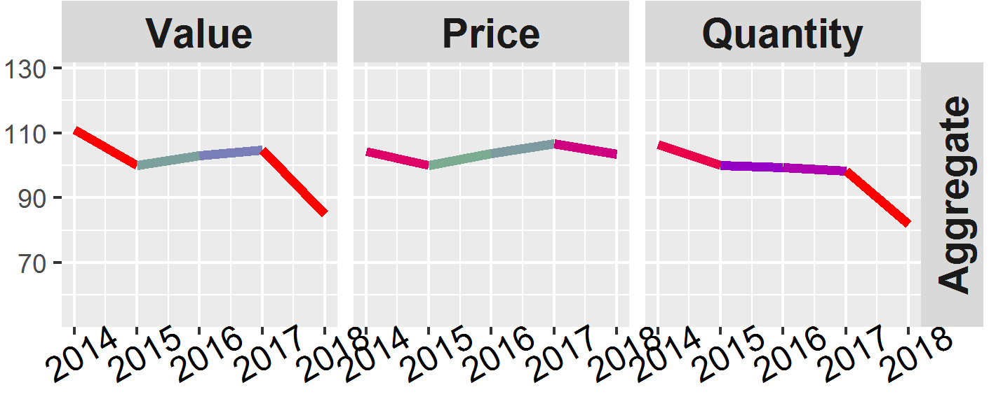
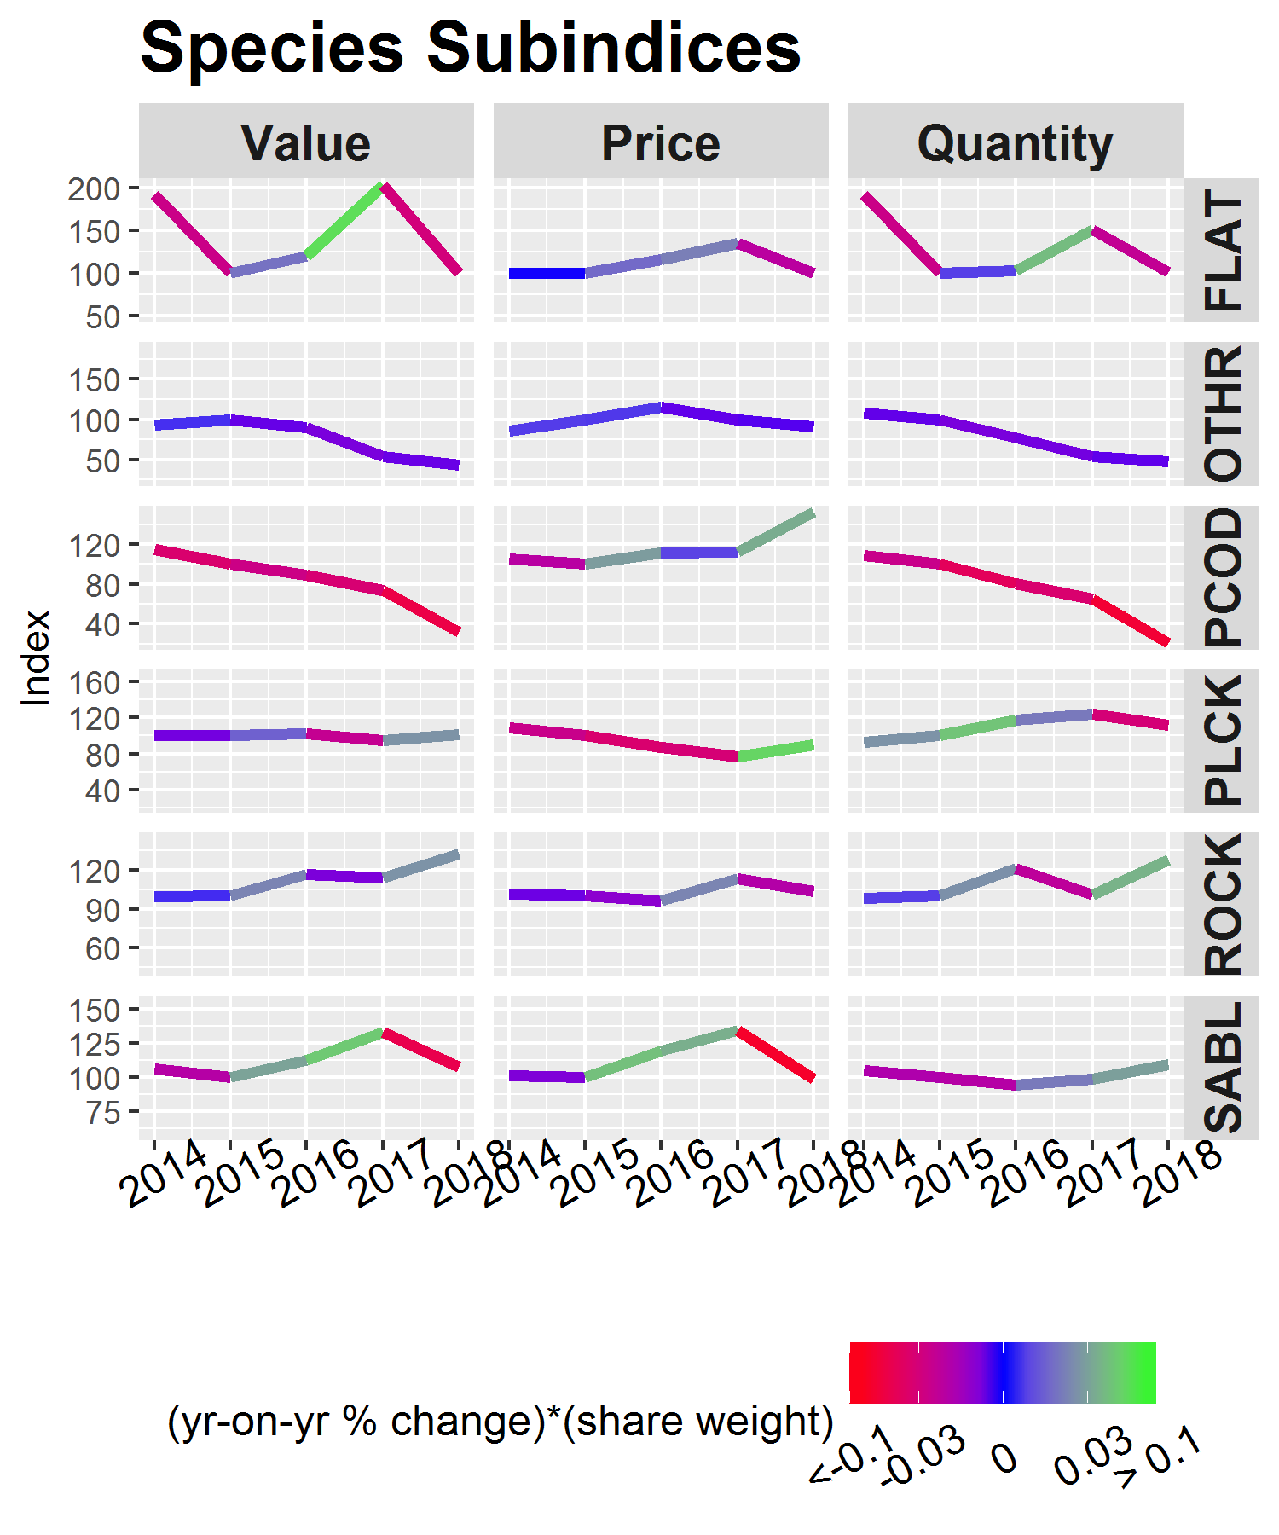
Species
GOA First-Wholesale
Economic Indices
Value decreases:
  Pollock
  Rockfish
Value increased:
  Pacific cod
  Sablefish
  Flatfish
Indices are nominal (not adjusted for inflation)

Slide 14
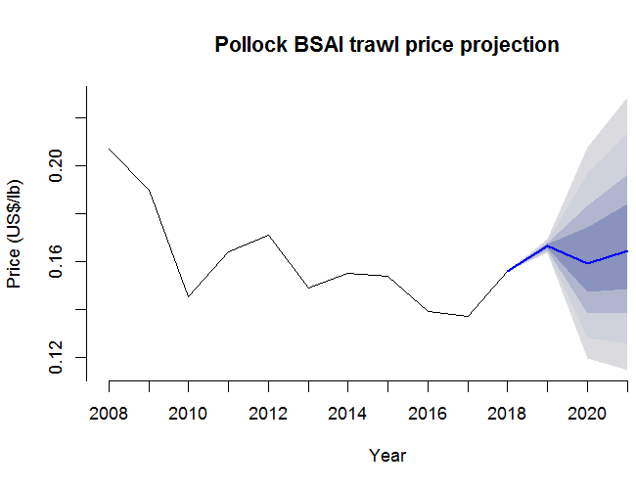
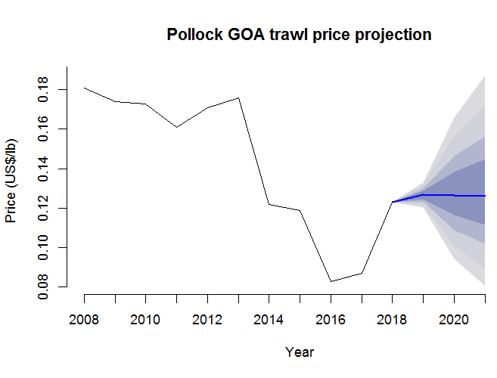
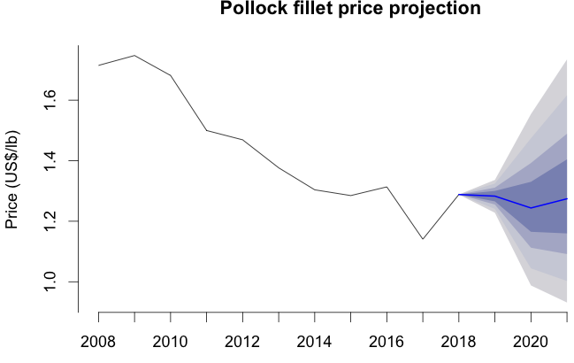
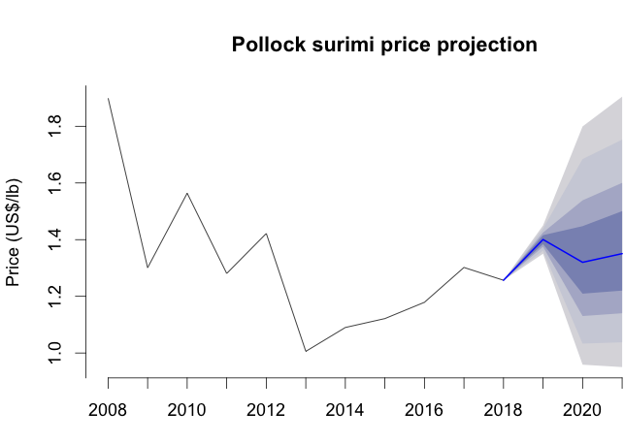
Pollock
Substantial yoy increases in 2018 ex-vessel prices bring back towards normal.
2019 ex-vessel will increase again though more modest.
With good prices and catch levels revenues can be expected to remain strong in 2019.
Increases in wholesale prices of fillet and H&G prices in 2018.
First-wholesale prices for 2019 show stable or modest price increases for fillets and H&G, increasing prices for surimi and decreasing price for roe.
Notes:
Increasing quality from Russia and better terms of trade potential headwind for US pollock prices in future.

Slide 15
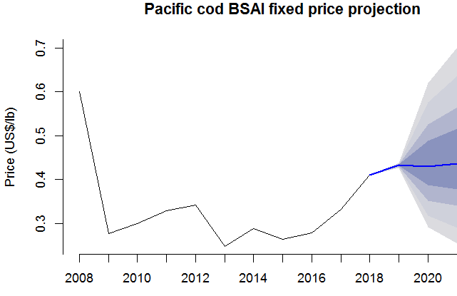
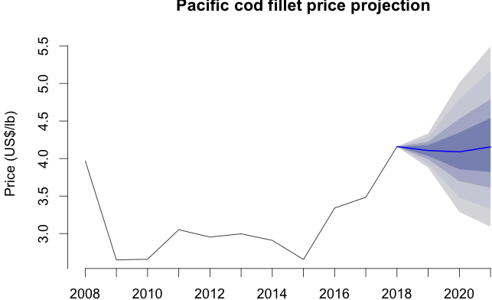
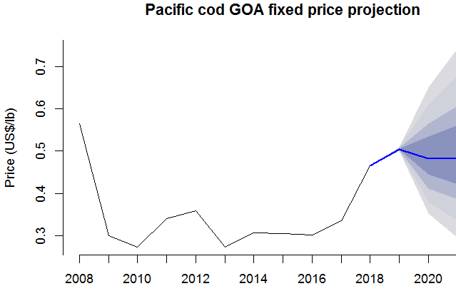
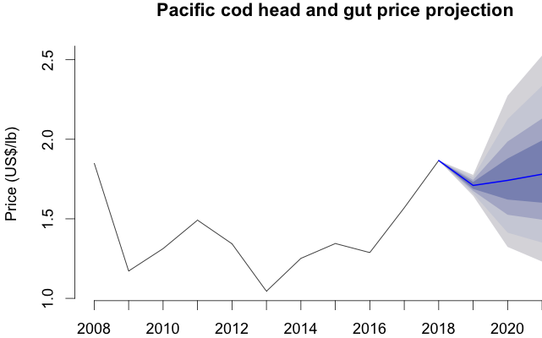
Pacific cod
Substantial yoy 2018 price increases both ex-vessel and first-wholesale largely driven by global supply constraints.
Ex-vessel prices expected to show modest increase in 2019.
High 2018 wholesale prices may have overshot as 2019 prices level off or decrease.
Strong prices have helped to maintain value. In the GOA where volumes have declined substantially not enough to offset. BSAI value increased despite modest decrease in volume.

Slide 16
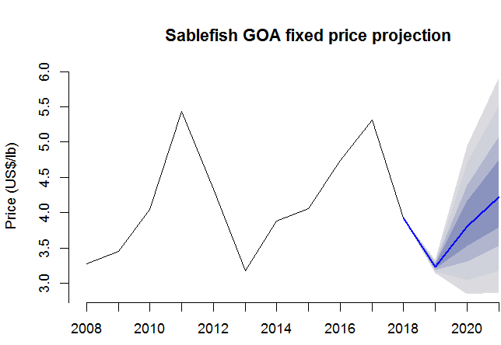
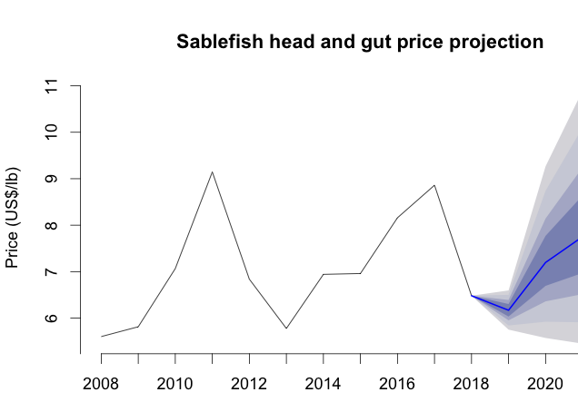
Sablefish
Revenues down in 2018 with substantial decrease in the average price of sablefish.
Decrease driven by decreases in size of average fish.
Increase in the price margin between fish sizes.
GOA fixed-gear sablefish prices ($/lb)
 | 2015 | 2016 | 2017 | 2018 (partial)
3-4 lbs | $ 0.91 | $ 0.75 | $ 1.05 | $ 1.15
5-7 lbs | $ 1.25 | $ 1.4 | $ 1.04 | $ 2.56
Margin | $ 1.97 | $ 2.11 | $ 1.96 | $ 3.51
D8 Discussion Paper: Sablefish Discard Allowance March 22, 2019
2019 prices expected to decrease further.

Slide 17
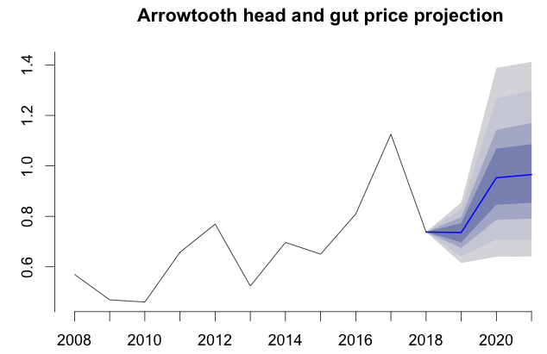
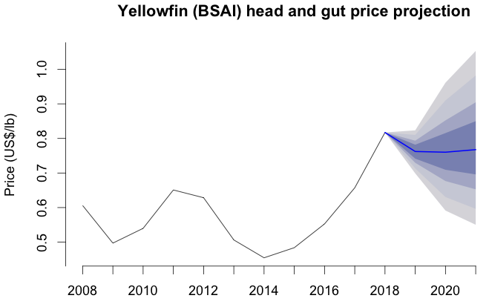
Flatfish
Most flatfish prices were increasing in 2018.
  Except arrowtooth price 2018 price reverted back follow increase in 2017.
Projections for 2019 show prices decrease or stable.
Tariff may be a contributing factor.
Flatfish mostly processed in China and caught up in trade dispute.
  Modest decrease in exports. Prices remain fairly strong though.
 | 2009-2013 Average | 2014 | 2015 | 2016 | 2017 | 2018 | 2019 (thru June)
Export quantity of yellowfin sole and rock sole K mt | 65.4 | 91.6 | 87.0 | 94.8 | 81.4 | 72.0 | 50.8
Export price/lb of yellowfin sole and rock sole US$ | $0.59 | $0.64 | $0.62 | $0.65 | $0.64 | $0.67 | $0.72
China's share of yellowfin sole and rock sole export value | 80% | 87% | 82% | 78% | 82% | 79% | 77%
Export quantity of NSPF Frozen Flatfish K mt | 14.7 | 20.0 | 12.1 | 18.3 | 22.9 | 14.1 | 6.8
Export price/.b of NSPF Frozen Flatfish US$ | $0.69 | $0.88 | $0.86 | $0.78 | $0.87 | $0.85 | $0.87
Share of U.S. exports of NSPF Frozen Flatfish to China² | 48.3% | 81% | 76% | 62% | 77% | 81% | 81%

Slide 18
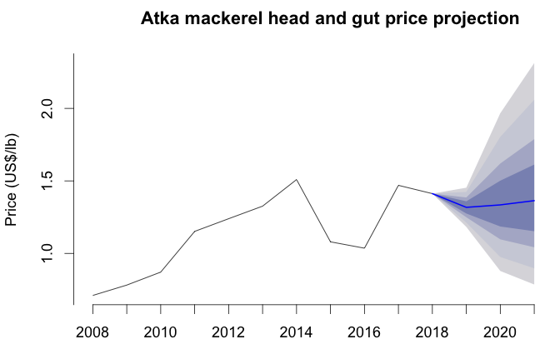
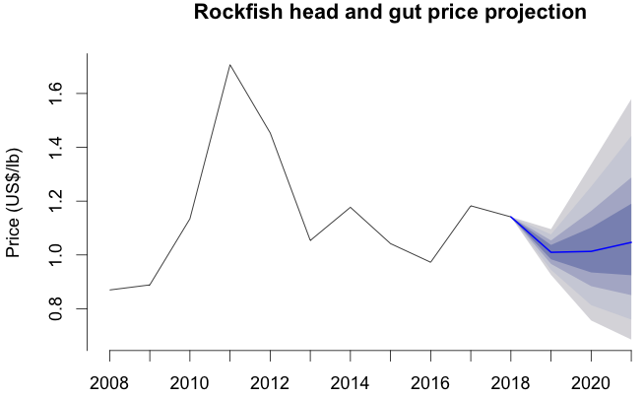
Atka and rockfish
Atka price decreased moderately in 2018 but remains strong
Projections indicate marginal decreases but fairly stable in 2019
Projections for 2019 show prices decrease
Tariff may be a contributing factor.
Rockfish mostly processed in China and caught up in trade dispute.
  Modest increase in exports.
  Export prices decreasing.
 | 2009-2013 average | 2014 | 2015 | 2016 | 2017 | 2018 | 2019 (thru June)
Export volume of Pac. Ocn. perch K mt | 12.5 | 23.8 | 22.7 | 25.6 | 22.7 | 27.8 | 4.1
Export price/lb of Pac. Ocn. perch US$ | $1.08 | $1.52 | $1.55 | $1.50 | $1.52 | $1.46 | $1.14
China's share of U.S. Pac. Ocn. perch export value | 56% | 65% | 52% | 67% | 55% | 62% | 79%

Slide 19
Ex-vessel Price Projections
Uses unadjusted fish ticket information through Sept. 2019 to estimate an (adjusted) 2019 annual ex-vessel price.
Ex-vessel price projection 2018 validation ($/lb)
 | 2018 nowcast | 2018 realized | Absolute difference | With 95% Bounds
Pacific cod BSAI fixed | $ 0.406 | $ 0.410 | $ 0.004 | Yes
Pacific cod BSAI trawl | $ 0.370 | $ 0.384 | $ 0.014 | No
Pacific cod GOA fixed | $ 0.447 | $ 0.465 | $ 0.018 | No
Pacific cod GOA trawl | $ 0.393 | $ 0.412 | $ 0.019 | No
Pollock BSAI trawl | $ 0.151 | $ 0.156 | $ 0.006 | No
Pollock GOA trawl | $ 0.116 | $ 0.123 | $ 0.007 | Yes
Sablefish GOA fixed | $ 4.005 | $ 3.929 | $ 0.076 | Yes
Notes:
Point estimates are good. Confidence bounds don’t appear to be providing the desired coverage.
Adjusted just means inclusive of post season adjustments which are more a factor in some fisheries than others.
Attempt to expand to include other shoreside fisheries: halibut, pop, and arrowtooth.
Couple with catch to now-cast revenues
2019 now-casts for pollock, cod, and sablefish from last year preformed well compared to realized price (within approx. $0.01/lb)

Slide 20
Economic Status Report, 2018
The Economic Status Report serves many purposes. Among them is to provide information to the Plan Team.
Please give us your feedback.
We invite feedback -- Ben.Fissel@noaa.gov
Notes:
We will try to accommodate to the extent that we can.

