Slide 1


Crab Plan Team
Research Priorities
2020 Recommendations

Slide 2
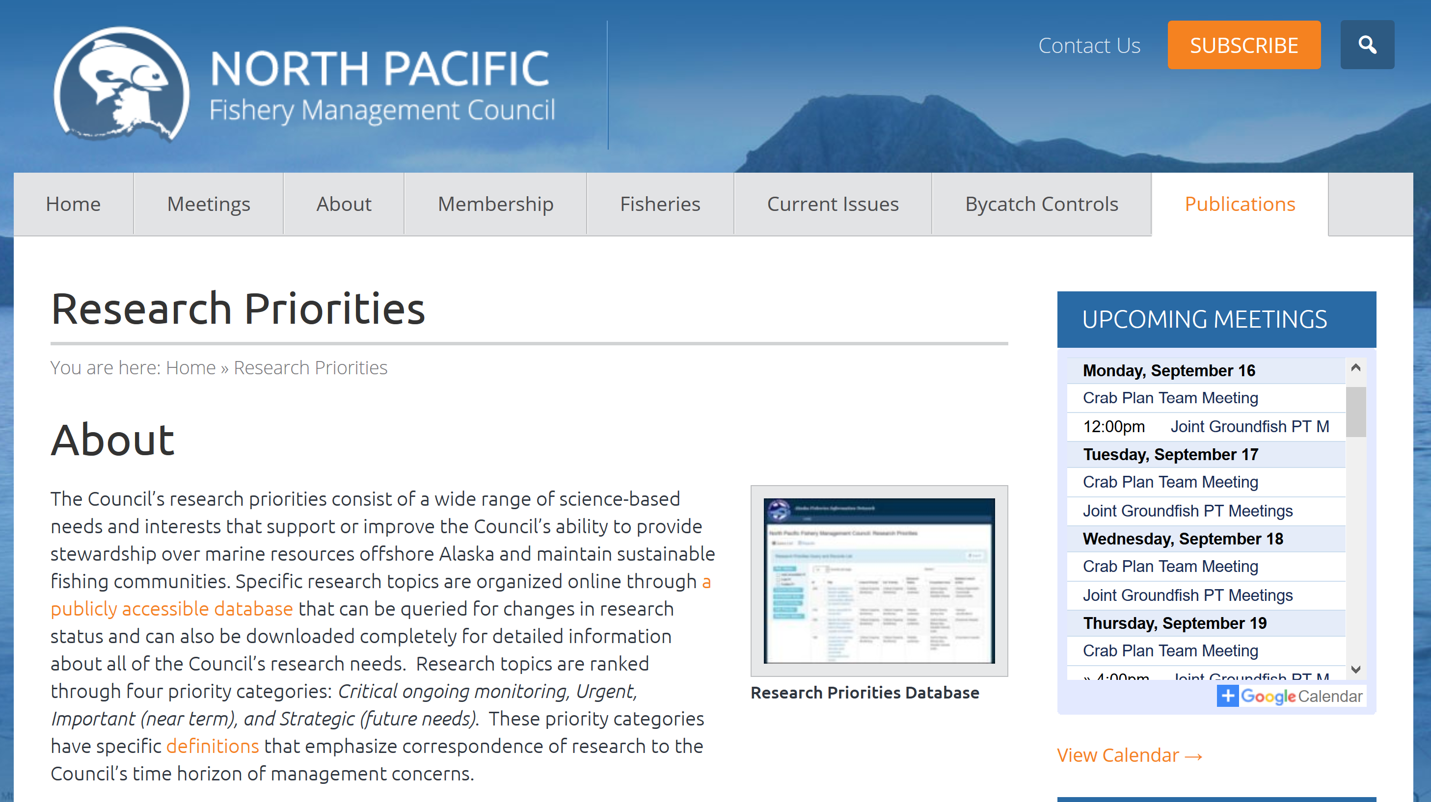
Data Gaps
SAFE Chapters
ESP
FEP
SSPT
Joint IPHC Mtgs
NPRB

Slide 3
MSA Mandate
“Each Council shall, in accordance with the provisions of this Act —
  (7) develop, in conjunction with the scientific and statistical committee, multi‐year research priorities for fisheries, fisheries interactions, habitats, and other areas of research that are necessary for management purposes, that shall —
  (A) establish priorities for 5‐year periods;
    (B) be updated as necessary; and
      (C) be submitted to the Secretary and the regional science centers of the National Marine Fisheries Service for their consideration in developing research priorities and budgets for the region of the Council; ”

Slide 4
Annual research priority process
February
Plan Team Review
Scallop
May
Plan Team Review
Crab and Groundfish
June
Review PT recommendations,
non-PT priorities
SSC
June
Review Top Ten, Recommend to SOC
Council

Slide 5
Annual research priority process
February
Plan Team Review
Scallop
May
Plan Team Review
Crab and Groundfish
June
Review PT recommendations,
non-PT priorities
SSC
June
Review Top Ten, Recommend to SOC
Council
Top 3-5
Top Ten

Slide 6
MSA Mandate
“Each Council shall, in accordance with the provisions of this Act —
  (7) develop, in conjunction with the scientific and statistical committee, multi‐year research priorities for fisheries, fisheries interactions, habitats, and other areas of research that are necessary for management purposes, that shall —
  (A) establish priorities for 5‐year periods;
    (B) be updated as necessary; and
      (C) be submitted to the Secretary and the regional science centers of the National Marine Fisheries Service for their consideration in developing research priorities and budgets for the region of the Council; ”

Slide 7
New Process
February 2019 –
  Annual to Triennial
    MSA does not require annual review
    Streamline the overall review process
    Include “top ten”
      Critical
      Strategic

Slide 8
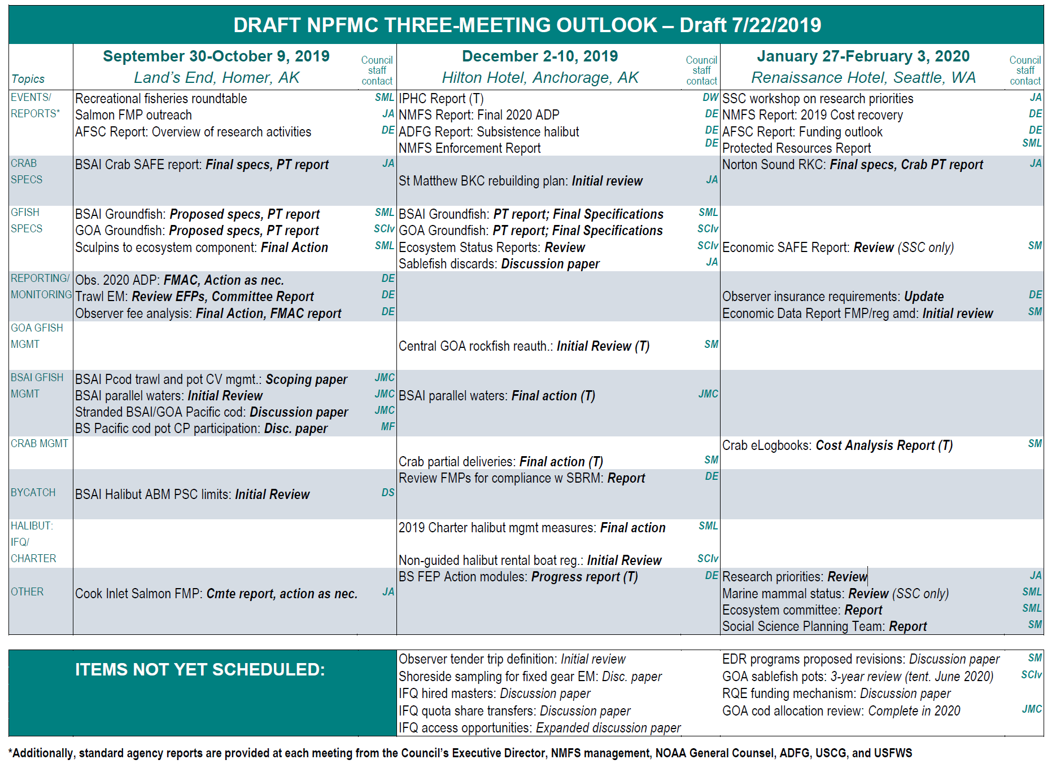
New Process
February 2019 –
  Annual to Triennial
    MSA does not require annual review
    Streamline the overall review process
    Include “top ten”
      Critical
      Strategic

Slide 9
Major Issues
Unclear info on origin, investigators, when/where results will be shared
  Brute force?
Level of specificity
  Vary by group
  Themes, Foci
Proposals for Changes and Additions
  Projevt specific
  Improve process

Slide 10
Major Issues
Unclear info on origin, investigators, when/where results will be shared
  Brute force?
Level of specificity
  Vary by group
  Themes, Foci
Proposals for Changes and Additions
  Projevt specific
  Improve process
Go to spreadsheet

Slide 11
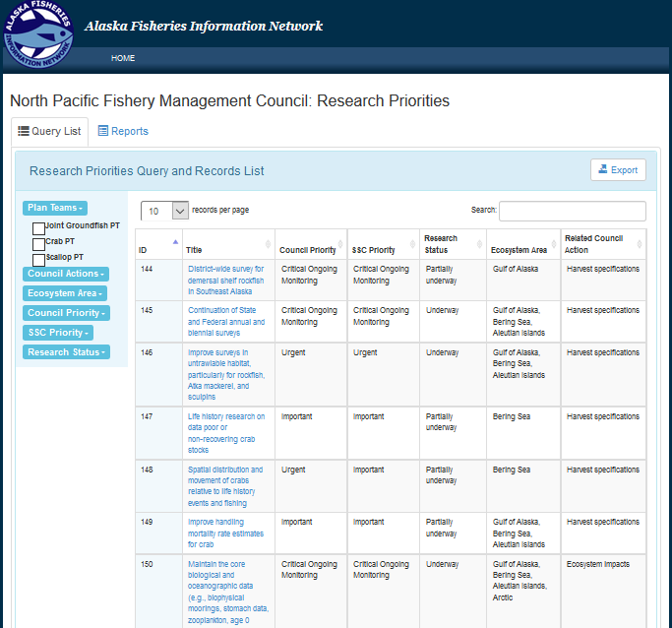
Database

Slide 12
Other Issues – Coordination with NPRB
NPFMC
link project-specific info in the research status field of the research priorities spreadsheet and detail progress (e.g., new, underway, completed, ongoing)
develop hierarchical structure to group research priorities in broad headings
NPRB
provide link in RFP to NPFMC priorities and AKFIN website to enable researchers to determine relevance to specific Council priorities
add information in proposal submission system to allow researchers to link their proposal to NPFMC priorities
develop a keyword function in project catalogue to associate projects to specific NPFMC priorities
develop database and interface to support queries

Slide 13
Major Issues
Unclear info on origin, investigators, when/where results will be shared
  Brute force?
Level of specificity
  Vary by group
  Themes, Foci
Proposals for Changes and Additions
  Projevt specific
  Improve process

