Slide 1
Bristol Bay Red King Crab Assessment in Fall 2019
J. Zheng and M.S.M. Siddeek
ADF&G, Juneau

Slide 2
Acknowledgements
Drs. Andre Punt, James Ianelli and D’Arcy Webber applied BBRKC data to GMACS for stock assessments and our Gmacs model mainly comes from their work, especially recent work by Andre.

Slide 3
Outline
4. Alternative baselines for B35% and ABC setting
2. New data and model scenarios
1. Responses to CPT and SSC Review Comments
3. Assessment results
5. Projections and future outlook

Slide 4
Response to CPT Comments
Response to CPT Comments (from September 2018):
“The CPT requested that the author consider a scenario based on 18.0a in which the asymptote to the retention function is estimated after 2004, rather than fixing it to 1 as it now is.”
Response: Done for all scenarios.

Slide 5
Response to CPT Comments
Response to CPT Comments (from May 2019):
“Explain why the likelihoods for size-compositions differ given the fits are very similar.”
Response: four reasons:
gmacs does not include the constant term whereas we consider a constant term in the robust normal for proportion likelihoods,
for sex combined normalized length compositions, the effective sample sizes are doubled for gmacs (gmacs adds them together),
for sex combined normalized length compositions, the robust constant for variance estimation is 1/36 for both males and females, while the assessment program in May 2019 or earlier used 1/20 for males and 1/16 for females, and
although it is an extremely small value, the past program does not compute likelihood for the first several length groups for retained catch due to zero proportions while gmacs computes it.
We made all length composition likelihoods be comparable in this report: models 18.0d and 18.0e drop the constant term; for sex combined normalized length compositions, effective sample sizes in data file are reduced to half for gmacs and the robust constant 1/36 is used for all models; and for retained length compositions, all groups are used to compute likelihood for models 18.0d and 18.0e.
Also, NMFS survey biomass likelihood was not comparable in the report in May 2019 between models 18.0e and 19.0 (gmacs). Gmacs has an extra term, 0.5σ, in the likelihood function and a constant term. We deleted the extra term from gmacs and added the constant term to models 18.0d and 18.0e. Now the likelihood function values for both NMFS and BSFRF survey biomass are comparable among the three models in this report.
dvector stdtmp = cpue_sd(k) * 1.0 / cpue_lambda(k); ///> Use Sigma scalar instead
// dvar_vector restmp = elem_div(log(elem_div(obs_cpue(k), pre_cpue(k))), stdtmp) + 0.5 * stdtmp;
dvar_vector restmp = elem_div(log(elem_div(obs_cpue(k), pre_cpue(k))), stdtmp);
nloglike(2,k) += sum(log(stdtmp)) + sum(0.5 * square(restmp));

Slide 6
Response to CPT Comments
Response to CPT Comments (from May 2019):
“Document how the two models penalize parameter values, in particular, differences in the sex ratio of recruits from 1:1,and explore whether the difference in results is due to difference in this penalty.”
Response:
Most of penalties with model 18.0e are on recruitment: sex ratio of recruits from 1:1 and recruitment variation over time. There are some very small penalties on bycatch fishing mortality deviations that generally do not affect the results.
Model 19.0 tried to have the same penalties as model 18.0e on recruitment and bycatch fishing mortalities.
Model 19.0 has further penalty on recruitment, such as sigmaR. Besides sigmaR, model 19.0 has many prior-densities and a penalty on natural mortality (M) deviations. Based on penalty values in negative likelihood components, prior-densities have the highest value, recruitment has the second, and M deviations have the third.
The impacts by sigmaR on results are very small. See the following table for sigmaR (the default sigmaR is 0.9):

Slide 7
Response to CPT Comments
Response to CPT Comments (from May 2019):
“Document how the two models penalize parameter values, in particular, differences in the sex ratio of recruits from 1:1,and explore whether the difference in results is due to difference in this penalty.”
Response:
(5) Surprisingly, the weighting factor (emphasis factor/prior) for recruitment ratios does not have large impacts on the results for model 19.0 (the default factor is 10):

Slide 8
Response to CPT Comments
Response to CPT Comments (from May 2019):
“Document how the two models penalize parameter values, in particular, differences in the sex ratio of recruits from 1:1,and explore whether the difference in results is due to difference in this penalty.”
Response:
(6) Finally, the penalty on M deviations has some impacts on the results for model 19.0, but the impacts are not very large (the default factor is 1):

Slide 9
Response to CPT Comments
Response to CPT Comments (from May 2019):
“Check whether GMACS is fitting to length-composition for males and females combined rather than by sex, and ensure that observed and predicted length-compositions are correctly plotted.”
Response: Gmacs has options whether fitting to length-composition for males and females combined, or by sex. It is the gmacs output that causes confusion. Gmacs normalizes all length composition output by sex even fitting to length-composition for males and females combined in the program. We changed gmacs output to match what are fitted in the program, and all plots are correct.
“Further examine the difference in OFL values from the two models, in particular check the inputs into the OFL calculation such as mean recruitment corresponding to MSY.”
Response: we compared mean recruitment, B_{35%}, and OFL between gmacs and model 18.0e for a lot of runs. The mean male recruitment (50% of total recruitment) for model 18.0e and gmacs (19.0) are 8.63 and 7.80 million, so gmacs has a lower B_{35%} as it should be, but it seems to be too low. We suspect that gmacs’ B_{35%} calculation may have some problems. We verified B_{35%} calculation for model 18.0e through a simple excel worksheet. We did check the gmacs codes; however, we need more time to figure out if there are any code problems for gmacs since we are not C++ experts. We will get it done and make sure the calculation is correct in the near future.
“Explain why the number of estimated parameters in GMACS differs from 18.0e (some of the additional parameters are the fully selected fishing mortalities due to bycatch in the Tanner crab fishery).”
Response: the extra number of estimated parameters for gmacs is 38 from the fully selected fishing mortalities due to bycatch in the Tanner crab fishery (deriving from fishing effort and model 18.0e does not count them as parameters), 3 for survey selectivity (model 18.0e uses three parameters for two sets of male and female logistic selectivity curves due to assuming the smallest length group has the same selectivity value for both sexes), and 2 for mean fishing mortality and female offset for Tanner crab fishery bycatch (model 18.0e estimates Tanner crab fishing mortalities without mean F and female offset).

Slide 10
Response to CPT Comments
Response to CPT Comments (from May 2019):
“Report fits to biomass indices (NMFS and BSFRF) and residuals by sex rather than aggregated over sex because that is how the data are included in the model likelihood.”
Response: done.
“Include the fits by GMACS and 18.0e on the same plot to ease comparisons.”
Response: done.
“Evaluate whether the two models have converged using a jitter analysis.”
Response: we did jitter analysis for model 18.0d and 18.0e. We tried to do the same for model 19.0 (gmacs); however, our approach (doing in R) does not work for gmacs (when taking in initial values from a parameter file, gmacs tried to estimate M, which should be fixed to 0.18). It may need to change initial parameter values from the control file for gmacs, and we have not figured out how to automate it. We tried many runs with Gmacs, which seems quite robust.
“Apply the CPT-approved naming conventions for the model scenarios.”
Response: hopefully, we got it right this time.

Slide 11
Response to SSC Comments
Response to SSC Comments specific to this assessment (from Oct. 2018):
“The SSC also agreed with the Team’s recommendation that the buffer be raised from 10% to 20%. Justification for this raise is (1) the over-prediction of 2018 observed survey biomass, (2) 20% is the buffer recommended for other crab stocks with similar uncertainty.”
Response: We will use a 20% buffer from now on.
“The SSC notes that a reduction of structural fauna providing protection for small crabs and increase in mobile predators of small crabs was reported from current ecosystem studies. The SSC encourages the author to investigate whether these ecosystem changes are linked to changes in natural mortality or reproductive success.”
Response: This is a good idea. We will look at this issue in the future.

Slide 12
Response to SSC Comments
Response to SSC Comments specific to this assessment (from June 2019):
“The authors identified seven areas for which the GMACS scenario needs some improvement or additional examination on the bottom of page 4 and top of page 5 of the assessment report. One of these issues includes an unbelievably high estimate of fishing mortality in 1981. The SSC supports the authors’ intentions to investigate these issues for the September assessment. Additionally, the SSC supports the CPT’s recommendations to the authors to provide additional diagnostics to facilitate comparisons among the base model with better bycatch data and GMACS model so that outcomes can be better understood. It is important to understand what drives differences among these models, and such an evaluation is critical before GMACS can be accepted. Finally, the SSC reiterates its request that model names should follow approved conventions.”to not use the subtraction method moving forward.”
Response: we tried to understand gmacs as much as we could. The gmacs results in May 2019 and earlier have been impacted by one parameter that seems not important at all. It is the offset female mortality for the trawl bycatch, that is, estimating separate mean fishing mortalities for male and female trawl bycatch. Due to unusual conditions for BBRKC in the early 1980s, this parameter causes confoundings among other parameters, especially estimated high natural mortality in the early 1980s. After fixing this parameter to be 0 (the same approach as models 18.0d and 18.0e), gmacs results are better understood than before. Besides the gmacs penalty and prior-density, we believe that the assumption of equal survey selectivity value for the smallest length group for both sexes and different treatments of the relationship between NMFS and BSFRF surveys can explain the differences of results between models 18.0e and 19.0. The difference of estimated NMFS survey selectivity values for small length groups are quite larger for these two models (Figure 8a (18.0e) and Figure 8a (19.0 (gmacs))) due to this survey selectivity assumption. More options are needed for relationships between NMFS and BSFRF surveys in gmacs; current options are unlikely to work for other stocks: snow and Tanner crabs.
The extremely high estimated fishing mortality in 1981 is a concern for all models. It is caused by a huge decrease of crab abundance. We watched this parameter all the time to make sure it does not cause any convergence problem.
Model names have been changed in this report. We also changed word “scenarios” to “models”.

Slide 13
Summary of Major Changes in Fall 2019
Changes to the input data:
  Updated NMFS trawl survey data through 2019.
  Updated the directed pot fishery catch and bycatch data through 2018 (i.e., completed 2018/19 fishery).
  Updated groundfish fisheries bycatch data during 1991-2018.

Slide 14
Summary of Major Changes in Fall 2019
Changes to the assessment methodology:
Three models:
  18.0d: the model rk18A.D18a in May 2019 with the 2019 data and is also the model 18.0a in the SAFE report in September 2018 with the 2019 data and separating the groundfish fisheries bycatch data into trawl and fixed gear during 1996-2018.
  18.0e: the same as model 18.0d except for the sum of length composition data for Tanner crab fishery bycatch each year is equal to 1 for both sexes combined (model 18.0d has the sum equal to 1 for each sex). This change treats the Tanner crab fishery bycatch length compositions the same way as the groundfish fisheries bycatch.
  19.0: this is the gmacs scenario with the same input data as model 18.0e and using the same approach as much as possible.

Slide 15
Some Differences between 19.0 (gmacs) & 18.0e
Likelihood values for catch and bycatch biomasses include constant terms under gmacs while constant terms are not included in the likelihood values under model 18.0e.
Penalties and prior-densities are much more extensively used with gmacs than model 18.0e.
Model 18.0e restricts the estimated survey selectivities to be equal for the smallest length group for both sexes for a given survey (two logistic curves with three parameters) while no such a restriction for gmacs (two logistic curves with four parameters).
Model 18.0e uses the smoothed trawl survey length compositions in the initial year divided by the estimated survey selectivities as estimated population length compositions in the initial year before the phase of estimating the population length composition parameters while model 19.0 uses the initial length composition parameters to estimate population length compositions before the estimating phase.
Gmacs uses the BSFRF survey selectivities as a limit to the NMFS trawl survey selectivities while model 18.0e assumes the BSFRF survey selectivities as availabilities to the NMFS trawl survey.
1 & 4 probably would not have much impacts on the results. 2, 3 & 5 could be main reasons for result differences.

Slide 17
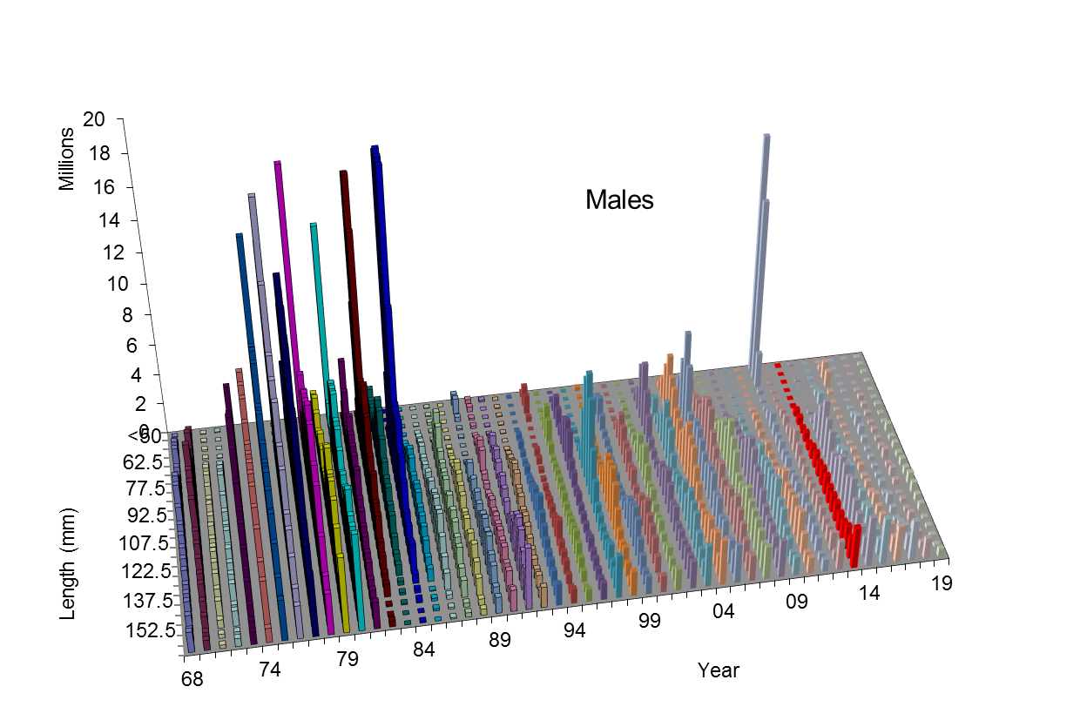


Slide 18
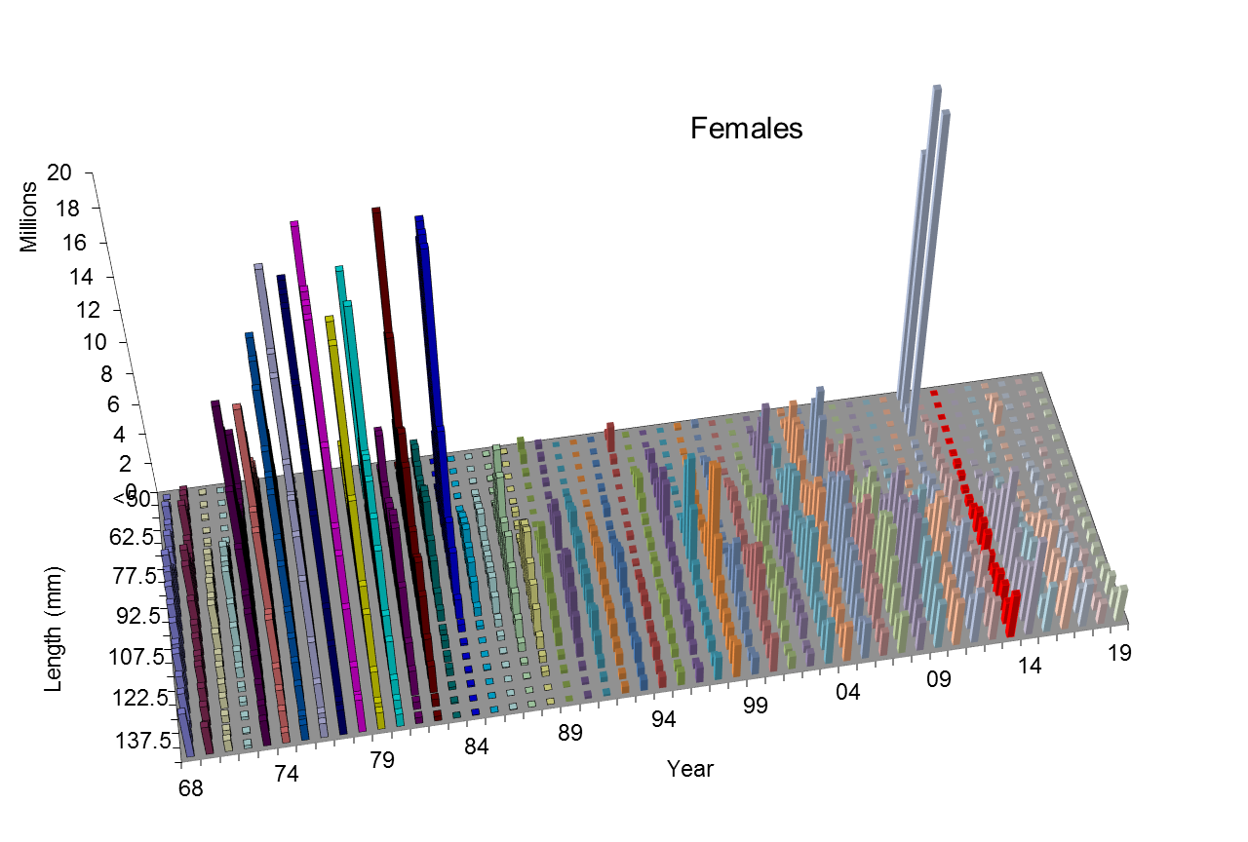

Slide 19
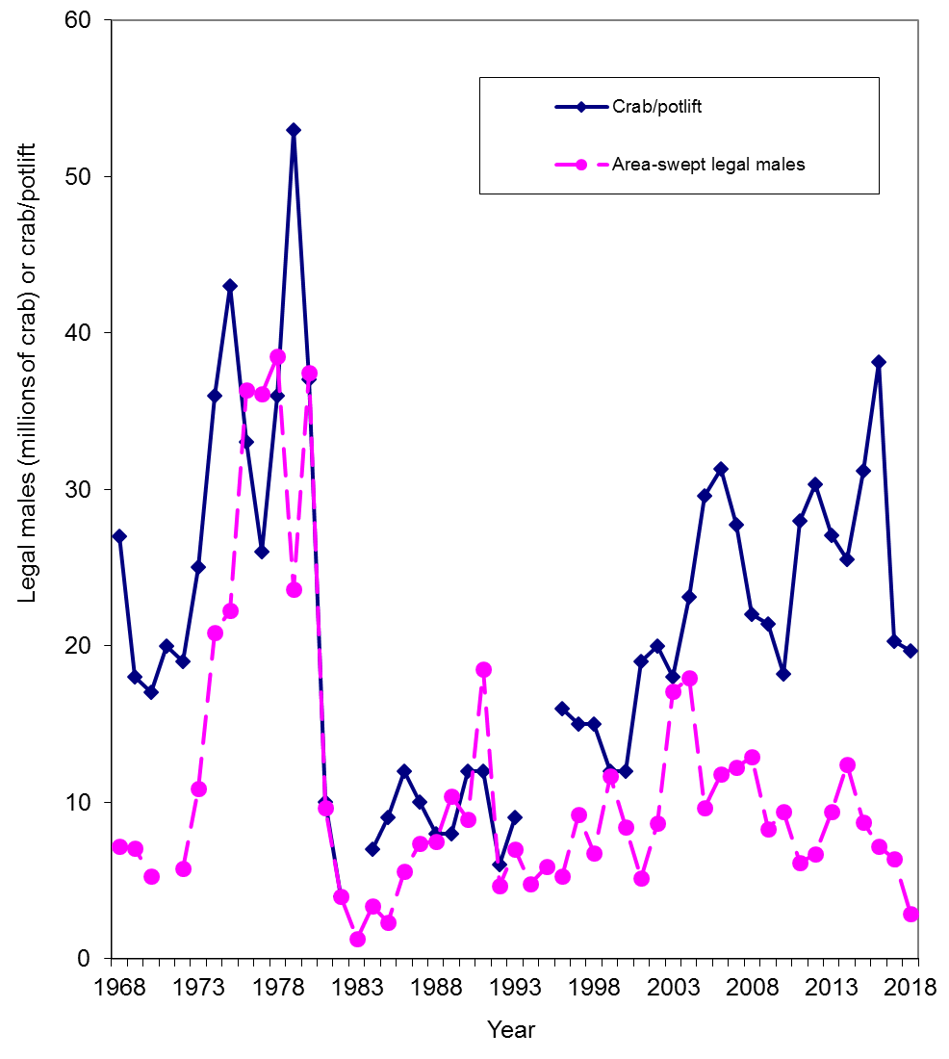

Slide 20
Comparisons of area-swept estimates of total NMFS survey biomass and model prediction for model estimates in 2019 under models 18.0d, 18.0e, and 19.0. The error bars are plus and minus 2 standard deviations.

Slide 21
Comparisons of NMFS survey area-swept estimates of male (>119 mm) and female (>89 mm) abundance and model prediction for model estimates in 2019 under models 18.0d, 18.0e, and 19.0.

Slide 22
Comparisons of mature male biomass on Feb. 15 under models 18.0d, 18.0e, and 19.0.
Estimated trawl survey catchabilities:
Model Q
18.0d 0.923
18.0e 0.925
19.0 0.925

Slide 23
Comparisons of total survey biomass estimates by the BSFRF survey and the model for model estimates in 2019 (models 18.0d, 18.0e, and 19.0). The error bars are plus and minus 2 standard deviations of model 19.0.

Slide 24
Comparison of estimated M and directed pot fishing mortality over time

Slide 25
Standardized residuals of total NMFS survey biomass
18.0e
19.0 (gmacs)

Slide 26
Comparisons of observed and predicted catch mortality biomass under models 18.0d, 18.0e, and 19.0. Mortality biomass is equal to caught biomass times a handling mortality rate.

Slide 27
Comparisons of observed and predicted bycatch mortality biomass under models 18.0d, 18.0e, and 19.0. Mortality biomass is equal to caught biomass times a handling mortality rate.

Slide 28
NMFS survey selectivities (including catchability)
18.0e
19.0 (gmacs)

Slide 29
Estimated selectivities of NMFS trawl survey during 1982-2019 with three models

Slide 30
Estimated selectivities of BSFRF trawl survey during 2007-08 and 2013-2016 with three models

Slide 31
Fisheries selectivities and retained proportions
18.0e
19.0 (gmacs)

Slide 32
18.0e
19.0 (gmacs)

Slide 33
Comparison of area-swept and model estimated NMFS survey length frequencies of Bristol Bay male red king crab by year under models 18.0d (solid black), 18.0e (dashed red) and 19.0 (green lines).

Slide 34
Comparison of area-swept and model estimated NMFS survey length frequencies of Bristol Bay female red king crab by year under models 18.0d (solid black), 18.0e (dashed red) and 19.0 (green lines).

Slide 35
Comparison of area-swept and model estimated BSFRF survey length frequencies of Bristol Bay red king crab by year under models 18.0d (solid black), 18.0e (dashed red) and 19.0 (green lines).

Slide 36
Comparison of observer and model estimated retained length frequencies of Bristol Bay male red king crab by year in the directed pot fishery under models 18.0d (solid black), 18.0e (dashed red) and 19.0 (green lines).

Slide 37
Comparison of observer and model estimated total length frequencies of Bristol Bay male red king crab by year in the directed pot fishery under models 18.0d (solid black), 18.0e (dashed red) and 19.0 (green lines).

Slide 38
Comparison of observer and model estimated discarded length frequencies of Bristol Bay female red king crab by year in the directed pot fishery under models 18.0d (solid black), 18.0e (dashed red) and 19.0 (green lines).

Slide 39
Comparison of observer and model estimated discarded length frequencies of Bristol Bay male red king crab by year in the groundfish trawl fisheries under models 18.0d (solid black), 18.0e (dashed red) and 19.0 (green lines).

Slide 40
Comparison of observer and model estimated discarded length frequencies of Bristol Bay female red king crab by year in the groundfish trawl fisheries under models 18.0d (solid black), 18.0e (dashed red) and 19.0 (green lines).

Slide 41
Comparison of observer and model estimated discarded length frequencies of Bristol Bay male red king crab by year in the groundfish fixed gear fisheries under models 18.0d (solid black), 18.0e (dashed red) and 19.0 (green lines).

Slide 42
Comparison of observer and model estimated discarded length frequencies of Bristol Bay female red king crab by year in the groundfish fixed gear fisheries under models 18.0d (solid black), 18.0e (dashed red) and 19.0 (green lines).

Slide 43
Comparison of observer and model estimated discarded length frequencies of Bristol Bay red king crab by year in the Tanner crab pot fishery under models 18.0e (dashed red) and 19.0 (green lines).

Slide 44
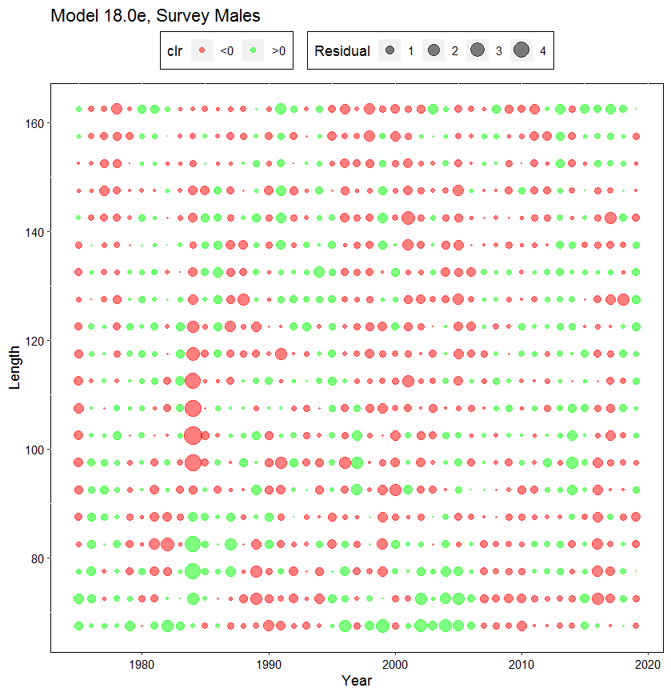
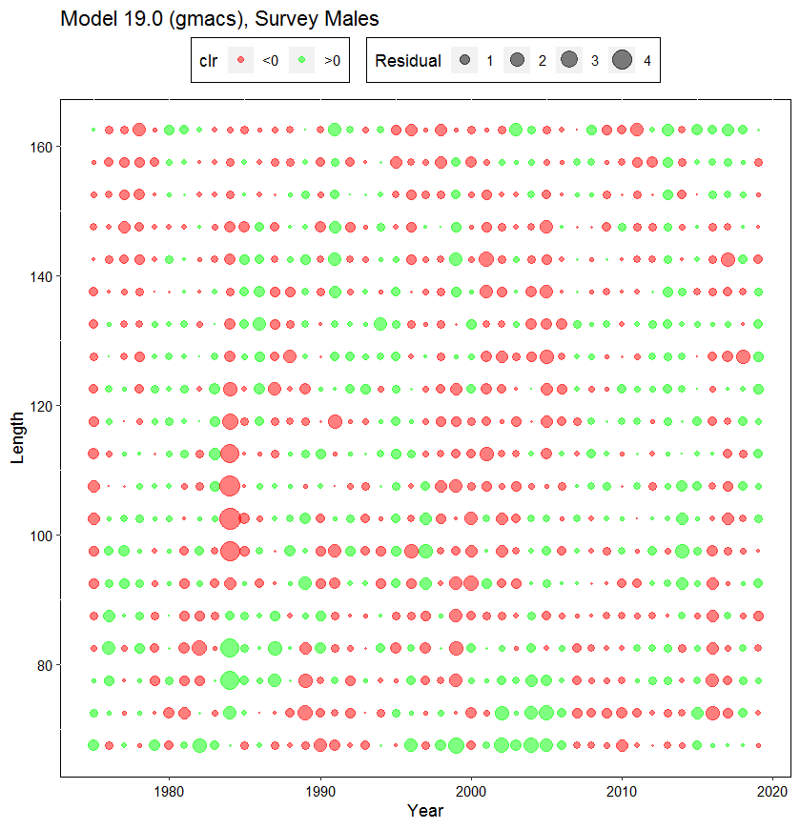
Comparison of standardized residuals of proportions of NMFS survey male red king crab by year and carapace length (mm)

Slide 45
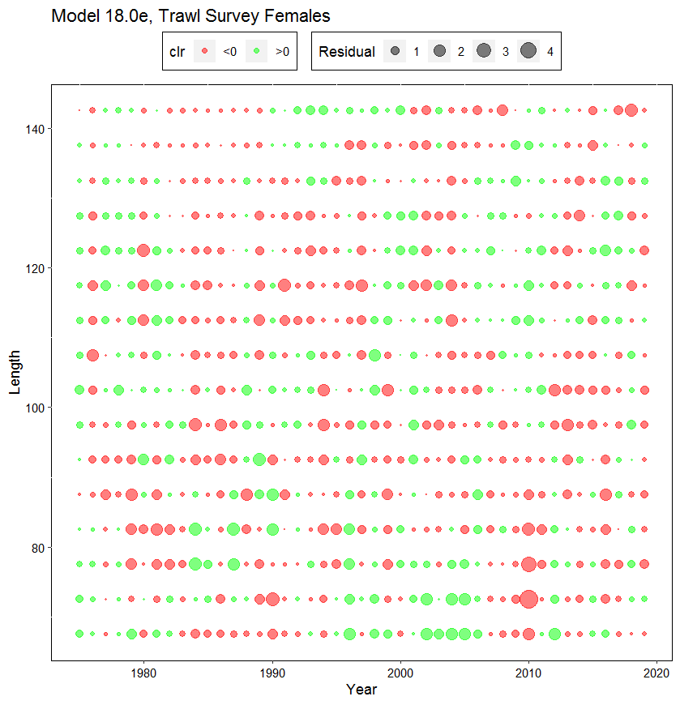
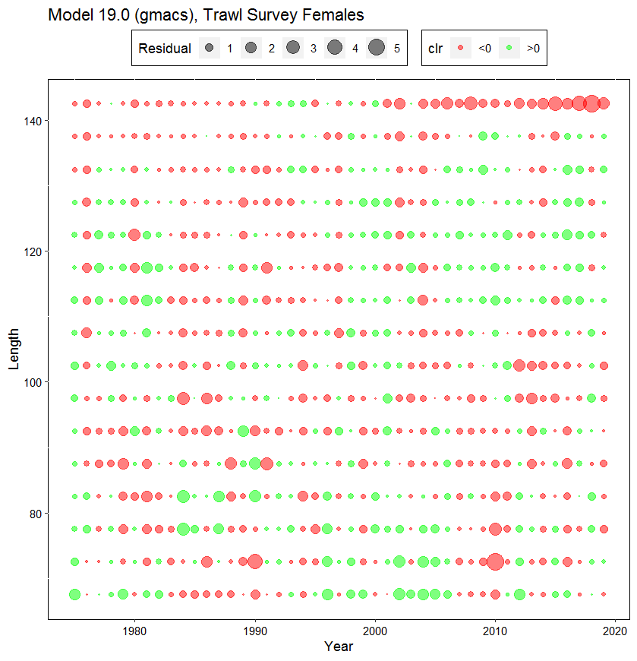
Comparison of standardized residuals of proportions of NMFS survey female red king crab by year and carapace length (mm)

Slide 46
Highlighted cells in yellow color are not comparable between model 19.0 and the other two models and between model 18.0d and the other two models.
Red values show large differences from the other models.

Slide 47
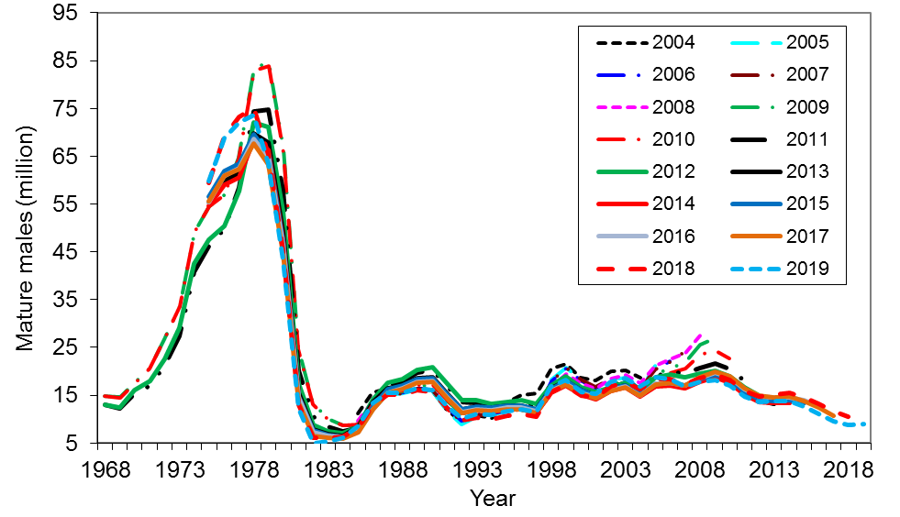
Model 19.0 (gmacs) for 2019 & historical results with different models

Slide 48
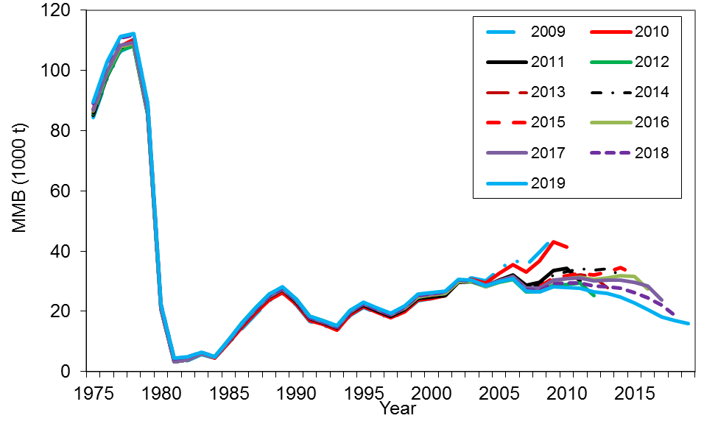
Comparison of hindcast estimates of MMB for model 19.0 (gmacs) from 1975 to 2019 made with terminal years 2009-2019.

Slide 49
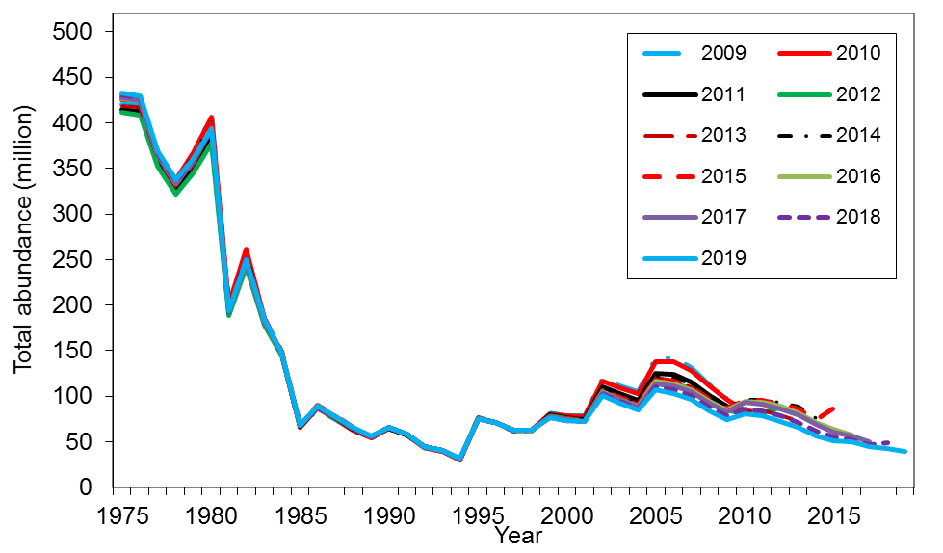
Comparison of hindcast estimates of total population abundance for model 19.0 (gmacs) from 1975 to 2019 made with terminal years 2009-2019.

Slide 50
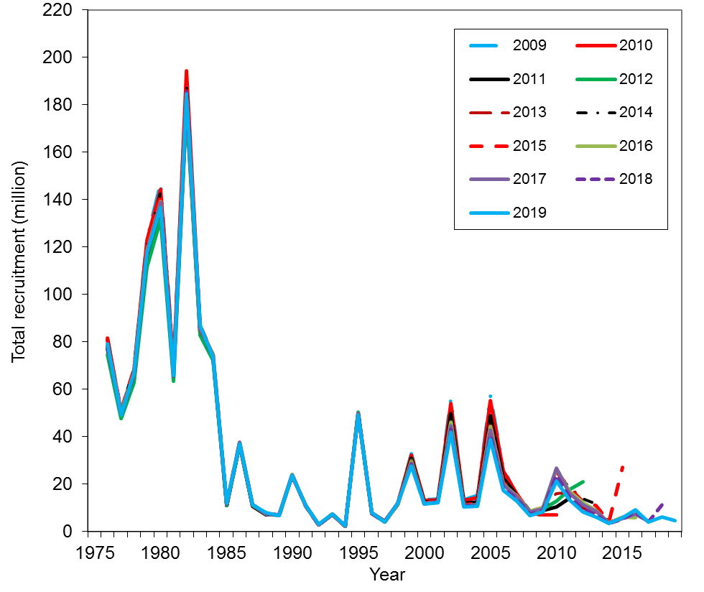
Comparison of hindcast estimates of total recruitment for model 19.0 (gmacs) from 1976 to 2019 made with terminal years 2009-2019.

Slide 51
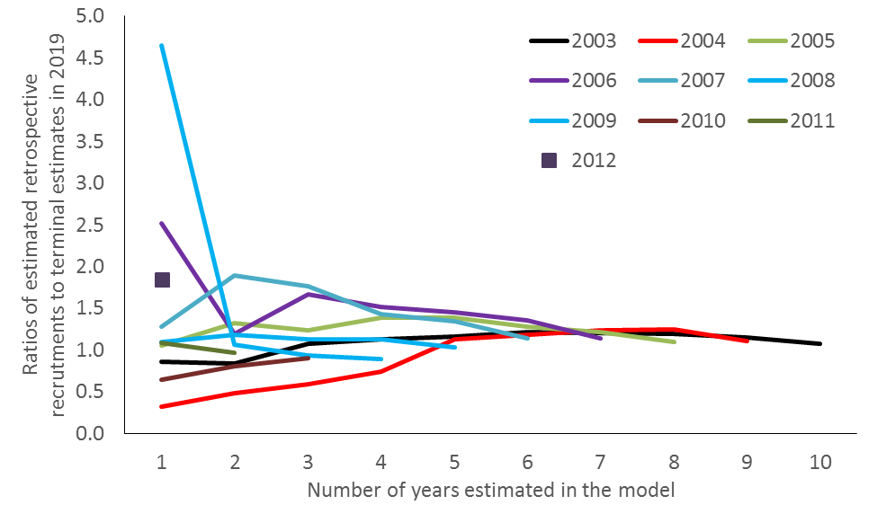
Figure 28b. Evaluation of Bristol Bay red king crab retrospective errors on recruitment estimates as a function of the number of years in the model for model 19.0 (gmacs).

Slide 52
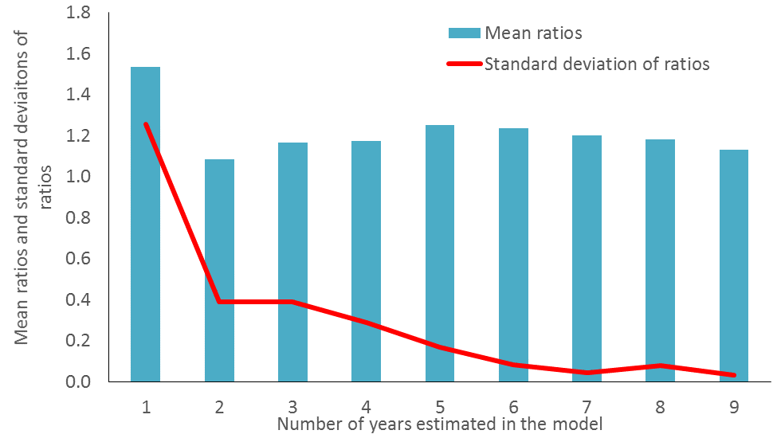
Figure 28c. Mean ratios of retrospective estimates of recruitments to those estimated in the most recent year (2019) and standard deviations of the ratios as a function of the number of years in the model for model 19.0 (gmacs).

Slide 54
Model 18.0e
Model 19.0 (gmacs)

Slide 55
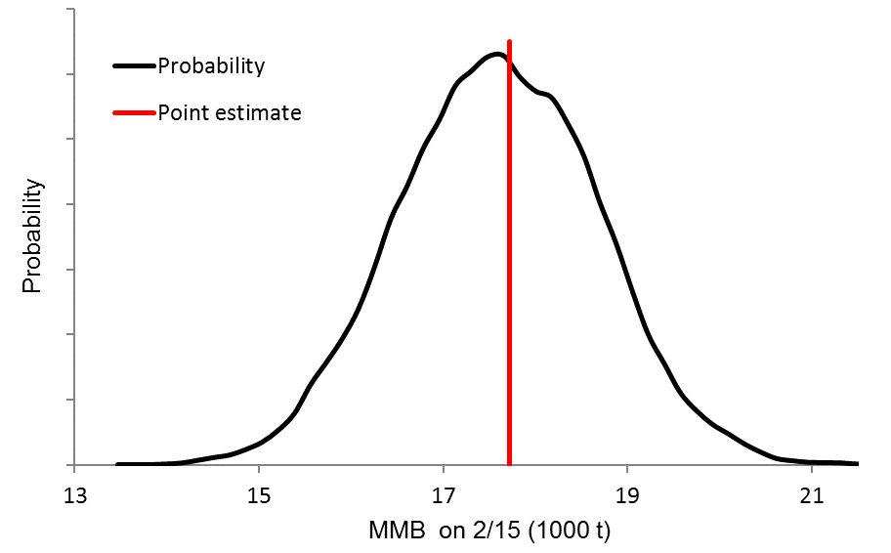
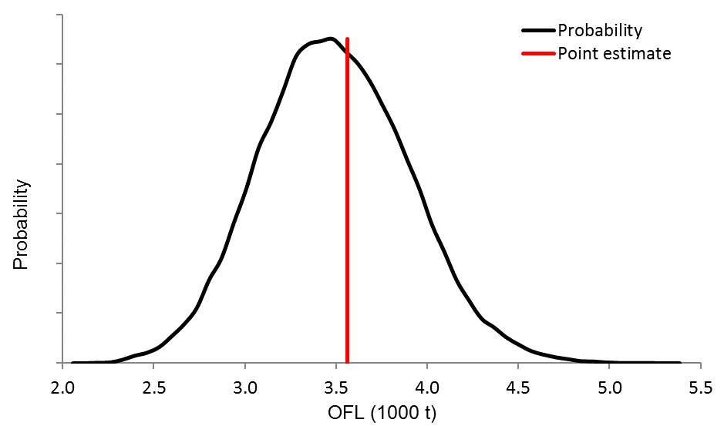
Model 18.0e
2019
Model 18.0e
2019

Slide 56
Summary
In 2018 and 2019, the survey biomasses decreased about 50% from 2017, more than expected. All models have much higher estimated NMFS survey biomass than the observed values in 2018 and 2019.
Model estimated relative NMFS survey biomasses are very similar between two non-gmacs models, are generally similar among all three models, and fit the survey data reasonably well.
Gmacs (model 19.0) results in lower mature male biomass estimates (thus lower recruitment estimates) than the other two models during the last 30 years; this may have something to do with a lower weight for BSFRF survey data through higher estimated additional CV for BSFRF survey biomass.
Generally speaking, model 18.0e fits all length compositions better than model 19.0 except for the directed pot fishery female discard. Model 19.0 fits the NMFS survey biomass much better than model 18.0e while model 18.0e fits the BSFRF survey biomass slightly better.
In terminal year, 2019, B_{35%}, mature male biomass and OFL estimates are lower for model 19.0 (gmacs) than model 18.0e. We have some concern with B_{35%} calculation with modle 19.0 and will likely to check it in the future.
Like the prior results, updated terminal year recruitment analysis with model 19.0 (gmacs) also suggests the estimated recruitment in the last year should not be used for estimating B_{35%}.

Slide 58
Recommendations
Model 18.0e or 19.0 (gmacs) is recommended for overfishing determination this year, because the results are hardly different between models 18.0d and 18.0e.
Although we think the gmacs approach of estimating B_{35%} needs to be verified, the gmacs model (19.0) is preferred due to better fits of NMFS survey biomass during recent years.

Slide 59
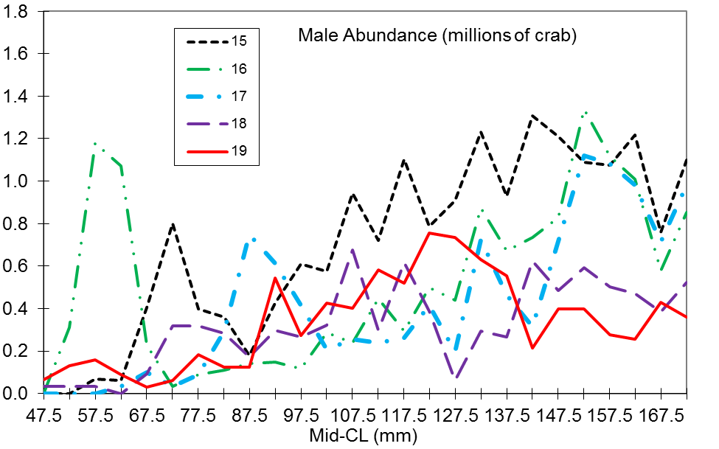
Male area-swept abundance during 2015-2019

Slide 60
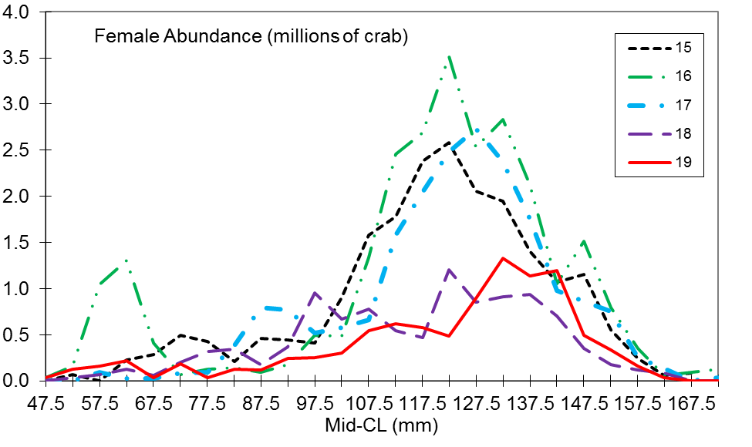
Female area-swept abundance during 2015-2019

Slide 61
Rambling thought about future GMACS work
Documentation. Very limited document is currently available.
The approach to estimate B_{35%} for tier 3 needs to be verified.
More options are needed for dealing with the relationship between NMFS survey and BSFRF survey. The current options are no relationships or NMFS survey selectivity values cannot be larger than BSFRF survey.
A wish: a jittering option for Gmacs.
Equations for instantaneous seasons may be problematic and need to be checked. We used continuous seasons, which seem to be fine.
Output and R plot scripts need to be further developed for more complex assessments like BBRKC.

Slide 62
Thanks

