Slide 1
Skip-molting and molting frequency for EBS male snow and Tanner crab and implications for population assessment
James Murphy
murphyjames04@gmail.com

Slide 2
Molting frequency: why care?
Growth rate: Molting frequency plus molt increments
Molting increments: relatively similar for a given molt
  Not assumed a large factor in determining size for these crabs
Size: determined by molting frequency

Slide 3
Molting frequency: why care?
Little research in EBS relative to other regions
  Been described for 30 years for snow crab in Atlantic Canada
  (papers by Conan and Comeau in early 1990s)
  Intensively studied for 20 years in Atlantic Canada
  (Benhalima et al., 1998; Hebert et al., Dawe et al., 2012)
Molting frequency incorrectly implemented in assessment models
Growth dynamics wrong in models
Impact unclear
  sky isn’t falling (?)
  likely more of an issue with Tanner than snow crab

Slide 4
Molting frequency
For snow crab, molting frequency details
worked out since the early 1990s in Atlantic Canada
Sexual development stage | Molting frequency per year
Juvenile | ≥ 1
Adolescent | 0 - 1
Adult | 0

Slide 5
Molting frequency
Sexual development stage | Molting frequency per year
Juvenile | ≥ 1
Adolescent | 0 - 1
Adult | 0
Important factors:
i) sexual development stage
ii) sex
iii) temperature
iv) other factors: possibly food supply, individual condition, and competition

Slide 6
Molting frequency: How is it determined?
Field sampling (repeated sampling of juvenile habitat)
Aquarium studies
Durometer readings (shell hardness)
Examination of shells in the laboratory (microscopy work)
Shell condition of adolescent crab

Slide 7
Molting frequency for adolescents
3 types of possible molting pathways for adolescent Tanner and snow crab in winter/spring molting season
  i) Pubertal molt (molt to another adolescent stage)
  ii) Terminal molt (molt to adult stage)
  iii) Skip molt (don’t molt)
    Don’t molt until following year
    Common in males, not for females
    Duration of skip-molt status can last more than one year
    More common in larger male adolescents
    Possibly related to bio-energetic requirements, as males get larger, acquiring sufficient energy for another molt becomes more difficult

Slide 8
Adolescent male skip molting
Atlantic Canada snow crab
  Up to 50% of adolescent males >50 mm CW in Southern Gulf of St. Lawrence in some years
  May be highly variable over time
  Can impact recruitment of large adolescents to the fishery
Sea of Japan crab
  Yamamoto et al., 2017
  Murphy (2019) mistakenly states 28% of adolescent crabs were skip-molters
    Actual rate seems much higher but reluctant to interpret their data
  Most crabs terminal-molted after skip-molt
  6% of sampled adolescents skipped at least two years

Slide 9
Adolescent male skip molting
Important consequence of skip-molting
  More skip-molting, fewer large males
  Males terminally-molt (molt to maturity) at smaller sizes
    Timing of terminal molt is function of size and age
  Lower survival for skip-molters? (speculative but has some support)
    Comeau et al. (1998) concluded low survival for skip-molters during study period (GoSL)
    Others suggest skip-molting results of inferior physical condition

Slide 10
EBS skip-molting research
Zaleski and Tamone, Journal of Crustacean Biology, 2014
  First mention of snow crab skip-molting in EBS in primary literature
  Examined hormones in different snow crab life-stages
  Described skip-molters as adolescent oldshell crabs
  Found physiological differences between skip-molters and annual molters

Slide 11
EBS skip-molting research
Murphy, Fisheries Research, 2019
  Relied on chela height (claw width) data (1989-2017)
  Estimated skip-molt proportions by size for snow and Tanner crab
  Population simulations to examine impact of skip molting on mature biomass
  Previous research in Atlantic Canada provided a template for data analysis

Slide 12
Murphy (2019)
Immature or
adolescent
Adult
Terminal molted
Relies on chela height data
Non-terminal molted
Chela height
Carapace (shell) width
Figure from NOAA technical report

Slide 13
Murphy (2019)
Immature or
adolescent
Adult
Terminal molted
Non-terminal molted
Chela height
Skip molt proportions:
Total oldshell immature crab
Total immature crab
Carapace (shell) width
Figure from NOAA technical report

Slide 14
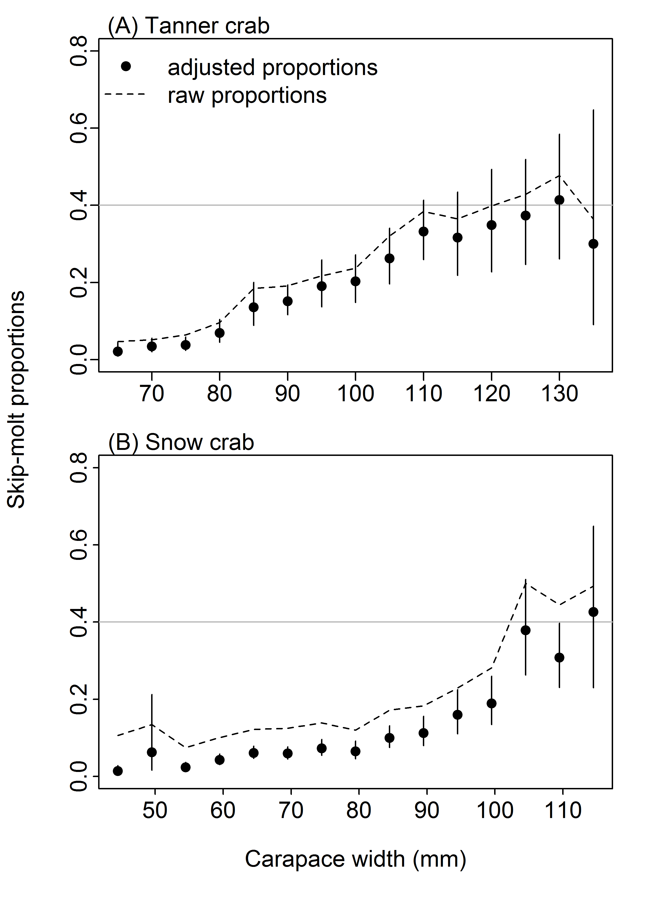
Results: Murphy (2019)
Annual means: proportion skip-molters
Snow crab: similar to Atlantic Canada
Tanner crab have higher skip-molt
  proportions than snow crab (accounting for size difference)

Slide 15
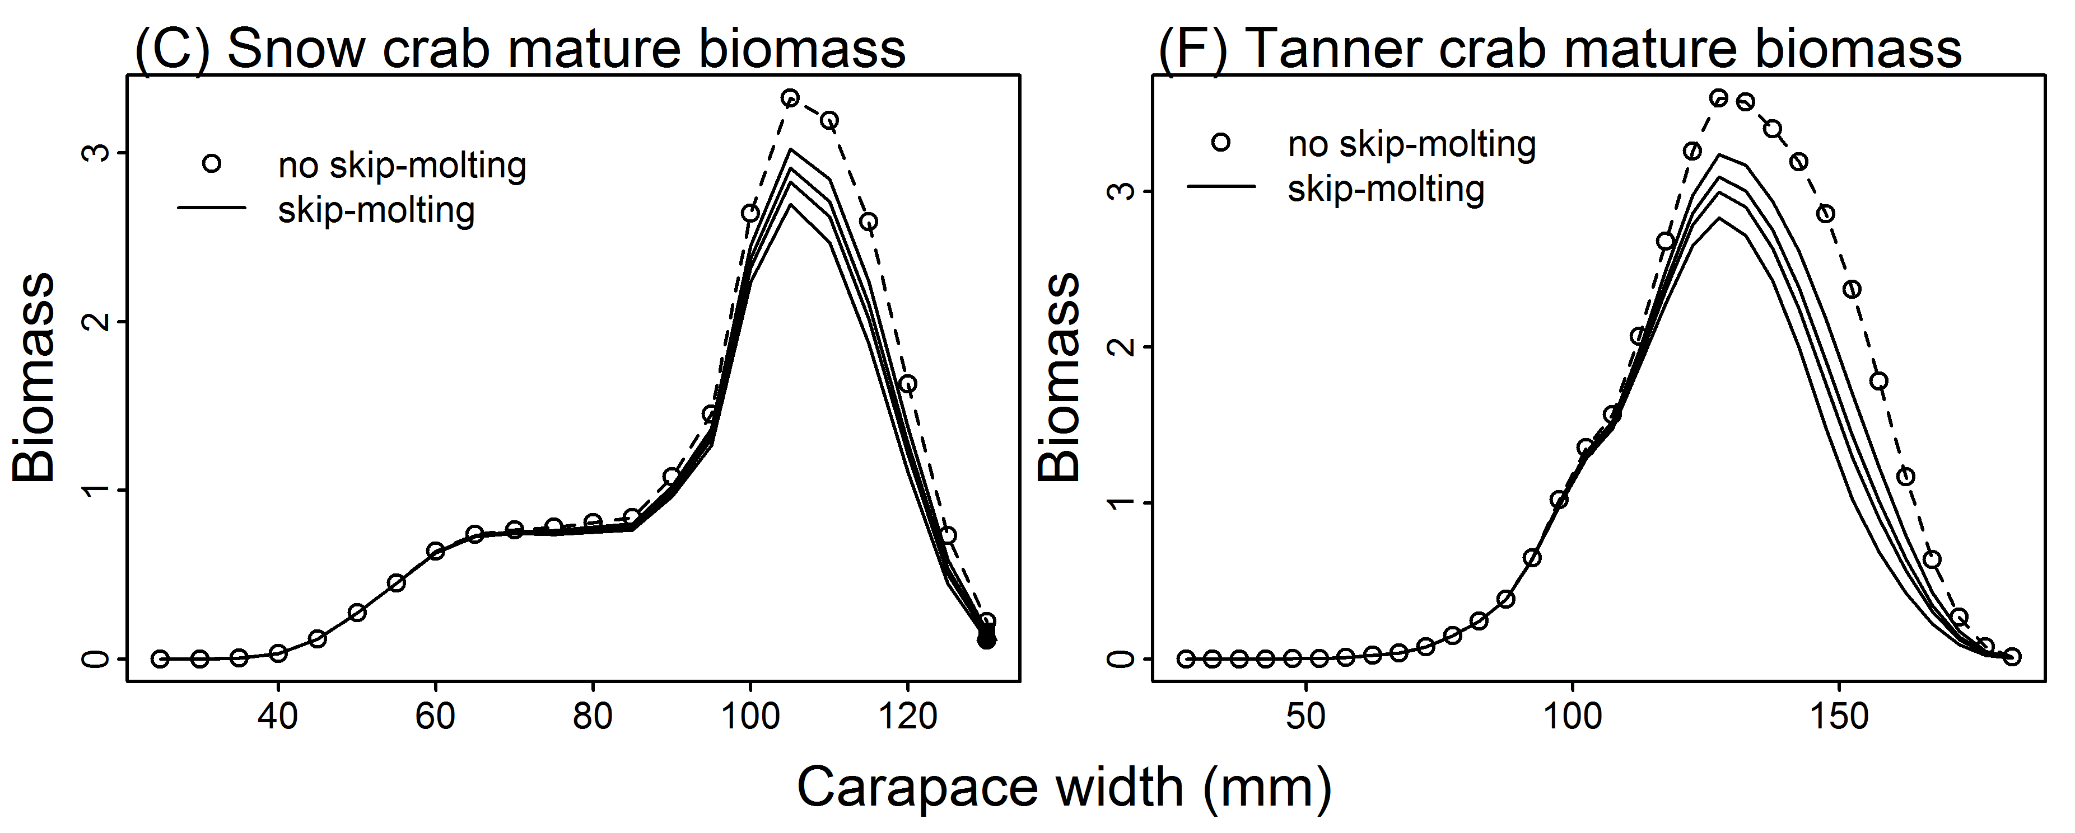
Simulation results: Murphy (2019)
Q: What is impact of skip-molting on mature male biomass relative to population without skip-molting?
Skip-molter annual survival:
0.68 (no change due to skip-molting), 0.61, 0.54, 0.48
Reduction in large mature males:
Snow crab: 12% - 24 %
Tanner crab: 23% - 47%

Slide 16
Murphy (2019) caveats
Relied on shell condition
  newshell adolescents and oldshell adolescents
  Shell condition unreliable for males
  Estimated proportions likely minimum values as proportions are underestimated
Non-random sampling for chela height data requires post-hoc weighting (not ideal)

Slide 17
Fisheries management implications
Why is skip-molting an issue here?
  Assessment models assume adolescent males molt each year
  Growth misspecified, models defective to some degree

Slide 18
Fisheries management implications
Critical question:
  How do assessment estimates change with correct growth dynamics?

Slide 19
Fisheries management implications
Critical question:
  How do assessment estimates change with correct growth dynamics?
Answers (?)
    Incorporate into stock assessment?
      Would require use of shell condition data, which is unreliable
      Doesn’t seem like a good idea, contrary to Murphy (2019)
  Simulation and estimation exercise
    Simulate population with skip-molting, estimate dynamics with model without skip-molting
    Explore a range of skip-molting probabilities for a given size range
    Explore various skip-molting survival scenarios

Slide 20
Future research suggestions
Aquaria-based studies (skip-molter survival)
Shell structure analysis (microscopy/histology)
Durometer data (shell hardness)
Condition data: size of digestive gland, muscle size, etc.
Collaboration / communication with scientists from DFO and Atlantic Canada and Japan

