Slide 1
Incidental Crab Catch in Groundfish Fisheries
Alaska Region
September 2019
Krista Milani

Slide 2
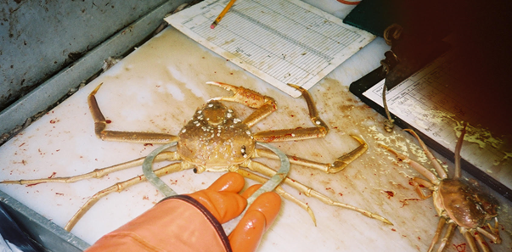
Observer Program Crab Lengths
The North Pacific Observer Program may be switching from measuring and reporting crab biological lengths to the nearest 5mm (e.g. 113,118,123,128) to measuring crab with vernier calipers and reporting lengths to the millimeter (the earliest would be 2021). We’d like to determine if this will cause any data concerns (with old v. new data). If you have any questions or concerns, please contact:
Paul McCluskey 206-526-4182
paul.mccluskey@noaa.gov

Slide 3
Vessels in Full Coverage vs Partial Coverage
Full coverage vessels (1 or 2 observers 100% of the time)
  Catcher Processors (limited exceptions for non-trawl CPs)
  Motherships
  AFA Pollock catcher vessels delivering shoreside
  Non-Pollock BSAI trawl catcher vessels can opt for 100% coverage during all fishing.
Partial Coverage
  Catcher Vessels fishing groundfish
  Catcher Vessels fishing IFQ/CDQ halibut/sablefish
  Small non-trawl Catcher Processors
No observer coverage
  Vessels using Electronic Monitoring (30% selection rate)
  40 feet and under
  Jig Catcher Vessels
  No FFP (can only fish inside three miles)
  State Guideline Harvest Level fisheries

Slide 4
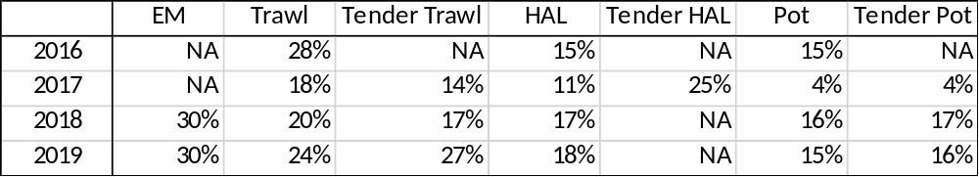
Groundfish Observer Coverage Rates (Partial Coverage vessels only)
Prior to 2013 observer coverage for CVs >= 60 ft and <125 ft was based on 30% of fishing days by gear and quarter, >= 125 ft CVs and CPs were 100%
2013 observer program restructured
In 2013 and 2014 partial observer coverage rates were the same for all gear types on vessels 57.5 feet and larger
  14.5% in 2013
  16% in 2014
2015 partial observer coverage rates were split by vessel size
  24% on vessels 57.5 feet and larger
  12% on vessels 40-57.5 feet

Slide 5
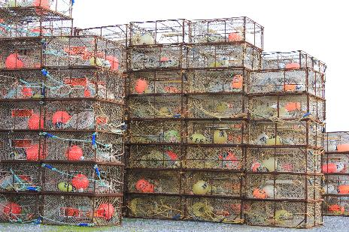
Incidental Crab Catch in Groundfish Fisheries
All weights are in kilograms
Mortality has not been applied
All weights are extrapolated from observer data
All weights came from AKFIN database
Incidental catch data in this presentation are for the crab year (July 1 to June 30) except for Pribilof Island Golden king crab which is a calendar year
Fixed gear includes pot, hook-and-line, and jig
Trawl gear includes non-pelagic and pelagic trawl

Slide 6
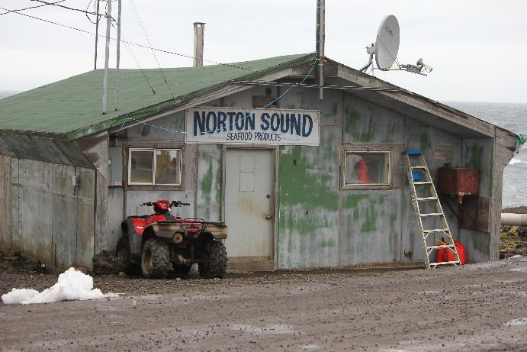
Norton Sound Red King Crab Incidental Catch in Groundfish Fisheries
Data by year is confidential
From 2014/15 – 2018/19 there is a total of 19 kg of red king crab taken from groundfish fisheries

Slide 7
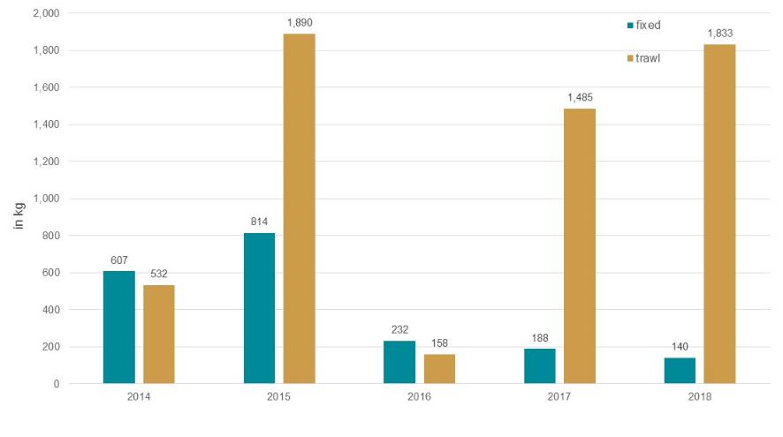
Pribilof Island Golden King Crab Incidental Catch in Groundfish Fisheries

Slide 8
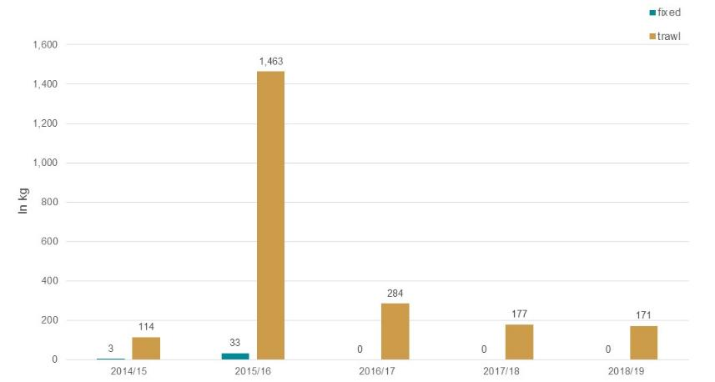
Aleutian Islands Red King Crab Incidental Catch in Groundfish Fisheries

Slide 9
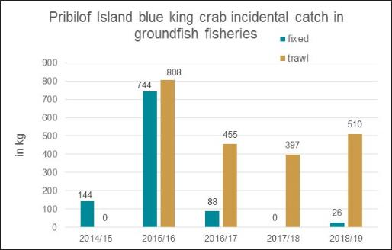
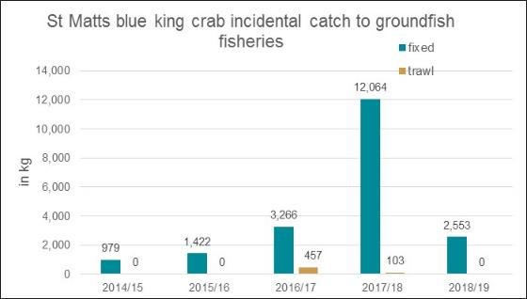
Incidental crab catch for overfished stocks
Overfishing occurred in the Pribilof Island blue king crab fishery in the 2015/16 season
No other overfishing has occurred since 2014/15 for either stock

Slide 10
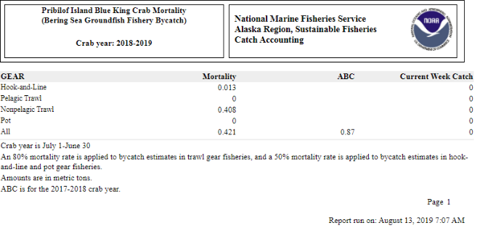
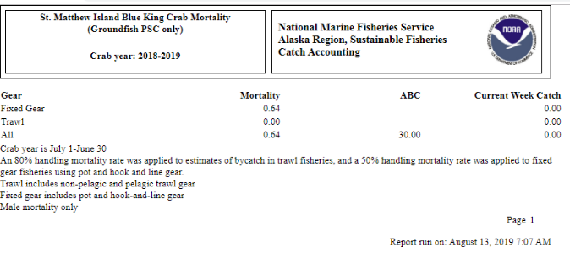
Incidental Catch of Overfished Stocks are Updated Weekly on NOAA Website
https://www.fisheries.noaa.gov/alaska/commercial-fishing/fisheries-catch-and-landings-reports#bsai-prohibited-species

Slide 11
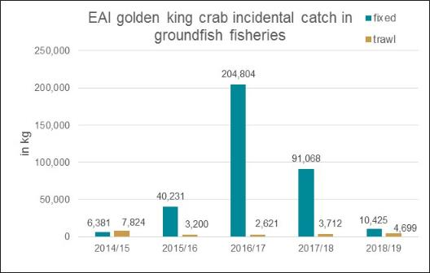
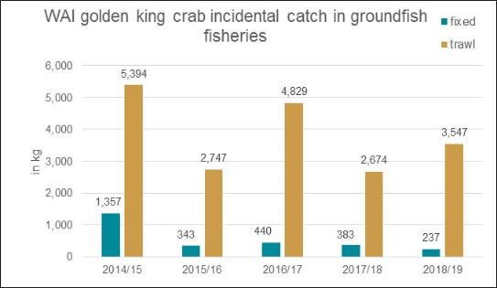
Eastern Aleutian Islands (EAI) Golden king crab is East of 174° W
Western Aleutian Islands (WAI) Golden king crab is West of 174° W

Slide 12
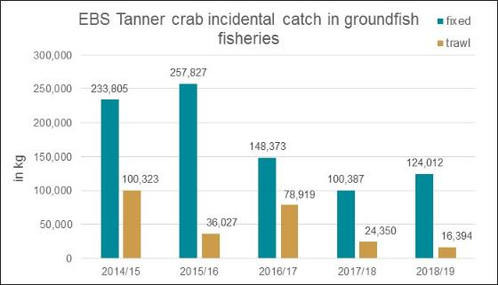
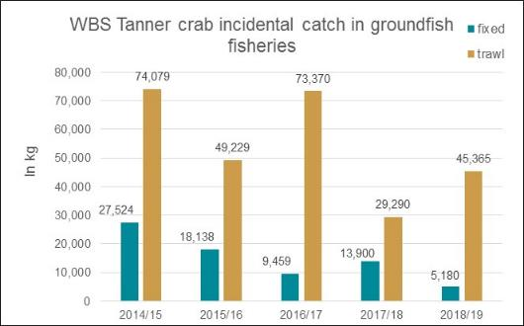
Eastern Bering Sea (EBS) Tanner crab is East of 166° W
Western Bering Sea (WBS) Tanner crab is West of 166° W

Slide 13
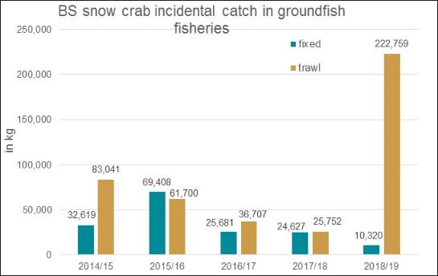
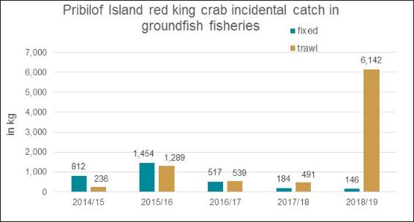

Slide 14
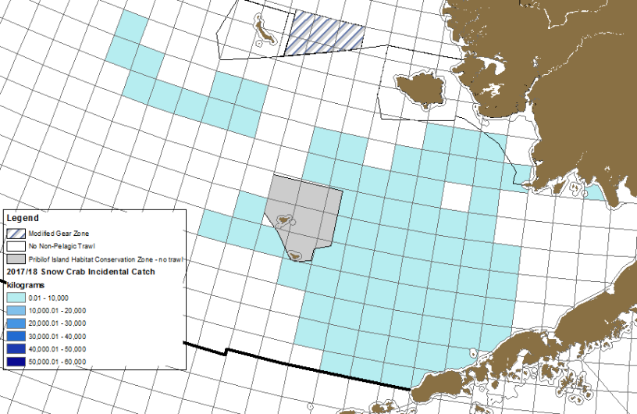
2017/18 Bering Sea Snow Crab Incidental Catch in Trawl Groundfish Fisheries

Slide 15
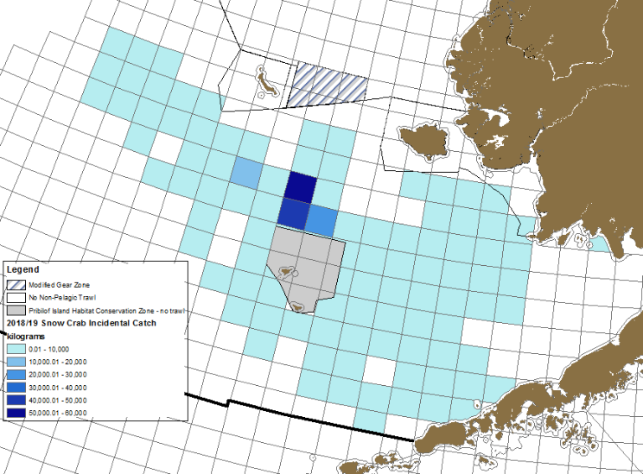
2018/19 Bering Sea Snow Crab Incidental Catch in Trawl Groundfish Fisheries

Slide 16
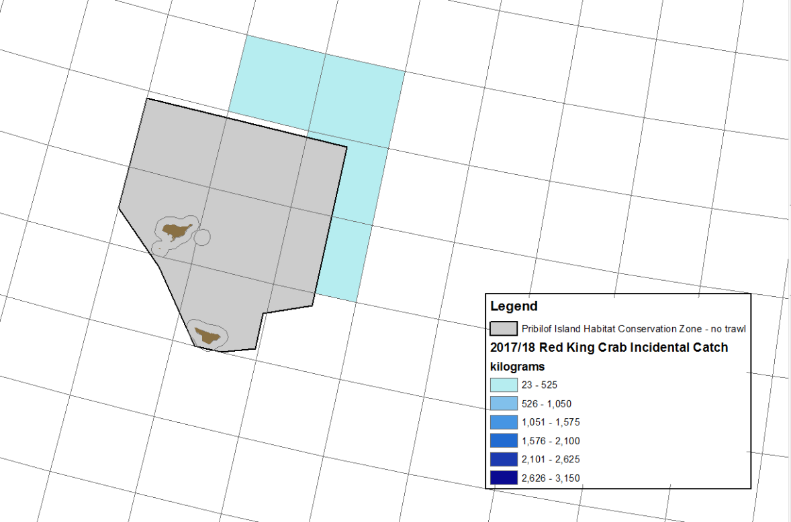
2017/18 Pribilof Island Red Crab Incidental Catch in Trawl Groundfish Fisheries

Slide 17
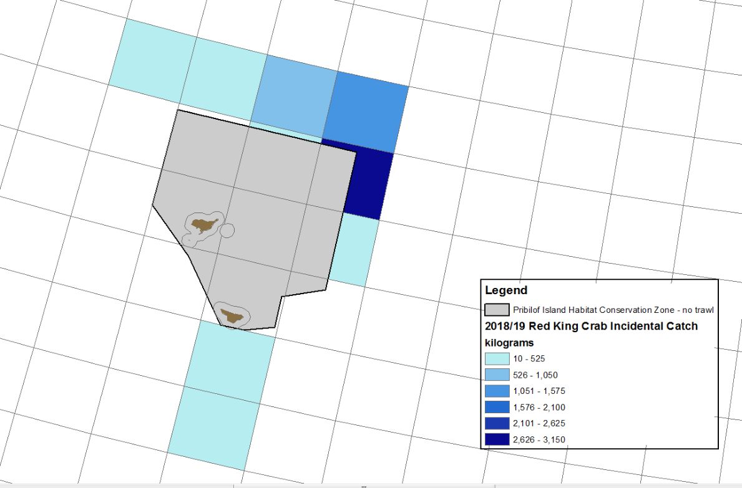
2018/19 Pribilof Island Red Crab Incidental Catch in Trawl Groundfish Fisheries

Slide 18
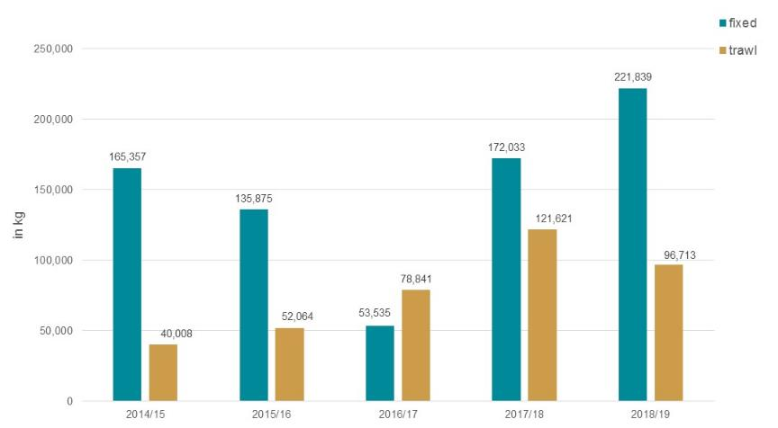
Bristol Bay Red King Crab Incidental Catch in Groundfish Fisheries

Slide 19
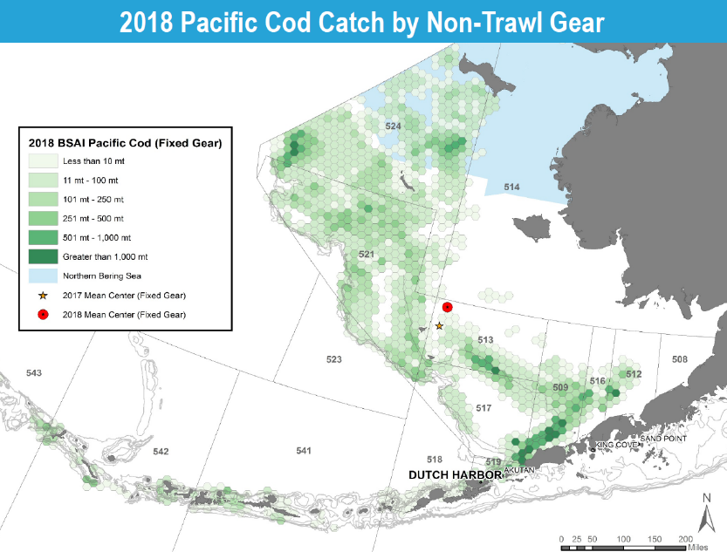

Slide 20
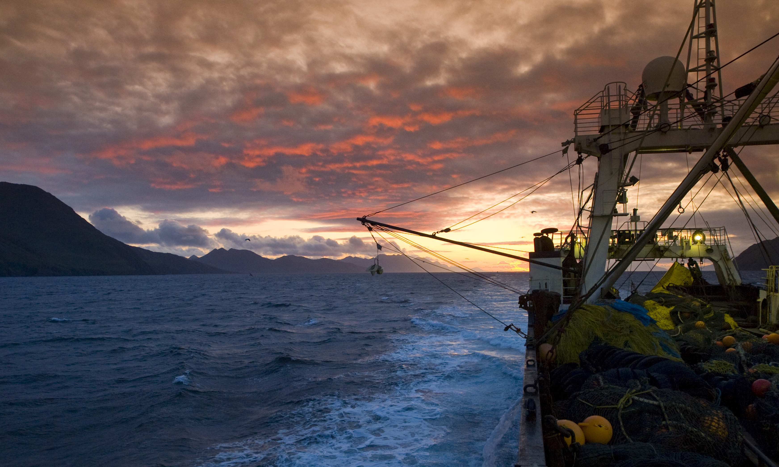
Thank you
Photo courtesy of Sam Zmolek

