Slide 1
2018/19 BSAI crab catch and fishery performance
Benjamin Daly
Crab Plan Team Meeting
September 16-20, 2019
Seattle, WA

Slide 3
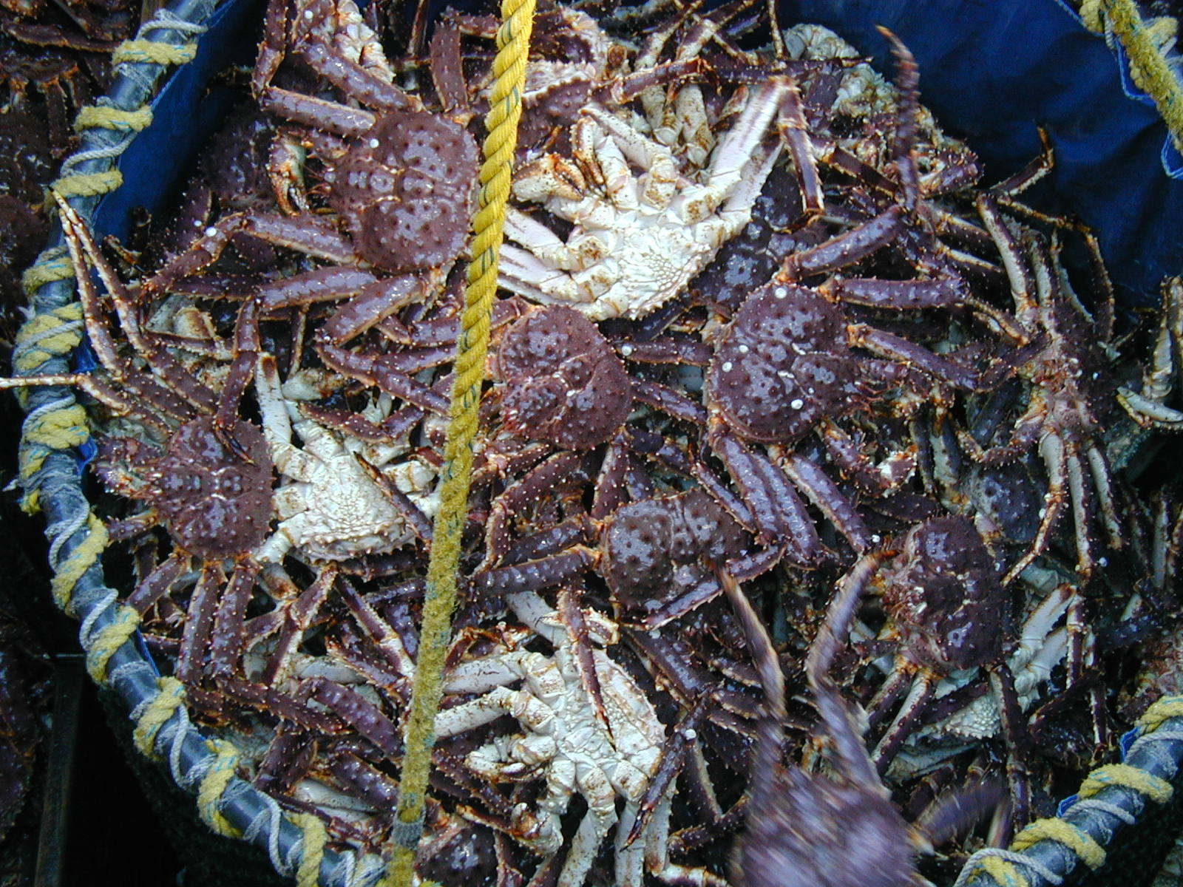
BBRKC

Slide 7
2018/19 BBRKC

Slide 8
2018/19 BBRKC

Slide 9
2018/19 BBRKC observations from the fleet
Continued increase in average weight since 2016/17 season.
  7.10 lbs in 2018/19, 6.84 lbs in 2017/18, 6.7 lbs in 2016/17.
  Captains commenting that they are fishing the same group of crab as last year that are a year older and year heavier.
  General concern from BBR captains on the increase in average weight.
Several vessels reported having to move gear off large masses of female crab where pots were catching as many as 200 females.
  One captain estimated the area with females to be a 25 x 6 nautical mile patch that he was trying to move gear out of [(56 37.30 N, -162 40.4 W) to (56 53.00 N, -162 04.80W)].
  Captain reports of a large female mass also at (56 43.36 N, -162 38.00 W) and (56 49.60 N, -162 49.6 W).

Slide 11
Trends of LNR and subtraction method track pretty well.
Focusing on the subtraction method, 2018 had a high discard rate
What gives?

Slide 12
Survey: relatively high proportion of legal-size males were oldshell
Similar pattern seen in at-sea observer pots and in the dockside data

Slide 13
Ratio of sublegal crabs up in 2018/19 relative to recent years, but comparable to the long-term trends
Vessels were seeing more sublegal male crabs than they have since 2011-ish
High discard mortality rate in 2018/19 likely due to 2 factors: 1) more sublegal crabs in pots, and 2) higher proportion of legal crabs in old shell condition

Slide 15
Bristol Bay red king crab

Slide 16
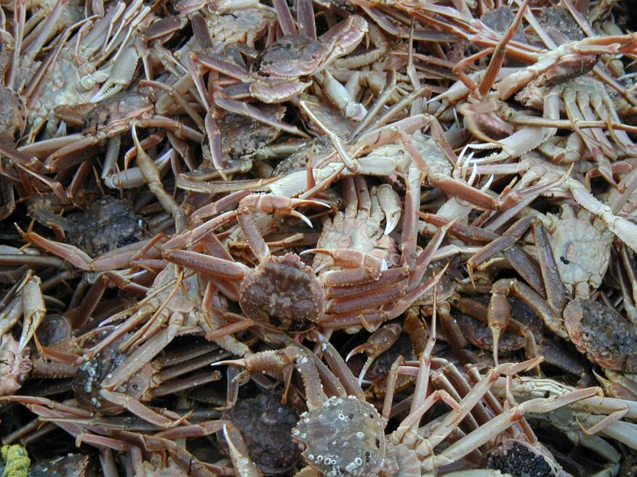
Snow crab

Slide 19
Snow crab

Slide 20
Snow crab

Slide 22
2018/19 snow crab

Slide 23
2018/19 BSS observations from the fleet
Many vessels ended up fishing SW of Saint Matthew Island where CPUE was high and there was clean (new shell) crab.
  Many vessels initially tried to fish in more traditional areas (W/NW of Pribilofs) before eventually moving north in search of better fishing.
Several captains reported having to move gear around more than usual to find clean crab in fish-able numbers.
Fishing W/NW of Pribilofs saw LOTS of juveniles (many reports from captains over the season). Captains reported that legal crab in these areas were “dirty” and described it as a “junkpile”, meaning that lots of sorting was required to end up with new shell 4-inch plus crab.
Sea ice did not impact the fishery. The ice edge stopped at Saint Matthew at maximum extend and then retreated North.
Majority of the fleet saw better fishing than in 2017/18 season.

Slide 26
Bering Sea snow crab

Slide 27
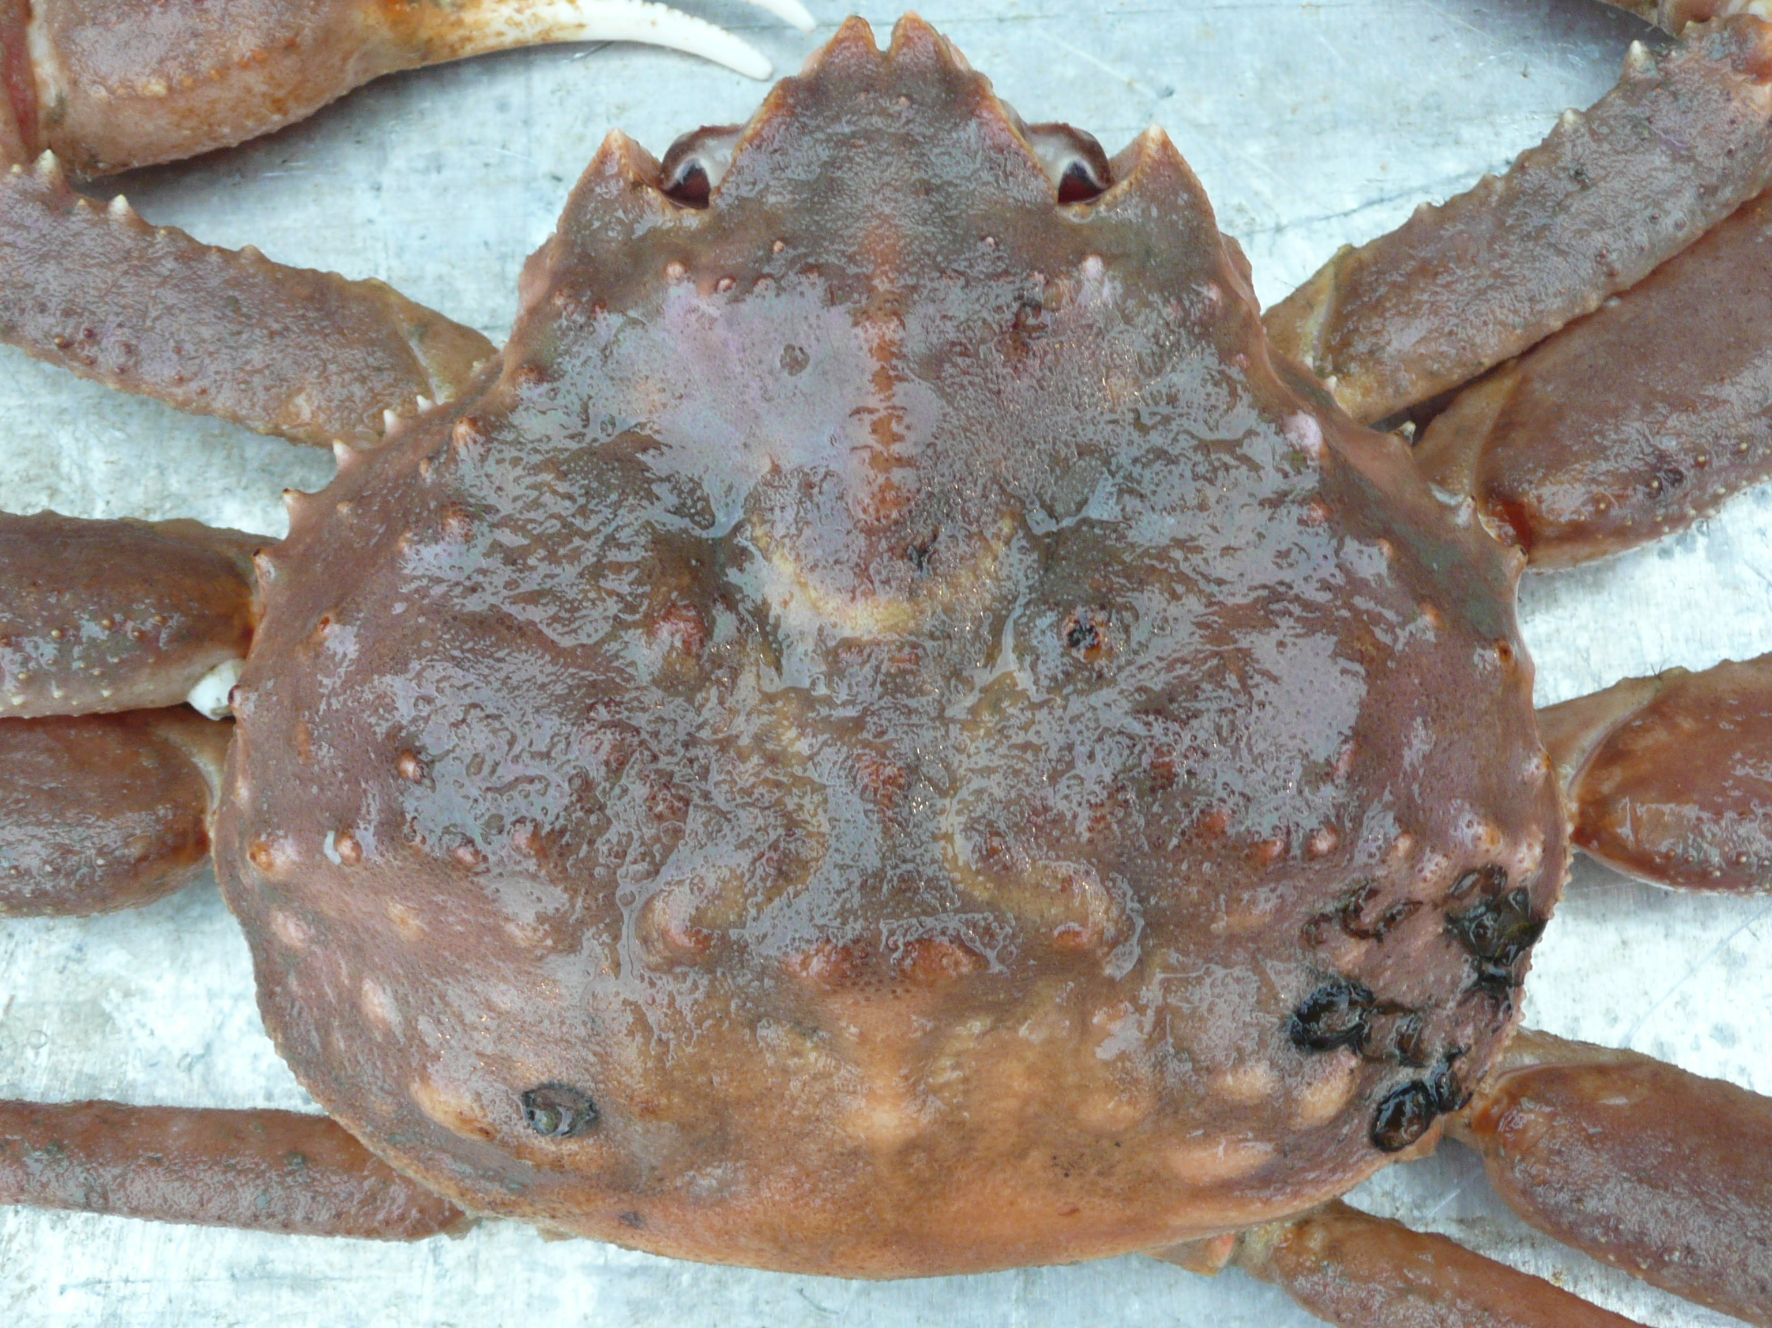
Tanner crab

Slide 29
East and west combined

Slide 30
Showing stat areas with 3+ vessel participation

Slide 32
2018/19 Tanner west

Slide 35
Western Bering Sea Tanner crab

Slide 36
2018/19 WBT observations from the fleet
Observed vessel CPUE ranged from 9 to 91.5.
Captains reported slow fishing in November (after finishing RKC), but fishing improved for vessels that waited to fish until February/March (after finishing BSS).
Fishing was spotty in general compared to 2017/18 season.

Slide 37
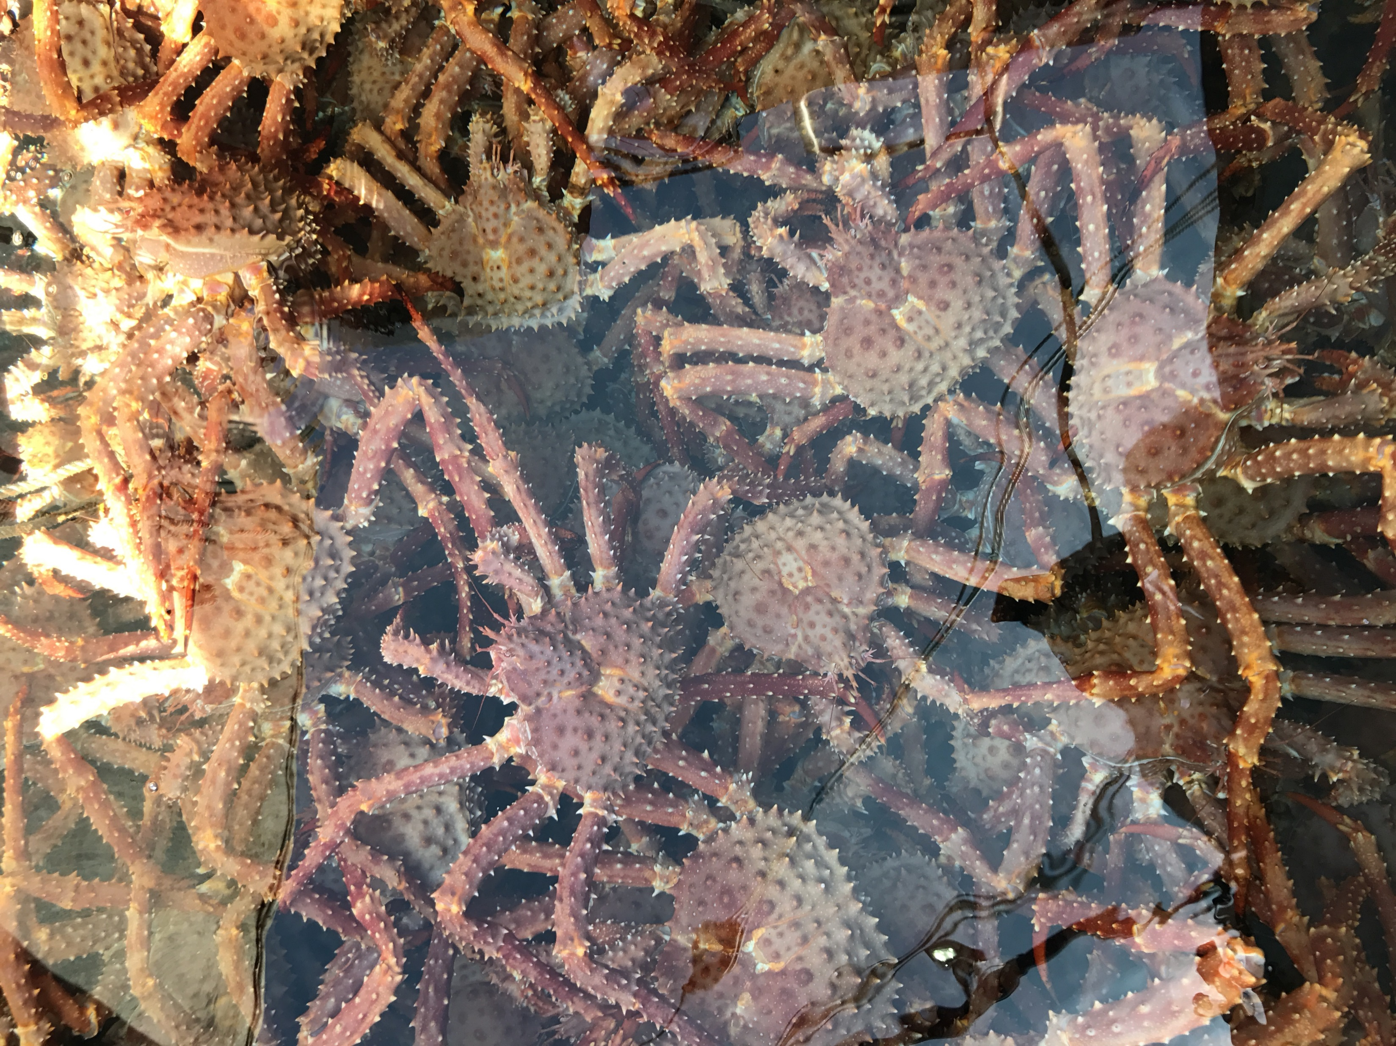
AIGKC

Slide 42
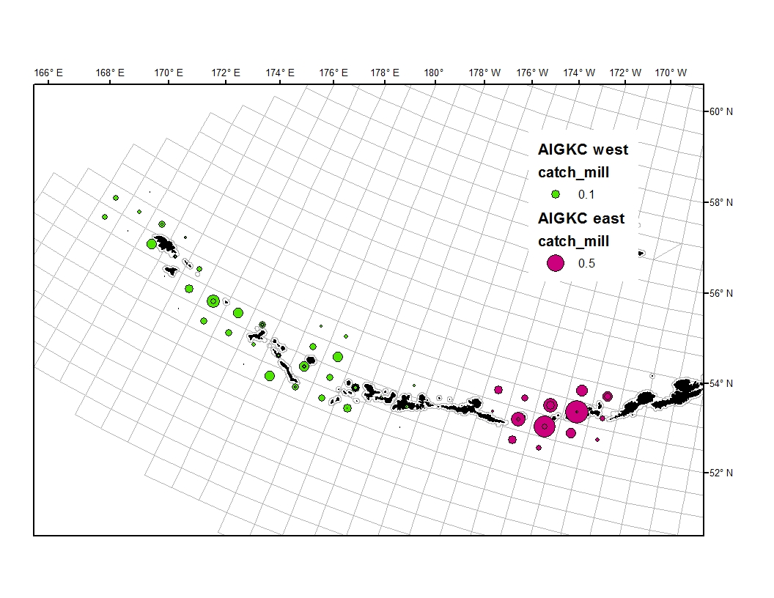
2018/19 Harvest Spatial Distribution

Slide 43
2018/19 AIGKC
EAG
WAG

Slide 44
2018/19 AIGKC observations from the fleet
EAG
All vessels reported exceptional fishing over the course of the season.
Some concern over the small average weight (4.08 lbs 2018/19).
  Lots of crab right at legal size (6 inches).
WAG
All vessels reported exceptional fishing over the course of the season.
Winter weather was severe and limited the number of days that some vessels could operate.

Slide 46
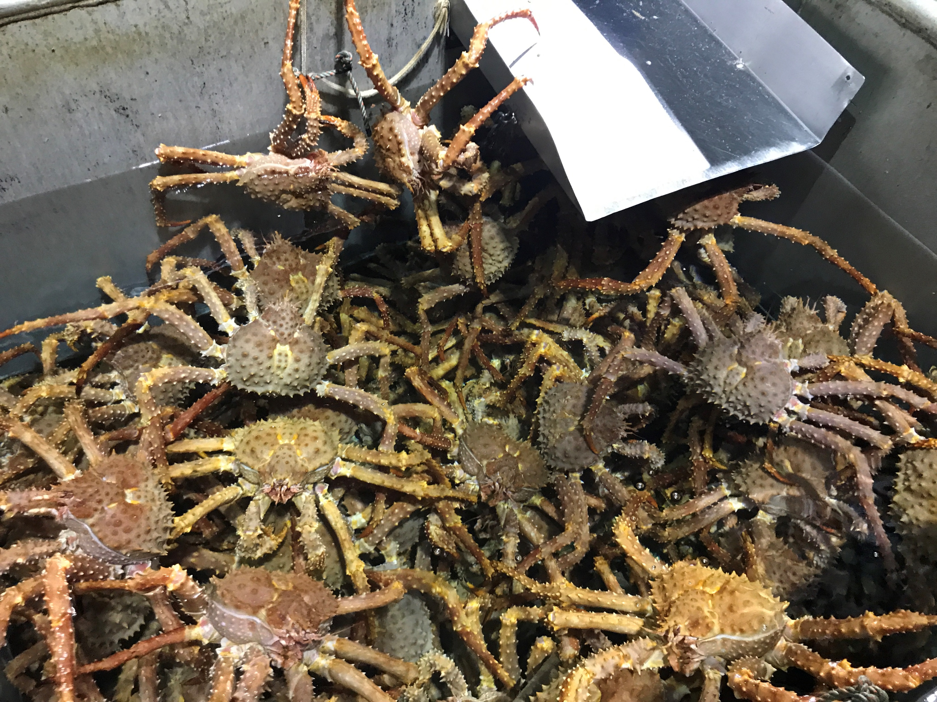
PIGKC

Slide 48
2018 + 2019 Pribilof GKC
Fishery conducted by calendar year
Specific catch numbers + spatial data confidential
  Waivers from vessels but not processors
1 vessel participated in the 2018 fishery
  GHL = 130,000 lb (59 t) was not achieved
2 vessels participated in the 2019 fishery
  GHL = 130,000 lb (59 t) was achieved

Slide 49
Observer pot location during Bering Sea golden king crab fisheries from 1992-2019 (n=7,402).
Pots north of the Pribilof District northern boundary were fished during the Northern District – Saint Matthew island Section fishery.
~95% of all observer pots

Slide 50
Proportion of historical catch by stat_area
69% of all historical catch

Slide 51
Mandatory catcher-vessel coverage requirements in FMP BSAI commercial crab
fisheries, per 5 AAC 39.645. All vessels processing crab must carry observers.
Fishery | Coverage
Bering Sea snow crab | 30-100% (a)
Bristol Bay red king crab | 20% (a)
Bering Sea Tanner crab | 30-100% (a)
Pribilof District red king crab | 100%
Pribilof District blue king crab | 100%
Saint Matthew Island blue king crab | 100%
Norton Sound red king crab | Discretionary
Aleutian Islands golden king crab | 50% (b)
Pribilof District golden king crab | 100%
Adak red king crab | 100%
ª Vessels required to carry observers are randomly selected.
^{b} All catcher vessels must carry an observer during harvest of 50% of total landed catch weight in each three-month trimester of nine-month season Aug 1 – Oct 31; Nov 1 – Jan 31; Feb 1 – April 30.
Notes:
Catcher-vessel observer coverage levels:
Funding for observer deployments on C/Vs in BBR, EBT, WBT and BSS, and corresponding CDQ fisheries has been provided through cost-recovery test fishing and funds granted to ADF&G from proceeds generated by a federal 3 percent CR tax.
Annually, ADF&G randomly selects a percentage of registered vessels in each fishery (BBR, EBT, WBT, and BSS) to carry state-funded observers during 100 percent of their fishing for the season. SMB and PIK observer deployments are pay-as-you-go and observer coverage is set at 100 percent.
ADF&G and COOTF determined that for fisheries where observer coverage is less than 100 percent and funding for observer costs is provided, randomly selecting vessels is the most cost effective and efficient manner in which to meet data collection needs in crab fisheries. In a pay as you go system, selection of only a portion of the registered vessels to carry observers would unfairly require some harvesters to pay for observer coverage. In fisheries where observer funding is pay-as-you-go, each harvester is required to carry an observer during a designated minimum percentage of their harvest as outlined in regulation, 5 AAC 39.645 (d)(4).

Slide 52
*AIGKC calculated by trip because of trimester regulation
Notes:
AIGKC coverage rates determined by the number of landings observed.

