Slide 1
Norton Sound Red King Crab
SAFE 2020
Sept 19 2019
Crab Plan Team Seattle WA
Toshihide “Hamachan” Hamazaki,
Jie Zheng
Alaska Department of Fish & Game
Division of Commercial Fisheries

Slide 2
NSRKC Stock Assessment Model
Modeling process
Available Data & model fit
5 months
Pot survey
Length
Natural
Mortality
Winter Harvest
& Discards
Winter fishery
Dec - May
NSRKC
SAFE Winter +Summer fishery
Feb 01
Abundance
July 01
Abundance
Summer fishery
Jun - Sept
Summer Harvest
& Discards
Length, CPUE
Molting, Growth &
Recruitment
Natural
Mortality
Trawl survey
Abundance, Length
Tag recovery
7 months

Slide 3
NSRKC Stock Assessment Model
Modeling process
Available Data & model fit
5 months
Length Prop
Pot survey
Natural
Mortality
Abundance
Trawl survey
ST. CPUE
Winter fishery
Dec - May
Feb 01
Abundance
July 01
Abundance
Summer fishery
Jun - Sept
Survey selectivity
=
Catch selectivity
Length Prop
Trawl Survey
Fishery: Retain
Discards
Molting, Growth
Recruitment
Natural
Mortality
7 months
Tag recovery

Slide 4
Assumptions
M = 0.18 for length class 1-6, higher mortality of classes 7 and 8
Same selectivity and catchability for New and Old Shells
Discards mortality = 0.2
Fishery harvests occur instantly:
  Winter fishery: Feb 01: Nov – May
  Summer fisher: July 01: Jun – Sept
Winter catch selectivity = winter pot survey selectivity

Slide 5
Changes Fishery & Data
Winter fishery 2019
  Commercial: 1,050 89% down from 2018 (9,180)
  Subsistence: 1,545 65% down from 2018 (4,424)
Summer commercial fishery 2018
  6/25-9/03: 24,506 73% down from 2018 (89,613)
Total retained harvest: 0.03 mill. lb. < ABC (0.19 mill. lb.)
All harvest and observer data NOT FINALIZED
Standardized CPUE update preliminary (Appendix B)
  60% down from 2018
ADF&G 2019 Summer trawl survey
  7/17-7/29: 4660.8 k, CV =0.60 420% up from 2018 (1,108.9)
NOAA 2019 Summer trawl survey
  7/28-8/30: Waiting for Haul data
NOAA 1976-1991 Summer trawl survey
  Abundance data updated
Winter Commercial Retained length-shell Not collected
Tag recovery: waiting (but may not need them).
Changes in fishery regulation: None

Slide 6
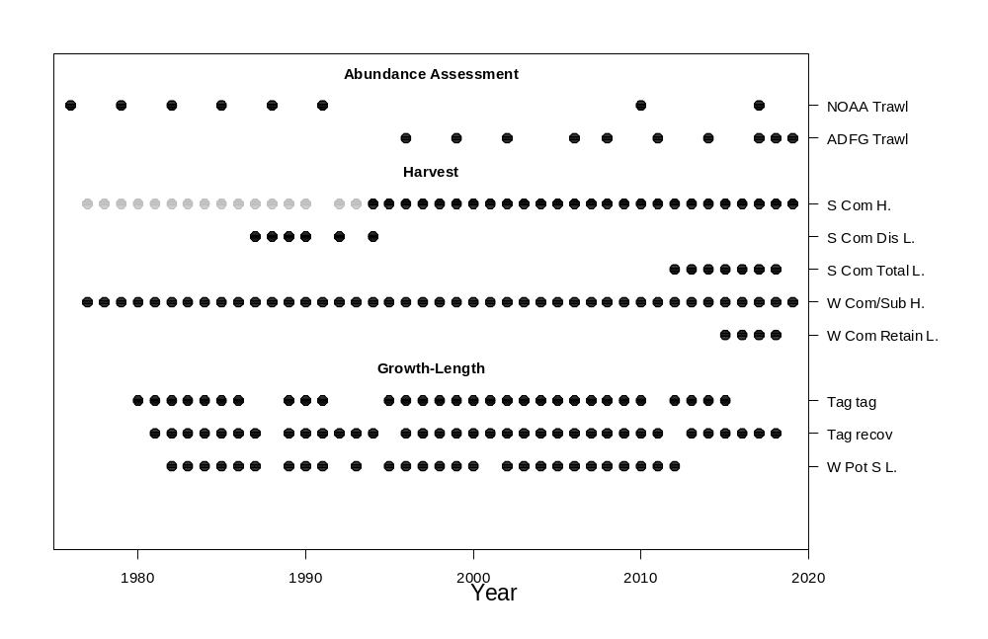
Model Data Time Series

Slide 7
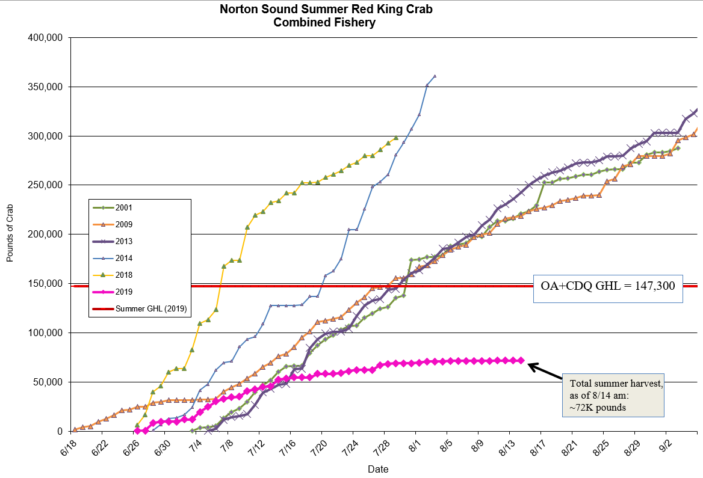
2019 Summer Commercial Fishery

Slide 8
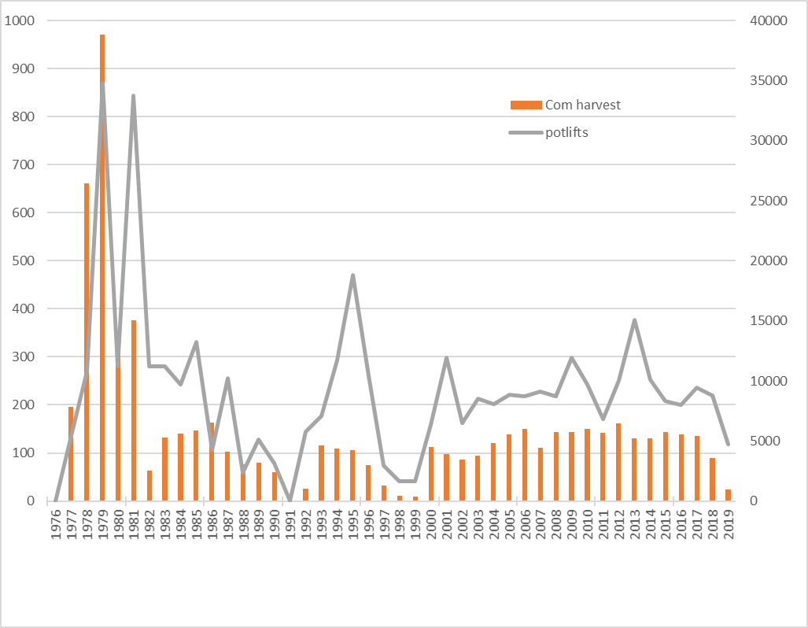
2019 Summer Commercial Fishery

Slide 9
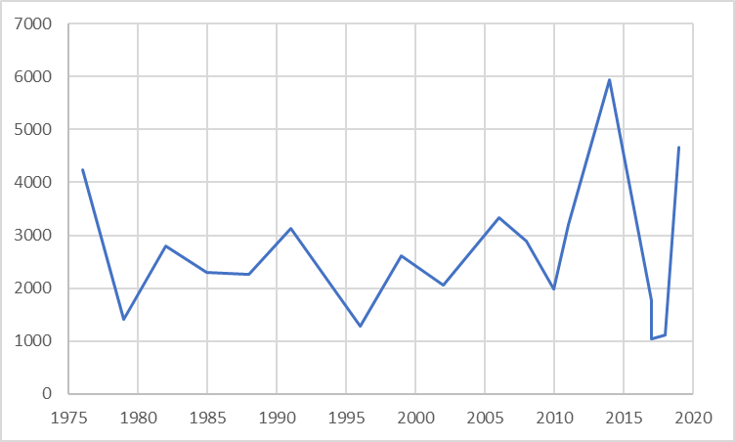
2019 Summer Trawl Survey

Slide 10
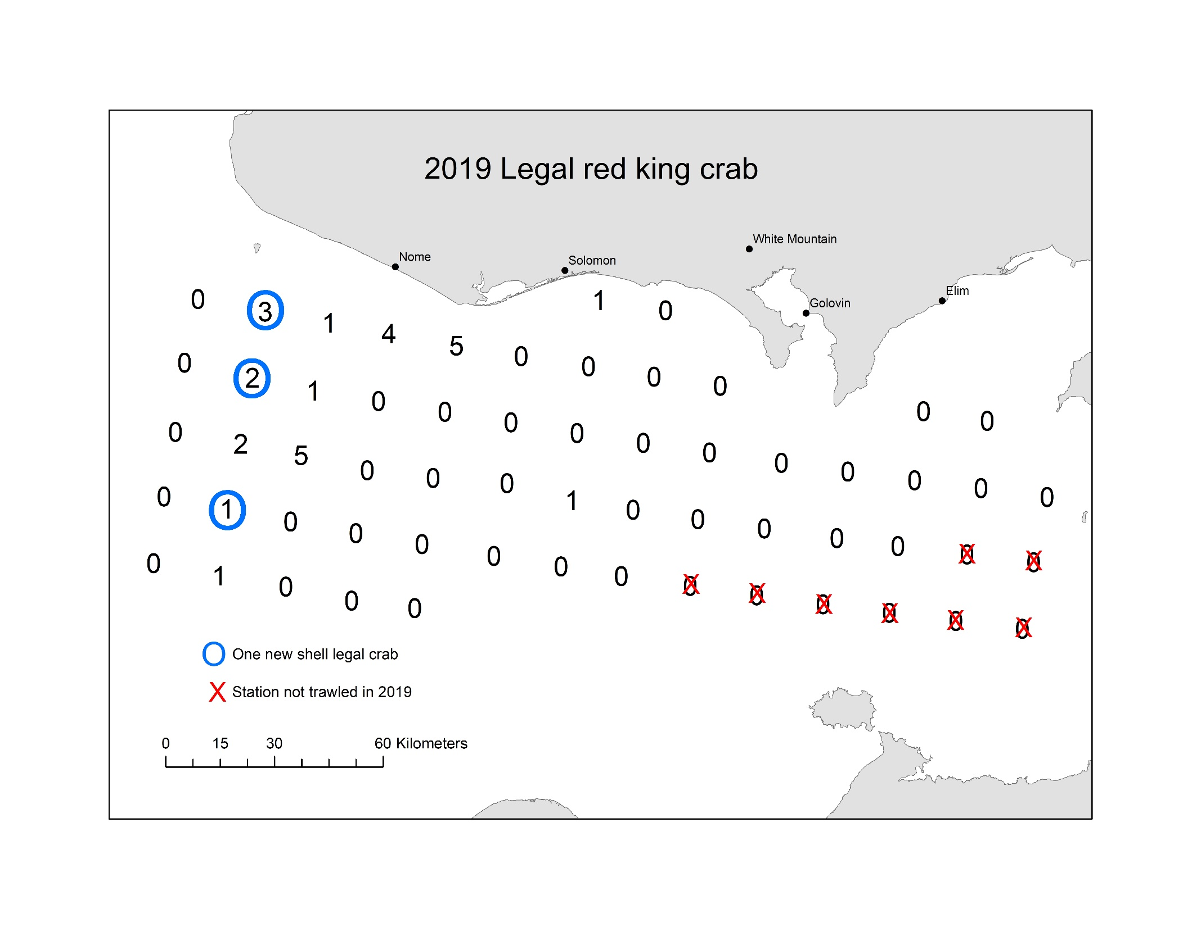
2019 Trawl Survey ADFG
Legal = 27

Slide 11
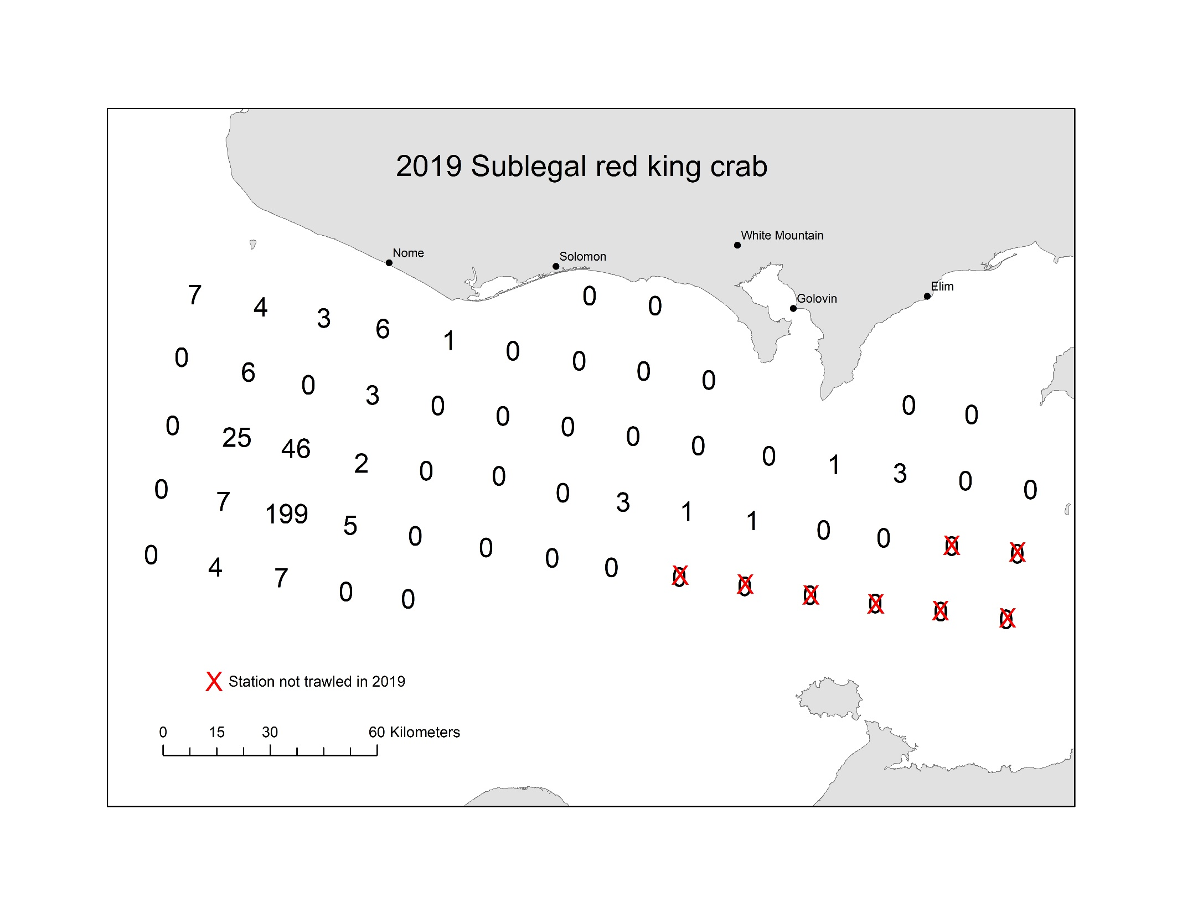
2019 Trawl Survey ADFG
Sublegal = 334

Slide 12

2019 Trawl Survey ADFG
Female= 385

Slide 13
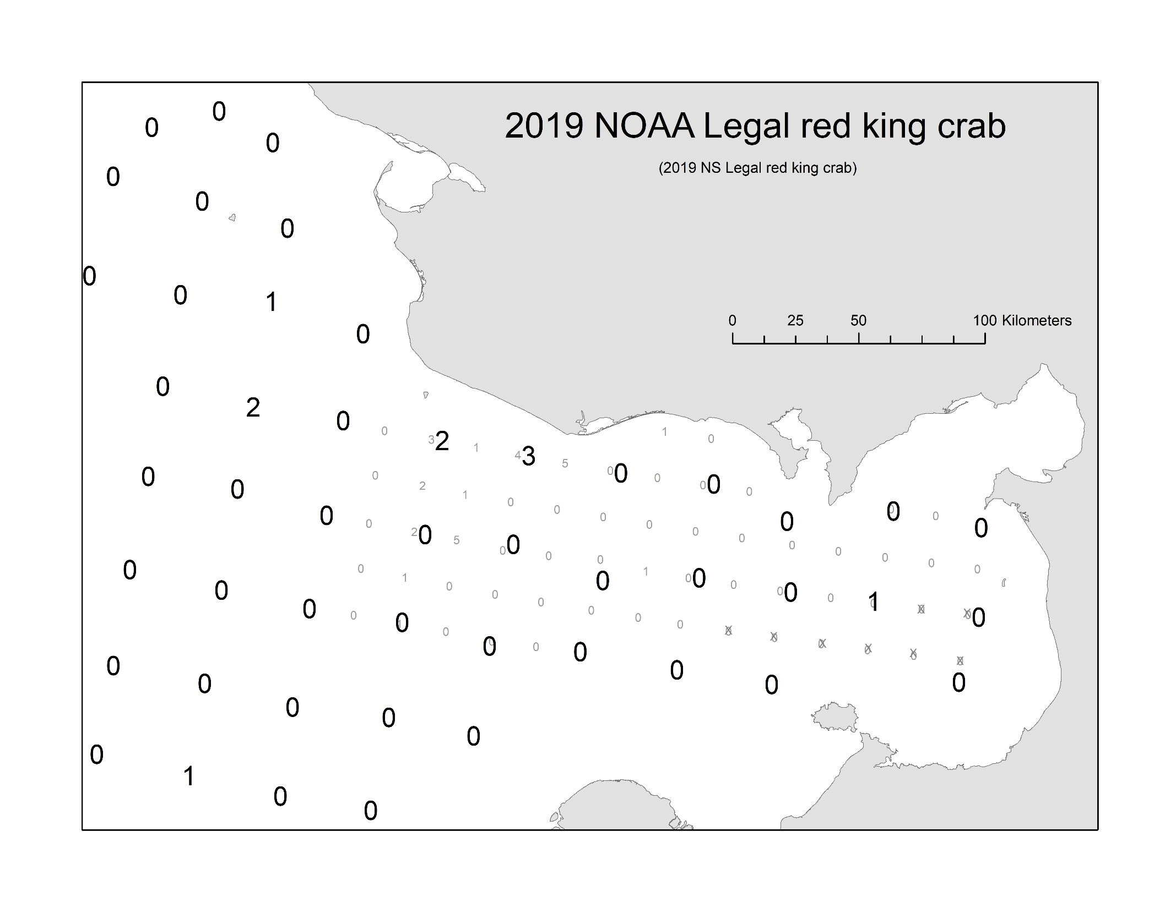
2019 Trawl Survey NMFS
Legal=6

Slide 14

2019 Trawl Survey NMFS
Subegal=70

Slide 15

2019 Trawl Survey NMFS
female=47

Slide 16
2019 Trawl Survey ADFG vs NMFS
Survey Coverage
  Commercial: 1,050 89% down from 2018 (9,180)
  Subsistence: 1,545 65% down from 2018 (4,424)
Summer commercial fishery 2018
  6/25-9/03: 24,506 73% down from 2018 (89,613)
Total retained harvest: 0.03 mill. lb. < ABC (0.19 mill. lb.)
All harvest and observer data NOT FINALIZED
Standardized CPUE update preliminary (Appendix B)
  60% down from 2018
ADF&G 2019 Summer trawl survey
  7/17-7/29: 4660.8 k, CV =0.60 420% up from 2018 (1,108.9)
NOAA 2019 Summer trawl survey
  7/28-8/30: Waiting for Haul data
NOAA 1976-1991 Summer trawl survey
  Abundance data updated
Winter Commercial Retained length-shell Not collected
Tag recovery: waiting (but may not need them).
Changes in fishery regulation: None

Slide 17
Observer Data
Year | FT: Pot | FT: Retain | Obs pots | SL | ML | L | Female | Total
2012 | 10041 | 161113 | 78 | 898 | 1055 | 177 | 152 | 2282
2013 | 15058 | 130603 | 199 | 2775 | 2166 | 258 | 123 | 5322
2014 | 10127 | 129656 | 147 | 1504 | 1838 | 341 | 104 | 3787
2015 | 8356 | 144224 | 69 | 969 | 1676 | 577 | 224 | 3446
2016 | 8,009 | 138997 | 67 | 264 | 1700 | 169 | 878 | 3011
2017 | 9440 | 135322 | 110 | 432 | 2174 | 122 | 373 | 3101
2018 | 8797 | 89613 | 78 | 547 | 1096 | 10 | 574 | 2227
2019 | 5436 | 24913 | 28 | 123 | 142 | 1 | 89 | 355

Slide 18
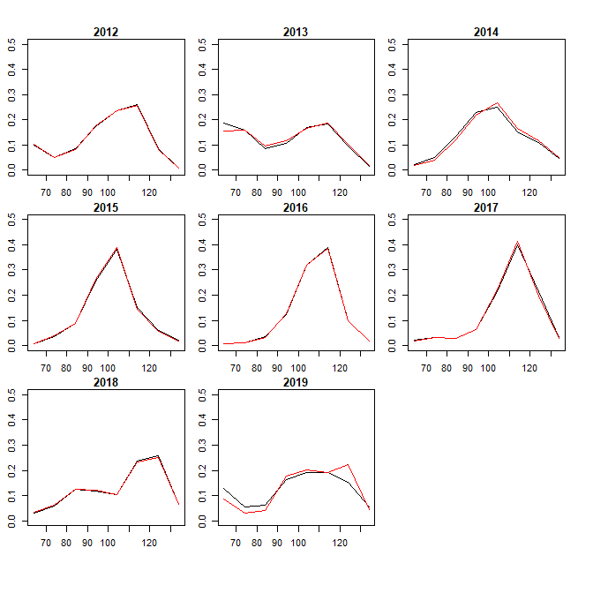
Observer Data: Length Comp
Black: Sample, Red: Spatial weighted

Slide 19
Discards Estimates
CPUE based (ob CPUE = total CPUE)
  LNR: Total Discards = (ob discards)*(total pot lifts)/(ob pot lifts)
  Sub: Total Discards = (ob total catch)*(total pot lifts)/(ob pot lifts) – total retain
Prop based (ob p discards = total p discards) (Assessment model)
  P: Total Discards = (ob discards)*(total retain)/(ob retain)
Year | CPUE.ob | CPUE.ft | Ratio
2012 | 13.53 | 16.05 | 0.84
2013 | 10.88 | 8.67 | 1.25
2014 | 12.50 | 12.80 | 0.98
2015 | 24.29 | 17.26 | 1.41
2016 | 25.37 | 17.36 | 1.46
2017 | 19.76 | 14.33 | 1.38
2018 | 14.05 | 10.19 | 1.38
2019 | 5.07 | 4.58 | 1.10
STAT Area | Trawl % Legal | Trawl Catch Prop | FT Prop | Ob. %Legal | Ob. Catch Prop | FT CPUE
666401 | 62% | 11% | 15% | 72% | 7% | 12.79
656401 | 21% | 19% | 21% | 62% | 18% | 12.03
646401 | 12% | 24% | 19% | 58% | 46% | 14.70
636401 | 31% | 18% | 33% | 68% | 19% | 15.78
626401 | 53% | 28% | 15% | 80% | 2% | 11.78

Slide 20
Discards Estimates
CPUE based (ob CPUE = total CPUE)
  LNR: Total Discards = (ob discards)*(total pot lifts)/(ob pot lifts)
  Sub: Total Discards = (ob total catch)*(total pot lifts)/(ob pot lifts) – total retain
Prop based (ob p discards = total p discards) (Assessment model)
  P: Total Discards = (ob discards)*(total retain)/(ob retain)

Slide 21
Responses to CPT & SSC
Implementation of VAST & GMACS, iterative weighting.
  Request trainings!!
Incorporation-collaboration of LK and TK in collaboration with local-tribal gours.
  Request training and guidance
Sensitivity Analyses: tag-recovery data (use 1 year in liberty), trawl survey Q .
  Alt model: 19.1, 19.2, 19.3
Include Options: const M, dome shape sel for trawl and Com fishery
  Alt model: 19.4, 19.5
Comparison NMFS vs. ADFG trawl survey (spatial modeling), revised Mohrn’s rho
  Request training and guidance (how results will be used for assessment model?)

Slide 22
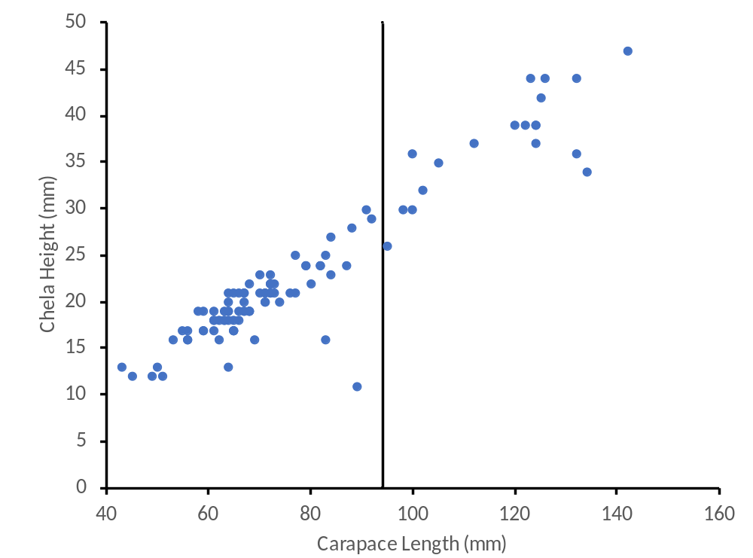
Responses to CPT & SSC
Male Maturity: Chela height does not seem to inform about male maturity

Slide 23
Responses to CPT & SSC
Standardized CPUE: dealing with changes of fishery practice and regulation
  Period 1: Large vessel: 1977-1993
  Period 2: Small vessel: 1994-2004
  Period 3: Buyer accepting large > 5.0 in CW only: 2005-2019
Original model
  Separate data two periods: 1977-1993, 1994-2019
SSC: Incorporate Period 3 in the standardization
  Option 1: Separate data into 3 periods and run separate GLM
    3 Fishery Qs
  Option 2: Include PD (Period 2, 3) as separate variable and run single GLM for 1994-2019 (SSC suggestion)
    2 Fishery Qs (SAFE model 18.6)
  Option 3: Include PD (Period 1,2,3) and run single GLM for 1976-2019
    1 Fishery Q

Slide 24
Responses to CPT & SSC
Option 3: Include PD (Period 1,2,3) and run single GLM for 1976-2019
  1 Fishery Q
Final model did not include PD
Model CV increased ~ 0.3 for all years
  Assessment model additional var ~ 0

Slide 25
Alternative model selection for 2020 SAFE
Model 19.0: Baseline SAFE 2019 model with updated data
Model 19.1: Fit only 1 year of tag recovery data
Model 19.2: NMFS (1976-1991) survey Q = 1.0 and estimate ADFG (1996-2018) survey Q (ADFG survey is biased)
Model 19.3: Estimate survey Q both NMFS, ADFG (Both surveys are biased)
Model 19.4: Estimate single M and dome shape selectivity (Hide & Kill All option 1)
Model 19.5: Estimate single M and dome shape selectivity (Hide & Kill All option 2)

Slide 26
Likelihood
Model | Model 19.0 | Model 19.1 | Model 19.2 | Model 19.3 | Model 19.4 | Model 19.5
Add Par |  |  |  | +1 | +14 | +14
Total | 306.1 | 254.4 | 306.2 | 305.8 | 296.5 | 288.6
TSA | 9.8 | 9.6 | 9.9 | 9.7 | 8.8 | 9.4
St.CPUE | -24.1 | -24.1 | -24.1 | -23.8 | -23.2 | -23.2
TLP | 110.8 | 109.7 | 110.5 | 110.6 | 108.4 | 105.4
WLP | 39.0 | 39.6 | 38.6 | 38.8 | 41.4 | 42.5
CLP | 48.4 | 48.9 | 48.3 | 48.3 | 54.1 | 50.2
OBS | 20.4 | 19.9 | 20.3 | 20.4 | 19.4 | 20.2
REC | 2.6 | 2.7 | 2.4 | 2.5 | 1.8 | 1.9
WN | 18.1 | 18.3 | 18.1 | 18.1 | 18.8 | 18.8
TAG | 81.2 | 30.0 | 81.2 | 81.2 | 65.0 | 61.8
Little changes among models

Slide 27
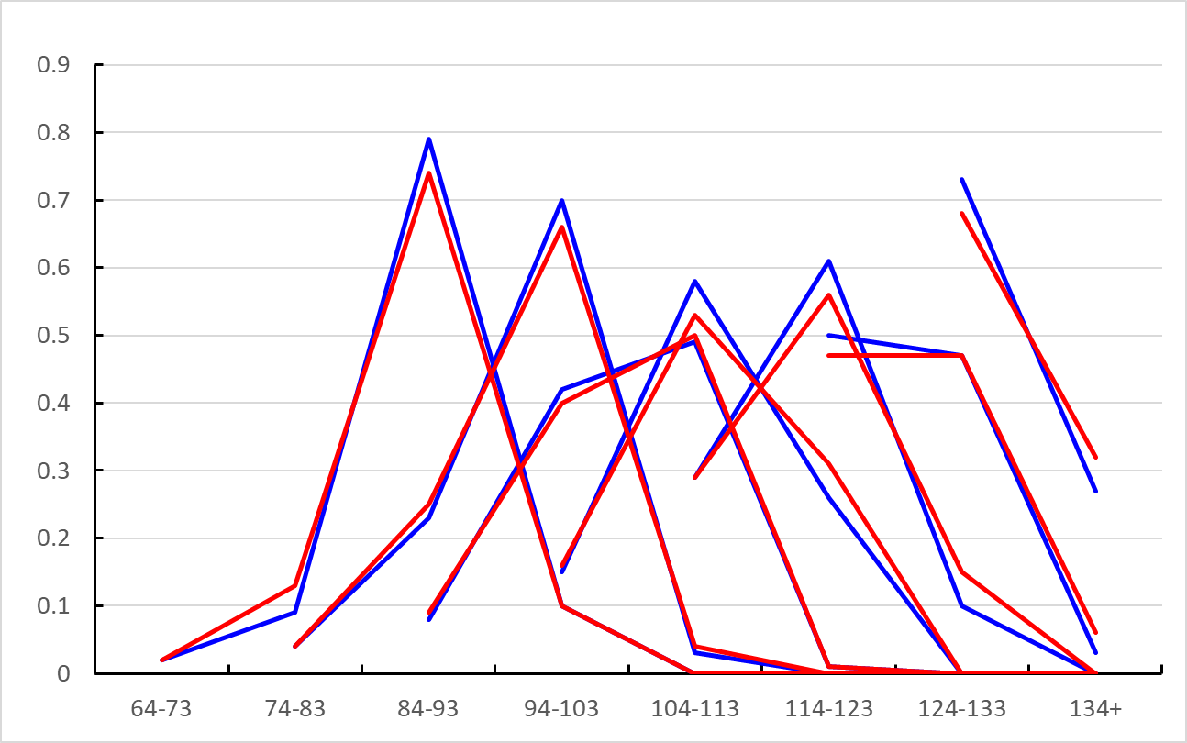
Alternative model selection for 2020 SAFE
Model 19.0 (blue) vs. 19.1(red) : Fit only 1 year of tag recovery data
  Little change in growth transition matrix.

Slide 28
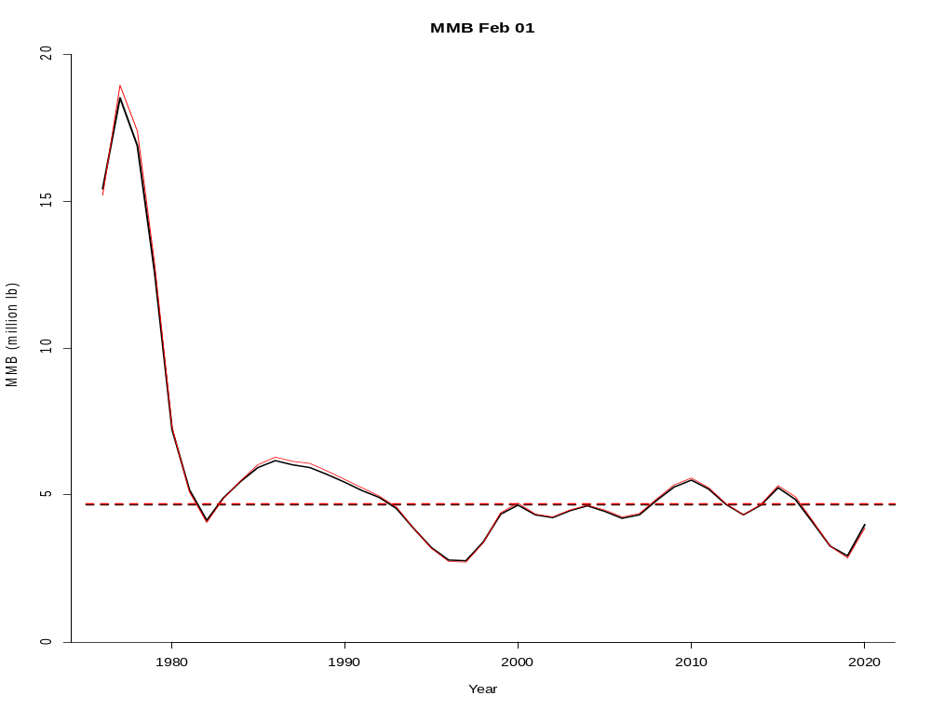
Alternative model selection for 2020 SAFE
Model 19.1: Fit only 1 year of tag recovery data
  Little change in MMB

Slide 29
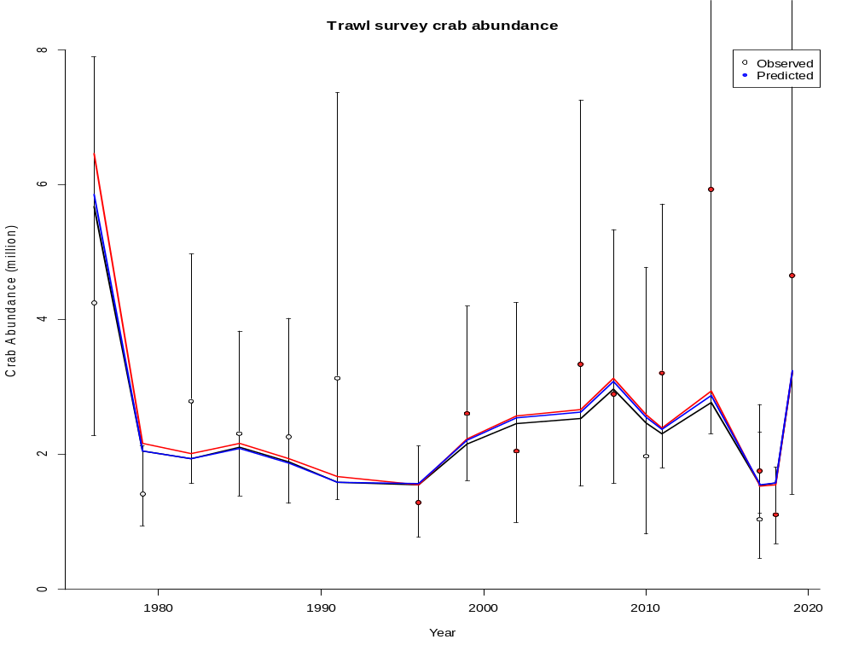
Alternative model selection for 2020 SAFE
Model 19.2: NMFS (1976-1991) survey Q = 1.0 and estimate ADFG (1996-2018) survey Q (red)
Model 19.3: Estimate survey Q both NMFS, ADFG (blue)
  ADFG survey Q > 1.0, NMFS survey Q < 1.0

Slide 30
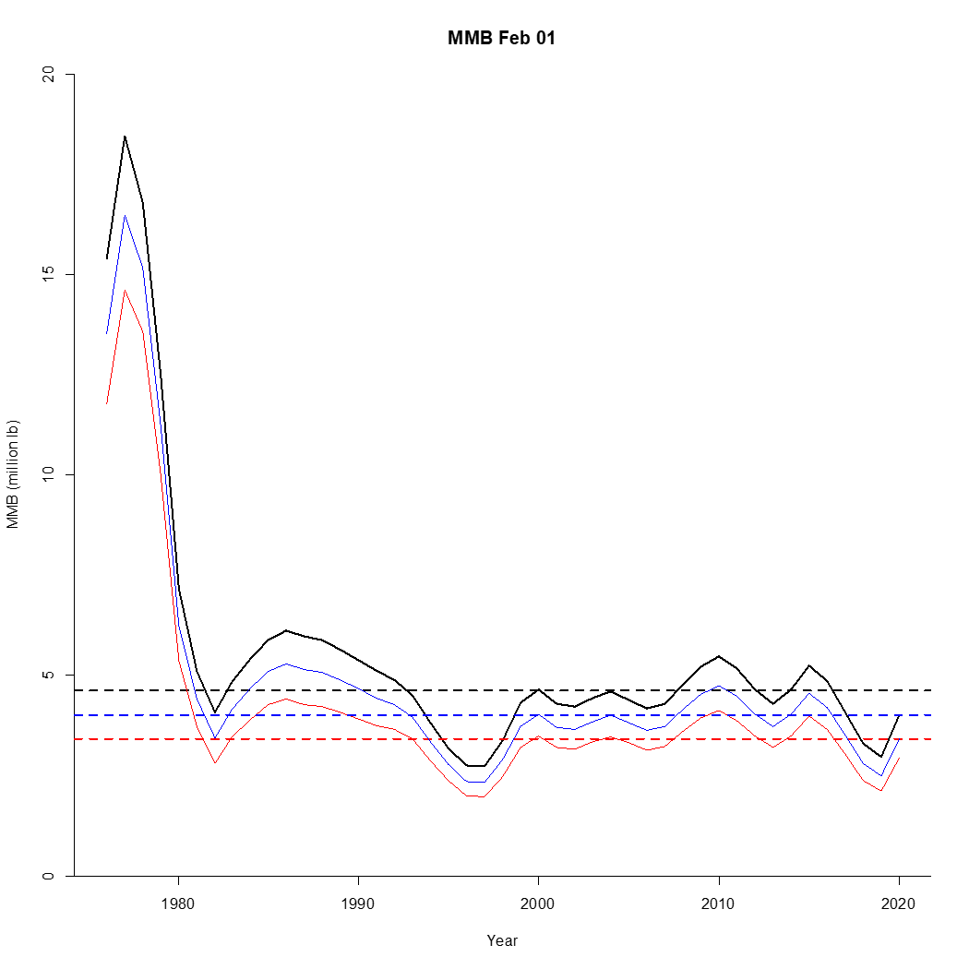
Alternative model selection for 2020 SAFE
Model 19.2 (red), 19.3 (blue)
  Q > 1.0: ADFG trawl surveys overestimate TRUE abundance

Slide 31
Alternative model selection for 2020 SAFE
Model 19.4 & 19.5 : Estimate single M and dome shape selectivity for com fish and trawl (Hide & Kill All option 1,2)
Selectivity of each length class was directly estimated (0 < sel < 1) (with smoothing penalty) with assumed sel= 1.0 in some length classes
Model 19.4: max sel 94-103 for trawl, 104-113 for com
Model 19.5: max sel 104-113 for trawl, 114-123 for com

Slide 32
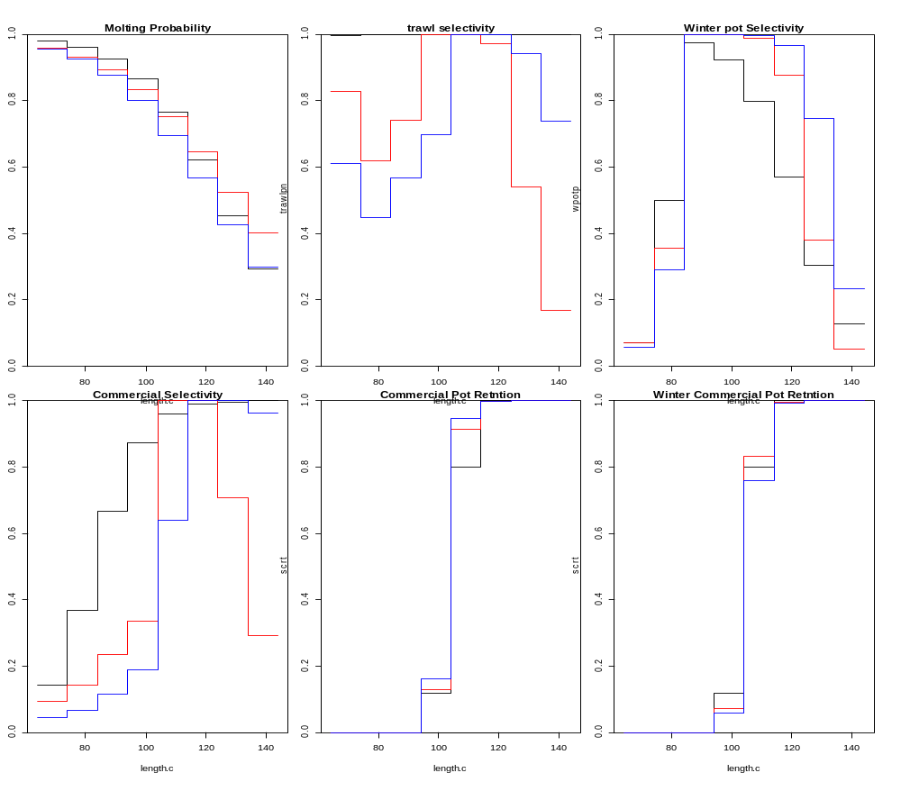
Alternative model selection for 2020 SAFE
Model 19.4 (red), 19.5 (blue) : (Hide & Kill All option 1,2)

Slide 33
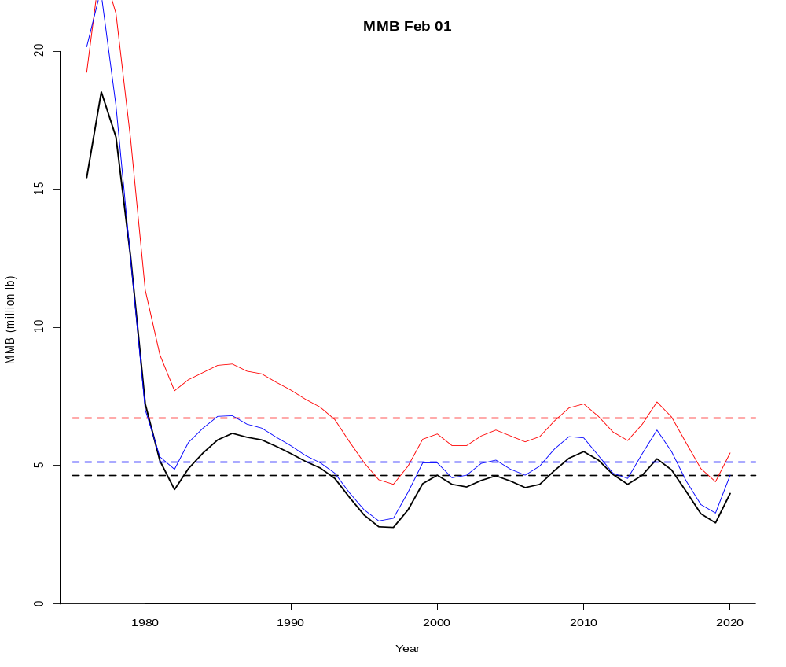
Alternative model selection for 2020 SAFE
Model 19.4, 19.5: (Hide & Kill All option 1,2: Existence of crab that are never caught nor observed -> Higher MMB)

Slide 34
Likelihood
Model | Model 19.0 | Model 19.1 | Model 19.2 | Model 19.3 | Model 19.4 | Model 19.5
BMSY(mil.lb) | 4.66 | 4.70 | 3.40 | 4.00 | 6.72 | 5.13
MMB(mil.lb) | 3.98 | 3.87 | 2.86 | 3.35 | 5.45 | 4.66
Legal crab Catchable (mil.lb) | 2.53 | 2.46 | 1.78 | 2.10 | 2.37 | 2.18
OFL(mil.lb) | 0.31 | 0.29 | 0.22 | 0.26 | 0.46 | 0.60
NOAA q | 0.70 | 0.68 | 1 | 0.81 | 0.66 | 0.71
ADFG q | 1 | 1 | 1.40 | 1.20 | 1 | 1
M | 018/0.58 | 018/0.64 | 018/0.52 | 018/0.55 | 0.31 | 0.43
Due to higher M: F_{OFL} = M

Slide 35
Model Recommendation for 2020 SAFE
Model 19.0 or 19.1: Remove or keep tag recovery data beyond 1 year at liberty
  Marginal decline in likelihood
  No practical difference in MMB
  No
Include NMFS 2019 trawl survey data
Include Observer total catch length

