Slide 1
Pribilof Island golden king crab
Assessment: Review of Tier status and future directions
Benjamin Daly
Crab Plan Team Meeting
Seattle, Sept 16-20, 2019

Slide 2
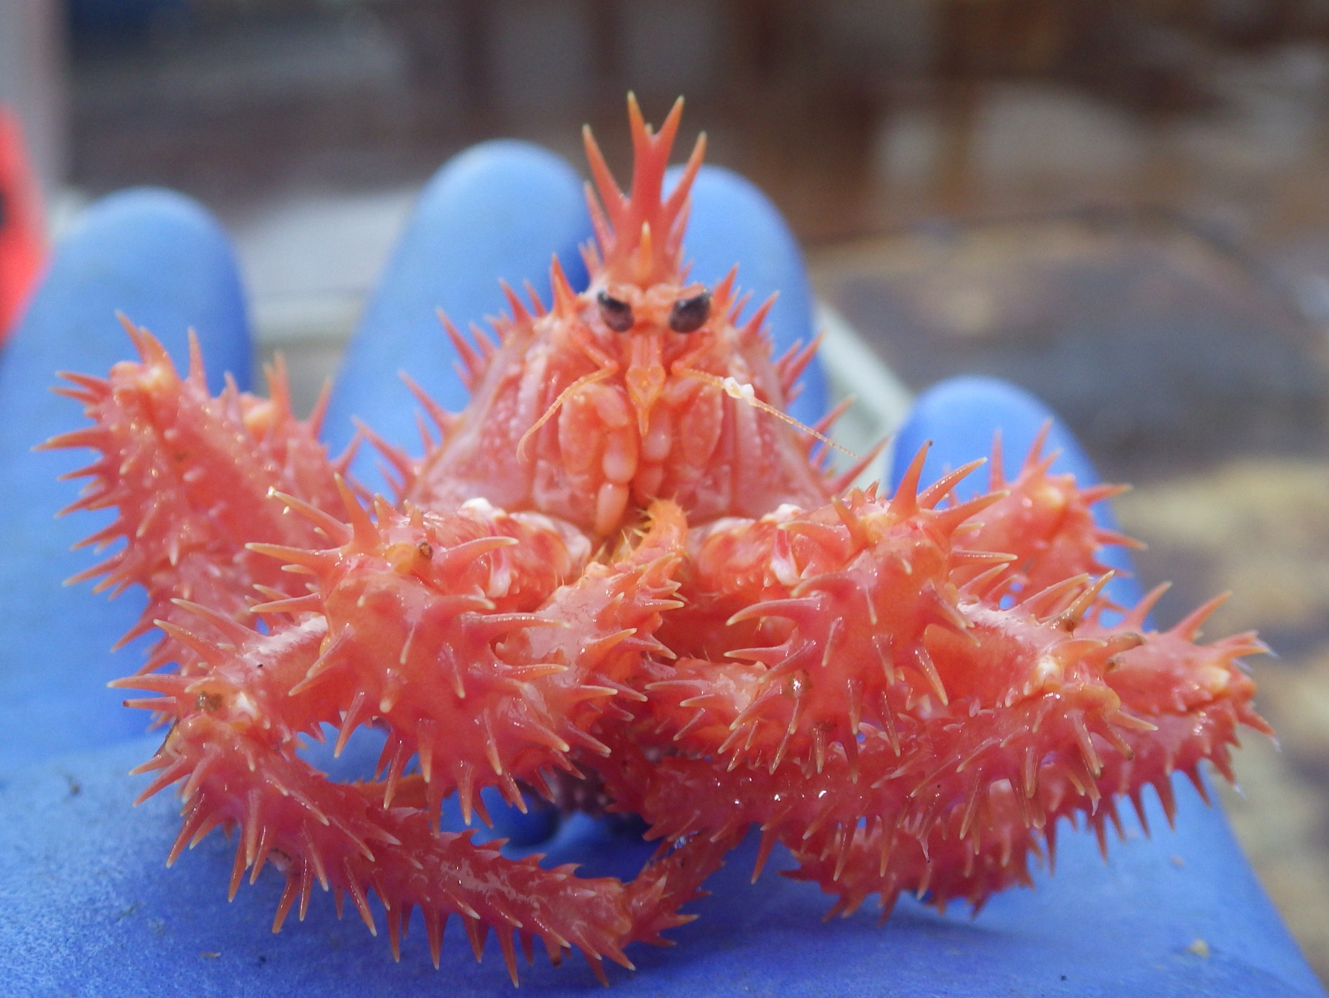
Fishery data
  100% observer coverage
  100% dockside sampled
Commissioner’s Permit fishery
  Ability to design survey style fishery
    Sample design, specific areas
Increased interest
  Decline in other BSAI crab fisheries
  Increased inquiries and participation
Requests for increased GHLs (currently 130,000 lb)
  Reevaluate stock assessment

Slide 3
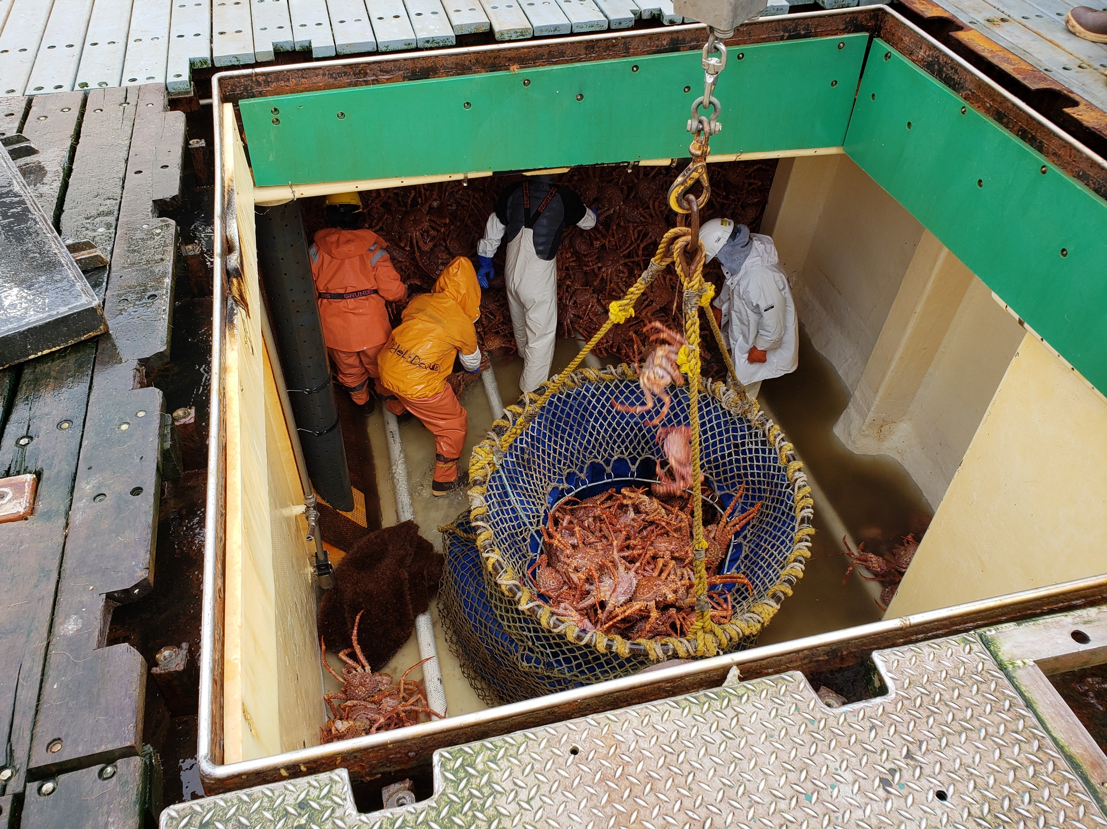

Slide 4
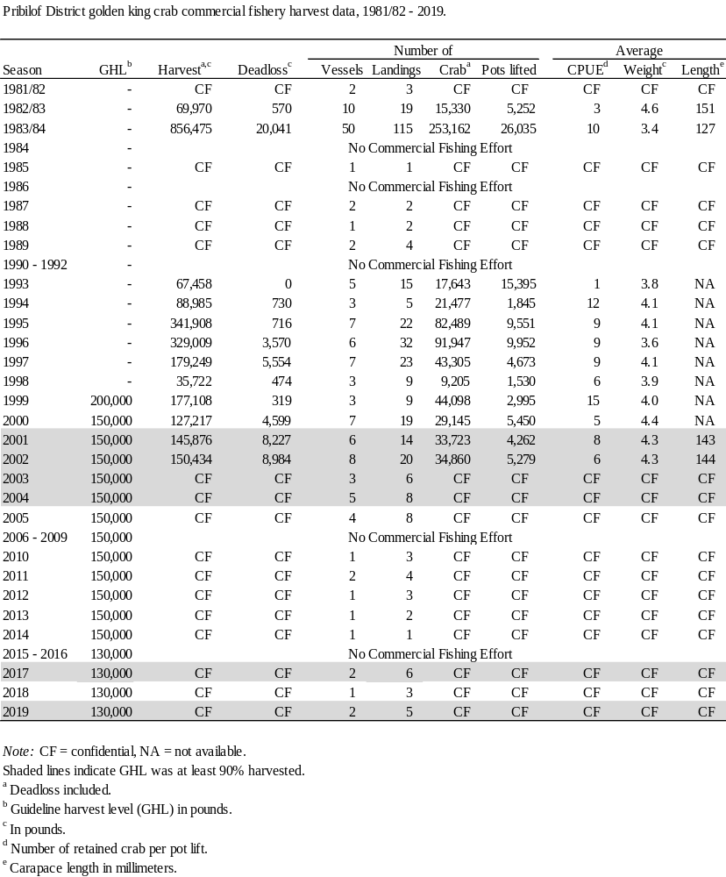

Slide 5
Tier Status
Currently Tier 5
Pervious discussion about moving to Tier 4 via random effect model and NOAA slope survey data

Slide 6
Tier 5 calculations
Same data and estimates for 2013-2019 OFLs
  average retained catch over the years 1993 to 1999 as the estimated OFL
  “The excluded years are from 1985 to 1992 and from 2000 to 2005 for Pribilof Islands golden king crab when the fishing effort was less than 10% of the average or the GHL was set below the previous average catch.”
  In May 2010, the CPT established a total-catch OFL computed as a function of the average retained catch during 1993–1998, a ratio-based estimate of the bycatch mortality during the directed fishery of that period, and an estimate of the “background” bycatch mortality due to other fisheries.
Other time periods, extending into years post-1999, had been considered for computing the average retained catch in the establishment of the 2009, 2010, and 2011 OFLs, but those time periods were rejected by the CPT and the SSC. Hence the period for calculating the retained-catch portion of the Tier 5 total-catch OFL for this stock has been firmly established by the CPT and SSC at 1993–1998 (the CPT said “this freezes the time frame...”).

Slide 7
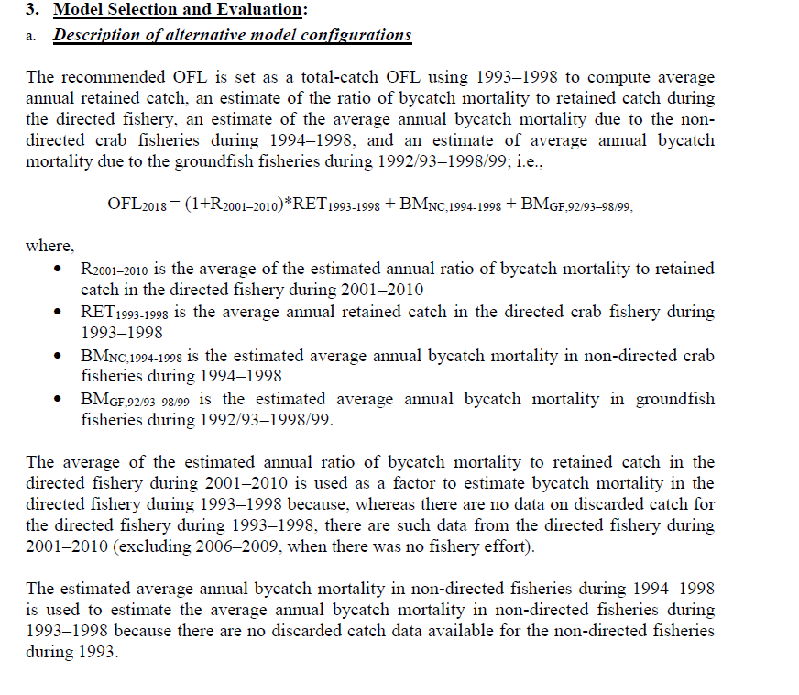
Tier 5 calculations

Slide 8
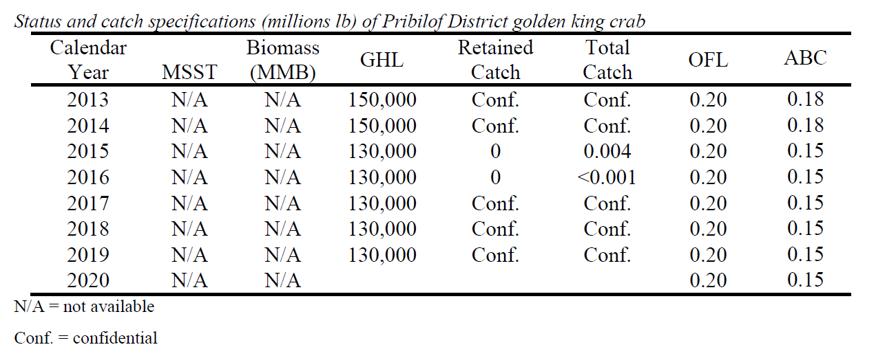
Tier 5 calculations

Slide 9
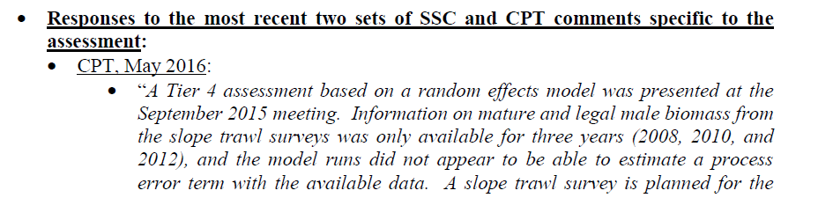
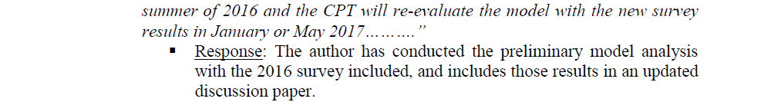

Slide 10
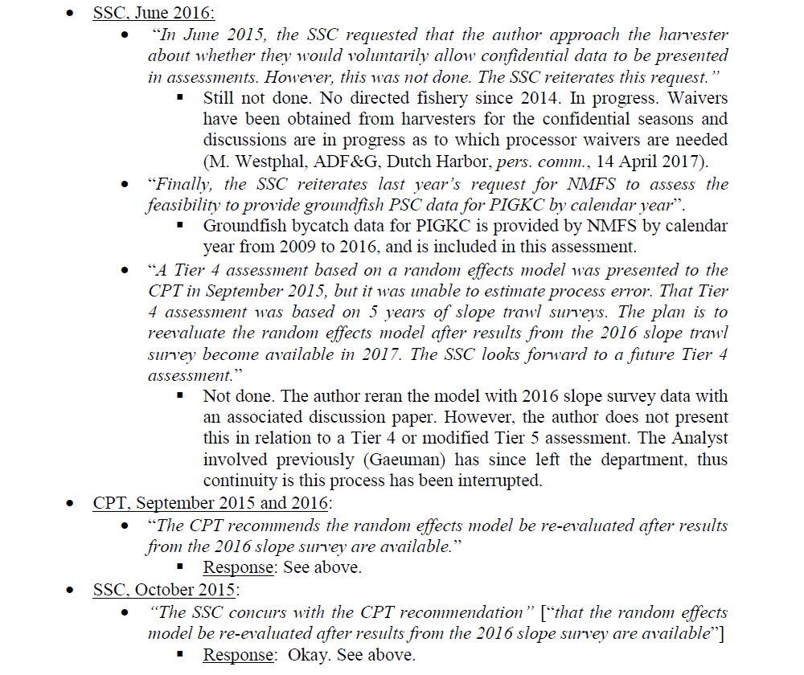

Slide 11
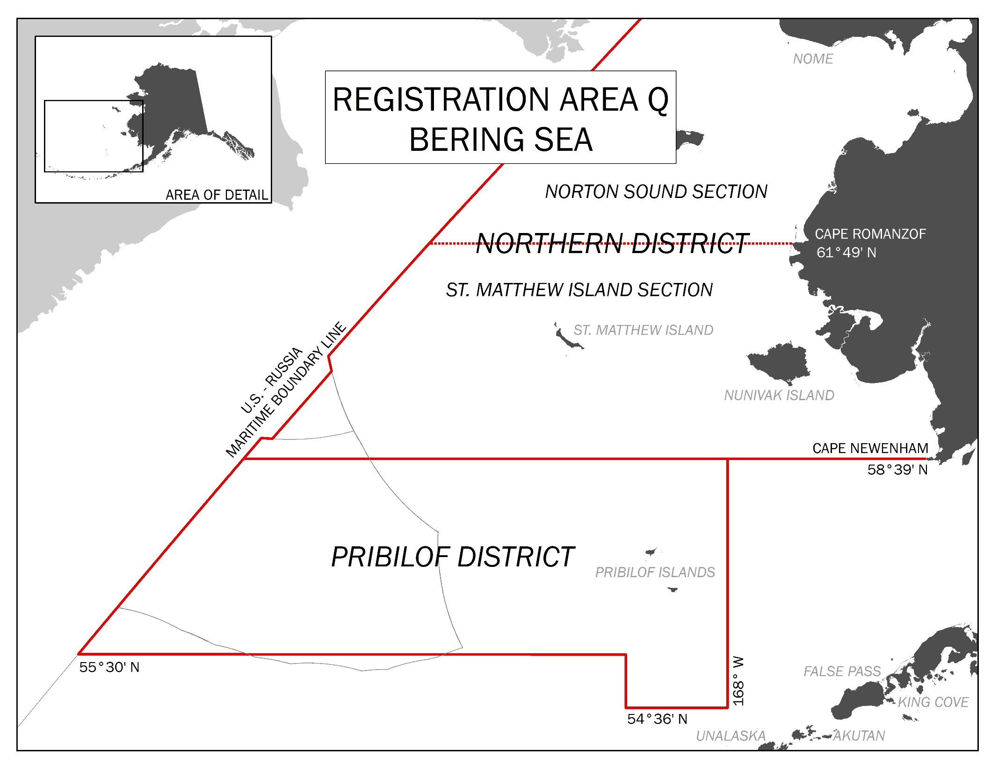
Notes:
The Pribilof District is part of king crab Registration Area Q, shown here.
The fishery is not rationalized and has been managed inseason to a guideline harvest level (GHL) since 1999.
Golden king crab can be harvested from 1 January through 31 December only under conditions of a permit issued by the commissioner of ADF&G (5 AAC 34.910 (b)(3)). Since 2001, those conditions have included the carrying of a fisheries observer.
Catch statistics for 2003–2005 and 2010–2014 are confidential under Sec. 16.05.815 of SOA statutes.

Slide 12
Observer pot location during Bering Sea golden king crab fisheries from 1992-2019 (n=7,402).
Pots north of the Pribilof District northern boundary were fished during the Northern District – Saint Matthew island Section fishery.
~95% of all observer pots

Slide 13
Proportion of historical (1985-2019) catch by stat_area
69% of all historical catch

Slide 14
NMFS EBS slope survey
Interest by CPT and SSC in using biennial Bering Sea upper continental slope survey data to establish annual OFL/ABC on the basis of biomass estimates as an alternative to the Tier 5 approach
Only post-2000 data used because of differences in sampling gear, survey design, sampling methodology, and species identification in 1979-91 and 2000 surveys
Total biomass (males and females) available starting in 2002, BUT mature and legal area-swept biomass estimates only available starting in 2008 (*working on 2004 data)
2006, 2014, and 2018 slope surveys cancelled
Notes:
I think 2008 is when CL measurements were part of the survey protocol.
With regard to survey catchability of golden king crab by size and sex, the survey uses a Poly Nor’eastern high-opening bottom trawl equipped with mud-sweeper roller gear and the opinion of ASFC scientists was conveyed to the CPT during the May meeting that, with respect to golden king crab, “… the catchability of the slope net is less than 1.0 and probably considerably lower than the shelf net due to the differences in the foot rope and surveyed habitat” (report of the May 2013 CPT meeting).

Slide 15
Biomass estimates
Maturity: 107 mm CL (Somerton and Otto 1986)
Legal size: 124 mm CL (proxy for 5.5 in CW)
Weight (g) = (0.0002988)x(CL)^{3.135}
An area-swept estimate of biomass and of the variance of the biomass estimate was computed for each stratum within a survey subarea and summed over strata within the subarea to obtain area-swept estimates of biomass within a subarea and of the variance of that biomass estimate; estimates of the biomass and of variances of estimates within subareas were summed over subareas to obtain estimates of biomass in aggregates of subareas and of the variances of those estimates.
*LW regression defined in FMP amendment 24

Slide 16
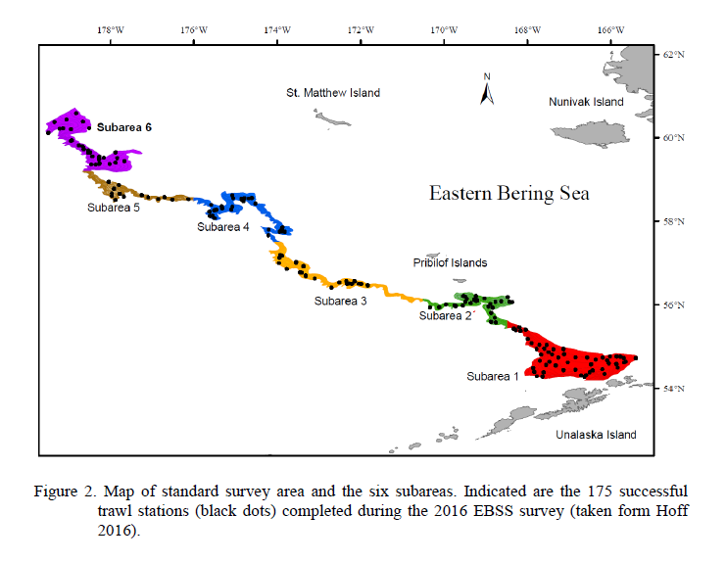
Notes:
NMFS-AFSC conducted an eastern Bering Sea continental slope trawl survey on a biennial schedule during 2002–2016 (the survey scheduled for 2014 was cancelled). Results of the 2016 slope survey are available via tech memo: Hoff 2016.
Briefly, the survey samples from an area of 32,723 km² in the 200–1,200 m depth zone. The surveyed area is divided into six subareas.
Each subarea is divided into strata defined by 200 m depth zones and tows are performed at randomly-selected locations within each stratum, with target sampling density within strata proportional to the area in each subarea and stratum.

Slide 17
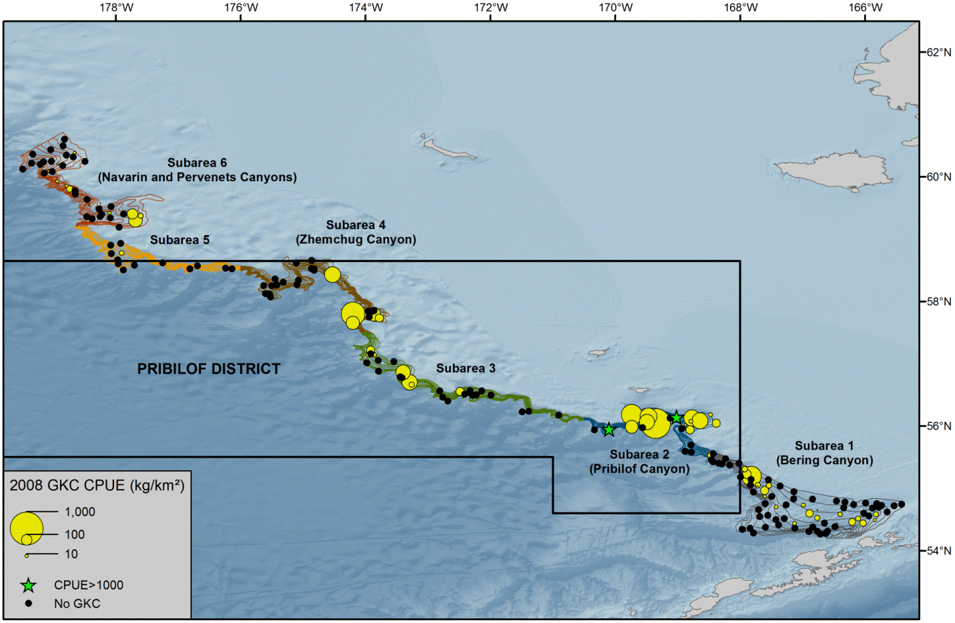
Notes:
Although highest densities of golden king crab are found in the deep canyons of the eastern Bering Sea continental slope, golden king crab occur sporadically on the surveyed slope at locations between those canyons in the eastern Bering Sea (Hoff 2013; Hoff and Britt 2003, 2005, 2009, 2011; Gaeuman 2013b, 2014).
Here, I will show CPUE (kg km-2) for the previous 4 surveys.
Highest survey CPUE occurs at tows within survey subareas 2–4 (particularly in subarea 2; i.e., Pribilof Canyon).
It appears that the areas of subareas 1 and 5 that lie within the Pribilof District support limited densities of golden king crab.

Slide 18


Slide 19


Slide 20


Slide 21
Population and fishery distribution
Survey distribution and fishery catch and effort distribution concentrated in the Prib Canyon area (survey subarea 2).
GKC sporadically distributed in survey subareas 3 and 4 with some limited catch and effort in those areas.
Portions of survey subareas 1 and 5 in the Prib Dist largely devoid of GKC.
GKC in survey subarea 6 exploited by St Matts section fishery when prosecuted.

Slide 22
Random Effects Model: Program “re.exe”
Considers the process errors as “random effects” (i.e., drawn from an underlying distribution) and integrated out of the likelihood.
Developed by the NPFMC groundfish plan team's survey averaging working group as a smoothing technique similar to the Kalman Filter
  Provides more flexibility with non-linear processes and non-normal error structures.

Slide 23
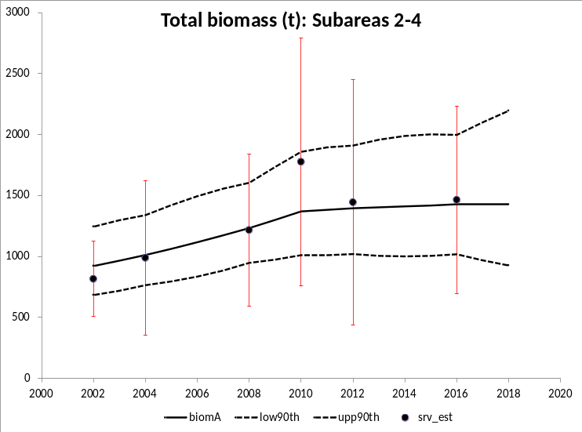
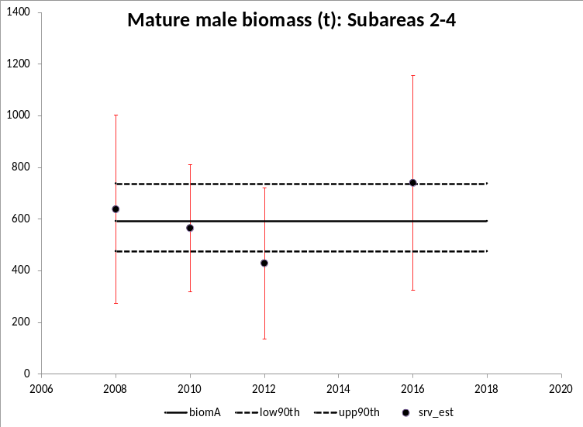
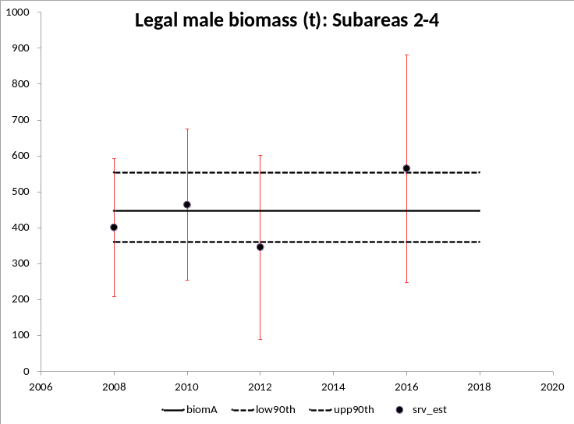
Model results
Notes:
Error bars are +/- 2 standard errors.
The following analyses to estimate trends in the Pribilof District stock were performed using survey data from only survey subareas 2, 3, and 4. Because of the high concentration of fishery effort and fishery catch in Pribilof Canyon and the high CPUE of golden king crab within Pribilof Canyon during the slope surveys, data summaries and analyses were also performed using data only from survey Subarea 2.

Slide 24
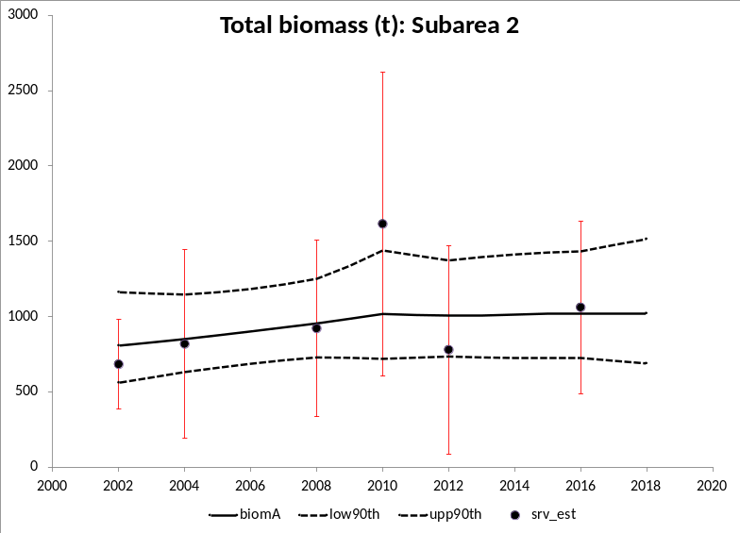
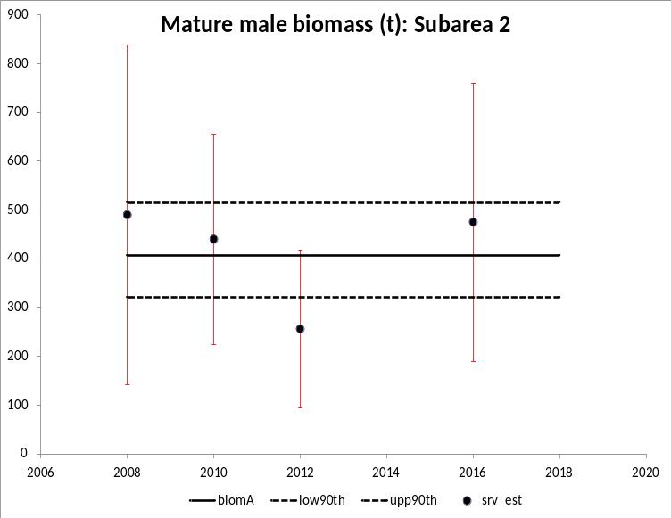
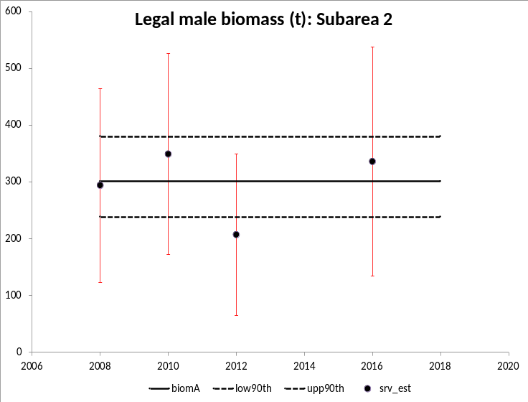
Model Results

Slide 25
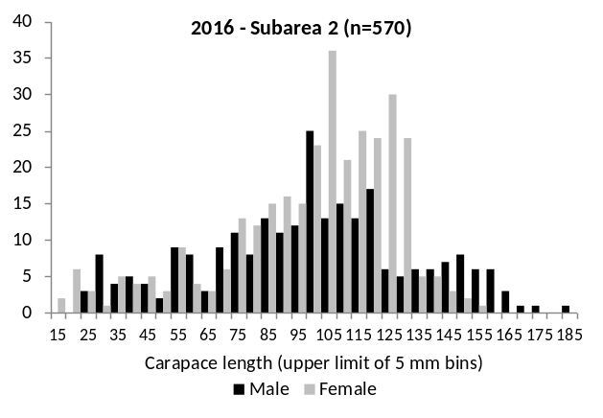
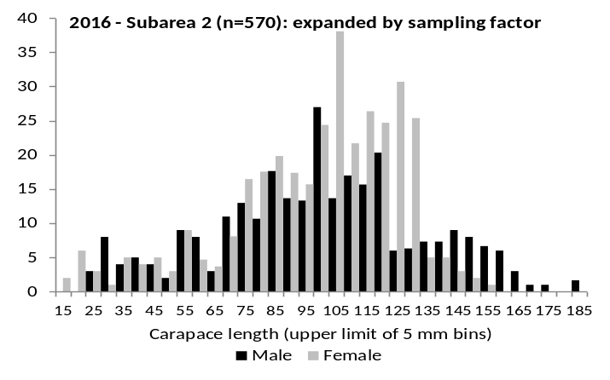
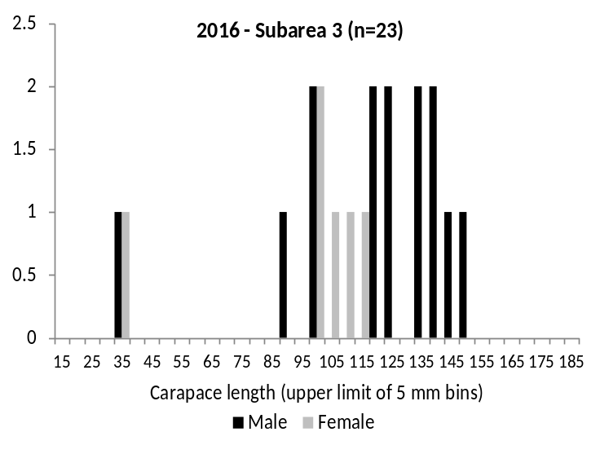
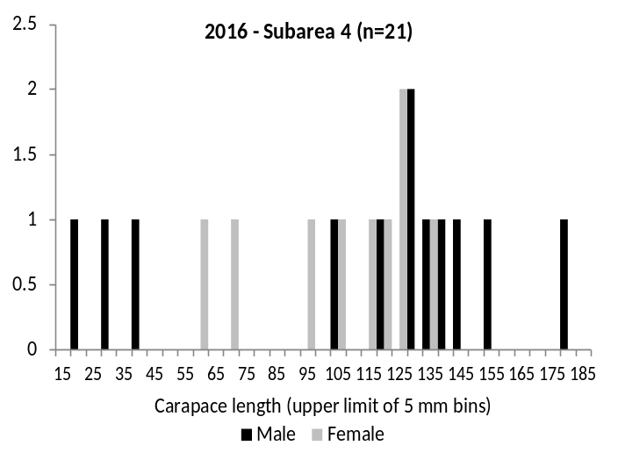
2016 Slope Survey

Slide 26
Model Performance and tier recommendation
Tier 4 description from SAFE:
“Tier 4 is for stocks where essential life-history, recruitment information, and understanding are insufficient to achieve Tier 3. Therefore, it is not possible to estimate the spawner-recruit relationship. However, there is sufficient information for simulation modeling that captures the essential population dynamics of the stock as well as the performance of the fisheries.”
2017 author recommendation: Keep PIGKC as a tier 5 stock, ABC applied 25% buffer on OFL
………CPT concurred

Slide 27
Regarding Tier 4….
The CPT agreed with the author’s recommendation of keeping PIGKC at Tier 5 until the model improves.
It is also noted that the model does run through the point estimate error bars. Ben Daly, Martin Dorn, and Jack Turnock discussed process error at the [May 2017] meeting break, and investigated the “par” files, which showed that the model did converge and estimated zero process error. As such, an argument could be made that the model did perform adequately and could be used to estimate mature and legal male biomass.

Slide 28
Regarding Tier 4….
Tier 5 OFL: 200,000 lbs
Tier 4 OFL: 462,448 lbs (includes male + female)
  Assumes 2002-2016 mean as Bmsy
  Assumes M of 0.18
  Sub-areas 2-4 (i.e., all survey stations in Pribilof Sidstrict)

Slide 29
CPT Guidance on Model Improvements
  Investigate whether size frequency data is available for the 2002 and 2004 surveys, so that biomass estimates for mature and legal males could be estimated and included in the model simulations
  Progress: Inquired. Size frequency data are available (J.Hoff, pers comm) for 2004 survey. Still need to work up biomass estimates of mature and legal size males by area/strata. Crab specimen data collection was not part of the sampling protocol for the 2002 survey.

Slide 30
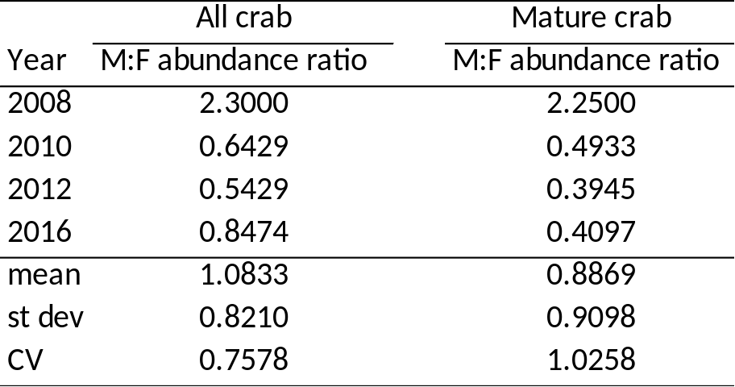
CPT Guidance on Model Improvements
  Investigating the sex ratios in 2008, 2012, 2012, and 2016 data. If the sex ratios are reasonably stable in each of those years, then mature and legal biomass estimates could be made in 2002 and 2004 using the sex ratios from the known survey years (i.e., use 2002 and 2004 raw survey data to get size compositions to extend time series backwards via scaling)
  Progress:
Sex ratios stable for 3 out of the 4 survey years?

Slide 31
CPT Guidance on Model Improvements
  Put bounds on the process error and rerun the model
  Progress: Not complete.

Slide 32
Future PIGKC cooperative pot survey?
Future of NOAA slope trawl survey uncertain
  Survey cancelled in 2006, 2014, 2018, 2020+
Focus pot survey on relatively small area: subarea 2 (Pribilof Canyon)
Work with fleet (similar to AIGKC survey)
  Define historical fishing footprint with grid pattern
  Randomly select stations within that footprint
  Perform survey during fishery

Slide 33
CPT Feedback?
Short-term: For May 2020
  Re-run model with 2004 survey size data
  Reconsider model performance?
  Include more recent catch data in Tier 5 calculation
    this will likely decrease OFL/ABC…recent catch lower than reference years mean
Long-term: next ~5+ years
  Expand survey data
    Future NOAA slope surveys is uncertain
      Very little chance of 2020 slope survey (J.Hoff, pers. comm.)
    New ADF&G pot survey?
  Work on model performance
  Try in GMACS?

