Slide 1
Pribilof Islands red king crab assessment
Cody Szuwalski
September 19, 2019

Slide 2
Big picture
PIRKC is at low levels, in spite of not being fished since 1998
Using status quo Tier 4 definitions of BMSY and status quo model, PIRKC is overfished
Using output from GMACS or a revised definition of BMSY, it is not overfished

Slide 3
What model to use to estimate biomass?
How to define BMSY?

Slide 4
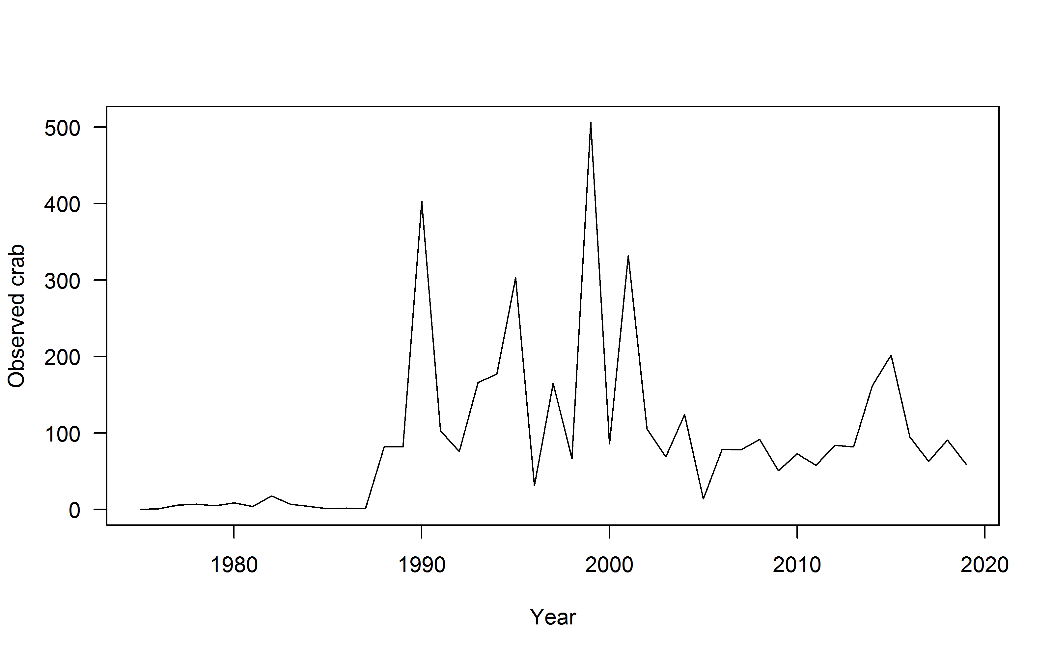
Small sample sizes are a problem for this stock and indices of abundance are extrapolated from a relatively small number of crab.

Slide 5
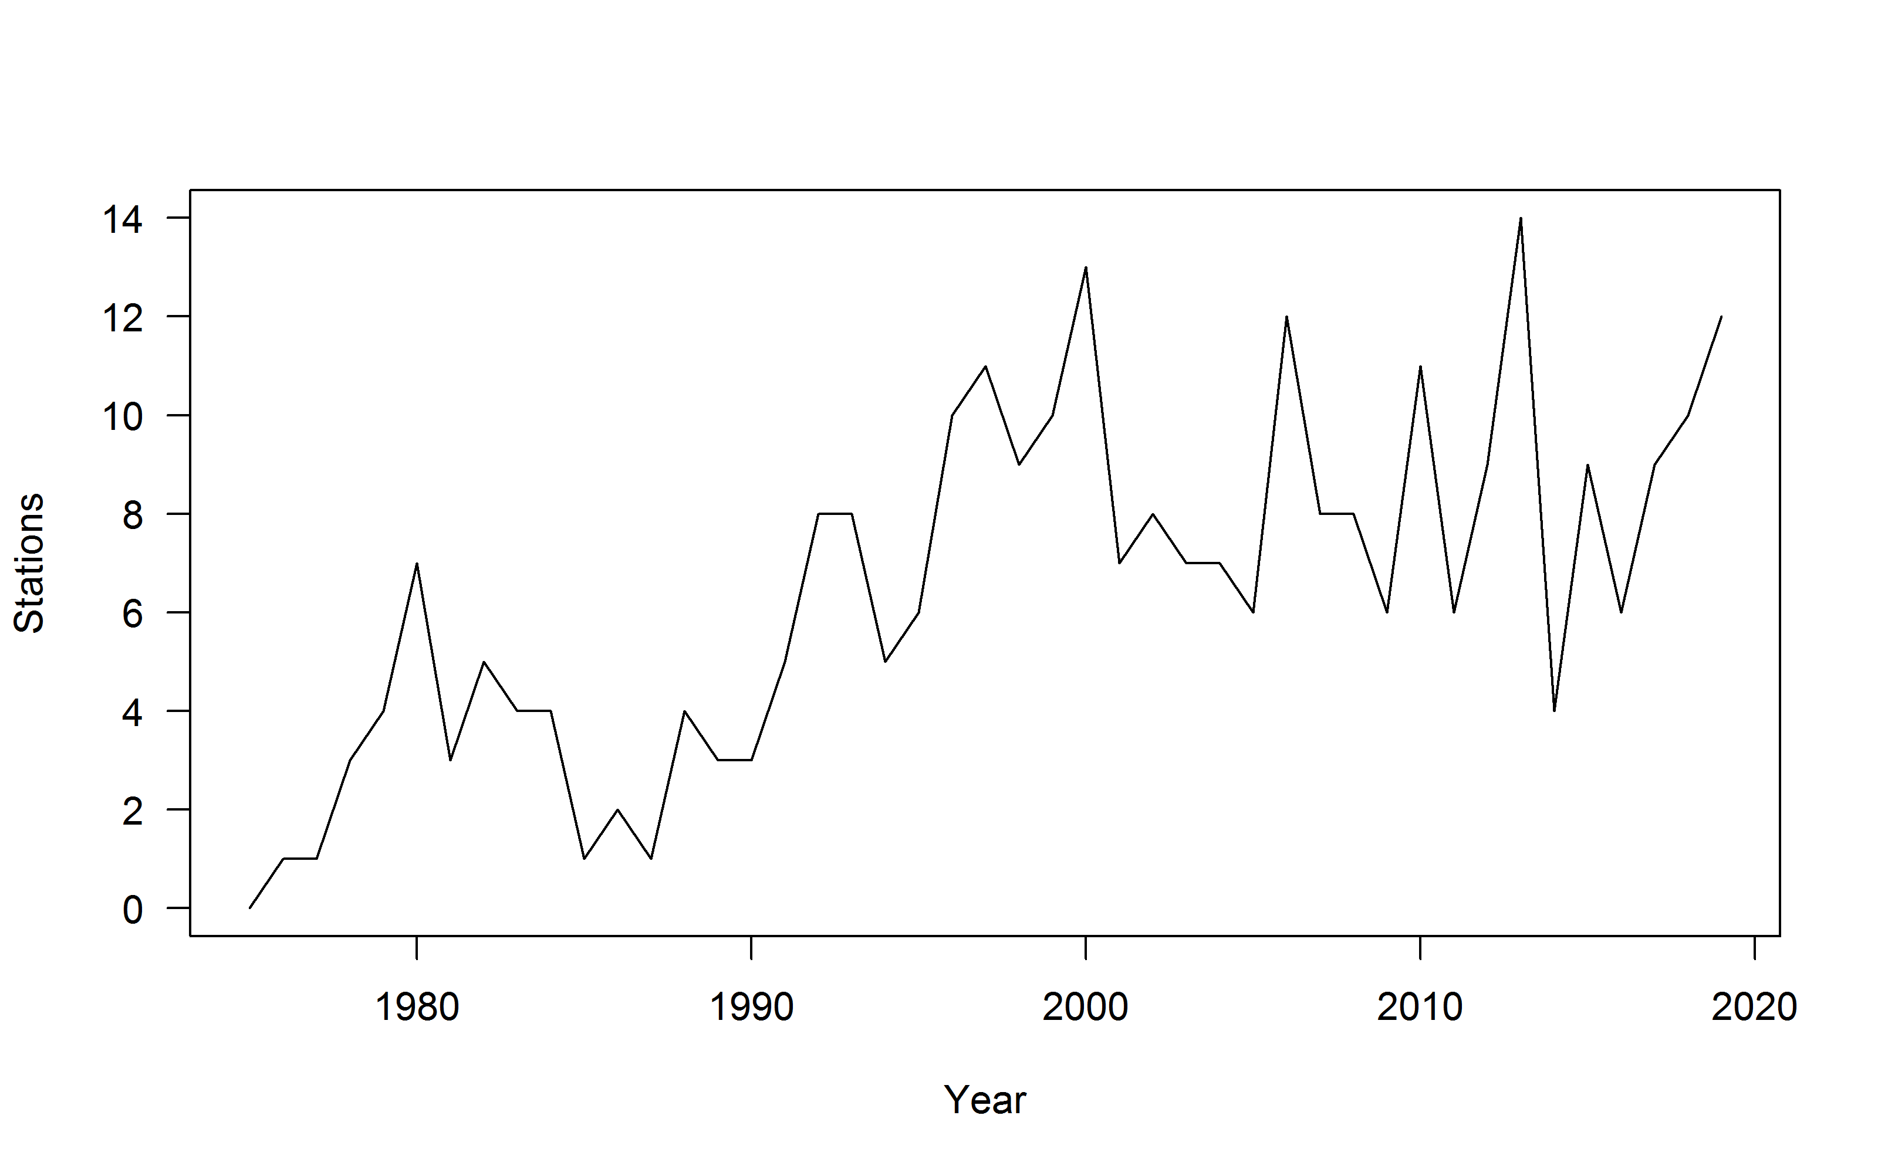
The number of stations at which crab were observed has never exceeded 14.

Slide 7
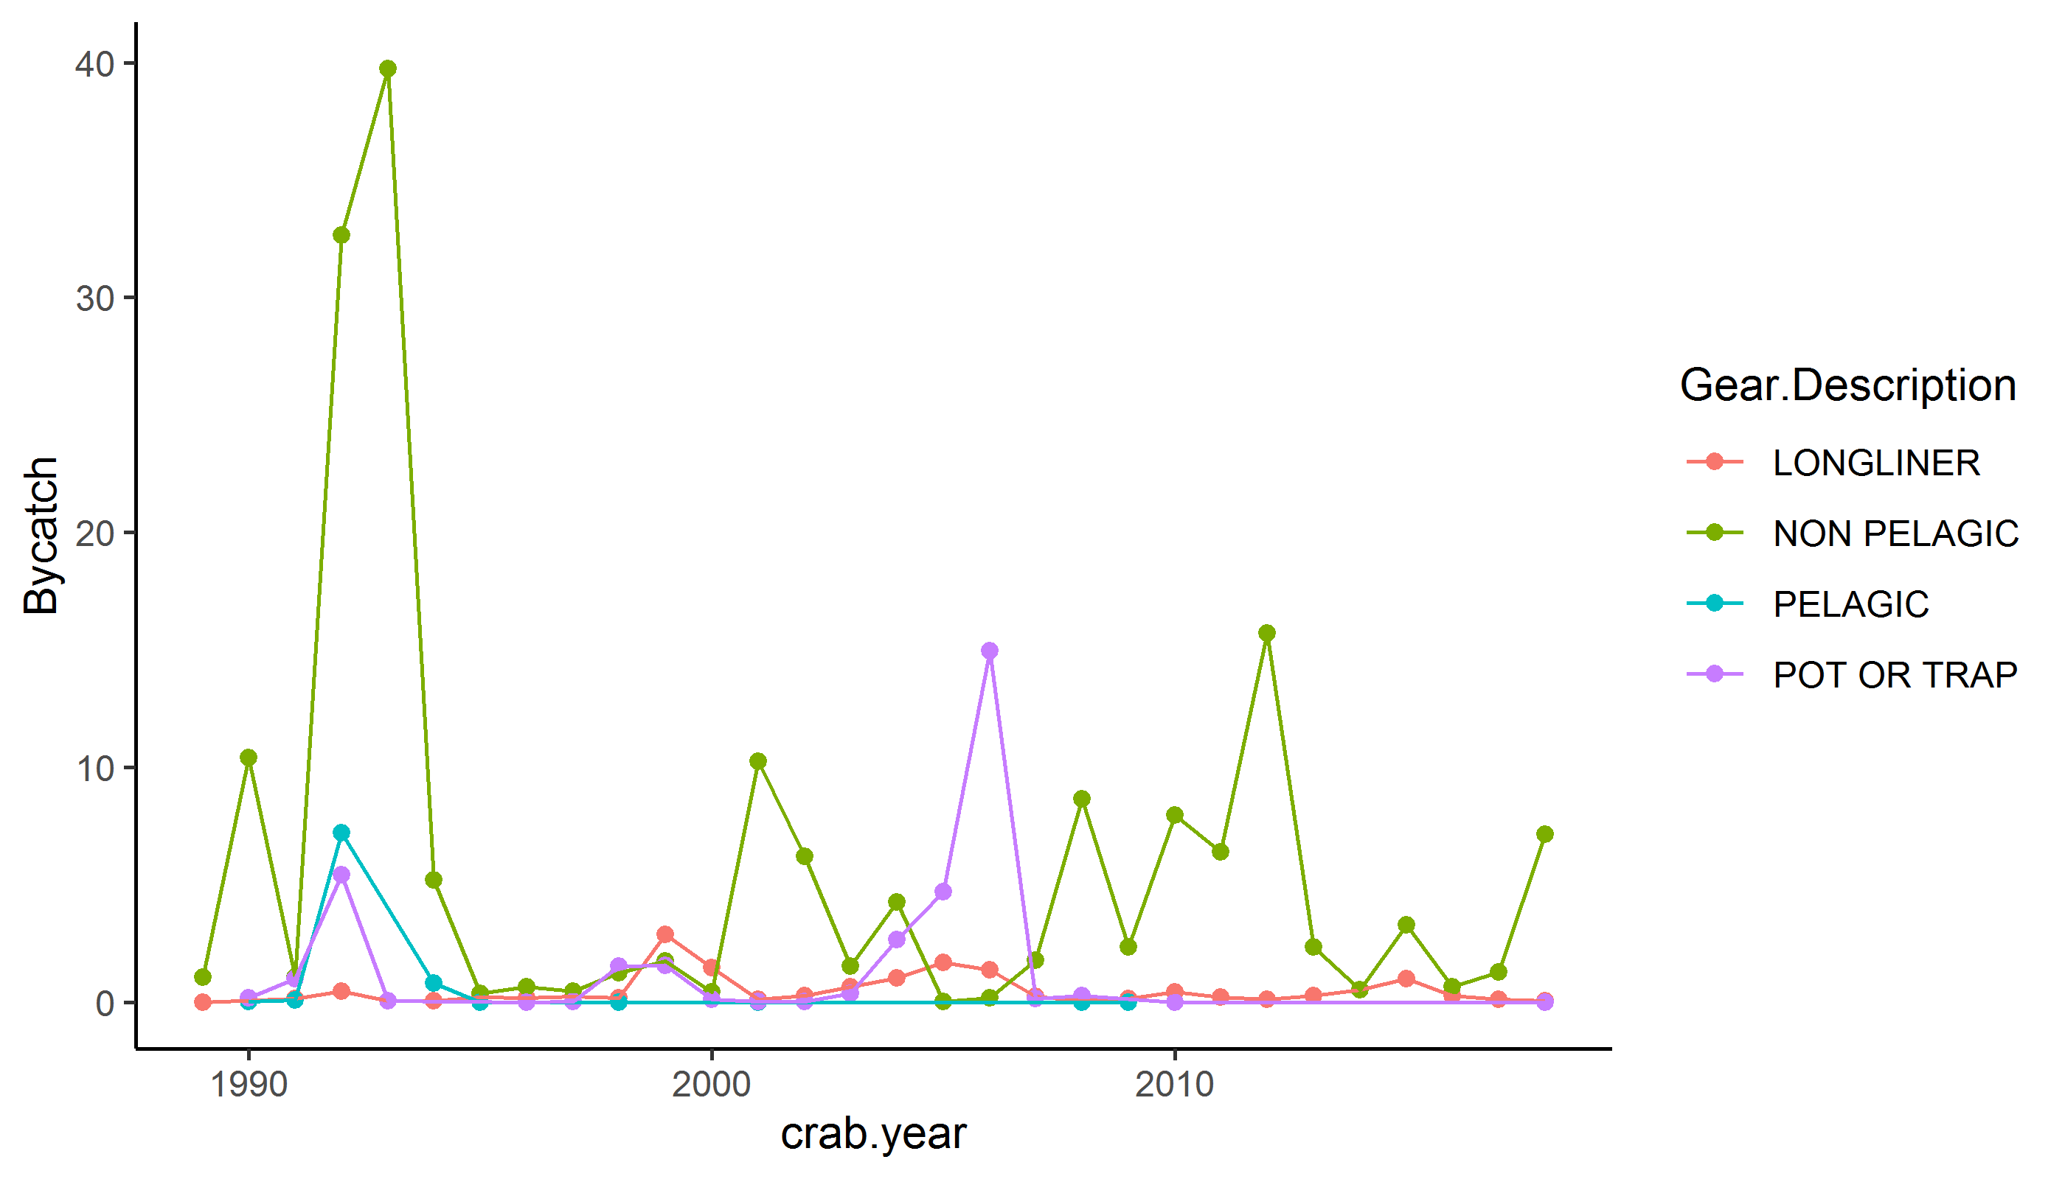

Slide 8
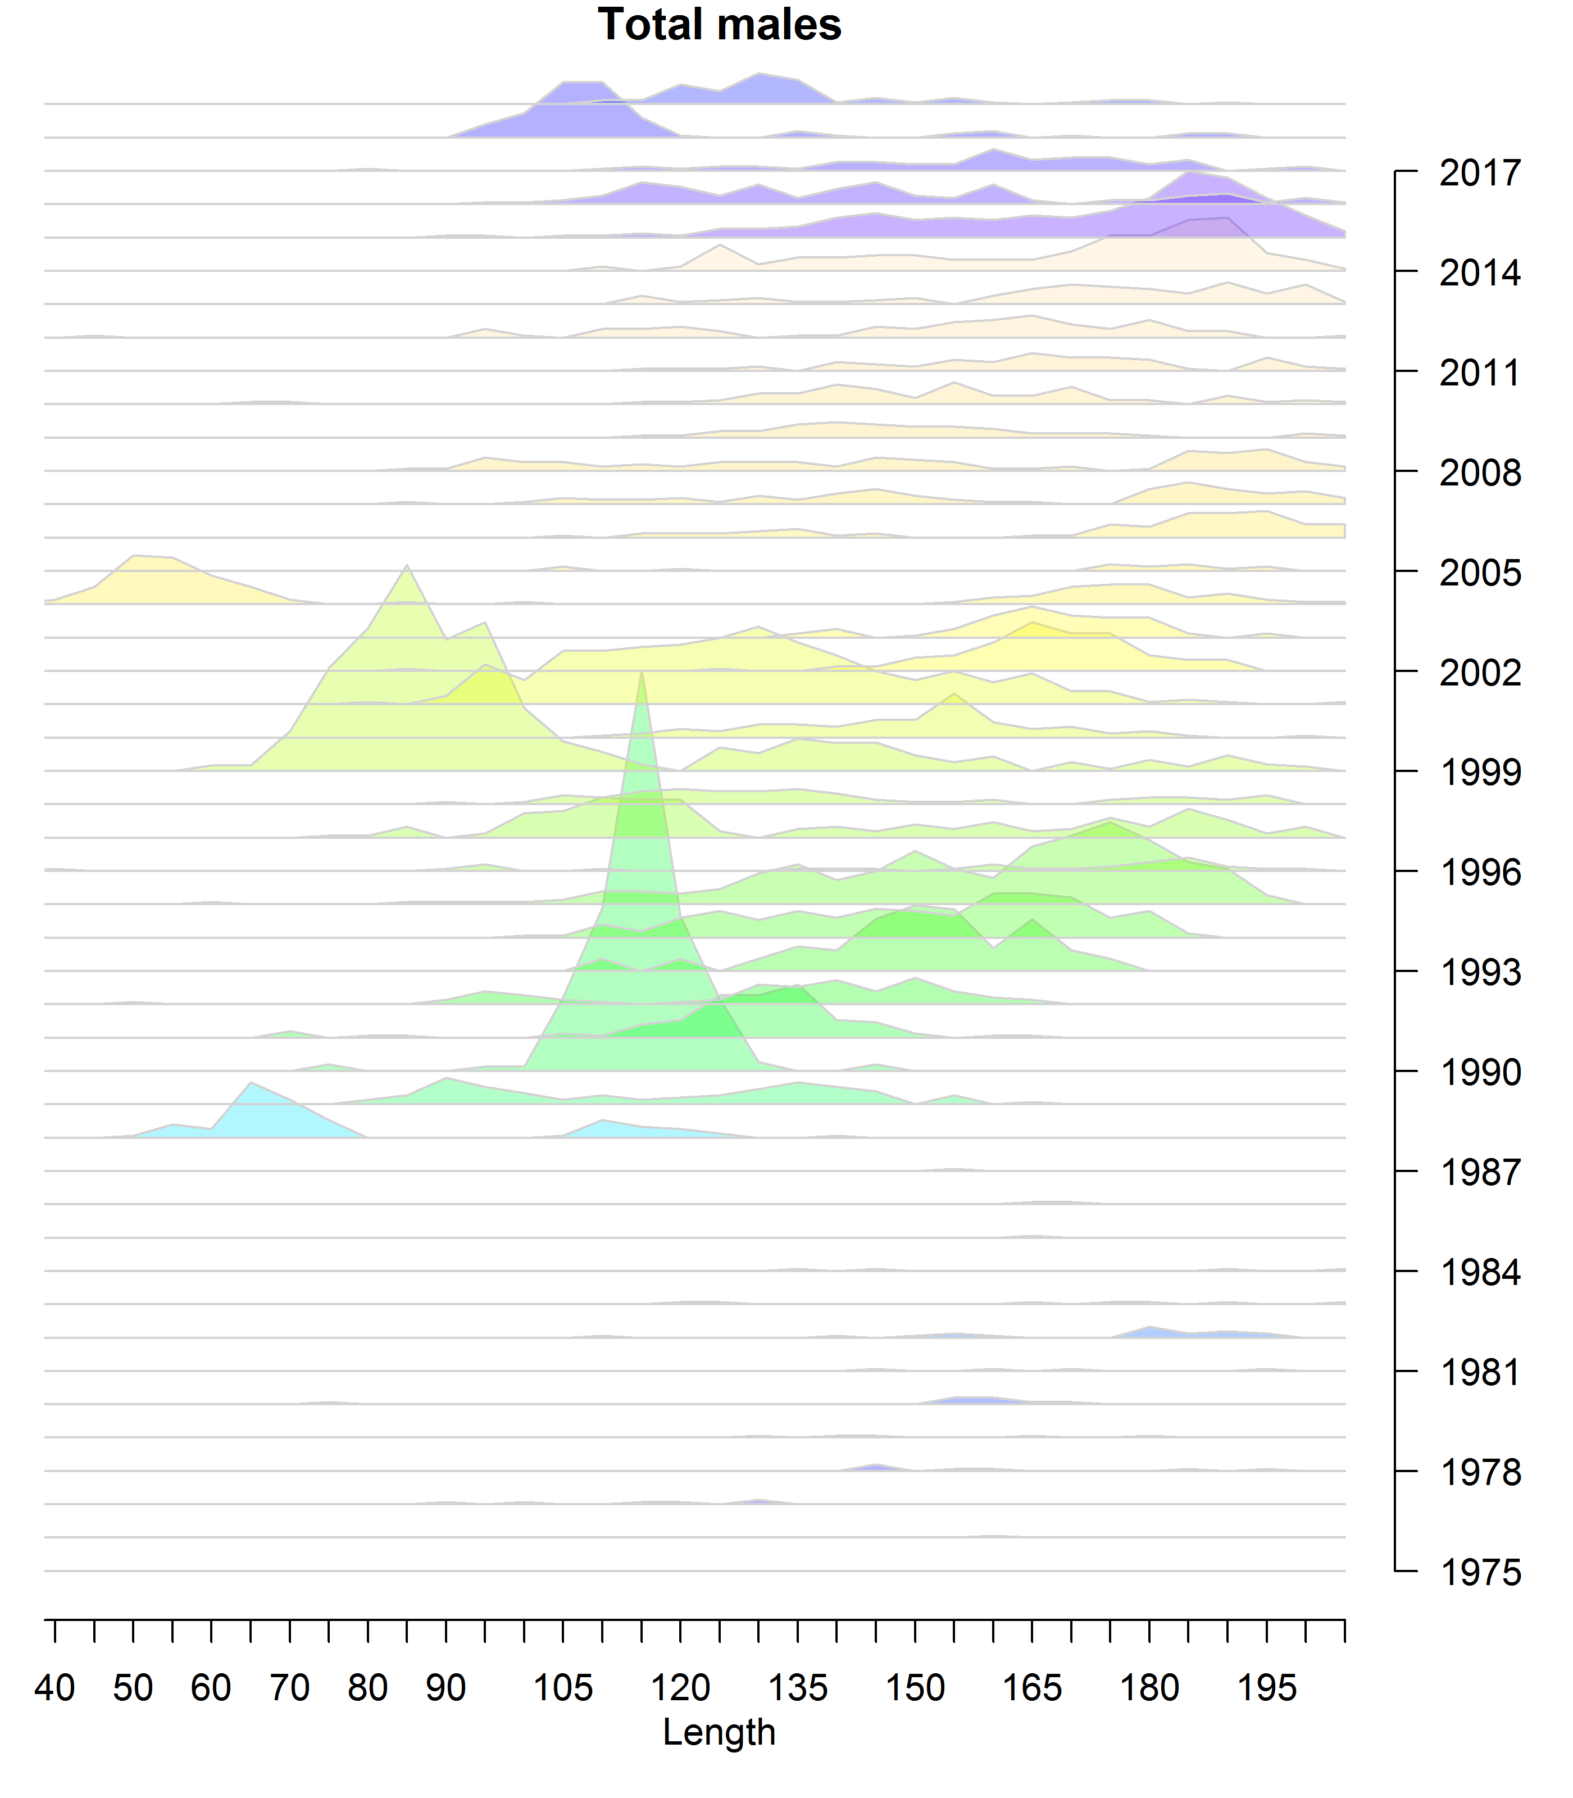

Slide 9
CPT and SSC requests
Describe tradeoffs between data and assumptions by moving to an integrated assessment that borrows from BBRKC.
  Included sensitivity scenarios
Why are some CVs exactly equal to one?
  Estimated biomass came from only one station.
Reevaluate the definition of BMSY
  Redefine based on ‘unfished’ or look at tier 3 in the future
Borrow data from BBRKC instead of studies from Kodiak
  Done
Fit to biomass rather than abundance
  Done
Thoroughly evaluate weights given to different data components
  Not done

Slide 10
Model Scenarios
*priors based on an assumed maximum age of 25, following BBRKC

Slide 11
3-year running average (inverse variance weighted)
Random effects model

Slide 13
GMACS
Data
  Males only
  NMFS survey biomass 1976-2019 (carapace width >120mm)
  NMFS size composition data 1988-2019
  Retained fishery catch 1993-1998
  Bycatch 1991-2018
Assumptions made
  Molting probability, survey q, trawl selectivity borrowed from BBRKC
  Natural mortality fixed to 0.18, 0.21, or 0.26
  Growth, survey selectivity, and recruitment are estimated

Slide 14
Integrated assessment scenarios estimate higher biomasses than smoothing algorithms.

Slide 15
Largely because they incorporate length composition data, which indicate a new cohort moving through the population.

Slide 17
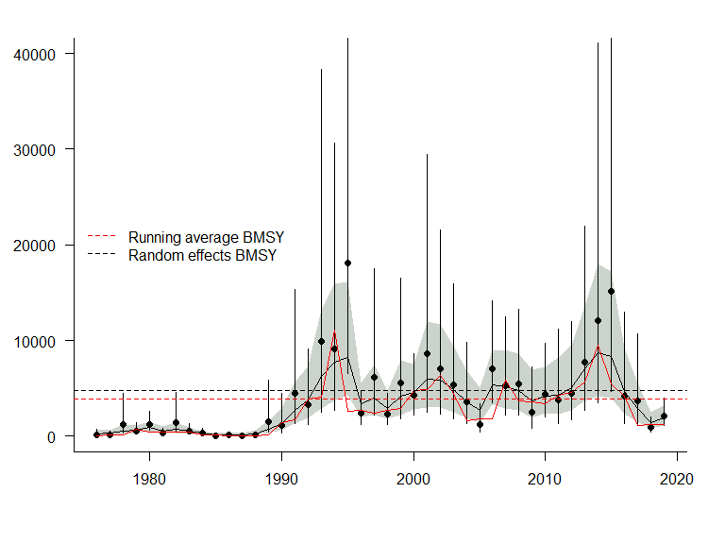
Both smoothing algorithms estimate biomass is low compared to the last 20 years.

Slide 24
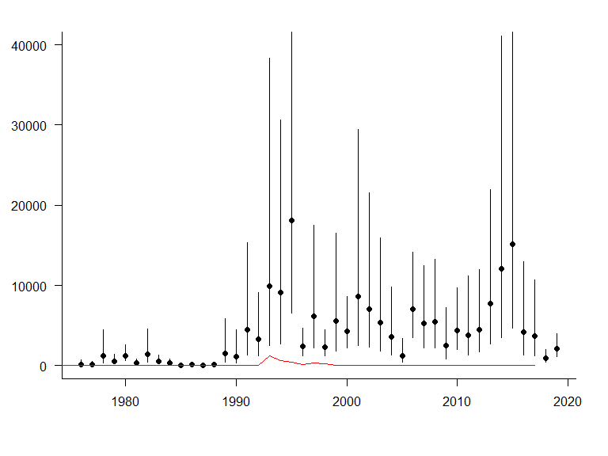
BMSY definition
Status quo: Average MMB from 1991-present
Modified: 35% of average MMB from 2000-present

Slide 26
Decisions to make
Assessment method
  Length comps are the best data source we have
  Lack of fits in later years
Natural mortality
  Hamel priors seem most defensible
BMSY
  Defining reference points is difficult with cohort driven stocks, but they should be internally consistent
Discussion for later—tier 3 vs. 4

Slide 27
The ‘fit’ problem (ft. Benjamin Button cohort)
If you assume a low natural mortality and essentially 2 strong year classes, the yearly changes in estimated MMB from the running average and the random effects model are unrealistic.
There is no recruitment observed to support the large biomasses in the mid-2010s (BB cohort).
  Time varying catchability is a potential reason we might see large crab appear out of nowhere. (Frantic end of life search for meaning?)
  Movement from elsewhere into the Pribilof district is another possibility.
Fit is at least as good as SMBKC!

Slide 29
Integrated assessment scenarios estimate higher biomasses than smoothing algorithms.

Slide 30
Largely because they incorporate length composition data, which indicate a new cohort moving through the population.

Slide 31
Decisions to make
Assessment method
  Length comps are the best data source we have
  Lack of fits in later years
Natural mortality
  Hamel priors seem most defensible
BMSY
  Defining reference points is difficult with cohort driven stocks, but they should be internally consistent
Discussion for later—tier 3 vs. 4

