Slide 1
Pribilof Islands red king crab assessment update
Cody Szuwalski
September 9, 2019

Slide 2
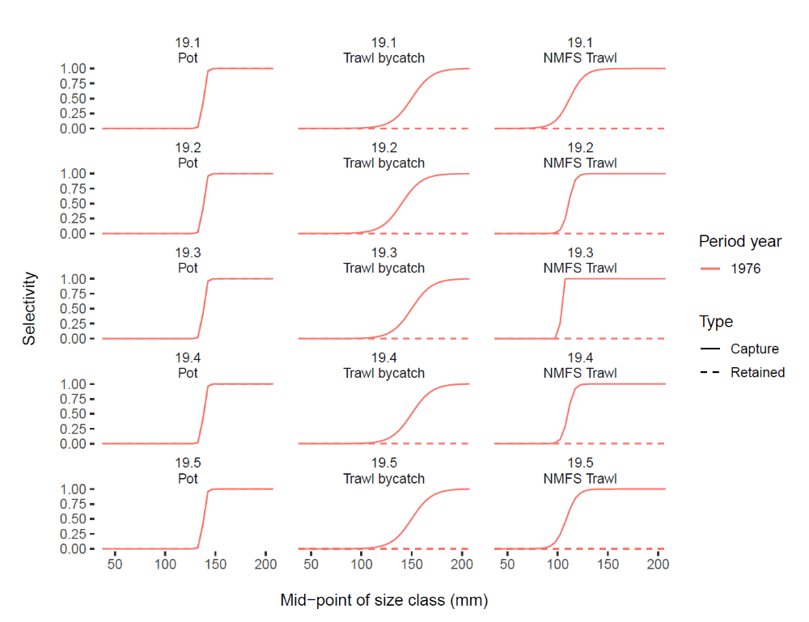
Problem
I used the parameters directly from the SAFE document for the trawl selectivity.
Apparently “trawl_L50” is not actually the length at 50% capture—there is some scaling occurring.
I was not able to determine exactly what kind of scaling was occurring, but I was able to roughly match the selectivity curve by selecting appropriate parameters.
I reran all models after changing the trawl selectivity.
The outcome of the assessments scenarios changed slightly, but my preferred model remains 19.4.

Slide 3
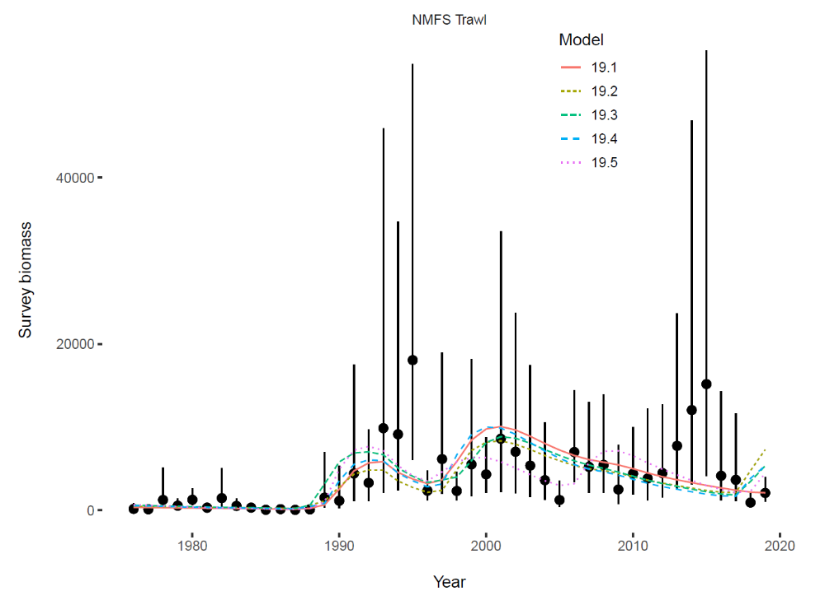
Integrated assessment scenarios estimate higher biomasses than smoothing algorithms.

Slide 4
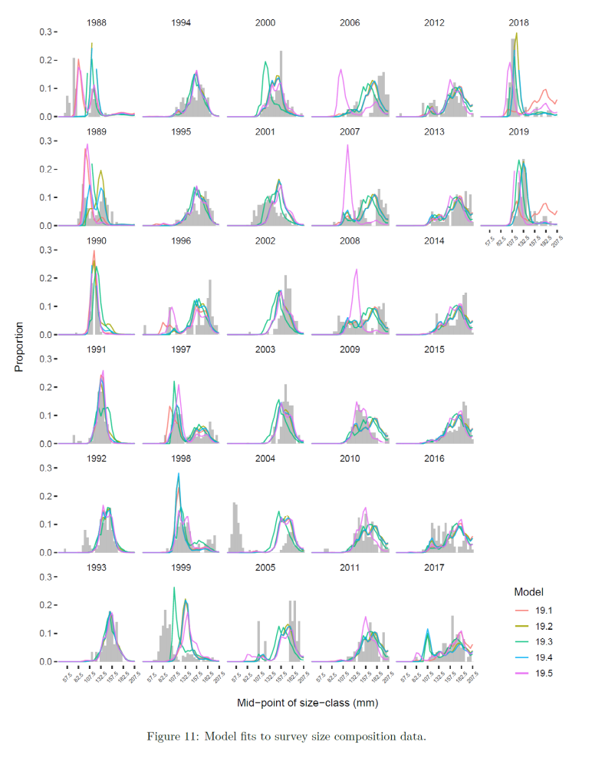
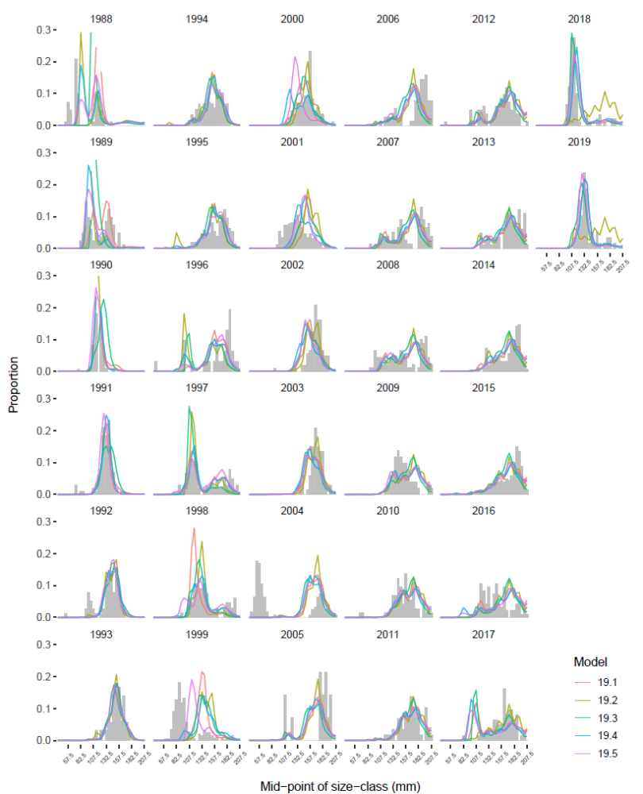
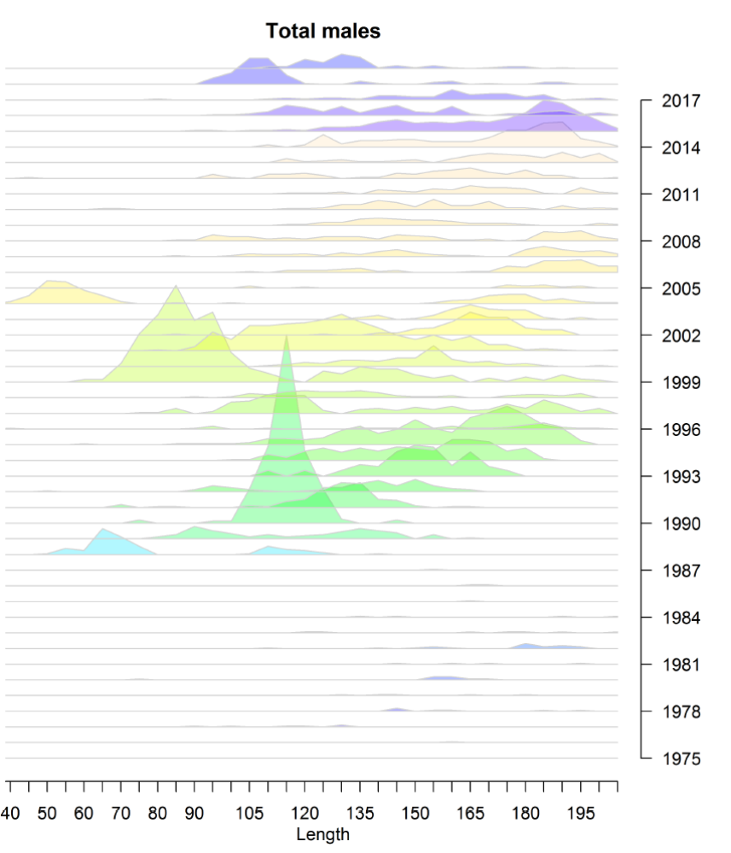

Slide 5
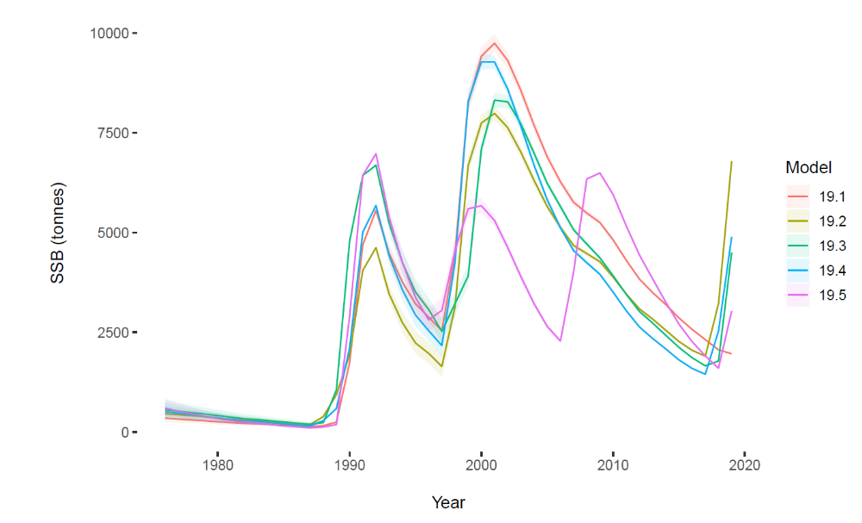

Slide 6
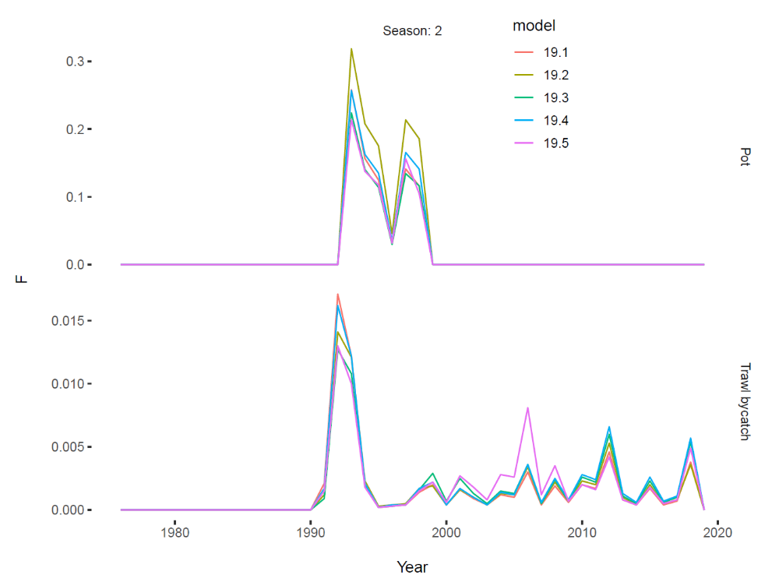

Slide 7
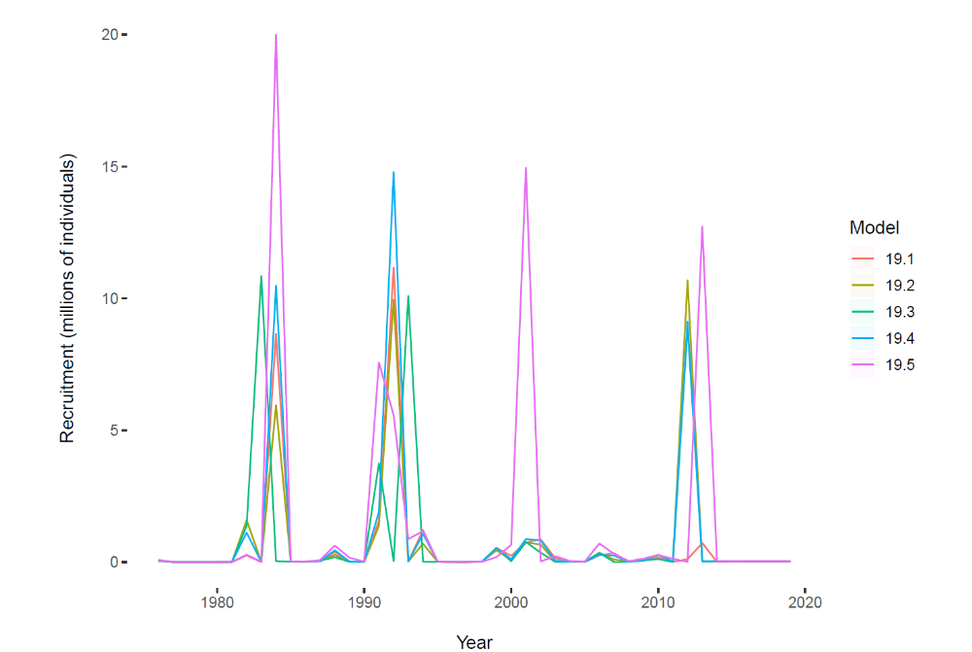

Slide 8
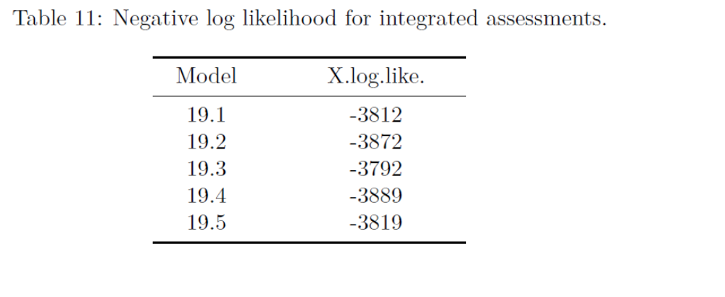

Slide 9
