Slide 1


Ecosystem
Socioeconomic
Profile
St. Matthew Blue
King Crab
SMBKC ESP Team: Erin Fedewa, Brian Garber-Yonts, Kalei Shotwell and Katie Palof
September 2019 CPT Meeting

Slide 2
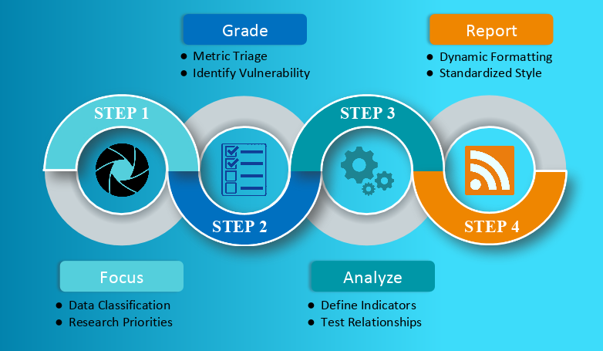
What is an Ecosystem-Socioeconomic Profile?
+
Because let’s face it, Monday was a long time ago…..
“A standardized framework that facilitates the integration of ecosystem and socioeconomic factors within the stock assessment process and acts as a proving ground for operational use in quota setting.”
Notes:
Data classification: standardized system using main categories of model input data- authors classify their stocks/complexes to identify high priority stocks for conducting an ESP. Grade metrics: select representative metrics for evaluation. Metrics are quantitative stock-specific measures that identify vulnerability or resilience of the stock with respect to biological or socioeconomic processes. Analyze: generate suite of indicators- (timeseries that is updated, reliable, consistent and long term), run statistical tests (i.e. rank scoring or stop light for data poor, Bayesian adaptive sampling for data rich), Report: standardized document with figs/tables, ESP as appendix in SAFE’s

Slide 3
SMBKC Data Classification
Data-limited stock (3 or less for nearly all categories)
4 out of 5 attributes highlighted as data gaps
Scores for national prioritization initiatives are moderate to high for SMBKC, suggesting high priority for ESP
+
Category | Current | Target | Gap
Catch | 3 | 4 | 1
Size/Age | 3 | 3 | 0
Abundance | 3 | 4 | 1
Life History | 2 | 3 | 1
Ecosystem | 1 | 3 | 2
Notes:
Seen are 5 attributes of model input data. Target of 5 for data rich stocks- fully coupled ecosystem linkage, comprehensive life history data ect. The national initiative prioritization scores for SMBKC are overall moderate to high primarily because the distribution of this stock depends greatly on habitat, and in 2018 the stock was declared overfished. Size-structured stock assessment is adequately supported. However, catch, abundance, life history and ecosystem linkage attributes were highlighted as having gaps between current and target data availability.

Slide 4
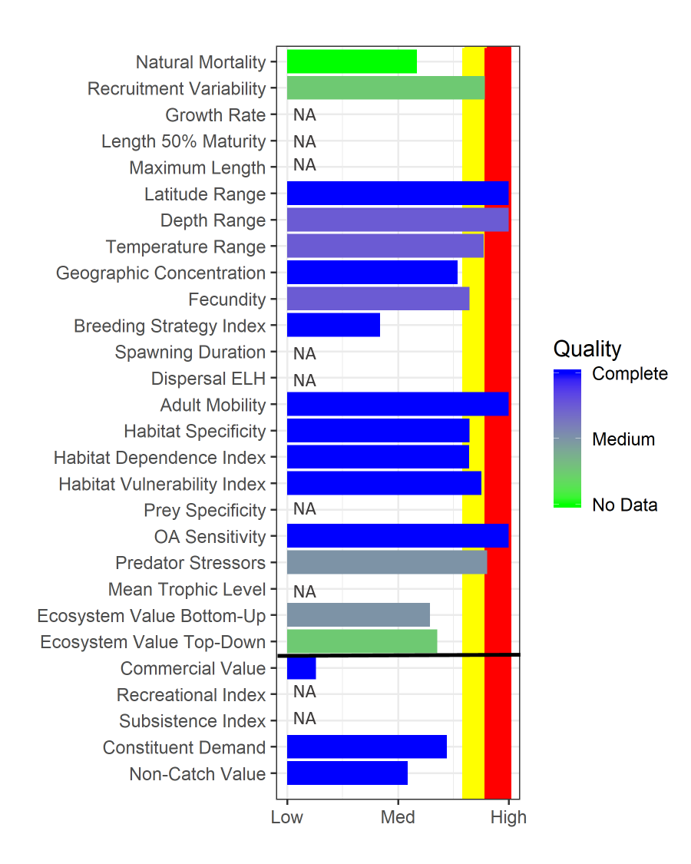
SMBKC Metric Panel
Ecosystem vulnerabilities: spatial range, temp, fecundity, mobility, habitat, OA sensitivity, predators
Socioeconomic vulnerabilities: medium to low vulnerability
Notes:
National initiative form data summarized into a metric panel and rescaled using percentile rank for SMBKC relative to all stocks to give context for how SMBKC relate to other groundfish and crab stocks and highlights the potential vulnerabilities and data gaps for the stock. Also included are data quality estimates (no data vrs complete). Vulnerabilities= high percentile rank value, red and yellow shaded areas. For SMBKC ecosystem metrics, latitude range, depth range, adult mobility, ocean acidification sensitivity and predator stressors fell within the 90th percentile rank of vulnerability, suggesting that BKC are habitat specialists and highly sensitive to changes in resource availability and habitat requirements. . For the three applicable socioeconomic metrics, values indicated medium to low vulnerability. Also highlighted are data gaps in LH info.
-Vulnerabilities:
Temp: BKC temp range 1.5-8 deg C in laboratory studies (Stoner et al, Long et al) but assigned a 4 (very limited temp range) as PIBKC and SMBKC are probably experiencing <5degC range in temps and BKC have a limited depth distribution of <100m
Site dependent stock restricted by thermal barriers and habitat requirements
Lat/depth range: Insular pockets of distribution, very specific habitat requirements
Fecundity: lower egg count, biannual reproduction

Slide 5
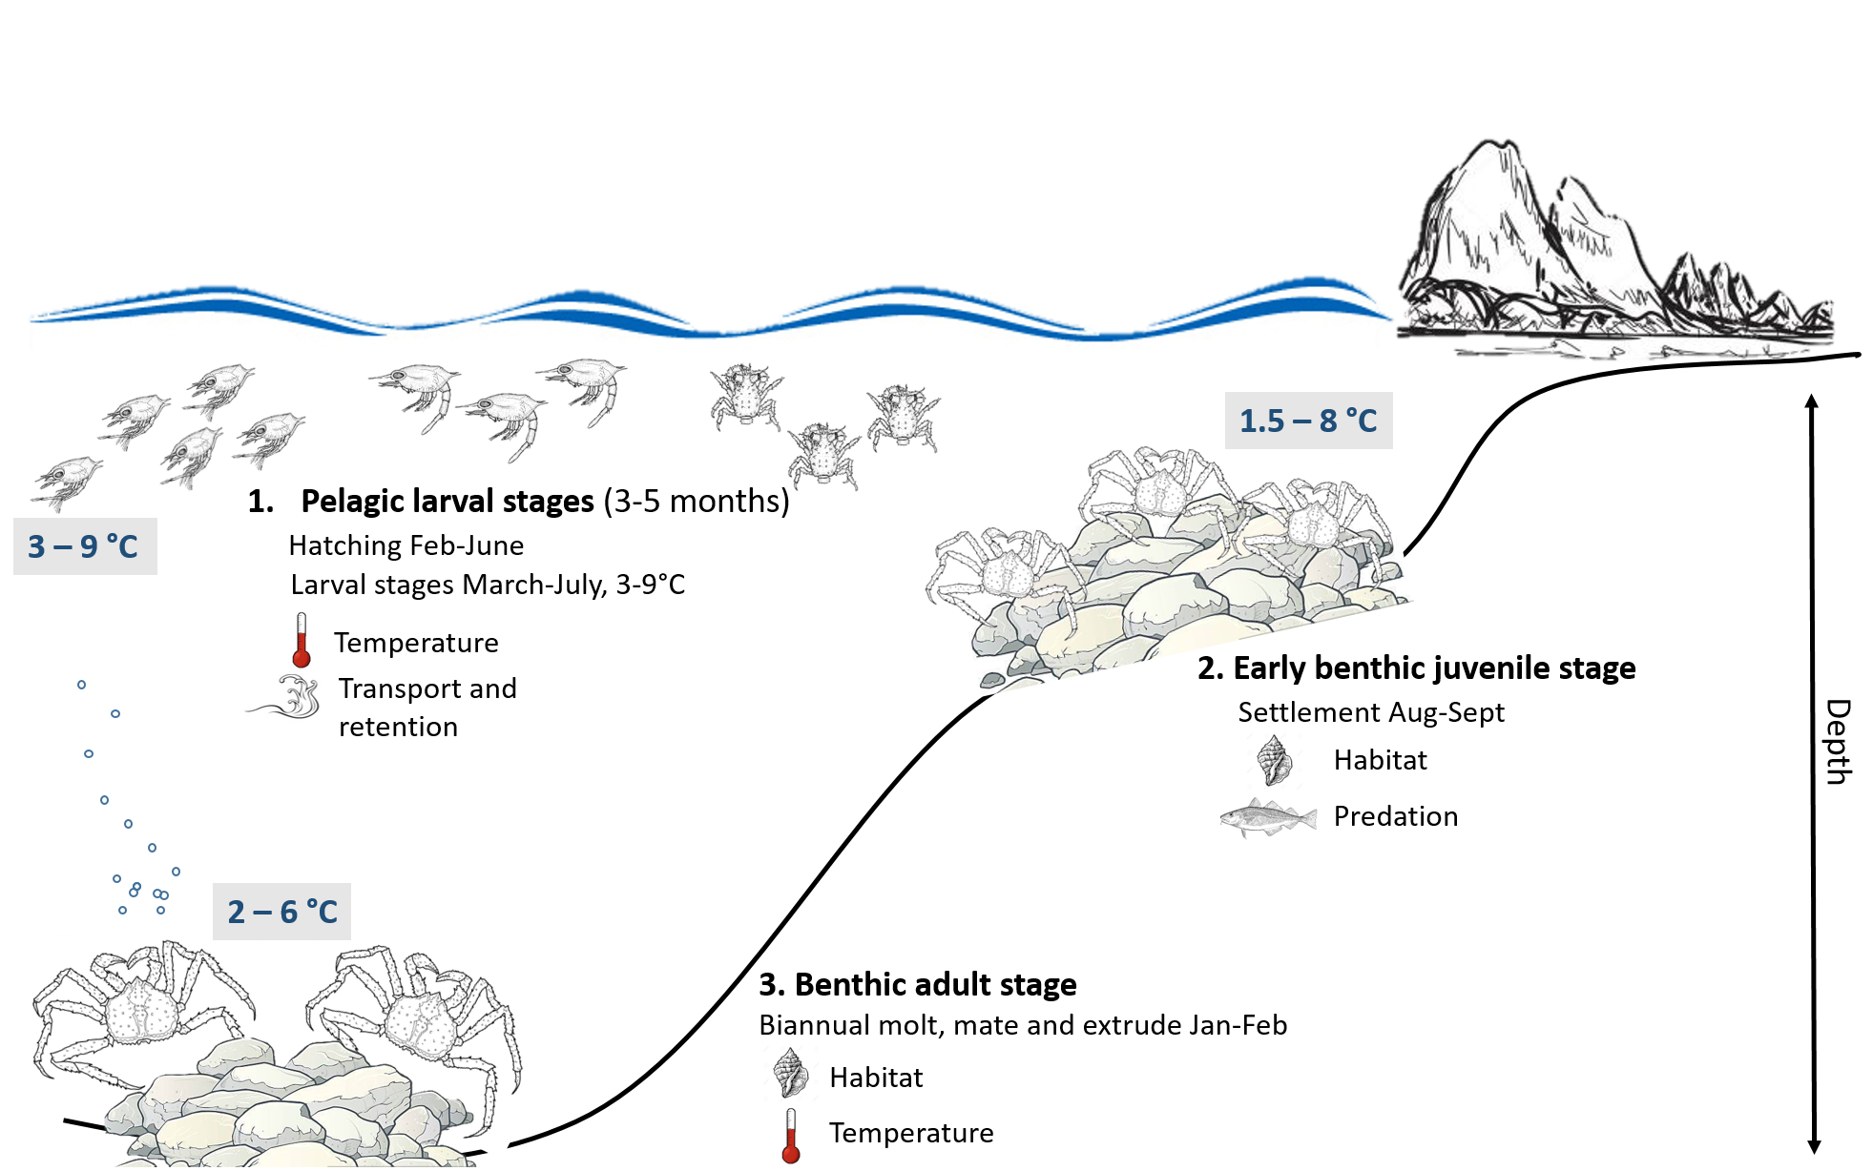
SMBKC Ecosystem Processes
Notes:
Metric panel results suggest that stage-based information regarding the implications of high predation, climate change, and habitat quality would be both valuable for the stock and would assist with subsequent indicator development. Data evaluated over ontogenetic shifts may also be helpful for identifying specific bottlenecks in productivity and relevant indicators for monitoring. As a first attempt to synthesize distribution, habitat usage and phenology of BKC across all life stages, we created a baseline life history conceptual model with the primary ecosystem processes influencing BKC life stages identified as water temp, larval transport and retention, habitat suitability and the impact of predation.
Larvae: increased sensitivity to warmer temperatures during development, successful recruitment dependent on transport to suitable habitat for settlement
Juvenile survival highly dependent on shell hash/gravel habitat for predator refuge as BKC are more cryptic, lacking spines and podding behavior seen in RCK juveniles although highly vulnerable during benthic instar molts.
Adults: While adults are not likely reaching temperature threshold for metabolic activities, we know that temperature drives distribution of BKC predators such as Pacific Cod. Warmer bottom temps may have implications for increased predation on adult BKC during molting as Pacific Cod move north and prey quantity/quality as benthic production is expected to decrease with increased carbon flux. Energetics may also play a role if limitations in prey are imposed by habitat.

Slide 6
SMBKC Ecosystem Indicators
Ecosystem Indicator Suite:
Based on metric panel vulnerabilities and ecosystem processes
1 indicator related to recruitment variability, 2 indicators related to climate and 2 indicators related to ecosystem
Notes:
Pre recruit biomass is often a reliable indicator of impending declines in mature male biomass and may be useful as an early indicator of stock recovery for the SMBKC rebuilding plan. Bottom temperature and cold pool indicators representing environmental conditions during the summer survey period are likely drivers of juvenile and adult BKC distribution, timing of the reproductive cycle and larval transport. Benthic predator biomass includes known predators of crab stocks (Pacific cod, sablefish, Pacific halibut, skates, sculpin, octopus and assorted flatfish) and increases may represent increased predation on BKC. Benthic invert biomass includes brittle stars, sea stars, sea cucumber, bivalves, non-commercial crab species, shrimp and polychaetes, which are all likely prey items of opportunistic BKC. This indicator could also be used in terms of benthic production. However, increases in highly mobile benthic foragers such as hermit crabs and sea stars may, instead, suggest increased competition with BKC for benthic resources

Slide 7
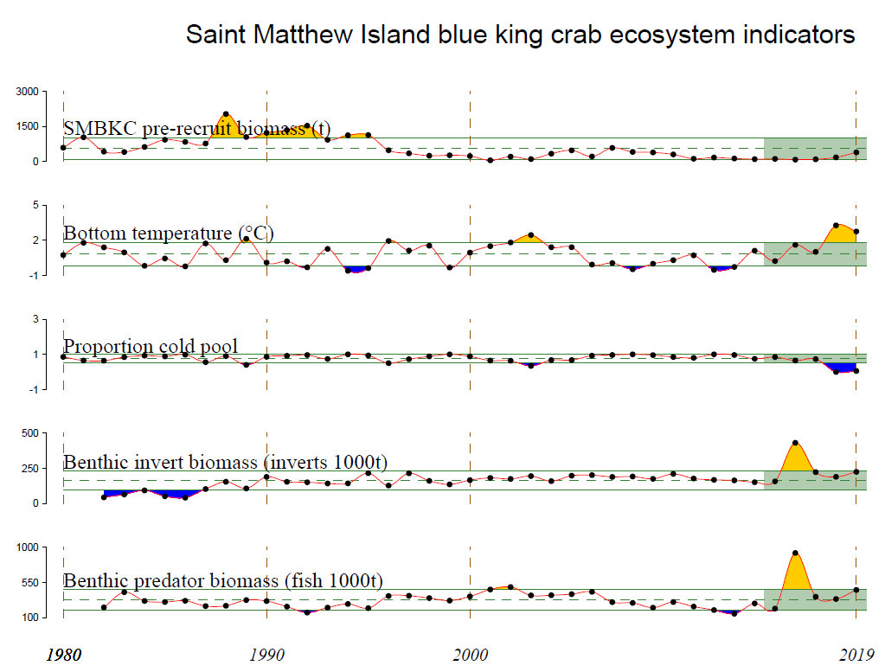
Notes:
Only two indicators updated for 2019. SMBKC pre-recruit biomass has been on a steady decline since the mid-1990’s and the 2017 recruitment estimate is the third lowest in the 41 year time-series, following the lowest previously observed in 2016. Breakpoint analysis suggest a SMBKC recruitment regime shift around 1996, corresponding with a 1989 brood year and there is empirical evidence for a 1989 regime shift in the North Pacific (declines in Bering Sea groundfish recruitment). Summer bottom water temperatures in the St. Matthew management area were at an all-time high in 2018 while the cold pool did not extend into the management area. Similar conditions were observed during 2019 summer survey operations. Benthic predator and benthic invert biomasses at all-time high in 2016 but have since declined.

Slide 8
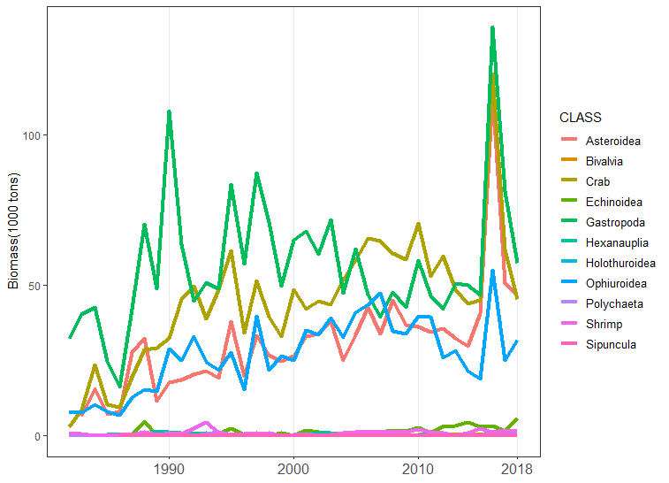
SMBKC management area characterized by high catches of sea stars, lyre and hermit crab, neptunids and basket stars.
Prey….or competitors?
Notes:
Increase in benthic production/prey quantity in 2016 for BKC? 2016 biomass increases in highly mobile decapods and echinoderms may also suggest increased competition for food resources available for juvenile and adult BKC.
Echin:- urchins, Hexa: barnacles, holo: sea cucumbers, Ophir: brittle stars, Sipuncula: marine worms

Slide 9
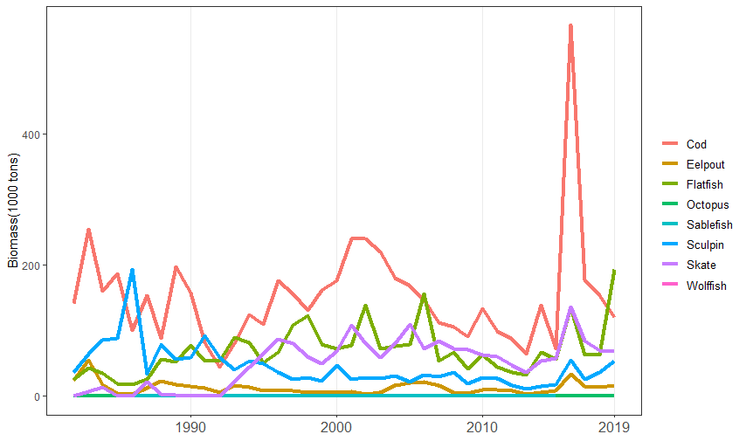
Benthic predator biomass was at an all-time high in 2016, attributed to high catches of Pacific cod surrounding St. Matthew Island.
Notes:
Consequences for recruitment to fishery in several years? Will increases in Pcod be more common with decreases in extent of cold pool within St. Matt mgmt area?

Slide 10
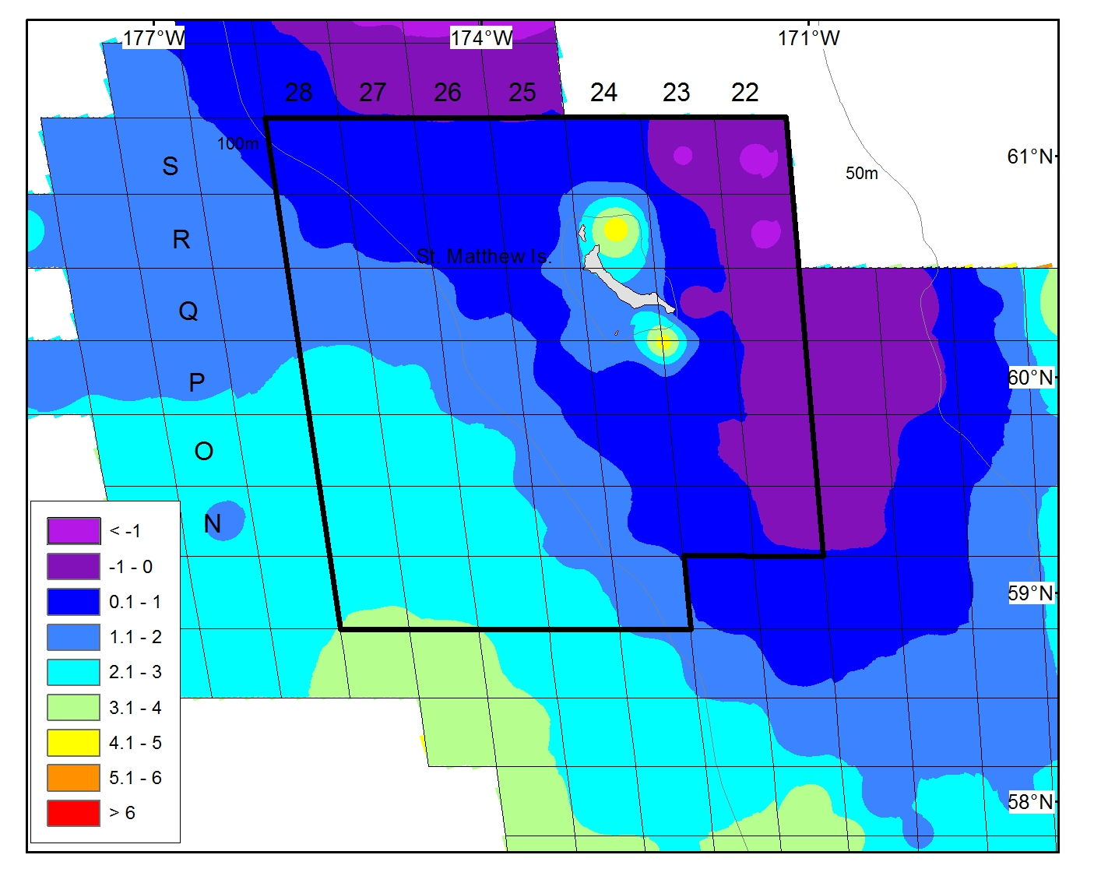
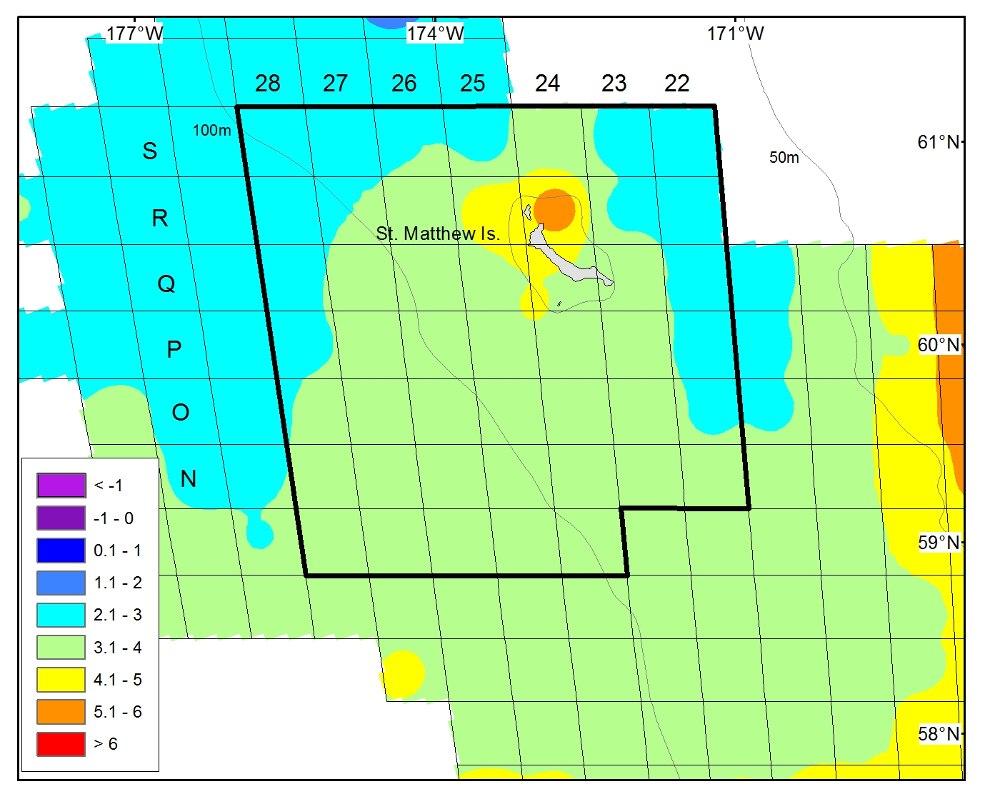
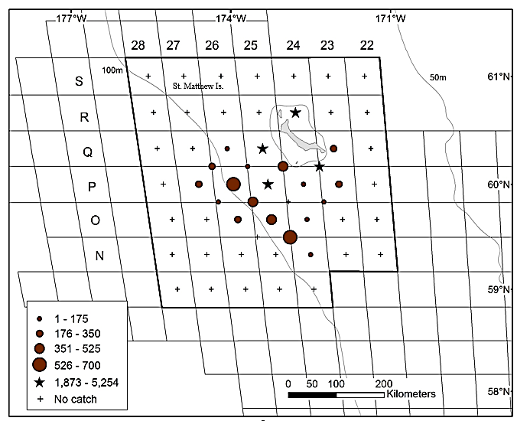
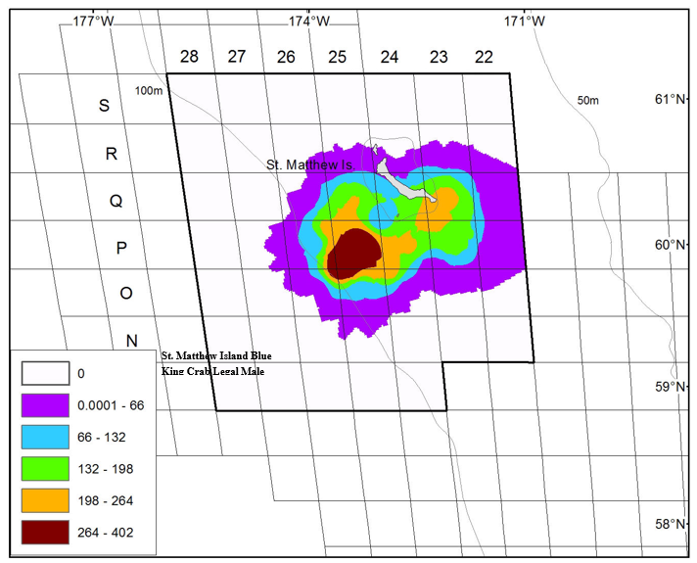
Is habitat quality decreasing? Shallow stations with historically high abundances of mature BKC are beginning to exceed the thermal optimum of BKC
Station R-24 in 2014
Station R-24 in 2018
Notes:
In 2014, 38% of the mature male biomass estimate located at R-24 and over 50% in 2017. In 2018, 6% of mature males caught at R-24. This site is also likely important settlement habitat given known distribution of females and clockwise circulation around the island. Adult mobility is vulnerability- does this stock have the ability to move if current habitat becomes unsuitable. BKC rely on realtively shallow habitats.

Slide 11
SMBKC Ecosystem Indicator Analysis and Considerations
Despite repeated fishery closures, SMBKC MMB and recruitment estimates remain below-average following a 1989 regime shift in the Bering Sea, suggesting that environmental factors may be impeding recruitment success and stock recovery.
Trend modeling for ecosystem indicators revealed poor conditions for SMBKC in recent years, attributed to above average bottom temperatures, a reduction in the cold pool extent, and an increase in mean benthic predator biomass
Highly specific thermal optimums and habitat requirements of SMBKC likely limit mobility in response to warmer than average bottom temperatures and shifting predator distributions.
Large catches of Pacific cod in the St. Matthew Island management boundary in 2016 preceded declines in BKC recruitment and the overfished declaration in 2018.
Indicator Traffic Light:
Notes:
The first stage of the indicator analysis is a simple assessment of the most recent year relative value and a traffic-light evaluation of the most current year where available. A symbol is provided if the most recent year of the time series is greater than (+), less than (-), or within (•) one standard deviation of the long-term mean for the time series. If the most recent year is also the current year than a color fill is provided for the traffic-light ranking based on whether the relative value creates conditions that are good (blue), average (yellow), or poor (red) for SMBKC. For many indicators, 2019 data was not yet available and this demonstrates significant data gaps for evaluating ecosystem and socioeconomic data for SMBKC. Benthic pred and benthic invert nearly above 1 SD of long term mean.

Slide 12
SMBKC Socioeconomic Indicators
Indicator Suite:
5 indicators related to commercial value and constituent demand
4 indicators related to fishing effort
Notes:
Indicators used for preliminary indicator analysis

Slide 13
Notes:
Brian, feel free to add additional slides beyond this as discussion points

Slide 14
SMBKC Socioeconomic Indicator Analysis and Considerations
Socioeconomic Considerations:
Vessel engagement in the SMBKC fishery has declined relative to the pre-rationalization period reflecting consolidation of the crab fleet following rationalization.
In the most recent open seasons, the active fleet has been reduced to 3-4 vessels, with TAC utilization also declining to 26% during the 2015/16 season.
Ex-vessel revenue share and the Local Quotient for Saint Paul both reached high values during 2010, concurrent with a peak in ex-vessel price; large declines in both metrics over the subsequent open seasons, despite relatively high ex-vessel prices during the next four open SMBKC seasons indicate that both vessels and processors active during those years have shifted into other fisheries.
Notes:
Brian, just to clarify on the stoplight figure as it looks a bit different than the one in the tech memo- Kalei changed her methods a bit from the 5-year trend/mean symbols and colors. With your raw data I’ve adjusted the symbols to represent 2016 as the most recent year data and assigned symbols for 2016 as greater than (+), less than (-), or within (•) one standard deviation of the long-term mean for the time series. May be worthwhile to note here your sentence in the ESP: “intermittent nature of the fishery and reliance on fishery-dependent socioeconomic data limits the available socioeconomic information to years when the fishery has opened” given that analysis for most recent data is 2016

Slide 15
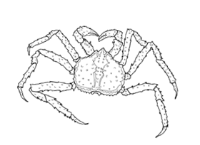

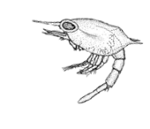
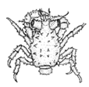

Ecosystem recommendations and future research priorities
Process-based studies to identify mechanisms that influence SMBKC recruitment and productivity:
Distribution of BKC life stages related to oceanographic processes
Spatiotemporal trends in predation on BKC across life stages
Determining the relative importance of ELH requirements on survival and recruitment success
Continued ecosystem indicator development:
Larval advection/retention indicator
Groundfish predation indicator
Spring bottom temperature indicator
Benthic production indicator
Notes:
Process-based studies are necessary in order to identify mechanistic links between life history processes and environmental factors for developing meaningful indicators. Examining larval drift patterns and spatial distributions of mature BKC around St. Matthew Island in relation to habitat characteristics will help to inform essential fish habitat models and the development of a larval retention indicator. Use of EFH BKC species distribution models as metrics of long term stock distribution by life stage. Environmental covariates in EFH can inform indicator development. Furthermore, additional groundfish stomach data outside of the summer survey time series would help to refine our understanding of predation pressure across life history stages of SMBKC. Likewise, spring bottom temperatures prior to the summer bottom trawl survey may help to understand SMBKC distribution in relation to survey catchability. Concerted focus on developing a better understanding of early life history processes given recruitment failures. Emphasis that indicators need to be readily available and processed on the time scales of the stock assessments they feed. Rebuilding plan scenarios driven by recruitment – 7 year black box

Slide 16
Socioeconomic recommendations and future research priorities
  Clarify objectives for use of socioeconomic indicators in ESP:
Inform assessment re: “upstream” social and economic drivers of the fishery -> bioeconomic models
Inform TAC-setting of ”downstream” social and economic effects of fishery on stakeholders and communities

Slide 17

Questions?
Notes:
And that’s all I have. Any questions?

Slide 18
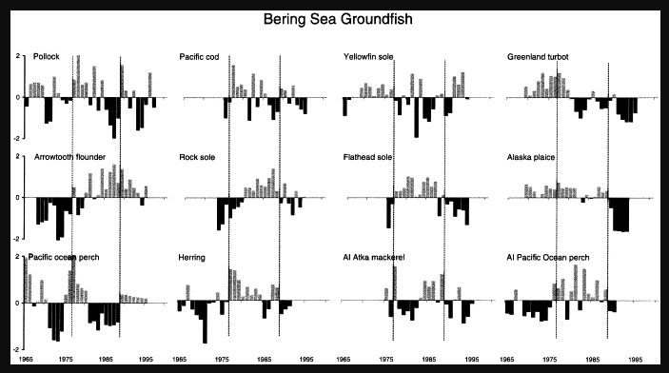
Hare and Mantua (2000) regime shift in 1989

