Slide 1
Saint Matthew Blue king crab stock assessment
Katie Palof & Jie Zheng
Crab plan team
September 2019
Acknowledgements: Jim Ianelli and Andre Punt for their assistance.

Slide 2
Outline
Stock status
  Background on SMBKC
  SCC / CPT comments and responses
  New data and model options
Reference point time frame considerations – Regime shift?
  Recommended OFL / ABC
ESP – presented by Erin
Rebuilding projections – keep in mind reference point time frame

Slide 3
Overview
Declared “Overfished”, no overfishing occurring
Rebuilding plan currently being constructed
  Initial rebuilding projections presented in May
2019 NOAA trawl survey biomass (of >90mm males) up 89% from 2018.
Still overall poor model fit to recent years in the two surveys

Slide 4
SSC/CPT comments
Reference Point Time Frames
  Consider method that doesn’t rely on a stock-recruit relationship (STARS)
  Bring forth both entire time frame (1978 – 2018) as well as current regime (1996-2018)
Rebuilding Analysis
  Bring forth projections 1 and 5 – both use random recruitment draws, and have matching reference point and recruitment years
  Examine the effect of increased bycatch on the rebuilding projections

Slide 5
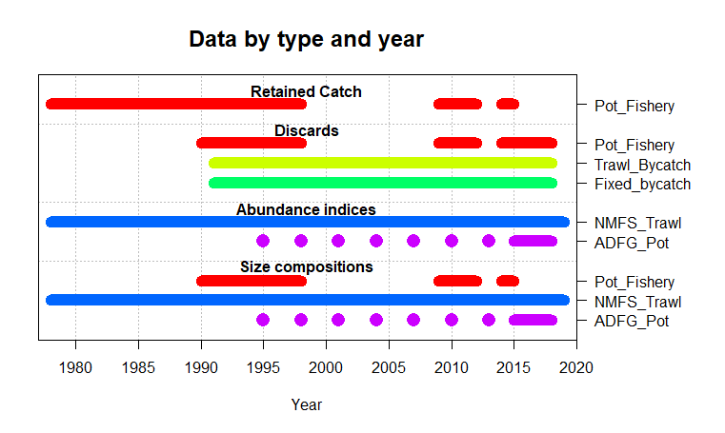

Slide 6

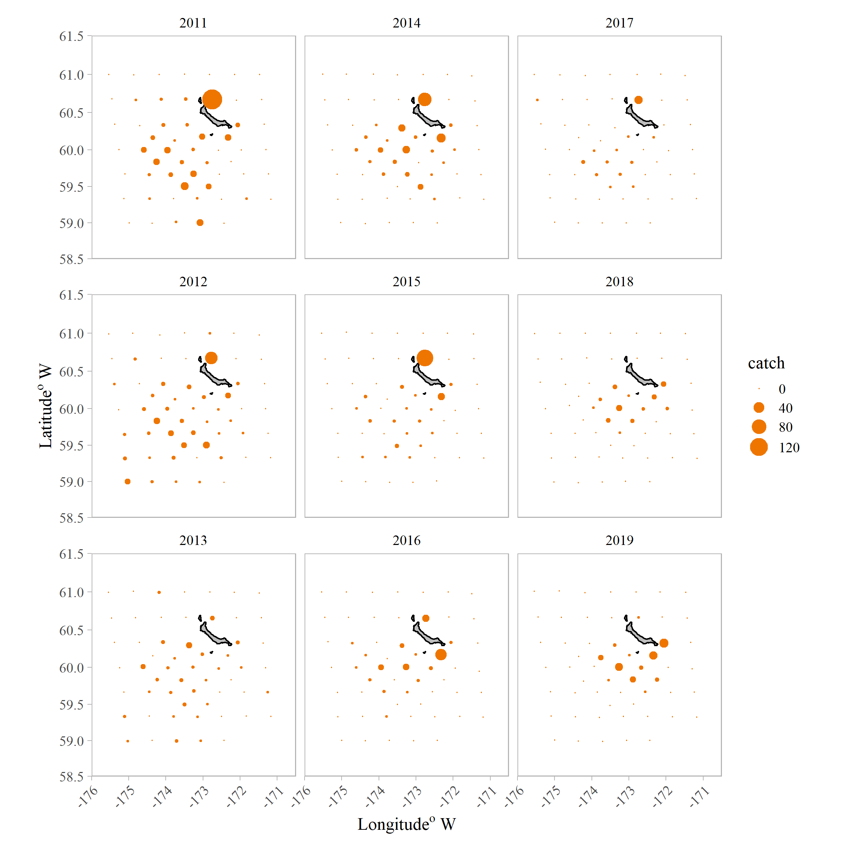
Bering Sea Trawl survey
2019
Male crab greater than >90mm
No large catch at R-24
Overall increase in crab in survey stations south and south east of the island
Notes:
2019 trawl survey saw an increase in crab caught and the distribution was similar to 2018 – no large amount of crab at R-24

Slide 7
Model options
18.0 - 2018 Model
  the 2018 recommended model without any new data (16.0)
19.0 - 2019 Reference Model
  new data for 2019: NMFS trawl-survey and bycatch updates for groundfish
19.0a - 2019 Model - alt reference pts
  model 19.0 with alternative time frames for reference points and projections
19.1 - Fit survey
  an exploratory scenario that’s the same as the reference model except the NMFS trawl survey is up-weighted by NMFS = 1.5 and the ADF&G pot survey is up-weighted by ADFG = 2
19.2 - add CV pot
  includes an estimated additional CV on the ADF&G pot survey

Slide 8
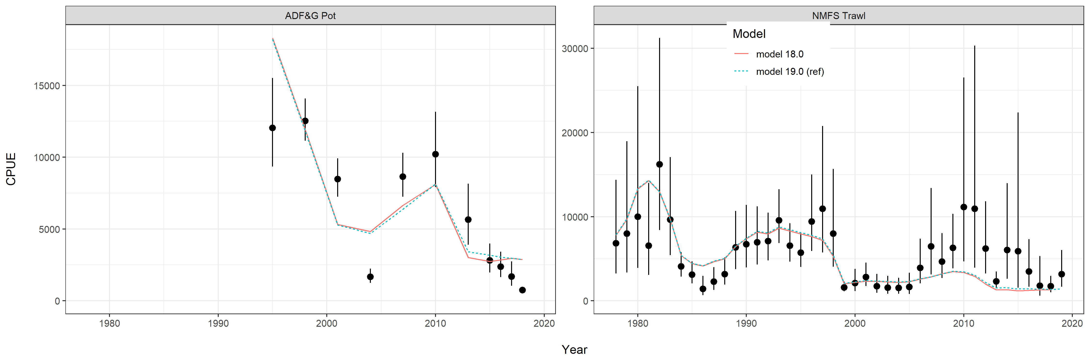
Reference model – new data

Slide 9
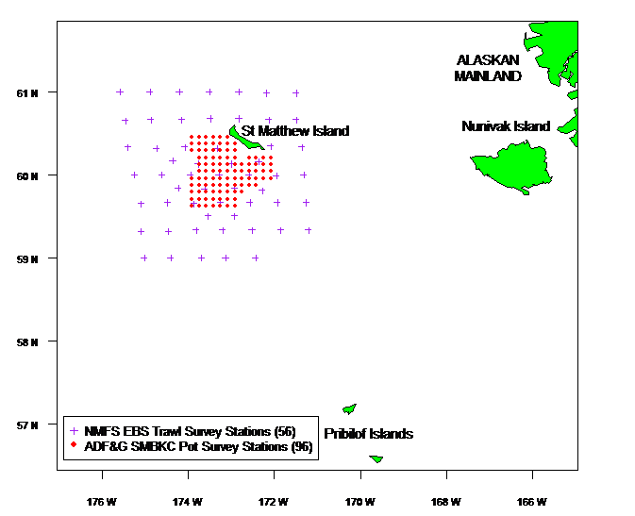

Slide 10

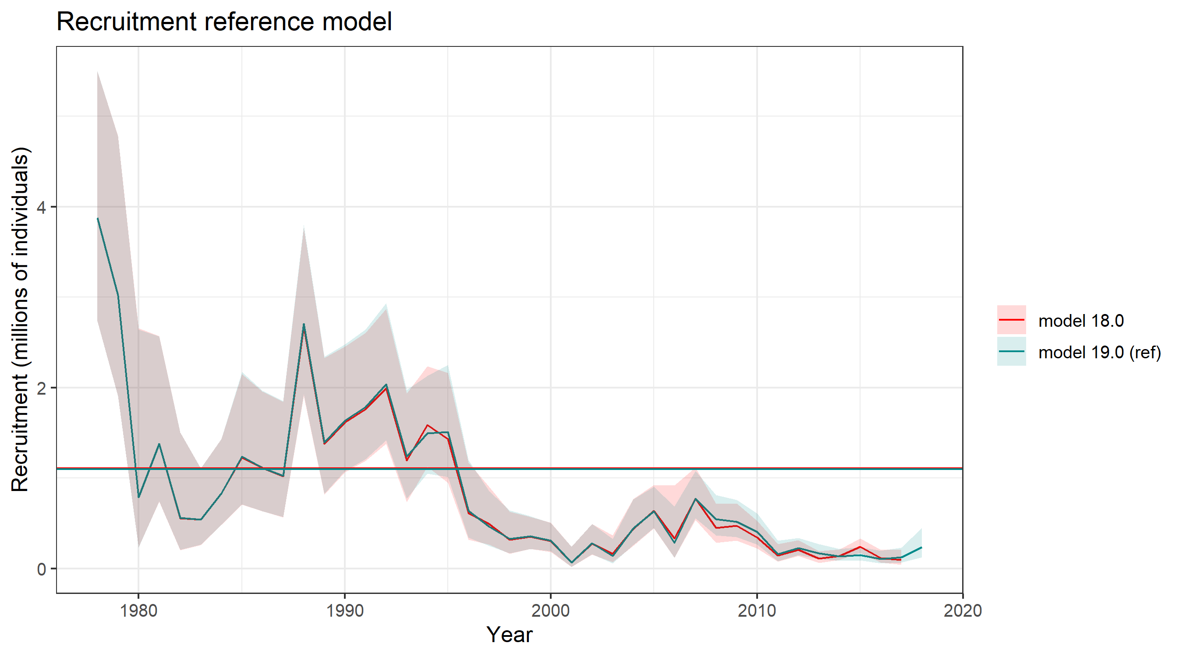

Slide 11
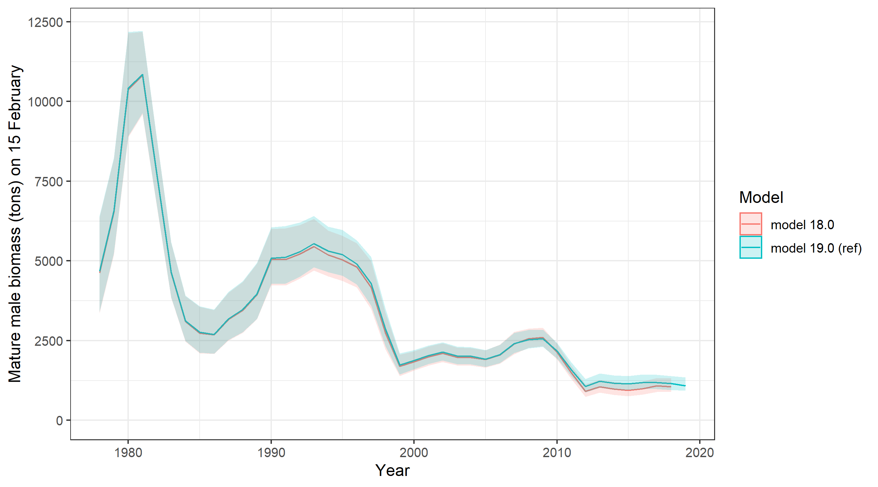

Slide 12
Model options
18.0 - 2018 Model
  the 2018 recommended model without any new data (16.0)
19.0 - 2019 Reference Model
  new data for 2019: NMFS trawl-survey and bycatch updates for groundfish
19.0a - 2019 Model - alt reference pts
  model 19.0 with alternative time frames for reference points and projections
19.1 - Fit survey
  an exploratory scenario that’s the same as the reference model except the NMFS trawl survey is up-weighted by NMFS = 1.5 and the ADF&G pot survey is up-weighted by ADFG = 2
19.2 - add CV pot
  includes an estimated additional CV on the ADF&G pot survey

Slide 13
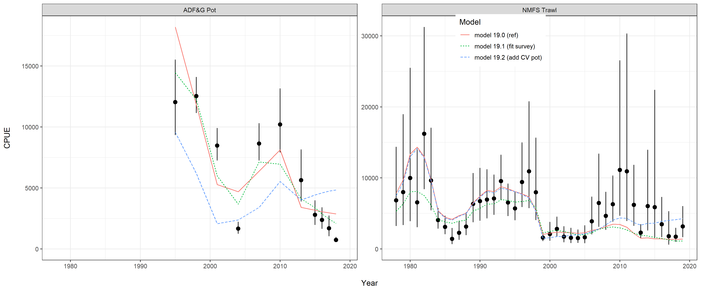

Slide 14
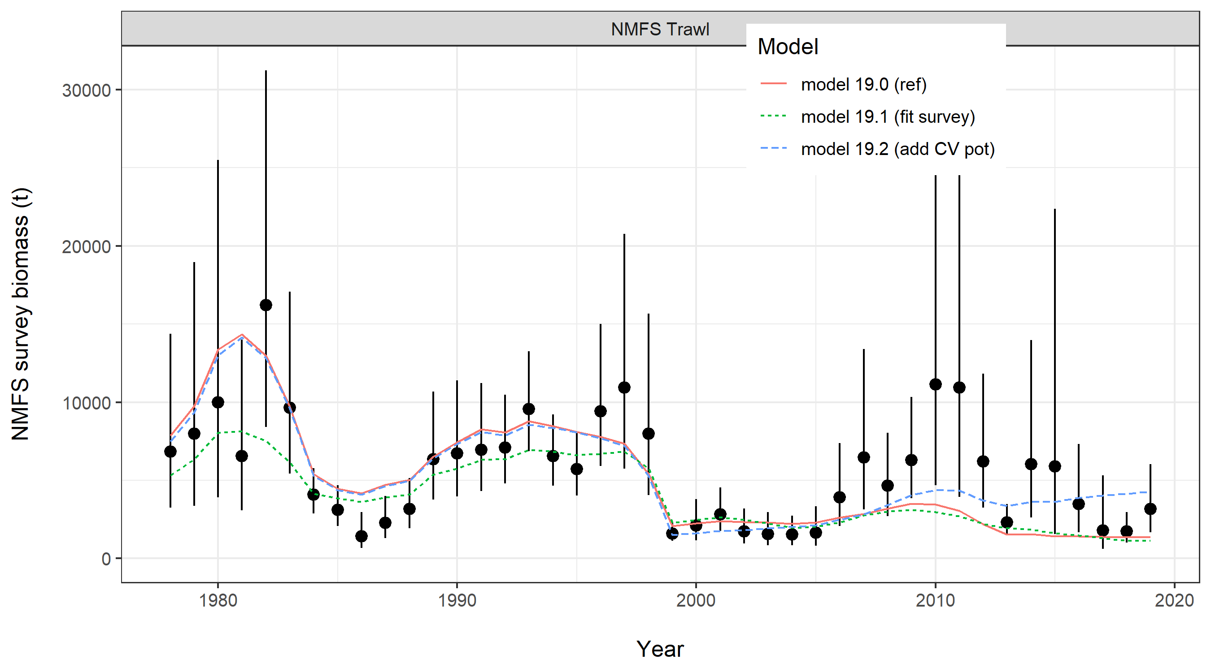

Slide 15
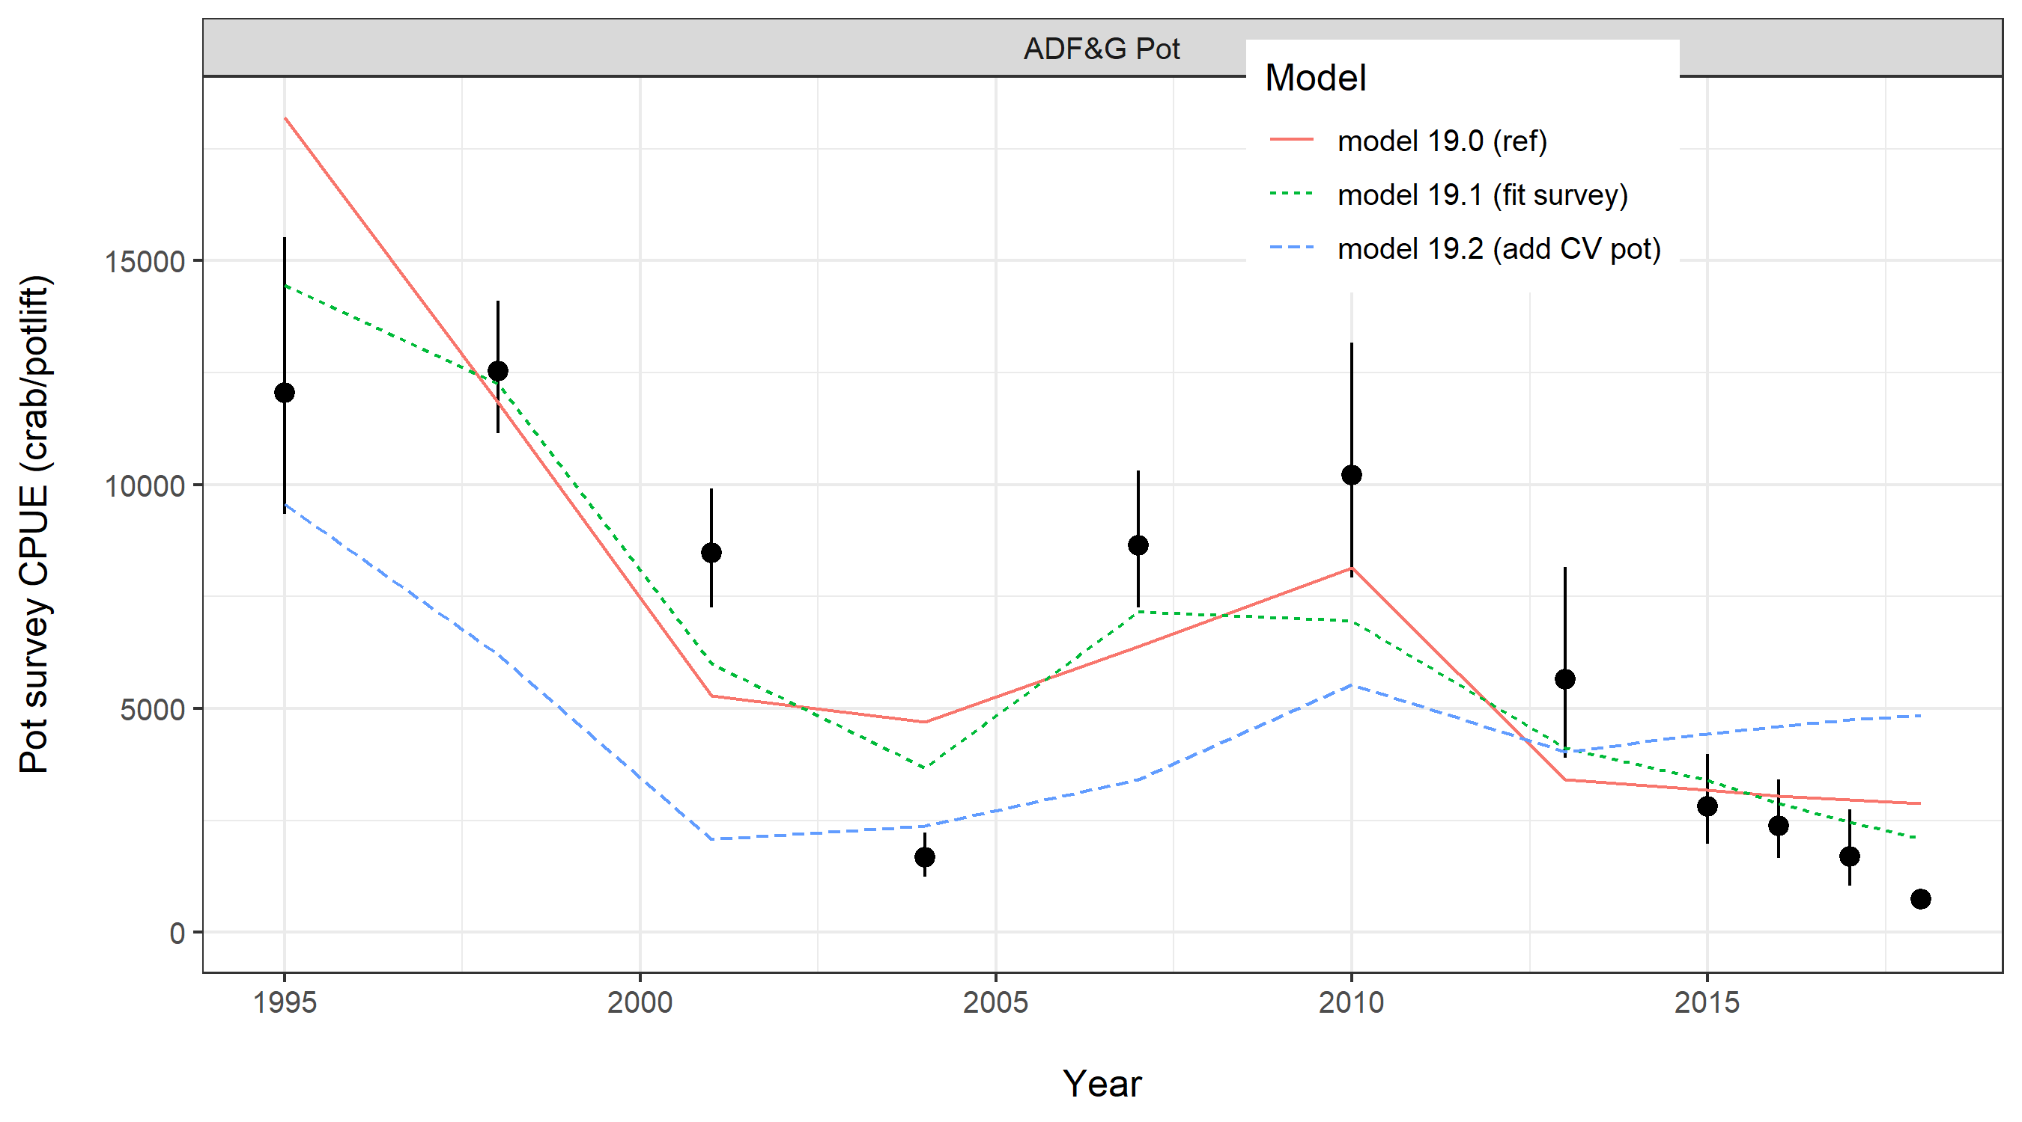

Slide 16
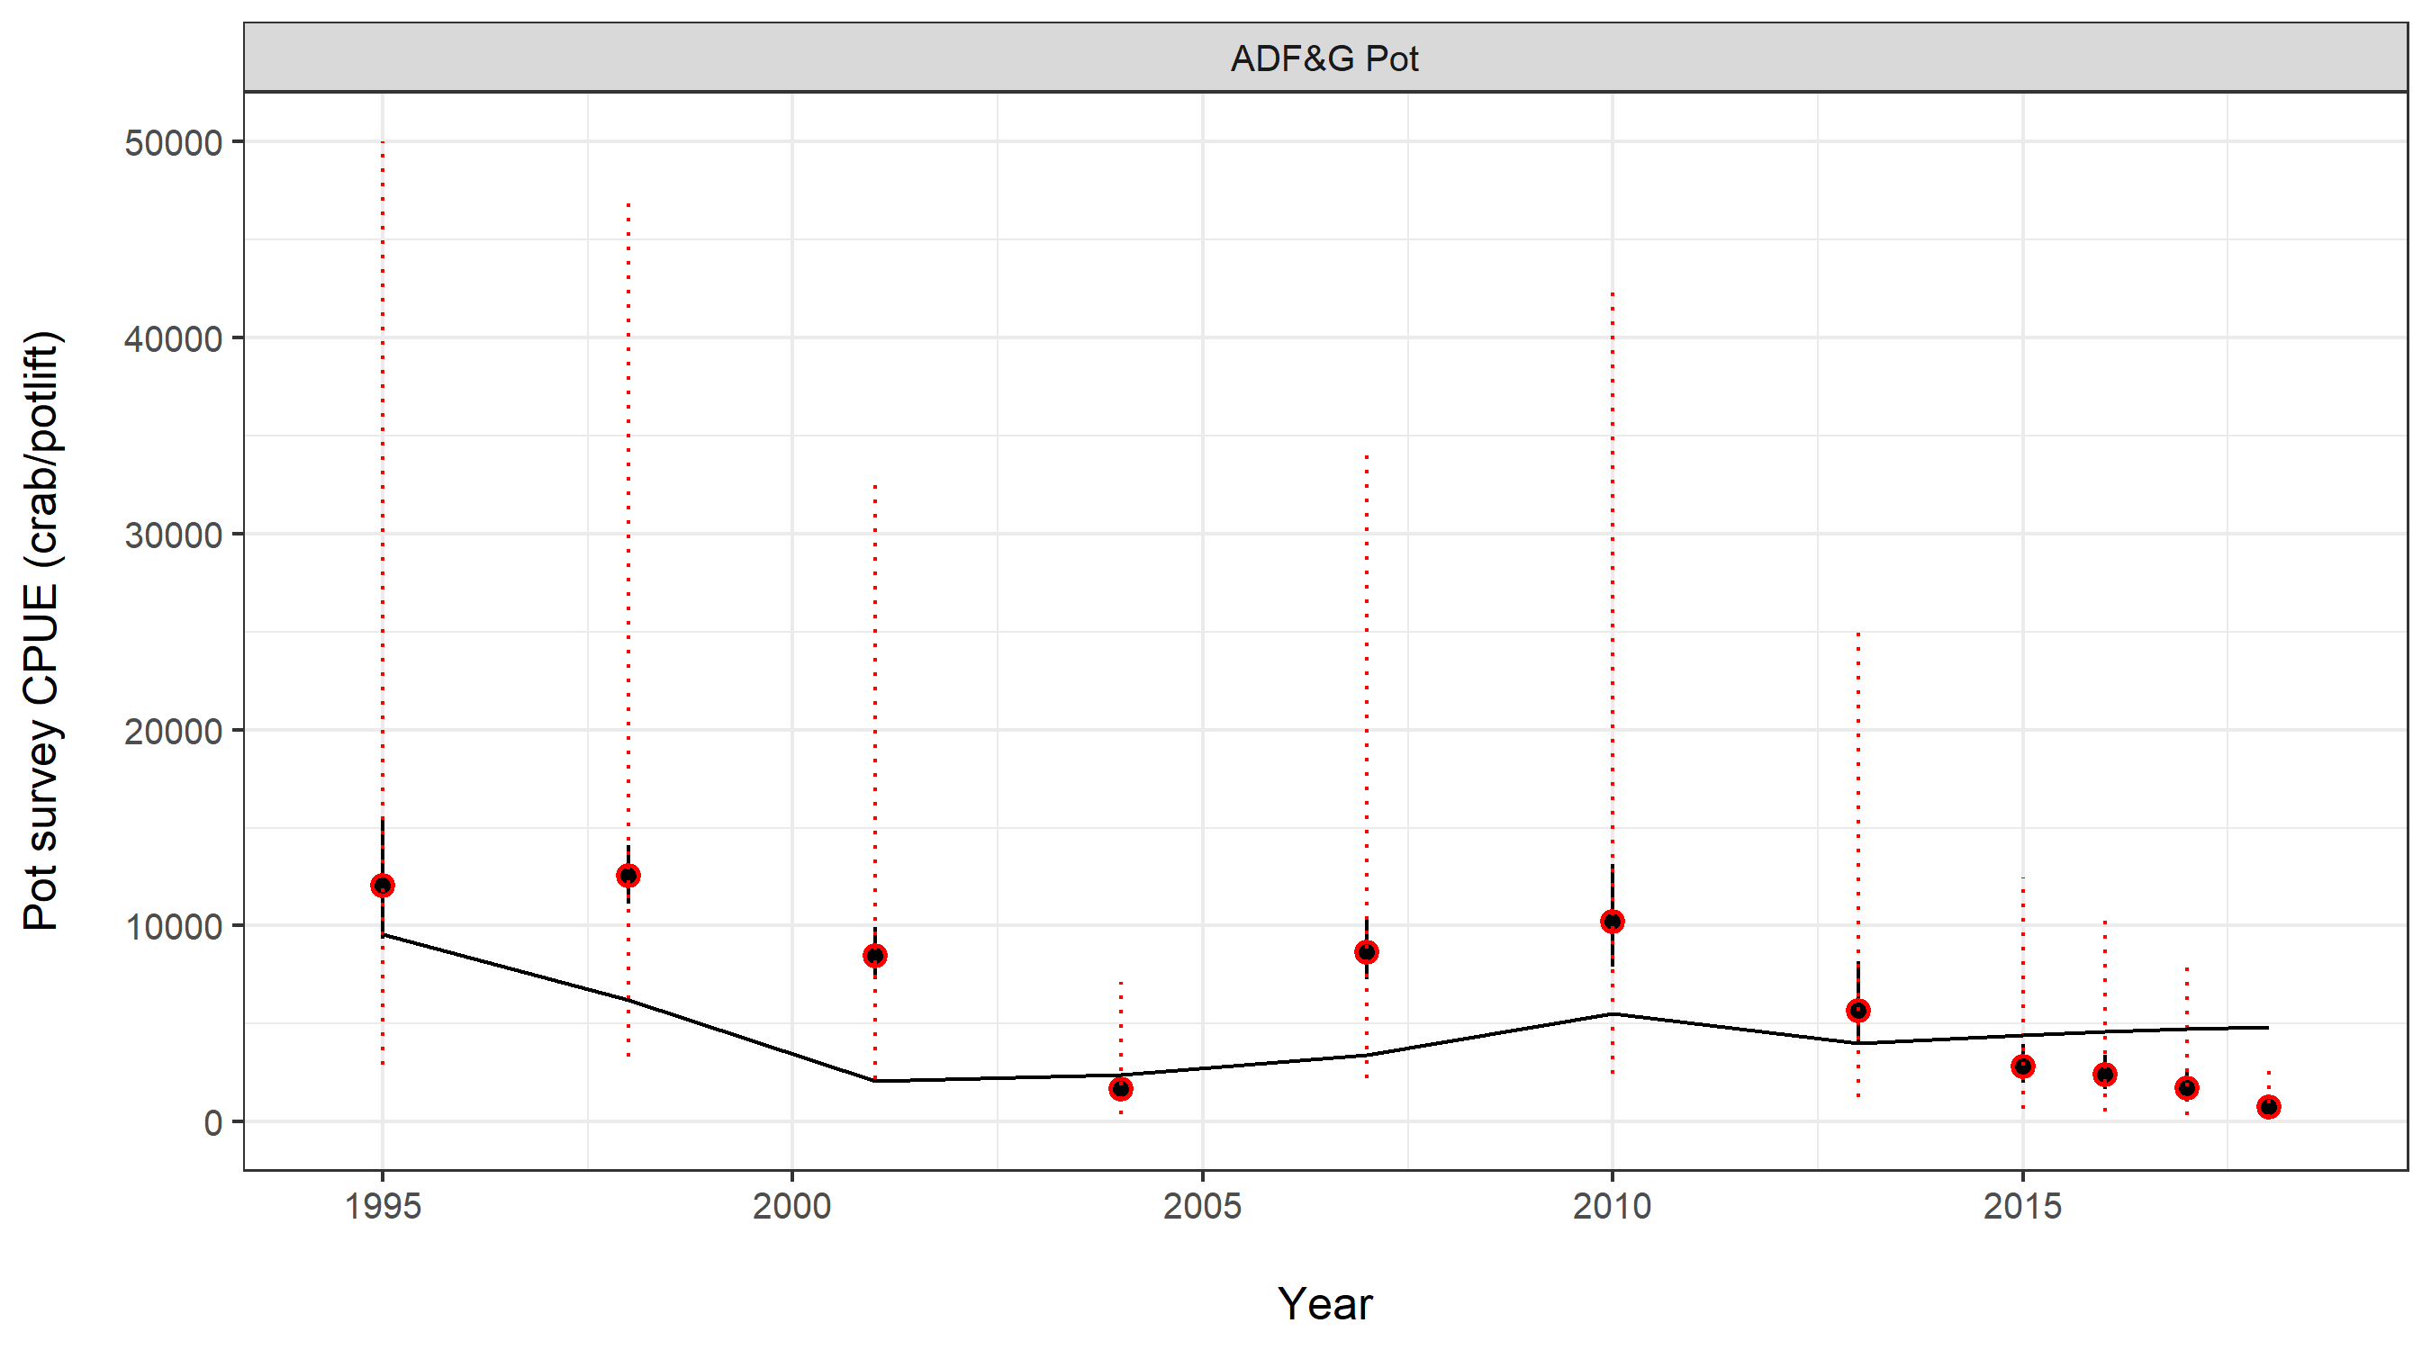
Add CV Pot survey
Large estimated additional CV
Flexibility in survey fit

Slide 17
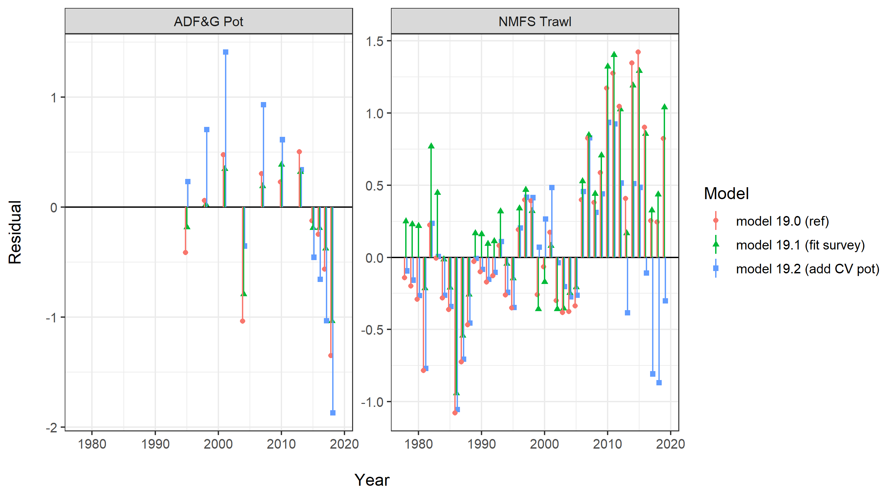

Slide 18
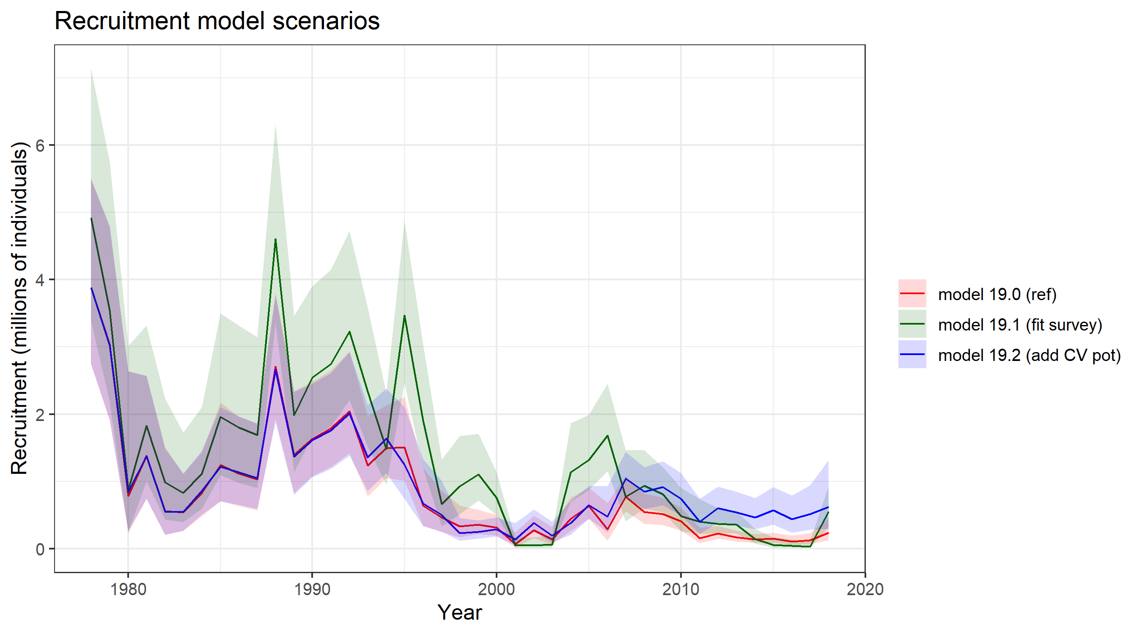

Slide 19
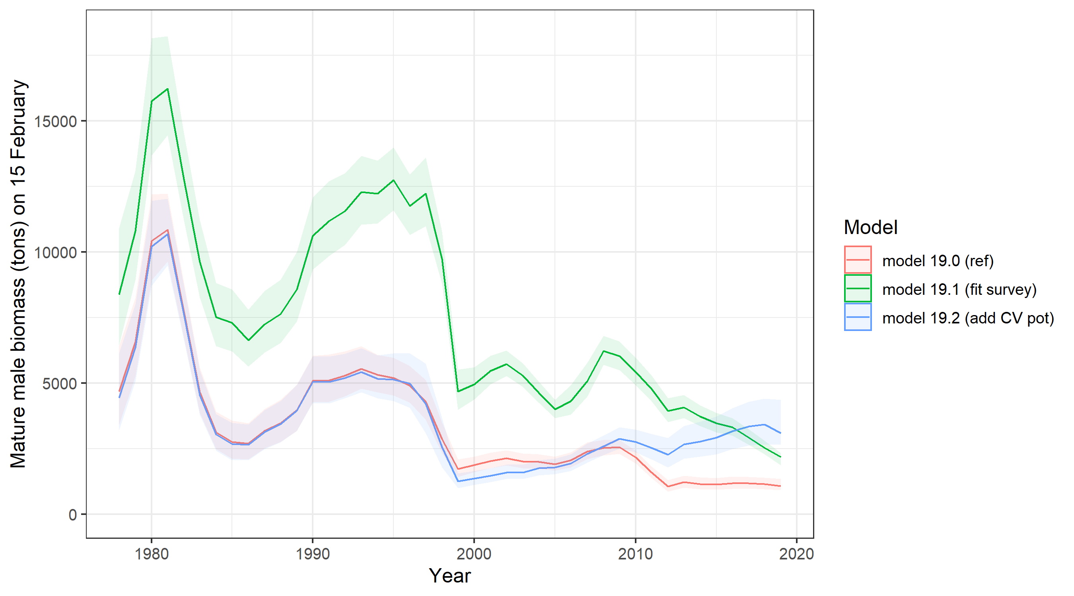

Slide 20
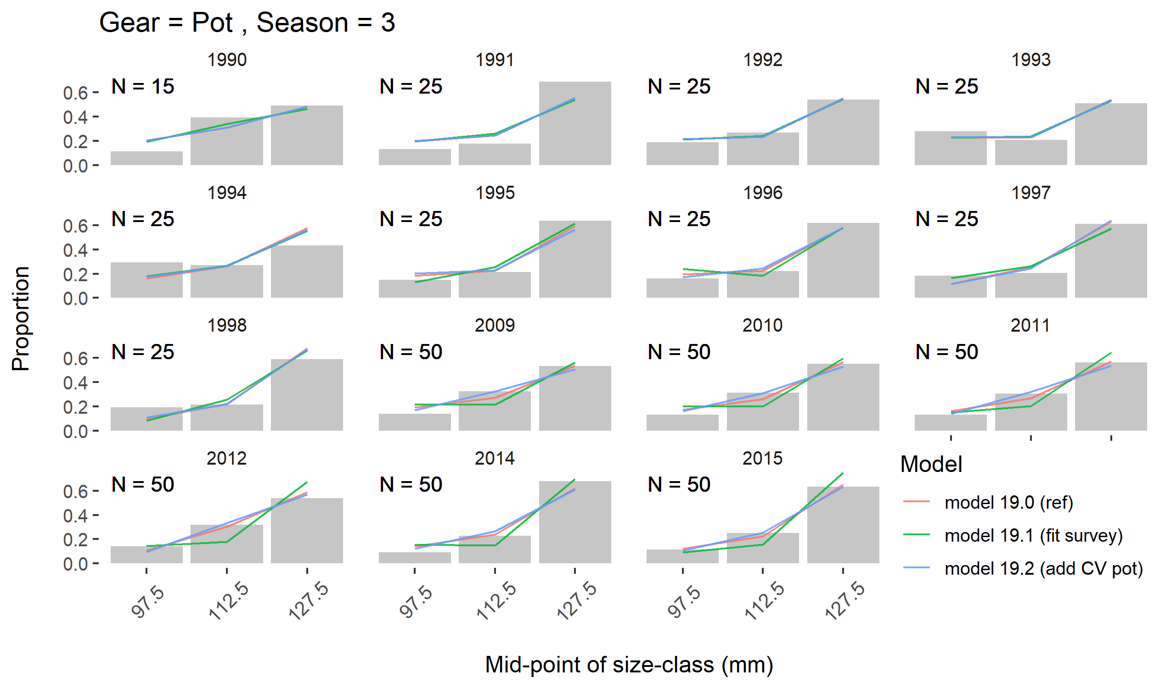

Slide 21
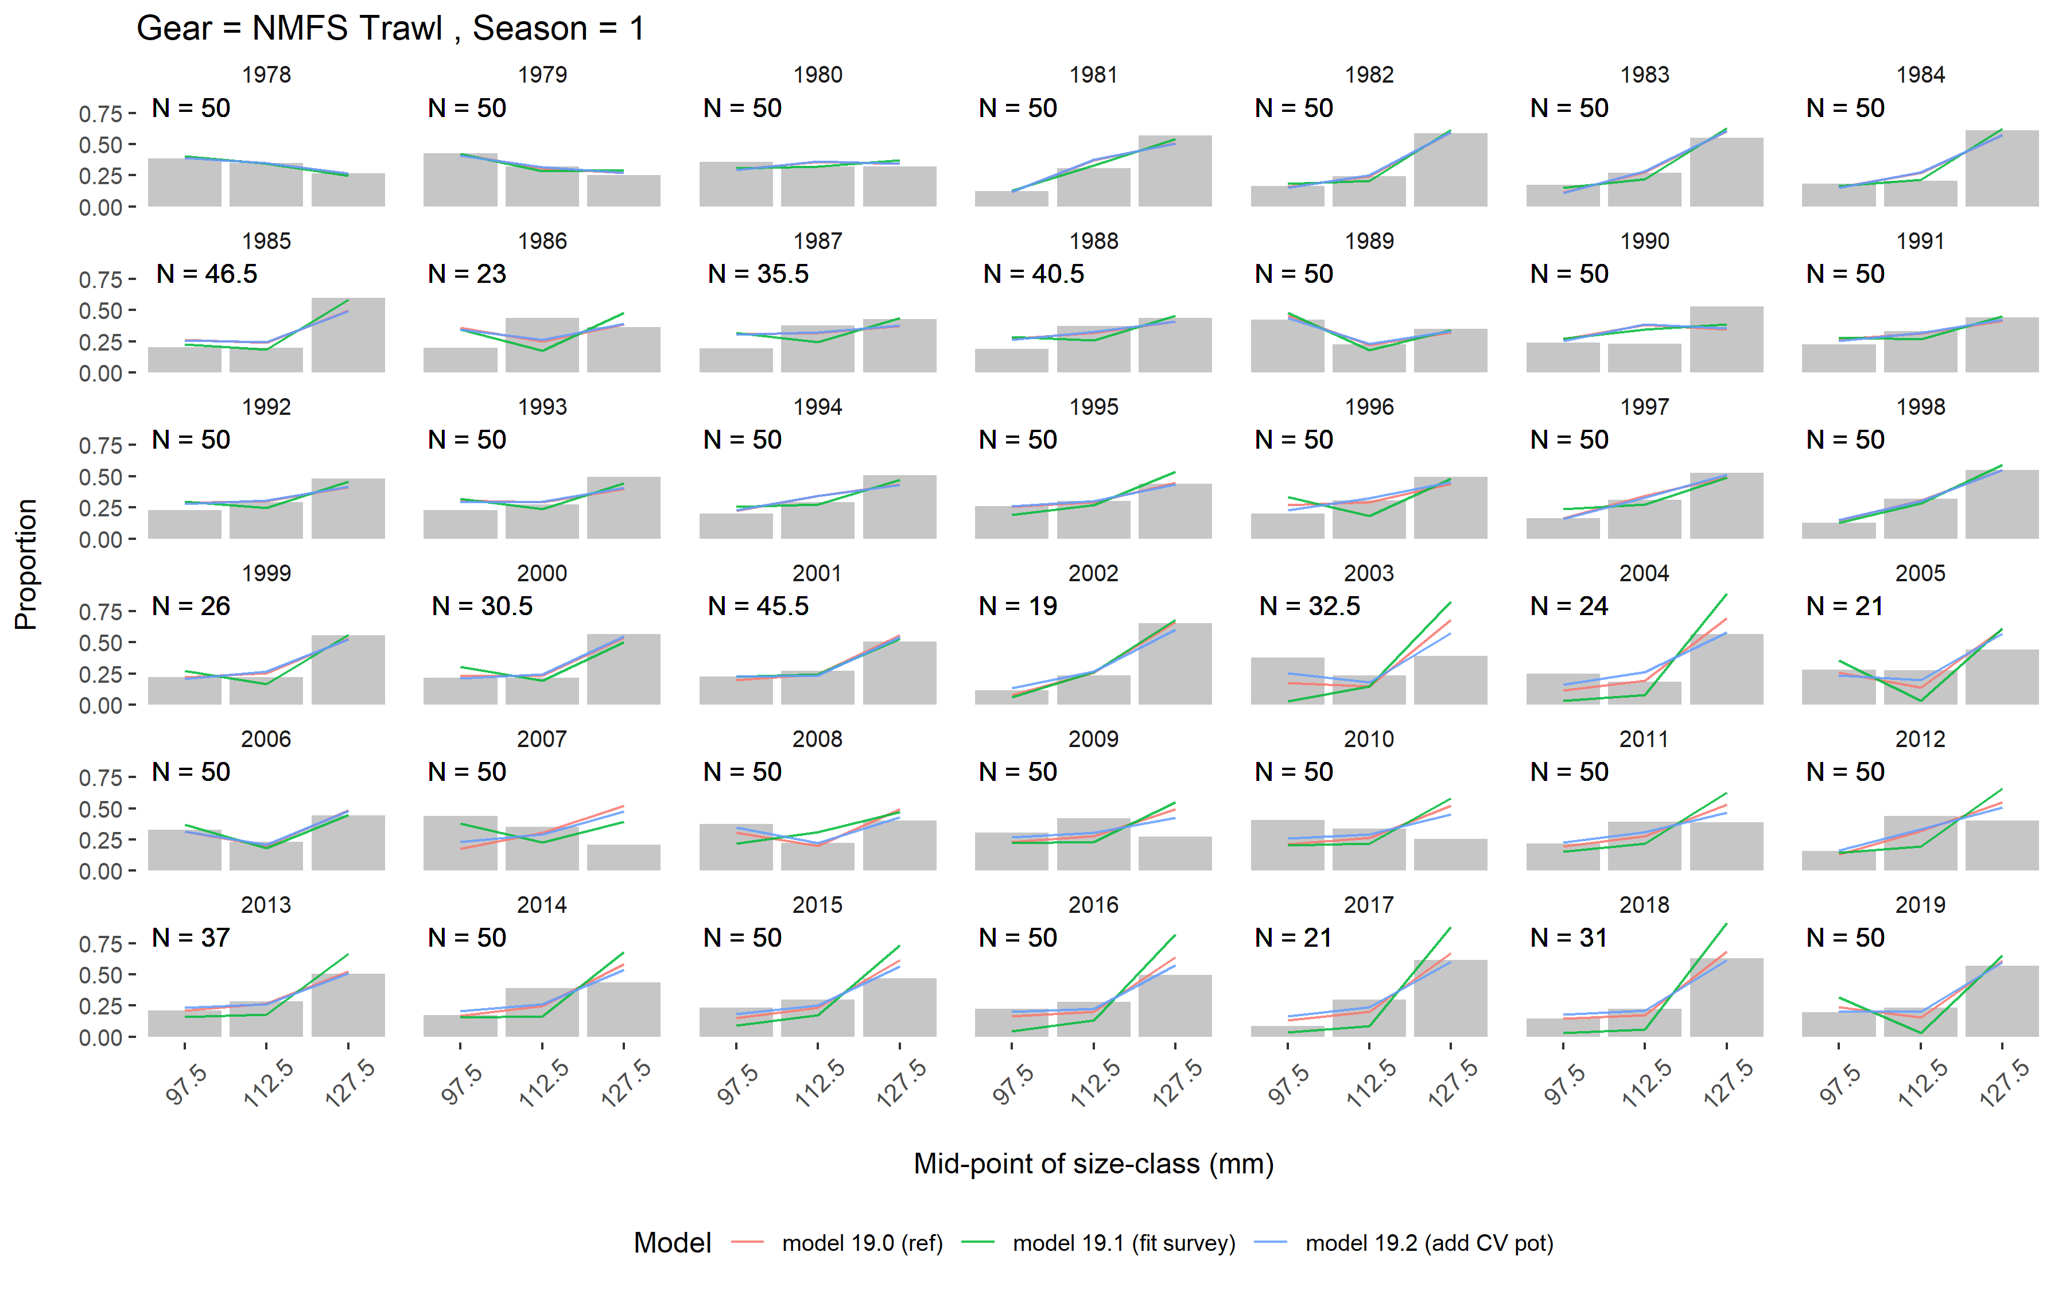

Slide 22
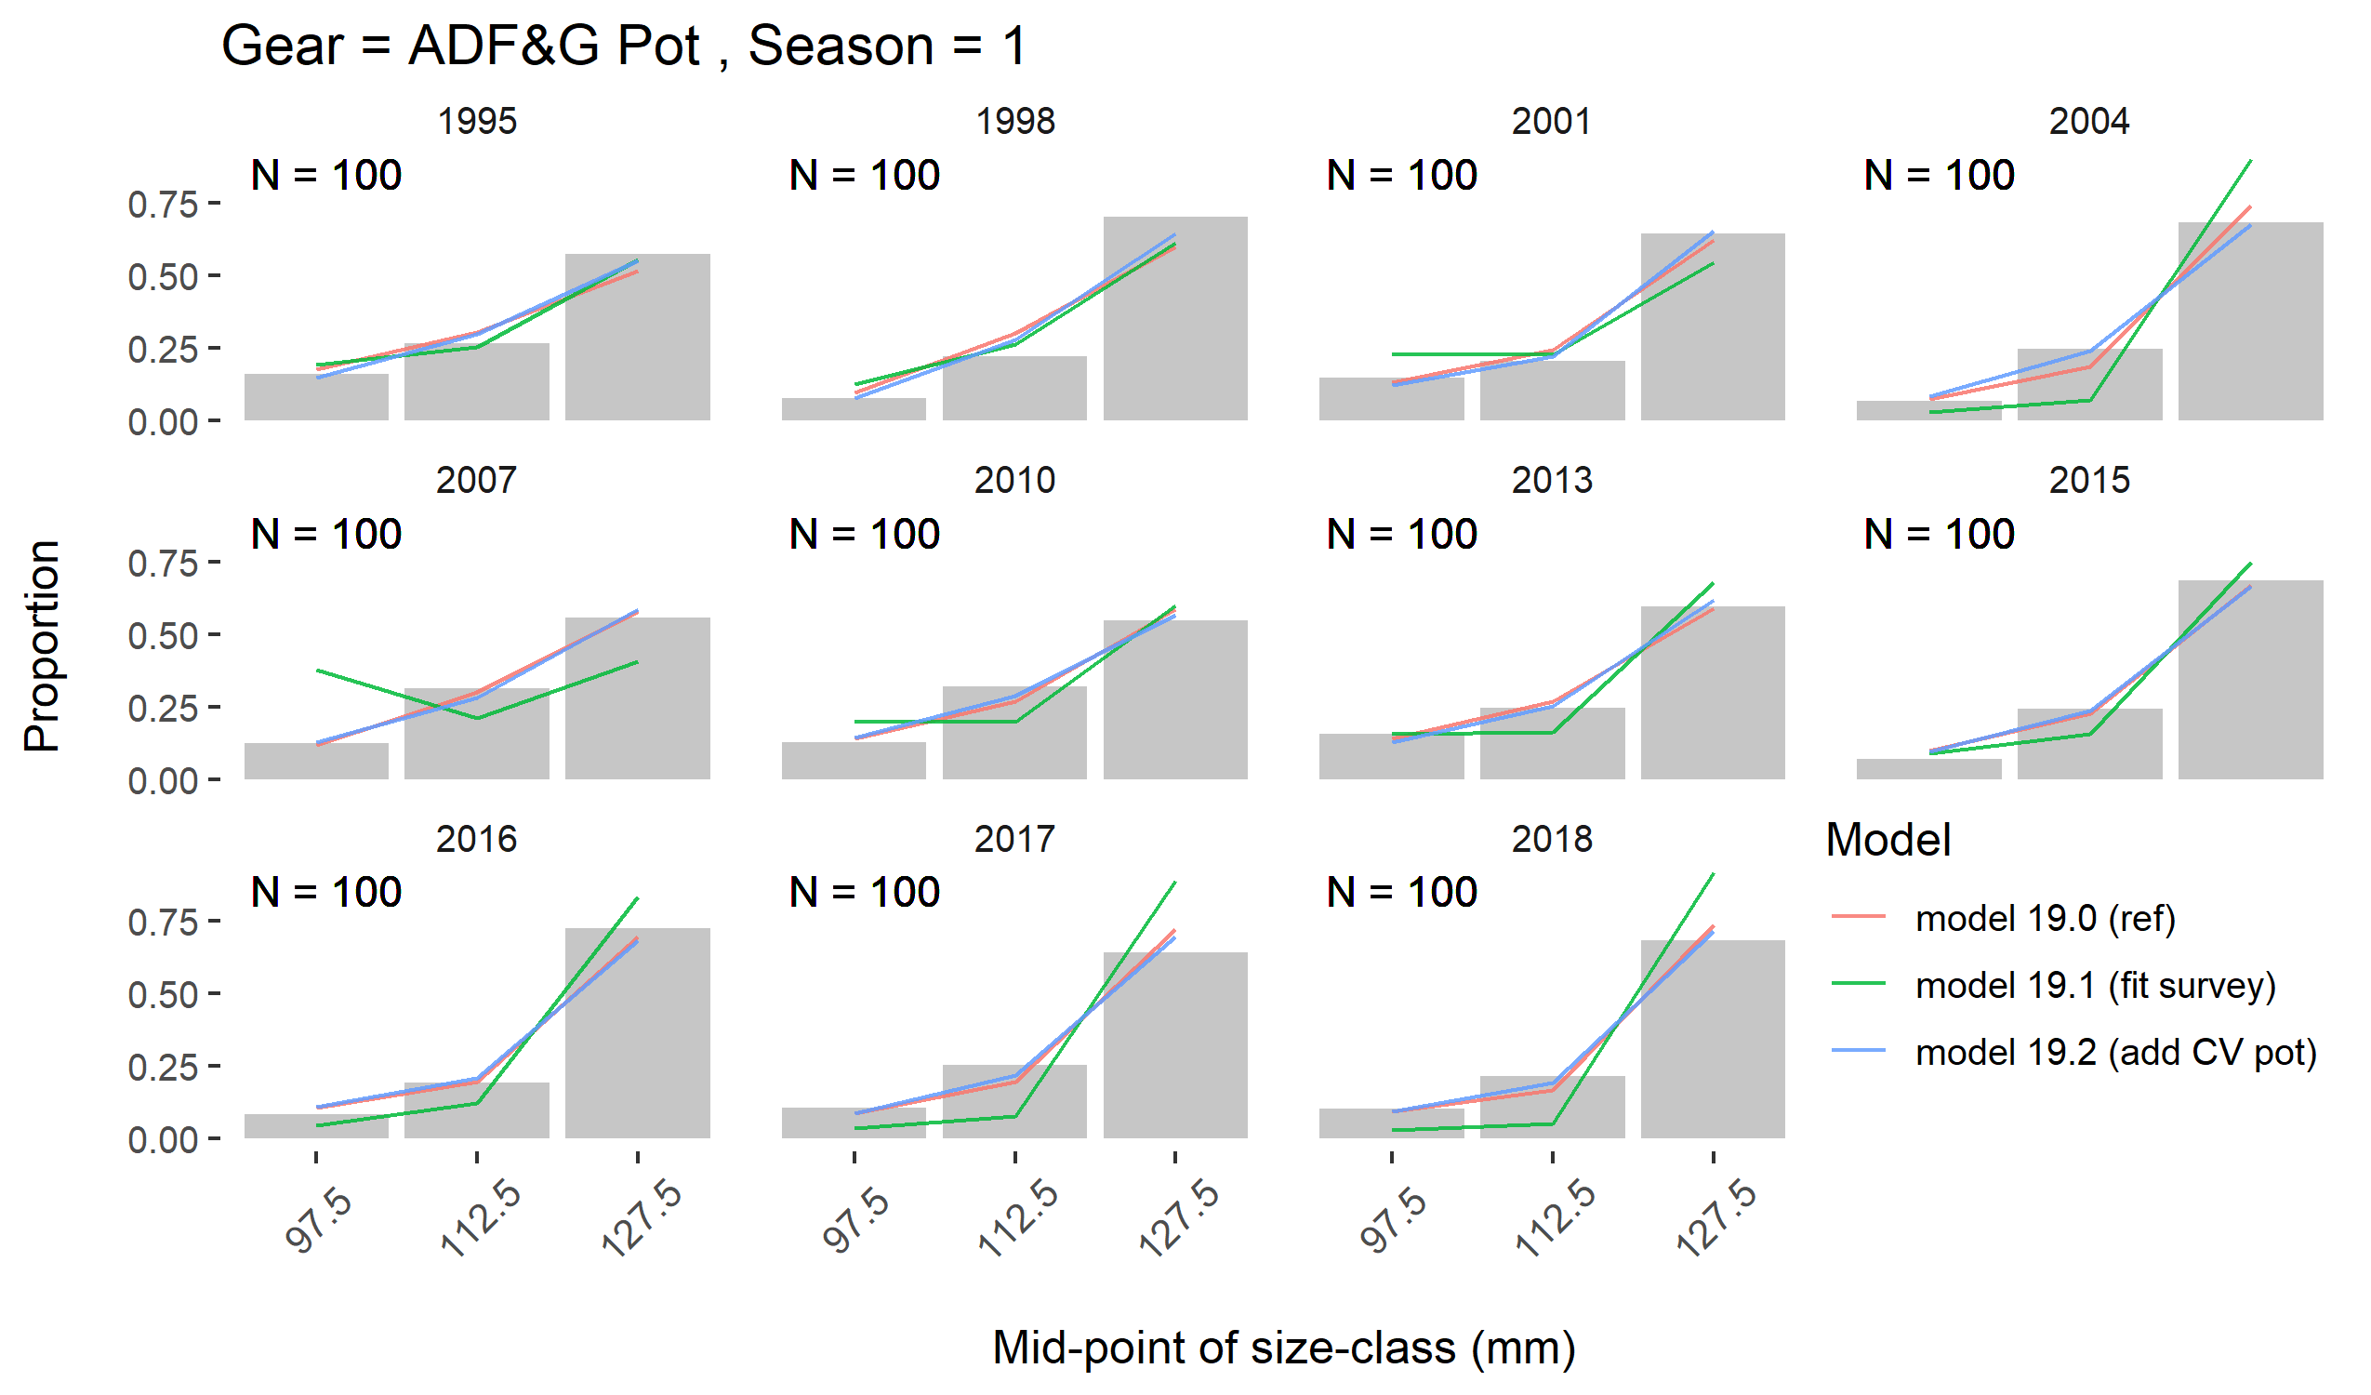

Slide 23
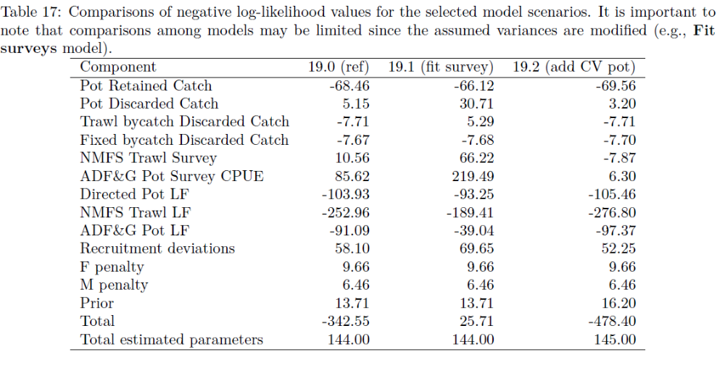

Slide 24
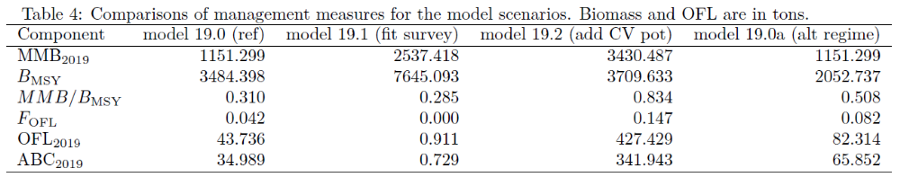
Recommend reference model for OFL/ABC for this coming year.
Consistency between assessment model and rebuilding plan
Subjectivity of survey weighting
Concerns:
Overall fit to the survey data in recent years
Reconciling pot and trawl survey trajectory differences

Slide 25
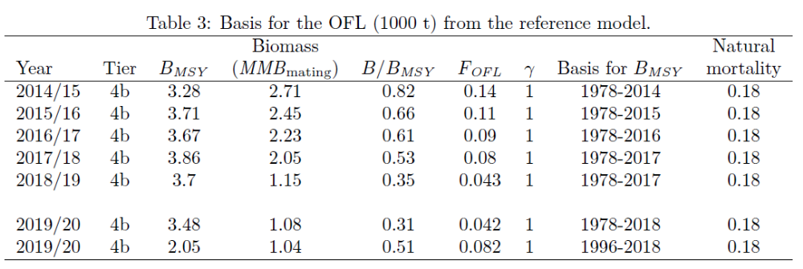

Slide 26
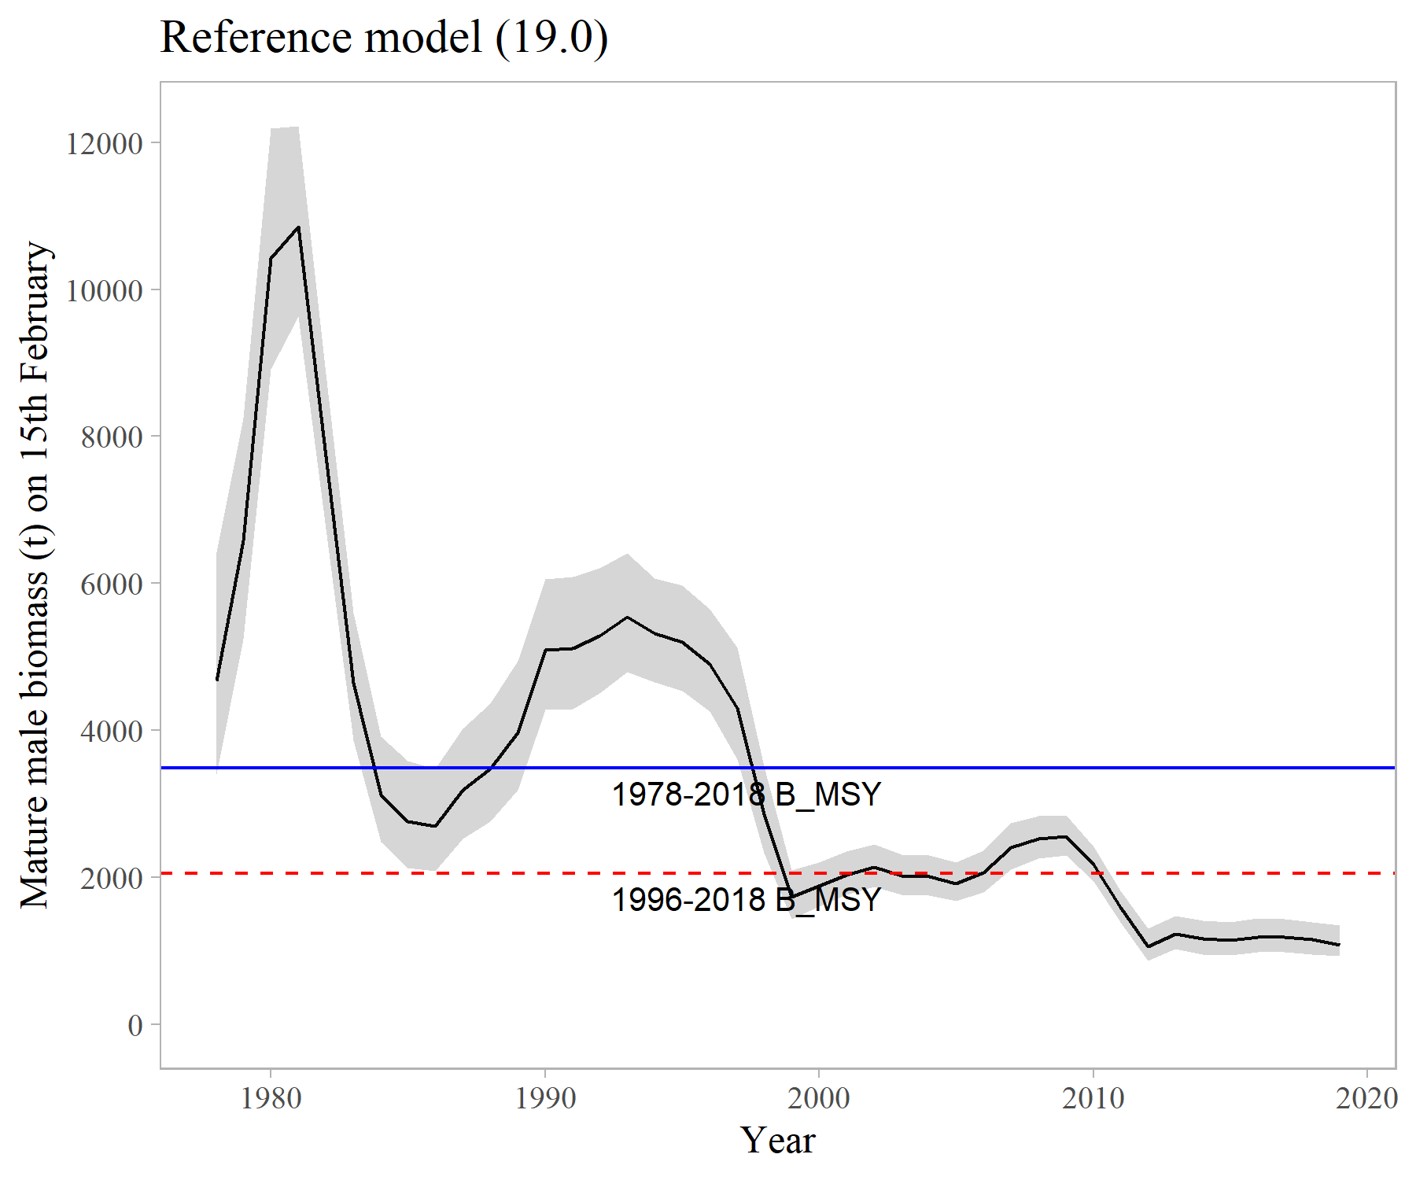
Reference point time frame?
Both STARS and breakpoint analysis suggest a break in recruitment in 1996
Responds to current regime and sets realistic expectations
Concerns:
  Both methods are based on model output

Slide 27
Decision points / Recommendations
Most probably assumption on regime / expectations of the stock?
Change B_{MSY} proxy years?
Recommendations:
Future work on model fit to surveys
Research priority on relationship between the two surveys / spatial extent of the stock

Slide 28
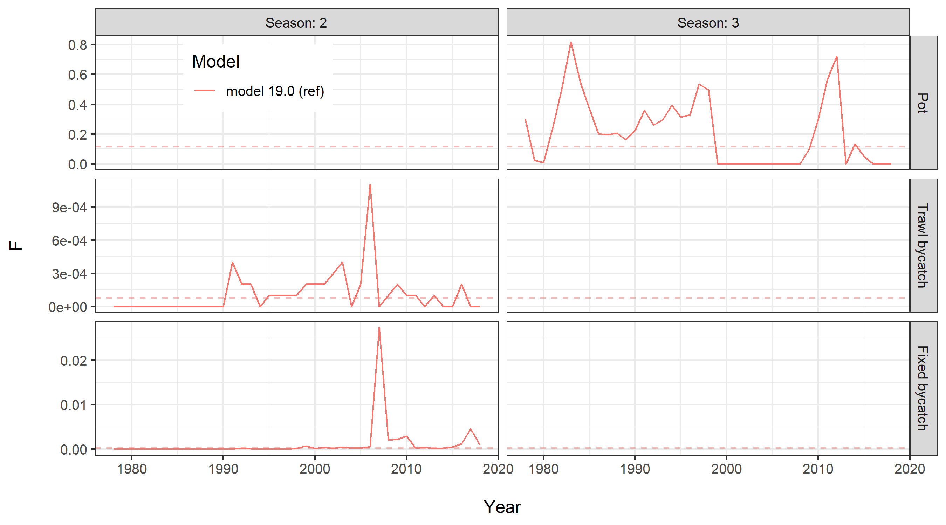
Fishing Mortality
Notes:
Dashed line is fbar

Slide 29
Rebuilding projections

Slide 30
Recap of early work
Bycatch of SMBKC minimal in groundfish fisheries (recent time frame) and does not impact projection output
May/June consensus to use “random recruitment” for projections
Fishing rate of F = 0.18 was taken out of projections, upper max is consistent with the current state harvest policy
Projection outcome directly linked to recruitment assumptions

Slide 31
Projection options
Projection | Recruitment | B_{MSY} proxy years | Recruitment years
1 | Random recruitment | 1978-2018 | 1978-2018
5 | Random recruitment | 1996-2018 | 1996-2018
Random recruitment – random draws from the recruitment time frame
Groundfish bycatch is present at average recent levels
F = 0 (no direct fishing) and an F = state harvest policy

Slide 32
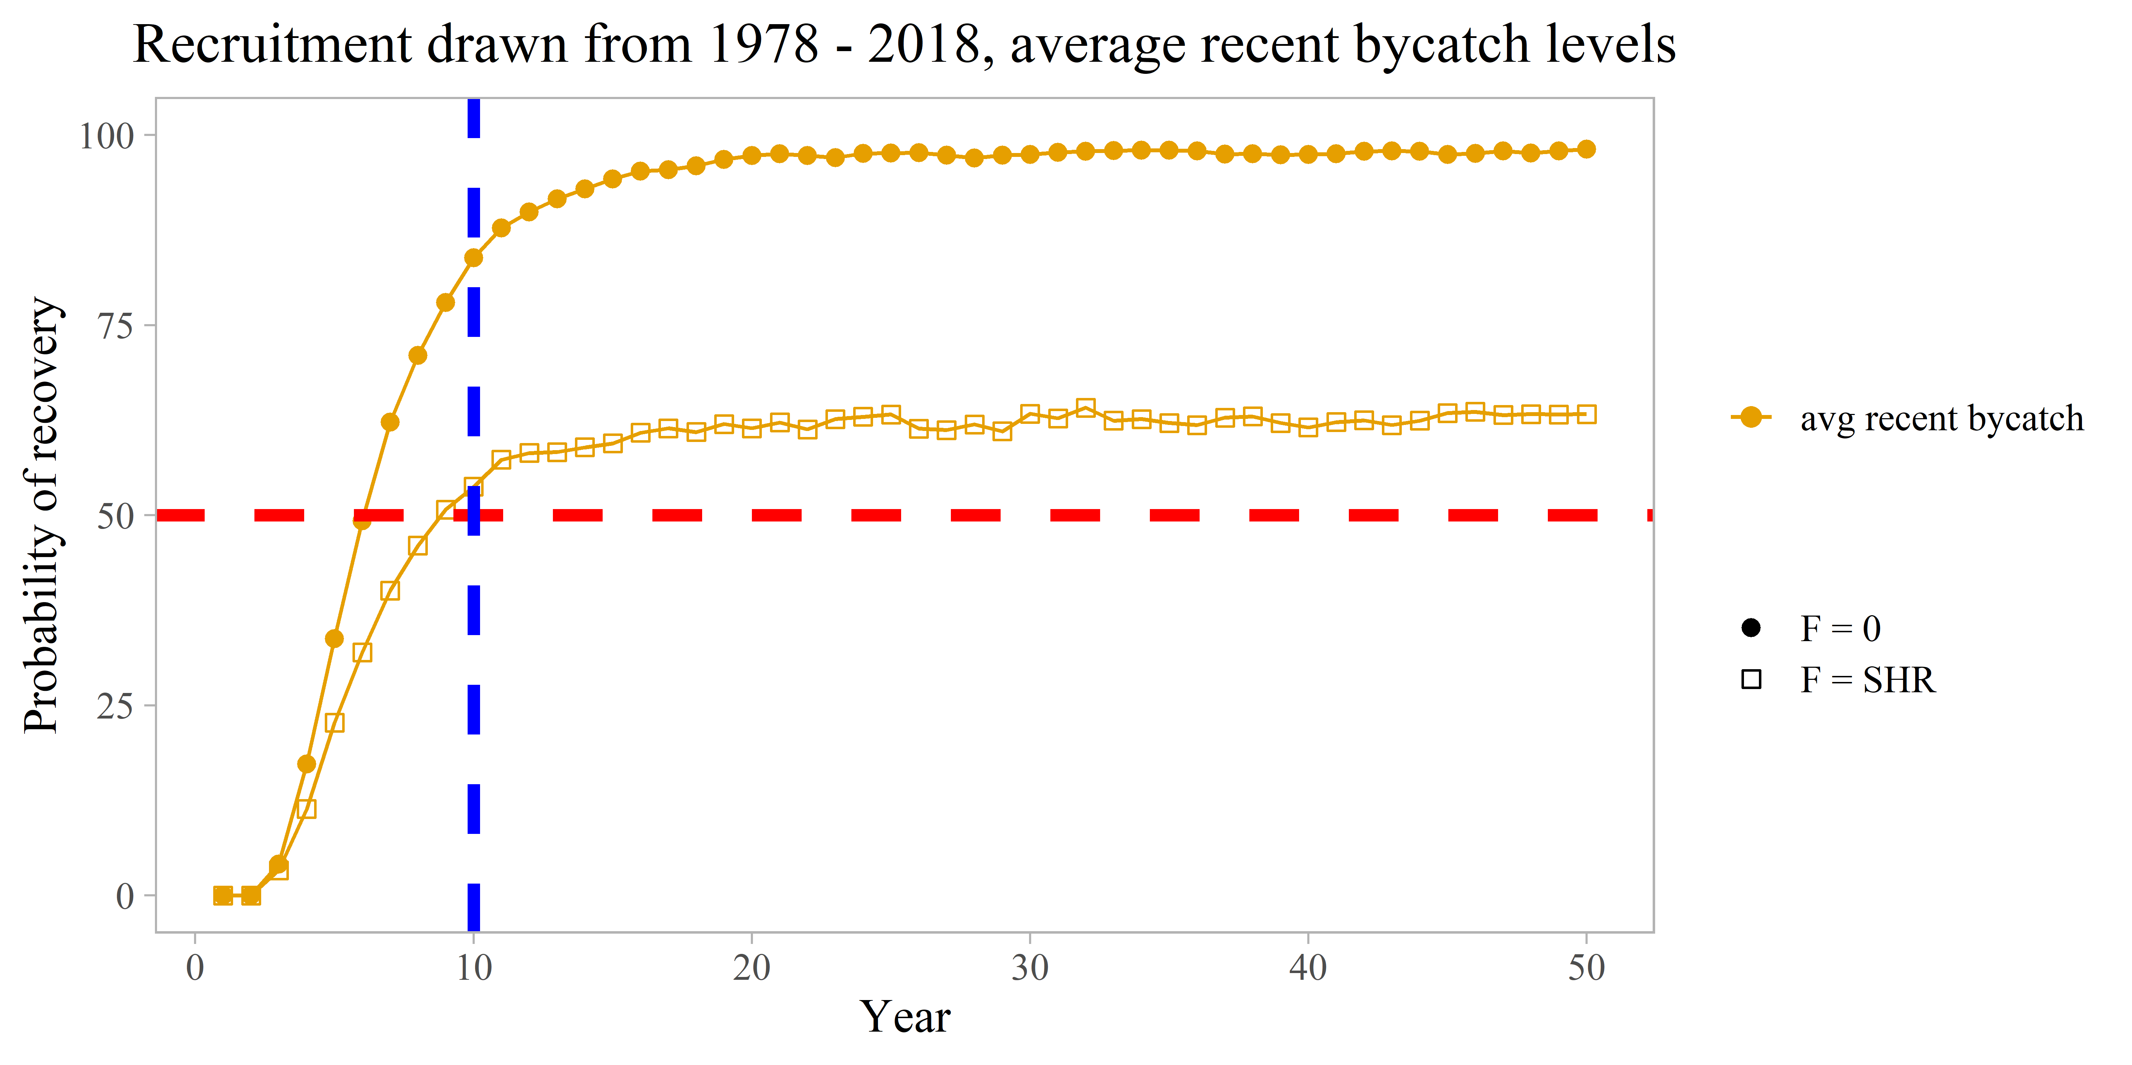

Slide 33
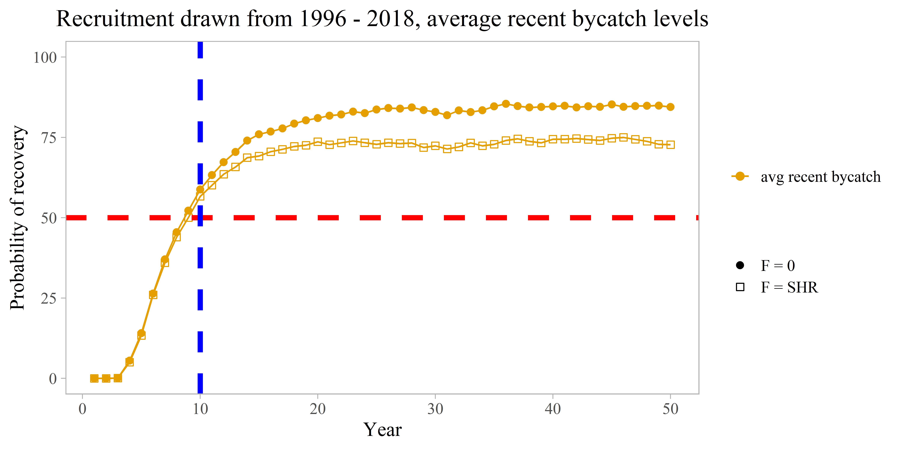

Slide 34
T_{MIN} options
Projection | Recruitment | B_{MSY} proxy years | Recruitment years | T_{min}
1 | Random recruitment | 1978-2018 | 1978-2018 | 6.05 yrs
5 | Random recruitment | 1996-2018 | 1996-2018 | 9.0 ys
No directed fishing (F = 0)
Recent bycatch levels
What if bycatch increases?

Slide 35
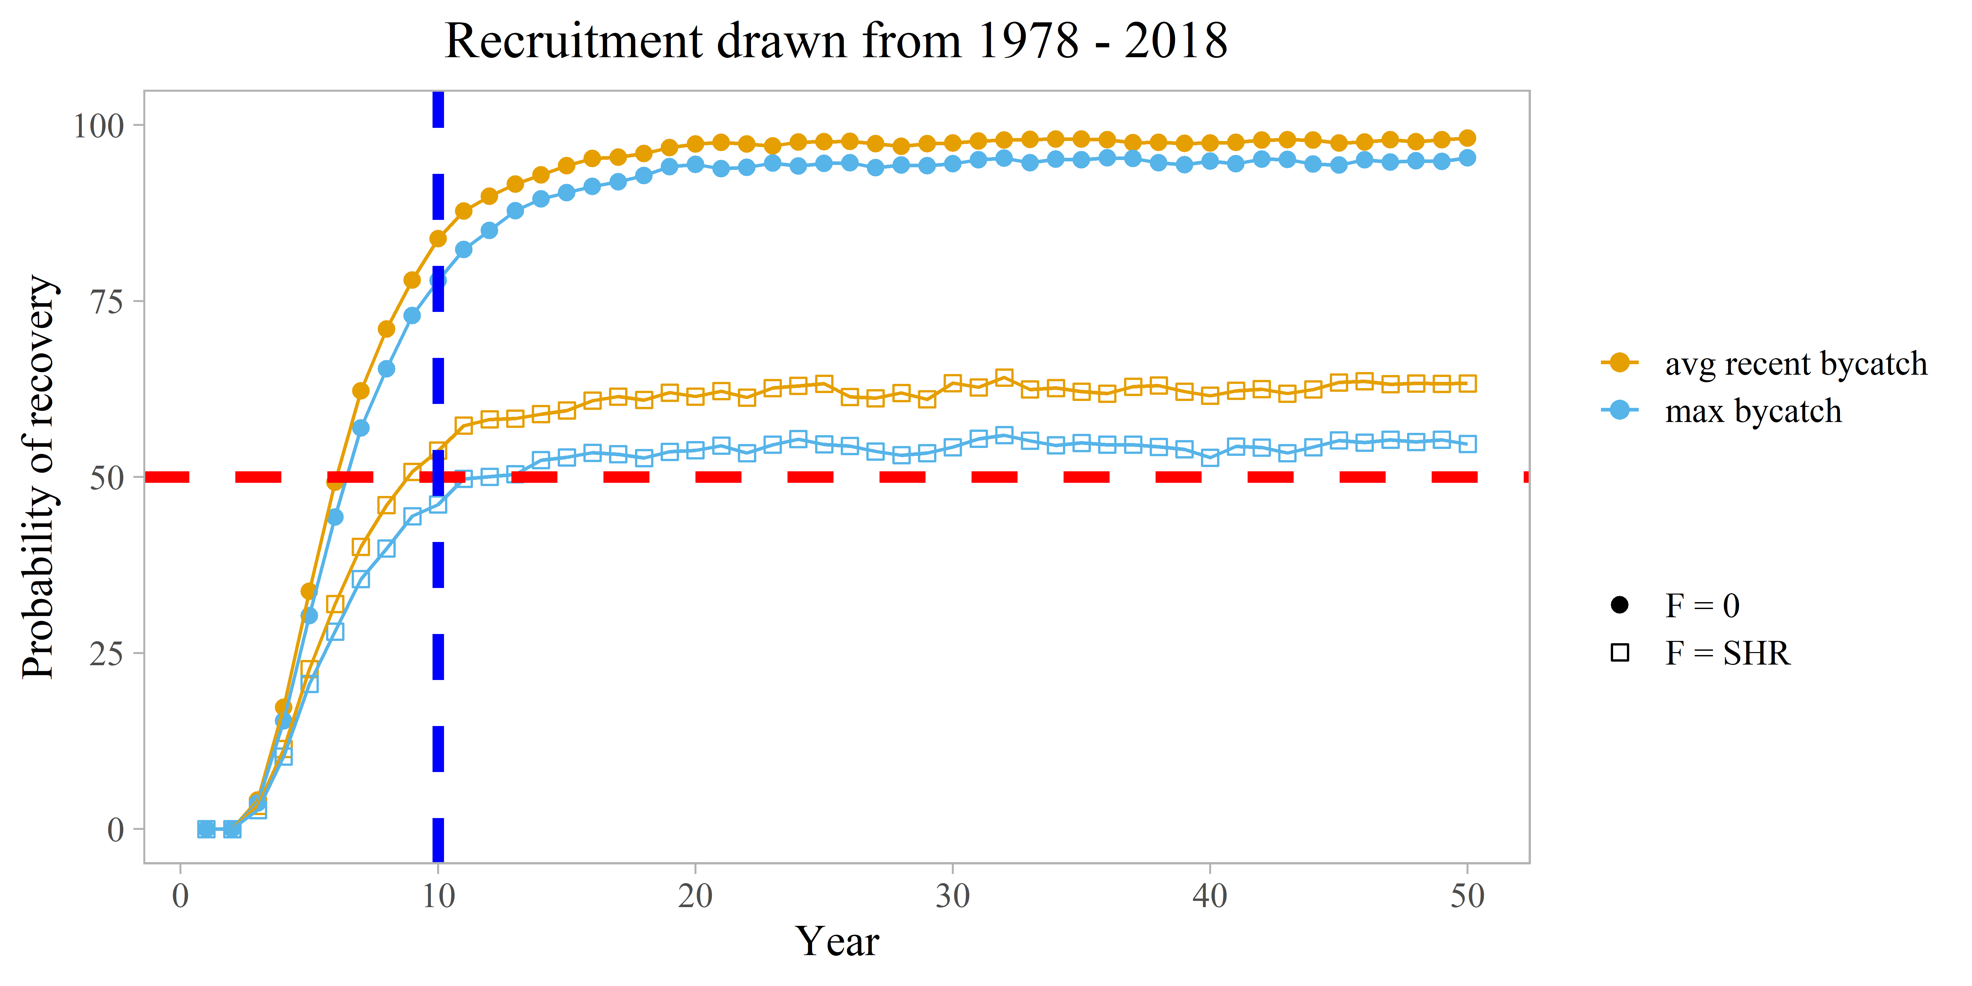
Increased Bycatch
Max observed bycatch levels
Persist at this level throughout 50 year projection

Slide 36
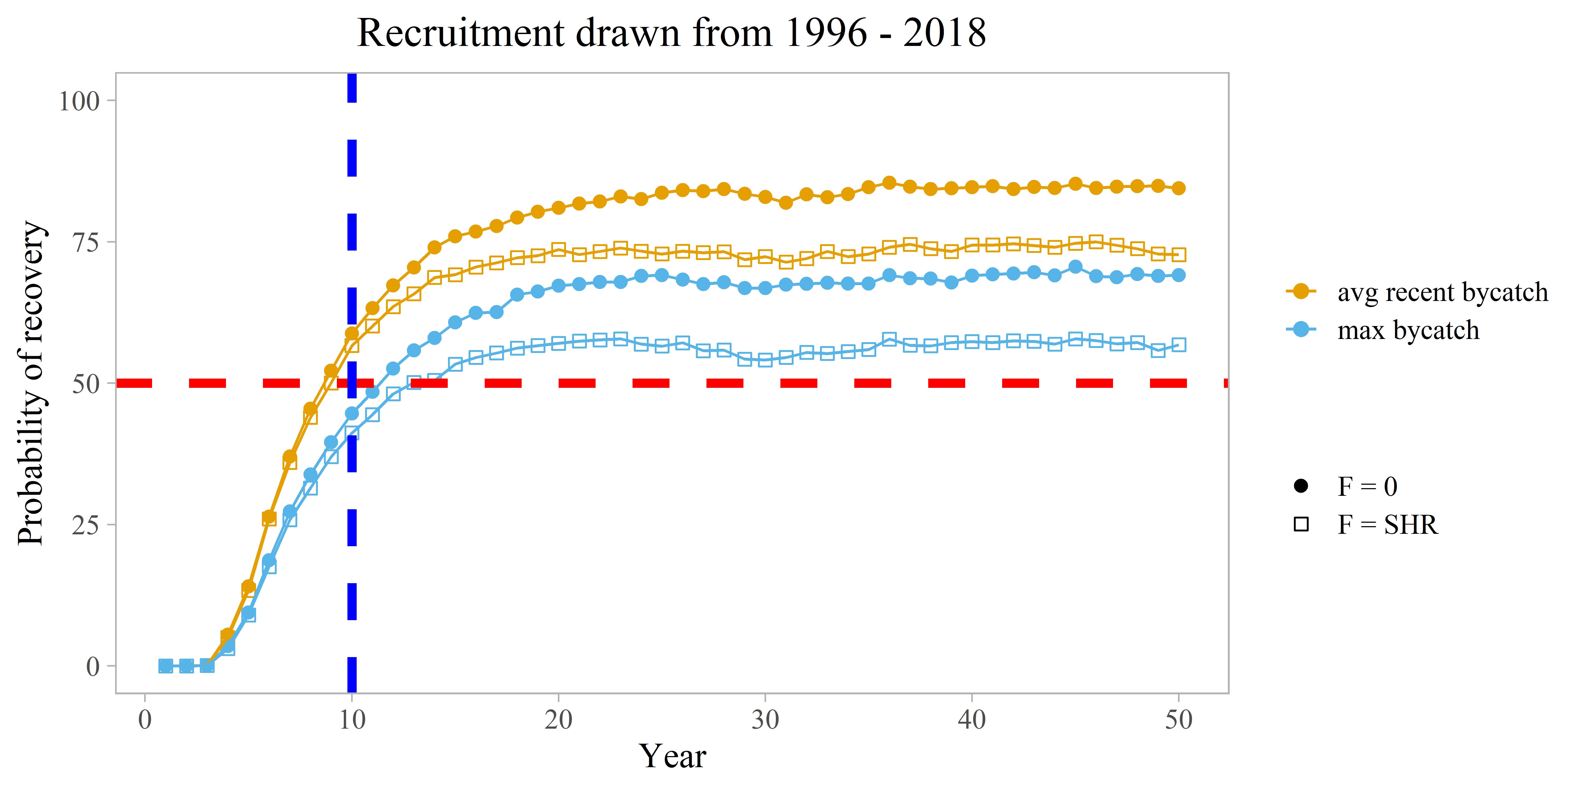

Slide 37
T_{MIN} options – under max observed bycatch levels
Projection | Recruitment | B_{MSY} proxy years | Recruitment years | T_{min}
1 – aa | Random recruitment | 1978-2018 | 1978-2018 | 6.5 yrs
5 – aa | Random recruitment | 1996-2018 | 1996-2018 | 11.25 ys
No directed fishing (F = 0)
Bycatch equivalent to 2007 levels – about 10x higher than recent levels.

Slide 38
Decision points
Most probably assumption on recruitment and expectations of stock potential?
Change B_{MSY} proxy years?
T_{MIN} based on these choices

Slide 39
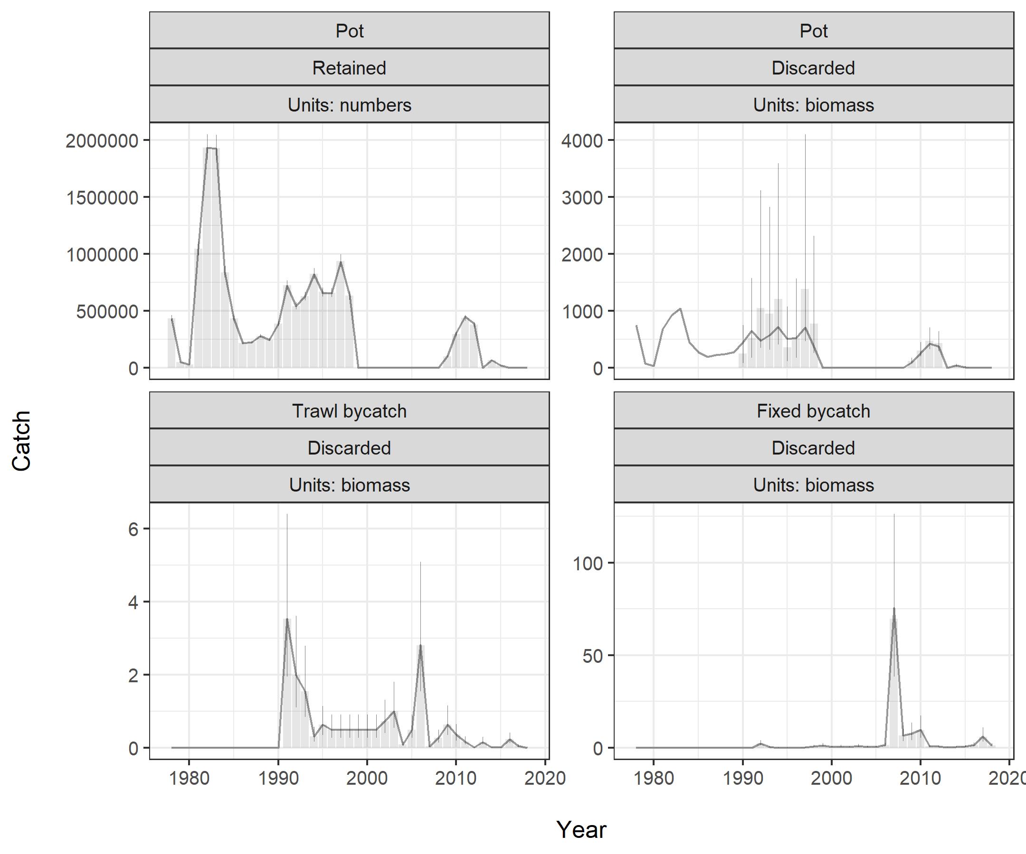
Notes:
Fit to catch.

Slide 40
