Slide 1
Eastern Bering Sea snow crab stock assessment
Cody Szuwalski
Crab Plan Team
September 17, 2019

Slide 2
Big picture
Decrease in observed survey MMB
Smaller increase in predicted MMB than projected, but still increasing
Continued instability in model output
Changes in natural mortality in assessment led to higher OFLs
Preferred OFL: 54,900 tons (85% higher than last year)
Projected status in 2019/2020: 133% of BMSY

Slide 3
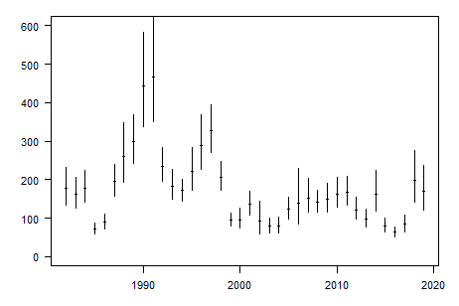
Slight decline in survey MMB in 2019

Slide 5
The stock is above MSST and fishing pressure is below F_{35%}

Slide 6
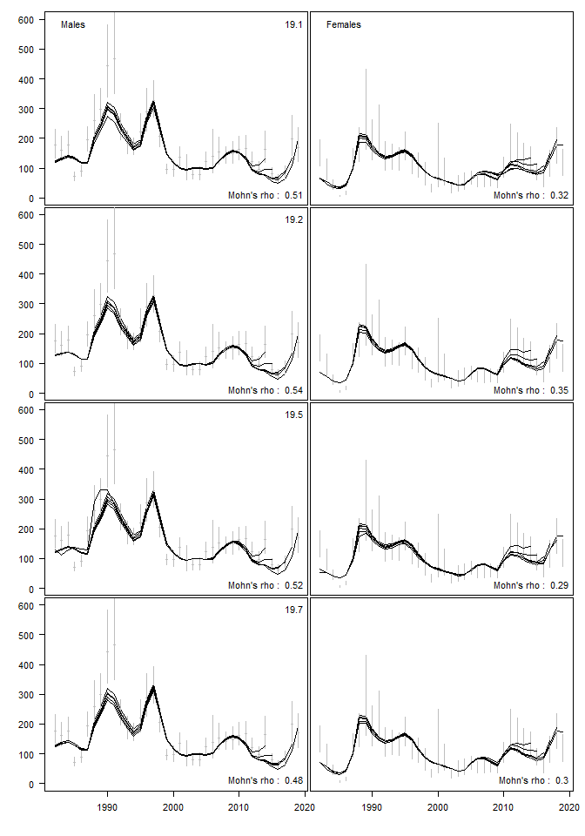
Instability
Jitters
Retrospective patterns
2018 model
2018 data
2018 model
2019 data
Neg log likelihood

Slide 7
Models considered
(based on CPT and SSC suggestions)

Slide 8
Recap of 2018 model
Median of the prior on M = 0.23
Kinked growth curves for both males and females
Separate recruitment deviations estimated for males and females
Distribution of recruits at length is fixed and shared among males and females

Slide 9
Models considered

Slide 11
0.49
Females
0.36
Males
“We consider the models as proof-of-concept estimation frameworks and their results preliminary.”

Slide 13
Natural mortality
Methods for empirical estimation of natural mortality from maximum age
Estimated from fits to observed values for fish (not crab) species
Then et al. (2015)
  “Evaluating the predictive performance of estimators of natural mortality…”
  Maximum age does the best
  M = 4.899(max_age)^-0.916
Hamel (2015) and Dick et al. (2018)
  “A method for calculating a meta-analytical prior for natural mortality…” &
  “The combined status of Blue and Deacon Rockfishes in U.S. waters…”
  Recalculated Then and force through the intercept
  M = 5.4/(age_max)

Slide 15
Natural mortality
SSC: Outside the model vs. inside?
Confounding with other processes
Large changes in management quantities
Maximum age is still poorly known

Slide 16
Models considered

Slide 17
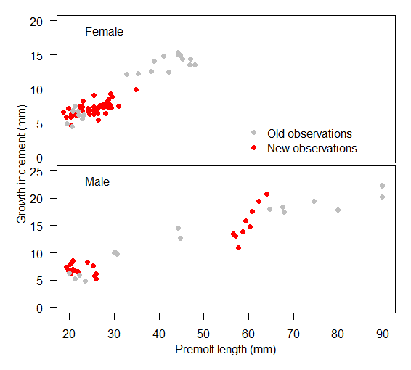
Growth model has been a source of instability
Kink included because of differences in growth for maturing crabs
2018 scenario fit linear growth for both males and females, but did not converge

Slide 18
Models considered

Slide 20
Models considered

Slide 21
New data
Subtraction method this year resulted in negatives in some length bins—set them to 0.
Next year won’t be a problem because I hope to move to GMACS and input data as total length comps

Slide 22
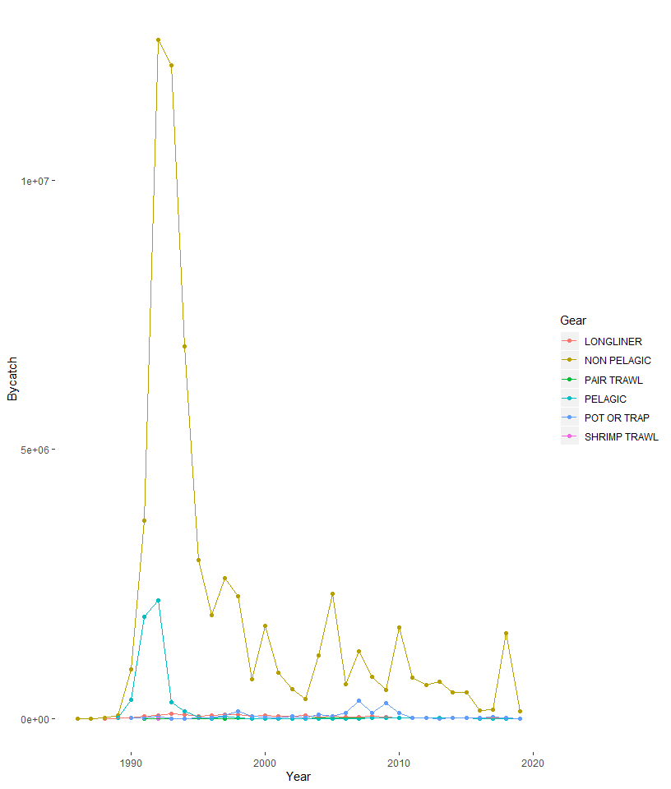

Slide 24
Model overview
July 1
Survey
Logistic selectivity in 2 ‘eras’
Linked to BSFRF data
Size composition and biomass index
7.5/12 M
Directed fishery
Non-directed fishery
Mating
4.5/12 M
Molting
Growth
Recruitment

Slide 25
Model overview
Survey
Mature males, immature for both sexes, mature females (Except 1)
Estimated with a prior
7.5/12 M
Directed fishery
Non-directed fishery
Mating
4.5/12 M
Molting
Growth
Recruitment

Slide 26
Model overview
Survey
7.5/12 M
Directed fishery
Logistic selectivity
Retention selectivity
Discard mortality equal to 30%
Fit to:
Retained length comps
Total length comps
Retained biomass
Male and female discard biomass
Non-directed fishery
Mating
4.5/12 M
Molting
Growth
Recruitment

Slide 27
Model overview
Survey
7.5/12 M
Directed fishery
Non-directed fishery
Logistic selectivity
Discard mortality equal to 80%
Mating
4.5/12 M
Molting
Growth
Recruitment

Slide 28
Model overview
Survey
7.5/12 M
Directed fishery
Non-directed fishery
Mating
Freely estimated maturity curves
February 15
4.5/12 M
Molting
Growth
Recruitment

Slide 29
Model overview
Survey
7.5/12 M
Directed fishery
Non-directed fishery
Mating
4.5/12 M
Molting
All immature crab assumed to molt
Terminal molt to maturity
Growth
Recruitment

Slide 30
Model overview
Survey
7.5/12 M
Directed fishery
Non-directed fishery
Mating
4.5/12 M
Molting
Growth
Two piece linear growth models estimated for both sexes
Recruitment

Slide 31
Model stability

Slide 32
Model | % converge | % at minimum
19.1 | 22 | 9
19.2 | 31 | 13
19.3 | 32 | 3
19.4 | 41 | 2
19.5 | 25 | 4
19.6 | 22 | 10
19.7 | 28 | 4

Slide 33
Retrospective patterns
A retrospective pattern is a consistent directional change in assessment estimates of management quantities (e.g. MMB) in a given year when additional years of data are added to an assessment.

Slide 34
Most models were instable when jittered.
All tested models had retrospective patterns influenced by “disappearing” large survey estimates .

Slide 35
Model | Pro | Con
19.1
19.2 |  | Worst retrospective pattern
19.3 | Best overall likelihood
19.4 |  | Poor jittering pattern
19.5 | Best jittering pattern
19.6
19.7

Slide 36
Model fits

Slide 37
Note: NMFS and BSFRF female biomass equal in 2009

Slide 39
Model | Pro | Con
19.1
19.2 |  | Worst retrospective pattern
19.3 | Best overall likelihood, linear fits to growth data without forcing
19.4 |  | Poor jittering pattern
19.5 | Best jittering pattern; linear male growth
19.6
19.7 | Linear male growth

Slide 42
Retained catch
Total catch

Slide 43
SURVEY

Slide 45
TRAWL

Slide 46
Estimated population processes

Slide 47
Survey
7.5/12 M
Directed fishery
Non-directed fishery
Mating
4.5/12 M
Molting
Growth
Recruitment

Slide 48
Survey
7.5/12 M
Directed fishery
Non-directed fishery
Mating
4.5/12 M
Molting
Growth
Recruitment

Slide 49
Model | Pro | Con
19.1
19.2 | Male survey q near implied q from BSFRF | Worst retrospective pattern
19.3 | Best overall likelihood, linear fits to growth data without forcing, Male survey q closer to implied q from BSFRF
19.4 |  | Poor jittering pattern
19.5 | Best jittering pattern; linear male growth
19.6
19.7 | Linear male growth, Male survey q closer to implied q from BSFRF

Slide 50
Survey
7.5/12 M
Directed fishery
Non-directed fishery
Mating
4.5/12 M
Molting
Growth
Recruitment

Slide 51
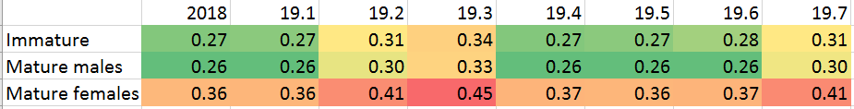
With a prior mean of 0.23, the model estimates M near the input value for the Then method.
With a prior mean from the Then method (0.27), the model estimates M near values near the Hamel method.

Slide 52
Model | Pro | Con
19.1 |  | Low M
19.2 | Male survey q near implied q from BSFRF, Increased M | Worst retrospective pattern
19.3 | Best overall likelihood, linear fits to growth data without forcing, Male survey q closer to implied q from BSFRF, Increased M
19.4 |  | Poor jittering pattern, low M
19.5 | Best jittering pattern; linear male growth | low M
19.6
19.7 | Linear male growth, Male survey q closer to implied q from BSFRF, Increased M

Slide 53
Survey
7.5/12 M
Directed fishery
Non-directed fishery
Mating
4.5/12 M
Molting
Growth
Recruitment

Slide 54
Survey
7.5/12 M
Directed fishery
Non-directed fishery
Mating
4.5/12 M
Molting
Growth
Recruitment

Slide 55
Survey
7.5/12 M
Directed fishery
Non-directed fishery
Mating
4.5/12 M
Molting
Growth
Recruitment

Slide 56
Model | Pro | Con
19.1 |  | Low M
19.2 | Male survey q closer to implied q from BSFRF, Increased M | Worst retrospective pattern
19.3 | Best overall likelihood, linear fits to growth data without forcing, Male survey q closer to implied q from BSFRF, Increased M
19.4 |  | Poor jittering pattern, low M
19.5 | Best jittering pattern; linear male growth | low M
19.6 | Better fits to trawl lengths | No change in estimated recruitment time series for females and males, low M
19.7 | Linear male growth, Male survey q near implied q from BSFRF, Increased M | Best retrospective pattern

Slide 57
The recommended model is ’19.7’
Recommended OFL is 54.92 kt

Slide 58
Moving forward
CPT and SSC seek a prioritized list of research
Moving to GMACS
  Biggest priority—2020 CIE review
Catchability
  BSFRF data
    We ‘know’ availability.
    Adding extra years
  Spatially derived index of time-varying catchability (tricky without considering confounded processes…)
  May address why increase in MMB was not as big as projected
Growth data
  Tracking down maturity data to inform a more realistic growth model
Spatial modeling
  Postdoc starting on developing a fully spatial assessment model as soon as visa resolved
  Explore impact of NBS on assessment
Natural mortality
  Radiometric aging of very old shell mature crab protected from the fishery

Slide 59
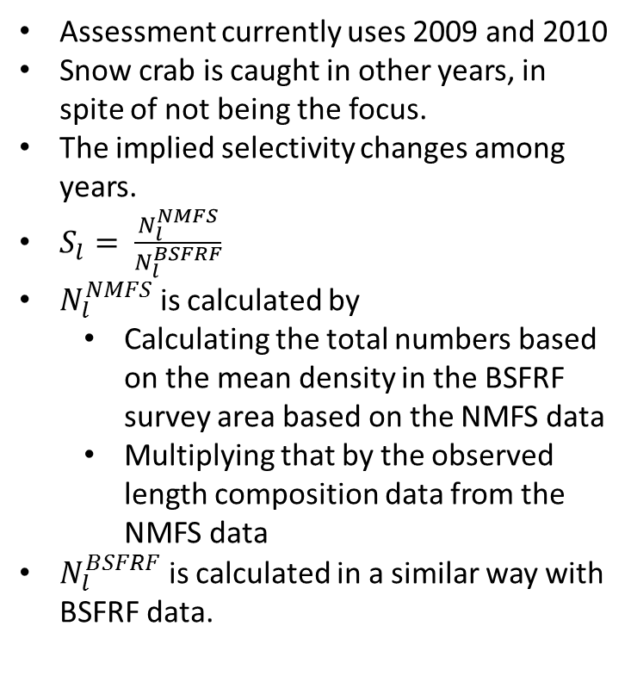
How can we better use the BSFRF data?
Assessment currently uses 2009 and 2010
Snow crab is caught in other years, in spite of not being the focus.
The implied selectivity changes among years.
$S_{l}= \frac{N_{l}^{NMFS}}{N_{l}^{BSFRF}}$
$N_{l}^{NMFS}$ is calculated by
  Calculating the total numbers based on the mean density in the BSFRF survey area based on the NMFS data
  Multiplying that by the observed length composition data from the NMFS data
$N_{l}^{BSFRF}$ is calculated in a similar way with BSFRF data.

Slide 62
Moving forward
CPT and SSC seek a prioritized list of research
Moving to GMACS
  Biggest priority—2020 CIE review
Catchability
  BSFRF data
    We ‘know’ availability.
    Adding extra years
  Spatially derived index of time-varying catchability (tricky without considering confounded processes…)
  May address why increase in MMB was not as big as projected
Growth data
  Tracking down maturity data to inform a more realistic growth model
Spatial modeling
  Postdoc starting on developing a fully spatial assessment model as soon as visa resolved
  Explore impact of NBS on assessment
Natural mortality
  Radiometric aging of very old shell mature crab protected from the fishery

Slide 63
How do crab in the NBS impact assessment?

Slide 64
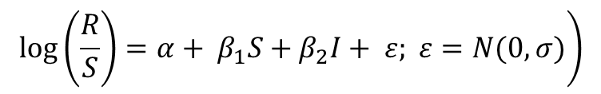
What drives productivity and distribution of crab in the Bering Sea?
Centroids of abundance, extent of population, and productivity
Linked to environmental variables
Projected forward based on global climate model output downscaled
$$\left.\log\left(\frac{R}{S}\right)=α+ β_{1}S+β_{2}I+ ε; ε=N(0,σ)\right)$$

Slide 65
 | Snow crab |  |  |  |  | Tanner crab |  |  |  |  | Red king crab
 | Recruits | Distribution | Latitude | Longitude |  | Recruits | Distribution | Latitude | Longitude |  | Recruits | Distribution | Latitude | Longitude
Ice cover | (+) |  |  |  |  |  |  |  |  |  | (-) |  | (-)
Sea surface temperature |  |  | (+) |  |  |  |  |  | (-) |  |  | (-)
Bottom temperature |  |  |  |  |  | (+) |  |  |  |  |  |  |  | (+)
Cod biomass |  |  |  |  |  | (-) |  |  | (+) |  | (-) |  |  | (-)
Arctic oscillation | (-) |  | (-) | (+) |  |  |  |  |  |  | (+) |  | (-)
Pacific decadal oscillation
Alaskan index
Aleutian low

