Slide 1
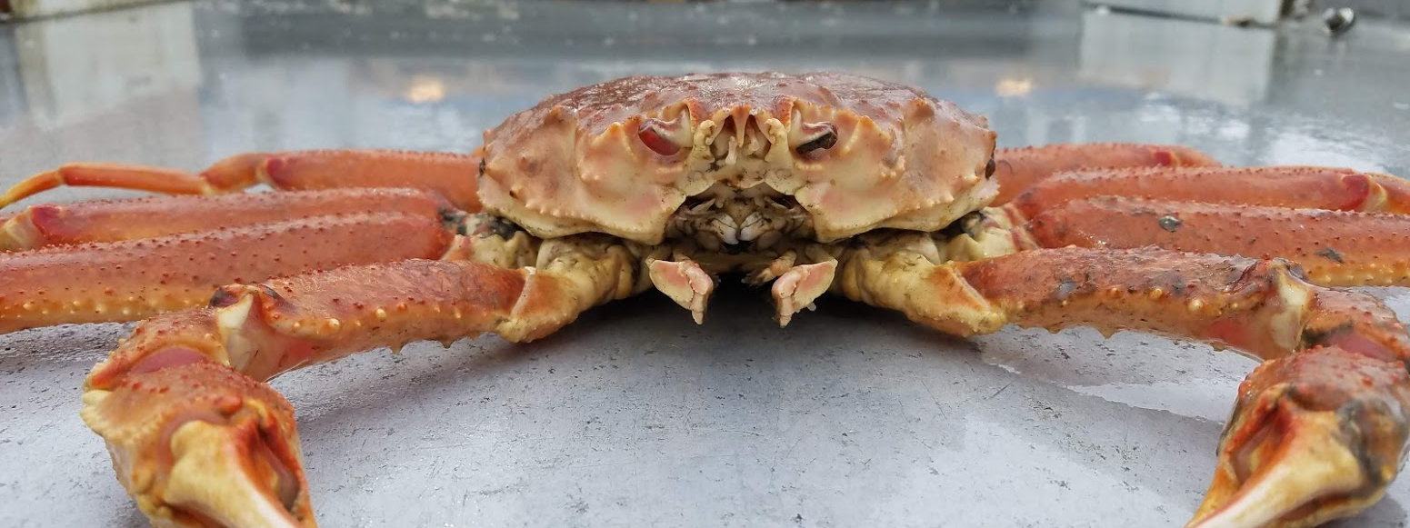
Tanner Crab MSE Update
Madison Shipley
Master’s Research
CPT Sept 2019

Slide 2
Talk Structure
1) Model Overview and HCRs
2)Trouble Shooting and Example Results
3) AWS Update

Slide 3
MSE Model Structure
2017 Tanner Crab Assessment
Operating Model (Projects “Truth”)
Estimation Model – Picks TAC from set HCR
Removes Total Fishing Mortality

Slide 4
1
2017 Base Model
MSE
2
Y = 2017/18
PARS
New Recruitment Set
&
Fishery Capture Rate (F)
for year Y estimated
2017/18 Data
Parameters
Operating Model
Data for year Y generated
HCR
Y = Y+1
3
Estimation model
Remove TAC (Catch) for year Y+1
Notes:
Recruitment pulled randomly from previous years

Slide 5
9 HCRs viable for updated HS
+ 4 HRCs Sensitivity Analyses
13 Total HCR Scenarios

Slide 6
The TAC is always constrained not to exceed 50% of estimated Effective Legal Males (ELM)
ELM defined as Males > 127mm at 40% Selectivity of Old Shell Animals

Slide 7
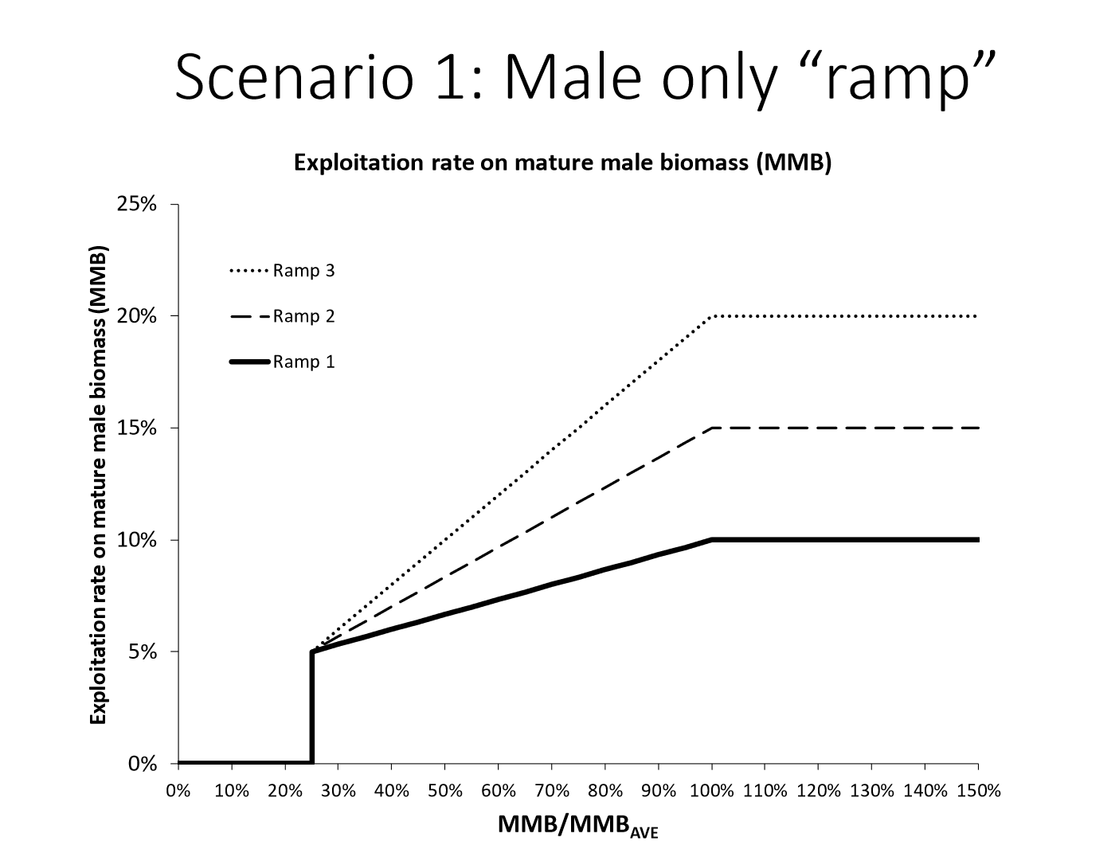

Slide 8
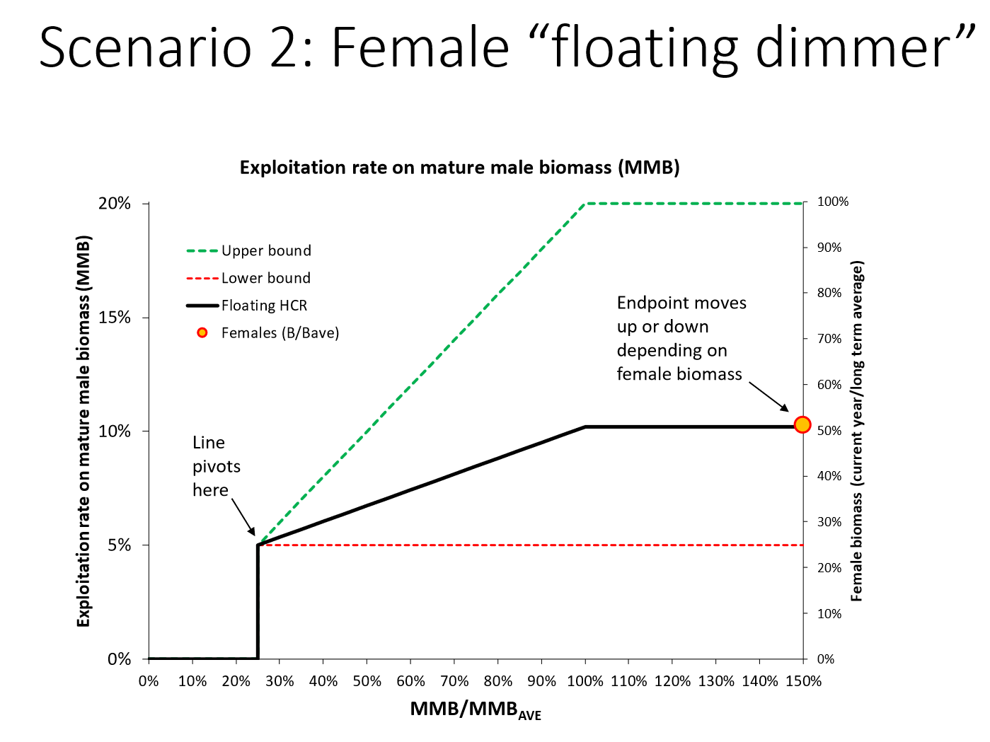

Slide 9
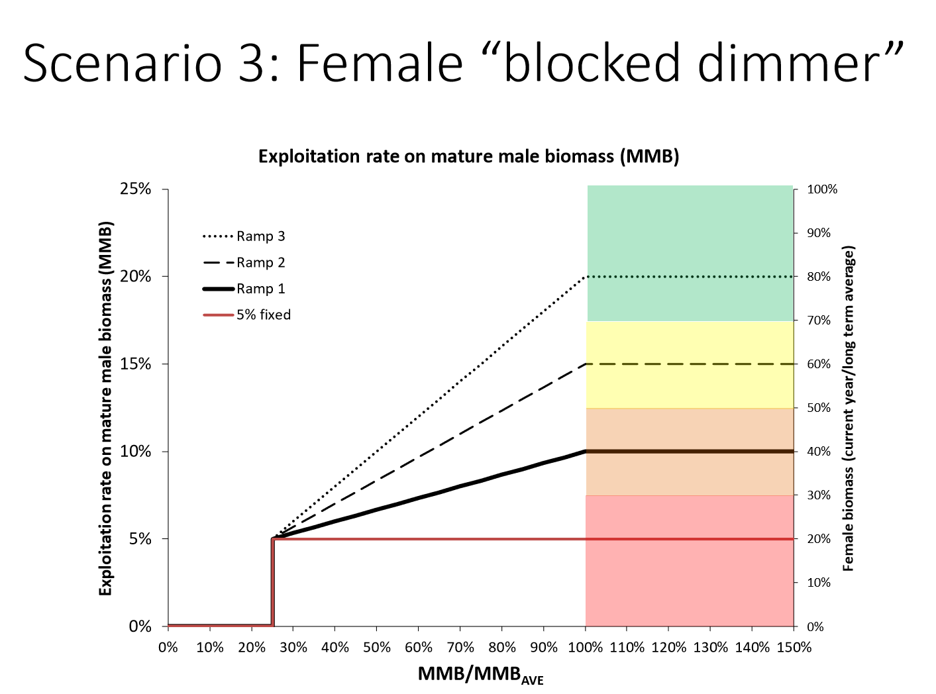

Slide 10
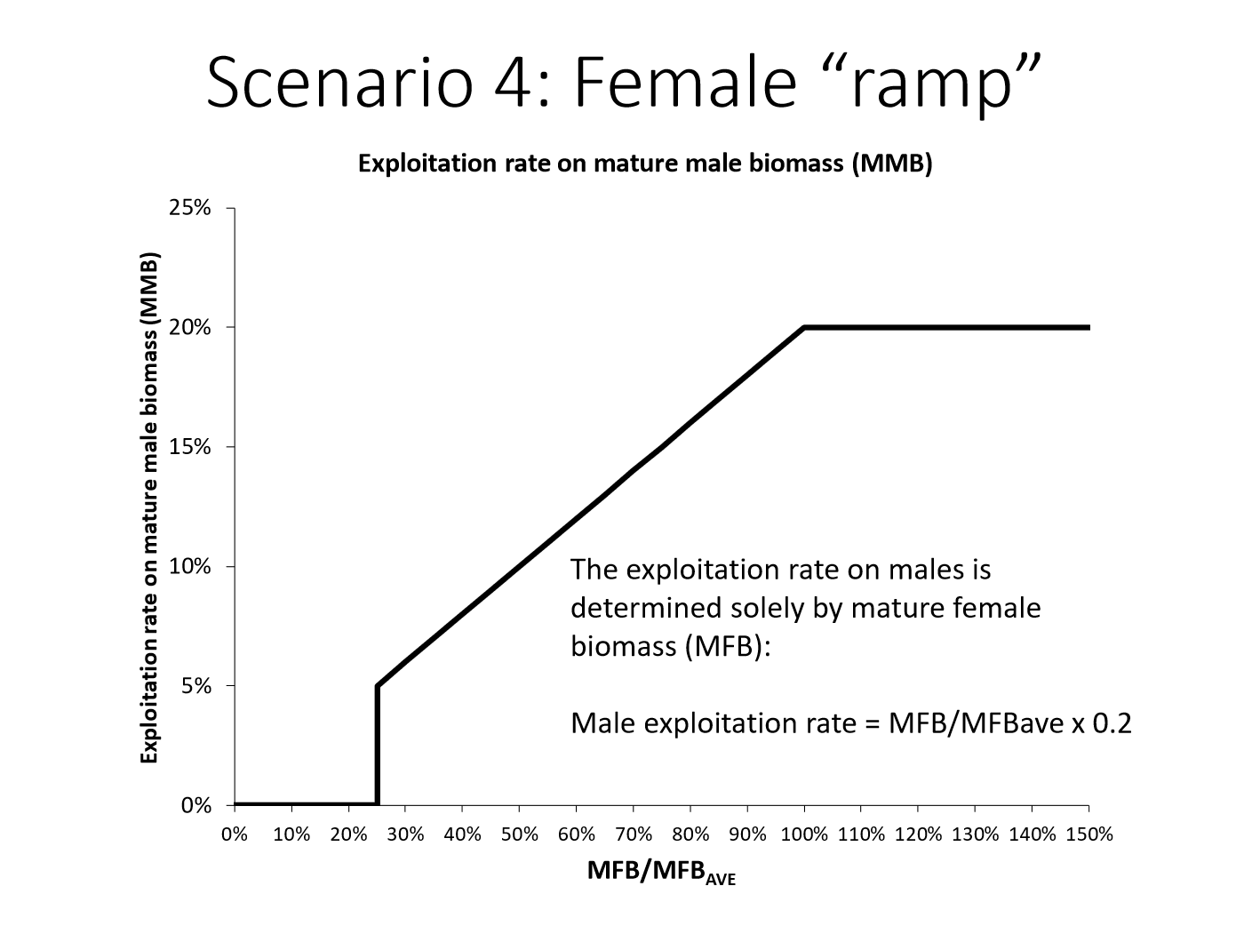

Slide 11
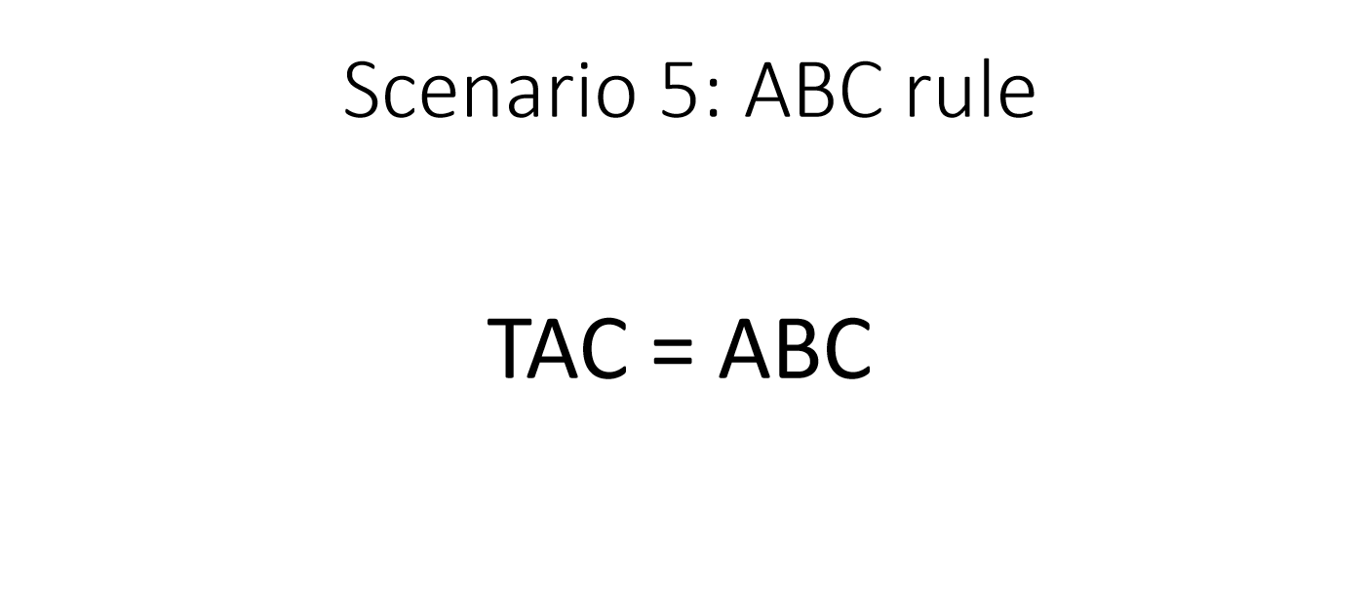
ABC = 20% of OFL

Slide 12
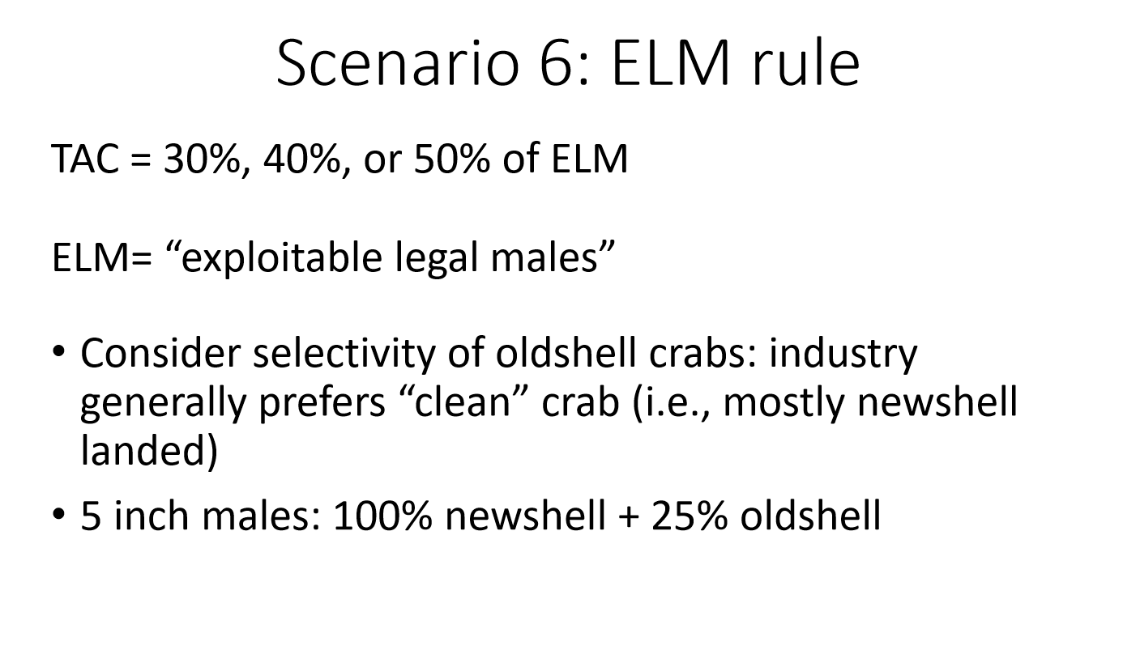

Slide 13

Scenario 7: Status Quo
$TAC=(F_{msy}∗ELM)∗(\frac{B}{B_{ave}}∗0.9)$
    Fmsy is a proxy for total fishing mortality
    ELM is exploitable legal males (>127mm)
    B is male biomass for the year
    Bave is the average male biomass
  Thresholds for Average Biomass 1982-2017
    40% Average Mature Female Biomass
    25% Average Mature Male Biomass
  Maturity definition changed for females (morphology)
  ½ TAC reduction following closure years

Slide 14
HCR Scenarios
Female only
Male only (3 exploitation rates + 2 Sensitivity Runs)
  TAC set at 15% Exploitation cap:
    Model Survey Estimates
    Survey Estimates
Female and male (2 Scenarios)
ELM (3 Scenarios)
TAC=ABC
Status Quo
13 Total Scenarios
9 Viable for the State HS
Notes:
This is the order of preliminary figures
The TAC is always constrained not to exceed 50% of estimated Effective Legal Males (ELM)

Slide 15

Abbreviated Results and Troubleshooting

Slide 16
CPT Results
All 13 HCRs
10 Years
3 Simulations
Limited by time
~1.25hours/Scenario
Bare bones figures and tables
Prep for cloud computing

Slide 17
Performance Metric File
TAC_Set (did the fishery close?)
TAC
OFL
MMB
MFB
5” Males
ELMB
Average Recruitment
Female Catch Biomass
  (Should always be 0)
ELM Catch Biomass
MM Catch Biomass
IM Catch Biomass
Female (Mature and Immature) Discard Biomass
ELM, MM, IM Discard Biomass

Slide 18
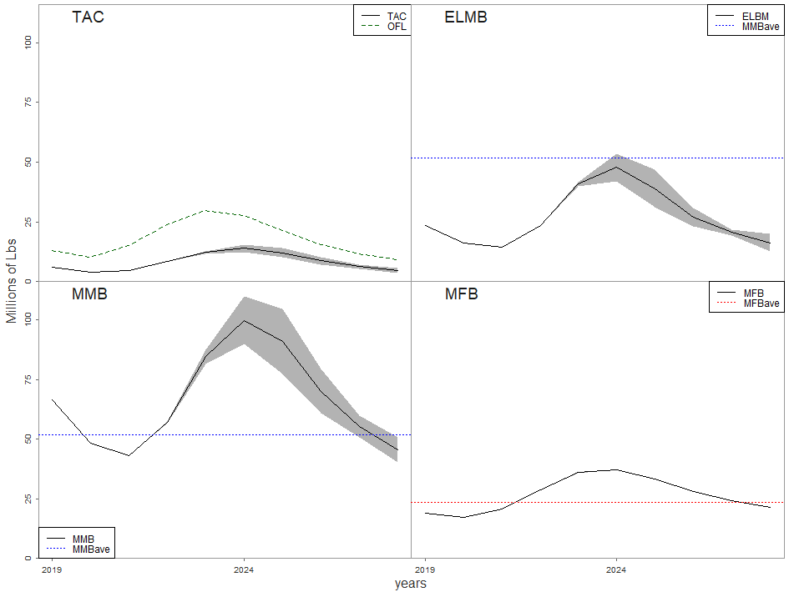
Female Only
1000’s of tons

Slide 19
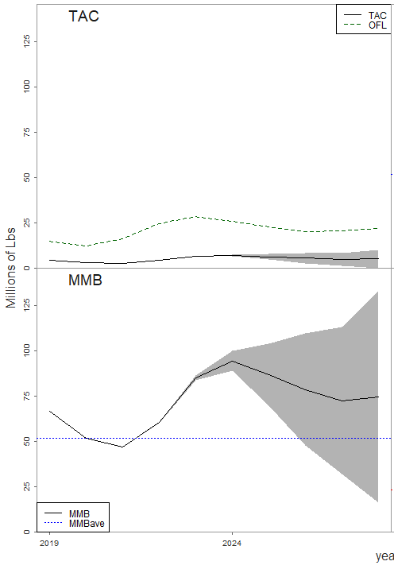
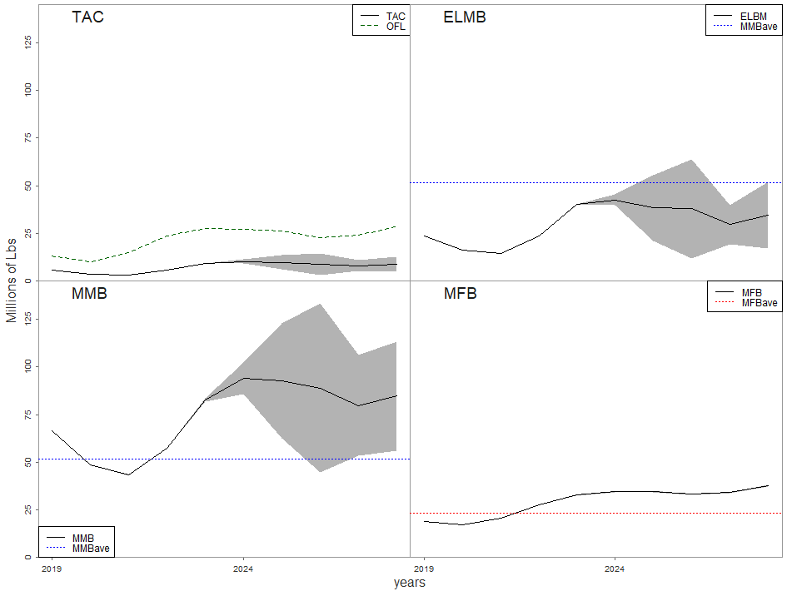
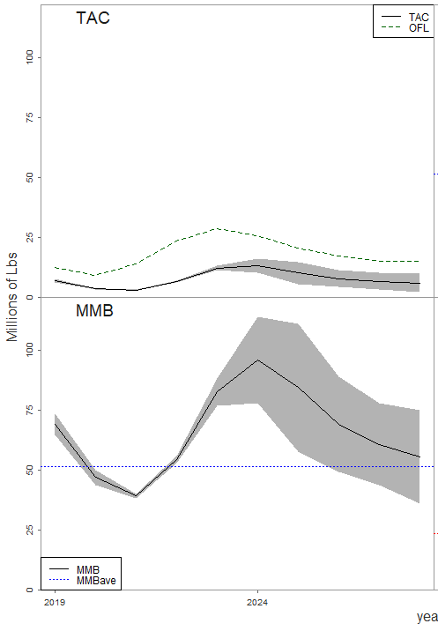
Male Only
10% Exploitation Cap
15% Exploitation Cap
20% Exploitation Cap
1000’s of tons
1000’s of tons
1000’s of tons
Notes:
20% at different scale (top tick mark is 100)

Slide 20
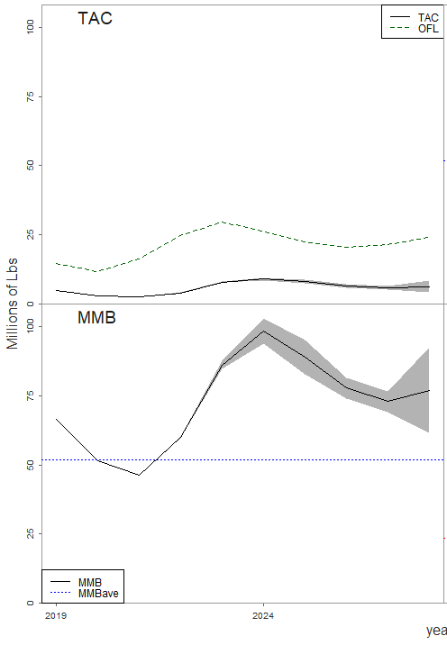
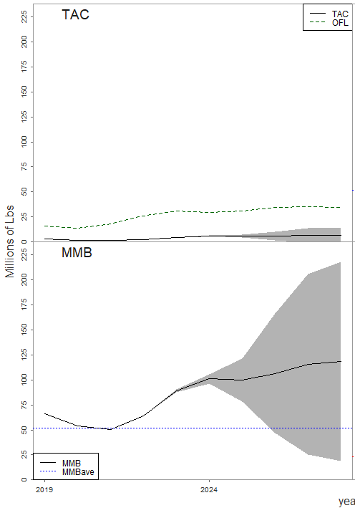
Sensitivity 1 Male Only 15% Exploitation Cap
Survey Est
Model Survey Est
Model Est
1000’s of tons
1000’s of tons
1000’s of tons
Notes:
Model survey Estimates Scale Very Different

Slide 21
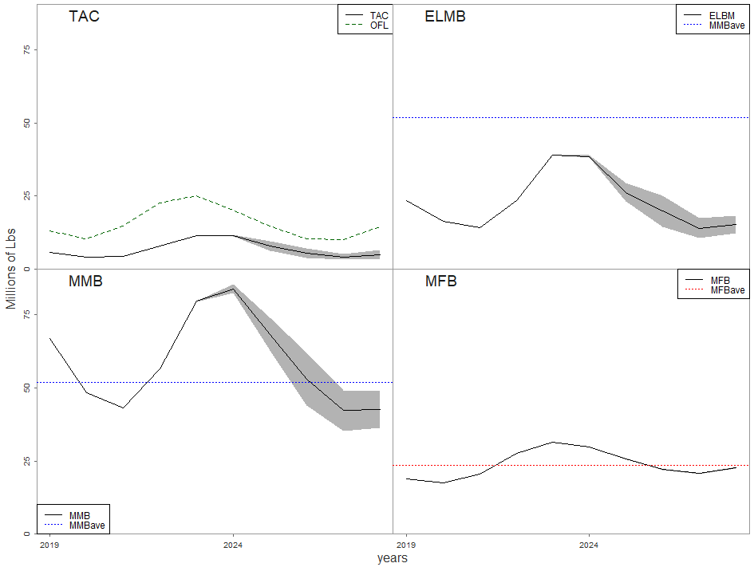
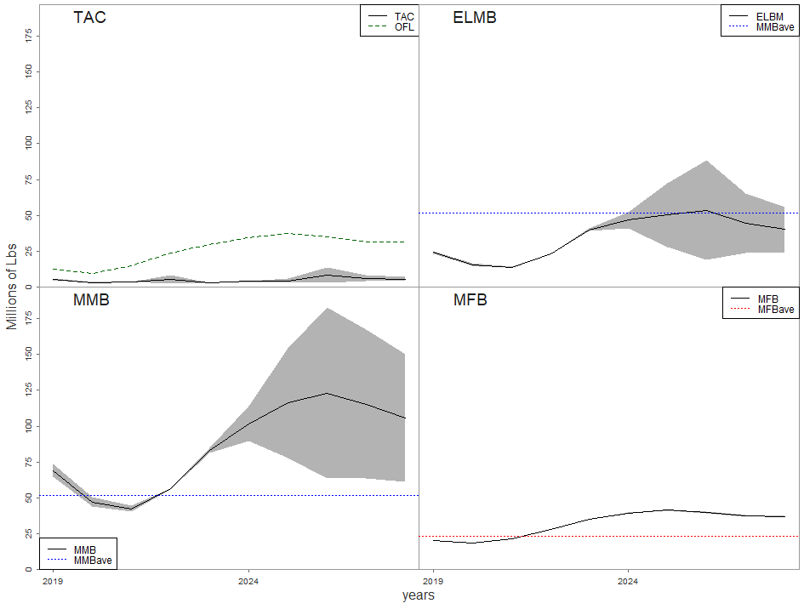
Male and Female
Dimmer
Block
1000’s of tons
1000’s of tons

Slide 22
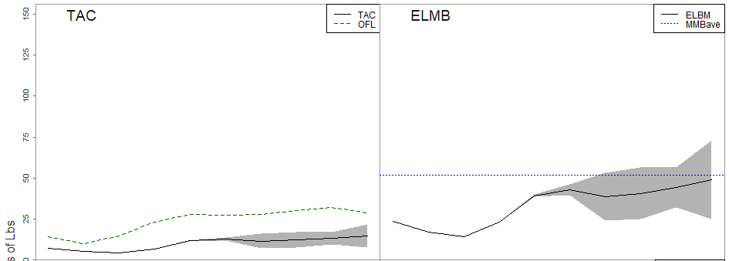
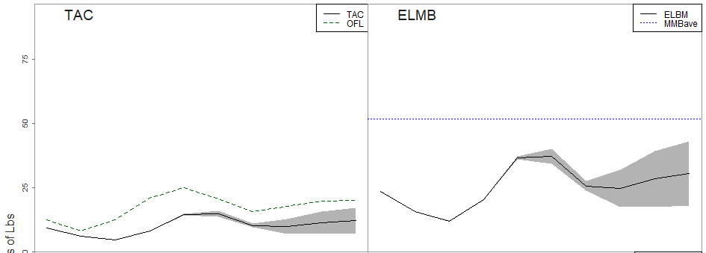
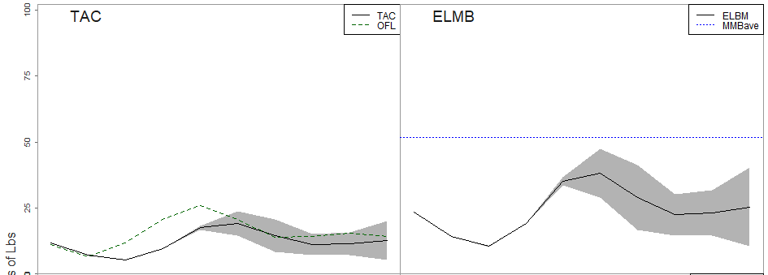
ELM
30% ELMB
1000’s of tons
40% ELMB
50% ELMB

Slide 23
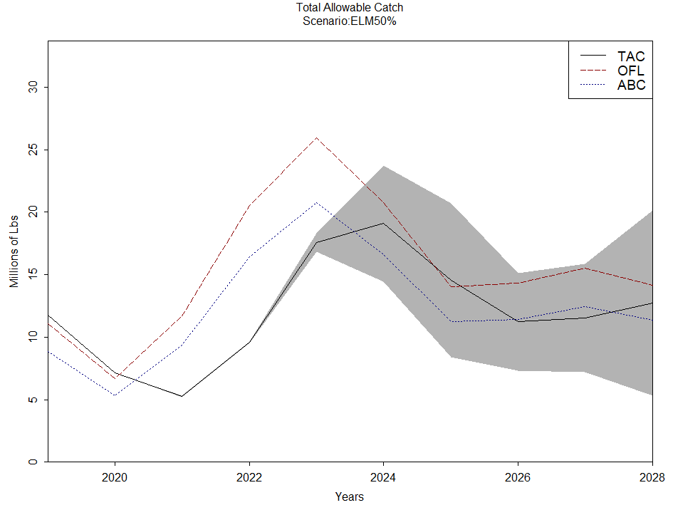
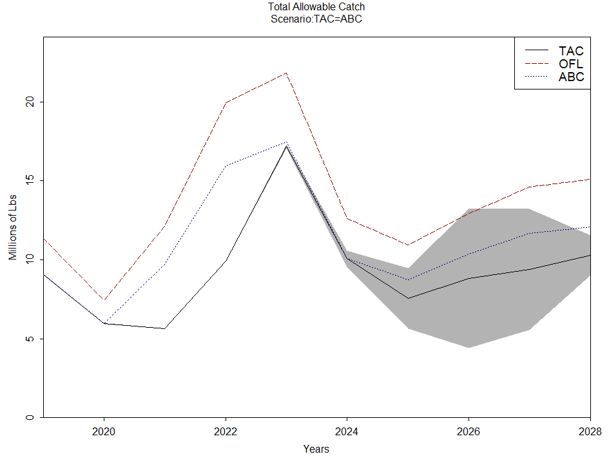
Sensitivity 2: TAC = ABC
1000’s of tons
1000’s of tons

Slide 24
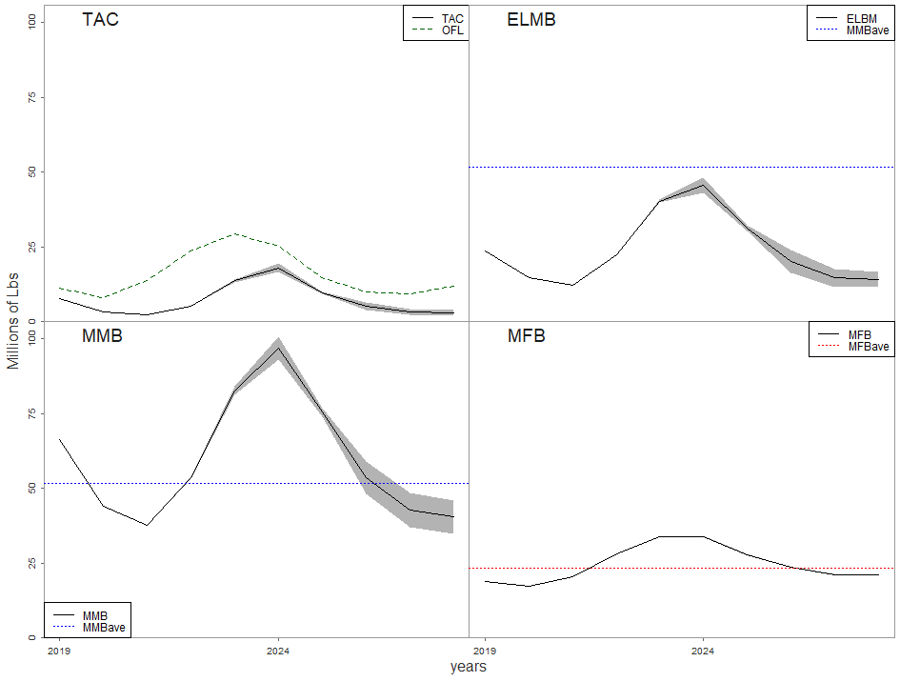
Status Quo
1000’s of tons

Slide 25
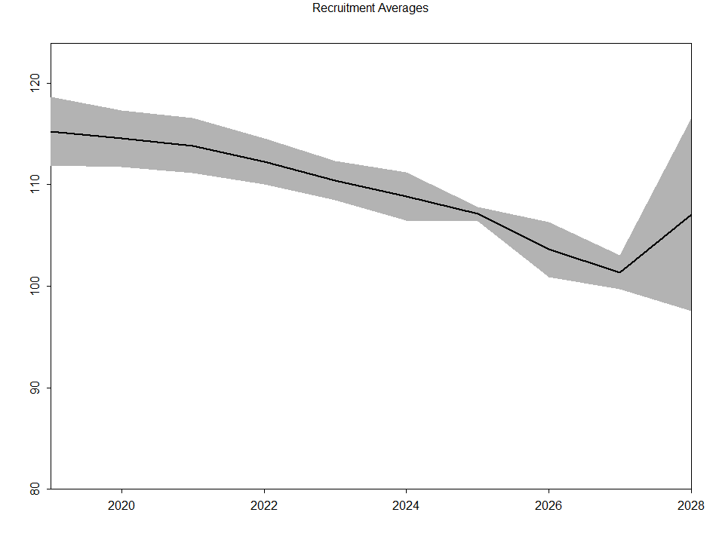
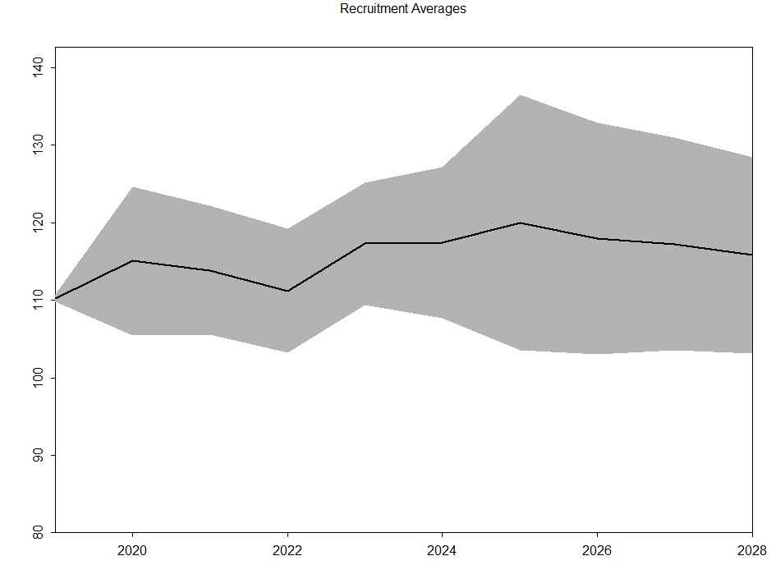
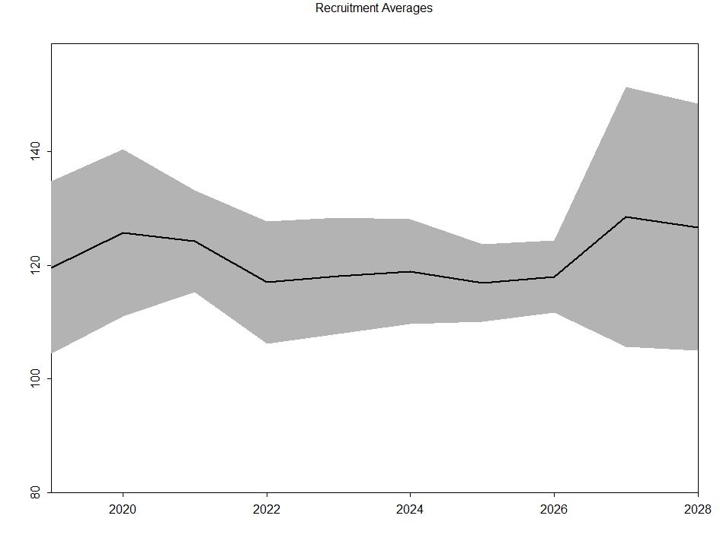
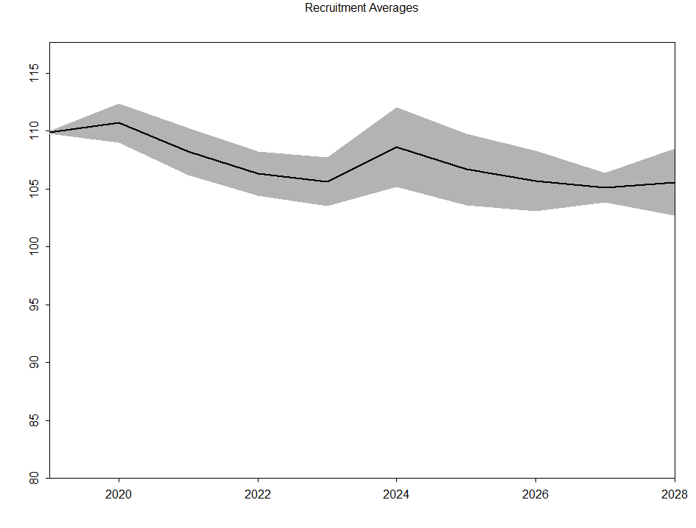
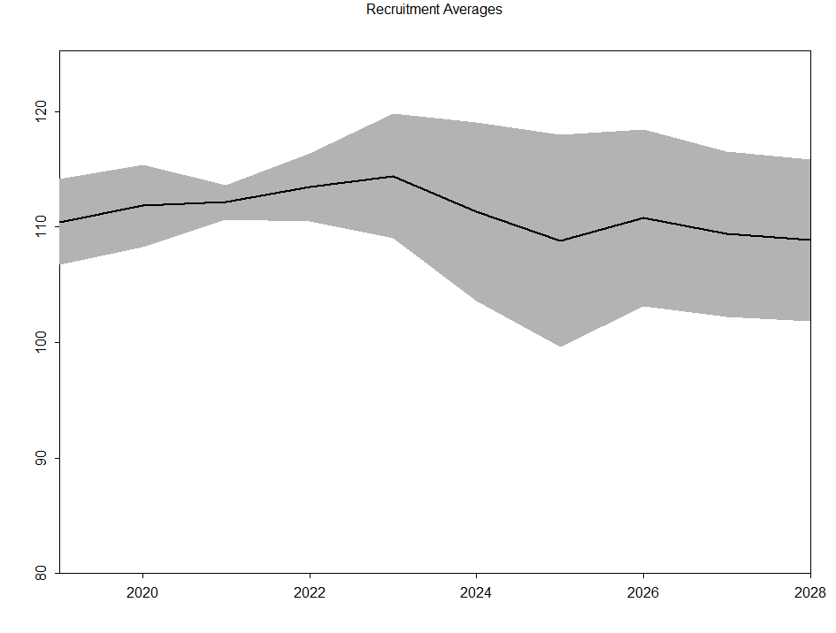
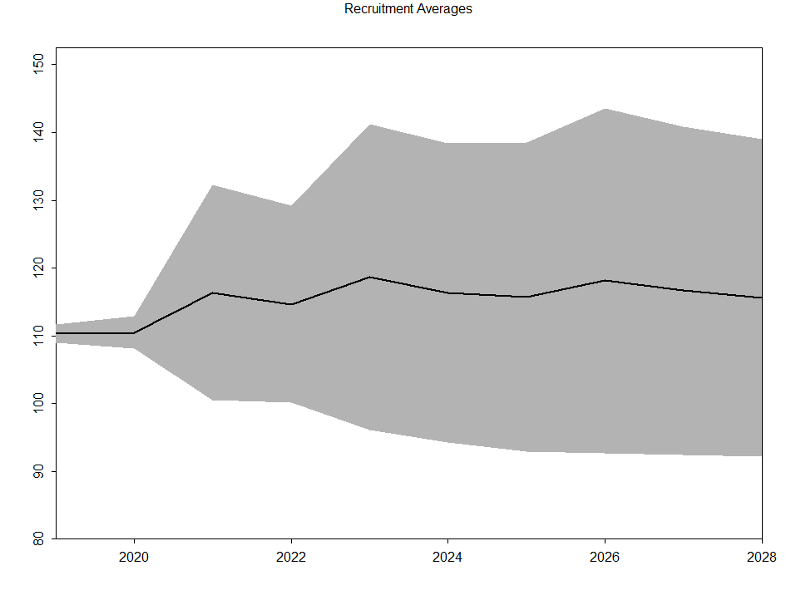
Recruitment Spread
Female Only
Male Only 15%
Block
Dimmer
40% ELMB
ModSurv

Slide 26
Table Examples
Limits
Biological
Catch
Discards

Slide 27
Limits
 | avgOFL | cvOFL | avgClosedYears | cvNOTAC | avgTAC | minTAC | maxTAC | cvTAC
Female Only | 17.70 | 0.07 | 0.00 | NaN | 8.10 | 3.87 | 15.71 | 0.07
Male Only 10% | 20.90 | 0.32 | 0.00 | NaN | 5.13 | 1.40 | 10.78 | 0.25
Male Only 15% | 21.93 | 0.15 | 0.00 | NaN | 7.41 | 3.19 | 15.24 | 0.17
Male Only 20% | 18.26 | 0.23 | 0.00 | NaN | 7.75 | 2.93 | 16.58 | 0.24
Dimmer | 15.67 | 0.05 | 0.00 | NaN | 6.82 | 3.21 | 11.72 | 0.07
Block | 26.16 | 0.25 | 0.00 | NaN | 5.03 | 2.11 | 14.01 | 0.17
ELM 30% | 23.56 | 0.08 | 0.00 | NaN | 9.99 | 4.32 | 23.00 | 0.06
ELM 40% | 17.35 | 0.13 | 0.00 | NaN | 10.22 | 4.84 | 17.40 | 0.08
ELM 50% | 15.47 | 0.28 | 0.00 | NaN | 12.04 | 5.18 | 24.35 | 0.22
ModelSurvey | 27.05 | 0.41 | 0.00 | NaN | 4.42 | 1.47 | 15.39 | 0.47
Survey | 21.30 | 0.08 | 0.00 | NaN | 5.93 | 2.56 | 9.58 | 0.07
ABC | 13.89 | 0.08 | 0.00 | NaN | 9.39 | 5.64 | 17.27 | 0.10
StatusQuo | 15.69 | 0.06 | 0.00 | NaN | 7.12 | 2.16 | 19.47 | 0.05

Slide 28
Notes:
Thousands of tons?

Slide 29
Notes:
UNITs

Slide 30
Notes:
5millions lbs = 2.2 thousand metrics tons
10 = 4.5
15 = 6.8
20 = 9

Slide 31
Notes:
5millions lbs = 2.2 thousand metrics tons
10 = 4.5
15 = 6.8
20 = 9

Slide 32
BioMetrics
 | avgMMB | cvMMB | avgMFB | cvMFB | avgELMB | cvELMB | avgRec | cvRec
Female Only | 66.11 | 0.06 | 26.62 | 0.06 | 26.89 | 0.06 | 109.42 | 0.01
Male Only 10% | 71.82 | 0.21 | 25.97 | 0.26 | 28.85 | 0.25 | 109.62 | 0.09
Male Only 15% | 73.85 | 0.14 | 29.17 | 0.14 | 30.14 | 0.16 | 115.62 | 0.07
Male Only 20% | 65.87 | 0.16 | 27.10 | 0.18 | 26.80 | 0.18 | 111.88 | 0.07
Dimmer | 58.30 | 0.04 | 23.68 | 0.04 | 23.09 | 0.05 | 107.25 | 0.01
Block | 86.03 | 0.22 | 31.96 | 0.20 | 35.30 | 0.25 | 121.35 | 0.07
ELM 30% | 78.23 | 0.05 | 32.12 | 0.06 | 33.28 | 0.06 | 117.25 | 0.02
ELM 40% | 60.94 | 0.07 | 27.56 | 0.09 | 25.55 | 0.08 | 111.14 | 0.04
ELM 50% | 57.46 | 0.19 | 27.16 | 0.20 | 24.09 | 0.22 | 108.97 | 0.07
ModelSurvey | 86.47 | 0.32 | 30.11 | 0.38 | 35.68 | 0.37 | 115.30 | 0.15
Survey | 72.48 | 0.05 | 26.90 | 0.07 | 29.27 | 0.05 | 111.57 | 0.02
ABC | 52.05 | 0.07 | 24.22 | 0.06 | 21.38 | 0.10 | 105.59 | 0.01
StatusQuo | 59.33 | 0.03 | 24.70 | 0.04 | 23.89 | 0.03 | 108.47 | 0.04

Slide 33
Notes:
51.7 Millions Pounds for Males (1982-2017)
23.5 Millions of Pounds for Females (1982-2017)

Slide 34
Notes:
51.7 1000’s of tons for Males (1982-2017)
23.5 1000’s of tons for Females (1982-2017)

Slide 35
Notes:
Scale?

Slide 36
Catches
 | avgELMC | cvELMC | avgMMCB | cvMMCB | avgIMCB | cvIMCB
Female Only | 8.61 | 0.07 | 42.98 | 0.06 | 0.03 | 0.07
Male Only 10% | 5.24 | 0.15 | 48.70 | 0.19 | 0.02 | 0.40
Male Only 15% | 7.46 | 0.17 | 48.52 | 0.16 | 0.03 | 0.16
Male Only 20% | 8.41 | 0.18 | 42.49 | 0.15 | 0.03 | 0.28
Dimmer | 7.30 | 0.06 | 37.73 | 0.04 | 0.03 | 0.09
Block | 5.73 | 0.13 | 58.14 | 0.23 | 0.02 | 0.10
ELM 30% | 9.32 | 0.07 | 50.64 | 0.05 | 0.04 | 0.08
ELM 40% | 10.03 | 0.05 | 37.70 | 0.06 | 0.05 | 0.11
ELM 50% | 11.19 | 0.18 | 34.60 | 0.18 | 0.06 | 0.30
ModelSurvey | 4.14 | 0.31 | 59.67 | 0.30 | 0.01 | 0.64
Survey | 5.96 | 0.04 | 48.71 | 0.04 | 0.02 | 0.10
ABC | 9.60 | 0.11 | 31.57 | 0.08 | 0.05 | 0.12
StatusQuo | 8.16 | 0.03 | 37.96 | 0.02 | 0.03 | 0.07
Notes:
calcBiomass(vdmN_fyxmsz,ptrMDS->ptrBio->wAtZ_xmz) EstMod
calcBiomass(vrmN_fxmsz,ptrMDS->ptrBio->wAtZ_xmz) OpMod

Slide 37
Discards
 | avgELMD | cvELMD | avgMMDB | cvMMDB | avgIMDB | cvIMDB | avgMFDB | cvMFDB | avgIFDB | cvIMDB
Female Only | 0.99 | 0.07 | 1.78 | 0.06 | 0.28 | 0.07 | 0.21 | 0.15 | 0.01 | 0.07
Male Only 10% | 0.77 | 0.17 | 1.28 | 0.18 | 0.19 | 0.45 | 0.08 | 0.22 | 0.01 | 0.45
Male Only 15% | 0.92 | 0.16 | 1.62 | 0.14 | 0.28 | 0.17 | 0.14 | 0.30 | 0.01 | 0.17
Male Only 20% | 0.97 | 0.19 | 1.74 | 0.17 | 0.28 | 0.30 | 0.20 | 0.39 | 0.01 | 0.30
Dimmer | 0.84 | 0.06 | 1.54 | 0.05 | 0.25 | 0.08 | 0.15 | 0.11 | 0.01 | 0.08
Block | 0.89 | 0.15 | 1.48 | 0.13 | 0.24 | 0.15 | 0.10 | 0.14 | 0.01 | 0.15
ELM 30% | 1.11 | 0.07 | 1.97 | 0.06 | 0.38 | 0.08 | 0.23 | 0.17 | 0.02 | 0.08
ELM 40% | 1.12 | 0.06 | 2.08 | 0.05 | 0.41 | 0.14 | 0.35 | 0.06 | 0.02 | 0.14
ELM 50% | 1.24 | 0.19 | 2.32 | 0.17 | 0.45 | 0.28 | 0.50 | 0.25 | 0.02 | 0.28
ModelSurvey | 0.80 | 0.29 | 1.25 | 0.30 | 0.19 | 0.60 | 0.08 | 0.36 | 0.01 | 0.60
Survey | 0.81 | 0.04 | 1.39 | 0.05 | 0.22 | 0.13 | 0.09 | 0.06 | 0.01 | 0.13
ABC | 1.06 | 0.10 | 2.00 | 0.09 | 0.38 | 0.09 | 0.37 | 0.15 | 0.02 | 0.09
StatusQuo | 0.93 | 0.03 | 1.68 | 0.03 | 0.24 | 0.09 | 0.22 | 0.07 | 0.01 | 0.09
Notes:
calcBiomass(vdmN_fyxmsz,ptrMDS->ptrBio->wAtZ_xmz) EstMod
calcBiomass(vdmN_fxmsz,ptrMDS->ptrBio->wAtZ_xmz) OpMod

Slide 38
Trouble Shooting/ Considerations
Fix Catch and Discard Biomass in perfmetrics output?
Model Failure when Growth Estimates are negative
  Jittering Turned off
    Still occasionally occurs
    Ends the Simulation
Recruitment trends
  Currently ave Recruitment from 1981-maxYr for males only
    (equal proportions for males and females)
    Projected Recruitment or Recruitment by year?

Slide 39
To Do
Continue developing figures to output results
Run Full Scenarios
Comparison tables and figures for Operating and Estimation models
  How close to “Truth” are the estimation model outputs?
Probability Reference Points
  Pr(TAC>OFL)
  Pr(MMB < MMB_{ave})
  Pr(TAC ≤ 5, 10, 15, and 20million lbs)

Slide 40

Amazon Web Services

Slide 41
Creation of Instances
13 Instances
  Clones of my computer
  Choosing Instances for memory optimization (maybe faster)
Estimated 16 Days to Run everything
  Leaves Buffer for errors that stop the model
    Keep running until 100 full simulations for each HCR
Results presented shortly after
Final Feedback before I press “Go”

Slide 42
Timeline
Winter 2019
Code in Operating model and HCRs
Spring 2019
Test Code, Run Simulations
Summer 2019
Preliminary Results, Analysis and Write Up
Sep. 2019
Presentation of Preliminary Results to CPT
Mar. 2020
Selected HCR Presented to Board of Fish
Oct. 2019
Full spread of results to ADFG and cooperative research partners

Slide 43






Am I missing anything?
Thank You!
Notes:
Thank cooperative research partners and emphasize the importance and unique opportunity this partnership affords me as a grad student and the resource as a whole

Slide 44
Supplementary Slides

