Slide 1
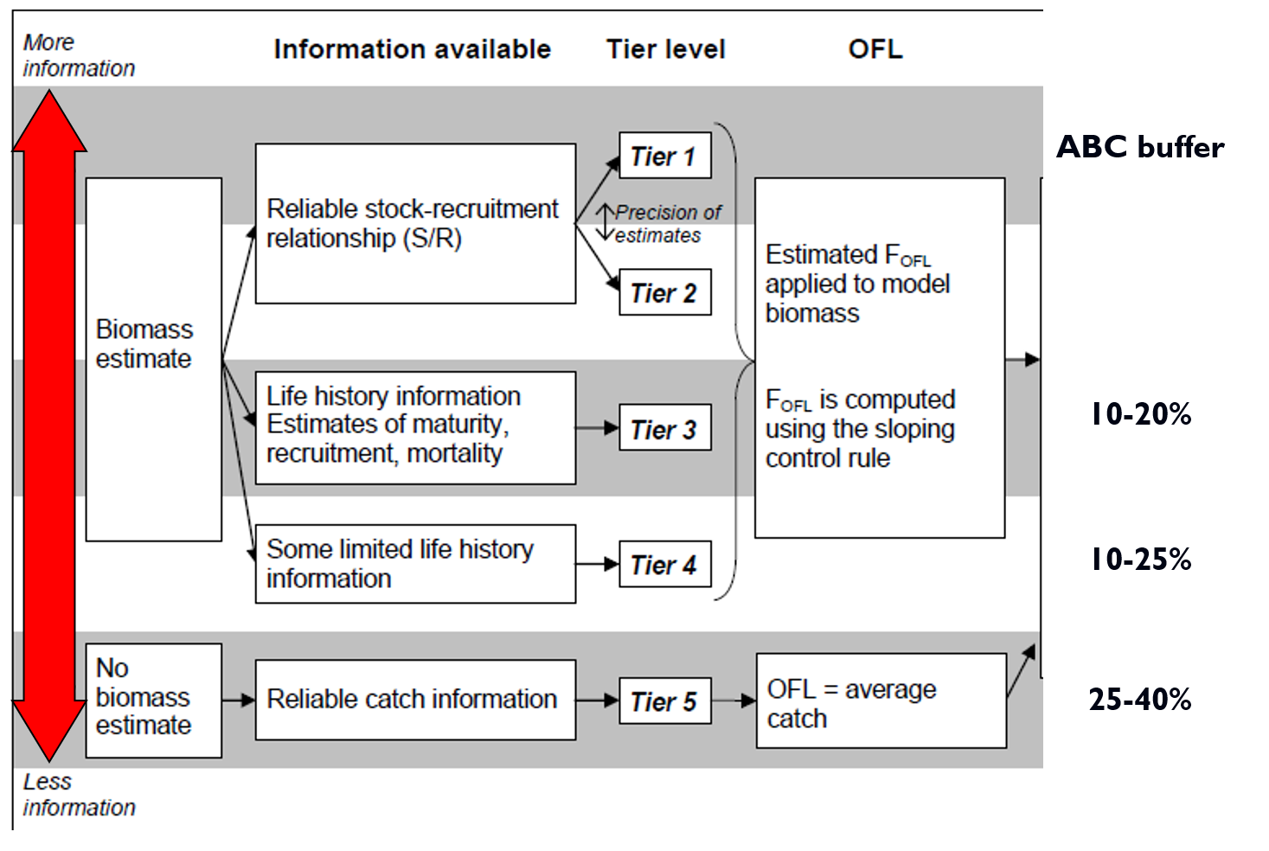

Slide 2
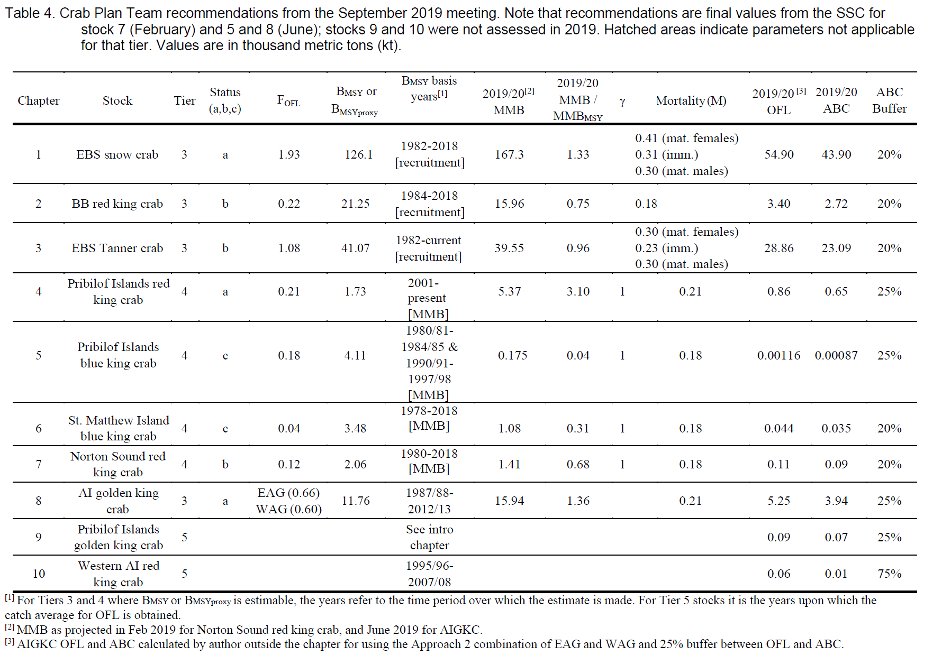

Slide 3
Options for dealing with the increased uncertainty due
the loss of the 2020 EBS bottom trawl survey:
1. No additional ABC buffers for any stock assessment to account for the loss of the 2020 survey
2. Add the same additional ABC buffer for all assessments affected by the loss of the survey (example 10% additional buffer).
3. Take a species-by-species approach to decide on a buffer. An additional buffer should be considered only for stocks where assessment uncertainty increases substantially.

Slide 4
Approach 3: Sensitivity analysis with high and low proxy surveys
This method evaluates the impact of different hypothetical 2020 survey outcomes, and is based on a SSC recommendation in its June minutes. For the survey time series fit in proposed base model for this year, calculate the multiplicative residuals, ${{\hat{y}}_{i}}/{y_{i}}$, where $y_{i}$ is observed survey observation, and ${\hat{y}}_{i}$ is the predicated survey observation after fitting the model. Obtain the 25th and the 75th percentiles of the multiplicative residuals (in R: quantile(mresids,prob=c(0.25,.75)). The rationale for the 25th and 75th percentiles is that they are a typical high and low value for the survey. Obtain the predicated survey value for the 2020 by putting in a trial survey value for 2020 with a very high CV, say 100, so that the model does not attempt to fit that observation. Multiply the predicted survey value by the 25th and 75th percentile of the multiplicative residual for a high and a low survey observation for 2020. Assume a CV equal to the median survey CV and fit these values in two model runs to evaluate sensitivity of ending year survey sensitivity. Large changes in management quantities such as OFL and MMB indicate high sensitivity.

