Slide 1
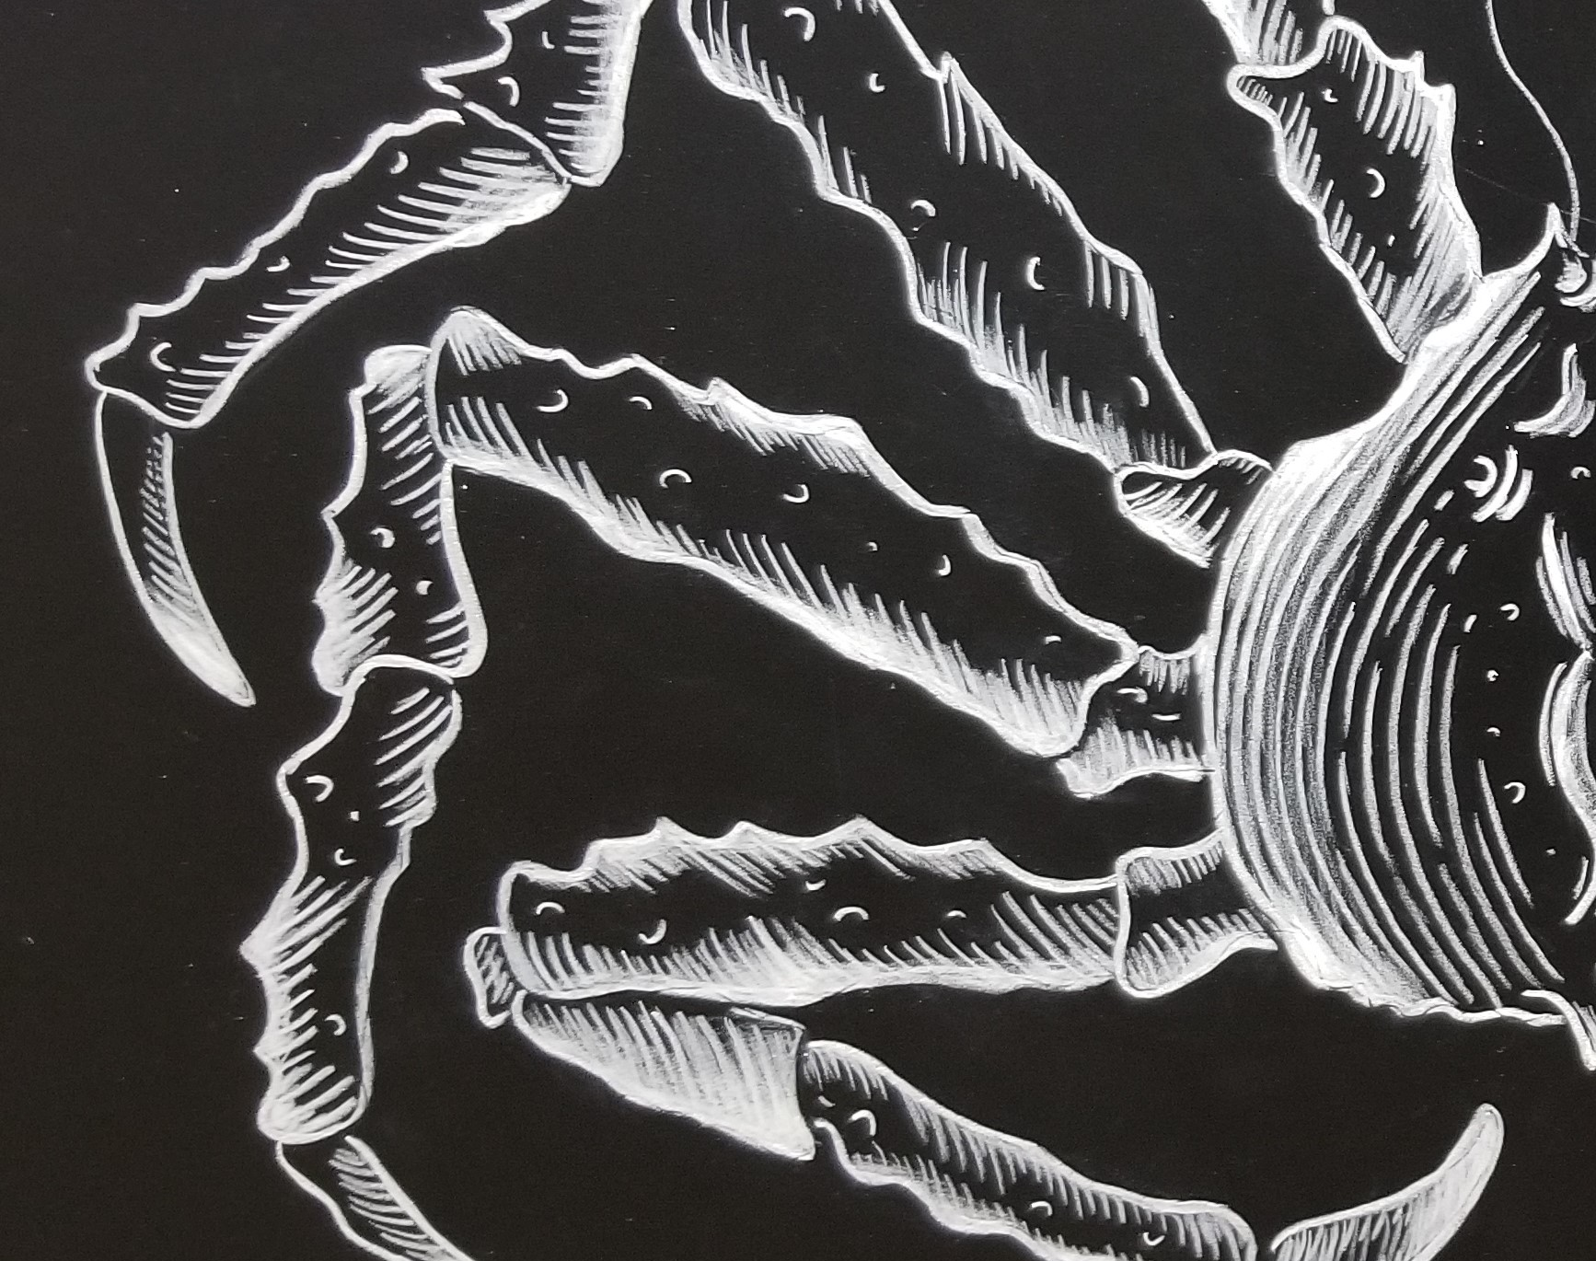
Bering Sea Crab
Bycatch Data and Mapping Review working draft - Sep 2020
Alaska Bering Sea Crabbers
Presented by: Jamie Goen
Primary author: Lou Forristall

Slide 2
QUESTIONS
How do PSC levels of bairdi, opilio and BBRKC in the Bering Sea compare to stock size?
Where does bycatch for the three crab species occur in the Bering Sea for all gear types?
Does the spatial distribution of bycatch indicate there are areas where local depletion is a concern?
WHY? To get a better understanding of bycatch to see if there is something we are missing that may have significant impacts on crab stocks and to inform improvements to management.
For details, see ABSC Comment submitted under Sep 2020 CPT meeting agenda for Crab Prohibited Species Catch.
This presentation only highlights concepts.

Slide 3
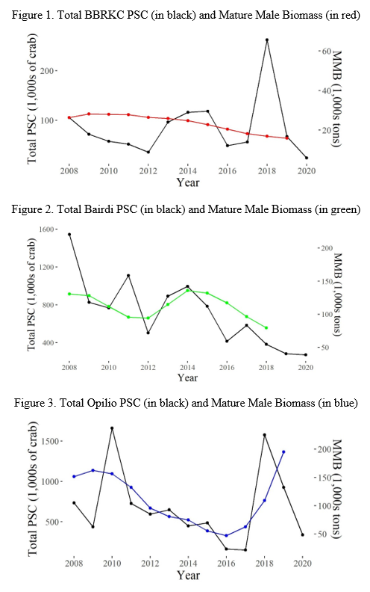
1. PSC & Stock Abundance
Is bycatch correlated with abundance?
  BBRKC → no
  Opilio and bairdi → yes
NOTE: This research question would benefit from further statistical analysis with better abundance estimates.

Slide 4
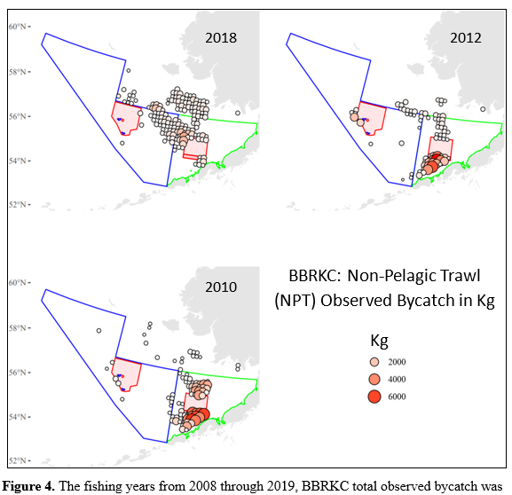
2. Bycatch Maps by Gear
Spatial look at bycatch by each gear –
non-pelagic trawl, pelagic trawl, pot,
hook-and-line
Years of high, middle, and low bycatch explored
Maps of observed bycatch in kg (even numbered figures) Example at right
Observations:
  NPT & POT highest bycatch
  BBRKC: Regardless of year or gear, bycatch highest on edges of RKCSA, particularly to S.
  Bairdi: bycatch widely distributed. More concentrated W of RKCSA at border Zone 1 and 2, W of Pribilof Islands closed area, and N of Unimak Island.
  Opilio: highest bycatch E of Pribilof Islands closed area and
  SE corner of COBLZ

Slide 5
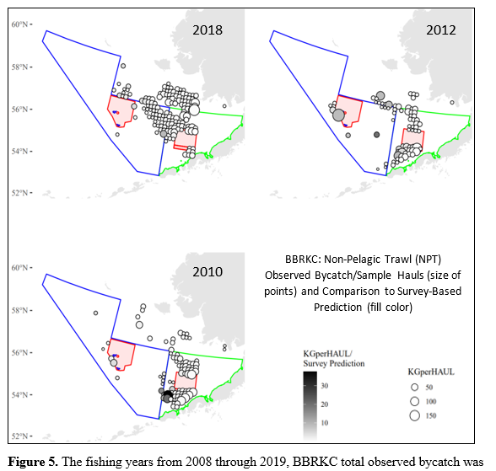
3. Localized Depletion
Spatial look at areas with higher than expected crab bycatch compared to the survey and high CPUE as indicator of localized depletion
  Note: could also indicate crab population seasonal shift in distribution or areas where survey sampled poorly
Maps of observed bycatch in kg (size of point) compared
to survey-based prediction (fill color) (odd numbered figures)
Example at right
Potential Areas of Concern –
  BBRKC: S of RKCSA, SE border of the Pribilof Islands closed area
  Bairdi: N of Unimak Island
  Opilio: E of Pribilof Islands
  closed area

