Slide 1
Bristol Bay Red King Crab Assessment in Fall 2020
J. Zheng and M.S.M. Siddeek
ADF&G, Juneau

Slide 2
Outline
2. Models
1. Responses to CPT and SSC Review Comments
3. Comparing model results
4. Recommendations

Slide 3
Response to CPT Comments
Response to CPT Comments (from May 2020):
“Given the above discussion, the CPT selected model 19.3 as the priority model (in addition to the status quo model, 19.0a) for presentation in September, understanding that time schedules for producing data used in the assessment may be compressed as a result of the global pandemic. Model 19.3 estimated male natural mortality in an early block (1980-1984) and then specified M as 0.18 thereafter. Female natural mortality was estimated as an offset from males in both periods. Survey selectivity was estimated separately for sexes, but a single catchability was estimated (still with a strong prior). If time allows, a model building from 19.3 in which the prior on catchability is relaxed and estimated separately by sex (and revisited in light of the catchability implied by the BSFRF data) would be useful for comparison.”
Response: We used model 19.3b to examine the sensitivity of trawl survey catchability estimate when the CV of the prior on catchability was doubled. The resulting catchability estimate was greater than 1.0. Different catchabilities for males and females in the NMFS survey were examined in model 19.5 in May 2020.
“Produce the empirical survey selectivity diagnostics that were produced for Tanner crab at this meeting, but for BBRKC. Specifically, display the ratio of NMFS to BSFRF (rather than NMFS/(NMFS+BSFRF)) numbers at size to provide a direct comparison to estimated survey selectivity.”
Response: Ratios of NMFS to BSFRF numbers at size are plotted in Figure 7 (a, b and c). The abundance-weighted average ratio is 0.891 for crab >135 mm carapace length from all four years (2013-2016) of data, about the same as the double-bag experiment, although the ratios changed greatly from year to year.

Slide 4
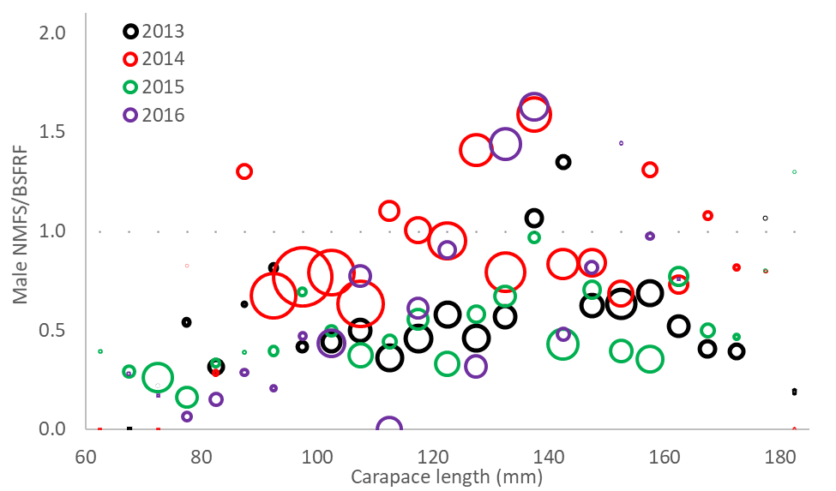
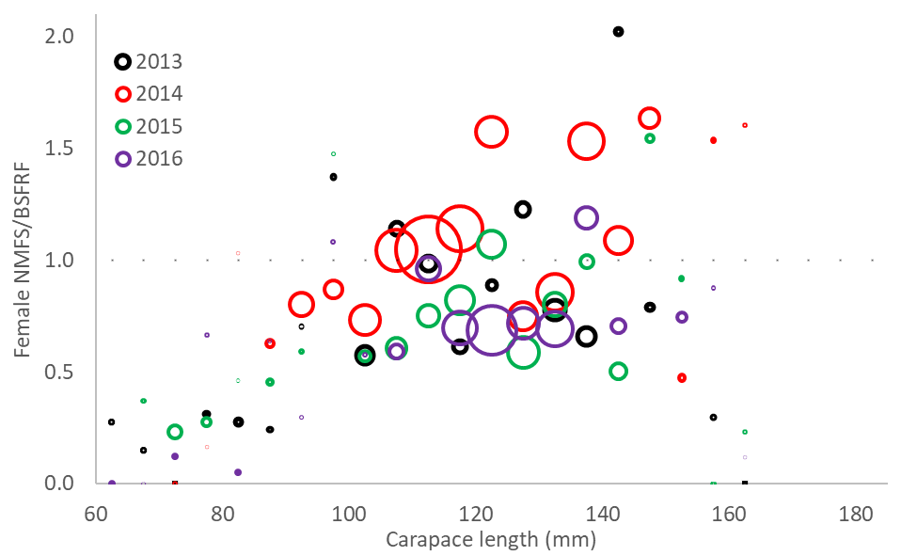
Figure 7. Comparison of NMFS survey abundance proportions of total NMFS and BSFRF side-by-side trawl surveys during 2013-2016. Sizes of circles are proportional to total abundances.

Slide 5
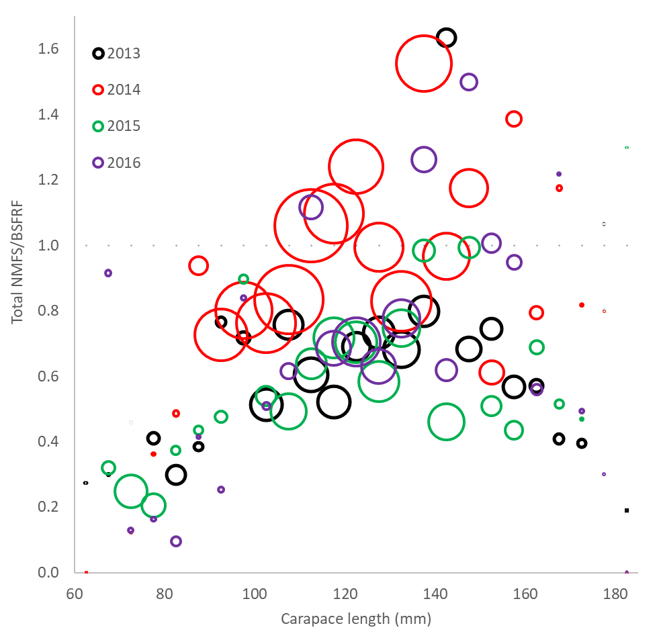
Figure 7. Comparison of NMFS survey abundance proportions of total NMFS and BSFRF side-by-side trawl surveys during 2013-2016. Sizes of circles are proportional to total abundances.
The abundance-weighted average ratio is 0.891 for crab >135 mm carapace length from all four years of data, about the same as the double-bag experiment (0.896 at size 162.5 mm), although the ratios changed greatly from year to year.

Slide 6
Response to CPT Comments
Response to CPT Comments (from May 2020):
“Describe how the sex ratios for OFL calculations were averaged. It is the same as the recruitments, but was difficult to confirm in the document.”
Response: We added text to explain the sex ratios for OFL calculations in Appendix A (B (b) (2) The proxy for BMSY).
“Check the calculation of total male directed fishery catch as inputted to GMACS to ensure accounting for discard mortality is appropriate. Check the tables for correct numbers and that they match the .DAT files provided. Consider splitting the tables needed by the State of Alaska from those presenting the data used in the assessment. CPT suggests that the methodology for how total catches are calculated should be added to the terms of reference for all assessments.”
Response: There are no problems with total male directed fishery catch in the GMACS input data file. An additional table (Table 2) is added to include all observer catch and discard data. Methods of bycatch estimation are added to the caption of Table 1a.

Slide 7
Response to CPT Comments
Response to CPT Comments (from May 2020):
“Highlight the ‘PriorDensity’ row in the table listing the contribution of likelihoods to the objective function value. Make sure that it is clear that differences in likelihood comparability are well represented in the tables. It appears that modifications will need to be made to the way that GMACS includes or does not include prior densities so that the objective function values from models with different numbers of parameters (but fitting to identical data) are comparable.”
Response: The “PriorDensity” row is highlighted, and a new row is added for total negative log likelihood values without prior densities for easy comparison.
“Provide justification for the assumed natural mortality for males of 0.18 yr-1. How does the 1% rule assumed in the assessment compare to empirical studies on natural mortality and longevity (e.g. Then et al. 2016)?”
Response: The 1% rule was accepted after very long, several year difficult discussion among the crab overfishing working group, CPT, and SSC. We will examine it again in May 2021.

Slide 8
Response to SSC Comments
Response to CPT Comments (from June 2020):
“The SSC agrees with the CPT’s model recommendations for September. Though promising, it is advisable to postpone the use of VAST estimates for this stock assessment until diagnostics for VAST can be more fully analyzed and better-fitting error distributions identified. The SSC also supports the other recommendations on this assessment offered by the CPT.”
Response: We follow these suggestions.

Slide 9
Model Scenarios
Seven models:
  19.0a: the model 19.0 in September 2019 except with mean recruitment sex ratio during the reference period to estimate B35%.
  19.0b: the same as model 19.0a except for fixing the recruitment in the terminal year to be the mean recruitment during the seven years prior to the terminal year for potential forward projection.
  19.3: the same as model 19.0a except for a constant M being estimated for males during 1980-1984, a constant M of 0.18 for males during the other years, and an estimated constant multiplier being used to multiply male M to estimate M for females. That is, M for females is relative to M for males each year.

Slide 10
Model Scenarios
Seven models:
  19.3a: the same as model 19.3 except for fixing the recruitment in the terminal year to be the mean recruitment during the seven years prior to the terminal year for potential forward projection.
  19.3b: the same as model 19.3 except for doubling the CV of the prior for trawl survey catchability.
  19.3l: the same as model 19.3 except for adding a low trawl survey biomass for 2020 (at 25 percentile) (Appendix D).
  19.3h: the same as model 19.3 except for adding a high trawl survey biomass for 2020 (at 75 percentile) (Appendix D).

Slide 11
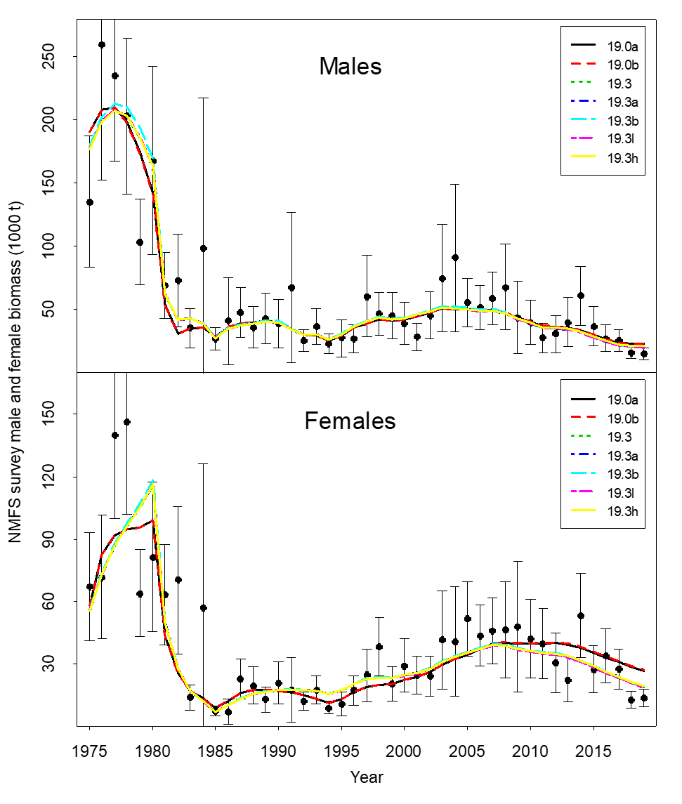
Comparisons of area-swept estimates of total NMFS survey biomass and model prediction for model estimates in 2020 under seven models. The error bars are plus and minus 2 standard deviations.

Slide 12
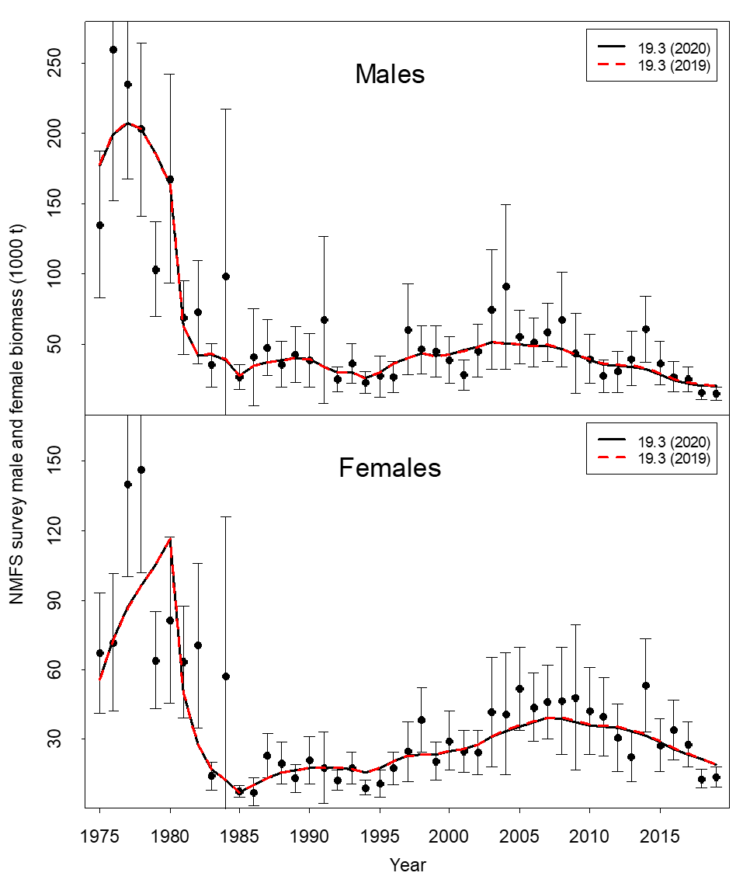
Comparisons of area-swept estimates of total NMFS survey biomass and model prediction for model estimates in 2020 under model 19.3 (2020 data) and model 19.3 (2019 data). The error bars are plus and minus 2 standard deviations.

Slide 13
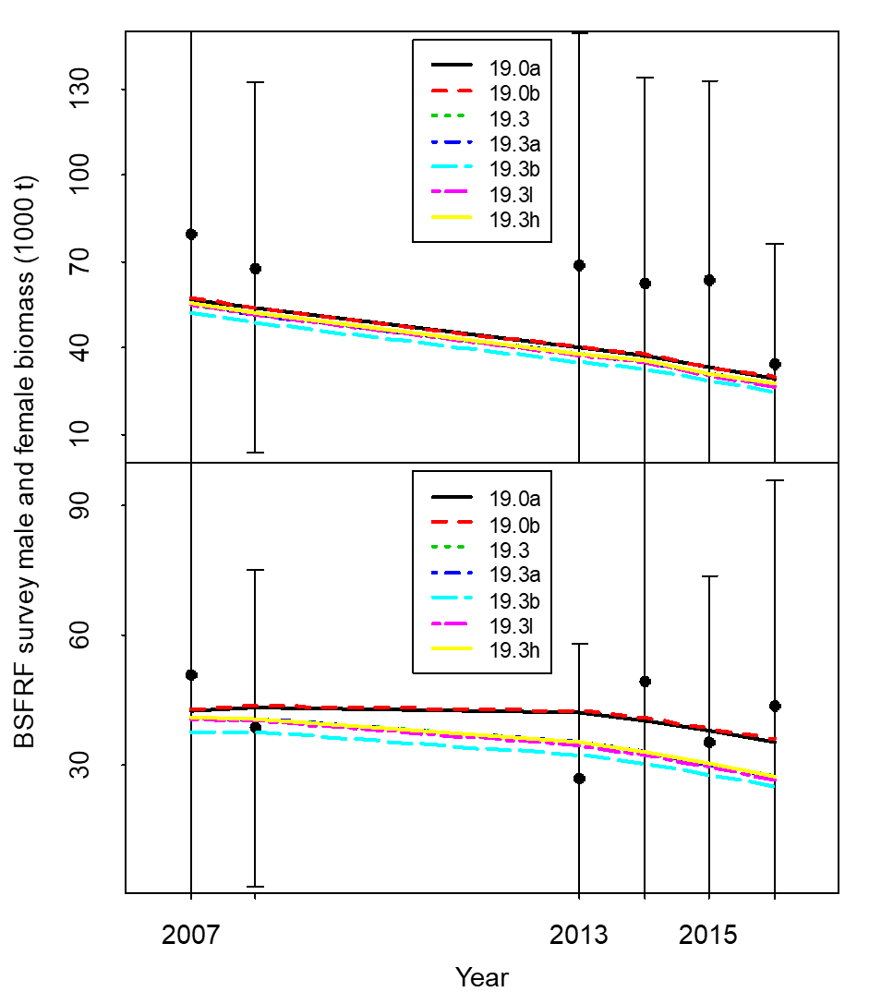
Comparisons of total survey biomass estimates by the BSFRF survey and seven models (upper plot: males; lower plot: females). The error bars are plus and minus 2 standard deviations of model 19.3.

Slide 14
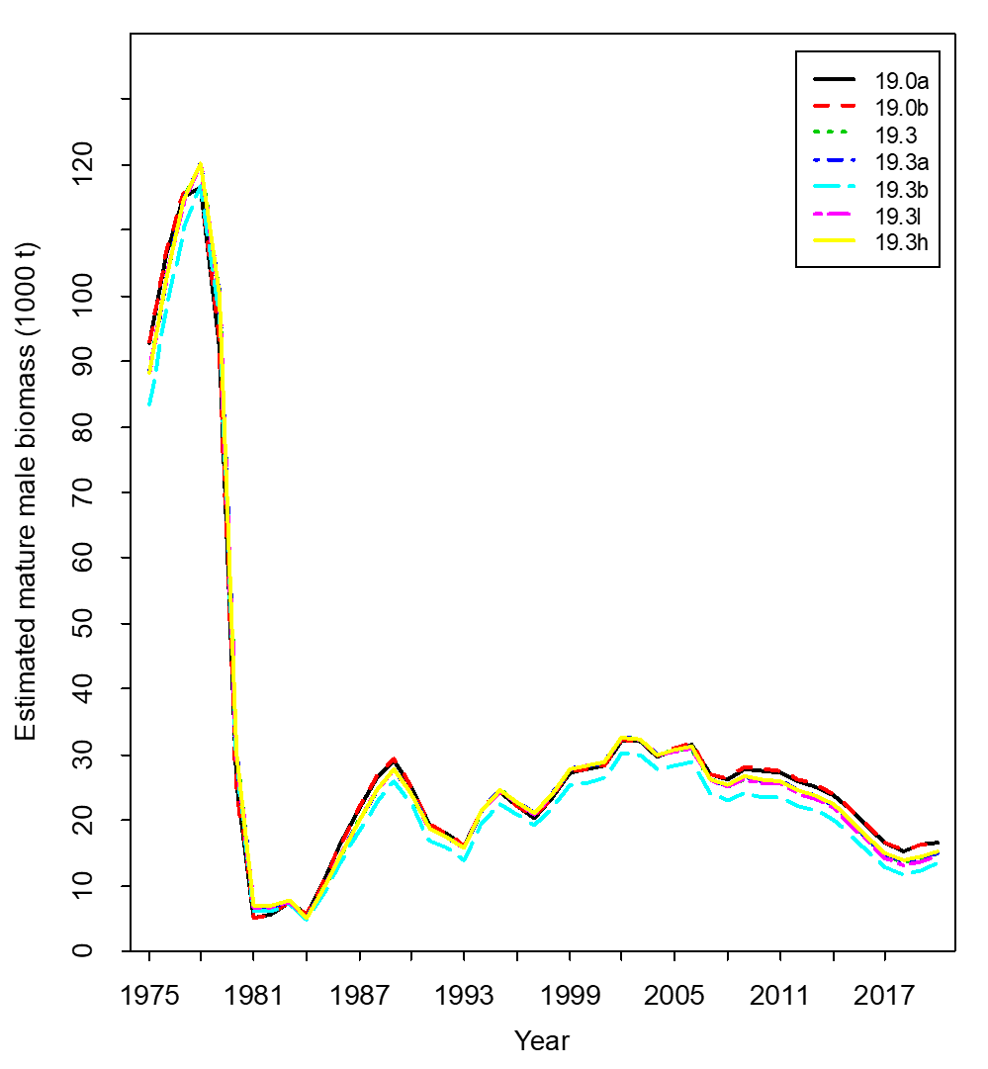
Comparisons of mature male biomass on Feb. 15 under seven models.
Estimated trawl survey catchabilities:
Model Q
19.0a 0.940
19.0b 0.936
19.3 0.959
19.3a 0.958
19.3b 1.053
19.3l 0.960
19.3h 0.959

Slide 15
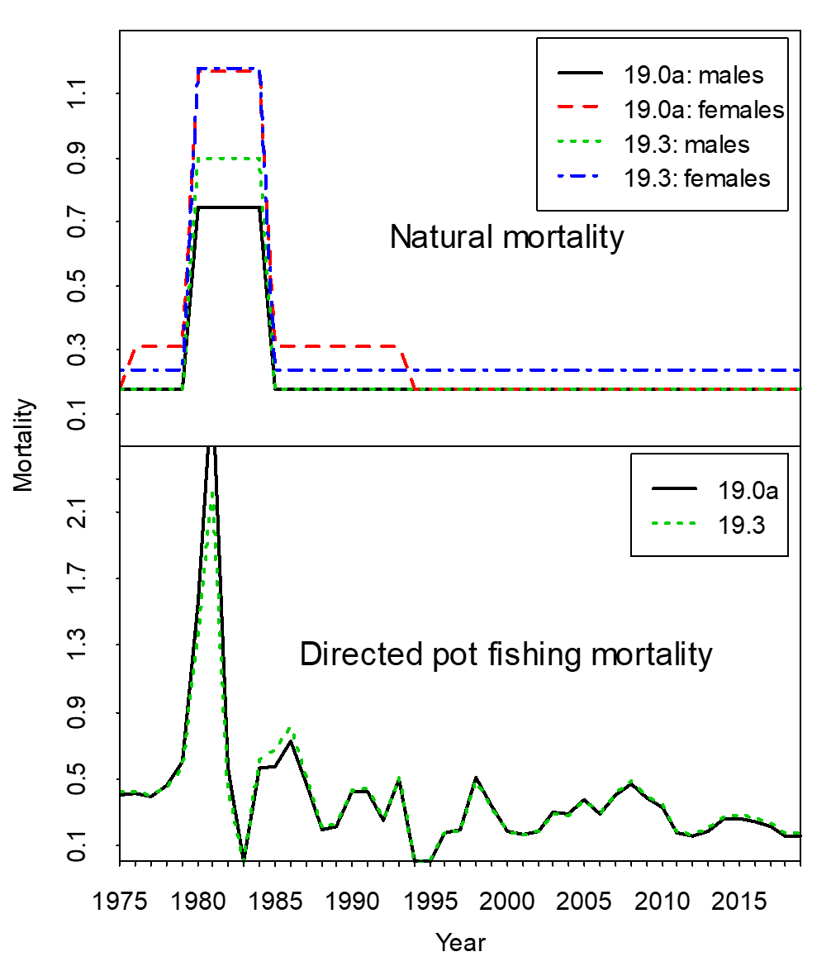
Comparison of estimated M and directed pot fishing mortality over time

Slide 16
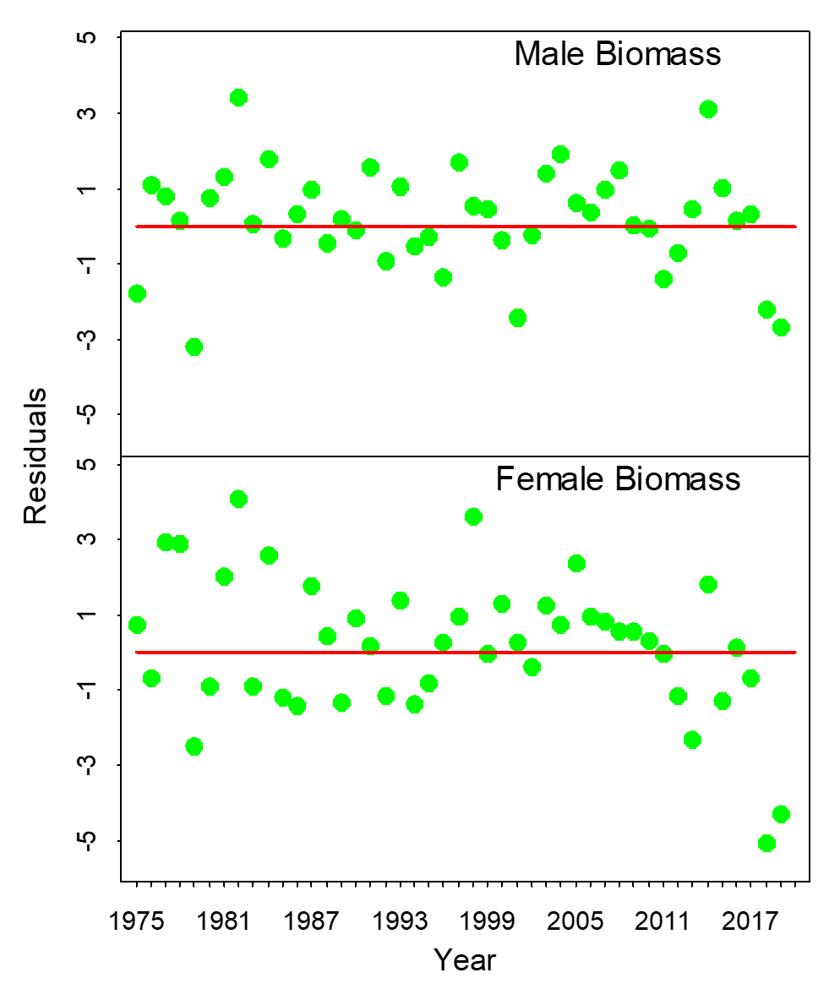
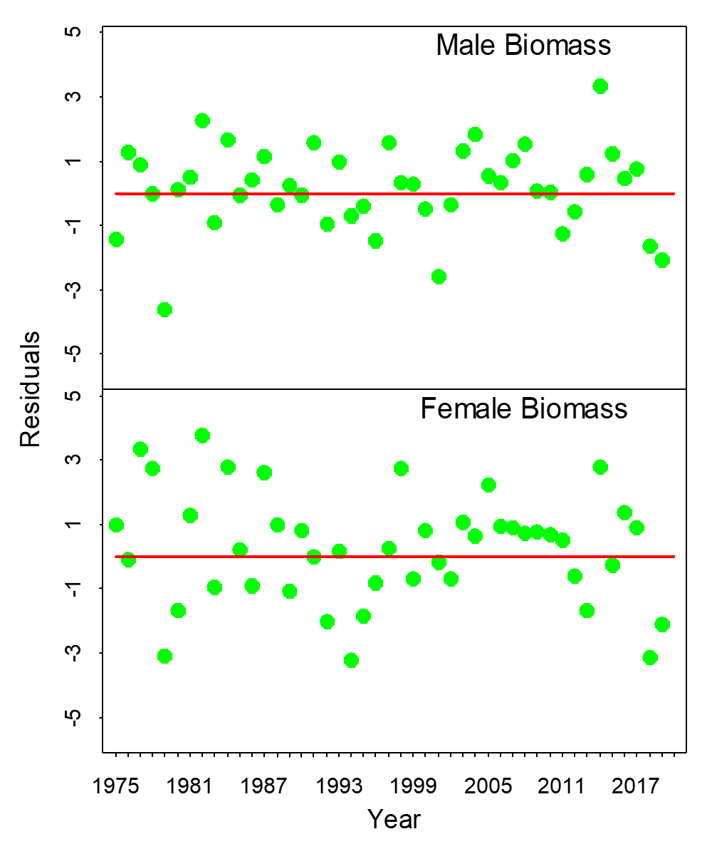
Standardized residuals of total NMFS survey biomass
19.0a
19.3

Slide 17
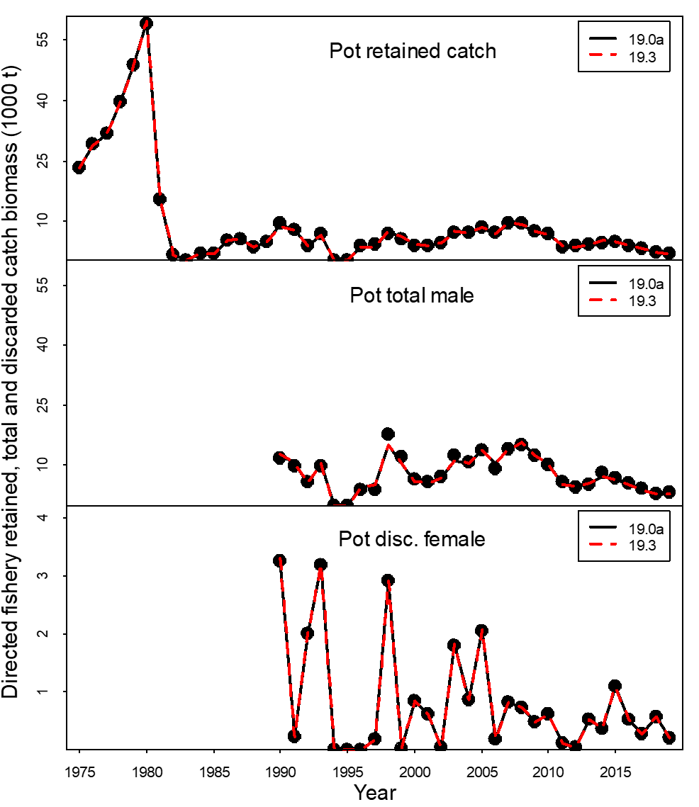
Comparisons of observed and predicted catch mortality biomass under models 19.0a and 19.3. Mortality biomass is equal to caught biomass times a handling mortality rate.

Slide 18
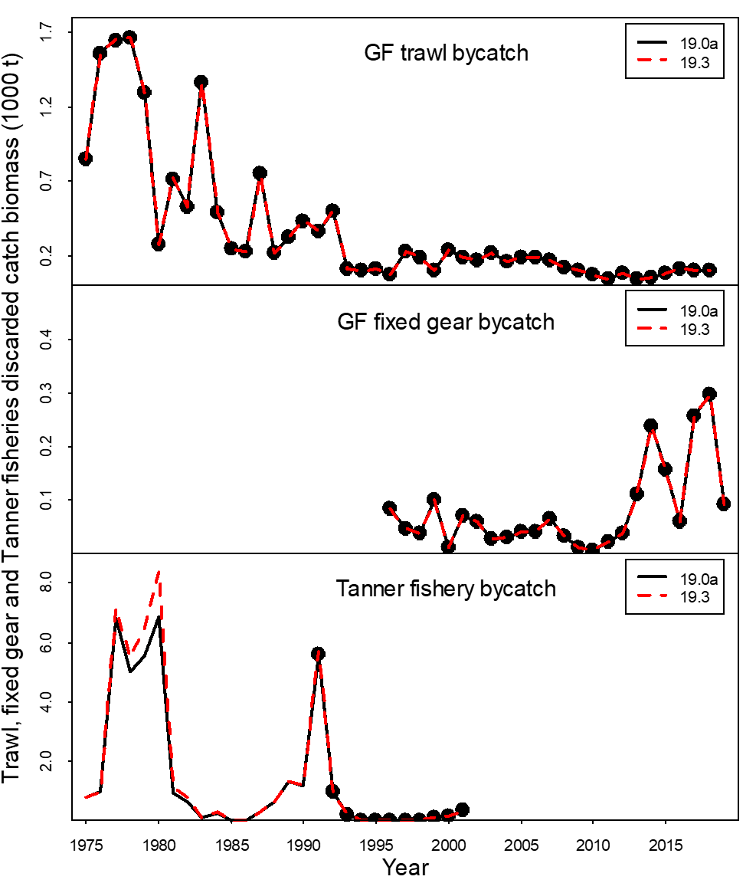
Comparisons of observed and predicted bycatch mortality biomass under models 19.0a and 19.3. Mortality biomass is equal to caught biomass times a handling mortality rate.

Slide 19
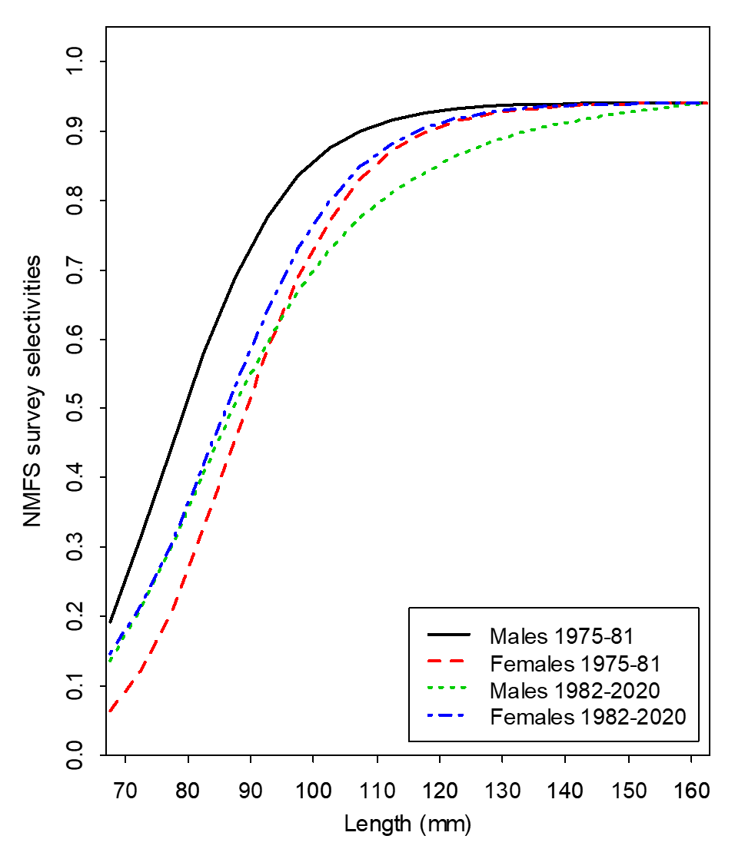
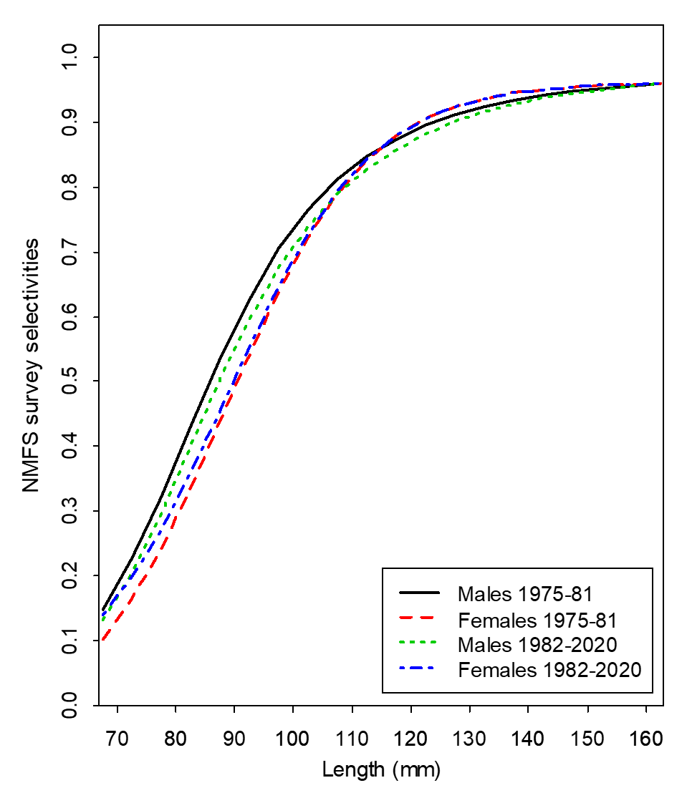
NMFS survey selectivities (including catchability)
19.0a
19.3

Slide 20
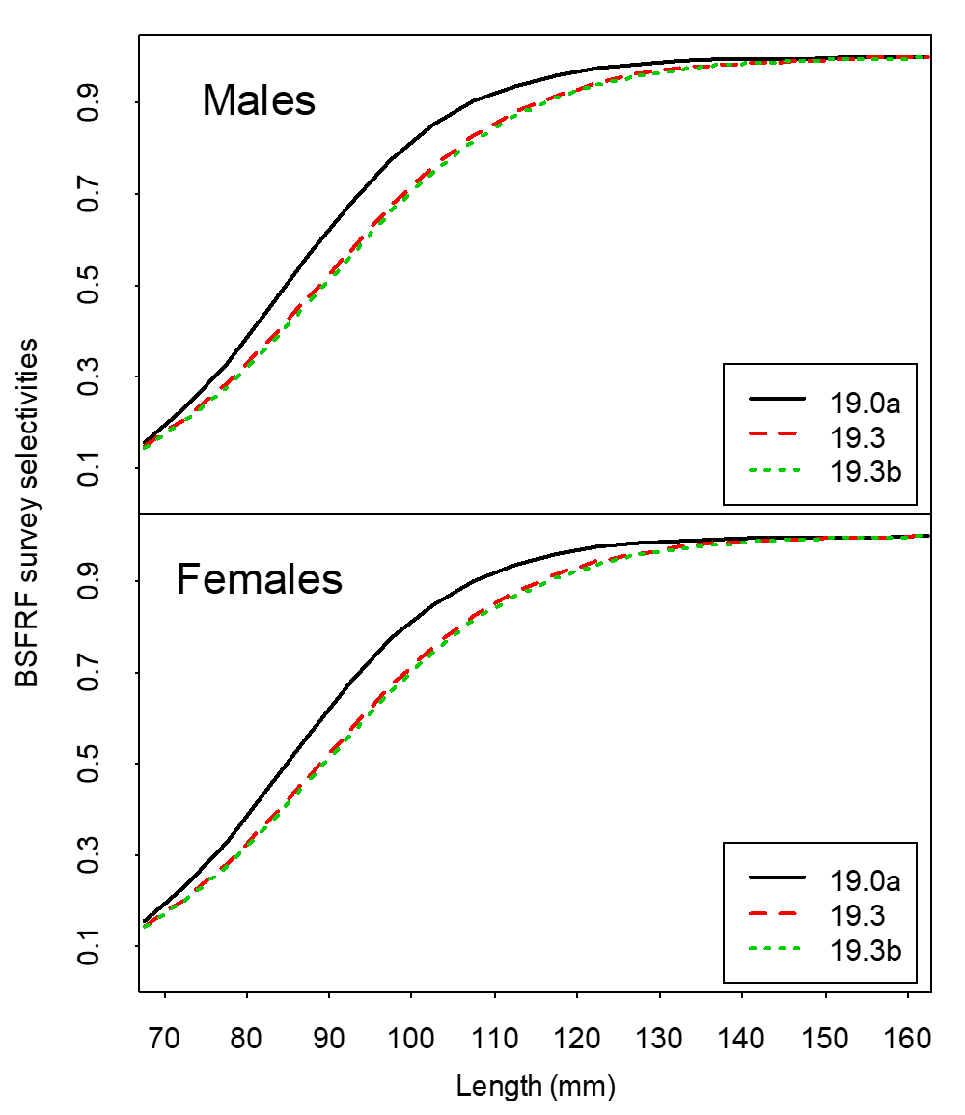
Estimated selectivities of BSFRF trawl survey during 2007-08 and 2013-2016 with three models

Slide 21
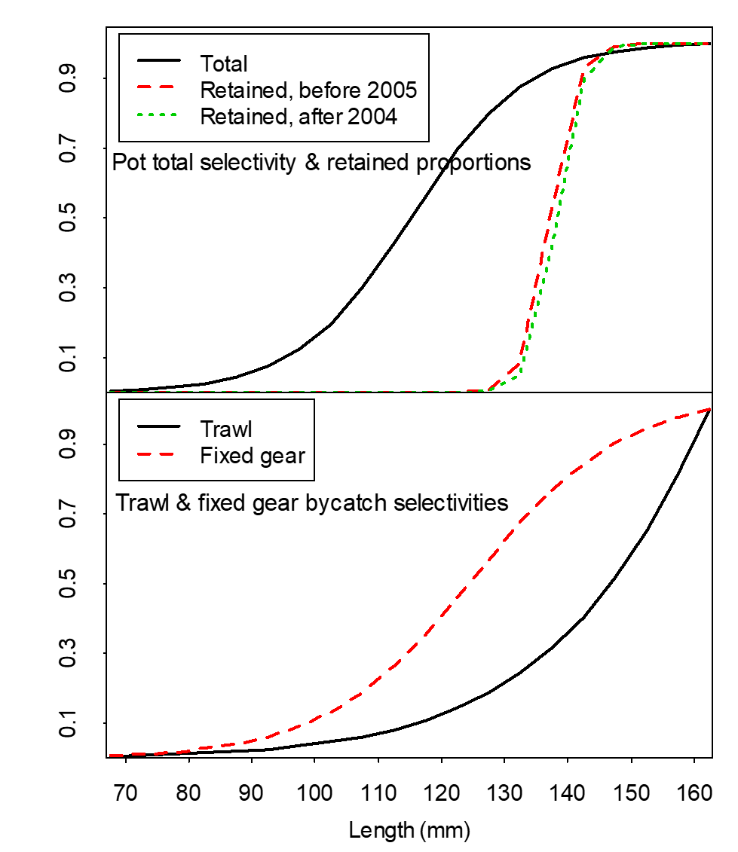
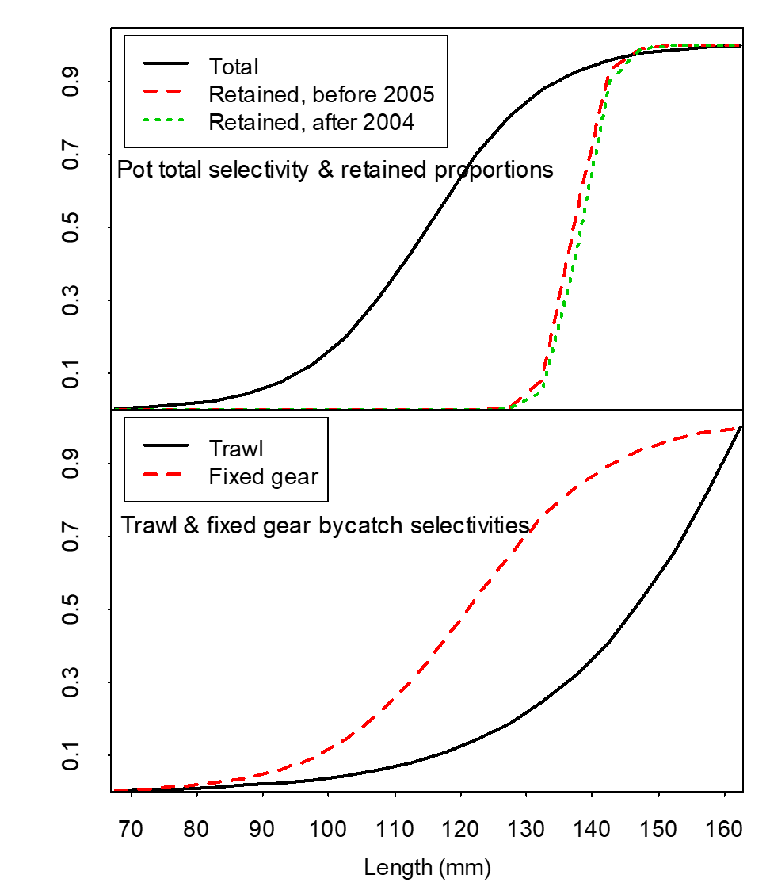
Fisheries selectivities and retained proportions
19.0a
19.3

Slide 22
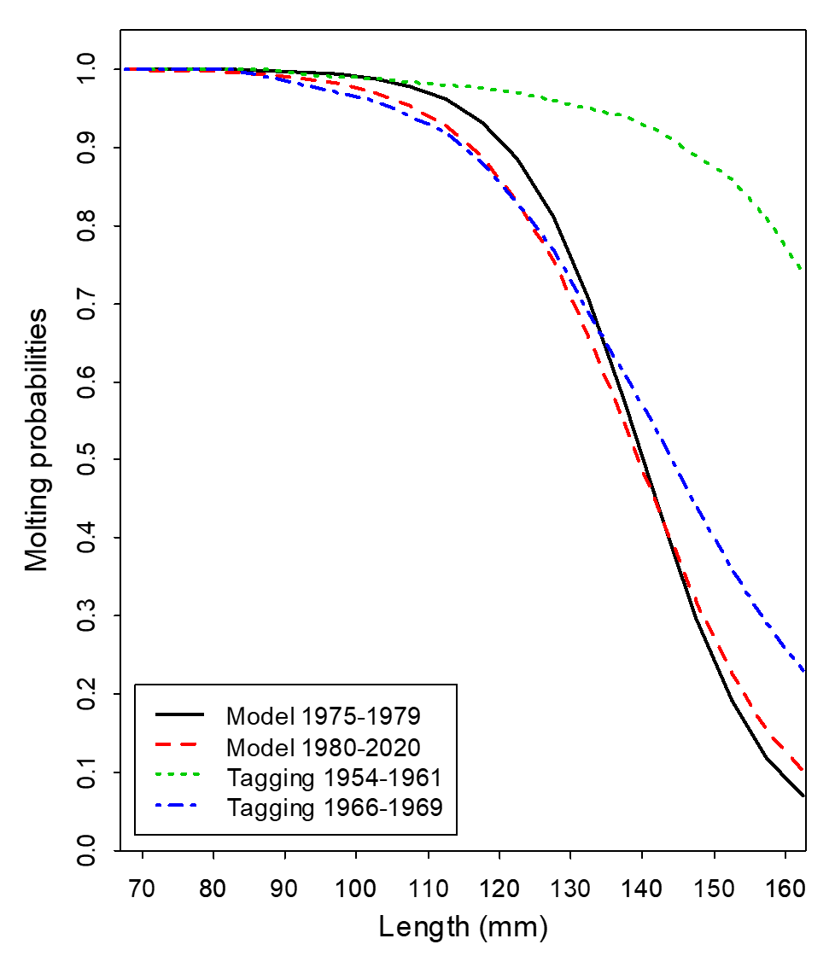

Molting Probabilities
19.0a
19.3

Slide 23
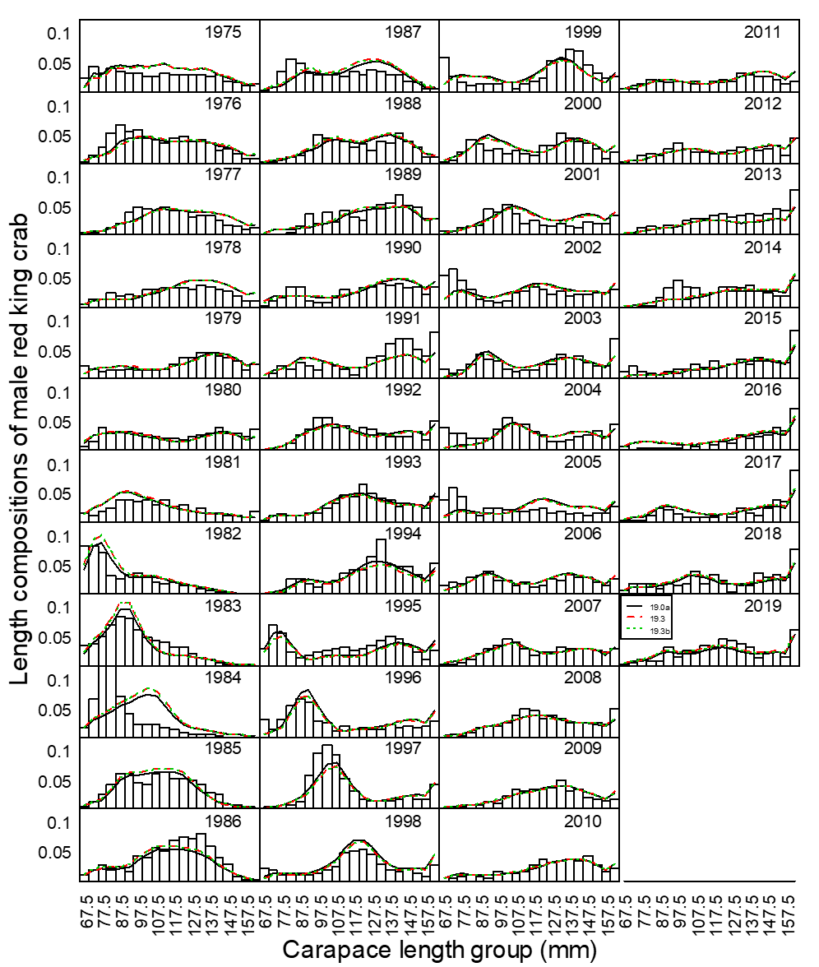
Comparison of area-swept and model estimated NMFS survey length frequencies of Bristol Bay male red king crab by year under three models.

Slide 24
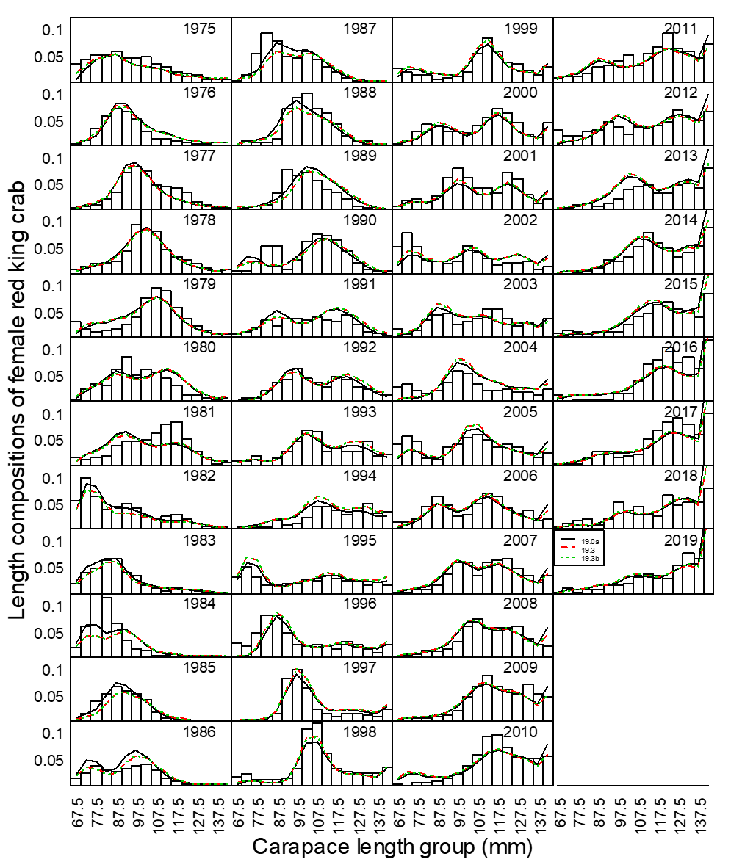
Comparison of area-swept and model estimated NMFS survey length frequencies of Bristol Bay female red king crab by year under three models.

Slide 25
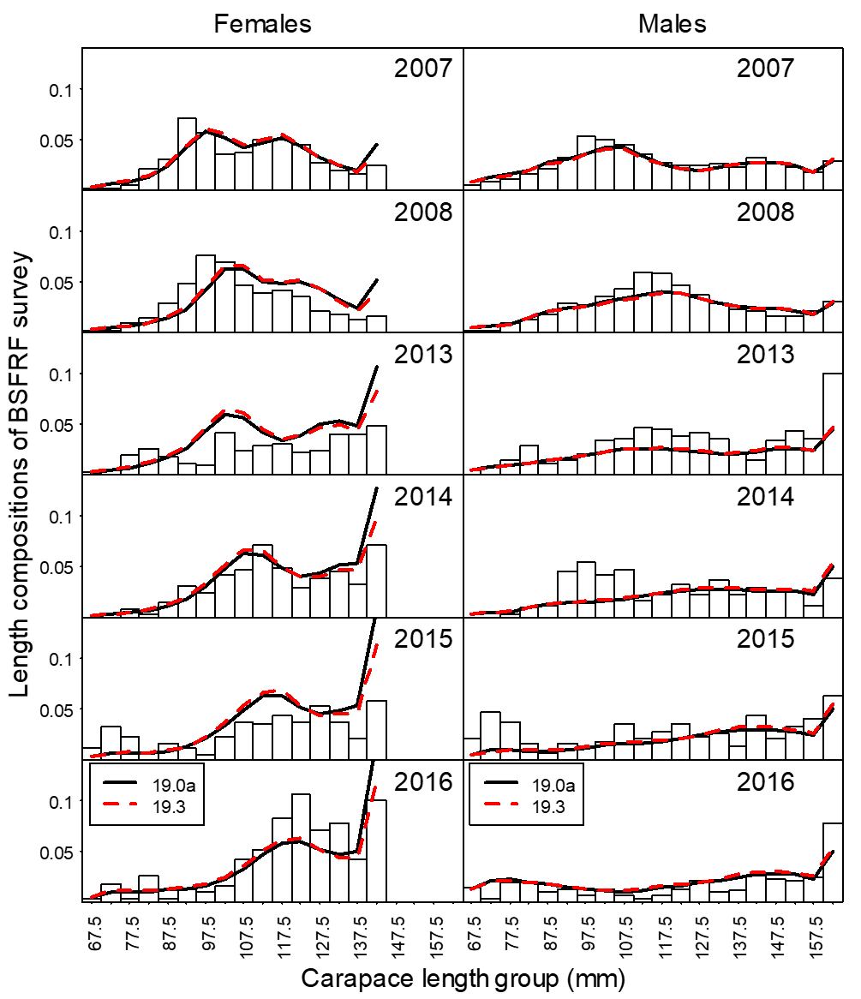
Comparison of area-swept and model estimated BSFRF survey length frequencies of Bristol Bay red king crab by year under three models.

Slide 26
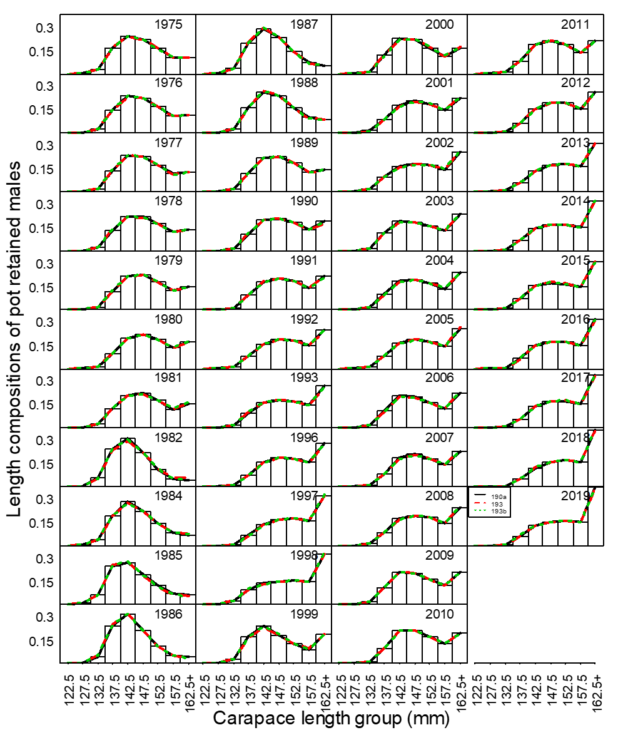
Comparison of observer and model estimated retained length frequencies of Bristol Bay male red king crab by year in the directed pot fishery under three models.

Slide 27
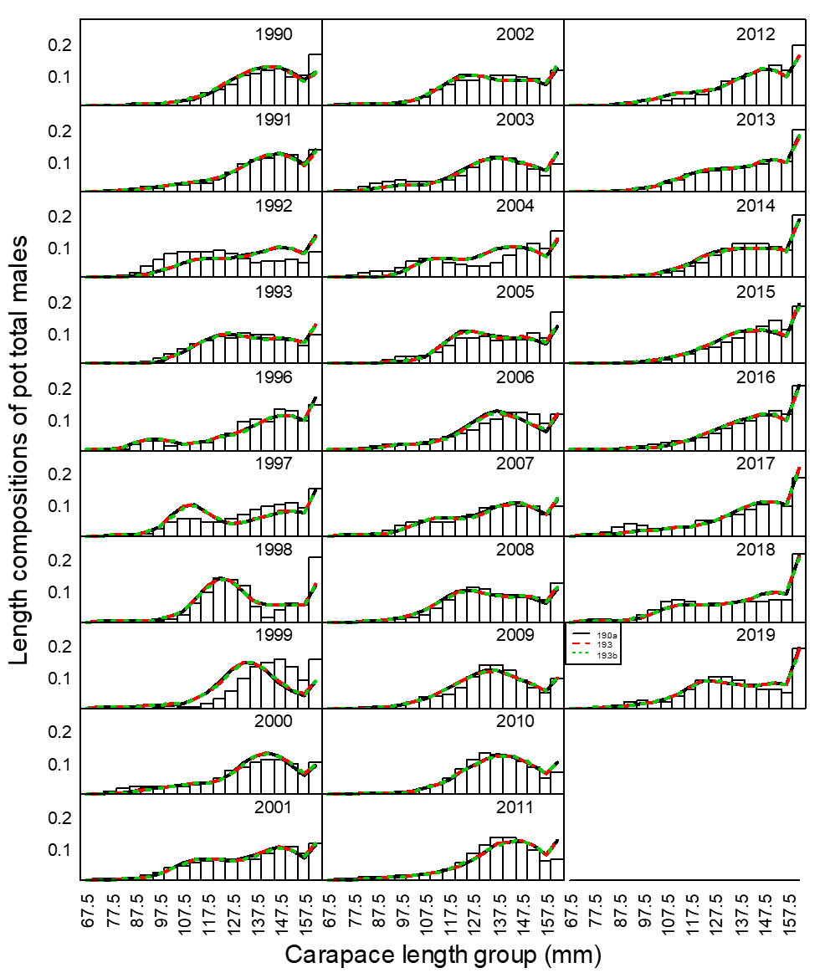
Comparison of observer and model estimated total length frequencies of Bristol Bay male red king crab by year in the directed pot fishery under three models.

Slide 28
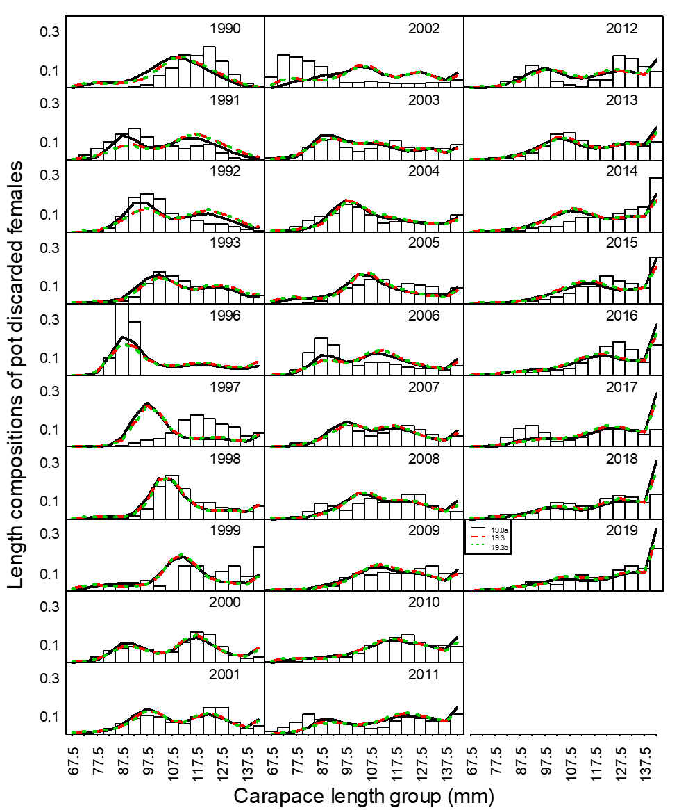
Comparison of observer and model estimated discarded length frequencies of Bristol Bay female red king crab by year in the directed pot fishery under three models.

Slide 29
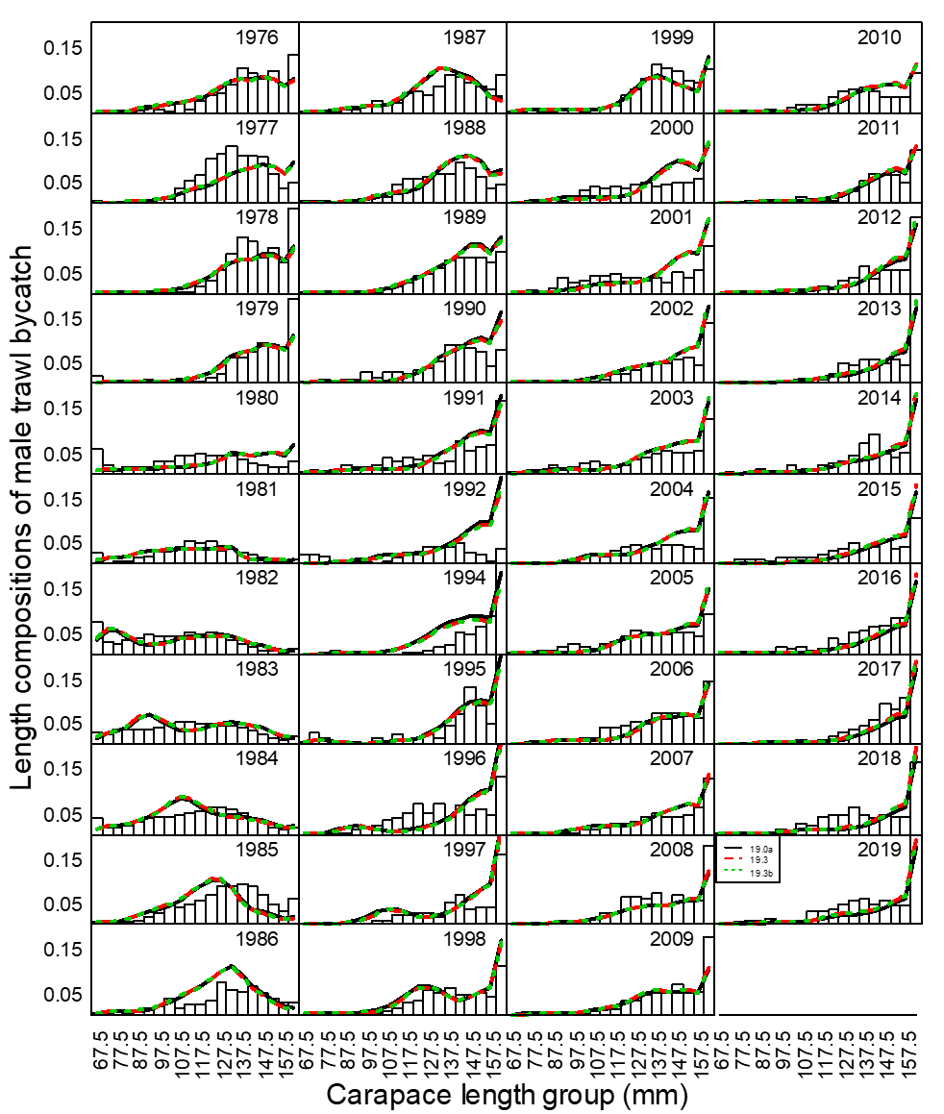
Comparison of observer and model estimated discarded length frequencies of Bristol Bay male red king crab by year in the groundfish trawl fisheries under three models.

Slide 30
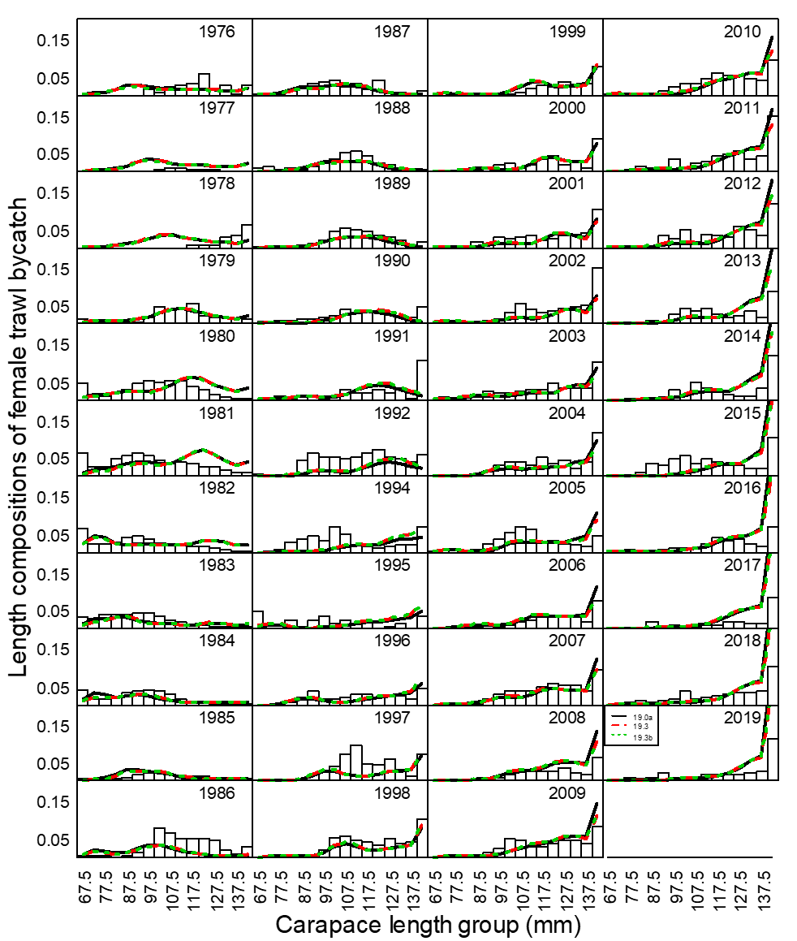
Comparison of observer and model estimated discarded length frequencies of Bristol Bay female red king crab by year in the groundfish trawl fisheries under three models.

Slide 31
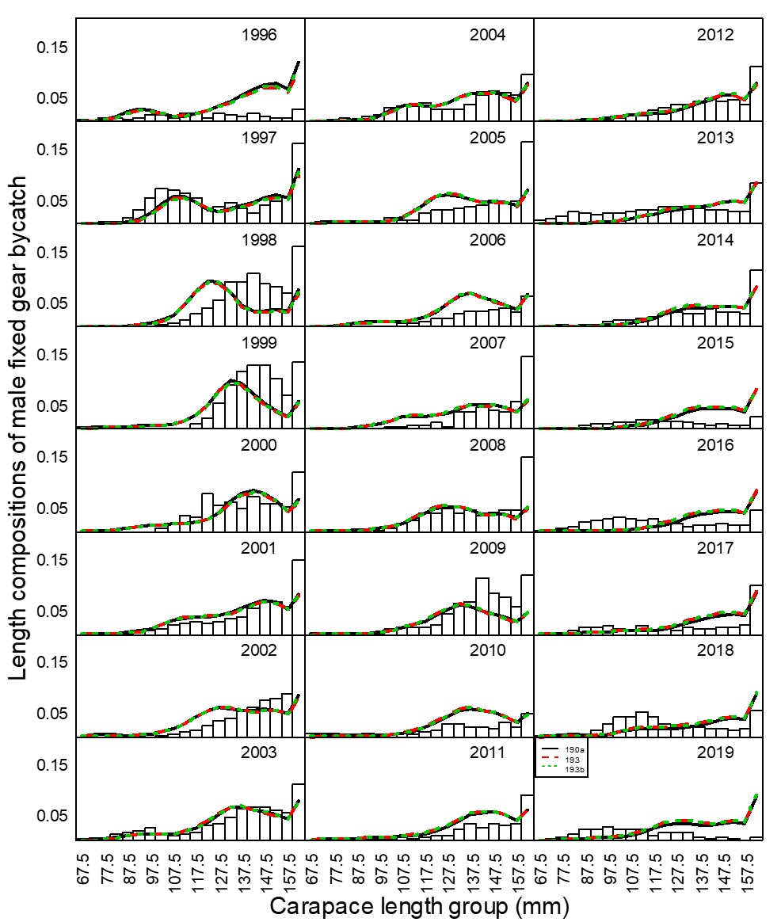
Comparison of observer and model estimated discarded length frequencies of Bristol Bay male red king crab by year in the groundfish fixed gear fisheries under three models.

Slide 32
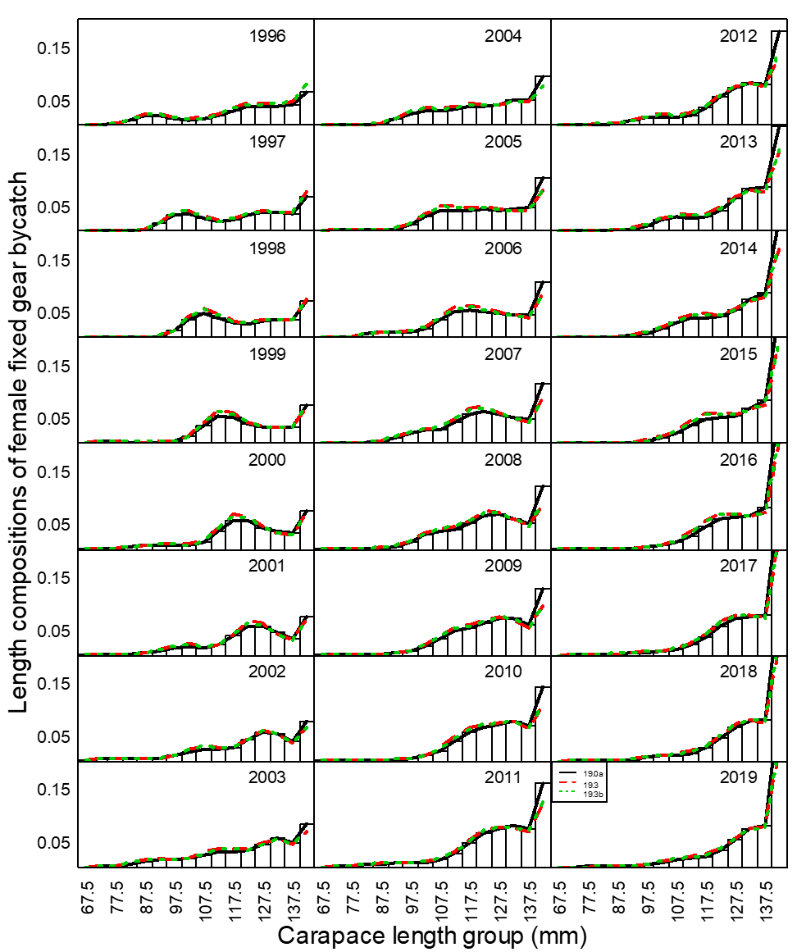
Comparison of observer and model estimated discarded length frequencies of Bristol Bay female red king crab by year in the groundfish fixed gear fisheries under three models.

Slide 33
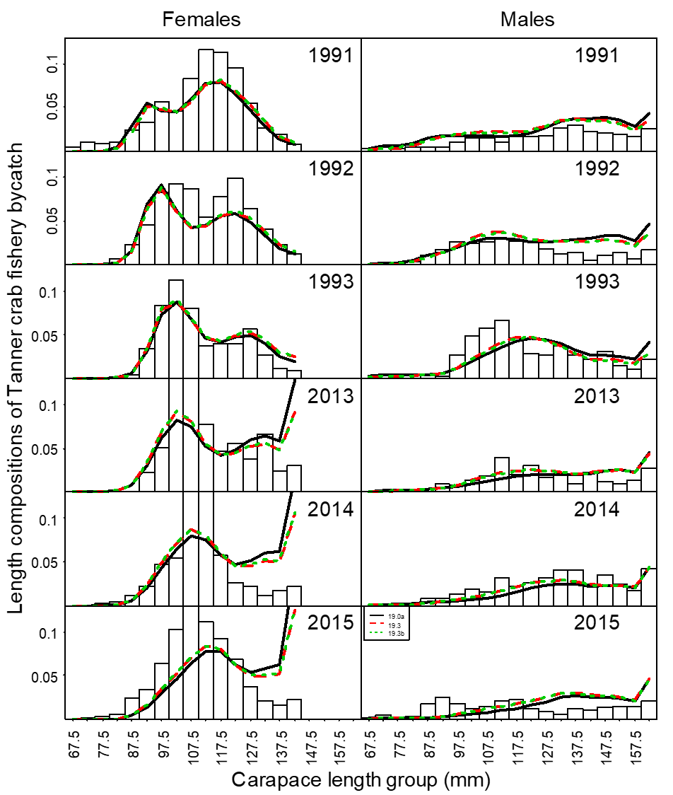
Comparison of observer and model estimated discarded length frequencies of Bristol Bay red king crab by year in the Tanner crab pot fishery under three models.

Slide 34
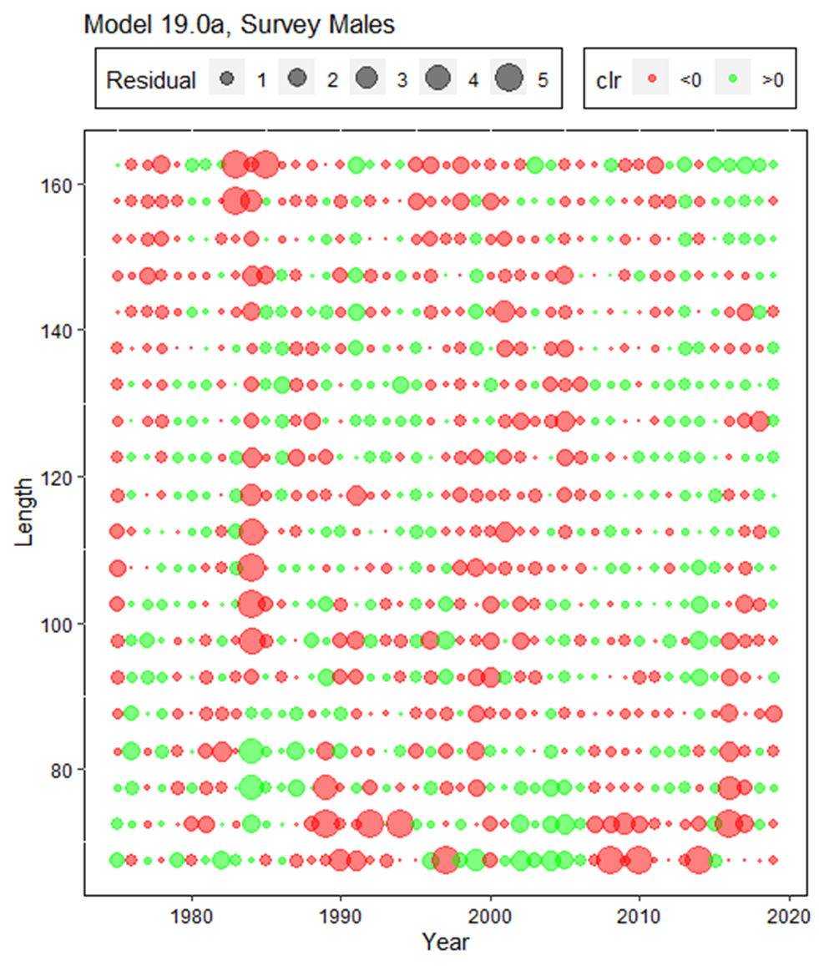
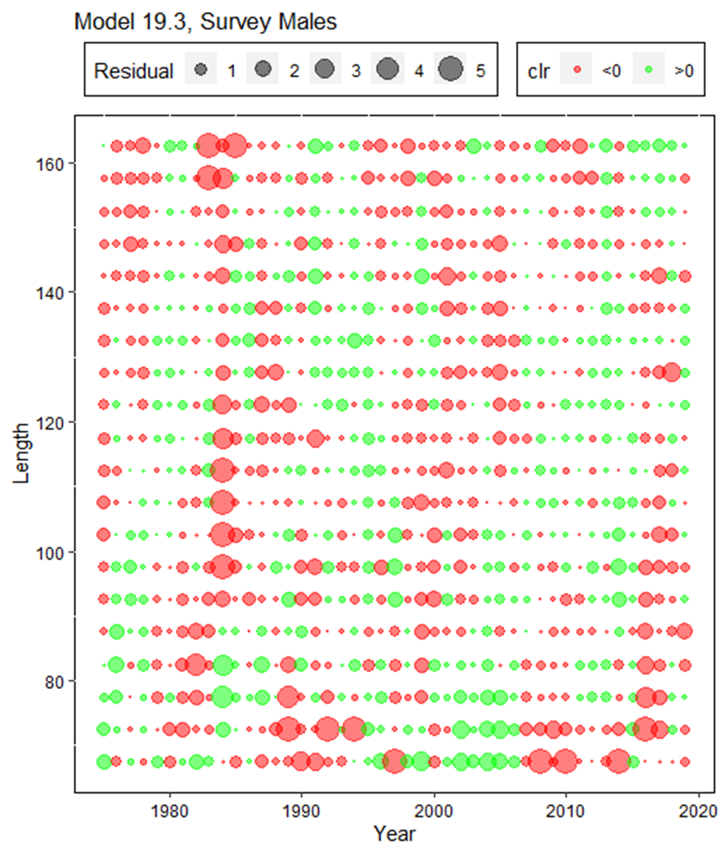
Comparison of residuals of proportions of NMFS survey male red king crab by year and carapace length (mm)

Slide 35
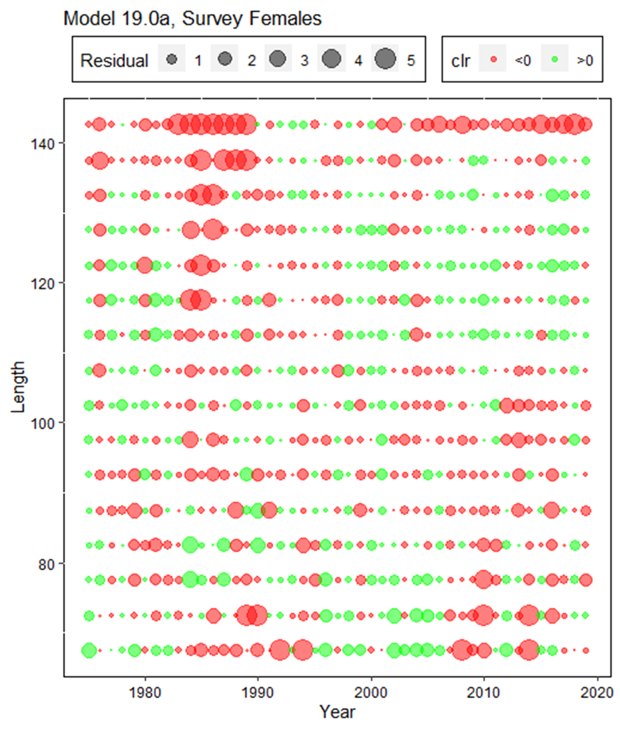
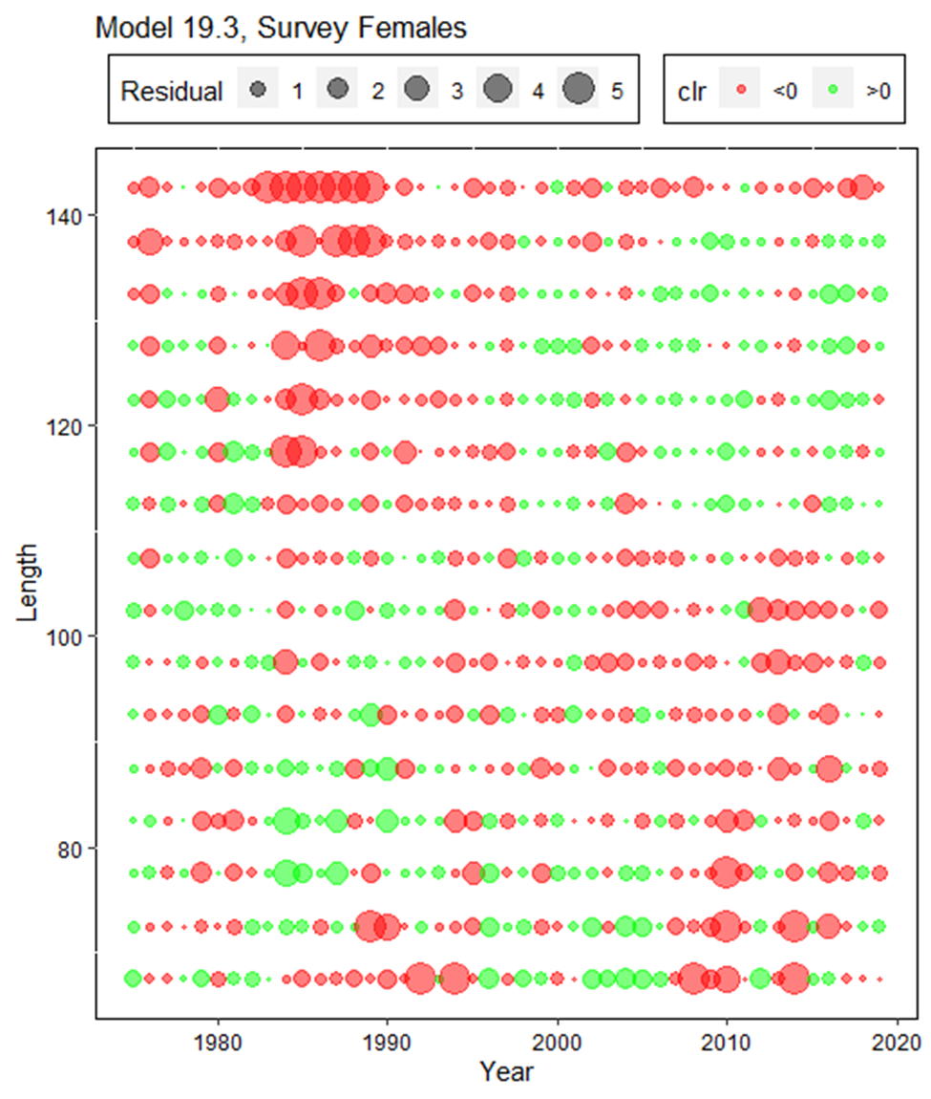
Comparison of residuals of proportions of NMFS survey female red king crab by year and carapace length (mm)

Slide 36
Negative log likelihood components for Models 19.0a, 19.0b, 19.3, 19.3a, 19.3b, 19.3l, and 19.3h and some management quantities.
Highlighted cells in yellow color show prior density values and total negative likelihood values without prior density.

Slide 37
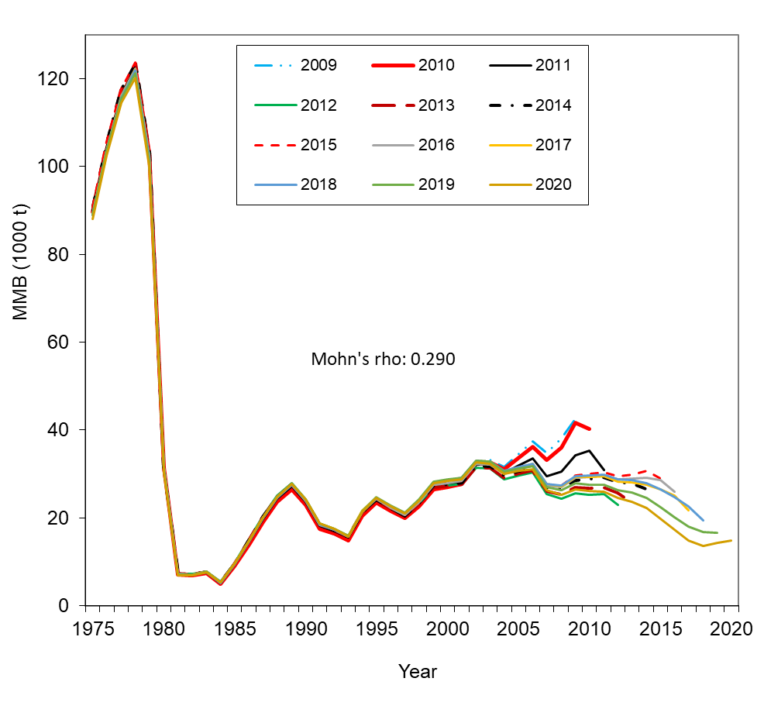
Comparison of hindcast estimates of MMB for model 19.3 from 1975 to 2020 made with terminal years 2009-2020.

Slide 38
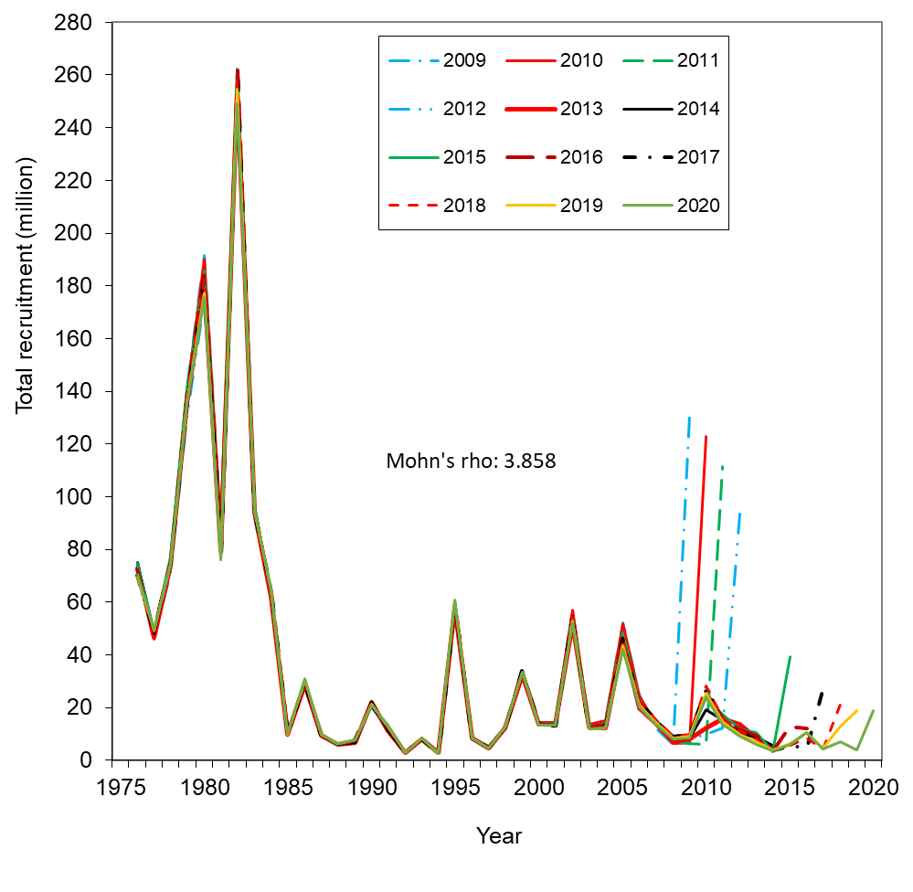
Comparison of hindcast estimates of total recruitment for model 19.3 from 1976 to 2020 made with terminal years 2009-2020

Slide 39
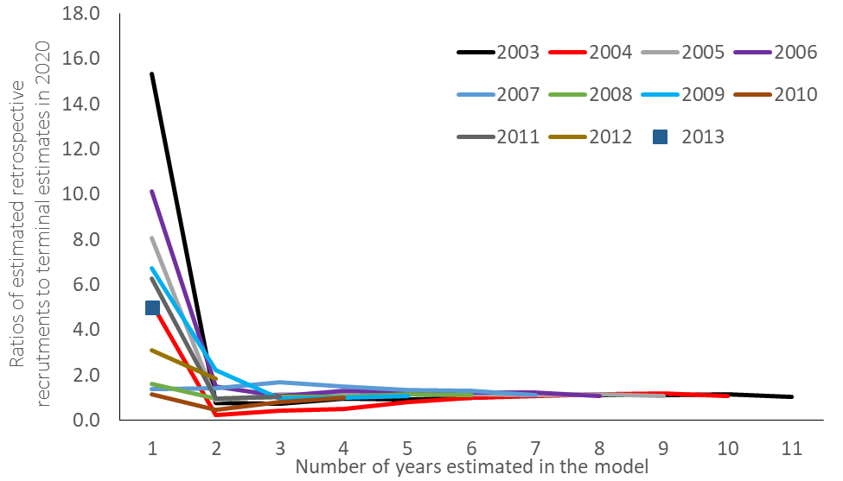
Figure 28b. Evaluation of Bristol Bay red king crab retrospective errors on recruitment estimates as a function of the number of years in the model for model 19.3.

Slide 40
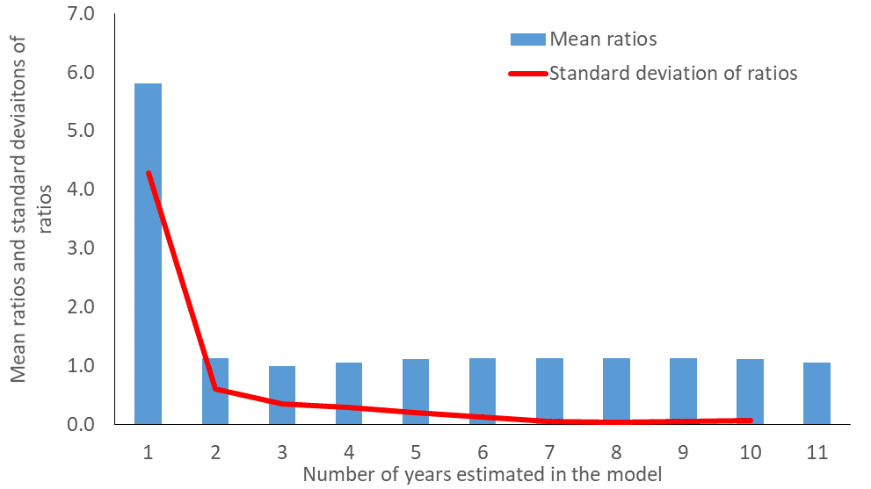
Figure 28c. Mean ratios of retrospective estimates of recruitments to those estimated in the most recent year (2020) and standard deviations of the ratios as a function of the number of years in the model for model 19.3.

Slide 41
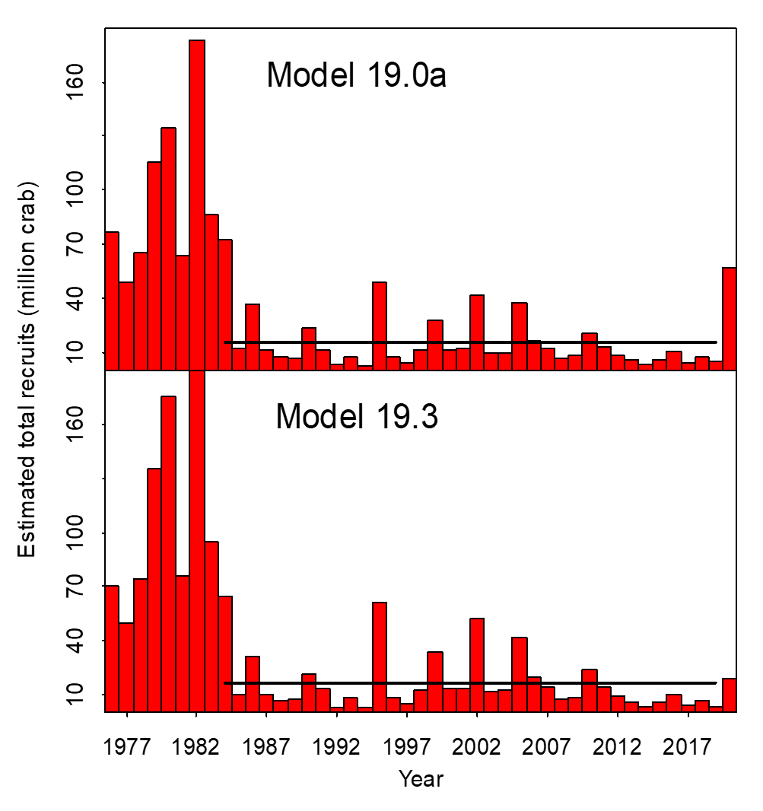

Slide 42
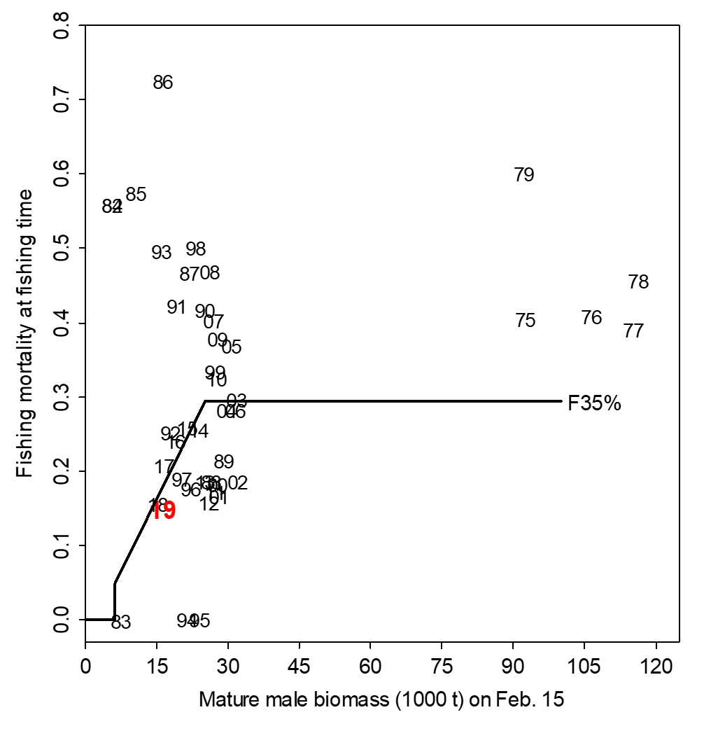
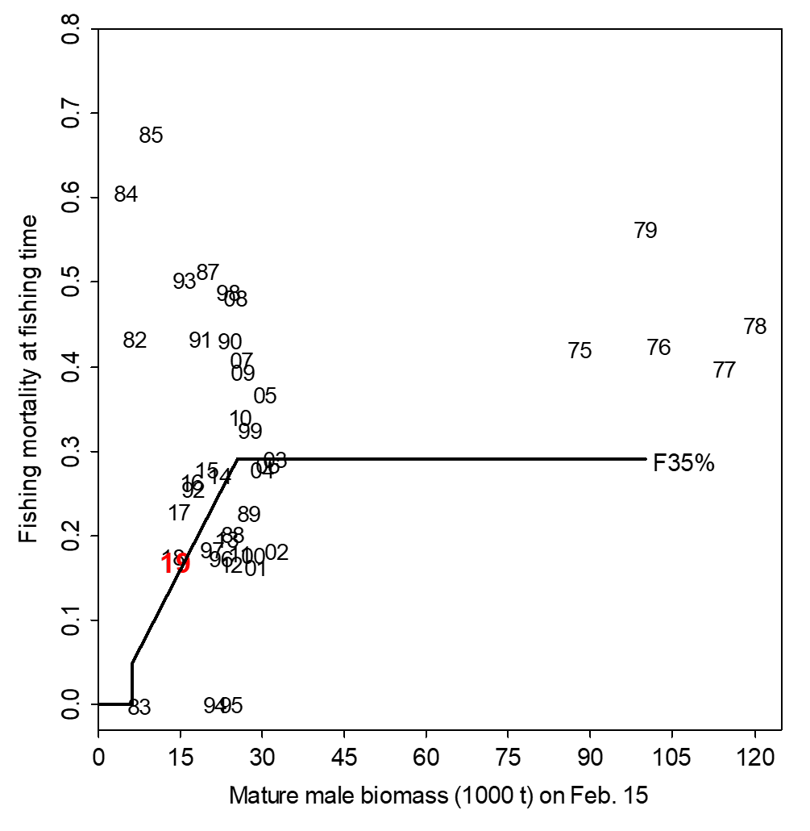
Model 19.0a
Model 19.3

Slide 43
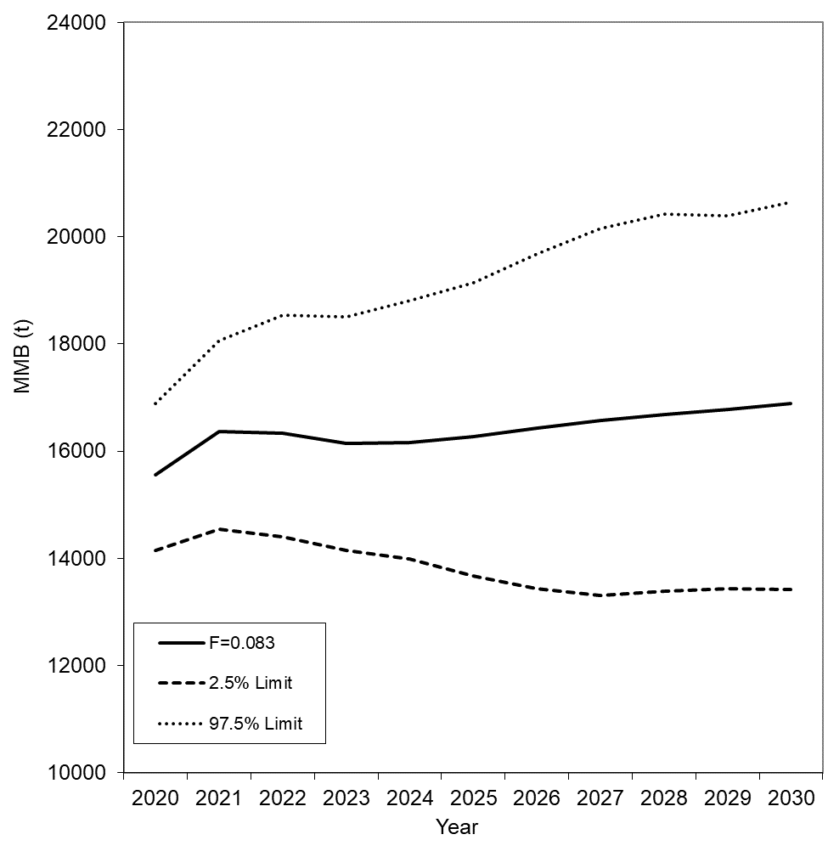
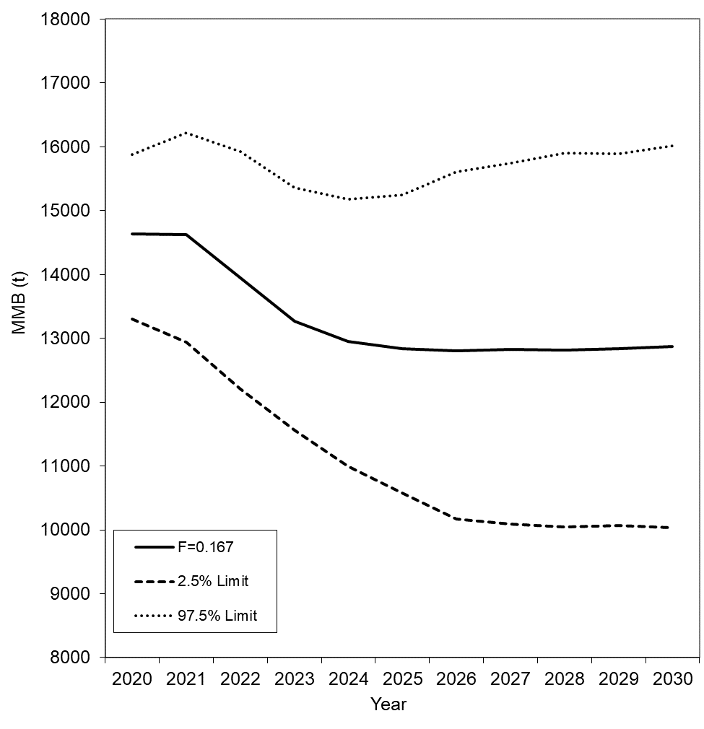
Population Forward Projection:
1. Model 19.3a,
2. Lowest recruitment period: 2012-2019, random draw,
3. F = 0.167 is about F_{ofl} in 2020.

Slide 44
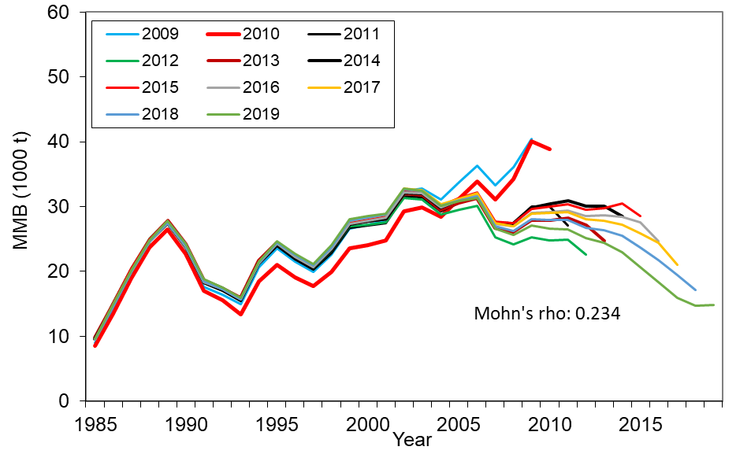
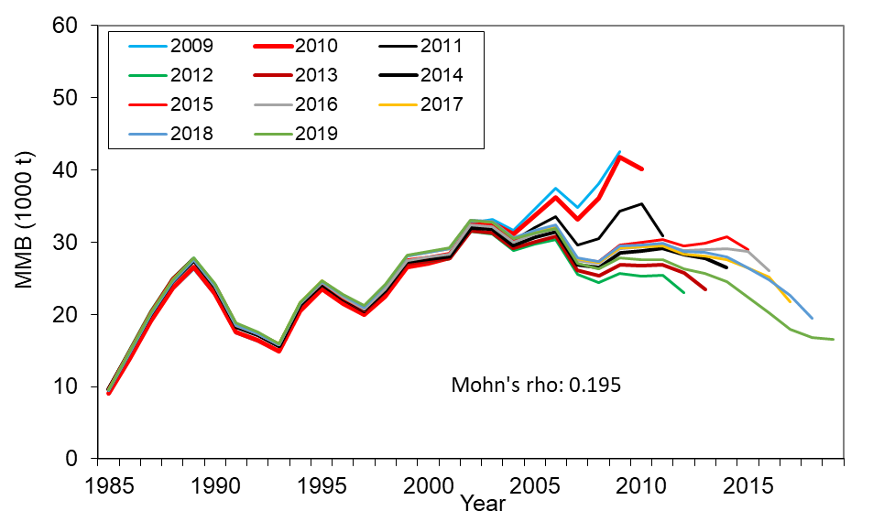
Appendix D. Assessing Uncertainty of Management Qualities without Trawl Survey in the Terminal Year (2020)
Approaches 1 & 2: Retrospective analysis with two sets of runs: with & without survey in the terminal years.
With survey
Without survey

Slide 45
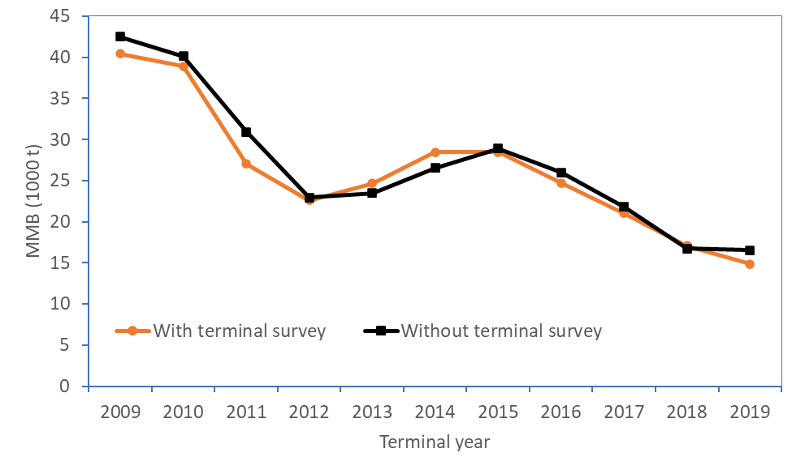
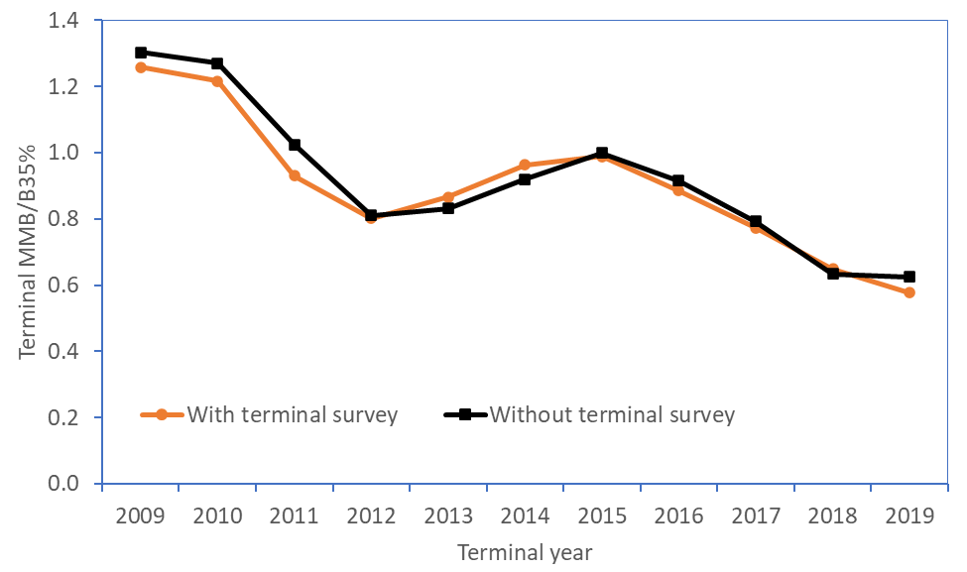
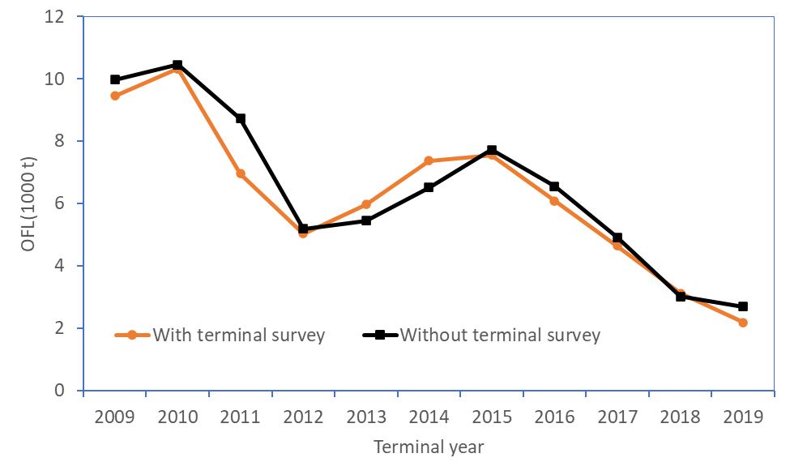
Relative error of with/without surveys (without survey relative to with survey):
Mean rel.error Mean abs. rel. error
MMB: 2.94% 5.04%
OFL: 4.67% 8.37%
MMB/B35%: -1.35% 4.11%
Mean CV over years: With Sur. Without Sur.
MMB: 0.07 0.08
OFL: 0.12 0.13
MMB/B35%: 0.06 0.06

Slide 46
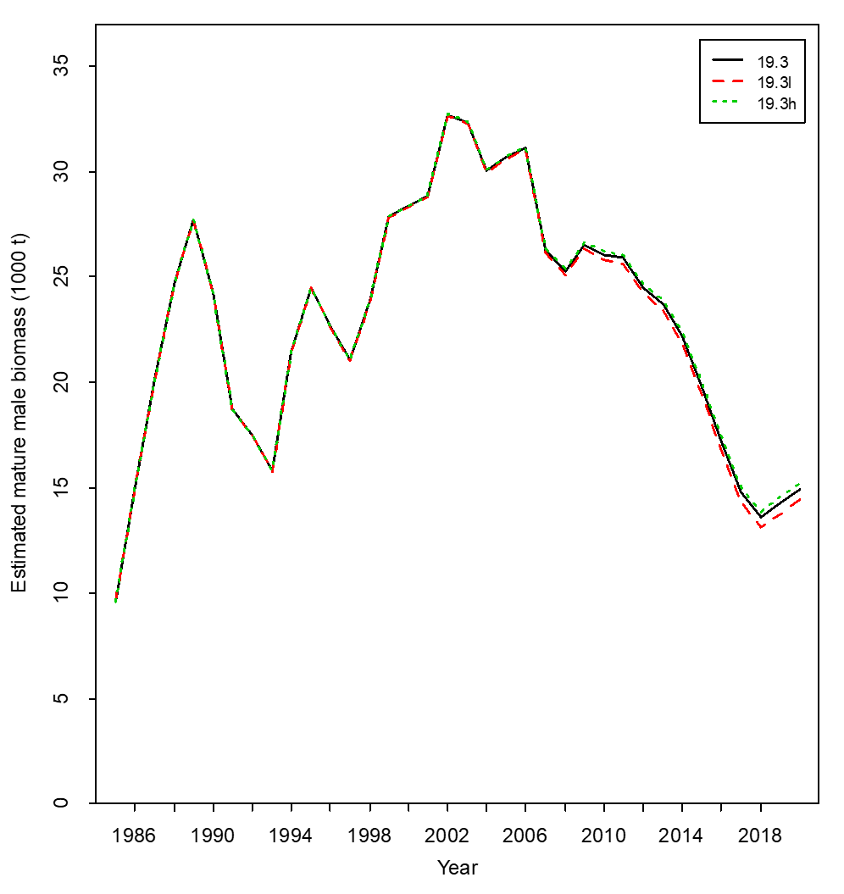
Approach 3: Sensitivity analysis with high and low proxy surveys:
Adding 25th (model 19.3l) and 75th (model 19.3h) model-expected percentile survey biomass to the terminal year (2020).
Summary:
Overall, differences of results from these three approaches are very small.
As unexpected, retrospective results are better without terminal survey than with terminal survey, maybe due to unexpected survey biomass in 2014, 2018 and 2019.

Slide 47
Summary
In 2018 and 2019, the survey biomasses decreased about 50% from 2017, more than expected. Models 19.0a and 19.3b have much higher estimated NMFS survey biomass than the observed values in 2018 and 2019. Model 19.3 and the related other four models have reasonable fits to NMFS survey biomass during recent years.
Absolute mature male biomasses for all models have a similar trend over time. Biomass estimates for model 19.0a and 19.0b are higher during recent years than the other 5 model scenarios.
As expected, model 19.3b estimates a higher trawl survey catchability (>1.0), thus resulting in overall lower absolute biomass estimates. The prior to trawl survey catchability has big impacts.
Like the prior results, updated terminal year recruitment analysis with model 19.3 also suggests the estimated recruitment in the last year should not be used for estimating B_{35%}.
Model 19.3 is the preferred model by the CPT in May 2020 and fits the data better with one less parameter than model 19.0a, thus being our preferred model for overfishing definition determination.
Analyses show the impacts without terminal survey in 2020 may be small.

Slide 49
Decision
Decision
Decision

Slide 50
Thanks

