Slide 1
Assessment of BSAI Greenland turbot
Meaghan D. Bryan, Steven J. Barbeaux,
Jim Ianelli, Stephani Zador, Jerry Hoff
November 19, 2020

Slide 2
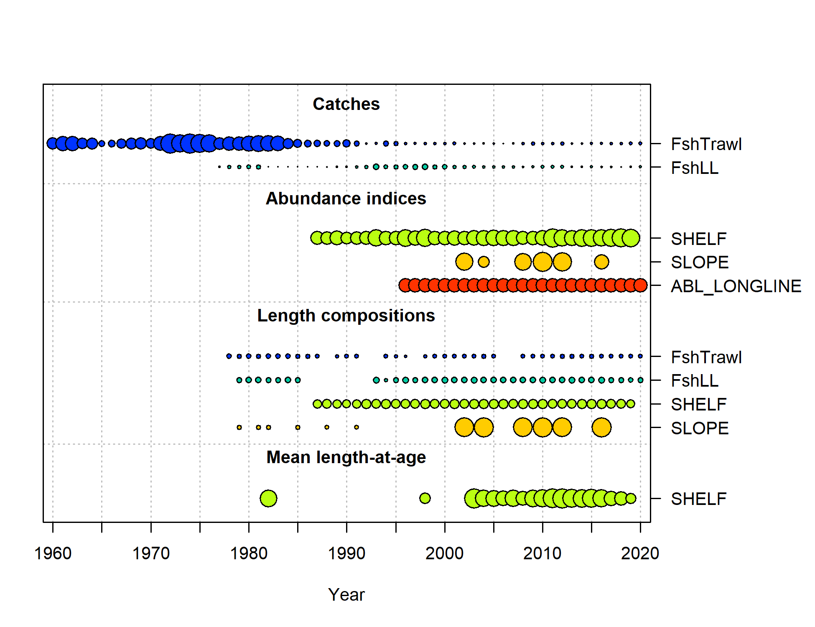
Data and model structure
Models developed in Stock Synthesis
2 fleets, 3 surveys
  Trawl fishery
  Longline fishery
  EBS shelf survey
  EBS slope survey
  ABL longline survey

Slide 3
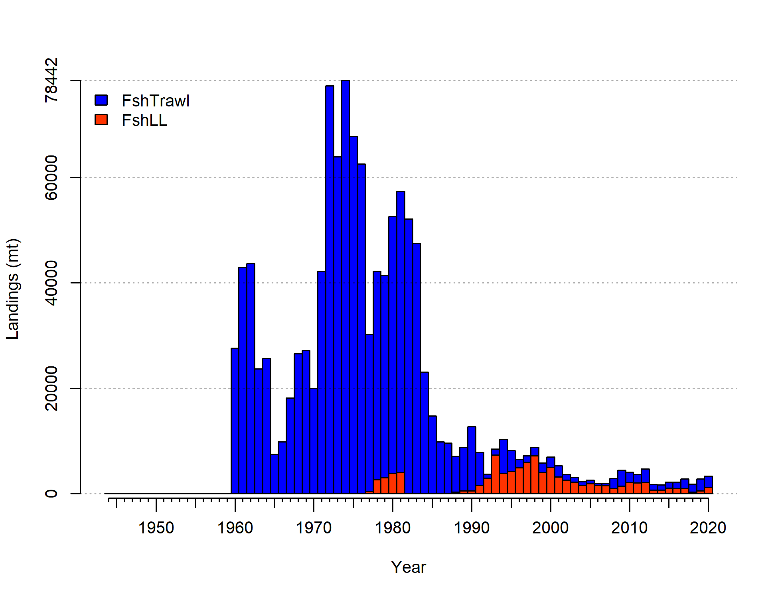
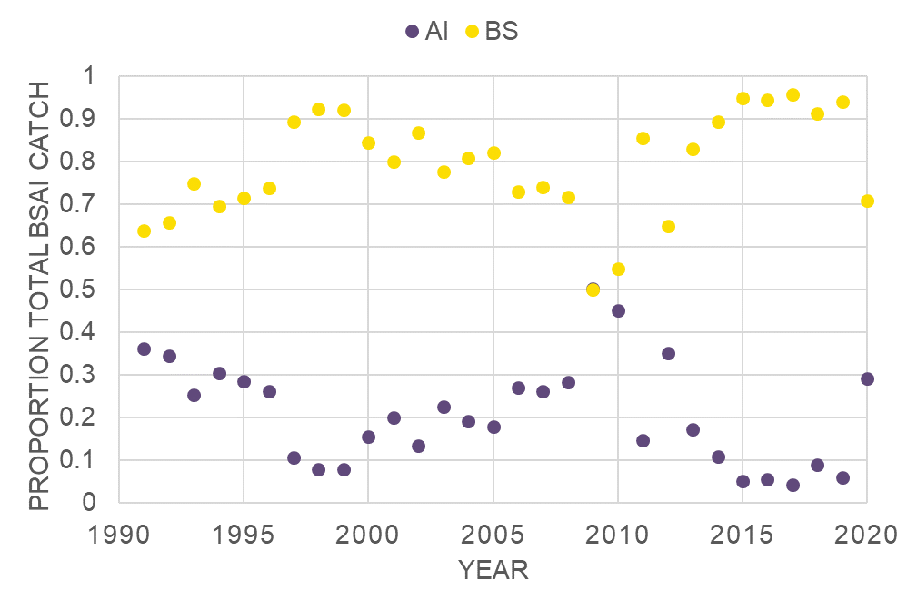
Fishery catch
MFCMA
Notes:
Early catch mainly trawl fishery
Peaked in early 1970s
Secondary peak in 1982
Large decline mid-80s
Starting in the1990s predominantly longline

Slide 4
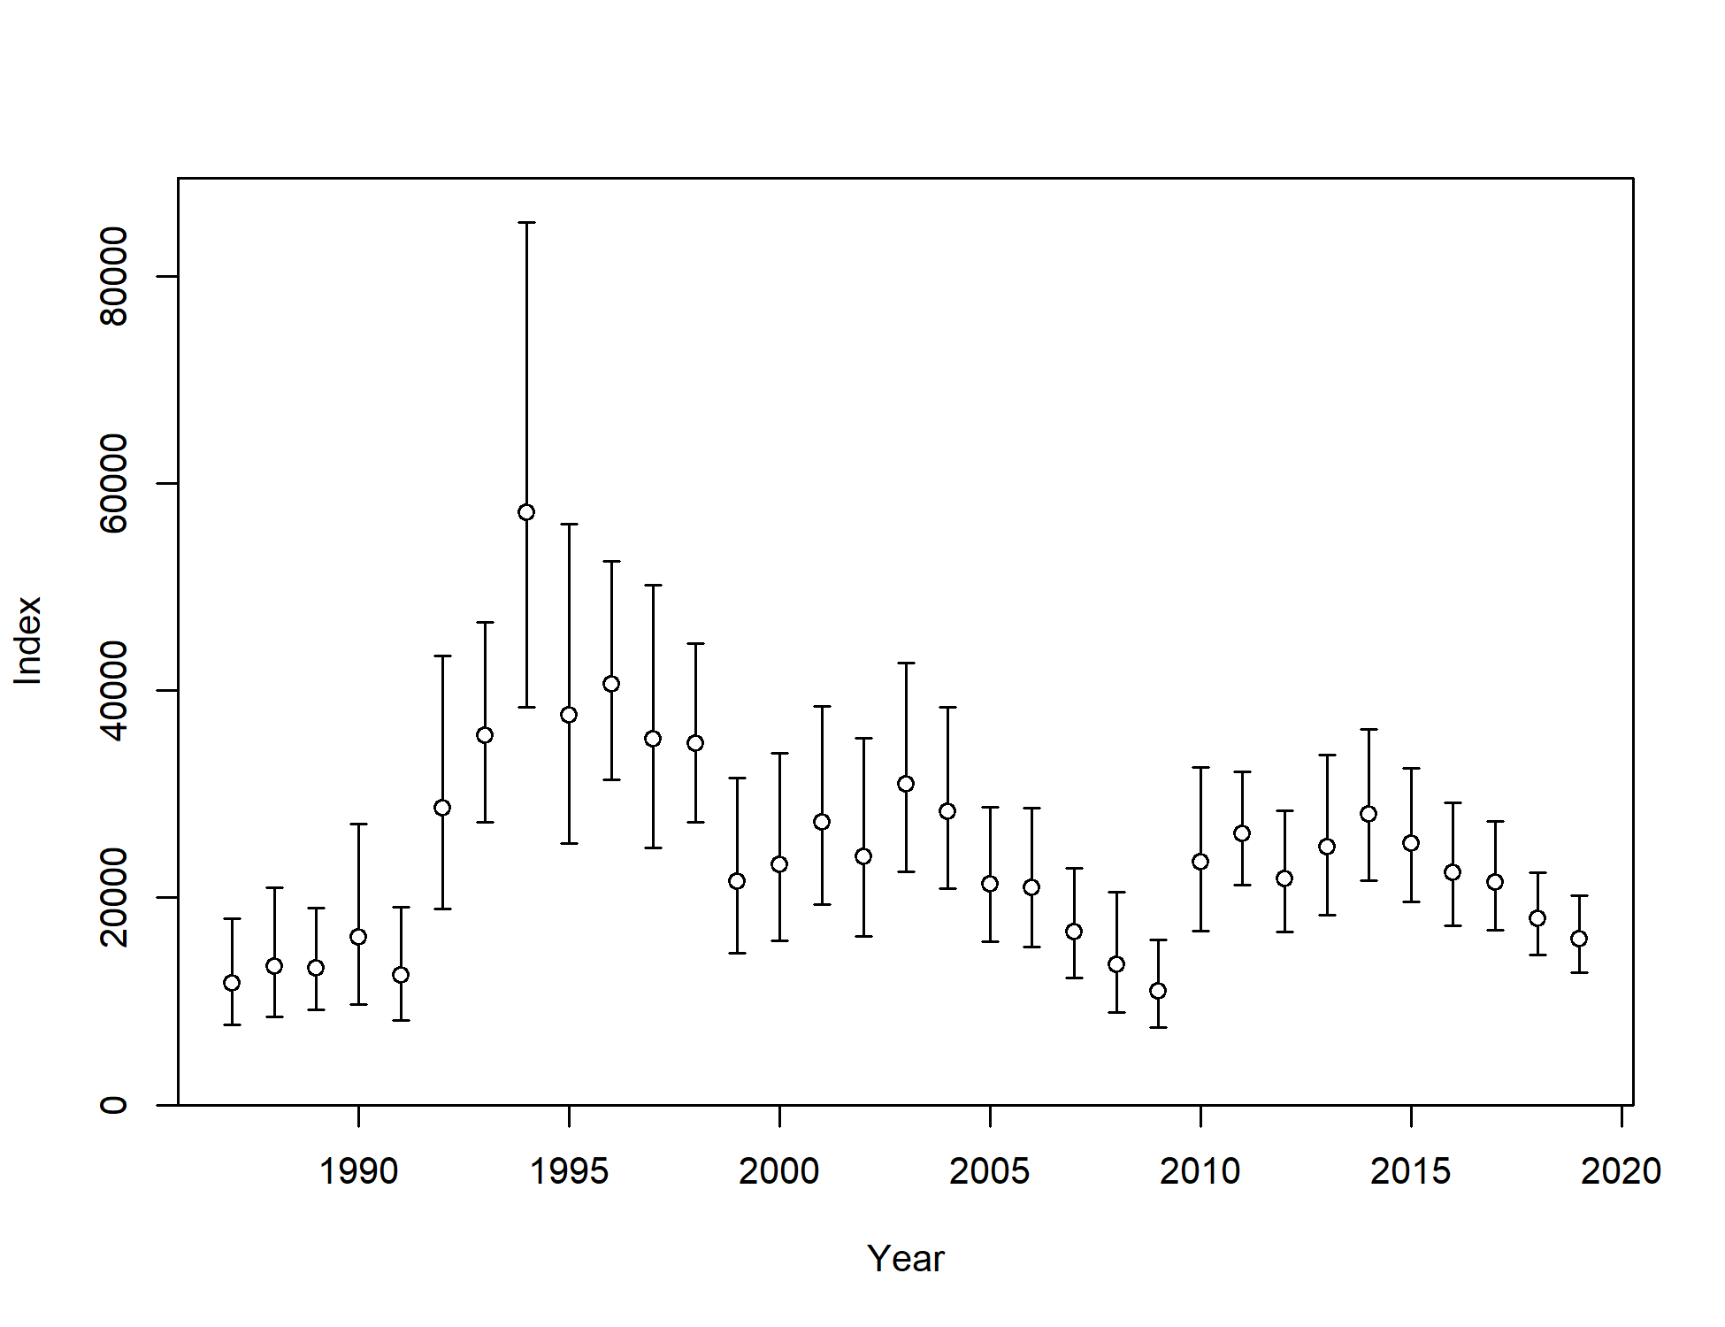
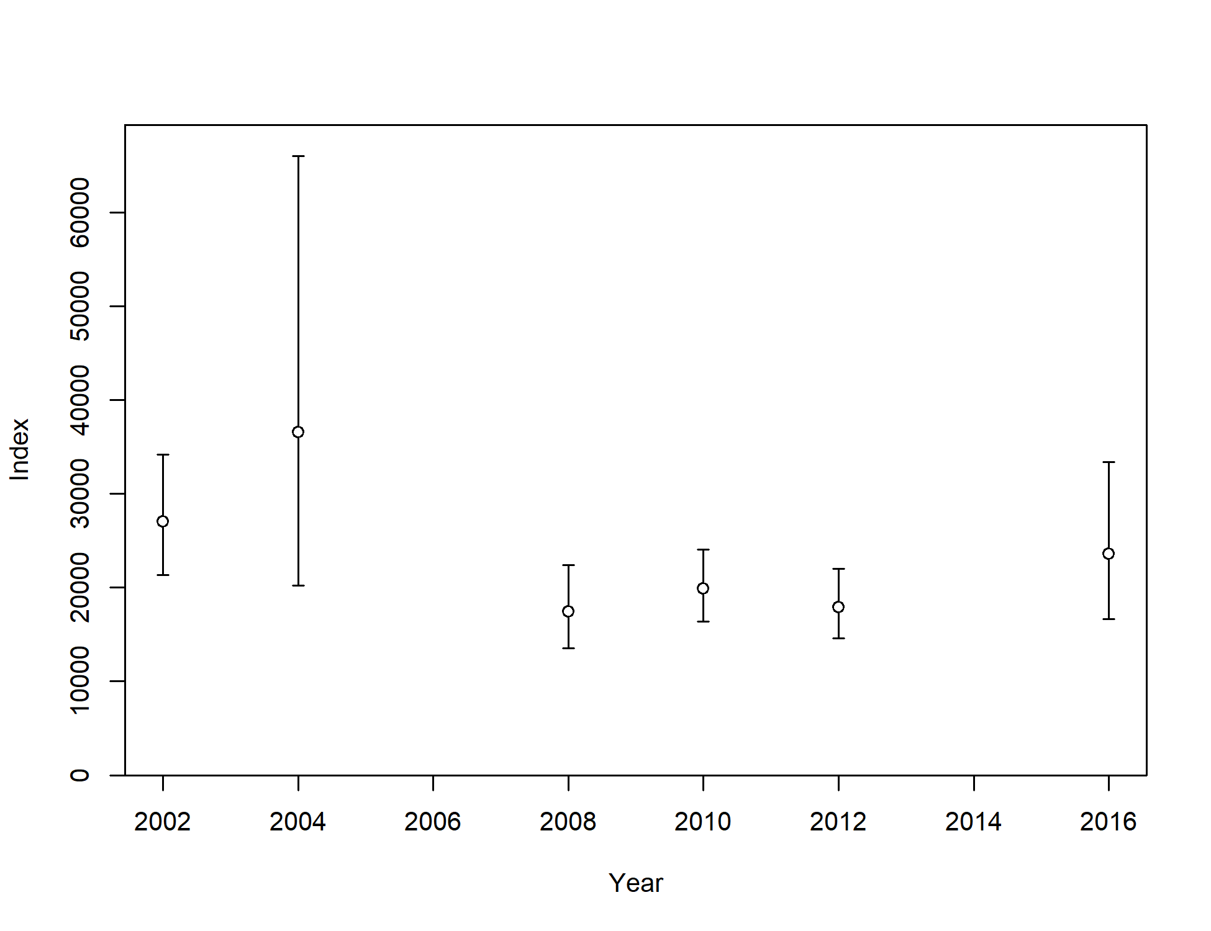
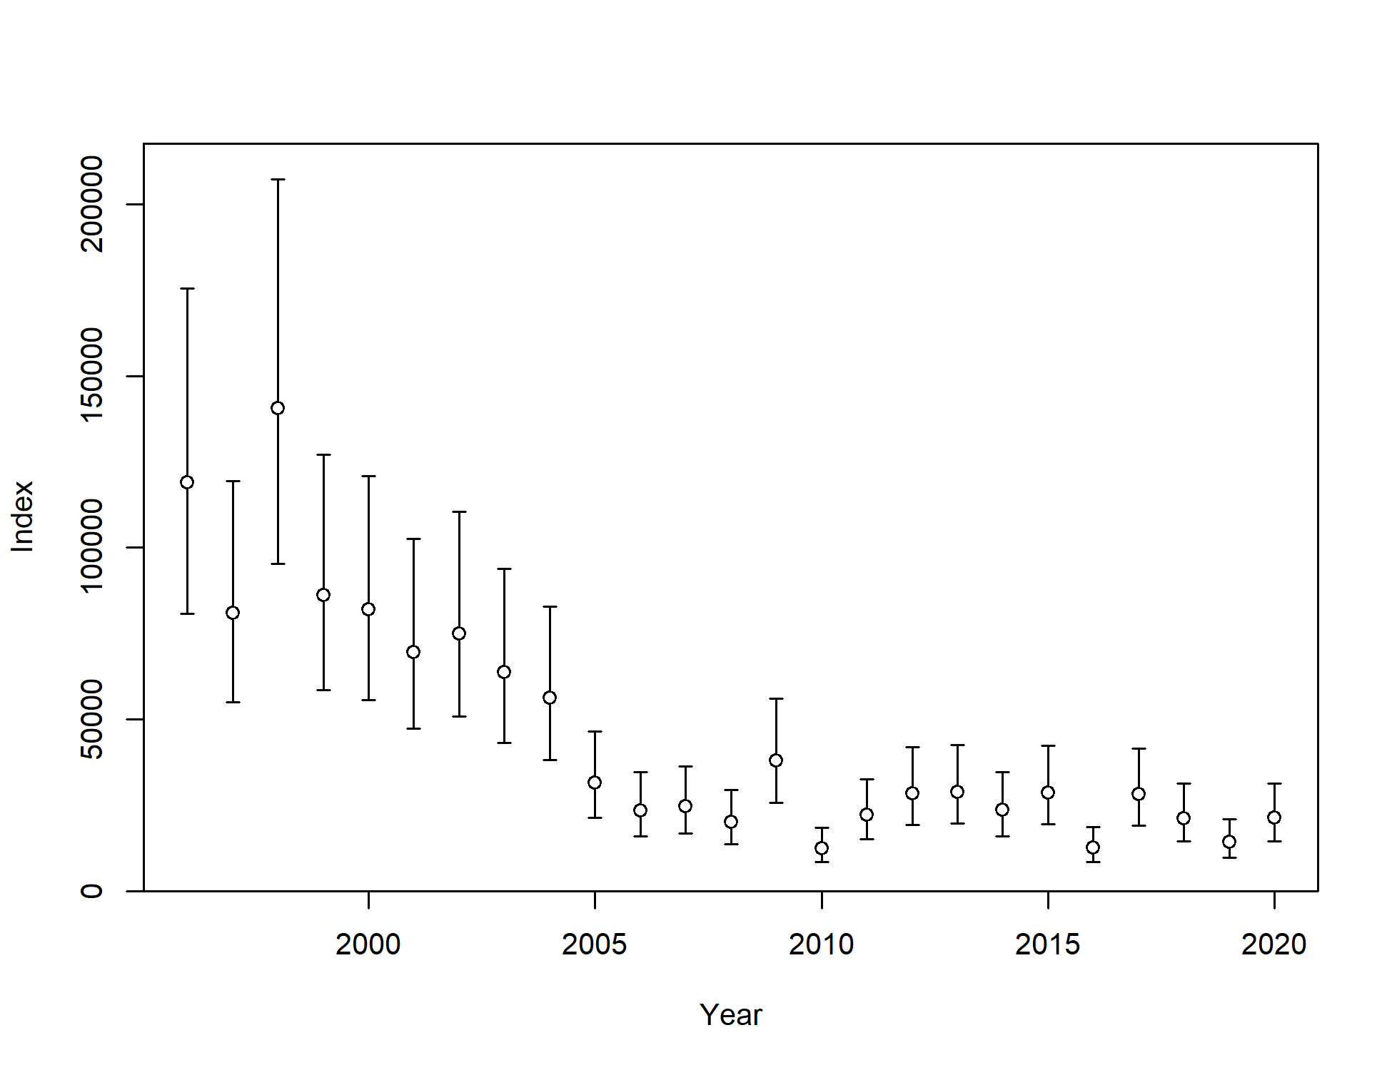
Survey estimates
Shelf
Slope
AFSC longline
Shelf
  Declined by 11% in 2019
AFSC longline - RPN
  Declined by 33% in 2019 (Bering Sea surveyed)
  Increased by 50% in 2020 (Aleutian Islands surveyed)
Notes:
RPN – relative population numbers

Slide 5
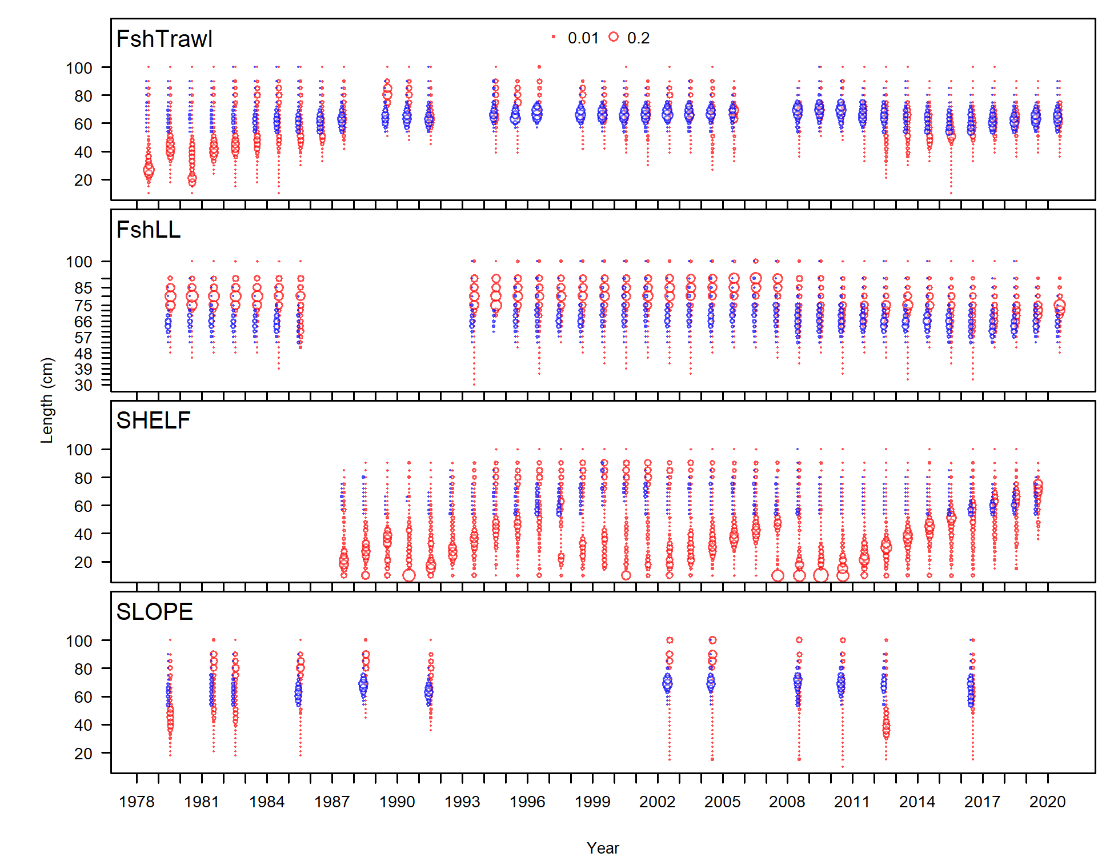
Length composition

Slide 6
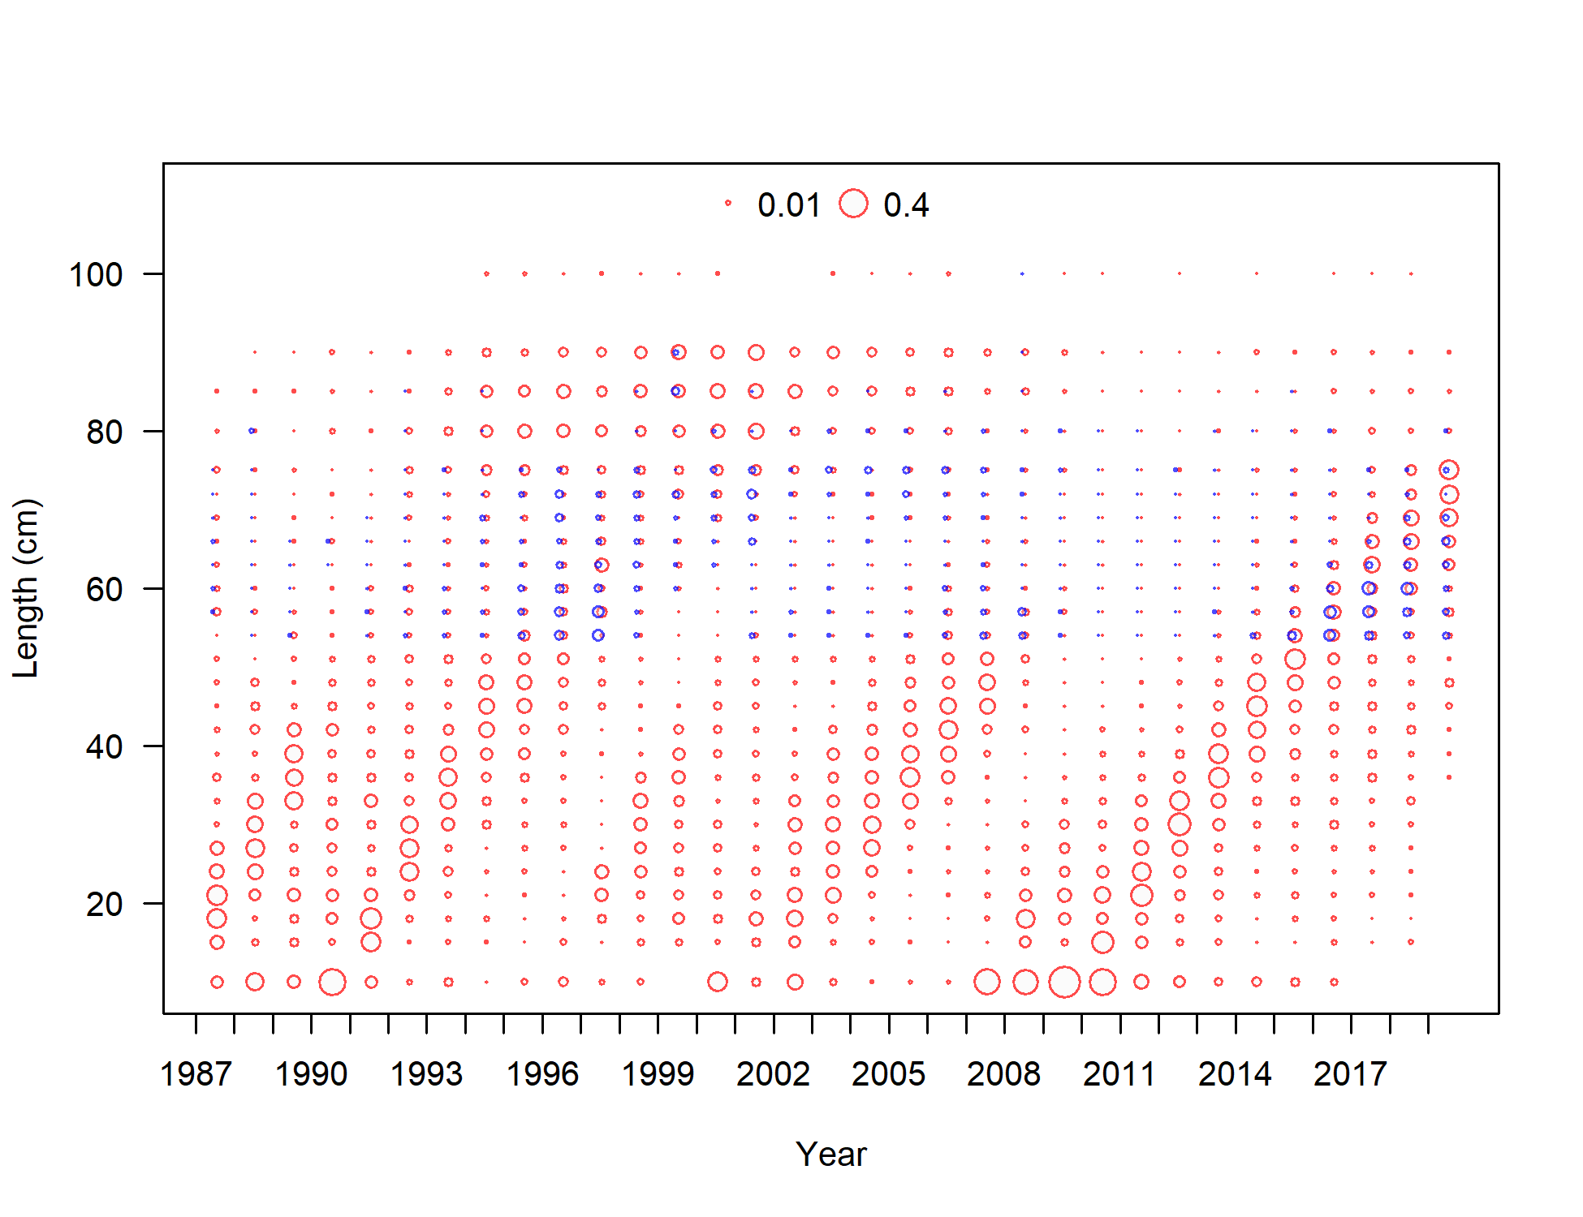
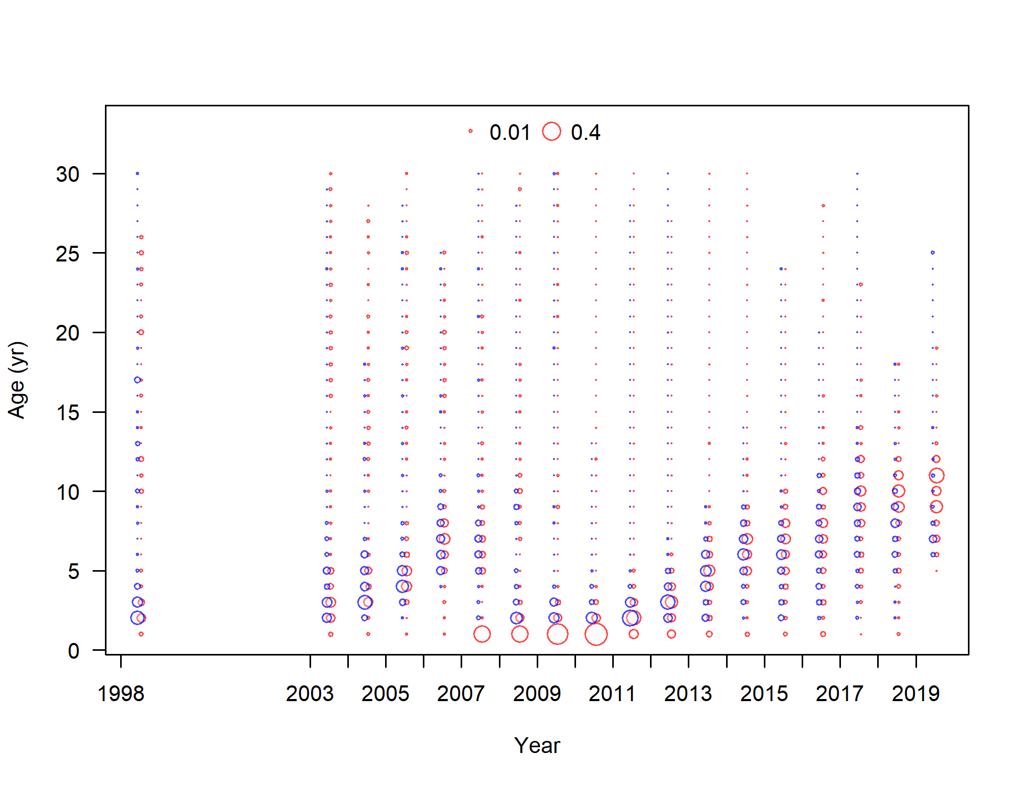
EBS shelf survey length and age composition
Notes:
Age data not included in the model.
Length and age truncation at smaller sizes and younger ages
Not seeing smaller/younger GT on the shelf

Slide 7
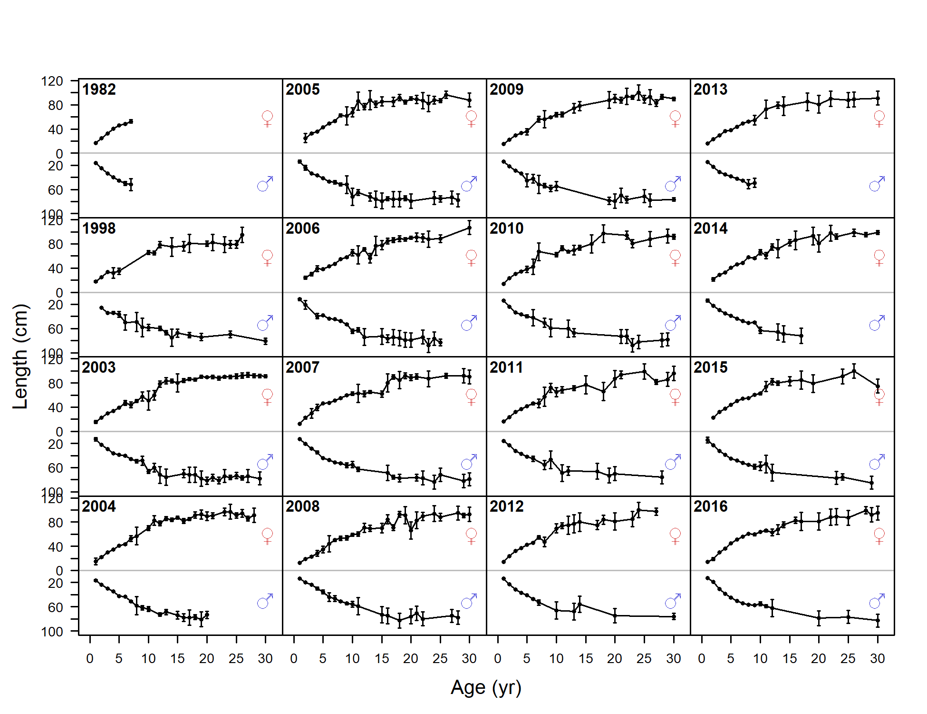
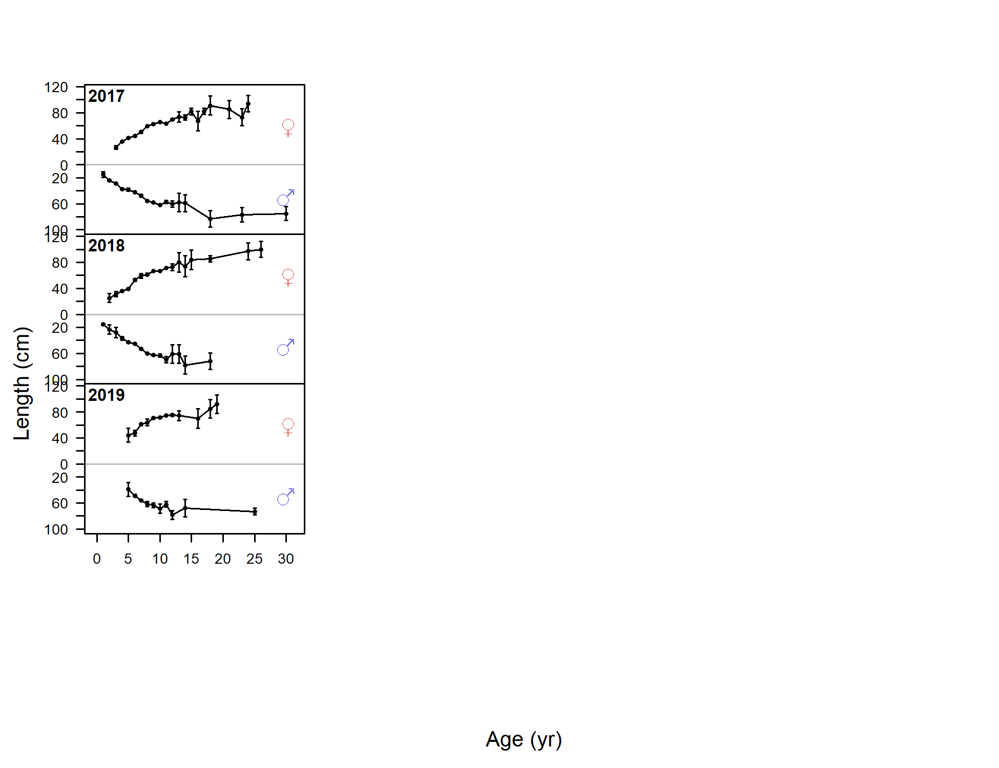
Mean weight-at-age

Slide 8
Model structure
Model has remained relatively unchanged
A minor correction was made – units of AFSC longline survey relative population numbers (RPN) correctly specified in numbers
Model comparisons in report:
  Model 16.4 – 2018 assessment
  Model 16.4a – corrected 2018 assessment
  Model 16.4a (2020) – corrected model with data updates

Slide 9
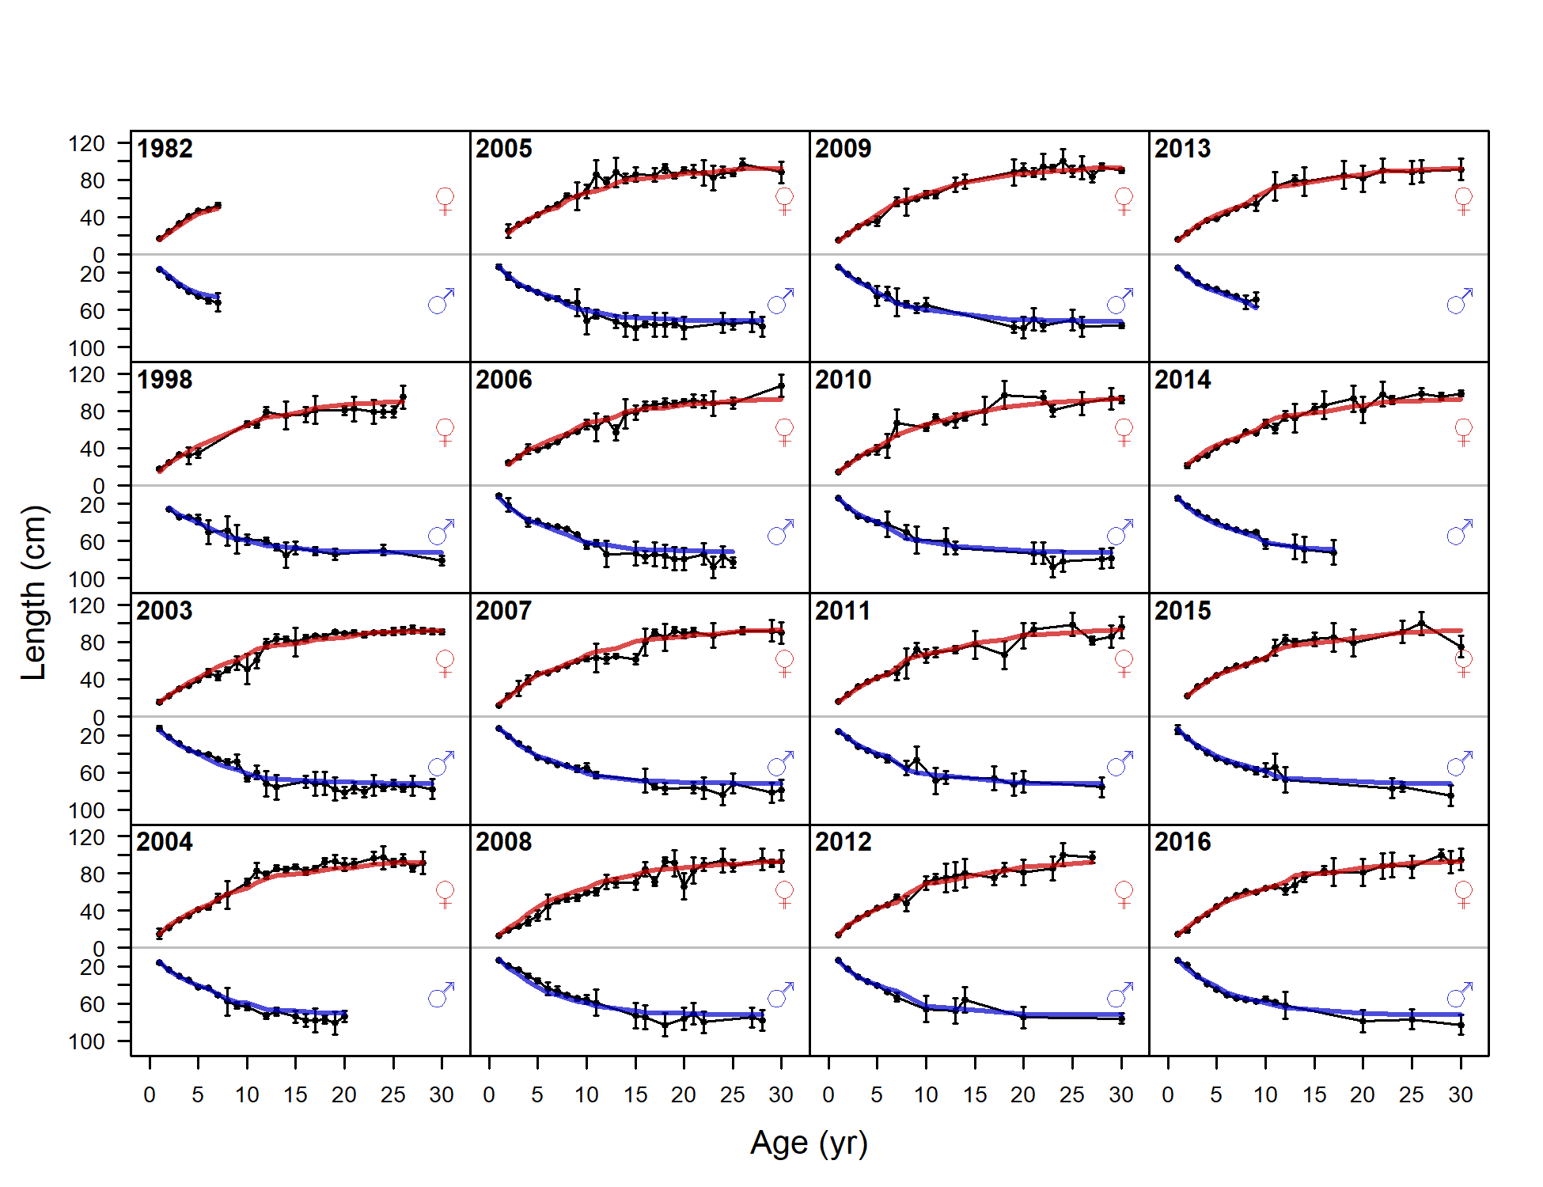
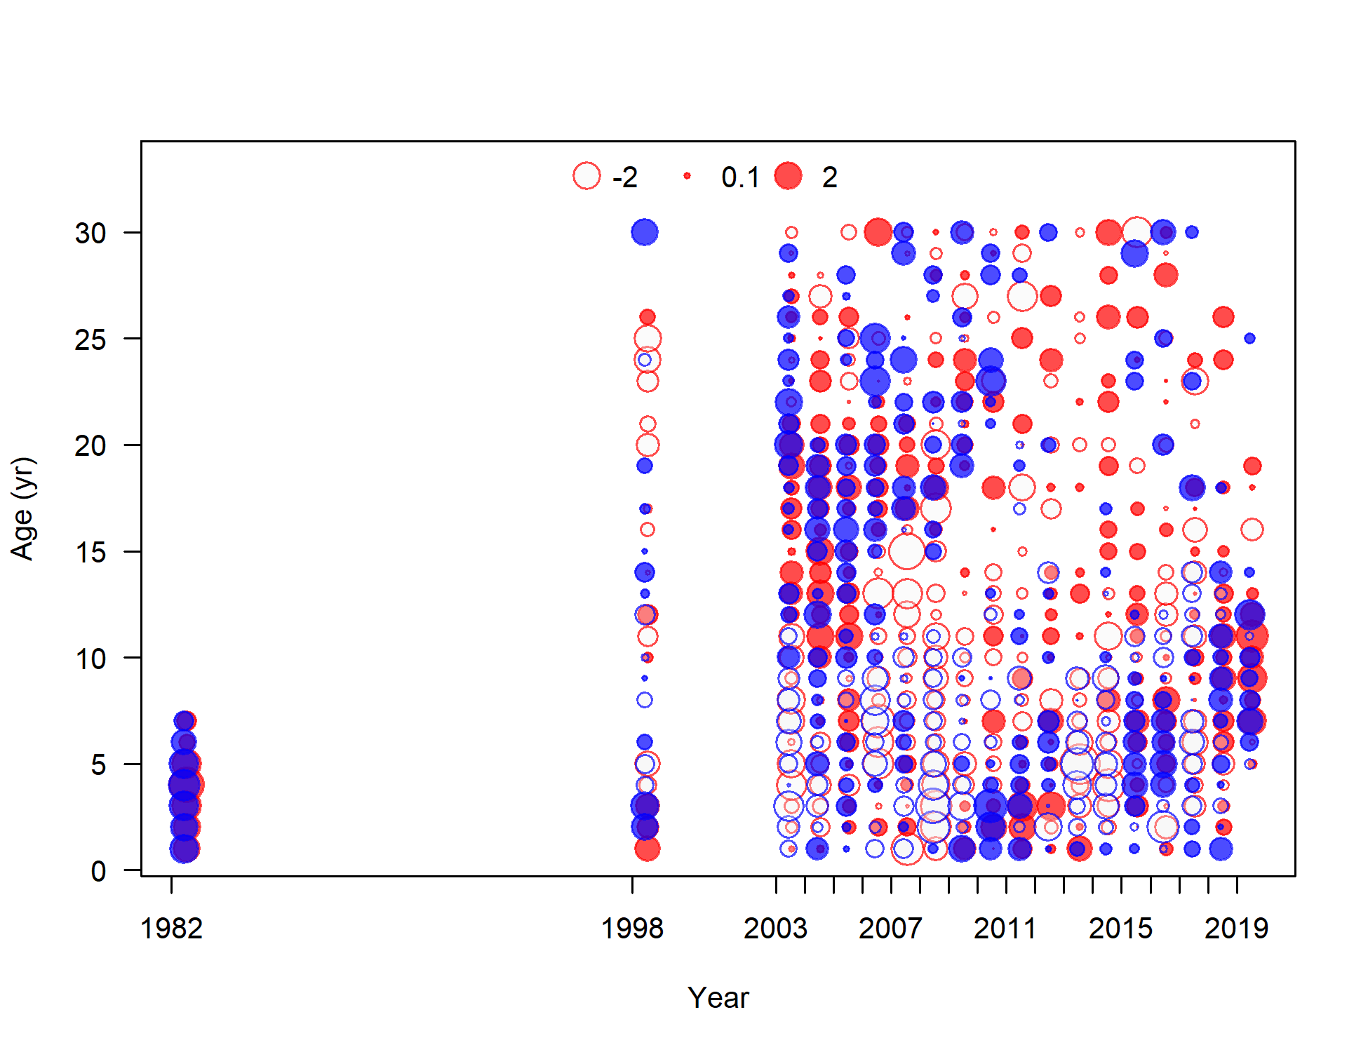
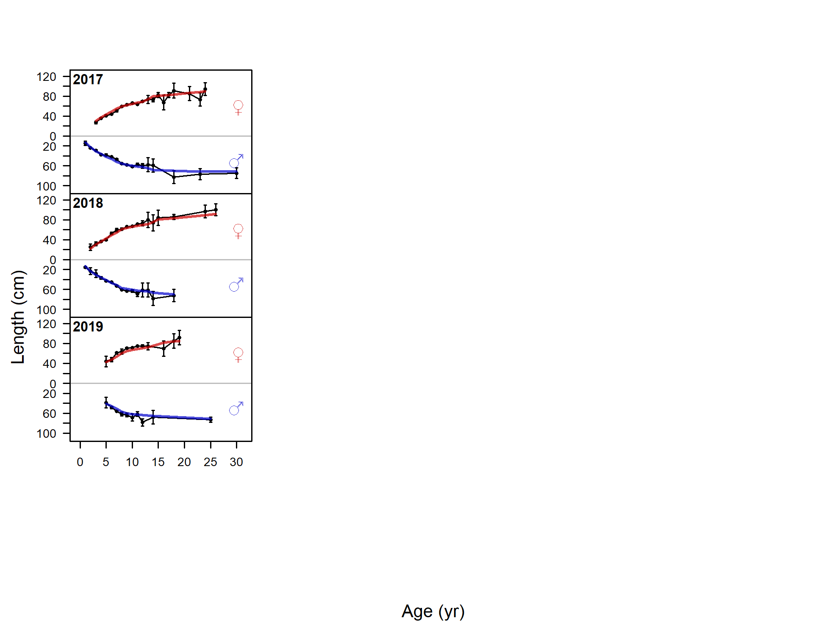
Model fit to mean size-at-age
Notes:
Likelihoods 12776.9 and 1277.2

Slide 10
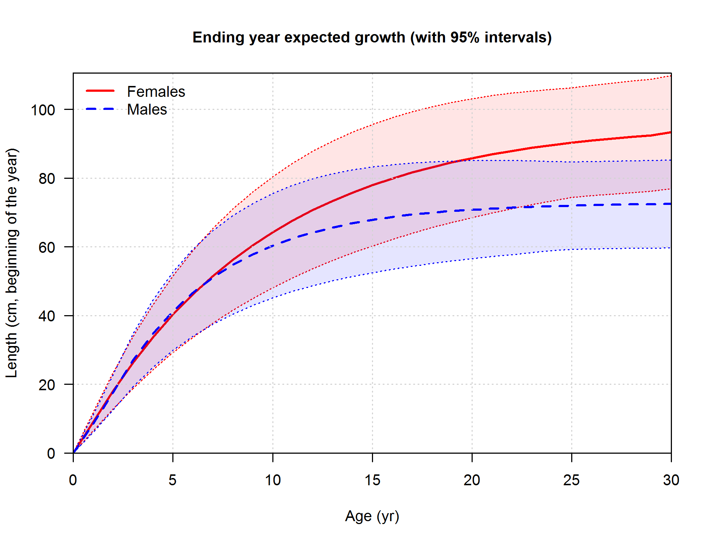

Growth estimates
 | 16.4 |  | 16.4a (2020)
Label | Value | StDev | Value | Stdev
Biology
L Amin female | 15.06 | 0.24 | 14.92 | 0.24
L Amax female | 90.29 | 0.43 | 90.34 | 0.42
von Bert k female | 0.11 | 0.00 | 0.11 | 0.00
L Amin male | 14.13 | 0.22 | 14.06 | 0.23
L Amax male | 71.99 | 0.35 | 71.70 | 0.33
von Bert k male | 0.19 | 0.00 | 0.19 | 0.00
Notes:
Estimated growth similar to previous assessment

Slide 11
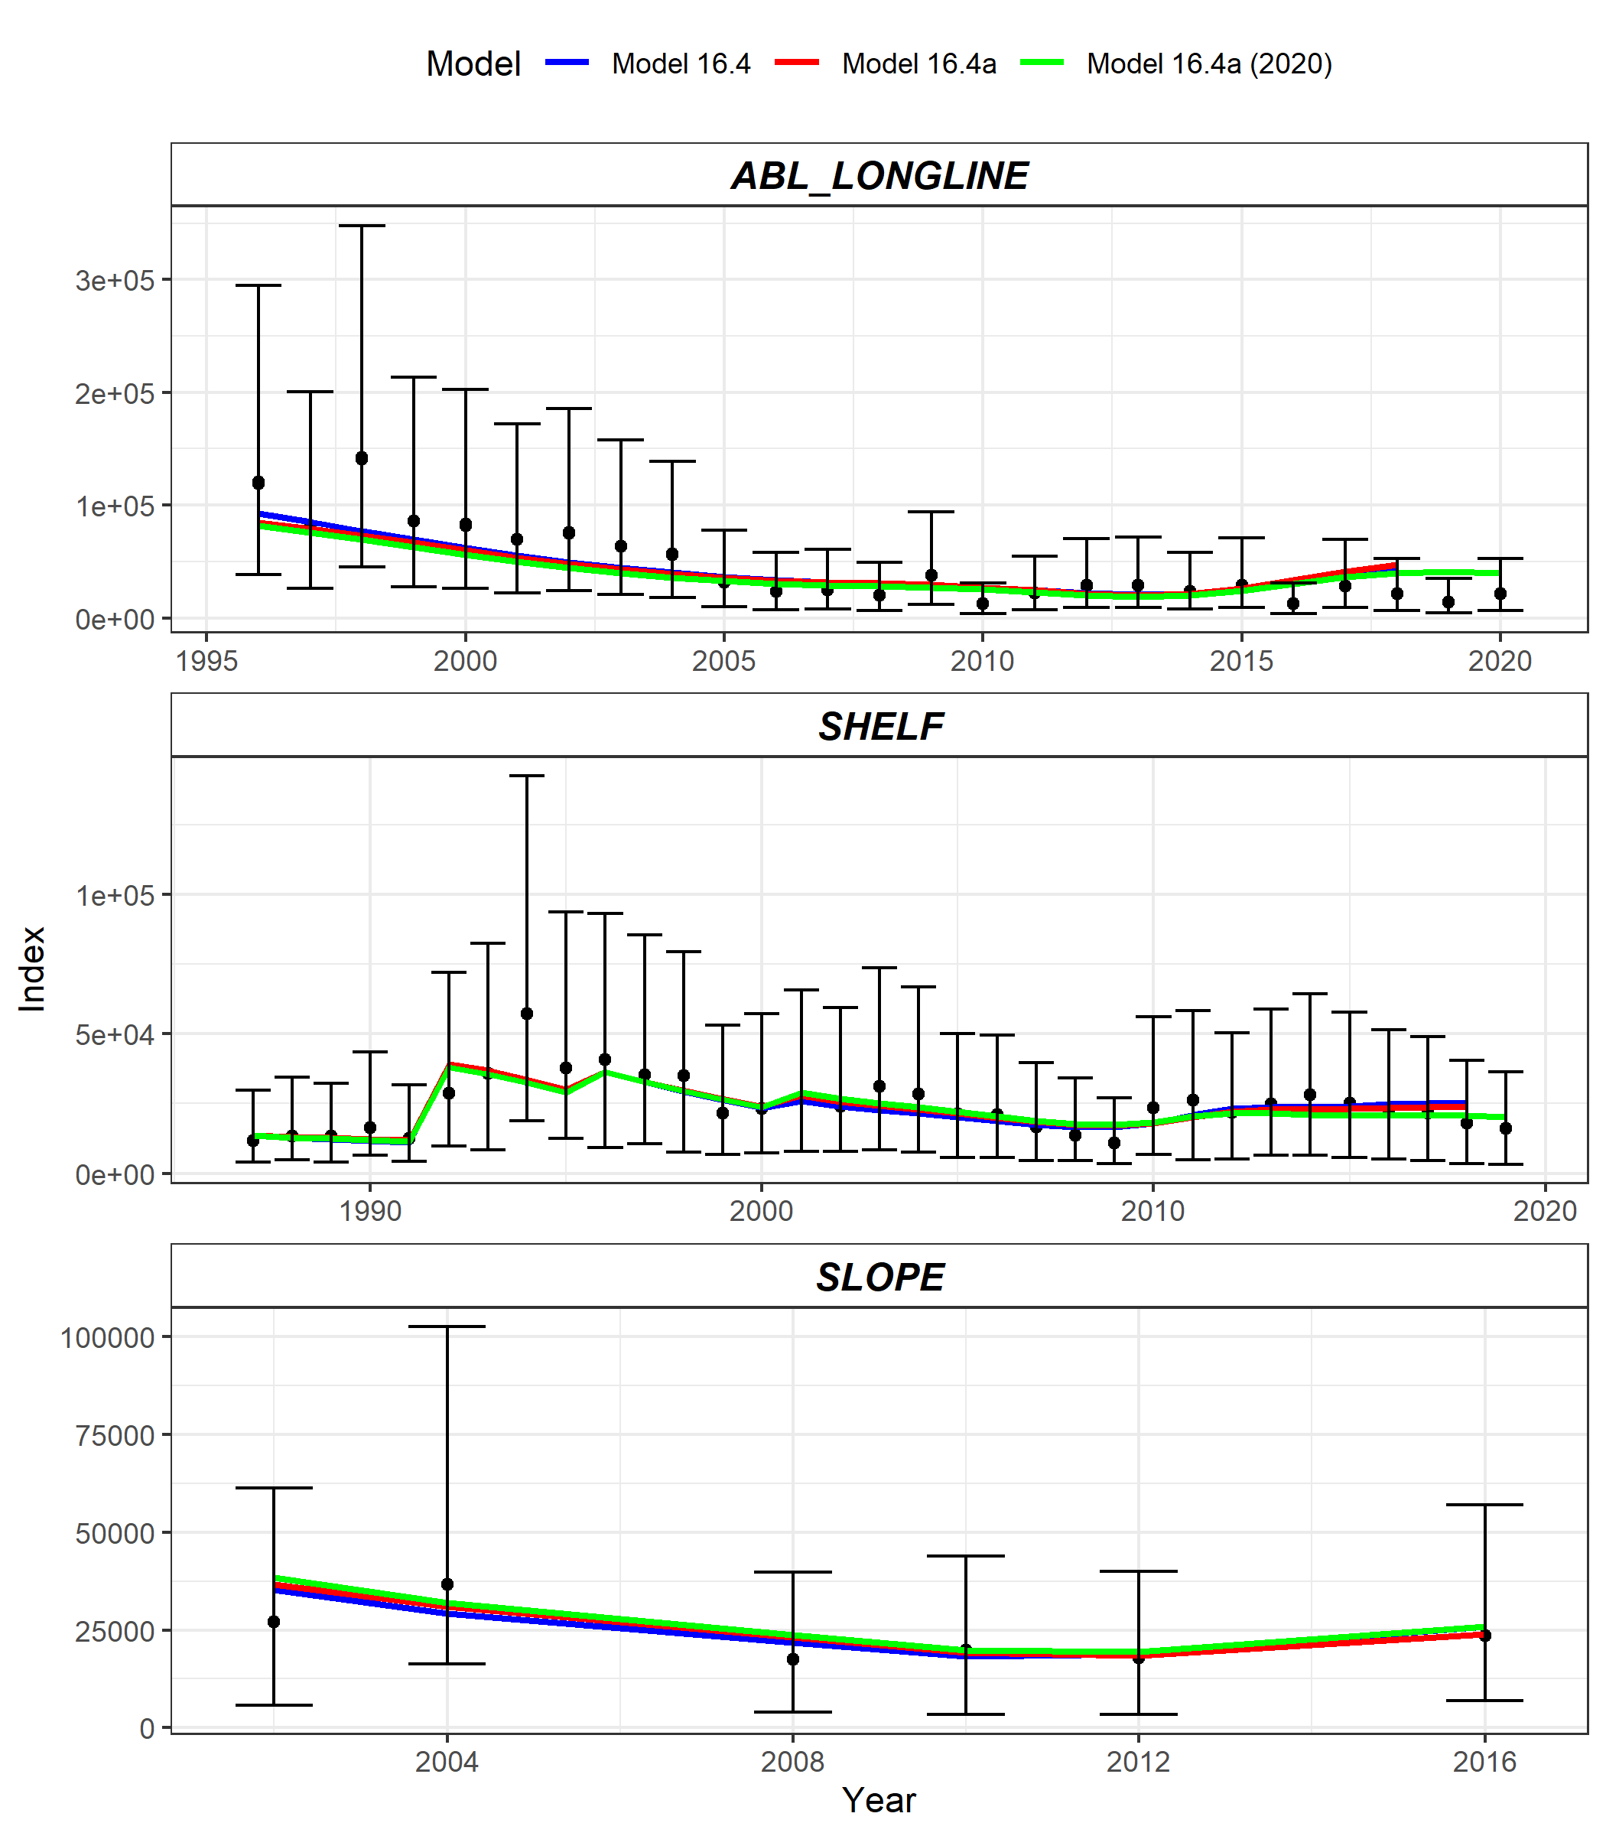
Model fit to indices
Model 16.4
Model 16.4a
Model 16.4a (2020)
LN(q) | 16.4 | 16.4a | 16.4a (2020)
Shelf | -0.49 | -0.49 | -0.49
Slope | -0.56 | -0.56 | -0.56
AFSC Longline | -0.54 | 0.98 | 0.79
Notes:
Changing units of AFSC longline the predicted RPN is now derived from Numbers not Numbers*Weight – see a large increase in the AFSC longline q.
16.4a – 2.66
16.4a(2020) – 2.2

Slide 12
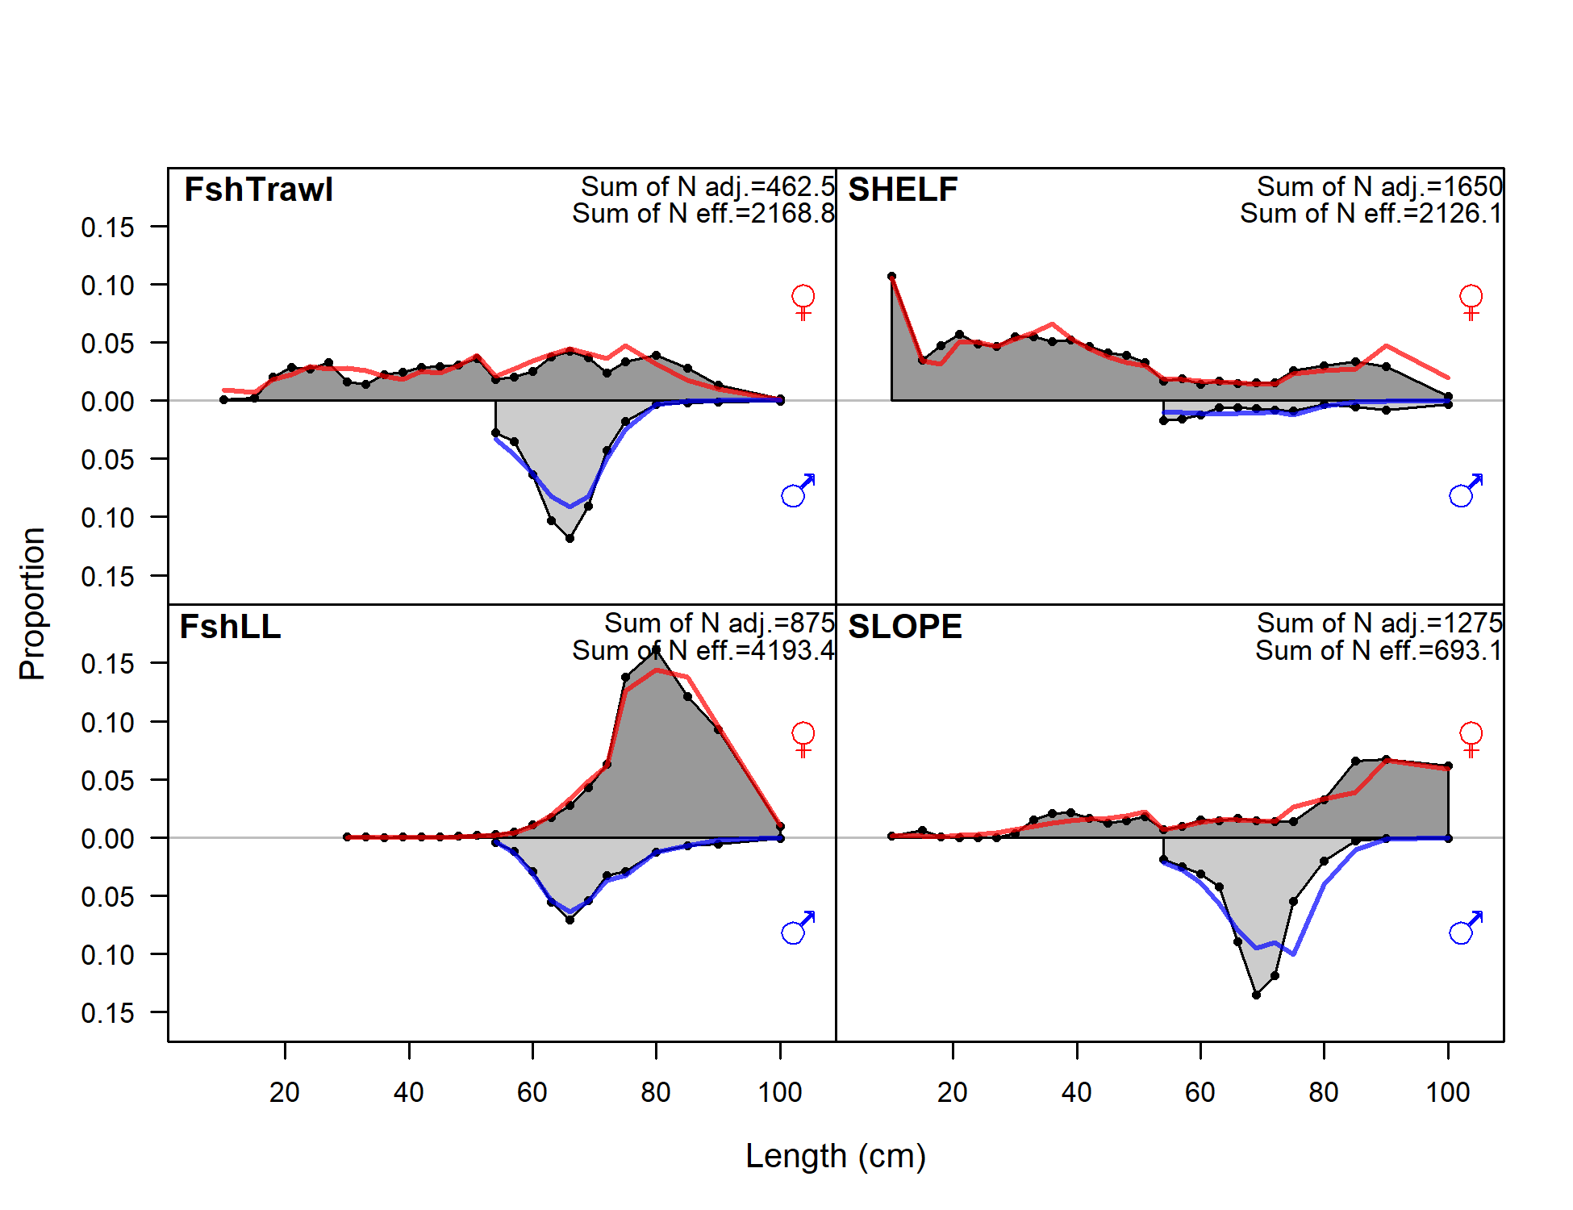
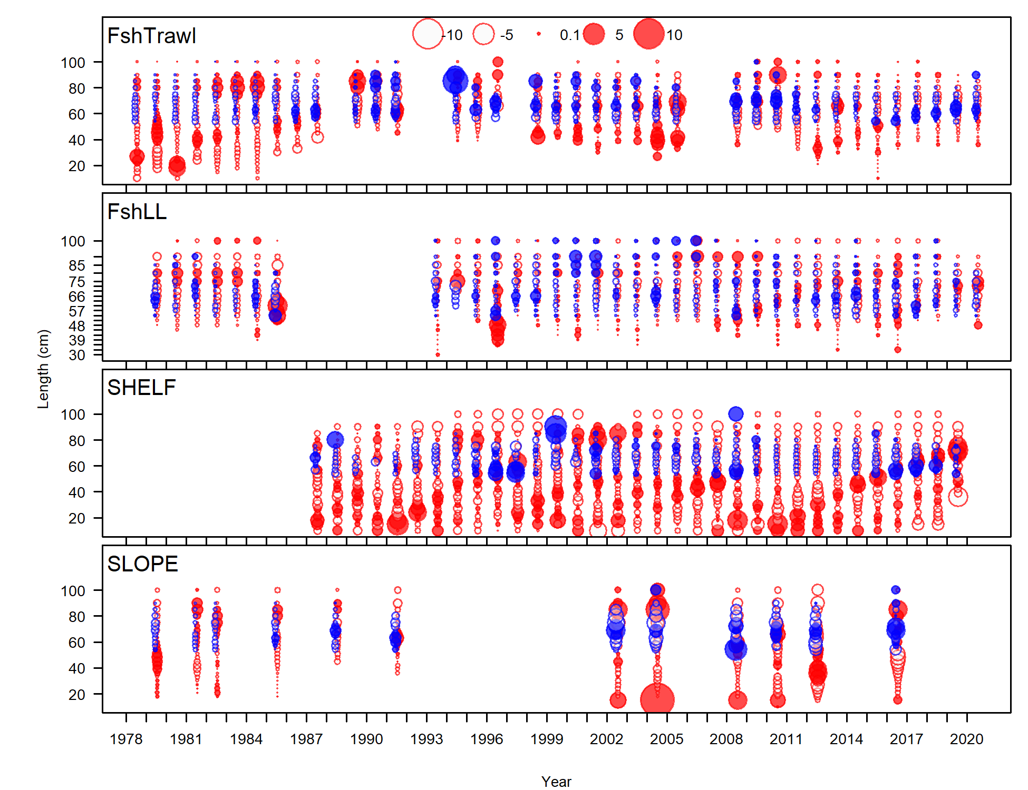
Fit to length composition estimates
Notes:
656.8 (16.1b) and 653.9 (16.1c)
Trade-off 16.1b fits LL and slope

Slide 13
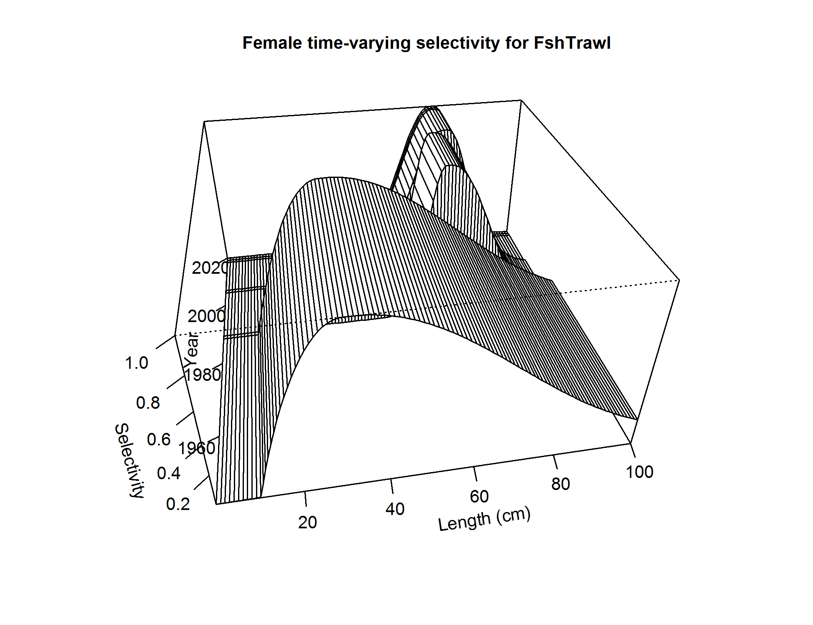
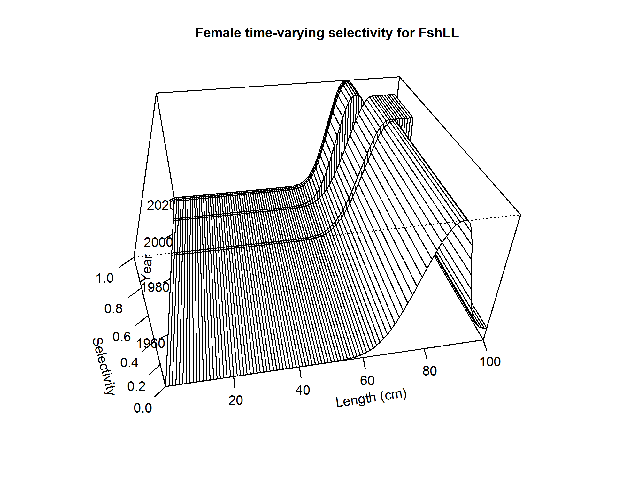
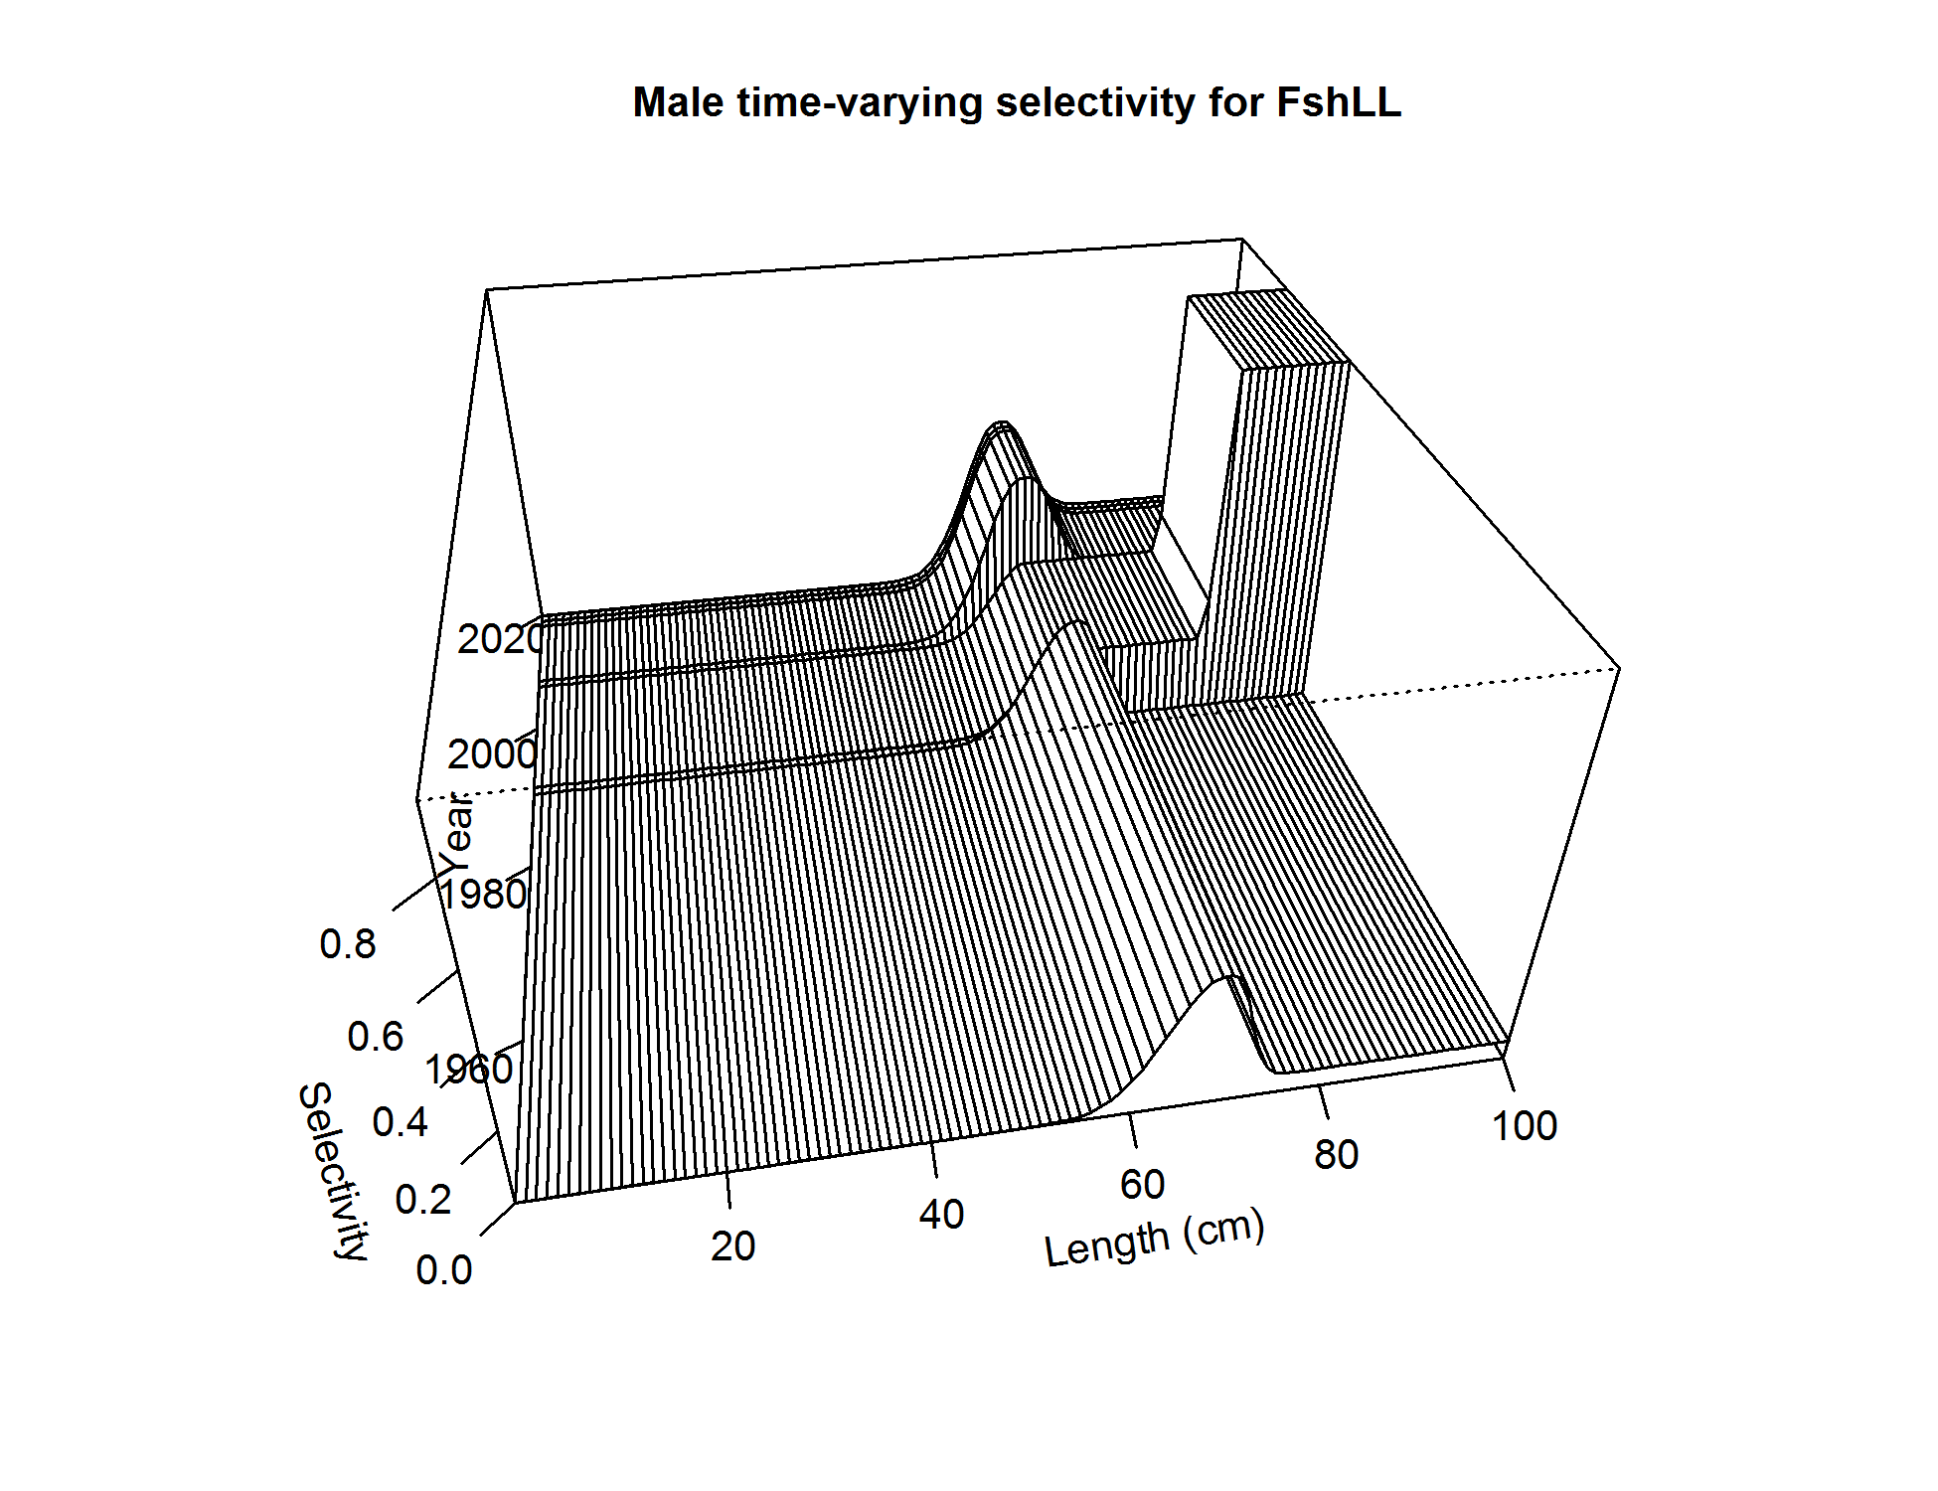
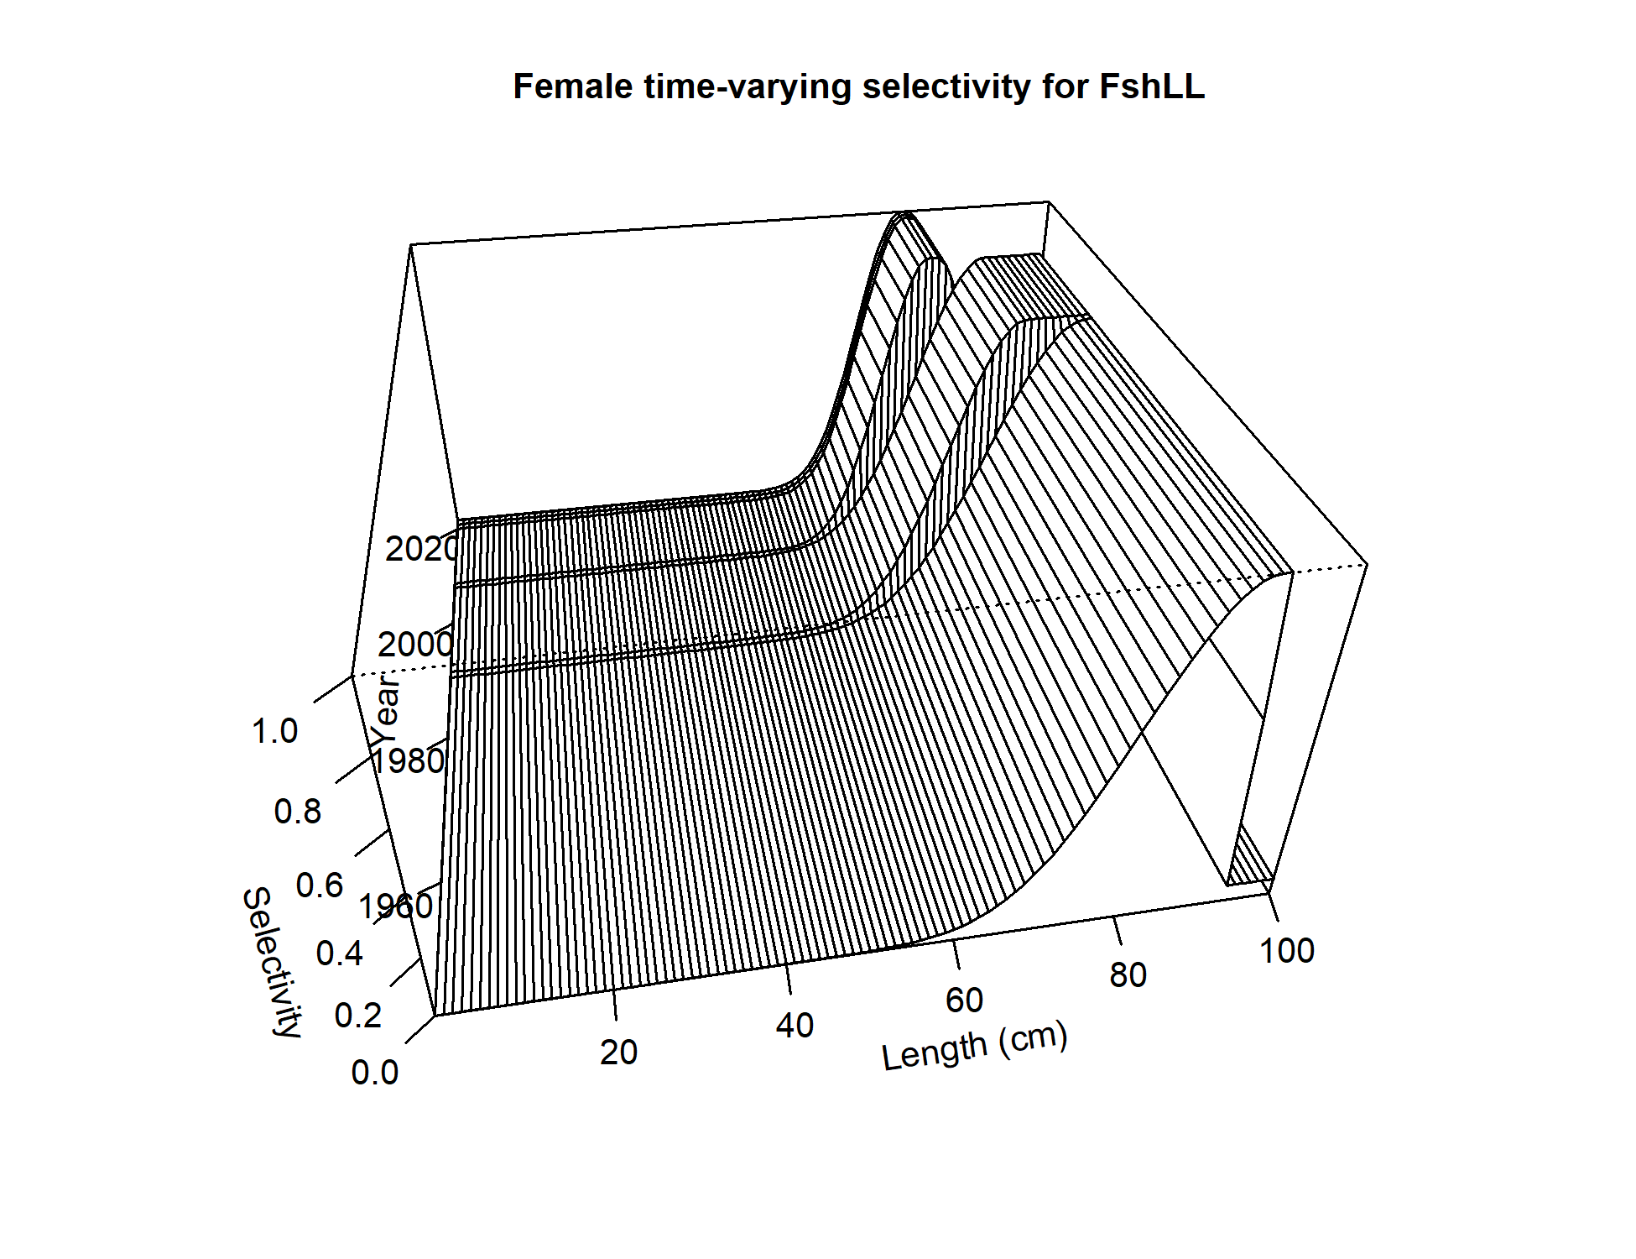
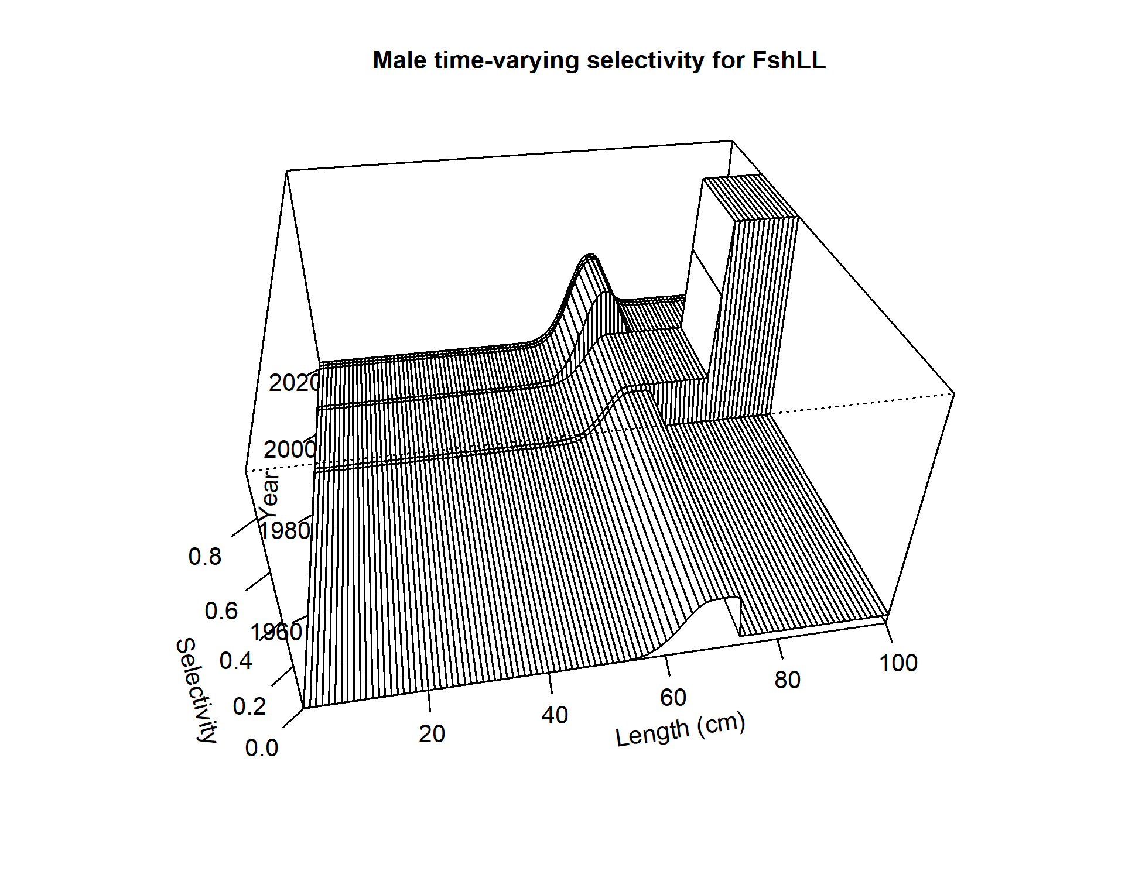
Selectivity: Longline fishery
Female
Male
Model 16.4
Model 16.4a (2020)

Slide 14
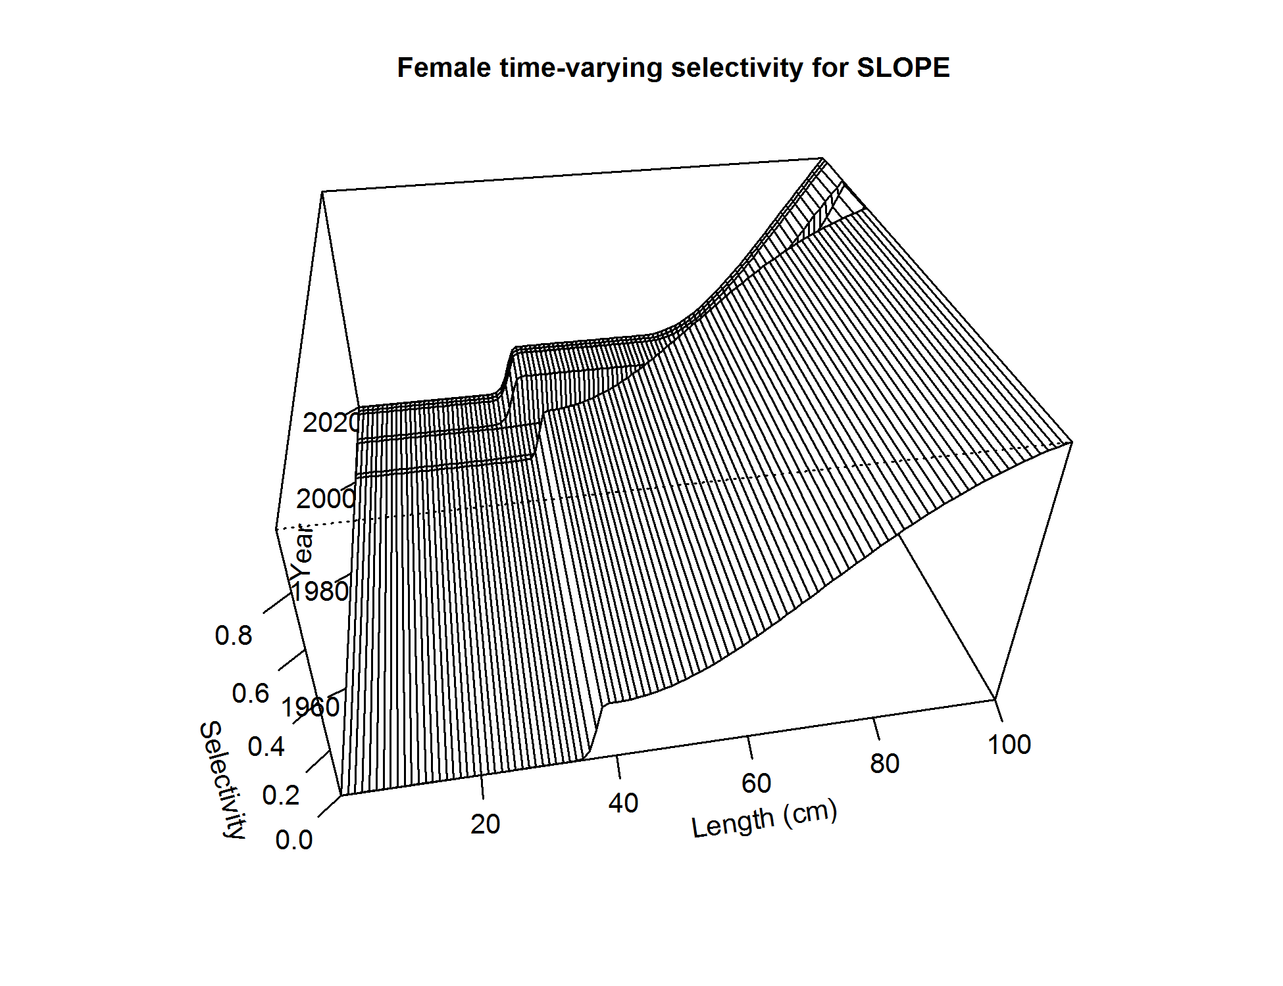
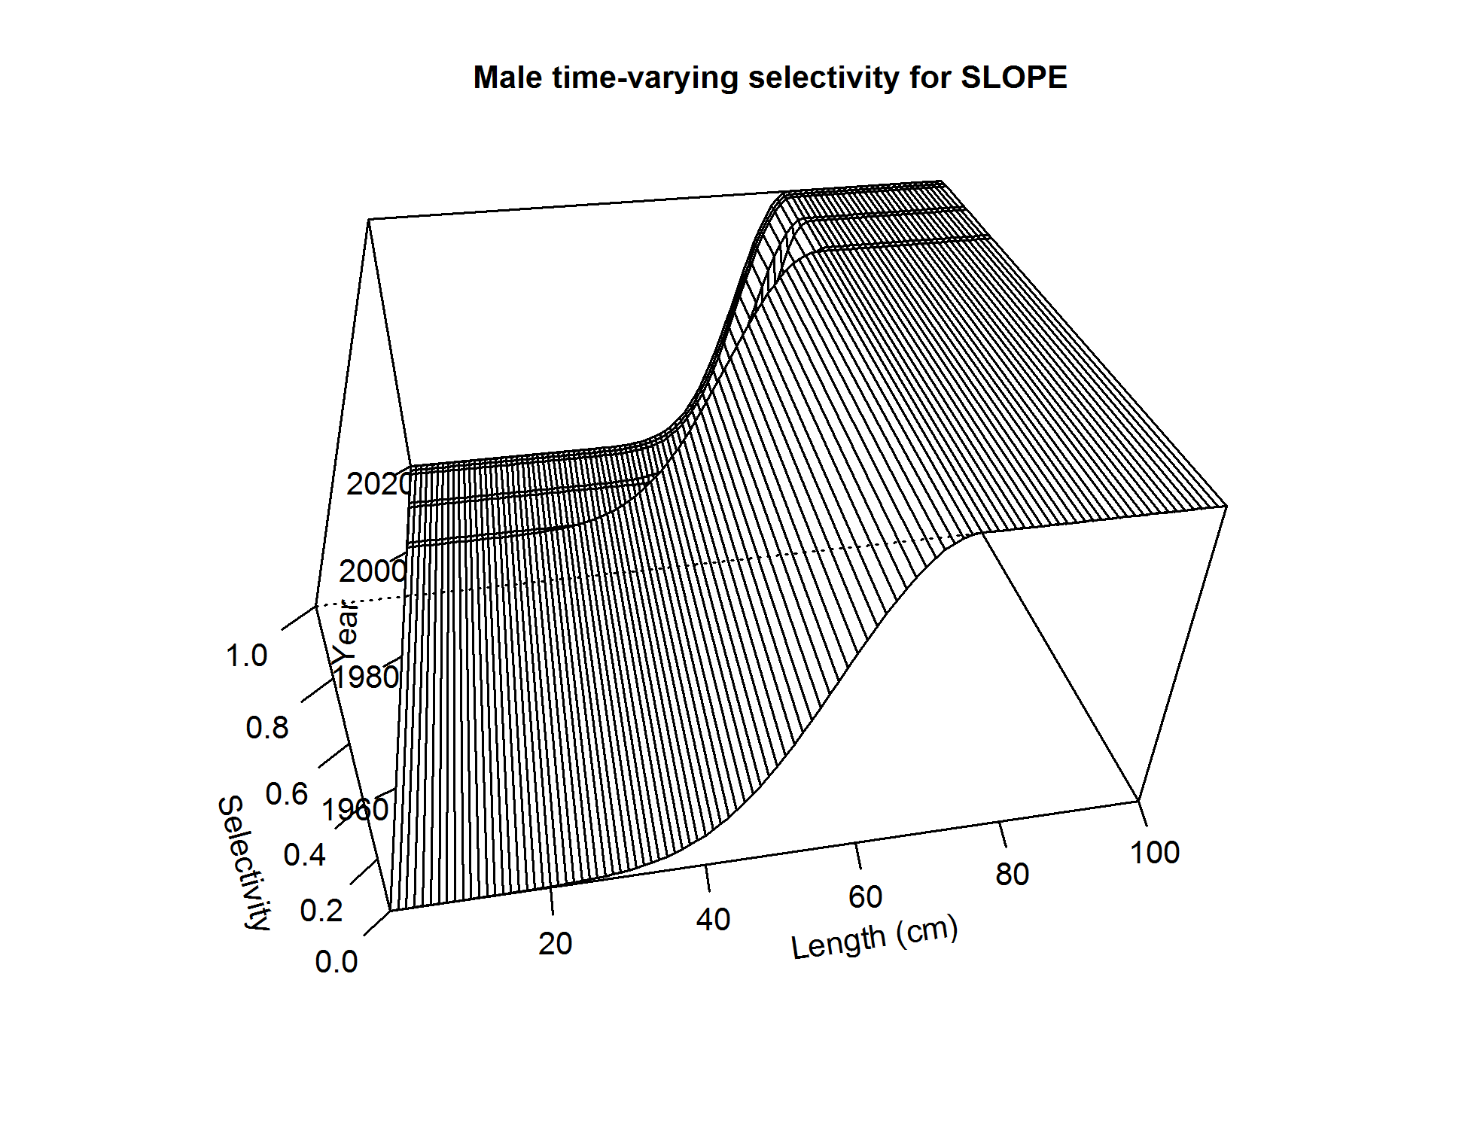
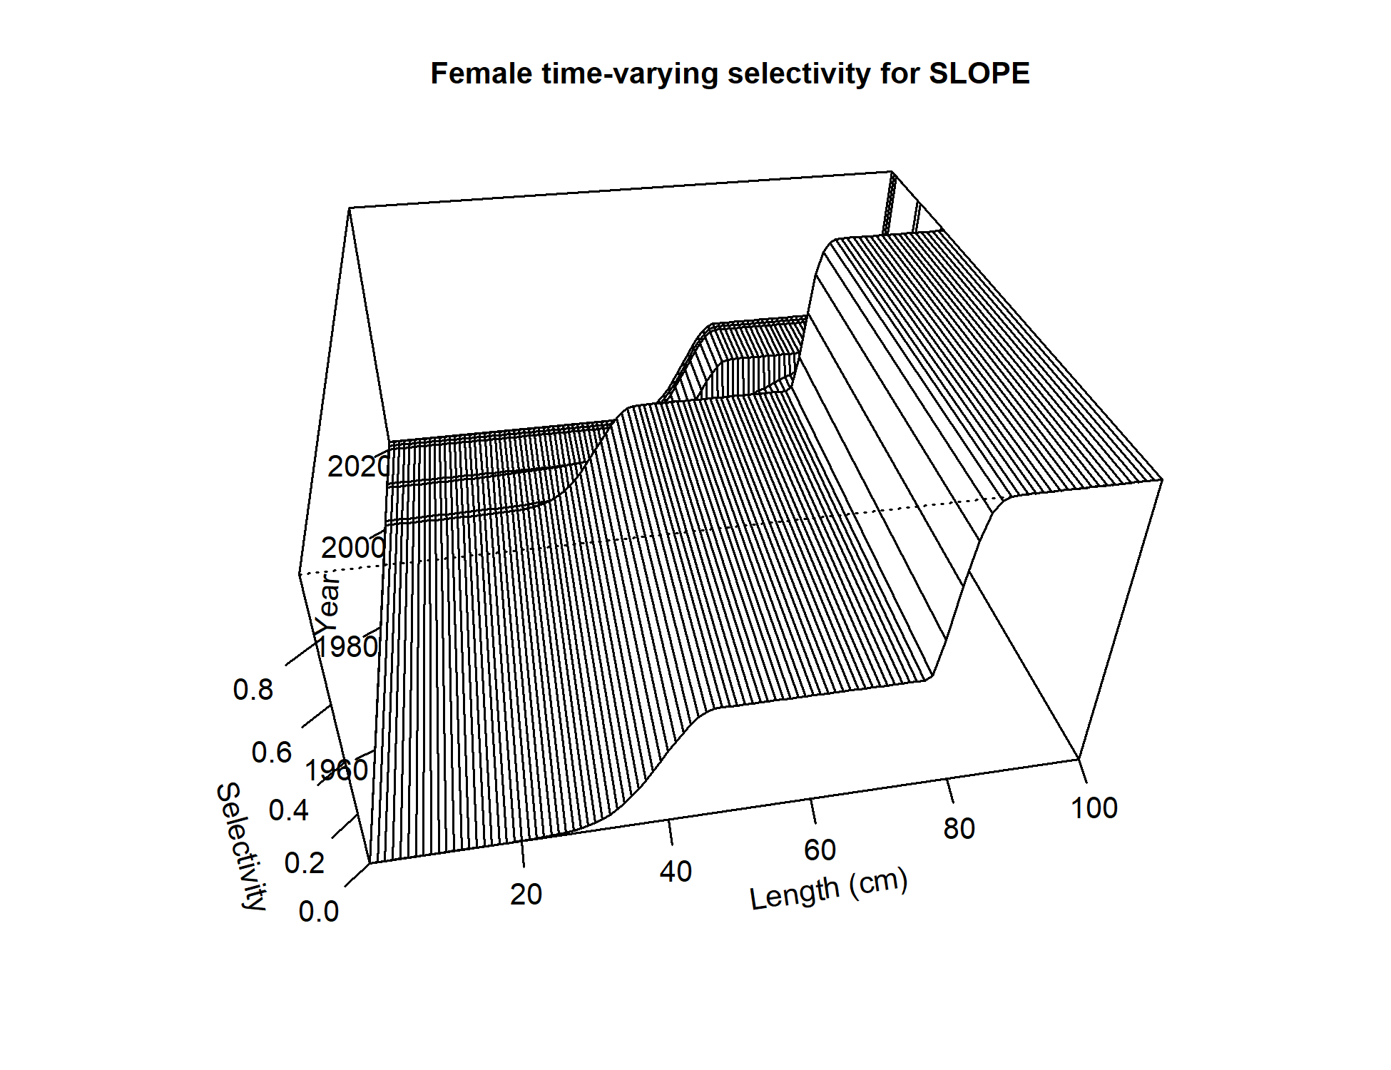
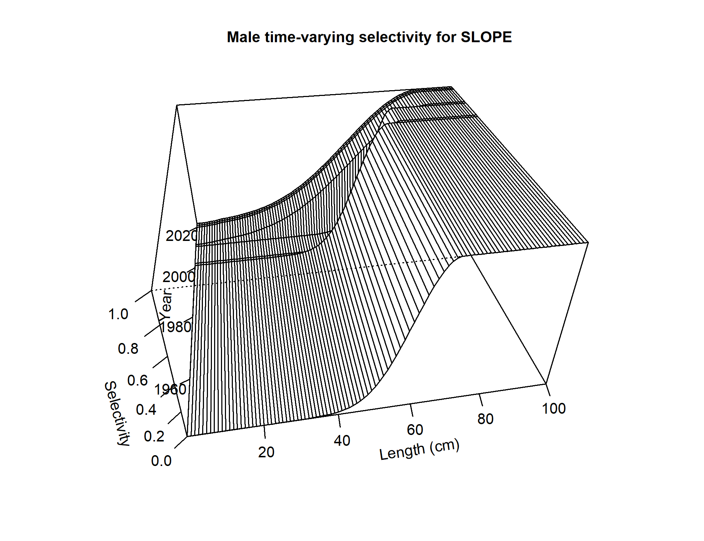
Selectivity: EBS slope survey
Female
Male
Model 16.4
Model 16.4a (2020)

Slide 15
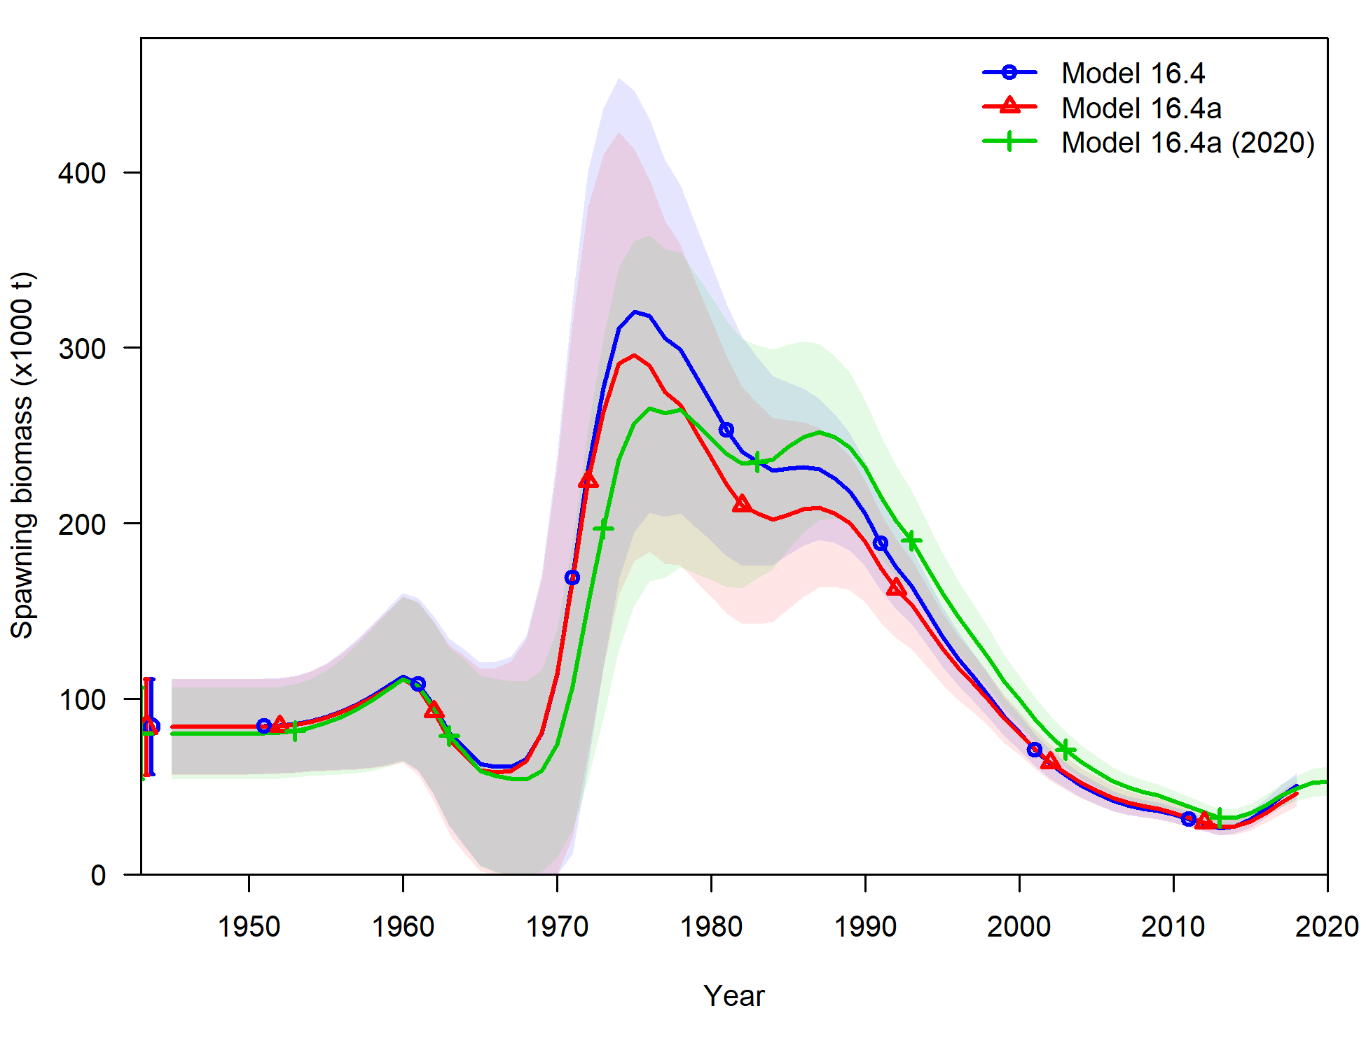
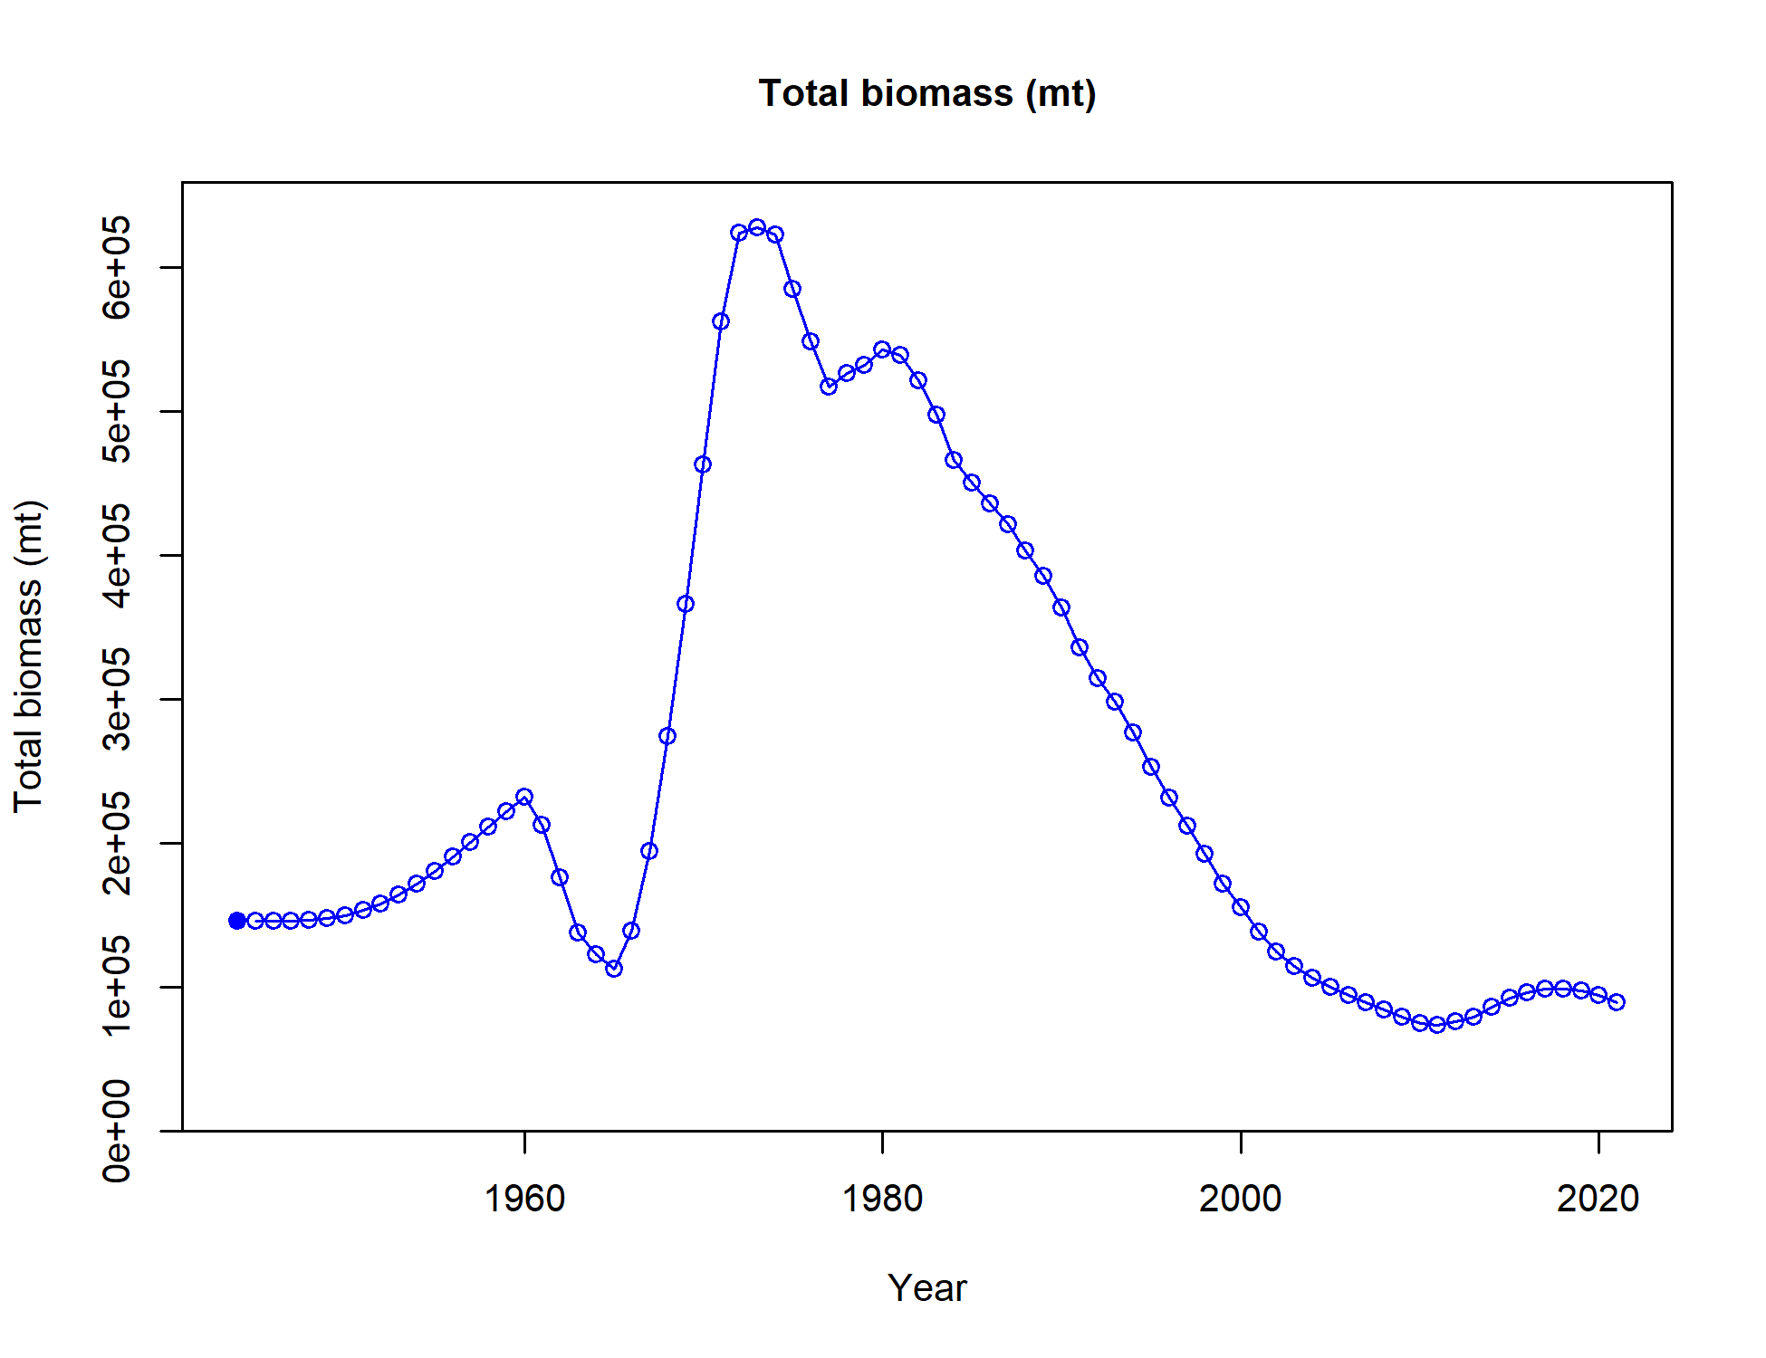
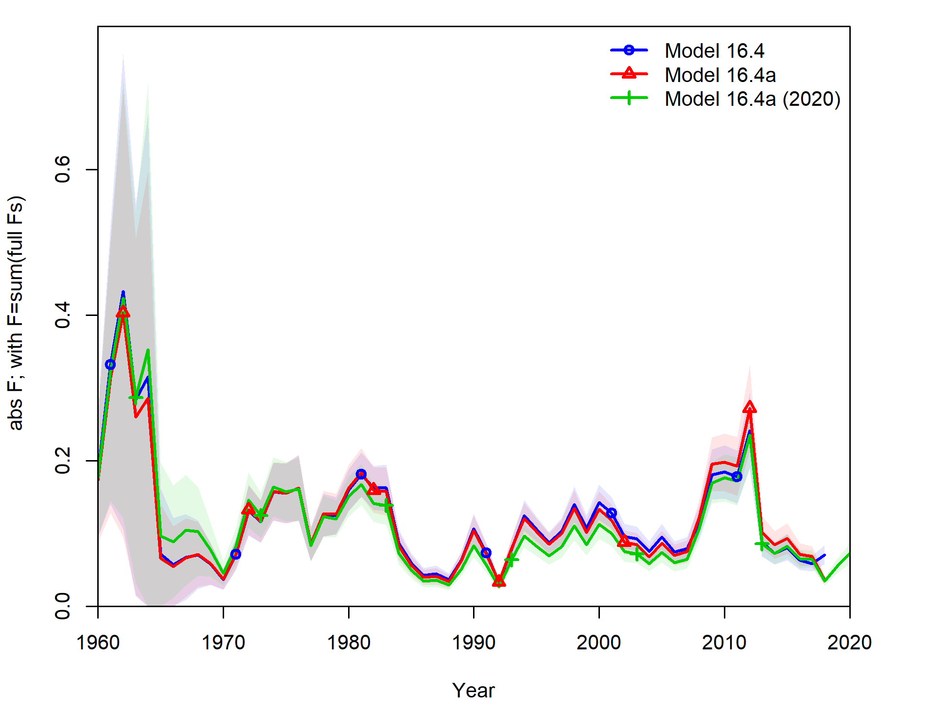
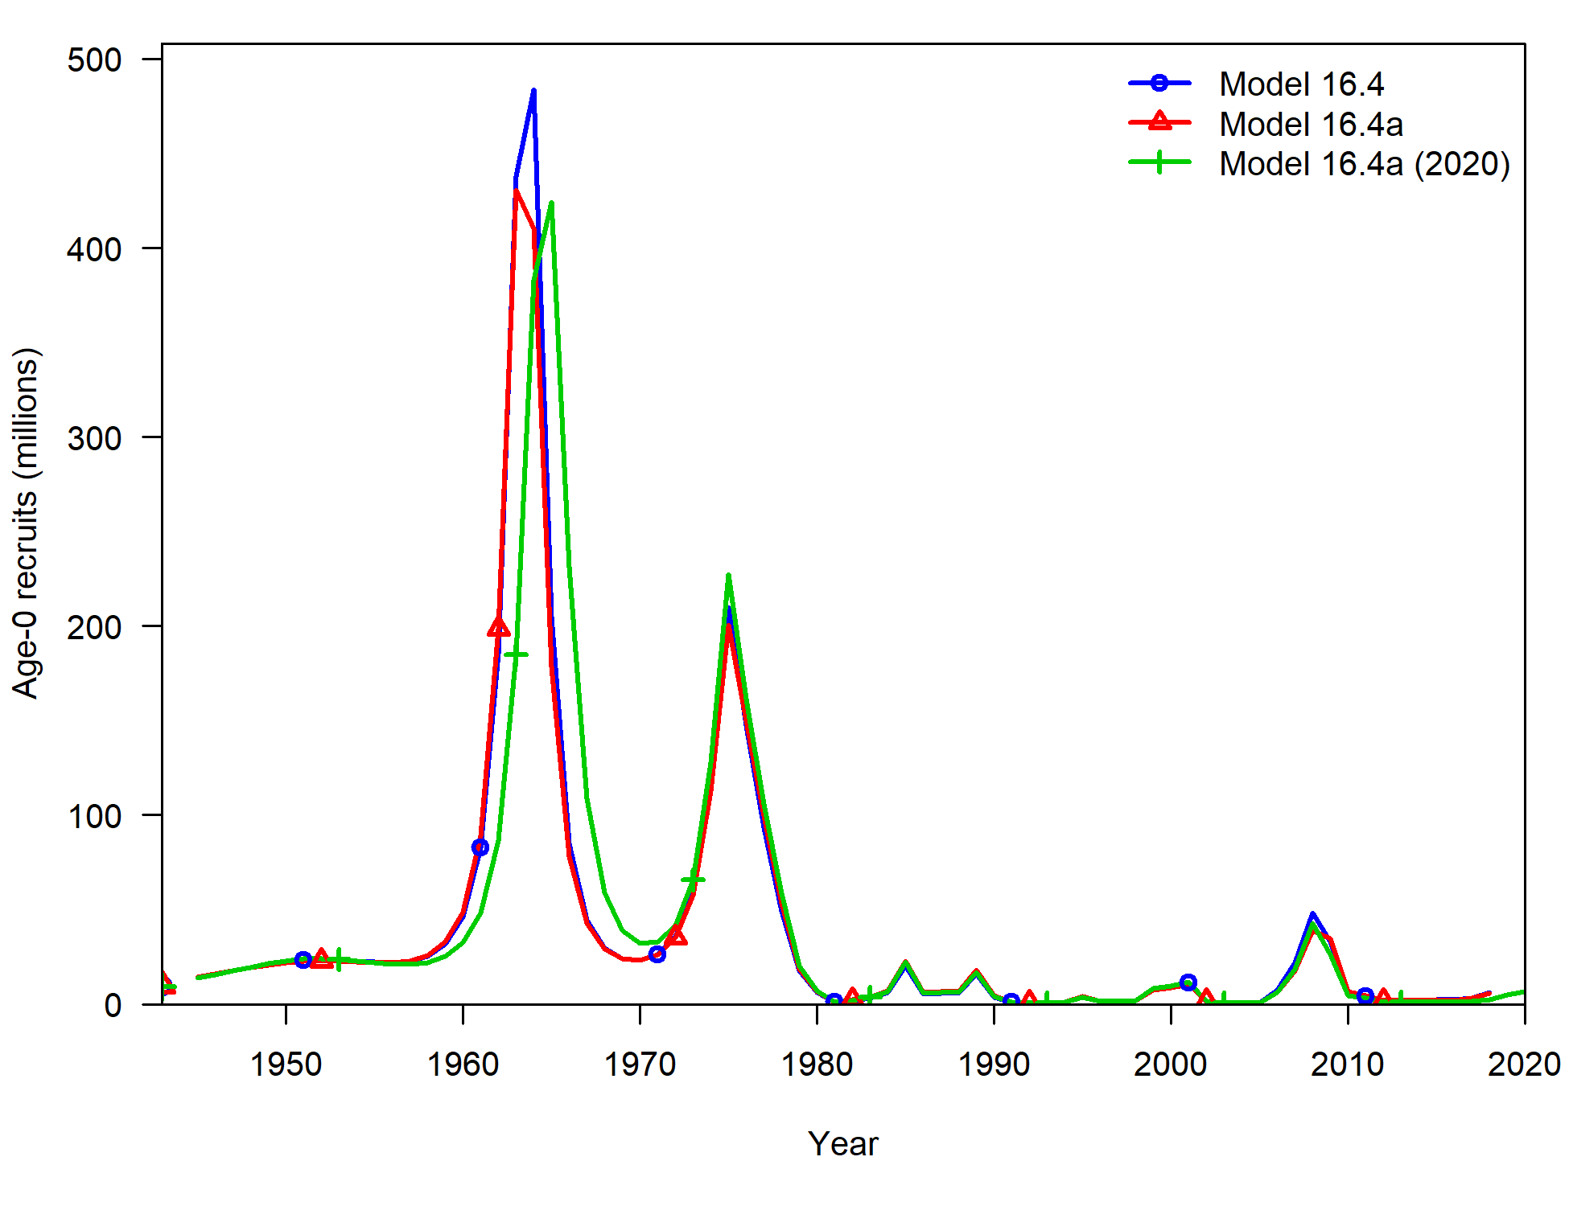
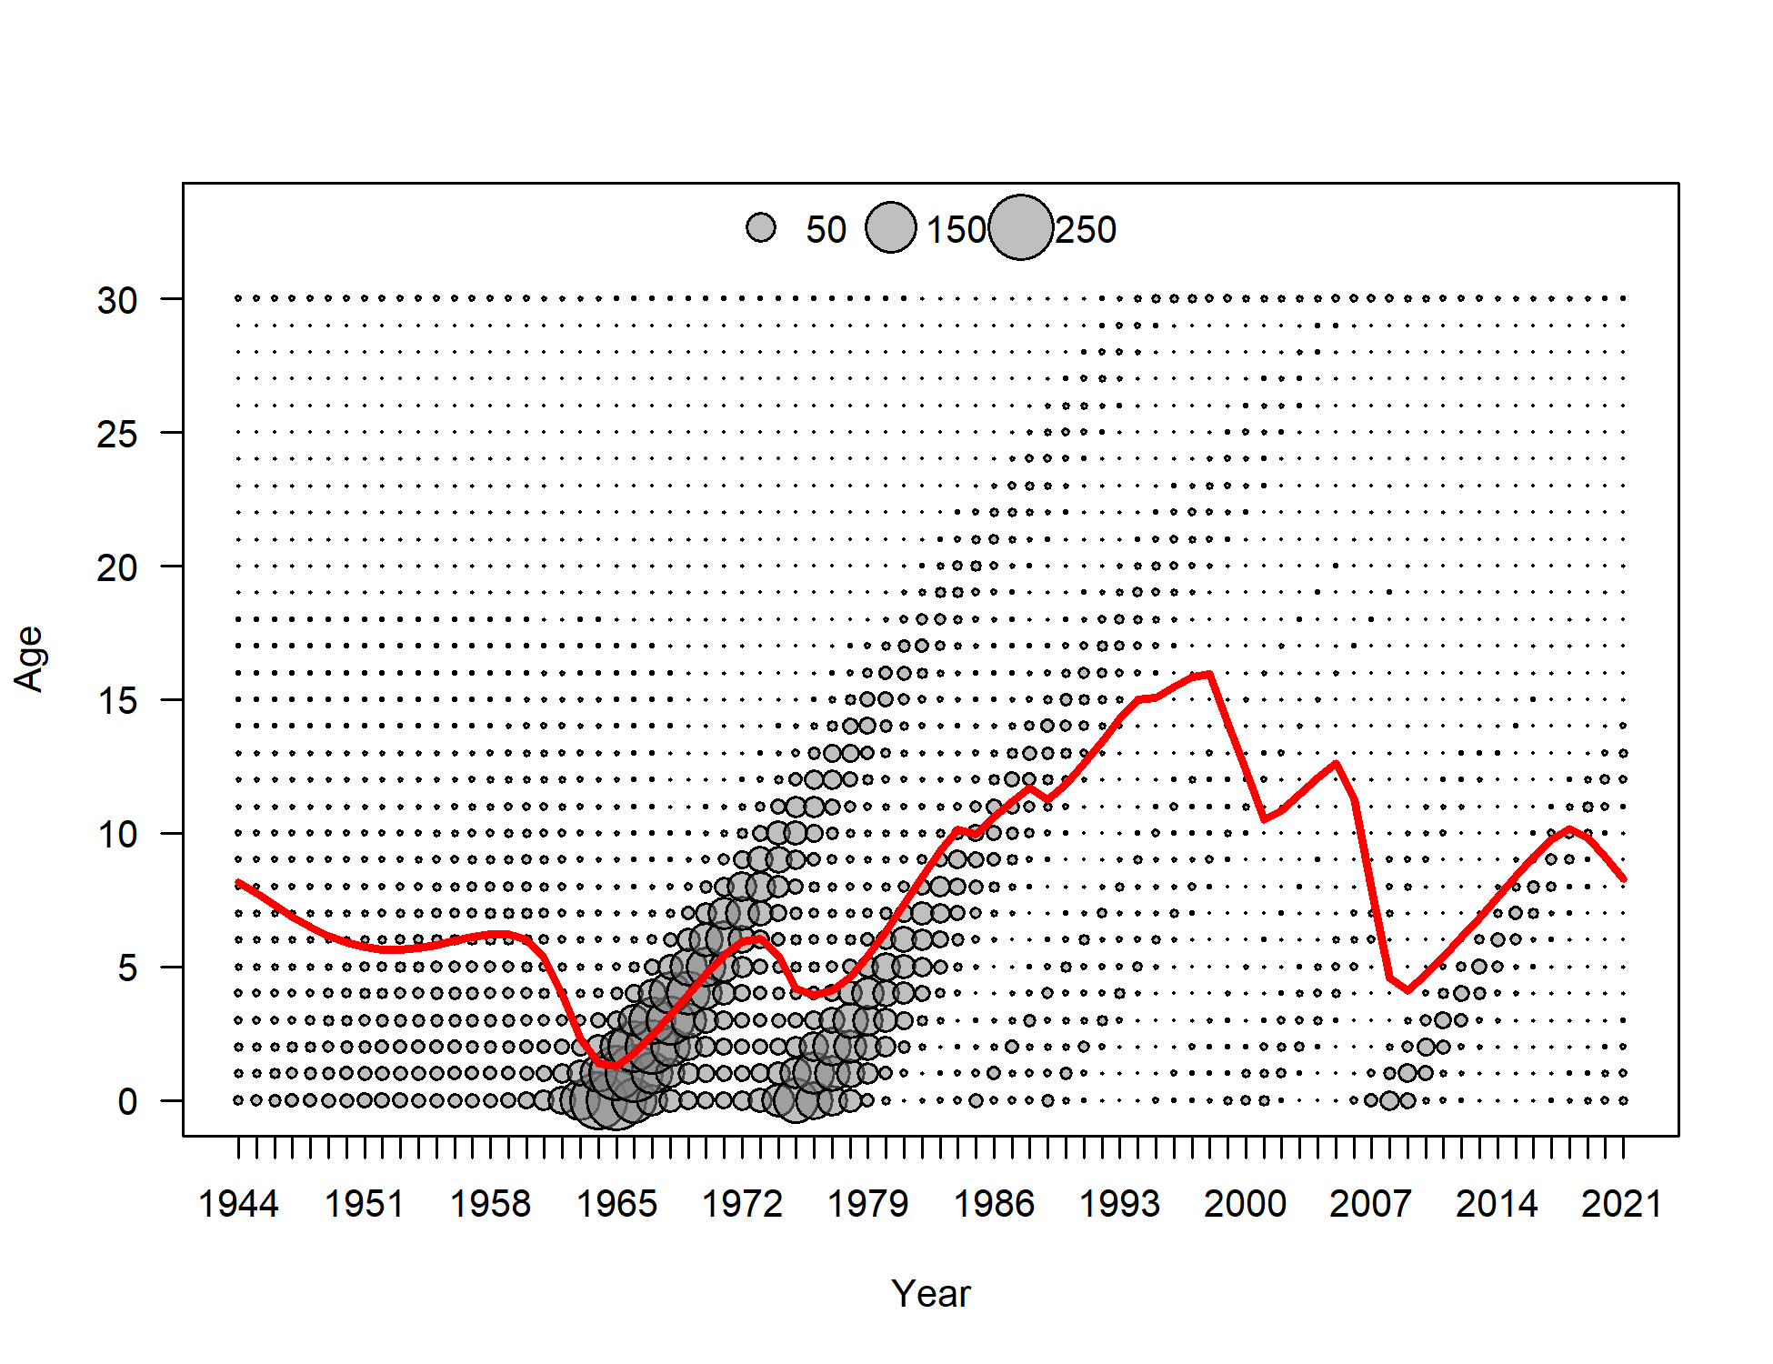

Time series
Notes:
Large increase in spawning biomass is driven by the large recruitment events in early 1960s and 1970s
Estimated selectivity in early period in dome-shaped for model 16.1b
2018 spawning biomass estimate similar

Slide 16
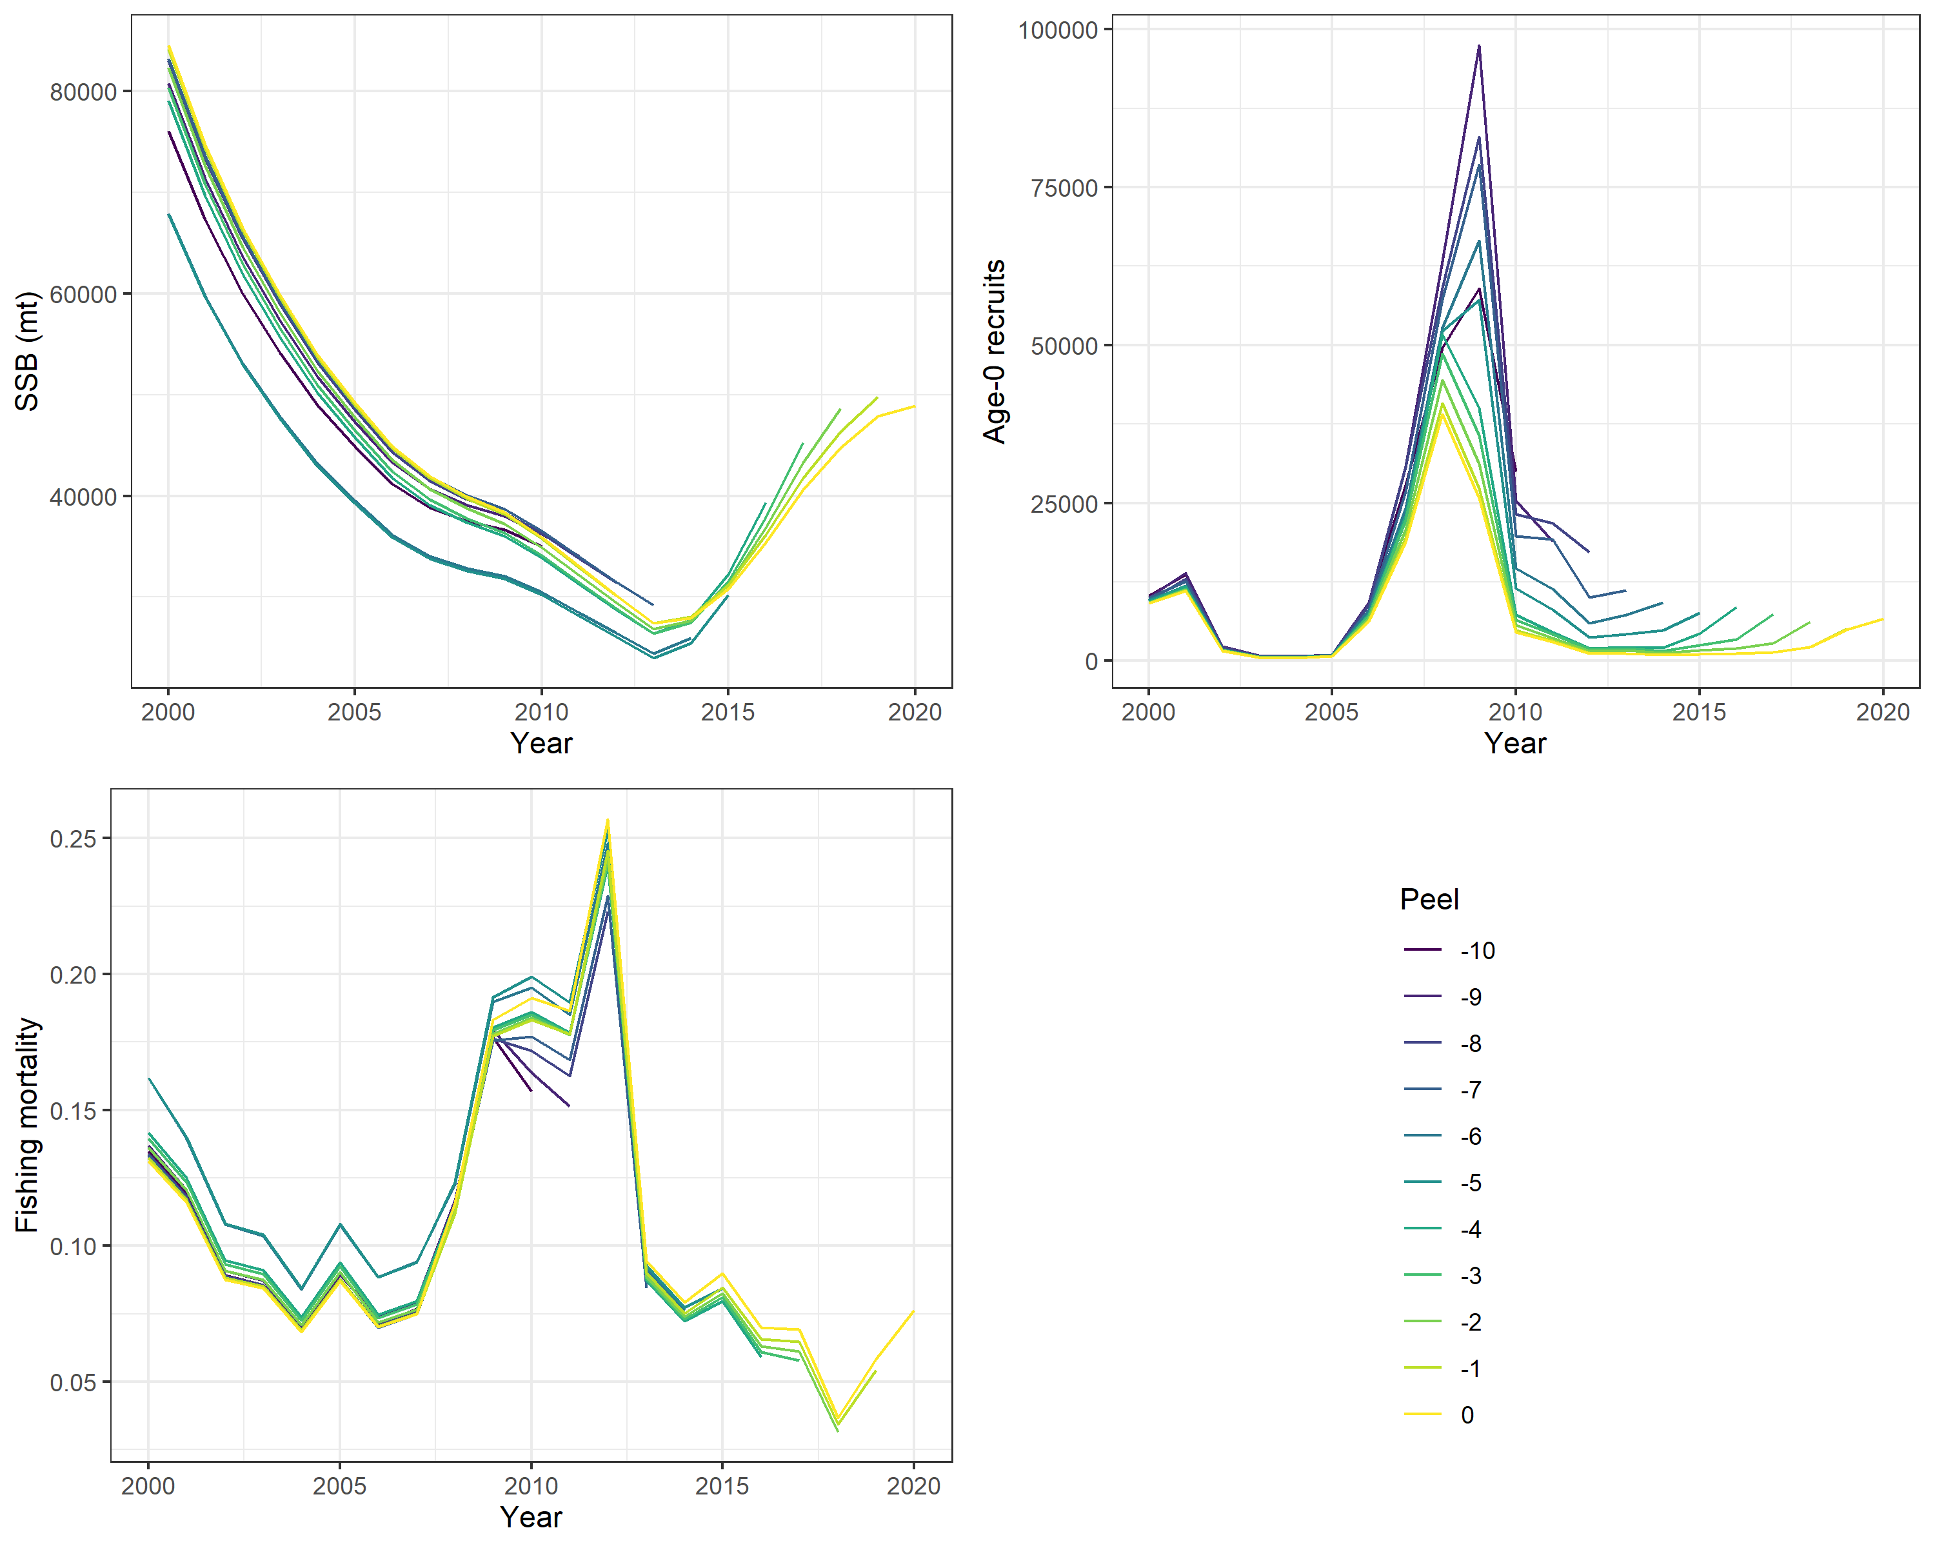
Retrospective analysis
ρ = 0.04
ρ = 6.17
ρ = -0.12
Notes:
Results form Model 16.4a (2020)
2018 assessment: SSB rho = 0.097

Slide 17
Harvest recommendations
Quantity | As estimated or specified last year for: |  | As estimated or recommended this year for:
 | 2020 | 2021 | 2021 | 2022
M (natural mortality rate) | 0.112 | 0.112 | 0.112 | 0.112
Tier | 3a | 3a | 3a | 3a
Projected total (age 1+) biomass (t) | 106,101 | 98,532 | 87,849 | 79,382
Female spawning biomass (t) | 57,094 | 53,617 | 51,914 | 47,197
B_{100%} | 90,534 | 90,534 | 89,054 | 89,054
B_{40%} | 36,213 | 36,213 | 35,622 | 35,622
B_{35%} | 31,687 | 31,687 | 31,169 | 31,169
F_{OFL} | 0.21 | 0.21 | 0.22 | 0.22
maxF_{ABC} | 0.18 | 0.18 | 0.18 | 0.18
F_{ABC} | 0.18 | 0.18 | 0.18 | 0.18
OFL (t) | 11,319 | 10,006 | 8,568 | 7,181
maxABC (t) | 9,625 | 8,510 | 7,326 | 6,139
ABC (t) | 9,625 | 8,510 | 7,326 | 6,139
Status | As determined last year for: |  | As determined this year for:
 | 2018 | 2019 | 2019 | 2020
Overfishing | No | n/a | No | n/a
Overfished | n/a | No | n/a | No
Approaching overfished | n/a | No | n/a | No
Notes:
* Projections are based on model 16.4a (2020) and preliminary catches of 3,321 t was used in place of maximum permissible ABC for 2020. The preliminary catch for 2020 was estimated as the product of the average proportion of the TAC captured over the previous 5 years (2015-2019) and the 2020 TAC.
Recruitment time-series: Age -1 recruits, 1978 – 2018
24% reduction in OFL from 2020
14% reduction in ABC from 2021
Estimates of numbers-at-age lower -> lessening strength of the 2007-2010 cohorts so expected total biomass and spawning biomass are less than the previous projections and we seeing a decline in the OFL and ABC

Slide 18
Apportionment
Area | 2021 ABC | 2022 ABC
Aleutian Islands | 1,150 | 964
Eastern Bering Sea | 6,175 | 5,175
Total | 7,326 | 6,139
Determined from the proportion of adult biomass observed in the EBS slope survey estimates and the Aleutian Islands since 2010 (when they overlapped)
  15.7%

Slide 19
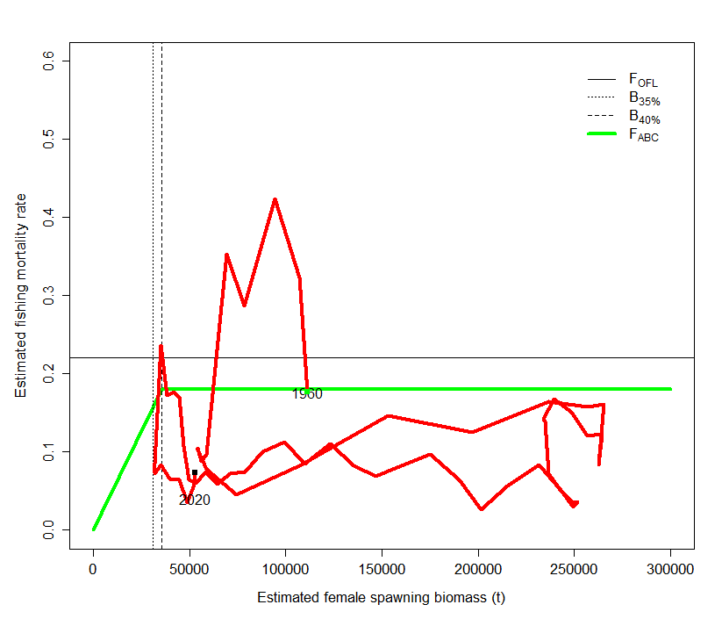
Phase plot
Estimated F
Estimated biomass (t)

Slide 20
Risk table
Assessment considerations – Level 1
  The EBS slope survey has not been conducted since 2016.
  Last survey happened when the 2007-2010 were moving onto the slope
Population dynamics – Level 1
  Recent increase in SSB and total biomass has been due to the growth of a strong year classes (2007-2010).
  Numbers are beginning to decline and there has been a lack of recruitment
Environment/Ecosystem considerations – Level 2
  “The cold pool extent in 2020 indicates average conditions for juvenile recruitment based on a previously established positive correlation between the cold pool and juvenile recruitment. Recent EBS shelf survey data indicates that the length distribution is truncating, with few to no young recruits in 2019. Although 2020 has an average cold pool extent, there is concern that with increased frequency of years with little to no cold pool there will be a continued lack of recruitment in the future.”
Fishery performance – Level 1

Slide 21
Future directions
An evaluation of non-binary environmental indices and methods for linking environmental covariates to recruitment
Spatial considerations
  Given the ontogeny of the species, spatial models accounting for this should be explored
Model’s ability to estimate selectivity parameters
  Investigate simplified time blocks

Slide 22
Divider Title
Additional Divider Information

Slide 23
Model structure
Natural mortality – Fixed
  M = 0.112 (Cooper et al. 2007)
  Same for females and males
Maturity at length – fixed parameters
  L50: 60 cm (D’yakov 1982)
  Slope: -0.25 (D’yakov 1982)
Weight-length relationship – fixed parameters
  Males: W = 3.4 x10⁻⁶L^{3.2189}
  Females: W = 2.43x10⁻⁶L^{3.325}
  Barbeaux et al. (2012)
von Bertalanffy growth
  Length at minimum age (estimated)
  Length at maximum age (estimated)
  Growth coefficient (estimated)
  CVs at young and old age (fixed)
    15% young and 9% old

Slide 24
Model structure
Stock-recruitment (Beverton-Holt)
  R0 – Estimated
  Steepness - Fixed = 0.79 (Myers et al. 1999)
  Sigma R - Fixed = 0.6
  Autocorrelation – Estimated
    Normal prior
    Mean = 0.473 and Stdev = 0.265 (Thorson et al. 2014)
  Recruitment deviations - Estimated
    Early: 1945 - 1970
    Main: 1970 - 2013
    Forecast: 2014 - 2019

Slide 25
Model structure
Selectivity
  Sex-specific, size-based
  ABL longline survey: Fixed logistic
  Double normal pattern
    Trawl fishery, longline fishery, EBS shelf and slope surveys
    Slope selectivity is constrained to be logistic
    Female selectivity offset from males for longline fishery and slope survey
    Male selectivity were offset from female for trawl fishery and shelf survey
  Time-varying selectivity using time blocks
    Trawl fishery: pre-1989 (10), 1989-2005 (14), 2006 -2018 (11)
    Longline fishery: pre-1991 (7), 1991-2007 (15), 2008-2018 (11)
    EBS shelf survey: pre-1992(5), 1992-1995 (4), 1996-2000 (5), 2001-2018 (18)
    EBS slope survey: pre-2002 (6), 2002-2010 (4), 2011-2018 (2)

