Slide 1
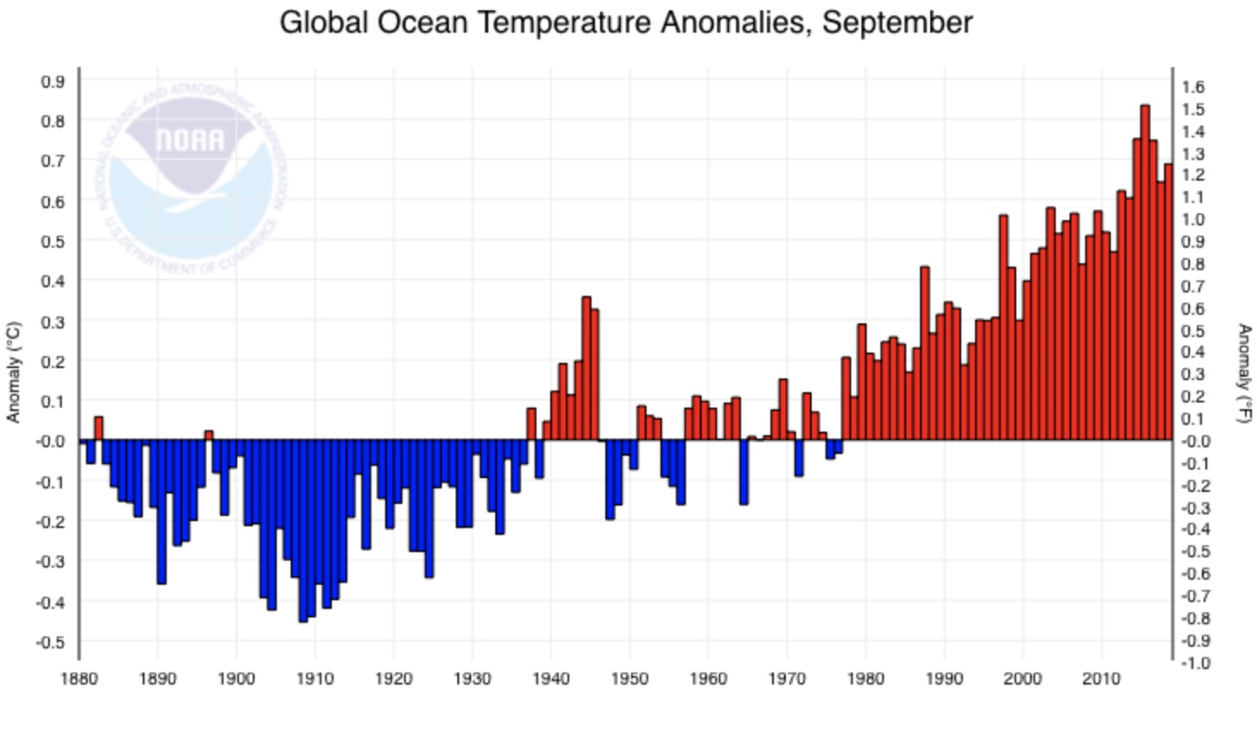
Bering Sea FEP Climate Change Task Force Meeting 2
Feb 26 -28, 2020
Overview
Anomaly from (1901-2000)
NOAA National Centers for Environmental information, Climate at a Glance: Global Time Series, published March 2019, retrieved on March 29, 2019 from https://www.ncdc.noaa.gov/cag/
Diana Stram
Kirstin Holsman
CPT update May, 2020
Notes:
The goal of the climate change module is to facilitate and support equitable climate change adaptation pathways and long-term resilience for the coupled social-ecological system of the Eastern Bering Sea (see geographic description in the FEP [ add link] ) . This module will support the capacity to i) evaluate management tools to develop incremental (normative) adaptation measures to preserve livelihoods, health and wellbeing across fisheries and dependent coastal communities, and, ii) enable transformative adaptation needed to ensure the productivity and sustainability of the coupled social-ecological Bering Sea system. To achieve this, the climate change module will be used to synthesize current knowledge regarding climate change effects on the EBS system, identify potential climate-resilient management measures that can improve adaptive capacity and avoid maladaptation (Figure 1), evaluate the risks, timescales, and probability of success of various climate-resilient management policies under future scenarios of change; and provide prioritized recommendations for actions that could be taken to advance the goals and minimize the risks identified.

Slide 2
Attendees Feb 26-28 Sea/ANC and on-line
CCTF Members:
Diana Stram
Kirstin Holsman
Brenden Raymond-Yakoubian
Mike LeVine
Jeremy Sterling
Scott Goodman
Steve Martell
Absent: Joe Krieger, Lauren Divine
Other attendees:
LK/TK/Subsistence co-chairs
Sarah Wise
Kate Haapala
FEP co-chairs
Kerim Aydin
Diana Evans
SocioEcon and Ecosystem AFSC group
Steve Kasperski
Ben Fissel
Alan Haynie
Stephanie Zador
Elizabeth Siddon
Crab Plan Team
Martin Dorn
Public:
Ernie Weiss
Steve Marx
Stephanie Madsen

Slide 3
Overarching workplan
Synthesize diverse sources of current knowledge regarding climate change effects on the Bering Sea ecosystem , including longer-term projections and forecasting;
Identify and analyze the risks and probabilities of success for potential climate-resilient management measures and policies under future scenarios of change; and
Provide recommendations for short-, medium-, and long-term actions that could be considered and initiated by the Council.

Slide 4
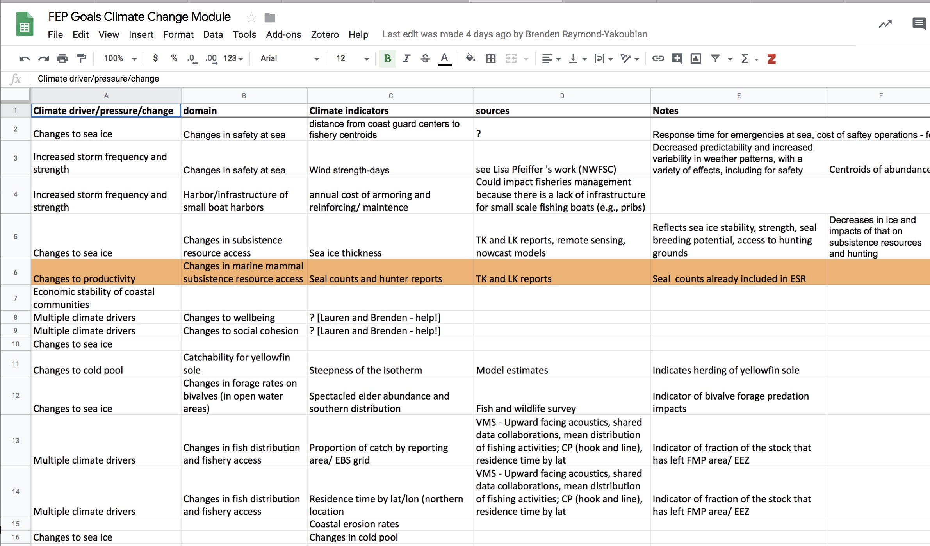
Indicators
DRAFT
Notes:
Cross-walking with FEP indicators, ESR indicators, etc.

Slide 5
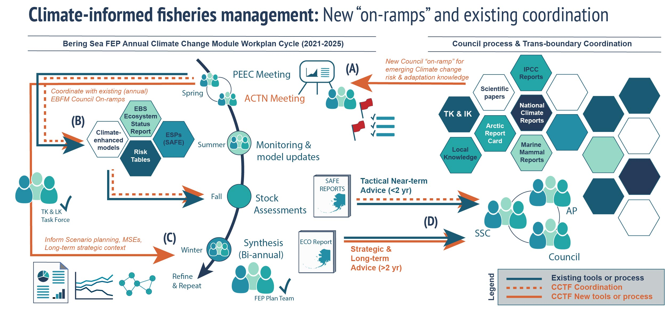
CCTF Process
“Hot of the press”
FOCAL TOPIC
(annual / as needed)
Notes:
Martin’s suggestion – add focal topics to strategic loop

Slide 6
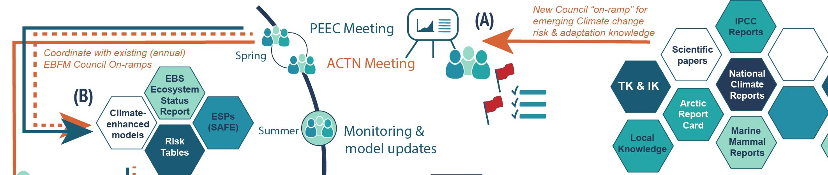
CCTF Process
ACT meeting will serve as systematic on-ramp of information to Council process
Tactical and near-term info and tools → Existing ESR/ESP/SAFE process
Long-term advice (no current on-ramp) → ECO report to Council (in conjunction with BSFEP)
Notes:
Adaptation & Climate Testimonials & New information Meeting

Slide 7
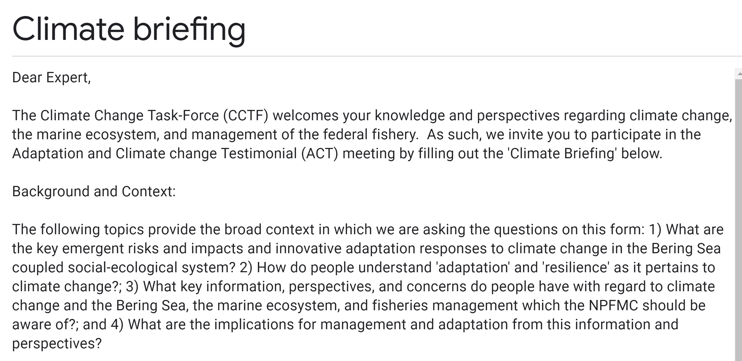
Climate testimonial google form
DRAFT

Slide 8
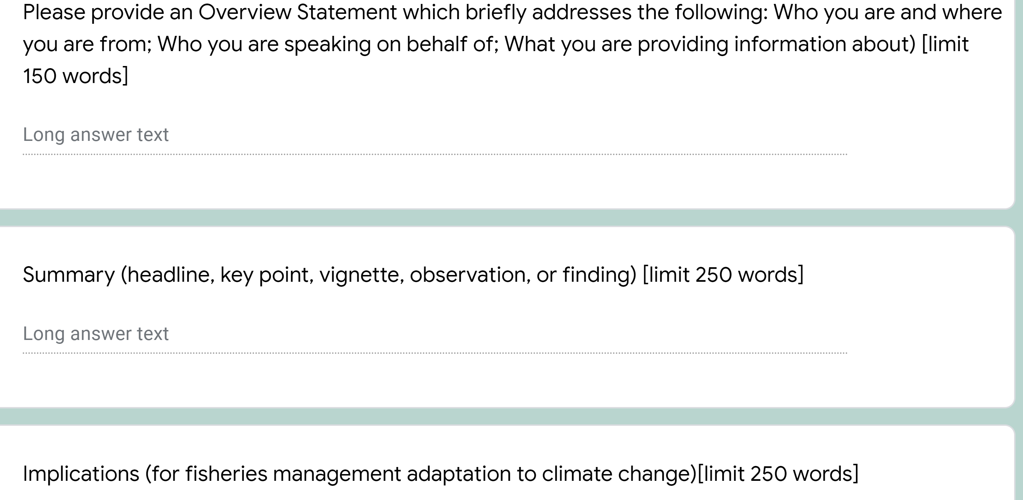
Climate testimonial google form
DRAFT

Slide 9
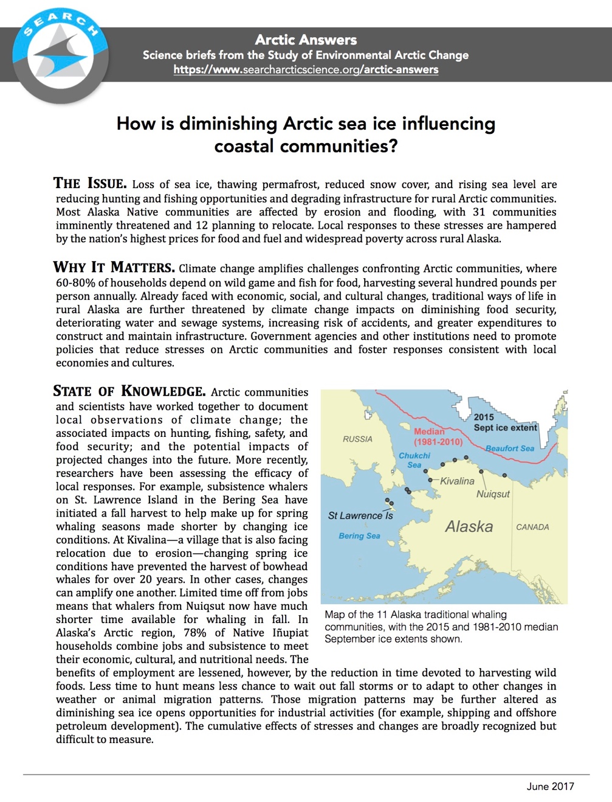
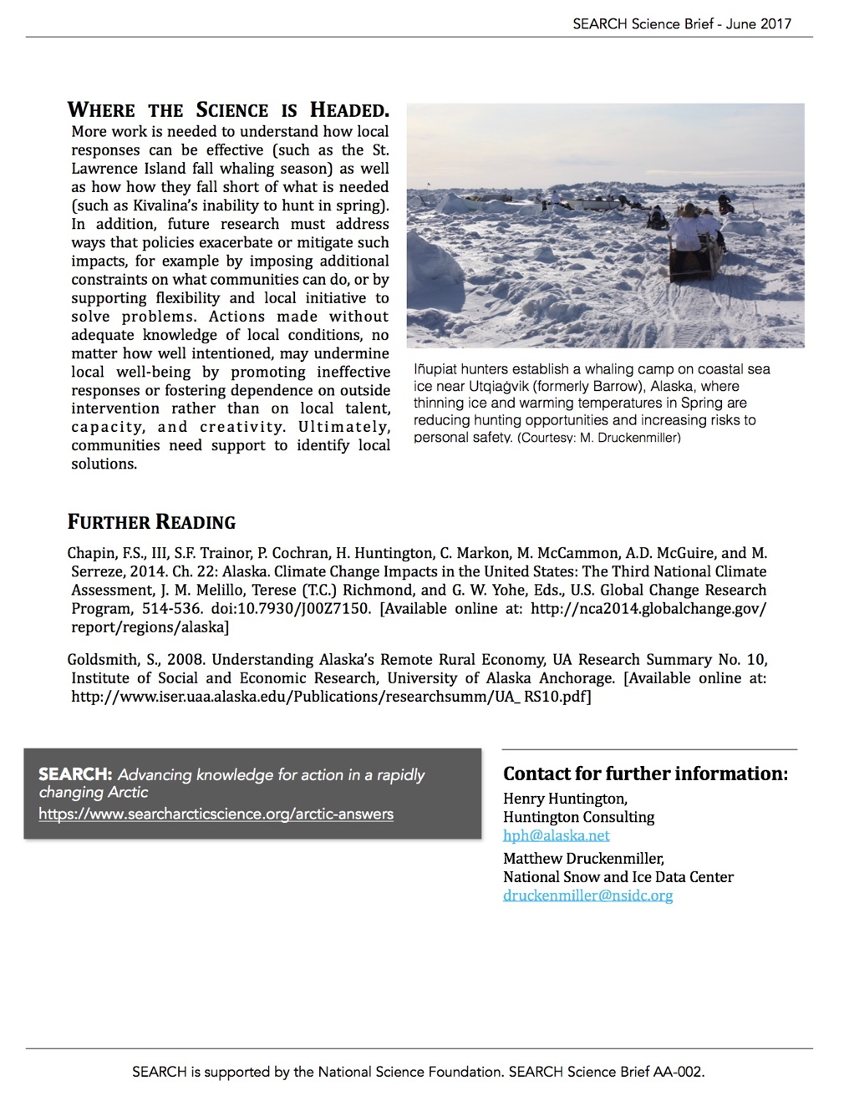
ACT Meeting template
An example…..

Slide 10
Discussion: Planning & logistics
Work Plan to be reviewed by EC, SSC/AP/Council at April (TBD) meeting (under FEP report)
  Track changes version with comments explaining revisions
Next steps (if plan endorsed):
  Test case ACT meeting (May 2020 2021); follow up CCTF June 2020 2021 : revise templates based on test meeting in prep for workshop
  Coordination with LK/TK module
    Joint meeting/workshop for test case ACTN meeting and ‘test’ process using case studies (Sept 2020 2021)
    Co-Chairs participating in meetings of both taskforces as needed
Coordination with other efforts (process as proposed)
  LK/TK/Subsistence AM TF, and the ongoing work of the Ecosystem Committee
  Work with ESR/ESP (tactical)
  Work with FEP Team ECO report (strategic)
Notes:
[BRY] Think some language could be added in here that is very general about integration with some other as-of-yet not finalized efforts which will have long-term Council impacts and will add to where these interfaces can occur, especially the results of current and upcoming work in the LK/TK/Subsistence AM TF, the CEC, and the ongoing work of the Ecosystem Committee and the SSPT.
Meetings/ joint meetings?
TORs for our group
Deliverables:
New: Proposed plan of action for evaluation and implementation of management tools [ML]
“Annual climate change hot-topics/ red flags/ considerations for the coming year?” (e.g., via the ESR?) [BRY: Would this potentially be where the ongoing re-evaluations of management strategies would also fall?]

Slide 11
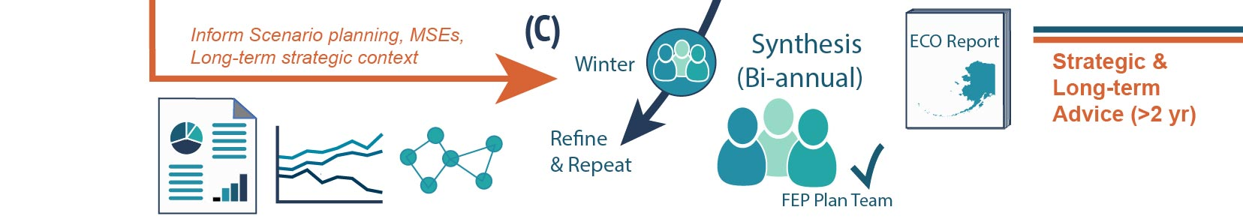
CCTF Process
Case Studies
Will serve as systematic on-ramp of information to Council process
Tactical and near-term info and tools → Existing ESR/ESP/SAFE process
Long-term advice (no current on-ramp) → ECO report
Notes:
Adaptation & Climate Testimonials & New information Meeting

Slide 12
Case Studies
Goal of case studies: Test the proposed process for a range fishery management issues and scale
  Small scale locally important state/federal management: NSRKC
  Broad scale stock moving out of traditional management/survey area: Bering Sea cod
  Bycatch: Incidental catch issues driven by environmental conditions: Bering Sea pollock fishery and squid catch

Slide 13
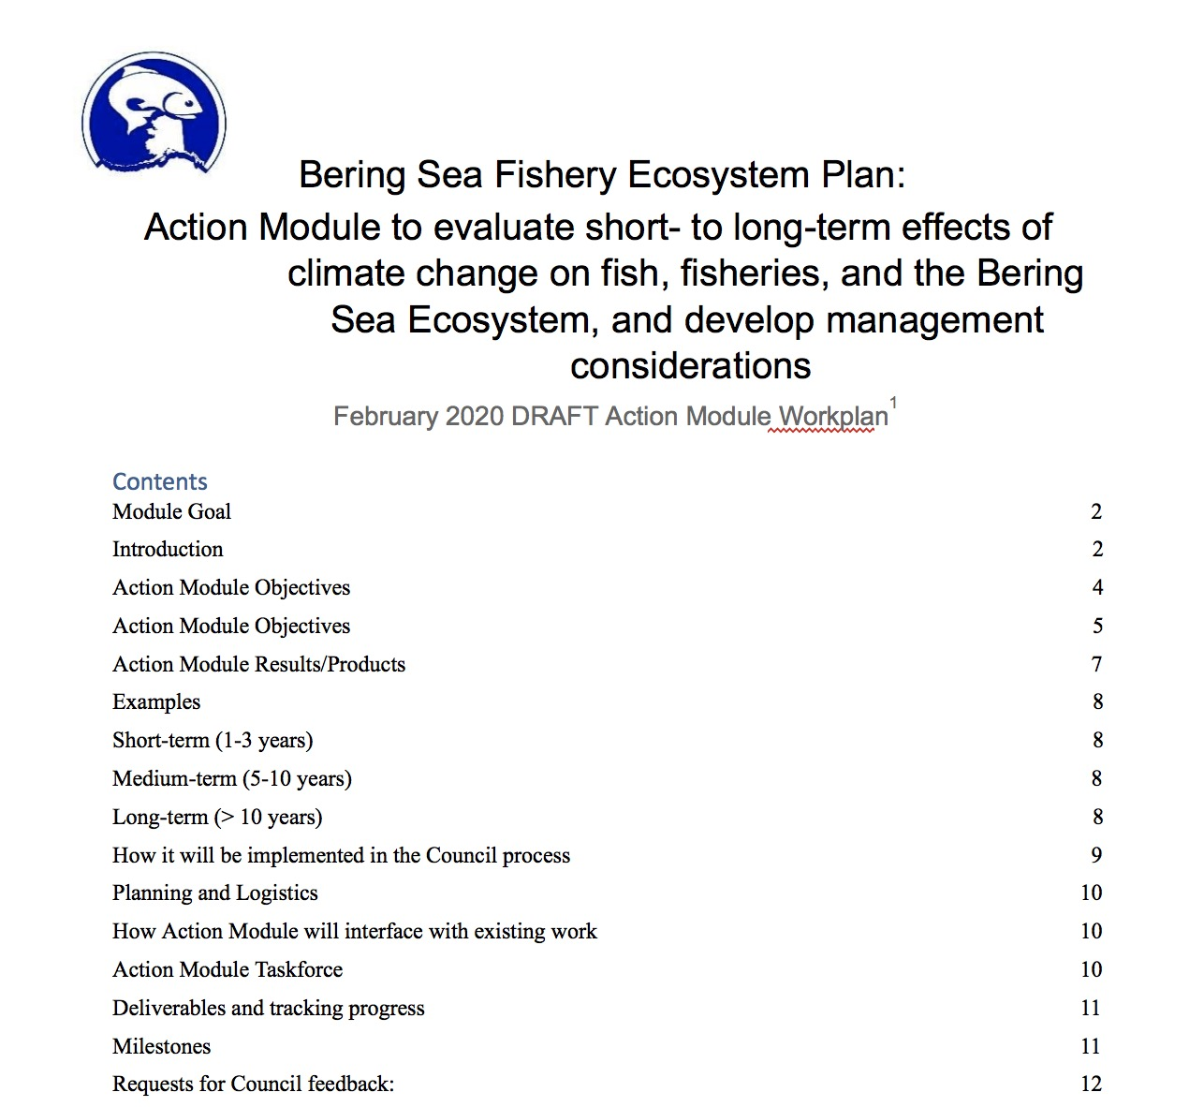
Updating workplan
Will include tracked changes version

Slide 14
Delivery module
ECO report to Council in conjunction with FEP report annually (strategic long-term planning)
Combined in with ESR
  Instead?
  Only when tactical advice affecting specs
Both: ESR and ECO
Other ideas? What is the most useful delivery of this information

