Slide 1
2019/20 BSAI crab catch and fishery performance
Benjamin Daly (ADF&G) and Krista Milani (NOAA)
Crab Plan Team Meeting
September 14-17, 2020
Virtual

Slide 2
Directed fishery observer coverage
Mandatory catcher-vessel coverage requirements, per 5 AAC 39.645.
All vessels processing crab must carry observers.
Fishery | Coverage
Bering Sea snow crab | 30-100% (a)
Bristol Bay red king crab | 20% (a)
Bering Sea Tanner crab | 30-100% (a)
Pribilof District red king crab | 100%
Pribilof District blue king crab | 100%
Saint Matthew Island blue king crab | 100%
Norton Sound red king crab | Discretionary
Aleutian Islands golden king crab | 50% (b)
Pribilof District golden king crab | 100%
Adak red king crab | 100%
2020/21 plan: Generally status quo: Supplement observer personnel with some ADF&G staff
No reduction from data point of view
ª Vessels required to carry observers are randomly selected.
^{b} All catcher vessels must carry an observer during harvest of 50% of total landed catch weight in each three-month trimester of nine-month season Aug 1 – Oct 31; Nov 1 – Jan 31; Feb 1 – April 30.
Notes:
Catcher-vessel observer coverage levels:
Funding for observer deployments on C/Vs in BBR, EBT, WBT and BSS, and corresponding CDQ fisheries has been provided through cost-recovery test fishing and funds granted to ADF&G from proceeds generated by a federal 3 percent CR tax.
Annually, ADF&G randomly selects a percentage of registered vessels in each fishery (BBR, EBT, WBT, and BSS) to carry state-funded observers during 100 percent of their fishing for the season. SMB and PIK observer deployments are pay-as-you-go and observer coverage is set at 100 percent.
ADF&G and COOTF determined that for fisheries where observer coverage is less than 100 percent and funding for observer costs is provided, randomly selecting vessels is the most cost effective and efficient manner in which to meet data collection needs in crab fisheries. In a pay as you go system, selection of only a portion of the registered vessels to carry observers would unfairly require some harvesters to pay for observer coverage. In fisheries where observer funding is pay-as-you-go, each harvester is required to carry an observer during a designated minimum percentage of their harvest as outlined in regulation, 5 AAC 39.645 (d)(4).

Slide 3
Directed fishery observer coverage
*AIGKC calculated by trip because of trimester regulation
Notes:
AIGKC coverage rates determined by the number of landings observed.

Slide 4
Directed fishery observer coverage

Slide 5
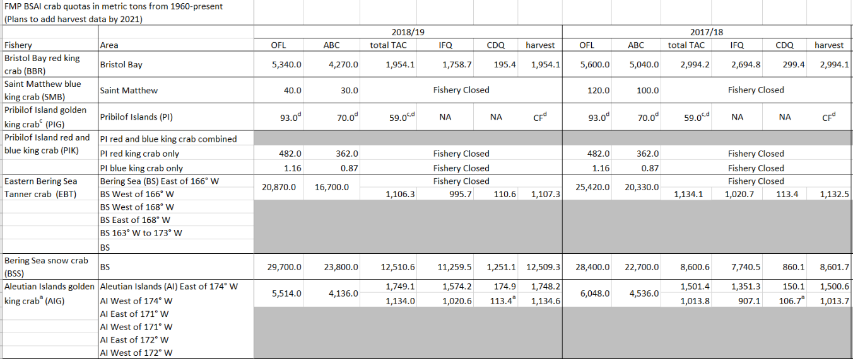
Groundfish Fisheries: Historical Crab Table
Now has directed fishery harvest!
Will be updated and available on the NOAA website as a PDF every November
Available in both metric tons and pounds
Table includes information beginning in 1960
Excel table is available upon request

Slide 6
GF Vessels in Full Coverage vs Partial Coverage
Full coverage vessels (1 or 2 observers 100% of the time)
  Catcher Processors (limited exceptions for non-trawl CPs)
  Motherships
  AFA Pollock catcher vessels delivering shoreside
  Non-Pollock BSAI trawl catcher vessels can opt for 100% coverage during all fishing
Partial Coverage
  Catcher Vessels fishing groundfish
  Catcher Vessels fishing IFQ/CDQ halibut/sablefish
  Small non-trawl Catcher Processors – They have to apply in advance
No observer coverage
  Vessels using Electronic Monitoring (30% selection rate)
  40 feet and under
  Jig Catcher Vessels
  No FFP (can only fish inside three miles)
  State Guideline Harvest Level fisheries

Slide 7
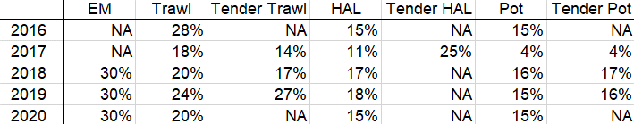
Partial Coverage Groundfish Observer Rates
Prior to 2013 observer coverage for CVs >= 60 ft and <125 ft was based on 30% of fishing days by gear and quarter, >= 125 ft CVs and CPs were 100%
2013 observer program restructured
In 2013 and 2014 partial observer coverage rates were the same for all gear types on vessels 57.5 feet and larger
  14.5% in 2013
  16% in 2014
2015 partial observer coverage rates were split by vessel size
  24% on vessels 57.5 feet and larger
  12% on vessels 40-57.5 feet

Slide 8
Groundfish Fisheries: Trawl Electronic Monitoring (EM)
Experimental fishing permit (EFP)
  Only applies to pelagic trawl catcher vessels targeting pollock
  No observers onboard
  No discarding allowed
  Plant observers monitor entire offload
Most likely will extend into 2021
Pollock vessels do not typically have crab bycatch

Slide 9
Groundfish Fisheries: 2020 Partial Coverage Observer Waivers
March 26 to June 28 NOAA waived observer coverage on partial coverage vessels due to COVID-19.
From April 19 to June 28 the port of Kodiak was not included in the partial coverage observer waiver.
EM vessels were not included under the waiver.
All BSAI A season Pcod fisheries were complete by the time the waiver went into effect.

Slide 10
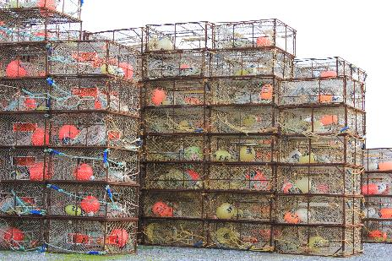
Incidental Crab Catch in Groundfish Fisheries
All weights are in kilograms
Mortality has been applied
(50% for fixed gear and 80%
for trawl gear)
All weights are extrapolated from
observer data
All weights came from AKFIN database
Incidental catch data in this presentation are for the crab year (July 1 to June 30) except for Pribilof Island Golden king crab and Norton Sound red king crab which are a calendar year
Fixed gear includes pot, hook-and-line, and jig
Trawl gear includes non-pelagic and pelagic trawl

Slide 11
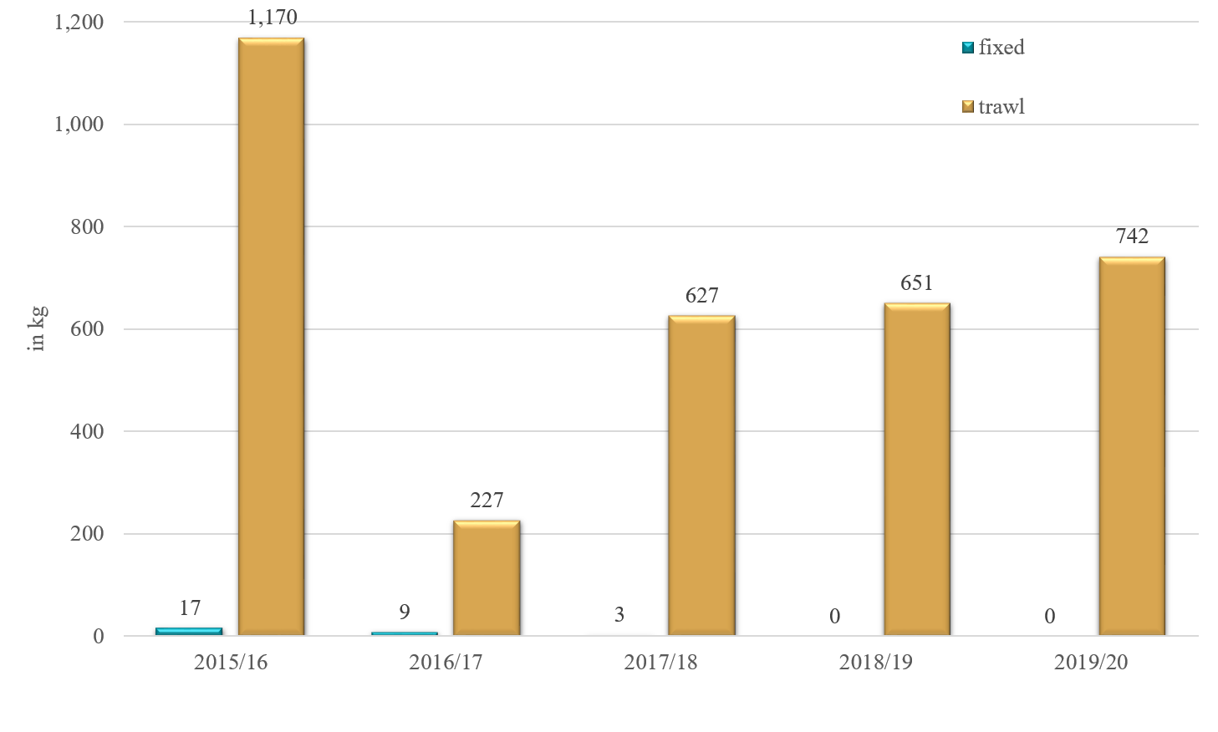
Aleutian Islands Red King Crab Incidental Catch in Groundfish Fisheries

Slide 12
Groundfish Fisheries: Definitions of Fishing Trip
CVs – time they start fishing until offload
CPs and Motherships:
(A) The effective date of a notification prohibiting directed fishing in the same area under §679.20 or §679.21;
(B) The offload or transfer of all fish or fish product from that vessel;
(C) The vessel enters or leaves an area where a different directed fishing prohibition applies;
(D) The vessel begins fishing with a different type of authorized fishing gear; or
(E) The end of a weekly reporting period,
whichever comes first.

Slide 13
Groundfish Fisheries: Trip Target Codes
The trip target code is assigned by the majority species for the fishing trip.
CVs and fixed gear CPs usually only target one species per fishing trip.
Trawl CPs and Motherships often target more than one species per fishing trip.
  For example if a CP or Mothership has 51% Atka mackerel and 49% rockfish for a fishing trip then all catch for that trip will be assigned the Atka mackerel target.

Slide 14
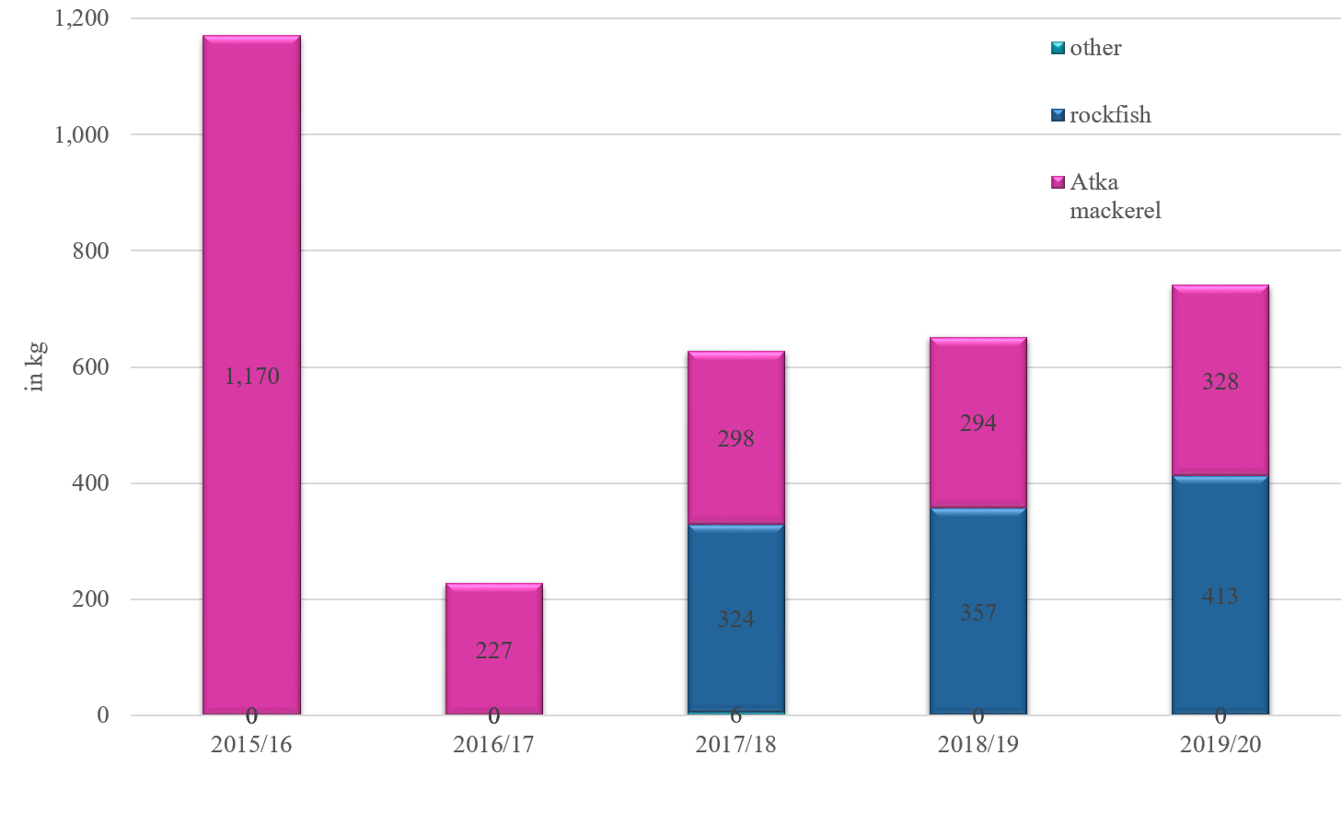
Aleutian Islands Red King Crab Trawl Incidental Catch by Trip Target

Slide 15
Challenges with model uncertainty in TAC setting
Survey and model abundance estimates can differ greatly
  In any given year we don’t know what estimate is closer to the true population size
Some level of uncertainty exists in all models
  OFL-ABC buffer addresses this, but
  Other model estimates used in TAC setting (MFB, MMB, legal male abund) not buffered
Options for setting TAC:
  Ignore model uncertainty, apply model outputs directly into state harvest strategy, OR
  ...Do something

Slide 16
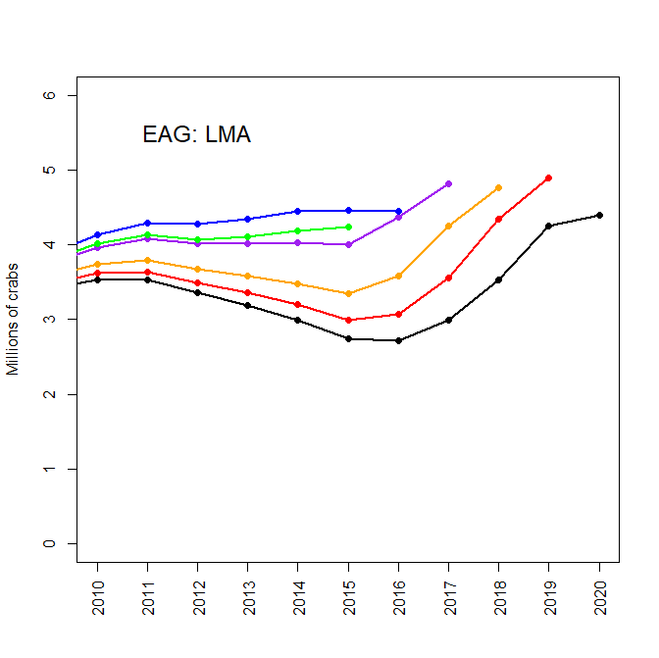
Using retrospective bias to inform uncertainty: AIGKC
What does this tell us about the 2020 estimate?
Likely an overestimate, but the degree of the bias depends on the number of years of subsequent data used to inform the original 2020 terminal year estimate
Here, 25% approximates mean bias observed over the past 3 years.....
Apply buffer to computed TAC post-hoc
?
13% lower
26% lower
38% lower
Terminal year generally overestimated
Notes:
How to improve model?
Improve size at maturity estimates.....more CH measurements
Improve size transition matrix......lab growth studies, tagging studies
Improve L-W regressions.....more weight measurements

Slide 17
Tanner crab
Sources of uncertainty:
  EBS-wide model estimates vs east/west management
  overestimates of 5-inch males
Treatment of TAC inputs:
  Apportion model estimates east/west based on raw survey proportions?
  Buffer 5-inch male estimates? Buffer computed TAC?
  Use raw survey area-swept estimates?
    Past harvest strategies have been “tuned” to survey estimates

Slide 18
Snow crab
Sources of uncertainty:
Maturity definitions: size cut-off, model ogive, logistic regression SM₅₀
  MMB is super sensitive to how maturity is defined
Retrospective pattern: risk of overharvesting
TAC treatment:
Use model uncertainty report card to guide buffers of computed TAC post-hoc?
Use survey estimates?

Slide 19
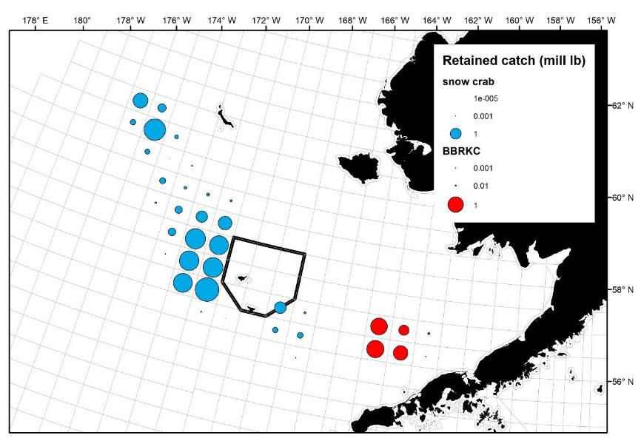
2019/20 BBRKC + snow crab directed fisheries
* Excludes stat areas with <3 vessels

Slide 20
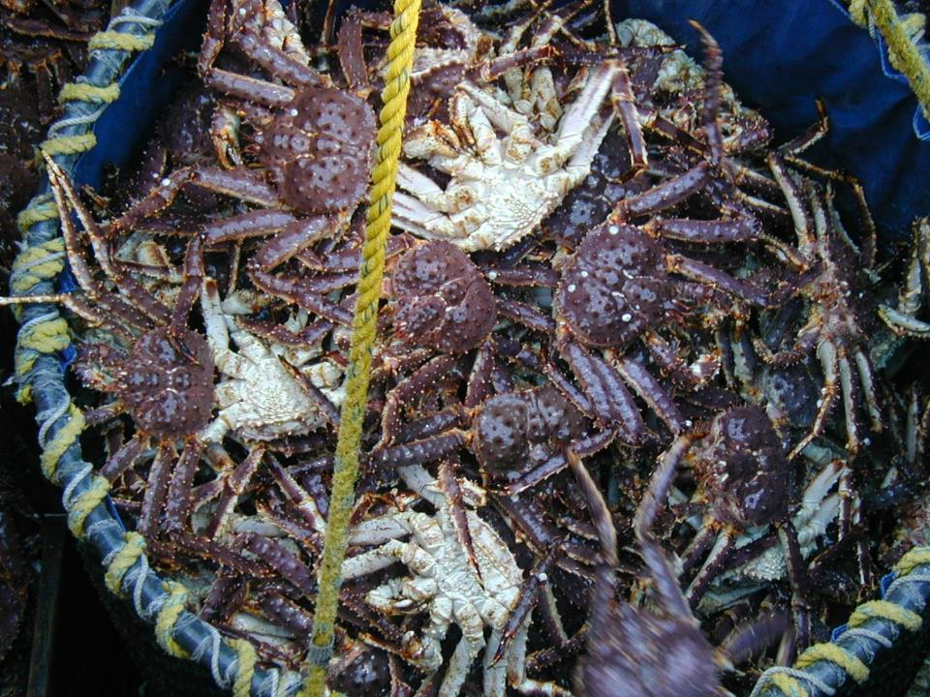
BBRKC

Slide 21
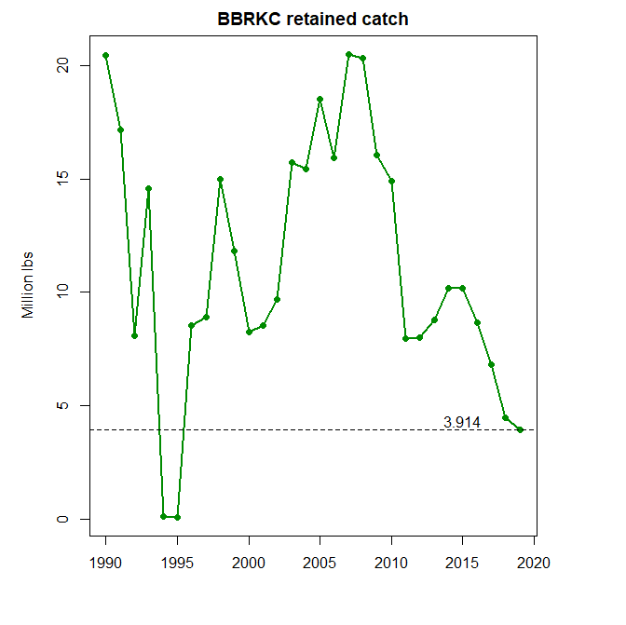

Slide 22
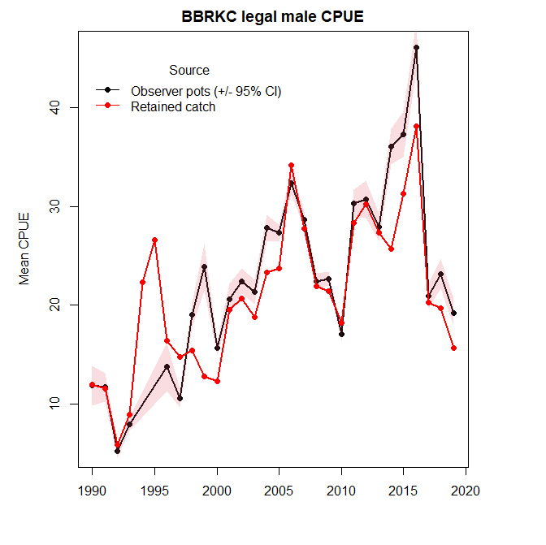

Slide 23
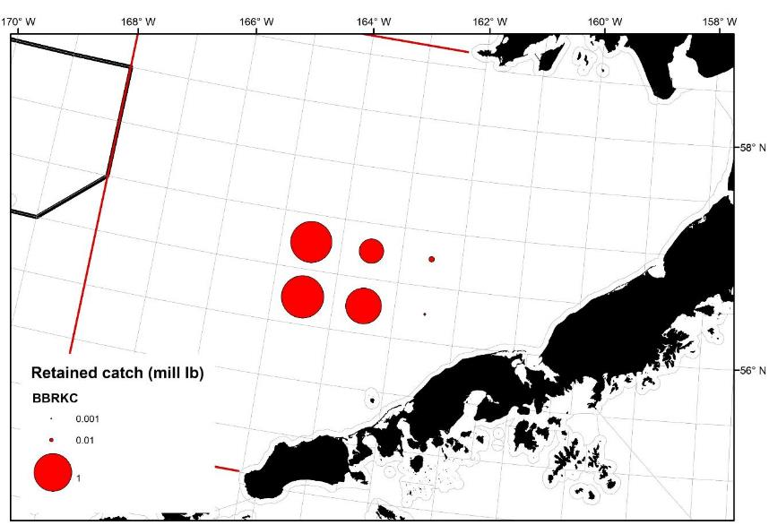
2019/20 BBRKC
* Excludes stat areas with <3 vessels

Slide 24
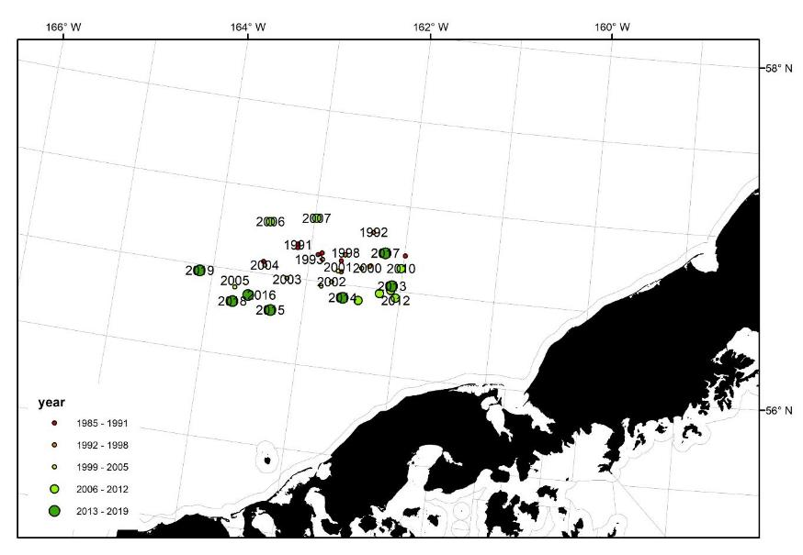
BBRKC weighted centers of catch

Slide 25
2019/20 BBRKC

Slide 26
BBRKC: observations from the fleet
Severe weather on the RKC grounds kept most of the fleet tied up in port until 10/17.
Seemed to be only one small school of crab that produced decent CPUEs for the few vessels that were on it, and that got cleaned up early in the fishery. Opposed to 2017/18 and 2018/19 fisheries, where there were larger schools of crab that produced high CPUEs for the duration of the fishery.
Low CPUE (scratch fishing) for most vessels throughout the fishery.
Many vessels were moving gear around trying to get on a school of crab, which never materialized.
Very large crab, with few recruits, in general.

Slide 27
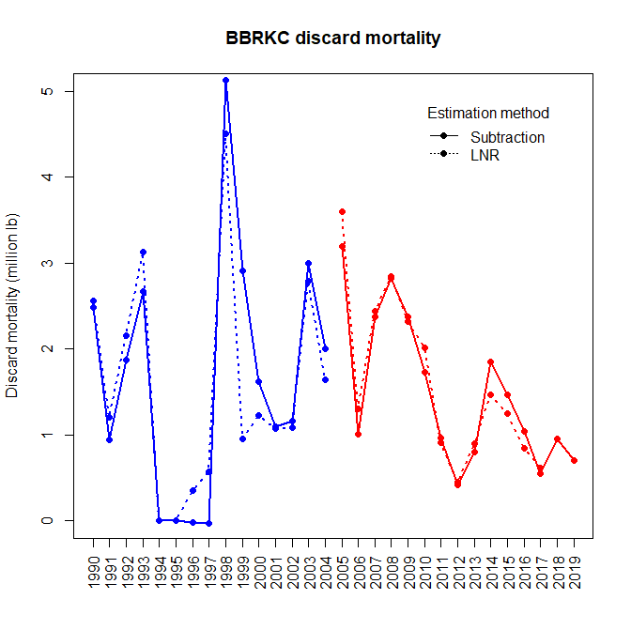

Slide 28
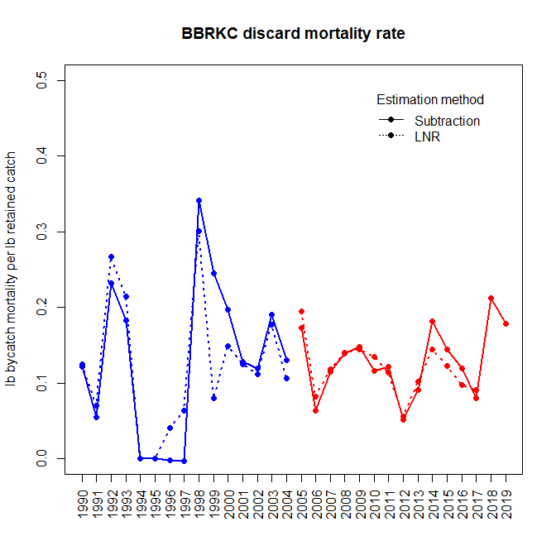
High discard rate in past 2 seasons

Slide 29
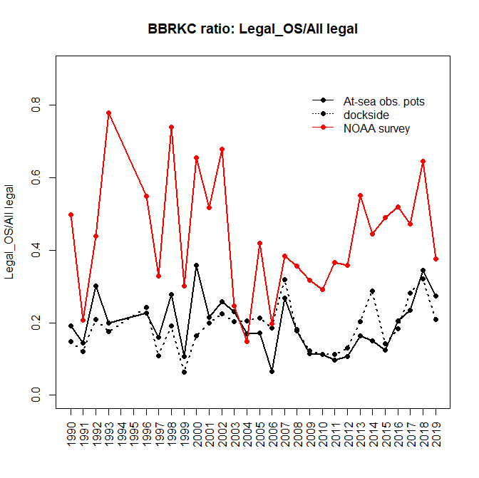
Similar patterns seen in at-sea observer pots and in the dockside data

Slide 30
Ratio of sublegal crabs up in 2018/19 + 2019/20 relative to recent years, but comparable to the long-term trends
Vessels were seeing more sublegal male crabs than they have since 2011-ish
High discard mortality rate in last 2 seasons likely due to 2 factors: 1) more sublegal crabs in pots, and 2) higher proportion of legal crabs in old shell condition

Slide 31
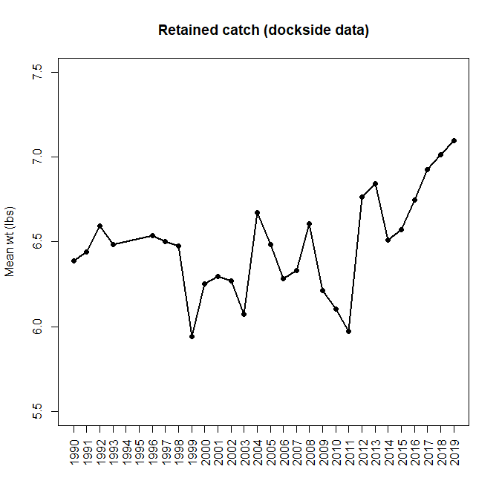
Steady increase in retained catch mean weight

Slide 32
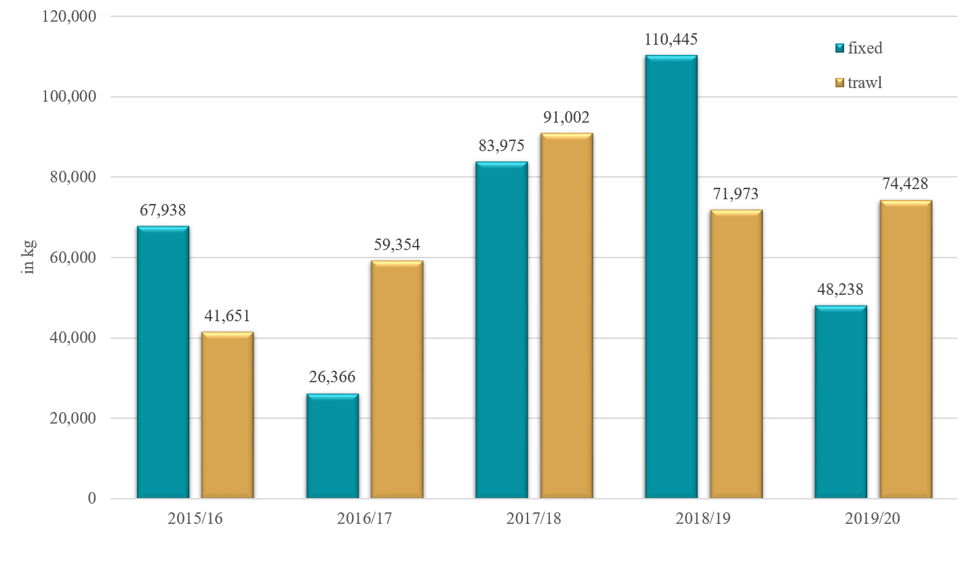
Bristol Bay Red King Crab Incidental Catch in Groundfish Fisheries

Slide 33
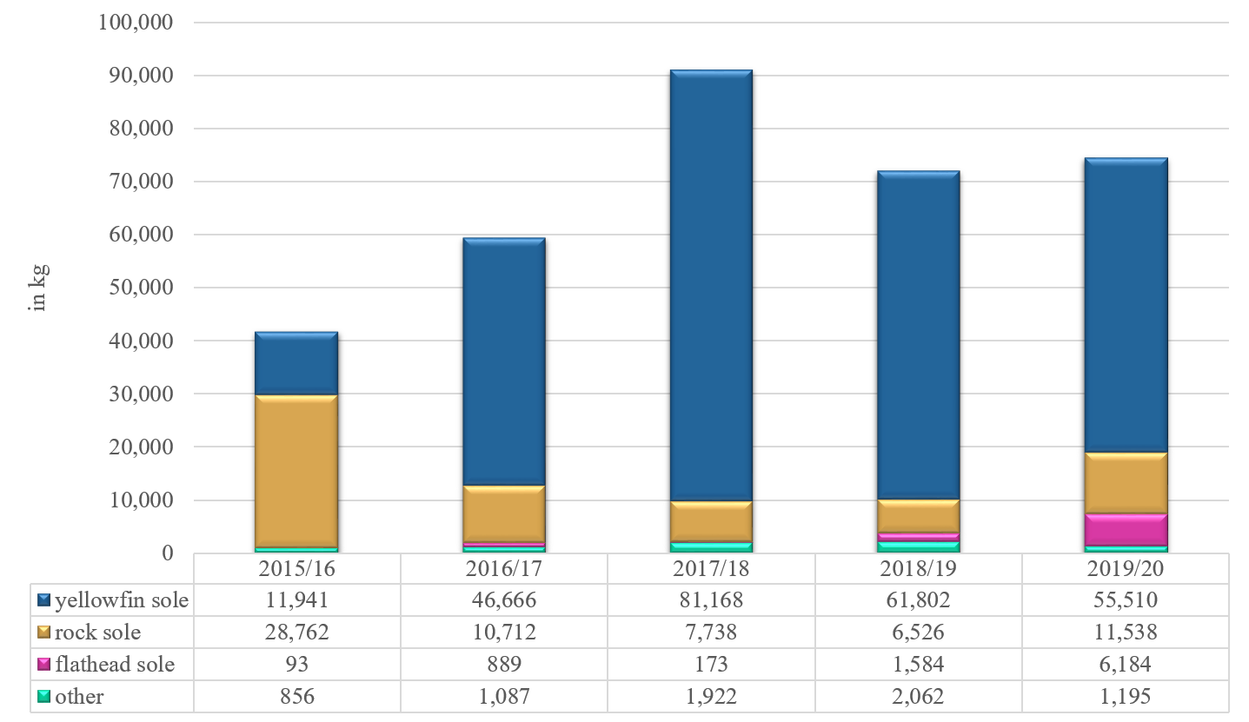
Bristol Bay Red King Crab Trawl Incidental Catch by Trip Target

Slide 34
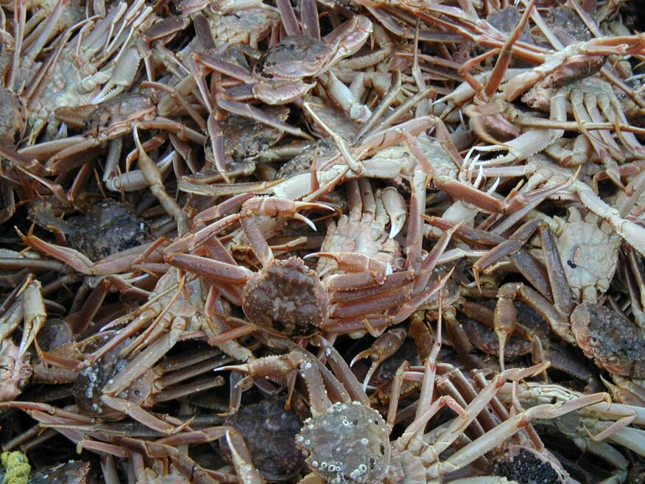
Snow crab

Slide 35
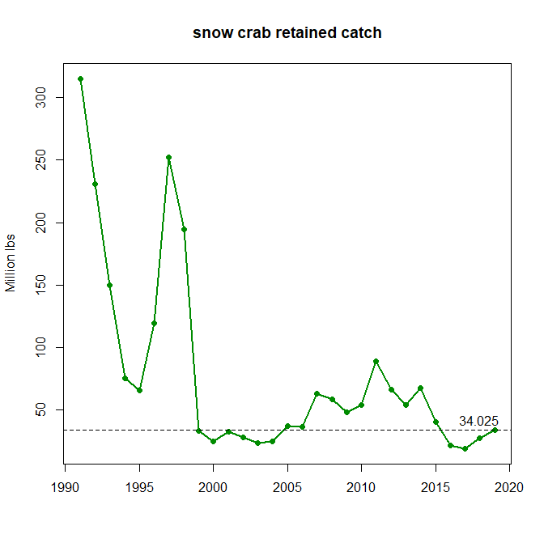

Slide 36
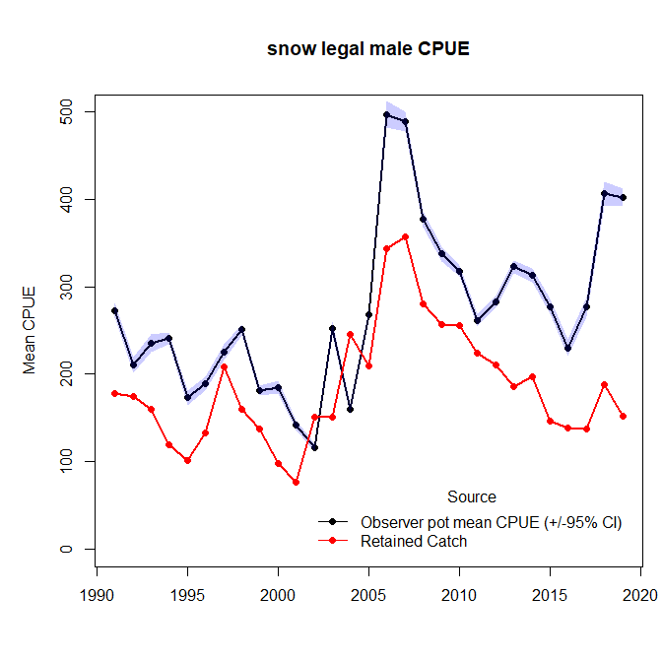

Slide 37
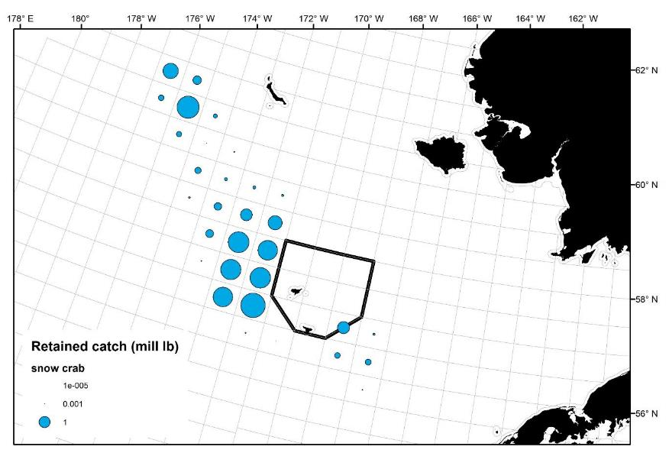
2019/20 snow crab retained catch
* Excludes stat areas with <3 vessels

Slide 38
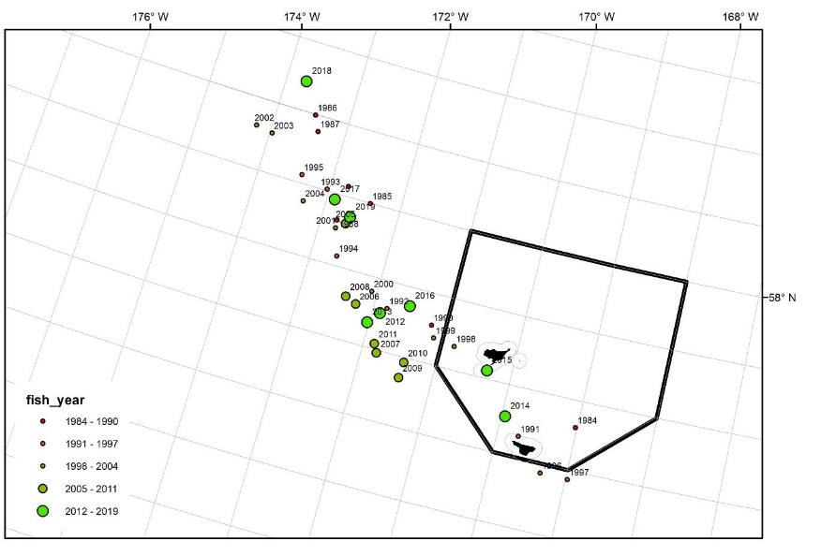
Snow crab weighted mean centers of catch

Slide 39
2019/20 snow crab

Slide 40
Snow crab: observations from the fleet
Lots of small crab (sub 4”) across the fishing grounds led to heavy sorting throughout the season. Many skippers reported individual pots with over 1000 crab, with only a couple hundred of those being at or above industry preferred size.
Higher CPUEs and cleaner fishing farther north near St. Matthew Island, but not the kind of numbers seen in 2018/19 fishery. Sea ice covered fishing grounds around St. Matthew Island in February.
Sea ice on the northern fishing grounds restricted the amount of area available for the fleet to work in. Especially high concentration of vessels fishing W/SW of the Pribilof Islands, all sorting through the same crab over and over for few industry preferred size males.
Sea ice was at maximum extent in early March when it reached the northern tip of Saint Paul Island. As sea ice retreated from northern fishing grounds in March, most vessels saw higher CPUEs in these areas.
Severe winter weather for much of the season – heavy freezing spray conditions.

Slide 41
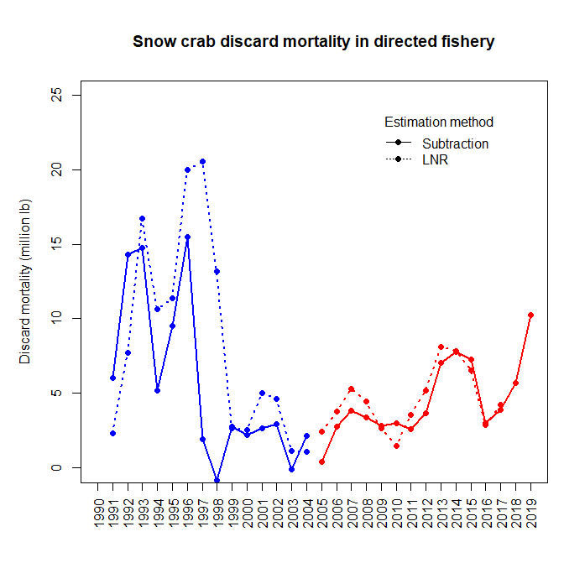

Slide 42
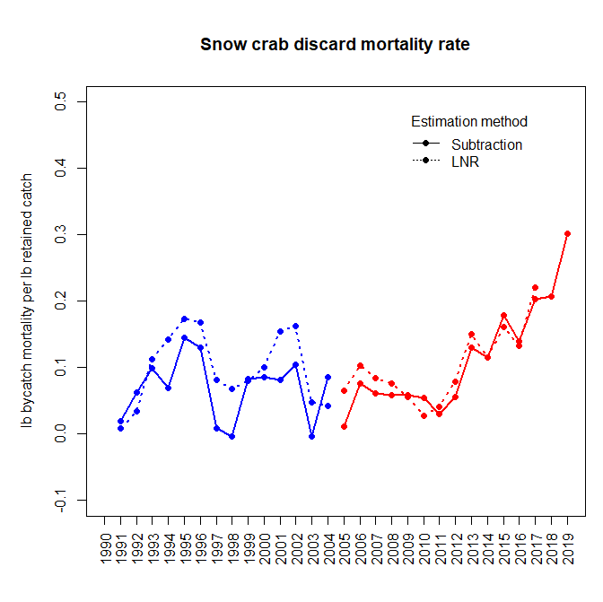

Slide 43
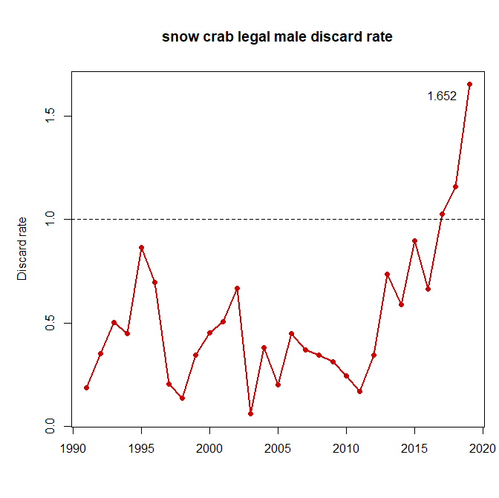

Slide 44
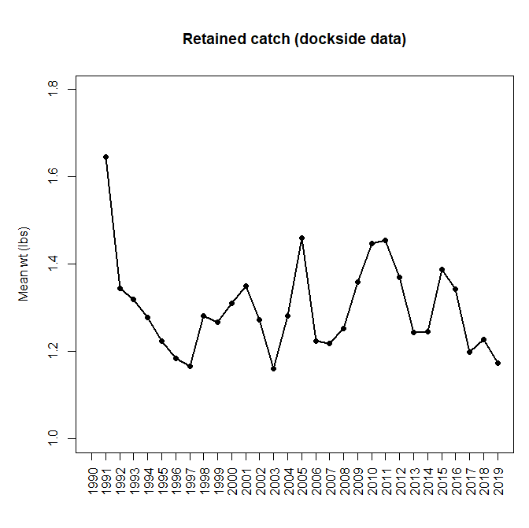

Slide 45
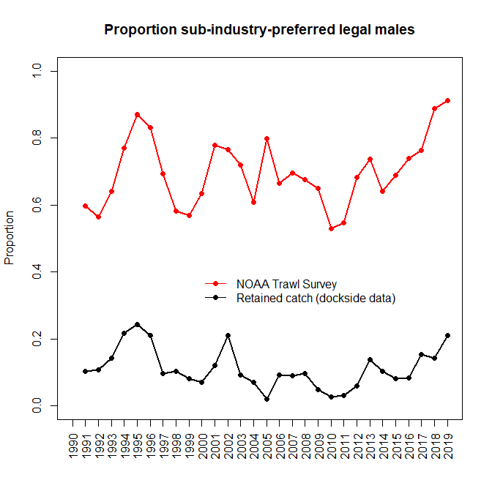

Slide 46
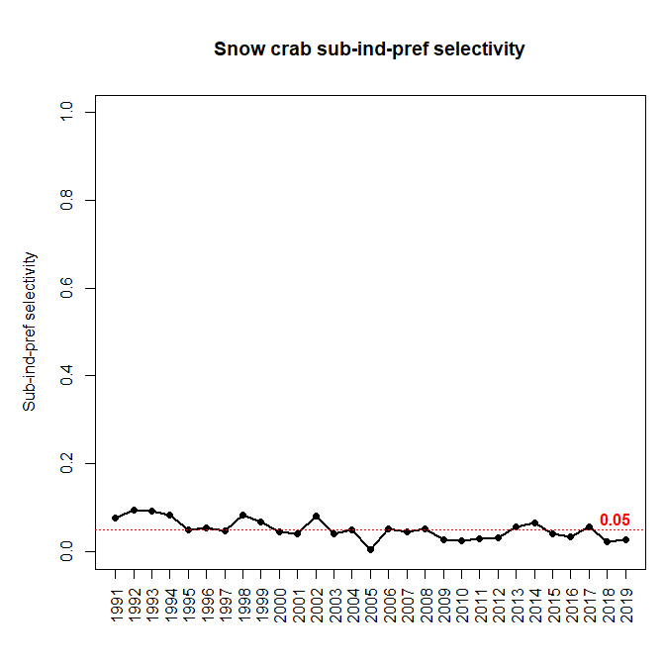
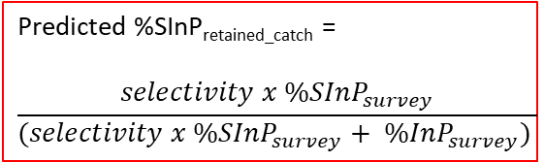
Solve for “selectivity”
Predicted %SInP_{retained_catch} =
$$\frac{{selectivity x \%SInP}_{survey}}{(selectivity x {\%SInP}_{survey}+ {\%InP}_{survey}) }$$

Slide 47
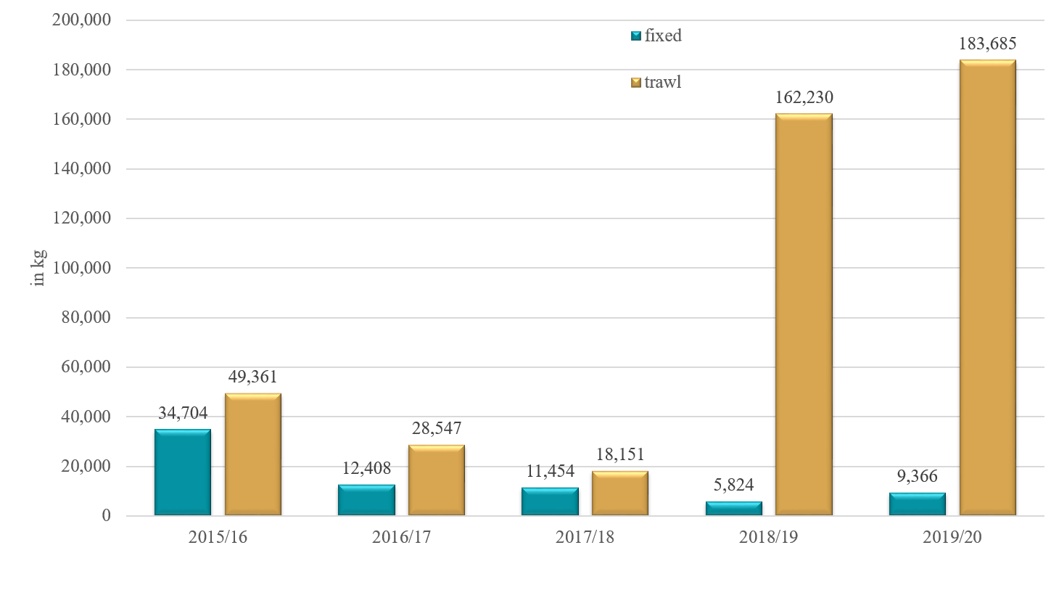
BS Snow Crab Incidental Catch in Groundfish Fisheries

Slide 48
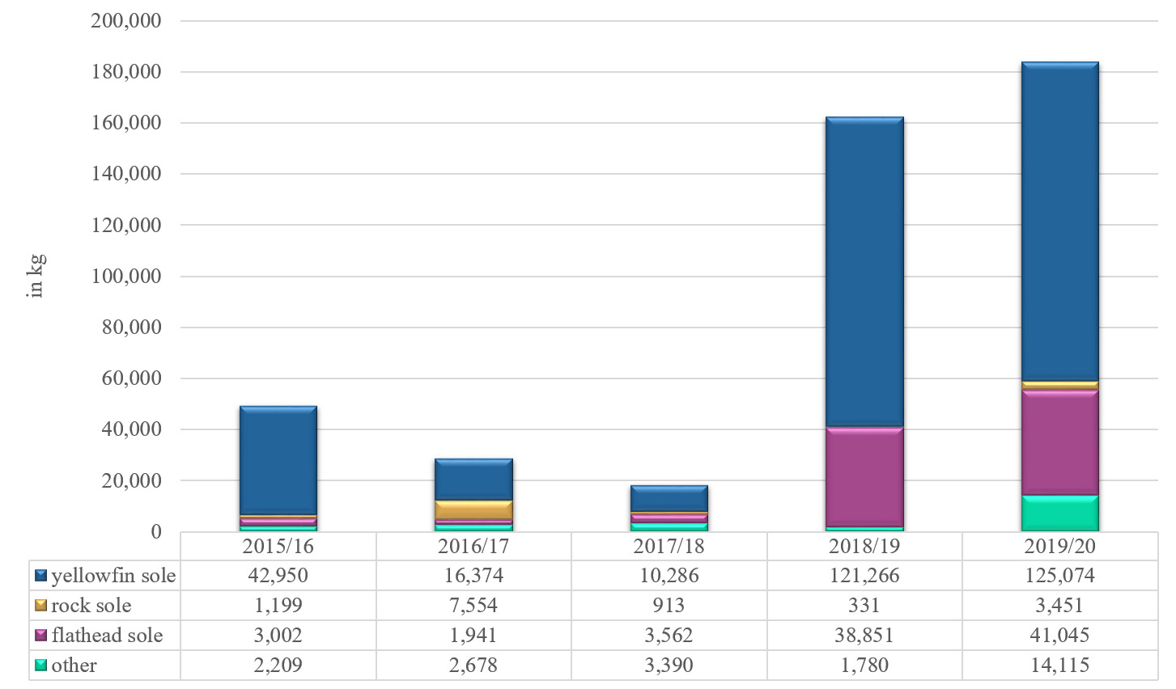
BS Snow Crab Trawl Incidental Catch by Trip Target

Slide 49
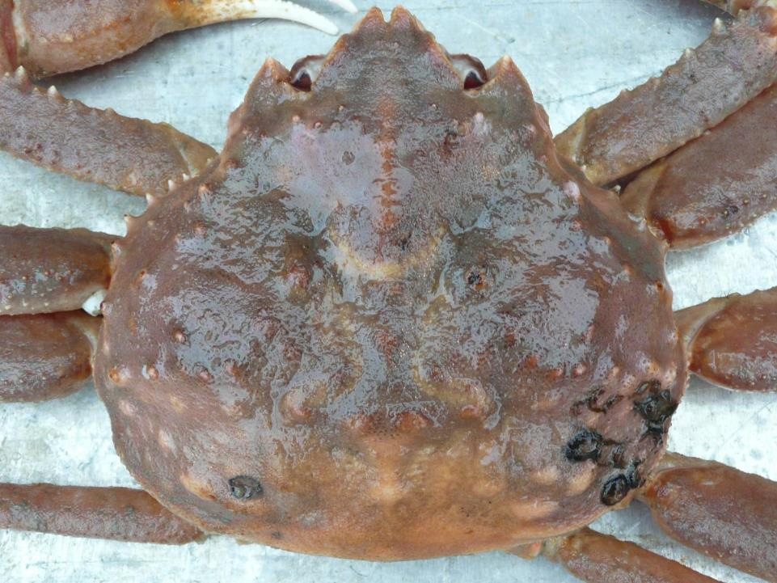
Tanner crab

Slide 50
East and west combined

Slide 51
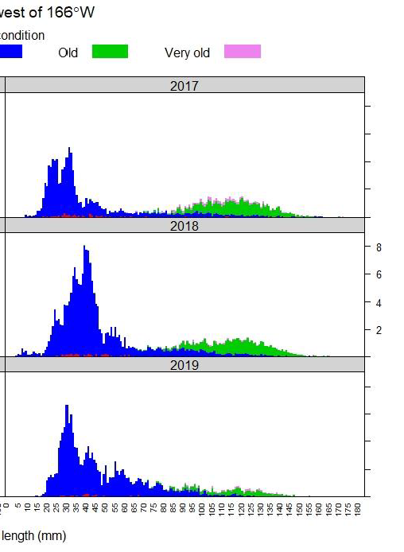
NOAA Survey
10.58 mill lb
0.45 mill lb
Hope for the future

Slide 52
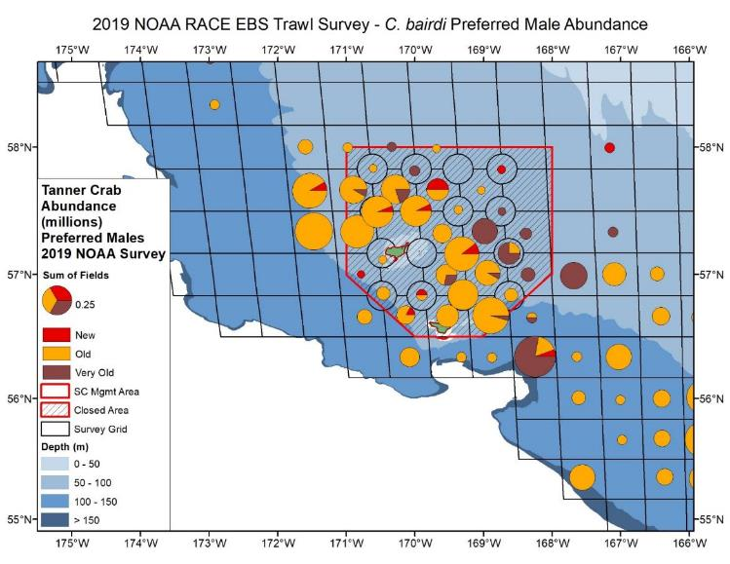
Pribilof Islands Closure Area
2019
~50% of the 5-inch crab available to fishery
NOAA Survey Data

Slide 53
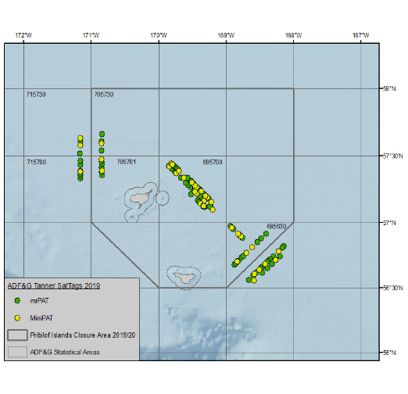
2019 Tanner satellite tag project
140 satellite tags (2 types)
Immigration/emigration rates across area closure boundaries between survey and fishery
Some lab work on behavioral effects of sat tags

Slide 54
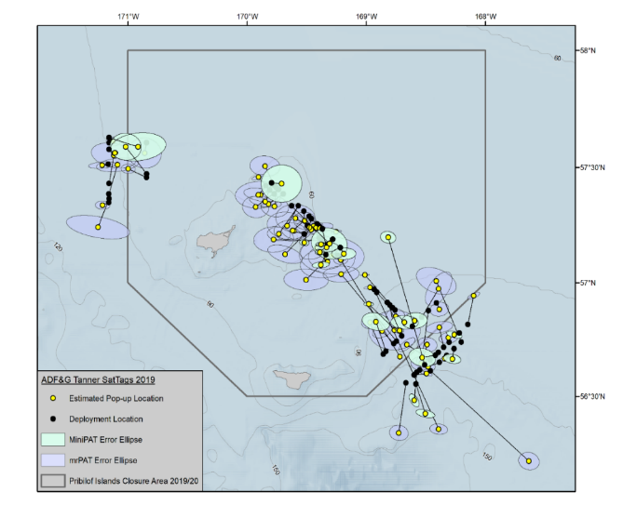
2019 Tanner satellite tag results
At liberty ~Sept-Jan
Approximates time between survey and fishery
Mean horizontal movement: 13.5 km ± 3.1 km
Mean horizontal movement rate: 0.116 km day⁻¹ ± 0.027 km day⁻¹
Error ellipses
  Argos error estimates
  Additional buffer based on estimated drift rates

Slide 55
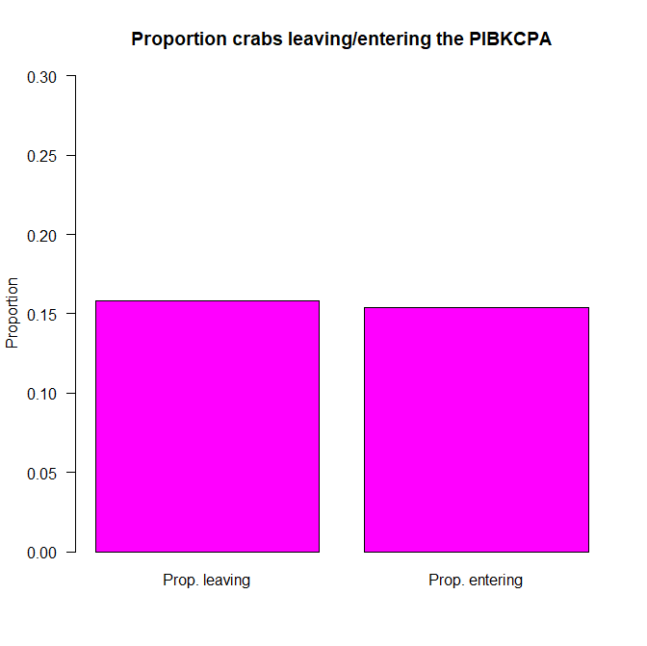

2019 Tanner satellite tag results
Along boundary, similar proportion crab entering/leaving closure area
Summer survey spatial distribution reasonable representation of the population at the time of the fishery

Slide 56
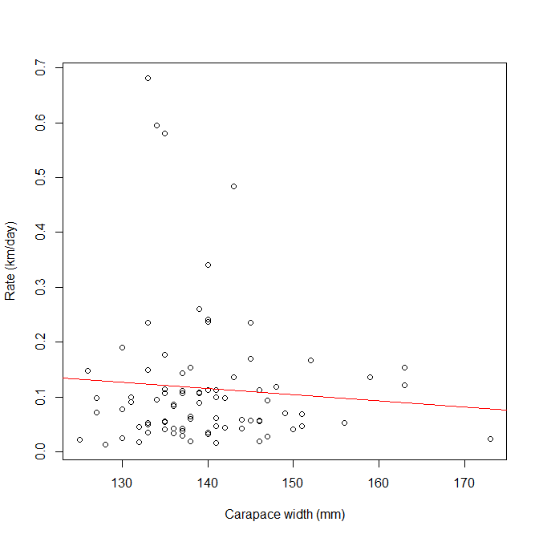
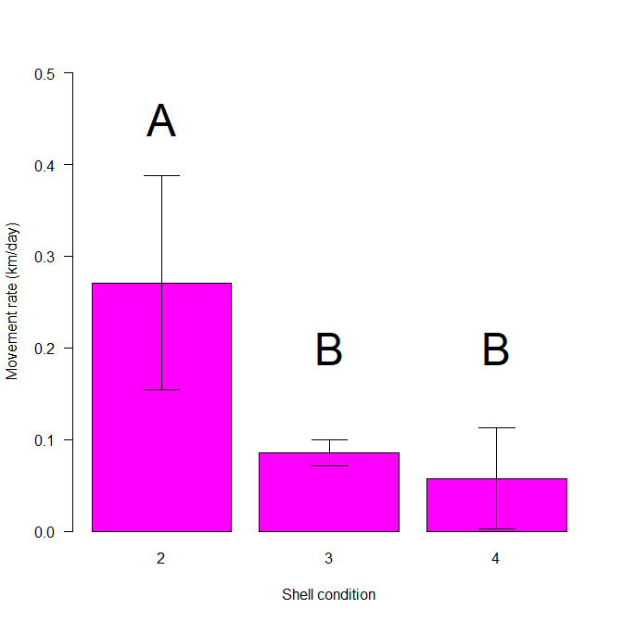
2019 Tanner satellite tag results
No relationship between movement rate and crab size
Newshell crab higher movement rate than oldshell crab

Slide 57
Showing stat areas with 3+ vessel participation

Slide 58
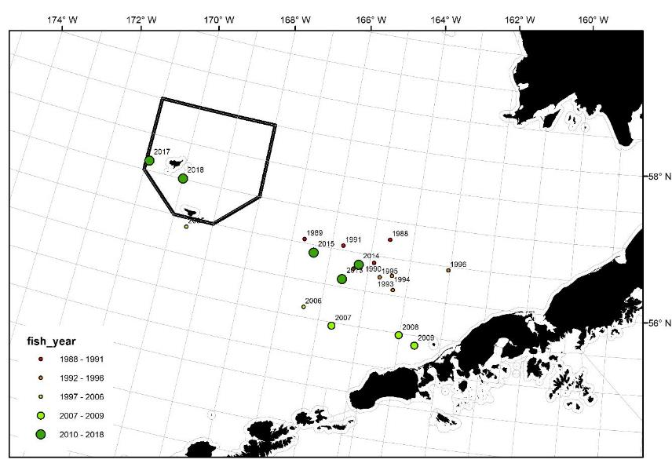
Tanner crab weighted mean centers of catch

Slide 59
2018/19 WBT observations from the fleet
Observed vessel CPUE ranged from 9 to 91.5.
Captains reported slow fishing in November (after finishing RKC), but fishing improved for vessels that waited to fish until February/March (after finishing BSS).
Fishing was spotty in general compared to 2017/18 season.

Slide 60
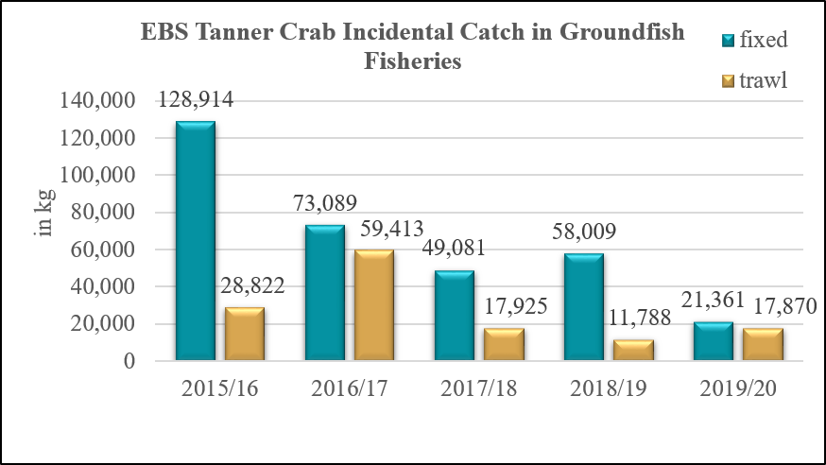
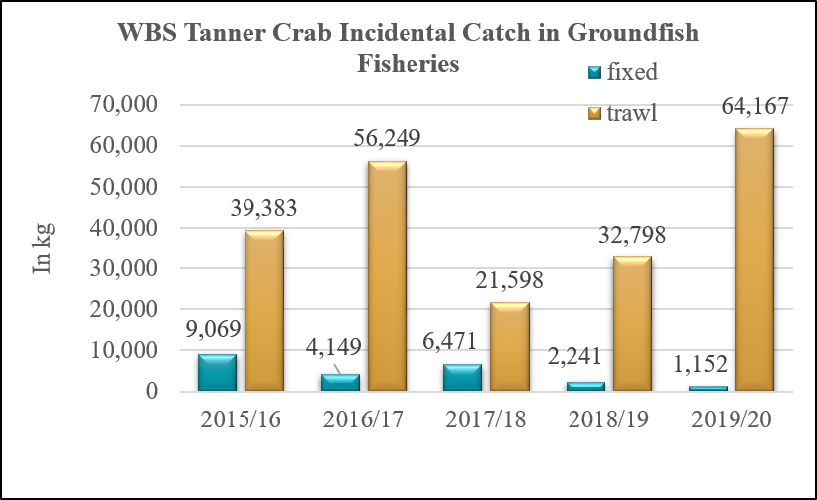
Eastern Bering Sea (EBS) Tanner crab is East of 166° W
Western Bering Sea (WBS) Tanner crab is West of 166° W

Slide 61
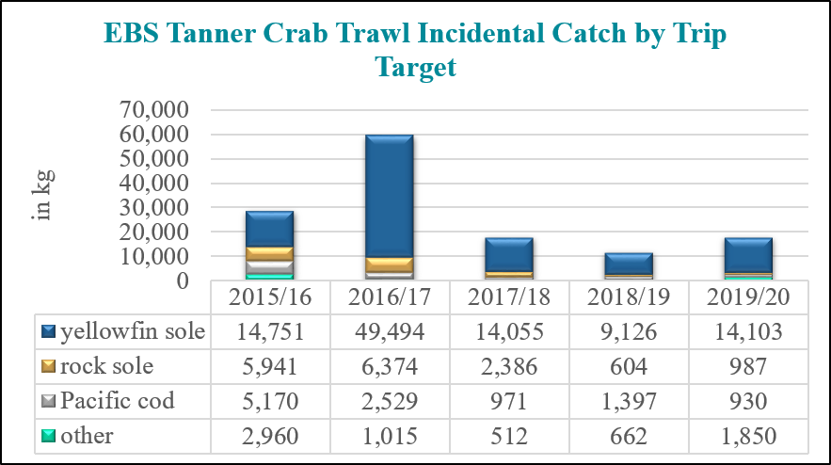
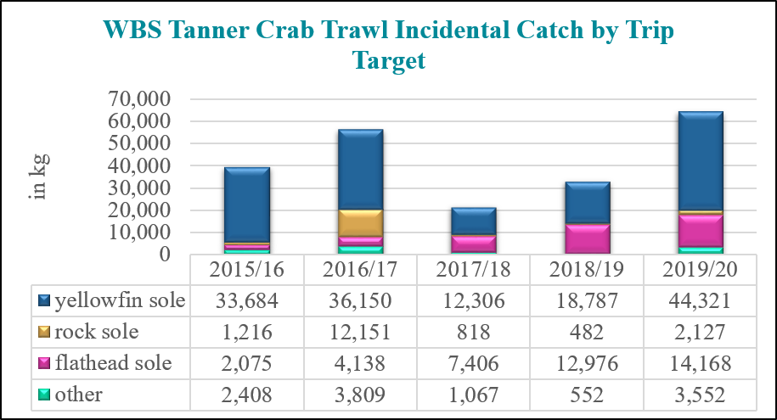
Eastern Bering Sea (EBS) Tanner crab is East of 166° W
Western Bering Sea (WBS) Tanner crab is West of 166° W

Slide 62
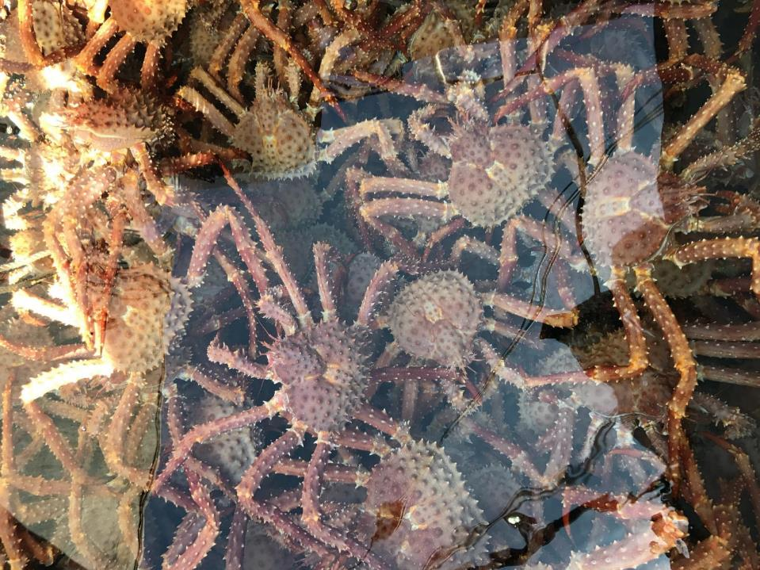
AIGKC

Slide 65
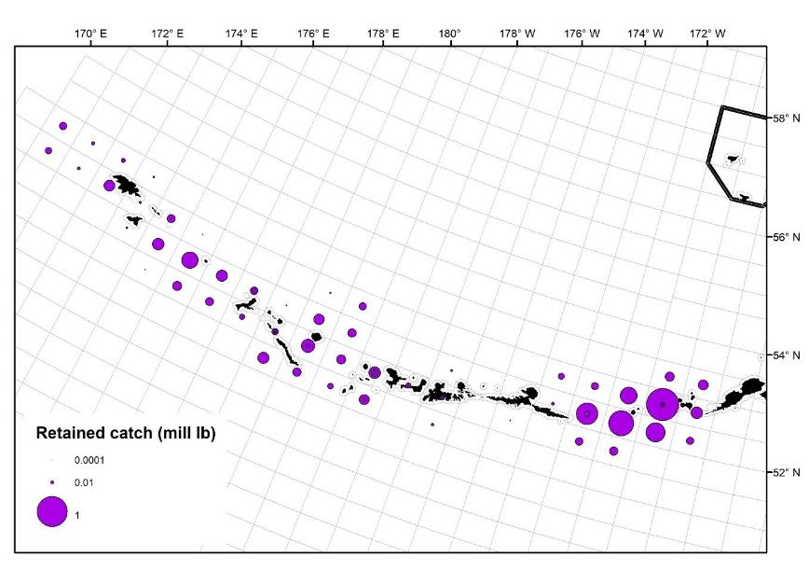
2019/20 Harvest Spatial Distribution

Slide 66
2019/20 AIGKC

Slide 67
2018/19 AIGKC observations from the fleet
EAG
All vessels reported exceptional fishing over the course of the season.
Some concern over the small average weight (4.08 lbs 2018/19).
  Lots of crab right at legal size (6 inches).
WAG
All vessels reported exceptional fishing over the course of the season.
Winter weather was severe and limited the number of days that some vessels could operate.

Slide 68
Bycatch mortality: area specific

Slide 69
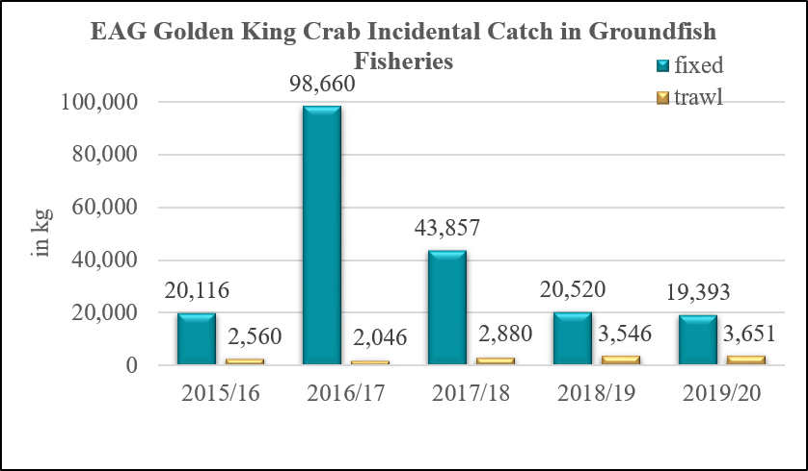
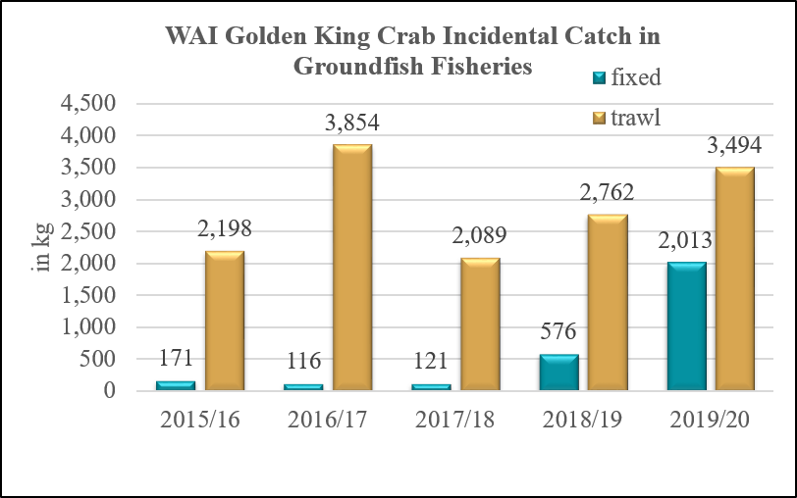
Eastern Aleutian Islands (EAI) Golden king crab is East of 174° W
Western Aleutian Islands (WAI) Golden king crab is West of 174° W

Slide 70
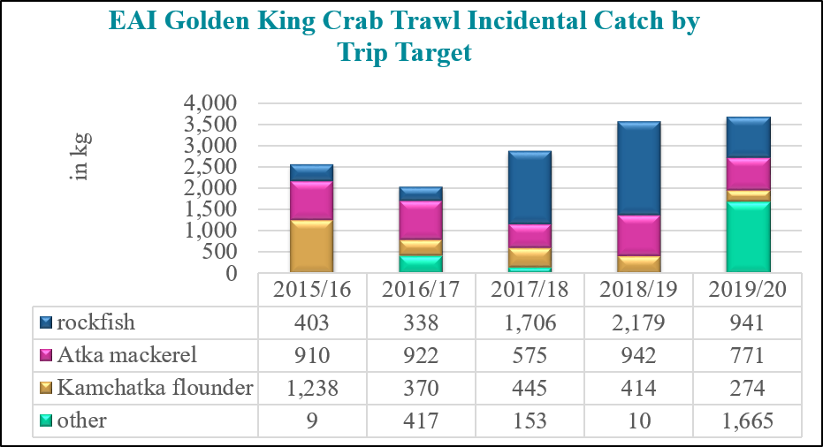

Eastern Aleutian Islands (EAI) Golden king crab is East of 174° W
Western Aleutian Islands (WAI) Golden king crab is West of 174° W

Slide 71

PIGKC

Slide 72
2018 + 2019 Pribilof GKC
Fishery conducted by calendar year
Specific catch numbers + spatial data confidential
  Waivers from vessels but not processors
1 vessel participated in the 2018 fishery
  GHL = 130,000 lb (59 t) was not achieved
2 vessels participated in the 2019 fishery
  GHL = 130,000 lb (59 t) was achieved

Slide 73
Observer pot location during Bering Sea golden king crab fisheries from 1992-2019 (n=7,402).
Pots north of the Pribilof District northern boundary were fished during the Northern District – Saint Matthew island Section fishery.
~95% of all observer pots

Slide 74
Proportion of historical catch by stat_area
69% of all historical catch

Slide 75

Pribilof Island Golden King Crab Incidental Catch in Groundfish Fisheries

Slide 76

Pribilof Island Golden King Crab Trawl Incidental Catch by Trip Target

Slide 77
Other BSAI crab stocks

Slide 78

Pribilof Islands Red King Crab Incidental Catch in Groundfish Fisheries

Slide 79

Pribilof Islands Red King Crab Trawl Incidental Catch by Trip Target

Slide 80


Incidental crab catch for overfished stocks
Overfishing occurred in the Pribilof Island blue king crab fishery in the 2015/16 season
No other overfishing has occurred since 2015/16 for either stock

Slide 81

Pribilof Islands Blue King Crab Trawl Incidental Catch by Trip Target

Slide 82

Norton Sound Red King Crab Incidental Catch in Groundfish Fisheries
2009 – 2017: no RKC bycatch in NSRKC stock area
In 2018: 8 kg of RKC bycatch (mortality applied)
In 2019: 13 kg of RKC bycatch (mortality applied)

Slide 83





Slide 84





Slide 85

Thank you
Photo courtesy of Sam Zmolek

