Slide 1
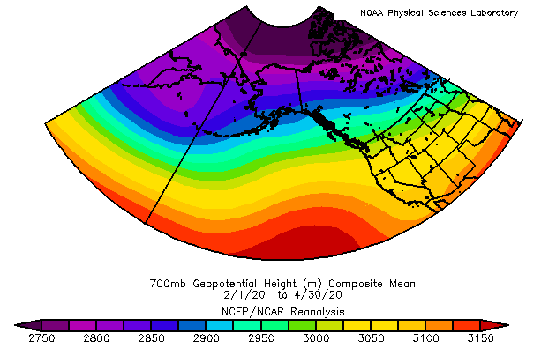

ECOSYSTEM STATUS REPORT
Elizabeth Siddon
Bridget Ferriss
Ivonne Ortiz
Stephani Zador
Kerim Aydin
NPFMC Crab Plan Team
September 14, 2020

Slide 2
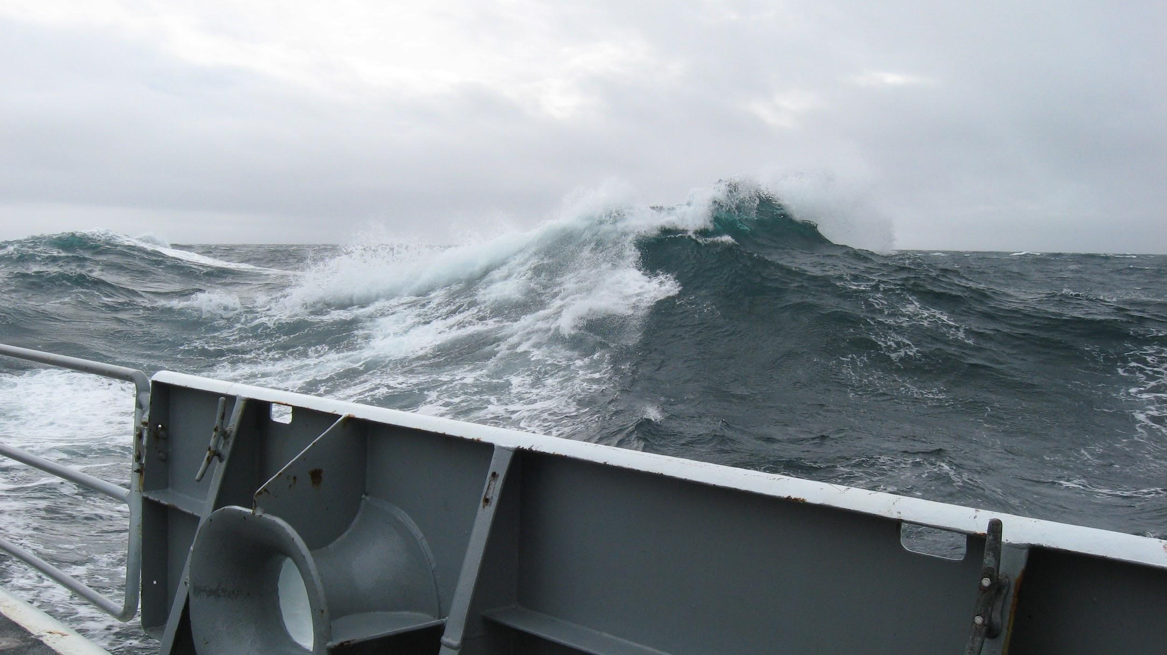
2019 crab-relevant information (review)
2020 climate and oceanography
2021 sea surface temperature forecasts

Slide 3
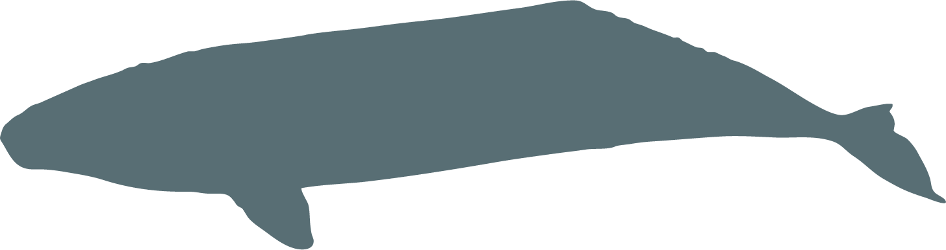



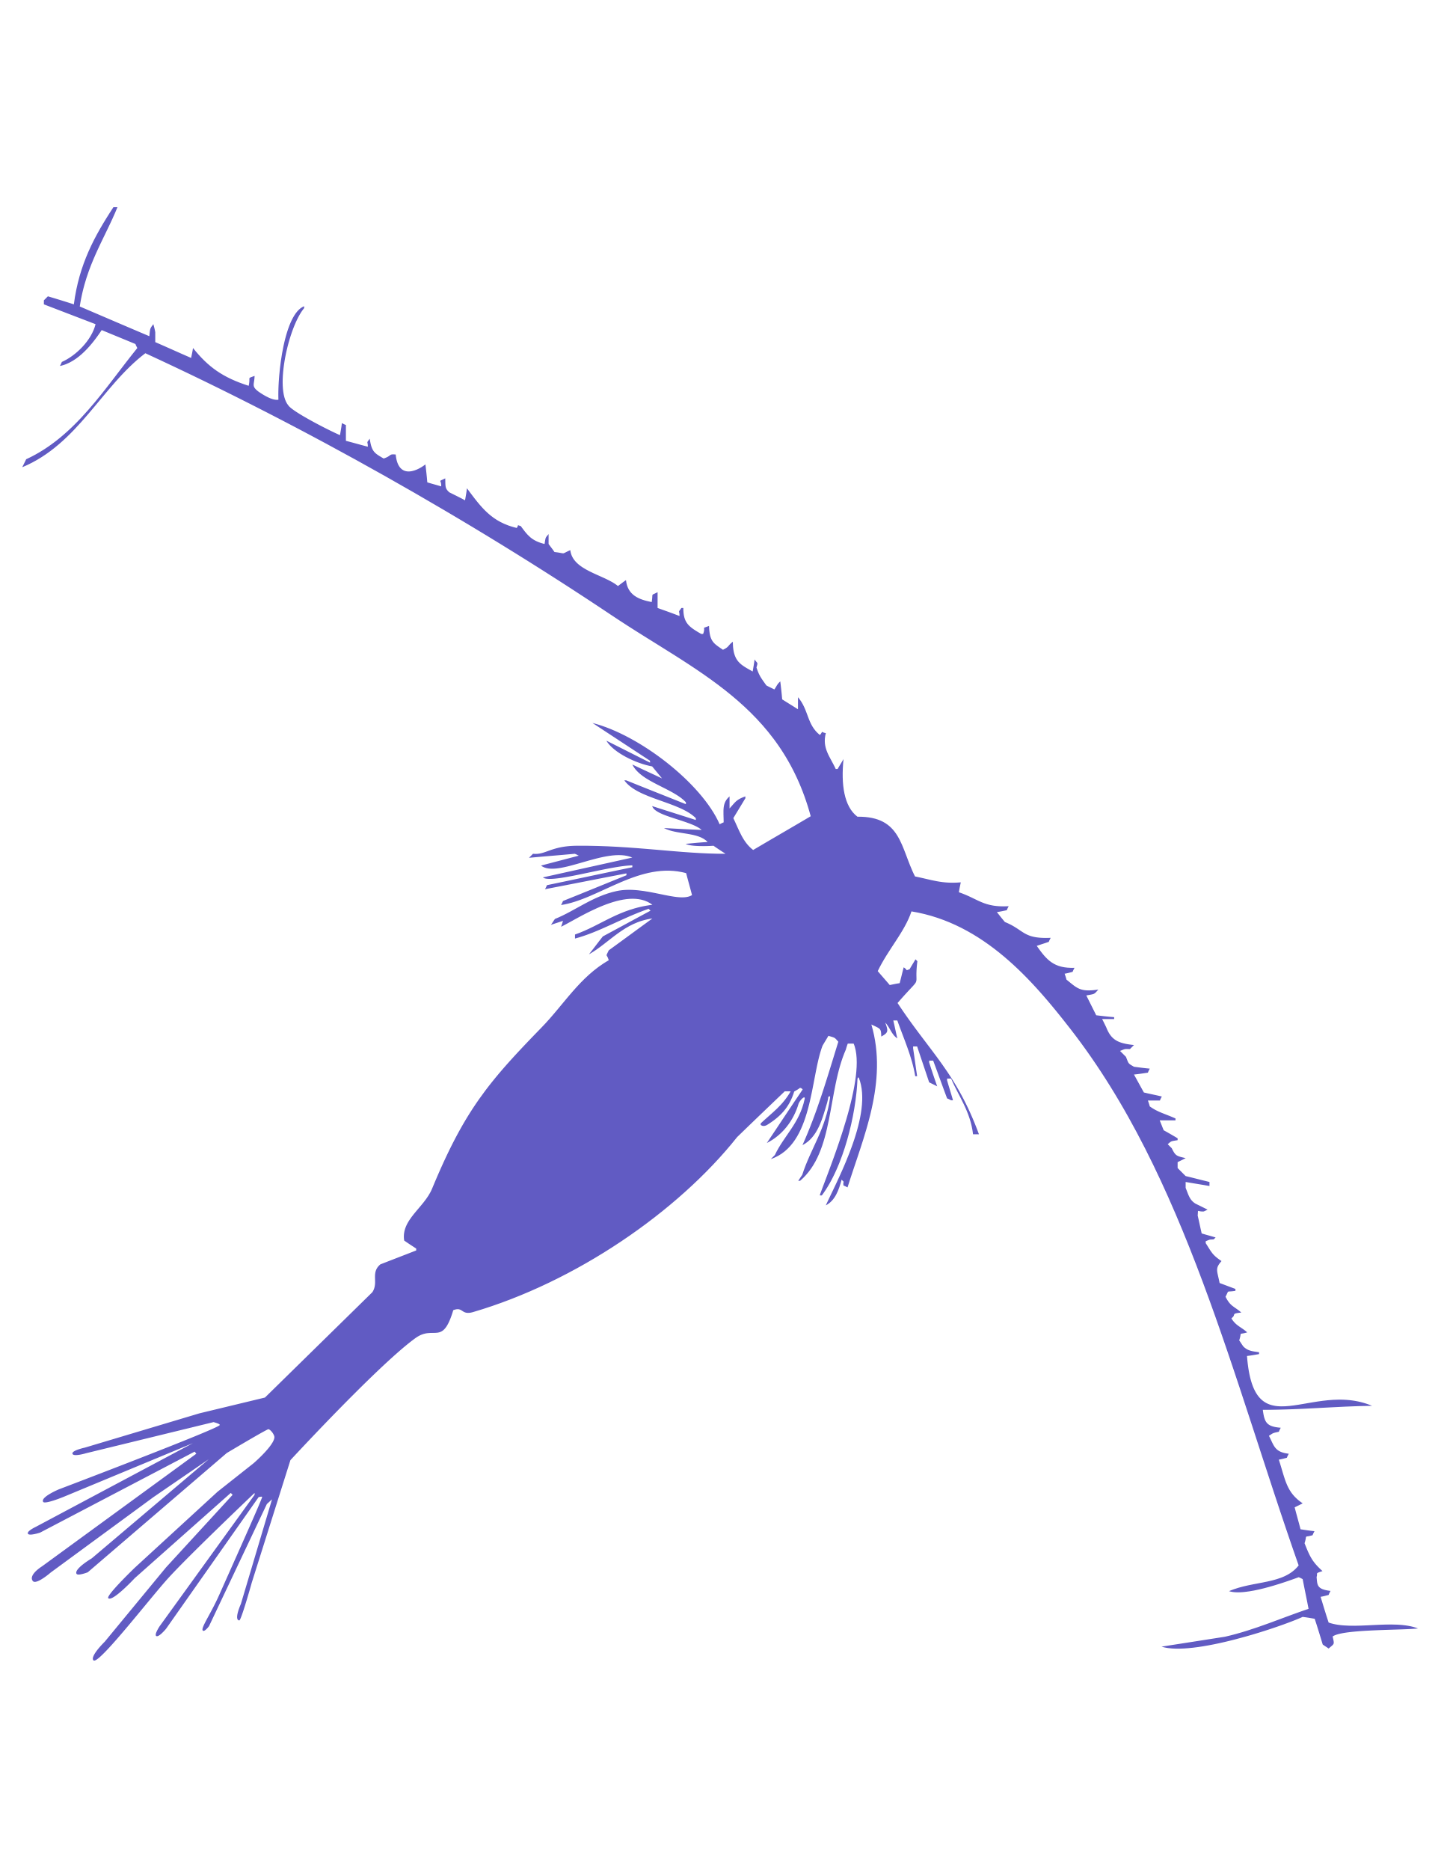
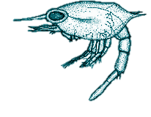
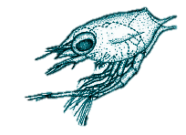
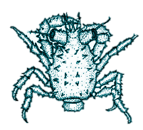





2019 pelagic larval indicators
PREDATORS
COMPETITORS
PREY
ENVIRONMENTAL PROCESSES
Notes:
Competitors for food and space/habitat (displacement)
Some of these can be overlapping impacts. Ex: Competitors can also create prey (facilitate detritus)

Slide 4


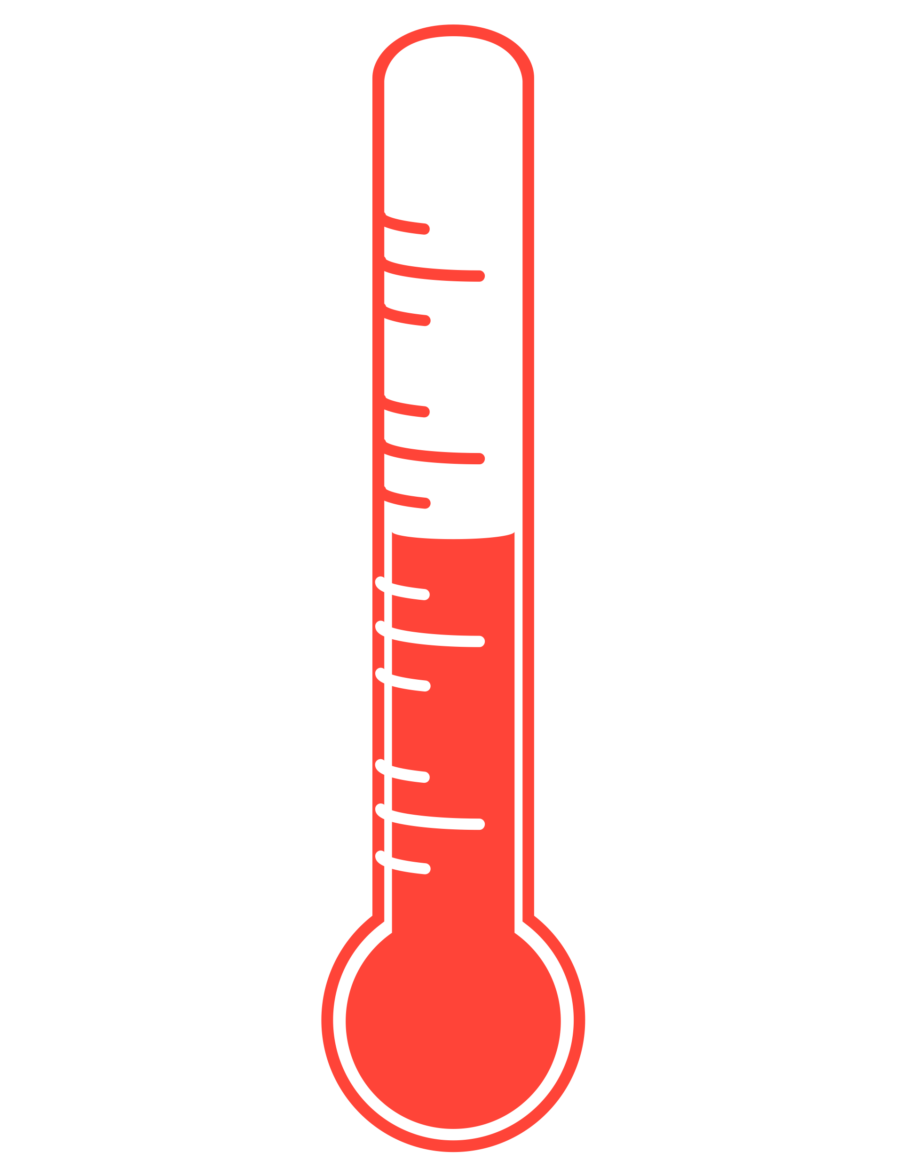
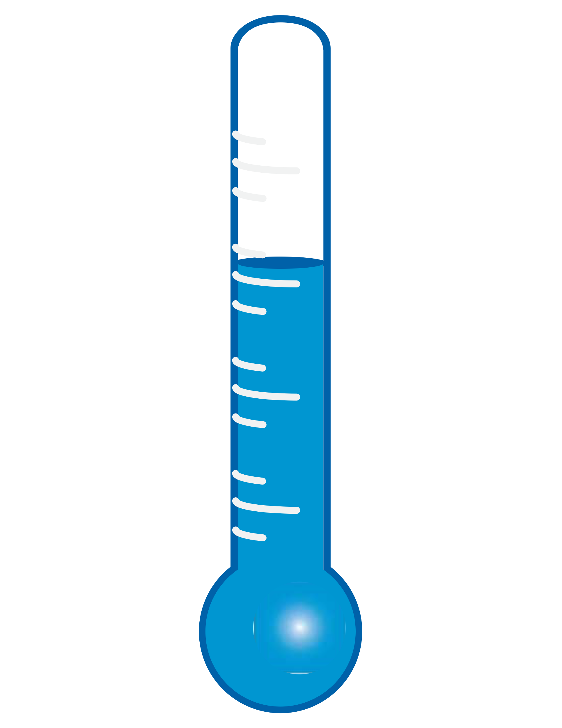






2019 benthic adult
indicators
PREDATORS
COMPETITORS
PREY
ENVIRONMENTAL PROCESSES

Slide 5
ENVIRONMENTAL PROCESSES

Slide 6
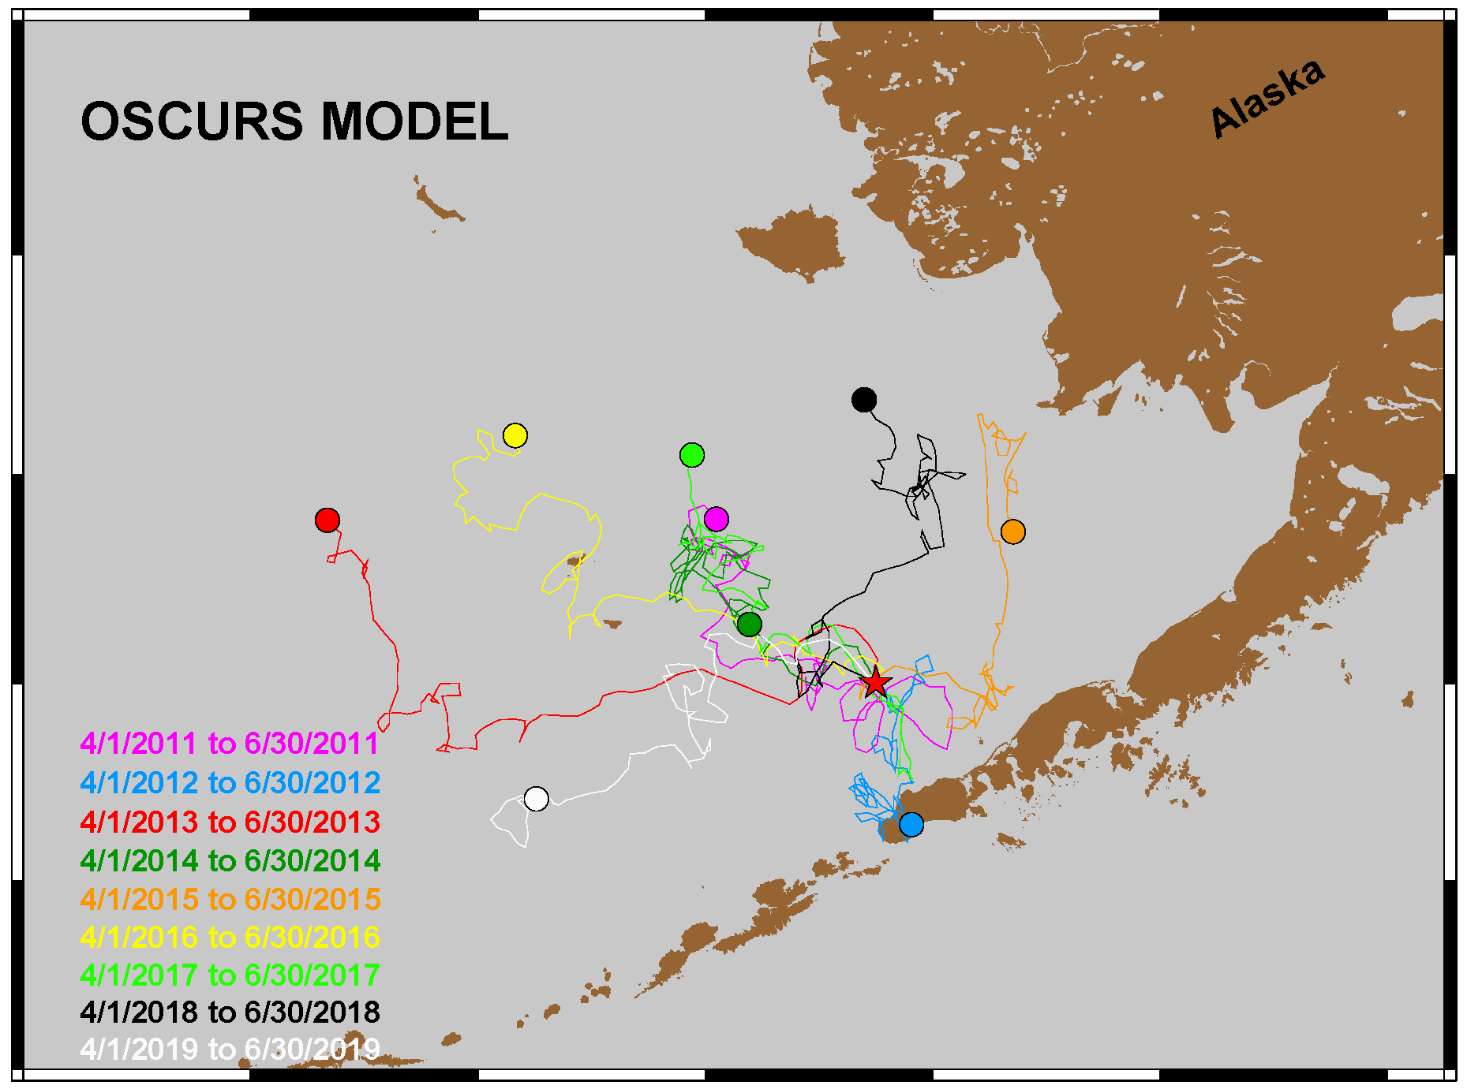
2019 Environmental Processes
Wilderbuer
The 2019 drift pattern (WHITE) had consistent westerly winds during the period April 1 through June 30.

Slide 7
2019 Environmental Processes
Wilderbuer
The 2019 drift pattern (WHITE) had consistent westerly winds during the period April 1 through June 30.
OSCURS correlates with recruitment success of winter-spawning flatfish; westerly winds are unfavorable for N. rock sole, Arrowtooth flounder, and Flathead sole.
Notes:
Flatfish are predators on settled life stages.

Slide 8
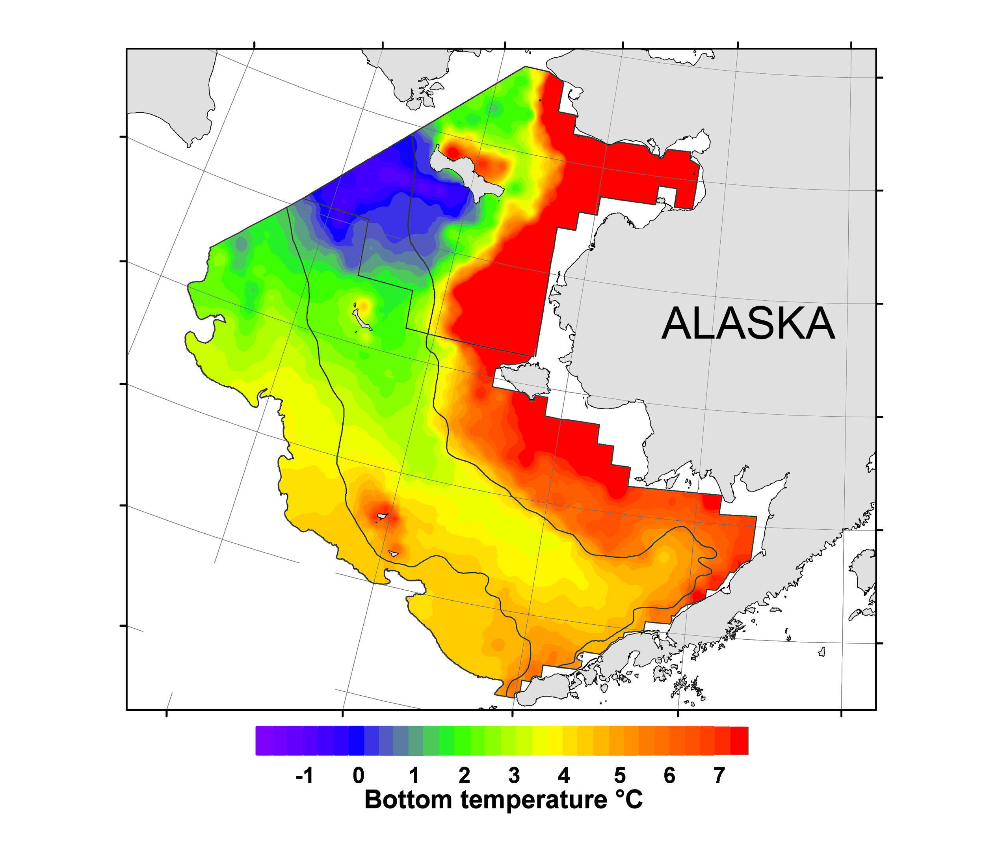
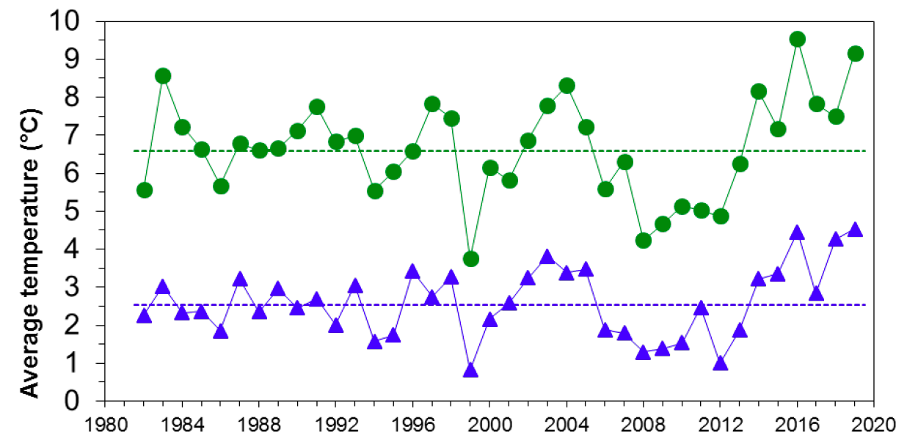
2019 Environmental Processes
Britt

Slide 9
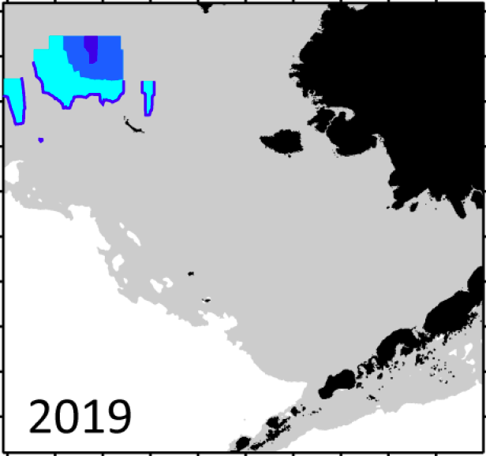
2019 Environmental Processes
Britt
A small cold pool was present over the northern shelf in 2019.

Slide 10
PREY

Slide 11
?
PREY

Slide 12
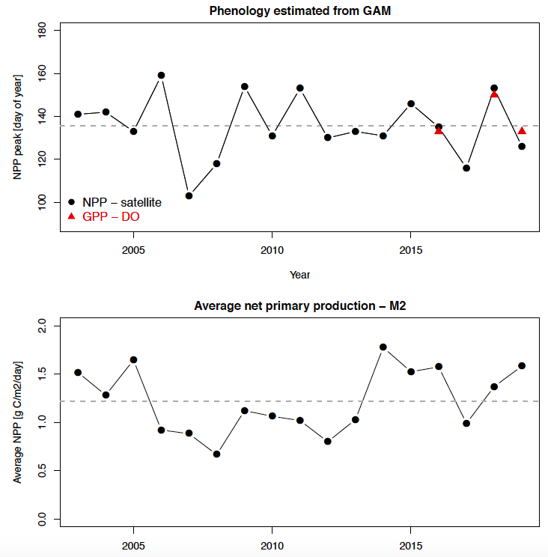
2019 Prey
Nielsen
Timing of the spring bloom
Spring bloom earlier than the long-term average.
Above-average net primary production.
Day of Year
Magnitude of the spring bloom
Average NPP
Notes:
Erin will show satellite estimate for 2020 (chla, no phenology)

Slide 13
COMPETITORS
Notes:
Competitors for food and space/habitat (displacement)
Some of these can be overlapping impacts. Ex: Competitors can also create prey (facilitate detritus)

Slide 14
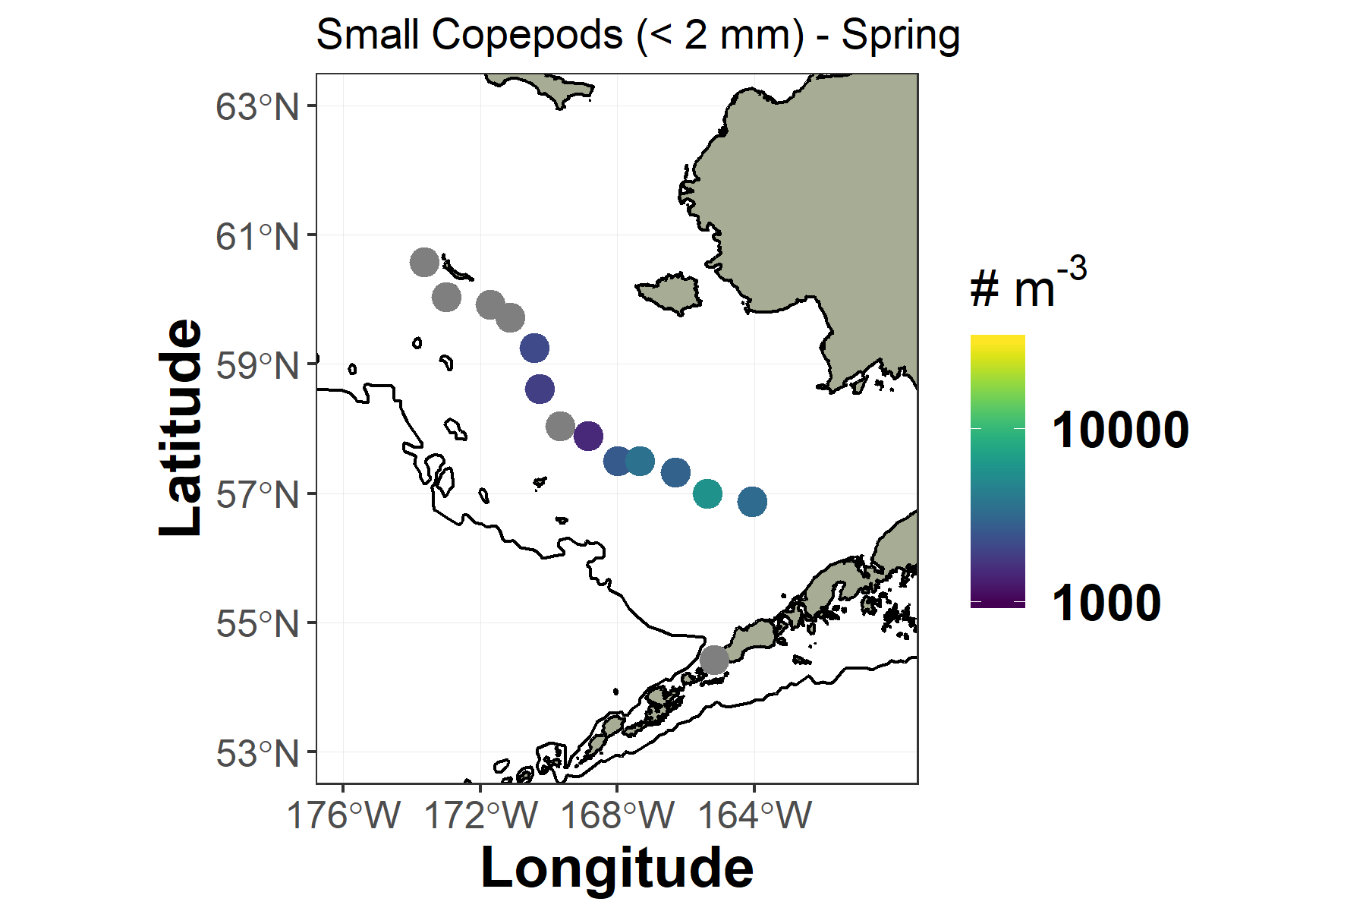
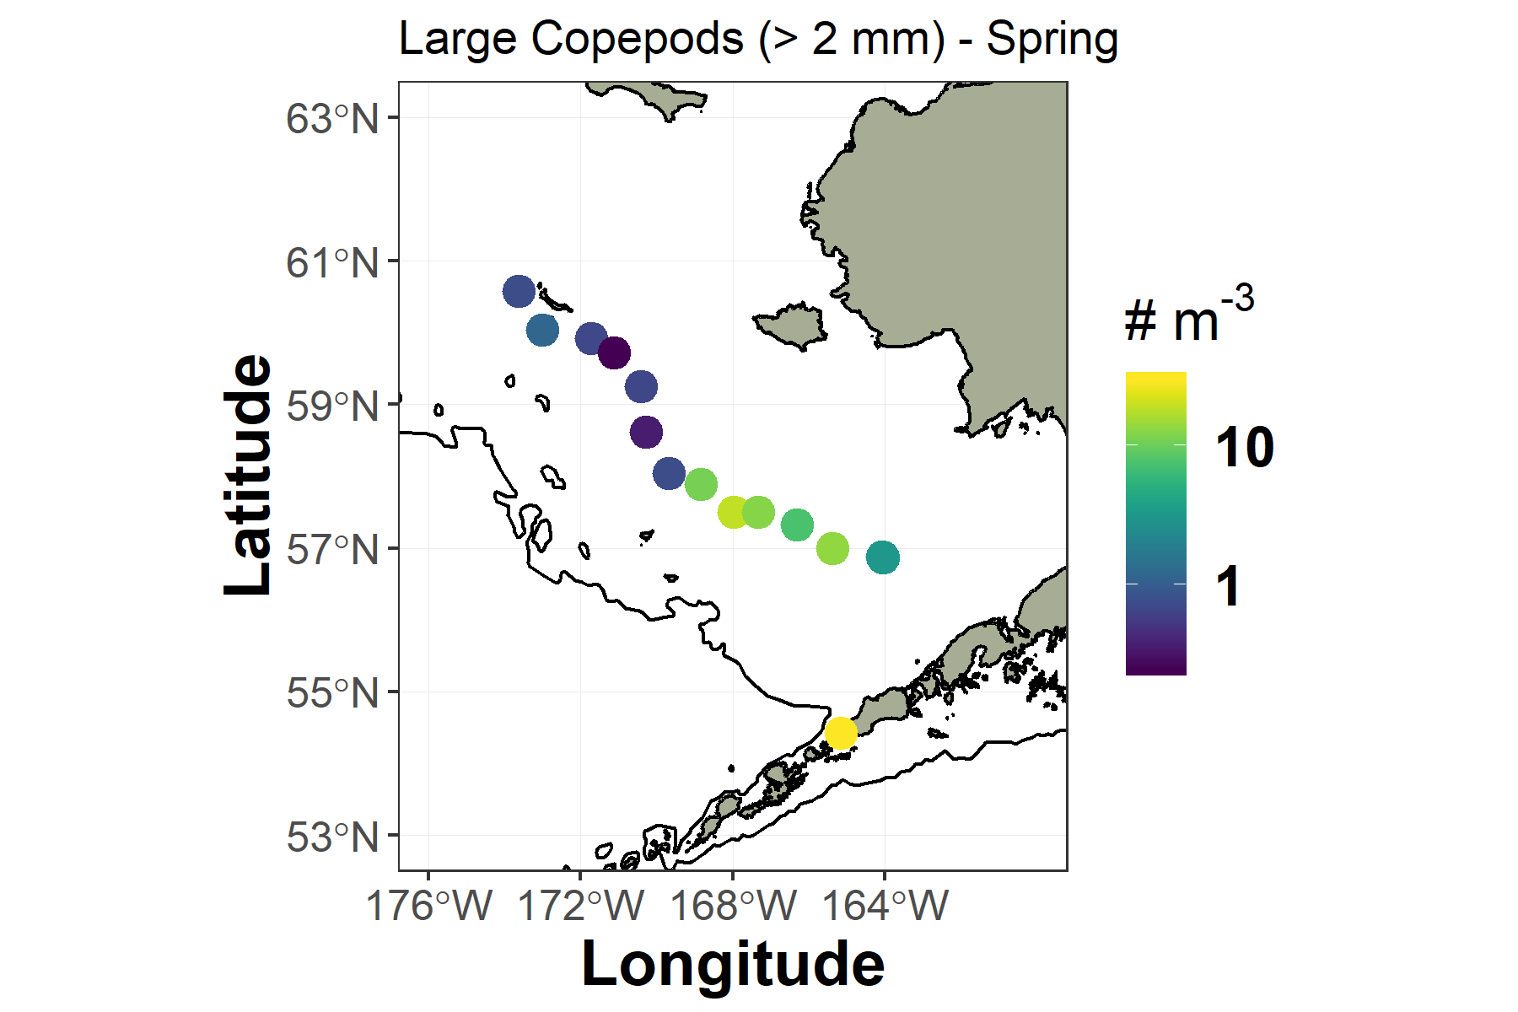
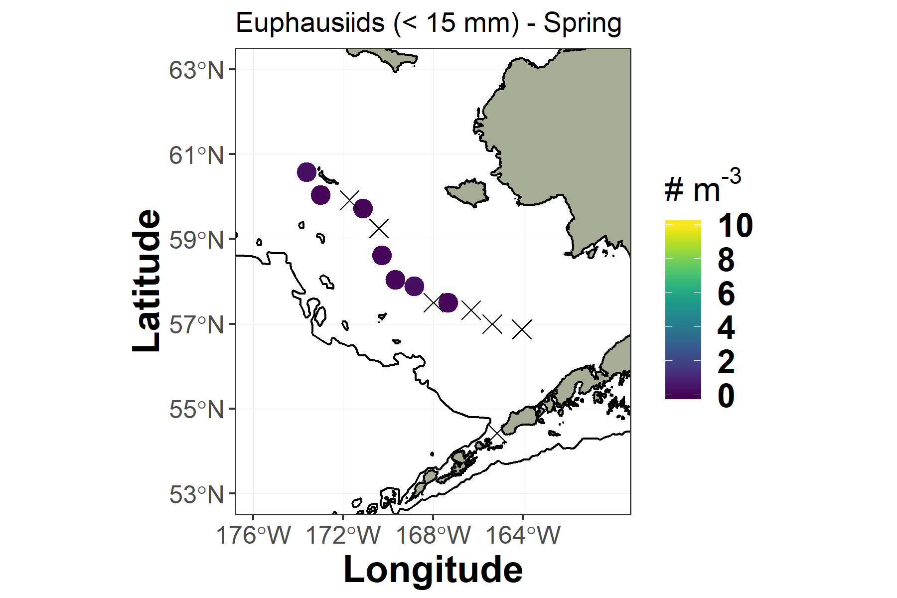
2019 Zooplankton
Kimmel
The spring zooplankton community was dominated by small copepods, had few large (lipid-rich) copepods, and euphausiids were near-absent.

Slide 15
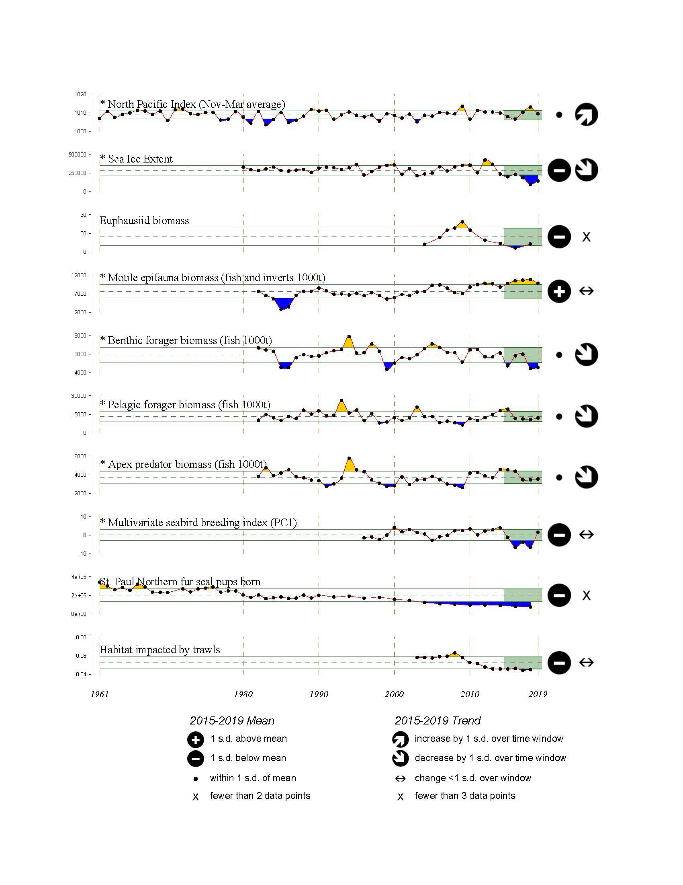
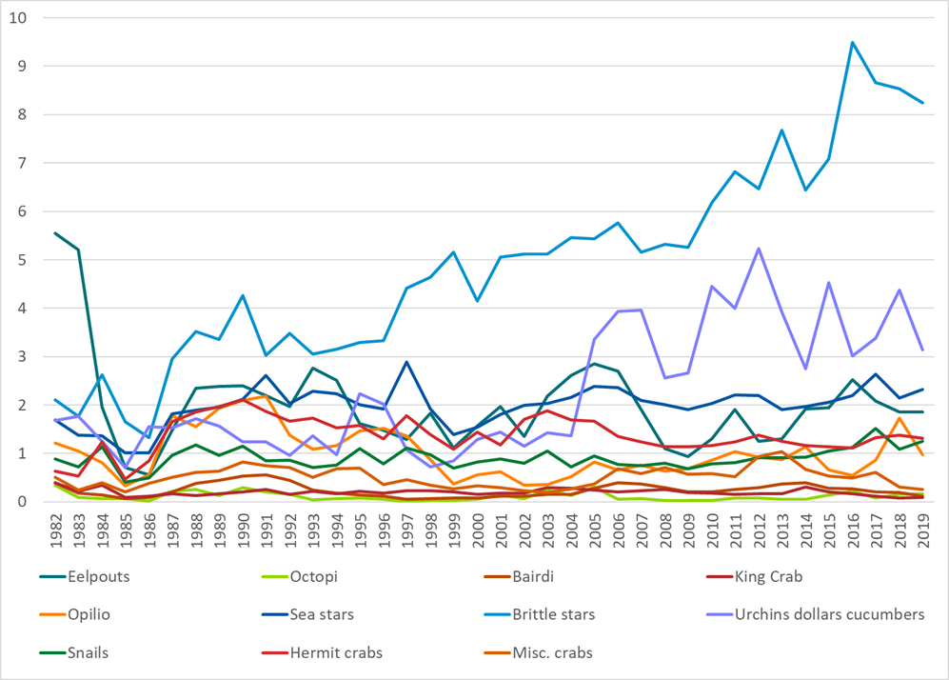
2019 Motile Epifauna
Motile epifauna biomass was above the long-term mean, but decreased 10% from 2018 to 2019.
The decrease was due to brittle stars (-3%) and urchins, sand dollars, and cucumbers (-28%); both groups remain above their long-term means.
Brittle stars →
Urchins, dollars, and cukes
Notes:
Competitors to adults for prey and space

Slide 16
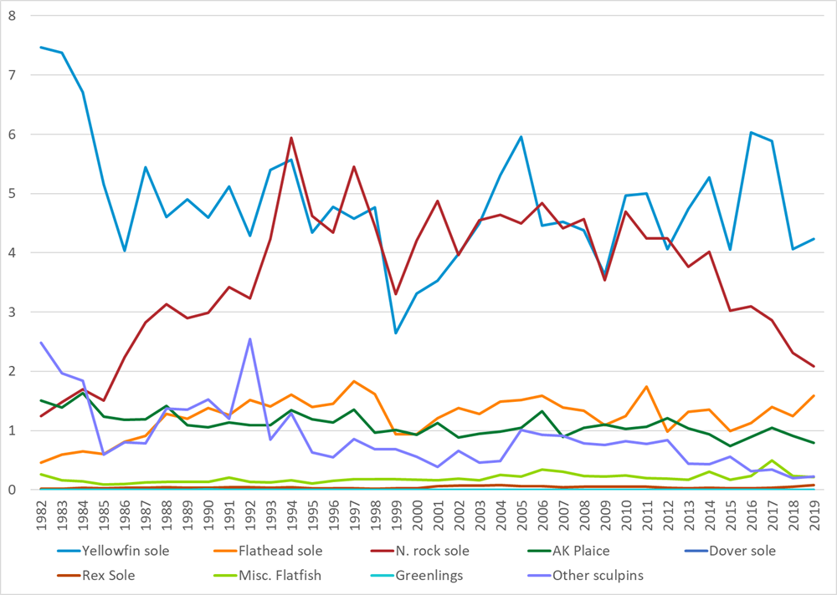
2019 Benthic
Foragers
Benthic foragers remained low in 2019.
Yellowfin sole and N. rock sole were below their long-term means.
N. rock sole have declined since 2010 and decreased 10% from 2018 to 2019.
Yellowfin →
N. rock sole →
Notes:
Competitors to adults for prey

Slide 17
PREDATORS

Slide 18
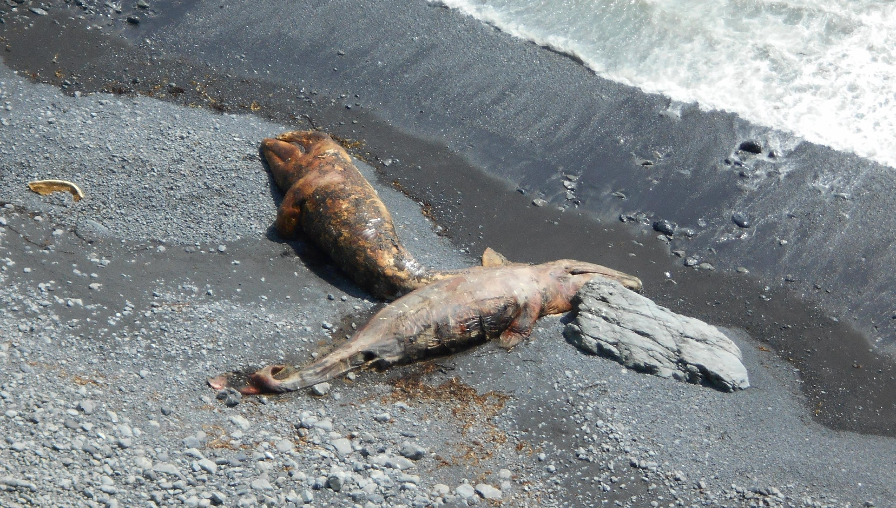
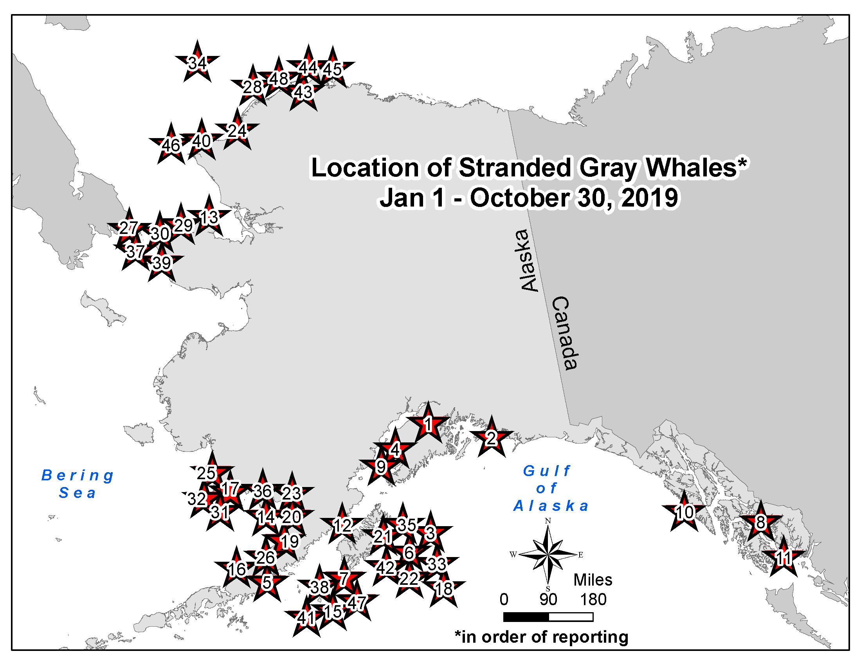
2019 Gray Whale
Unusual Mortality Event
Savage
Brent Pristas
Kodiak Is.
July 3, 2019
Gray Whale Strandings in 2019
Canada | 10
US Total | 122
Alaska - 48
Washington - 34
Oregon - 6
California - 34
Mexico | 81
Total | 213
What do gray whales
have to do with crab?

Slide 19
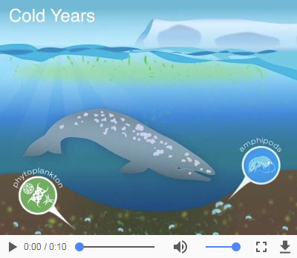
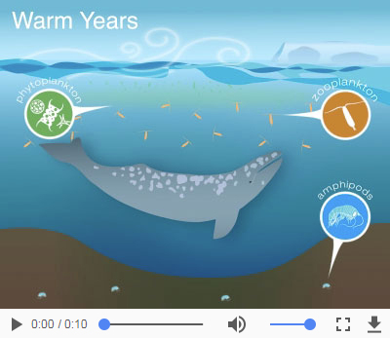
2019 Gray Whale
Unusual Mortality Event
Savage
Preliminary necropsy results showed evidence of emaciation.
May reflect summer and fall feeding conditions in the Bering and Chukchi Seas.
Gray whales feed on amphipods, mysids, and larval crab, possibly more so in warm years.
Cold years
Warm years

Slide 20
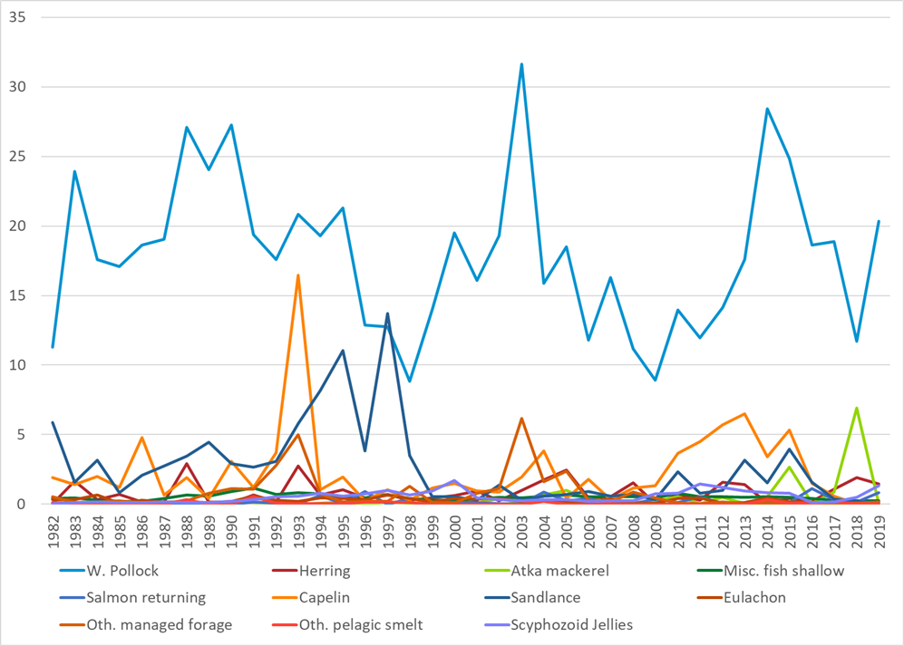
2019 Pelagic
Foragers
Pelagic foragers increased 13% from 2018 to 2019, but are below the long-term mean.
Pollock increased 74% and Jellyfish 164%.
Pollock →
Notes:
Pelagics are predators of larvae, but may also create prey for adults via detritus.

Slide 21
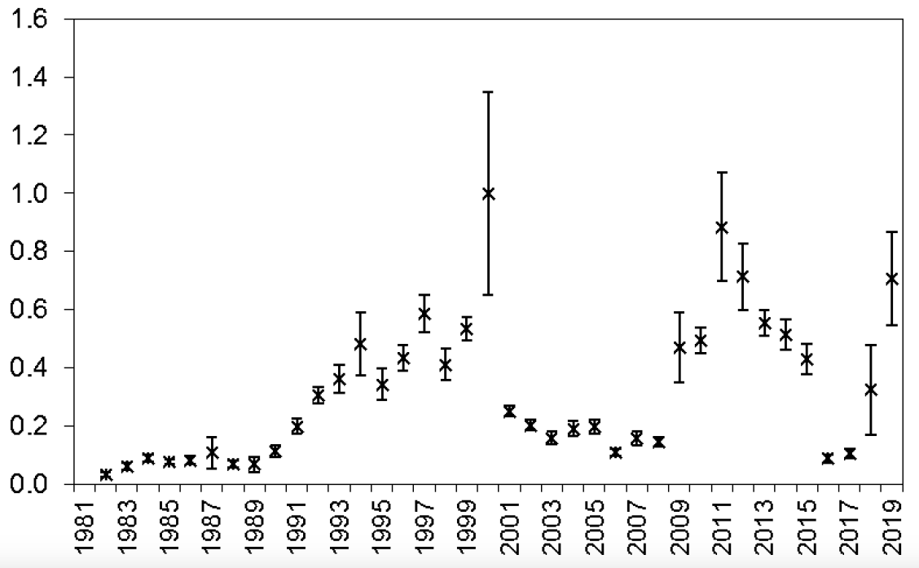
2019 Pelagic
Foragers
Jellyfish
Pelagic foragers increased 13% from 2018 to 2019, but are below the long-term mean.
Pollock increased 74% and Jellyfish 164%.

Slide 22
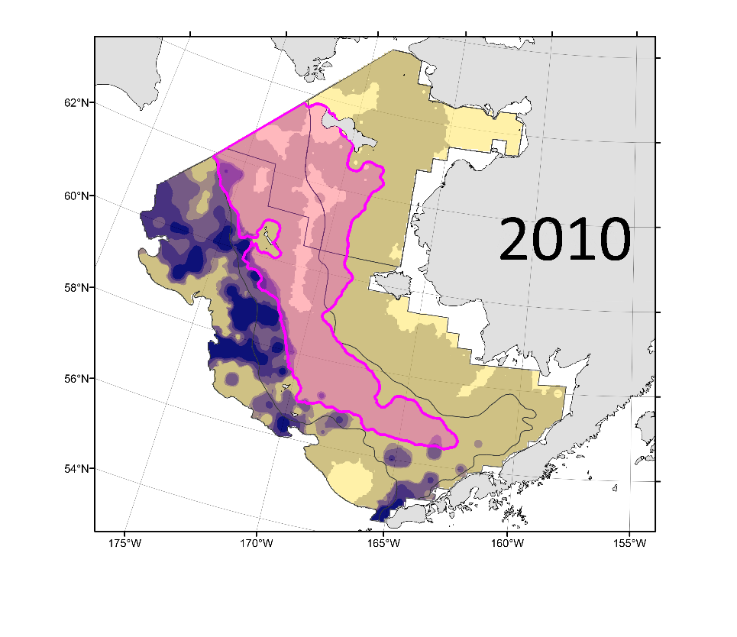
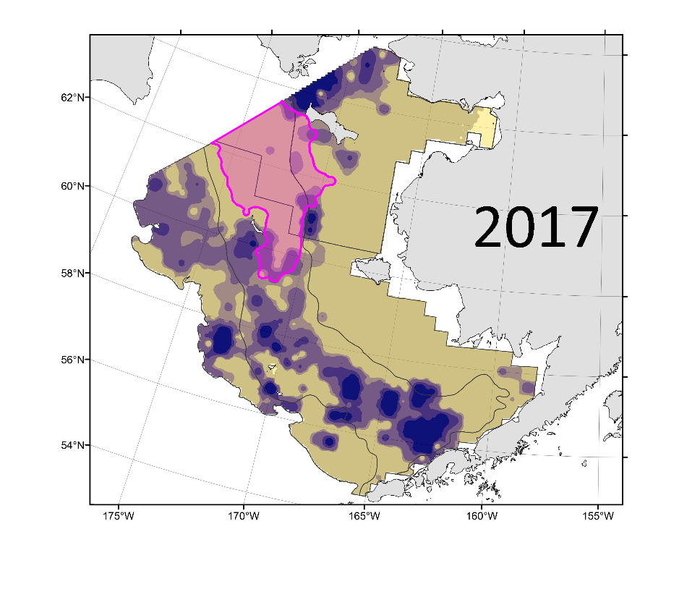
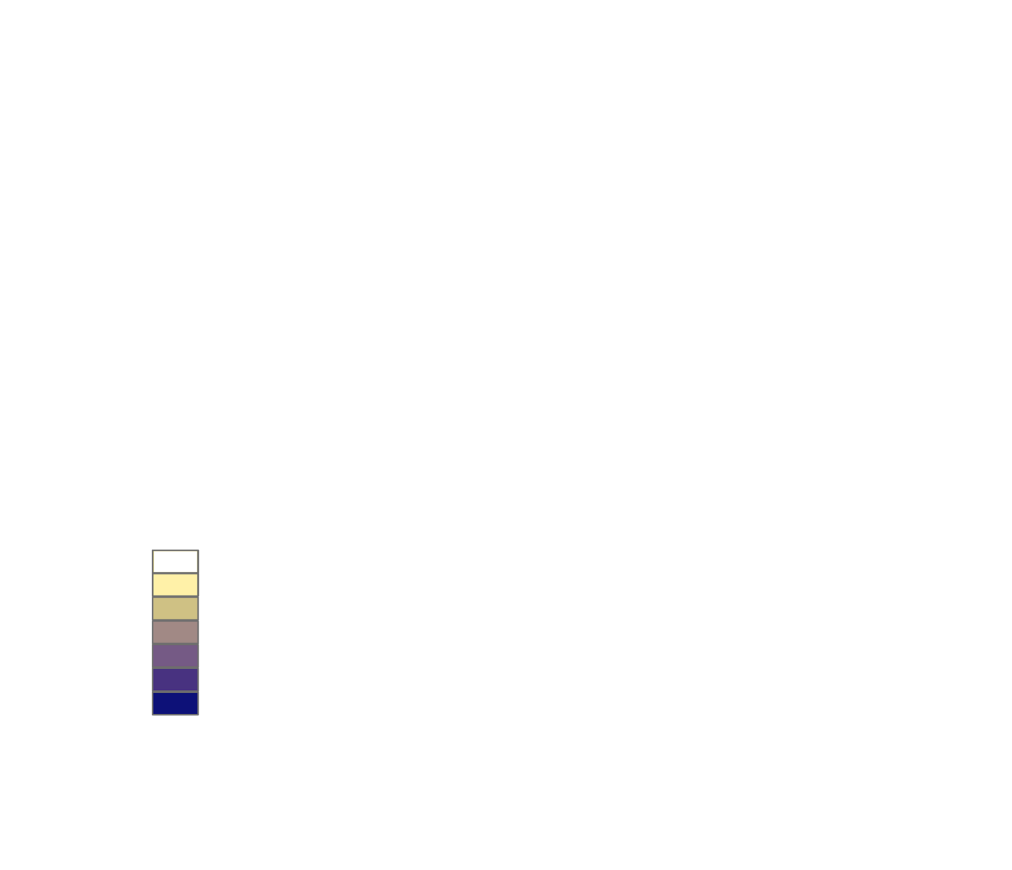
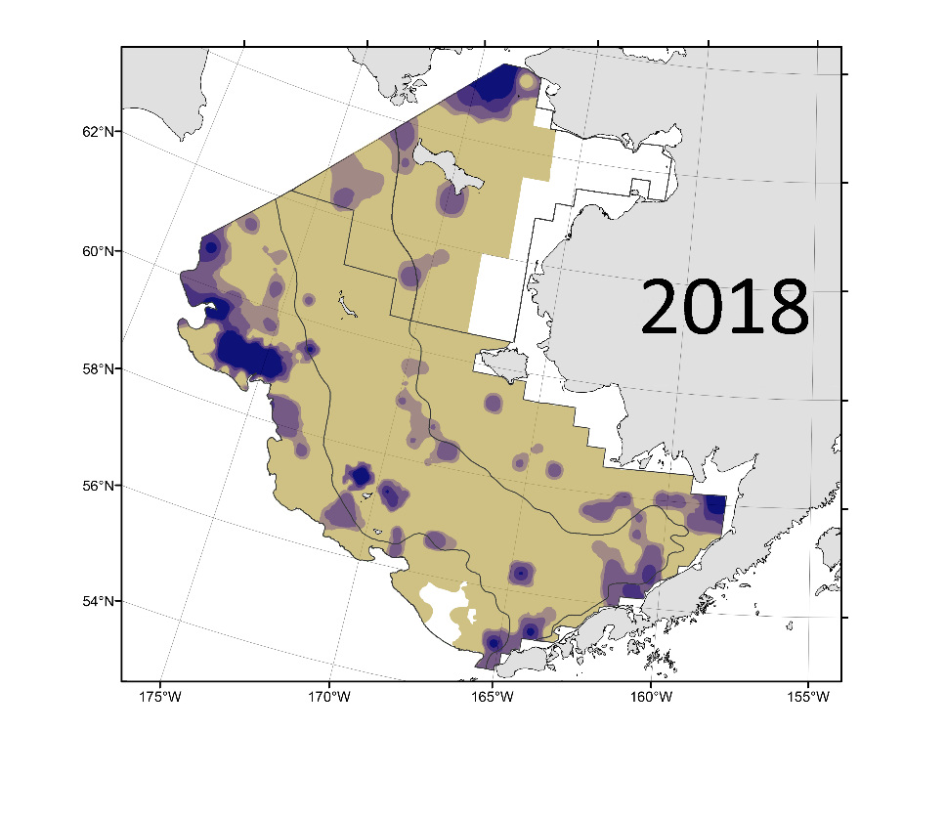
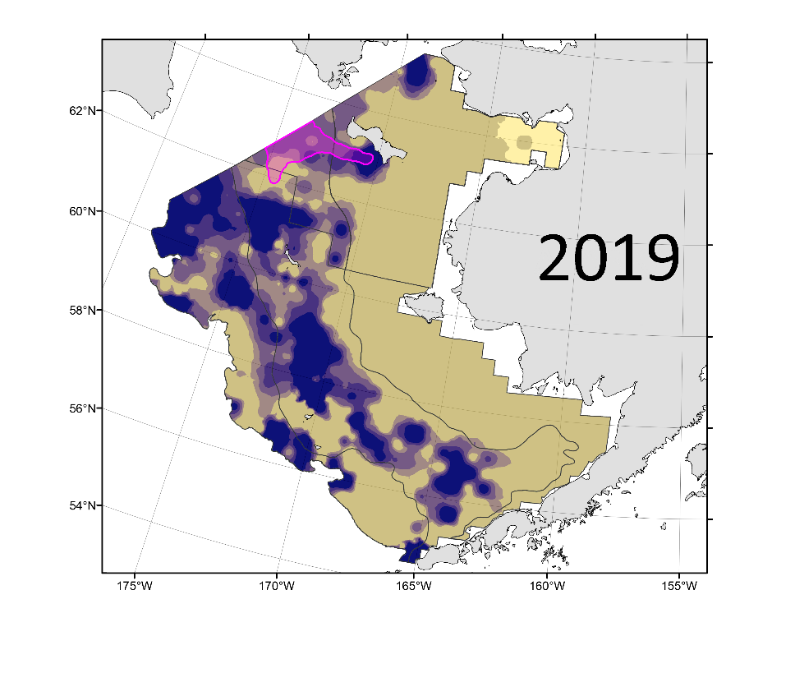
2019 Pelagic
Foragers
Walleye pollock
Northern Bering Sea
Biomass -11% from 2017.
Abundance +59%.
Indicates recruitment of age-1 fish.
Southeastern Bering Sea
Biomass +75% from 2018.
Abundance +53%.
Indicates movement of adult fish.
Temp <0°C
Temp <0°C
kg/ha
no catch
> 0 - 75
> 75 - 100
> 100 - 150
> 150 - 200
> 200 -300
> 300
Min temp =1.6°C
Temp <0°C

Slide 23
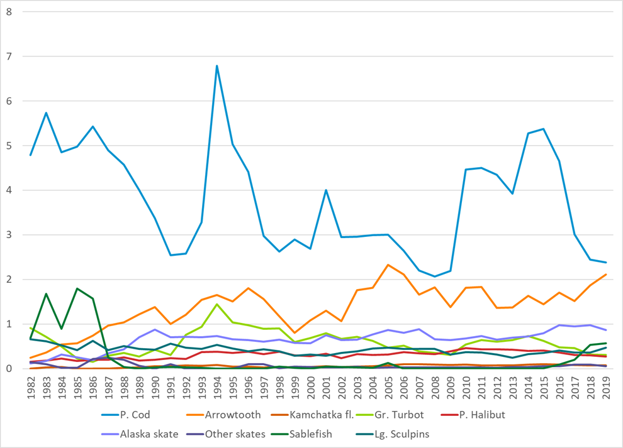
2019 Apex Predators
Apex predators increased 2% from 2018 to 2019 and are at the long-term mean.
P. cod have decreased since 2015 and are below their long-term mean.
Declines in P. cod have been partially offset by increases in Arrowtooth flounder, which increased 13% from 2018 to 2019.
Pacific cod →
ATF →
Notes:
Apex are predators on settled crab, but may also create prey for adults via detritus.

Slide 24
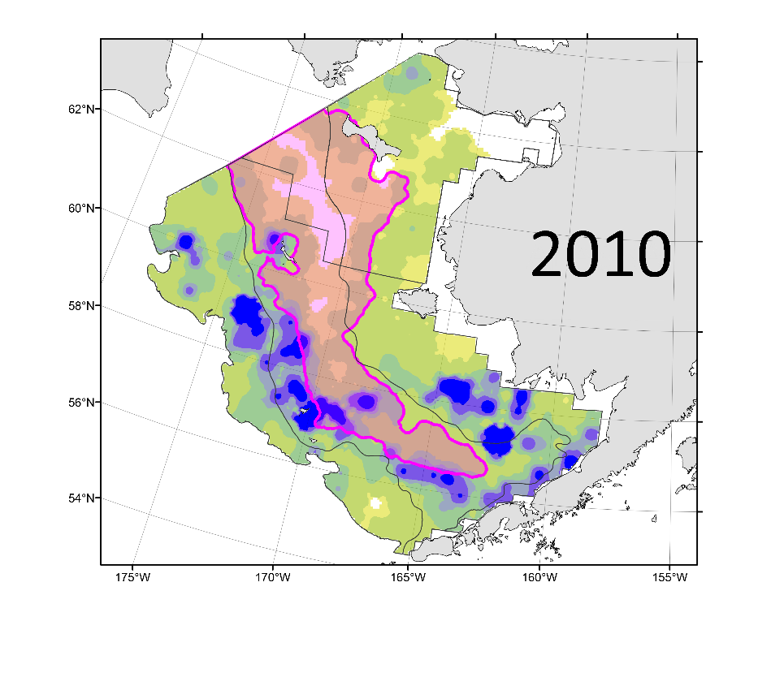
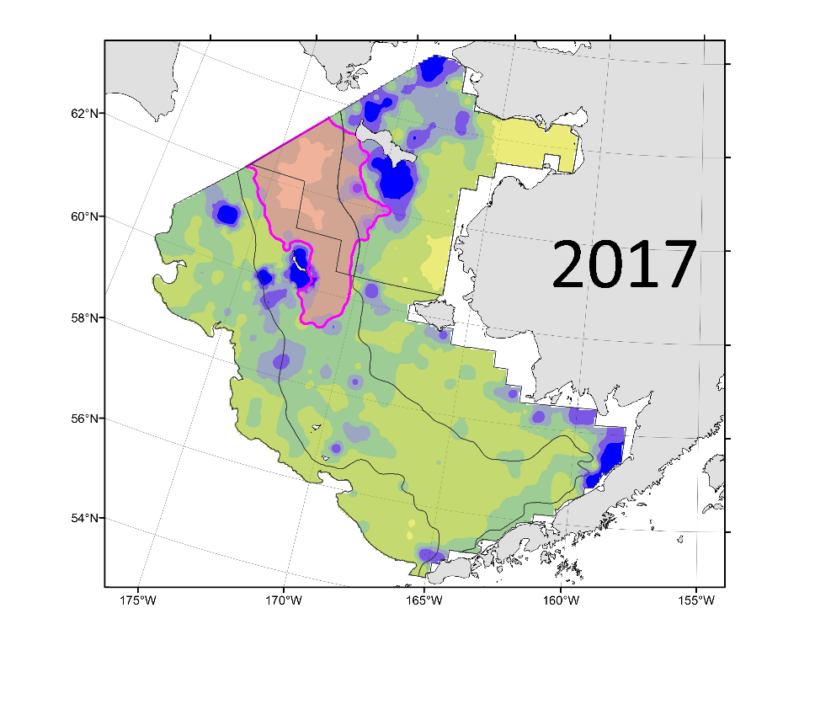
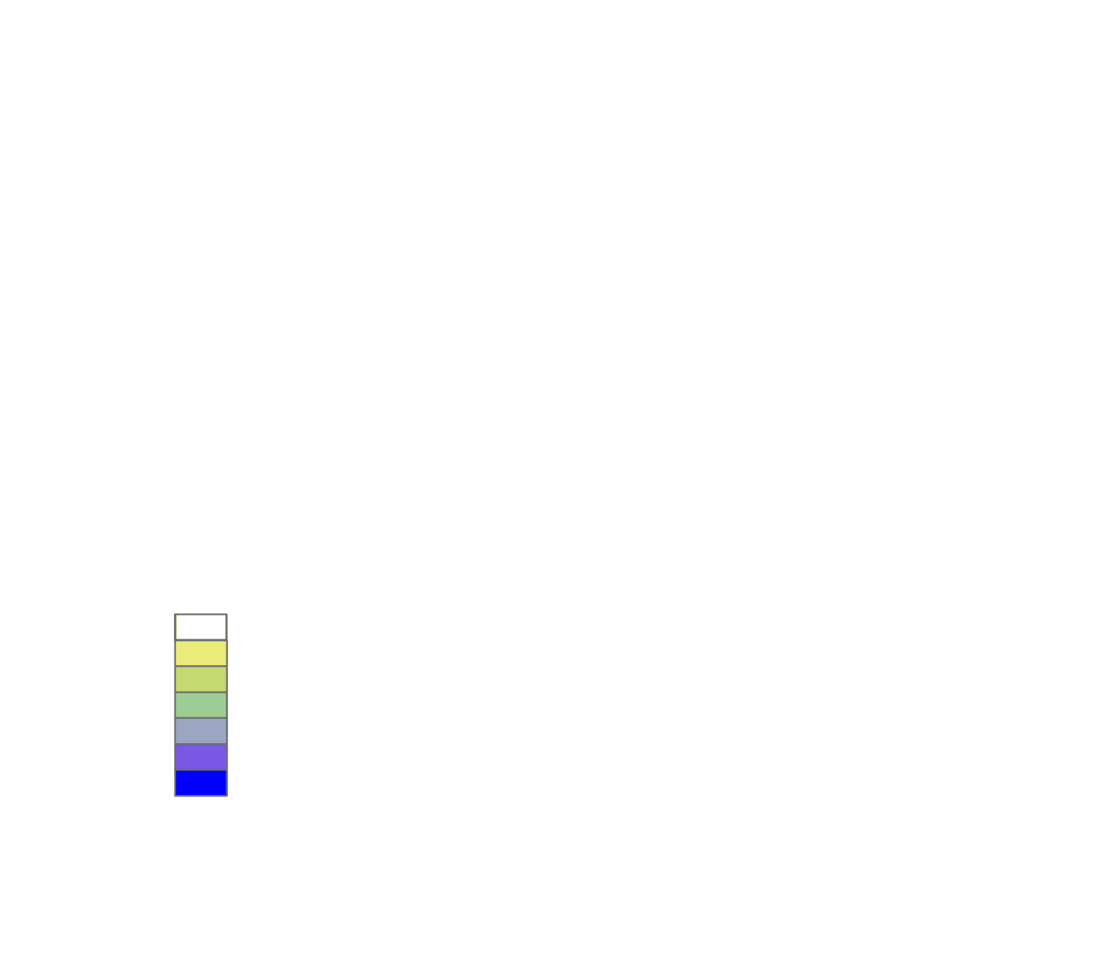
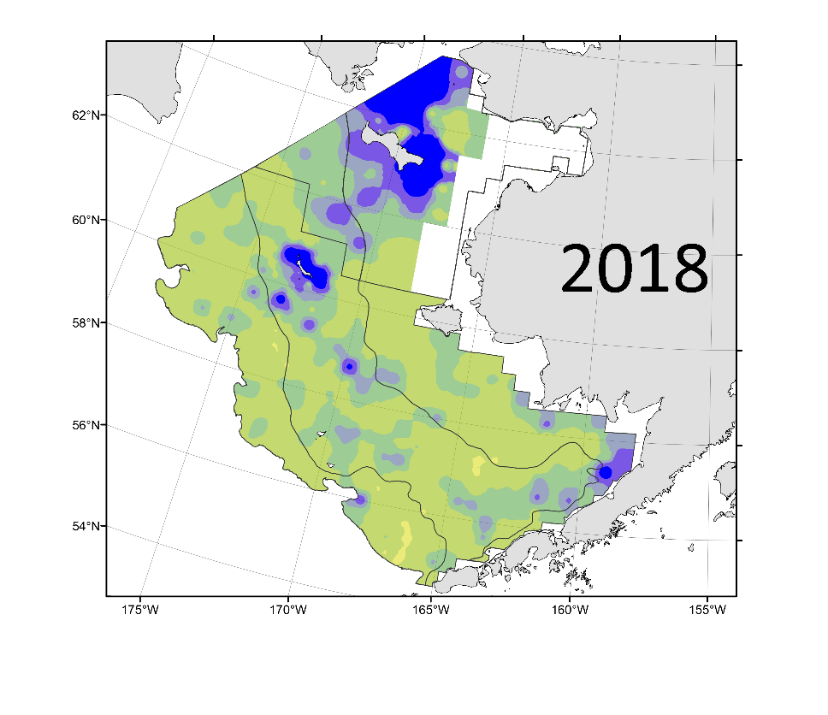
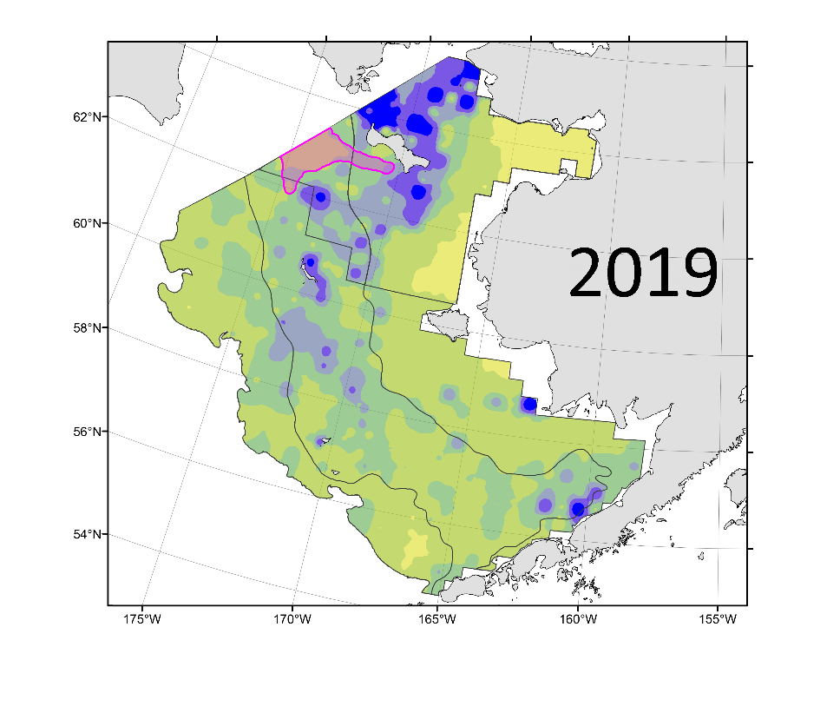
2019 Pelagic
Foragers
Pacific cod
Northern Bering Sea
Biomass +30% from 2017.
Abundance +52%.
Fish appeared healthy.
Southeastern Bering Sea
Biomass +2% from 2018.
Abundance +112%.
Indicates recruitment of age-1 fish.
Temp <0°C
Temp <0°C
kg/ha
no catch
> 0 - 1
> 1 - 10
> 10 - 20
> 20 - 30
> 30 - 40
> 40
Min temp =1.6°C
Temp <0°C

Slide 25
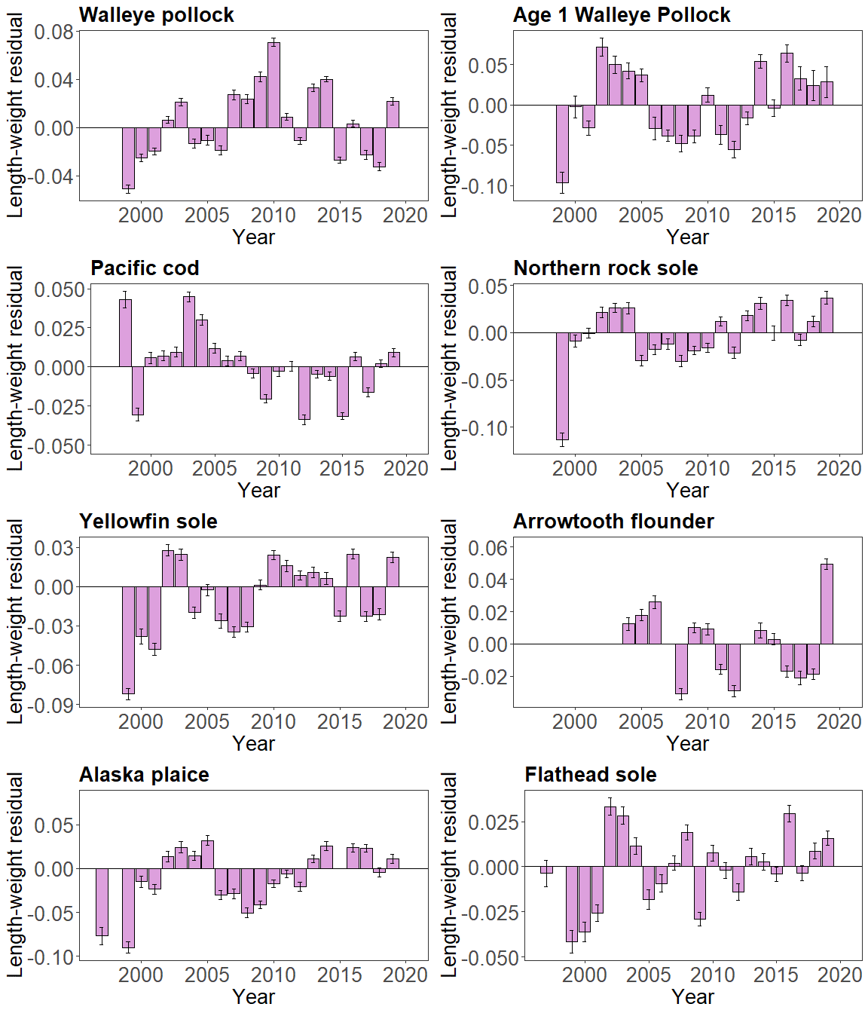
2019 Groundfish Condition
Laman
Groundfish condition increased in 2019 relative to 2018.
Condition was positive for all species shown.
Large increases were seen for pollock, N. rock sole, YF sole, ATF, and FH sole.
These species are either predators or competitors with crab.
Notes:
Pollock = predator
YFS = competitor (worm eater)

Slide 26
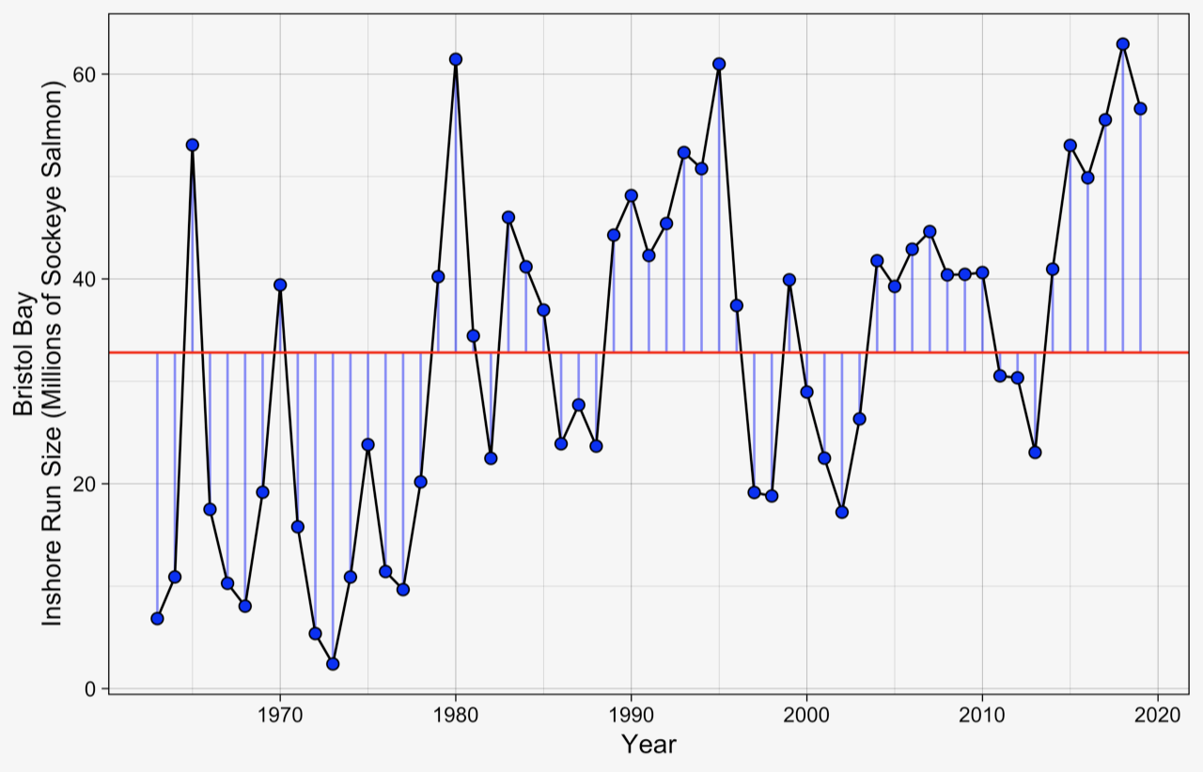
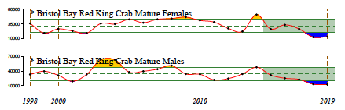
2019 Bristol Bay Sockeye Salmon Cunningham
2019 inshore run was 56.6 million.
4th largest since 1963.
Fish experienced positive conditions at ocean entry in the summers of 2016 and 2017, and winters of 2016/2017 and 2017/2018.

Slide 27
2019 Summary
& Larval Implications
-
-
PREDATORS
COMPETITORS
-
+
PREY
ENVIRONMENTAL PROCESSES
+

Slide 28
2019 Summary
& Adult Implications
-
PREDATORS
COMPETITORS
+
-
-
+
PREY
ENVIRONMENTAL PROCESSES
?

Slide 29
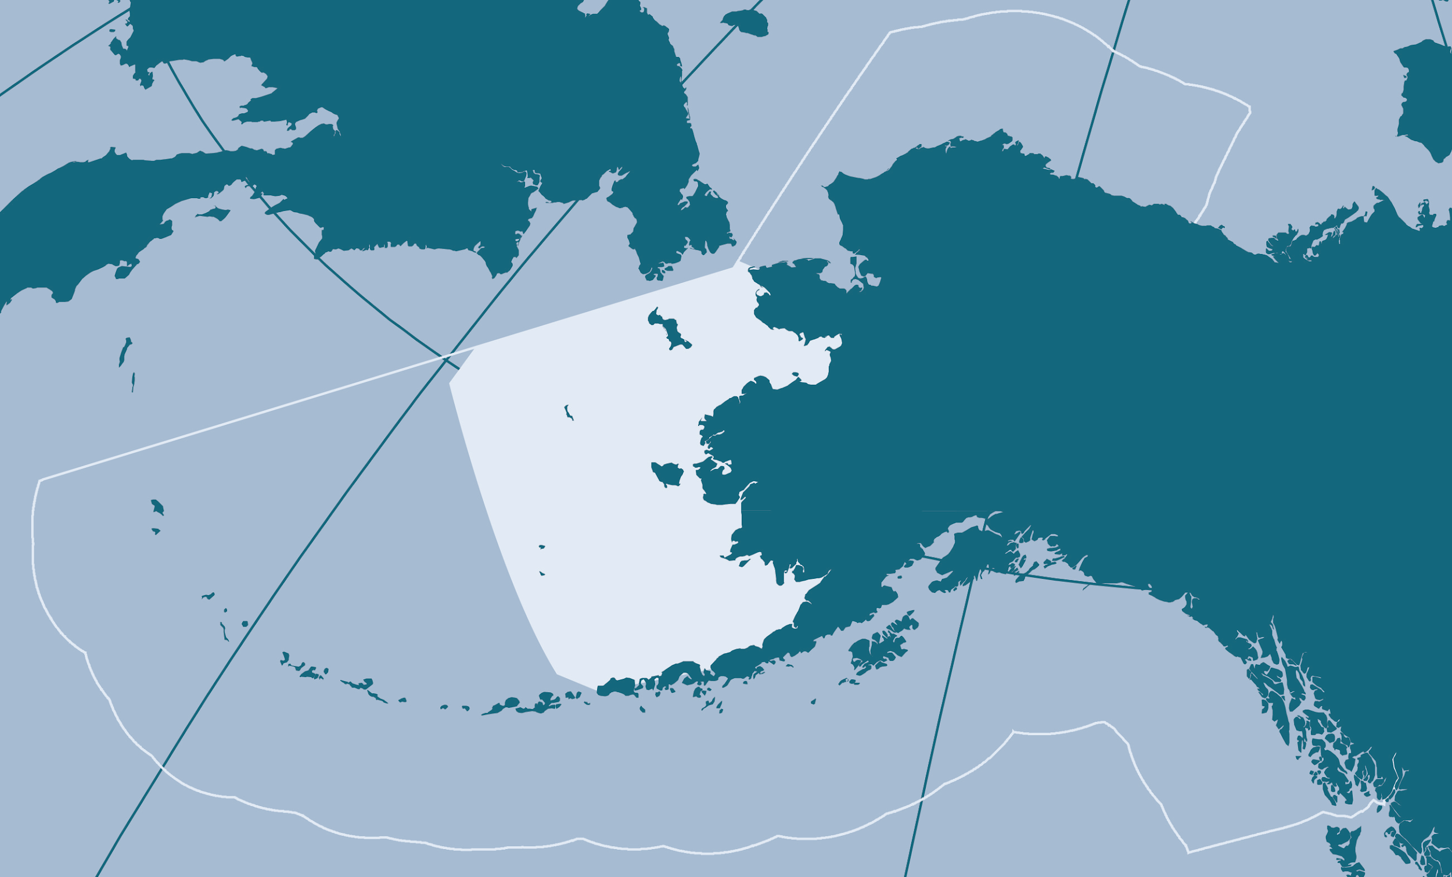
2020 climate and oceanography

Slide 30
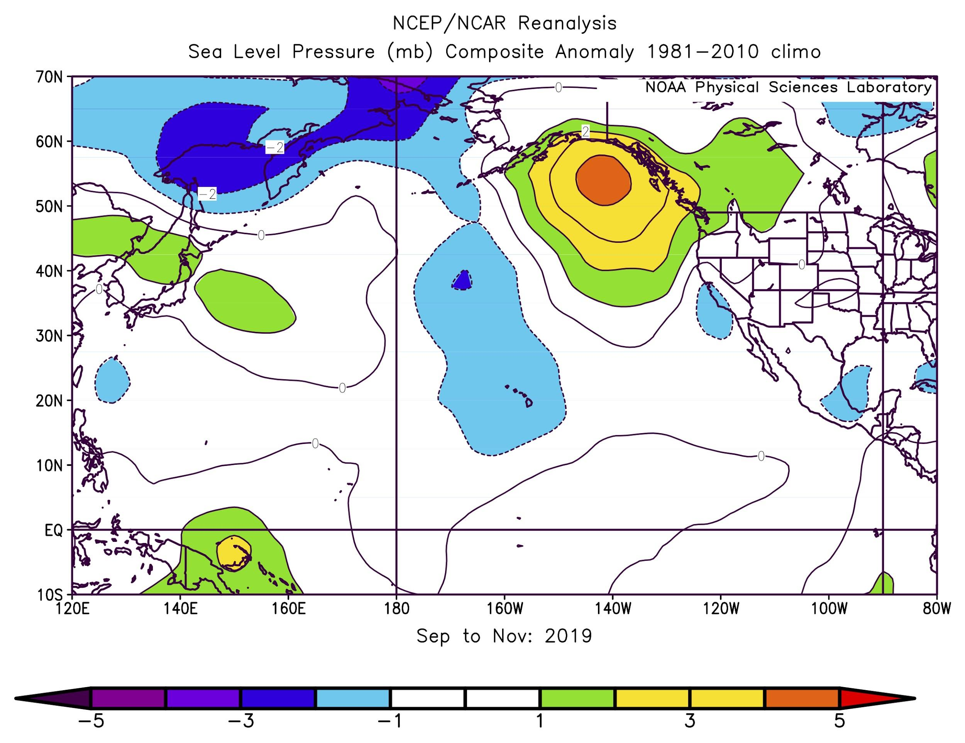
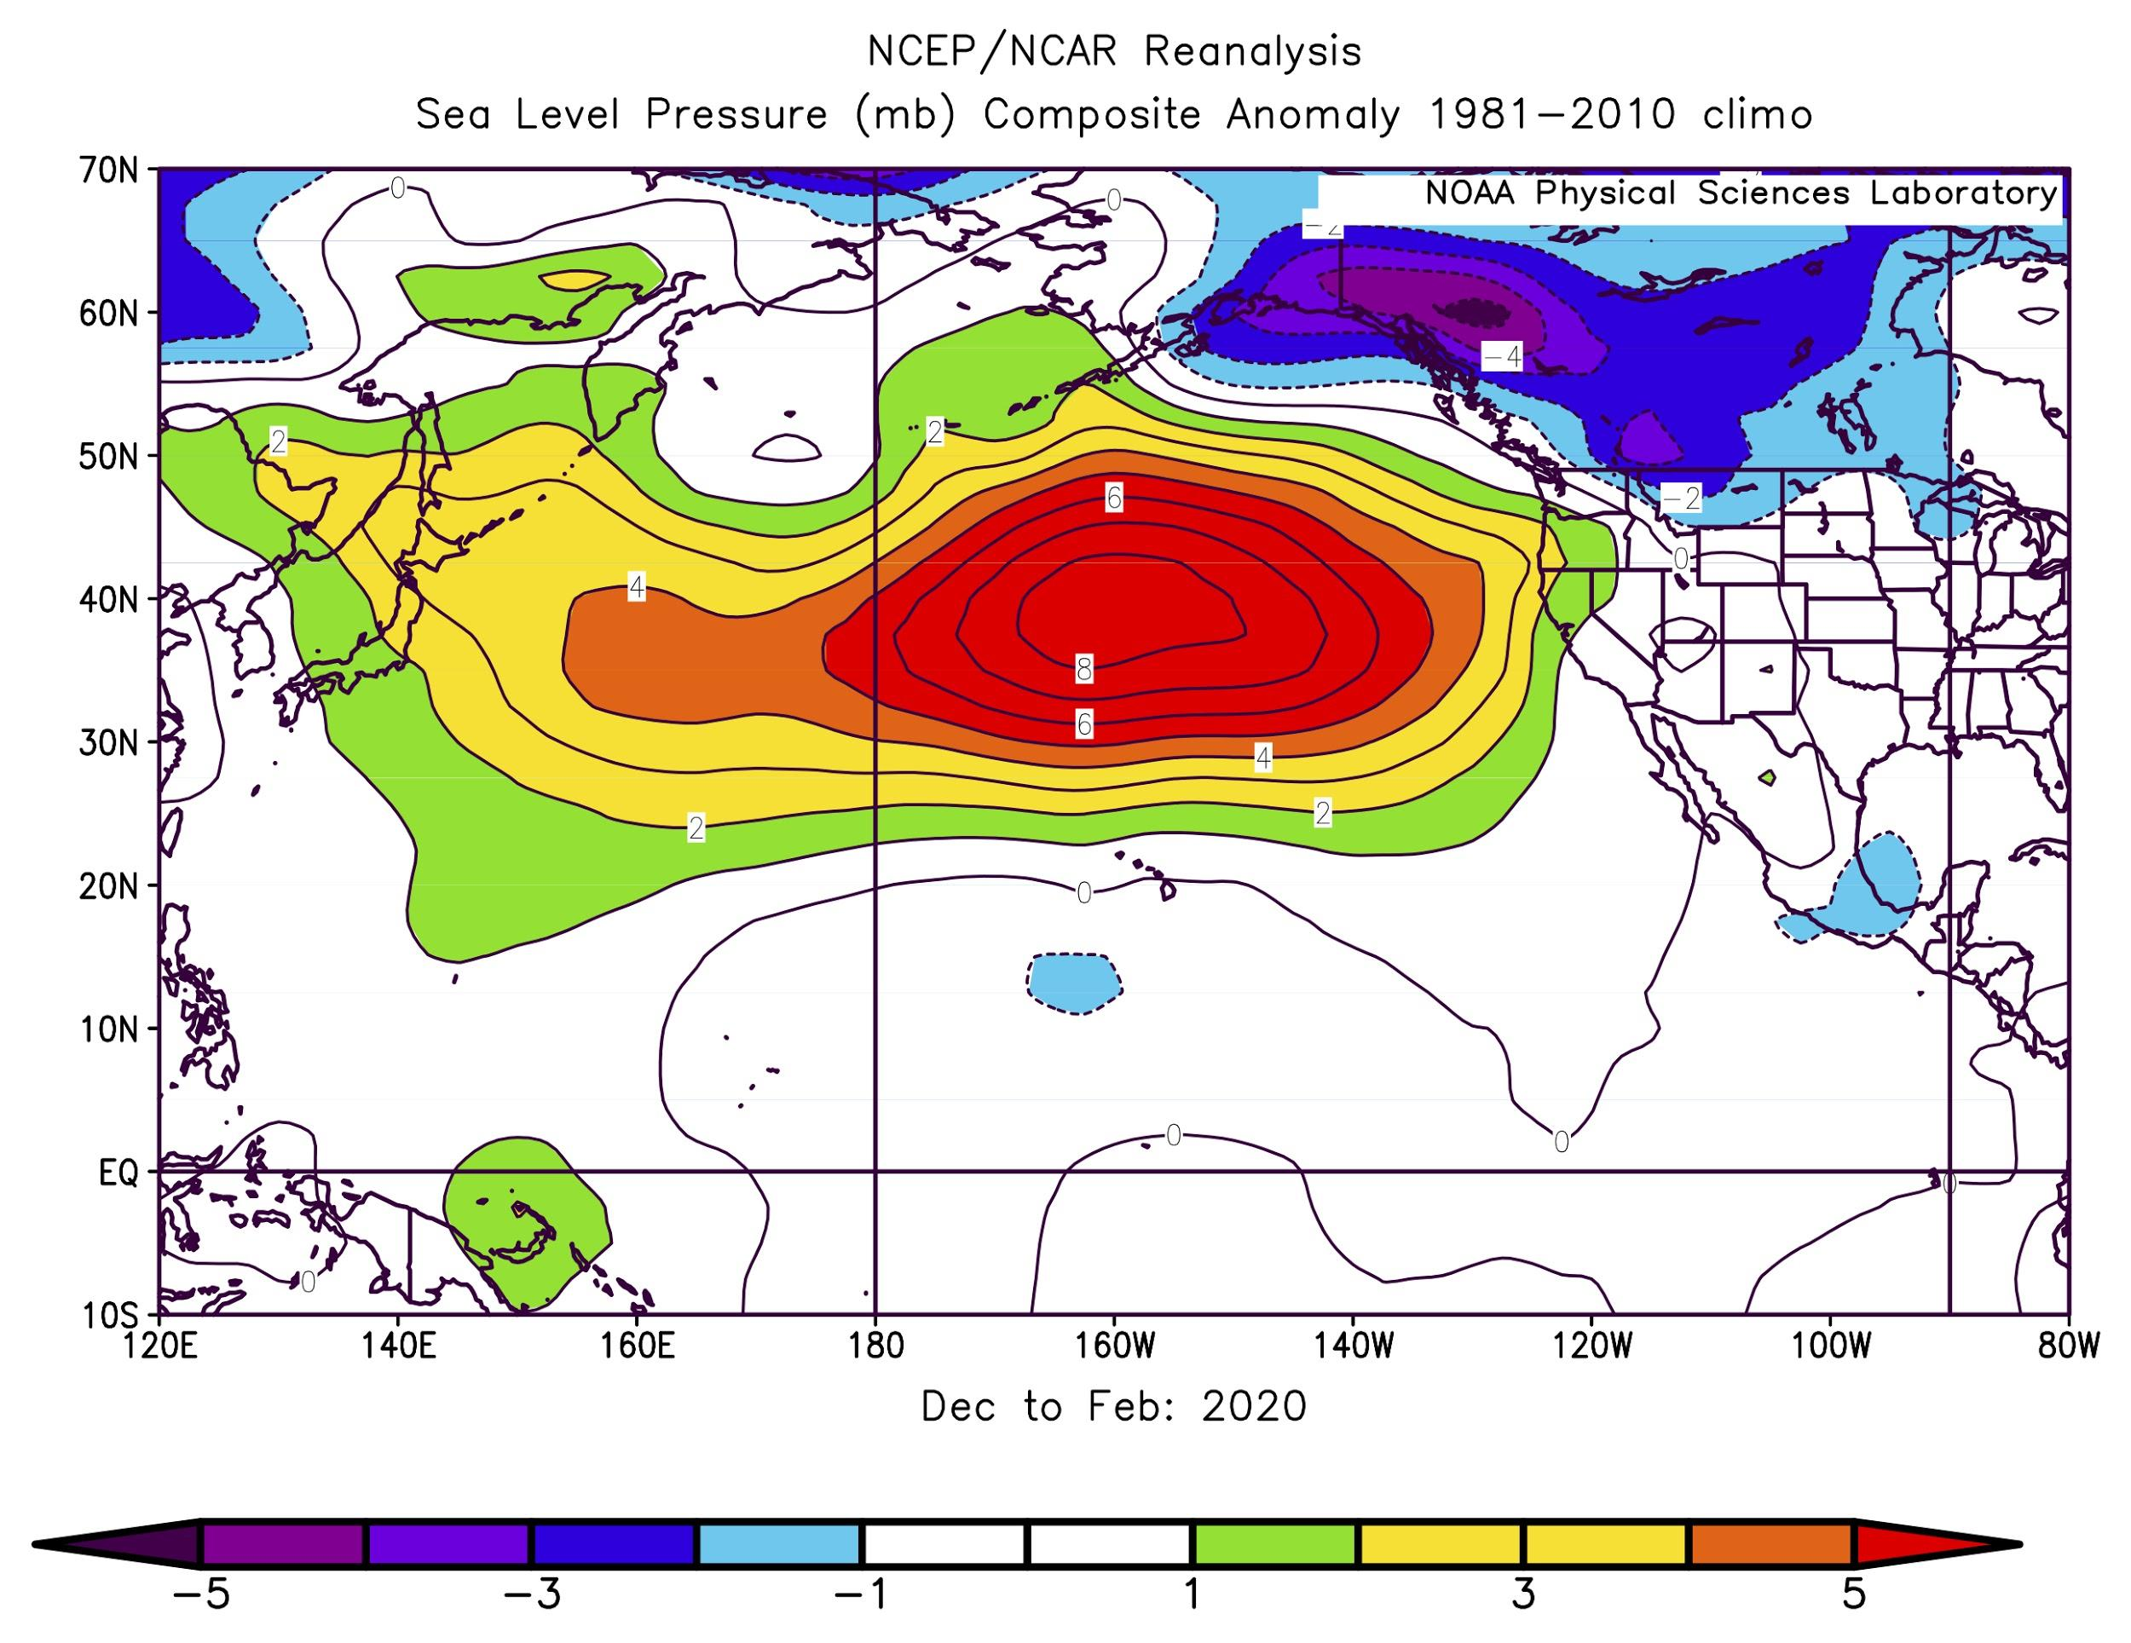
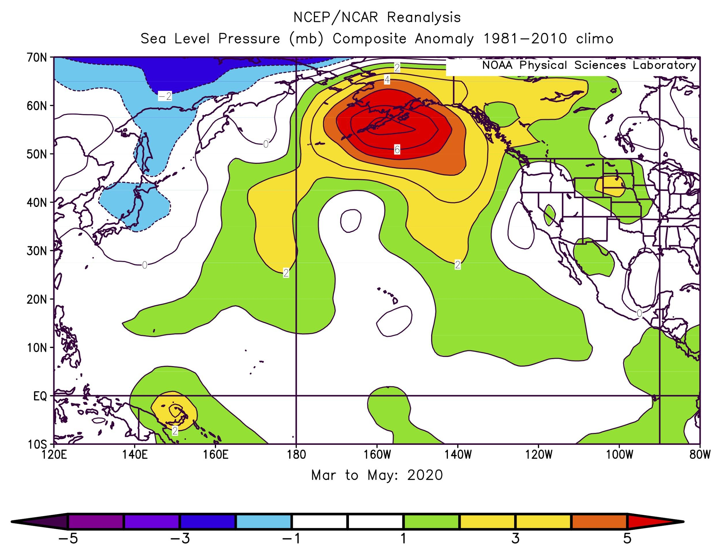
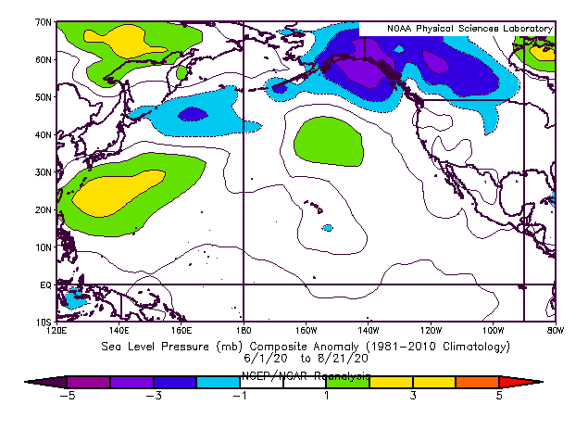
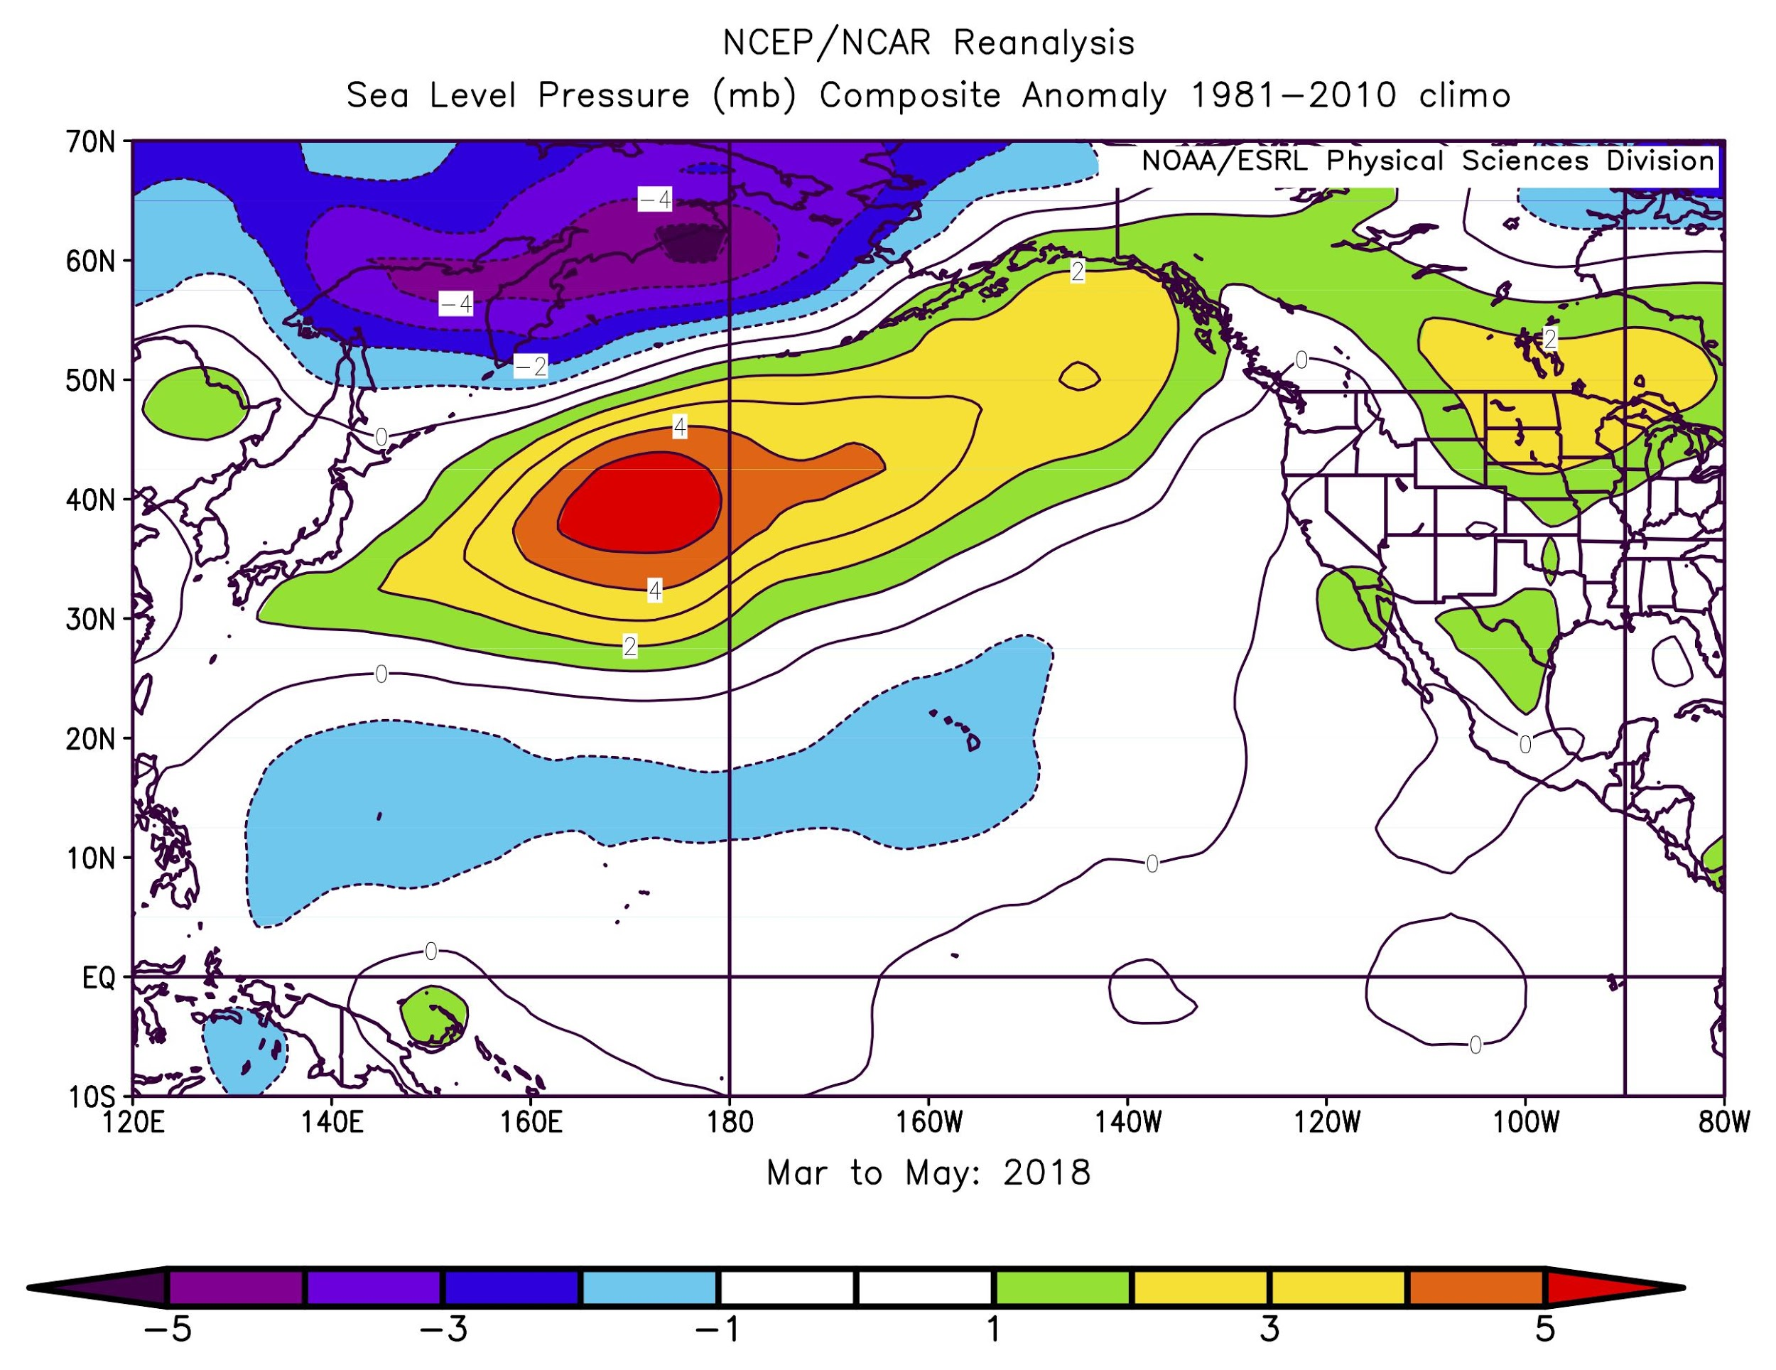
Sea Level Pressure Anomalies
Bond
Positive in central GOA; warm SSTs and upwelling-
favorable winds.
Large positive
anomaly;
suppressed
storminess;
equatorward
transport.
Autumn 2019
Winter 2019/20
Positive SLP continued; westerly winds in CGOA; upwelling-
favorable in EGOA; southerly wind in EBS.
Low pressure over GOA; northerly winds brought warm/dry air from mainland to W&C GOA.
Spring 2020
Summer 2020
From the NCEP/NCAR
Reanalysis project
Notes:
Autumn = SON
Winter = DJF
Spring = MAM
Summer = JJA
Anomalies are relative to mean conditions 1981-2010
Warm colors are positive anomalies; cool colors are negative anomalies.

Slide 31
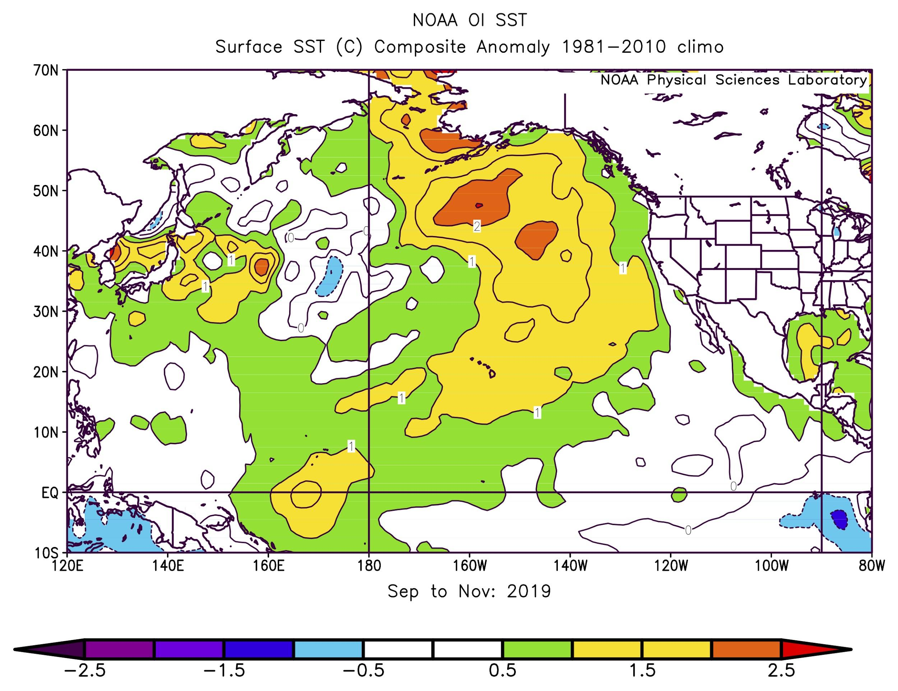
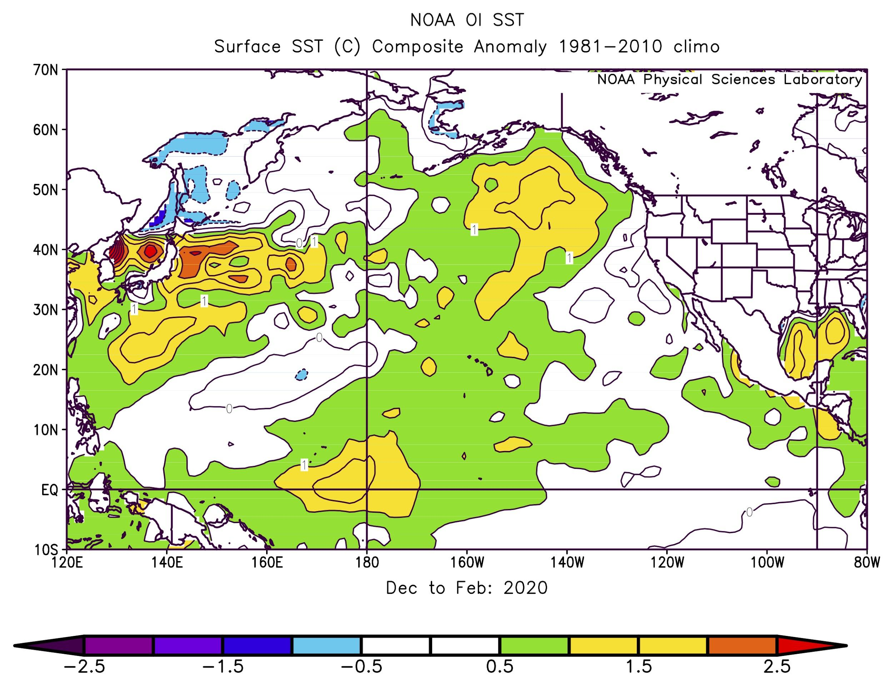
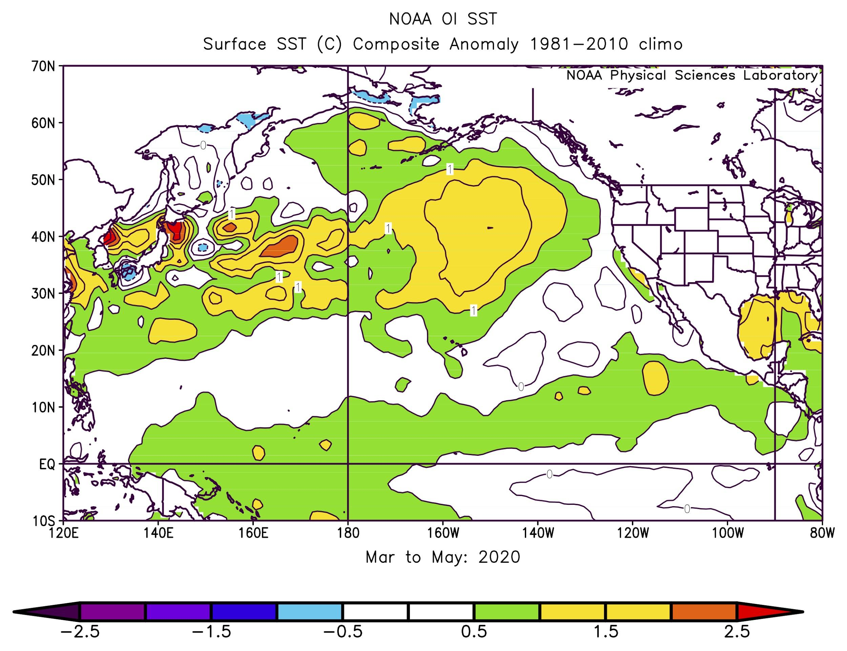
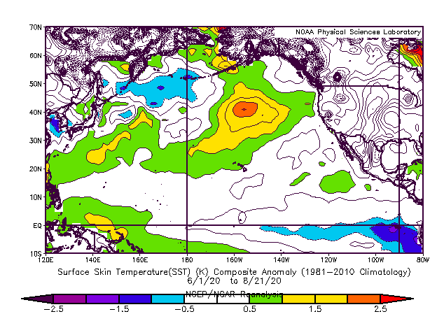

Sea Surface Temperature Anomalies
Bond
Warmer than normal across the region (EBS and WGOA); moderate temps in EGOA due to upwelling.
Moderation of warmth in GOA; considerable cooling in EBS. A weak El Niño developed.
Autumn 2019
Winter 2019/20
Warm across region; Increased SSTs in SEBS and rapid ice retreat. Weak El Niño faded.
Warmth east of dateline; cooling west of dateline. Negative anomalies in WAI. La Niña?
Spring 2020
Summer 2020
From NOAA’s Optimum
Interpolation SST analysis

Slide 32

Climate Indices
Bond
NINO3.4 - Weak El Niño conditions.
PDO declined (cooling along west coast, warming in North Pacific), then increased to neutral.
NPI spike correlates with a weak Aleutian Low. Currently in a neutral state.
NPGO remains negative; high SLP over GOA.
AO spike resulted in coldest winter since 1988/89. Currently near neutral.
Notes:
Climate indices provide an alternative means of characterizing the state of the North Pacific.
NINO3.4 index reflects El Niño/Southern Oscillation (ENSO),
PDO index (leading mode of North Pacific SST variability),
North Pacific Index (NPI) where a spike correlates with a weak Aleutian Low,
North Pacific Gyre Oscillation (NPGO), and
Arctic Oscillation (AO).
Legend: Monthly values normalized based on 1981-2010, then smoothed with three-month running means.

Slide 33




Arctic Sea Ice Extent
National Snow and Ice Data Center
March 2018
March 2019
March 2020

Slide 34

Arctic Sea Ice Extent
National Snow and Ice Data Center
Past 5 years all had lower-than-median ice extent in spring.
2020 had near-normal spatial extent of ice.
2020 ice retreated similarly to previous warm years, especially after June.

Slide 35

Bering Sea Ice Extent
Thoman
Residual warmth delayed freeze-up into winter.
Cooling in late winter resulted in a rapid build-up of sea ice.
Exceeded median in Feb/March.
Southerly (warm) winds in spring promoted rapid ice retreat.
Notes:
Autumn = SON = residual warmth delayed freeze-up
Winter = DJF = cooling SSTs; sea ice build-up
Spring = MAM
Summer = JJA

Slide 36


Spring Conditions in EBS
Overland
Jet stream
SLP
March to May 2020
March to May 2020
The jet stream was located very far south (over Japan).
Sea ice extent was typical until south winds in spring deteriorated it.
Low pressure (purple) brought south winds over the EBS;
Warm temperatures to the NBS.

Slide 37

Summer Conditions in EBS
Overland
Summer winds were light in the SEBS.
The NBS had west winds in the summer.
June to July 2020

Slide 38

EBS Sea Surface Temperature
Watson
2020 late winter temperatures were closer to the long-tem mean.
North of 60°N
South of 60°N
Notes:
Updated twitter figure 8/31/2020
Data for the shelf (10-200m)
Autumn = SON
Winter = DJF
Spring = MAM
Summer = JJA
Sea ice = -1.8C

Slide 39
EBS Sea Surface Temperature
Watson
2020 late winter temperatures were closer to the long-tem mean.
Above-average temperatures returned in spring and summer, especially over the southeastern shelf.
North of 60°N
South of 60°N

Slide 40
EBS Sea Surface Temperature
Watson
2020 late winter temperatures were closer to the long-tem mean.
Above-average temperatures returned in spring and summer, especially over the southeastern shelf.
Current temperatures remain above average, similar to those observed in 2019.
North of 60°N
South of 60°N

Slide 41


EBS Bottom Temperatures and Cold Pool Extent
Kearney, Aydin, Britt, Ladd
Bering 10K ROMS hindcast
Notes:
The hindcast simulation now extends from Jan 15, 1970--Aug 15, 2020.

Slide 42

EBS Bottom Temperatures and Cold Pool Extent
Kearney, Aydin, Britt, Ladd
1971
1995
2000
2020 was an average year.
Slightly above average <2° water and slightly below average <0° water.
Spatially, 2020 clusters with 1995, 1997, 2000, and 2011.
2020 most closely resembles 1997.
1974
1997
2011
1992
1999
2020
Notes:
Within the standard SEBS survey area at the beginning of July.

Slide 43

Coccolithophore Bloom
Ladd
August 27, 2020
A coccolithophore bloom started in mid-August.
Blooms typically peak in September (stay tuned…).
A large bloom occurred in 1997, associated with a die-off of short-tailed shearwaters.
Thought to reduce foraging success for visual predators.

Slide 44

Ocean Acidification
Pilcher, Cross
The spatial extent (% of the EBS shelf) of bottom waters with an average Ωarag value <1 for July - Sept.
Ωarag value <1 ≈ pH7.8. Considered corrosive.
2020 value only through Aug. 15 (underestimate).

Slide 45

Ocean Acidification
Pilcher, Cross
2020 July - Aug. 15 Bottom Ω_{Arag} Anomaly
Anomaly plot shows 2020 compared to the 2003 - 2019 mean.
Blue is better; red is worse.

Slide 46

2021 Sea Surface Temperature Forecasts

Slide 47



SST Projections from the National Multi-Model Ensemble
Bond
Oct - Dec 2020
TOP: continued warmth in Bering Sea with delayed sea ice; warmth for AI; near-normal SSTs in GOA (an end of the current MHW?).
MIDDLE: similar spatial pattern, but decreased magnitude of anomalies.
BOTTOM: near-normal temps along coast, moderate warmth in EBS, slight warmth in C&W AI.
Possible La Niña; weakens by Spring 2021.
Dec 20 - Feb 21
Feb - April 2021

