Slide 1


Groundfish Plan Team
Subgroups for Research Priority
Review/Update

Slide 2
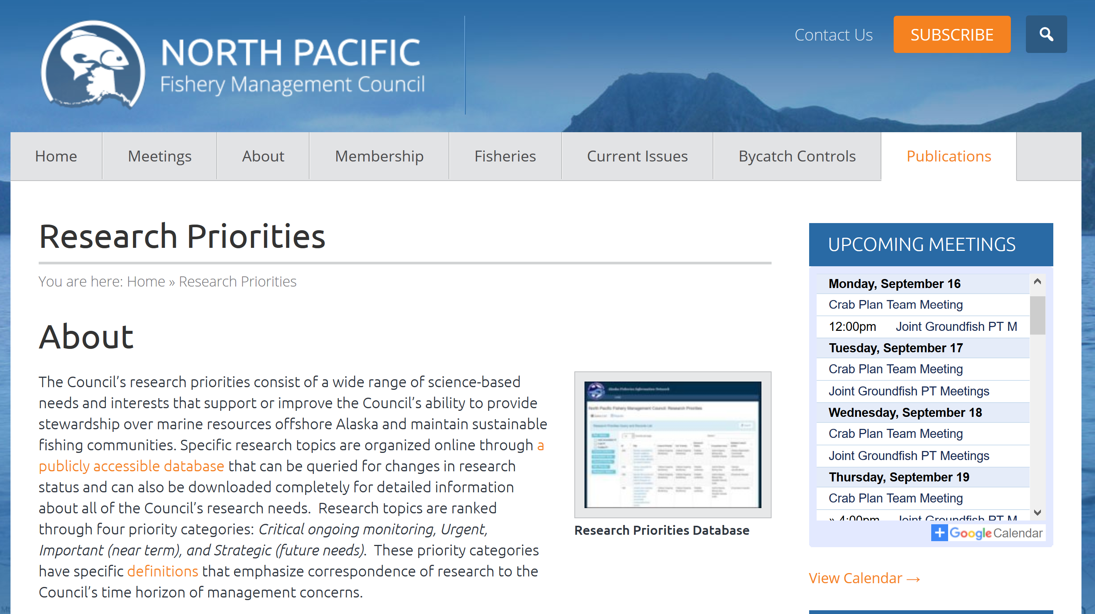

Slide 3
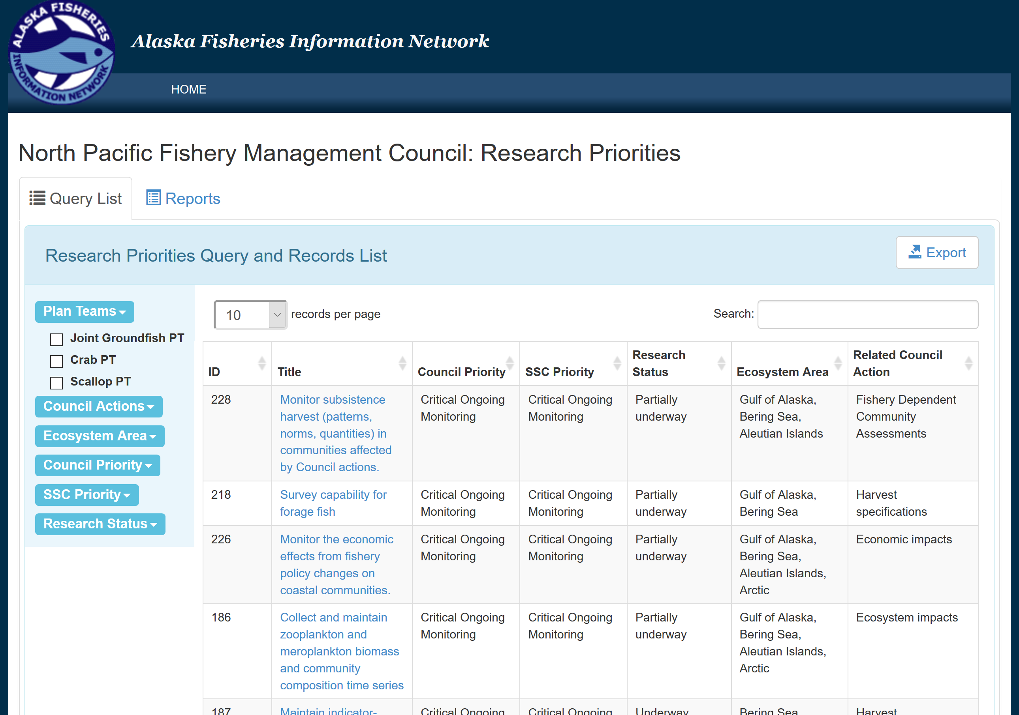

Slide 6
“Annual” research priority process
February
Plan Team Review
Scallop
May
Plan Team Review
Crab and Groundfish
June
Review PT recommendations,
non-PT priorities
SSC
June
Review Top Ten, Recommend to SOC
Council
Top 3-5
Top Ten

Slide 7
MSA Mandate
“Each Council shall, in accordance with the provisions of this Act —
  (7) develop, in conjunction with the scientific and statistical committee, multi‐year research priorities for fisheries, fisheries interactions, habitats, and other areas of research that are necessary for management purposes, that shall —
  (A) establish priorities for 5‐year periods;
    (B) be updated as necessary; and
      (C) be submitted to the Secretary and the regional science centers of the National Marine Fisheries Service for their consideration in developing research priorities and budgets for the region of the Council; ”

Slide 8
New Process
February 2019 –
  Annual to Triennial
    MSA does not require annual review
    Streamline the overall review process
    Include “top ten”
      Critical
      Strategic

Slide 9
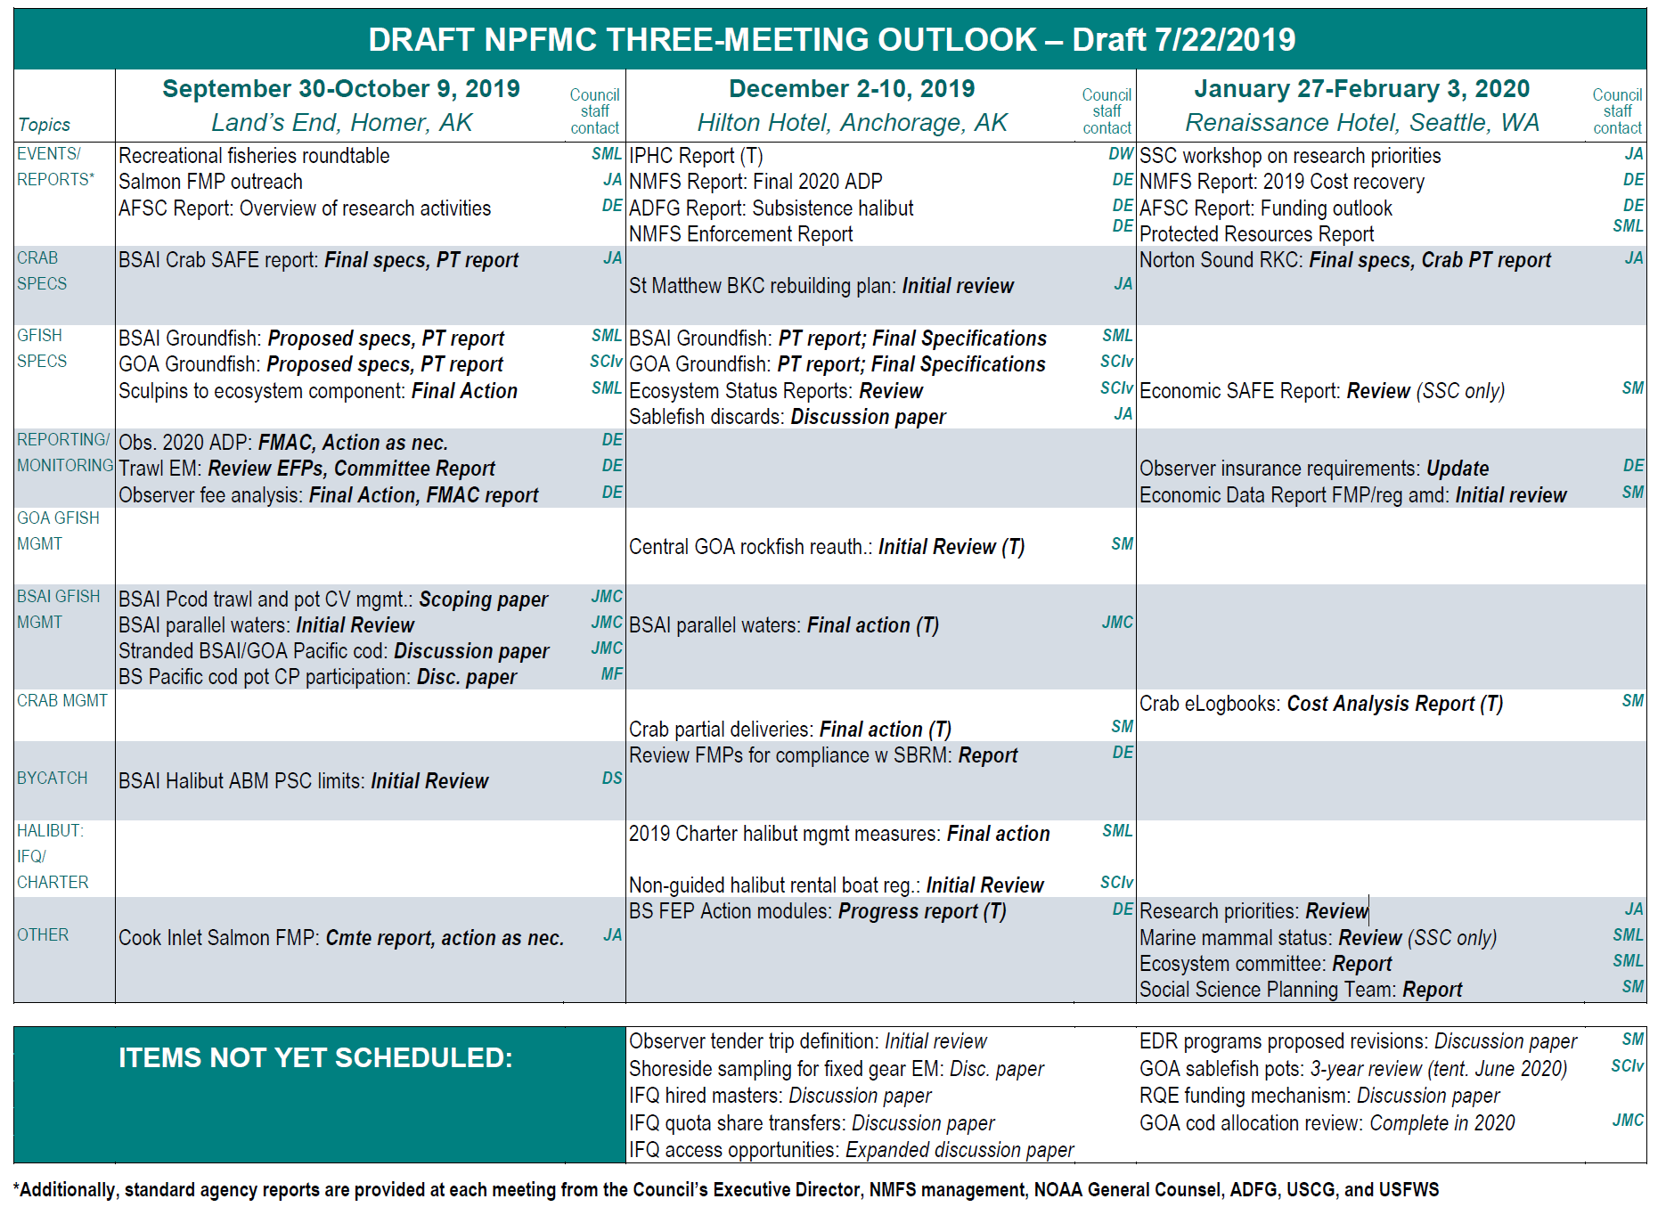
New Process
February 2019 –
  Annual to Triennial
    MSA does not require annual review
    Streamline the overall review process
    Include “top ten”
      Critical
      Strategic

Slide 10
GF Plan Team Review
Update
  Research Status
  Priority
  Any other details, as needed
Establish Top Projects for highlighting to SSC
Identify New Projects
Proposals for Improvement

Slide 11
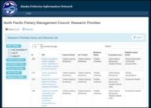
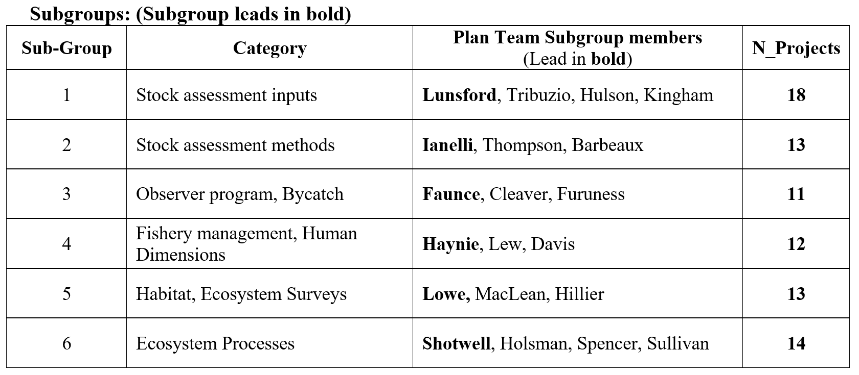
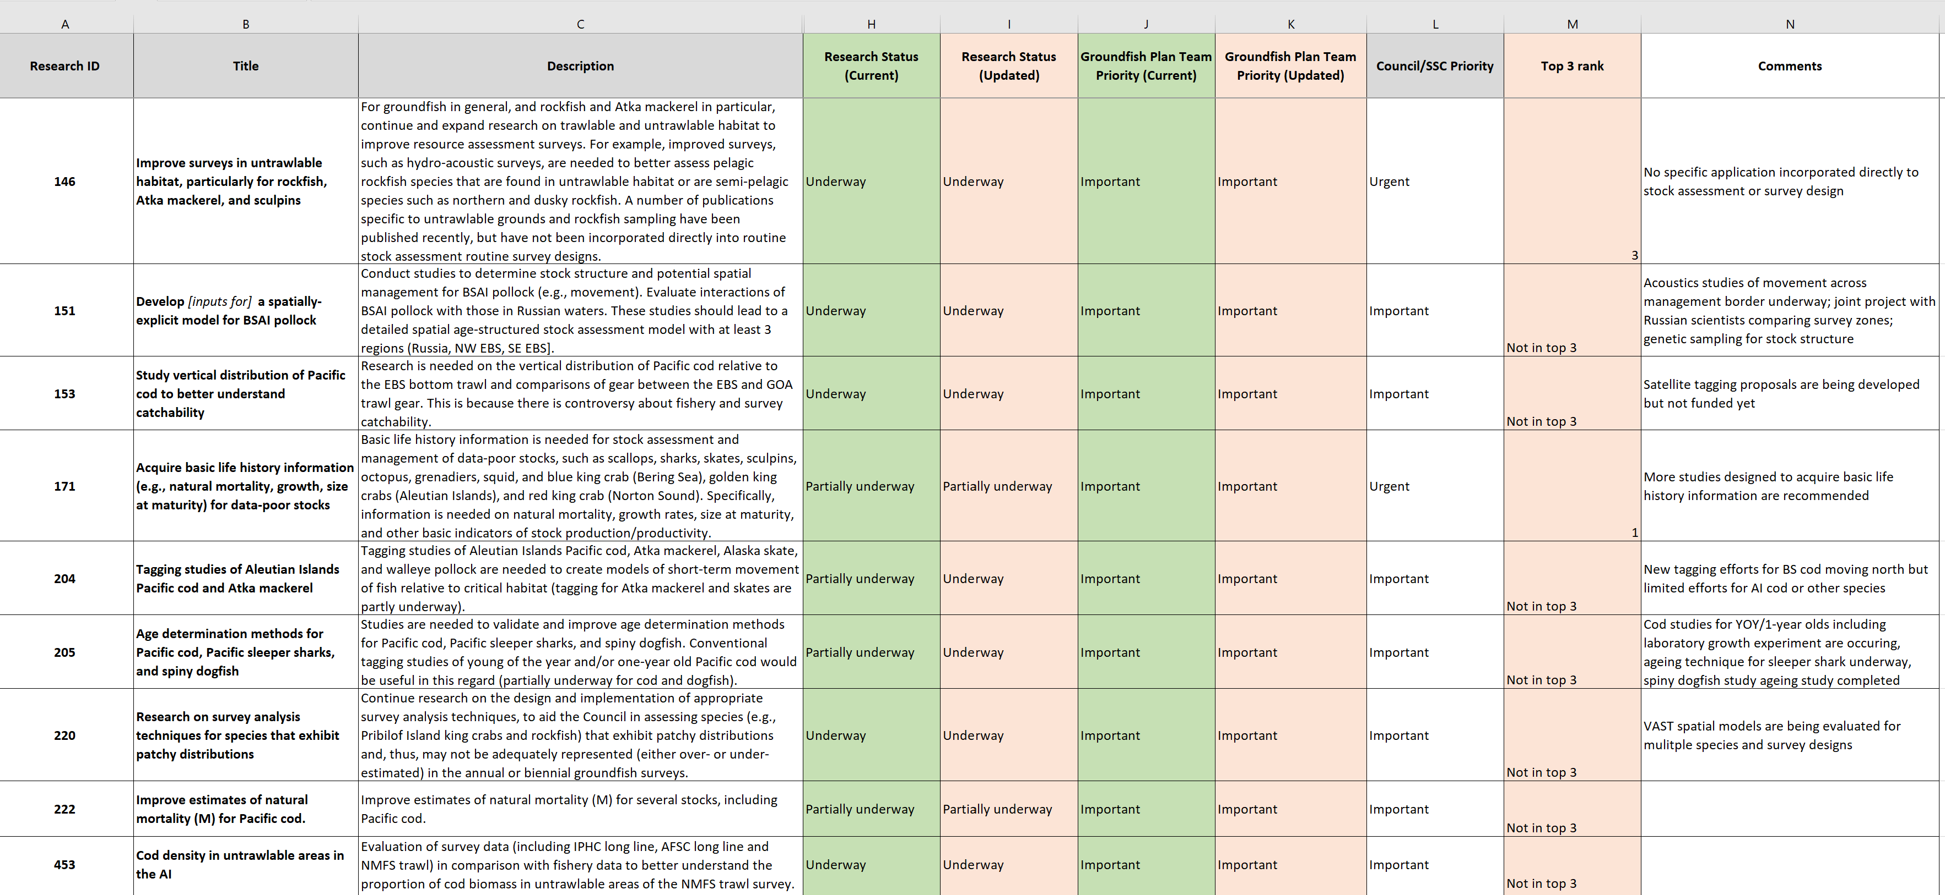
Methods

Slide 12
Project counts among “themes”

Slide 13
Methods

Slide 14
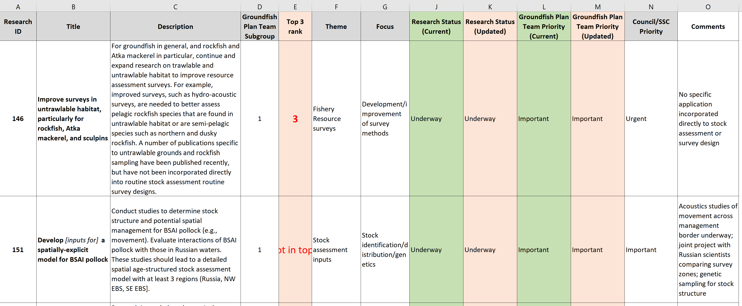
Methods

Slide 15
Results

Slide 16
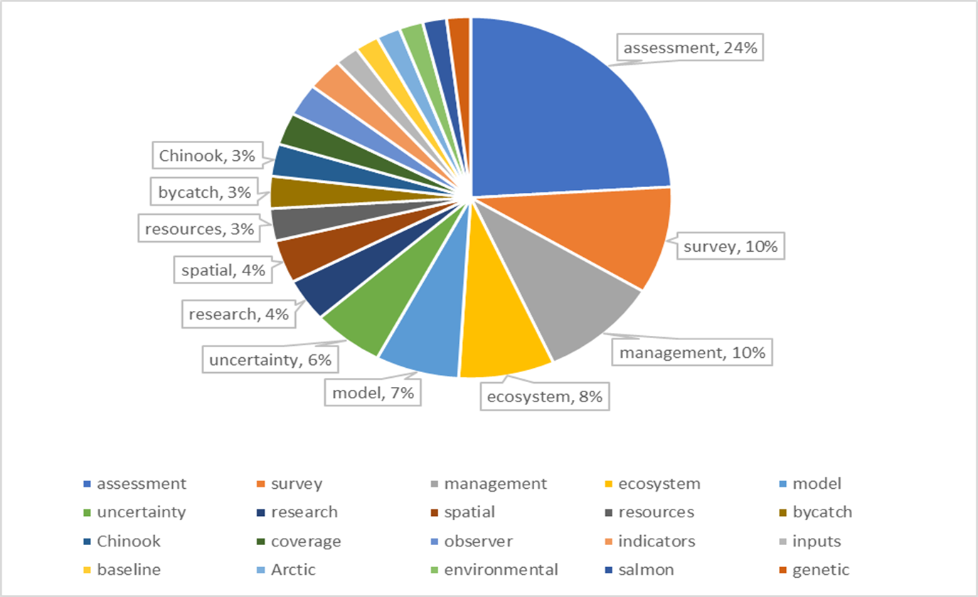
Results

Slide 17
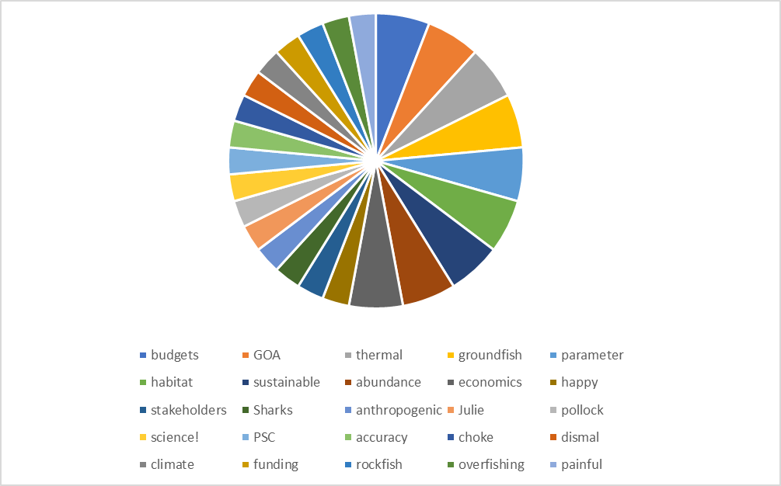
Results

Slide 18
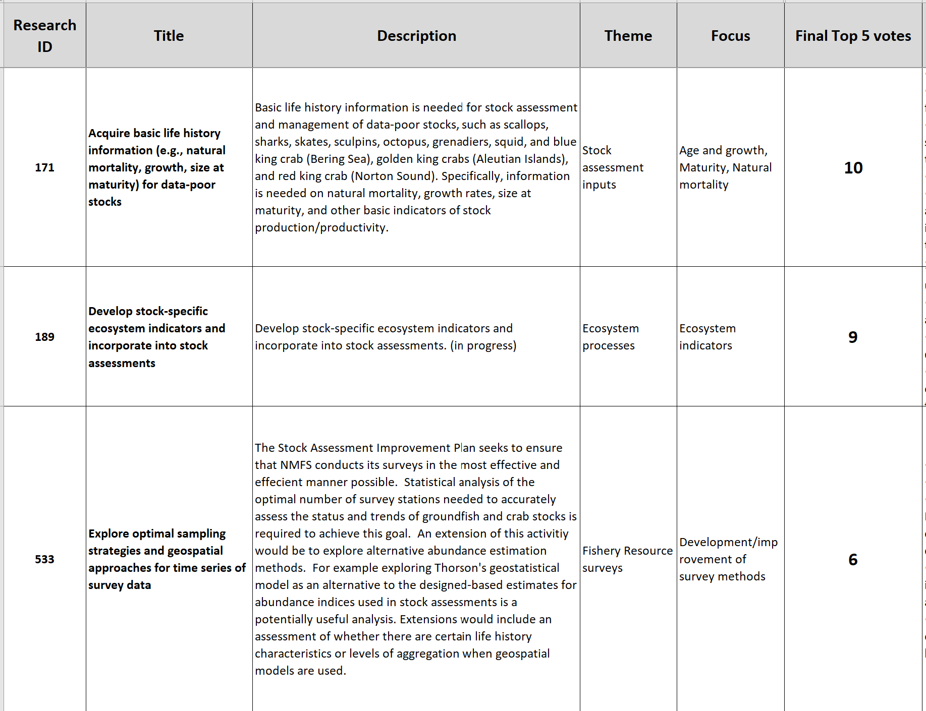

Slide 19
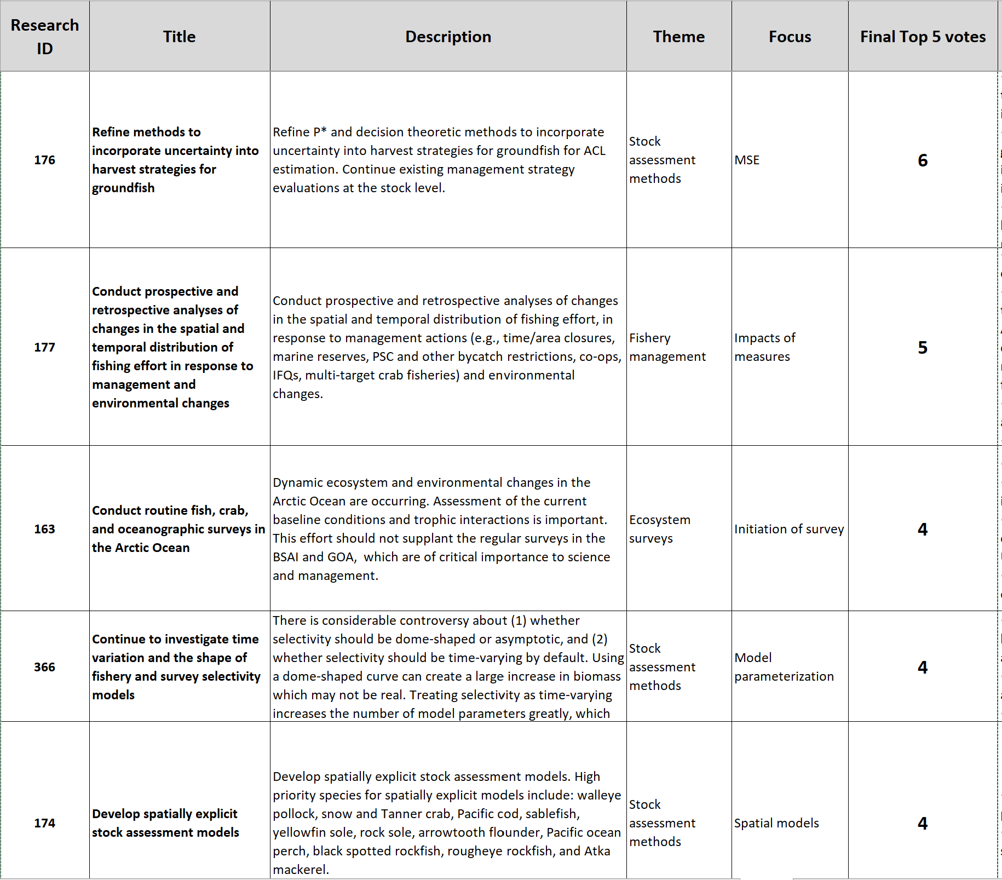

Slide 20
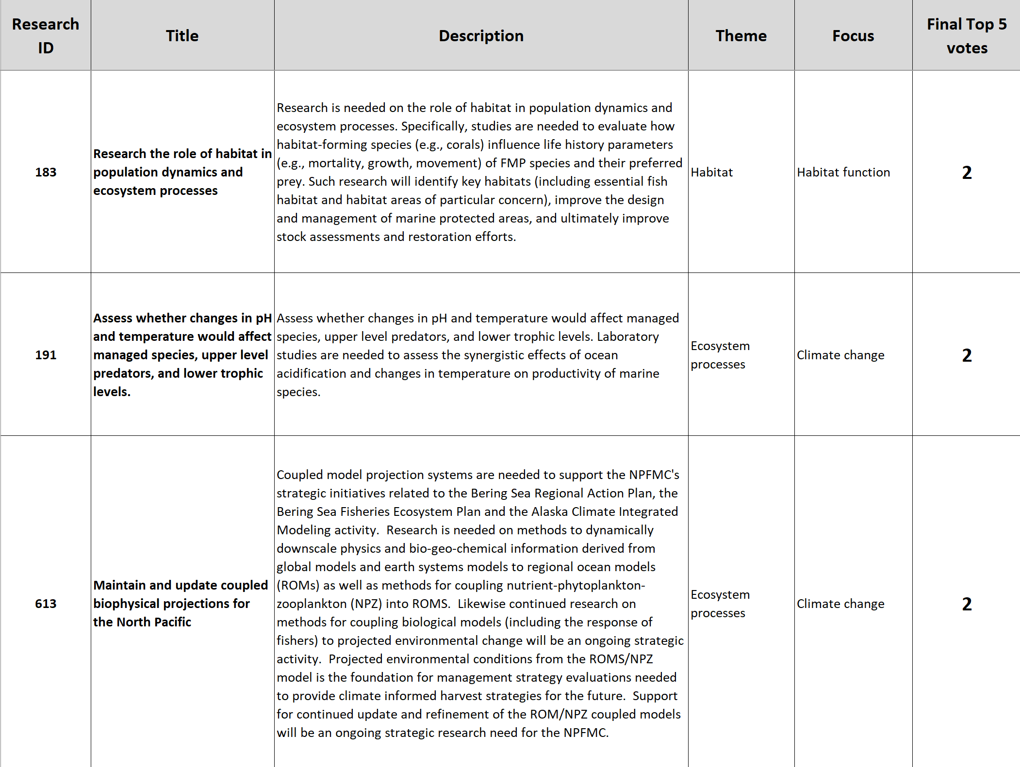

Slide 21
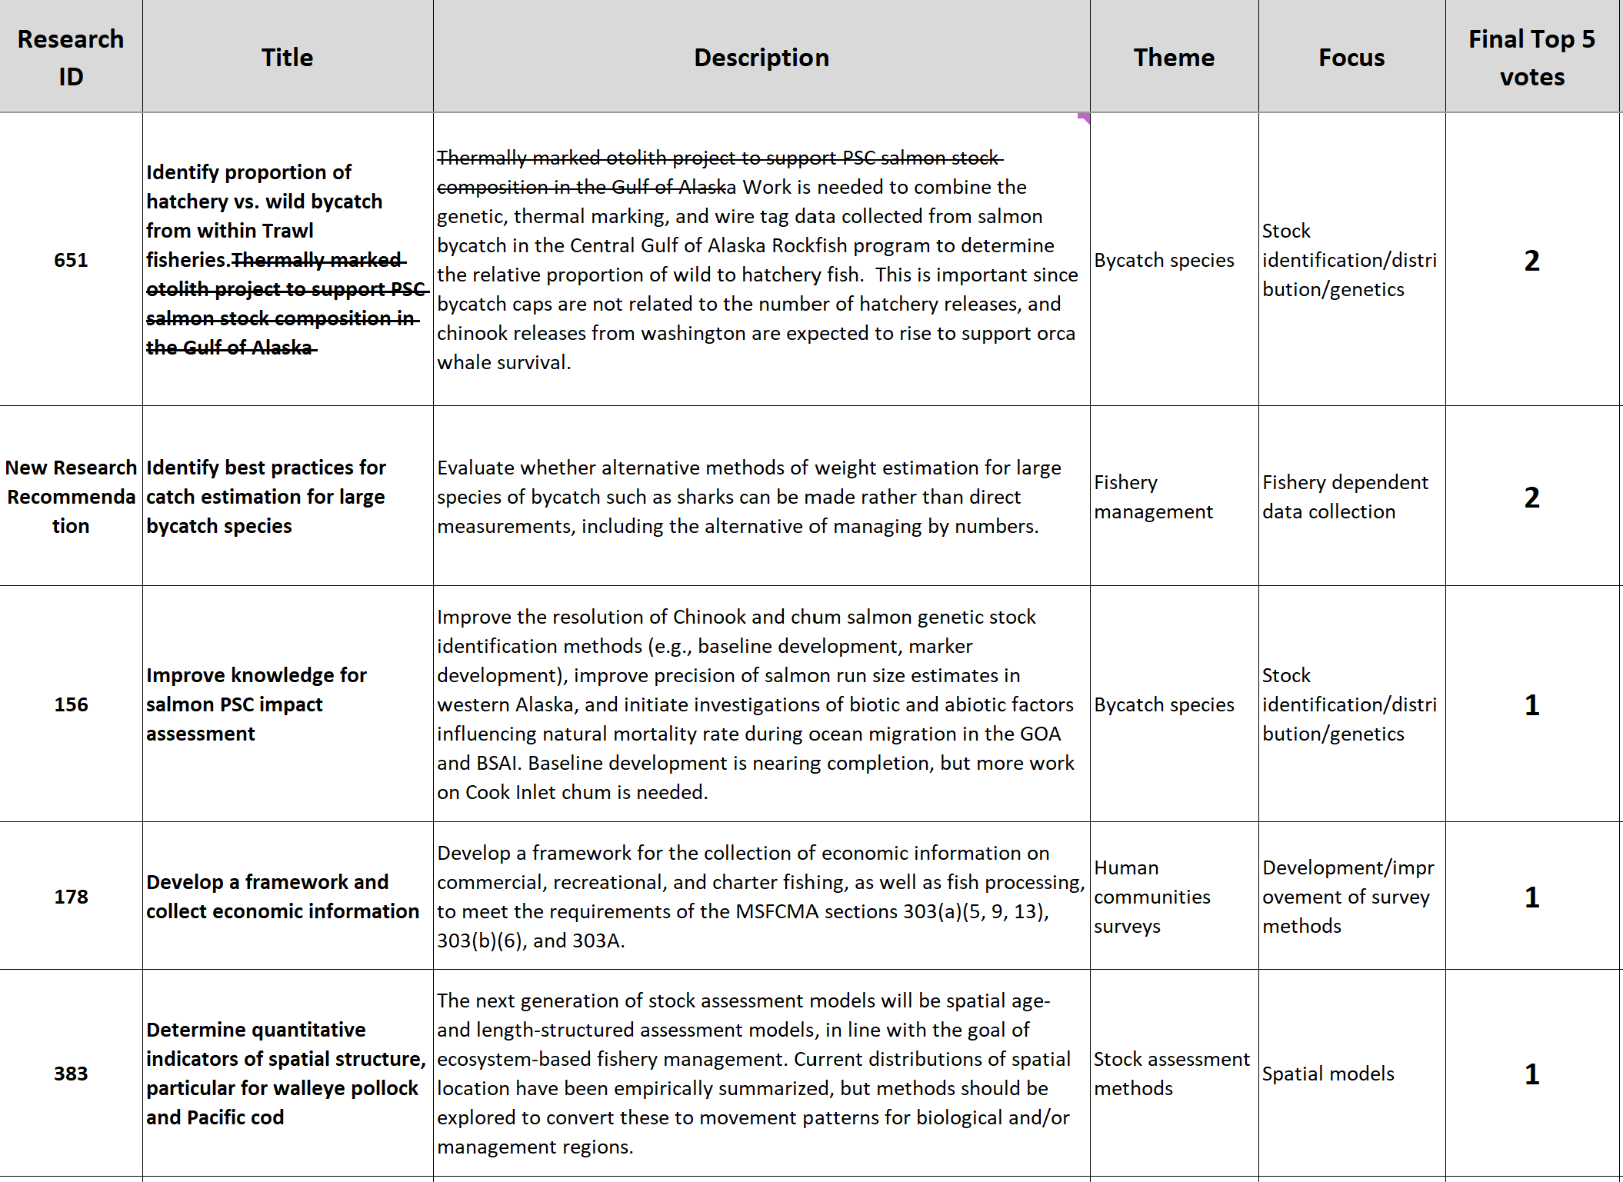

Slide 22
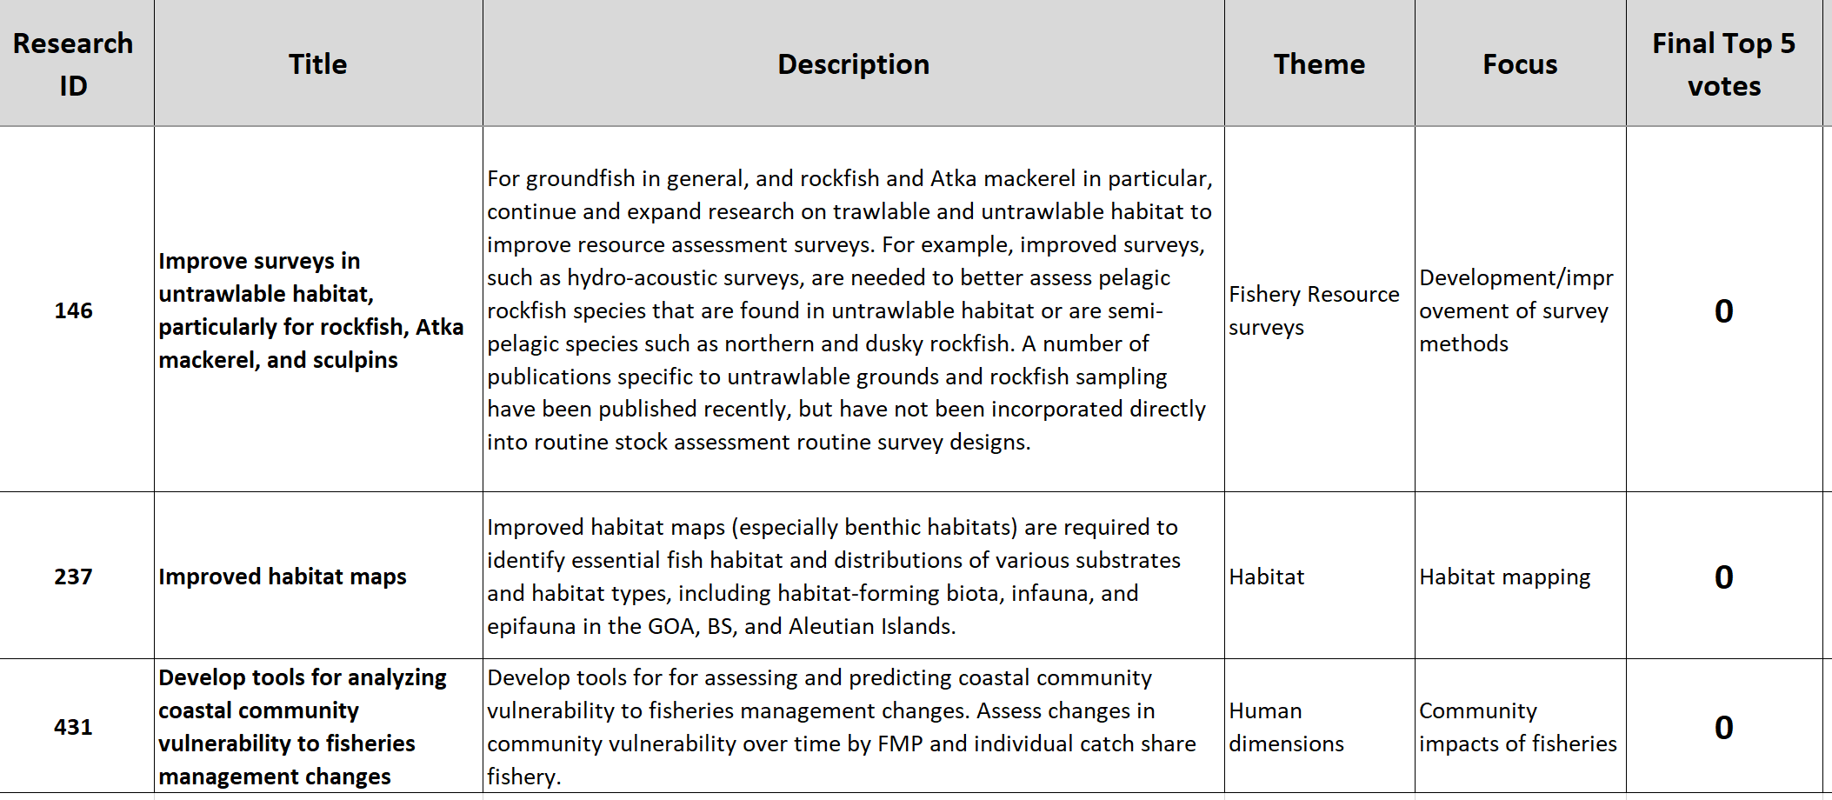

Slide 23
Removed, Added

Slide 24
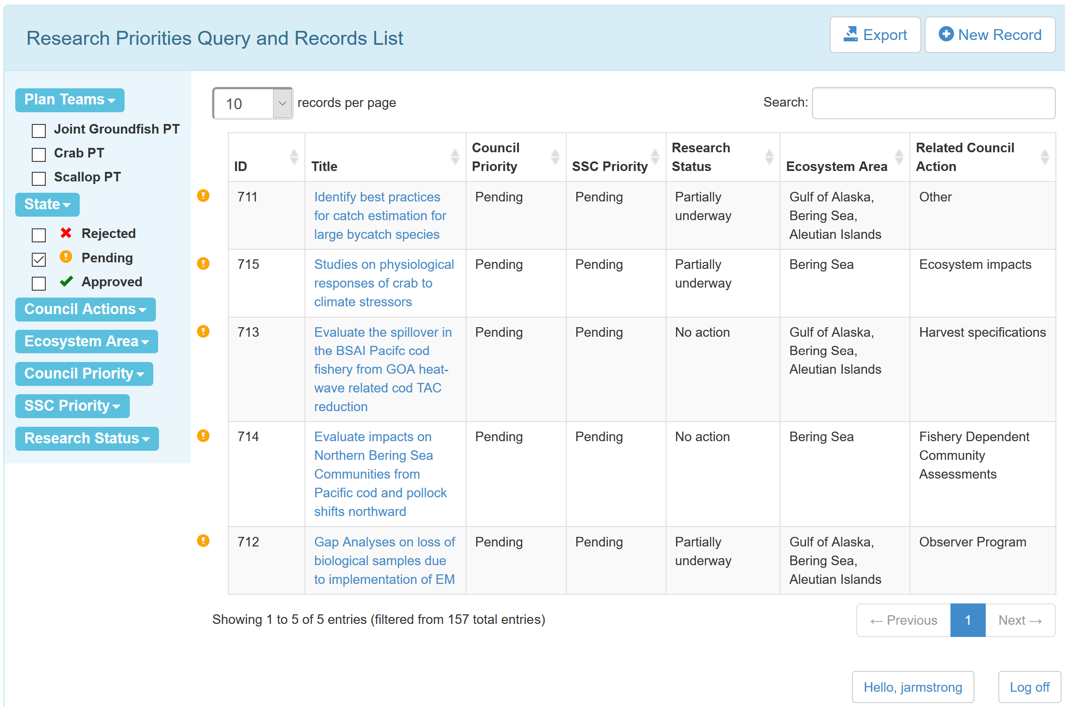
Database

Slide 25
Process Improvements
Wholescale revision
  Organize research needs within a hierarchy of themes and focus areas
  Facilitate/assign review within themes
  Communicate research needs and activity at varying levels of detail
  Develop matrices of research/data adequacy within themes
  Identify specific “projects” that can be linked to

