Slide 1




Halibut DMRs
For in-season management of non-target groundfish fisheries in 2020

Slide 2
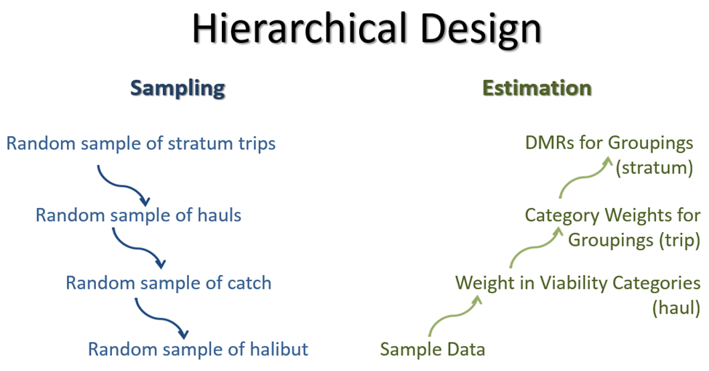
Methods
Excluded:
  Directed fishery
  EM
  Halibut deck-sorting EFP
Rockfish Program trips flagged

Slide 3
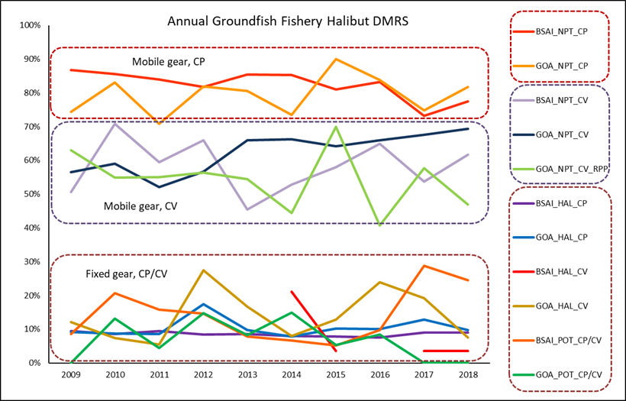
Fisheries

Slide 4
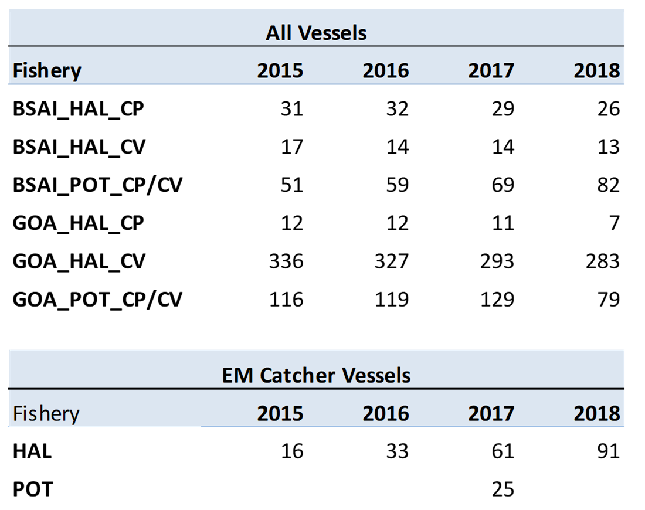
EM
DMR estimation is observer-based only
Viability protocol not established for EM
Release method

Slide 5
Research
Survivability assessment of discarded Pacific halibut in excellent condition (IPHC).
Capture of hook release method by electronic monitoring (IPHC)
Model-based discard mortality rates based on alternatives to halibut condition data (FMA)

Slide 6
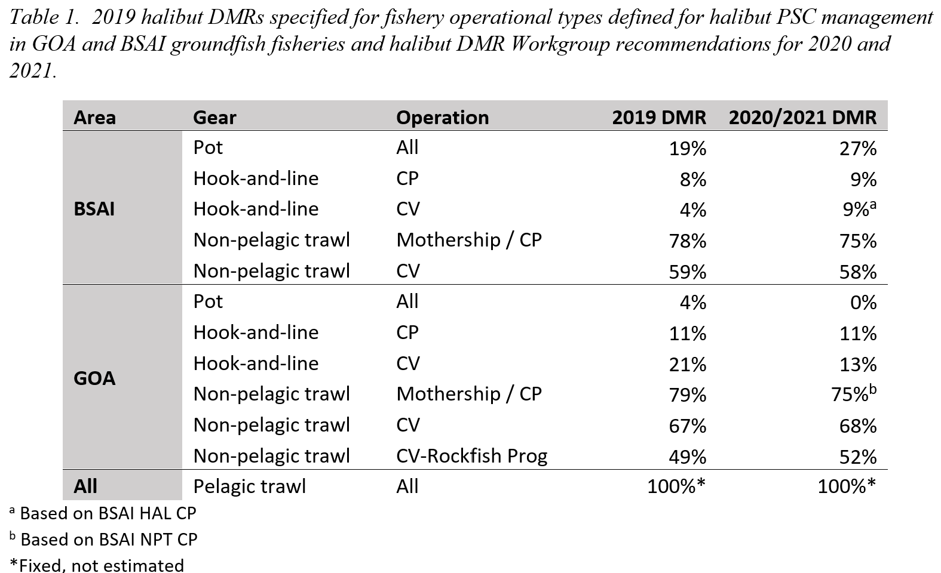
Recommendations

Slide 7
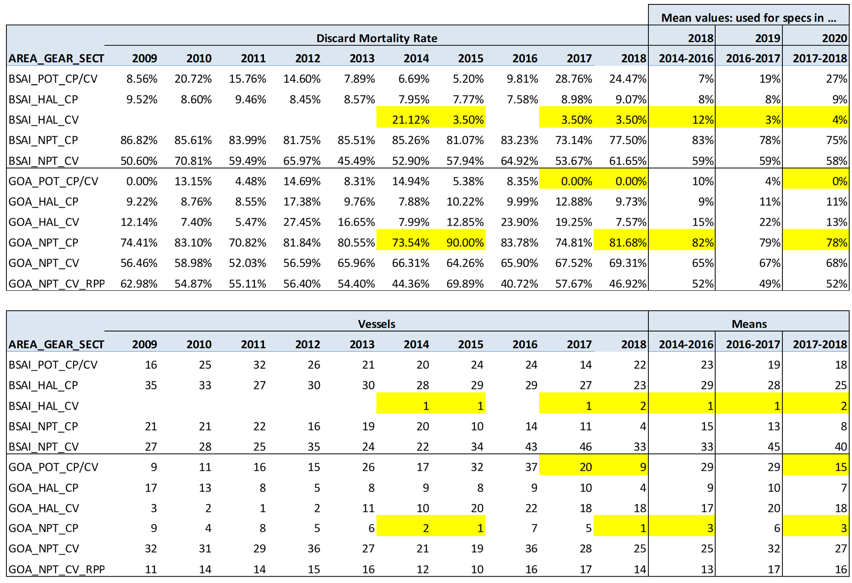
Recommendations

Slide 8
Recommendations
Maintain current methods?
2-year reference period (2017-2018)?
Extrapolation for missing values ?
Agree with WG recommendations?

