Slide 1
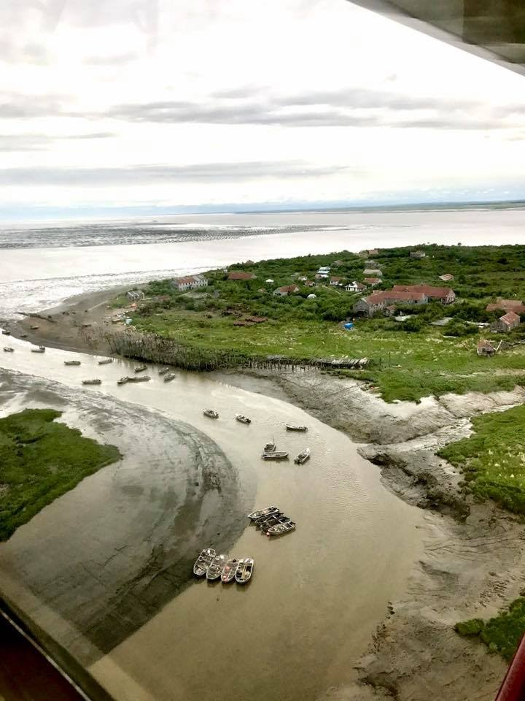
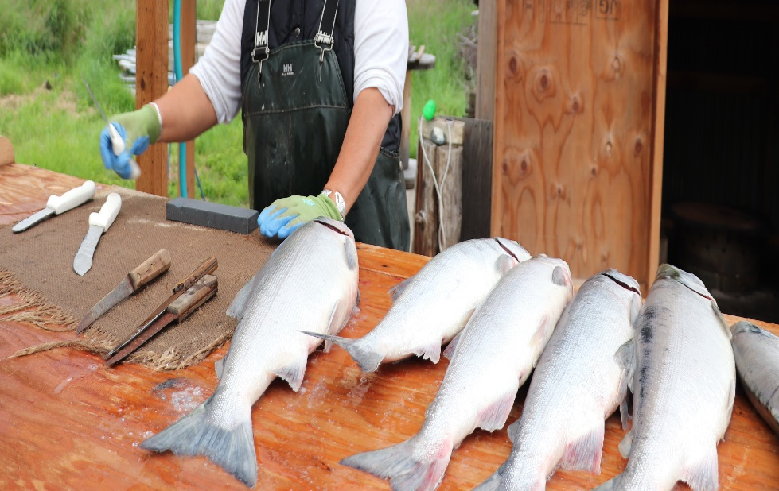
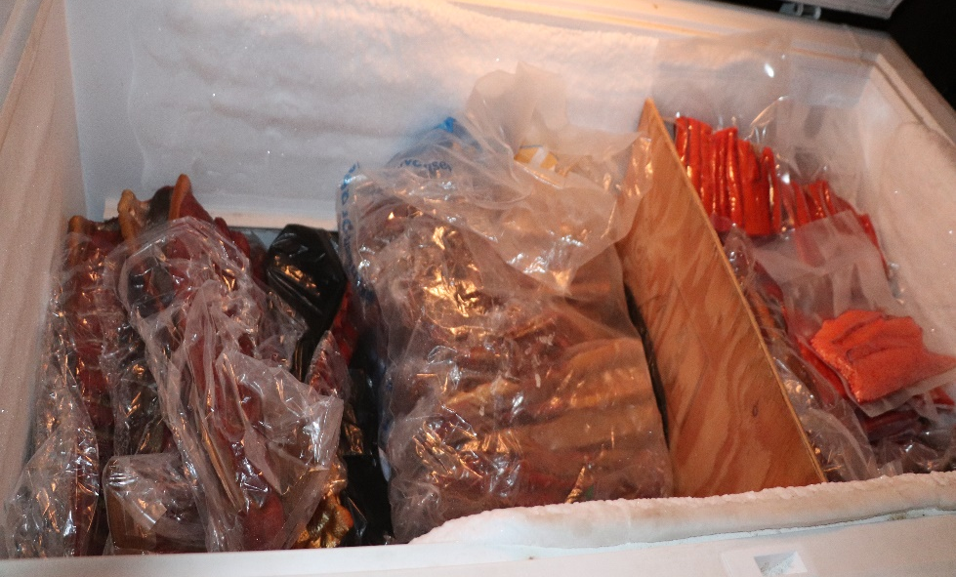
Local Knowledge, Traditional Knowledge, and Subsistence Taskforce
Fishcamp- Graveyard, AK
Update for the Crab Plan Team
May 7th, 2020
Co-chairs: Sarah Wise
sarah.wise@noaa.gov and
Kate Haapala
kate.haapala@noaa.gov
Photo: Judy Jo Matsun

Slide 2
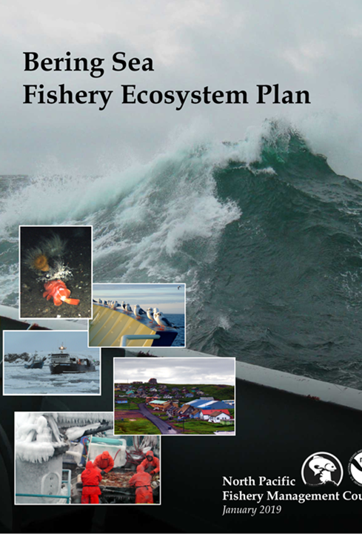
Review of Action Module Goal
Develop protocols for operationalizing Local Knowledge (LK), Traditional Knowledge (TK) in management and formulate methods for assessing the likelihood a given Council action may affect subsistence resources and users. (BS FEP 2019, pg. 9)

Slide 3
Council minutes February 2020
“The SSC suggests that joint efforts could be focused on a case study designed to address the primary goals of both the CCTF and LK/TK TF. One example may be a case study focused on Norton Sound red king crab. This case combines the need for long-term, strategic recommendations on how to adapt to climate change with a need to involve a variety of local stakeholders.”
Goal of case study:
To groundtruth proposed framework for using LKTK in council process
Related questions
How to identify LKTK?
What are the appropriate pathways for collaboration? with LK and TK holders?
What are the social and cultural connections to the fishery?
Mechanism to identify and communicate “Red Flags” in fishery/community?

Slide 4
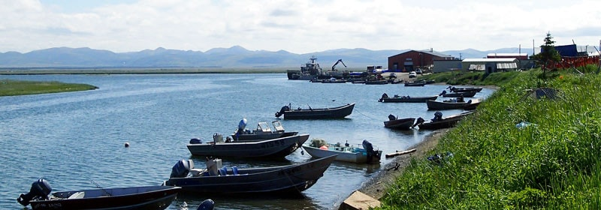
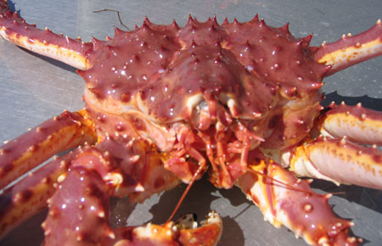
Ideas - Council suggested
Questions
What do we want to get out of the case study?
How will it support Goals 1&2?
What are some limits?
  Jointly managed
  Secondary data exists
  Budgetary constraints
  Time constraints
Will Norton Sound RKC do this?
Norton Sound Red King Crab
Important fishery across scale (time, region, type)
Small fishery
Active commercial and subsistence fisheries
Experiencing significant change

Slide 5
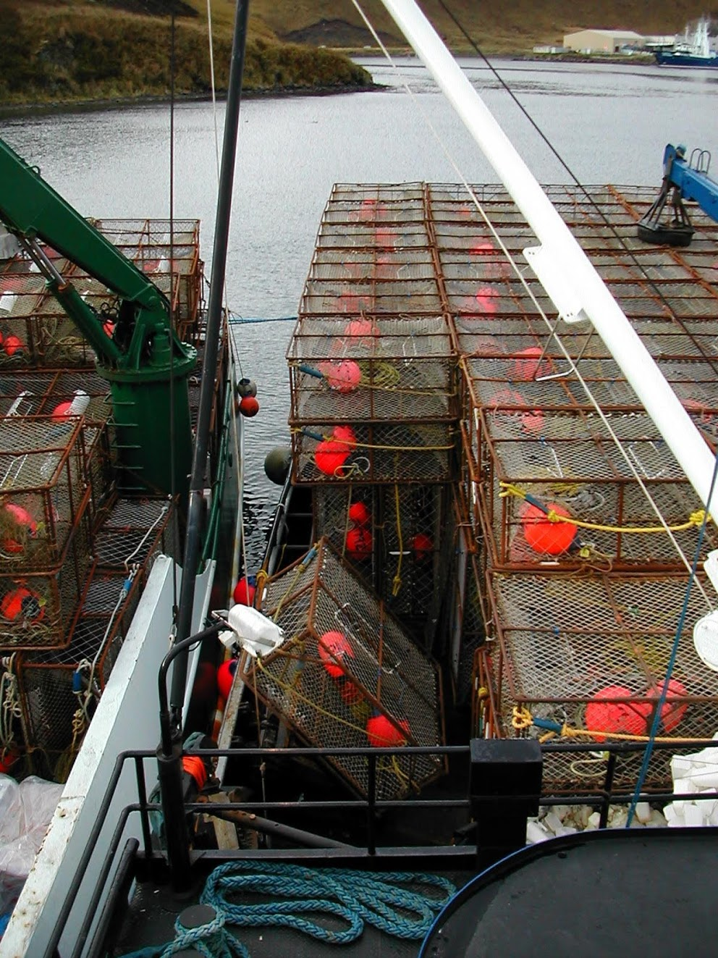
Meeting Outcomes
Positive feedback from Taskforce members
  Timely given ongoing climate and economic impacts
  NS RKC is an important fishery experiencing dramatic change, especially in last 5 years.
Case study on hold until 2021
  Pause in all travel and research in-region until 2021 due to Covid-19.
  Important to develop a community-driven case study
  Timing of case study in relation to Taskforce protocol development
Will revisit case study next Taskforce meeting
  October - December 2020?

Slide 6
Questions, Feedback and Discussion

