Slide 1
Stock Boundaries
Alaska Region
September 2020

Slide 2
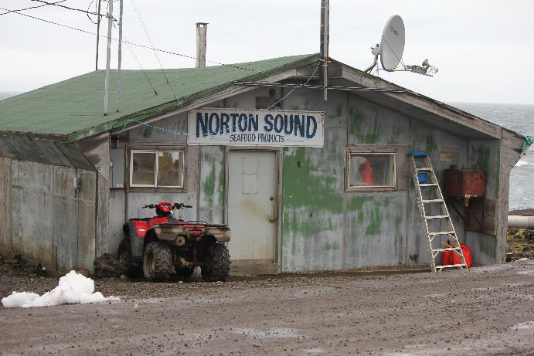
Norton Sound Red King Crab Incidental Catch in Groundfish Fisheries
2009 – 2017: no RKC bycatch in NSRKC stock area
In 2018: 8 kg of RKC bycatch (mortality applied)
In 2019: 13 kg of RKC bycatch (mortality applied)

Slide 3
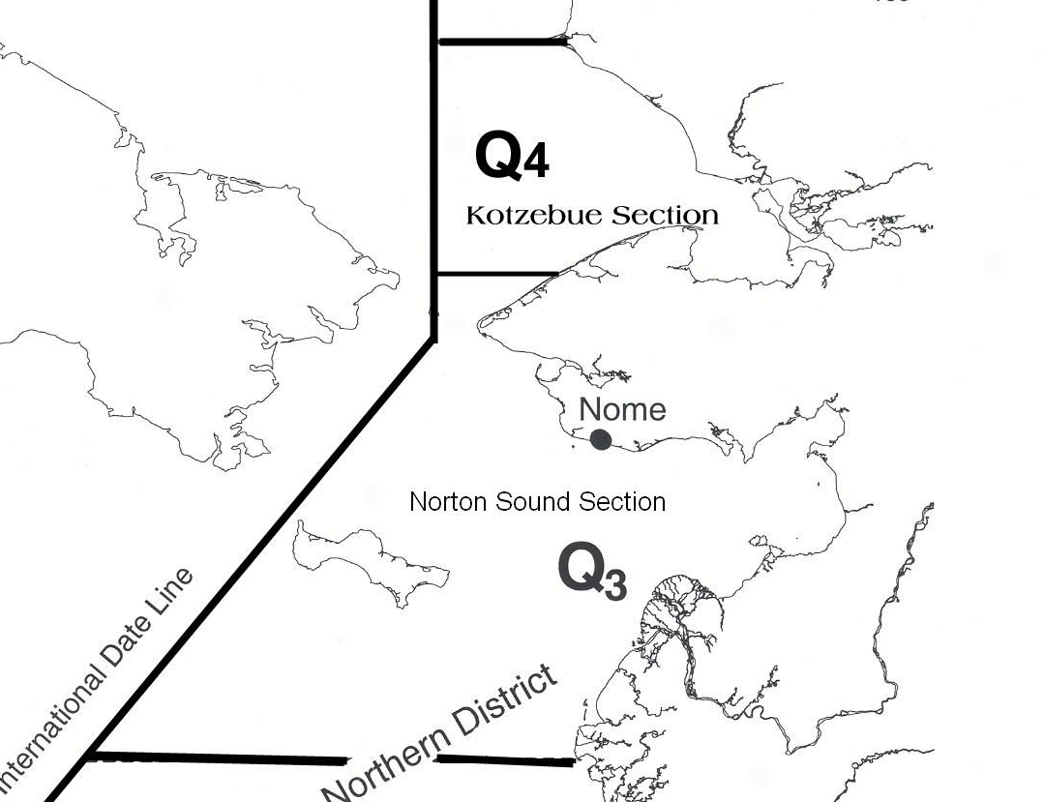
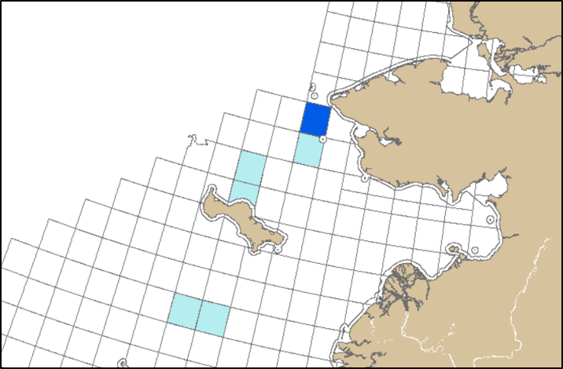
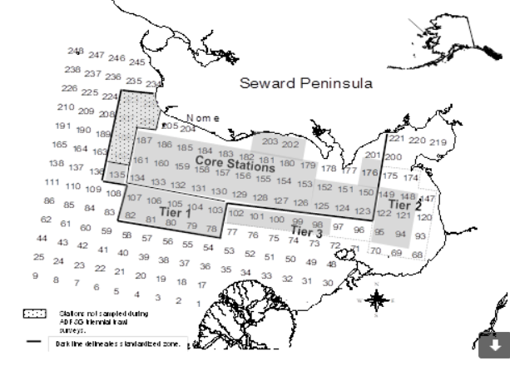
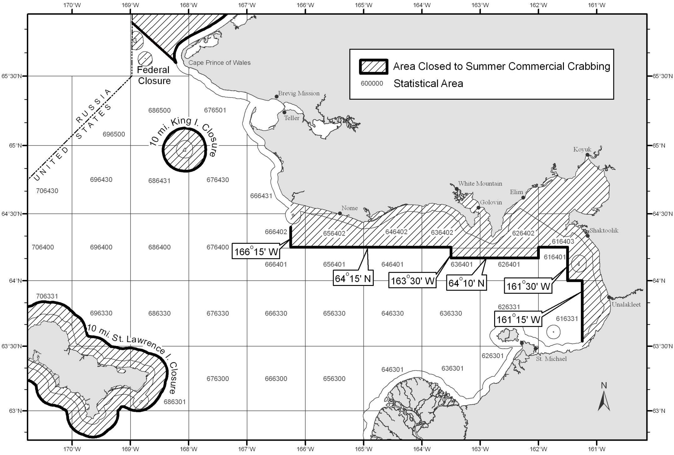
Statistical Areas Where RKC Bycatch was Observed in 2018 and 2019

Slide 4
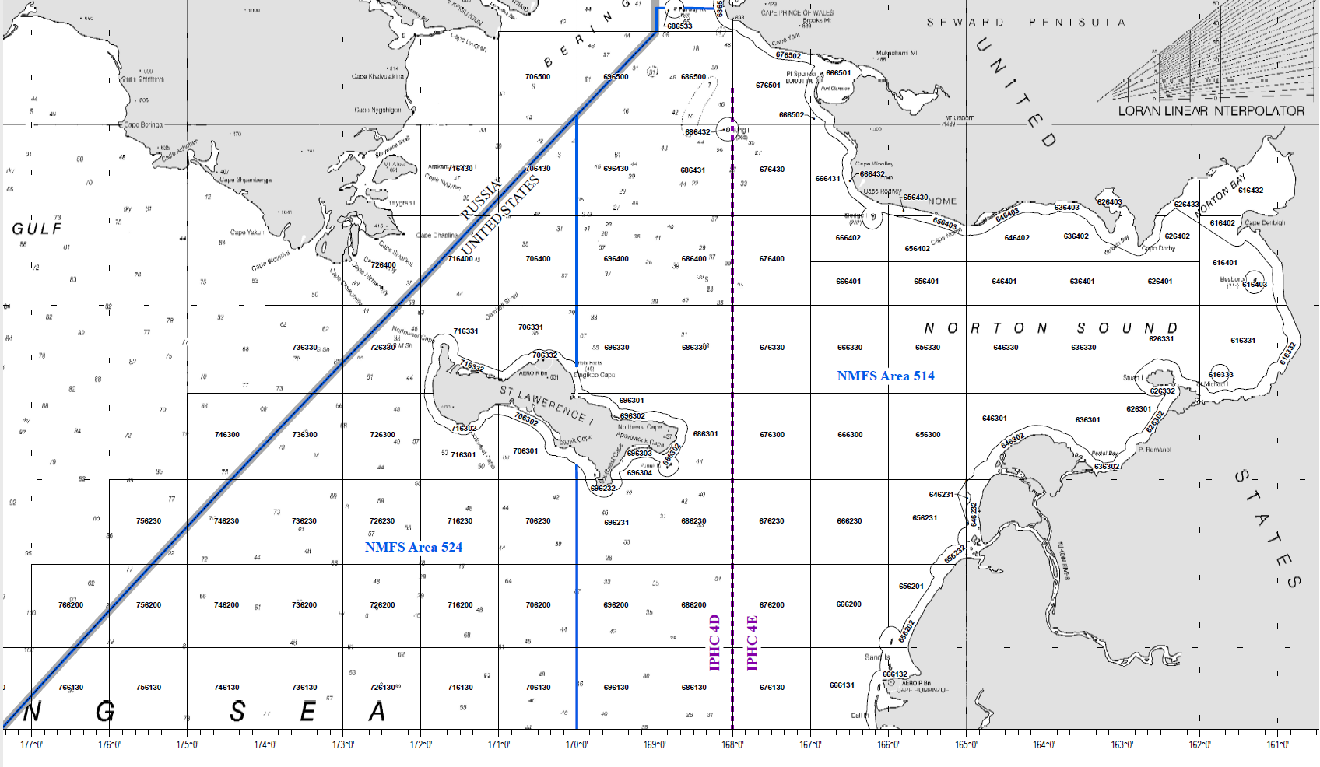
NSRKC Bycatch?

Slide 5
FMP
5 Description of Fishery Management Unit
“This FMP applies to commercial fisheries for red king crab Paralithodes camtschaticus, blue king crab P. platypus, golden (or brown) king crab Lithodes aequispinus, Tanner crab Chionoecetes bairdi, and snow crab C. opilio in the BS/AI area, except for ...”
“The BS/AI area contains several stocks of king and Tanner crabs (see Appendix F) that are discrete from stocks in the Gulf of Alaska.”

Slide 6
FMP
Appendix F. Current and Historic Boundaries for Registration Areas and Fishing Districts, Sub-districts, and Sections within the BSAI Management Unit
  Current Registration Areas
King Crab
Bering Sea Registration Area (Statistical Area Q)
Outdated language: Norton Sound Section Q3: waters east of 168° W. long., and north of latitude of Cape Romanzof (61°49' N. lat.) and south of the latitude of Cape Prince of Wales (65°36' N. lat.);
Alaska Admin Code
5 AAC 34.905. Description of Registration Area Q districts
(a) Repealed 6/14/80.
(b) Pribilof District: waters of Registration Area Q south of the latitude of Cape Newenham (58°39' N. lat.).
(c) Northern District: waters of Registration Area Q north of the latitude of Cape Newenham (58° 39' N. lat.).
(1) Norton Sound Section: waters, north of the latitude of Cape Romanzof (61° 49’N. lat.) and south of 66° N. lat.);
(2) Saint Matthew Island Section: waters north of the latitude of Cape Newenham (58° 39’ N. lat.) and south of the latitude of Cape Romanzof (61° 49' N. lat.);
(3) Kotzebue Sound Section: all remaining waters of the district.

Slide 7
From the NSRKC SAFE:
2. General Distribution: Norton Sound red king crab is one of the northernmost red king crab populations that can support a commercial fishery (Powell et al. 1983). It is distributed throughout Norton Sound with a westward limit of 167-168° W. longitude, depths less than 30 m, and summer bottom temperatures above 4° C. The Norton Sound red king crab management area consists of two units: Norton Sound Section (Q3) and Kotzebue Section (Q4) (Menard et al. 2011). The Norton Sound Section (Q3) consists of all waters in Registration Area Q north of the latitude of Cape Romanzof, east of the International Dateline, and south of 66°N latitude (Figure 1). The Kotzebue Section (Q4) lies immediately north of the Norton Sound Section and includes Kotzebue Sound. Commercial fisheries have not occurred regularly in the Kotzebue Section. This report deals with the Norton Sound Section of the Norton Sound red king crab management area.
3. Evidence of stock structure: Thus far, no studies have investigated possible stock separation within the putative Norton Sound red king crab stock.

Slide 8
MSA on Stocks
National Standards of the Magnuson-Stevens Fishery Conservation and Management Act: 3. To the extent practicable, an individual stock of fish shall be managed as a unit throughout its range, and interrelated stocks of fish shall be managed as a unit or in close coordination.

Slide 9
FMP Category 2 (frameworked in FMP):
The FMP authorizes the State to adjust district, subdistrict, and section boundaries on the basis of any of the following criteria:
(1) if the area contains a reasonably distinct stock of crab that requires a separate GHL estimate to avoid possible overharvest,
(2) if the stock requires a different size limit from other stocks in the registration area,
(3) if different timing of molting and breeding requires a different fishing season,
(4) if estimates of fishing effort are needed preseason so that overharvest can be prevented, or
(5) if part of an area is relatively unutilized and unexplored, and if creation of a new district, subdistrict, or section will encourage exploration and utilization.

