Slide 1
St. Matthew Blue King Crab
May 2020 Model exploration
Katie Palof, Jie Zheng, and jim Ianelli

Slide 2
Current status
Overfished
Rebuilding plan – final action in June NPFMC meeting
  No changes to fishing regulations
  No further bycatch restrictions
  Focused on recruitment expectations
Core model issues
  Discrepancies in trends between pot survey and trawl survey
  Spatial hot spots in surveys
  Poor fit of models to recent years survey data (2010+)

Slide 3
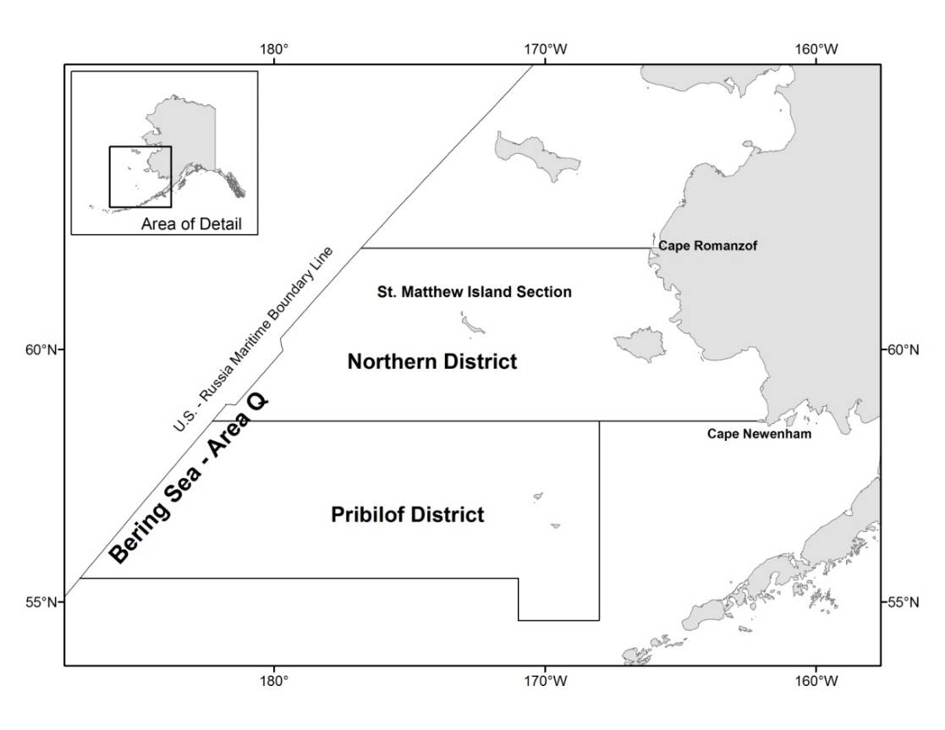

Slide 4
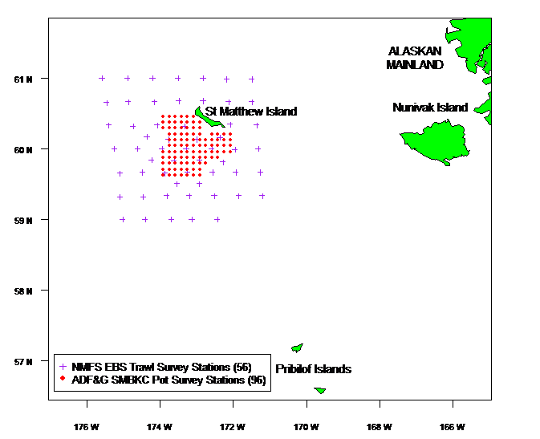

Slide 5
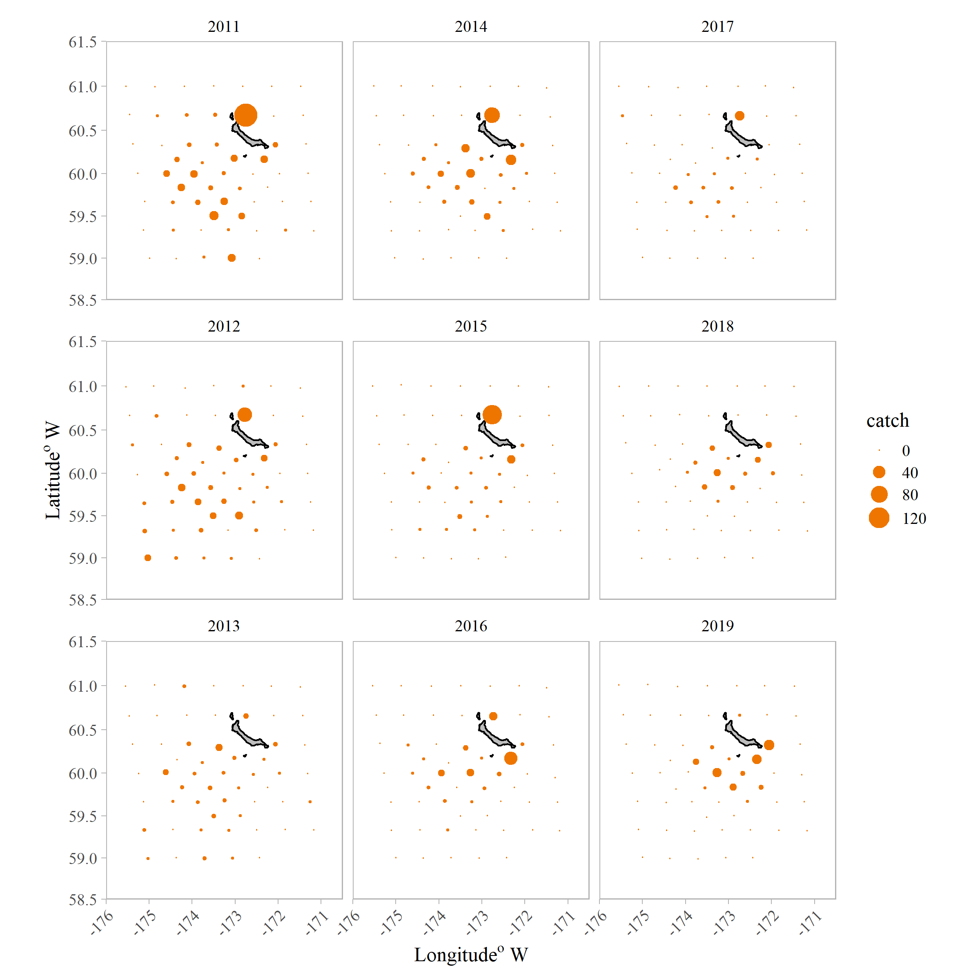
Trawl survey (area-swept) spatial breakdown in catch

Slide 6
SSC/CPT Comments
Retrospective analyses
  Planned for Sept. 2020 – at least for base model
  If implemented in GMACS could expand this to other model runs
Model scenarios for 2020:
  Extra CV on both surveys (19.3, 19.2)
  Random walk / exploration of pot survey catchability (19.4)
Explore potential explanations for the discrepancy in the time trends of the two types of survey data, including movement hypotheses using spatial models (not necessarily VAST)
  Limited progress, just received detailed ADF&G data (delays due to current world events). Plan to explore this more before Sept.
Correct model numbering
  16.0 is the base/reference model.

Slide 7
Model evaluations
16.0 - 2019 Reference Model:
  updated with Jan 2020 updates to GMACS
19.1 - VAST NMFS trawl data:
  model 16.0 with VAST data output for the NMFS trawl survey time series
19.2 - add CV pot:
  model 16.0 + an estimated additional CV on the ADF&G pot survey
19.3 - add CV both:
  model 16.0 + an estimated additional CV on the ADF&G pot survey and the NOAA trawl survey
19.4 - q time block pot:
  time block estimated q’s for ADF&G pot survey.
  2 time blocks:1995 to 2013 and 2015 to 2018.

Slide 8
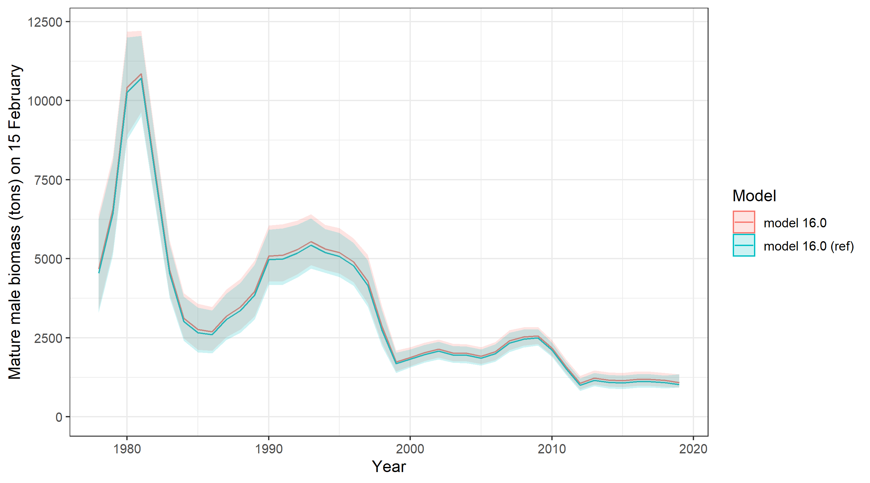
Notes:
Updates to GMACS in Jan 2020 produced very similar Model results – ssb and Recruitment.

Slide 9
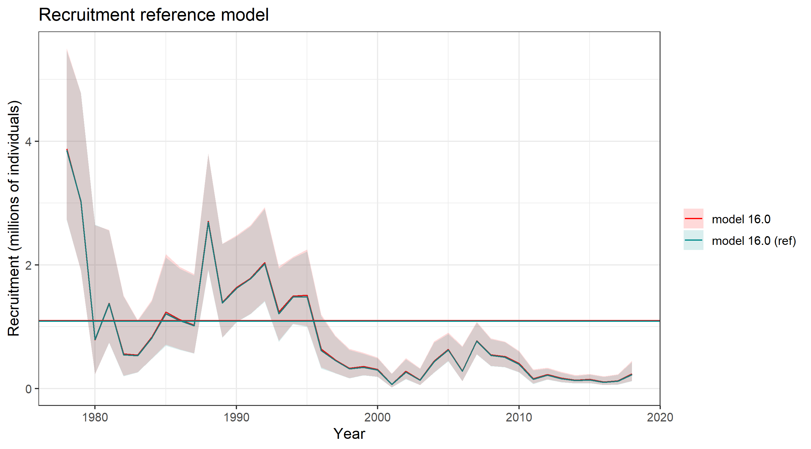

Slide 10
Model evaluations
16.0 - 2019 Reference Model:
  updated with Jan 2020 updates to GMACS
19.1 - VAST NMFS trawl data:
  model 16.0 with VAST data output for the NMFS trawl surveytime series
19.2 - add CV pot:
  model 16.0 + an estimated additional CV on the ADF&G pot survey
19.3 - add CV both:
  model 16.0 + an estimated additional CV on the ADF&G pot survey and the NOAA trawl survey
19.4 - q time block pot:
  time block estimated q’s for ADF&G pot survey.
  2 time blocks:1995 to 2013 and 2015 to 2018.

Slide 11
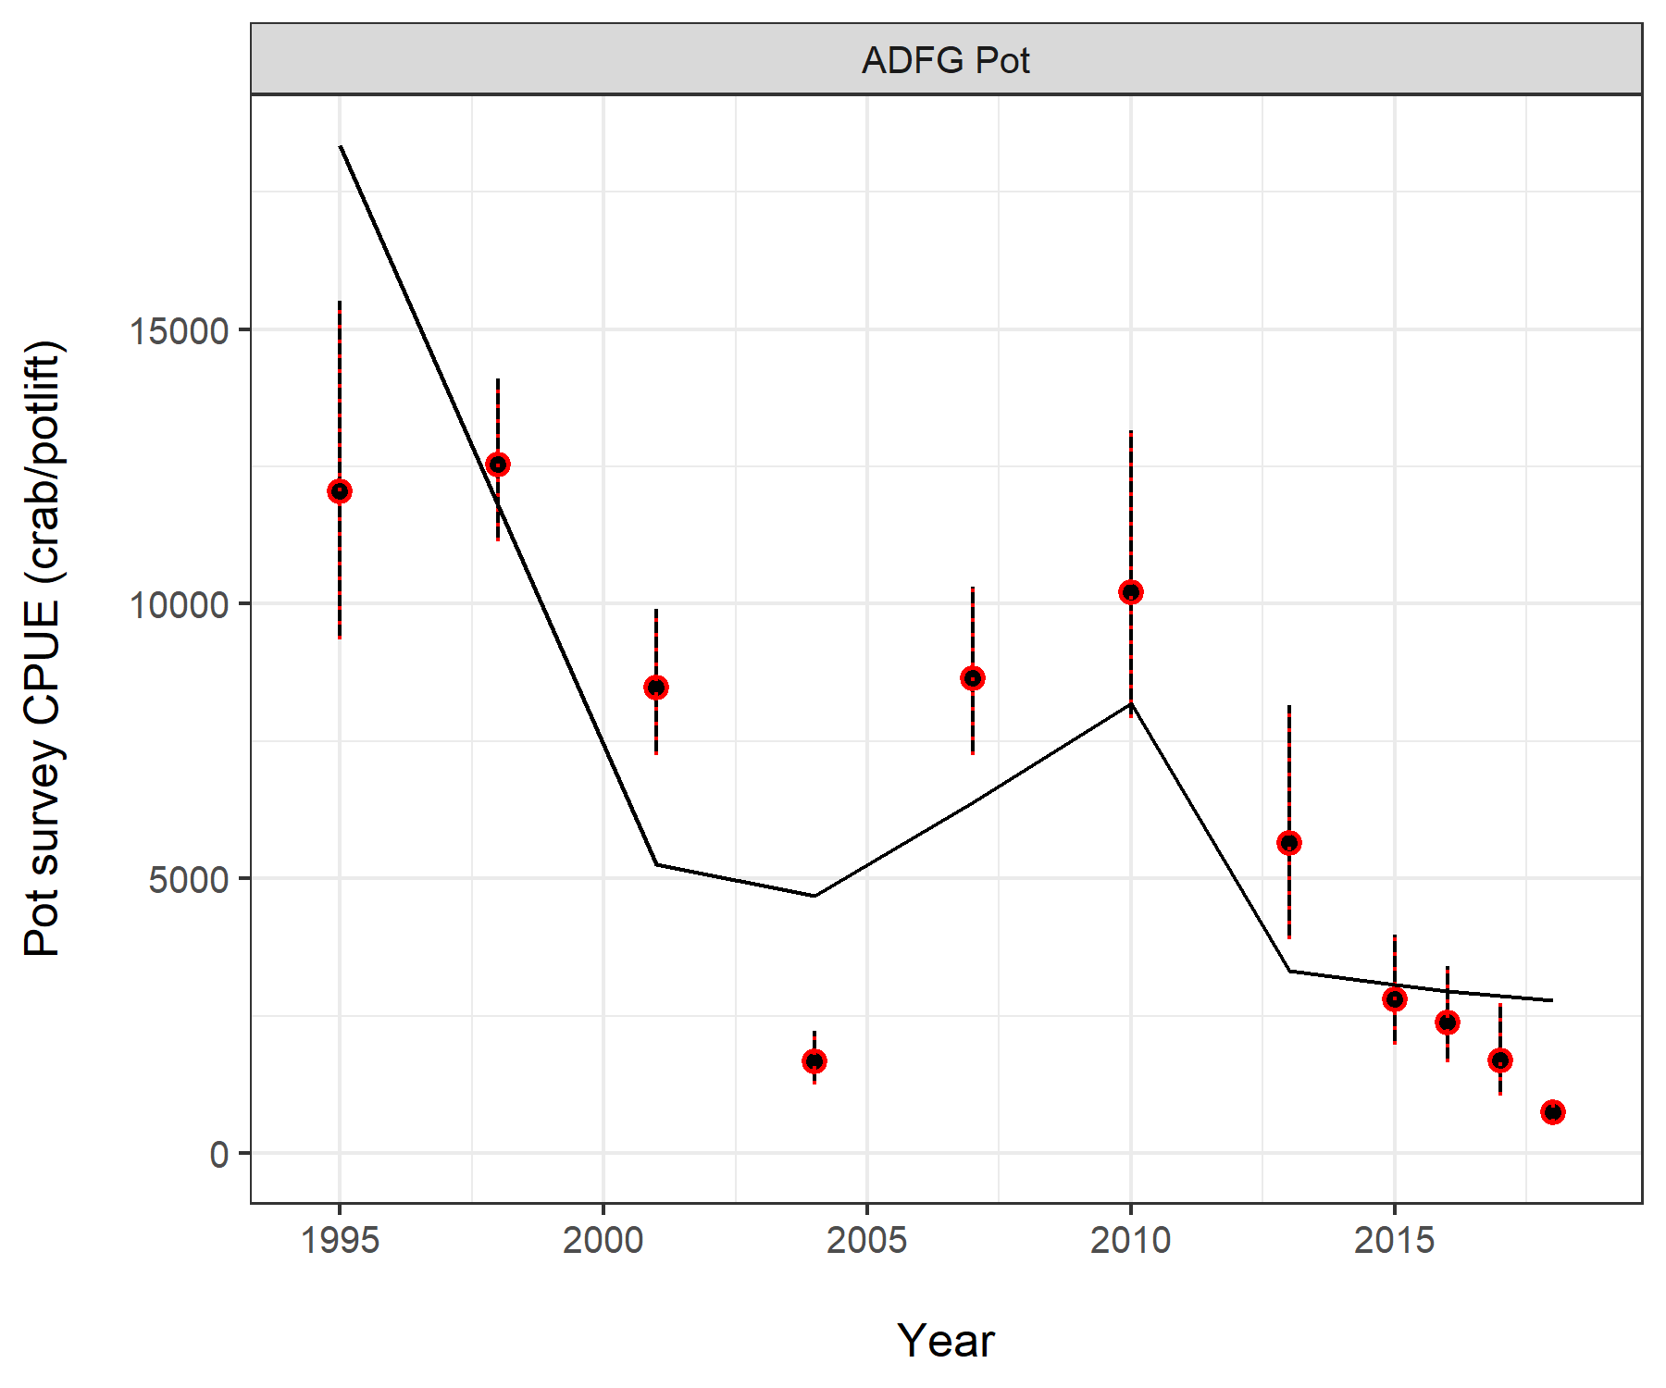
ADF&G Pot survey
Reference model
Notes:
2 reasons to pick this time block – 1 annual survey instead of trieenial, also pattern of negative residuals in the reference model.

Slide 12
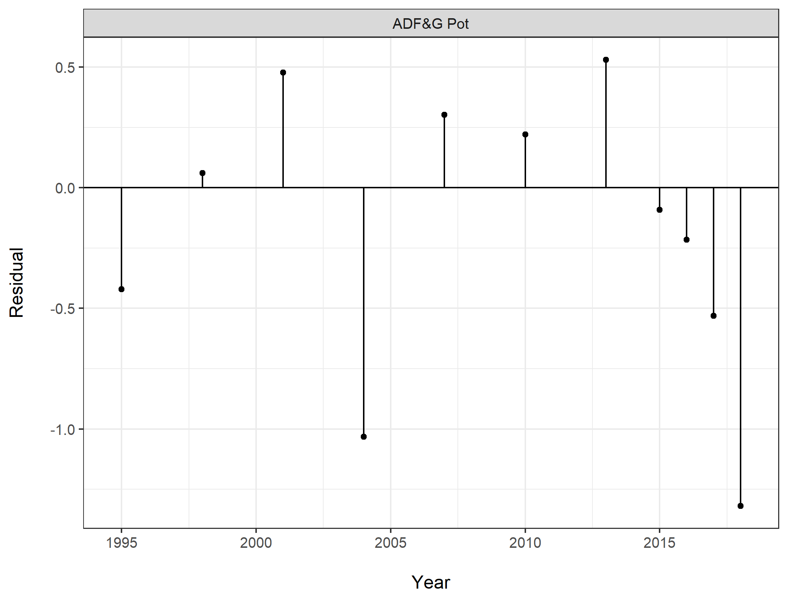
Residuals
ADF&G Pot survey
Reference model
Notes:
2 reasons to pick this time block – 1 annual survey instead of trieenial, also pattern of negative residuals in the reference model.

Slide 13
Survey Fit
- NOAA trawl
- ADF&G Pot

Slide 14
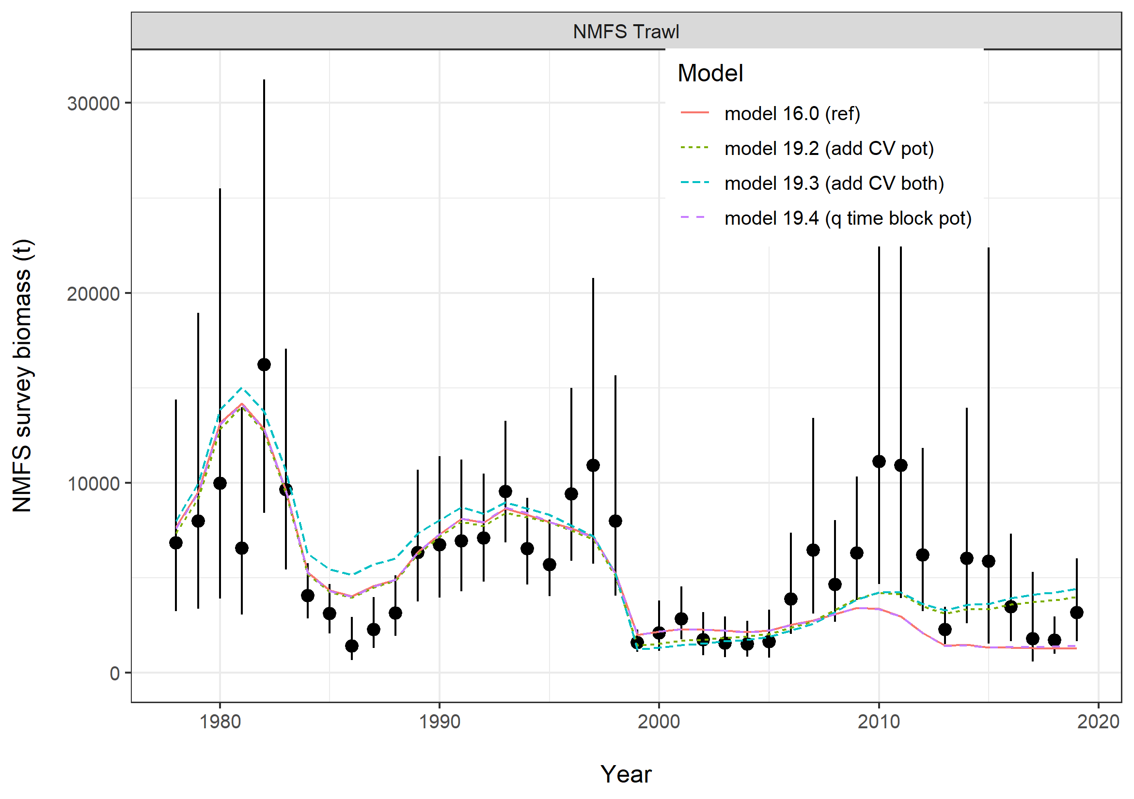
Notes:
2019 data point increased from 17 and 18. However base model did not respond to this or fit recent surveys years well (2010+). Add CV models over fit the recent time period. Suggesting that the pull downward of this fit has something to do with the pot survey CPUE data.

Slide 15
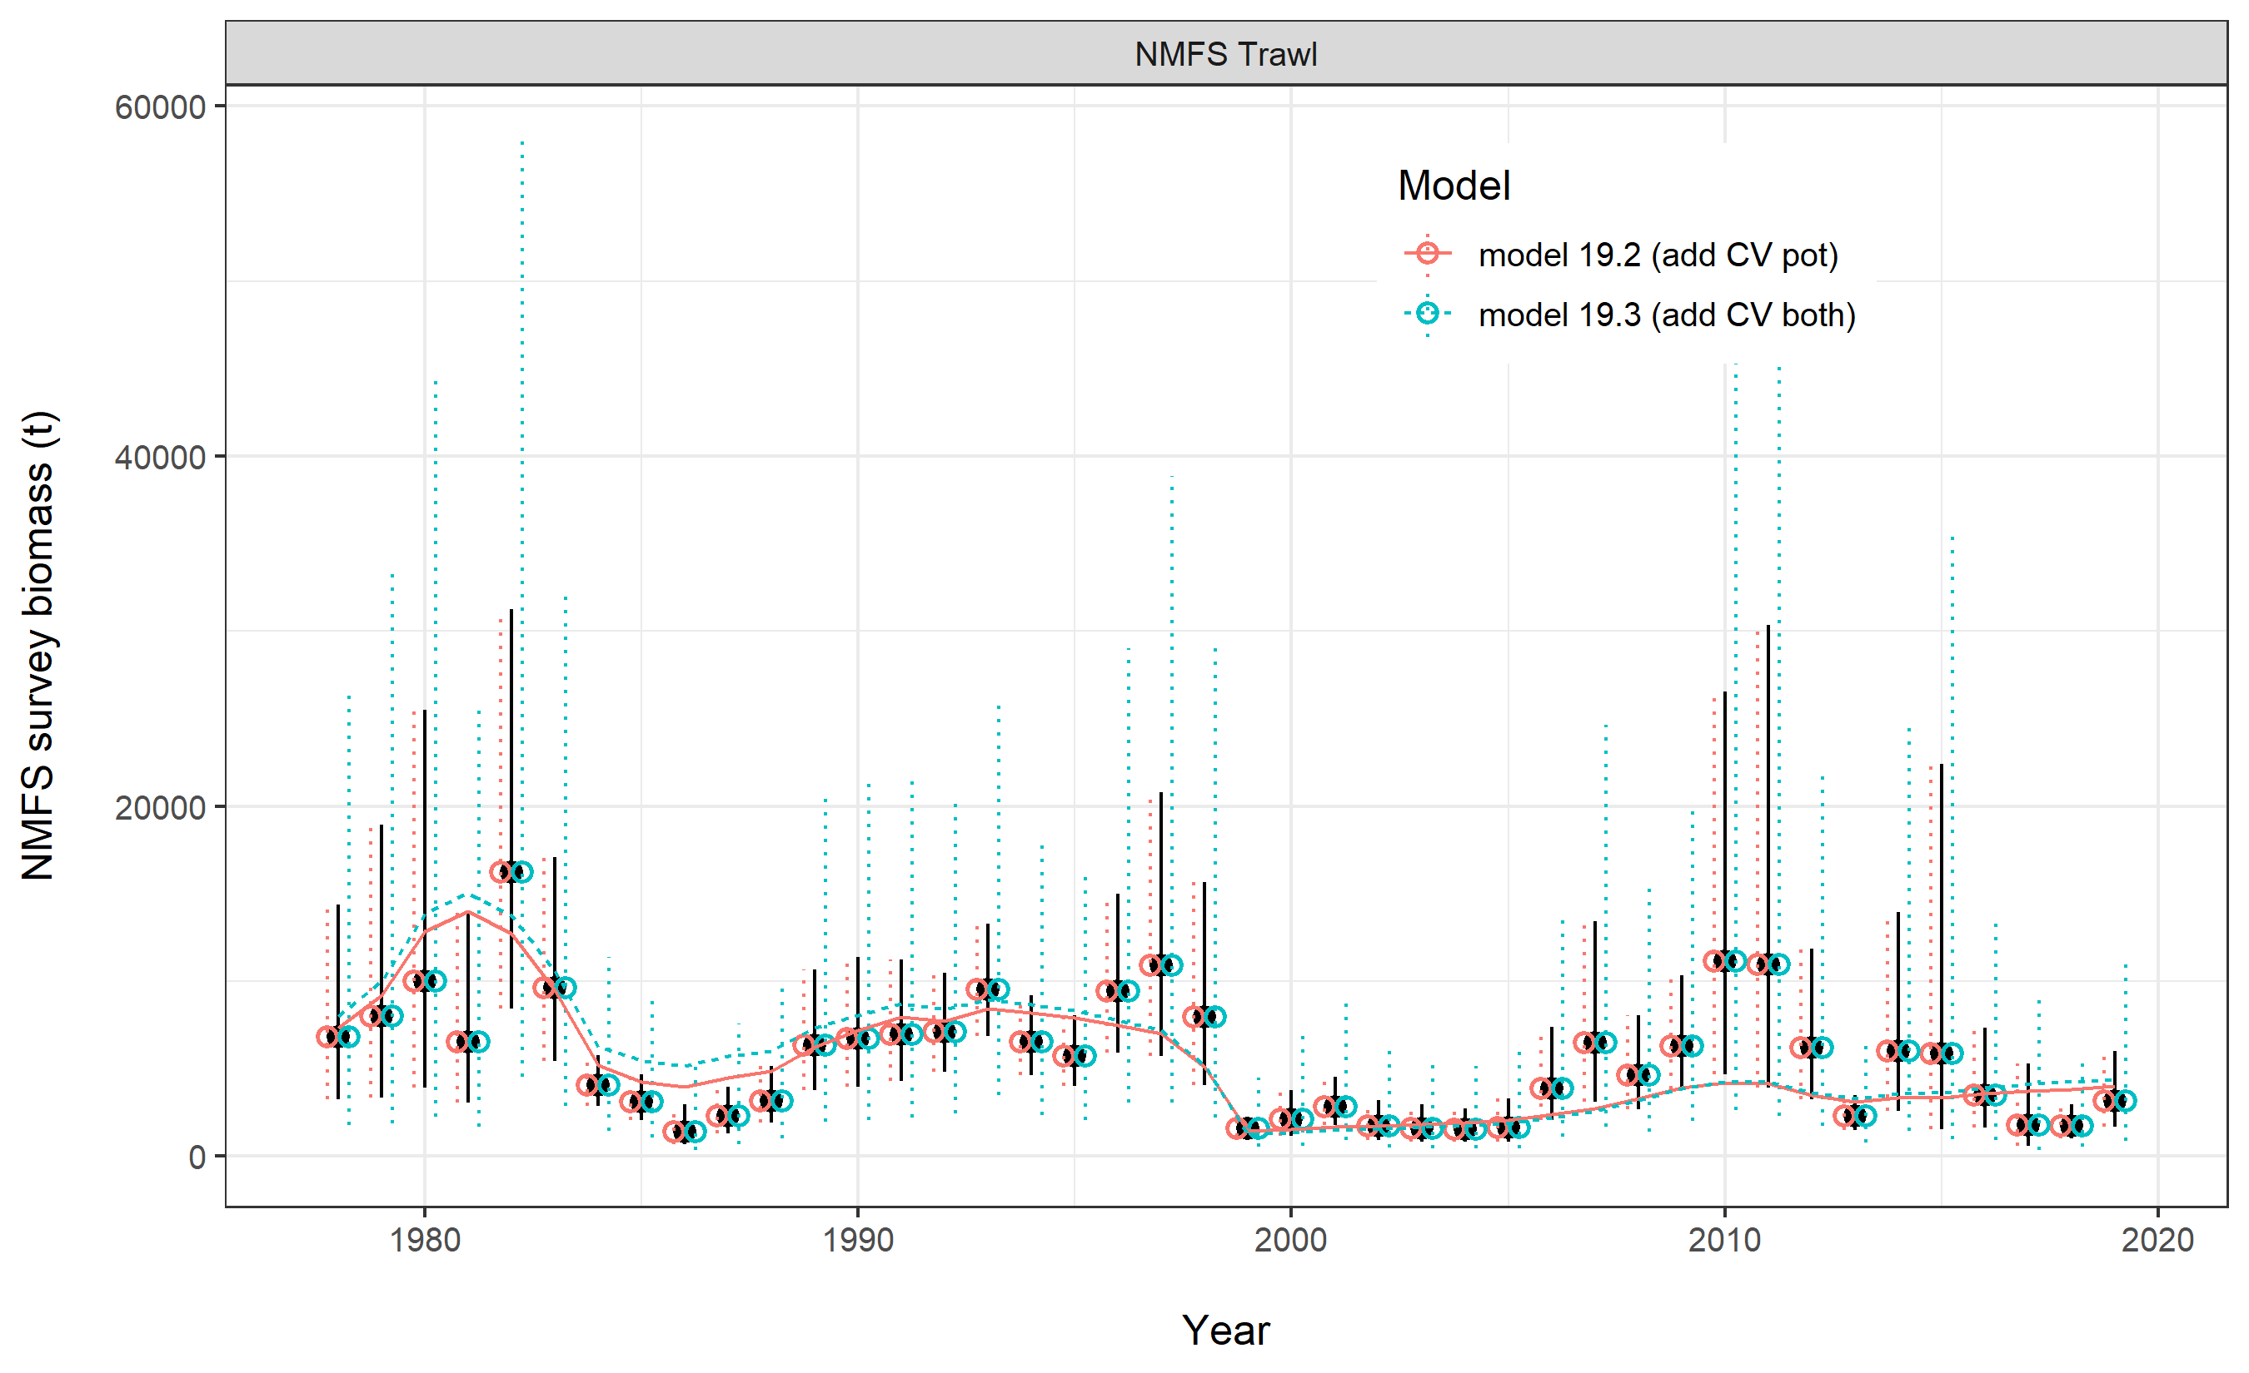

Slide 16
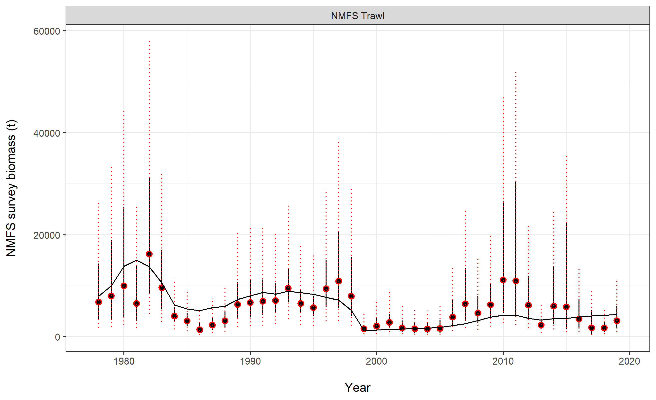
Model 19.3 – add CV both

Slide 17
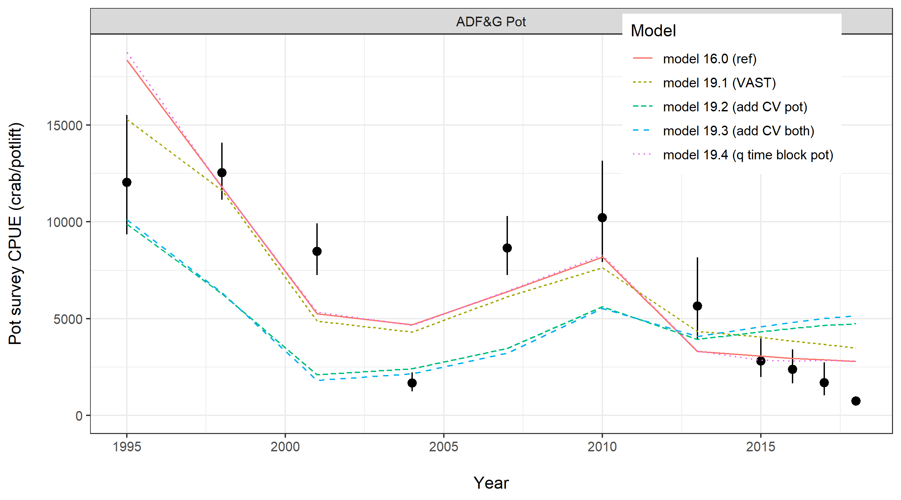

Slide 18
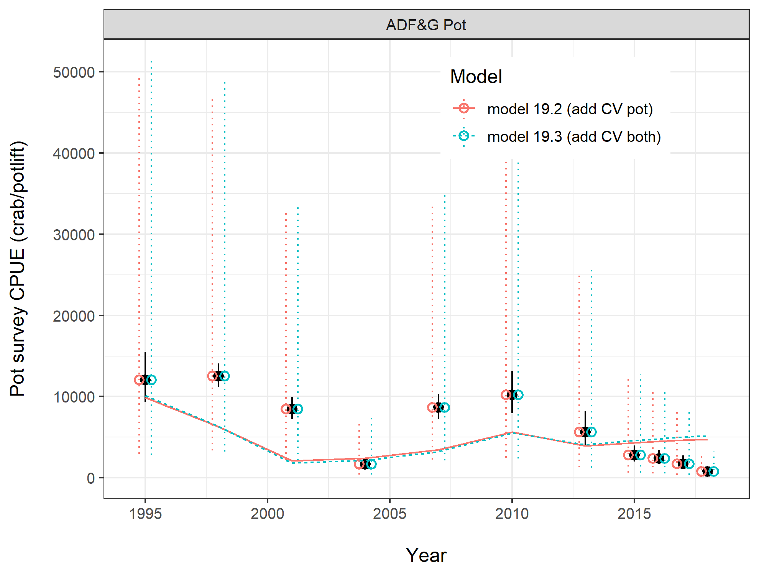

Slide 19
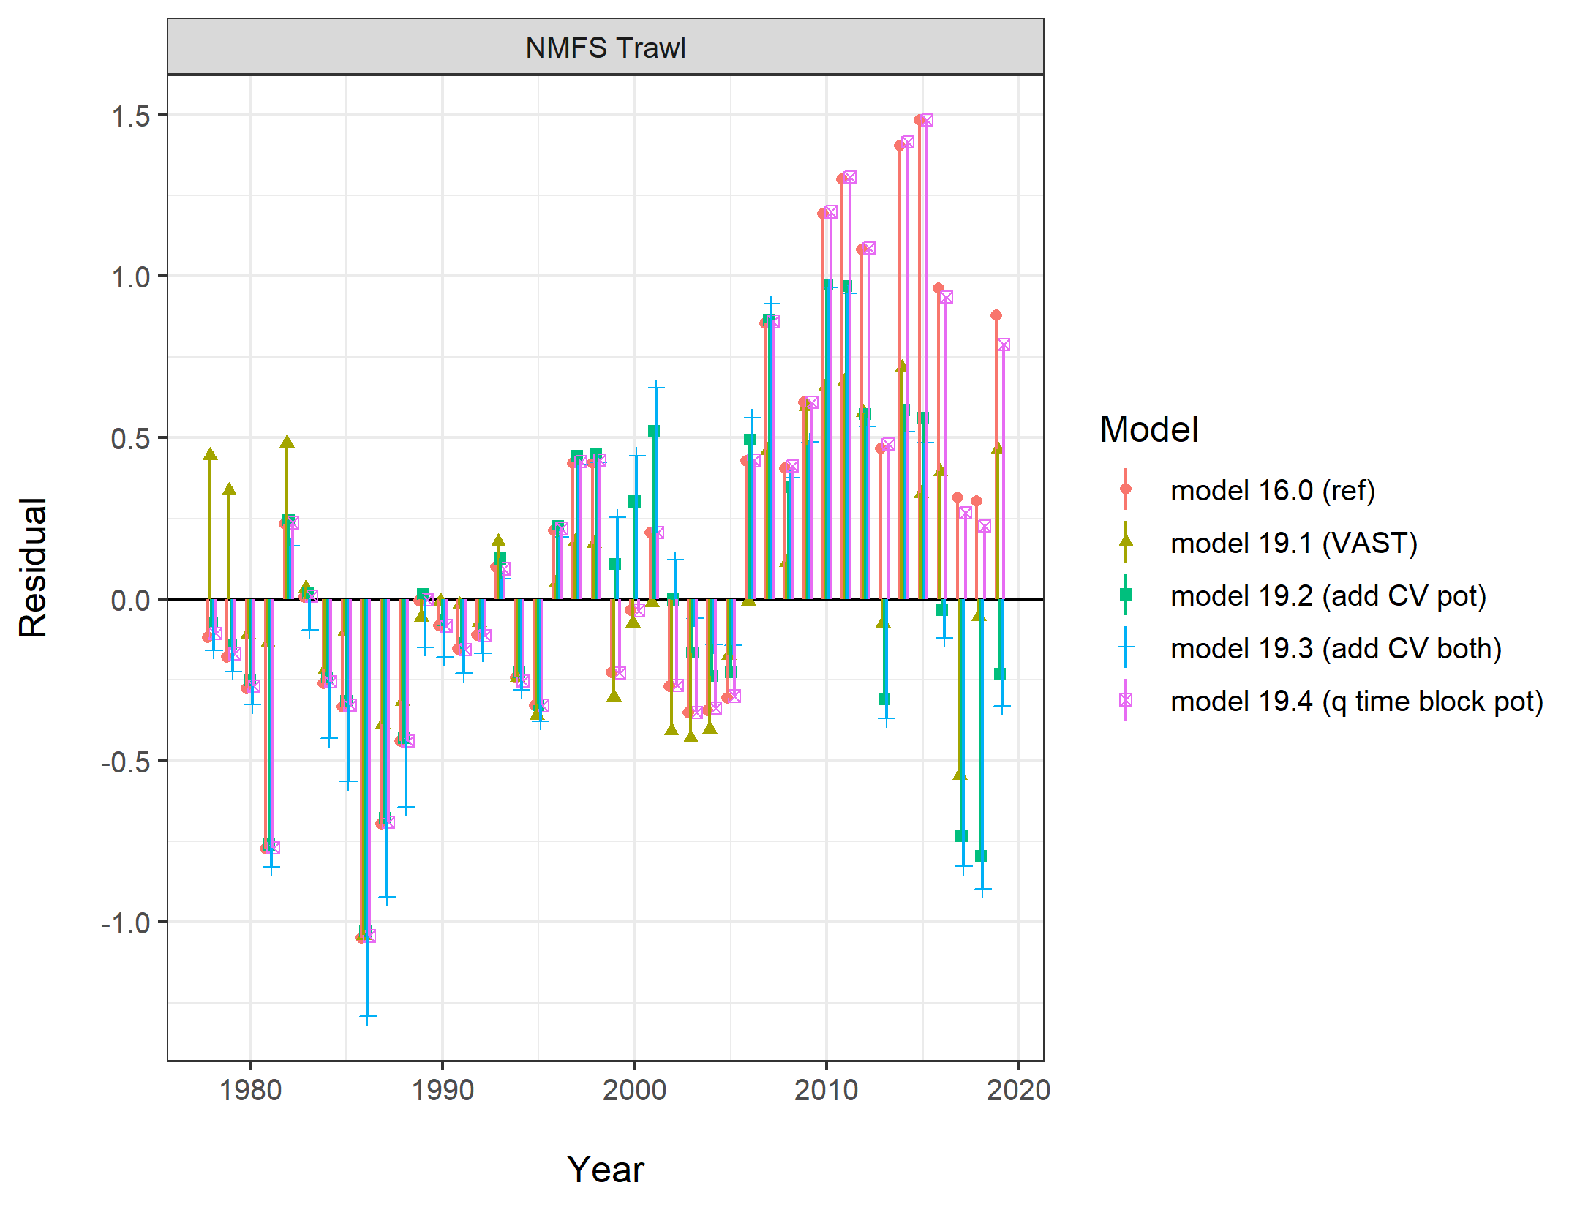

Slide 20
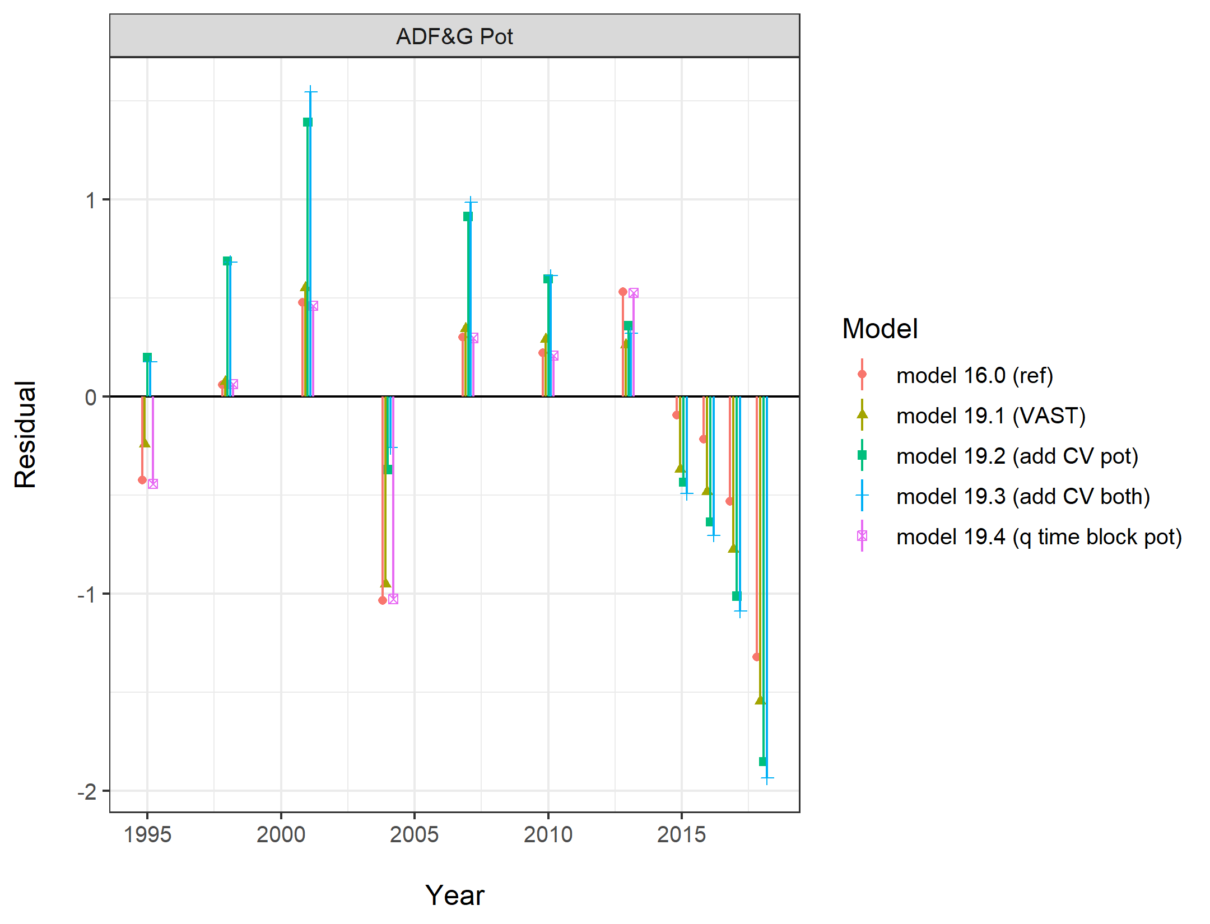

Slide 21
VAST vs. Area Swept
(Noaa Trawl survey)

Slide 22
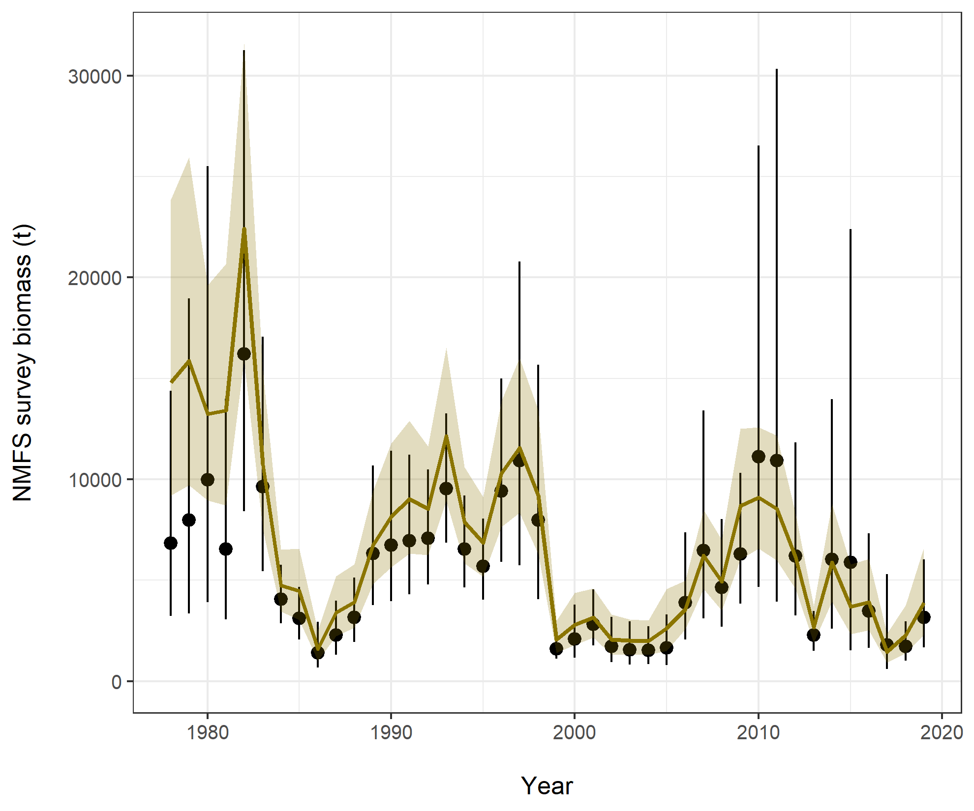
AREA-SWEPT
  black circles
VAST
  gold line
Concerns with VAST methods:
Approach to island (work underway to address this)
Only used on trawl survey

Slide 23
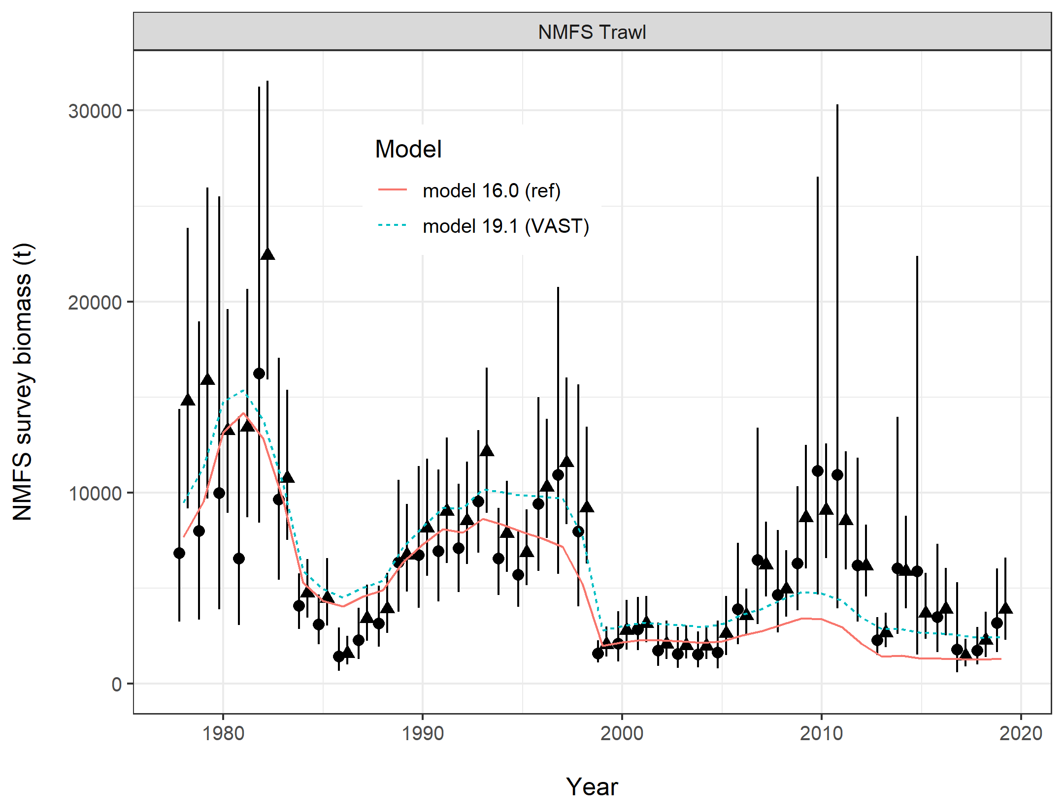
Area-swept
VAST
Notes:
Model fits to the 2 data sets. Circles are area-swept, Triangles VAST

Slide 24
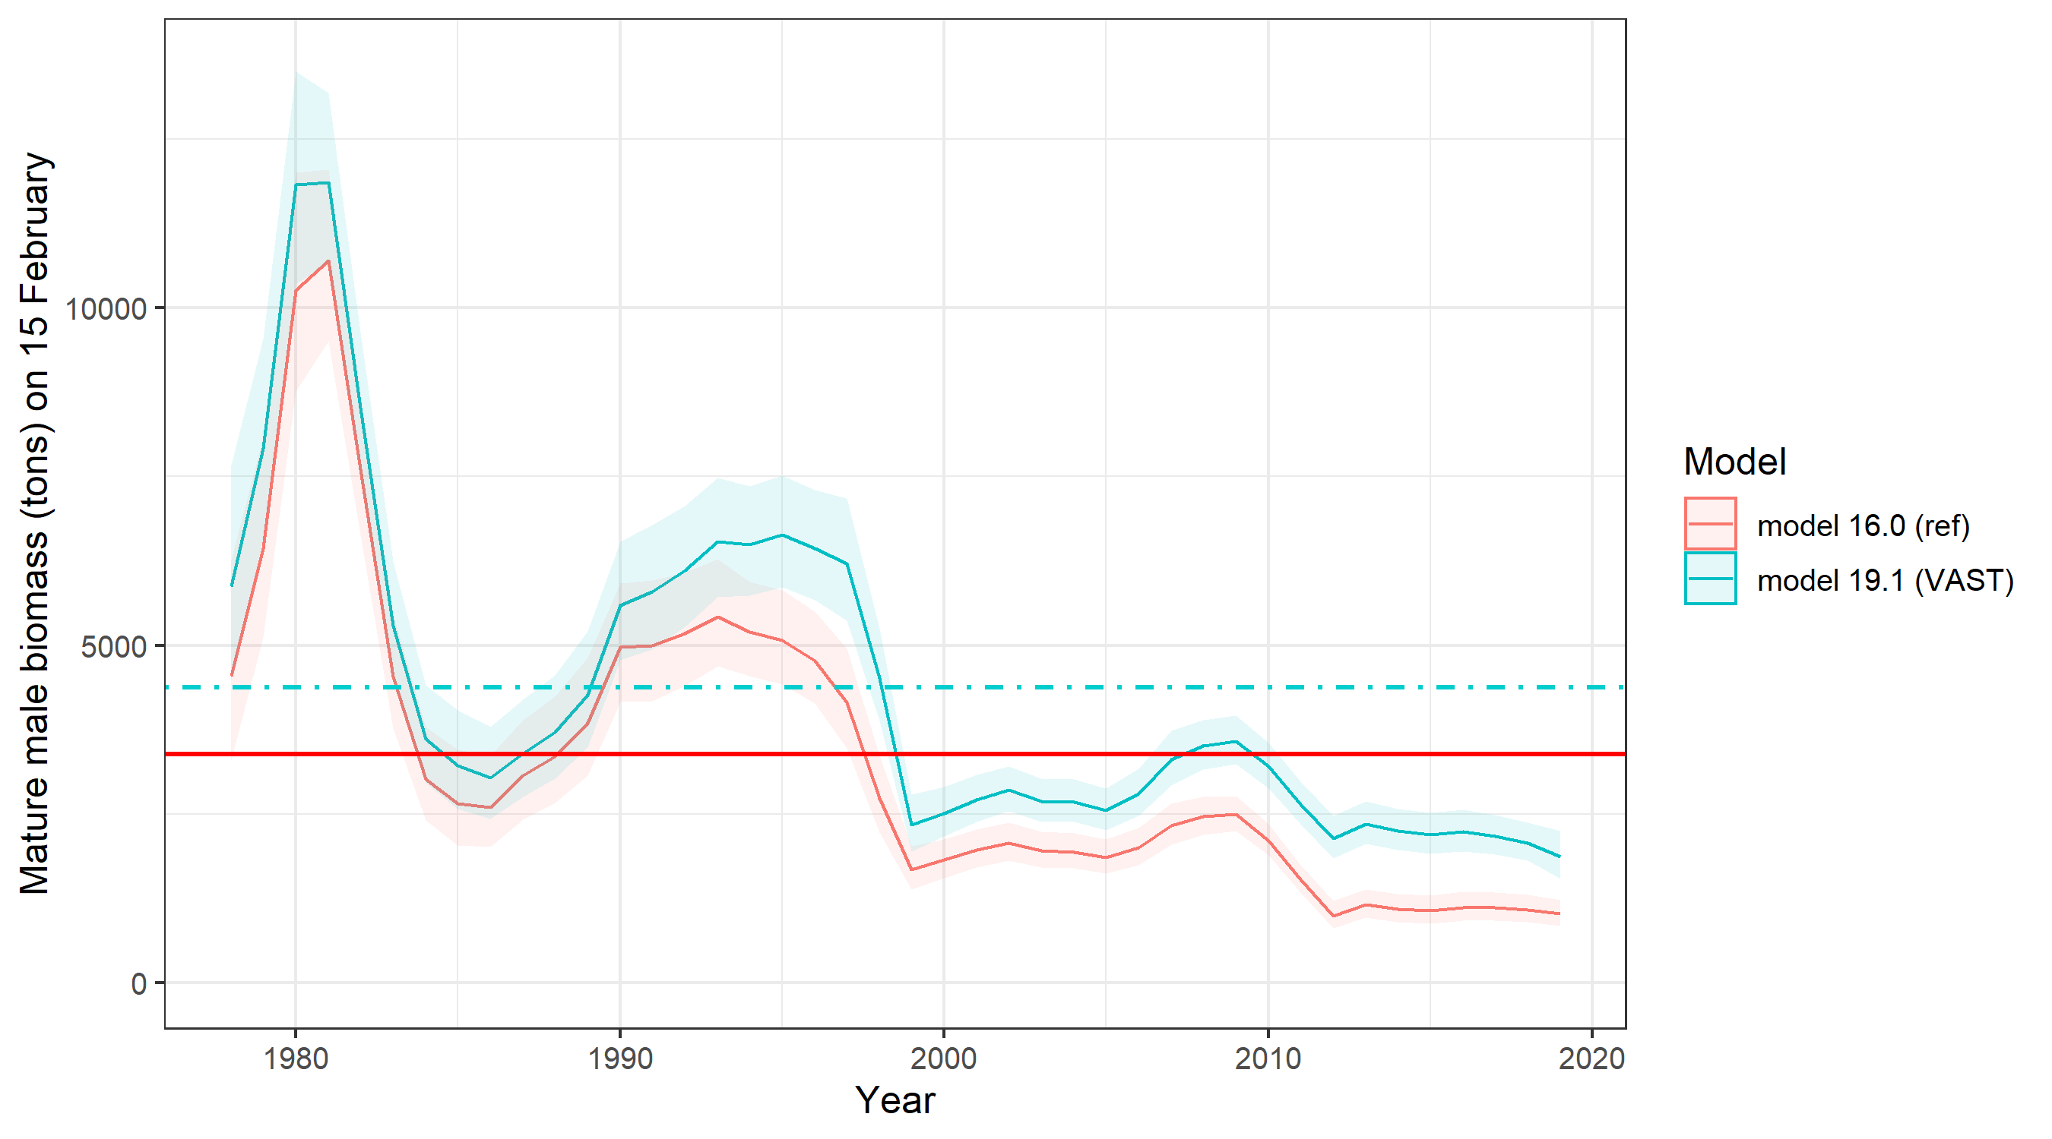

Slide 25
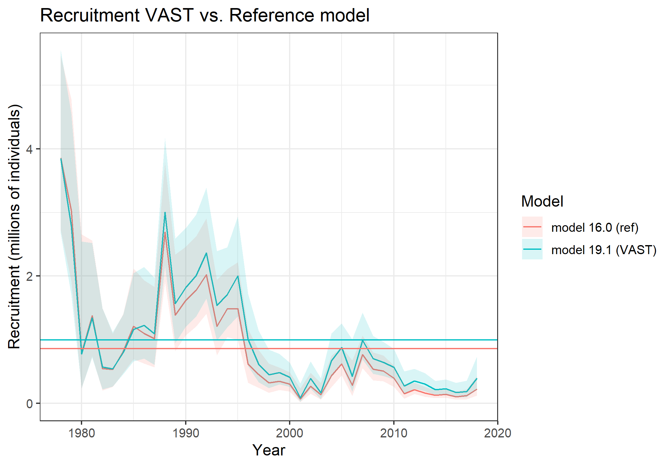

Slide 26
MMB and recruitment

Slide 27
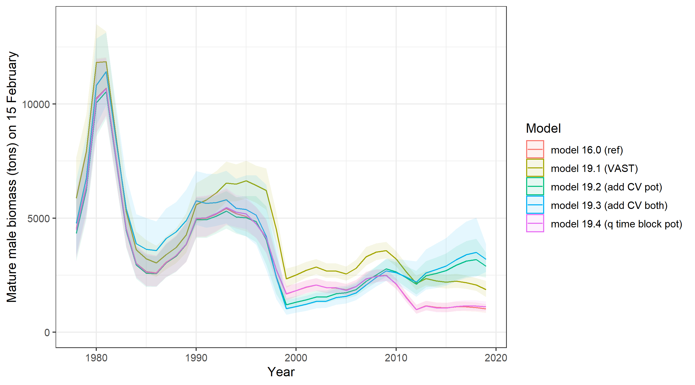

Slide 28
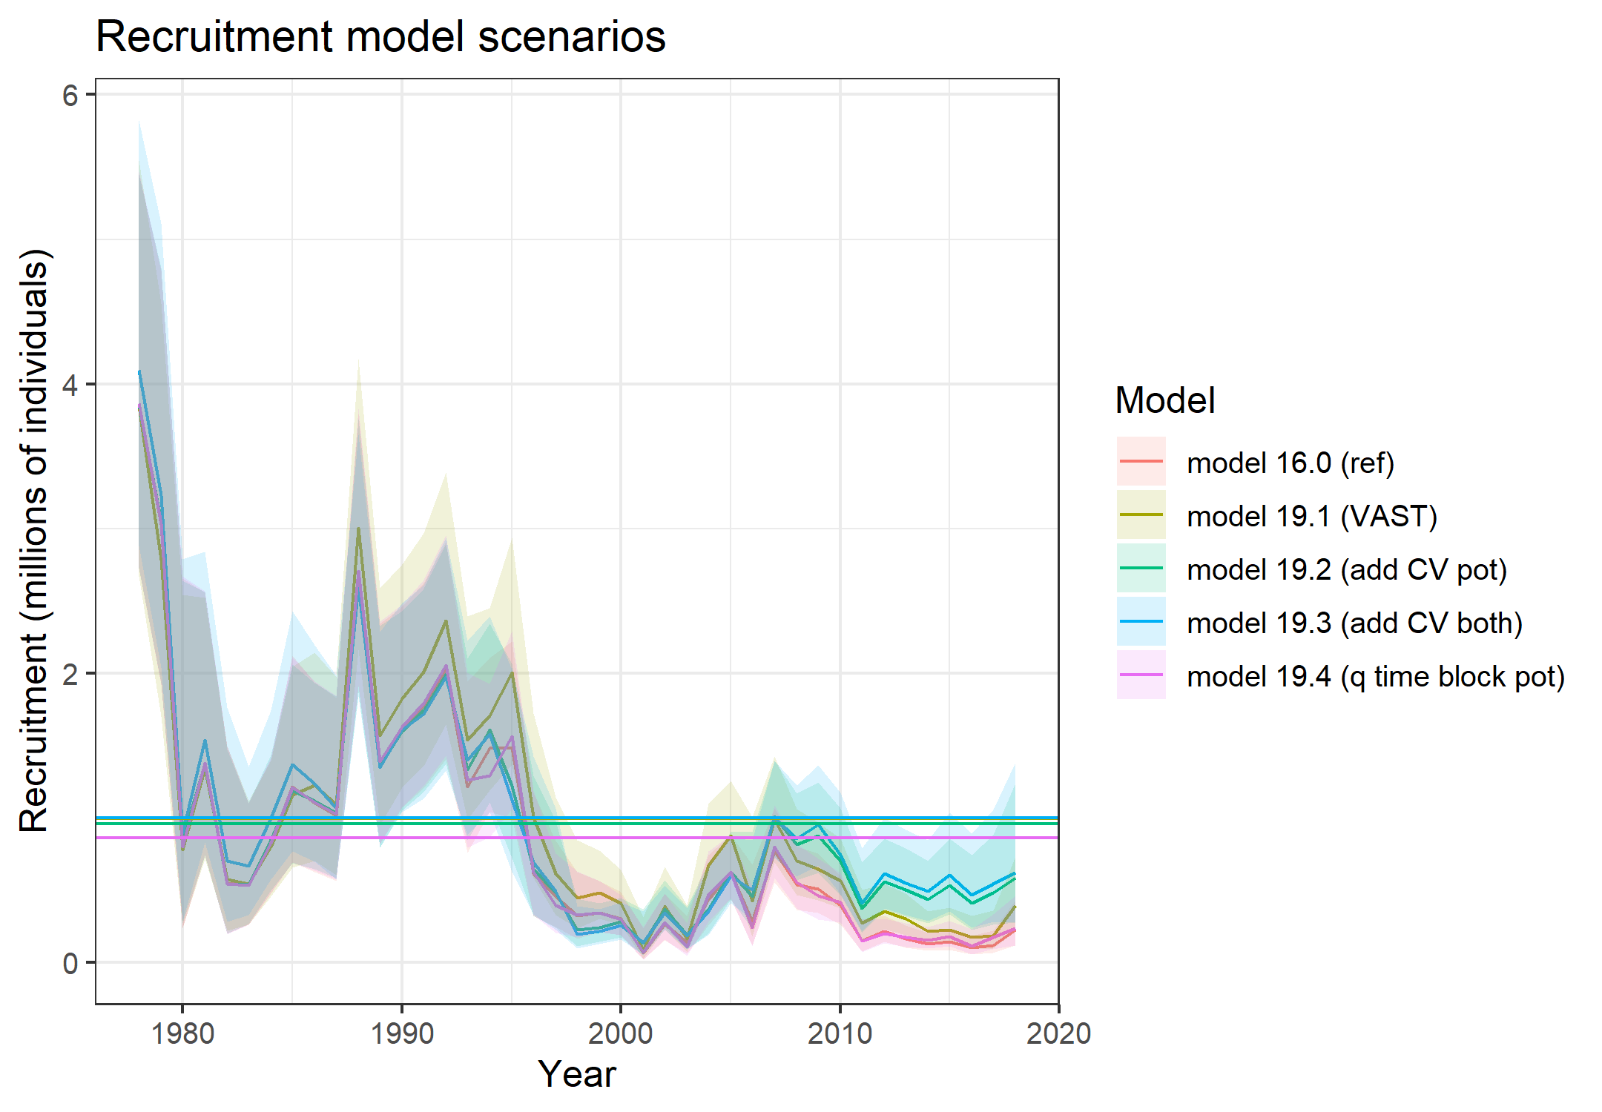

Slide 29
Size compositions
&
Selectivity

Slide 30
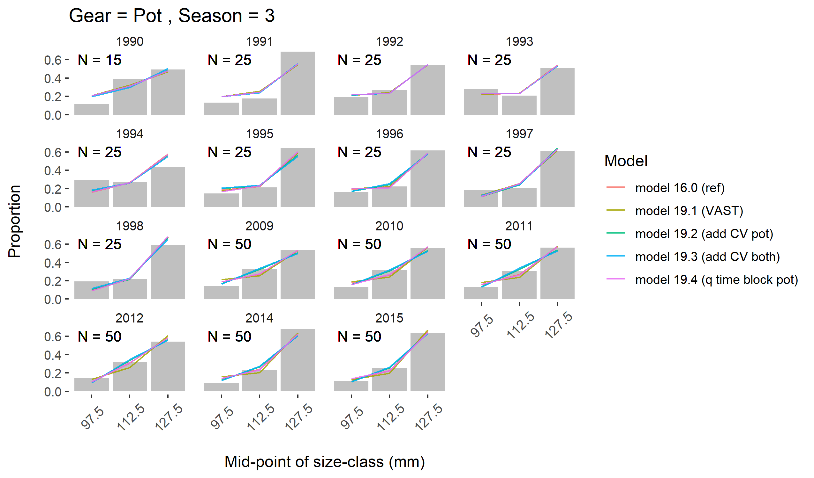

Slide 31
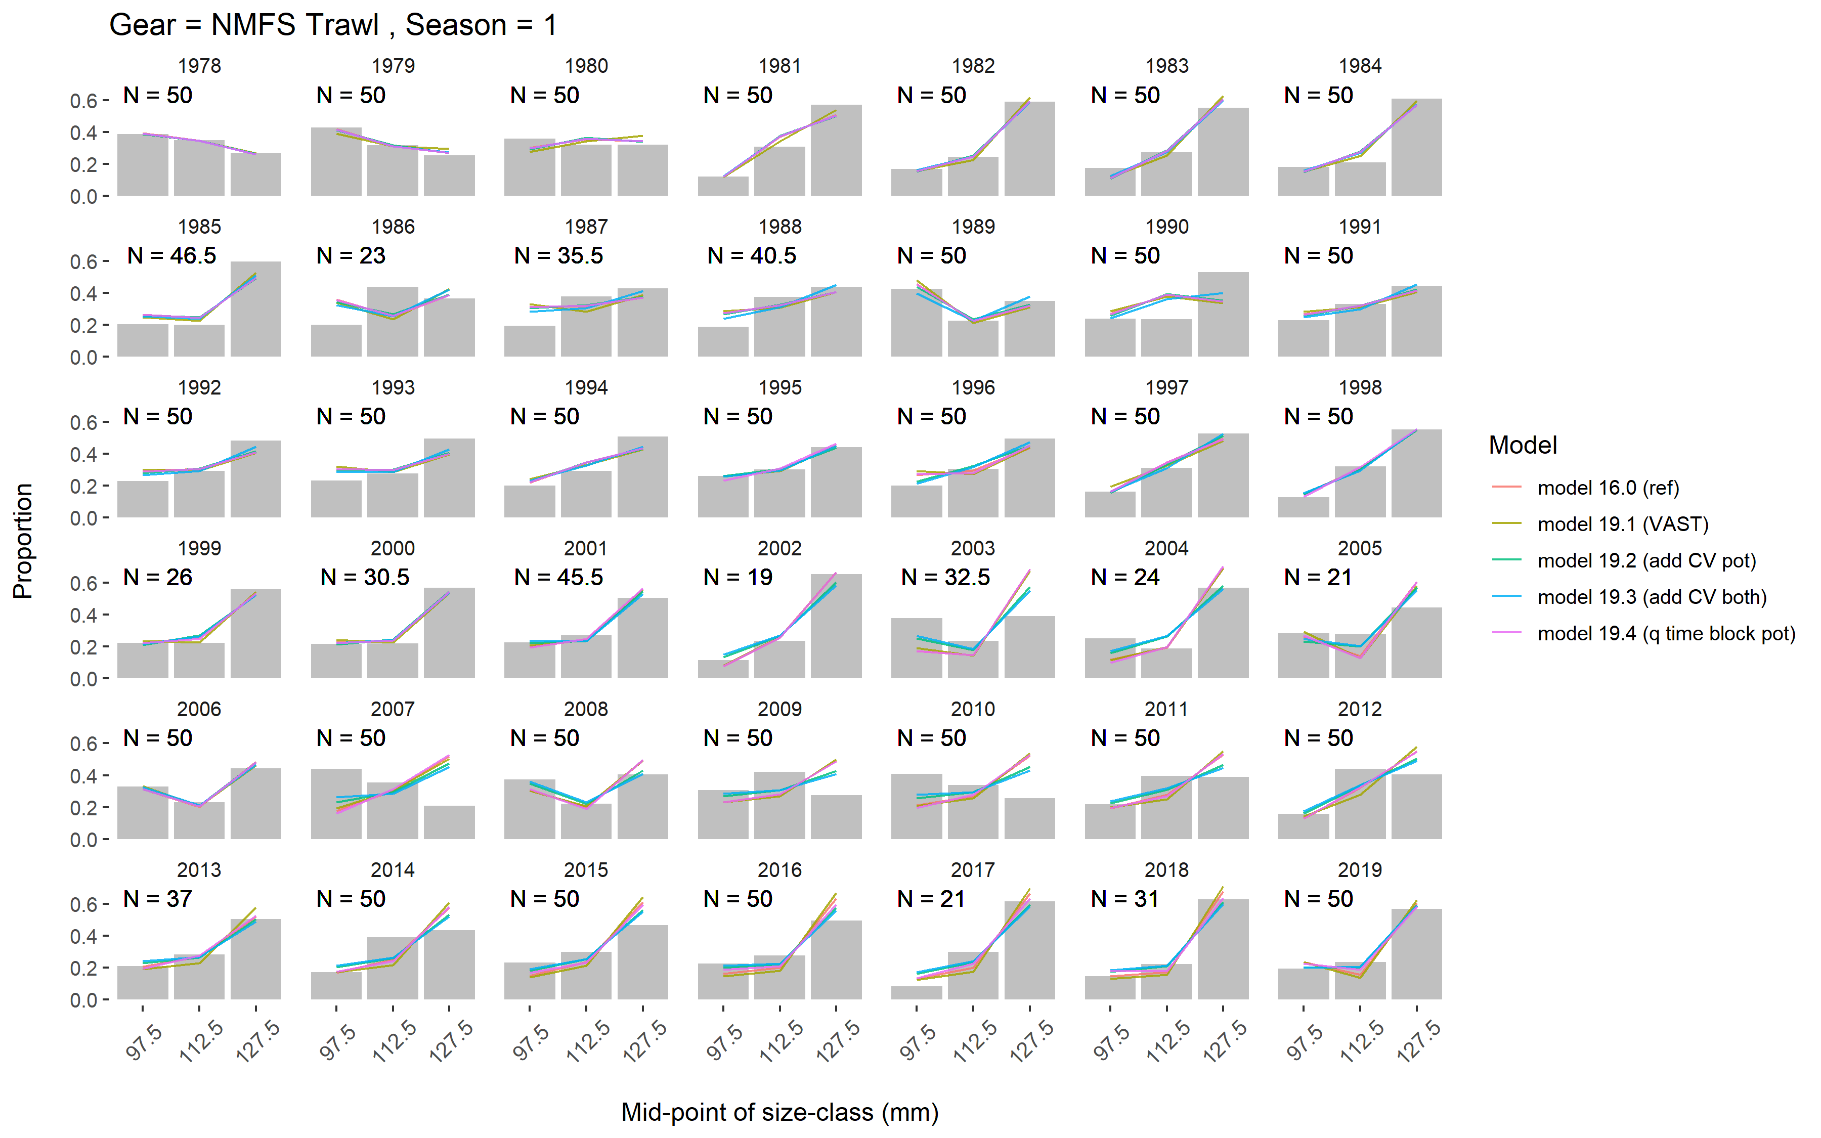

Slide 32
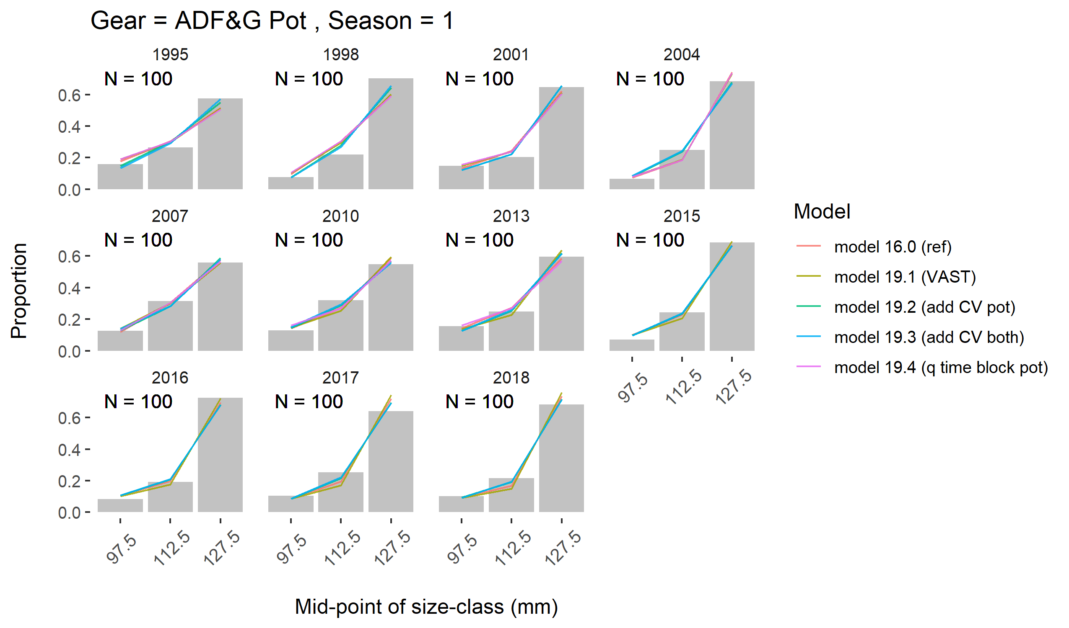

Slide 33
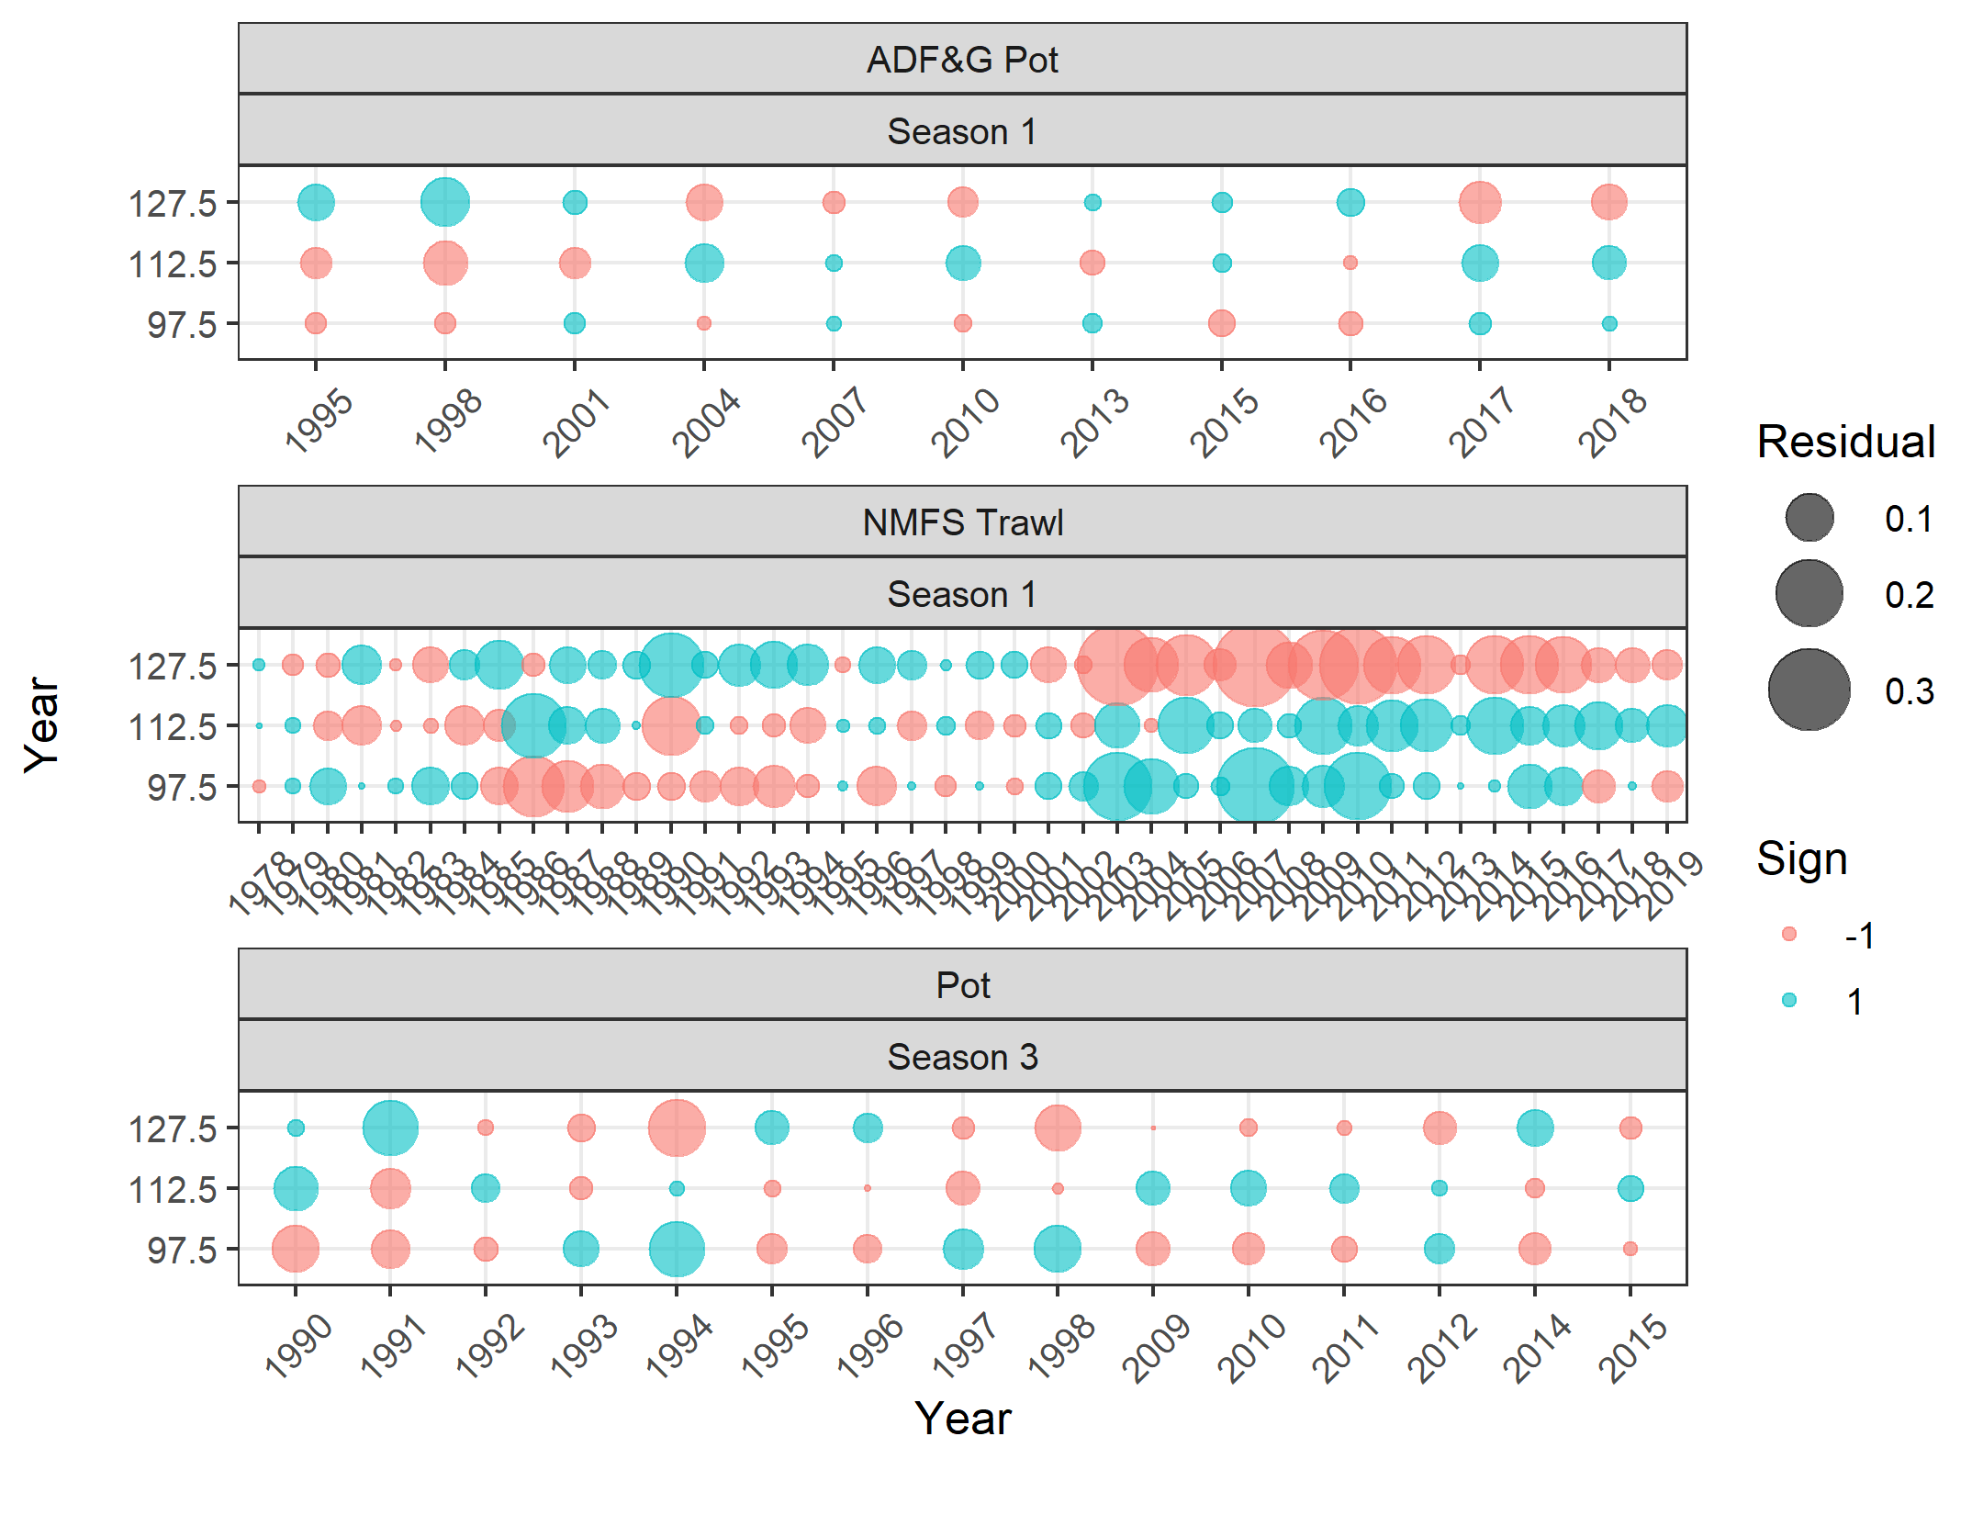
Reference 16.0 size comp residuals

Slide 34
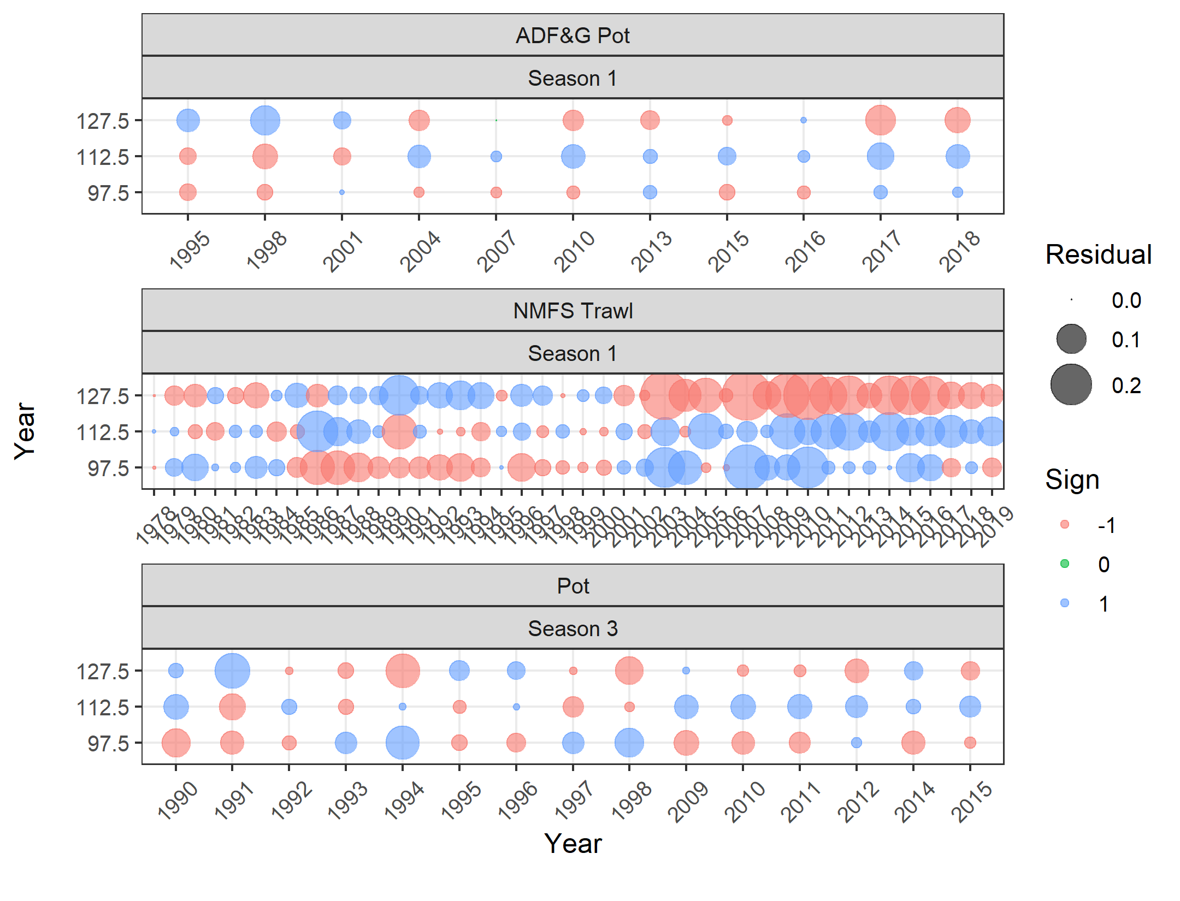
Vast 19.1 size comp residuals

Slide 35
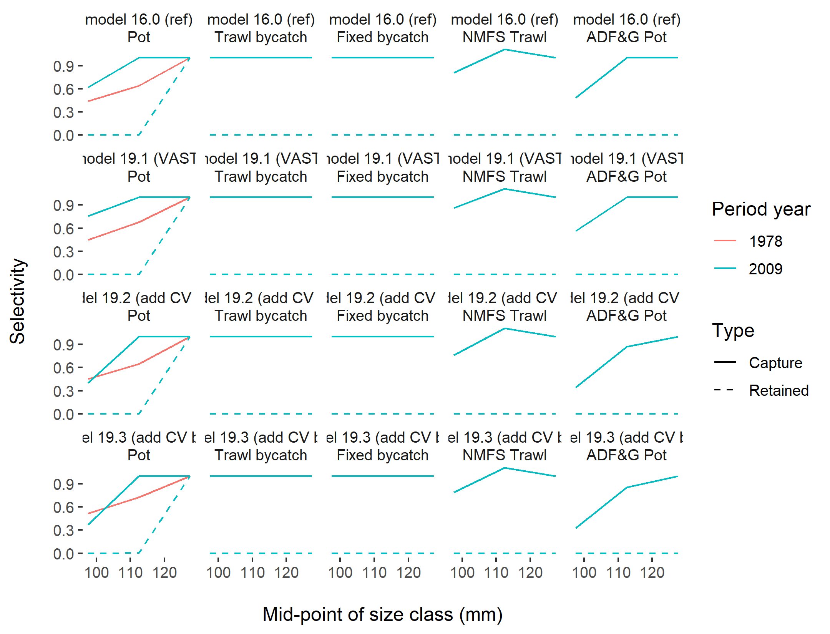
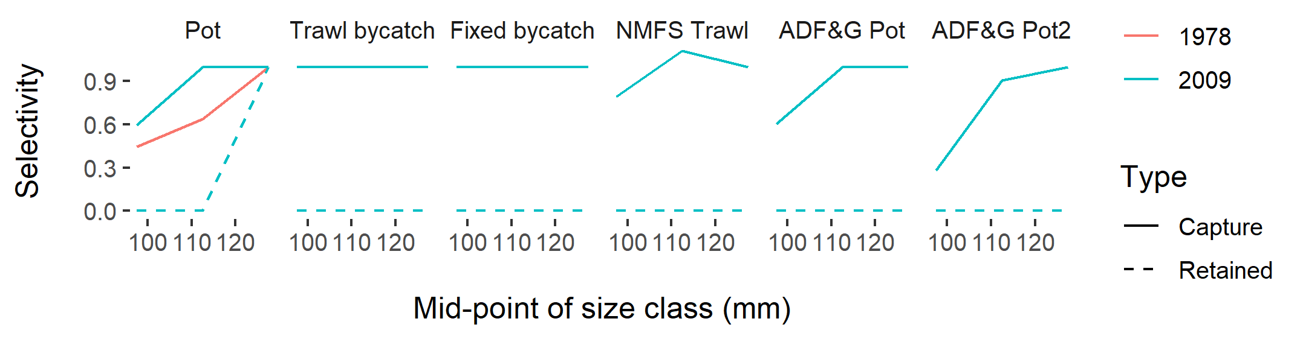
Selectivity

Slide 36
Parameter estimates and model fit

Slide 37
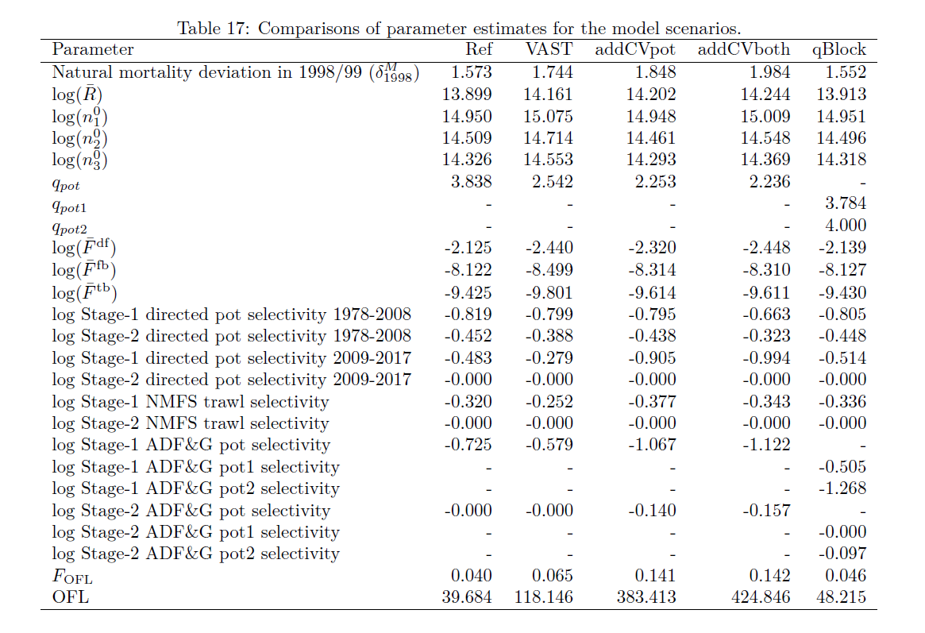

Slide 38
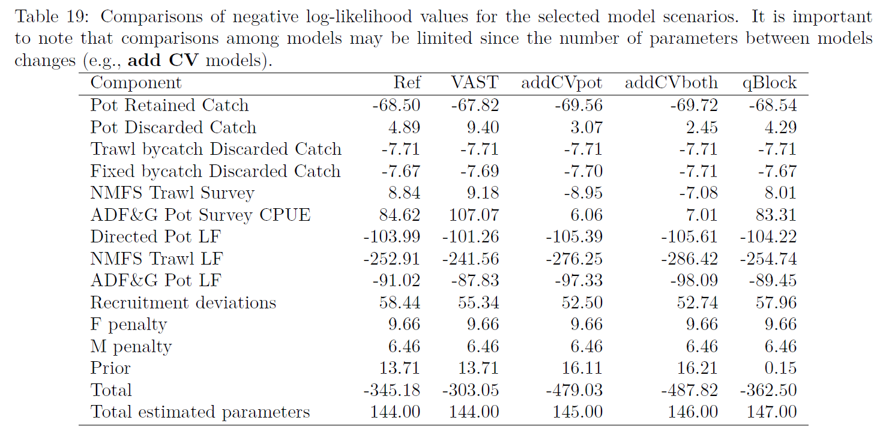

Slide 39
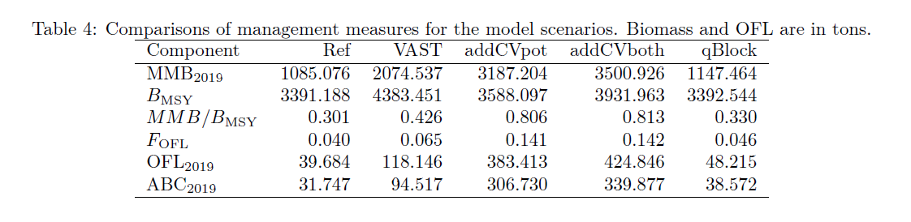
Models without additional CV all results in the same stock status - over-fished

Slide 40
Summary
September options
  Reference model
  VAST model? (Need more diagnostics, island issue, etc.)
Ideas for catchability?
  Other time blocks?
  Other thoughts on random walk options?
Add CV models – identify issue with pot survey but don’t solve problems.
Ideas for exploration of the two surveys spatially?

Slide 41


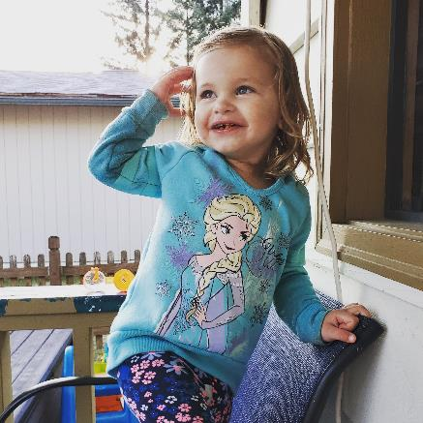

Thanks!
Co-authors and colleagues!
Special thanks to Disney + and Frozen 2 – without which this work would have not been possible
Family, friends, co-workers

Slide 42
