Slide 1
Saint Matthew Blue King Crab 2020
Katie Palof, Jie Zheng, and Jim Ianelli

Slide 2
Current Status
Overfished status
Rebuilding plan approved by Council June 2020
  No changes in direct fishing regulations (State harvest strategy)
  No further bycatch restrictions
  Focused on recruitment expectations (surveys are key to observing rebuilding)
Core model issues
  Contrast in trends between pot survey and trawl survey
  Spatial hot spots in survey
  Poor fit of models to recent years of survey data (2010 +)
  Simple model – male only, 3 size groups

Slide 3
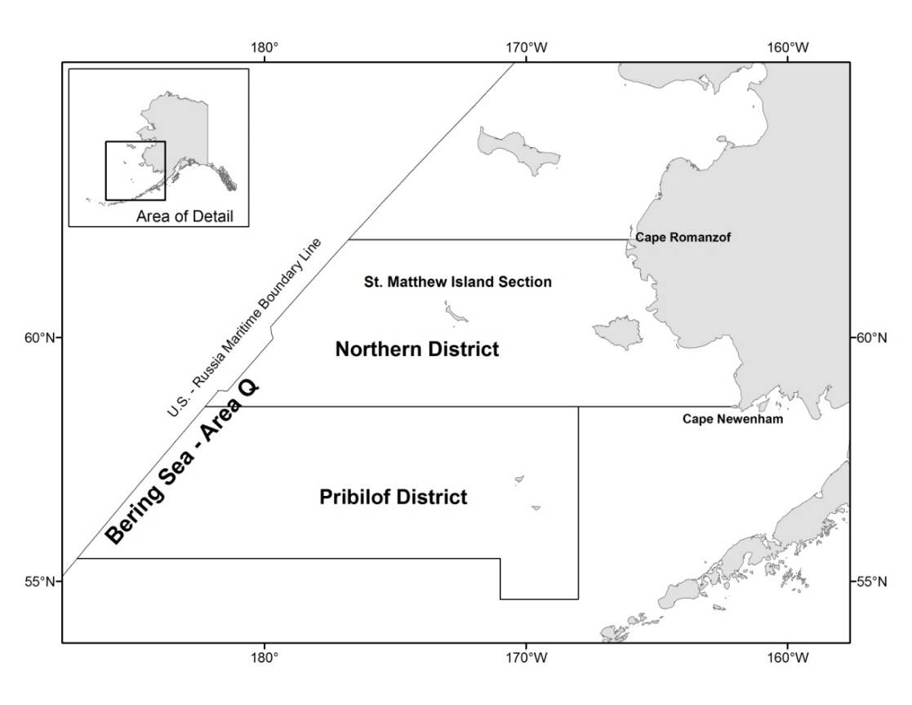

Slide 4
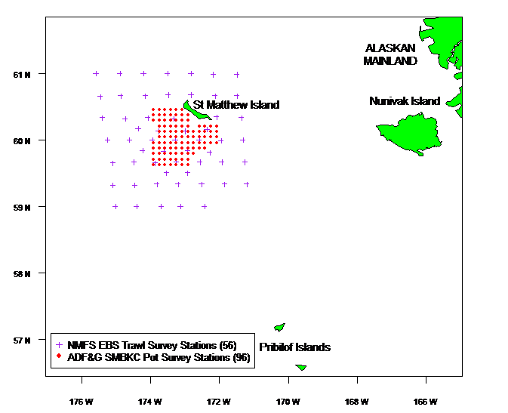

Slide 5
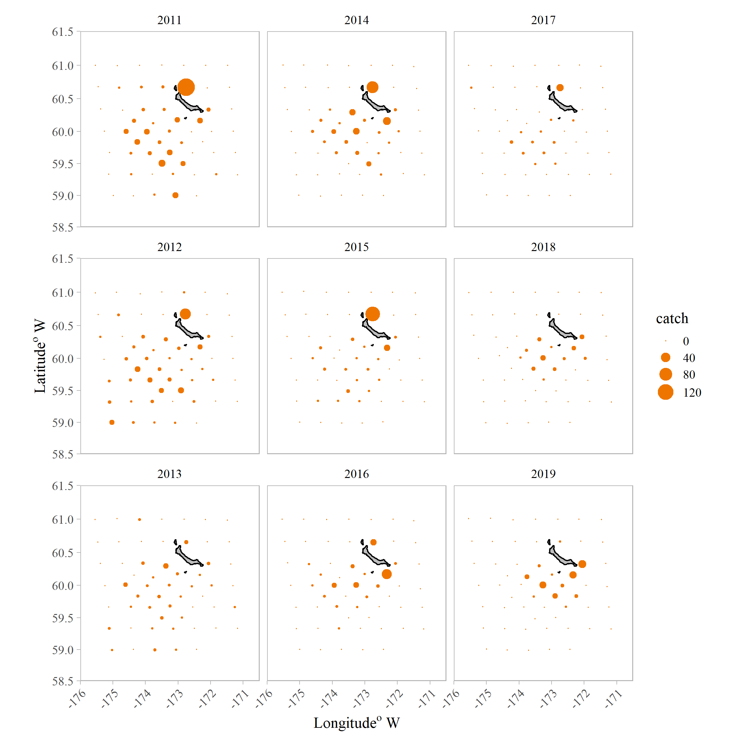
Trawl survey (area-swept) spatial breakdown in catch

Slide 6
SSC/CPT Comments
Retrospective analyses
  Completed for base model – with and without terminal survey year
  Still needs to be implemented in GMACS
Model scenarios for 2020:
  Sensitivity run without pot survey data (20.1)
  Random walk of pot survey catchability – future work (May 2021), needs to be coded into GMACS
Explore potential explanations for the discrepancy in the time trends of the two types of survey data, including movement hypotheses using spatial models (not necessarily VAST)
  Limited progress, plans to pursue this in the upcoming year. Current years effort was focused on uncertainty due to loss of 2020 survey and retrospective analyses
Explore models with VAST estimates
  Work underway to explore VAST with island effect considerations. Working with Jon Richar (and others) on this and attempts to use VAST with both surveys
Correct model numbering
  16.0 is the base/reference model.

Slide 7
Model evaluations
16.0 – 2019 Reference Model
16.0 – 2020 Reference Model
  2019 accepted model updated with 2010 – 2019 groundfish bycatch
16.0a – 2020 Reference Model with fixed terminal year recruitment
  model 16.0 with terminal year recruitment fixed as the average of the last seven years
20.1 – no ADF&G pot survey data
  model 16.0 – excludes ADF&G pot survey data – abundance and length comps

Slide 8
Survey fit
- TRAWL NMFS
- Pot ADF&G

Slide 9
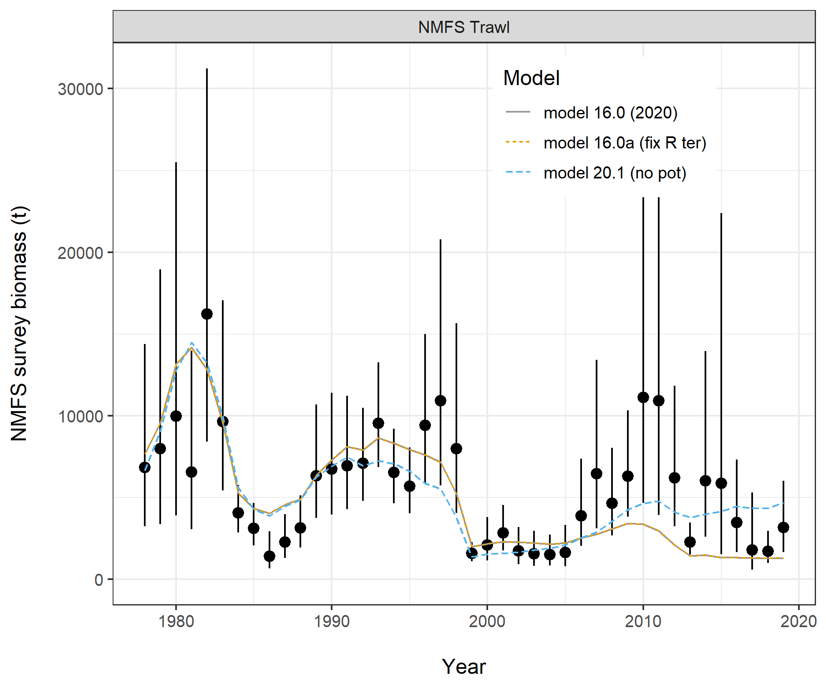

Slide 10
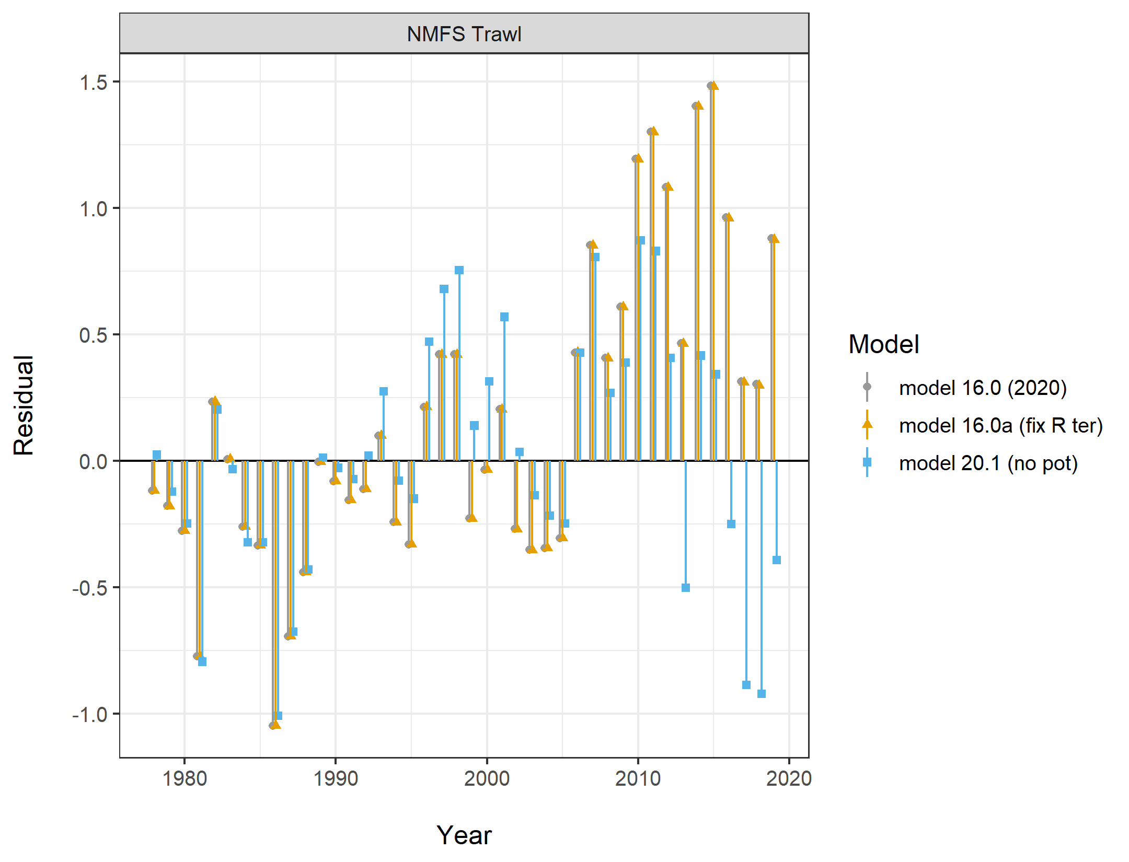

Slide 11
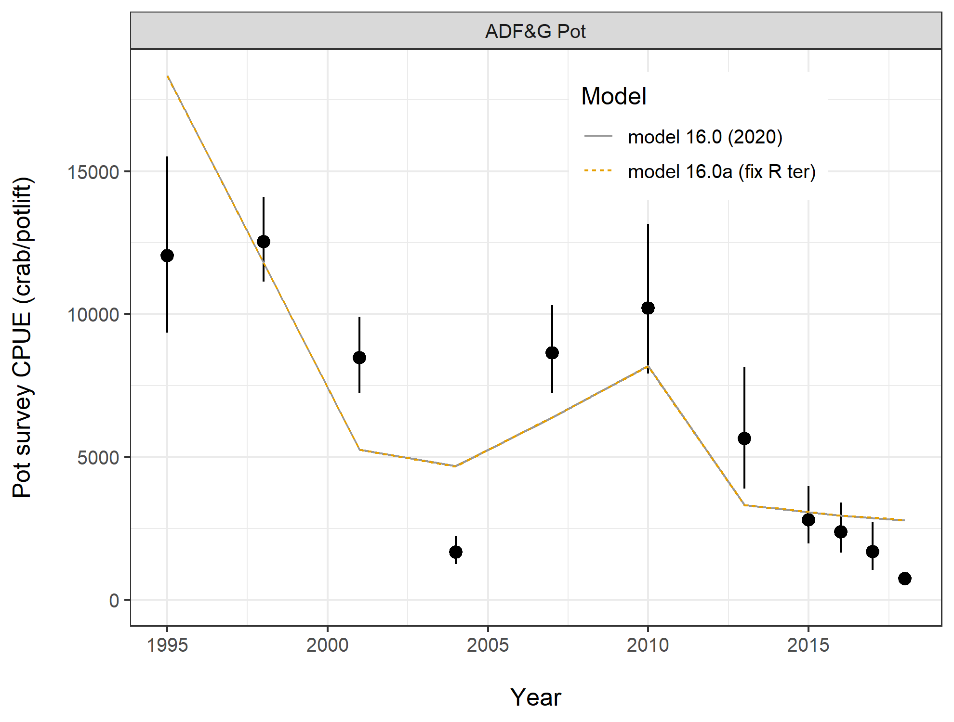

Slide 12
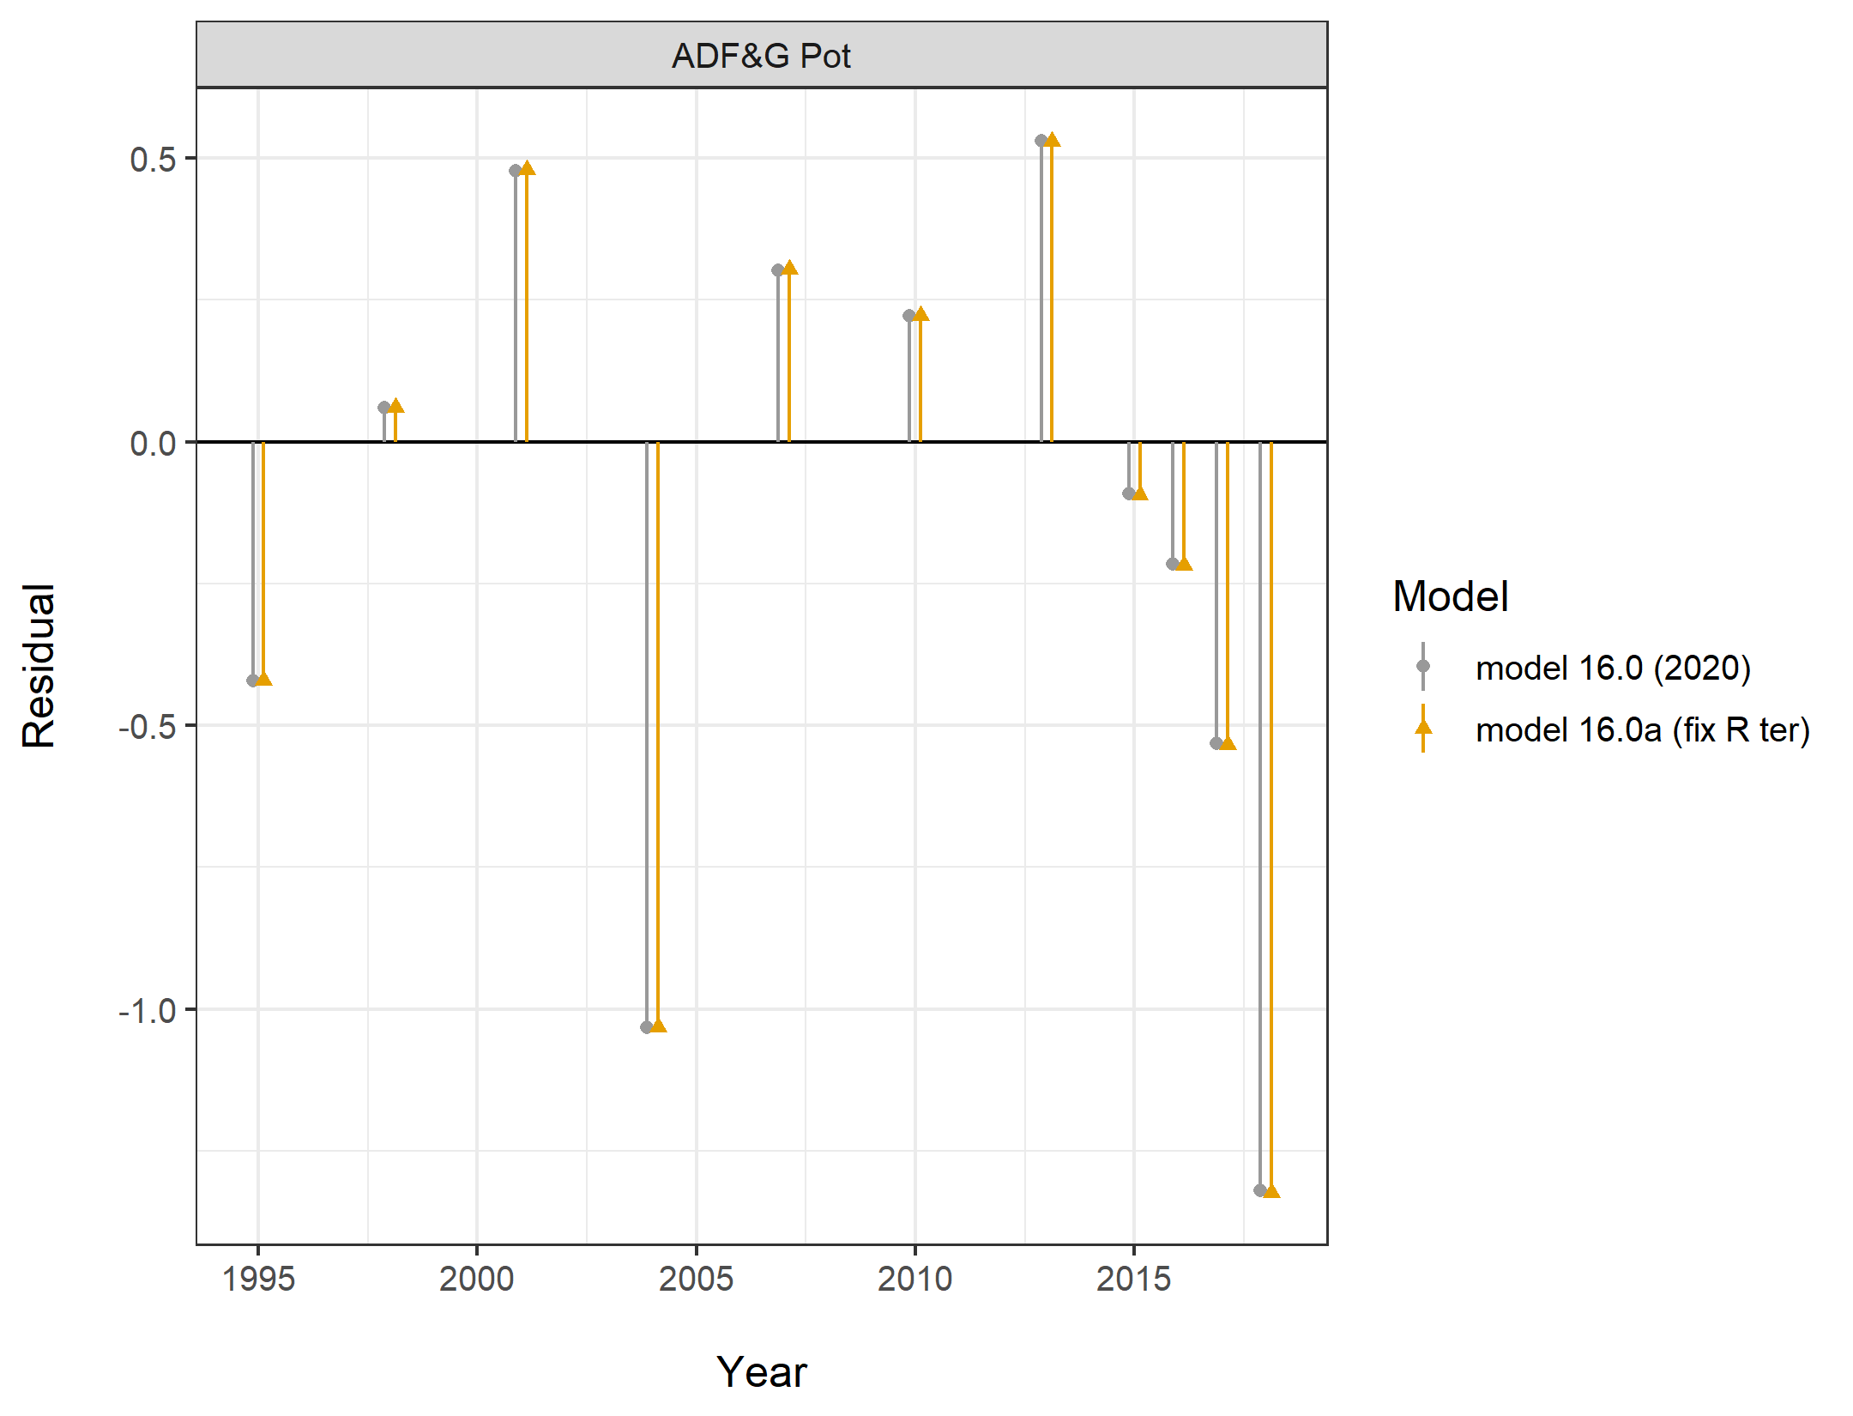

Slide 13
MMB & Recruitment

Slide 14
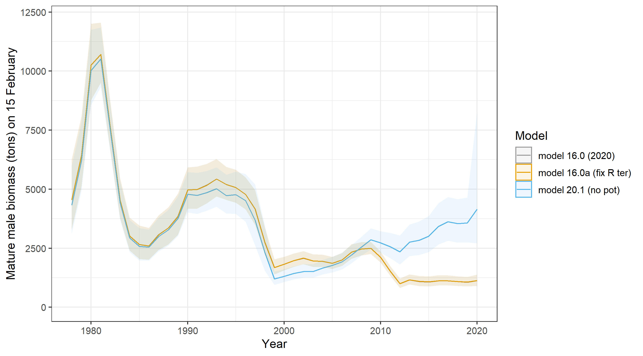

Slide 15
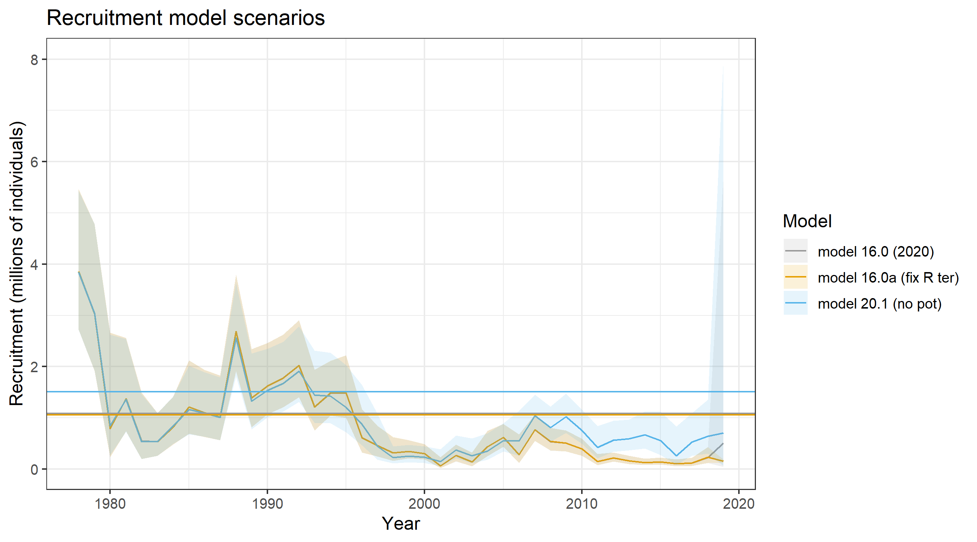

Slide 16
SIZE Compositions and Selectivity, fishing mortality, etc.

Slide 17
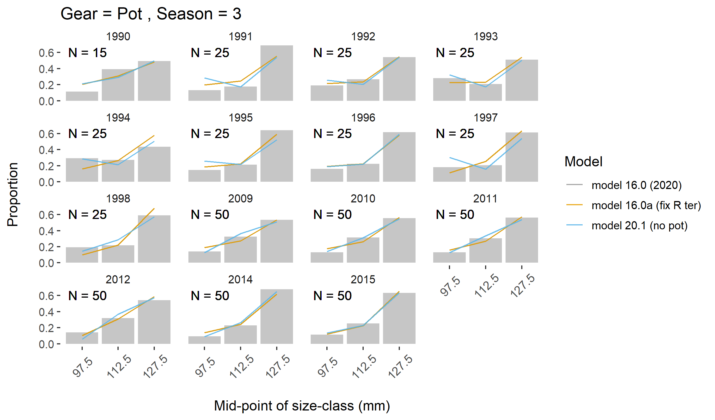

Slide 18
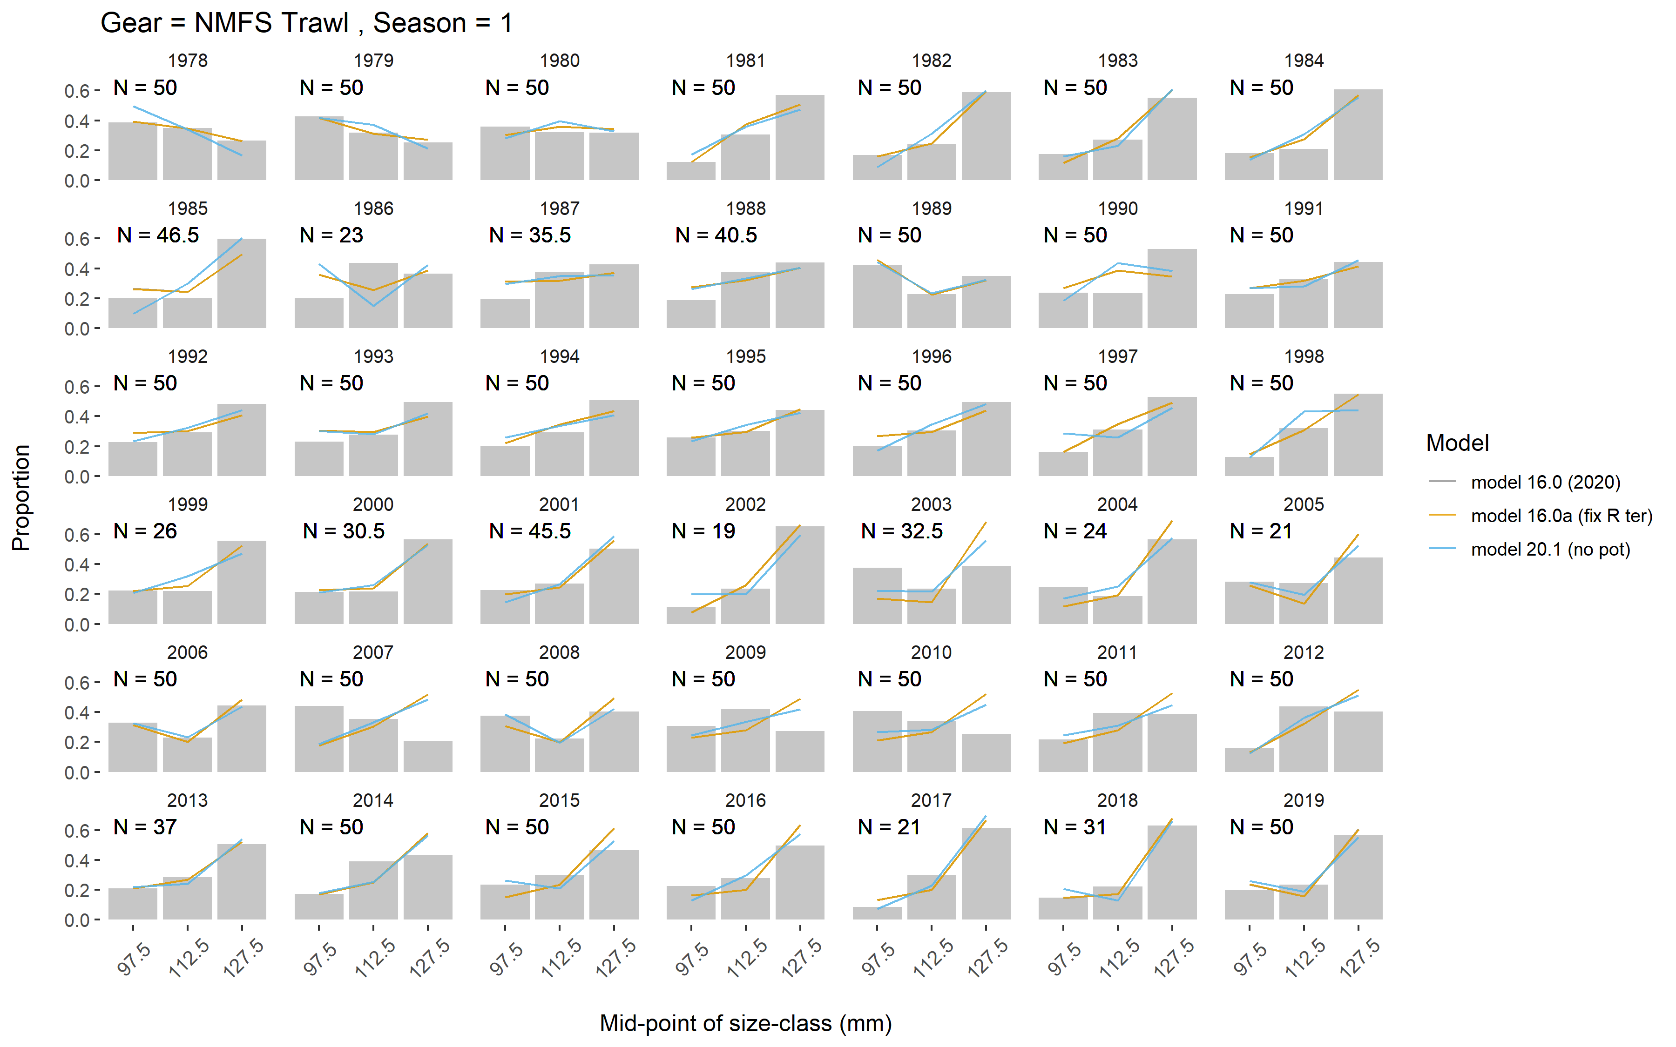

Slide 19
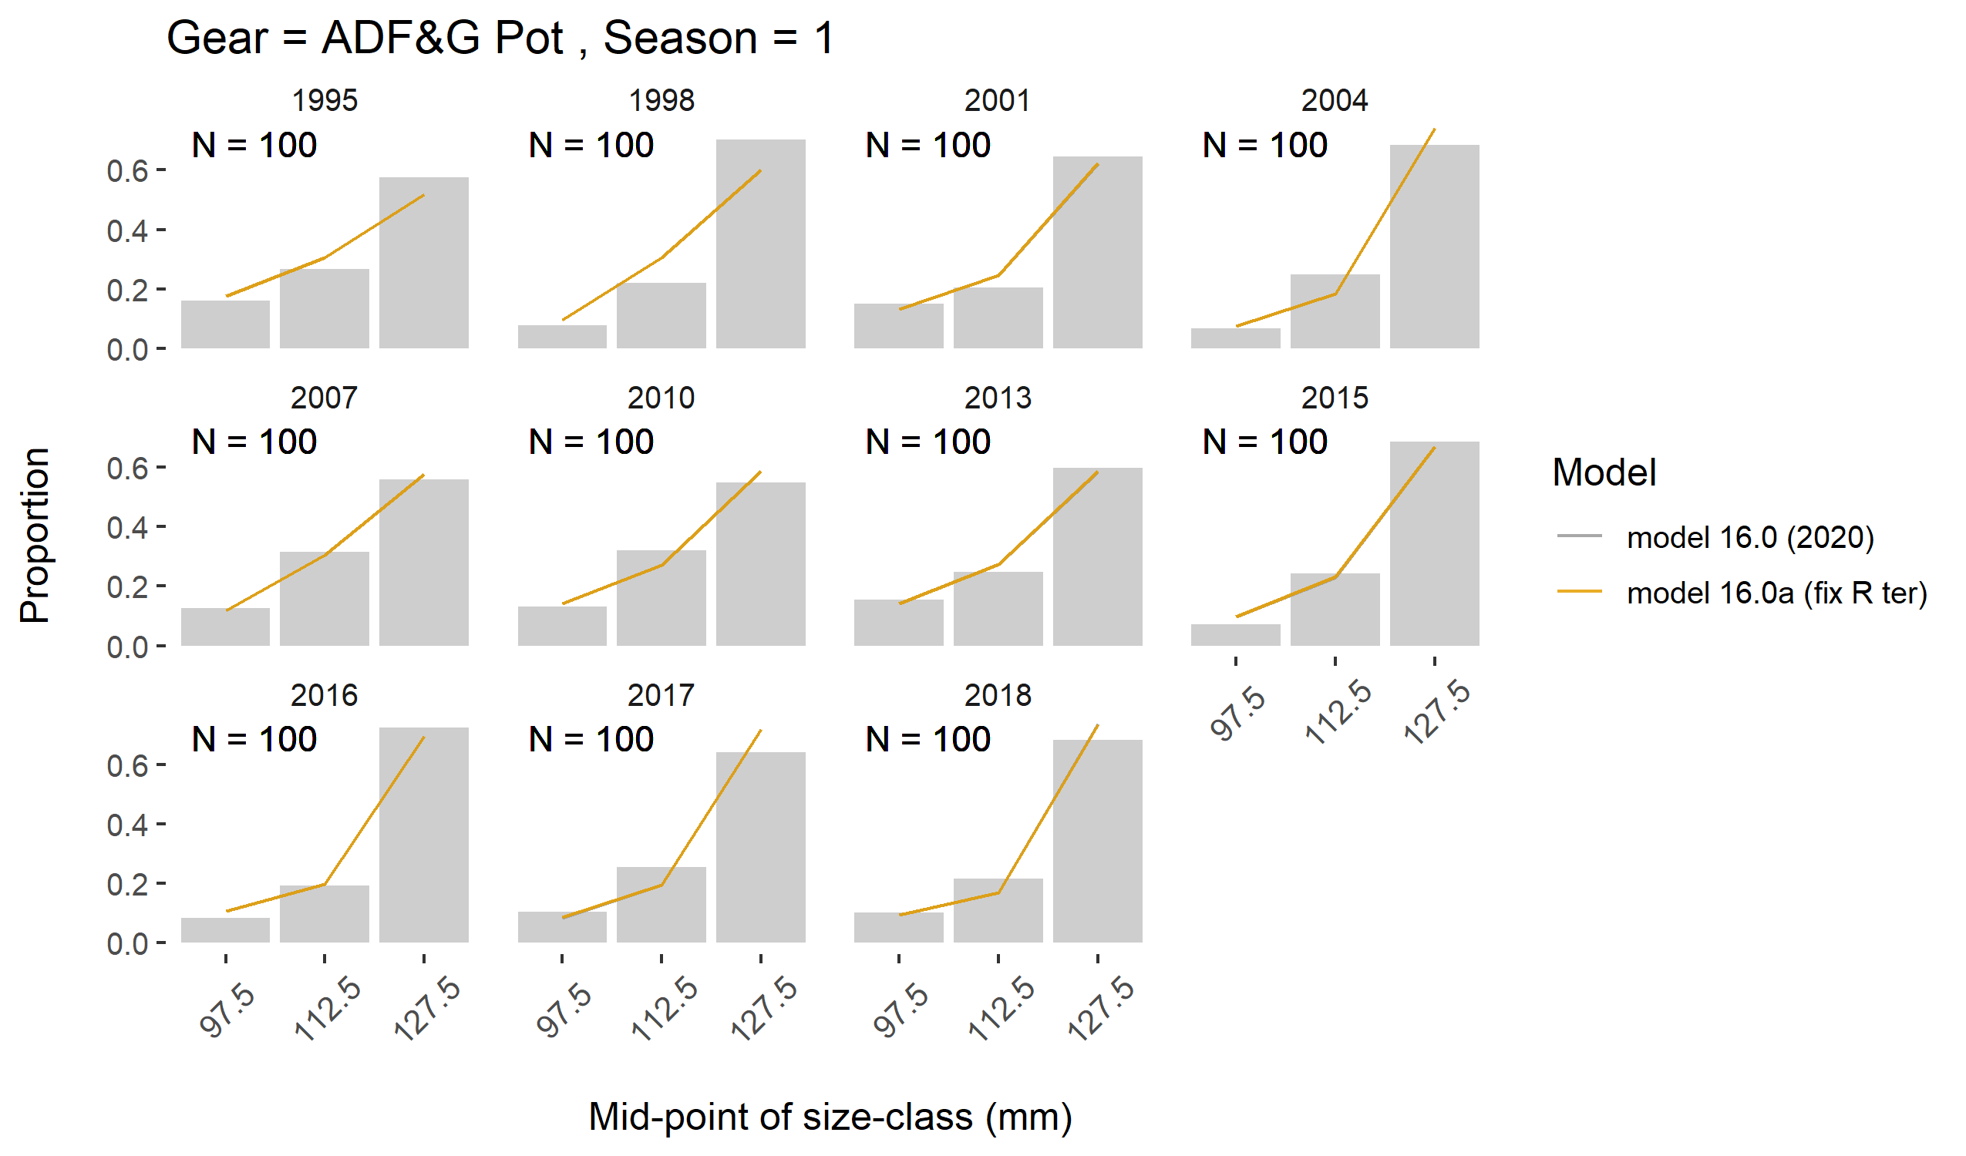

Slide 20
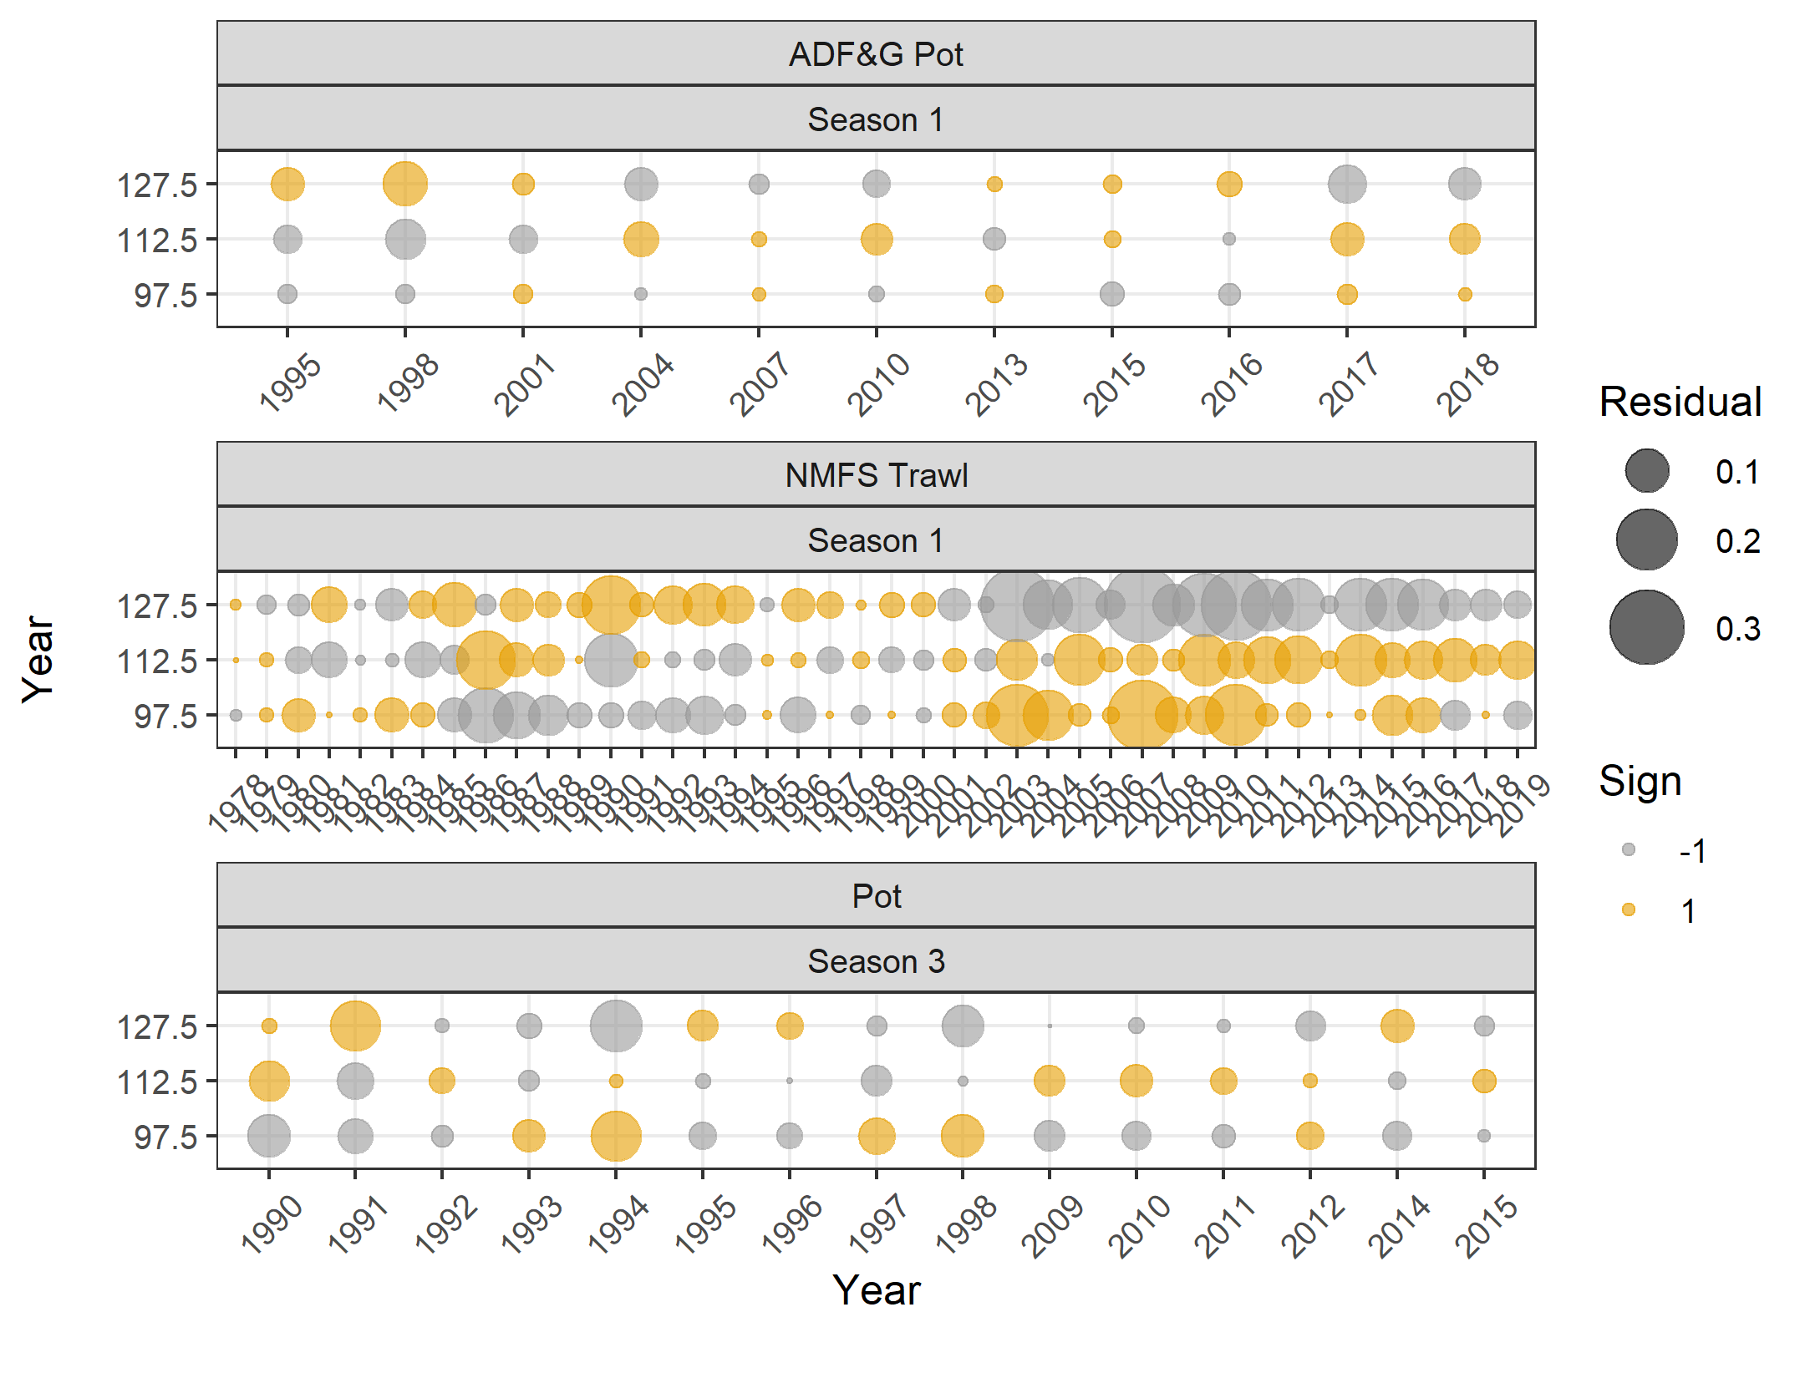
Reference 16.0 size comp residuals

Slide 21

Fix
Terminal
Recruitment
16.0a size comp residuals

Slide 22
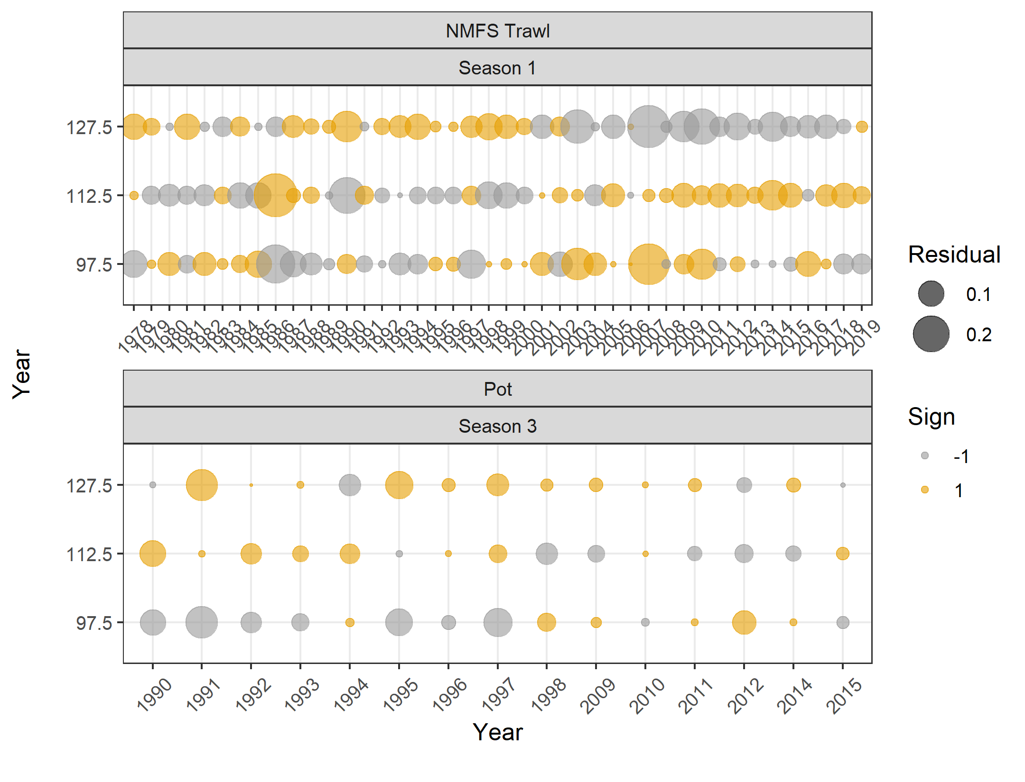
No pOt
20.1 size comp residuals

Slide 23
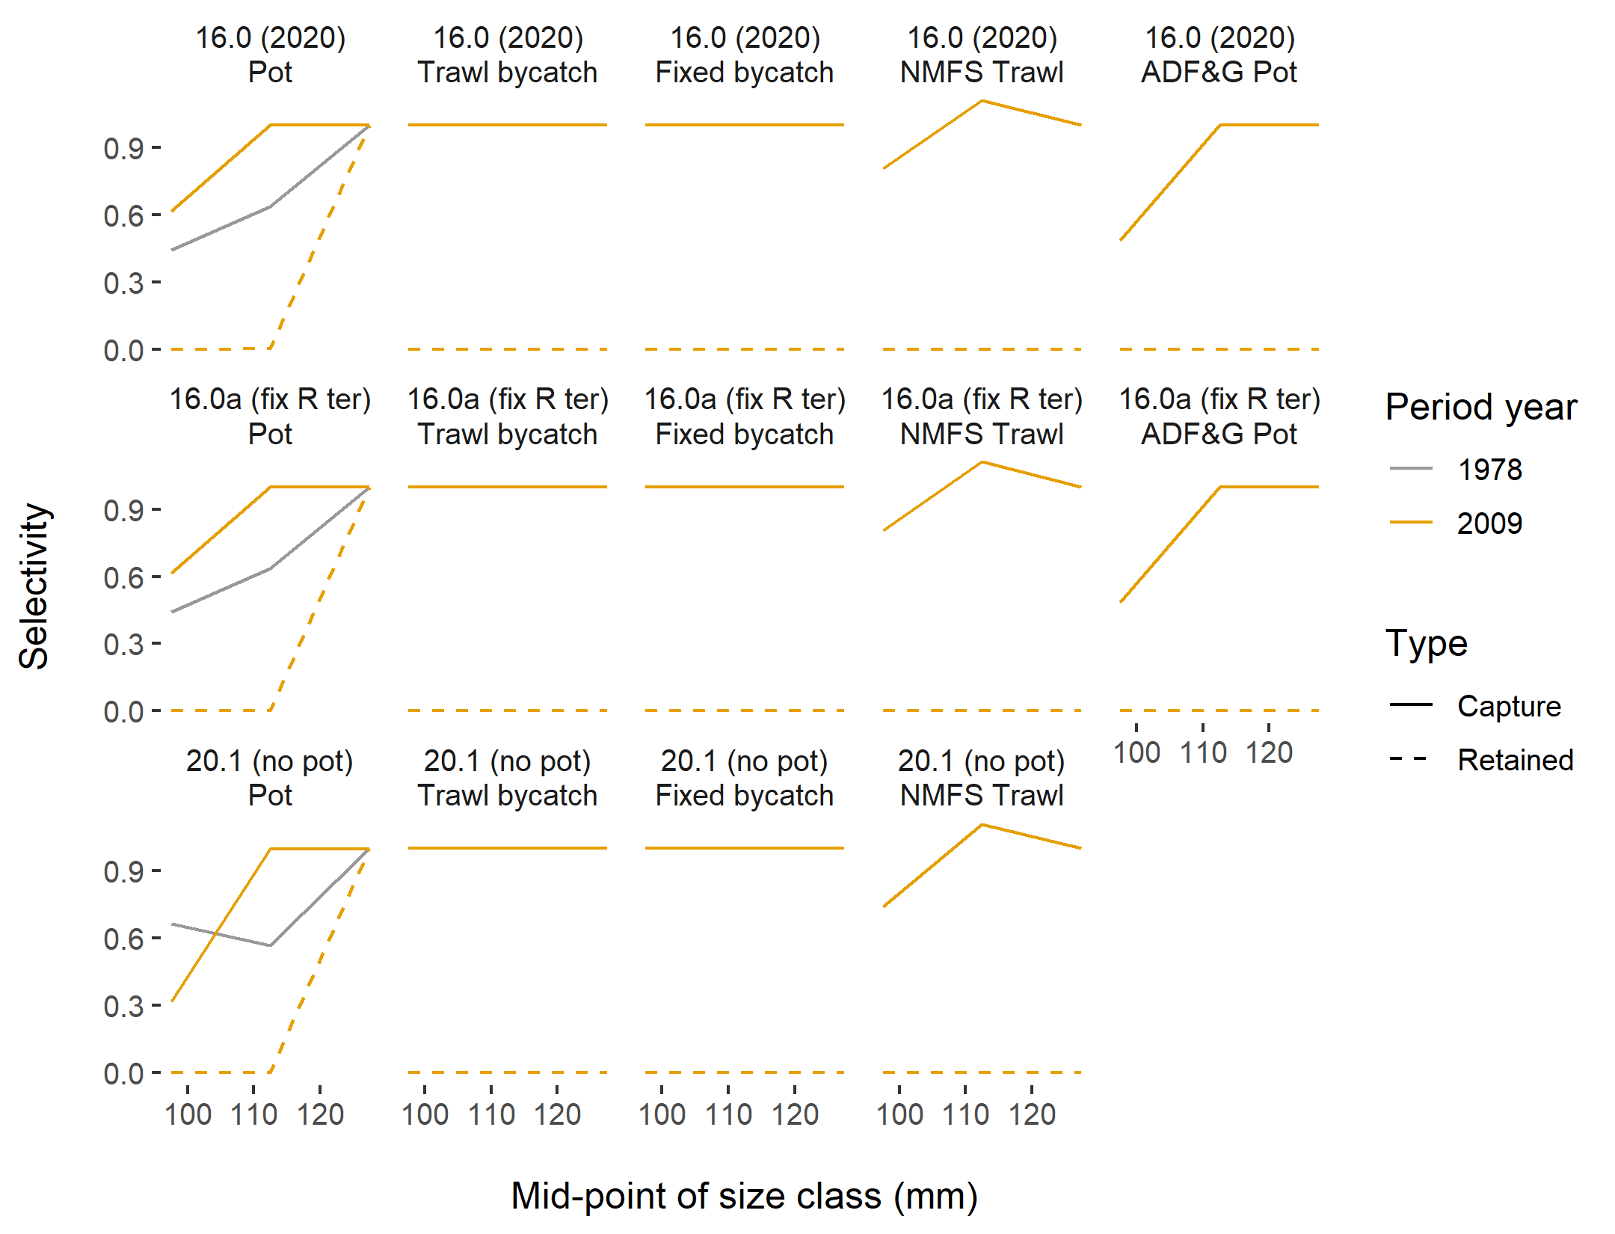
Selectivity

Slide 24
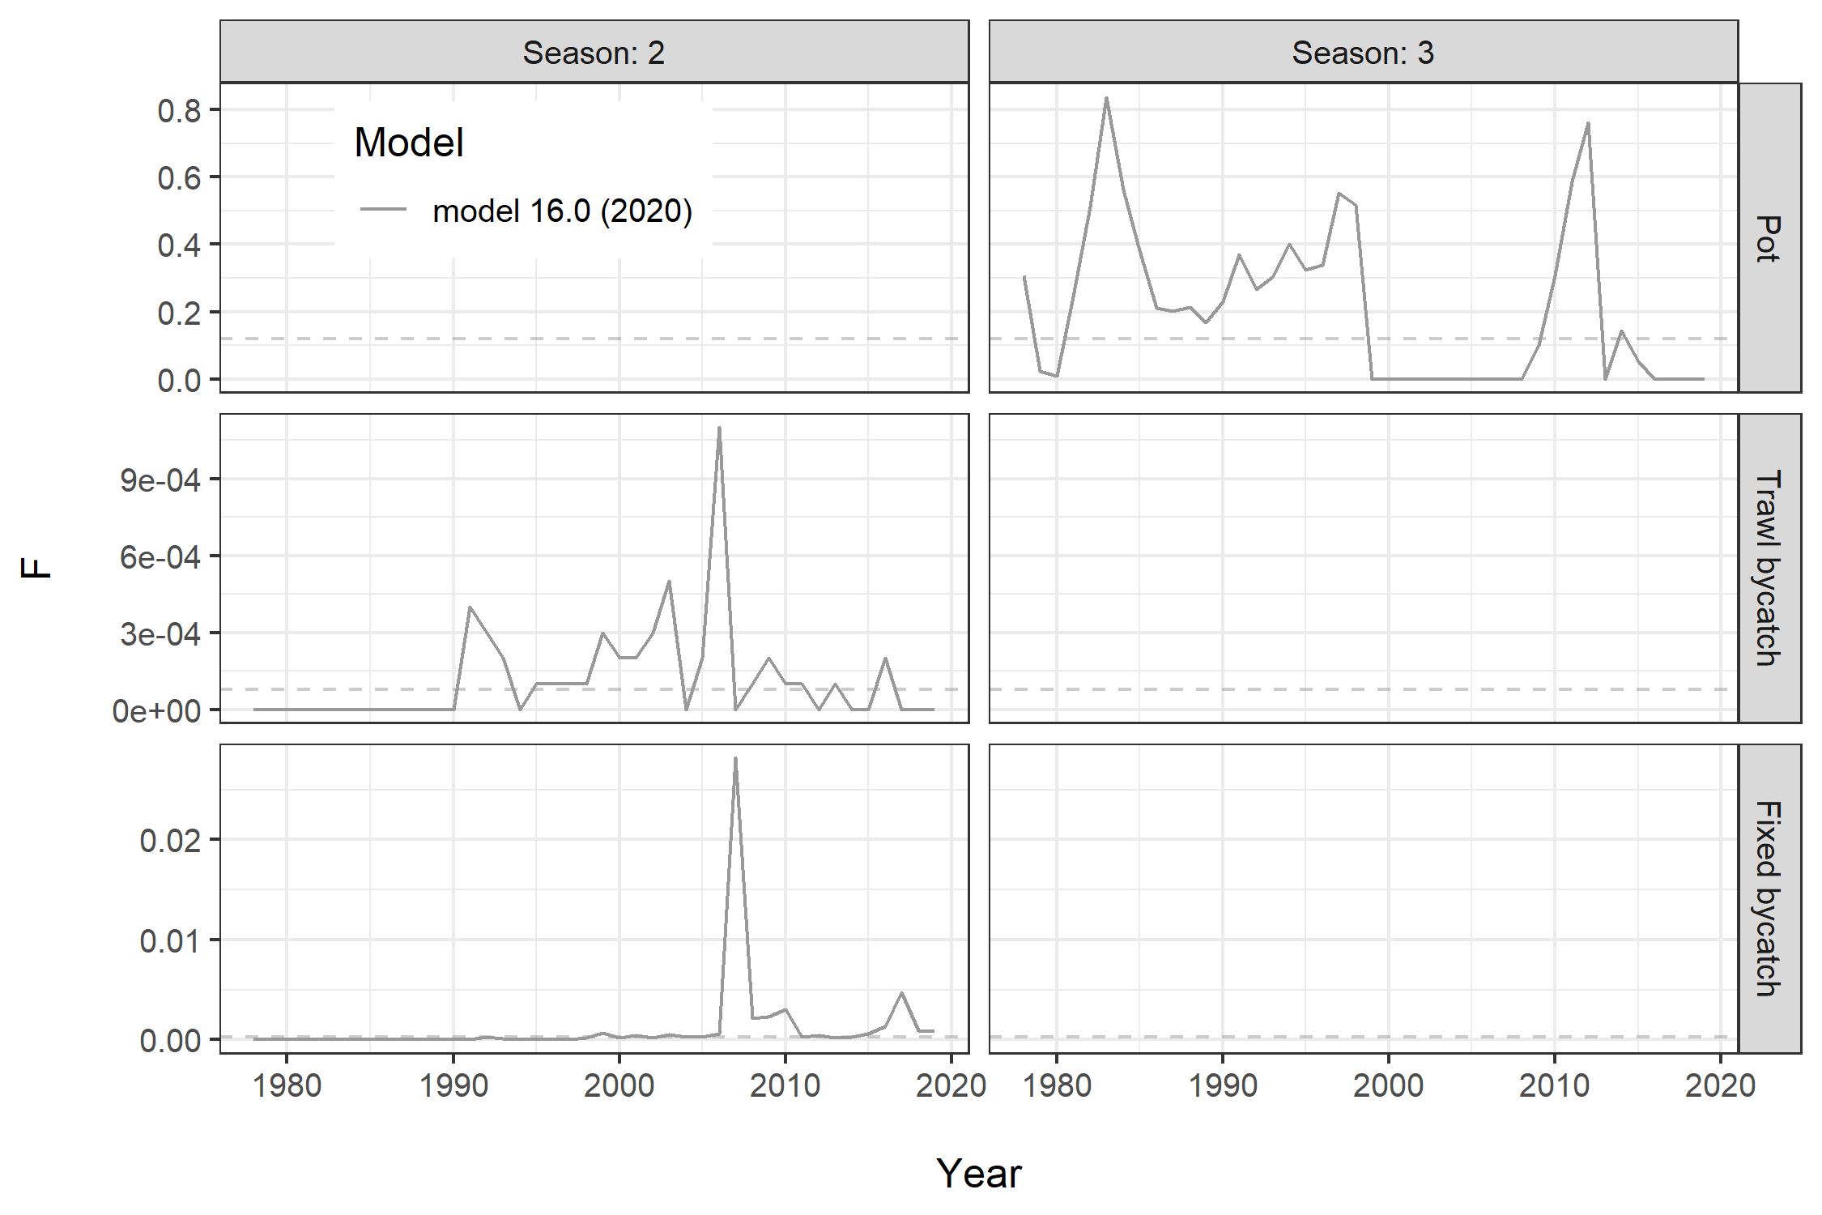
Fishing Mortality

Slide 25
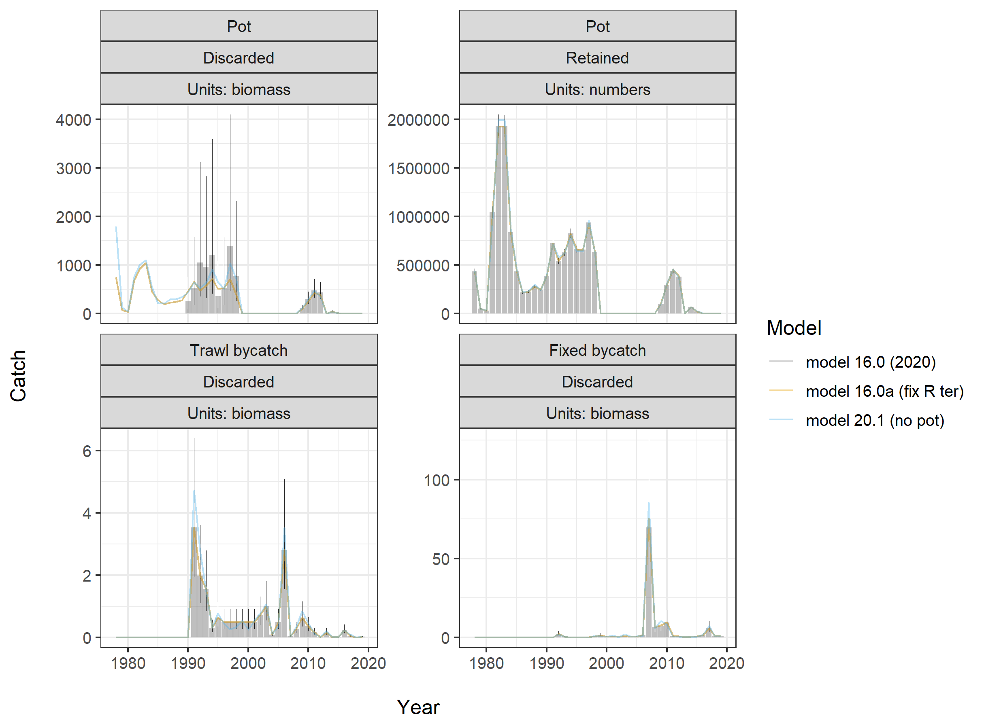
Retained catch and bycatch fit

Slide 26
Parameter Estimation and Model FIT

Slide 27
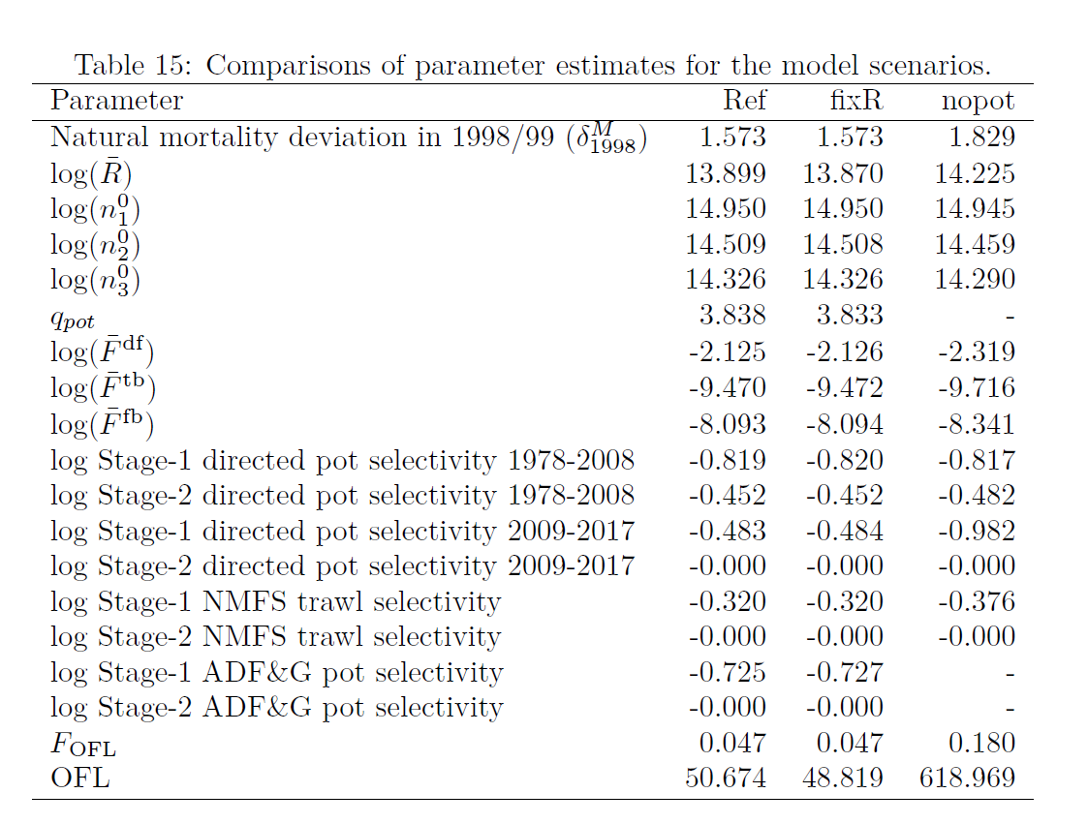

Slide 28
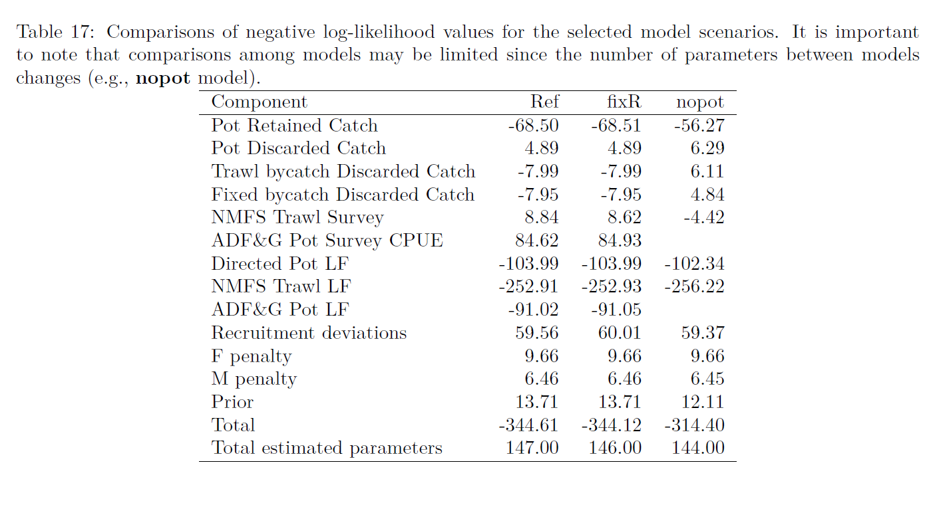

Slide 29
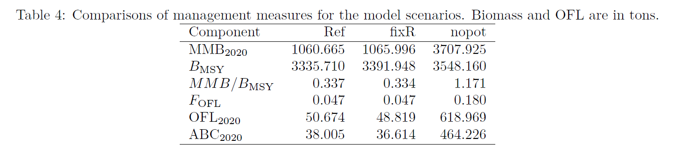

Slide 30
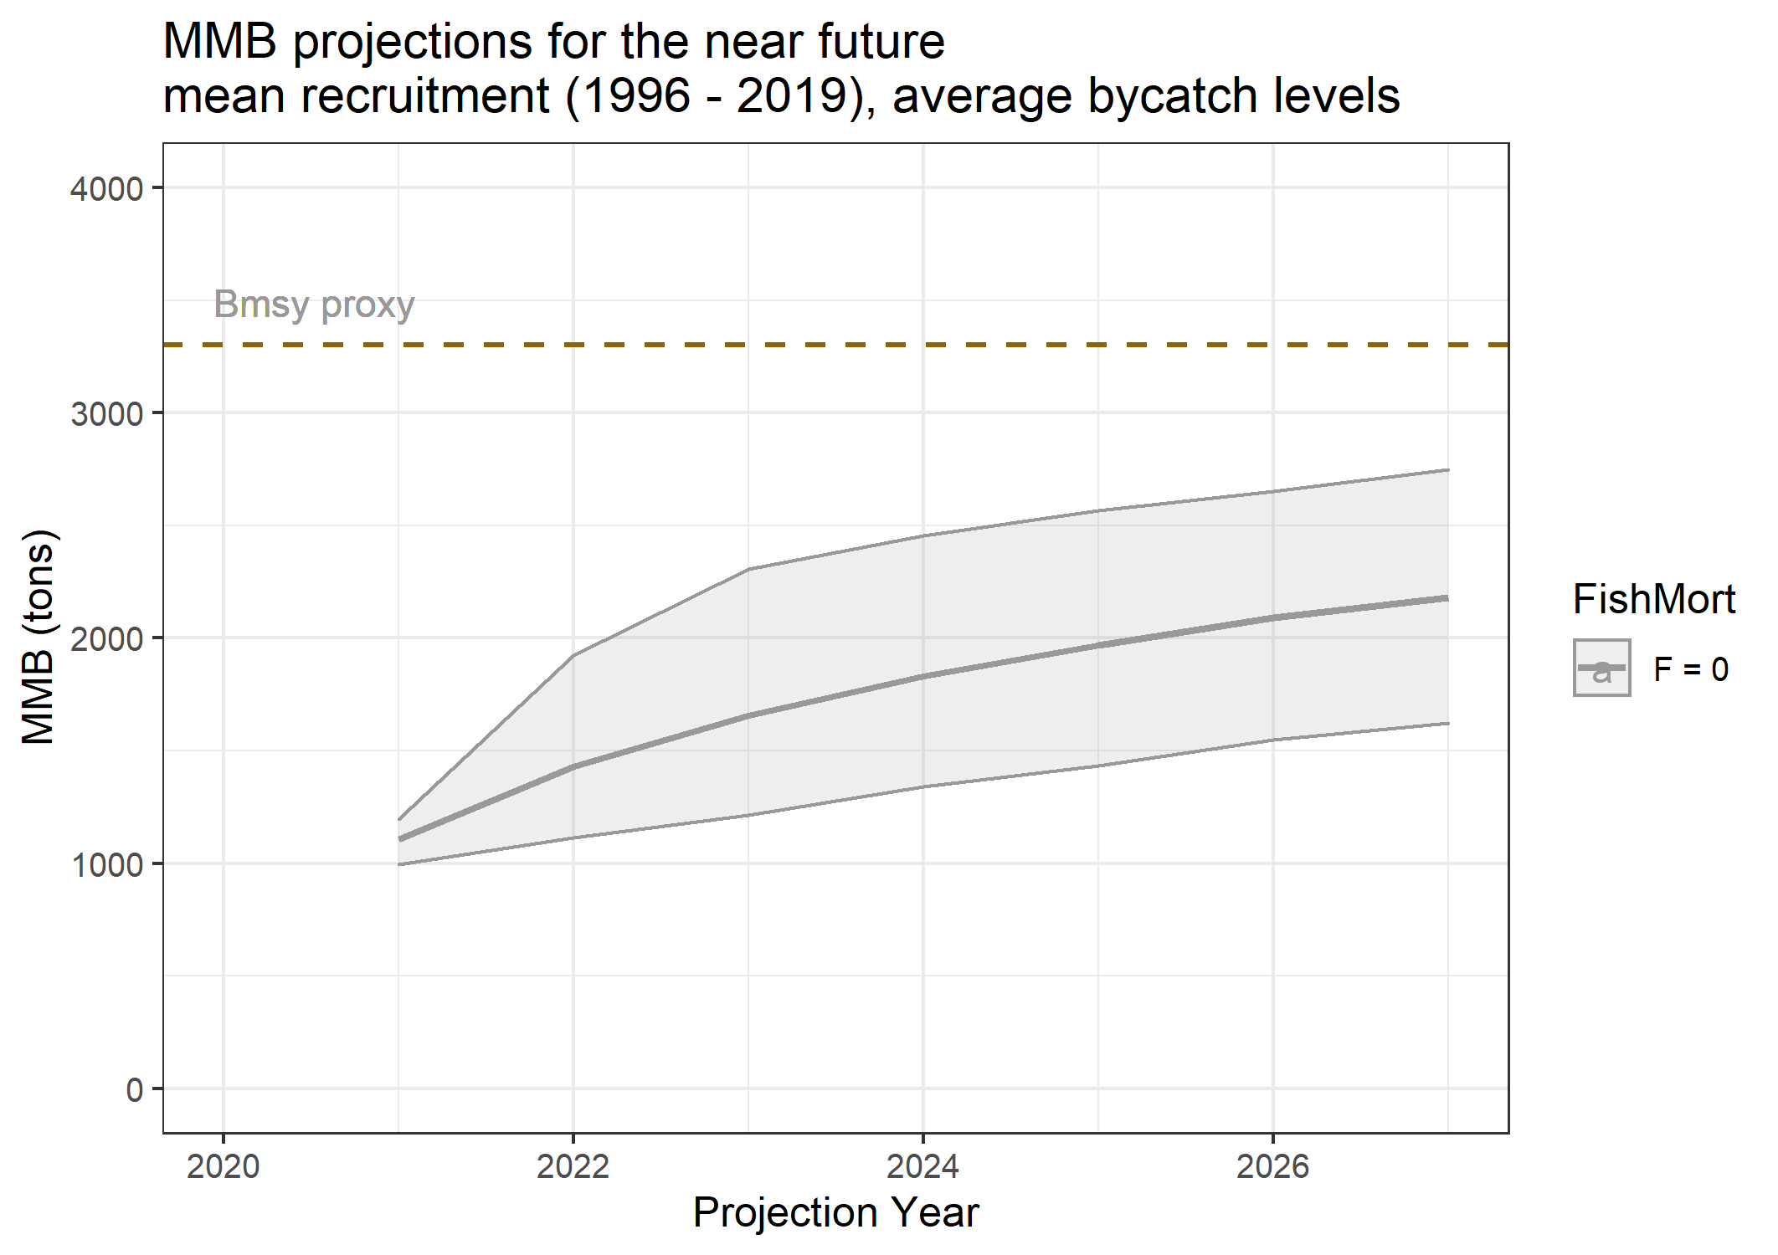

Slide 31
Appendix C – Evaluating Uncertainty due to lack of 2020 survey data
Retrospective analysis with and without terminal year of survey data (abundance and size comps)
Runs to determine sensitivity to hypothetical 2020 data – high and low values based on current variability of survey data (Approach 3)

Slide 32
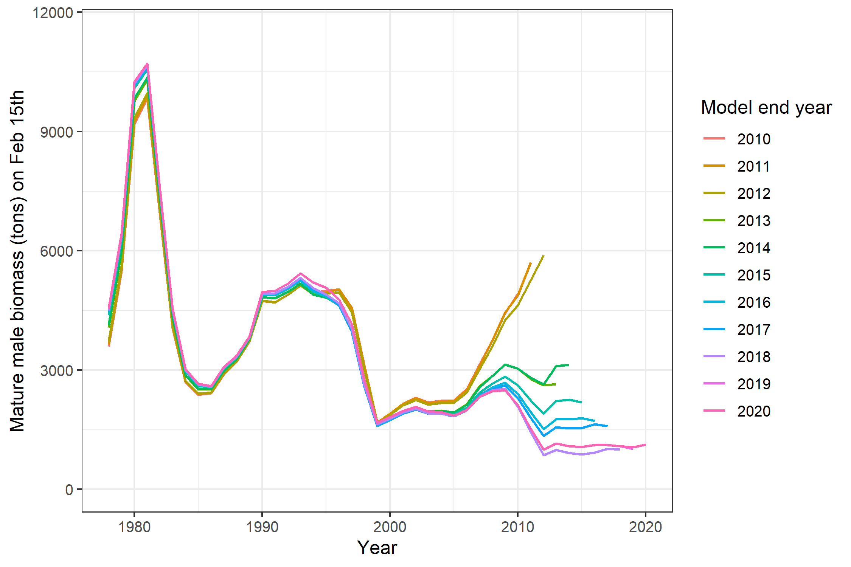
Retrospective
(MMB)
Mohn’s rho: -0.346

Slide 33
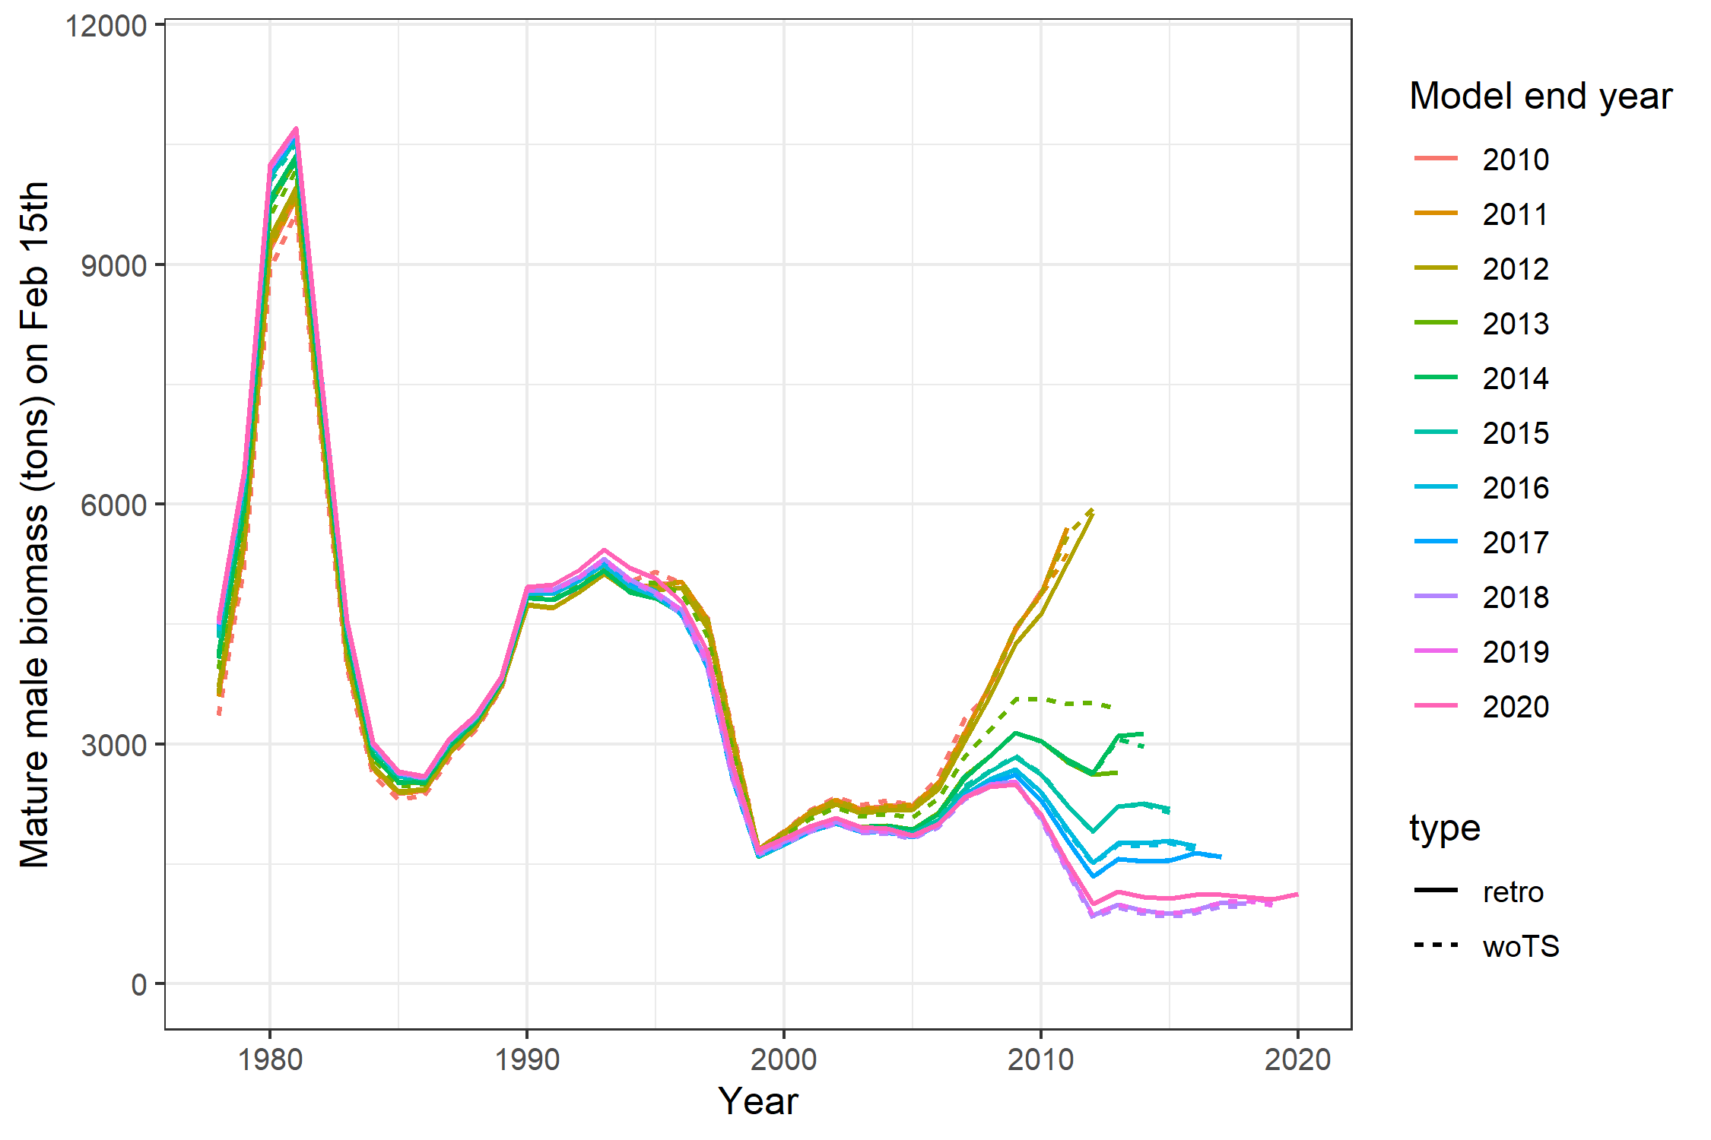
Retrospective
(MMB)
- with & without terminal year of survey data

Slide 34
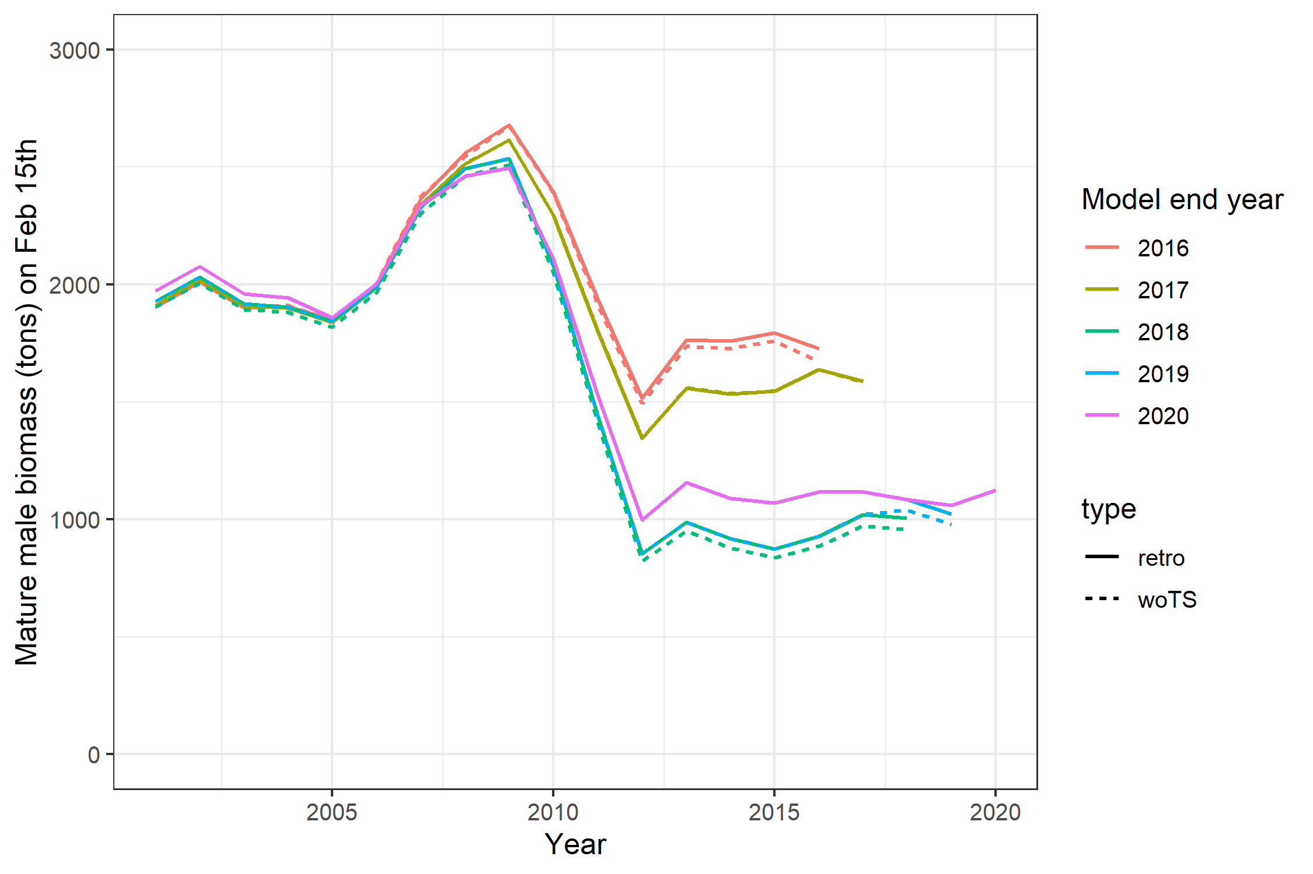

Slide 35
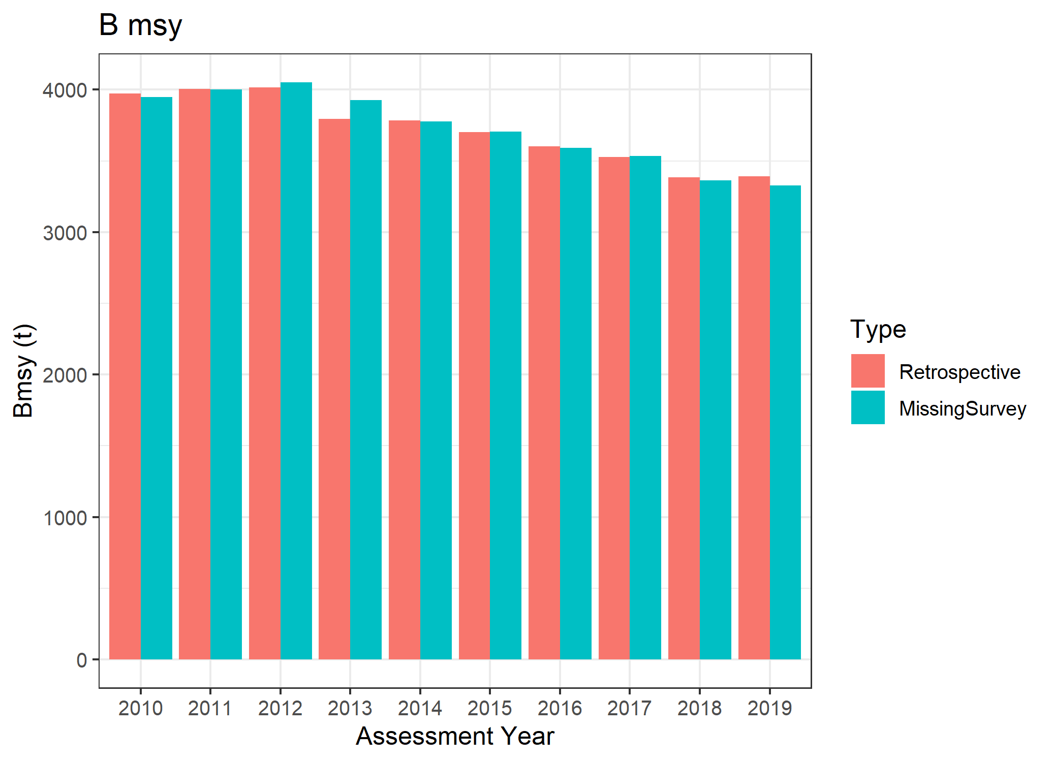
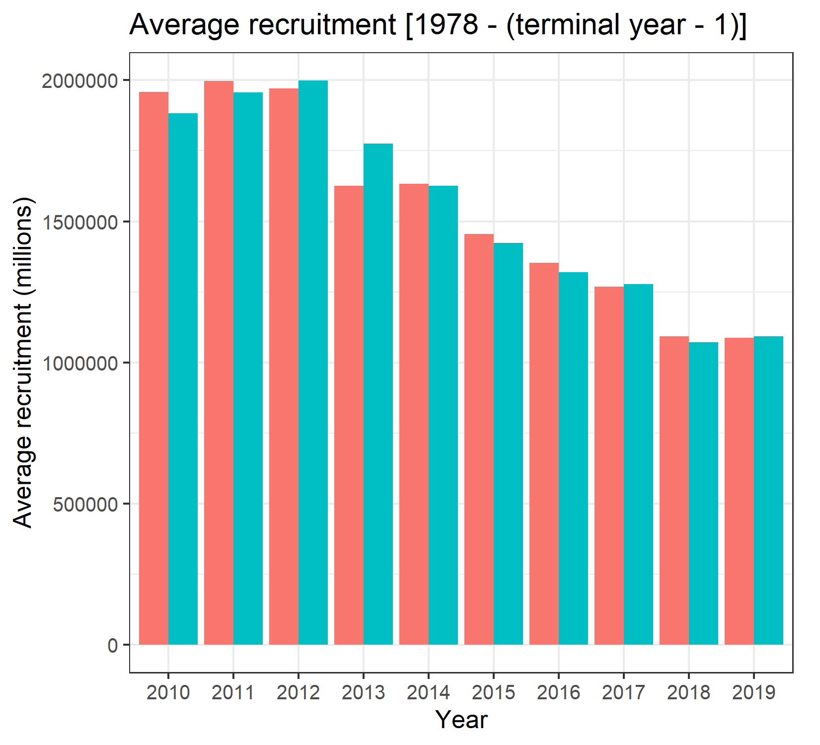

Slide 36
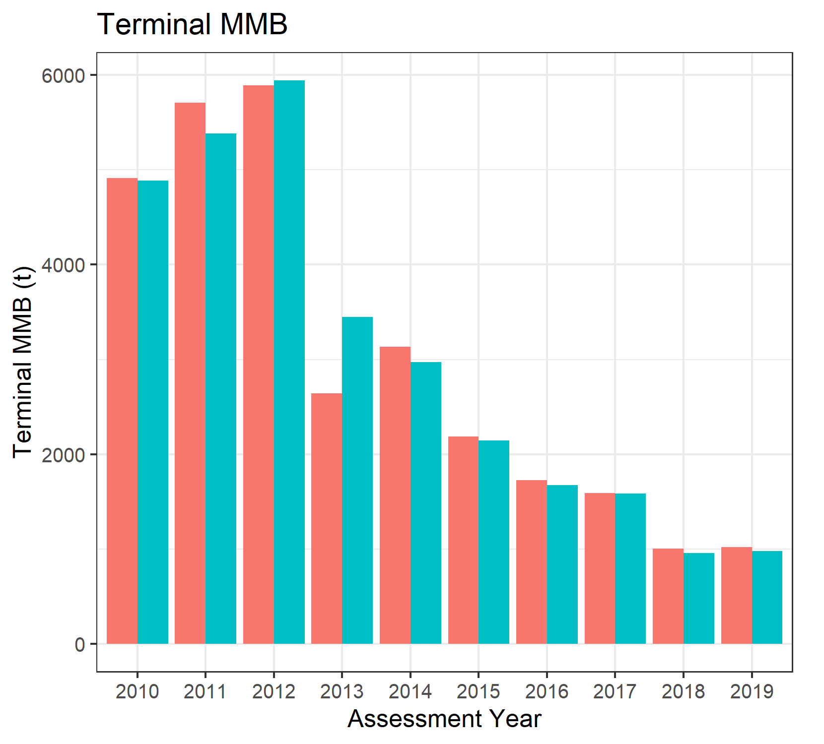
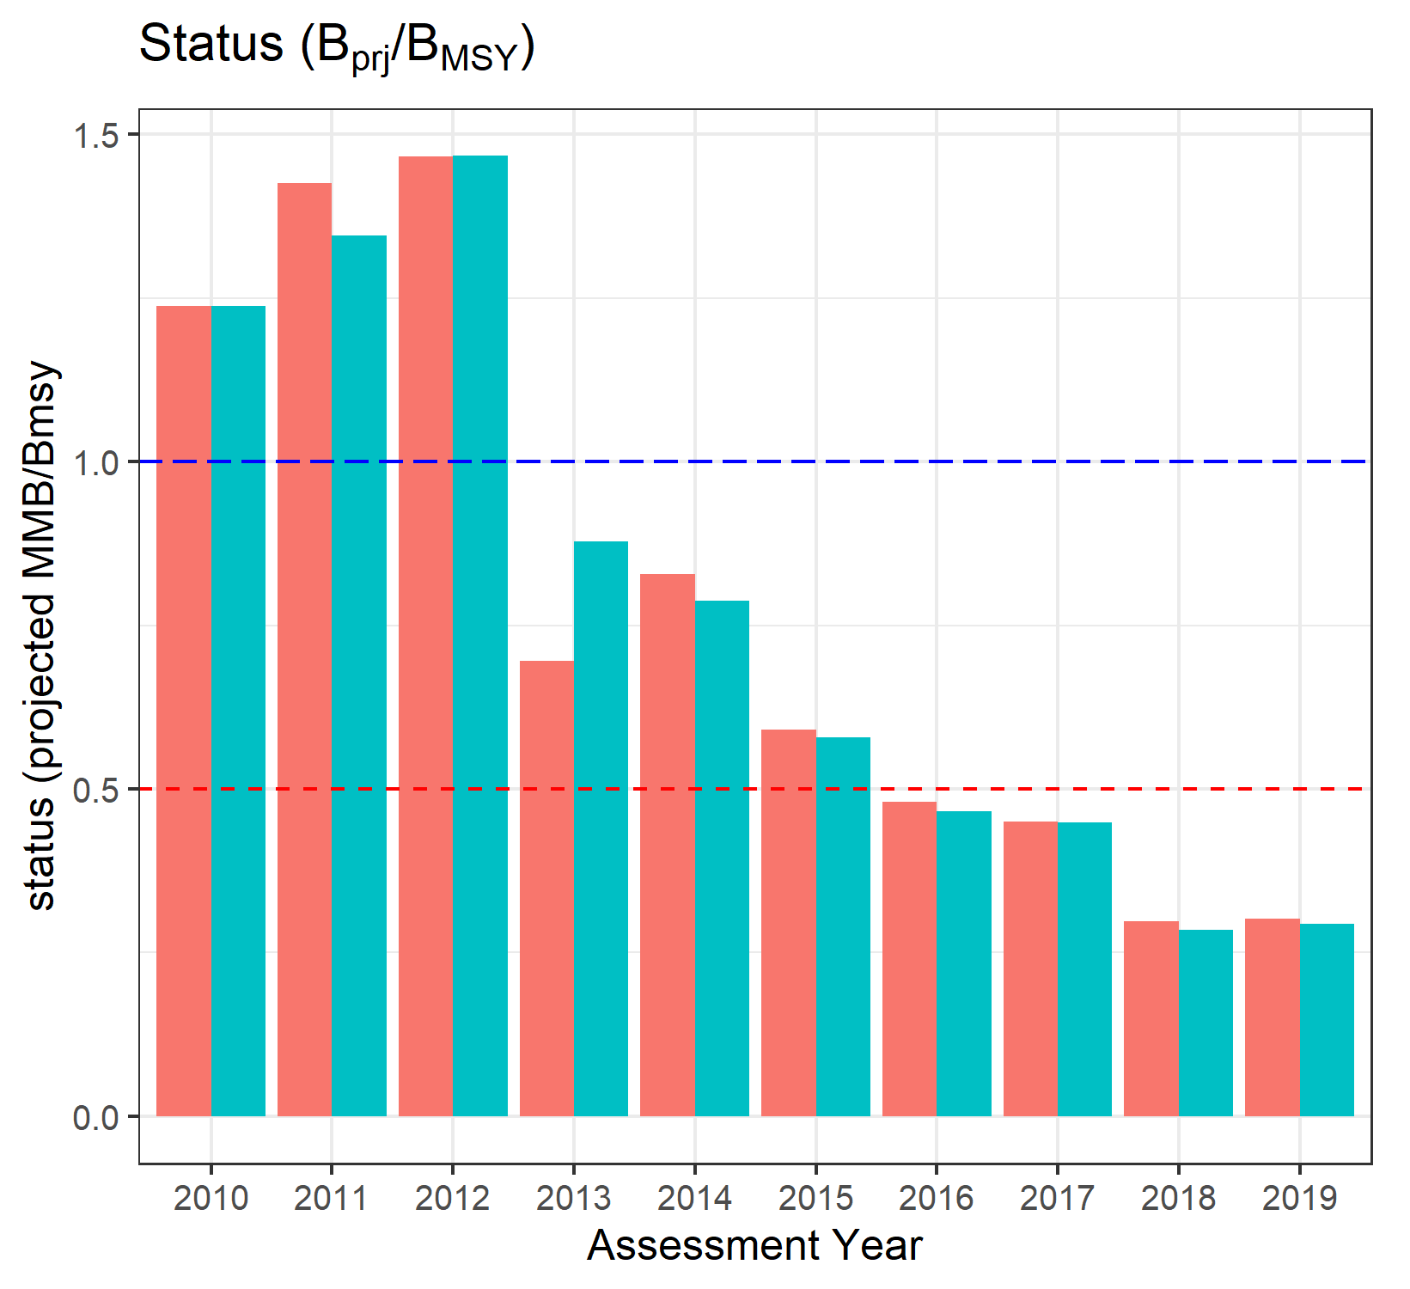

Slide 37
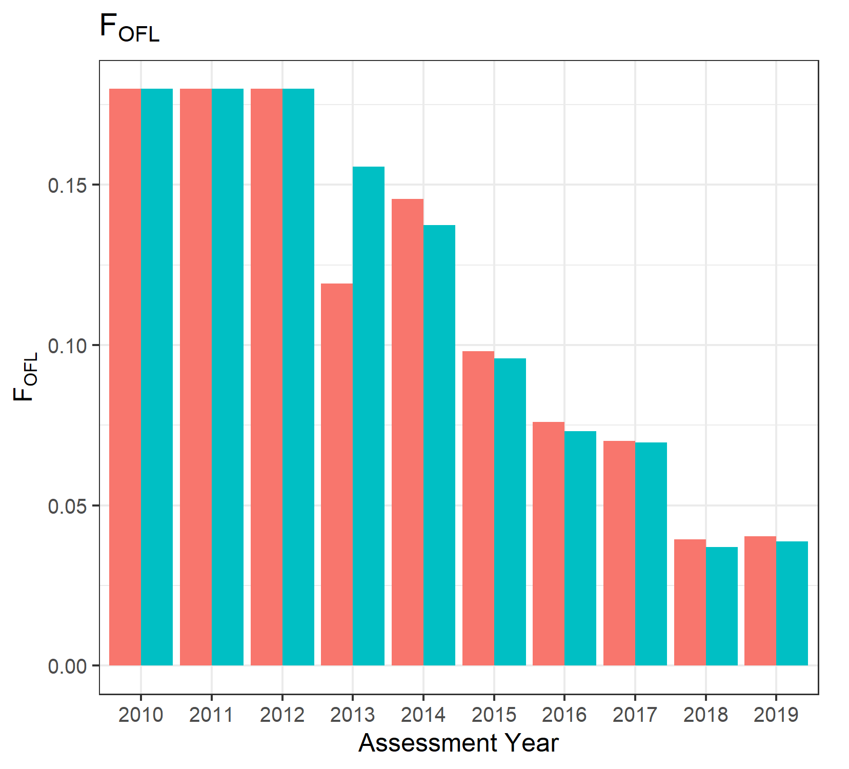
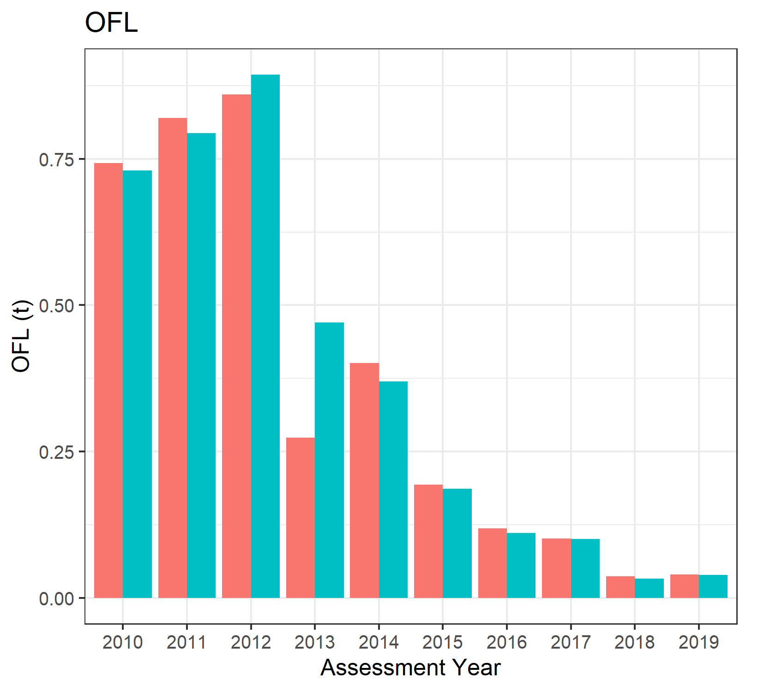

Slide 38
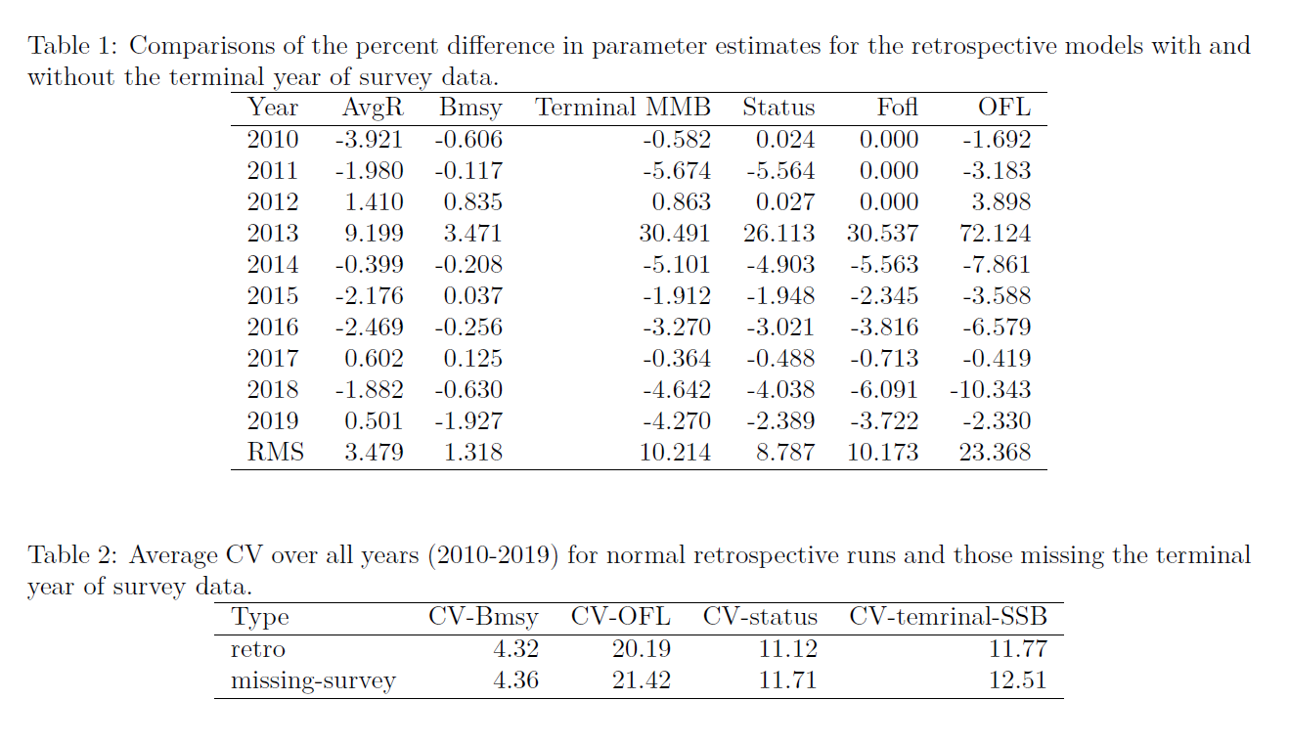

Slide 39
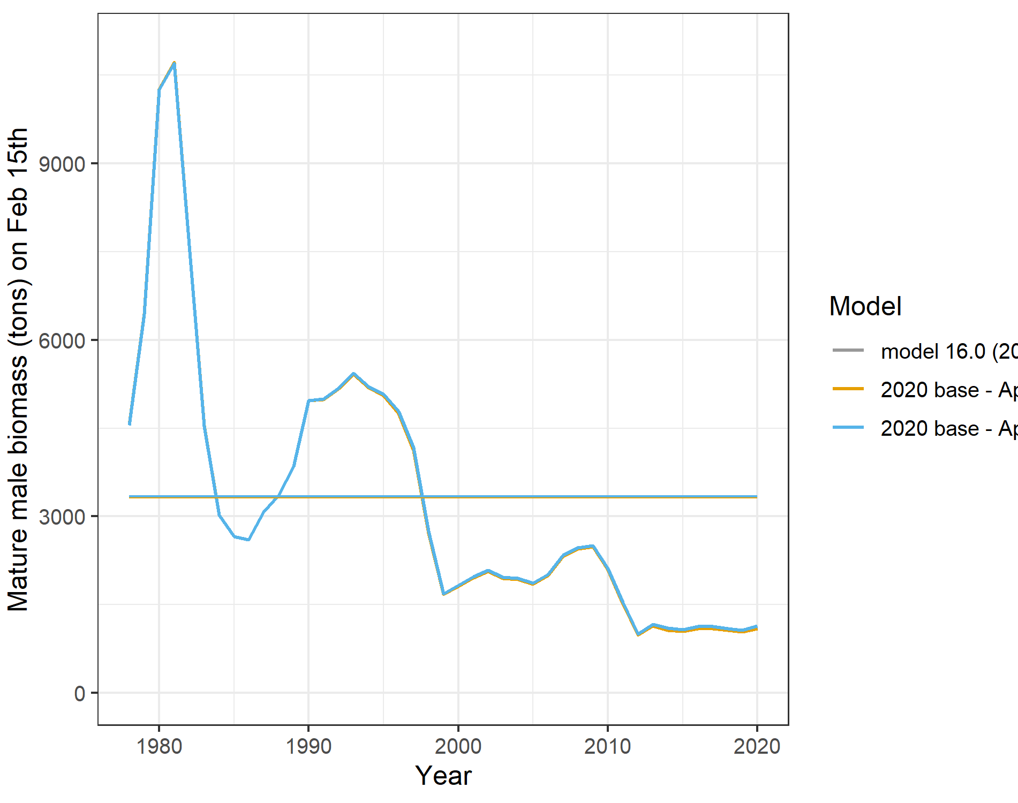
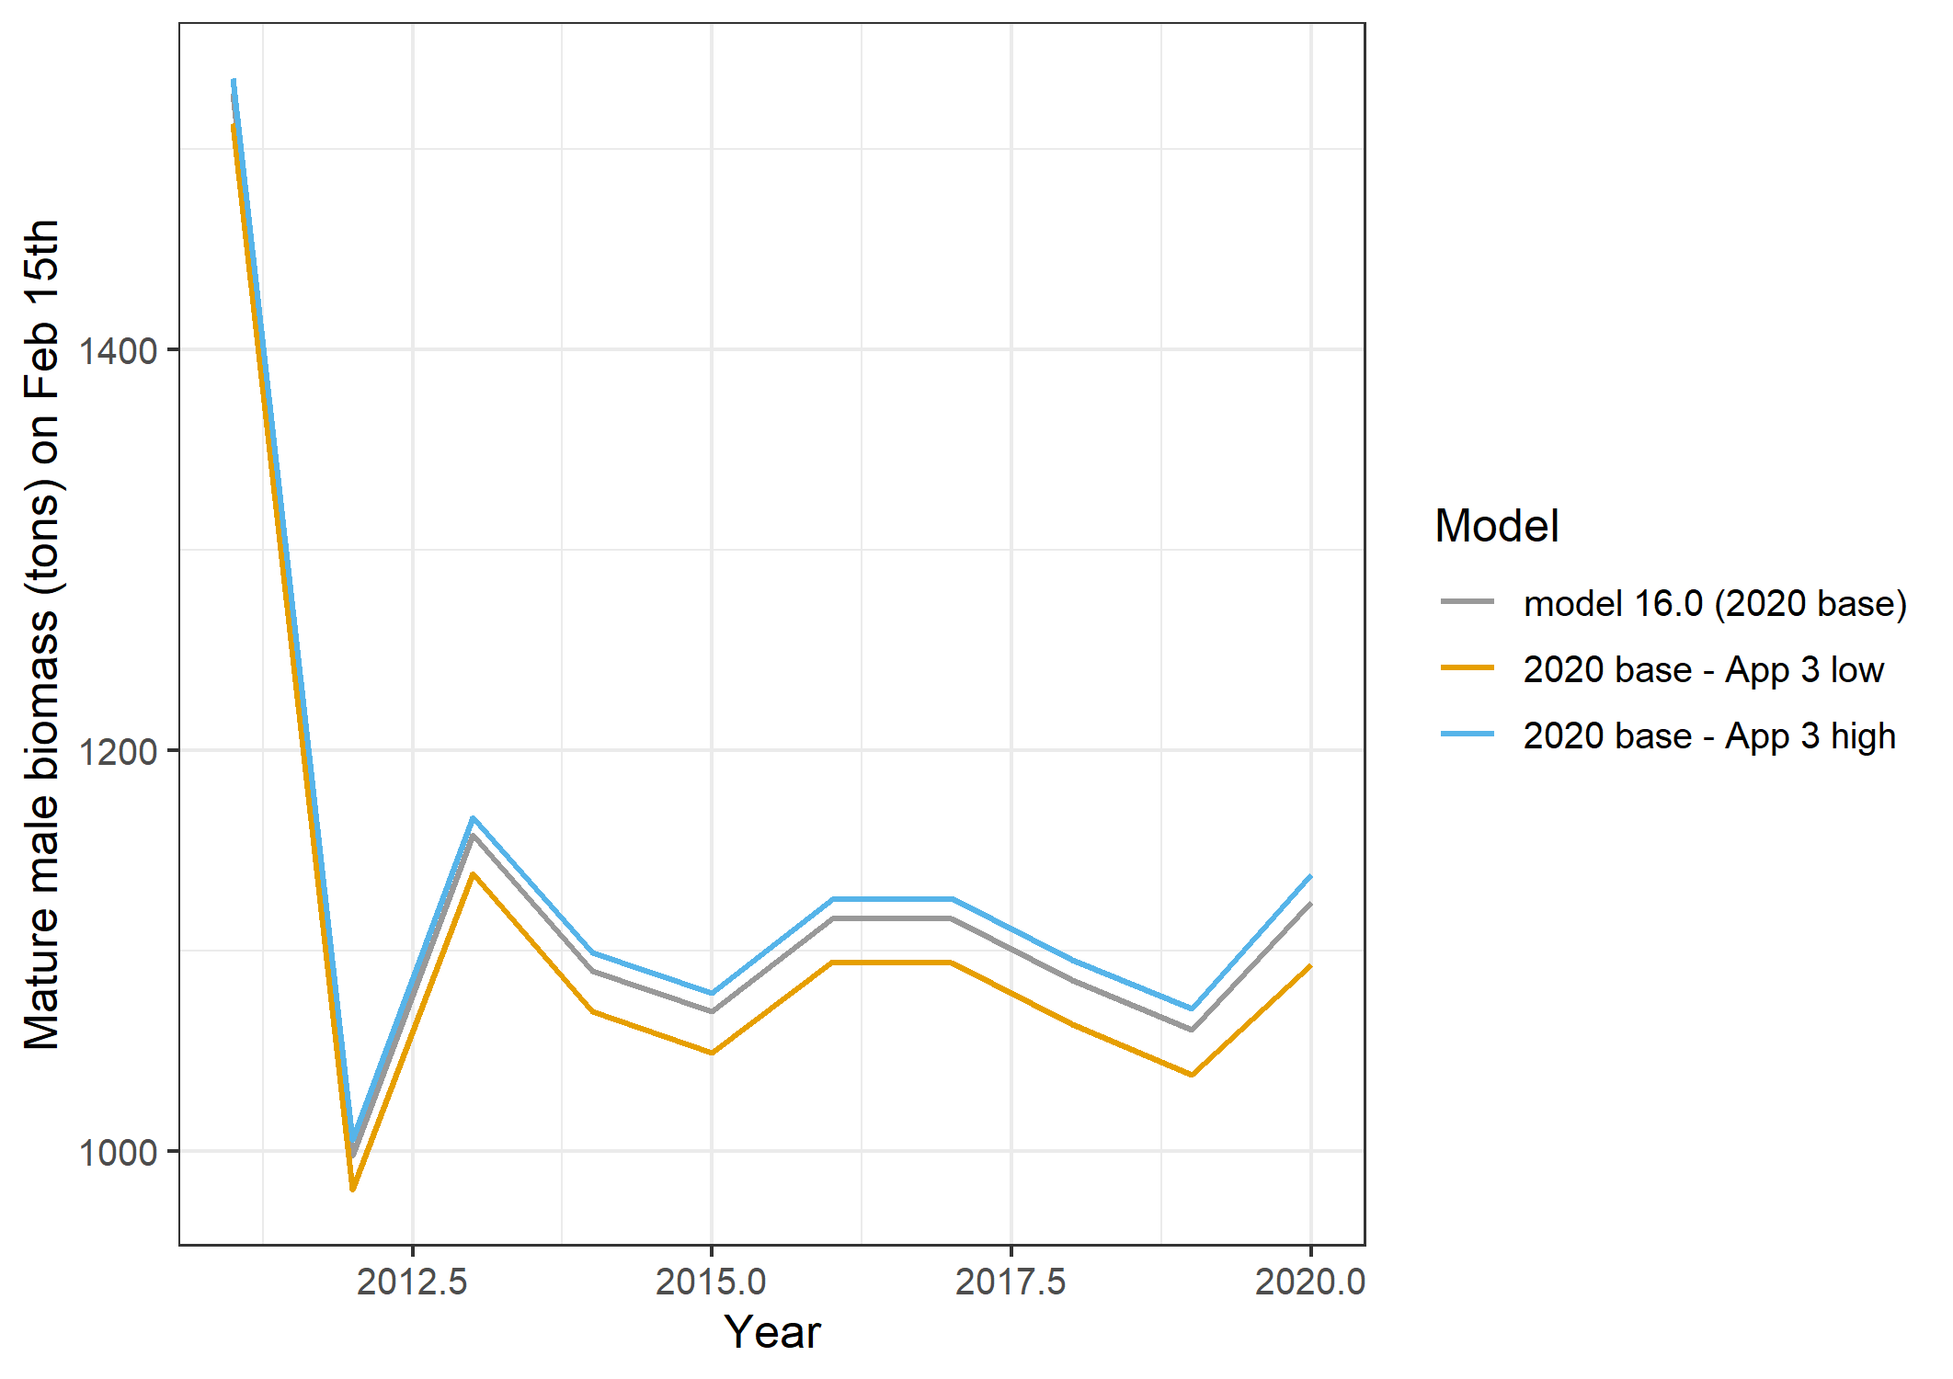
Approach 3 –
high and low 2020 survey values

Slide 40
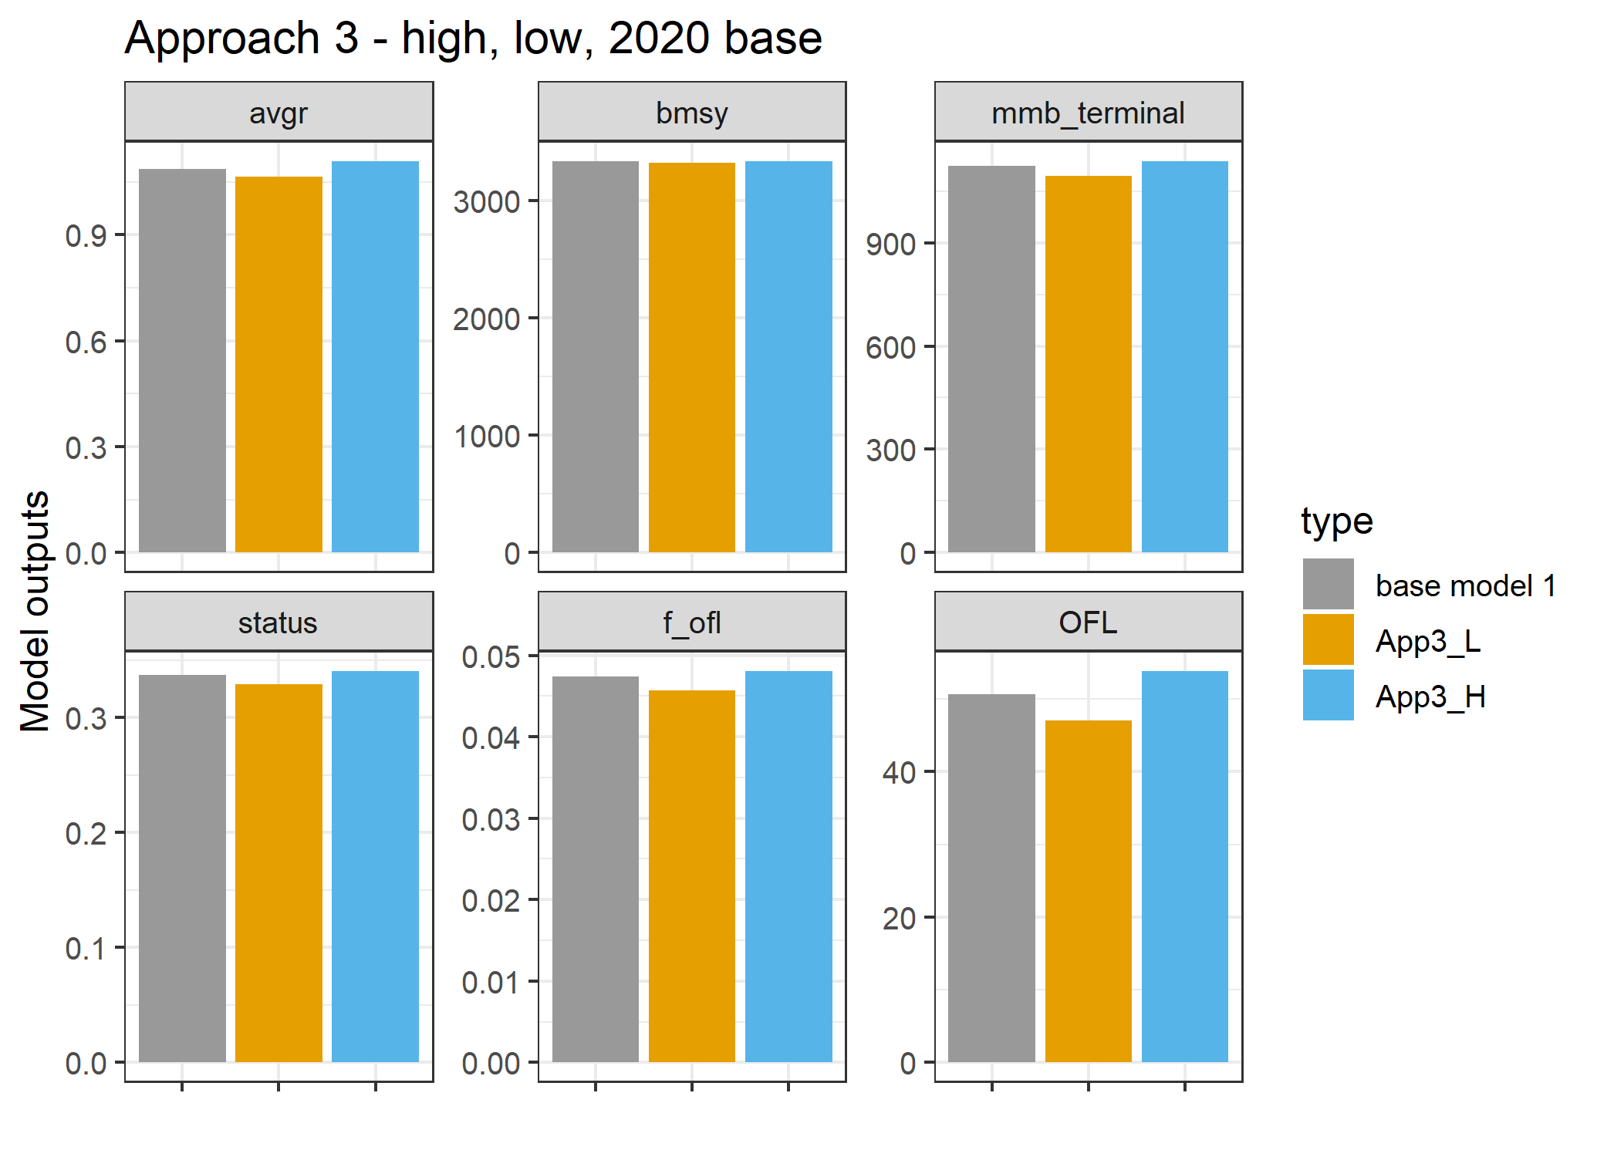

Slide 41
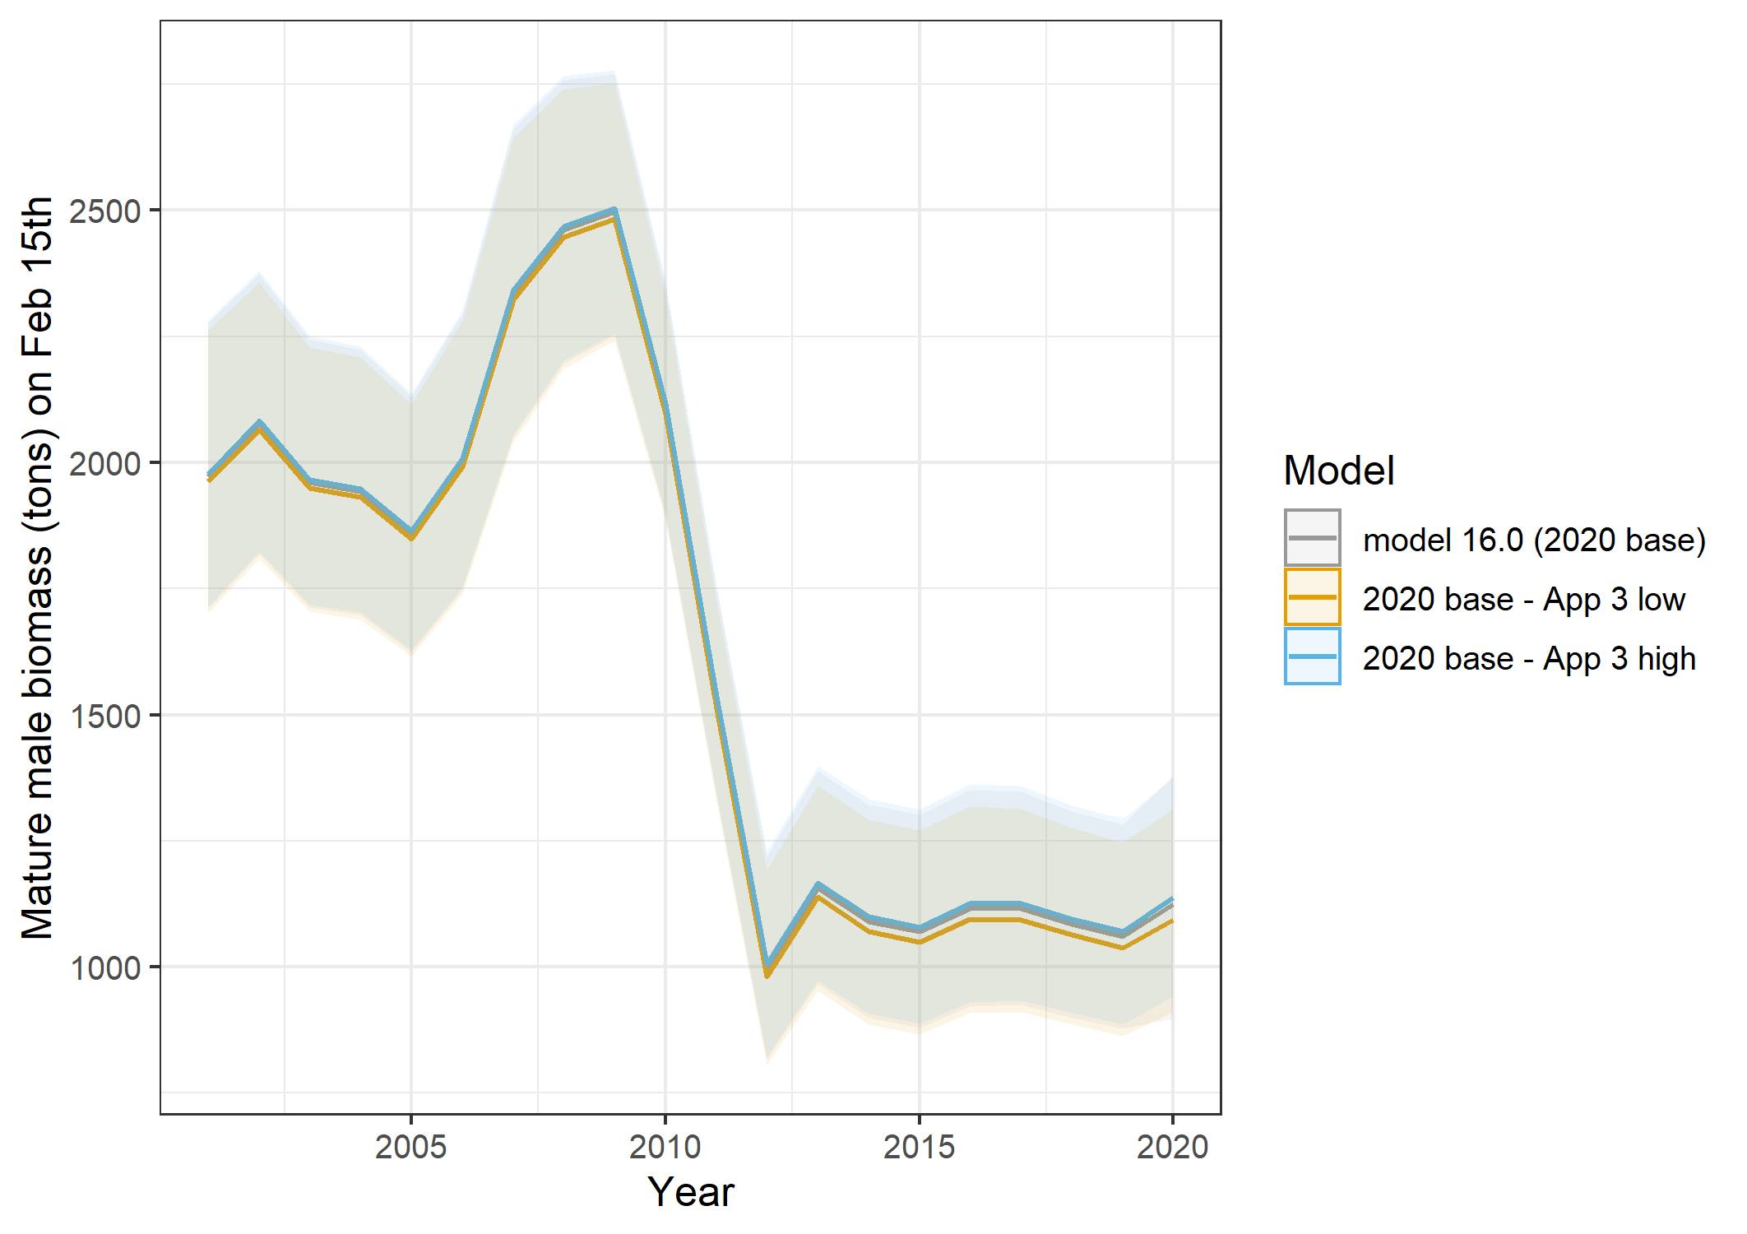
Conclusions:
- variability in base model covers high and low runs.

Slide 42
Summary & Future work
Base model still preferred model.
  16.0a sensitivity on the influence of large terminal year recruitment estimate (no influence on model with exception of recruitment)
Uncertainty
  No strong evidence that lack of 2020 data adds additional uncertainty to the model and essential model estimates
  Author does not recommend increases in ABC buffer based on these analyses
Future work on difference between two surveys
  Spatial, temporal, catchability differences
  Work with Jon Richar to explore VAST model with both data sets (assuming we can deal with the island issues)
Literature review to confirm life history parameters (growth, M, etc.) are the best available for this stock

Slide 43
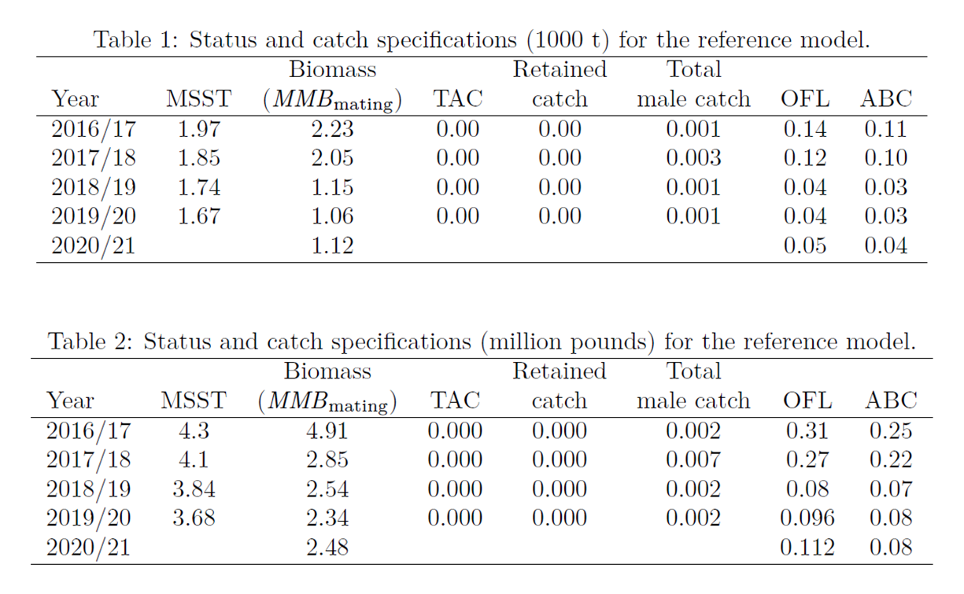
Based on model 16.0 (reference model)

Slide 44

Thanks!
Jie Zheng and Jim Ianelli
Siddeek and Tyler Jackson for review
All those supporting telework and childcare balancing

